Slide 1
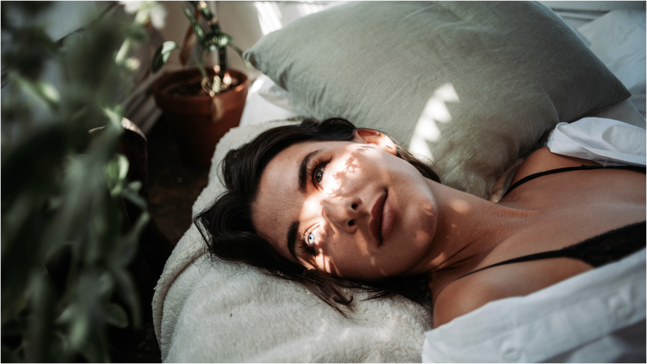


Perfumery & Beauty Joint Solutions

Slide 2


Well-being is a ​
priority for over 2/3 of the world’s population (1)​
Solutions that positively impact the 3 dimensions of well-being (1):
PHYSICAL
MENTAL
SOCIAL WELL-BEING
61%
Of consumers are feeling MINDFUL:
balance personal, environmental & social well-being.
top #5 of most experienced emotions (2)
Sources:
(1) Edelman Data & Intelligence, this third edition of the Global Well-being Report surveyed respondents in 14 countries, including the USA, Canada, the UK, Australia,
Japan, Singapore, China and New Zealand, with 1,000 people per market, for a total of 14,000 participants ( May 1 and June 6, 2023)
(2) Firmenich Global Consumer Insights, wave 4 & wave 5, 2023, 14 countries

Slide 3
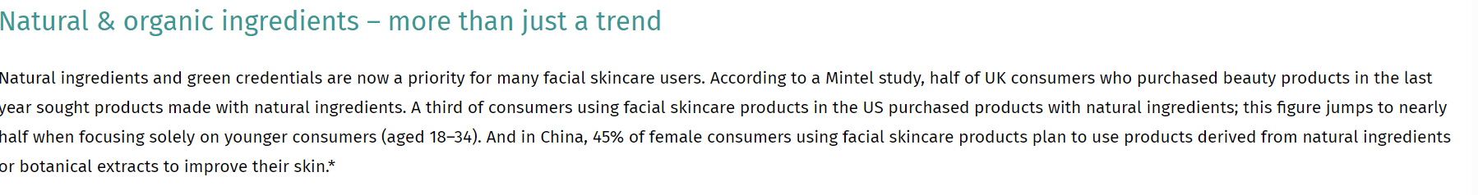

The beauty & skincare routine plays a significant role
Consumers look for natural skincare products with EFFICIENT NATURAL/ORGANIC INGREDIENTS
Consumers believe in the HEALING & MOOD BOOSTING PROPERTIES of essential oils
Consumers look for
ME MOMENTS
#selfcare
56.9 billion
views on TikTok (1)
34%
of consumers preferred to buy natural and organic skin care when given the option to do so (2)
Post covid growing appreciation of scents driven ₍₃₎
#1
by the sensorial
experience
#2
by the additional benefits conveyed
by fragrances
i.e : active scents
aromatherapy
50%
of Chinese anti-ageing facial skincare users would be attracted to buy products that replace strong, effective ingredients with plant extracts to achieve similar effects.
Sources :
Tik tok on nov 2023
Prodege, 2021
Firmenich Global Consumer Insights, Wave 4 & wave 5, 2023, 14 countries

Slide 4

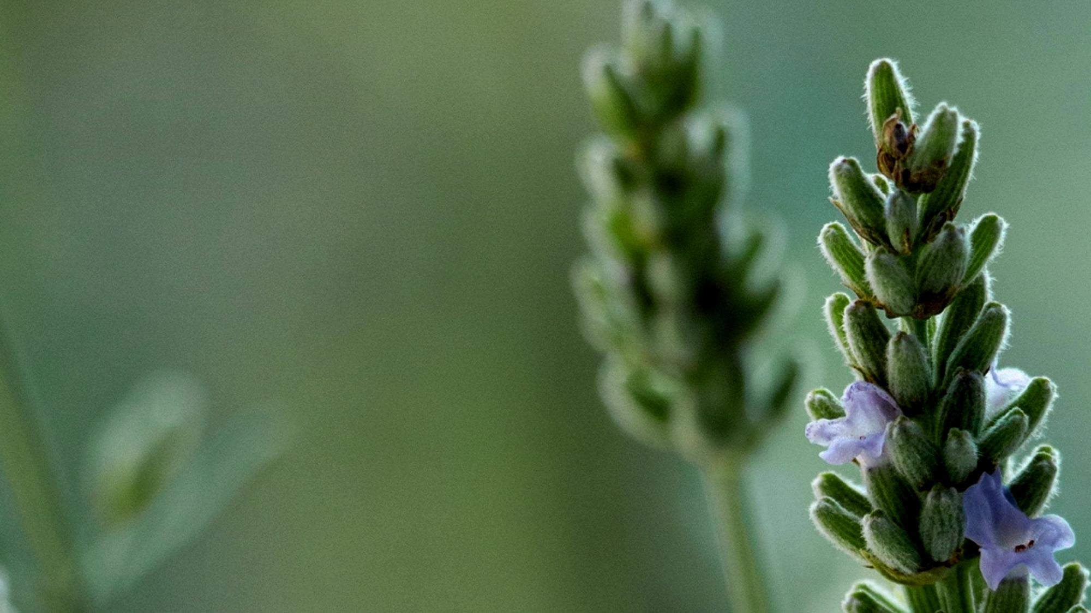
NATURALITY and AROMATHERAPY aren't in the spotlight for several reasons
NO SCIENTIFIC PROOFS ON SKIN & MIND
LACK OF EFFICACY
LACK OF SENSORIALITY
UNPLEASANT SMELL

Slide 5
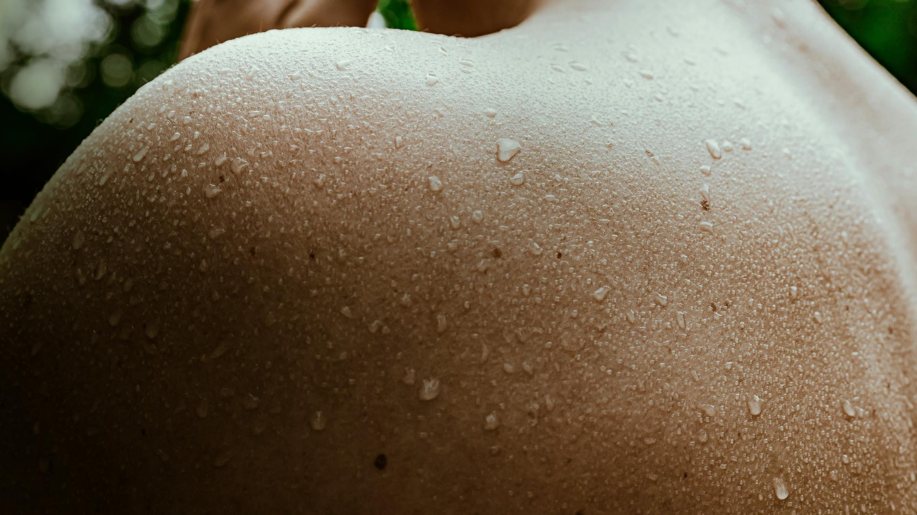
At dsm-firmenich,
we join forces to create the
most effective & sensorial range of aromatherapy infused skin & body ritual.

Slide 6





Personal care
Perfumery
A large range of
POWERFUL, CLINICALLY PROVEN NATURAL OR ORGANIC BIOACTIVES
Harnessing the power
of nature at the highest
efficacy level
AROMATHERAPEUTIC
YET PLEASURABLE
DELIGHTFUL SCENT
WITH ESSENTIAL OIL BLENDS, for a skincare signature
100% natural origin fragrances
carefully designed by Firmenich perfumers with more than
50% essential oils
PROVEN IMPACT ON EMOTIONS
neuro-scientifically
validated via fMRI
following FIRMENICH
DESIGN RULES
From
more than
95% natural origin formulation
to cosmos
Certification*
+
FORMULATION
EXPERTISE
to maximize efficacy, sensoriality & stability throughout the process of development with our trained sensorial expert panel
Eco-design
score assessment
*Only the transformative cleanser is Cosmos compliant

Slide 7



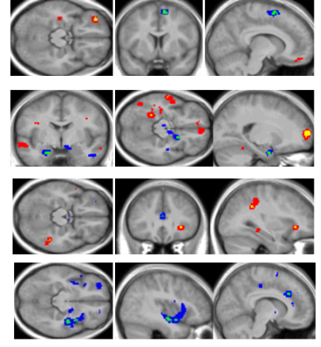

dsm-firmenich Emotion Program in Aromactive
Fragrance technology
That elicit a targeted emotion
Full Fragrance AI generated Design
With Natural Essential Oils
Validated to improve
Mental Efficiency
Tested by fMRI
Proven with cognitive science
NEW!
Patented methodology
Includes Phyto actives
Certification Supported
Certification on full Fragrance
EmotiWaves®
Fragrance technology designed to elicit the targeted emotion, supported by neurological activity
Link between EmotiWaves® &
Feelings (from ScentMove® validated
by fMRI brain activity)
EmotiCode TM
AI-generated cross category design rules to develop fragrances that deliver a benefit

Slide 8
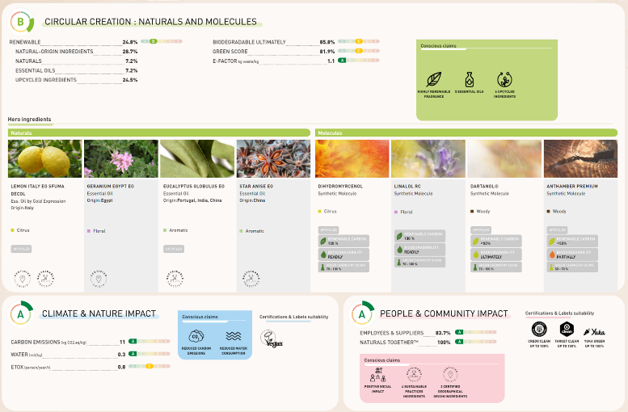
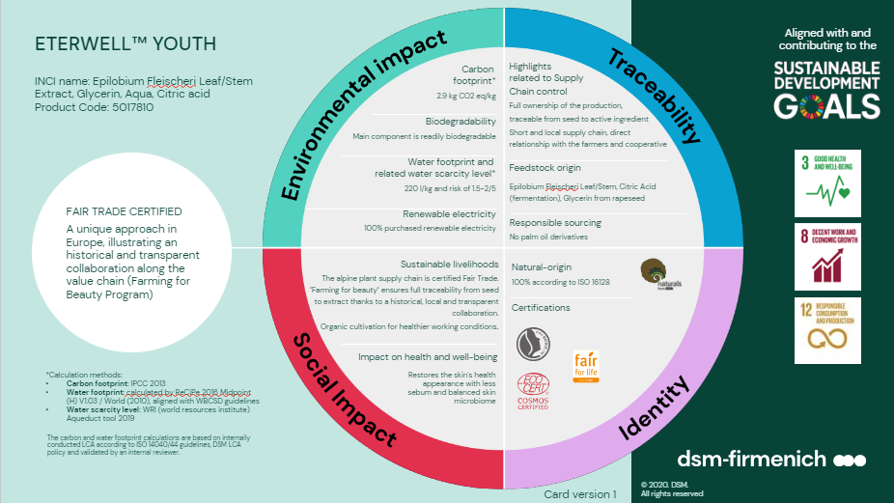
dsm-firmenich Sustainability tools
Sustainability Imp’Act Cards™:
Making Sustainability tangible for our customers
EcoScent Compass®:
Create consciously & share transparently
dsm-firmenich‘s integrated science-based impact measurement digital tool for eco-fragrance design & transparent fragrance diagnostic.
Imp’Act CardsTM measure the footprint of our products and provide customers with transparent & holistic information.
8

Slide 9





Well-being rituals made with scents and care.

Slide 10


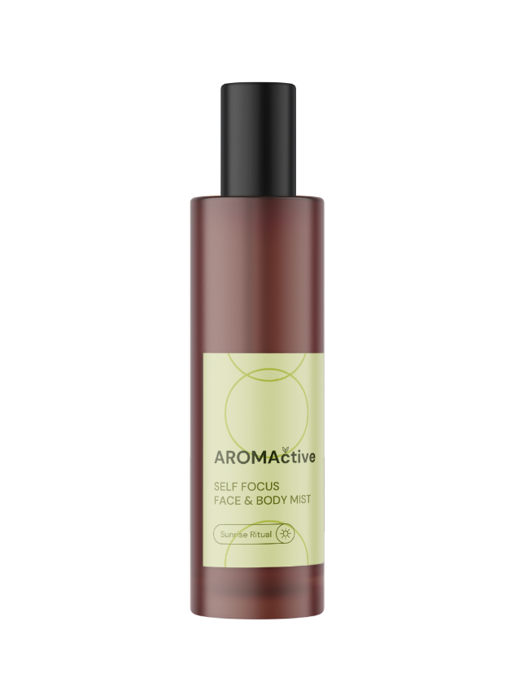
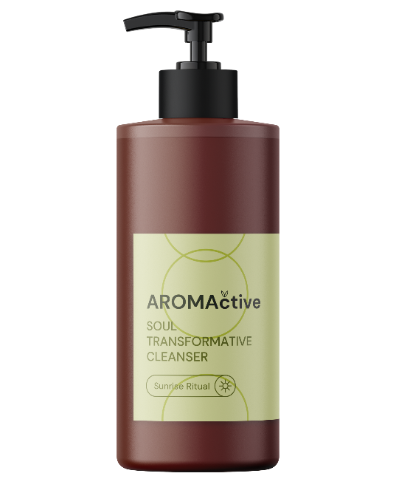
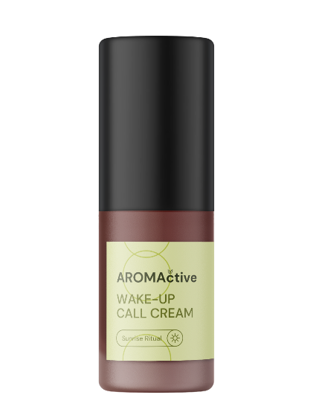
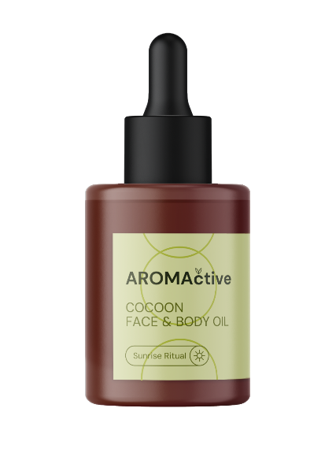

Well-being rituals made with scents and care.
SOUL
TRANSFORMATIVE
CLEANSER
WAKE UP
CALL
CREAM
COCOON
FACE & BODY
OIL
SELF FOCUS
FACE & BODY
MIST

Slide 11

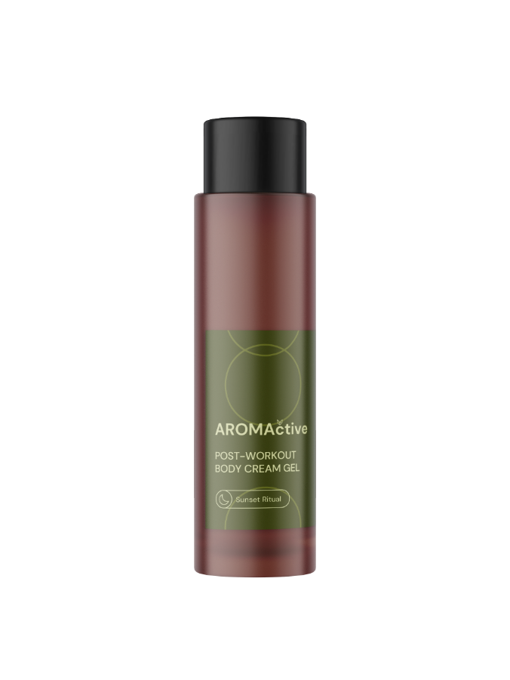
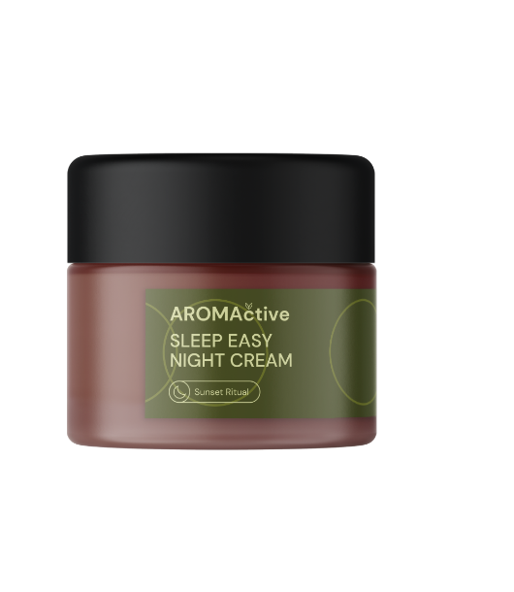
Well-being rituals made with scents and care.
SLEEP EASY
NIGHT CREAM
POST-WORKOUT
BODY CREAM GEL

Slide 12

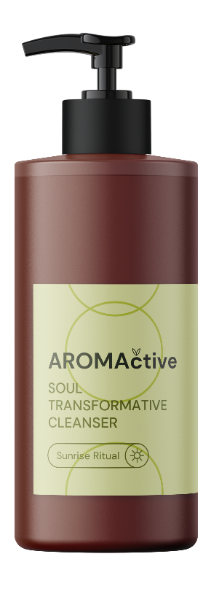




SOUL TRANSFORMATIVE
CLEANSER (FACE)
FORMULA ID CARD
A gentle cleansing gel that melts on skin and transforms into milky lotion in contact with water
Cleanes and gives skin comfort, instant hydration, antipollution action, strenghtens the skin’s barrier
PERFORMANCE INGREDIENTS
POSSIBLE MARKETING CLAIMS
ALPAFLOR® NECTAPURE PF
PENTAVITIN®
ARGAN OIL
100% NATURAL ORIGIN
FORMULA (ISO 16128)
COSMOS COMPLIANT
PENTAVITIN®: No more skin dryness after cleansing
Reverses the 5 symptoms of dehydrated skin: roughness, dullness, flakiness, tightness, redness
Binds to keratin as magnet power**
Strengthens skin’s
barrier for long-term hydration
Perfectly connects with the skin’s top layers

Slide 13
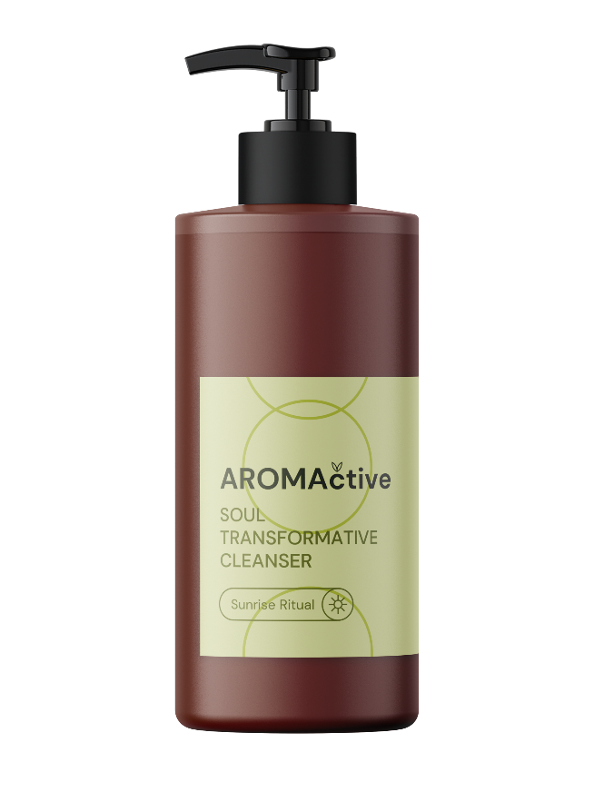
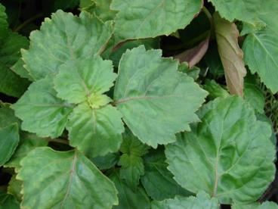

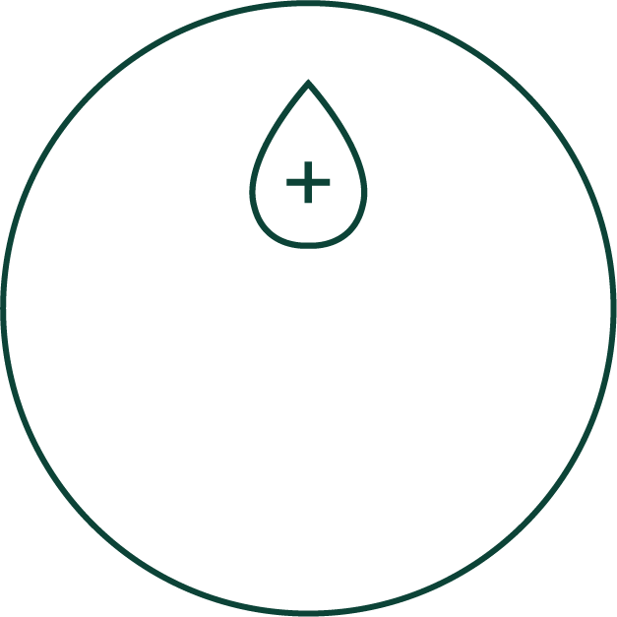
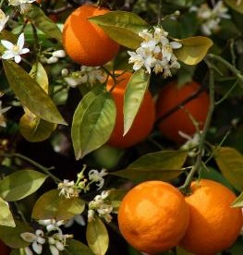
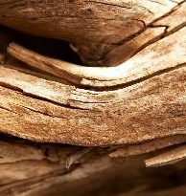

SOUL TRANSFORMATIVE
CLEANSER (FACE)
FRAGRANCE ID CARD
FRAGRANCE DESCRIPTIVE SENTENCE
Inspired by a happy walk by the sea, this 100% natural origin fragrance brings a fresh and clean orange flower bloom to your skincare routine
56% essential
oils blends
complex
FRAGRANCE NAME
AROMACTIVE LAGOON P01A748
TECHNOLOGY & CLAIMS INSPIRATION
Fragrance designed to elicit HAPPY EMOTION,
tested for brain activity using an fMRI methodology and is referred to as dsm-firmenich.
100% NATURAL ORIGIN
COSMOS COMPLIANT
100% RENEWABLE PERFUME
24% OF UPCYCLED INGREDIENTS
Patented methodology
Certification Supported

Slide 14
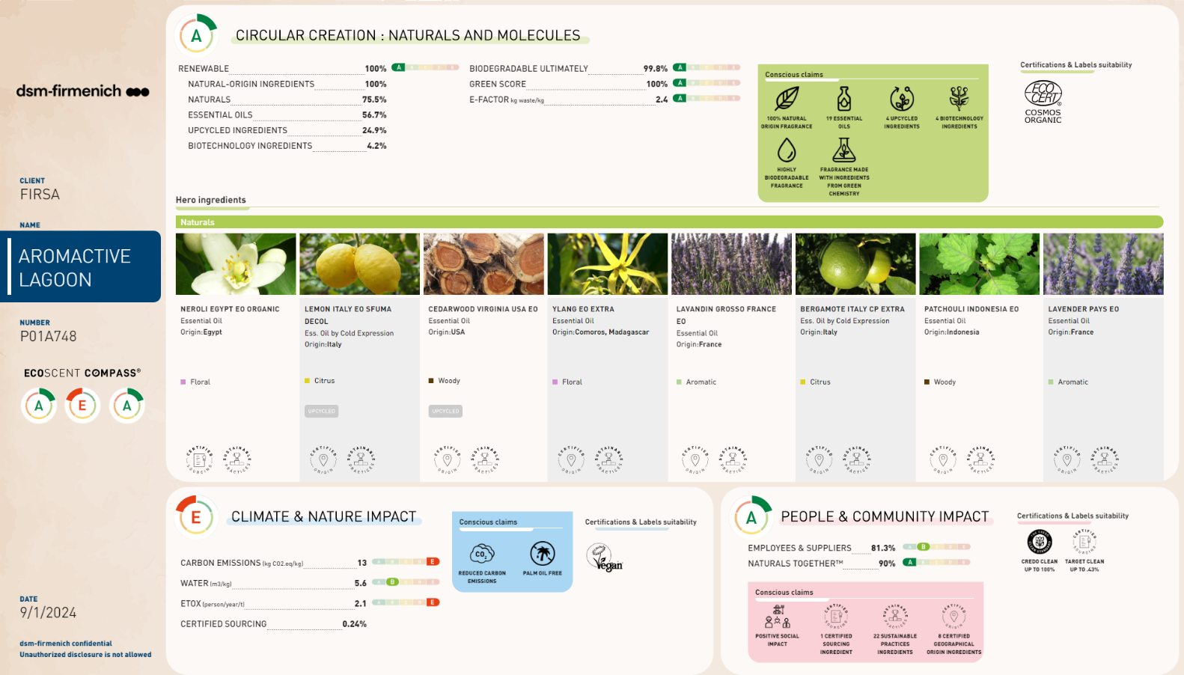
SOUL TRANSFORMATIVE
CLEANSER
FRAGRANCE ID CARD

Slide 15
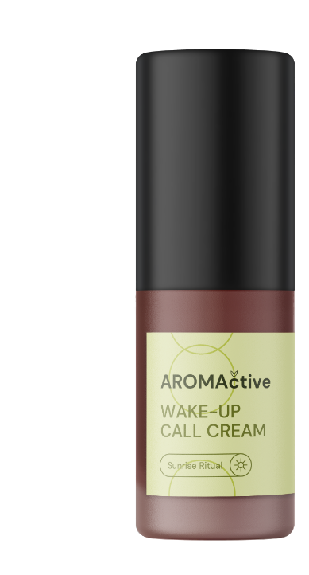
WAKE UP CALL
CREAM (FACE)
FORMULA ID CARD
An energizing light cream formula awakening the senses
Moisturizing with a radiant glow, cellular booster, antioxidant, firmness and plumpness.
PERFORMANCE INGREDIENTS
PENTAVITIN®
ALPAFLOR® NECTAPURE PF
PEPHA®-CTIVE CB
VALVANCE® Touch 210
Mixed Tocopherols 95
POSSIBLE MARKETING CLAIMS
>97% NATURAL ORIGIN
FORMULA (ISO 16128)
PEPHA®-CTIVE CB
Perfect luminous skin with the power of microalgae
Boosts the cellular energy for a luminous looking skin with a radiant glow complexion
Giving power to tired skin
A powerful cocktail of amino acids, carbohydrates, minerals, and proteins, which have the ability to reload the skin with new energy
Protects the cell’s battery ( mitochondria) against oxidative stress caused by free radicals*
Increases the ATP content in keratinocytes up to 140%*
Increases the proliferation rate of fibroblasts up to 320%*
Drastically increases skin renewal, inducing faster skin renewal by 4 to 5 days. The result is a fresher looking appearance**
*:in vitro ** in vivo

Slide 16
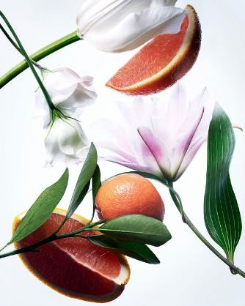
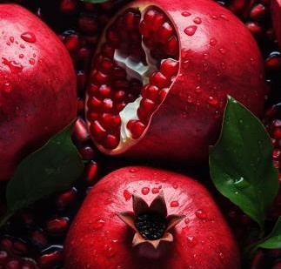
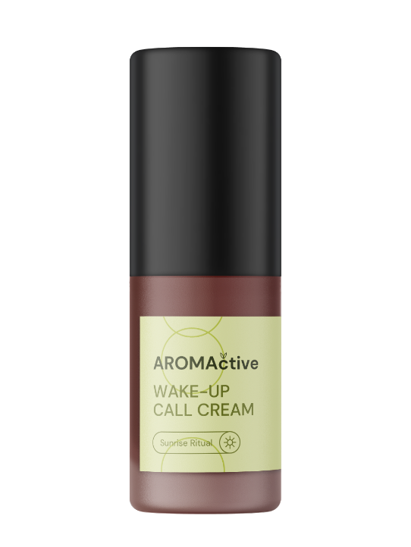
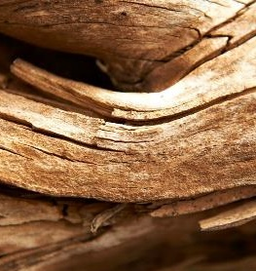
WAKE UP CALL
CREAM (FACE)
FRAGRANCE ID CARD
FRAGRANCE DESCRIPTIVE SENTENCE
Through woods and fruits, the fragrance conveys a stimulating and moisturizing sensation
FRAGRANCE NAME
AROMACTIVE AURORA P01A741
58% essential
oils blends
complex
TECHNOLOGY & CLAIMS INSPIRATION
Fragrance designed to elicit ENERGY EMOTION, tested for brain activity using an fMRI methodology and
is referred to as dsm-firmenich.
100% NATURAL ORIGIN
100% RENEWABLE PERFUME
52% OF UPCYCLED INGREDIENTS
Patented methodology
Certification Supported

Slide 17
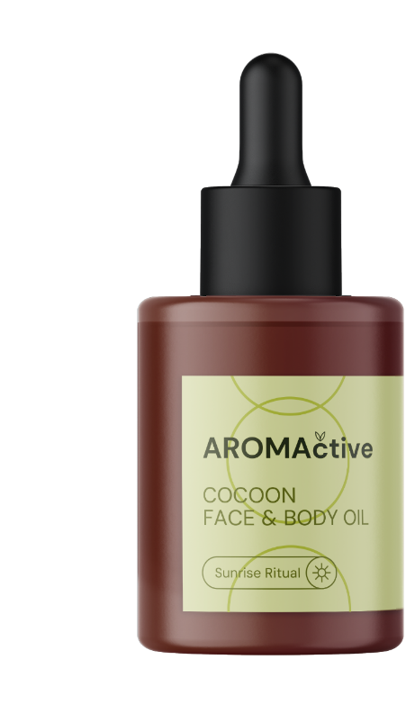
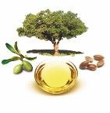

COCOON
FACE & BODY OIL
FORMULA ID CARD
An enveloping face & body oil with a velvety dry finish on skin
Regenerate and restore skin functions, providing firmness, elasticity, softness, anti-stretchmarks action
PERFORMANCE INGREDIENTS
RETINOL CB 50
ARGAN OIL
life’sGLA™ '10’ n-6 OIL
Mixed Tocopherols 95
POSSIBLE MARKETING CLAIMS
>99% NATURAL ORIGIN
FORMULA (ISO 16128)
RETINOL CB 50
Gold standard for well ageing skin for regenerated and healthy skin.
Boosts strongly collagen
Visibly improves skin photo-damages in just 1 month
Proven to reduce crow’s feet wrinkles in just 4 weeks
Smoothens skin and perceptibly improves tactile skin roughness
Improves skin firmness & elasticity
Rebalances uneven skin tone

Slide 18
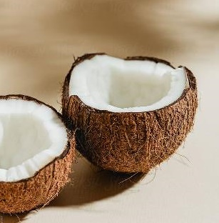
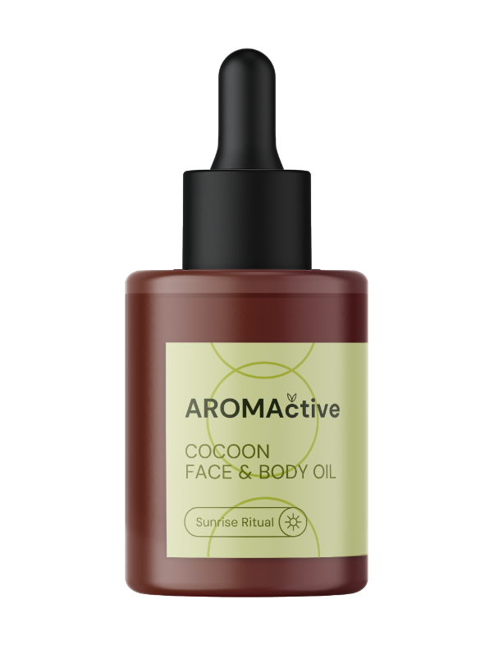
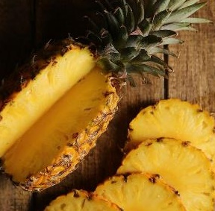

COCOON
FACE & BODY OIL
FRAGRANCE ID CARD
FRAGRANCE DESCRIPTIVE SENTENCE
Freshness and juiciness are the key word for this fruity coconut explosion that give you smile and comfort
FRAGRANCE NAME
AROMACTIVE COCOON P01A742
53% essential
oils blends
complex
TECHNOLOGY & CLAIMS INSPIRATION
Fragrance designed to elicit ENERGY EMOTION, tested for brain activity using an fMRI methodology and
is referred to as dsm-firmenich.
100% NATURAL ORIGIN
100% RENEWABLE PERFUME
46% OF UPCYCLED INGREDIENTS
Patented methodology
Certification Supported

Slide 19
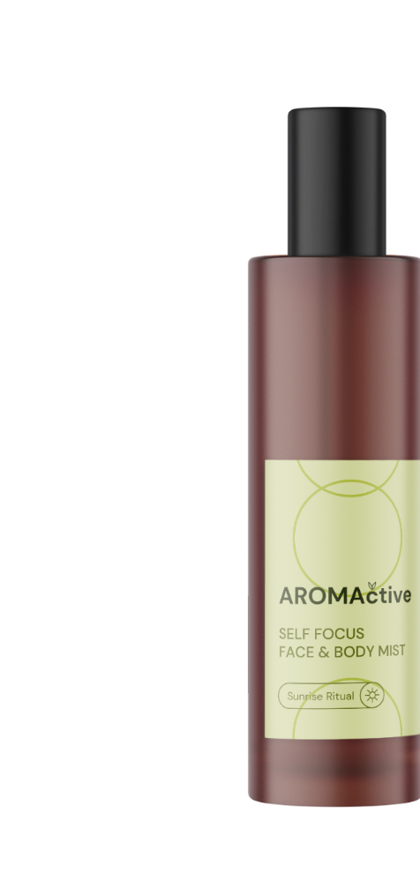


SELF FOCUS
FACE & BODY MIST
FORMULA ID CARD
An energizing mist formula awakening the senses with PENTAVITIN®
for an immediate and long-lasting skin hydration
PERFORMANCE INGREDIENTS
POSSIBLE MARKETING CLAIMS
PENTAVITIN®
99% NATURAL ORIGIN
FORMULA (ISO 16128)
PENTAVITIN®
Reverses the 5 symptoms of dehydrated skin: roughness, dullness, flakiness, tightness, redness
Strengthens skin’s
barrier for long-term hydration
72 HOURS long-lasting deep hydration
Perfectly connects with the skin’s top layers
Prolongs skin hydration
up to 6 DAYS after last treatment

Slide 20
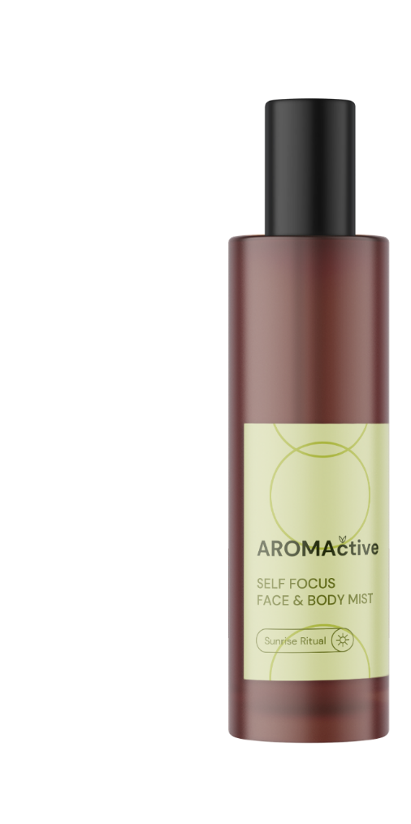
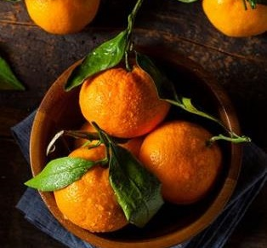



SELF FOCUS
FACE & BODY MIST
FRAGRANCE ID CARD
FRAGRANCE DESCRIPTIVE SENTENCE
Inspired by a quiet meditative walk in a Roseraie, this 100% natural fragrance is a mindful floral gourmand bouquet for the soul.
FRAGRANCE NAME
AROMACTIVE RETREAT P01B373
3% Essential
Oils blends
complex
TECHNOLOGY & CLAIMS INSPIRATION
Full fragrance designed with AI and scientifically validated to amplify Mental Efficiency and better Focus.
Fragrance created using patent-pending fragrance design rules which were shown to be associated with an increase of mental performance in two
cognitive tasks
✓ Helps me get in the flow
✓ Boosts attention
✓ Keeps me on track
✓ Boosts mental performance
✓ Gives my brain a boost
✓ Improves my clarity of mind
✓ Sharpens my mind
✓ Think more clearly
✓ Be less distracted
100% NATURAL ORIGIN
100% RENEWABLE PERFUME
4,7% OF UPCYCLED INGREDIENTS
Patented-pending methodology
Certification Supported

Slide 21
Well-being rituals made with scents and care.
SLEEP EASY
NIGHT CREAM
POST-WORKOUT
BODY CREAM GEL

Slide 22


SLEEP EASY
NIGHT CREAM (FACE)
FORMULA ID CARD
A soothing night balm that alleviates facial tensions while promoting well-ageing properties
Firming and wrinkle reduction, enhanced skin texture, overnight cell rejuvenation, restoring the skin from oxidative stress, strengthening the barrier function, reverting skin-damages
PERFORMANCE INGREDIENTS
POSSIBLE MARKETING CLAIMS
ETERWELL™ YOUTH
REVITALIN® CB
SYN®-COLL CB
Mixed Tocopherols 95
> 99% NATURAL ORIGIN
FORMULA (ISO 16128)
REVITALIN® CB – ‘Clean Vitality Booster’ to sustain a healthy-looking skin
Helps to accelerate skin renewal by up to 4 days to sustain a healthy-looking skin**
REVITALIN® CB recharges skin cells with energy during the skin's nighttime *
Delivers a lot of ATP by boosting both fundamental bioenergetic processes: glycolysis and mitochondrial respiration*
Vitality boost for less energetic (tired or stressed) skin cells*
Restores mitochondrial vitality after UV stress* by stimulating mitochondria-related genes linked to cell energy, regeneration and detoxification*
ETERWELL™ YOUTH acts in synergy with SYN®-COLL CB – by clearing specifically senescent fibroblasts with
ETERWELL™ YOUTH, the activity of SYN®-COLL CB is potentialized for stimulating even stronger collagen
Reverses visible signs of premature aging
helps recover healthy skin with key well ageing benefits such as wrinkle reduction, improved skin elasticity and smoothness
Sculpt facial contours
Pore refining
The skin texture and structure are restored, for a rejuvenated skin appearance.

Slide 23
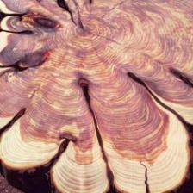
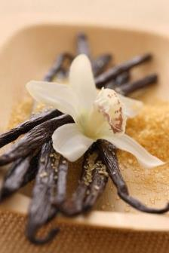
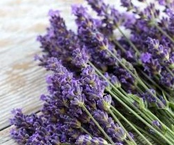
SLEEP EASY
NIGHT CREAM (FACE)
FRAGRANCE ID CARD
FRAGRANCE DESCRIPTIVE SENTENCE
Round and comfortable, this fragrance is an invitation let go,
the sweet & modern lavender structure coats you and make you feel relaxed
FRAGRANCE NAME
AROMACTIVE MOONSHINE P01A746
50% Essential
Oils blends
complex
TECHNOLOGY & CLAIMS INSPIRATION
Fragrance designed to elicit A RELAXING SENSATION / EMOTION, tested for brain activity using an fMRI methodology and
is referred to as dsm-firmenich.
100% NATURAL ORIGIN
100% RENEWABLE PERFUME
25% OF UPCYCLED INGREDIENTS
Patented methodology
Certification Supported

Slide 24
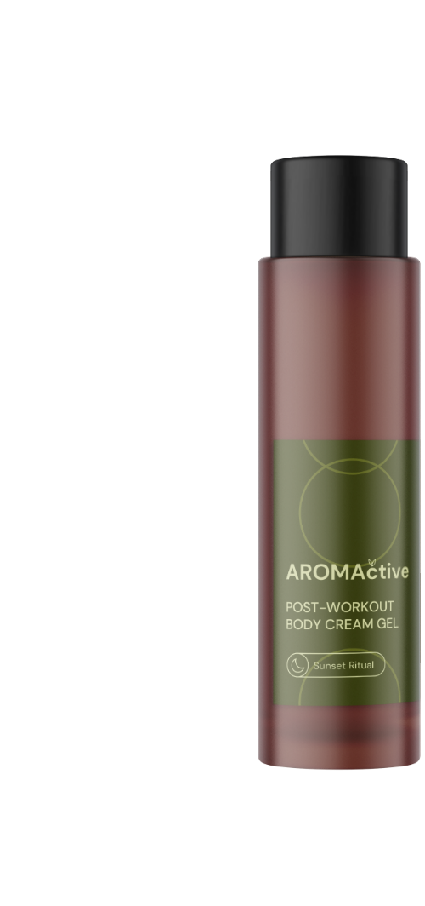
POST-WORKOUT
BODY CREAM GEL
FORMULA ID CARD
A cooling body cream gel to relieve stressed skin after a workout
Decongestant, relief for heavy legs, post-workout recovery, instant cooling effect
PERFORMANCE INGREDIENTS
POSSIBLE MARKETING CLAIMS
REGU®-AGE CB
ALPAFLOR® SAMBUCUS AO
ALPAFLOR® SCUTELLARIA CB
VALVANCE ® Touch 210
> 99% NATURAL ORIGIN
FORMULA (ISO 16128)
ALPAFLOR® SCUTELLARIA CB
Strong calming and soothing effects on irritated and sensitive skin,
Relieves the unpleasant sensation by stimulating neuromediators such as GABA_{B} receptors and ß-endorphins for a comfortable skin
Reinforcing the skin barrier function, alleviating dull complexion
Strong free radical scavengers, reducing the oxidative stress generated by pollution or lifestyle
ALPAFLOR® SAMBUCUS AO
Dose-dependent reduction of skin inflammation reactions by decreasing VEGF production
Helps relieve heavy legs
Supports against diffuse reddening
REGU®-AGE CB
Collagenase and elastase inhibitor
Stimulates fibroblasts proliferation in vitro
increases the clotting time already at low levels and hence improves capillary circulation
Improves skin texture by more than 30% in 4 weeks in vivo

Slide 25
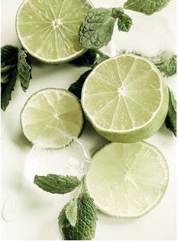
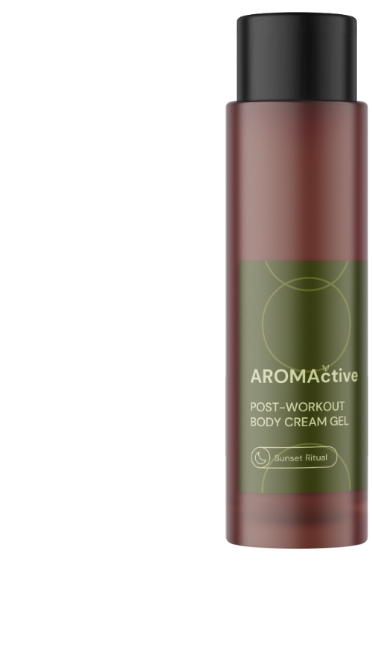
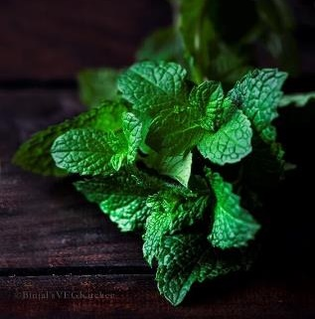
POST-WORKOUT
BODY CREAM GEL
FRAGRANCE ID CARD
FRAGRANCE DESCRIPTIVE SENTENCE
This fragrance is inspired by a spa moment after a workout session
Crushed mint and juicy citrus notes are the perfect combination
to feel relax.
Associated to touch of menthol for an instant cooling
sensation.
FRAGRANCE NAME
AROMACTIVE HARMONY P01A744
67% Essential
Oils blends
complex
TECHNOLOGY & CLAIMS INSPIRATION
Fragrance designed to elicit A RELAXING SENSATION / EMOTION, tested for brain activity using an fMRI methodology and is referred to as dsm-firmenich.
100% NATURAL ORIGIN
100% RENEWABLE PERFUME
40% OF UPCYCLED INGREDIENTS
Patented methodology
Certification Supported

Slide 26



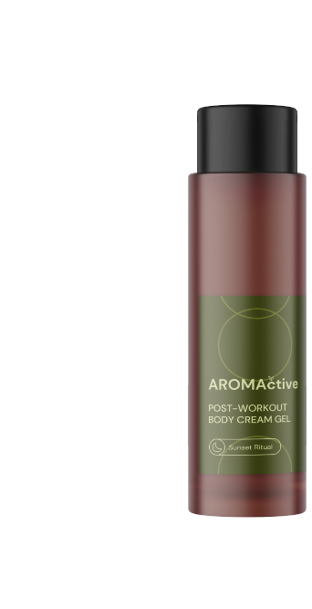
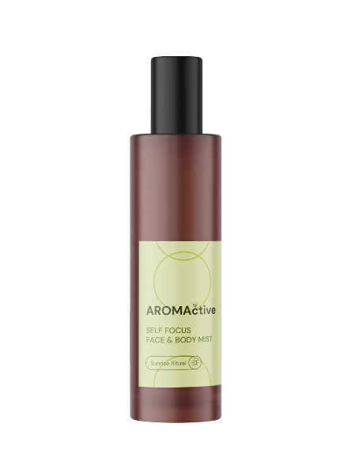

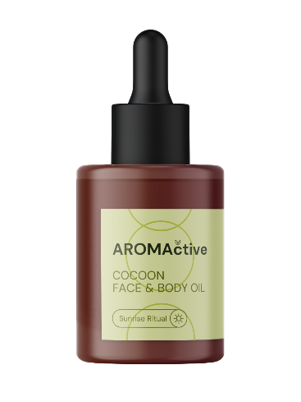
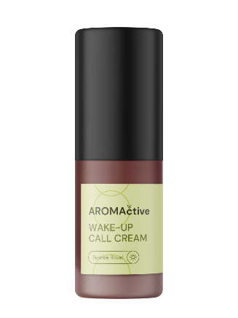


Product concepts are for illustration only and are not for sale. Any claims in this document are for inspiration only and the customer is solely responsible for any marketing claims used on its product.
Well-being rituals made with scents and care.
SOUL
TRANSFORMATIVE
CLEANSER
WAKE UP
CALL
CREAM
COCOON
FACE & BODY
OIL
SELF FOCUS
FACE & BODY
MIST
SLEEP EASY
NIGHT CREAM
POST-WORKOUT
BODY CREAM GEL
ALPAFLOR® NECTAPURE PF
PENTAVITIN®
PENTAVITIN®
ALPAFLOR® NECTAPURE PF
PEPHA®-CTIVE CB
RETINOL CB 50
PENTAVITIN®
ETERWELL™ YOUTH
REVITALIN® CB
SYN COLL® CB
REGU®-AGE CB
ALPAFLOR® SAMBUCUS AO
ALPAFLOR® SCUTELLARIA CB
SKIN &
MOOD
BENEFITS
Skin comfort, antipollution,
Instant hydration,
Strengthens the skin’s barrier
Regenerate, Anti-stretch marks, Firmness, elasticity & softness
Hydrates and
perfumes
Wrinkle reduction,
Cell rejuvenation overnight,
Antioxidant
A cooling body cream gel to relieve stressed skin after a workout
Moisturizing & glow,
Cellular booster, Antioxidant
HAPPY
ENERGY
ENERGY
FOCUS
RELAX
RELAX

Slide 27
THANK YOU

Slide 28


FORMULA ID CARD
PHASE | INGREDIENTS | FUNCTION | % W/W
A | Sucragel® AP V2 | GLYCERIN, AQUA, SUCROSE LAURATE | 20,00
 | SUCRABLEND SP V2 | SUCROSE STEARATE, SUCROSE PALMITATE | 0,50
 | CremerGLYC Refined Glycerine Organic | GLYCERIN | 10,00
B | ARGAN OIL | ARGANIA SPINOSA KERNEL OIL | 2,00
 | Myritol® 318 | CAPRYLIC/CAPRIC TRIGLYCERIDE | 30,70
 | Eutanol® G | OCTYLDODECANOL | 30,00
 | Cetiol® C5 | COCO-CAPRYLATE | 5,00
C | ALPAFLOR® NECTAPURE PF | THYMUS VULGARIS (THYME) FLOWER/LEAF EXTRACT, BUDDLEJA DAVIDII LEAF EXTRACT, GLYCERIN, AQUA | 1,00
 | PENTAVITIN® | SACCHARIDE ISOMERATE, AQUA, CITRIC ACID, SODIUM CITRATE | 0,50
 | AROMACTIVE LAGOON P01A748 | PARFUM, LIMONENE, LINALOOL, CITRUS AURANTIUM PEEL OIL, JUNIPERUS VIRGINIANA OIL, CITRUS AURANTIUM BERGAMIA PEEL OIL, LINALYL ACETATE | 0,30
PROCEDURE
1
SOUL TRANSFORMATIVE CLEANSER
Heat Phase A to 75-80°C to solubilize Sucrablend.
Add very slowly Phase B under strong stirring.
Cool down to Room Temperature.
Add Phase C to Phase A+B slowly under high stirring.
TECHNICAL DATA
Viscosity
(spindle
RV-5/10 rpm)
pH
NA
39 560 mPa.s.
SK-E-102559-5
The formulation fulfils the 6 weeks stability at 50°C and the 3 months stability at 4°C, 40°C, room temperature and daylight.

Slide 29
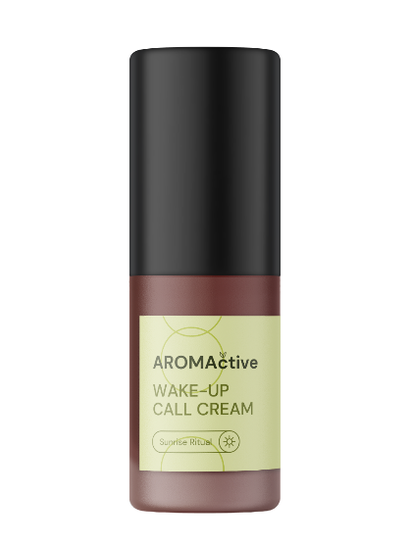
FORMULA ID CARD
PHASE | INGREDIENTS | FUNCTION | % W/W
A | Water Dem | AQUA | 61,85
 | Propanediol | PROPANEDIOL | 3,00
B | Beauté by Roquette® DS 112 | STARCH ACETATE, HYDROXYETHYLCELLULOSE, XANTHAN GUM | 1,50
C | Emulfree CBG MB | ISOSTEARYL ALCOHOL, BUTYLENE GLYCOL COCOATE, ETHYLCELLULOSE | 4,00
 | Emulium® Dermolea MB | POLYGLYCERYL-6 DISTEARATE, CANDELILLA/JOJOBA/RICE BRAN POLYGLYCERYL-3 ESTERS | 4,00
 | Dermol 99 | ISONONYL ISONONANOATE | 6,25
 | Lanette® O | CETEARYL ALCOHOL | 1,00
 | Compritol 888 CG MB Pellets | GLYCERYL BEHENATE | 3,00
 | Cosphaderm® Feel | TRIHEPTANOIN | 5,00
D | VALVANCE® Touch 210 | SILICA | 3,00
 | Mixed Tocopherols 95 | TOCOPHEROL | 0,20
 | E-Leen GC 8 | CAPRYLYL GLYCOL, GLYCERYL CAPRYLATE/CAPRATE, GLYCERIN | 1,00
 | PENTAVITIN® | SACCHARIDE ISOMERATE, AQUA, CITRIC ACID, SODIUM CITRATE | 2,00
 | ALPAFLOR® NECTAPURE PF | THYMUS VULGARIS (THYME) FLOWER/LEAF EXTRACT, BUDDLEJA DAVIDII LEAF EXTRACT, GLYCERIN, AQUA | 2,00
 | PEPHA®-CTIVE CB | DUNALIELLA SALINA EXTRACT, AQUA, PENTYLENE GLYCOL, CITRIC ACID | 2,00
 | AROMACTIVE AURORA P01A741 | PARFUM, LAVANDULA OIL/ EXTRACT, JUNIPERUS VIRGINIANA OIL, LINALYL ACETATE, VANILLIN, LINALOOL, BETA-CARYOPHYLLENE | 0,20
PROCEDURE
2
WAKE-UP
CALL CREAM
Prepare Phase A and heat up to 80°C under stirring.
Add Phase B into Phase A at the end of the heating process under stirring.
Prepare Phase C and heat up to 80°C under stirring.
Add Phase C into Phase A+B under stirring and homogenize.
Add ingredients of Phase D one by one into the formulation under stirring.
TECHNICAL DATA
Viscosity
(spindle
RV-6/10 rpm)
pH
5.9
13 000 mPa.s.
SK-E-102554-3
The formulation fulfils the 3 months stability at 4°C, 40°C, 50°C, room temperature and daylight.

Slide 30

FORMULA ID CARD
PHASE | INGREDIENTS | FUNCTION | % W/W
A | Cetiol® LC | COCO-CAPRYLATE/CAPRATE | 14,00
 | Cetiol® OE | DICAPRYLYL ETHER | 13,50
 | Myritol® 318 | CAPRYLIC/CAPRIC TRIGLYCERIDE | 12,50
 | Eutanol® G | OCTYLDODECANOL | 30,50
B | Macadamianussöl raff kbA DE-ÖKO-001 | MACADAMIA INTEGRIFOLIA/TETRAPHYLLA SEED OIL | 24,50
 | ARGAN OIL | ARGANIA SPINOSA KERNEL OIL | 3,00
 | Mixed Tocopherols 95 | TOCOPHEROL | 0,20
 | RETINOL CB 50 | RETINOL, UNDECANE, TRIDECANE, TOCOPHEROL | 0,10
 | Sanddornfruchtfleischoel kbA DE-OEKO-001 | HIPPOPHAE RHAMNOIDES OIL | 0,10
 | life'sGLA™ '10' n-6 Oil | OENOTHERA BIENNIS SEED EXTRACT, ASCORBYL PALMITATE, TOCOPHEROL | 1,00
 | AROMACTIVE COCOON P01A742 | PARFUM, LIMONENE, CITRUS AURANTIUM PEEL OIL, CITRUS LIMON PEEL OIL, LINALOOL, PINENE, GERANYL ACETATE, VANILLIN, CITRONELLOL, JUNIPERUS VIRGINIANA OIL, CITRAL | 0,50
PROCEDURE
3
COCOON
FACE & BODY OIL
Prepare Phase A and stir it with a magnetic stirrer.
Prepare Phase B and stir it with a magnetic stirrer.
Add Phase B to Phase A under stirring.
TECHNICAL DATA
pH
Viscosity:
NA
Liquid
SK-E-102553-12
The formulation fulfils the 3 months stability at 4°C, 40°C, 50°C, room temperature and daylight.

Slide 31

PHASE | INGREDIENTS | FUNCTION | % W/W
A | AROMACTIVE RETREAT P01B373 | PARFUM, CITRONELLOL, GERANIOL, HYDROXYCITRONELLAL, LIMONENE, LINALOOL, BETA-CARYOPHYLLENE, CITRUS AURANTIUM BERGAMIA PEEL OIL, JUNIPERUS VIRGINIANA OIL, LINALYL ACETATE, PINENE, POGOSTEMON CABLIN OIL, ROSE FLOWER OIL/EXTRACT, VANILLIN | 4,00
 | PARSOL® GUARD | OCTOCRYLENE, HOMOSALATE, BUTYL METHOXYDIBENZOYLMETHANE, TOCOPHEROL, HELIANTHUS ANNUUS (SUNFLOWER) SEED OIL | 0,30
B | Ethanol Surfin Denature | ALCOHOL, AQUA, T-BUTYL ALCOHOL, DENATONIUM BENZOATE | 62,70
C | Water Dem | AQUA | 30,00
D | PENTAVITIN® | SACCHARIDE ISOMERATE, AQUA, CITRIC ACID, SODIUM CITRATE | 1,00
 | Propanediol | PROPANEDIOL | 2,00
PROCEDURE
4
SELF FOCUS
FACE & BODY MIST
Premix Perfume and PARSOL® Guard with a spatula.
Add Phase B and mix until complete dissolution.
Add Phase C under stirring.
Freeze and filter the mix.
Add PENTAVITIN® and propanediol under stirring.
TECHNICAL DATA
pH
Viscosity
NA
Liquid
SK-E-102626-1

Slide 32


PHASE | INGREDIENTS | FUNCTION | % W/W
A | Water Dem | AQUA | 67,30
 | A-Leen 8 | CAPRYLYL GLYCOL | 0,50
 | AGENAJEL 20.313 | HYDROXYPROPYL STARCH PHOSPHATE | 3,00
B | Propanediol | PROPANEDIOL | 5,00
 | Keltrol® CG-T | XANTHAN GUM | 0,30
C | Olivem® 1000 MB | CETEARYL OLIVATE, SORBITAN OLIVATE | 5,00
 | Cetiol® LC | COCO-CAPRYLATE/CAPRATE | 5,00
 | Cosphaderm® Feel | TRIHEPTANOIN | 5,00
 | Cutina® FS 45 | STEARIC ACID, PALMITIC ACID | 0,75
 | Dermosoft® GMCY MB | GLYCERYL CAPRYLATE | 0,25
 | Mixed Tocopherols 95 | TOCOPHEROL | 0,10
D | ETERWELL™ YOUTH | EPILOBIUM FLEISCHERI LEAF/STEM EXTRACT, GLYCERIN, AQUA, CITRIC ACID | 3,00
 | REVITALIN® CB | GLYCOPROTEINS, GLUTAMIC ACID, VALINE, THREONINE, AQUA, 1,2-HEXANEDIOL, CAPRYLYL GLYCOL | 2,00
 | SYN®-COLL CB | PALMITOYL TRIPEPTIDE-5, GLYCERIN, AQUA | 2,50
E | AROMACTIVE MOONSHINE P01A746 | PARFUM, LAVANDULA OIL/ EXTRACT, JUNIPERUS VIRGINIANA OIL, LINALYL ACETATE, VANILLIN, LINALOOL, BETA-CARYOPHYLLENE | 0,30
PROCEDURE
5
SLEEP EASY
NIGHT CREAM
Prepare Phase A and add Hydroxypropyl Starch Phosphate under stirring.
Heat-up Phase A to 75-80°C.
When Phase A achieve 60°C, add Phase B into Phase A under stirring.
Prepare Phase C and heat-up to 75-80°C.
Add Phase C to Phase A+B and homogenize with Ultra-Turrax.
Cool down to room temperature under stirring.
Add Phase D under stirring.
Adjust the pH to 5-5.5 with Phase E.
Add Phase F and homogenize with Ultra-Turrax.
TECHNICAL DATA
Viscosity
(spindle
RV-5/10 rpm)
pH
5.5
31880 mPa.s.
SK-E-102555-4
The formulation fulfils the 3 months stability at 4°C, 40°C, 50°C, room temperature and daylight.

Slide 33

PHASE | INGREDIENTS | FUNCTION | % W/W
A | Water Dem | AQUA | 80,61
 | Ecogel™ | LYSOLECITHIN, SCLEROTIUM GUM, PULLULAN, XANTHAN GUM | 2,50
 | Propanediol | PROPANEDIOL | 3,00
 | E-Leen GC 8 | CAPRYLYL GLYCOL, GLYCERYL CAPRYLATE/CAPRATE, GLYCERIN | 0,20
 | Cosphaderm® Pentiol natural | PENTYLENE GLYCOL | 3,00
B | Myritol® 318 | CAPRYLIC/CAPRIC TRIGLYCERIDE | 5,00
C | VALVANCE® Touch 210 | SILICA | 1,00
D | REGU®-AGE CB | GLYCINE SOJA (SOYBEAN) PROTEIN, HYDROLYZED RICE PROTEIN, SUPEROXIDE DISMUTASE, GLYCERIN, AQUA, PENTYLENE GLYCOL, 1,2-HEXANEDIOL, CAPRYLYL GLYCOL, SODIUM BENZOATE, SODIUM DEXTRAN SULFATE | 2,00
 | ALPAFLOR® SAMBUCUS AO | SAMBUCUS NIGRA FLOWER EXTRACT, GLYCERIN, AQUA, CITRIC ACID, SODIUM BENZOATE, POTASSIUM SORBATE | 1,00
 | ALPAFLOR® SCUTELLARIA CB | GLYCERIN, AQUA, CITRIC ACID, SCUTELLARIA ALPINA FLOWER/LEAF/STEM EXTRACT | 1,00
 | AromActive Harmony P01A744 | PARFUM, LIMONENE, CITRUS AURANTIUM PEEL OIL, LINALOOL, CITRUS LIMON PEEL OIL, PINENE, MENTHOL, MENTHA PIPERITA OIL, CITRAL, POGOSTEMON CABLIN OIL, MENTHA VIRIDIS LEAF OIL, CARVONE, | 0,50
 | Menthol Nat 957789 | MENTHOL | 0,10
E | RonaCare® Sodium Hydroxide 10% Solution | SODIUM HYDROXIDE, AQUA | 0,09
PROCEDURE
6
POST-WORKOUT BODY CREAM GEL
Prepare Phase A and heat-up to 75°C-80°C under stirring for 30 min.
Prepare Phase B under stirring.
Add Phase B into Phase A under stirring.
Add Phase C into Phase A+B and homogenize at 18000 rpm for 2 min.
Cool down to 35°C under stirring.
Add ingredients of Phase D one by one into the emulsion under stirring.
Adjust pH to 7 with Phase E.
TECHNICAL DATA
Viscosity
(spindle
RV-4/10 rpm)
pH
6.9
8420 mPa.s.
SK-E-102552-2
The formulation fulfils the 3 months stability at 4°C, 40°C, 50°C, room temperature and daylight.

Slide 34




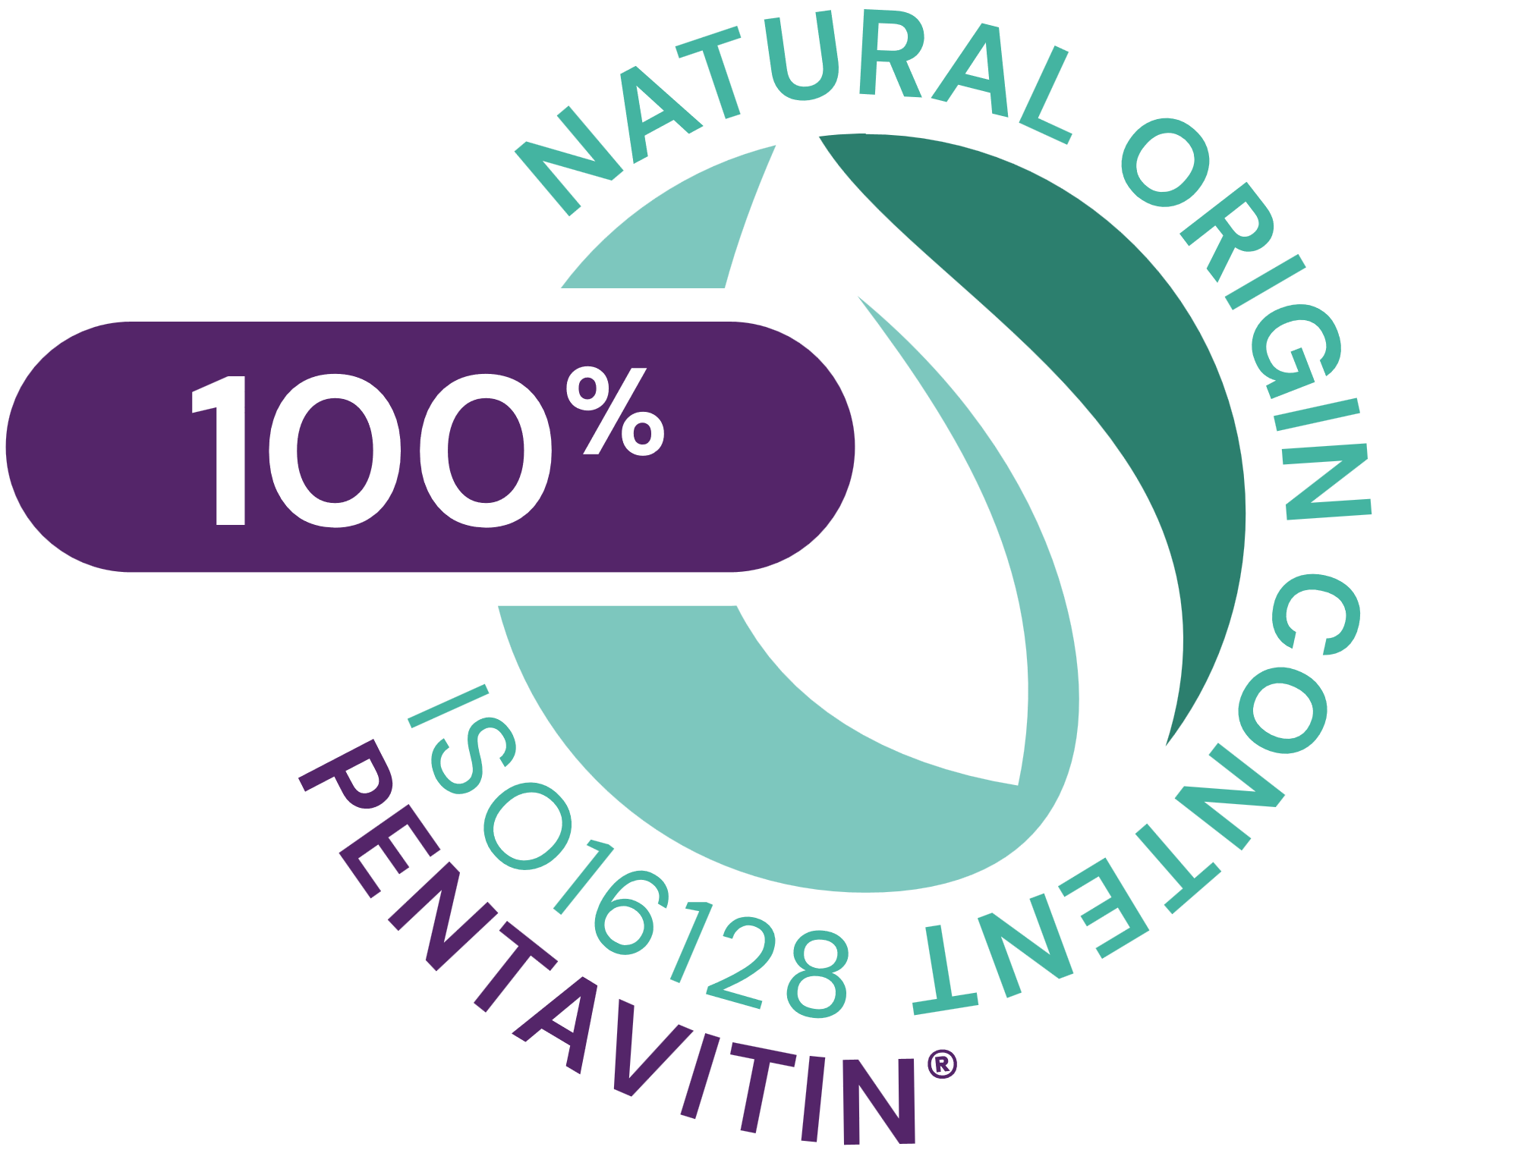









PENTAVITIN®
INCI NAME: Saccharide Isomerate, Aqua, Citric acid, Sodium citrate
ID CARD
TECHNOLOGY
Skin identical sugar complex extracted from edible maize kernel, results from a smart isomerization reaction
TECHNICAL | pH OF USE | FORM | USE LEVEL | PRESERVATIVE | SOLUBILITY | BIODEGRADABLE
3.0-10.0
Liquid
0.2-5%
Free
Water
Yes
BENEFITS | Binds to keratin as magnet power and gives back vitality to your skin* Helps to repair sun-damaged skin barrier* Instant hydration boost to excessively dry skin areas** Restores & calms stressed skin that lasts for up to 24 hours** 72 hours long-lasting deep hydration** Reverses the 5 signs of dehydrated skin: roughness, dullness, flakiness, tightness, redness**
REGISTRATION CERTIFICATION
Raw material verified by ECOCERT GREENLIFE, conform to the COSMOS Standard
NATRUE
Approved
* In vitro ** in vivo
VIEW IMPACT CARD

Slide 35


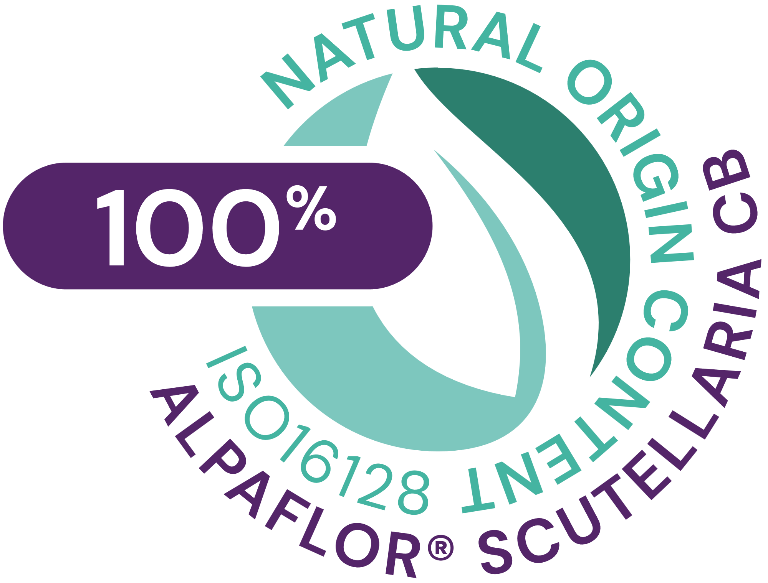




ALPAFLOR® SCUTELLARIA CB
INCI NAME: Scutellaria Alpina Flower/Leaf/Stem Extract, Glycerin, Aqua, Citric Acid
ID CARD
TECHNOLOGY
Sustainable gentle extraction of dried plant (with water/organic ethanol) following green chemistry principles
TECHNICAL | pH OF USE | FORM | USE LEVEL | PRESERVATIVE | SOLUBILITY | BIODEGRADABLE
3.5-6.5
Liquid
1-3%
Free
Water
main components readily biodegradable
BENEFITS | Activates key neuromediators such as GABAB receptors and β-endorphin* Protects the skin’s barrier function* Rare alpine plant species with unique composition Relieves unpleasant sensations and hydrates the skin for incomparable comfort** Keeps healthy looking skin and improves skin appearance** Alleviates skin dull complexion** Protects and calms irritated skin
REGISTRATION CERTIFICATION
* In vitro ** in vivo
VIEW IMPACT CARD

Slide 36


ALPAFLOR® NECTAPURE PF
INCI NAME (active): Buddleja Davidii Leaf Extract, Thymus Vulgaris (Thyme) Flower/leaf Extract, Glycerin, Aqua
ID CARD
TECHNOLOGY
Sustainable gentle extraction of dried plant (with water/organic ethanol) following green chemistry principles
TECHNICAL | pH OF USE | FORM | USE LEVEL | PRESERVATIVE | SOLUBILITY | BIODEGRADABLE
3.5-5.5
Liquid
1-5%
Free
Water
main components readily biodegradable
BENEFITS | Decreases significantly and dose-dependently pro-inflammatory cytokines after ozone exposure (-78% TNFα and -42% IL8)* Long lasting, in vivo, moisturization effect** Protects the skin against urban pollution* Relieves irritated skin Unique combination of 2 plants species attracting butterflies with specific chemical profile
REGISTRATION CERTIFICATION
* In vitro ** in vivo
VIEW IMPACT CARD

Slide 37





PEPHA®-CTIVE CB
INCI NAME: Dunaliella Salina Extract, Pentylene Glycol, Citric acid, Aqua
ID CARD
TECHNOLOGY
Derived from Dunaliella salina microalgae sustainably farmed in photo-bioreactors, guaranteeing maximum quality (no risk of contamination, reproducibility of process, fully traceable). Cultivated in controlled conditions, optimally exposed to the right cellular stress: high salinity, high light intensity, nutrient deprivation, and extreme temperatures
TECHNICAL | pH OF USE | FORM | USE LEVEL | PRESERVATIVE | SOLUBILITY | BIODEGRADABLE
3.0-6.0
Liquid
1-3%
Free
Water
Yes
BENEFITS | Protects the mitochondria against oxidative stress caused by free radicals * Cellular energy activation and cellular proliferation significantly increased* Accelerates skin cell renewal for revived, glowing complexion ** Visible improvement in skin brightness and luminosity**
REGISTRATION CERTIFICATION
Raw material verified by ECOCERT GREENLIFE, conform to the
COSMOS Standard
* In vitro ** in vivo
VIEW IMPACT CARD

Slide 38

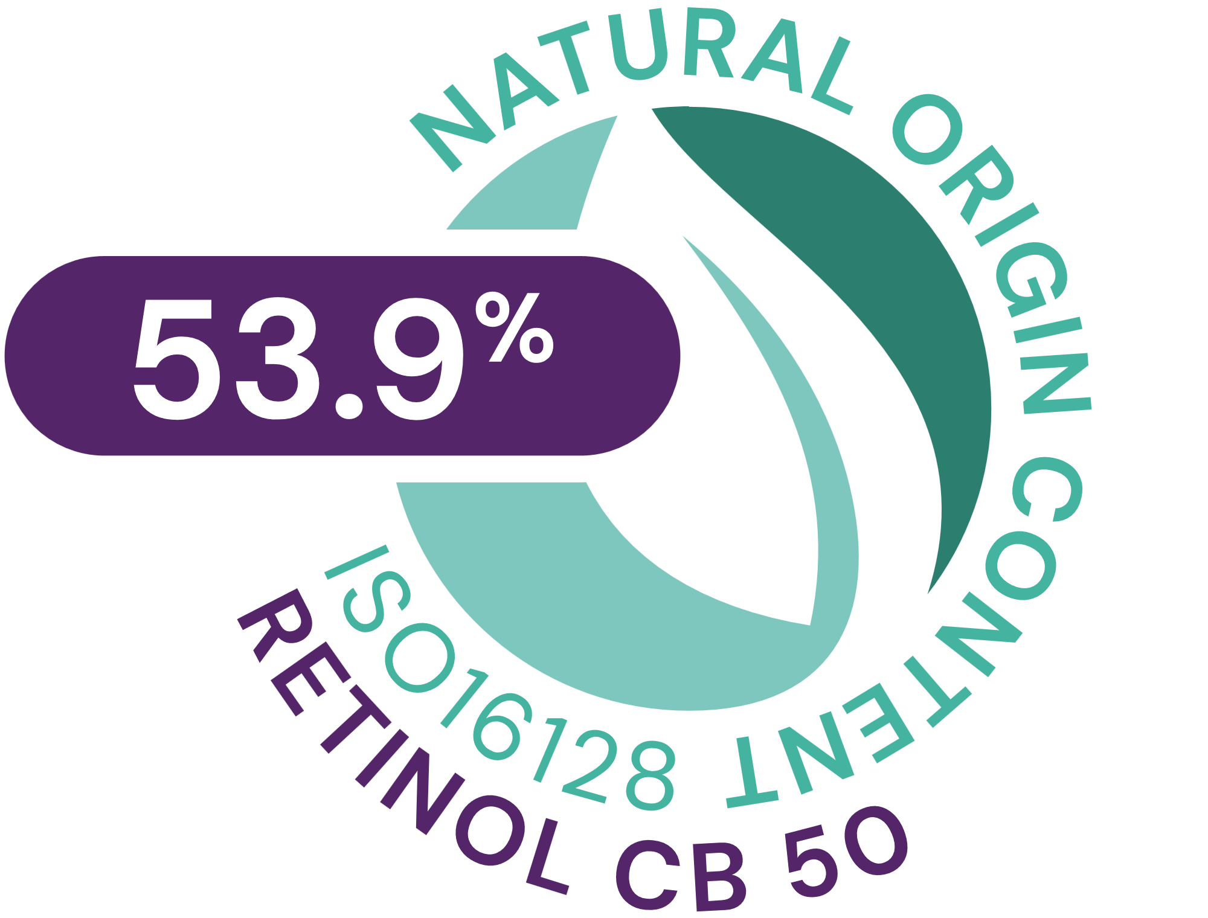




RETINOL CB 50
INCI NAME: Retinol, Undecane, Tridecane, Tocopherol
ID CARD
TECHNOLOGY
RETINOL CB 50 is made from retinyl acetate by hydrolysis, followed by a dissolution into a mixture of undecane and tridecane from natural origin
TECHNICAL | pH OF USE | FORM | USE LEVEL | PRESERVATIVE | SOLUBILITY | BIODEGRADABLE
4.5-8.0
Liquid
0.05-0.6%
Free
Oil and fat soluble
Yes
BENEFITS | Increases synthesis of Collagen & Elastin, inhibits MMPs* Reduces skin photodamage** Improves the appearance of fine lines & wrinkles** Improves skin firmness, smoothness & elasticity** Rebalances uneven skin tone. Reduces skin discoloration and mottled pigmentation**
REGISTRATION CERTIFICATION
* In vitro ** in vivo
VIEW IMPACT CARD

Slide 39

ALPAFLOR® SAMBUCUS AO
INCI NAME: Sambucus Nigra Flower Extract, Glycerin, Water, Citric Acid, Sodium Benzoate, Potassium Sorbate
ID CARD
TECHNOLOGY
Sustainable gentle extraction of dried plant (with water/organic ethanol) following green chemistry principles
TECHNICAL | pH OF USE | FORM | USE LEVEL | PRESERVATIVE | SOLUBILITY | BIODEGRADABLE
3.5-5.5
Liquid
1-3%
Free
Water
main components readily biodegradable
BENEFITS | Inhibits inflammatory markers such as IL1α, IL1β, TNFα and VEGF (Vascular Endothelial Growth factor)* Helps against puffiness Supports against diffuse reddening and heavy legs
REGISTRATION CERTIFICATION
* In vitro/Literature
VIEW IMPACT CARD

Slide 40
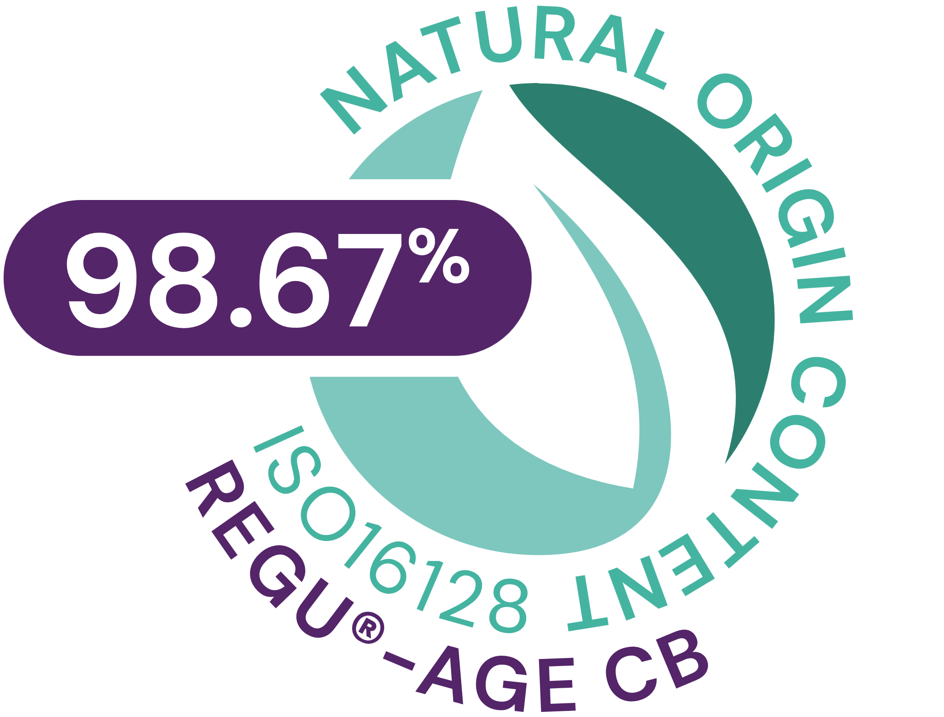



REGU®-AGE CB
INCI NAME: Glycine Soja (Soybean) Protein, Hydrolyzed Rice Protein, Superoxide Dismutase, Glycerin, Aqua, Pentylene Glycol, 1,2-Hexanediol, Caprylyl Glycol, Sodium Benzoate, Sodium Dextran Sulfate
ID CARD
TECHNOLOGY
Skin identical sugar complex extracted from edible maize kernel, results from a smart isomerization reaction
TECHNICAL | pH OF USE | FORM | USE LEVEL | PRESERVATIVE | SOLUBILITY | BIODEGRADABLE
3.5–8.0
Liquid
2–5%
Sodium Benzoate
Water
Yes
BENEFITS | Protects the collagen and elastin matrix* Beneficial effect on capillary circulation by increasing clotting time* Helps reduce wrinkles appearance around eyes, nose and neck** Visibly reduces under-eye dark circles and eye puffiness** Increases skin smoothness already in 1 day**
REGISTRATION CERTIFICATION
* In vitro ** in vivo
VIEW IMPACT CARD

Slide 41

REVITALIN® CB
INCI NAME: Glycoproteins, Glutamic Acid, Valine, Threonine, Aqua, 1,2-Hexanediol, Caprylyl Glycol
ID CARD
TECHNOLOGY
Contains a combination of energy-providing postbiotic glycoproteins produced by fermentation of extraordinary baker’s yeast strain and three revitalizing amino acids (glutamic acid, valine, threonine). Origin: Fermentation - Vegetable
TECHNICAL | pH OF USE | FORM | USE LEVEL | PRESERVATIVE | SOLUBILITY | BIODEGRADABLE
3.0–7.5
Liquid
1–5%
Free
Water
Yes
BENEFITS | Delivers a lot of ATP by boosting both fundamental bioenergetic processes: glycolysis and mitochondrial respiration* Recharges skin cells with energy during the skin's nighttime and boosts daily energy levels when skin needs it most*. Vitality boost for less energetic (tired) skin cells. Energy kick for stressed skin cells* Helps to accelerate cell renewal activity**
REGISTRATION CERTIFICATION
* In vitro ** in vivo
VIEW IMPACT CARD

Slide 42

ETERWELL™ YOUTH
INCI NAME: Epilobium Fleischeri Leaf/Stem Extract, Glycerin, Water, Citric Acid
ID CARD
TECHNOLOGY
Gentle ethanolic extraction of dried plant following green chemistry principles
TECHNICAL | pH OF USE | FORM | USE LEVEL | PRESERVATIVE | SOLUBILITY | BIODEGRADABLE
3.5-5.5
Liquid
1-3%
Free
Water
main components readily biodegradable
BENEFITS | Helps revert skin damage induced by zombie cells in excess* Boost collagen* Appearance of wrinkles are significantly reduced** Restores the skin structure with improved skin elasticity and smoothness** Increases skin resilience with skin texture rebirth** Helps slow down the premature ageing of skin** Provides a rejuvenated skin appearance with vibrant healthy looking-skin**
REGISTRATION CERTIFICATION
* In vitro ** in vivo
VIEW IMPACT CARD

Slide 43

SYN®-COLL CB
INCI NAME: Palmitoyl Tripeptide-5, Glycerin, Aqua
ID CARD
TECHNOLOGY
Peptide sequence: Palm-Lys-Val-Lys-OH (MW 840 g/Mol), 11 granted and 2 pending patents worldwide. Patent number: WO2004/099237
TECHNICAL | pH OF USE | FORM | USE LEVEL | PRESERVATIVE | SOLUBILITY | BIODEGRADABLE
3.0–7.0
Liquid
1-3%
Free
Water
Yes
BENEFITS | Reverses visible signs of photo-ageing in just 4 weeks**! First TGF-β booster on the market Boosts collagen and protects it from degradation* Ethnic anti-ageing expert Sculpts face for a firmer, lifted skin appearance** Refines skin appearance with less visible pores**
REGISTRATION CERTIFICATION
* In vitro ** in vivo
VIEW IMPACT CARD

