Slide 1
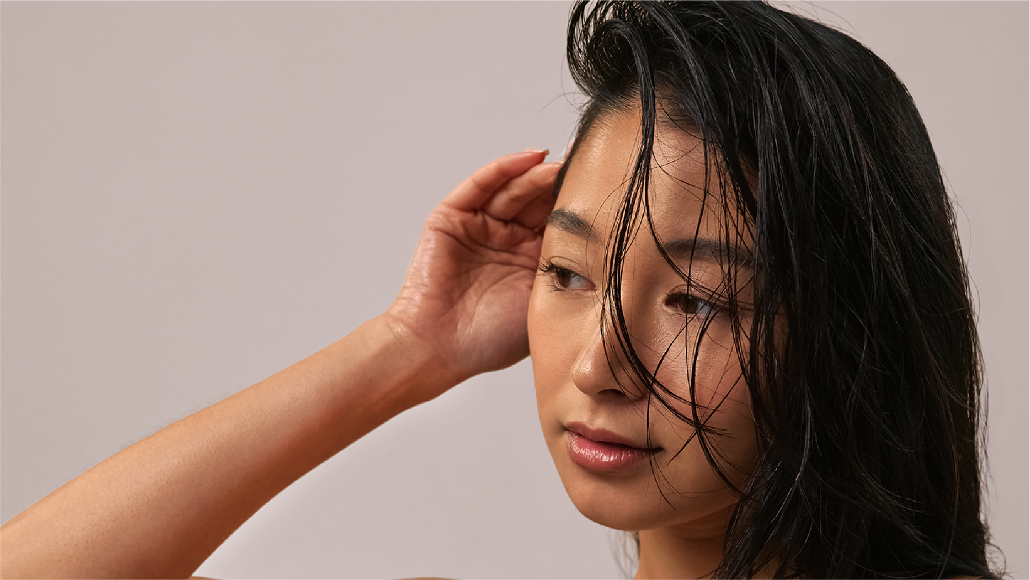

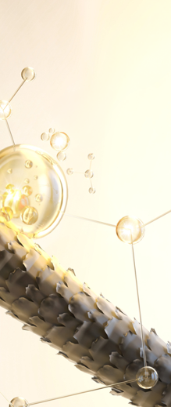




featuring
OXY 229 CB
2 in 1
ACTION
Scalp Vitality
& Strand Integrity
BIOTECH
Derived
Technology
PEPTIDE 743
04.2026

Slide 2





The hero behind the scene
OXY 229 CB
743 peptides bonding* to hair, effectively mending and strengthening each strand.
Benefits:
3 trends in one product: bond* repair or structural repair, biotech-beauty, oxygenating scalp care (Cellular beauty)
Strengthens the hair – restores the hair integrity
Improves combability
Enhances sensory experience
Smooths hair surface
Formulated with Natural Peptides for hair fiber care
Delivers scalp energy
Easy to use: 1% addition delivers immediate results
BIOTECH
Derived
Technology
OXY 229 CB, a comprehensive solution for hair repair and consumer delight
* Van der Waals interactions, hydrogen bonds and hydrophobic interactions.

Slide 3




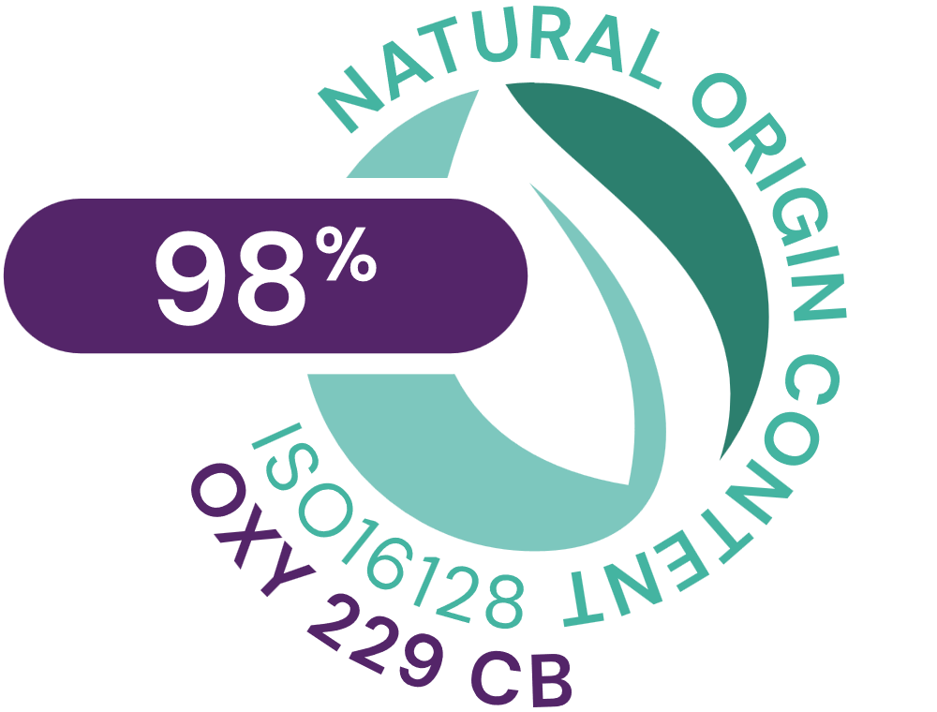

OXY 229 CB
ID card
INCI NAME:
Aqua, Glycerin, Caprylyl Glycol, 1,2-Hexanediol, Saccharomyces Lysate, Valine, Threonine, Glutamic acid, Glycine, Disodium Succinate
TECHNOLOGY:
Amino Acids, Postbiotics peptides obtained by fermentation of yeast (specific strain)
98% of natural origin (according to ISO 16128)
Solubility: water soluble
Biodegradability: readily biodegradable
TECHNICAL:
Form: liquid
Use level: 1–3%
pH of use: 3–7.5
Preservative: free
BENEFITS:
Repairs Hair damages
Restores the hair integrity
Prevents keratin from damage
Strengthens hair strands
Smooths the hair surface
Improves combability
Enhances hair sensory experience
Helps cells respiration (oxygen uptake)*
Stimulates cell viability, revitalizing the scalp*
REGISTRATIONS
CERTIFICATION
*In vitro

Slide 4
featuring
OXY 229 CB
Hair battles daily stress. UV exposure, pollution, heat, color, humidity, emotional stress — every day leaves a mark on the hair fiber and on the scalp.
That’s why BOND AID was created: a biotech-powered ritual designed to restore hair from the inside out.
Powered by OXY 229 CB at 1%, a 743-peptide innovation obtained through sustainable biotechnology, BOND AID delivers a powerful
2-in-1 action: it enhances structural integrity while revitalizes the scalp, while increases cells oxygen uptake up to +750%*.
The result? Stronger strands, smoother surface, and visible renewal since the first use.
More than performance, BOND AID is where science meets emotion.
A comforting, sophisticated fragrance powered by emotiOn™ ENERGY, designed to boost your mood and natural vitality, combined with lockscent™ the fragrance locker for hair, for long-lasting scent, transforms care into a sensorial experience for hair and mind.
Now, take a moment. Your ritual of restoration begins.
BIOTECH
Derived
Technology
* in vitro data

Slide 5


Slide 6
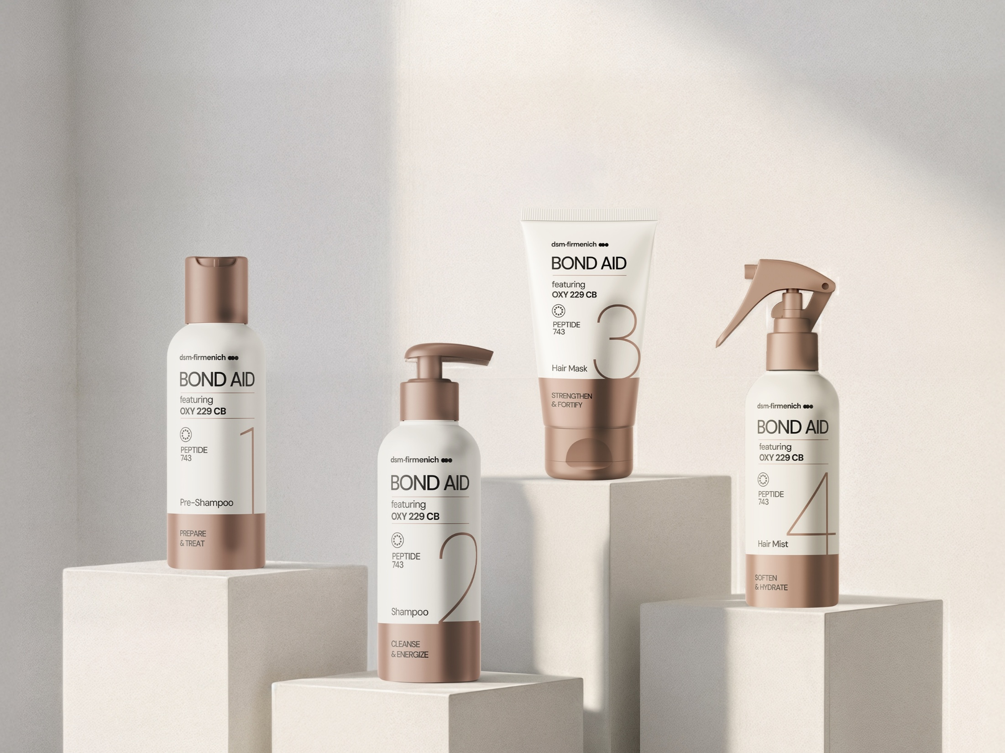


STEP 1 – PRE-SHAMPOO
STEP 2 – SHAMPOO
STEP 3 – HAIR MASK
STEP 4 – HAIR MIST
PREPARE & TREAT
CLEANSE
& ENERGIZE
STRENGTHEN & FORTIFY
SOFTEN
& HYDRATE
Helps to rebuild the fiber inner structure
Gently cleanses and revitalizes
Strengthens the fiber and smoothens the cuticles
Seales the routine and enhances softness
featuring
OXY 229 CB
Minimal steps, maximum impacts
This 4-step ceremony restores hair integrity from scalp to strands, attaching to keratin fibers to help rebuild what daily stress takes away. Created for dry, damaged, or color-treated hair.
2 in 1 ACTION
Scalp Vitality
& Strand Integrity
BIOTECH
Derived
Technology
PEPTIDE 743

Slide 7
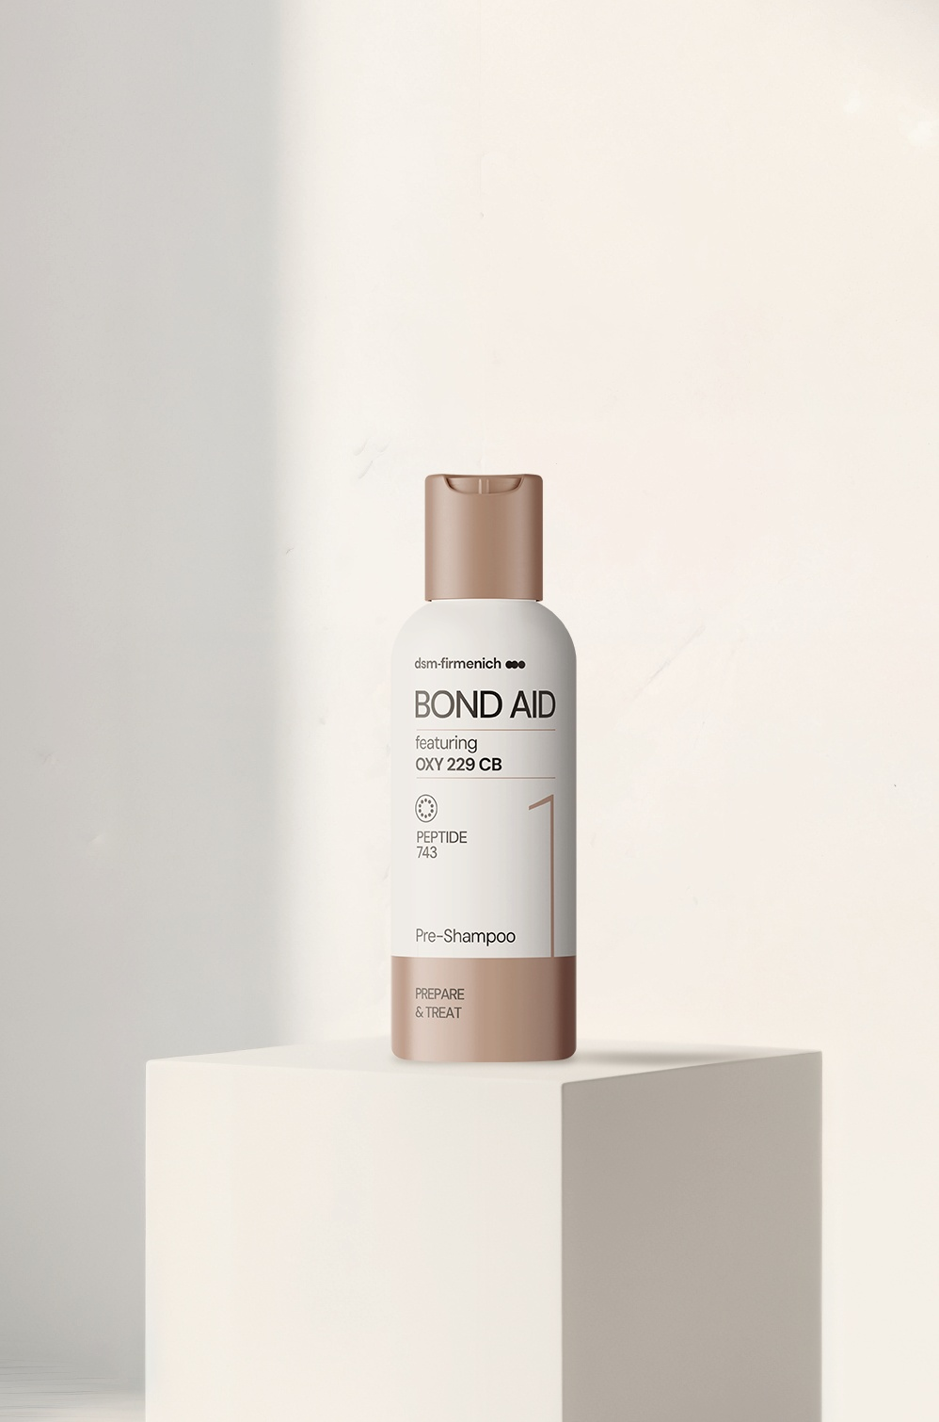


Prepared fiber. Boosted performance. Maximized impacts.
featuring
OXY
229 CB
STEP 1 – PRE-SHAMPOO
PREPARE
& TREAT
Stronger hair starts before you even step into the shower.
This pre‑shampoo treatment primes the fiber to reinforce, protect, and energize your hair and scalp.
More than a pre-shampoo, it is a treatment that helps strengthen the fiber’s inner structure, preparing it for the washing process.
OXY 229 CB - Strength starts here
Biotech natural peptides reinforce the fiber from the first use and smooth the surface. First step toward stronger, more resilient hair.
Phytantriol - Protect and preserve
Forms a color‑protective veil and supports the deposition of panthenol & keratin amino acids.
Niacinamide PC - Scalp and fiber readiness
Helps improve resilience for a healthier scalp and contribute to thicken & strength the fiber.
2 in 1
ACTION
Scalp Vitality
& Strand Integrity
BIOTECH
Derived
Technology
PEPTIDE 743

Slide 8
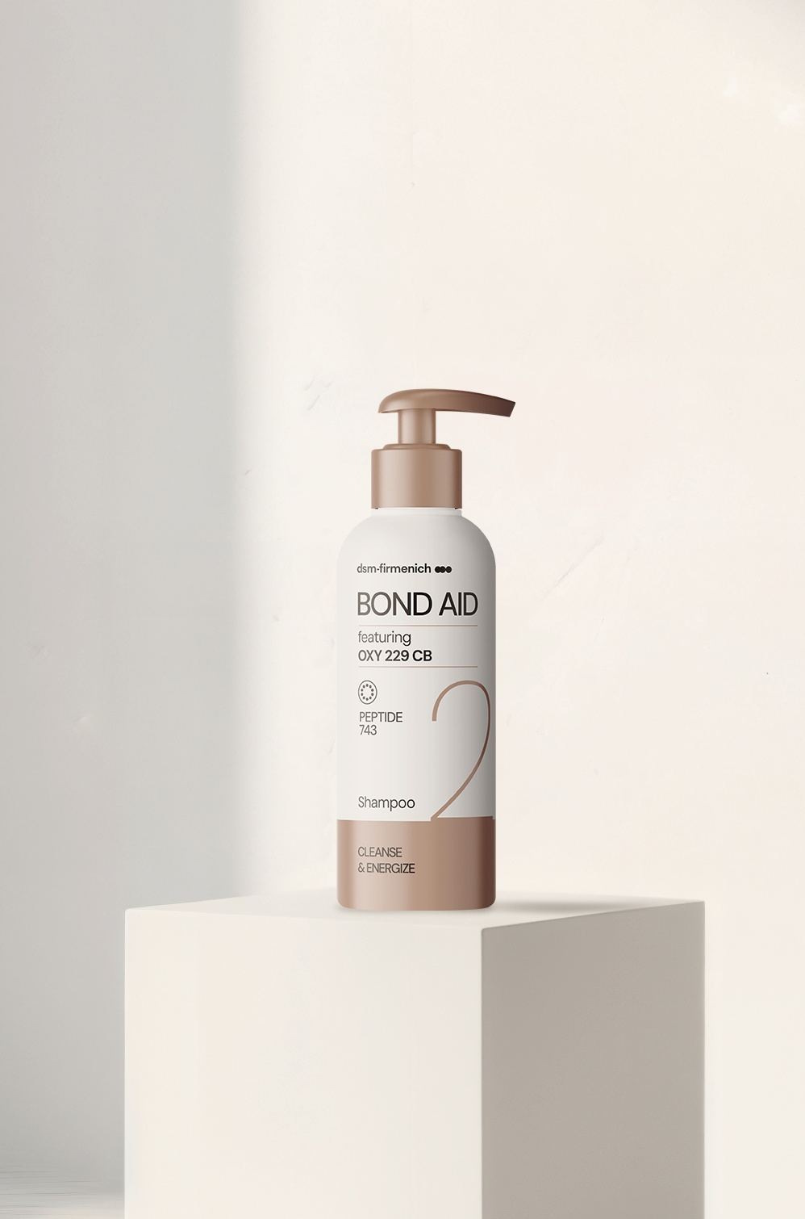

Clean feel. Strong strands. Energized results.
featuring
OXY
229 CB
STEP 2 –SHAMPOO
CLEANSE
& ENERGIZE
This gentle, sulfate‑free shampoo creates a soft, cushioning lather that cleanses without stripping. Making it ideal even for sensitive scalps. It removes impurities while respecting the scalp barrier, leaving hair feeling fresh, soft, and ready for the repair routine.
OXY 229 CB - Strength and energy
Biotech natural peptides reinforce the fiber from within, smooth the surface, and improve combability, while boosting cellular oxygen uptake and scalp vitality for stronger, more energized hair after every wash.
TILAMAR® Quat 640 - Weightless conditioning
A high‑performance conditioning polymer delivering superior wet & dry combability, smooth slip, and a clean rinse with no build‑up, keeping hair light, silky, and easy to manage.
PENTAVITIN® - Rinse‑off survivor
A natural sugar derivative that binds to keratin and scalp, helping reinforce the scalp barrier within 24 hours, reduce flaking and excess sebum, and keep the scalp hydrated, even with frequent washing.
2 in 1
ACTION
Scalp Vitality
& Strand Integrity
BIOTECH
Derived
Technology
PEPTIDE 743

Slide 9
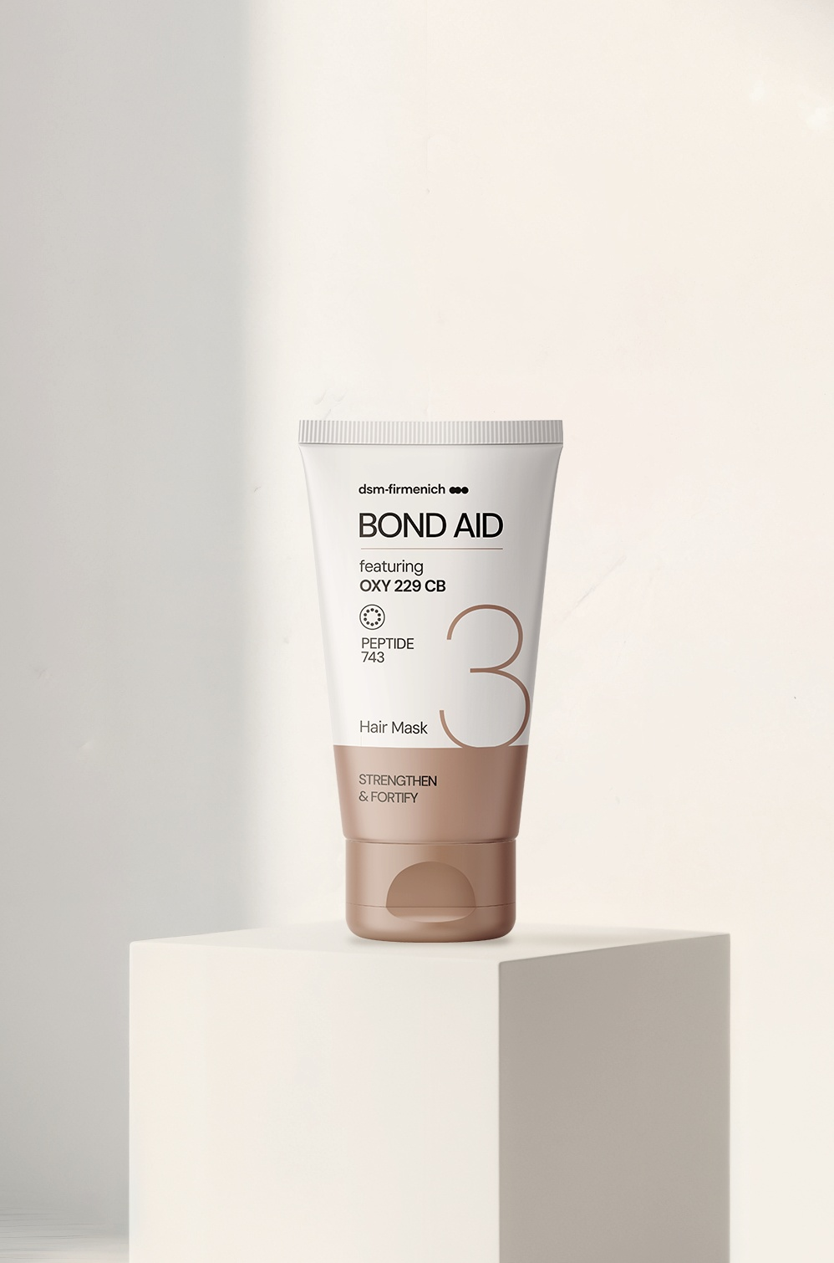

Stronger fiber. Smoother feel. Fortified finish.
featuring
OXY
229 CB
STEP 3 – HAIR MASK
STRENGTHEN
& FORTIFY
A rich, strengthening mask that dives deep into the fiber to fortify, smooth, and restore.
This step of the BOND AID routine, designed to lock in structural reinforcement strengthen the fiber while smoothing the cuticles, delivering an incredible feel-good texture.
After use it delivers stronger, softer, visibly renewed hair.
OXY 229 CB - Deep fiber strength
The biotech natural peptide complex reinforces the hair from within, improves tensile strength, and smooths the fiber surface for easier combing and a fortified finish. Proven to deliver measurable structural repair.
Panthenol - Moisture and resilience
Panthenol helps strengthen the scalp barrier and boost moisturization. It contributes to hair-thickening effect by helping increase fiber diameter.
STIMU-TEX® AS — Powerful nourishing blend
It helps reduce breakage, smooth frizz, improve ease of combing, and reduce split‑ends, while supporting scalp comfort with soothing and calming properties.
2 in 1
ACTION
Scalp Vitality
& Strand Integrity
BIOTECH
Derived
Technology
PEPTIDE 743

Slide 10
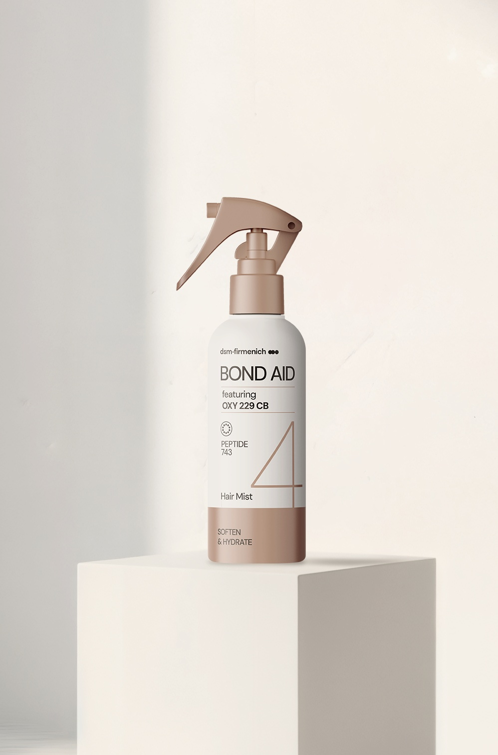

Soft strands. Weightless moisture. Boosted mood.
featuring
OXY
229 CB
STEP 4 – HAIR MIST
SOFTEN
& HYDRATE
A lightweight, non‑greasy mist that seals the final step of the BOND AID routine. This mist softens, hydrates, and protects the fiber while boosting all preceding repair steps.
Its mood‑boosting, sophisticated fragrance locks onto your hair for hours, leaving an irresistible trail.
OXY 229 CB — Softness with strength
Our Biotech natural peptide complex delivers lightweight fiber reinforcement, smoothing the surface for instant softness and easier combability - keeping the hair conditioned and more resilient throughout the day.
HYA‑ACT™ M— Weightless hydration
This efficient form of hyaluronic acid provides immediate hydration.
Fragrance — BOND AND BEYOND
A bright citrus opening softened by vanilla and warm sandalwood elevates the final step into a sensorial seal. Powered by lockscent™ the fragrance locker for hair, for long-lasting scent and emotiOn™ ENERGY, designed to boost your natural vitality.
2 in 1
ACTION
Scalp Vitality
& Strand Integrity
BIOTECH
Derived
Technology
PEPTIDE 743

Slide 11

Fragrance
BOND AND BEYOND
TOP NOTES
Grapefruit ​
Lemon Pie ​
​
HEART NOTES
Pineapple Flower​
Vanilla Orchid ​
​
BASE NOTES
Brown Sugar​
Sandalwood ​
Zesty and sparkling citrus, softened by vanilla and sandalwood notes, create a sophisticated scent that elevates repair to a sensorial ritual.​
ORANGE TERP CITRONOVA® & SANDALBLOOM™: upcycled ingredients
NIRVANOL®: dsm-firmenich´s captive
lockscent™, ​
the fragrance locker for hair ​
A selection of high-impact ingredients from
dsm-firmenich’s palette that bond with hair
keratin and diffuse their scents throughout
the day​.
emotiOn™ ENERGY
fragrance made to feel
Powered by 30 years of neuroscience.
Designed to boost your natural vitality.​

Slide 12

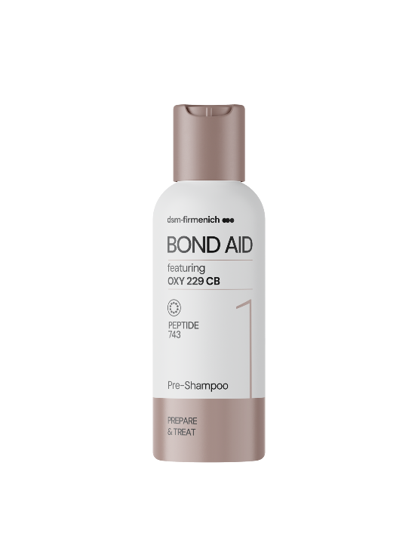
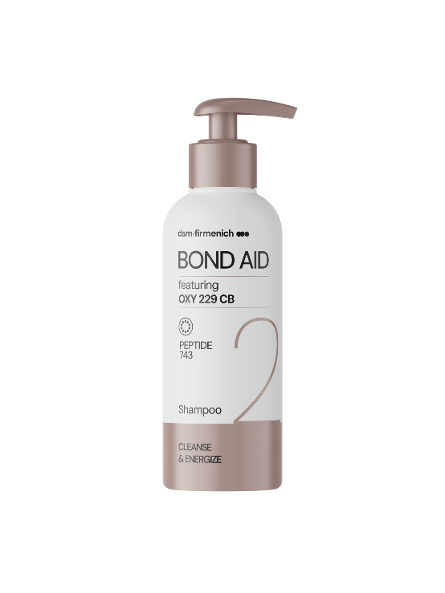


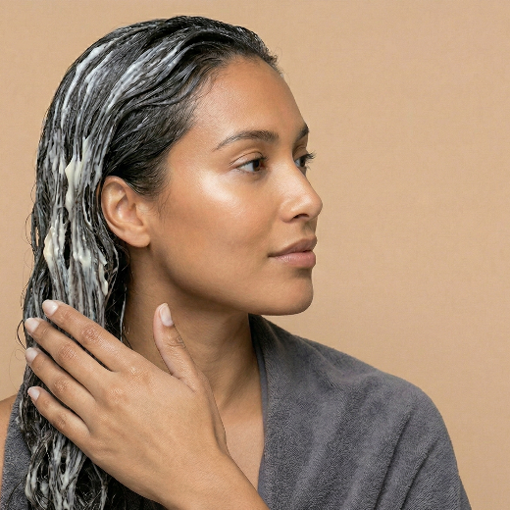
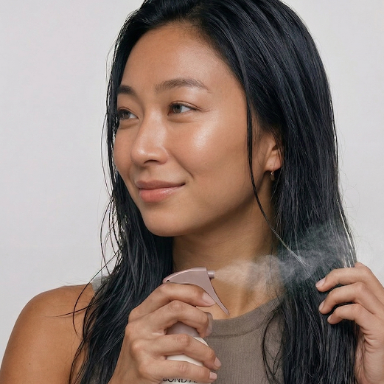
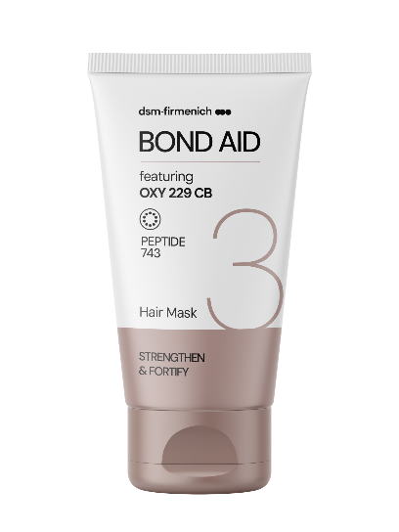
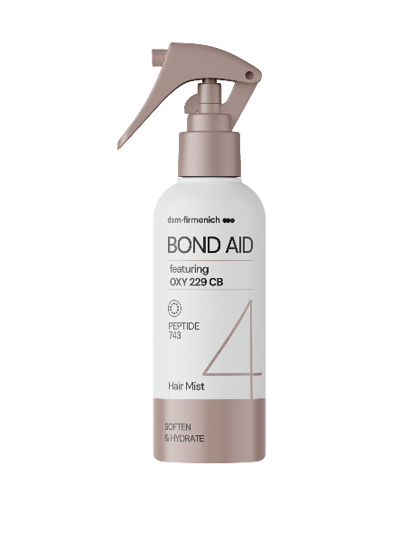
Take a bath to boost your mood while treating your strands.
PREPARE
& TREAT
CLEANSE
& ENERGIZE
STRENGTHEN
& FORTIFY
SOFTEN
& HYDRATE
PRE-SHAMPOO
SHAMPOO
HAIR MASK
HAIR MIST
Professional tip
Use before every wash.
Apply on damp hair from roots to ends and let it sit for a few minutes to maximize the performance.
Professional tip
Use it like your regular shampoo as often as required.
Massage gently to help enhance energizing benefits.
Professional tip
Leave on for 5–10 minutes
for deep, targeted strengthening. Use after every wash.
Professional tip
Mist 3x lightly over damp hair to veil the fiber in weightless hydration, continuous protection, and effortless manageability.

Slide 13
With biotech-powered care for scalp vitality and strand integrity,
BOND AID RITUAL helps hair look restored, feel renewed, and perform at its best.
STEP 1 – PRE-SHAMPOO
STEP 2 – SHAMPOO
STEP 3 – HAIR MASK
STEP 4 – HAIR MIST
featuring
OXY 229 CB
Prep the core.
Strength starts with reinforcement of the
inner structure of the fiber.
Cleanse with
purpose.
Vitality and repair
in every wash.
Fortify the surface.
Mask‑driven strength
and smoothness.
Seal with softness.
A hydrating mist and energizing fragrance veil complete the transformation.
Four steps.
One impacting journey.
This 4-step peptide‑powered routine featuring OXY 229 CB reinforces the fiber inner structure, vitalizes the scalp, strengthens, and hydrates — delivering hair that looks restored, feels renewed, and performs like never before.
2 in 1 ACTION
Scalp Vitality
& Strand Integrity
BIOTECH
Derived
Technology
PEPTIDE 743

Slide 14
featuring OXY 229 CB
for scalp vitality & strand integrity
What consumer will perceive
Visible transformation from first use
Stronger strands: up to 22% more strength after just one application. - Hair feels reborn, resilient, radiant, full of life.
Smoother feel: easier to comb, softer feel. - A touch of luxury you can feel in every strand.
Surface renewal: scientifically proven smoother hair surface. - Less damage, more shine.
Scalp & Hair wellness
Scalp vitality boost: +750% oxygen uptake and +10% more cell vitality. - A revitalized scalp, the secret to hair longevity.
Clean Beauty promise: gentle on you, kind to the planet.
Confidence you can wear
Every day is a good hair day: hair that feels protected, and full of life.
Science you can trust: Advanced care, inspired by nature, perfected by biotechnology innovation.
Advanced fragrance technology: long-lasting scent, powered by mood boosting experience.
BIOTECH
Derived
Technology

Slide 15
Disclaimer
Copyright © dsm-firmenich Switzerland AG, 2026, 4002 Basel, Switzerland.
www.dsm-firmenich.com. All rights reserved.
dsm-firmenich has used diligent care to ensure that the information provided herein is accurate and up-to-date to the best of its knowledge. However, dsm-firmenich makes no representation or warranty, either expressly or implied, of the accuracy, reliability, completeness, or suitability thereof. The information provided herein contains scientific and product information for business-to-business use and does not constitute or provide scientific or medical advice, diagnosis or recommendation for treatment options. Country or region-specific information should be considered when labelling or advertising to final consumer. In no event shall dsm-firmenich be liable for any direct or indirect damages arising from or reliance upon, or use of, any information provided herein. The content of this document is subject to change without further notice. Please contact your local dsm-firmenich representative for the latest information. All trademarks listed in this document are either (registered) trademarks of, or trademarks licensed by, the dsm-firmenich group of companies, unless explicitly stated otherwise.
Disclaimer Formulation Guideline
The information provided herein is provided for information purposes only and has been prepared by dsm-firmenich in accordance with its own methodology.
dsm-firmenich has used diligent care to ensure that it is accurate and up-to-date, however, dsm-firmenich makes no representation or warranty, either expressly or implied, of the accuracy, reliability, or completeness thereof. In no event shall dsm-firmenich be liable for any damages arising from or reliance upon, or use of, any information provided herein. Further, dsm-firmenich shall not bear any liability for the application and/or use of any processed material containing its product(s). The formulation of the finished product is the customer’s sole responsibility. It is the customer’s responsibility to determine the suitability of dsm-firmenich’s products regarding user specific purposes, assess compatibility and stability of their finished product(s) and to ensure compliance of their finished product(s) with relevant laws and regulations. Any product, marketing or other claims made by customer are its sole responsibility. The content of this document is subject to change without further notice. Please contact your local dsm-firmenich representative for further details. © dsm-firmenich Switzerland AG, 2026.
© 2026

Slide 16
We bring progress to life

Slide 17


Slide 18




featuring
OXY 229 CB
BIOTECH
Derived
Technology

Slide 19
featuring
OXY 229 CB
BIOTECH
Derived
Technology

Slide 20
Phase | Ingredient | INCI | % w/w
A | Water Dem | AQUA | 69.50
 | Citric Acid Anhydrous | CITRIC ACID | 0.40
 | Polycos CA-50 ECO | GUAR HYDROXYPROPYLTRIMONIUM CHLORIDE | 0.25
 | Edeta® BD | DISODIUM EDTA | 0.10
B | TEGO Betain F50 | COCAMIDOPROPYL BETAINE, AQUA | 3.80
 | PLANTACARE® 818 UP | COCO-GLUCOSIDE, AQUA | 5.50
 | Prebiulin C90 | CELLULOSE GUM, XANTHAN GUM, INULIN, CELLULOSE, GLUCOSE, FRUCTOSE | 0.20
 | D‑Panthenol 75 L | PANTHENOL, AQUA, PANTOLACTONE | 0.50
C | DL‑alpha‑Tocopheryl Acetate | TOCOPHERYL ACETATE | 1.00
 | Lanette® 18 | STEARYL ALCOHOL | 3.00
 | Kokosöl raffiniert kbA DE‑ÖKO‑001 | COCOS NUCIFERA OIL | 3.00
 | AminoSensyl HC | BRASSICA ALCOHOL, BRASSICYL VALINATE ESYLATE | 3.00
 | Mixed Tocopherols 95 | TOCOPHEROL | 0.50
 | Lanette® 16 | CETYL ALCOHOL | 3.00
 | Phytantriol | PHYTANTRIOL | 0.25
 | life'sGLA™ '10' n‑6 Oil | OENOTHERA BIENNIS SEED EXTRACT, ASCORBYL PALMITATE, TOCOPHEROL | 0.50
 | ARGAN OIL | ARGANIA SPINOSA KERNEL OIL | 0.50
 | Varisoft BT 85 | BEHENTRIMONIUM CHLORIDE, ISOPROPYL ALCOHOL | 1.50
D | Niacinamide PC | NIACINAMIDE | 0.20
 | PENTAVITIN® | SACCHARIDE ISOMERATE, AQUA, CITRIC ACID, SODIUM CITRATE | 0.50
 | OXY 229 CB | SACCHAROMYCES LYSATE, VALINE, THREONINE, GLUTAMIC ACID, GLYCINE, GLYCERIN, AQUA, DISODIUM SUCCINATE, 1,2‑HEXANEDIOL, CAPRYLYL GLYCOL | 1.00
 | PUROX® S | SODIUM BENZOATE | 0.60
E | BOND AND BEYOND P04E062 | PARFUM, BENZYL SALICYLATE, CITRAL, CITRONELLOL, COUMARIN, LIMONENE, CITRUS AURANTIUM PEEL OIL, DIMETHYL PHENETHYL ACETATE, GERANYL ACETATE, PINENE, TERPINEOL, TETRAMETHYL ACETYLOCTAHYDRONAPHTHALENES | 1.20
STEP 1 – PRE-SHAMPOO
PREPARE
& TREAT
91 % Natural Origin content according to ISO 16128 by including formulation water.
HC-E-103387-7

Slide 21
Phase | Ingredient | INCI | % w/w
A | Water Dem | AQUA | 37.55
 | TEGO Betain F50 | COCAMIDOPROPYL BETAINE, AQUA | 5.00
 | Bio-Terge AS-40 HASB | SODIUM C14-16 OLEFIN SULFONATE, AQUA | 12.00
 | Amphosol DM | COCO-BETAINE | 3.00
 | Comperlan® KD | COCAMIDE DEA | 2.00
 | Oramix L 30 | SODIUM LAUROYL SARCOSINATE | 8.00
 | Jaguar® C 162 SGI | HYDROXYPROPYL GUAR HYDROXYPROPYLTRIMONIUM CHLORIDE | 0.30
 | TEGIN BL 315 | GLYCOL DISTEARATE | 2.00
 | Citric Acid 25% sol. | AQUA, CITRIC ACID | 1.10
B | Water Dem | AQUA | 20.00
 | TC‑BIO‑CARBOMER 380 | CARBOMER | 0.20
 | Sodium Hydroxide 10% | AQUA, SODIUM HYDROXIDE | 0.25
C | Citric Acid 25% solution | AQUA, CITRIC ACID | 1.10
D | TEGO SOLVE 61 MB | POLYGLYCERYL-6 CAPRYLATE, POLYGLYCERYL-6 RICINOLEATE, POLYGLYCERYL-4 CAPRATE, POLYGLYCERYL-3 COCOATE, AQUA | 2.40
 | BOND AND BEYOND P04E062 | PARFUM, BENZYL SALICYLATE, CITRAL, CITRONELLOL, COUMARIN, LIMONENE, CITRUS AURANTIUM PEEL OIL, DIMETHYL PHENETHYL ACETATE, GERANYL ACETATE, TETRAMETHYL ACETYLOCTAHYDRONAPHTHALENES | 0.80
E | D‑Panthenol 75 L | PANTHENOL, AQUA, PANTOLACTONE | 1.00
 | PENTAVITIN® | SACCHARIDE ISOMERATE COMPLEX | 0.50
 | TILAMAR® Quat 640 | POLYQUATERNIUM‑6, AQUA | 1.00
 | Sodium Chloride Emprove exp | SODIUM CHLORIDE | 0.50
 | PUROX® S | SODIUM BENZOATE | 0.40
 | Potassium Sorbate | POTASSIUM SORBATE | 0.20
 | OXY 229 CB | SACCHAROMYCES LYSATE, VALINE, THREONINE, GLUTAMIC ACID, GLYCINE, GLYCERIN, AQUA, DISODIUM SUCCINATE, 1,2‑HEXANEDIOL, CAPRYLYL GLYCOL | 1.00
 | Sodium Hydroxide 30% Solution | AQUA, SODIUM HYDROXIDE | 0.80
STEP 2 –SHAMPOO
CLEANSE
& ENERGIZE
91 % Natural Origin content according to ISO 16128 by including formulation water.
HC-E-103475-3

Slide 22
Phase | Ingredient | INCI | % w/w
A | Water Dem | AQUA | 80.05
 | L(+) Lactic Acid 90% | LACTIC ACID, AQUA | 0.50
 | Polycos CA-50 ECO | GUAR HYDROXYPROPYLTRIMONIUM CHLORIDE | 0.25
 | CremerGLYC Refined Glycerine Organic | GLYCERIN | 3.00
 | Ucare Polymer JR-125 | POLYQUATERNIUM-10, AQUA, SODIUM ACETATE, SODIUM CHLORIDE, ISOPROPYL ALCOHOL | 0.10
B | Solagum GM | GLUCOMANNAN | 0.50
C | DL-alpha-Tocopheryl Acetate | TOCOPHERYL ACETATE | 0.50
 | Mixed Tocopherols 95 | TOCOPHEROL | 0.10
 | TEGO Care Eco CAT MB | DISTEAROYLISOPROPYL DIMONIUM METHOSULFATE | 3.00
 | PARSOL® SLX | POLYSILICONE-15 | 0.50
 | life'sGLA '10' n-6 Oil | OENOTHERA BIENNIS SEED EXTRACT, ASCORBYL PALMITATE, TOCOPHEROL | 1.00
 | STIMU-TEX® AS | ARGANIA SPINOSA KERNEL OIL, TOCOPHEROL, BUTYROSPERMUM PARKII BUTTER EXTRACT, SPENT GRAIN WAX | 1.50
 | Lanette O | CETEARYL ALCOHOL | 5.00
D | euxyl K 712 | AQUA, SODIUM BENZOATE, POTASSIUM SORBATE | 0.80
 | OXY 229 CB | SACCHAROMYCES LYSATE, VALINE, THREONINE, GLUTAMIC ACID, GLYCINE, GLYCERIN, AQUA, DISODIUM SUCCINATE, 1,2-HEXANEDIOL, CAPRYLYL GLYCOL | 1.00
E | D-Panthenol 75 L | PANTHENOL, AQUA, PANTOLACTONE | 1.00
 | BOND AND BEYOND P04E062 | PARFUM, BENZYL SALICYLATE, CITRAL, CITRONELLOL, COUMARIN, LIMONENE, CITRUS AURANTIUM PEEL OIL, DIMETHYL PHENETHYL ACETATE, GERANYL ACETATE, PINENE, TERPINEOL, TETRAMETHYL ACETYLOCTAHYDRONAPHTHALENES | 1.20
STEP 3 – HAIR MASK
STRENGTHEN
& FORTIFY
96 % Natural Origin content according to ISO 16128 by including formulation water.
HC-E-103385-5

Slide 23
STEP 4 – HAIR MIST
Phase | Ingredient | INCI | % w/w
A | Water Dem | AQUA | 67.32
 | L(+) Lactic Acid 90% | LACTIC ACID, AQUA | 0.18
 | HYA-ACT™ M | SODIUM HYALURONATE | 0.10
B | Hydrolite 5 green | PENTYLENE GLYCOL | 2.00
 | OXY 229 CB | SACCHAROMYCES LYSATE, VALINE, THREONINE, GLUTAMIC ACID, GLYCINE, GLYCERIN, AQUA, DISODIUM SUCCINATE, 1,2-HEXANEDIOL, CAPRYLYL GLYCOL | 2.00
 | Niacinamide PC | NIACINAMIDE | 0.20
 | Pyridoxine HCl | PYRIDOXINE HCL | 0.20
 | D-Panthenol 75L | PANTHENOL, AQUA, PANTOLACTONE | 1.00
 | PUROX S | SODIUM BENZOATE | 0.20
 | Potassium Sorbate | POTASSIUM SORBATE | 0.40
 | Magnesium Citrate | MAGNESIUM CITRATE | 0.20
C | Cremophor RH40 | PEG-40 HYDROGENATED CASTOR OIL | 4.50
 | BOND AND BEYOND P04E062 | PARFUM, GERANIOL, BENZYL SALICYLATE, CITRAL, CITRONELLOL, COUMARIN, EUGENOL, LIMONENE, LINALOOL, BENZALDEHYDE, BETA-CARYOPHYLLENE, CITRUS AURANTIUM PEEL OIL, DIMETHYL PHENETHYL ACETATE, GERANYL ACETATE, PINENE, ROSE KETONES, TERPINEOL, TETRAMETHYL ACETYLOCTAHYDRONAPHTHALENES, | 0.80
D | Bio-Ethanol | ALCOHOL | 20.00
 | Mixed Tocopherols 95 | TOCOPHEROL | 0.20
 | DL-alpha-Tocopheryl Acetate | TOCOPHERYL ACETATE | 0.50
 | Argan Oil | ARGANIA SPINOSA KERNEL OIL | 0.10
 | Phytantriol | PHYTANTRIOL | 0.10
SOFTEN
& HYDRATE
92 % Natural Origin content according to ISO 16128 by including formulation water.
HC-E-103392-7

