Slide 1
BOND AID
Every day is a good hair day!

Slide 2



Damaged hair is a primary concern for consumers
TRENDS
*Source: Euromonitor
*Source: Euromonitor
Today’s consumers seek hair that feels truly restored—strong, resilient, and radiant—with effortless repair they can see and feel.
Top global hair concerns (2022)*
58%
54%
42%
Aging hair
Damaged hair
Scalp problems

Slide 3


TRENDS
Biotechnology
The hair care category is being reshaped by the latest narratives in marketing and technology.
Damage repair
“Bond repair”

Slide 4
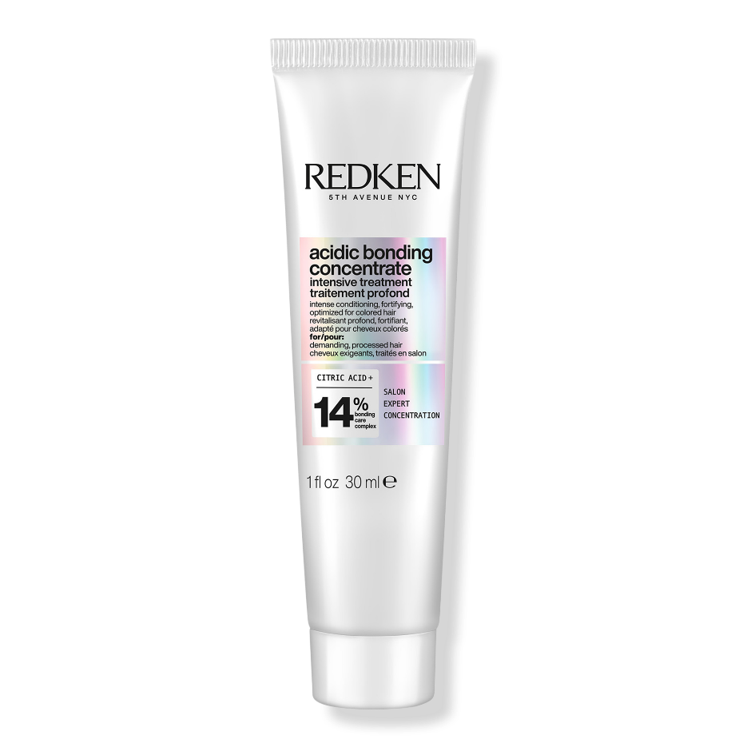
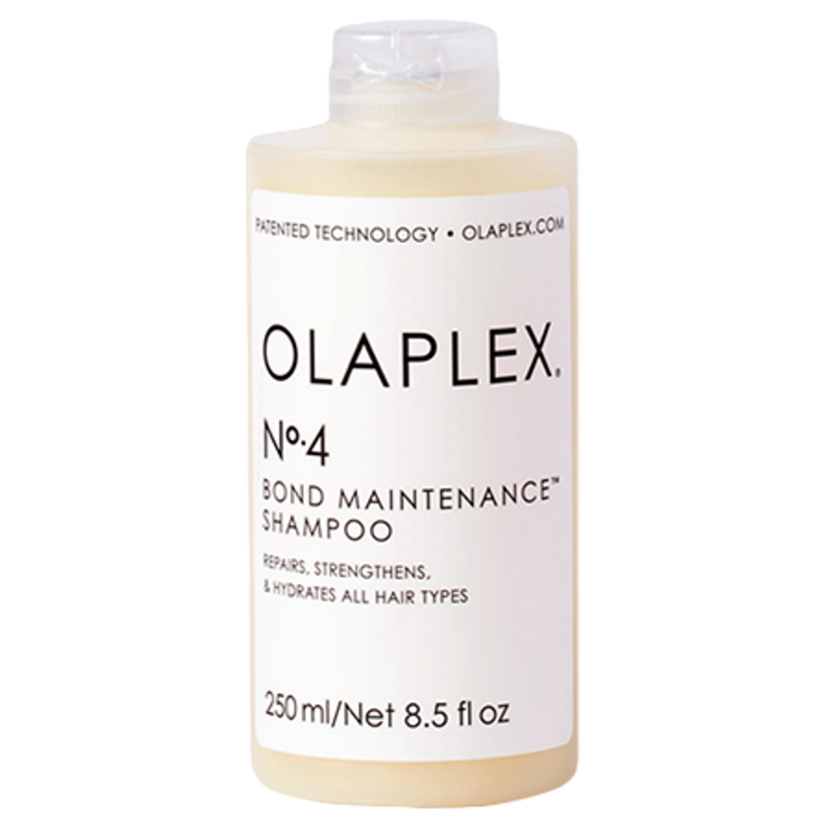
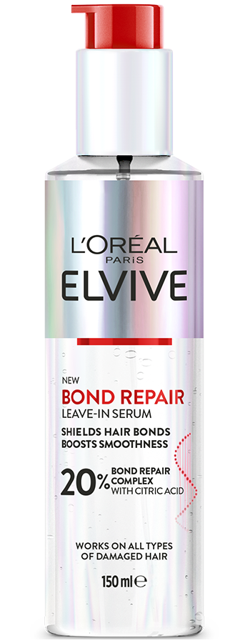
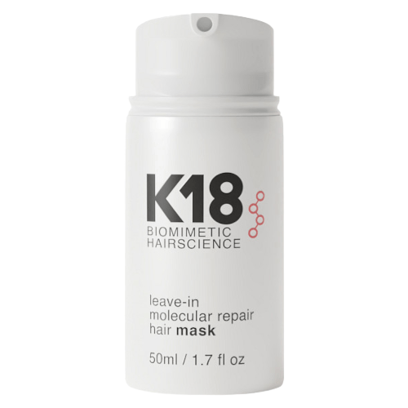
TRENDS
Repairing hair bonds is at the forefront of today’s damage-care innovations.
Notes:
Image source: L’Oreal Paris Australia,
Olaplex: https://cdn11.bigcommerce.com/s-vhltk7paz7/images/stencil/1280x1280/products/3345/9936/n4-product_450x450.1600214812__68341.1627446799.500.750__58623.1642136868.png?c=2
Redken: https://media.ulta.com/i/ulta/2594678
K18: https://cdn.shopify.com/s/files/1/1588/9573/files/K18Leave-InMolecularRepairMask50ml.png?v=1692165595

Slide 5
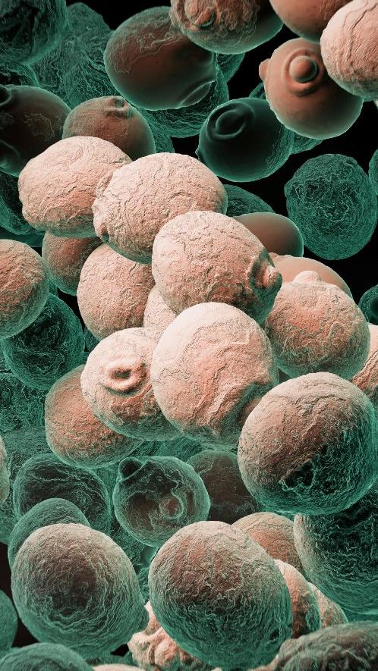
TRENDS
Biotechnology isn’t just a trend—it’s reshaping the future of cosmetics by redefining standards in quality, sustainability, and innovation.

Slide 6
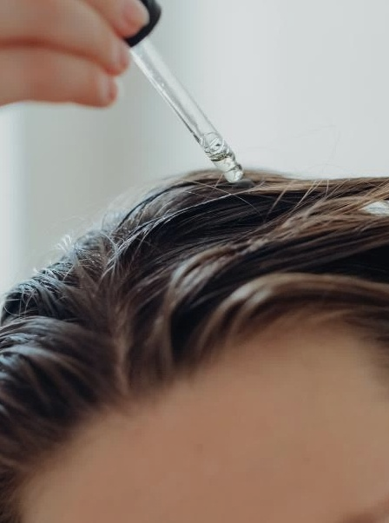
Oxygenating skincare is emerging as a key innovation, enhancing skin vitality by increasing cells oxygen uptake for more energy—aligned with longevity and cellular wellness trends.
TRENDS
Skinification

Slide 7
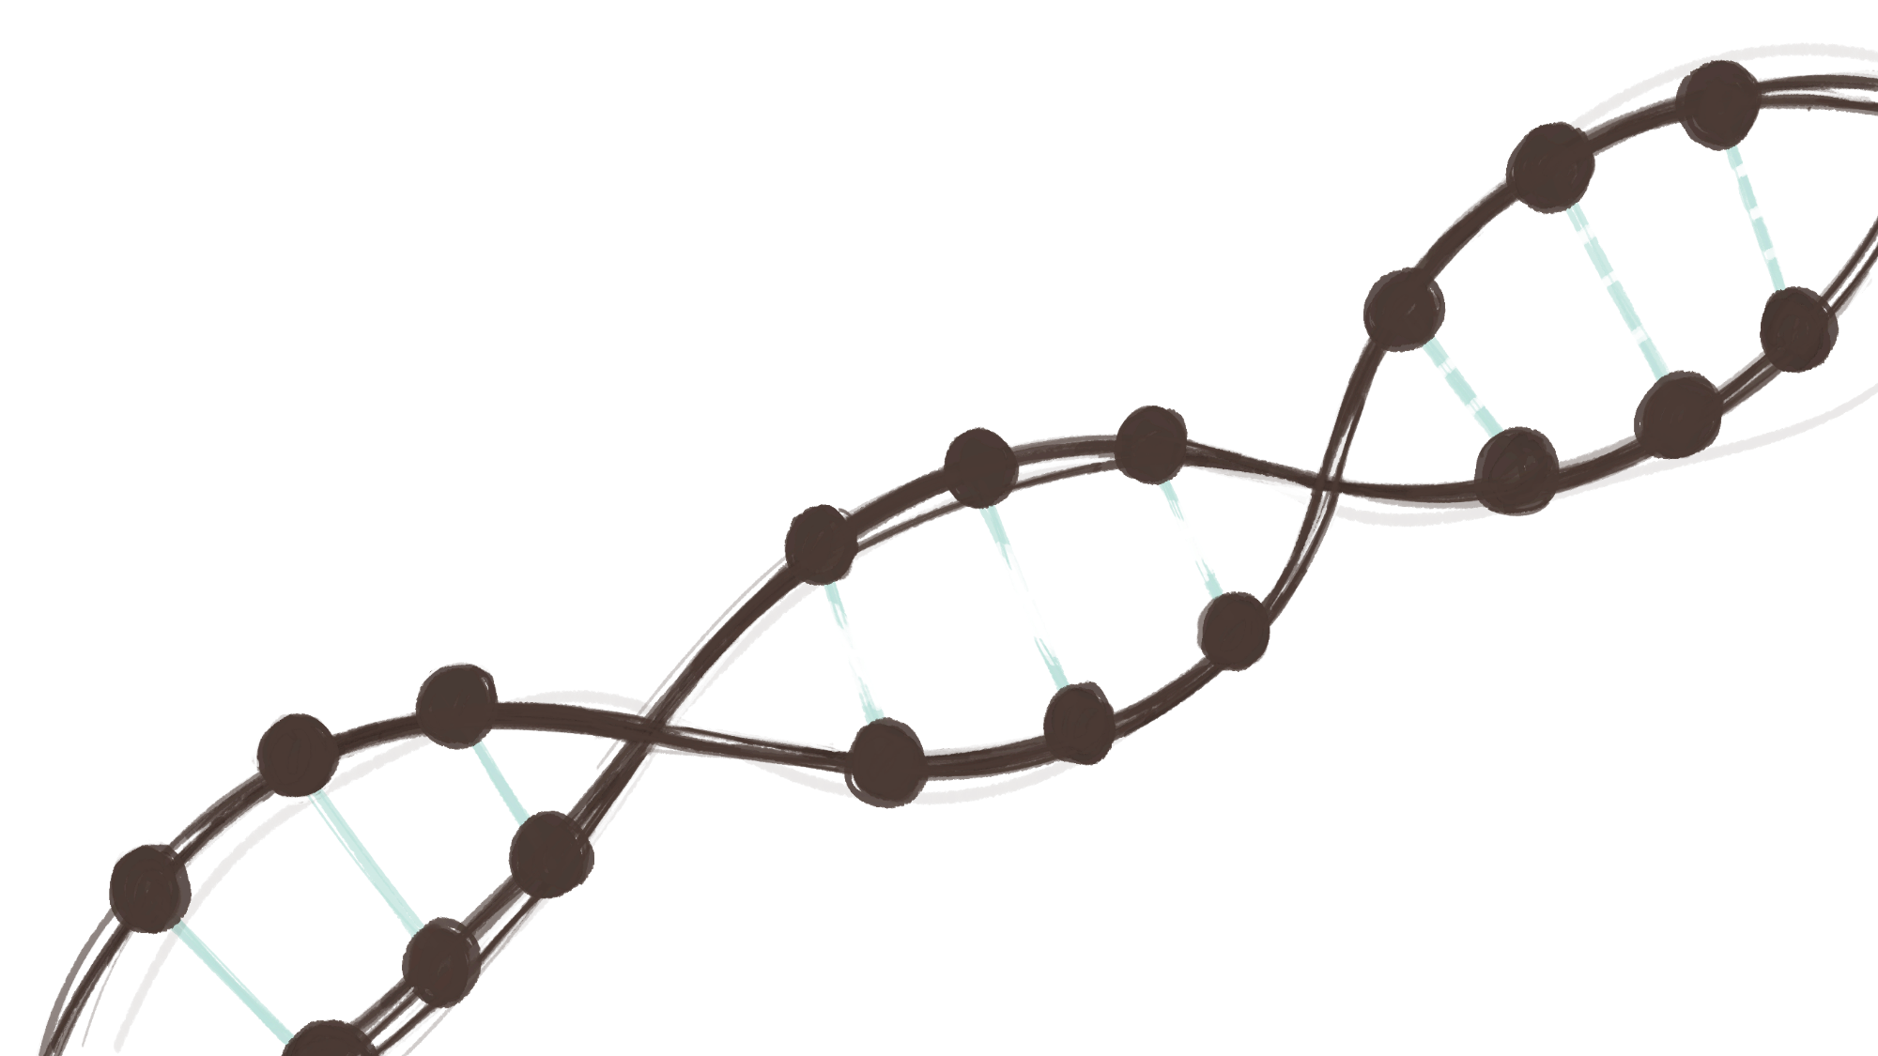
Bond Repair*
BOND REPAIR, STATE OF THE ART
Throughout its lifespan, our hair is subjected to various aggressors—both external and internal—that can damage its inner structure and compromise the molecular integrity of keratin.
Damaged Keratin
Weaken molecular bonding
* Common representation in the industry
Intact Keratin
Strong molecular bonding

Slide 8
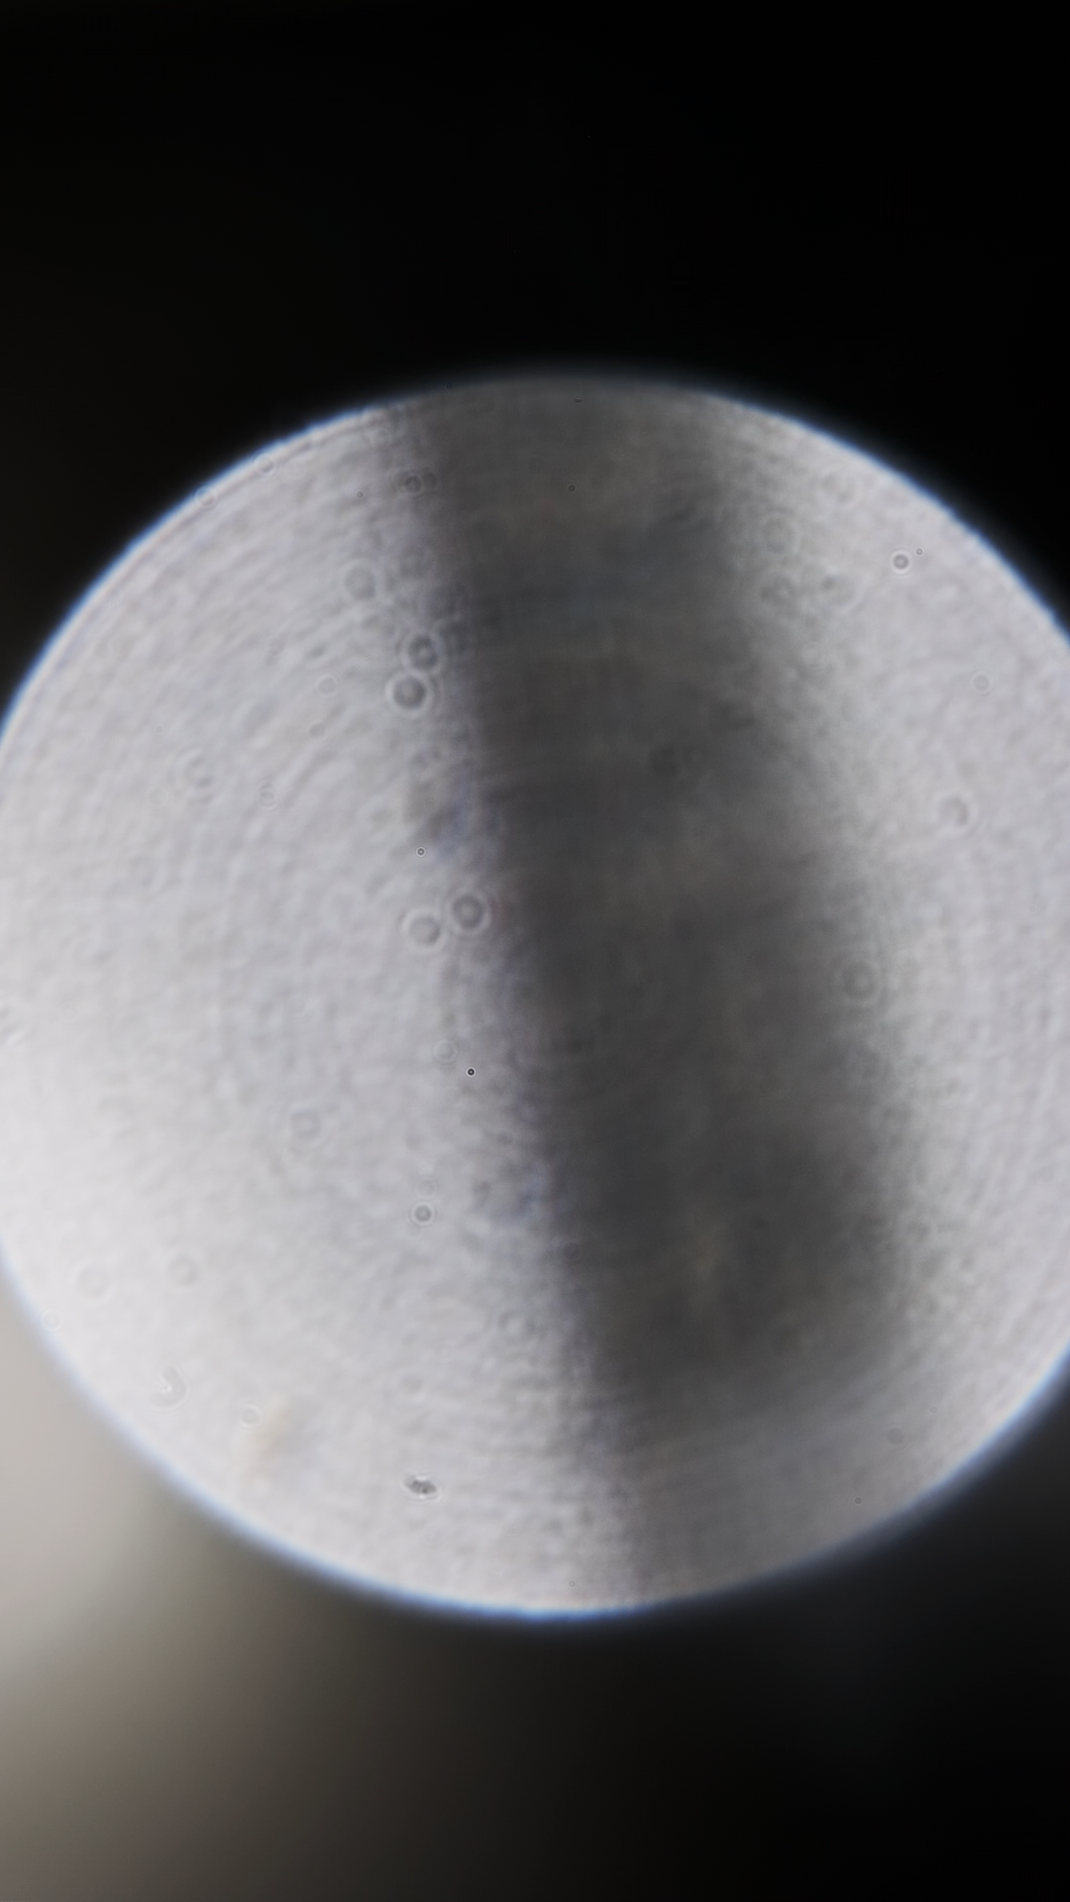
BOND REPAIR, STATE OF THE ART
Industry insight:
The concept of bond building remains ambiguous and lacks rigorous scientific definition.
Disulfide bonds cleavage is regarded as irreversible while most cosmetics products acts by reinforcing weaker bonds and enhancing hair elasticity.
New definitions are emerging:
“A bond builder is a formulation component that is able to penetrate into the hair and improve or restore the internal structure of hair, giving rise to an improvement in hair mechanical properties.”*
* P&G in How Bond Builders ‘Repair’ Hair; Cosmetics and Toiletries (Feb. 27th, 2023)
Notes:
Image: https://www.thisiscolossal.com/wp-content/uploads/2022/05/ky-2.jpg

Slide 9


MYTH OR REALITY?
The science behind the concept is unclear to consumers, yet they love the idea of 'bond repair’ and embrace the concept.
Notes:
Change to bullet points.

Slide 10

IT IS ALL ABOUT CONSUMERS’ SATISFACTION
By bridging the gap between scientific understanding and consumer perception — and within the damaged hair structure itself — we introduce
BOND AID
a Hair Structural Repair approach and a true healing experience for the consumers.

Slide 11
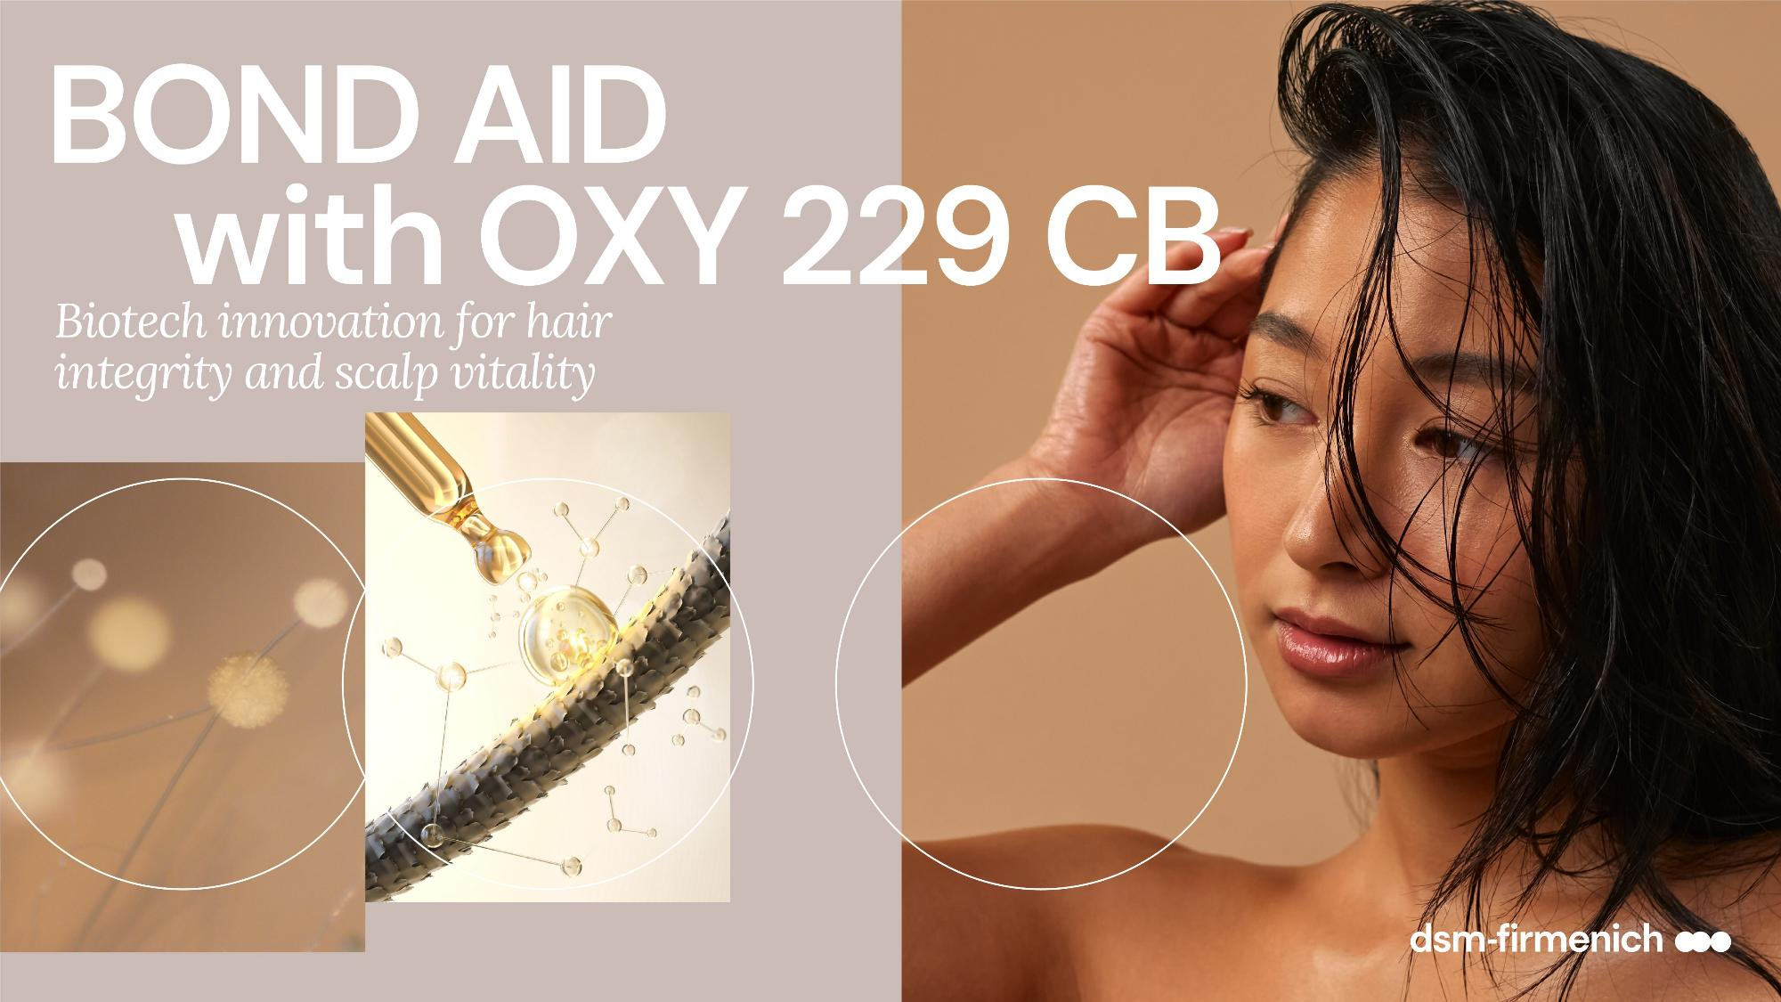

Slide 12
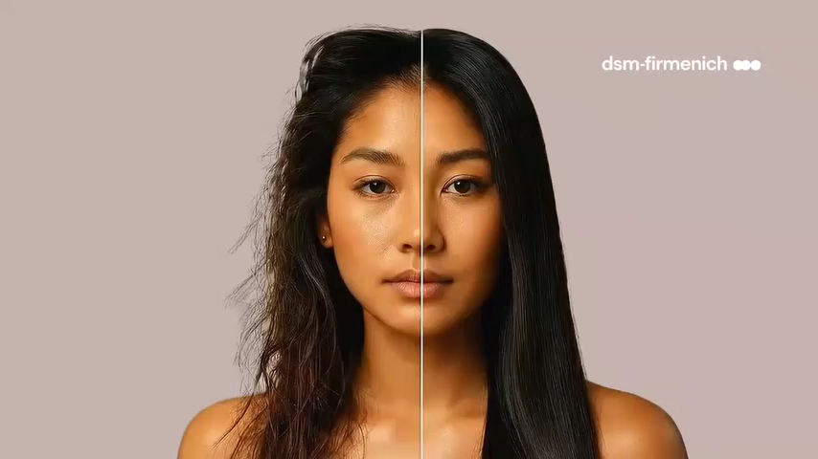
THE EXPOSOME

Slide 13
BOND AID
Structural repair begins with strengthening the hair fiber.

Slide 14
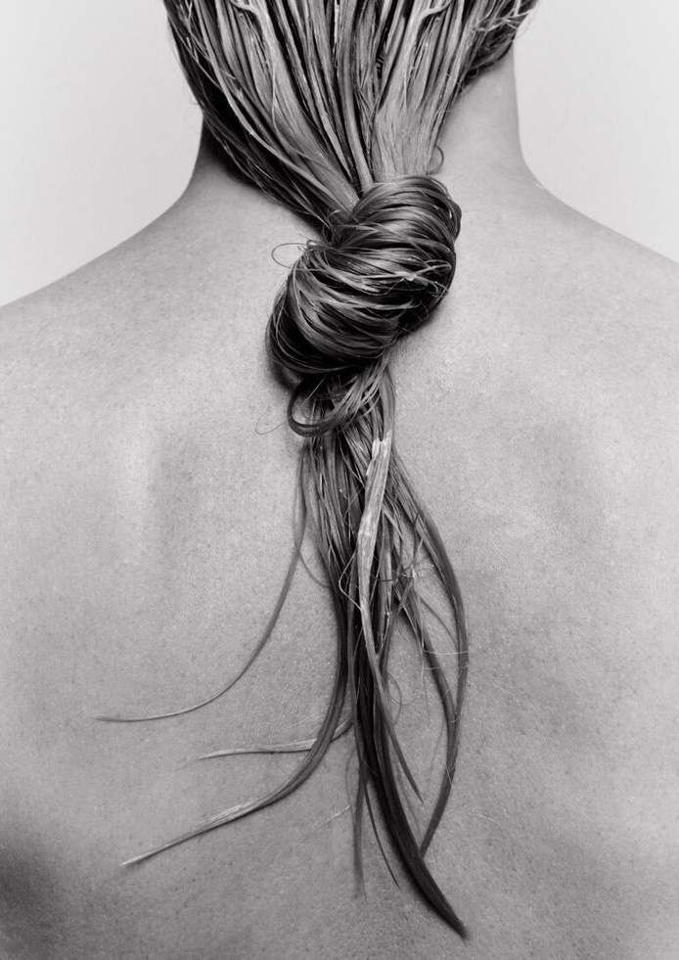
TENSILE STRENGTH
Assessment of 1% OXY 229 CB in the tensile strength test method versus benchmark
Protocol:
  Brown Caucasian hair has been bleached twice with commercial bleaching powder according to product description and rinsed thoroughly
  Afterwards soaking of hair tresses for 1 hour in demineralized water and drying overnight in climate room at 20°C / 60% humidity
  Application of aqueous solutions of test substance (0.12g/g hair respectively) on the hair tresses and drying overnight (leave-in)
Tensile test has been done with 50 hair fibers for each sample including hair fibers diameter measurements at 22°C and 55% humidity
*External test institute

Slide 15

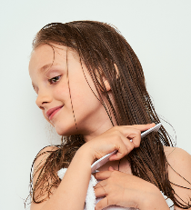
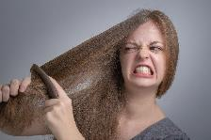
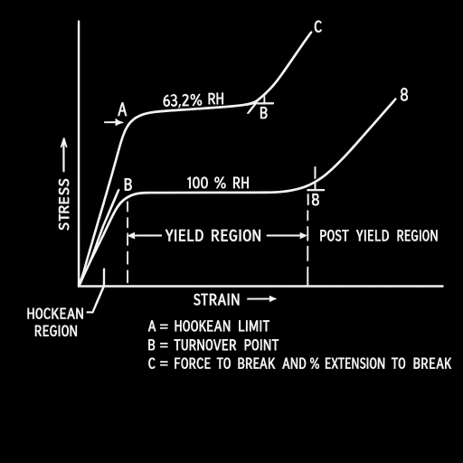
TENSILE STRENGTH
Results interpretation
Metric | What It Measures | What It Tells Us
Young’s Modulus | Elastic stiffness (stress/strain) | Higher = Stronger, more resilient fiber
Break Stress | Force needed to break the fiber | Higher = Greater tensile strength

Slide 16
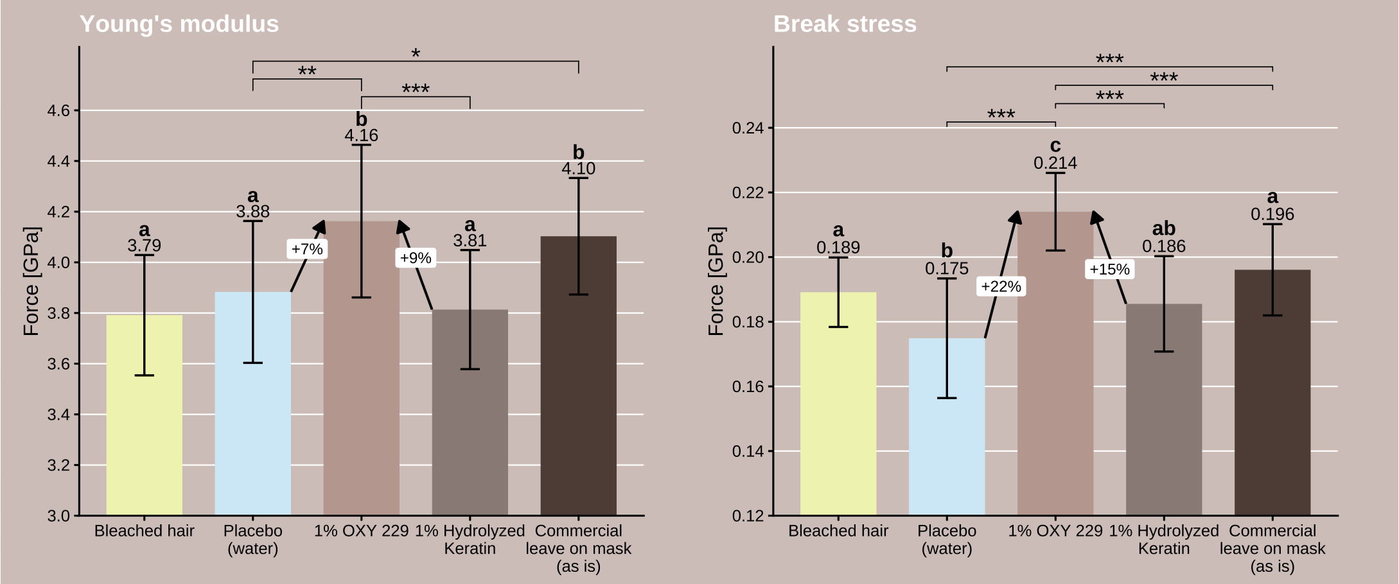
INCREASED TENSILE STRENGTH WITH OXY 229 CB
Results:
7% improvement
22% improvement
bleached hair
placebo
(water)
1%
OXY 229 CB
1%
benchmark 1
benchmark 5
(as is)
(commercial
leave on mask)
bleached hair
placebo
(water)
1%
OXY 229 CB
1%
benchmark 1
benchmark 5
(as is)
(commercial
leave on mask)
OXY 229 CB improves hair strength after one-time application at 1% use level
It generates better hair strength recovery than 1% benchmark proteins and commercial leave on mask applied as is
Bars show means ± IQR.
Letters indicate CLD groupings (groups sharing a letter are not significantly different, alpha = 0.05).
Selected pairwise comparisons are shown with brackets: * p < 0.05, ** p < 0.01, *** p < 0.001.
Notes:
Benchmark 1 = Nutrilan® Keratin LM (INCI: Hydrolyzed Keratin), active content=100%, 1% aqueous solution
Benchmark 5 = K18 leave on mask (pure product applied on hair tresses) = formulation
K18 mask: ingredients list: water (aqua), alcohol denat., propylene glycol, cetearyl alcohol, dicaprylyl ether, cetyl esters, behentrimonium chloride, polysorbate 20, SH-oligopeptide-78, hydrolysed wheat protein, hydrolysed wheat starch, isopropyl alcohol, tocopherol, phenoxyethanol, potassium sorbate, citric acid, fragrance (parfum), geraniol, linalool, hexyl cinnamal, benzyl alcohol
IQR: Inter Quantile Range
CLD: is Compact Letter Display

Slide 17
BOND AID
To earn trust, structural repair must deliver benefits that consumers can clearly perceive

Slide 18
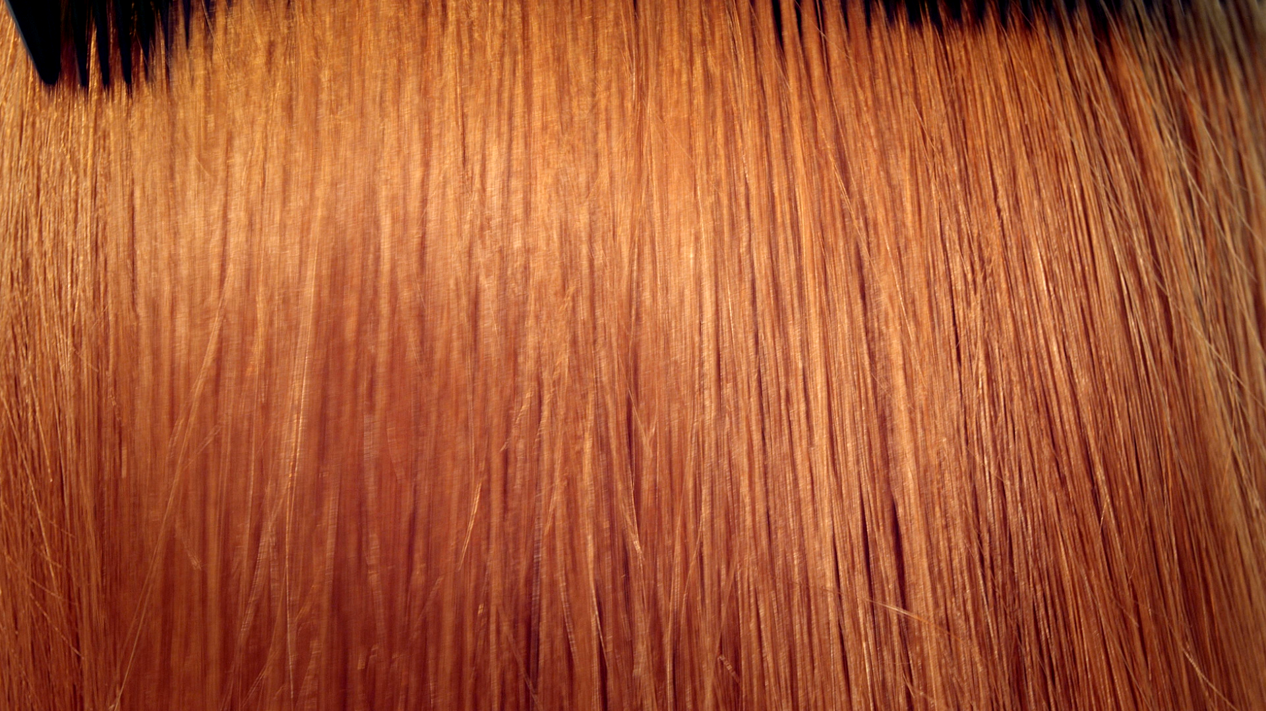

COMBING FORCE - 1
Assessment of 1% OXY 229 CB in shampoo and leave-in tonic vs benchmark
Protocol:
  European strong bleached hair, 3 tresses per test sample, has been bleached once again and soaked for 50min in deionized water and drying overnight.
  2x washing with test shampoo (0.12g/g hair) for 30 sec. and rinsing for 30 sec. with 39°C tap water.
  Application of test tonic (0.12g/g hair) and drying in climate chamber at 40°C / 60% humidity for 4 hours.
  Repeat the process of shampooing and tonic application 4 times (4 cycles).
  Dry slightly with paper towels and start combing force measurement with wet hair.
  Drying in climate chamber at 20°C / 60% humidity overnight and do combing force measurement with dry hair.
Combing force measurement with Instron at 20°C / 60% humidity
*External test institute
Notes:
Bleaching:
Mix commercial bleaching agent according to description on packaging.
Spread the mixture homogeneously on dry (not washed) hair​.
Cover with alu foil for 45 min.
Rinse off with 39°C tap water until water is clear.
Leave hair tresses for 50 min. in deionized water.
Dry slightly with paper towels.
Let tresses dry in climate room overnight at 20°C / 60% humidity.
Material:
European strong bleached hair (20cm long, Art.Nr. 814010-E-D)

Slide 19
COMBING FORCE - 1
Test formulations
Test shampoo
trade name | INCI | weight-% | weight-%
Water Dem | Aqua | 57.65 | 56.65
UCARE™ Polymer JR-125 | Aqua, Polyquaternium-10, Sodium Acetate, Sodium Chloride, Isopropyl Alcohol | 0.10 | 0.10
Texapon® NSO BZ | Aqua, Sodium Laureth Sulfate | 35.00 | 35.00
TEGO Betain F50 | Aqua, Cocamidopropyl Betaine | 5.00 | 5.00
PUROX® S | Sodium Benzoate | 0.50 | 0.50
L(+) Lactic Acid 90% | Lactic Acid, Aqua | 0.25 | 0.25
Natriumchlorid 99.99 Suprapur | Sodium Chloride | 1.50 | 1.50
OXY 229 CB | Aqua, Saccharomyces Lysate, Valine, Threonine, Glutamic Acid, Glycine, Glycerin, Disodium Succinate, 1,2-Hexandiol, Caprylyl Glycol |  | 1.00
Test leave-on tonic
Trade name | INCI | weight % | weight %
Water demin. | Aqua | 64.85 | 63.85
Cosphaderm Pentiol | Pentylene Glycol | 5.00 | 5.00
PQ-37 | Polyquaternium-37 | 0.15 | 0.15
Ethanol absolut | Alcohol | 30.0 | 30.00
OXY 229 CB | Aqua, Saccharomyces Lysate, Valine, Threonine, Glutamic Acid, Glycine, Glycerin, Disodium Succinate, 1,2-Hexandiol, Caprylyl Glycol |  | 1.00
Notes:
SHAMPOOS:HC-E-100174-13 (without OXY); HC-E-100174-20 (with OXY)
TONIC: HC-E-100001-10 (without OXY); HC-E-100001-40 (with OXY)

Slide 20
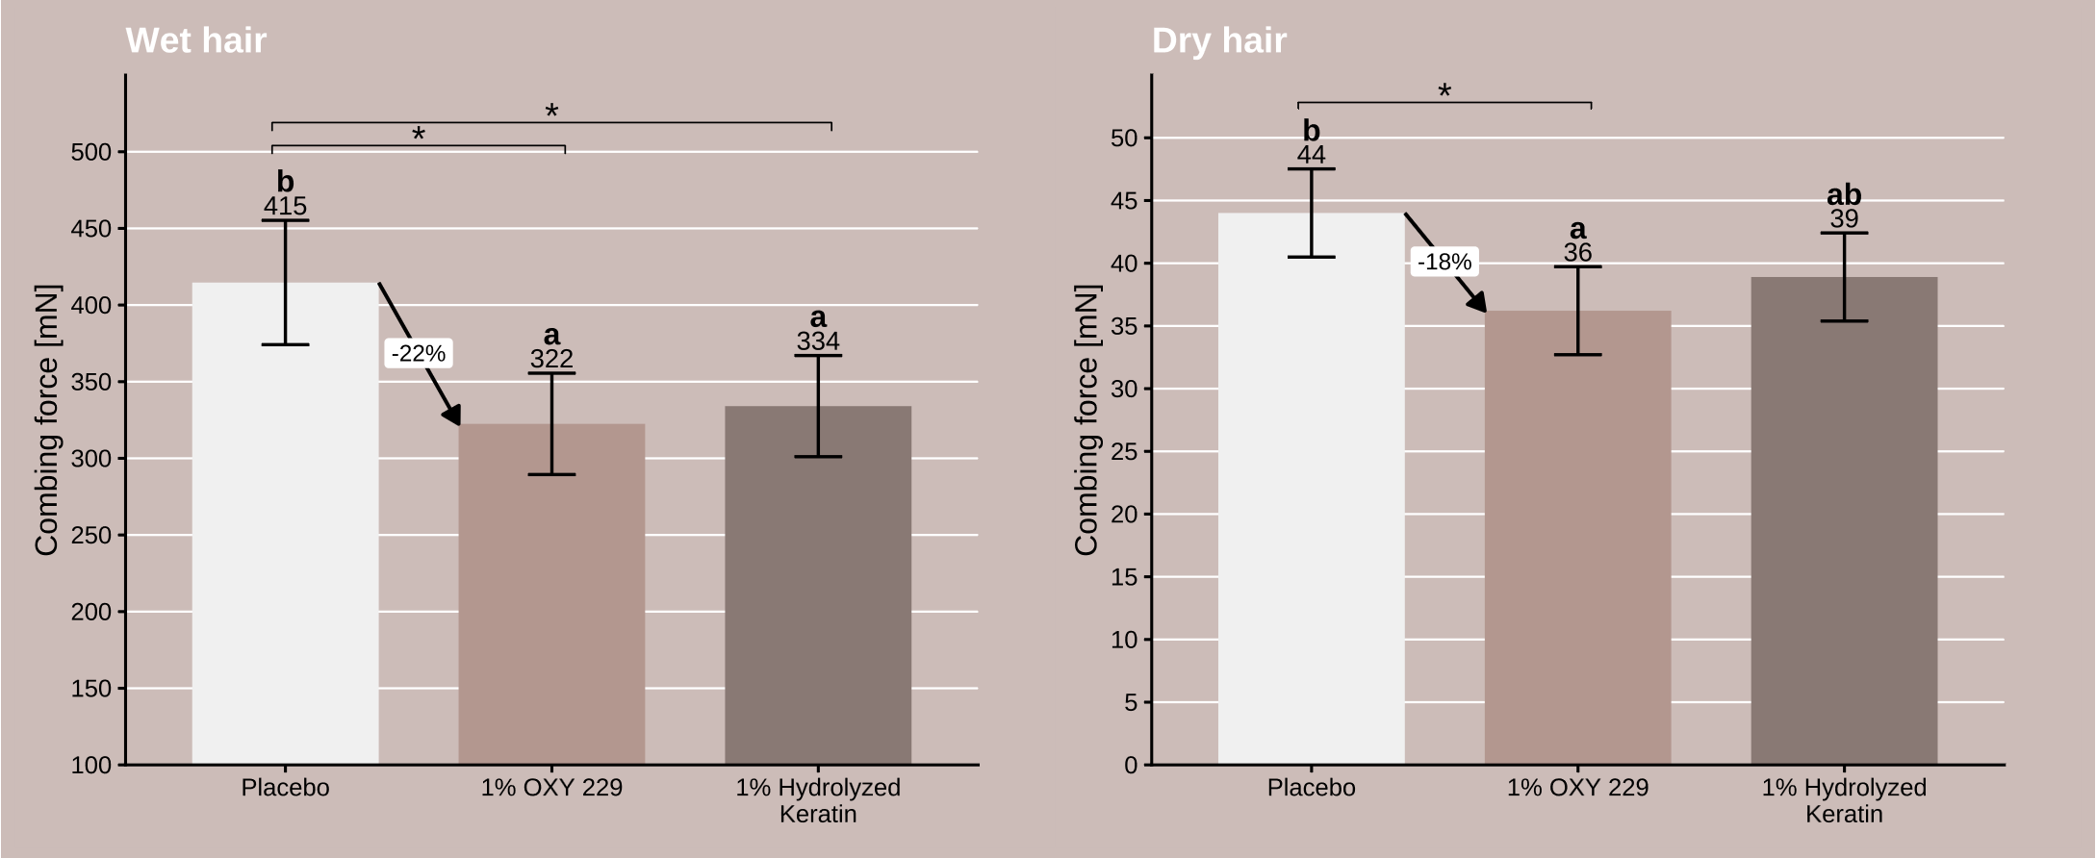
REDUCED COMBING FORCE WITH OXY 229 CB
Shampoo/tonic → 4 treatment cycles
Results:
placebo
1% OXY 229 CB
1% benchmark 1
placebo
1% OXY 229 CB
1% benchmark 1
Significant improvements on wet and dry combability by OXY 229 CB at 1% use level
Bars show means and 95% confidence intervals.
Letters indicate CLD groupings (groups sharing a letter are not significantly different, alpha = 0.05).
Pairwise comparisons are shown with brackets: * p < 0.05, ** p < 0.01, *** p < 0.001.
Notes:
Benchmark 1 = Nutrilan® Keratin LM (INCI: Hydrolyzed Keratin), 1% aqueous solution
CLD: Compact Letter Display

Slide 21
BOND AID
Delivering more than just healing, structural repair preserves hair integrity

Slide 22
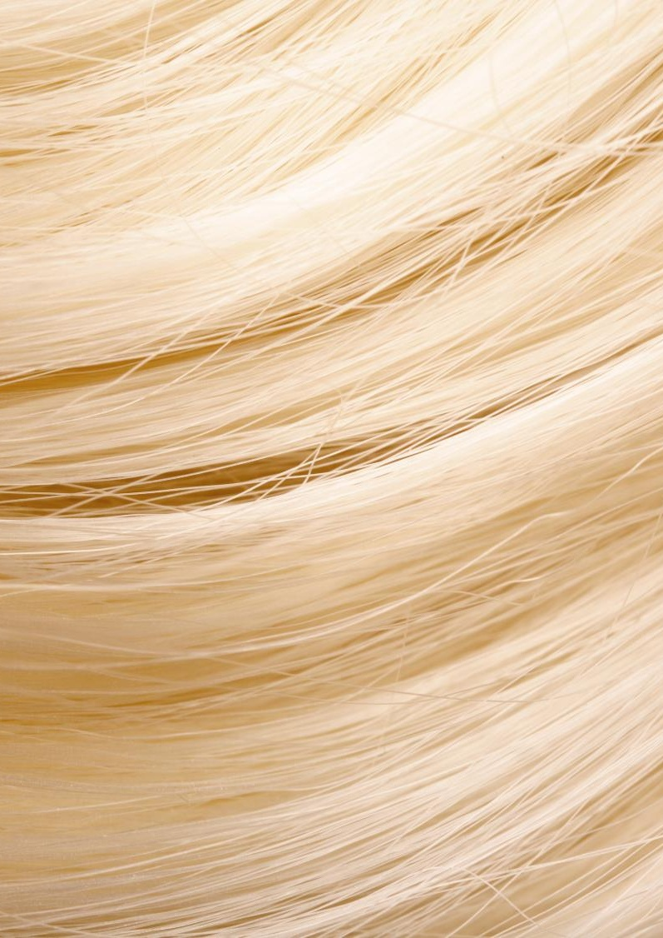
COMBING FORCE -2
Assessment of 1% OXY 229 CB in bleaching agent vs benchmark
Protocol:
  Brown Caucasian hair, 3 tresses per test sample.
  Mix commercial bleaching agent according to description on packaging.
  Add 1% OXY 229 CB to the bleaching mixture.
  Spread the mixture homogeneously on dry (not washed) hair​.
  Cover with alu foil for 45 min.
  Rinse off with 39°C tap water until water is clear.
  Leave hair tresses for 50 min. in deionized water.
  Dry slightly with paper towels.
  Let tresses dry in climate room overnight at 20°C / 60% humidity.
  Repeat the full bleaching procedure a second time.
Combing force measurement with Instron at 20°C / 60% humidity
*External test institute
Notes:
Bleaching agent: Wella BLONDER + Welloxon Perfect, mixing ratio 1:1.5.
Material:
European brown hair (20cm long, Farne 6/0, Mischung 745))
Addition of a hair repair active to the bleaching agent is found in commercial products where similarly the active ingredient(s) is (are) mixed before use.

Slide 23
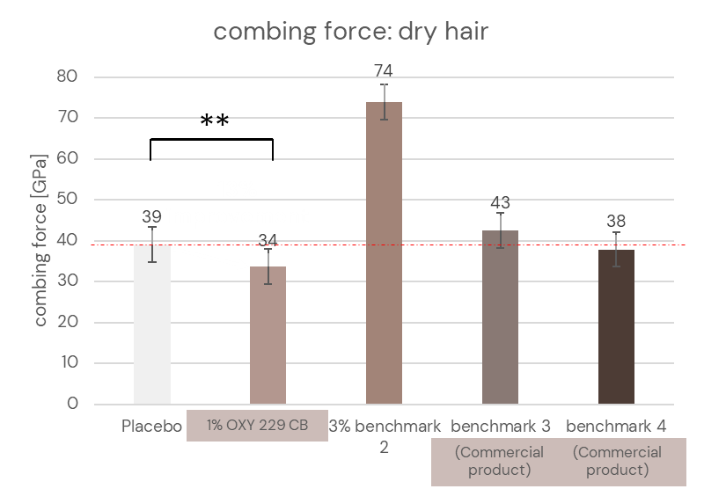
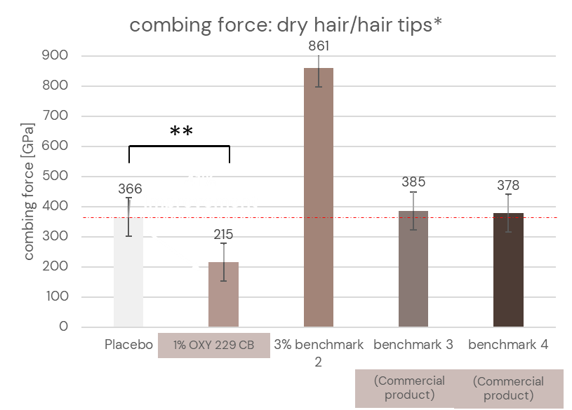
REDUCED COMBING FORCE WITH OXY 229 CB
OXY 229 CB in bleaching mixture
Results: dry hair
* Combing force calculated on the hair tips (last 2 cm of the hair length 1 cm before the tip)
** p ≤ 0.01
** p ≤ 0.01
Significant improved dry combability by OXY 229 CB at 1% use level
Benchmark ingredient (protein) showed adverse effect in combing
No visible improvement with commercial benchmarks
Notes:
Benchmark 2 = Quinoa Pro NPNF, INCI: Water (and) Hydrolyzed Quinoa (signature ingredient of L’Oreal “L’Oreal professional / Absolut Repair”
Benchmark 3 = pH Plex-1 (finished market product)
Benchmark 4 = Ref 01 Bonder (finished market product)
** p = 0.004 and ** p = 0.002

Slide 24
BOND AID
Structural repair delivers combing benefits to your formulations

Slide 25
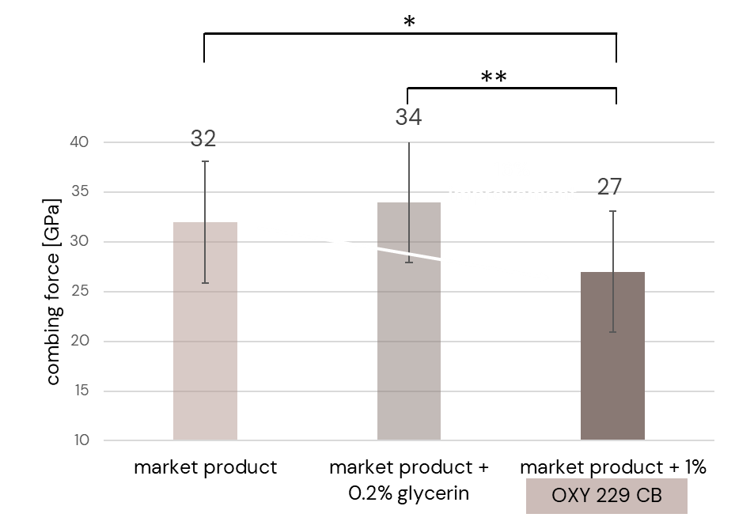
COMBING TEST
Samples:
1 | market product
2 | market product + 0.2% glycerin
3 | market product + 1% OXY 229 CB
  Market product is good
  Market product + 1% OXY 229 CB is statistically significant smoother than market product added with 0.2% glycerin*
  Market product + 1% OXY 229 CB is statistically significant smoother than market product
* p ≤ 0.05 ** p ≤ 0.01
Adding 1% of OXY 229 CB significantly improved the combing force of the commercial product
* The combing force improvement is not coming from the glycerin contained in OXY 229 CB
Notes:
Bleaching agent: Wella Professionals Blondor Multi Blonde 7 Powder + Wella Welloxon, Hydrogène, développeur, Oxydant - 9% 30 Vol. (ratio 1:2)
Commercial finished market product: “Redken Acidic Bonding”-range:
step 1: Redken Acidic bonding concentrate 14%
step 2: Redken Acidic bonding Shampoo 7%
Addition of OXY 229 CB 1% is made in both steps.
Why did we test 0.2% glycerin? Oxy 229 CB contains 17% glycerin. When using 1% Oxy 229, there are automatically 0.17% glycerin in the product. To make sure that the measured effects are only coming from the active ingredients of Oxy 229 and not from glycerin, we tested 0.2% glycerin as reference as well.

Slide 26
BOND AID
Structural repair delivers sensory benefits to diverse formulations

Slide 27

COMBING & SENSORY EVALUATION (DRIED HAIR)
Assessment of 1% OXY 229 CB added to leading market products
Protocol:
  Hair tresses of European hair, strong bleached, 20cm, color 10/0
  Bleaching with commercial bleaching agent
  Exposure to bleaching solution: 50 min
  Rinsing with tap water at 38°C
  Soaking for 30 min in deionized water
  Storage at 20°C/60% humidity
  Washing procedure according to recommendation of each commercial finished product*
  4 samples:
Hair sensory panel evaluation by 30 trained panelists. (max. 3 panelists per hair tress)
*See annex for the specific procedure details of Market product
1 | Basic Shampoo without PQ
2 | market product
3 | market product + 0.2% glycerin
4 | market product + 1% Oxy 229
OXY 229 CB
Notes:
Bleaching agent: Wella Professionals Blondor Multi Blonde 7 Powder + Wella Welloxon, Hydrogène, développeur, Oxydant - 9% 30 Vol. (ratio 1:2)
Commercial finished market product: “Redken Acidic Bonding”-range:
step 1: Redken Acidic bonding concentrate 14%
step 2: Redken Acidic bonding Shampoo 7%
Addition of OXY 229 CB 1% is made in both steps.
Why did we test 0.2% glycerin? Oxy 229 CB contains 17% glycerin. When using 1% Oxy 229, there are automatically 0.17% glycerin in the product. To make sure that the measured effects are only coming from the active ingredients of Oxy 229 and not from glycerin, we tested 0.2% glycerin as reference as well.

Slide 28
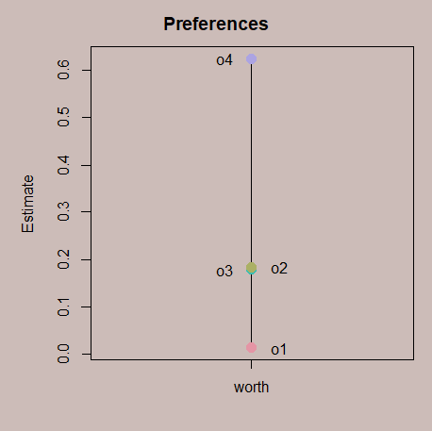
SENSORY EVALUATION (DRIED HAIR) ON MARKET TREATMENT 1
Samples:
Pairwise comparison:
1 | Basic Shampoo without PQ
2 | market product
3 | market product + 0.2% glycerin
4 | market product + 1% OXY 229 CB
  Sample one (negative control) is poor
  Sample 2 is good
  0.2% of glycerin (sample 3) adds no benefit
  Sample 4 is statistically significant smoother than sample 3*
  Sample 4 is statistically significant smoother than sample 2
Adding 1% of OXY 229 CB significantly improved the sensory of the commercial product
* The sensory improvement is not coming from the glycerin contained in OXY 229 CB
Notes:
Treatment 1: Redken Acidic Bonding
Good correlation with the combing results made in the same conditions.

Slide 29
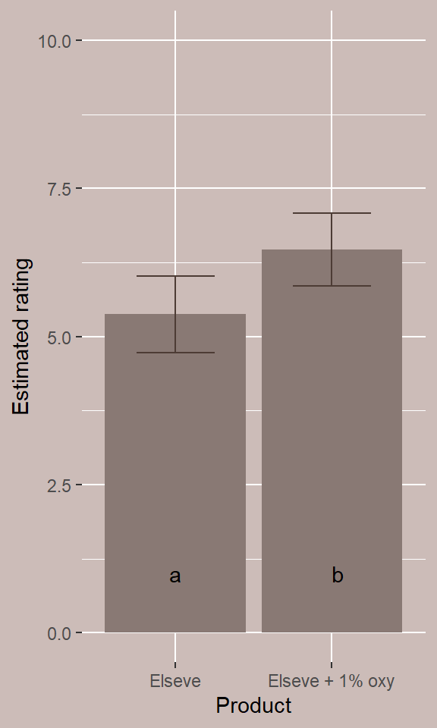
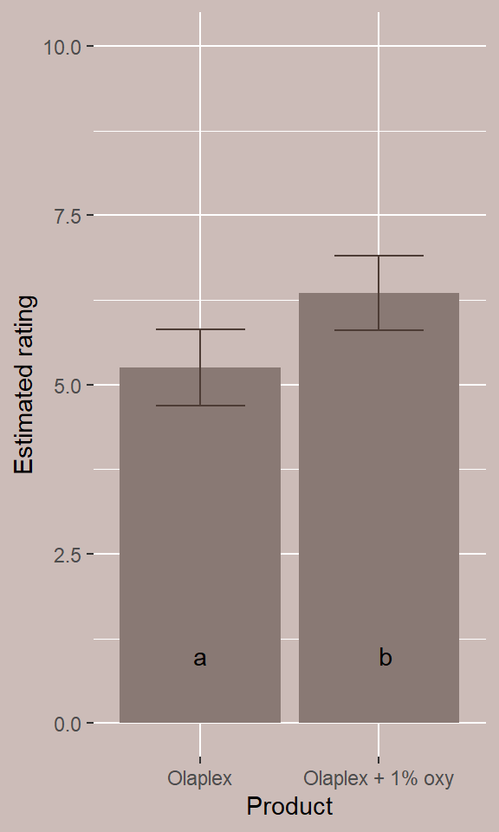
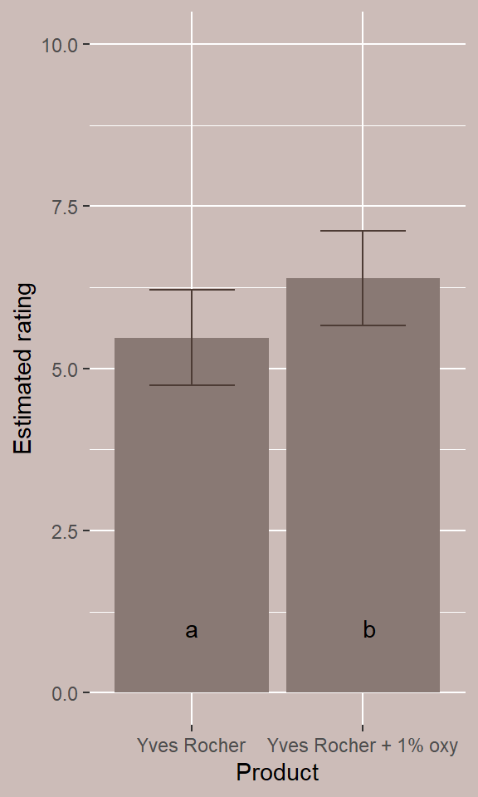

SENSORY EVALUATION (DRIED HAIR) ON DIFFERENT MARKET PRODUCTS
**
**
**
As is
+ 1% OXY 229 CB
As is
+ 1% OXY 229 CB
As is
+ 1% OXY 229 CB
Masstige
Premium
Mass Market
p=0.005
p=0.001
p=0.004
Adding 1% of OXY 229 CB significantly improved the sensory qualities of all the tested commercial products
Notes:
Masstige: Step 1 - L'Oréal Paris Elseve Bond Repair ​Rescue Pre-Shampoo​​; Step 2 - L'Oréal Paris Elseve ​​Bond Repair Shampoo
Premium: Step 1 – Olaplex N° 3 Hair Perfector; Step 2 - Olaplex​ Bond Maintenance No. 4
Mass Market:​ Yves Rocher Repair Shampoo​
Addition of OXY 229 CB 1% is made in both steps when relevant (Yves Rocher is a single step shampoo).
The black point represents the average sensory value. The red arrows indicate the highest and lowest deviations — with the highest deviation measured from the lower average and the lowest from the higher average. There is no overlap between these deviations in the measurements with and without OXY 229 CB, confirming a significant improvement.

Slide 30
BOND AID
Healing from the inside out, structural repair strengthens deep within and smooths the surface

Slide 31
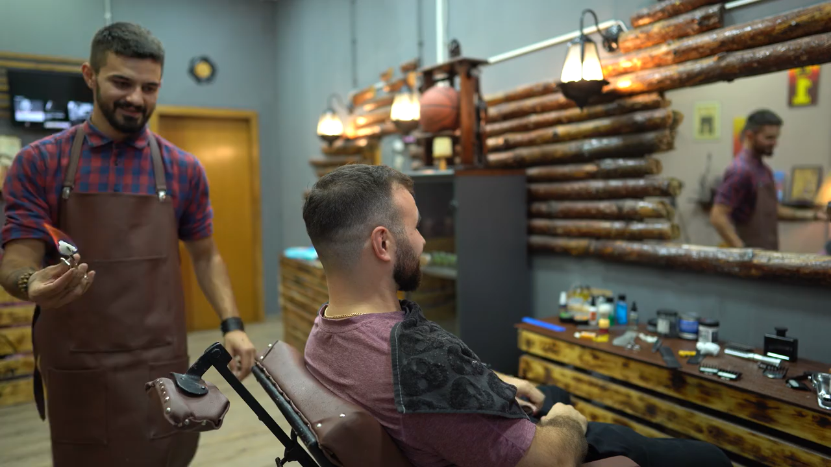
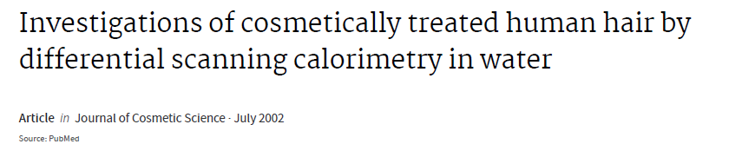
MEASURING HAIR DEGRADATION
Using Differential Scanning Calorimetry
* Originally proposed by Prof. Feughelman
Materials made from hard alpha-keratin, including human hair, exhibit a complex, morphologically fine structure. The study of the mechanical properties has led to the two-phase filament-matrix model for alpha-keratins.*
In this model, axially oriented crystalline filaments, traditionally called microfibrils are embedded in an amorphous matrix.
The thermal analysis of keratins in water by applying Differential Scanning Calorimetry (DSC) was found to be especially suited to investigate the denaturation performance of the alpha-helicaI lF structures, the role of the Cystine cross-linked IF APs, and the effects of physical and chemical treatments

Slide 32
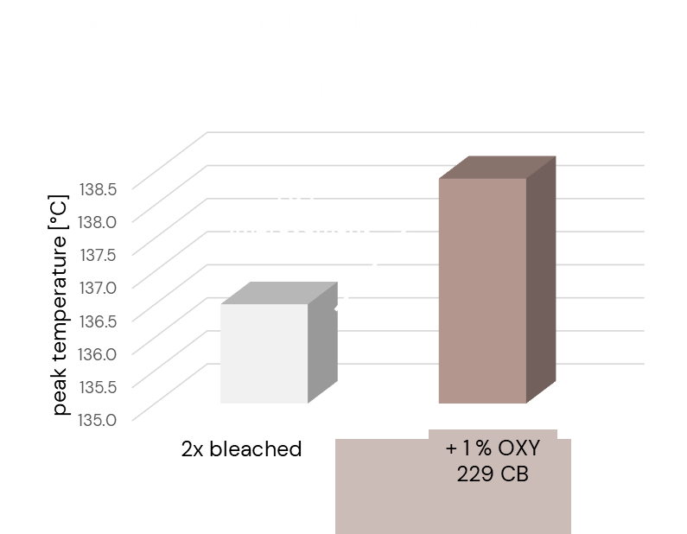
DSC TEMPERATURE INCREASE WITH OXY 229 CB
DSC measurements of damaged hair after bleaching:
Brown hair damaged by 2x bleaching
Treatment with 1% OXY 229 CB
  In bleaching agent
Added to the bleaching agent, OXY 229 CB provided a 1.9°C increased peak temperature

Slide 33
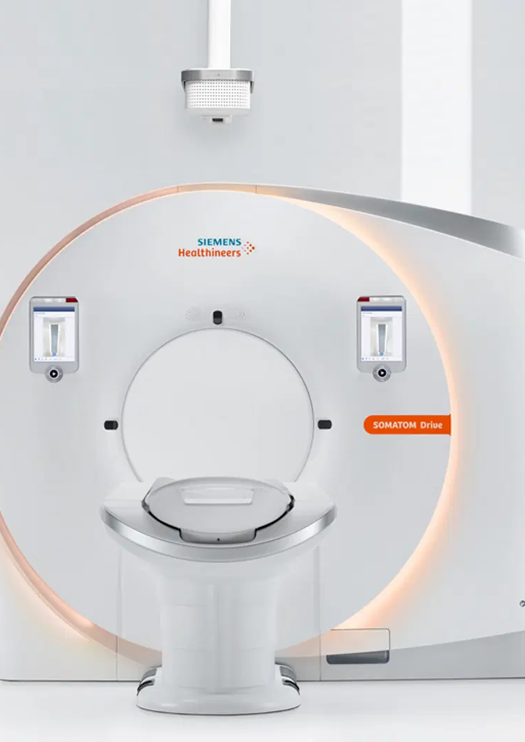
MICRO-COMPUTER TOMOGRAPHY (µCT) ANALYSIS
Micro-CT is a high-resolution 3D X-ray imaging technique, akin to hospital CT scans but designed for smaller samples with much finer detail. It allows unprecedented 3D visualization of the hair.
Protocol:
Hair tresses of European hair, strongly bleached, 20cm, color 10/0
Bleaching with commercial bleaching agent
Exposure to bleaching solution: 50 min
Rinsing with tap water at 38°C
Soaking for 30 min in deionized water
Let dry overnight at 20°C/60% humidity
Repetition of bleaching step
Treatment with test sample: soaking hair tresses in OXY 229 CB (as is) for 15 minutes
Let dry overnight at 20°C/60% humidity
Notes:
Picture is an illustration to show the analogy with MRI equipment used as medical device.

Slide 34
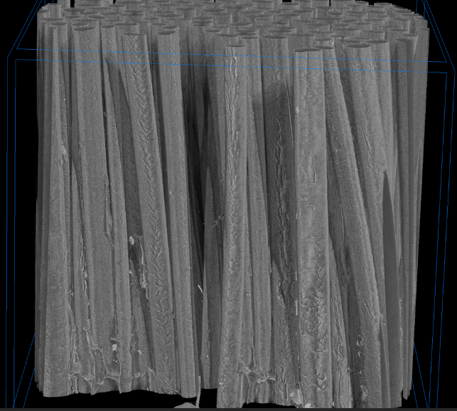
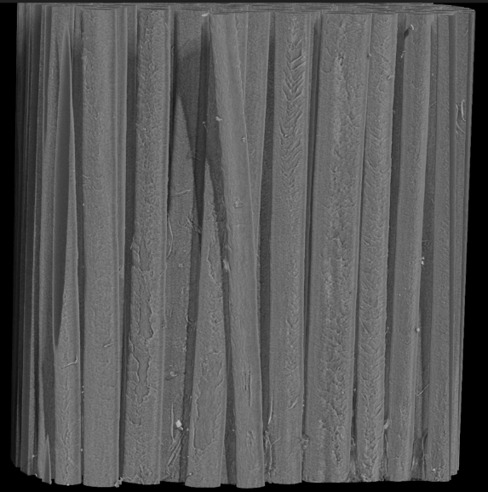
MICRO-COMPUTER TOMOGRAPHY (µCT) ANALYSIS
Bleached hair
Bleached hair treated with OXY 229 CB
OXY 229 CB smooths the hair surface, leading to easier combing and a better sensory experience.
Notes:
Clear difference between the hair surface on a full hair tress! Not on the best part of the best hair as could be shown with a SEM picture.

Slide 35
BOND AID
Structural repair mode of action

Slide 36
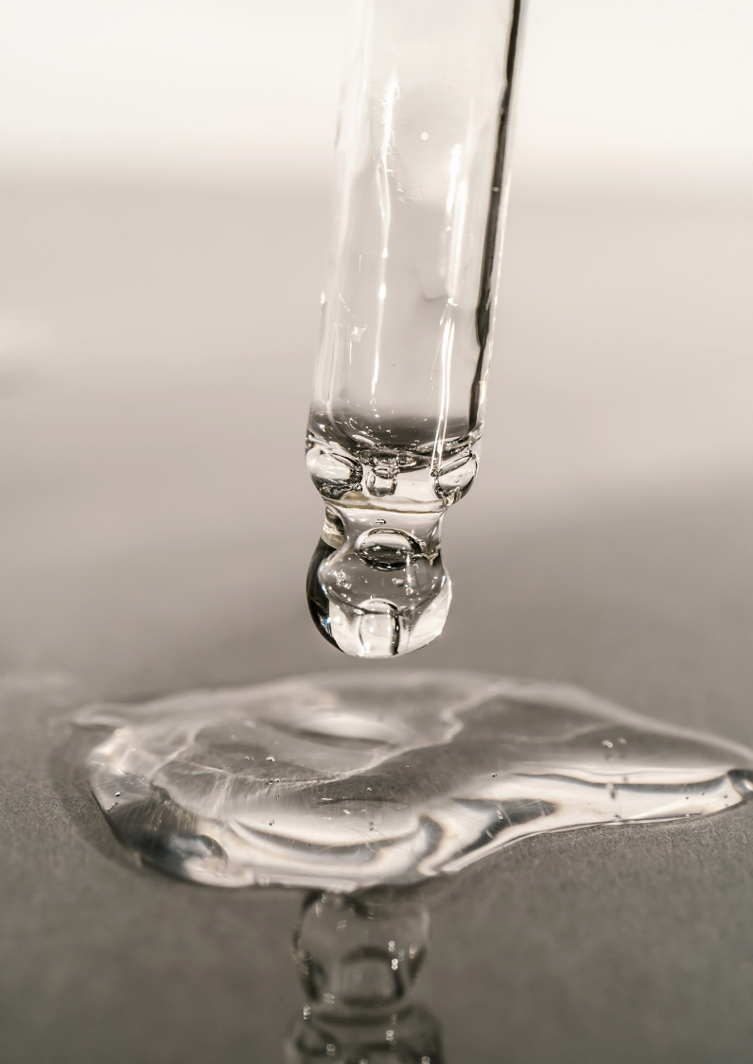
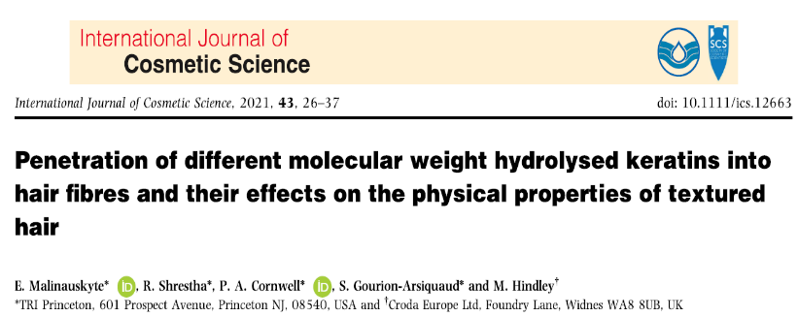
BOND AID MODE OF ACTION
Peptides penetrate inside the hair structure:
Low-MW (221 Da) and mid-range keratin peptides (2577 Da) were able to penetrate deeper into the cortex.
High-MW keratin peptides (75440 Da) only penetrated the surface layers of relaxed textured hair.
Both the mid-range and the high-MW keratin peptides were able to improve breakage parameters (Young’s modulus, break stress, number of premature fractures).

Slide 37
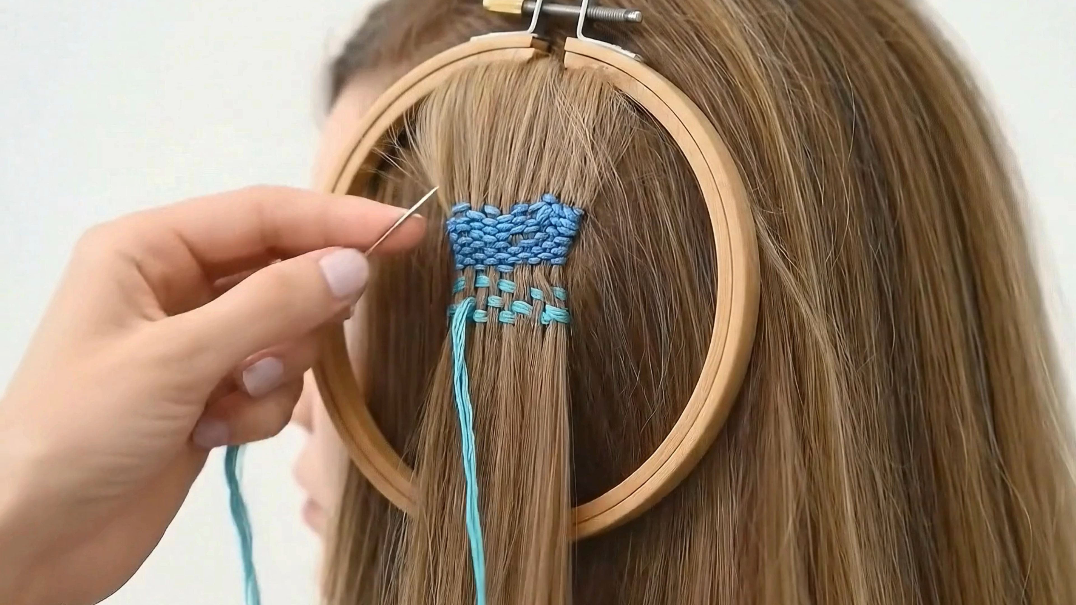
THE HERO BEHIND THE SCENE
OXY 229 CB
743 peptides bonding* to hair, effectively mending and strengthening each strand
* Van der Waals interactions, hydrogen bonds and hydrophobic interactions.

Slide 38

FROM OUR ANALYTICS
743 evenly distributed peptides will reenforce the hair filler action of amino acids in OXY 229 CB helping to heal the internal hair structure and promote repair and strand strength!
Peptides length | # of peptides | % of number
2 | 14 | 1.9%
3 | 62 | 8.3%
4 | 88 | 11.8%
5 | 72 | 9.7%
6 | 92 | 12.4%
7 | 99 | 13.3%
8 | 127 | 17.1%
9 | 72 | 9.7%
10 | 45 | 6.1%
>10 | 72 | 9.7%
TOTAL | 743
Notes:
Peptide analysis method:
System: UPLC/HR-MS, Vanquish Horizon, Orbitrap Exploris 240 (Thermo Scientific)
Column: Acquity BEH C18 Premier (Waters) 150 x 2.1 mm ID (Waters). Oven: 40°C
Solvents: A: 0.1% formic acid in water, B: 0.1% formic acid in acetonitrile. Flow: 0.4 mL/min
Gradient: 0% B, 3.0 min; 0-18% B in 12 min; 18-100% B in 2 min; 100% B, 1 min; equilibrate for 2 min
MS: Positive ESI in ddMS2 mode (AcquireX with background exclusion)

Slide 39
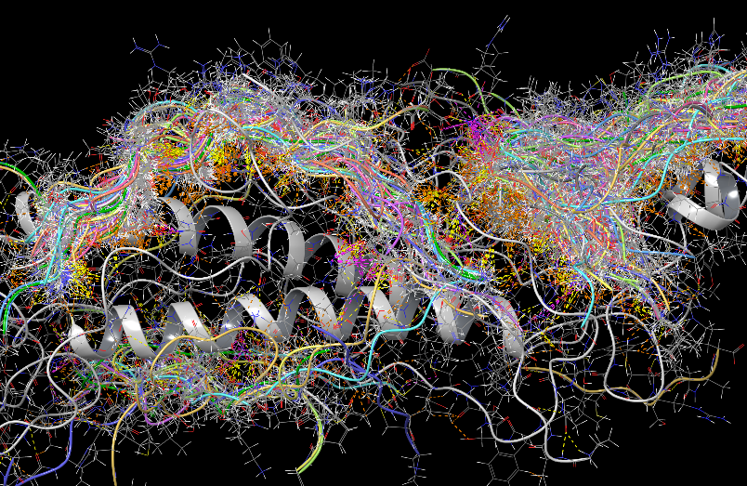
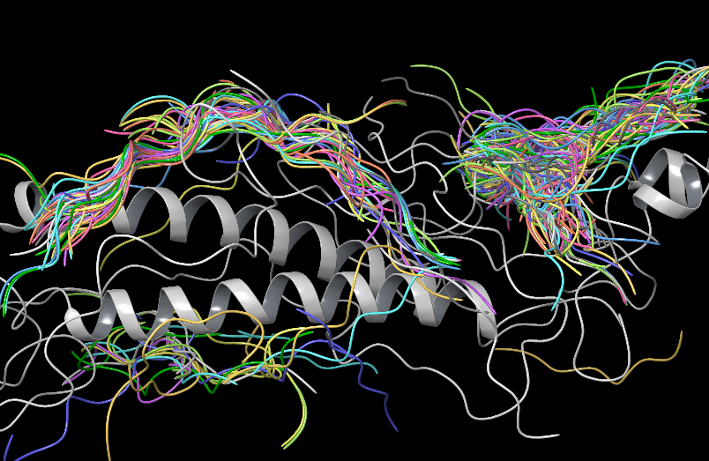
HEALING THE HAIR
Using computer molecular modeling, we can visualize how the peptides* in OXY 229 CB interact with keratin dimers through Van der Waals forces, hydrogen bonding, and hydrophobic interactions. This advanced methodology reveals the peptides' ability to self-organize on the keratin protein. With this behavior the peptides can accumulate in damaged areas, effectively filling structural gaps and contributing to hair healing.**
* Modeling conduced on 19 of the peptides composing OXY 229 CB
** In the amorphous keratin structure of the hair
Keratin model adapted from René HafnerNils WolfgrammPeter Klein*Herbert M. Urbassek* in “Adsorption of Diclofenac and PFBS on a Hair Keratin Dimer”, The journal of Physical Chemistry, Dec. 2023

Slide 40
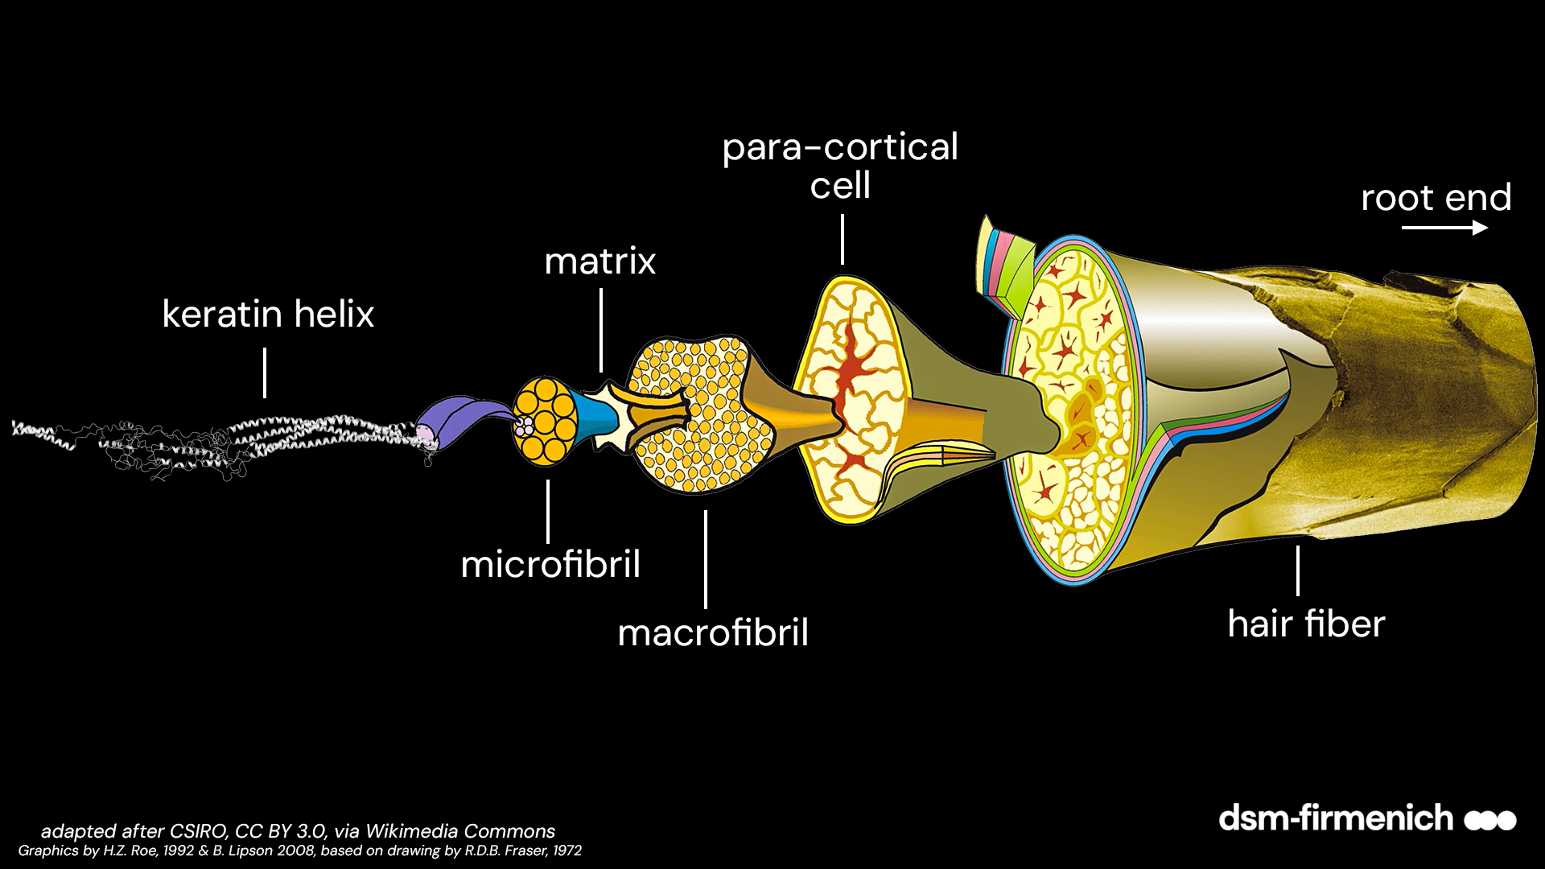

PUSHING THE “BONDARIES”
Assuming access to the crystalline keratin structure were possible, the interactions previously modeled with keratins in the surrounding matrix would remain the same.
Modeling conduced on 19 of the peptides composing OXY 229 CB

Slide 41


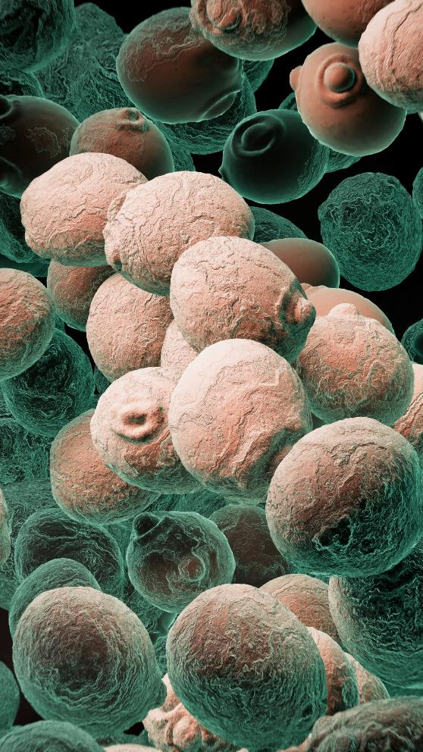
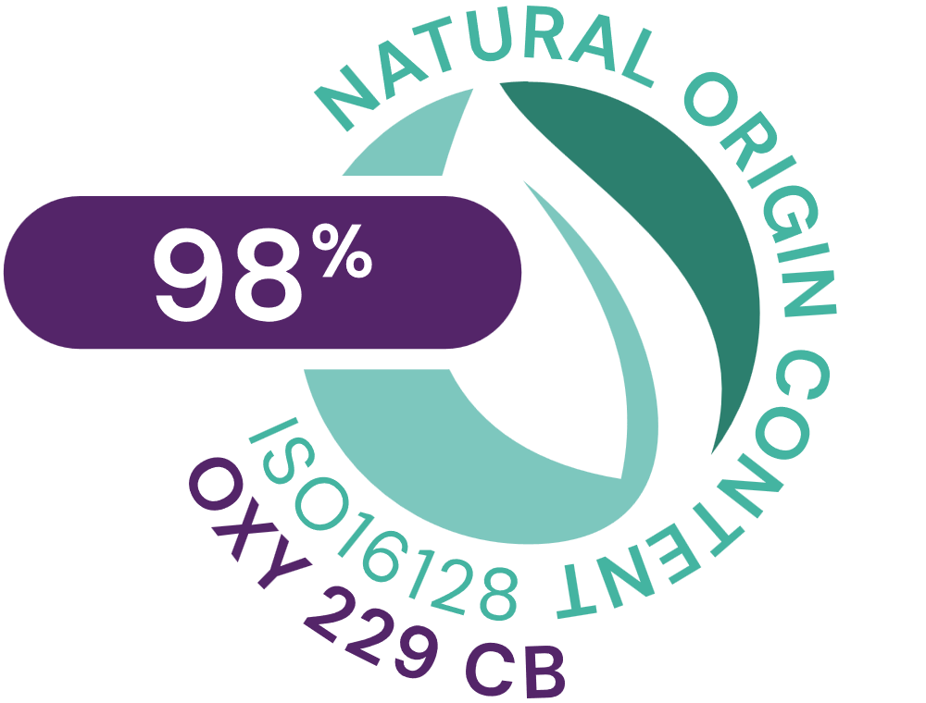


OXY 229 CB, Hair healing Biotechnology
Technology: Amino Acids, Postbiotics peptides obtained by fermentation of yeast
INCI Name: Aqua, Glycerin, Caprylyl Glycol, 1,2-Hexanediol, Saccharomyces Lysate, Valine, Threonine, Glutamic acid, Glycine, Disodium Succinate
Natural origin content: 98% according to ISO16128
Suggested concentration: 1–3% OXY 229 CB

Slide 42

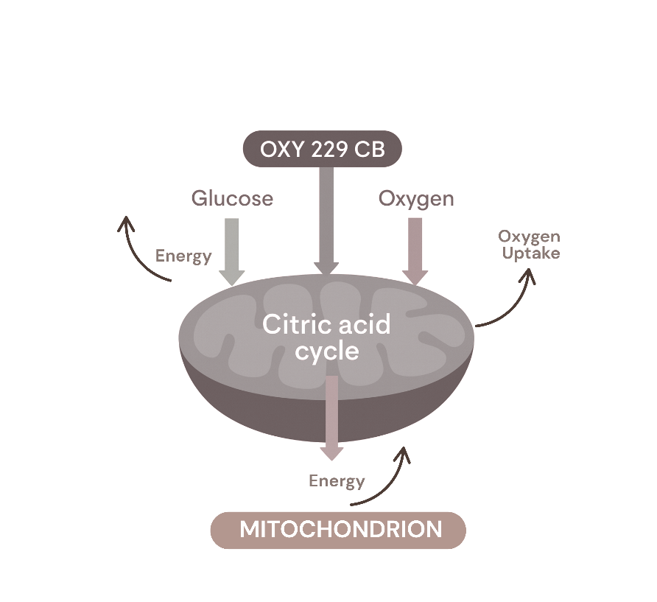
NOW BREATHE!
A finding from our skin biology research:
OXY 229 CB increases cells oxygen uptake for more energy and faster turnover to maintain a healthy scalp. The increase is likely due to stimulation of the citric acid cycle, a key driver of the skin’s energy production process:

Slide 43
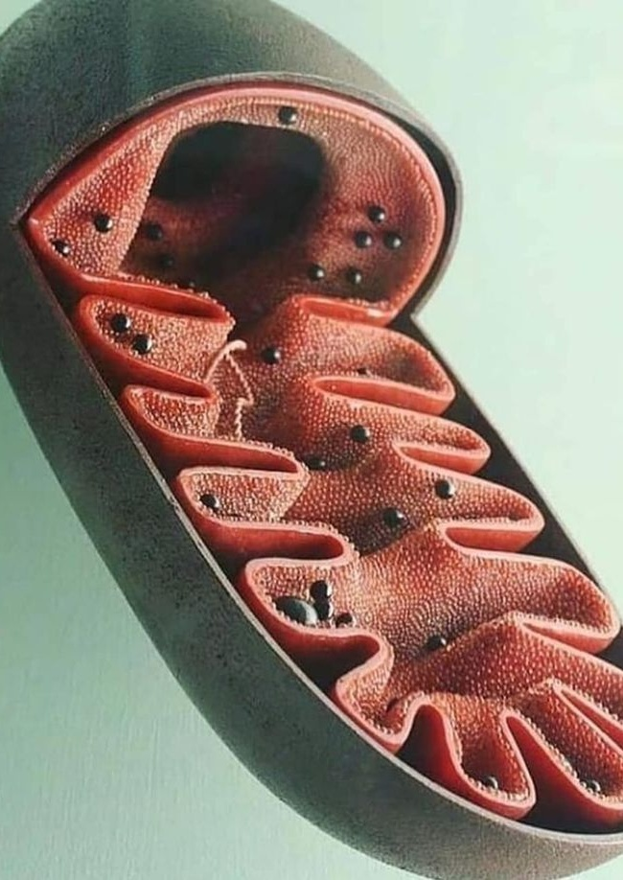
MODE OF ACTION
Gives cells the energy they need
OXY 229 CB’s biotech is enriched with Amino Acids and Disodium succinate, a sophisticated mixture of cells respiration facilitators:
Threonine –
essential Amino Acid
Plays a role in the process of cells energy production in the matrix of the mitochondria (known as the “powerhouses of the cell,” mitochondria produce the energy necessary for the cell's survival and functioning)
Glycine – non-essential Amino Acid
Improves mitochondrial
health
Glutamic acid –
non-essential Amino Acid
Supports cells energy production
Valine – essential Amino Acid
Serves as an energy fuel
Disodium succinate
Helps cells respiration
Notes:
Image: https://i.pinimg.com/736x/5e/75/56/5e7556c35804d476560089d580bc256e.jpg

Slide 44
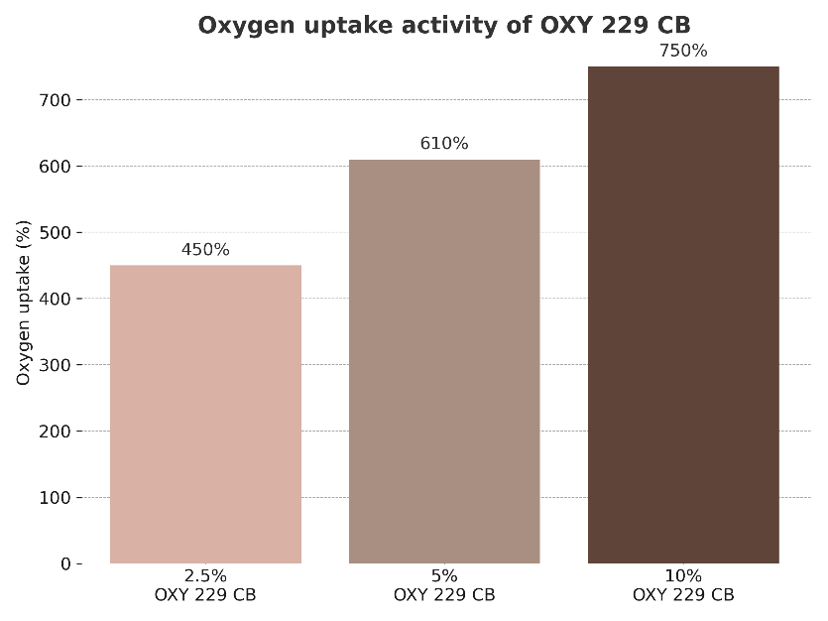
OXY 229 CB ENHANCES OXYGEN UPTAKE
A high uptake of oxygen in skin/scalp cells is a sign of good metabolic activity and is very important to the natural revitalizing capacity of the scalp.
The activity of OXY 229 CB was evaluated using the Gilson Respirometer, which measured oxygen uptake by a known quantity of a tissue homogenate. The oxygen consumption was determined one hour after the addition of the OXY 229 CB samples compared to untreated control.
*In vitro
OXY 229 CB enhances cells oxygen uptake by up to 750%*

Slide 45
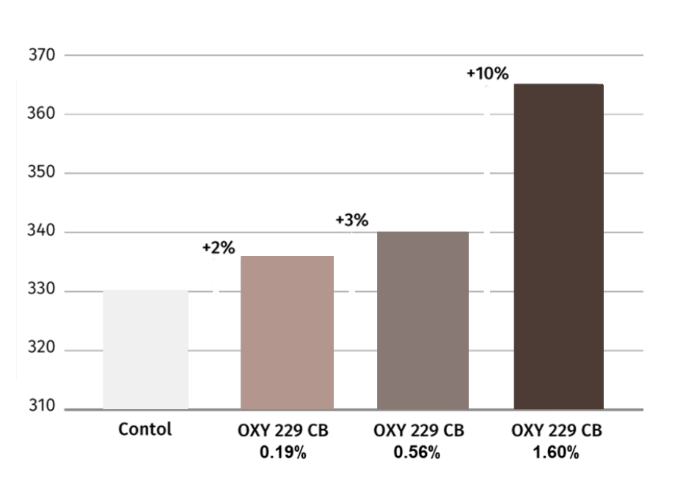
OXY 229 CB INDUCES CELL VIABILITY
Metabolic activity in cells must be high enough for them to carry out their normal functions and survive. The more active the cells, the healthier scalp will be.
The effect of OXY 229 CB on the growth and survival of fibroblasts was investigated using the colorimetric MTT-tetrazolium assay.
Effect of OXY-229 CB on cell viability
*In vitro
Cell Viability increase (%)
OXY 229 CB induces cell viability by up to 10%*

Slide 46

SUMMARY
BOND AID
with OXY 229 CB
Every day is a good hair day!
Benefits:
3 trends in one product: bond* repair or structural repair, biotech-beauty, oxygenating scalp care (Cellular beauty)
Strengthens the hair – restores the hair integrity
Improves combability
Enhances sensory experience
Smooths hair surface
Formulated with Natural Peptides for hair fiber care
Delivers scalp energy
Easy to use: 1% addition delivers immediate results
OXY 229 CB, a comprehensive solution for hair repair and consumer delight
* van der Waals interactions, hydrogen bonds and hydrophobic interactions.

Slide 47
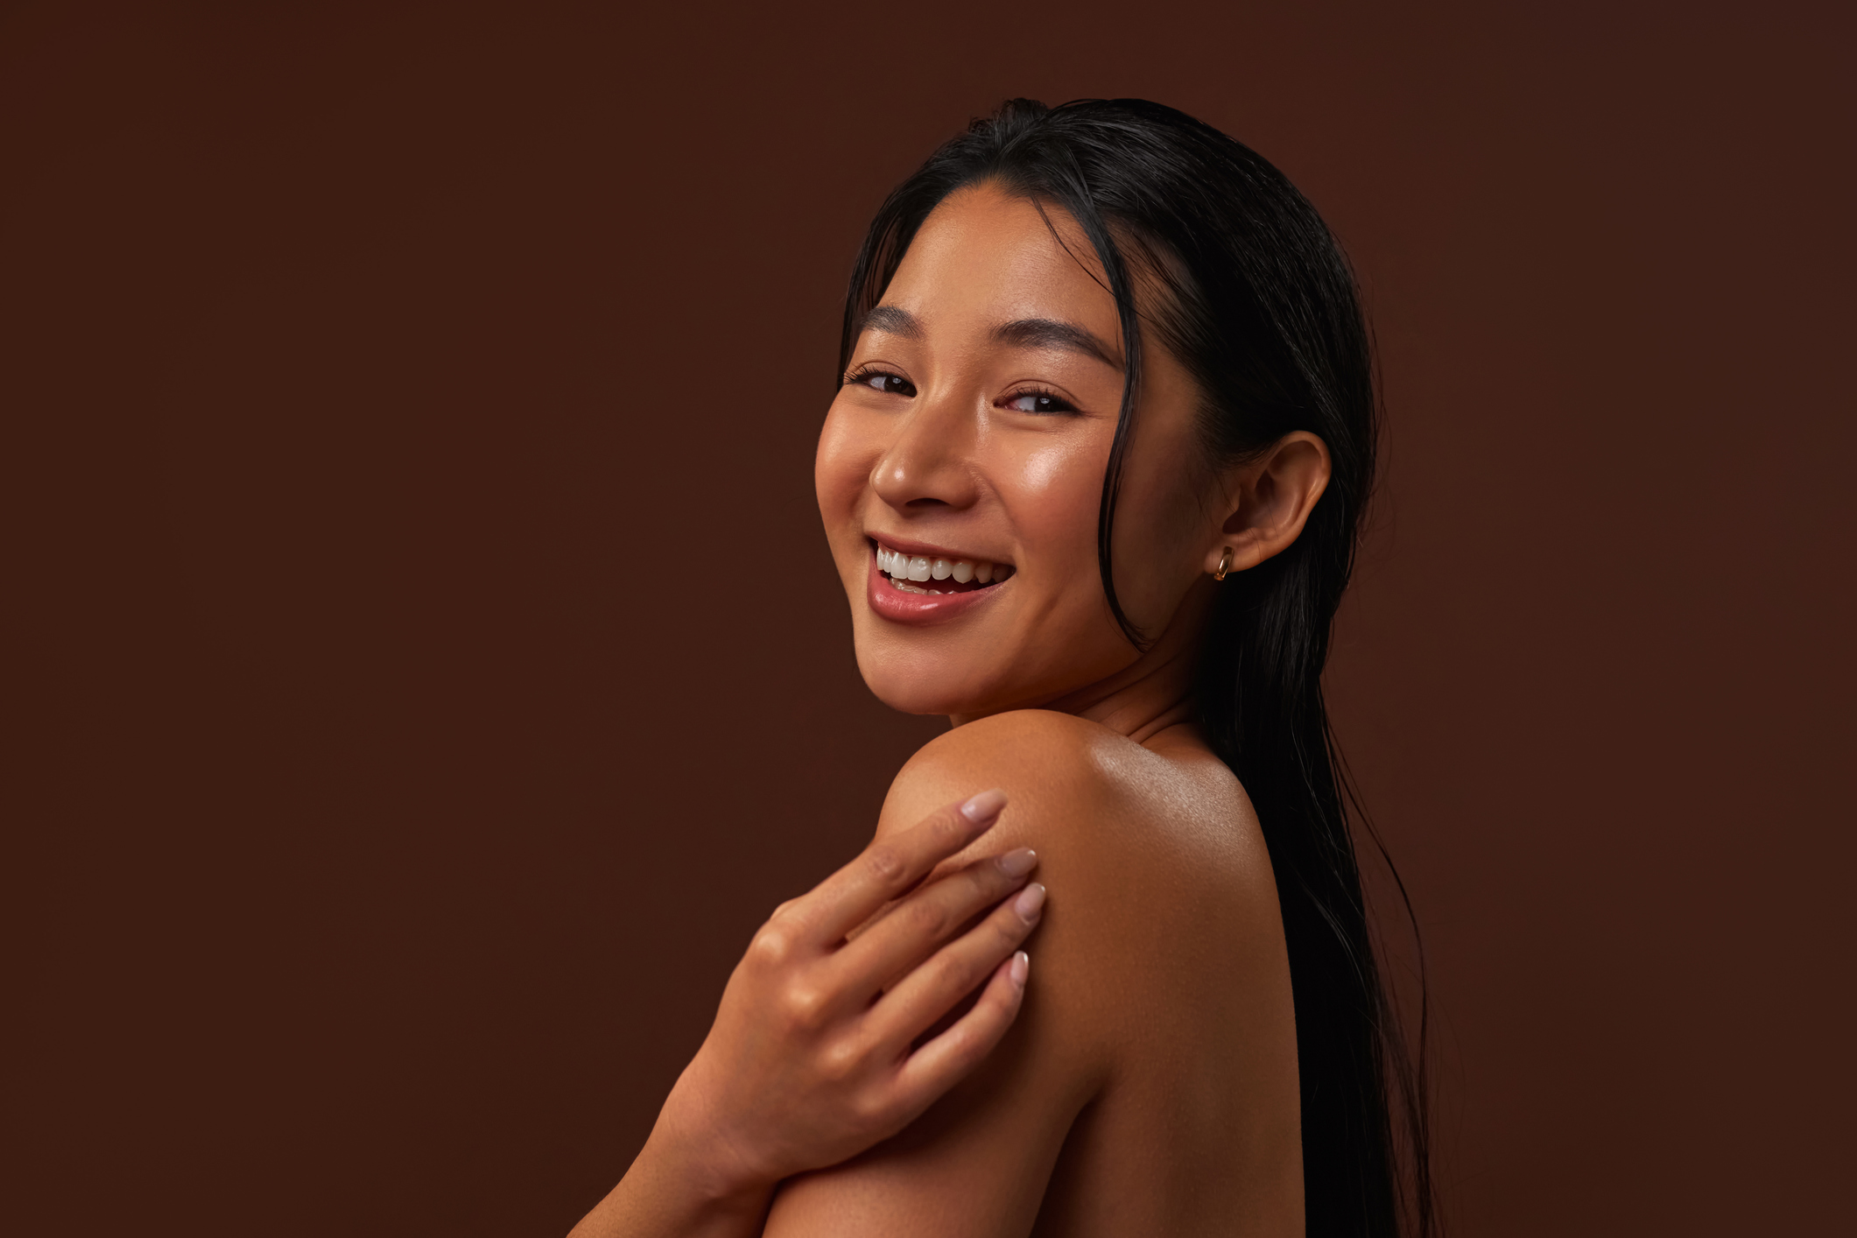
WHAT IS IN FOR CONSUMERS
BOND AID
with OXY 229 CB
Visible transformation from first use:
Stronger strands: Up to 22% more strength after just one application. Hair feels reborn, resilient, radiant, full of life.
Smoother feel: Easier to comb, softer to touch. A touch of luxury you can feel in every strand.
Surface renewal: Scientifically proven smoother hair surface. Less damage, more shine.
Scalp & Hair wellness
Scalp vitality boost: Up to 750% more oxygen uptake and +10% cell viability. A revitalized scalp, the secret to hair longevity.
Clean Beauty promise: Gentle on you, kind to the planet.
Confidence you can wear
Every day is a good hair day: Hair that feels repaired, protected, and full of life.
Science you can trust: Bond Aid made simple. Advanced care, inspired by nature, perfected by innovation.

Slide 48
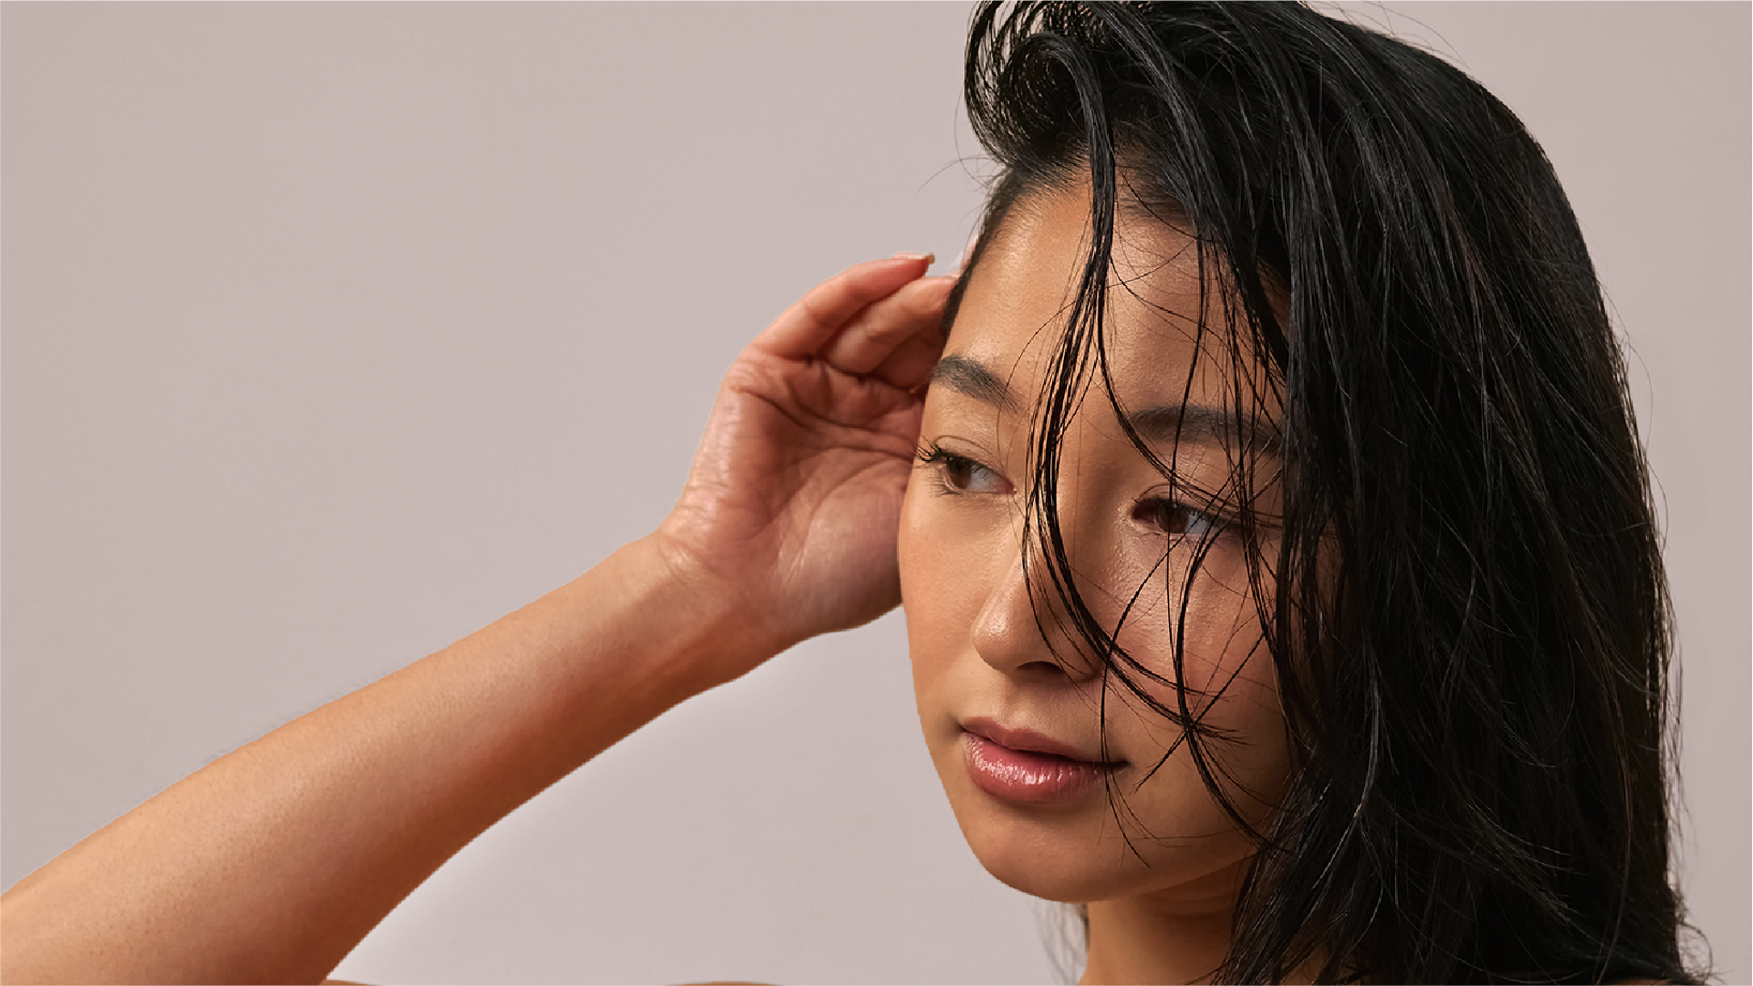

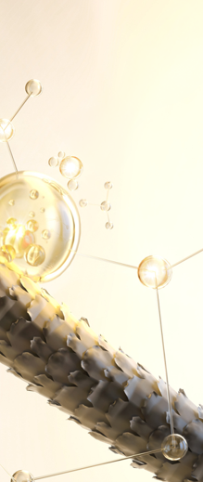




featuring
OXY 229 CB
2 in 1
ACTION
Scalp Vitality
& Strand Integrity
BIOTECH
Derived
Technology
PEPTIDE 743

Slide 49

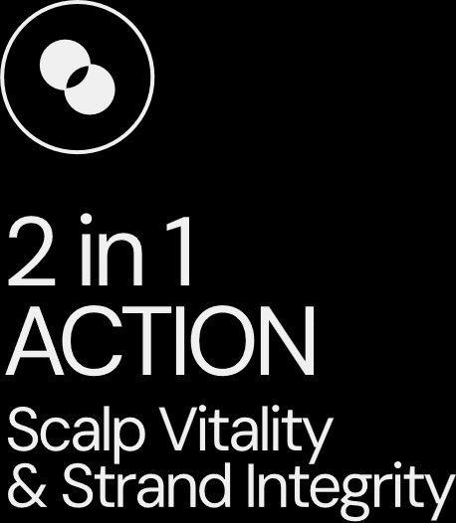


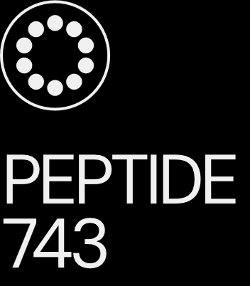
The hero behind the scene
OXY 229 CB
743 peptides bonding* to hair, effectively mending and strengthening each strand.
Benefits:
3 trends in one product: bond* repair or structural repair, biotech-beauty, oxygenating scalp care (Cellular beauty)
Strengthens the hair – restores the hair integrity
Improves combability
Enhances sensory experience
Smooths hair surface
Formulated with Natural Peptides for hair fiber care
Delivers scalp energy
Easy to use: 1% addition delivers immediate results
BIOTECH
Derived
Technology
OXY 229 CB, a comprehensive solution for hair repair and consumer delight
* Van der Waals interactions, hydrogen bonds and hydrophobic interactions.

Slide 50





OXY 229 CB
ID card
INCI NAME:
Aqua, Glycerin, Caprylyl Glycol, 1,2-Hexanediol, Saccharomyces Lysate, Valine, Threonine, Glutamic acid, Glycine, Disodium Succinate
TECHNOLOGY:
Amino Acids, Postbiotics peptides obtained by fermentation of yeast (specific strain)
98% of natural origin (according to ISO 16128)
Solubility: water soluble
Biodegradability: readily biodegradable
TECHNICAL:
Form: liquid
Use level: 1–3%
pH of use: 3–7.5
Preservative: free
BENEFITS:
Repairs Hair damages
Restores the hair integrity
Prevents keratin from damage
Strengthens hair strands
Smooths the hair surface
Improves combability
Enhances hair sensory experience
Helps cells respiration (oxygen uptake)*
Stimulates cell viability, revitalizing the scalp*
REGISTRATIONS
CERTIFICATION
*In vitro

Slide 51
featuring
OXY 229 CB
Hair battles daily stress. UV exposure, pollution, heat, color, humidity, emotional stress — every day leaves a mark on the hair fiber and on the scalp.
That’s why BOND AID was created: a biotech-powered ritual designed to restore hair from the inside out.
Powered by OXY 229 CB at 1%, a 743-peptide innovation obtained through sustainable biotechnology, BOND AID delivers a powerful
2-in-1 action: it enhances structural integrity while revitalizes the scalp, while increases cells oxygen uptake up to +750%*.
The result? Stronger strands, smoother surface, and visible renewal since the first use.
More than performance, BOND AID is where science meets emotion.
A comforting, sophisticated fragrance powered by emotiOn™ ENERGY, designed to boost your mood and natural vitality, combined with lockscent™ the fragrance locker for hair, for long-lasting scent, transforms care into a sensorial experience for hair and mind.
Now, take a moment. Your ritual of restoration begins.
BIOTECH
Derived
Technology
* in vitro data

Slide 52


Slide 53
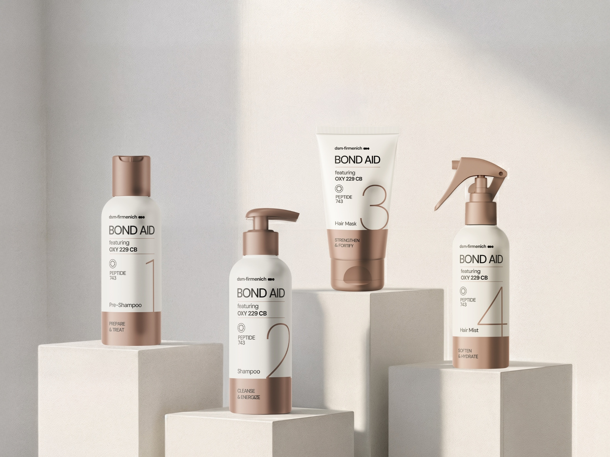


STEP 1 – PRE-SHAMPOO
STEP 2 – SHAMPOO
STEP 3 – HAIR MASK
STEP 4 – HAIR MIST
PREPARE & TREAT
CLEANSE
& ENERGIZE
STRENGTHEN & FORTIFY
SOFTEN
& HYDRATE
Helps to rebuild the fiber inner structure
Gently cleanses and revitalizes
Strengthens the fiber and smoothens the cuticles
Seales the routine and enhances softness
featuring
OXY 229 CB
Minimal steps, maximum impacts
This 4-step ceremony restores hair integrity from scalp to strands, attaching to keratin fibers to help rebuild what daily stress takes away. Created for dry, damaged, or color-treated hair.
2 in 1 ACTION
Scalp Vitality
& Strand Integrity
BIOTECH
Derived
Technology
PEPTIDE 743

Slide 54
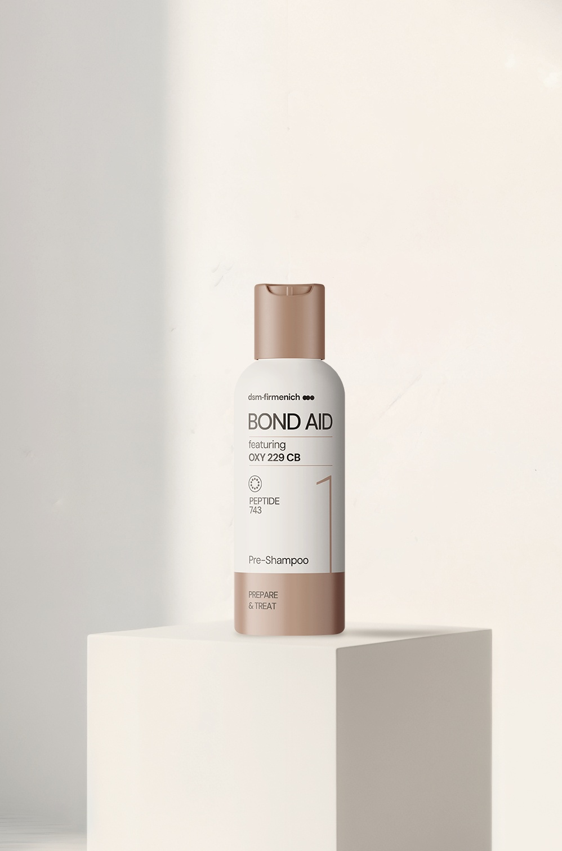


Prepared fiber. Boosted performance. Maximized impacts.
featuring
OXY
229 CB
STEP 1 – PRE-SHAMPOO
PREPARE
& TREAT
Stronger hair starts before you even step into the shower.
This pre‑shampoo treatment primes the fiber to reinforce, protect, and energize your hair and scalp.
More than a pre-shampoo, it is a treatment that helps strengthen the fiber’s inner structure, preparing it for the washing process.
OXY 229 CB - Strength starts here
Biotech natural peptides reinforce the fiber from the first use and smooth the surface. First step toward stronger, more resilient hair.
Phytantriol - Protect and preserve
Forms a color‑protective veil and supports the deposition of panthenol & keratin amino acids.
Niacinamide PC - Scalp and fiber readiness
Helps improve resilience for a healthier scalp and contribute to thicken & strength the fiber.
2 in 1
ACTION
Scalp Vitality
& Strand Integrity
BIOTECH
Derived
Technology
PEPTIDE 743

Slide 55


Clean feel. Strong strands. Energized results.
featuring
OXY
229 CB
STEP 2 –SHAMPOO
CLEANSE
& ENERGIZE
This gentle, sulfate‑free shampoo creates a soft, cushioning lather that cleanses without stripping. Making it ideal even for sensitive scalps. It removes impurities while respecting the scalp barrier, leaving hair feeling fresh, soft, and ready for the repair routine.
OXY 229 CB - Strength and energy
Biotech natural peptides reinforce the fiber from within, smooth the surface, and improve combability, while boosting cellular oxygen uptake and scalp vitality for stronger, more energized hair after every wash.
TILAMAR® Quat 640 - Weightless conditioning
A high‑performance conditioning polymer delivering superior wet & dry combability, smooth slip, and a clean rinse with no build‑up, keeping hair light, silky, and easy to manage.
PENTAVITIN® - Rinse‑off survivor
A natural sugar derivative that binds to keratin and scalp, helping reinforce the scalp barrier within 24 hours, reduce flaking and excess sebum, and keep the scalp hydrated, even with frequent washing.
2 in 1
ACTION
Scalp Vitality
& Strand Integrity
BIOTECH
Derived
Technology
PEPTIDE 743

Slide 56


Stronger fiber. Smoother feel. Fortified finish.
featuring
OXY
229 CB
STEP 3 – HAIR MASK
STRENGTHEN
& FORTIFY
A rich, strengthening mask that dives deep into the fiber to fortify, smooth, and restore.
This step of the BOND AID routine, designed to lock in structural reinforcement strengthen the fiber while smoothing the cuticles, delivering an incredible feel-good texture.
After use it delivers stronger, softer, visibly renewed hair.
OXY 229 CB - Deep fiber strength
The biotech natural peptide complex reinforces the hair from within, improves tensile strength, and smooths the fiber surface for easier combing and a fortified finish. Proven to deliver measurable structural repair.
Panthenol - Moisture and resilience
Panthenol helps strengthen the scalp barrier and boost moisturization. It contributes to hair-thickening effect by helping increase fiber diameter.
STIMU-TEX® AS — Powerful nourishing blend
It helps reduce breakage, smooth frizz, improve ease of combing, and reduce split‑ends, while supporting scalp comfort with soothing and calming properties.
2 in 1
ACTION
Scalp Vitality
& Strand Integrity
BIOTECH
Derived
Technology
PEPTIDE 743

Slide 57


Soft strands. Weightless moisture. Boosted mood.
featuring
OXY
229 CB
STEP 4 – HAIR MIST
SOFTEN
& HYDRATE
A lightweight, non‑greasy mist that seals the final step of the BOND AID routine. This mist softens, hydrates, and protects the fiber while boosting all preceding repair steps.
Its mood‑boosting, sophisticated fragrance locks onto your hair for hours, leaving an irresistible trail.
OXY 229 CB — Softness with strength
Our Biotech natural peptide complex delivers lightweight fiber reinforcement, smoothing the surface for instant softness and easier combability - keeping the hair conditioned and more resilient throughout the day.
HYA‑ACT™ M— Weightless hydration
This efficient form of hyaluronic acid provides immediate hydration.
Fragrance — BOND AND BEYOND
A bright citrus opening softened by vanilla and warm sandalwood elevates the final step into a sensorial seal. Powered by lockscent™ the fragrance locker for hair, for long-lasting scent and emotiOn™ ENERGY, designed to boost your natural vitality.
2 in 1
ACTION
Scalp Vitality
& Strand Integrity
BIOTECH
Derived
Technology
PEPTIDE 743

Slide 58

Fragrance
BOND AND BEYOND
TOP NOTES
Grapefruit ​
Lemon Pie ​
​
HEART NOTES
Pineapple Flower​
Vanilla Orchid ​
​
BASE NOTES
Brown Sugar​
Sandalwood ​
Zesty and sparkling citrus, softened by vanilla and sandalwood notes, create a sophisticated scent that elevates repair to a sensorial ritual.​
ORANGE TERP CITRONOVA® & SANDALBLOOM™: upcycled ingredients
NIRVANOL®: dsm-firmenich´s captive
lockscent™, ​
the fragrance locker for hair ​
A selection of high-impact ingredients from
dsm-firmenich’s palette that bond with hair
keratin and diffuse their scents throughout
the day​.
emotiOn™ ENERGY
fragrance made to feel
Powered by 30 years of neuroscience.
Designed to boost your natural vitality.​

Slide 59









Take a bath to boost your mood while treating your strands.
PREPARE
& TREAT
CLEANSE
& ENERGIZE
STRENGTHEN
& FORTIFY
SOFTEN
& HYDRATE
PRE-SHAMPOO
SHAMPOO
HAIR MASK
HAIR MIST
Professional tip
Use before every wash.
Apply on damp hair from roots to ends and let it sit for a few minutes to maximize the performance.
Professional tip
Use it like your regular shampoo as often as required.
Massage gently to help enhance energizing benefits.
Professional tip
Leave on for 5–10 minutes
for deep, targeted strengthening. Use after every wash.
Professional tip
Mist 3x lightly over damp hair to veil the fiber in weightless hydration, continuous protection, and effortless manageability.

Slide 60
With biotech-powered care for scalp vitality and strand integrity,
BOND AID RITUAL helps hair look restored, feel renewed, and perform at its best.
STEP 1 – PRE-SHAMPOO
STEP 2 – SHAMPOO
STEP 3 – HAIR MASK
STEP 4 – HAIR MIST
featuring
OXY 229 CB
Prep the core.
Strength starts with reinforcement of the
inner structure of the fiber.
Cleanse with
purpose.
Vitality and repair
in every wash.
Fortify the surface.
Mask‑driven strength
and smoothness.
Seal with softness.
A hydrating mist and energizing fragrance veil complete the transformation.
Four steps.
One impacting journey.
This 4-step peptide‑powered routine featuring OXY 229 CB reinforces the fiber inner structure, vitalizes the scalp, strengthens, and hydrates — delivering hair that looks restored, feels renewed, and performs like never before.
2 in 1 ACTION
Scalp Vitality
& Strand Integrity
BIOTECH
Derived
Technology
PEPTIDE 743

Slide 61
featuring OXY 229 CB
for scalp vitality & strand integrity
What consumer will perceive
Visible transformation from first use
Stronger strands: up to 22% more strength after just one application. - Hair feels reborn, resilient, radiant, full of life.
Smoother feel: easier to comb, softer feel. - A touch of luxury you can feel in every strand.
Surface renewal: scientifically proven smoother hair surface. - Less damage, more shine.
Scalp & Hair wellness
Scalp vitality boost: +750% oxygen uptake and +10% more cell vitality. - A revitalized scalp, the secret to hair longevity.
Clean Beauty promise: gentle on you, kind to the planet.
Confidence you can wear
Every day is a good hair day: hair that feels protected, and full of life.
Science you can trust: Advanced care, inspired by nature, perfected by biotechnology innovation.
Advanced fragrance technology: long-lasting scent, powered by mood boosting experience.
BIOTECH
Derived
Technology

Slide 62
Disclaimer
Copyright © dsm-firmenich Switzerland AG, 2026, 4002 Basel, Switzerland.
www.dsm-firmenich.com. All rights reserved.
dsm-firmenich has used diligent care to ensure that the information provided herein is accurate and up-to-date to the best of its knowledge. However, dsm-firmenich makes no representation or warranty, either expressly or implied, of the accuracy, reliability, completeness, or suitability thereof. The information provided herein contains scientific and product information for business-to-business use and does not constitute or provide scientific or medical advice, diagnosis or recommendation for treatment options. Country or region-specific information should be considered when labelling or advertising to final consumer. In no event shall dsm-firmenich be liable for any direct or indirect damages arising from or reliance upon, or use of, any information provided herein. The content of this document is subject to change without further notice. Please contact your local dsm-firmenich representative for the latest information. All trademarks listed in this document are either (registered) trademarks of, or trademarks licensed by, the dsm-firmenich group of companies, unless explicitly stated otherwise.
Disclaimer Formulation Guideline
The information provided herein is provided for information purposes only and has been prepared by dsm-firmenich in accordance with its own methodology.
dsm-firmenich has used diligent care to ensure that it is accurate and up-to-date, however, dsm-firmenich makes no representation or warranty, either expressly or implied, of the accuracy, reliability, or completeness thereof. In no event shall dsm-firmenich be liable for any damages arising from or reliance upon, or use of, any information provided herein. Further, dsm-firmenich shall not bear any liability for the application and/or use of any processed material containing its product(s). The formulation of the finished product is the customer’s sole responsibility. It is the customer’s responsibility to determine the suitability of dsm-firmenich’s products regarding user specific purposes, assess compatibility and stability of their finished product(s) and to ensure compliance of their finished product(s) with relevant laws and regulations. Any product, marketing or other claims made by customer are its sole responsibility. The content of this document is subject to change without further notice. Please contact your local dsm-firmenich representative for further details. © dsm-firmenich Switzerland AG, 2026.
© 2026

Slide 63
We bring progress to life

Slide 64
OXY 229 CB
ID Card
INCI NAME:
Aqua, Glycerin, Caprylyl Glycol, 1,2-Hexanediol, Saccharomyces Lysate, Valine, Threonine, Glutamic acid, Glycine, Disodium Succinate
TECHNOLOGY:
Amino Acids, Postbiotics peptides obtained by fermentation of yeast (specific strain)
98% of natural origin (according to ISO 16128)
Solubility: water soluble
Biodegradability: readily biodegradable
TECHNICAL:
Form: liquid
Use level: 1–3%
pH of use: 3–7.5
Preservative: free
BENEFITS:
Repairs Hair damages
Restores the hair integrity
Prevents keratin from damage
Strengthens hair strands
Smooths the hair surface
Improves combability
Enhances hair sensory experience
Helps cells respiration (oxygen uptake)*
Stimulates cell viability, revitalizing the scalp*
REGISTRATION
CERTIFICATION
*In vitro

Slide 65


Slide 66

SENSORY EVALUATION,
A PROFESSIONALY DESIGNED TEST SET UP
*External test institute

Slide 67
Sensory evaluation of OXY 229 CB in market product
Bleaching:
Mix commercial bleaching agent according to description on packaging.
Spread the mixture homogeneously on dry (not washed) hair​.
Cover with alu foil for 45 min.
Rinse off with 39°C tap water until water is clear.
Leave hair tresses for 50 min. in deionized water.
Dry slightly with paper towels.
Let tresses dry in climate room overnight at 20°C / 60% humidity.
Material:
European strong bleached hair (20cm long, Art.Nr. 814010-E-D)
Notes:
Bleaching with Wella Professionals Blondor Multi Blonde 7 Powder + Wella Welloxon, Hydrogène, developer, Oxydant - 9% 30 Vol. (ratio 1:2)

Slide 68
Sensory evaluation of OXY 229 CB in market product
Procedure:
Hair tresses of European hair, strongly bleached, 20cm, color 10/0
Washing procedure according to recommendation of commercial finished product
Bleaching: exposure time 30 minutes
Rinsing with tap water at 38°C
Soaking for 30 min in deionized water
Storage at 20°C/60% relative Humidity
Hair sensory panel evaluation by trained panelists (max. 3 panelist assessing the same hair set)
Notes:
Bleaching with Wella Professionals Blondor Multi Blonde 7 Powder + Wella Welloxon, Hydrogène, developer, Oxydant - 9% 30 Vol. (ratio 1:2)

Slide 69
Sensory evaluation of OXY 229 CB in market product
Design of the questionnaire
Test: Each panelist has done a comparison of 3 tresses in a specific order and rated them (see example below)
Tress 1 vs 3 / Tress 3 vs 4 and Tress 1 vs 4 => each panelist express a preference in terms of smoothness of the tress.
Rating: Each panelist should evaluate the difference of preference on a scale from 0 to 10 (worst to best) between the 3 tresses tested
 | TEST |  |  | RATING
Panelist xxx-1 | Tresses 1-3 | Tresses 3-4 | Tresses 1-4 | Tress 1 | Tress 3 | Tress 4
 | 3 | 4 | 4 | 2 | 3 | 7
Panelist xxx-2 | Tresses 1-3 | Tresses 3-6 | Tresses 1-6 | Tress 1 | Tress 3 | Tress 6
 | 3 | 6 | 6 | 3 | 3.5 | 7
Panelist xxx-3 | Tresses 1-4 | Tresses 4-5 | Tresses 1-5 | Tress 1 | Tress 4 | Tress 5
 | 4 | 4 | 0 | 2 | 6 | 2
Panelist xxx-4 | Tresses 1-4 | Tresses 4-5 | Tresses 1-5 | Tress 1 | Tress 4 | Tress 5
 | 4 | 0 | 5 | 2 | 4 | 4
Panelist xxx-5 | Tresses 1-5 | Tresses 5-6 | Tresses 1-6 | Tress 1 | Tress 5 | Tress 6
 | 5 | 6 | 6 | 1 | 3 | 6

Slide 70
Sensory evaluation of OXY 229 CB in market product
Parameter taken into consideration for statistics:
Number of ratings per product
Number of products per session
Number of sessions per panelist
Number of NA in ratings
Number of NA in pairwise comparisons
Number of pairwise comparison per pair
Number of pairwise comparison per product

Slide 71
Phase | Ingredient | INCI | % w/w
A | Water Dem | AQUA | 69.50
 | Citric Acid Anhydrous | CITRIC ACID | 0.40
 | Polycos CA-50 ECO | GUAR HYDROXYPROPYLTRIMONIUM CHLORIDE | 0.25
 | Edeta® BD | DISODIUM EDTA | 0.10
B | TEGO Betain F50 | COCAMIDOPROPYL BETAINE, AQUA | 3.80
 | PLANTACARE® 818 UP | COCO-GLUCOSIDE, AQUA | 5.50
 | Prebiulin C90 | CELLULOSE GUM, XANTHAN GUM, INULIN, CELLULOSE, GLUCOSE, FRUCTOSE | 0.20
 | D‑Panthenol 75 L | PANTHENOL, AQUA, PANTOLACTONE | 0.50
C | DL‑alpha‑Tocopheryl Acetate | TOCOPHERYL ACETATE | 1.00
 | Lanette® 18 | STEARYL ALCOHOL | 3.00
 | Kokosöl raffiniert kbA DE‑ÖKO‑001 | COCOS NUCIFERA OIL | 3.00
 | AminoSensyl HC | BRASSICA ALCOHOL, BRASSICYL VALINATE ESYLATE | 3.00
 | Mixed Tocopherols 95 | TOCOPHEROL | 0.50
 | Lanette® 16 | CETYL ALCOHOL | 3.00
 | Phytantriol | PHYTANTRIOL | 0.25
 | life'sGLA™ '10' n‑6 Oil | OENOTHERA BIENNIS SEED EXTRACT, ASCORBYL PALMITATE, TOCOPHEROL | 0.50
 | ARGAN OIL | ARGANIA SPINOSA KERNEL OIL | 0.50
 | Varisoft BT 85 | BEHENTRIMONIUM CHLORIDE, ISOPROPYL ALCOHOL | 1.50
D | Niacinamide PC | NIACINAMIDE | 0.20
 | PENTAVITIN® | SACCHARIDE ISOMERATE, AQUA, CITRIC ACID, SODIUM CITRATE | 0.50
 | OXY 229 CB | SACCHAROMYCES LYSATE, VALINE, THREONINE, GLUTAMIC ACID, GLYCINE, GLYCERIN, AQUA, DISODIUM SUCCINATE, 1,2‑HEXANEDIOL, CAPRYLYL GLYCOL | 1.00
 | PUROX® S | SODIUM BENZOATE | 0.60
E | BOND AND BEYOND P04E062 | PARFUM, BENZYL SALICYLATE, CITRAL, CITRONELLOL, COUMARIN, LIMONENE, CITRUS AURANTIUM PEEL OIL, DIMETHYL PHENETHYL ACETATE, GERANYL ACETATE, PINENE, TERPINEOL, TETRAMETHYL ACETYLOCTAHYDRONAPHTHALENES | 1.20
STEP 1 – PRE-SHAMPOO
PREPARE
& TREAT
91 % Natural Origin content according to ISO 16128 by including formulation water.
HC-E-103387-7

Slide 72
Phase | Ingredient | INCI | % w/w
A | Water Dem | AQUA | 37.55
 | TEGO Betain F50 | COCAMIDOPROPYL BETAINE, AQUA | 5.00
 | Bio-Terge AS-40 HASB | SODIUM C14-16 OLEFIN SULFONATE, AQUA | 12.00
 | Amphosol DM | COCO-BETAINE | 3.00
 | Comperlan® KD | COCAMIDE DEA | 2.00
 | Oramix L 30 | SODIUM LAUROYL SARCOSINATE | 8.00
 | Jaguar® C 162 SGI | HYDROXYPROPYL GUAR HYDROXYPROPYLTRIMONIUM CHLORIDE | 0.30
 | TEGIN BL 315 | GLYCOL DISTEARATE | 2.00
 | Citric Acid 25% sol. | AQUA, CITRIC ACID | 1.10
B | Water Dem | AQUA | 20.00
 | TC‑BIO‑CARBOMER 380 | CARBOMER | 0.20
 | Sodium Hydroxide 10% | AQUA, SODIUM HYDROXIDE | 0.25
C | Citric Acid 25% solution | AQUA, CITRIC ACID | 1.10
D | TEGO SOLVE 61 MB | POLYGLYCERYL-6 CAPRYLATE, POLYGLYCERYL-6 RICINOLEATE, POLYGLYCERYL-4 CAPRATE, POLYGLYCERYL-3 COCOATE, AQUA | 2.40
 | BOND AND BEYOND P04E062 | PARFUM, BENZYL SALICYLATE, CITRAL, CITRONELLOL, COUMARIN, LIMONENE, CITRUS AURANTIUM PEEL OIL, DIMETHYL PHENETHYL ACETATE, GERANYL ACETATE, TETRAMETHYL ACETYLOCTAHYDRONAPHTHALENES | 0.80
E | D‑Panthenol 75 L | PANTHENOL, AQUA, PANTOLACTONE | 1.00
 | PENTAVITIN® | SACCHARIDE ISOMERATE COMPLEX | 0.50
 | TILAMAR® Quat 640 | POLYQUATERNIUM‑6, AQUA | 1.00
 | Sodium Chloride Emprove exp | SODIUM CHLORIDE | 0.50
 | PUROX® S | SODIUM BENZOATE | 0.40
 | Potassium Sorbate | POTASSIUM SORBATE | 0.20
 | OXY 229 CB | SACCHAROMYCES LYSATE, VALINE, THREONINE, GLUTAMIC ACID, GLYCINE, GLYCERIN, AQUA, DISODIUM SUCCINATE, 1,2‑HEXANEDIOL, CAPRYLYL GLYCOL | 1.00
 | Sodium Hydroxide 30% Solution | AQUA, SODIUM HYDROXIDE | 0.80
STEP 2 –SHAMPOO
CLEANSE
& ENERGIZE
91 % Natural Origin content according to ISO 16128 by including formulation water.
HC-E-103475-3

Slide 73
Phase | Ingredient | INCI | % w/w
A | Water Dem | AQUA | 80.05
 | L(+) Lactic Acid 90% | LACTIC ACID, AQUA | 0.50
 | Polycos CA-50 ECO | GUAR HYDROXYPROPYLTRIMONIUM CHLORIDE | 0.25
 | CremerGLYC Refined Glycerine Organic | GLYCERIN | 3.00
 | Ucare Polymer JR-125 | POLYQUATERNIUM-10, AQUA, SODIUM ACETATE, SODIUM CHLORIDE, ISOPROPYL ALCOHOL | 0.10
B | Solagum GM | GLUCOMANNAN | 0.50
C | DL-alpha-Tocopheryl Acetate | TOCOPHERYL ACETATE | 0.50
 | Mixed Tocopherols 95 | TOCOPHEROL | 0.10
 | TEGO Care Eco CAT MB | DISTEAROYLISOPROPYL DIMONIUM METHOSULFATE | 3.00
 | PARSOL® SLX | POLYSILICONE-15 | 0.50
 | life'sGLA '10' n-6 Oil | OENOTHERA BIENNIS SEED EXTRACT, ASCORBYL PALMITATE, TOCOPHEROL | 1.00
 | STIMU-TEX® AS | ARGANIA SPINOSA KERNEL OIL, TOCOPHEROL, BUTYROSPERMUM PARKII BUTTER EXTRACT, SPENT GRAIN WAX | 1.50
 | Lanette O | CETEARYL ALCOHOL | 5.00
D | euxyl K 712 | AQUA, SODIUM BENZOATE, POTASSIUM SORBATE | 0.80
 | OXY 229 CB | SACCHAROMYCES LYSATE, VALINE, THREONINE, GLUTAMIC ACID, GLYCINE, GLYCERIN, AQUA, DISODIUM SUCCINATE, 1,2-HEXANEDIOL, CAPRYLYL GLYCOL | 1.00
E | D-Panthenol 75 L | PANTHENOL, AQUA, PANTOLACTONE | 1.00
 | BOND AND BEYOND P04E062 | PARFUM, BENZYL SALICYLATE, CITRAL, CITRONELLOL, COUMARIN, LIMONENE, CITRUS AURANTIUM PEEL OIL, DIMETHYL PHENETHYL ACETATE, GERANYL ACETATE, PINENE, TERPINEOL, TETRAMETHYL ACETYLOCTAHYDRONAPHTHALENES | 1.20
STEP 3 – HAIR MASK
STRENGTHEN
& FORTIFY
96 % Natural Origin content according to ISO 16128 by including formulation water.
HC-E-103385-5

Slide 74
STEP 4 – HAIR MIST
Phase | Ingredient | INCI | % w/w
A | Water Dem | AQUA | 67.32
 | L(+) Lactic Acid 90% | LACTIC ACID, AQUA | 0.18
 | HYA-ACT™ M | SODIUM HYALURONATE | 0.10
B | Hydrolite 5 green | PENTYLENE GLYCOL | 2.00
 | OXY 229 CB | SACCHAROMYCES LYSATE, VALINE, THREONINE, GLUTAMIC ACID, GLYCINE, GLYCERIN, AQUA, DISODIUM SUCCINATE, 1,2-HEXANEDIOL, CAPRYLYL GLYCOL | 2.00
 | Niacinamide PC | NIACINAMIDE | 0.20
 | Pyridoxine HCl | PYRIDOXINE HCL | 0.20
 | D-Panthenol 75L | PANTHENOL, AQUA, PANTOLACTONE | 1.00
 | PUROX S | SODIUM BENZOATE | 0.20
 | Potassium Sorbate | POTASSIUM SORBATE | 0.40
 | Magnesium Citrate | MAGNESIUM CITRATE | 0.20
C | Cremophor RH40 | PEG-40 HYDROGENATED CASTOR OIL | 4.50
 | BOND AND BEYOND P04E062 | PARFUM, GERANIOL, BENZYL SALICYLATE, CITRAL, CITRONELLOL, COUMARIN, EUGENOL, LIMONENE, LINALOOL, BENZALDEHYDE, BETA-CARYOPHYLLENE, CITRUS AURANTIUM PEEL OIL, DIMETHYL PHENETHYL ACETATE, GERANYL ACETATE, PINENE, ROSE KETONES, TERPINEOL, TETRAMETHYL ACETYLOCTAHYDRONAPHTHALENES, | 0.80
D | Bio-Ethanol | ALCOHOL | 20.00
 | Mixed Tocopherols 95 | TOCOPHEROL | 0.20
 | DL-alpha-Tocopheryl Acetate | TOCOPHERYL ACETATE | 0.50
 | Argan Oil | ARGANIA SPINOSA KERNEL OIL | 0.10
 | Phytantriol | PHYTANTRIOL | 0.10
SOFTEN
& HYDRATE
92 % Natural Origin content according to ISO 16128 by including formulation water.
HC-E-103392-7

Slide 75




featuring
OXY 229 CB
BIOTECH
Derived
Technology

Slide 76
featuring
OXY 229 CB
BIOTECH
Derived
Technology

