Slide 1
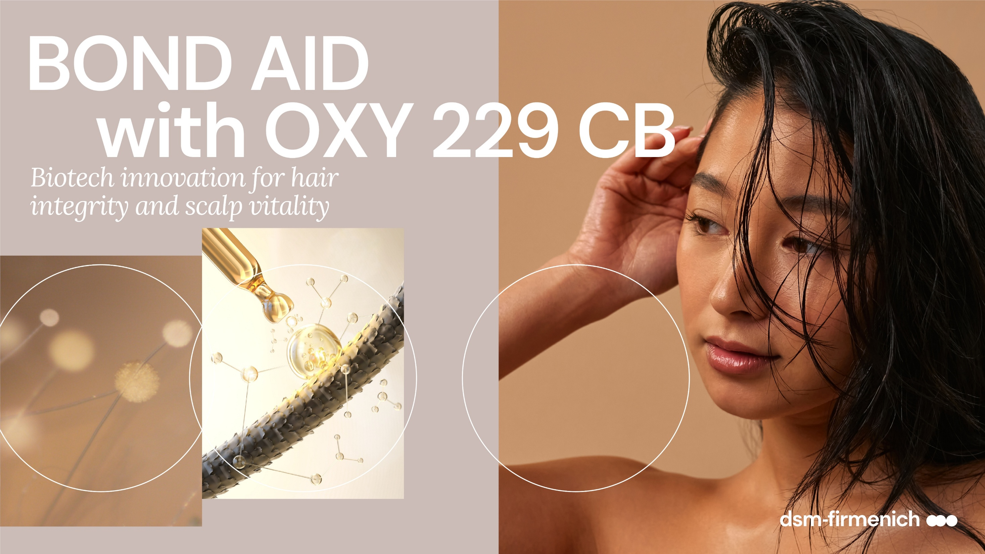

Slide 2



Damaged hair is a primary concern for consumers
TRENDS
*Source: Euromonitor
*Source: Euromonitor
Today’s consumers seek hair that feels truly restored—strong, resilient, and radiant—with effortless repair they can see and feel.
Top global hair concerns (2022)*
58%
54%
42%
Aging hair
Damaged hair
Scalp problems

Slide 3


TRENDS
Biotechnology
The hair care category is being reshaped by the latest narratives in marketing and technology.
Damage repair
“Bond repair”

Slide 4


SUMMARY
BOND AID
with OXY 229 CB
Every day is a good hair day!
Benefits:
3 trends in one product: bond* repair or structural repair, biotech-beauty, oxygenating scalp care (Cellular beauty)
Strengthens the hair – restores the hair integrity
Improves combability
Enhances sensory experience
Smooths hair surface
Formulated with Natural Peptides for hair fiber care
Delivers scalp energy
Easy to use: 1% addition delivers immediate results
OXY 229 CB, a comprehensive solution for hair repair and consumer delight
* van der Waals interactions, hydrogen bonds and hydrophobic interactions.

Slide 5
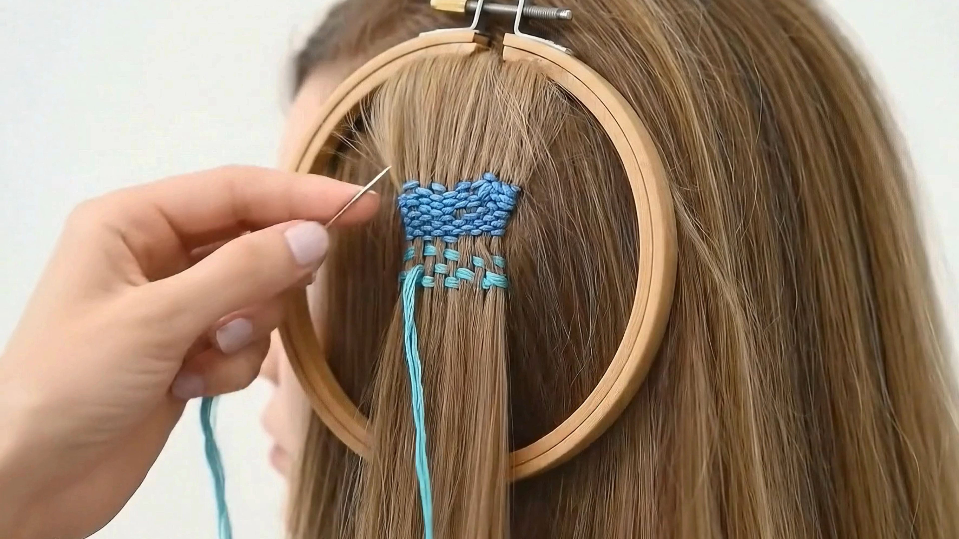
THE HERO BEHIND THE SCENE
OXY 229 CB
743 peptides bonding* to hair, effectively mending and strengthening each strand
* Van der Waals interactions, hydrogen bonds and hydrophobic interactions.

Slide 6
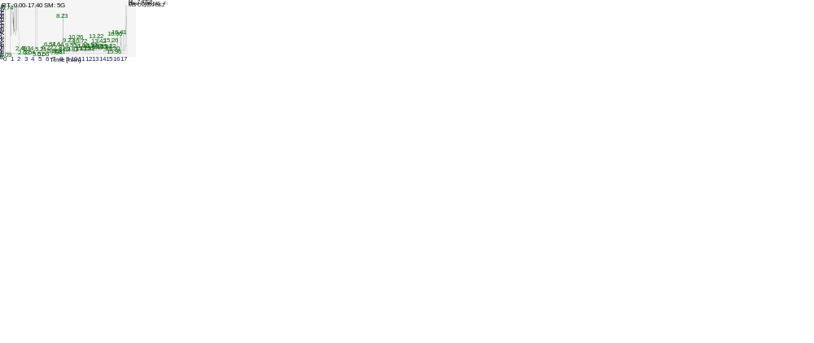
FROM OUR ANALYTICS
743 evenly distributed peptides will reenforce the hair filler action of amino acids in OXY 229 CB helping to heal the internal hair structure and promote repair and strand strength!
Peptides length | # of peptides | % of number
2 | 14 | 1.9%
3 | 62 | 8.3%
4 | 88 | 11.8%
5 | 72 | 9.7%
6 | 92 | 12.4%
7 | 99 | 13.3%
8 | 127 | 17.1%
9 | 72 | 9.7%
10 | 45 | 6.1%
>10 | 72 | 9.7%
TOTAL | 743
Notes:
Peptide analysis method:
System: UPLC/HR-MS, Vanquish Horizon, Orbitrap Exploris 240 (Thermo Scientific)
Column: Acquity BEH C18 Premier (Waters) 150 x 2.1 mm ID (Waters). Oven: 40°C
Solvents: A: 0.1% formic acid in water, B: 0.1% formic acid in acetonitrile. Flow: 0.4 mL/min
Gradient: 0% B, 3.0 min; 0-18% B in 12 min; 18-100% B in 2 min; 100% B, 1 min; equilibrate for 2 min
MS: Positive ESI in ddMS2 mode (AcquireX with background exclusion)

Slide 7
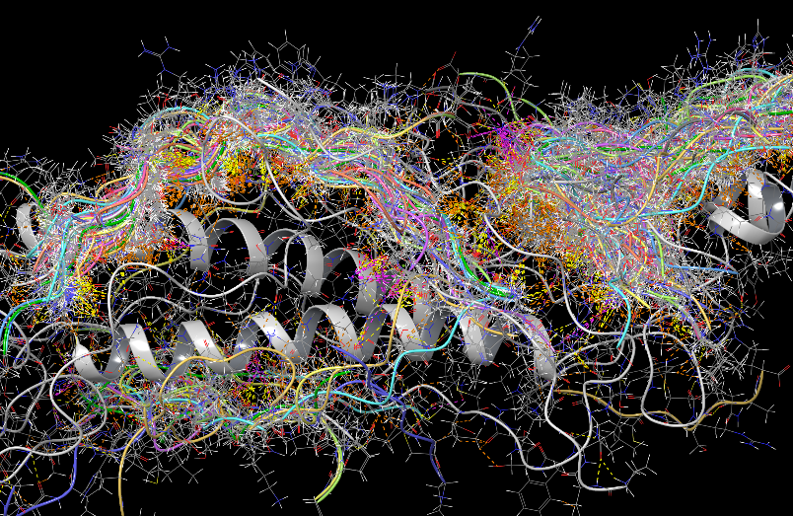
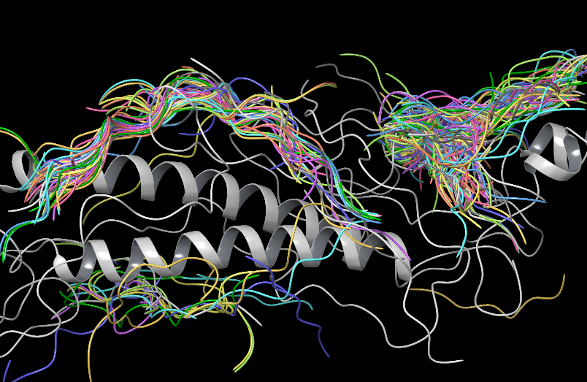
HEALING THE HAIR
Using computer molecular modeling, we can visualize how the peptides* in OXY 229 CB interact with keratin dimers through Van der Waals forces, hydrogen bonding, and hydrophobic interactions. This advanced methodology reveals the peptides' ability to self-organize on the keratin protein. With this behavior the peptides can accumulate in damaged areas, effectively filling structural gaps and contributing to hair healing.**
* Modeling conduced on 19 of the peptides composing OXY 229 CB
** In the amorphous keratin structure of the hair
Keratin model adapted from René HafnerNils WolfgrammPeter Klein*Herbert M. Urbassek* in “Adsorption of Diclofenac and PFBS on a Hair Keratin Dimer”, The journal of Physical Chemistry, Dec. 2023

Slide 8

WHAT IS IN FOR CONSUMERS
BOND AID
with OXY 229 CB
Visible transformation from first use:
Stronger strands: Up to 22% more strength after just one application. Hair feels reborn, resilient, radiant, full of life.
Smoother feel: Easier to comb, softer to touch. A touch of luxury you can feel in every strand.
Surface renewal: Scientifically proven smoother hair surface. Less damage, more shine.
Scalp & Hair wellness
Scalp vitality boost: Up to 750% more oxygen uptake and +10% cell viability. A revitalized scalp, the secret to hair longevity.
Clean Beauty promise: Gentle on you, kind to the planet.
Confidence you can wear
Every day is a good hair day: Hair that feels repaired, protected, and full of life.
Science you can trust: Bond Aid made simple. Advanced care, inspired by nature, perfected by innovation.

Slide 9
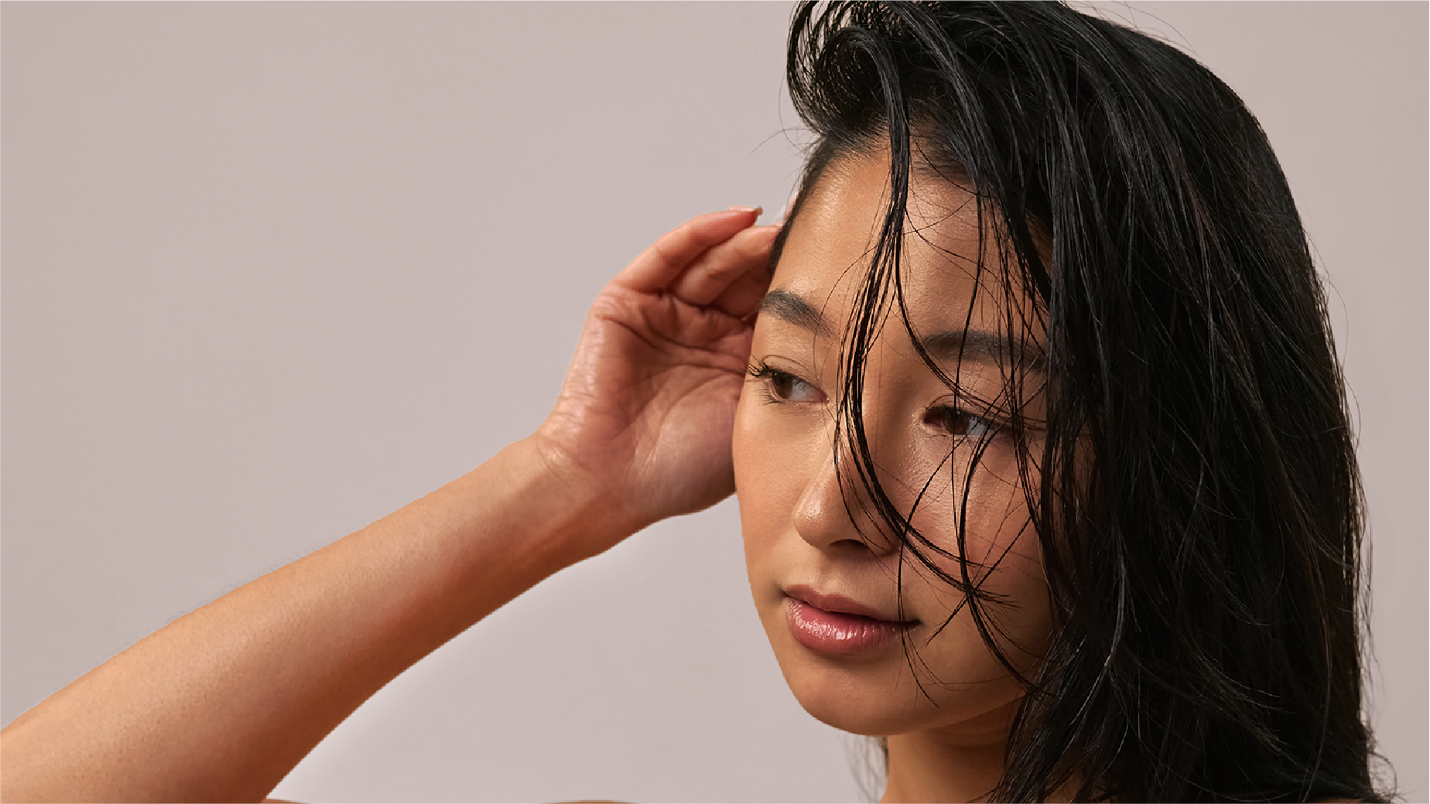






featuring
OXY 229 CB
2 in 1
ACTION
Scalp Vitality
& Strand Integrity
BIOTECH
Derived
Technology
PEPTIDE 743

Slide 10
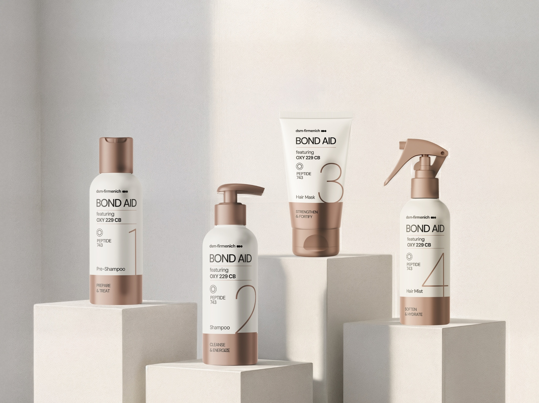


STEP 1 – PRE-SHAMPOO
STEP 2 – SHAMPOO
STEP 3 – HAIR MASK
STEP 4 – HAIR MIST
PREPARE & TREAT
CLEANSE
& ENERGIZE
STRENGTHEN & FORTIFY
SOFTEN
& HYDRATE
Helps to rebuild the fiber inner structure
Gently cleanses and revitalizes
Strengthens the fiber and smoothens the cuticles
Seales the routine and enhances softness
featuring
OXY 229 CB
Minimal steps, maximum impacts
This 4-step ceremony restores hair integrity from scalp to strands, attaching to keratin fibers to help rebuild what daily stress takes away. Created for dry, damaged, or color-treated hair.
2 in 1 ACTION
Scalp Vitality
& Strand Integrity
BIOTECH
Derived
Technology
PEPTIDE 743

Slide 11




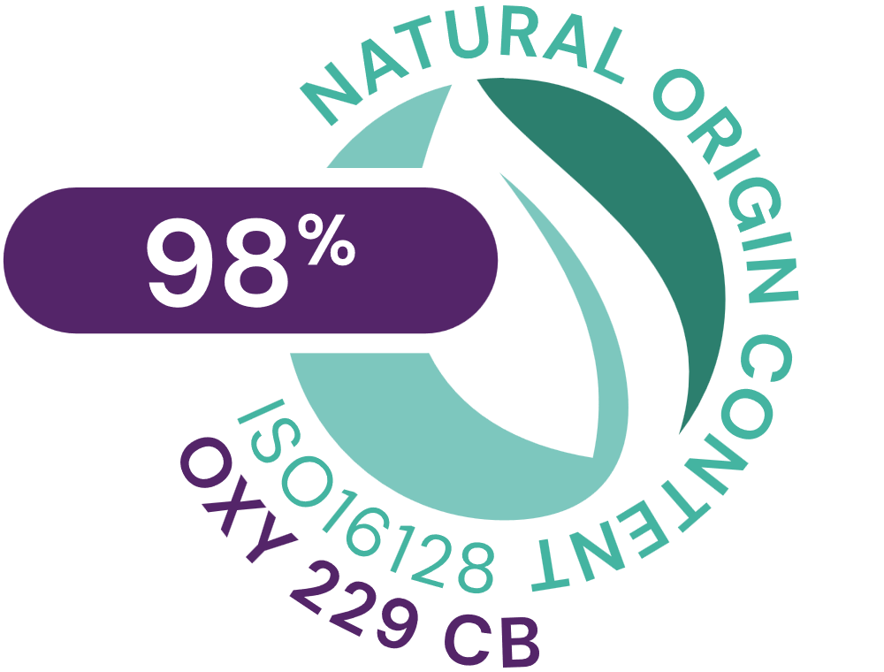

OXY 229 CB
ID card
INCI NAME:
Aqua, Glycerin, Caprylyl Glycol, 1,2-Hexanediol, Saccharomyces Lysate, Valine, Threonine, Glutamic acid, Glycine, Disodium Succinate
TECHNOLOGY:
Amino Acids, Postbiotics peptides obtained by fermentation of yeast (specific strain)
98% of natural origin (according to ISO 16128)
Solubility: water soluble
Biodegradability: readily biodegradable
TECHNICAL:
Form: liquid
Use level: 1–3%
pH of use: 3–7.5
Preservative: free
BENEFITS:
Repairs Hair damages
Restores the hair integrity
Prevents keratin from damage
Strengthens hair strands
Smooths the hair surface
Improves combability
Enhances hair sensory experience
Helps cells respiration (oxygen uptake)*
Stimulates cell viability, revitalizing the scalp*
REGISTRATIONS
CERTIFICATION
*In vitro

Slide 12
Disclaimer
Copyright © dsm-firmenich Switzerland AG, 2026, 4002 Basel, Switzerland.
www.dsm-firmenich.com. All rights reserved.
dsm-firmenich has used diligent care to ensure that the information provided herein is accurate and up-to-date to the best of its knowledge. However, dsm-firmenich makes no representation or warranty, either expressly or implied, of the accuracy, reliability, completeness, or suitability thereof. The information provided herein contains scientific and product information for business-to-business use and does not constitute or provide scientific or medical advice, diagnosis or recommendation for treatment options. Country or region-specific information should be considered when labelling or advertising to final consumer. In no event shall dsm-firmenich be liable for any direct or indirect damages arising from or reliance upon, or use of, any information provided herein. The content of this document is subject to change without further notice. Please contact your local dsm-firmenich representative for the latest information. All trademarks listed in this document are either (registered) trademarks of, or trademarks licensed by, the dsm-firmenich group of companies, unless explicitly stated otherwise.
Disclaimer Formulation Guideline
The information provided herein is provided for information purposes only and has been prepared by dsm-firmenich in accordance with its own methodology.
dsm-firmenich has used diligent care to ensure that it is accurate and up-to-date, however, dsm-firmenich makes no representation or warranty, either expressly or implied, of the accuracy, reliability, or completeness thereof. In no event shall dsm-firmenich be liable for any damages arising from or reliance upon, or use of, any information provided herein. Further, dsm-firmenich shall not bear any liability for the application and/or use of any processed material containing its product(s). The formulation of the finished product is the customer’s sole responsibility. It is the customer’s responsibility to determine the suitability of dsm-firmenich’s products regarding user specific purposes, assess compatibility and stability of their finished product(s) and to ensure compliance of their finished product(s) with relevant laws and regulations. Any product, marketing or other claims made by customer are its sole responsibility. The content of this document is subject to change without further notice. Please contact your local dsm-firmenich representative for further details. © dsm-firmenich Switzerland AG, 2026.
© 2026

Slide 13
We bring progress to life

