Slide 1

In-Fact
The truth behind the labels
April 2025
April 2025

Slide 2

IN-FACT is a line that contains the most important element for more consciouschoices: the truth behind the labels.
More than high-performance ingredients, the line combines the best of science, research and leadership in sustainable innovation in skin care, sunscreen, makeup and hair care products. Solutions built on the latest trends and facts
to deliver truly greener choices and visible effects.
It is the result of dsm-firmenich's commitment to always stand by its partners at all times, to build trust and co-create the future of cosmetics.

Slide 3
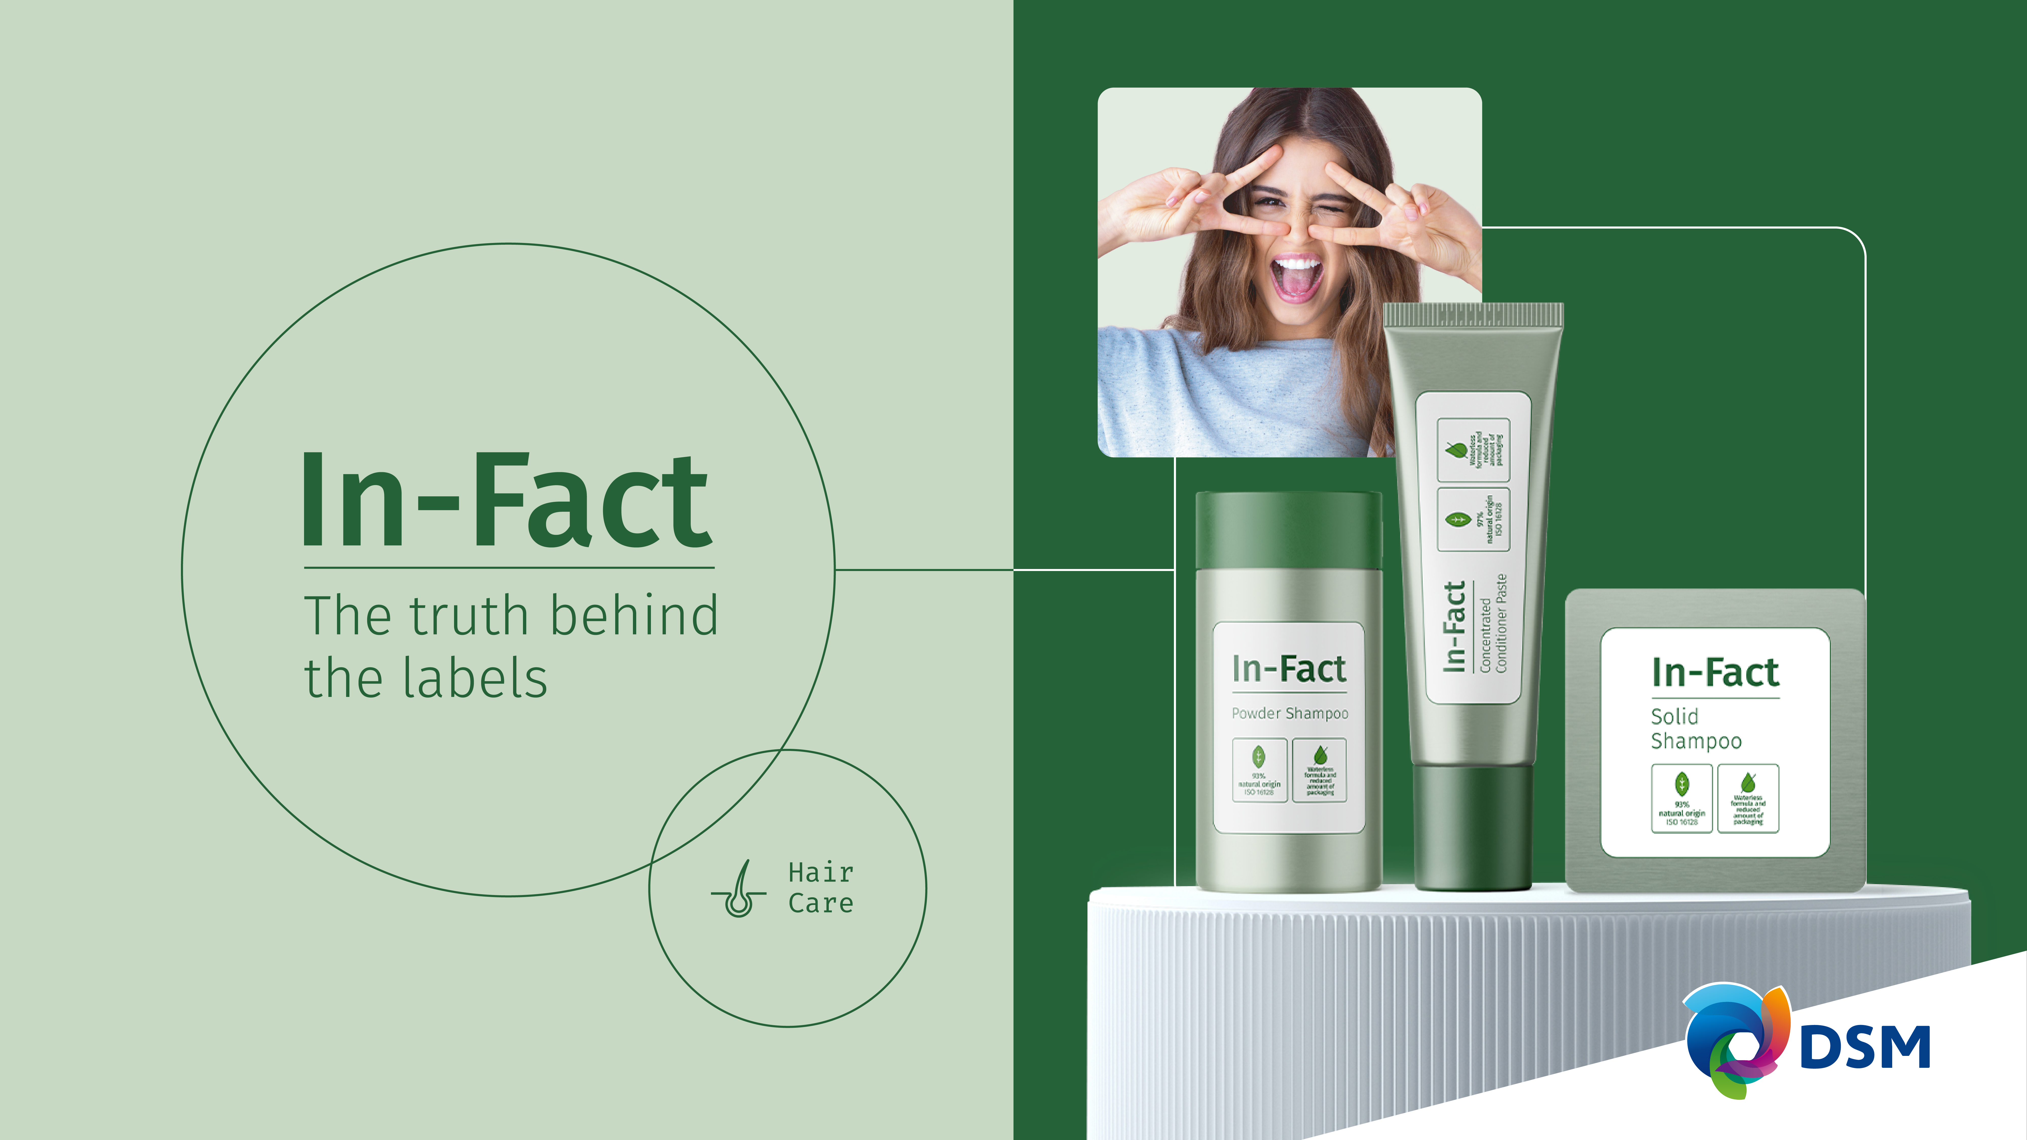

Products are for illustration only, not for sale.
dsm-firmenich is not responsible for final product claims.
Waterless solutions

Slide 4
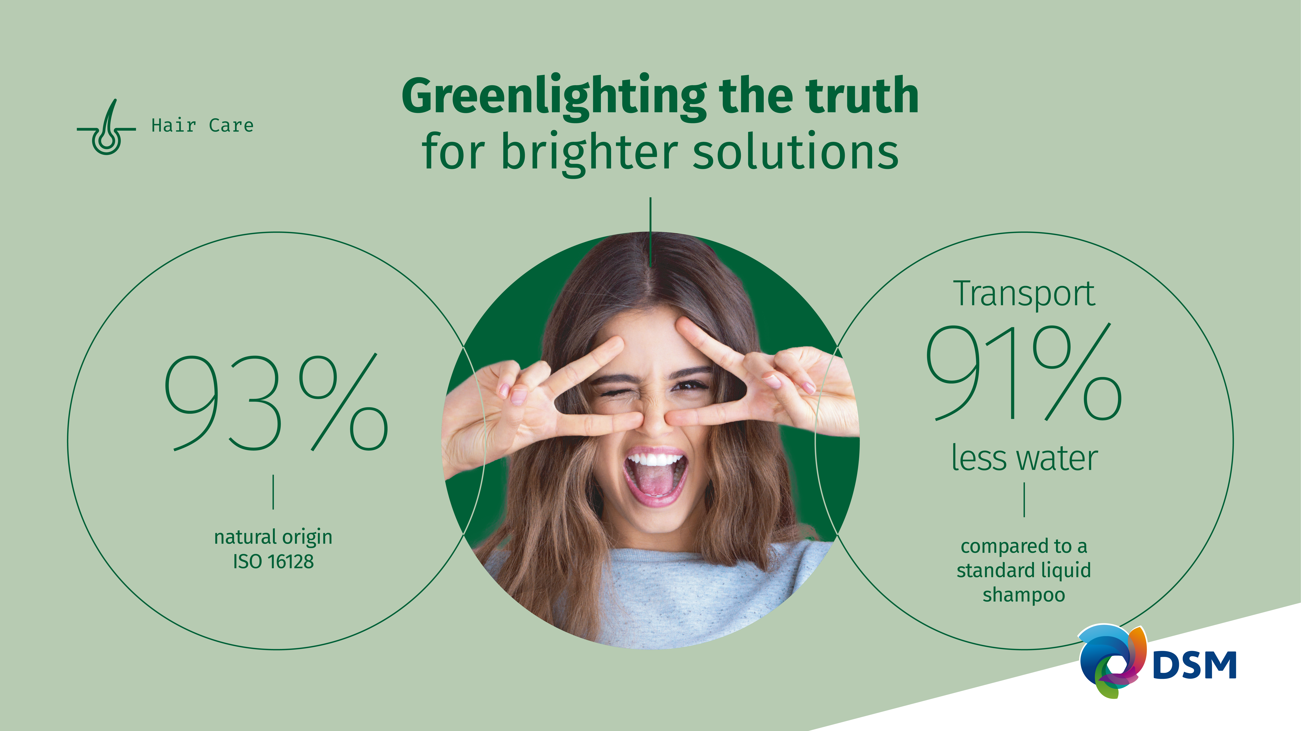

Greenlighting the truth
for brighter solutions

Slide 5




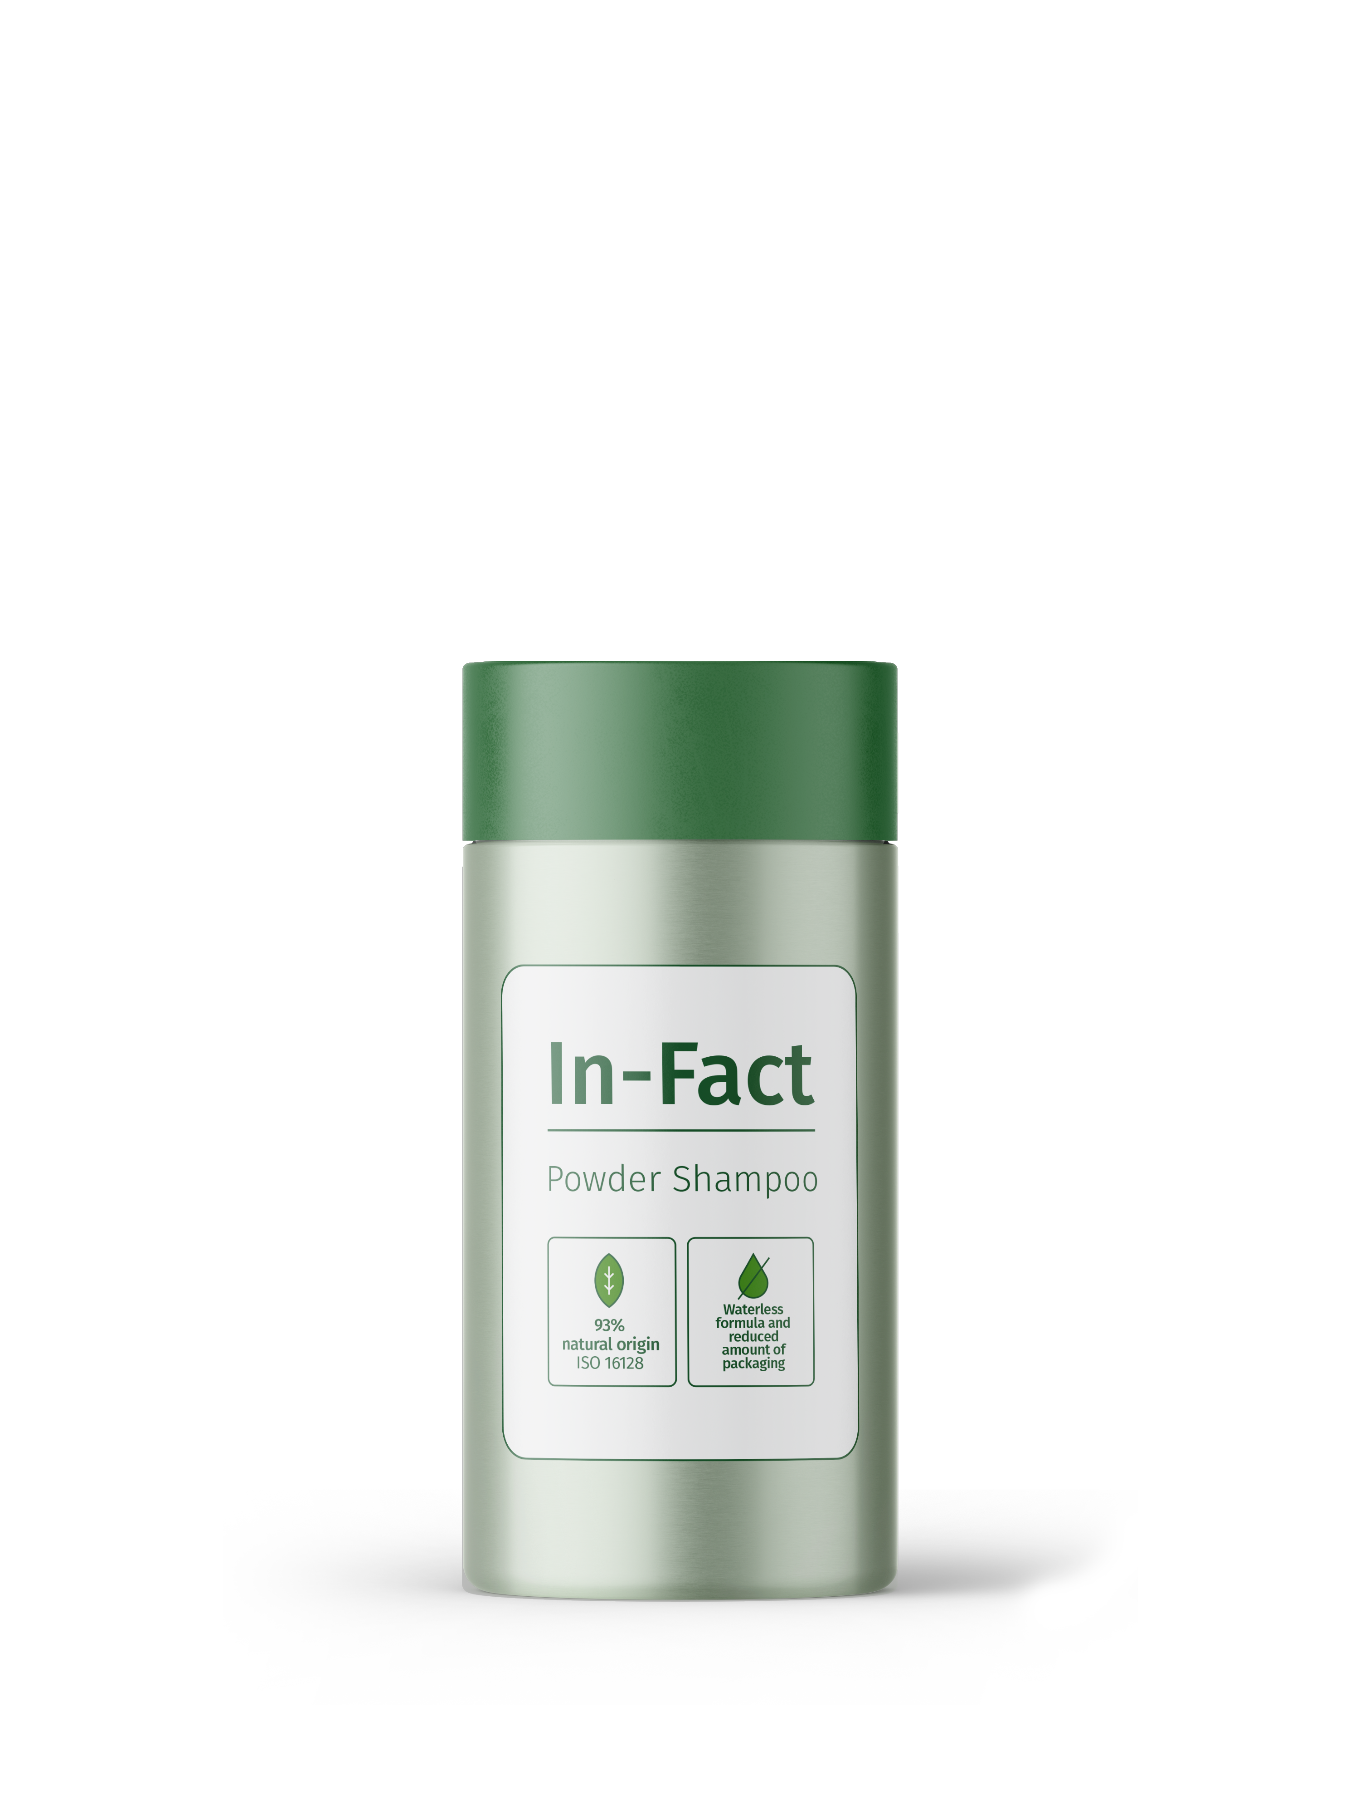




5X
Can last as long as 5 standard liquid shampoo bottles
POWDER SHAMPOO
Good for the scalp, hair and the environment
Smooth
hair
combing
Hydration,
sebum
reduction &
anti-flaking
Products are for illustration only, not for sale. DSM is not responsible for final products claims.
Products are for illustration only, not for sale. dsm-firmenich is not responsible for final product claims.
The same performance as a liquid shampoo, only in powdered form which is activated by water in the shower.
It hydrates and strengthens the scalp's barrier, reducing sebum and flaking in addition to being an eco-friendly product that uses less water in its composition and reduces the amount of packaging.
Waterless
formula and
reduced
amout of
packaging
93%
natural origin
ISO 16128

Slide 6
Smooth combing with the Powder Shampoo:
21%
21% dry combing force reduction vs market benchmark shampoo.***
POWDER SHAMPOO
It contains PENTAVITIN®, a 100% natural and biodegradable ingredient, clinically tested after frequent showering *:
The truth behind the labels
60%
60% of consumers stated “my scalp feels hydrated and healthy”.
Products are for illustration only, not for sale. DSM is not responsible for final products claims.
37%
Products are for illustration only, not for sale. dsm-firmenich is not responsible for final product claims.
37% sebum reduction.
55%
Up to 55% reduction in scalp flaking.
Thanks to its waterless formulation, 1 powder shampoo bottle (250g) can last as long as 5 standard liquid shampoo bottles (250mL), reducing the amount of packaging by a factor 5.
Transport 91% less water compared to a standard liquid shampoo.
*Clinical study, 30 volunteers, 18 – 50 years old, self assessment,
0.5% PENTAVITIN®, 28 days​, rinse-off, ​standard liquid shampoo applied every 2 days
Innovative Scalp Color 3D Mapping Technology**
Visible Hydration Power
Visible Sebum Reduction
**After 7 days of frequent use of PENTAVITIN® (0.5%)
in a standard liquid shampoo compared to placebo
*** Instrumental test
Notes:
Market benchmark shampoo: The Powder Shampoo.
Method for water content measurement: Halogen moisture analyzer (Mettler Toledo HR 83) at 105°C.
Average % of water in a standard liquid shampoo can be up to 80%.

Slide 7
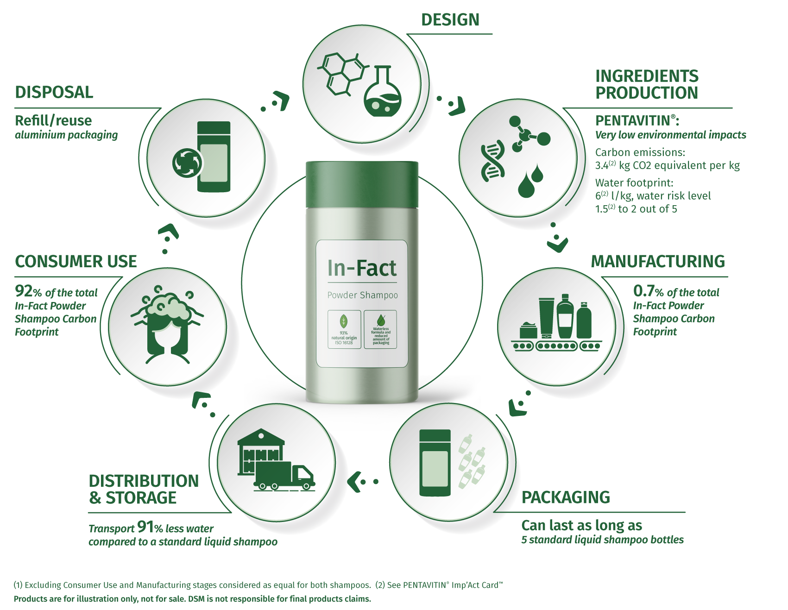
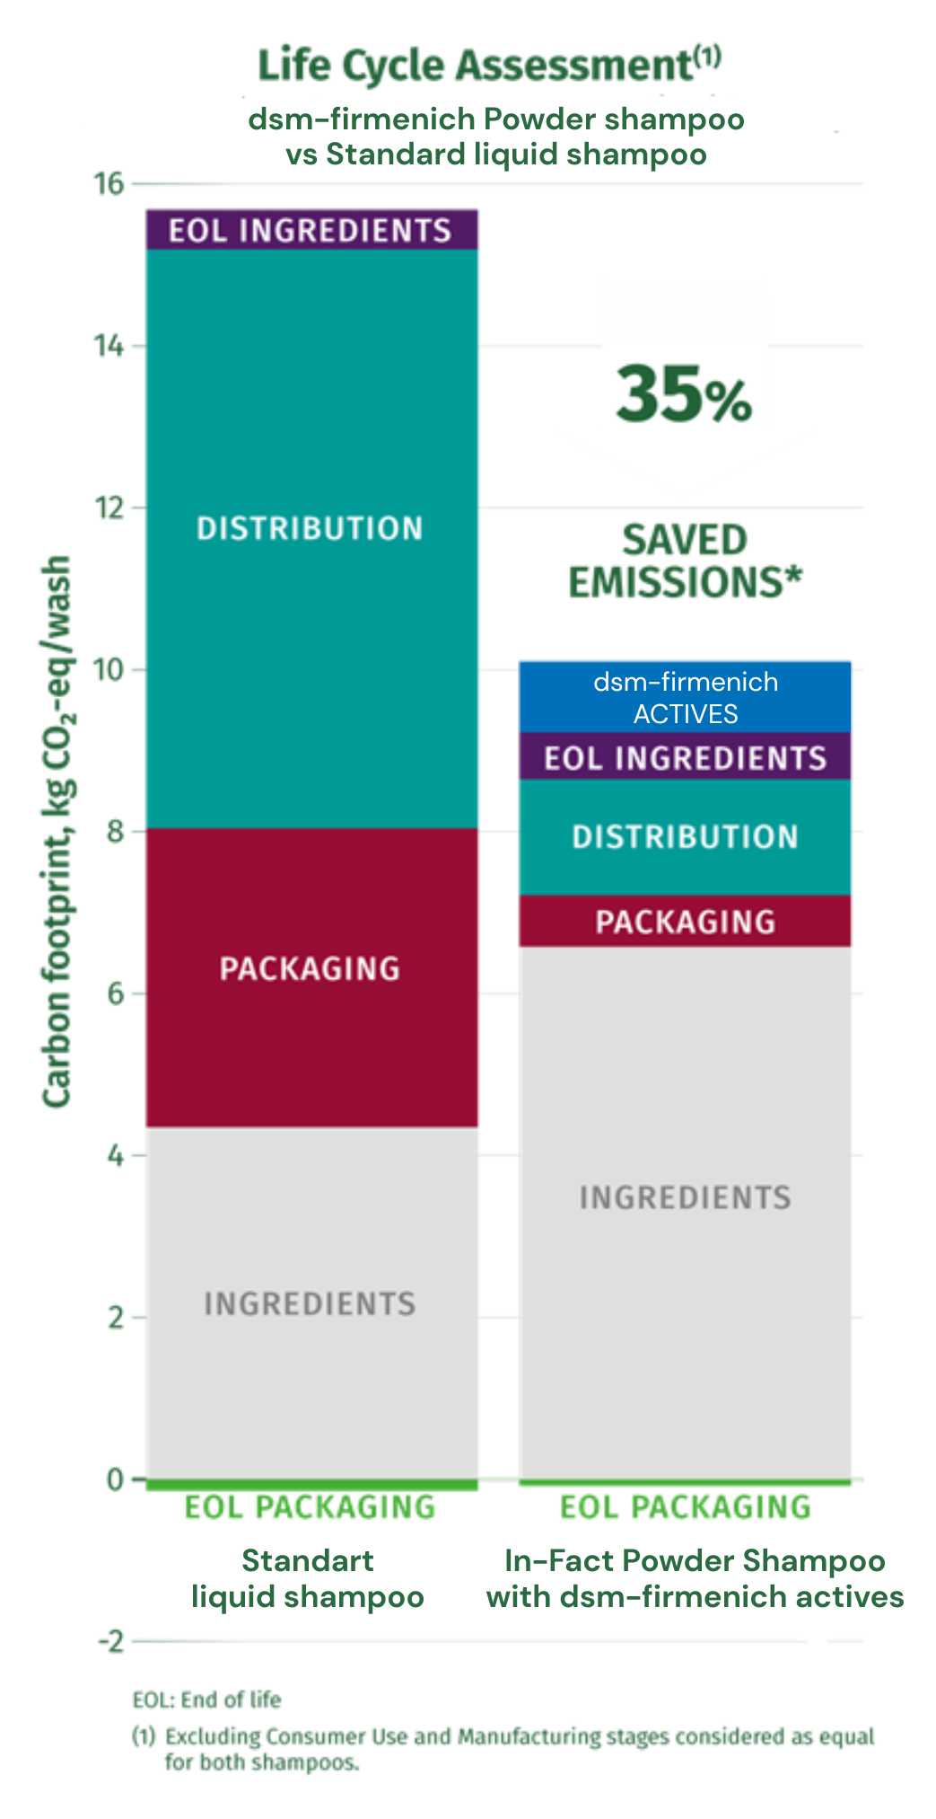
Life Cycle Assessment of the In-Fact Powder Shampoo
Decrease by 35% the carbon footprint vs a standard liquid shampoo⁽¹⁾
Products are for illustration only, not for sale.
dsm-firmenich is not responsible for final product claims.
Notes:
LCA conducted according to the European Union Product Eco Footprint Product Category Rule (EU PEFCR) for shampoo.
The consumer use phase is very dominant in the total environmental impact of a shampoo.
As they are considered as equal for both types of shampoo, Consumer Use and Manufacturing stages have been excluded in the LCA comparison.
The In-Fact Powder Shampoo formulation reduces substantially the carbon footprint related to both packaging and distribution. The In-Fact Powder Shampoo has indeed a significantly lower environmental impact because less packaging is required, and less water has to be transported and stored compared to a standard liquid shampoo.
This benefit enables the addition of starch carriers and active ingredients in the In-Fact Powder Shampoo formulation maintaining an overall lower carbon footprint vs a standard liquid shampoo.
The In-Fact Powder Shampoo offers improved functionality and lower environmental impact compared to a standard liquid shampoo.

Slide 8
Mechanical combing test performance on hair swatches.
Scalp Color 3D Mapping Technology (scalp hydration and sebum mappings).
Hair care Formulation expertise and guide formulations library to develop performing hair and scalp care products.
POWDER SHAMPOO
Products are for illustration only, not for sale. DSM is not responsible for final products claims.
Services behind these facts?

Slide 9

PHASE | INGREDIENTS | INCI NAME | % W / W
A | MAISITA 21.001 | ZEA MAYS STARCH | 25,60
 | MST MAKIGREEN RICE S | ORYZA SATIVA STARCH, MAGNESIUM STEARATE | 10,00
 | AGENAJEL 20.383 | HYDROXYPROPYL STARCH PHOSPHATE | 10,50
 | Allantoin | ALLANTOIN | 1,00
 | QUATIN® 350 UP-DP POWDER | HYDROXYPROPYLTRIMONIUM INULIN | 1,00
 | BeauPlex® VH | NIACINAMIDE, CALCIUM PANTOTHENATE, SODIUM ASCORBYL PHOSPHATE, TOCOPHERYL ACETATE, PYRIDOXINE HCL, MALTODEXTRIN, SODIUM STARCH OCTENYLSUCCINATE, SILICA | 1,50
B | COLHIBIN CB | HYDROLYZED RICE PROTEIN, GLYCERIN, AQUA, SODIUM BENZOATE, PENTYLENE GLYCOL | 2,00
 | PENTAVITIN® | SACCHARIDE ISOMERATE, AQUA, CITRIC ACID, SODIUM CITRATE | 1,00
 | ARGAN OIL | ARGANIA SPINOSA KERNEL OIL | 1,00
 | PERFUME MINT LIME 1 RS80383 | PARFUM | 1,40
C | Amisoft® LS-11 | SODIUM LAUROYL GLUTAMATE | 24,00
 | Jordapon® SCI Powder | SODIUM COCOYL ISETHIONATE | 17,00
 | Honey Powder | MEL POWDER, MALTODEXTRIN | 4,00
POWDER SHAMPOO
Good for the scalp, hair and the environment
^{HC-E-102180-3}
Use instructions: Pour the product into the palm of the moistened hands, emulsify and then applied on the hair.
Procedure:
1. Combine powder ingredients of Phase A and mix using a blender.
2. Mix ingredients of Phase B with fragrance and spray on the bulk. Powder will form distinctly bigger particles and density of the powder will be lower.
3. Add surfactant powder ingredients of Phase C and mix them until homogenous.
4. Let the bulk pass through a screen to filter large agglomerates. The large agglomerates can be added back to the bulk after milling using a disc mill.
Technical Data:
pH: | NA | Viscosity: | Powder
The formulation fulfils the 3 months stability at 4°C, 40°C, Room Temperature and Daylight

Slide 10
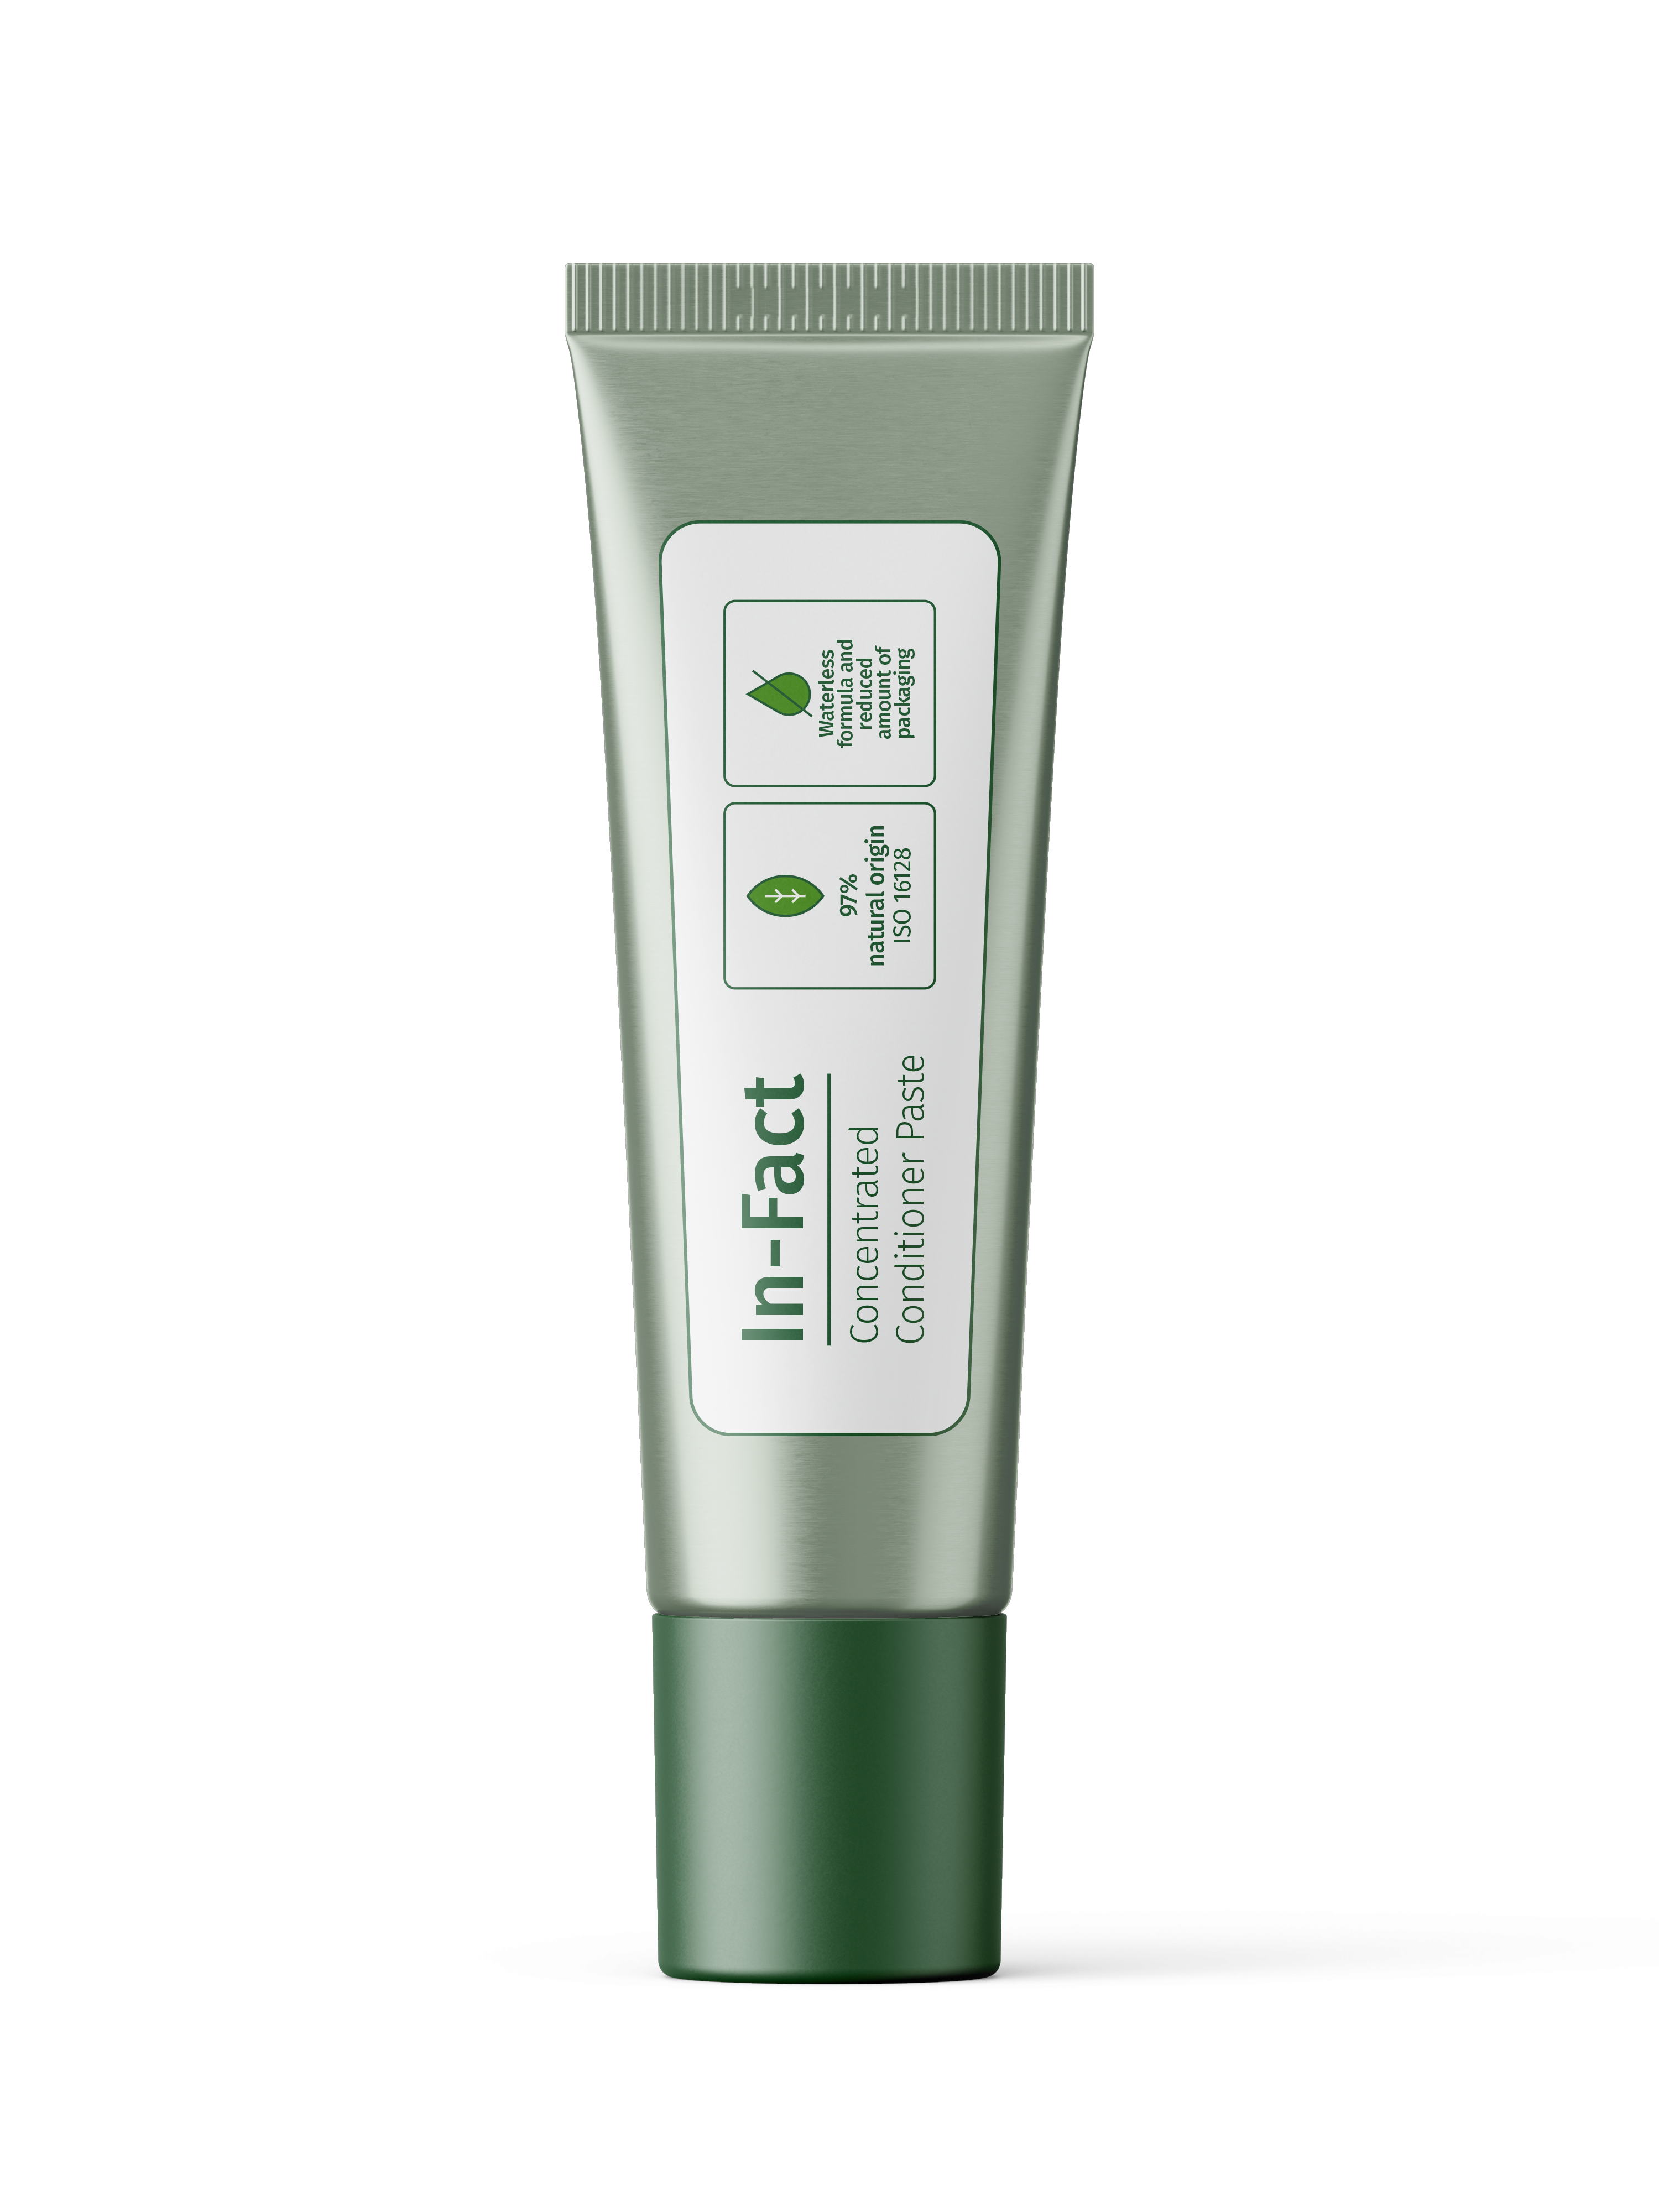


3X
Can last as long
as 3 standard conditioner bottles
CONCENTRATED
CONDITIONER PASTE
Waterless
formula and
reduced
amout of
packaging
Ecosolution for beautiful, strong and ageless hair
Products are for illustration only, not for sale. DSM is not responsible for final products claims.
Products are for illustration only, not for sale. dsm-firmenich is not responsible for final product claims.
97%
natural origin
ISO 16128
A multi-benefit concentrated conditioner activated by the water in the shower, which combines easy combing and softness, helps prevent hair loss and reduce the appearance of greying hair, in addition to being an eco-friendly product that uses less water in its composition and reduces the amount of packaging.
Helps prevent hair loss and reduce appearance of greying hair
Easy
combing
Prevent hair loss is a drug claim in USA to use improves hair density

Slide 11
36%
36% dry combing force reduction vs market benchmark conditioner.***
It contains ALPAFLOR® EDELWEISS CB, 100% natural, sustainably and organically cultivated, clinically tested:
CONCENTRATED CONDITIONER PASTE
The truth behind
the labels
90% of volunteers treated with ALPAFLOR® EDELWEISS CB noticed an increase in hair density after 5 months.*
90%
Products are for illustration only, not for sale. DSM is not responsible for final products claims.
Products are for illustration only, not for sale. dsm-firmenich is not responsible for final product claims.
20% more hair in the anagen phase with ALPAFLOR® EDELWEISS CB than placebo after 5 months.*
20%
Thanks to its waterless formulation,
1 concentrated conditioner paste tube (250g)
can last as long as 3 standard conditioner bottles (250mL), reducing the amount of packaging
by a factor 3.
Transport 91% less water compared to
a standard liquid conditioner.
* Clinical study, 30 Volunteers, 18-65 years old, 3% ALPAFLOR® EDELWEISS CB applied daily in a leave-on
50%
50% less grey hair versus Placebo after 4 months.**
**Clinical study, 30 volunteers, 18–45 years old, self assessment, 3% ALPAFLOR® EDELWEISS CB applied daily
in a leave-on
Prevent hair loss is a drug claim in USA to use improves hair density
*** Instrumental test
Notes:
Market benchmark conditioner: Everist.
Method for water content measurement: Halogen moisture analyzer (Mettler Toledo HR 83) at 105°C.
Average % of water in a standard liquid conditioner can be up to 95%.

Slide 12
CONCENTRATED CONDITIONER PASTE
Mechanical combing test performance on hair swatches.
Hair care Formulation expertise and guide formulations library to develop performing hair and scalp care products.
Products are for illustration only, not for sale. DSM is not responsible for final products claims.
Services behind these facts?

Slide 13
PHASE | INGREDIENTS | INCI NAME | % W / W
A | Glycerin 99.8% | GLYCERIN | 59,80
 | HYA-ACT ™ XS | HYDROLYZED HYALURONIC ACID | 0,20
 | Propanediol | PROPANEDIOL | 4,00
B | STEPAN-MILD GCC/MB | GLYCERYL CAPRYLATE/CAPRATE | 8,00
 | Varisoft W575 PG SG | QUATERNIUM-87, PROPYLENE GLYCOL | 4,00
 | Montanov 202 | ARACHIDYL ALCOHOL, BEHENYL ALCOHOL, ARACHIDYL GLUCOSIDE | 4,00
 | Lanette® 22 | BEHENYL ALCOHOL | 2,50
 | STIMU-TEX® AS | ARGANIA SPINOSA KERNEL OIL, TOCOPHEROL, BUTYROSPERMUM PARKII BUTTER EXTRACT, SPENT GRAIN WAX | 3,50
 |  | C15-19 ALKANE, DEXTRIN PALMITATE | 1,00
C | Amisoft® CS-11 | SODIUM COCOYL GLUTAMATE | 6,00
 | Honey Powder | MEL POWDER, MALTODEXTRIN | 3,00
 | Quatin® 350 UP-DP Powder | HYDROXYPROPYLTRIMONIUM INULIN | 1,00
D | ALPAFLOR® EDELWEISS CB | LEONTOPODIUM ALPINUM FLOWER/LEAF EXTRACT, GLYCERIN, AQUA, CITRIC ACID | 2,00
 | PERFUME MINT LIME 1 RS80383 | PARFUM | 1,00
CONCENTRATED
CONDITIONER PASTE
Ecosolution for beautiful, strong and ageless hair
^{HC-E-102181-3}
Procedure:
1. Mix ingredients of Phase A in a separate vessel and stir moderate. Begin heating to 75°C.
2. Add the contents of Phase B to the main vessel and begin heating to 75°C. Continue mixing until all solids are melted.
3. At 75°C add the content of Phase A to the main vessel (Phase B) with mixing. Add ingredients of Phase C step by step and homogenize moderate until the formulation is uniform.
4. Cool to 45°C and add ingredients of Phase D under stirring until the paste is uniform.
Use instructions: Pour the product into the palm of the moistened hands, emulsify and then applied on the hair.
Technical Data:
pH: | NA | Viscosity: | 35.000 mPa.s ± 10.000 mPa.s
The formulation fulfils the 3 months stability at 4°C, 40°C, Room Temperature and Daylight

Slide 14
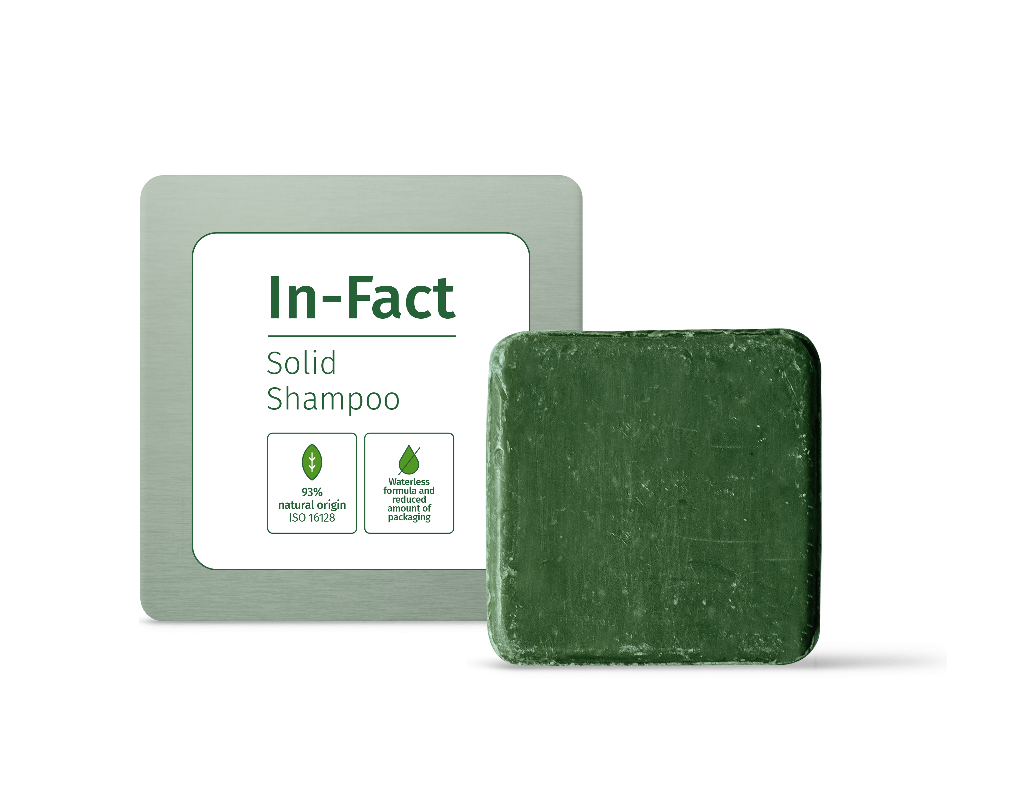


4X
Can last as long as 4 standard liquid shampoo bottles
93%
natural origin
ISO 16128
SOLID SHAMPOO
Waterless
formula and
reduced
amout of
packaging
Ecosolution for beautiful, strong and ageless hair
This solid shampoo is enriched with Pro-Vitamin B5 to enhance moisturization while strengthening the hair, and
HYA-ACT™ XS, a microbiome-friendly and Ecocert approved hyaluronic acid to moisturize and nourish the scalp.
This shampoo also combines 4 natural ingredients STIMU-TEX® AS, life'sGLA™ '10' n-6 Oil, COLHIBIN CB and PHYTALURONATE® PF which work together to improve combing properties, and deliver extra shine, anti-frizz and anti-breakage effects in addition to being an eco-friendly product that uses less water in its composition and reduces the amount of packaging.
Products are for illustration only, not for sale. dsm-firmenich is not responsible for final product claims.
Easy
combing
Anti-breakage,
shine and
anti-frizz
Scalp
moisturization

Slide 15
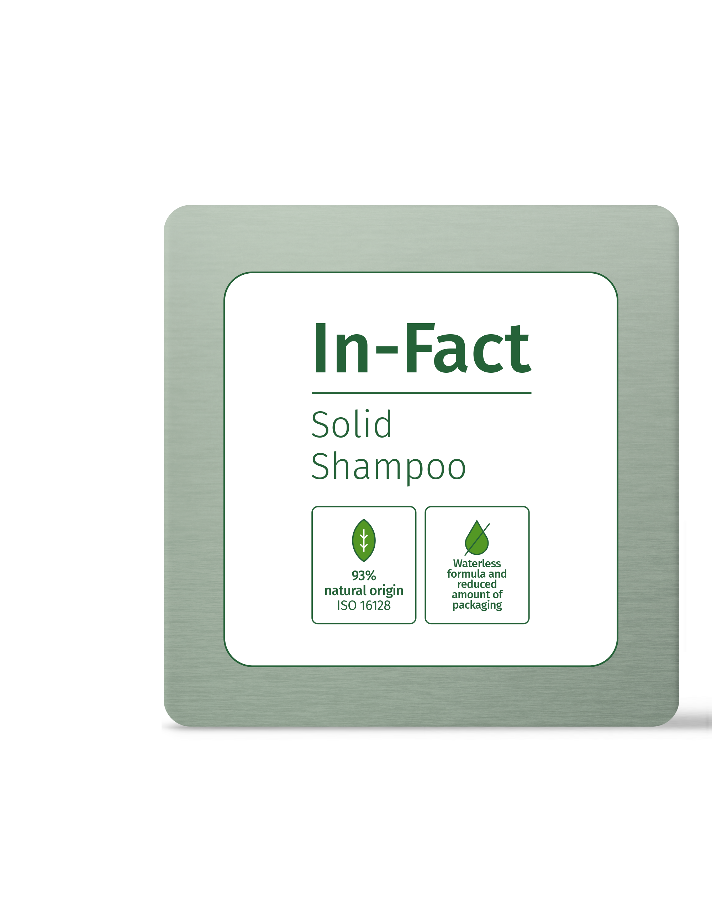
It contains Panthenol (Pro-Vitamin B5) which improves fiber resistance to breakage.
SOLID SHAMPOO
The truth behind the labels
HYA-ACT™ XS, a Microbiome-friendly ingredient to moisture and nourish the scalp.
Products are for illustration only, not for sale. dsm-firmenich is not responsible for final product claims.
4 natural ingredients STIMU-TEX® AS, life'sGLA™ '10' n-6 Oil, COLHIBIN CB and PHYTALURONATE® PF which work together for:
Easier combing: 60% wet combing force reduction vs solid shampoo base.***
Extra Shine.
Anti-frizz.
Thanks to its waterless formulation,
1 Solid shampoo (55 g) can last as long as
4 standard liquid shampoo bottles (250mL),
reducing the amount of packaging by a factor 4.
Transport 93% less water compared to
a standard liquid shampoo.
*** Instrumental test

Slide 16
Mechanical combing test performance on hair swatches.
Hair care Formulation expertise and guide formulations library to develop performing hair and scalp care products.
CONCENTRATED CONDITIONER PASTE
Services behind these facts?

Slide 17
PHASE | INGREDIENTS | INCI NAME | % W / W
A | Propanediol | PROPANEDIOL | 3,90
 | Mackol CAS-100N MB | SODIUM COCO-SULFATE | 37,00
 | Jordapon® SCI | SODIUM COCOYL ISETHIONATE | 25,00
 | Tego Betain F50 | COCAMIDOPROPYL BETAINE | 6,00
B | PHYTALURONATE® PF | CERATONIA SILIQUA GUM, AQUA, CITRIC ACID, PHENOXYETHANOL, ETHYLHEXYLGLYCERIN | 3,00
 | HYA-ACT ™ XS | HYDROLYZED HYALURONIC ACID | 0,10
 | COLHIBIN CB | HYDROLYZED RICE PROTEIN, GLYCERIN, AQUA, SODIUM BENZOATE, PENTYLENE GLYCOL | 2,00
 | STIMU-TEX® AS | ARGANIA SPINOSA KERNEL OIL, TOCOPHEROL, BUTYROSPERMUM PARKII BUTTER EXTRACT, SPENT GRAIN WAX | 2,00
 | life'sGLA™ '10' n-6 Oil | OENOTHERA BIENNIS OIL, TOCOPHEROL, ASCORBYL PALMITATE | 1,25
 | DL-PANTHENOL 50L | PANTHENOL, AQUA, CITRIC ACID | 1,00
 | Perfume Green Power RT10054 | PARFUM | 1,20
 | Nature col. Green LC720L | CI 75810 | 0,10
C | Maisita 21.001 | ZEA MAYS (Corn) STARCH | 17,45
SOLID SHAMPOO
Ecosolution for beautiful, strong and ageless hair
^{HC-E-100111-3}
Procedure:
1. Mix ingredients of phase A. Heat to 55-60˚C and knead/mix until almost fully dissolved/blended. Don’t overheat during this stage. Maintain heat and knead/mix slowly to combine and avoid excess air being introduced.
2. Add ingredients of Phase B step by step to Phase A and heat to 60˚C–65°C until fully melted – approx. 15 minutes. Do not overheat but maintain heat during this time. Knead/mix slowly until homogenous, be careful to limit air being introduced.
3. Add ingredient of Phase C. Knead/mix through under low shear until homogenous.
4. Keep at 60°C-65°C while pouring off into molds. Allow to set fully before removing molds.
Technical Data:
pH: | NA | Viscosity: | Powder
The formulation fulfils the 3 months stability at 4°C, 40°C, Room Temperature and Daylight

Slide 18

1: in the In-Fact powder shampoo. 2: in the In-Fact concentrated conditioner paste. 3: in the solid shampoo. 4: One bottle of shampoo powder can last as long as 5 standard liquid shampoo bottles.
5: 35% saved emissions with the dsm-firmenich Powder Shampoo vs standard liquid shampoo according to our LCA. 6: with ingredients having low carbon footprint (PENTAVITIN®, ALPAFLOR® EDELWEISS CB).
Prevent hair loss is a drug claim in USA to use improves hair density.
Products are for illustration only, not for sale. dsm-firmenich is not responsible for final product claims.

Slide 19
Disclaimer
Copyright © DSM Nutritional Products Ltd 2025, 4002 Basel, Switzerland.
www.dsm-firmenich.com. All rights reserved.
dsm-firmenich has used diligent care to ensure that the information provided herein is accurate and up-to-date to the best of its knowledge. However, dsm-firmenich makes no representation or warranty, either expressly or implied, of the accuracy, reliability, completeness, or suitability thereof. The information provided herein contains scientific and product information for business-to-business use and does not constitute or provide scientific or medical advice, diagnosis or recommendation for treatment options. Country or region-specific information should be considered when labelling or advertising to final consumer. In no event shall dsm-firmenich be liable for any direct or indirect damages arising from or reliance upon, or use of, any information provided herein. The content of this document is subject to change without further notice. Please contact your local dsm-firmenich representative for the latest information. All trademarks listed in this document are either (registered) trademarks of, or trademarks licensed by, the dsm-firmenich group of companies, unless explicitly stated otherwise.
Disclaimer Formulation Guideline
The information provided herein is provided for information purposes only and has been prepared by dsm-firmenich in accordance with its own methodology.
dsm-firmenich has used diligent care to ensure that it is accurate and up-to-date, however, dsm-firmenich makes no representation or warranty, either expressly or implied, of the accuracy, reliability, or completeness thereof. In no event shall dsm-firmenich be liable for any damages arising from or reliance upon, or use of, any information provided herein. Further, dsm-firmenich shall not bear any liability for the application and/or use of any processed material containing its product(s). The formulation of the finished product is the customer’s sole responsibility. It is the customer’s responsibility to determine the suitability of dsm-firmenich’s products regarding user specific purposes, assess compatibility and stability of their finished product(s) and to ensure compliance of their finished product(s) with relevant laws and regulations. Any product, marketing or other claims made by customer are its sole responsibility. The content of this document is subject to change without further notice. Please contact your local dsm-firmenich representative for further details. © DSM Nutritional Products AG, 2025.

