Slide 1
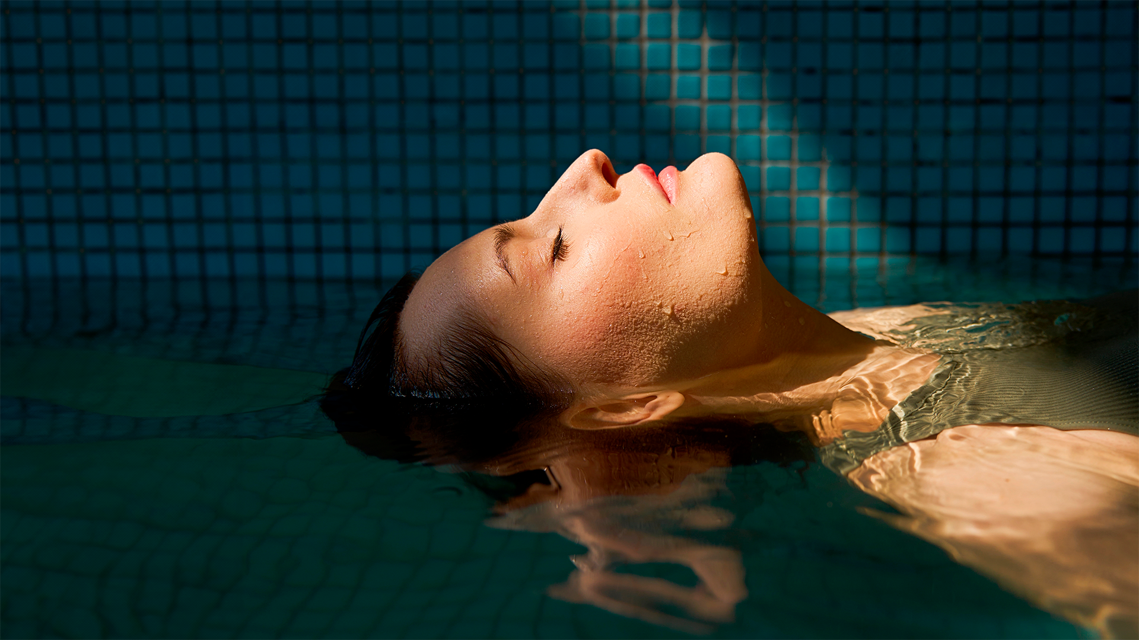


Scalp science x Aromatherapy
FABRICE GUILLEMARD
AUDE BAUDRIER-GREVELLEC

Slide 2

HAIR CARE EVOLUTION
HAIR CARE MARKET
SCALP CARE
Is the second largest market in Personal Care Industry and count for over 89 Bn$. Market growth rate is over 7%*.
+
Counts for 5 Bn$ in the global retail market and is on a high growth with 10%** of the new hair care product launches claiming Scalp Care.
* Euromonitor 2023 / ** Mintel GNDP

Slide 3
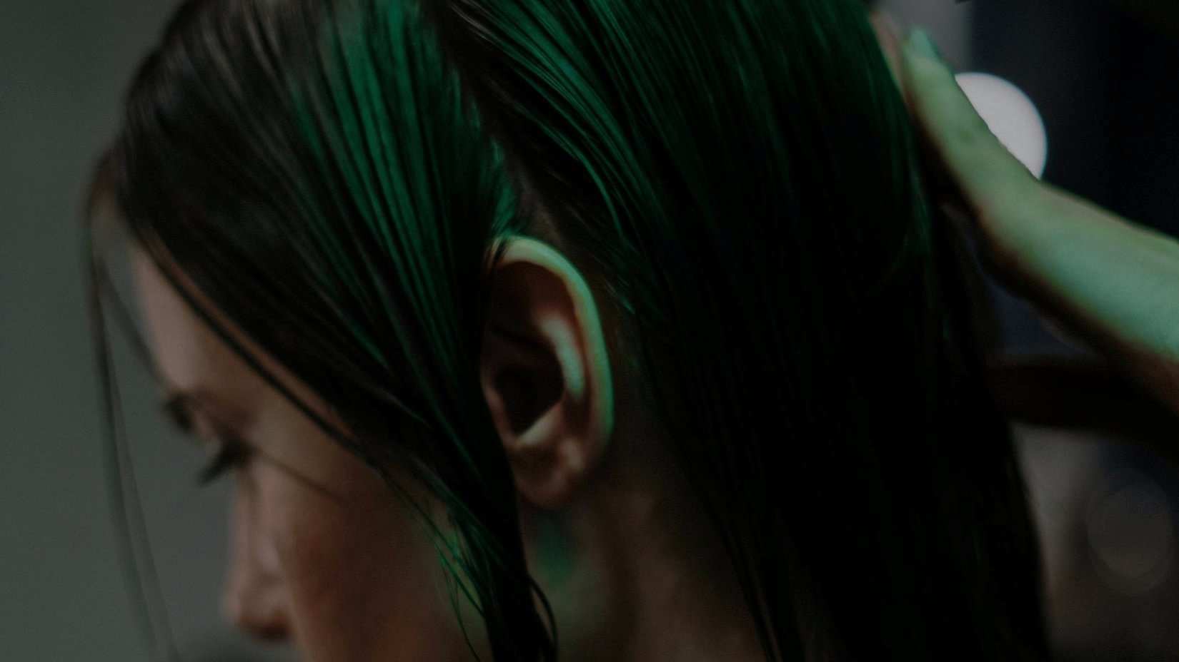
SCALP OVER HAIR?
Healthy scalp is the new motto
GLOBALLY,
63%*
OF EARLY ADOPTERS
51%* OF MARKET REPRESENTATIVES
LOOK FOR
GLOBALLY,
55%*
OF EARLY ADOPTERS
44%* OF MARKET REPRESENTATIVES
LOOK FOR A
HEALTHY
HAIR
HEALTHY
SCALP
* Haircare rebound, dsm-firmenich 2021, Global online survey China, Japan, US, Brazil, France, Germany, India, Philippines, Indonesia, 3600 women
When choosing shampoo in the future, what are the key benefits you will look for? Please select all that apply. A shampoo that will … % of respondents having selected at least one of these benefits

Slide 4

From Anti-Dandruff heritage to skincare influence
CLASSICAL ANTI-DANDRUFF
NEW EXPRESSIONS OF SCALP CARE
For customized scalp and beauty care
1
2
3
4
“CLASSICAL” ANTI-DANDRUFF SOLUTION
SCALP CARE
SCALP PURIFICATION
SCALP STRENGTH
Hydrating
& moisturizing
Root
Strengthening
Detoxifying
Repairing
Refreshing
Anti-hair loss
& Resilience
Soothing
& calming
Balancing

Slide 5

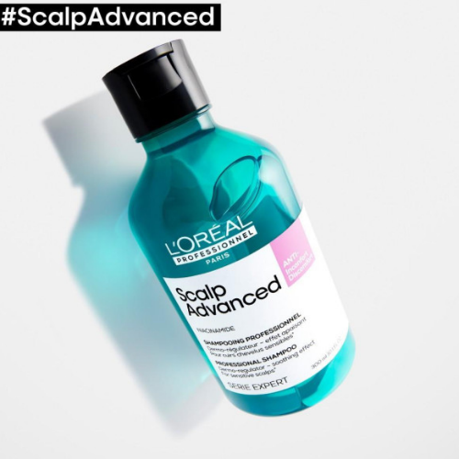
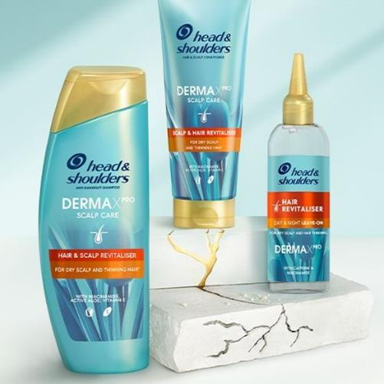
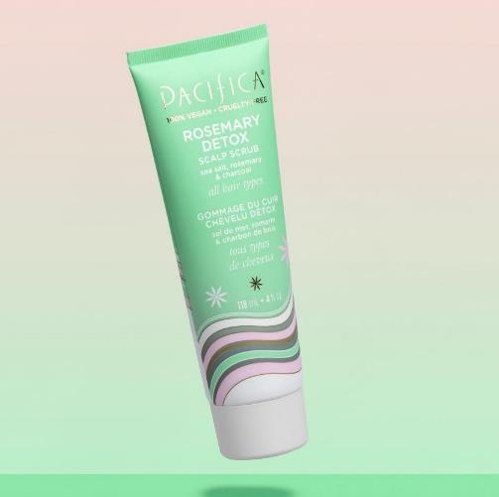
SCALP CARE IS IN THE HAIR
L’OREAL PROFESSIONNEL
Scalp Advanced,
Anti-Incomfort Discomfort shampoo
FR, August 2022
HEAD & SHOULDERS
Scalp Care –
Hair & Scalp Revitalizer
UK, March 2023
PACIFICA
Rosemary detox range
Scalp scrub
US, March 2022
SCIENTIFICALLY PROVEN - TO RELIEVE ITCHY SCALP :AFTER JUST ONE USE, +83% SCALP SOOTHING AND +49% FIBRE HYDRATION
DERMATOLOGICALLY TESTED - FOR A DANDRUFF-FREE, MOISTURISED AND REVITALISED SCALP AND UP TO 95% LESS HAIR LOSS
EXFOLIATES THE SCALP & REMOVE ENVIRONMENTAL TOXINS- WITH ROSEMARY & SEA SALT

Slide 6

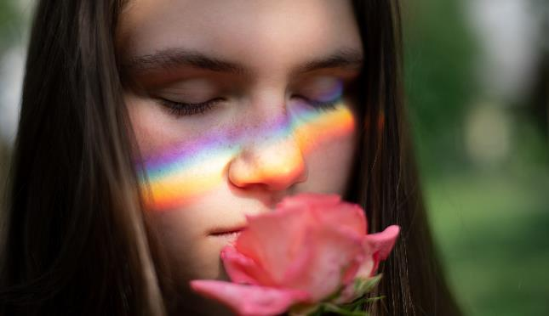
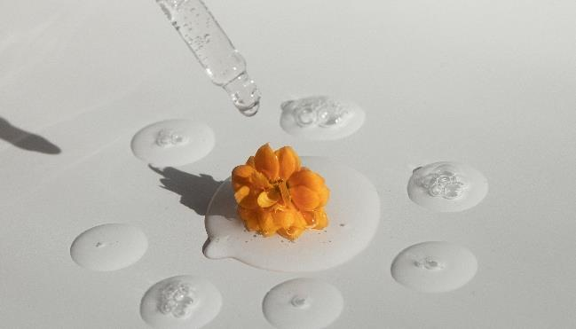
INCREASED POWER OF FRAGRANCE
Latest global insights from our proprietary dsm-firmenich barometer
GLOBALLY,
71%* OF CONSUMERS
APPRECIATE
SCENT MORE
2/3* OF CONSUMERS
BELIEVE THAT A FRAGRANCE
CAN DO MORE
THAN JUST MAKE MY PRODUCTS SMELL GOOD
* Global Barometer, dsm-firmenich 2023, Global online survey China, Japan, US, Brazil, France, Germany, India, Philippines, Indonesia, South Africa, Saudi Arabia, Mexico, Thailand, Vietnam, 8400 Men and women. How much do you agree with the following statements regarding the scent of your products? Agreement scale T2B
The fragrance of the Personal and Home care products that you use…

Slide 7




GLOBAL DEMAND FOR AROMATHERAPY
Aromatherapy is the next generation of hero ingredient concept
GLOBALLY,
83%* OF EARLY ADOPTERS
FOUND VERY INTERESTING THE
AROMATHERAPY
CONCEPT
GLOBALLY,
68%* OF MARKET REPRESENTATIVES
FOUND VERY INTERESTING THE
AROMATHERAPY
CONCEPT
* Haircare rebound, dsm-firmenich 2021, Global online survey China, Japan, US, Brazil, France, Germany, India, Philippines, Indonesia, 3600 women
How appealing do you find this new idea for shampoo? % of respondents T2B (very/extremely)

Slide 8
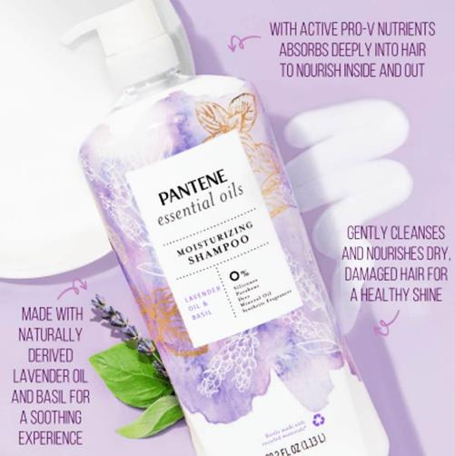
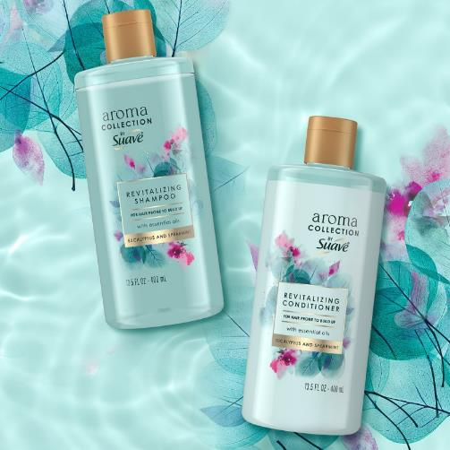
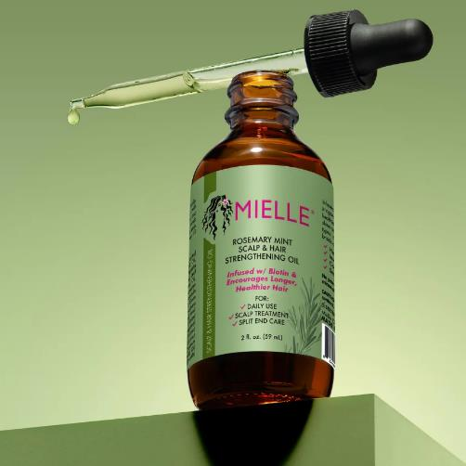
AROMATHERAPY & ESSENTIAL OIL RISING IN HAIR CARE
PANTENE
Essential oils Moisturizing Shampoo
US
SUAVE
Aroma collection Eucalyptus & Spearmint
US
MIELE
Rosemary Mint Scalp
& Hair Strengthening Oil
US
SOOTHING EXPERIENCE
WITH ESSENTIAL OILS LAVENDER & BASIL
FOR HAIR PRONE TO BUILD UP
WITH ESSENTIAL OILS EUCALYPTUS & SPEARMINT
HAIR & SCALP STRENGTHENING OIL
WITH ESSENTIAL ROSEMARY & MINT OIL

Slide 9















KEY INGREDIENTS FOR A GLOBAL AROMATHERAPY RANGE*
#1 Lavender
#1 Lavender
#1 Lavender
#3 Rosemary
#3 Lavender
#3 Rosemary
#6 Peppermint
#1 Lavender
#3 Rosemary
#1 Lavender
#2 Rosemary
#5 Rosemary
#4 Lavender
#1 Lavender
#3 Rosemary
#4 Peppermint
Market representative
#2 Rosemary
Early Adopters
* Haircare rebound, dsm-firmenich 2021, Global online survey China, Japan, US, Brazil, France, Germany, India, Philippines, Indonesia, 3600 women
Please select the ingredients you would associate to this new product idea (aromatherapy) for a shampoo

Slide 10

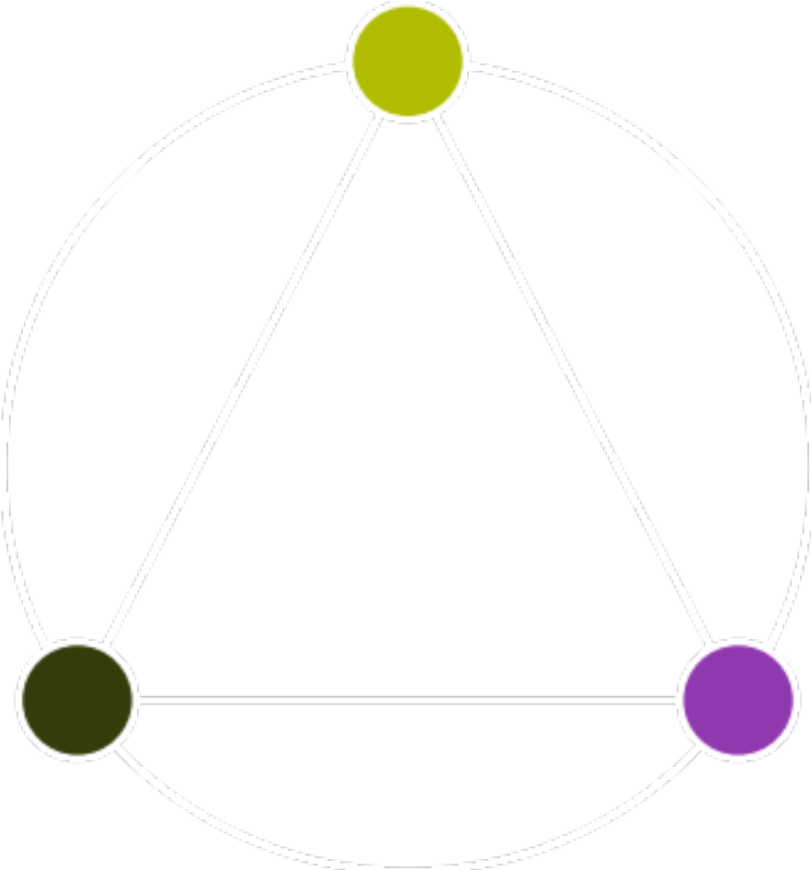
BEYOND HAIR & SCALP CARE,
THE FUTURE IS AN
HOLISTIC APPROACH
MIND
HAIR CARE
SCALP CARE
HEAD CARE
anti-dandruff
20’s
(amplified by covid)
SCALP
HAIR

Slide 11



The best of SKIN EFFICACY & AROMACOLOGY for healthy hair, scalp & mind:
PERSONAL CARE
UNIQUE NATURAL
EXTRACT WITH CLINICALLY PROVEN EFFICACY on skin
& scalp:
ALPAFLOR®
CONSCIOUSLY DESIGNED
>90% natural origin formula
natural origin fragrance
PERFUMERY
Minimum 5%
of POTENT
ESSENTIAL OIL
& FRAGRANCE INNOVATION
with proven impact on mood

Slide 12

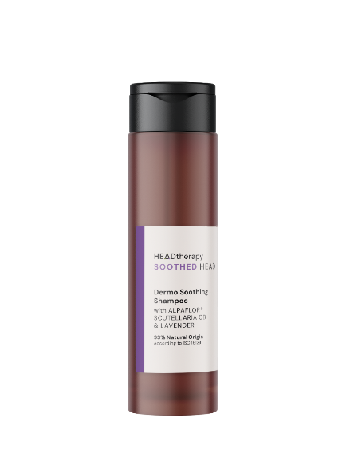
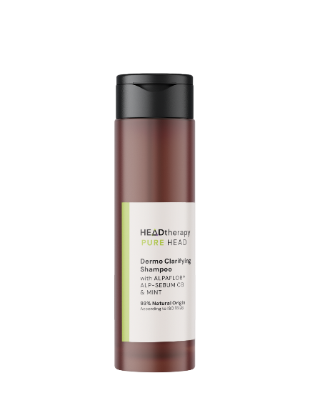
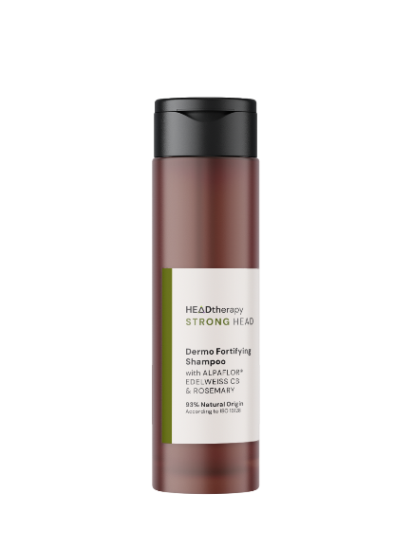
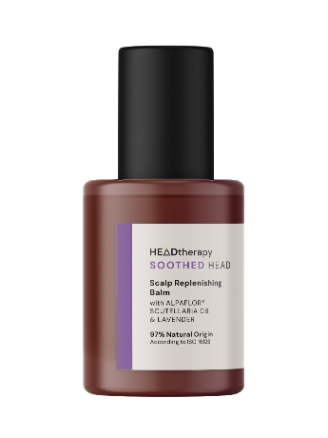
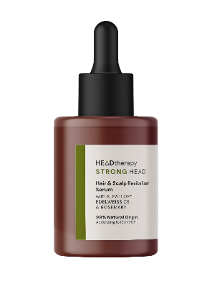
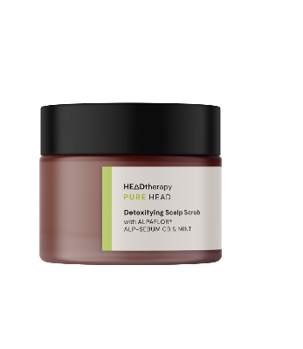
A unique natural range balancing Hair, Scalp and Mind
SOOTHED HEAD
for stressed mind, itchy scalp, dull hair
PURE HEAD
for dull mind, oily scalp, greasy hair
STRONG HEAD
for insecure mind, fragile scalp, hair loss*
DERMO SOOTHING
SHAMPOO
SCALP REPLENISHING
BALM
DETOXIFYING
SCALP SCRUB
DERMO CLARIFYING SHAMPOO
DERMO FORTIFYING
SHAMPOO
HAIR & SCALP REVITALIZER SERUM
with soothing ALPAFLOR® SCUTELLARIA CB
& calming** Lavender Essential Oil
with scalp purifying ALPAFLOR® ALP SEBUM CB
& detoxifying** Mint Essential Oil
with anti-aging ALPAFLOR® EDELWEISS CB
& strengthening** Rosemary Essential Oil
Products are for illustration only, not for sale. dsm-firmenich is not responsible for final products claims.
* Hair loss is a drug claim in USA
** Mentha piperita: Essential Oil and Extracts, Their Biological Activities, and Perspectives on the Development of New Medicinal and Cosmetic Products - PMC (nih.gov) & Treatment options for androgenetic alopecia: Efficacy, side effects, compliance, financial considerations, and ethics - PMC (nih.gov) & Essential Oils in the Treatment of Various Types of Acne-A Review - PubMed (nih.gov)
12

Slide 13


>90% natural origin formula & natural origin fragrance*
SOOTHED HEAD
for stressed mind, itchy scalp, dull hair
>2.5% of a dsm-firmenich NATURAL TOGETHERTM LAVENDER ESSENTIAL OIL
>5% of lavender essential oils in total
EMOTIWAVES® RELAXED - an essential oil shown to elicit relaxing feelings
Dermo Soothing
Shampoo
Scalp
Replenishing Balm
Products are for illustration only, not for sale. dsm-firmenich is not responsible for final products claims.
HEAD CARE
93% Natural Origin
According to ISO 16128
97% Natural Origin
According to ISO 16128
ALPAFLOR® SCUTELLARIA CB:
Relieve urban stress, soothing**
PENTAVITIN®: Achieve long lasting moisturization and reinforce your scalp barrier
D-Panthenol 75 L:
Panthenol for thicker and stronger hair
with soothing ALPAFLOR® SCUTELLARIA CB
& calming*** Lavender Essential Oil
*** Essential Oils in the Treatment of Various Types of Acne-A Review - PubMed (nih.gov)
*Natural origin fragrance = >50% carbon renewable
** Tested in vivo in leave on formulation on facial skin at 3%

Slide 14



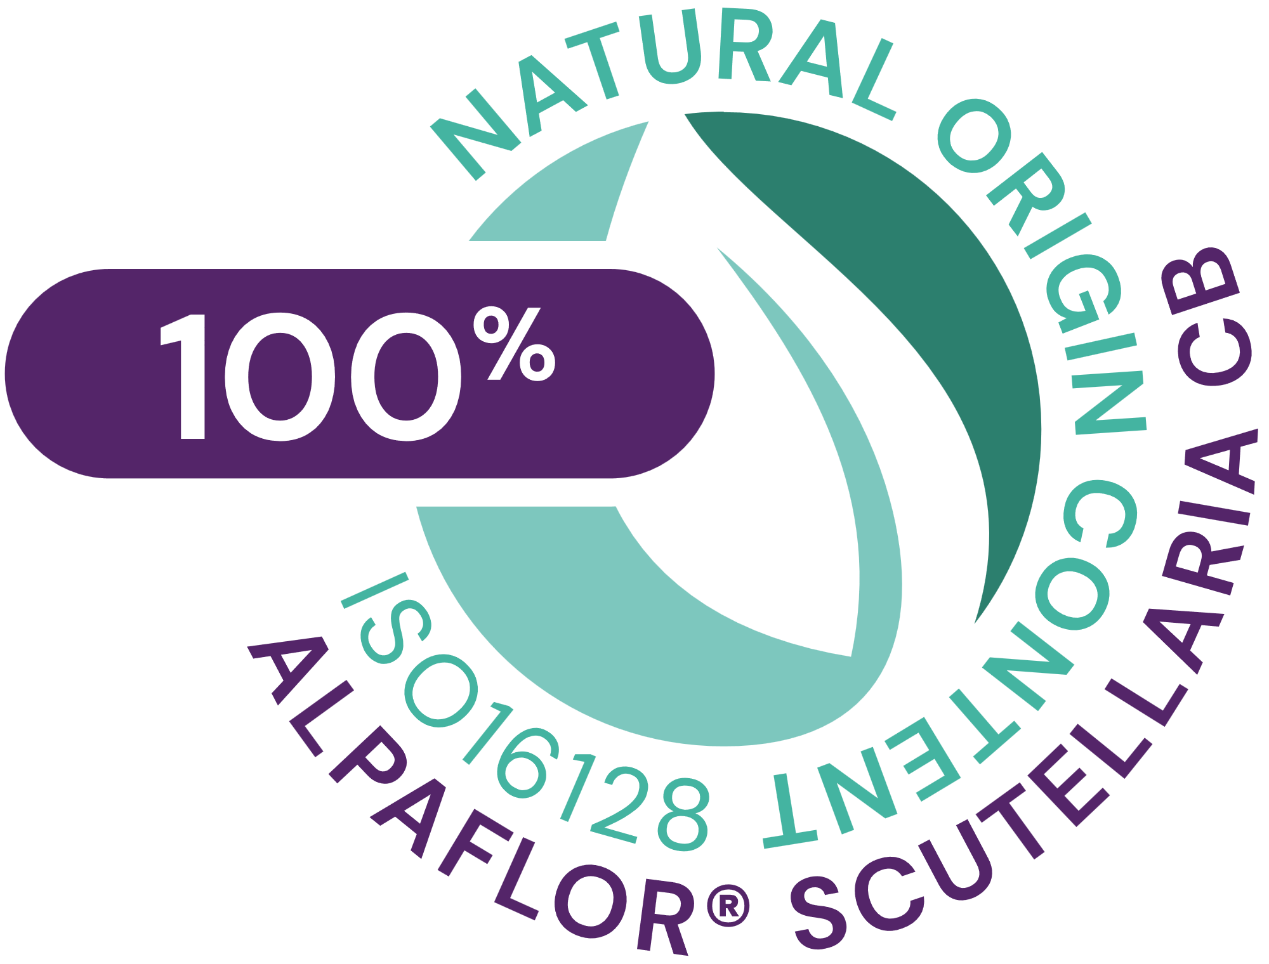








ALPAFLOR® SCUTELLARIA CB
INCI NAME: Scutellaria Alpina Flower/Leaf/Stem Extract, Glycerin, Water, Citric Acid
ID CARD
TECHNOLOGY
Sustainable gentle extraction of dried plant (with water/organic ethanol) following green chemistry principles
TECHNICAL | pH OF USE | FORM | USE LEVEL | PRESERVATIVE | SOLUBILITY | BIODEGRADABLE
3,5-5,5
Liquid
1-3%
Free
Water
main components readily biodegradable
BENEFITS | Activates key neuromediators such as GABAB receptors and β-endorphin* Protects the skin’s barrier function* Rare alpine plant species with unique composition Relieves unpleasant sensations and hydrates the skin for incomparable comfort** Keeps healthy looking skin and improves skin appearance** Alleviates skin dull complexion** Protects and calms irritated skin
REGISTRATION CERTIFICATION
* in vitro ** in vivo
VIEW IMPACT CARD

Slide 15
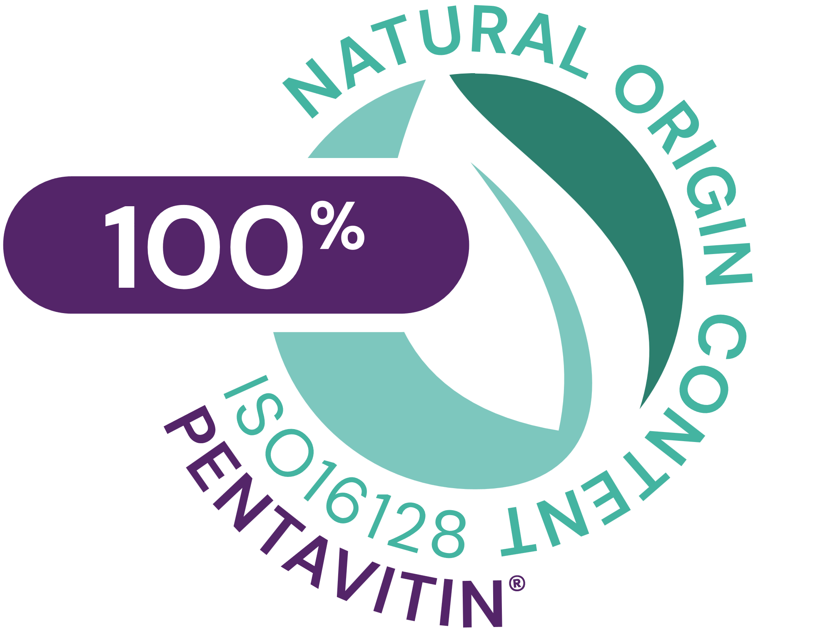






PENTAVITIN®
INCI NAME: Saccharide Isomerate, Aqua, Citric acid, Sodium citrate
ID CARD
TECHNOLOGY
Skin identical sugar complex extracted from edible maize kernel, results from a smart isomerization reaction
TECHNICAL | pH OF USE | FORM | USE LEVEL | PRESERVATIVE | SOLUBILITY | BIODEGRADABLE
4-9
Liquid
0.2-1%
Free
Water
Biodegradable
BENEFITS | Binds to keratin as magnet power and gives back vitality to your skin* Moisturizes dry scalp / Strong scalp barrier** Provides visible reduction of scalp flaking** Reduces Sebum** Boosts Foam*
REGISTRATION CERTIFICATION
* In vitro ** in vivo
VIEW IMPACT CARD
Refer to “Hair Care from Scalp to Tip” master presentation for more information

Slide 16

>90% natural origin formula
& natural origin / highly biodegradable fragrance*
PURE HEAD
for dull mind, oily scalp, greasy hair
>5% of a produced by & exclusive to dsm-firmenich MINT ESSENTIAL OIL
EMOTIWAVES® REVITALIZED - an essential oil shown to elicit revitalizing feelings
DETOXIFYING
SCALP SCRUB
DERMO CLARIFYING SHAMPOO
Products are for illustration only, not for sale. dsm-firmenich is not responsible for final products claims.
HEAD CARE
ALPAFLOR® ALP SEBUM CB:
reduced sebum production & purifies the scalp
OXY 229 CB:
enhances cells oxygen uptake
by 7 times**
Vitamin B6:
Sebum reduction
Hair Thickening (hair diameter)
96% Natural Origin
According to ISO 16128
93% Natural Origin
According to ISO 16128
with scalp purifying ALPAFLOR® ALP SEBUM CB & detoxifying*** Mint Essential Oil
*** Mentha piperita: Essential Oil and Extracts, Their Biological Activities, and Perspectives on the Development of New Medicinal and Cosmetic Products - PMC (nih.gov)
*Natural origin fragrance = >50% carbon renewable
Highly biodegradable fragrance = min 90% ultimately
** Tested in vitro on skin cell culture

Slide 17








ALPAFLOR® ALP SEBUM CB
INCI NAME: Epilobium Fleischeri Flower/Leaf/Stem Extract, Glycerin, Water, Citric Acid
ID CARD
TECHNOLOGY
Gentle ethanolic extraction of dried plant following green chemistry principles
TECHNICAL | pH OF USE | FORM | USE LEVEL | PRESERVATIVE | SOLUBILITY | BIODEGRADABLE
3,5-5,5
Liquid
1-3%
Free
Water
main components readily biodegradable
BENEFITS | Sebum Reduction (strong 5-α-reductase inhibitor) * Helps prevent hair loss (based on literature) Scalp Care (anti-irritation and soothing properties): decrease on production of pro-inflammatory cytokines IL 8 with 0.075% ALPAFLOR® ALP SEBUM in human epidermal keratinocyte*
REGISTRATION CERTIFICATION
* In vitro ** in vivo
VIEW IMPACT CARD
Refer to “Hair Care from Scalp to Tip” master presentation for more information

Slide 18


OXY 229 CB
INCI NAME: Saccharomyces Lysate, Valine, Threonine, Glutamic acid, Glycine, Disodium Succinate
ID CARD
TECHNOLOGY
Contains postbiotics from a specific yeast strain obtained by fermentation and a sophisticated mixture of skin respiration facilitators
TECHNICAL | pH OF USE | FORM | USE LEVEL | PRESERVATIVE | SOLUBILITY | BIODEGRADABLE
3-7,5
Liquid
1-5%
Free
Water
No data available
BENEFITS | Enhances cells oxygen uptake by up to 750%* Stimulates cell viability in the epidermis to revitalize skin* Up to 25% increased skin cell turnover** Helps to modulate oily skin **
REGISTRATION CERTIFICATION
* in vitro ** in vivo

Slide 19

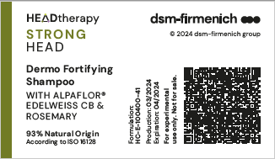
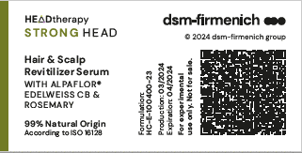
>90% natural origin formula
& natural origin / highly biodegradable fragrance*
STRONG HEAD
for insecure mind, fragile scalp, hair loss
>5% of a dsm-firmenich NATURAL TOGETHERTM ROSEMARY ESSENTIAL OIL
EMOTIBOOST® CONFIDENCE – an accord proven to be associated with feelings of confidence
DERMO FORTIFYING
SHAMPOO
HAIR & SCALP REVITALIZER SERUM
Products are for illustration only, not for sale. dsm-firmenich is not responsible for final products claims.
HEAD CARE
ALPAFLOR® EDELWEISS CB:
helps prevent hair loss**
Life’s GLA™ ‘10’ n-6 Oil:
conditioning, reduces hair damage, shine
Biotin:
helps prevent hair loss***
93% Natural Origin
According to ISO 16128
99% Natural Origin
According to ISO 16128
with anti-aging ALPAFLOR® EDELWEISS CB & strengthening**** Rosemary Essential Oil
**** Treatment options for androgenetic alopecia: Efficacy, side effects, compliance, financial considerations, and ethics - PMC (nih.gov)
*Natural origin fragrance = >50% carbon renewable
Highly biodegradable fragrance = min 90% ultimately
**Hair loss is a drug claim in USA
***based on literature for oral use

Slide 20








ALPAFLOR® EDELWEISS CB
INCI NAME: Leontopodium Alpinum Flower/Leaf Extract, Glycerin, Water, Citric Acid
ID CARD
TECHNOLOGY
Gentle ethanolic extraction of dried plant following green chemistry principles
TECHNICAL | pH OF USE | FORM | USE LEVEL | PRESERVATIVE | SOLUBILITY | BIODEGRADABLE
3,5-5,5
Liquid
1-3%
Free
Water
main components readily biodegradable
BENEFITS | Contains high levels of leontopodic acid and flavonoids Strong antioxidant with radical scavenging properties* Prolongs anagen growing phase of hair 1.8 x more than placebo*** 50% increase of hair follicles keratinocytes proliferation*** 13% increase in hair density after 5 months** 13% darker hair after 4 months** 50% less grey hair versus Placebo**
REGISTRATION CERTIFICATION
* in vitro ** in vivo *** ex vivo
VIEW IMPACT CARD
Refer to “Hair Care from Scalp to Tip” master presentation for more information

Slide 21




Life’s GLA™ ‘10’ n-6 Oil
INCI NAME: Oenothera Biennis (Evening Primrose) Seed Extract
ID CARD
TECHNOLOGY
Prepared by extraction of oil from seeds of Oenothera plant or Evening primrose (9% GLA)
TECHNICAL | pH OF USE | FORM | USE LEVEL | PRESERVATIVE | SOLUBILITY | BIODEGRADABLE
3-9
Liquid
Up to 1%
Free
Oil
readily biodegradable
BENEFITS | Anti hair breakage* Anti- frizz* Conditioning/ ease of combing* Split-ends reduction* Shine *
REGISTRATION CERTIFICATION
* In vitro
*Refer to “Hair Care from Scalp to Tip” master presentation for more information

Slide 22
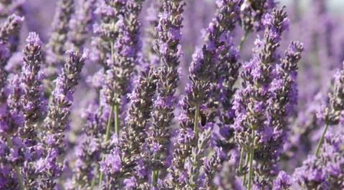
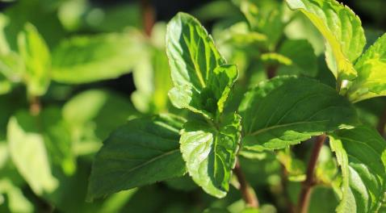
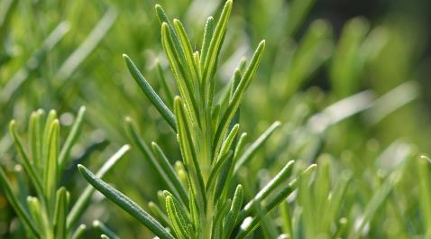

Natural origin fragrances* with high % of potent essential oils
SOOTHED HEAD
with calming** Lavender Essential Oil
PURE HEAD
with detoxifying ** Mint Essential Oil
STRONG HEAD
with strengthening ** Rosemary Essential Oil
Aromatic – Lavender - Floral - Ambery
>2.5% of a dsm-firmenich Natural togetherTM Lavender essential oil
>5% of lavender essential oils in total
Natural origin fragrance*
Emotiwaves® Relaxed - an essential oil shown to elicit relaxing feelings
Aromatic – Mint – Floral – Watery
>5% of a produced by & exclusive to dsm-firmenich Mint essential oil
Natural origin & highly biodegradable fragrance*
Emotiwaves® Revitalized - an essential oil shown to elicit revitalizing feelings
Aromatic – Rosemary – Floral - Musks
>5% of a dsm-firmenich Natural togetherTM Rosemary essential oil
Natural origin & highly biodegradable fragrance*
EmotiBoost® Confidence – an accord shown to be associated with feelings of confidence
Products are for illustration only, not for sale. dsm-firmenich is not responsible for final products claims
*Natural origin fragrance = >50% carbon renewable / Highly biodegradable fragrance = min 90% ultimately
** Mentha piperita: Essential Oil and Extracts, Their Biological Activities, and Perspectives on the Development of New Medicinal and Cosmetic Products - PMC (nih.gov) & Treatment options for androgenetic alopecia: Efficacy, side effects, compliance, financial considerations, and ethics - PMC (nih.gov) & Essential Oils in the Treatment of Various Types of Acne-A Review - PubMed (nih.gov)

Slide 23
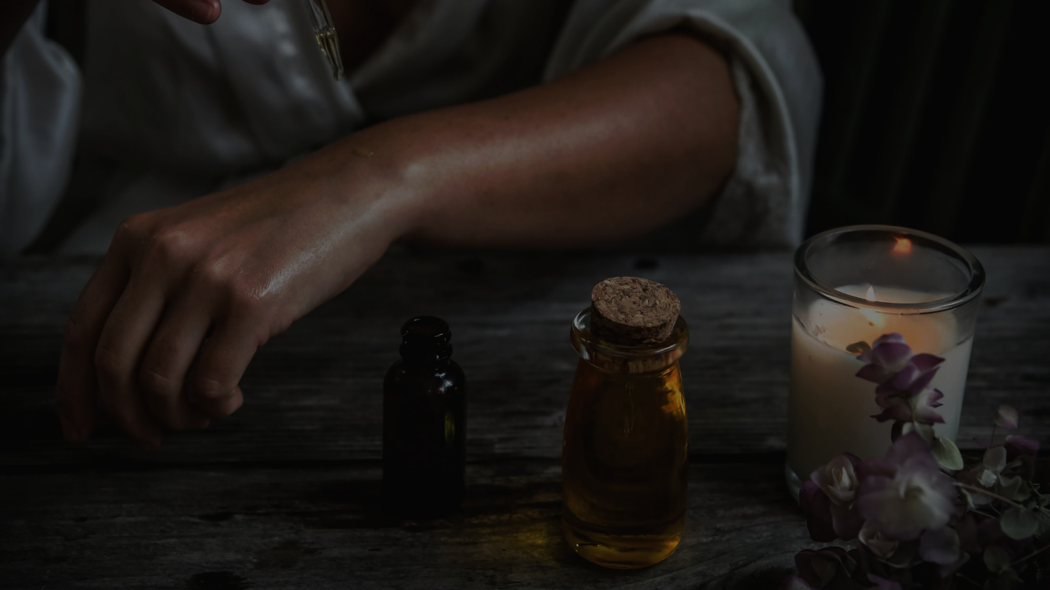

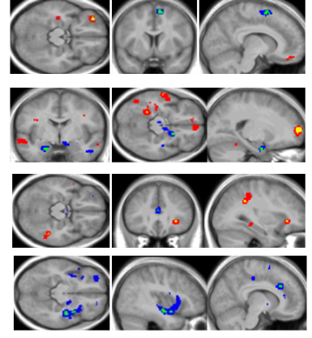
Fragrance innovations for your mind
SOOTHED HEAD
with EMOTIWAVES® RELAXED
an essential oil shown to elicit relaxing feelings
PURE HEAD
with EMOTIWAVES® REVITALIZED - an essential oil shown to elicit revitalizing feelings
STRONG HEAD
with EMOTIBOOST® CONFIDENCE – an accord shown to be associated with feelings of confidence
Fragrance technology shown to elicit a targeted emotion
Patented methodology using fMRI
With Natural Essential Oils
Fragrance technology shown to be associated with a targeted emotion
Patented testing method by Neurohm
using time response measure
Exclusive to dsm-firmenich
Associated claim :
an essential oil shown to elicit relaxing/revitalizing feelings
Associated claim :
an exclusive accord shown to be associated with feelings of confidence
Products are for illustration only, not for sale. dsm-firmenich is not responsible for final products claims

Slide 24

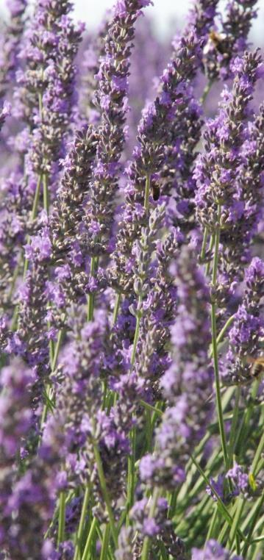


Natural origin fragrances with high % of potent essential oils
Lavandula angustifolia
SOOTHED HEAD
with 2.5%* of a dsm-firmenich NATURAL TOGETHERTM
LAVENDER ESSENTIAL OIL
DISTILLATION PROCESS
NATURALS TOGETHER™
Obtained by distillation of the biomass with water, or steam.
The essential oil is physically separated from the aqueous phase by decantation.
OLFACTIVE DESCRIPTION
Very floral, fresh, aromatic, herbaceous with sweet coumarin undertone.
ORIGIN: Ingredient sourced from France and distilled locally.
SUSTAINABLE PRACTICES: Responsibly sourced ingredient recognized for its rated sustainable practices of production.
This very floral lavender oil can be used in Fine or Consumer Fragrances with aromatic, fougere and floral accord.

Slide 25
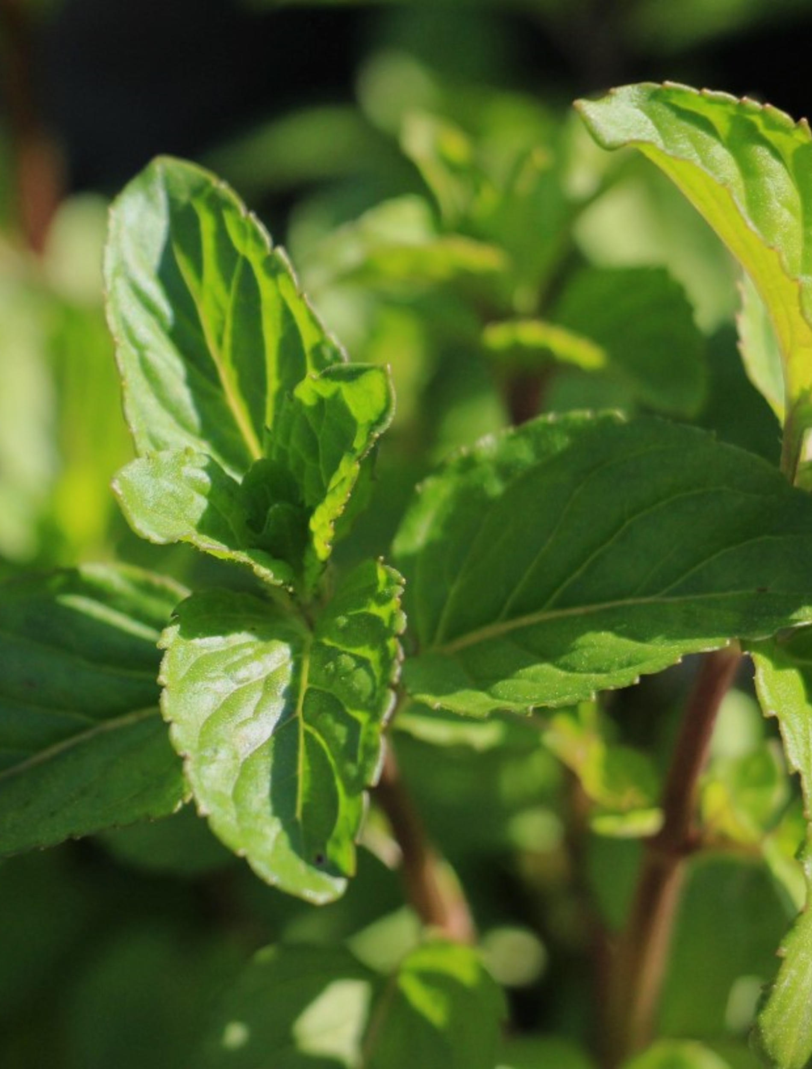


Natural origin fragrances with high % of potent essential oils
Mentha piperita
PURE HEAD
with 5%* of a produced by & exclusive to dsm-firmenich
MINT ESSENTIAL OIL
DISTILLATION PROCESS
EXCLUSIVE DSM-FIRMENICH CAPTIVE
Obtained by distillation of the biomass with water, or steam. The essential oil is physically separated from the aqueous phase by decantation.
OLFACTIVE DESCRIPTION
Full-bodied and intense, fresh and aromatic herbal notes of hay, gently supported by lactonic and floral hints.
A dsm-firmenich captive is strictly reserved for our perfumers.
This profile will bring uniqueness and mint signature in many Home care and Body care applications.

Slide 26
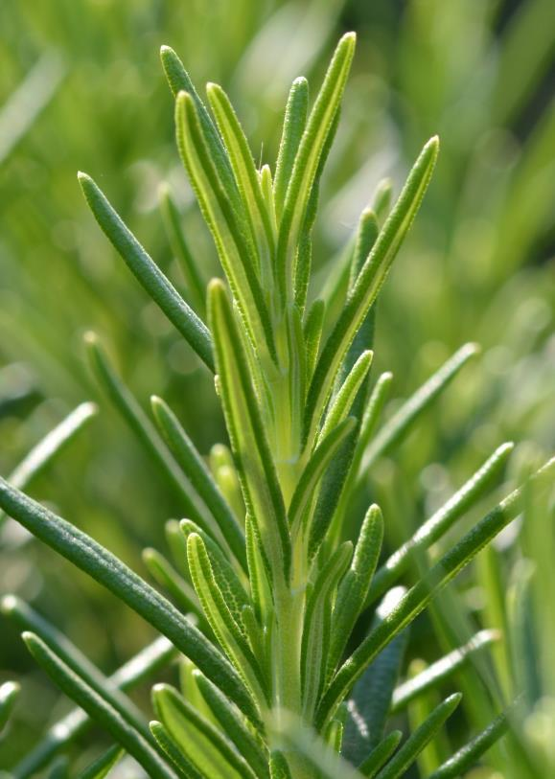
Natural origin fragrances with high % of potent essential oils
Rosmarinus officinalis
STRONG HEAD
with 5%* of a dsm-firmenich NATURAL TOGETHERTM
ROSEMARY ESSENTIAL OIL
DISTILLATION PROCESS
NATURALS TOGETHER™
Obtained by distillation of the biomass with water, or steam.
The essential oil is physically separated from the aqueous phase by decantation.
OLFACTIVE DESCRIPTION
Aromatic, herbaceous, fresh, camphorated,
eucalyptus and woody odor.
SUSTAINABLE PRACTICES: Responsibly sourced ingredient recognized for its rated sustainable practices of production. Harvested in Morocco and Tunisia
Give freshness with a characteristic herbal and camphor effect in aromatic compositions. Can be used in blend with lavender, lavandin,basil, thyme, mints, eucalyptus.

Slide 28
Disclaimer
Copyright © DSM Nutritional Products Ltd 2025, 4002 Basel, Switzerland.
www.dsm-firmenich.com. All rights reserved.
dsm-firmenich has used diligent care to ensure that the information provided herein is accurate and up-to-date, however, dsm-firmenich makes no representation or warranty, either expressly or implied, of the accuracy, reliability, or completeness thereof. The information provided herein contains scientific and product information for business to business use and does not constitute or provide scientific or medical advice, diagnosis or recommendation for treatment. Country or region-specific information should be considered when labelling or advertising to final consumer. In no event shall dsm-firmenich be liable for any damages arising from or reliance upon, or use of, any information provided herein. The content of this document is subject to change without further notice. Please contact your local dsm-firmenich representative for further details. All trademarks listed in this document are either (registered) trademarks of, or trademarks licensed by, the dsm-firmenich group of companies, unless explicitly stated otherwise.
Disclaimer Formulation Guideline
This information is for illustration purposes only and based upon our current knowledge and experience at the time of printing. We do not make any representation or warranty of any kind, express or implied, including merchantability or fitness for a particular use, with respect to such information or its application. Use of this information is at your discretion and risk. Nothing herein relieves you from carrying out your own suitability determinations and tests. You are responsible for observing all laws and regulations relevant to your products, uses or processes. We do not assume any liability in connection with your product and its use. The foregoing information and suggestions are also provided without warranty of non-infringement as to the intellectual property rights of third parties and shall not be construed as any inducement to infringe the rights of third parties.

Slide 29
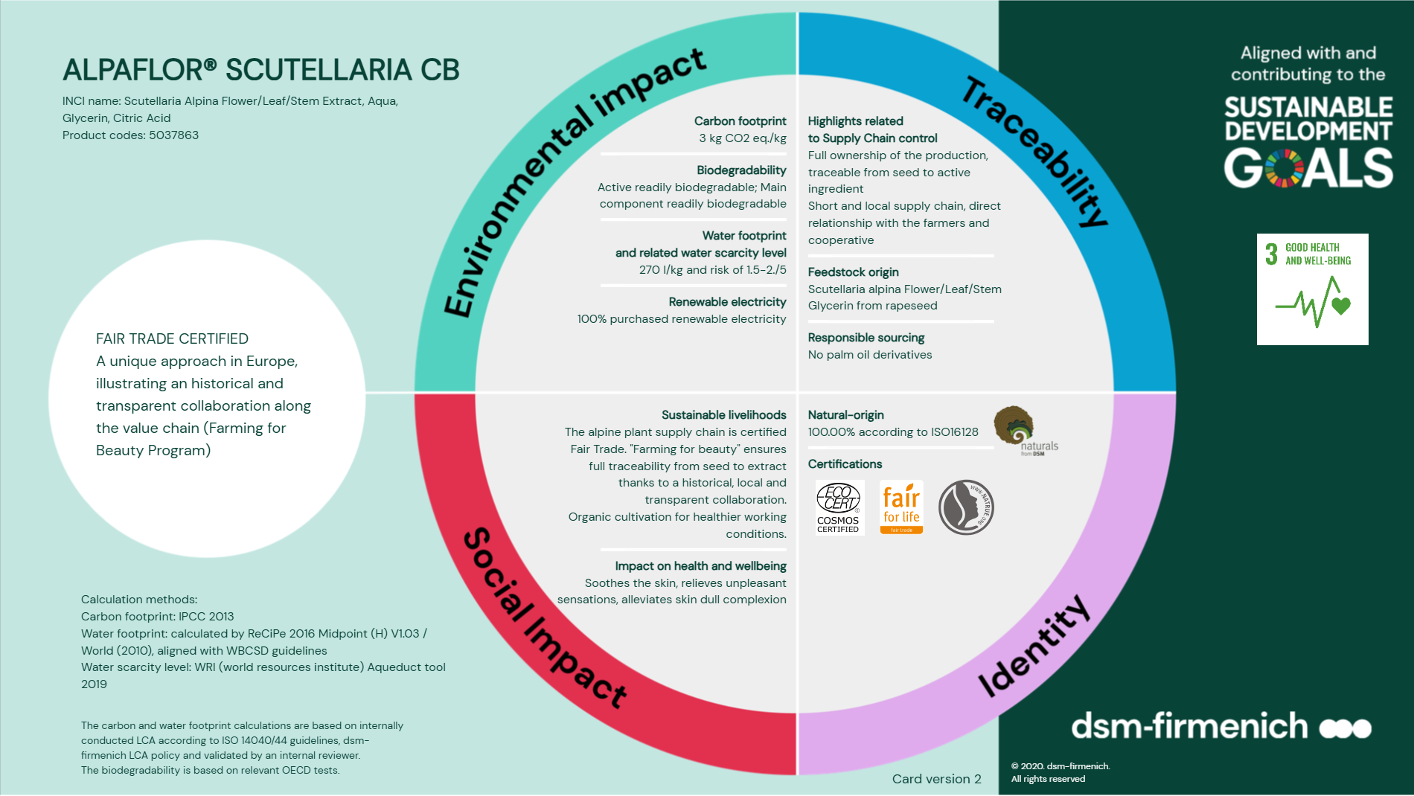

Slide 30
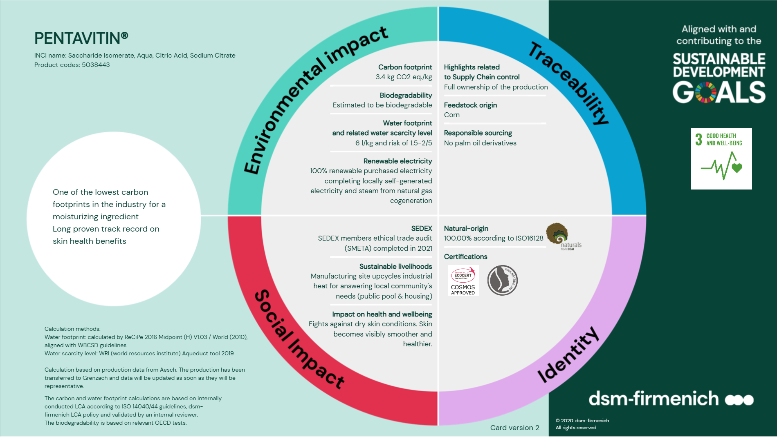

Slide 31
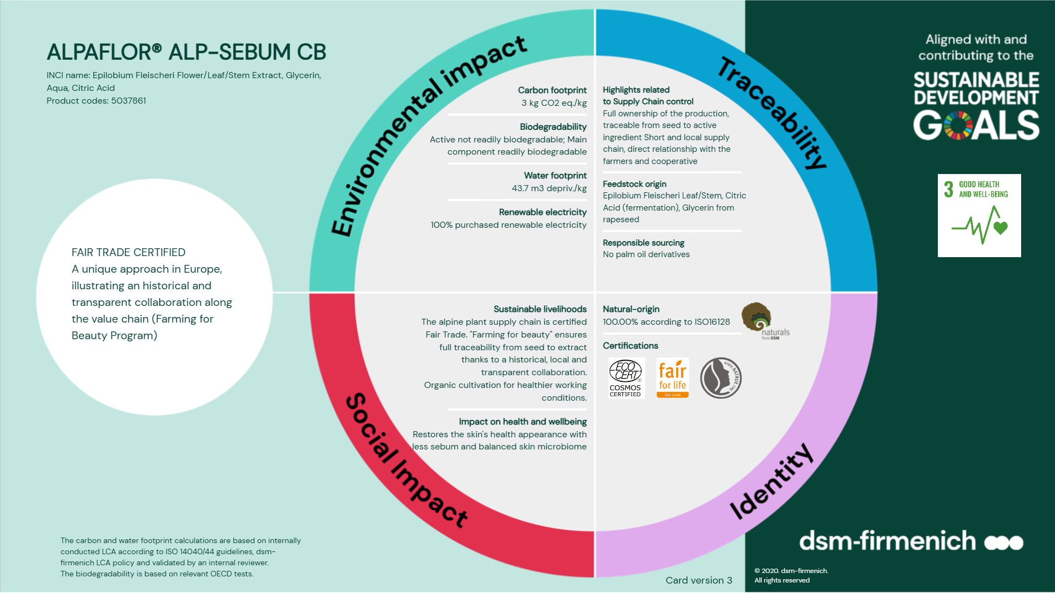

Slide 32


Slide 33
Phase | Ingredients | INCI Name | % w / w
A | Water Dem | AQUA | 59,00
 | Jaguar® C 162 SGI | HYDROXYPROPYL GUAR HYDROXYPROPYLTRIMONIUM CHLORIDE | 0,20
 | L(+) Lactic Acid 90% | LACTIC ACID, AQUA | 0,20
 | D-Panthenol 75 L | PANTHENOL, AQUA, PANTOLACTONE | 0,35
B | Activsoft S | CYAMOPSIS TETRAGONOLOBA GUM | 0,10
 | Propanediol | PROPANEDIOL | 1,50
C | ISELUX® Ultra Mild | SODIUM LAUROYL METHYL ISETHIONATE, COCAMIDOPROPYL BETAINE, SODIUM METHYL OLEOYL TAURATE, LAURYL GLUCOSIDE, COCO-GLUCOSIDE | 10,00
 | EcoSense 919 | COCO-GLUCOSIDE | 2,00
 | Potassium Sorbate | POTASSIUM SORBATE | 0,20
 | PUROX® S | SODIUM BENZOATE | 0,40
D | PENTAVITIN® | SACCHARIDE ISOMERATE, AQUA, CITRIC ACID, SODIUM CITRATE | 0,25
 | ALPAFLOR® SCUTELLARIA CB | GLYCERIN, AQUA, CITRIC ACID, SCUTELLARIA ALPINA FLOWER/LEAF/STEM EXTRACT | 3,00
E | TEGO SOLVE 61 MB | POLYGLYCERYL-6 CAPRYLATE, POLYGLYCERYL-6 RICINOLEATE, POLYGLYCERYL-4 CAPRATE, POLYGLYCERYL-3 COCOATE, AQUA | 3,00
 | HEAD THERAPY SOOTHING P01C302 | PARFUM, ALPHA-ISOMETHYL IONONE, CITRONELLOL, COUMARIN, LINALOOL | 0,80
F | AMONYL 675 SB | COCAMIDOPROPYL HYDROXYSULTAINE | 8,00
 | NANSA® LSS 38/AV | SODIUM C14-16 OLEFIN SULFONATE | 11,00
SOOTHED HEAD
for stressed mind, itchy scalp, dull hair
DERMO SOOTHING
SHAMPOO
Products are for illustration only, not for sale. dsm-firmenich is not responsible for final products claims.
93% Natural Origin
with soothing ALPAFLOR® SCUTELLARIA CB
& calming Lavender Essential Oil
Technical Data:
pH: 5,7
Viscosity(HR-10/plate 40mm/ shear rate 1/s): 3.000 mPa.s
HC-E-100400-40

Slide 34
Phase | Ingredients | INCI Name | % w / w
A | Water Dem | AQUA | 71,75
 | Allantoin | ALLANTOIN | 1,00
 | PUROX® S | SODIUM BENZOATE | 0,60
B | AMPHISOL® K | POTASSIUM CETYL PHOSPHATE | 0,50
 | Olivem® 1000 MB | CETEARYL OLIVATE, SORBITAN OLIVATE | 2,50
 | STIMU-TEX® AS | ARGANIA SPINOSA KERNEL OIL, TOCOPHEROL, BUTYROSPERMUM PARKII (SHEA) BUTTER EXTRACT, SPENT GRAIN WAX | 1,50
 | SOFTISAN® condition HAIR | PCA GLYCERYL OLEATE | 1,50
C | Activsoft S | CYAMOPSIS TETRAGONOLOBA GUM | 0,10
 | Propanediol | PROPANEDIOL | 5,00
D | BIO-ETHANOL (ETA bis 99.9%) | ALCOHOL | 10,00
E | HEAD THERAPY SOOTHING P01C302 | PARFUM, ALPHA-ISOMETHYL IONONE, CITRONELLOL, COUMARIN, LINALOOL, LIMONENE | 1,00
 | HYA-ACTTM XS | HYDROLYZED HYALURONIC ACID | 0,10
 | ALPAFLOR® SCUTELLARIA CB | GLYCERIN, AQUA, CITRIC ACID, SCUTELLARIA ALPINA FLOWER/LEAF/STEM EXTRACT | 3,00
 | PENTAVITIN® | SACCHARIDE ISOMERATE, AQUA, CITRIC ACID, SODIUM CITRATE | 0,25
 | D-Panthenol 75 L | PANTHENOL, AQUA, PANTOLACTONE | 1,20
SOOTHED HEAD
for stressed mind, itchy scalp, dull hair
SCALP REPLENISHING
BALM
Products are for illustration only, not for sale. dsm-firmenich is not responsible for final products claims.
97% Natural Origin
with soothing ALPAFLOR® SCUTELLARIA CB
& calming Lavender Essential Oil
Technical Data:
pH: 5,5
Viscosity(HR-10/plate 40mm/ shear rate 1/s): 1.500 mPa.s
HC-E-100400-25

Slide 35
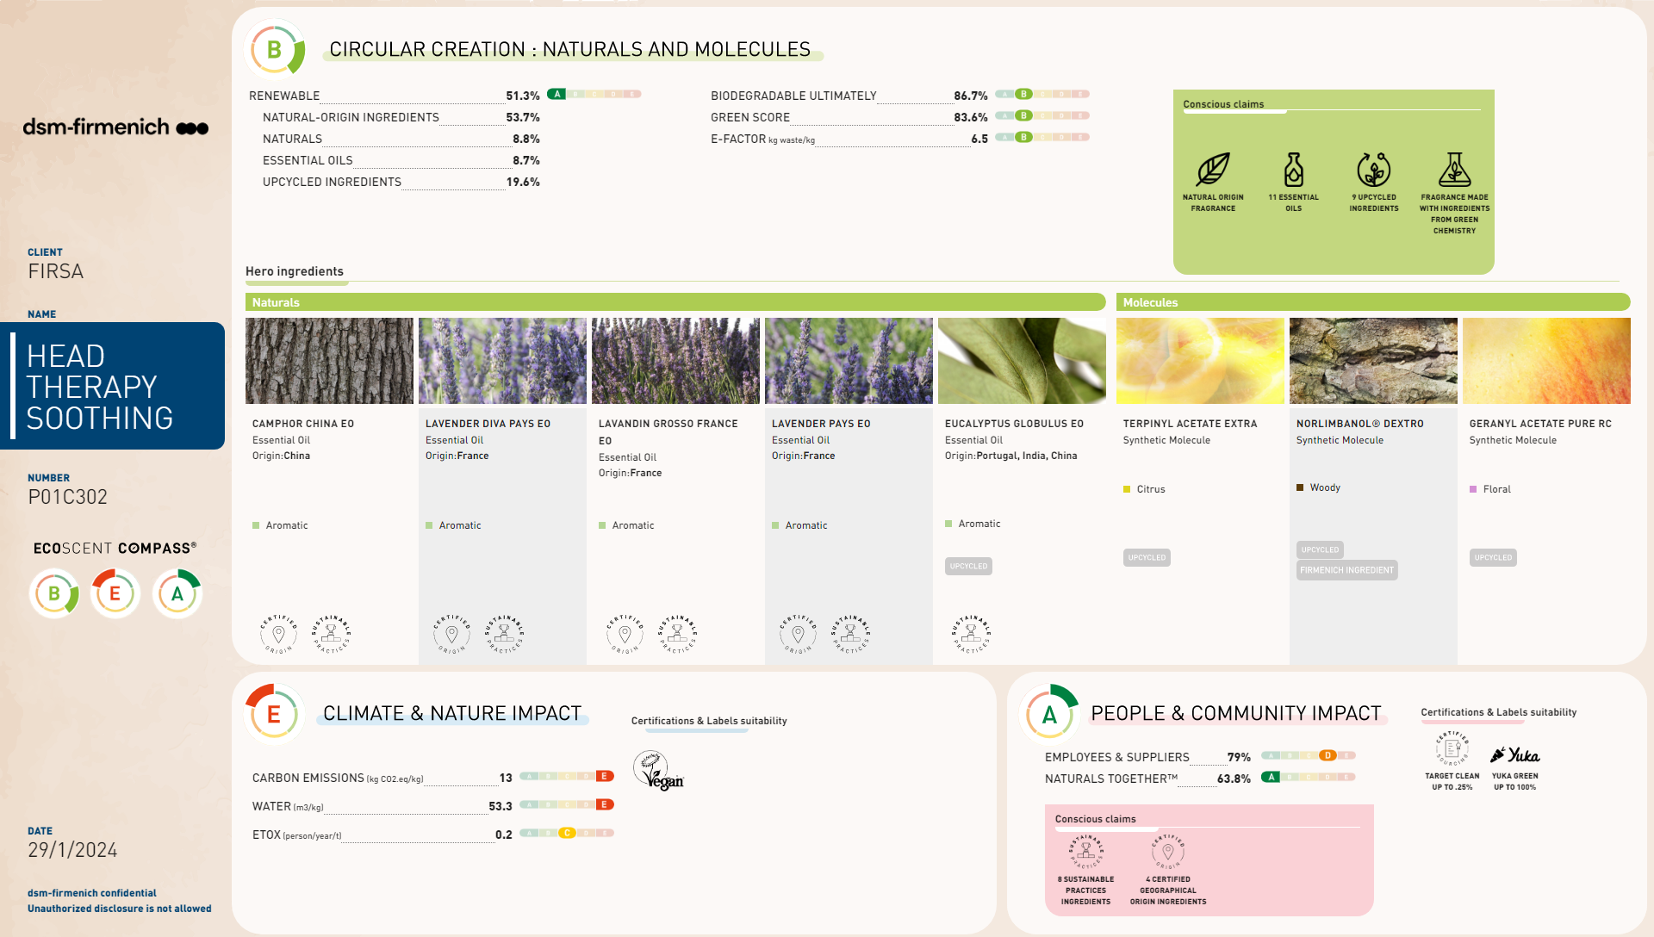

Slide 36
Phase | Ingredients | INCI Name | % w / w
A | Water Dem | AQUA | 65,50
 | PYRIDOXINE HYDROCHLORIDE | PYRIDOXINE HCL | 0,20
 | SILIGEL | XANTHAN GUM, SCLEROTIUM GUM, LECITHIN, PULLULAN | 2,50
 | GLYCOLIC ACID 70% | GLYCOLIC ACID | 0,60
 | Potassium Sorbate | POTASSIUM SORBATE | 0,30
 | PUROX® S | SODIUM BENZOATE | 0,60
 | Propanediol | PROPANEDIOL | 5,00
B | QUATIN® 350 UP-DP POWDER | HYDROXYPROPYLTRIMONIUM INULIN | 0,60
 | Amisoft® CS-11 | SODIUM COCOYL GLUTAMATE | 6,00
 | LAMESOFT PO 65 | COCO-GLUCOSIDE, GLYCERYL OLEATE | 3,00
 | PuraBeet | BETAINE | 1,00
C | OXY 229 CB | SACCHAROMYCES LYSATE, VALINE, THREONINE, GLUTAMIC ACID, GLYCINE, GLYCERIN, AQUA, DISODIUM SUCCINATE, 1,2-HEXANEDIOL, CAPRYLYL GLYCOL | 2,00
 | ALPAFLOR® ALP-SEBUM CB | EPILOBIUM FLEISCHERI FLOWER / LEAF / STEM EXTRACT | 3,00
 | ARGAN OIL | ARGANIA SPINOSA KERNEL OIL | 0,40
 | HEAD THERAPY PURIFYING P01C304 | PARFUM, ALPHA ISOMETHYL IONONE, GERANIOL, LIMONENE, LINALOOL, HYDROXYCITRONELLAL | 1,00
D | AGENAJEL® 20.313 | HYDROXYPROPYL STARCH PHOSPHATE | 4,80
E | Celluloscrub 300 | CELLULOSE | 3,50
(Vit. B6)
PURE HEAD
for dull mind, oily scalp, greasy hair
DETOXIFYING
SCALP SCRUB
Products are for illustration only, not for sale. dsm-firmenich is not responsible for final products claims.
96% Natural Origin
with scalp purifying ALPAFLOR® ALP SEBUM CB
& detoxifying Mint Essential Oil
Technical Data:
pH: 5,3
Viscosity(HR-10/plate 40mm/ shear rate 1/s): 6.000 mPa.s
HC-E-100400-21

Slide 37
Phase | Ingredients | INCI Name | % w / w
A | Water Dem | AQUA | 58,40
 | Jaguar® C 162 SGI | HYDROXYPROPYL GUAR HYDROXYPROPYLTRIMONIUM CHLORIDE | 0,20
 | L(+) Lactic Acid 90% | LACTIC ACID, AQUA | 0,20
 | PYRIDOXINE HYDROCHLORIDE | PYRIDOXINE HCL | 0,20
B | Propanediol | PROPANEDIOL | 1,50
 | Activsoft S | CYAMOPSIS TETRAGONOLOBA GUM | 0,10
C | ISELUX® Ultra Mild | SODIUM LAUROYL METHYL ISETHIONATE, COCAMIDOPROPYL BETAINE, SODIUM METHYL OLEOYL TAURATE, LAURYL GLUCOSIDE, COCO-GLUCOSIDE | 10,00
 | AMONYL 675 SB | COCAMIDOPROPYL HYDROXYSULTAINE | 8,00
D | PUROX® S | SODIUM BENZOATE | 0,40
 | Potassium Sorbate | POTASSIUM SORBATE | 0,20
 | OXY 229 CB | SACCHAROMYCES LYSATE, VALINE, THREONINE, GLUTAMIC ACID, GLYCINE, GLYCERIN, AQUA, DISODIUM SUCCINATE, 1,2-HEXANEDIOL, CAPRYLYL GLYCOL | 2,00
 | ALPAFLOR® ALP-SEBUM CB | EPILOBIUM FLEISCHERI FLOWER / LEAF / STEM EXTRACT, GLYCERIN, AQUA, CITRIC ACID | 3,00
E | TEGO SOLVE 61 MB | POLYGLYCERYL-6 CAPRYLATE, POLYGLYCERYL-6 RICINOLEATE, POLYGLYCERYL-4 CAPRATE, POLYGLYCERYL-3 COCOATE, AQUA | 3,00
 | HEAD THERAPY PURIFYING P01C304 | PARFUM, ALPHA ISOMETHYL IONONE, LIMONENE, LINALOOL | 0,80
F | NANSA® LSS 38/AV | SODIUM C14-16 OLEFIN SULFONATE | 12,00
PURE HEAD
for dull mind, oily scalp, greasy hair
(Vit. B6)
DERMO CLARIFYING SHAMPOO
Products are for illustration only, not for sale. dsm-firmenich is not responsible for final products claims.
93% Natural Origin
with scalp purifying ALPAFLOR® ALP SEBUM CB
& detoxifying Mint Essential Oil
Technical Data:
pH: 5,6
Viscosity(HR-10/plate 40mm/ shear rate 1/s): 3.000 mPa.s
HC-E-100400-42

Slide 38
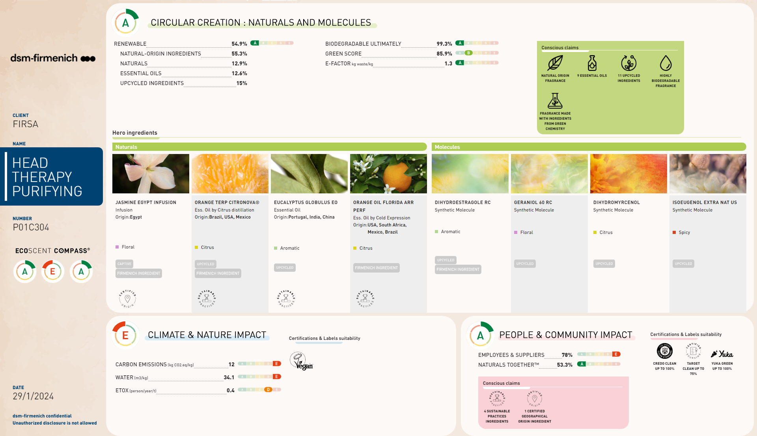
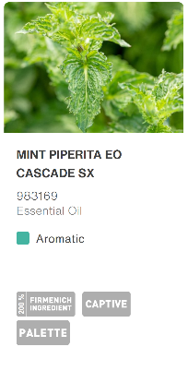

Slide 39
Phase | Ingredients | INCI Name | % w / w
A | Water Dem | AQUA | 56,39
 | Jaguar® C 162 SGI | HYDROXYPROPYL GUAR HYDROXYPROPYLTRIMONIUM CHLORIDE | 0,20
 | L(+) Lactic Acid 90% | LACTIC ACID, AQUA | 0,30
 | D-Biotin | BIOTIN | 0,02
B | Activsoft S | CYAMOPSIS TETRAGONOLOBA GUM | 0,10
 | Propanediol | PROPANEDIOL | 1,50
C | ISELUX® Ultra Mild | SODIUM LAUROYL METHYL ISETHIONATE, COCAMIDOPROPYL BETAINE, SODIUM METHYL OLEOYL TAURATE, LAURYL GLUCOSIDE, COCO-GLUCOSIDE | 10,00
 | AMONYL 675 SB | COCAMIDOPROPYL HYDROXYSULTAINE | 8,00
 | Proteol OAT PF | SODIUM LAUROYL OAT AMINO ACIDS | 2,00
D | ALPAFLOR® EDELWEISS CB | LEONTOPODIUM ALPINUM FLOWER/LEAF EXTRACT, GLYCERIN, AQUA, CITRIC ACID | 3,00
 | PUROX® S | SODIUM BENZOATE | 0,40
 | Potassium Sorbate | POTASSIUM SORBATE | 0,20
E | TEGO SOLVE 61 MB | POLYGLYCERYL-6 CAPRYLATE, POLYGLYCERYL-6 RICINOLEATE, POLYGLYCERYL-4 CAPRATE, POLYGLYCERYL-3 COCOATE, AQUA | 3,00
 | life'sGLATM '10' n-6 Oil | OENOTHERA BIENNIS SEED EXTRACT, ASCORBYL PALMITATE, TOCOPHEROL | 0,10
 | HEAD THERAPY STRENGTHENING P01C303 | PARFUM, LIMONENE, LINALOOL | 0,80
F | NANSA® LSS 38/AV | SODIUM C14-16 OLEFIN SULFONATE | 14,00
STRONG HEAD
for insecure mind, fragile scalp, hair loss*
DERMO FORTIFYING
SHAMPOO
Products are for illustration only, not for sale. dsm-firmenich is not responsible for final products claims.
93% Natural Origin
with anti-aging ALPAFLOR® EDELWEISS CB & strengthening Rosemary Essential Oil
Technical Data:
pH: 5,7
Viscosity(HR-10/plate 40mm/ shear rate 1/s): 3.500 mPa.s
HC-E-100400-41

Slide 40
Phase | Ingredients | INCI Name | % w / w
A | Water Dem | AQUA | 69,13
 | D-Biotin | BIOTIN | 0,02
 | HYA-ACTTM XS | HYDROLYZED HYALURONIC ACID | 0,15
B | SILIGEL | XANTHAN GUM, SCLEROTIUM GUM, LECITHIN, PULLULAN | 1,40
C | Propanediol | PROPANEDIOL | 5,00
 | BIO-ETHANOL (ETA bis 99.9%) | ALCOHOL | 12,00
D | MIGLYOL® 829 ECO | CAPRYLIC/CAPRIC/SUCCINIC TRIGLYCERIDE | 7,50
 | life'sGLATM '10' n-6 Oil | OENOTHERA BIENNIS SEED EXTRACT, ASCORBYL PALMITATE, TOCOPHEROL | 0,50
 | HEAD THERAPY STRENGTHENING P01C303 | PARFUM, BENZYL SALICYLATE, CITRAL, GERANIOL, LIMONENE, LINALOOL | 1,00
E | ALPAFLOR® EDELWEISS CB | LEONTOPODIUM ALPINUM FLOWER/LEAF EXTRACT, GLYCERIN, AQUA, CITRIC ACID | 3,00
 | Cosphaderm® Hexiol natural | 1,2-HEXANEDIOL | 0,30
STRONG HEAD
for insecure mind, fragile scalp, hair loss*
HAIR & SCALP REVITALIZER SERUM
Products are for illustration only, not for sale. dsm-firmenich is not responsible for final products claims.
99% Natural Origin
with anti-aging ALPAFLOR® EDELWEISS CB & strengthening Rosemary Essential Oil
Technical Data:
pH: 5,2
Viscosity(HR-10/plate 40mm/ shear rate 1/s): 1.000 mPa.s
HC-E-100400-23

Slide 41
