Slide 1


DSM’s House of Naturals
Surprisingly natural
January, 2022

Slide 2

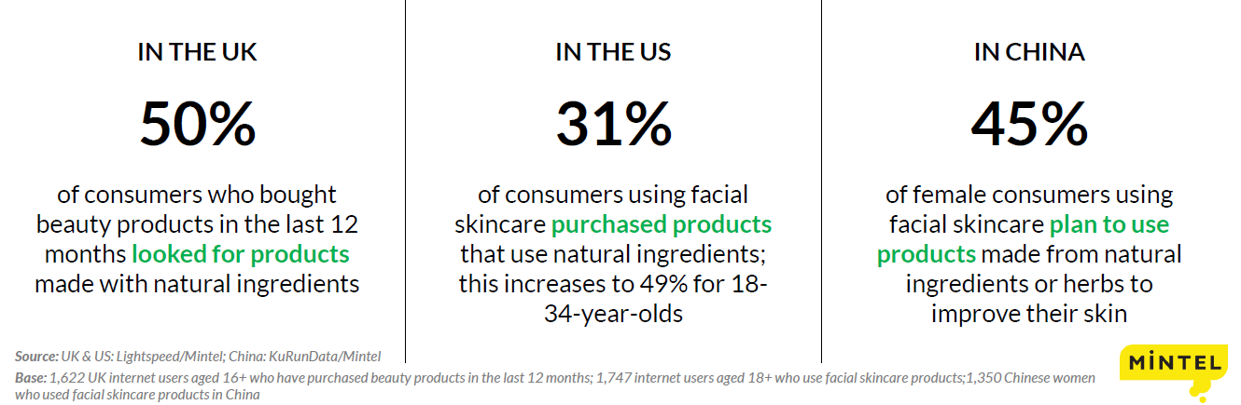

People seek naturally derived beauty products
The natural and organic personal care market is estimated to continue growing at a rate of around 8% (consumer products retail sales)
The highest growth is expected in Skin Care and Bath & Shower, followed by Hair Care and Sun Care*
* Source: Euromonitor The broadening Meaning of Green Beauty - 2017

Slide 3
Consumers show willingness to pay a bit more for products with natural or botanical ingredients
Claimed interest in the face of price trade-offs is a better predictor of purchase behaviours, as opposed to simple “interest in natural products”
Between preferring “Lower Price” and “Natural or botanical ingredients”, in a Global Survey, on average around 40% of consumers choose “Natural or Organic ingredients”
Natural or Organic product features are among the most desired by consumers
Source: Euromonitor The broadening Meaning of Green Beauty - 2017

Slide 4

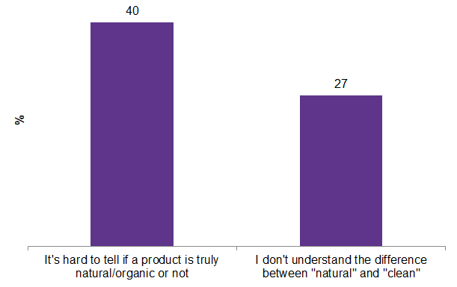
More clarity is needed within the natural
Consumers are confused about what
«natural or organic» really means
40% say it’s hard to tell if a product is truly natural/organic or not
The lack of regulation around clean and natural products leads to confusion among consumers
The inconsistent messaging for natural can lead some consumers to question the integrity and honesty of natural beauty and personal care products, underscoring the need for more industry consensus.
Select attitudes and behaviors toward natural/organic products,
October 2019
28% think there should be stricter regulations regarding natural and organic claims and 24% are confused about what certain natural certifications mean
Natural and organic personal care consumer,
US - Mintel

Slide 5
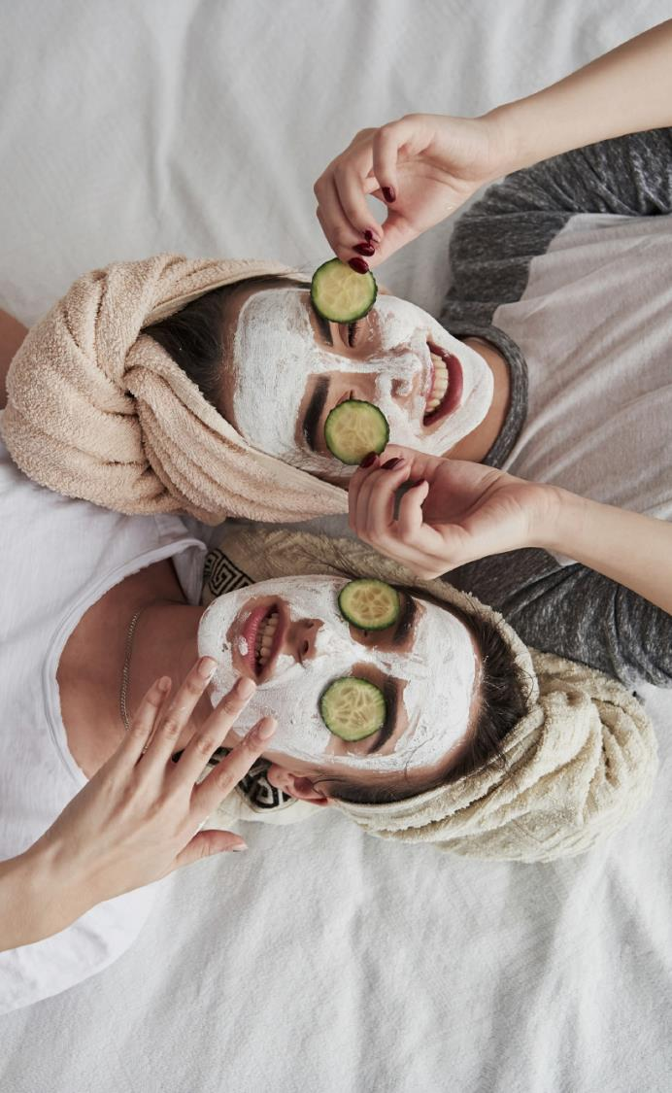

Most relevant customer needs concerning Natural ingredients
Efficacy
Transparency and Certifications
Compelling Stories and Ingredient Names
Avoidance of Supply Issues
Suppliers with Breadth of Portfolio
Production Sustainability
Ingredients’ high purity
Formulation and Colour Stability
Ingredient Safety
Source: DSM mini-customer survey 2017, top 40 manufacturers with natural marketing claims on finished products packaging

Slide 6
Consumer Products Companies invest in natural products
Growing number of products launched with natural claims**
More than 65% of all skin care launches since 2016 carried natural on-pack claim*
Number of Global product launches with natural claims on pack**
* Source: Mintel GNPD,
** Products (BPC without fragrances) with claims All Natural Product, Botanical/Herbal, Organic
Source: Mintel GNPD

Slide 7


Welcome to our
DSM Naturals range
Page
7

Slide 8



DSM House of Naturals
The DSM House of Naturals is a portfolio of products that are of natural origin*
More than 55 ingredients
Representing more than 45% of DSM’s Personal Care Portfolio
* : according to ISO 16128 standard
Page
8

Slide 9
DSM House of Naturals
The DSM House of Naturals includes products that are having a natural origin score of 60% or above:
  Calculation according to the ISO 16128 standard “Guidelines on technical definitions and criteria for natural and organic cosmetic ingredients and products- parts 1 and 2”
  Calculation giving a content above 60% for mixes and an index above 0.6 for pure compound
We volontarily discard from the DSM House of Naturals the following products even if they are compliant with the above definition:
  Any ingredients containing extracts of animal part
  Any ingredients where the active part is not of natural origin
Page
9

Slide 10










The DSM House of Naturals
The DSM House of Naturals is a portfolio of products that are of natural origin
& Fermentation

Slide 11

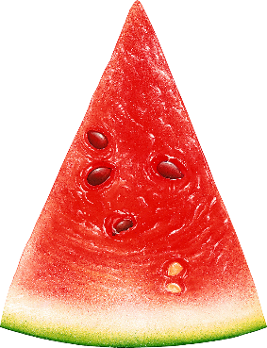
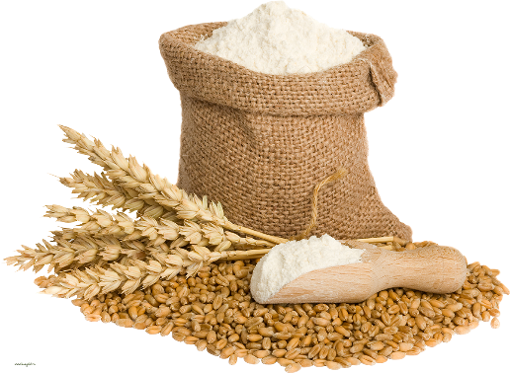



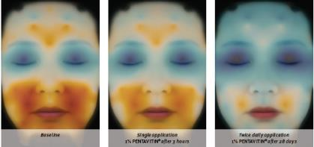

  Well-known, safe ingredients,
  used also topically since centuries
  Rice, soy and wheat germs deliver beneficial natural protein and/or natural peptide content
EXAMPLES
  PEPHA®-PROTECT, extract of Citrullus lanatus, a species of watermelon that originates from Kalahari desert.
    In order to survive, it synthesizes tough defensive compounds, so-called compatible solutes - to protect important cellular structures such as DNA. Strengthens skin’s own cell regeneration ability and helps to protect from DNA damage.
  PENTAVITIN®, a 100% plant derived active from maize kernels.
    It binds to the skin like a magnet. Brings tired, dry skin back to life. Ensures instant deep moisturization for 72 hours.
      • Visible facial hydration after 3 hours and 28 days with 1% PENTAVITIN®
      • Used for 28 days, 1% PENTAVITIN brings tired, dry skin back to life.
Page
11

Slide 12

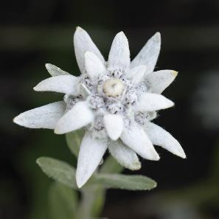
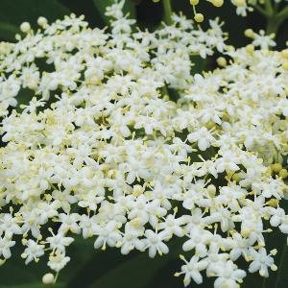
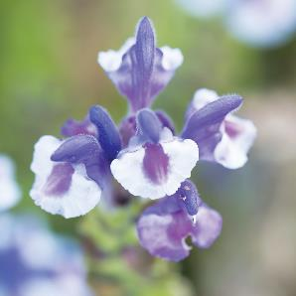

  Our herbs extracts offer high performing organic bioactives cultivated at high altitude in the Swiss Mountains.
EXAMPLES
  ALPAFLOR® EDELWEISS CB
  Carefully selected variety of Edelweiss flowers having high content of skin actives like leontopodic acid
  A powerful antioxidant and a potent
  skin barrier enhancer, without any preservative
  ALPAFLOR® GIGAWHITE CB Organic solution based on the extract of 7 alpine herbs
  Illuminates the skin in a natural way, without any preservative
ALPAFLOR® SCUTELLARIA CB Extracted from the leaves, stems and flowers of Scutellaria Alpina
  Wellness for illuminating happy skin, softens the sensitive skin, relieves unpleasant skin sensation, without any preservative
Page
12

Slide 13

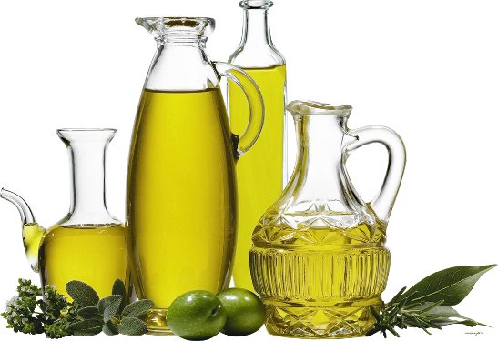
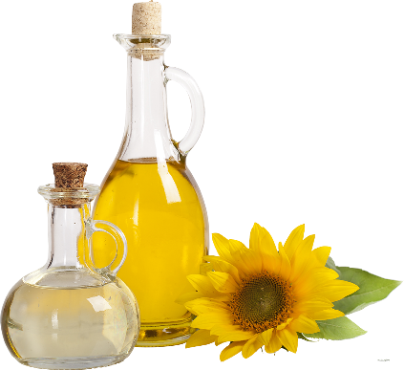

  Argan, sunflower, soy and sesame oils are some of the most traditional and well-known sources of beneficial compounds like unsaturated fatty acids and unsaponifiables.
EXAMPLES
  Mixed Tocopherols 95 Soy-derived, natural-origin Vitamin E
    Strong antioxidant, capturing free oxygen radicals generated by exposure to UV-light or pollution and preventing further damage.
  REGU®–SEB Obtained from
  Argan tree, sesame, saw palmetto
    Effective long term regulation and control of sebum production, based on 5α-reductase inhibition.
Page
13

Slide 14

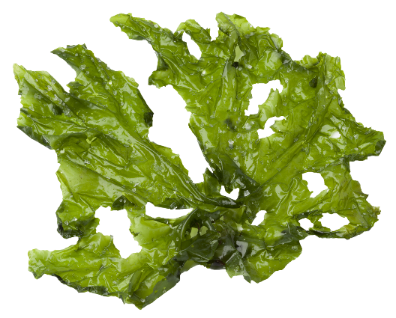
  More than 70% of the earth is covered by water. This provides many unique environments and rich resources that have great potential to produce bioactive compounds that can be used as pharmaceuticals, nutraceuticals and cosmeceuticals.
EXAMPLES
  PEPHA®-AGE CB Produced from the green freshwater microalgae Scenedesmus rubescens.
    Thanks to its unique composition of valuable components including algal monosaccharides, trace elements, and vitamins it stimulates skin’s own defense against sunlight and helps to minimize the signs of aging caused by exposure to sunlight.
  PEPHA®-CTIVE CB Microalgae extract (Dunaliella salina)
    Protects and stimulates mitochondria by increasing ATP levels. Improves skin radiance.
PEPHA®-TIGHT CB Based on highly purified microalgae Nannochloropsis occulata.
    Excellent skin tightening. Long-term filming and protection properties
Page
14

Slide 15

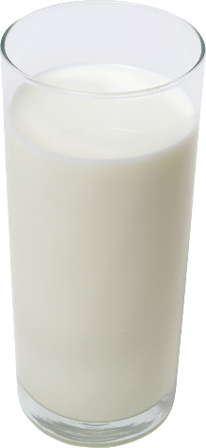
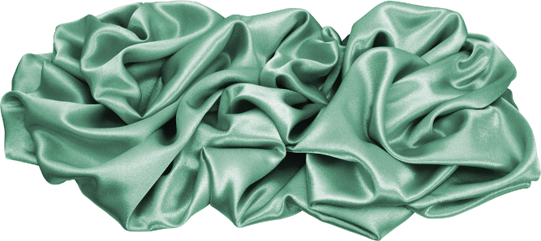
  Milk is widely known for incomparable skin benefits. Bathing in milk has been a popular beauty regimen among women for thousands of years
  Traditional and precious Silk-derived cocoon protein Sericin enhances skin with a shimmering, silk-like appearance and also offers smoothing and moisturizing benefits.
EXAMPLES
  SERICIN Sericin from silk, improves skin relief and decreases TEWL.
    Smoothing and moisturizing activity, film-forming persists even after washing. Leads to a silky skin touch.
  LACTOMIDE Liposomal dispersion obtained from milk fermentation
    Compensates loss of lipids in permeability barrier, reduces TEWL.
Page
15

Slide 16

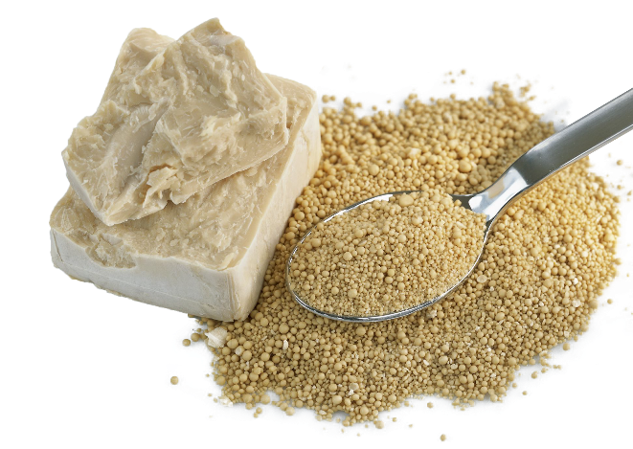

& Fermentation
  Preparations from yeast have long been used for cosmetic and pharmaceutical purposes
  Fermentation is perhaps the most ancient process mankind has ever used, as it unleashes many different compounds, some of which are very beneficial to the skin.
EXAMPLES
  ERYTHRULOSE Produced via fermentation, gives a new dimension to your self-tanning products.
    Leads to a deep, even and natural long-lasting tan without streaks, while avoiding skin dryness.
  TILAMAR PDO with NØØVISTATM. Multifunctional ingredient combining naturality, sustainability, conscious beauty, and high performance in only one product
  Designed to reduce formulation complexity by acting as a preservative booster, a skin humectant, sensory enhancer and actives carrier..
Page
16

Slide 17

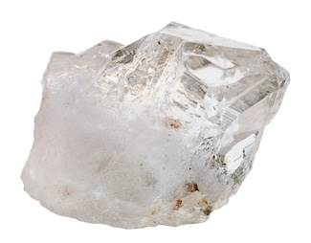
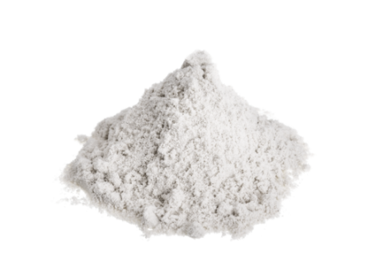
  Silica and Titanium Dioxide are minerals found in nature, used as versatile ingredients and as filters for UV protection
EXAMPLES
  VALVANCETM Look 100 Silica and Titanium dioxide
  Provides subtle and light coverage that hides chromatic disorders for a flawless skin tone. Blurring effect on fine lines and wrinkles.
  PARSOL® TX Rutile-type titanium dioxide (TiO2) core with a very tight double coating of silica and dimethicone, for easy formulation and optimized sensory.
  UVB filter providing a very good SPF performance as well as a significant contribution to UVA protection. It also offers high transparency in formulations, and is compatible with acrylate thickeners.
Page
17

Slide 18







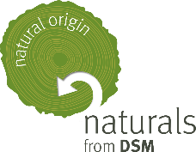
Making natural ingredients naturally simple to understand through the lens of three clear definitions
Certified organic.
Certified Organic
according to
Cosmos / Natrue standards.
Verified natural.
Conform to Ecocert, Cosmos or Natrue standards.
Natural origin.
Ingredients with a
ISO 16128 natural origin score of 60%* or above.
* content above 60% for mixes and index above 0.6 for single molecules
18
Notes:
ISO score : either index for a pure compound either content for a mixture
We decided to discard any extract from animal part and also actives, even with an ISO score >60%, but where the active ingredient is not natural (ex Peptides,

Slide 19
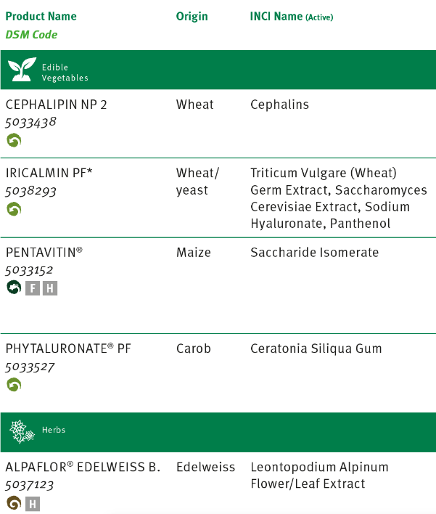

DSM House of Natural: How it all plays out - Examples
CEPHALIPIN NP2’s origin is from Edible vegetables, specifically Wheat. This product is from Natural Origin, as it has at least a 60% score on natural origin, as per ISO 12168
PENTAVITIN® is from Edible Vegetables, specifically Maize Kernels. This product is classified as Verified Natural (it complies with Ecocert, Cosmos and Natrue standards)
ALPAFLOR ® EDELWEISS CB is from Herbs, specifically Edelweiss. This product is classified as Certified Organic
(it is certified Ecocert, Cosmos and Natrue)

Slide 20







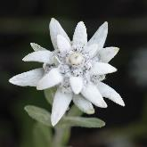
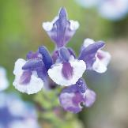


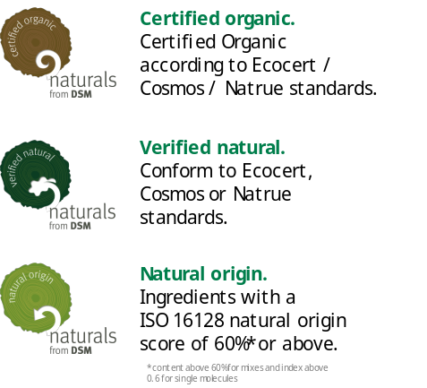
 | APPEARANCE |  |  | SENSATION | PHOTO-PROTECTION AND SENSORY BENEFITS
 | SKIN AGEING PREVENTION & REJUVENATION | SKIN REVITALIZATION & CONTOUR REMODELING | SKIN TONE, SHINE CONTROL & PORE REFINEMENT | SKIN BARRIER PROTECTION, SENSITIVITY&COMFORT AND MOISTURIZING
Edible vegetables | COLHIBIN PF – rice ELHIBIN® PF – soy PEPHA®-PROTECT – watermelon REGU®-AGE PF - rice/soy/yeast PREREGEN® PF - soy/yeast | REGU®-SLIM – guarana PENTACARE-NA-PF– wheat/carob |  | PENTAVITIN® – maize kernels PHYTALURONATE® PF – carob CEPHALIPIN NP2 – wheat IRICALMIN® PF* - wheat/yeast
Herbs | ALPAFLOR® ARTEMISIA AO – genepi ALPAFLOR® BUDDLEJA AO – buddleja ALPAFLOR® IMPERATORIA AO - masterwort ALPAFLOR® SAMBUCUS AO – elderflower |  | ALPAFLOR® GIGAWHITE CB – mix 7 plants ALPAFLOR® ALP-SEBUM CB – alpine willow herb | ALPAFLOR® LINUM AO – alpine flax ALPAFLOR® MALVA AO - mallow ALPAFLOR® MARRUBIUM AO - horehound ALPAFLOR® SCUTELLARIA CB – alpine skullcap ALPAFLOR® EDELWEISS CB – edelweiss ALPAFLOR® NECTAPURE PF – thyme/buddleja
Oils | D-alpha-TOCOPHERYL ACETATE – soy MIXED TOCOPHEROLS 95 - soy Life’s GLATM’10 n-6 Oil – evening primrose Life’s GLATM’25 n-6 Oil – borage | BEAUACTIVE® – sunflower | BEAUACTIVE® - sunflower REGU®-SEB – argan tree, sesame, saw palmetto | STIMU-TEX® AS – barley/argan tree /shea butter ARGAN OIL – argan tree

Slide 21
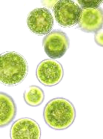

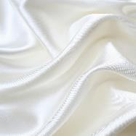
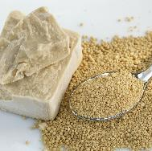
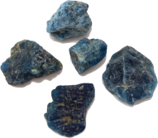

 | APPEARANCE |  |  | SENSATION | PHOTO-PROTECTION AND SENSORY BENEFITS AND MULTIFUNCTIONAL
 | SKIN AGEING PREVENTION & REJUVENATION | SKIN REVITALIZATION & CONTOUR REMODELING | SKIN TONE, SHINE CONTROL & PORE REFINEMENT | SKIN BARRIER PROTECTION, SENSITIVITY&COMFORT AND MOISTURIZING
Marine / Algae | PEPHA®-AGE CB – Scenedesmus Rubescens algae | PEPHA®-CTIVE CB – Dunaliella salina algae PEPHA®-TIGHT CB – Nannochloropsis occulata algae
Silk & Milk |  |  |  | SERICIN – silk SETAKOL® PF – silk LACTOMIDE – milk/fermentation
Yeast & Fermentation | DISMUTIN PF – yeast REGU®-AGE PF– rice/soy/yeast PREREGEN® PF* – soy/yeast ASCORBIC ACID– corn STAY-C® 50– corn | OXY 229-PF – yeast REVITALIN® PF – yeast | ERYTHRULOSE – fermentation STAY-C® 50– corn | HYALURONIC ACID-BT – bacteria HYA-ACTTM M/S/XS - bacteria HYASOL-PF – bacteria IRICALMIN® PF – wheat/yeast LACTOMIDE – milk / fermentation LIPOGARD – yeast Vitamin B12 cryst - corn
Minerals |  |  |  |  | PARSOL® TX – titanium dioxide PARSOL® ZX – zinc oxide VALVANCE® Look 100 – silica/titanium dioxide VALVANCE® Touch 250 – silica VALVANCE® Touch 210 - silica
TILAMAR® PDO with NOOVISTATM–
rapeseed
Except Silk&Milk origin

Slide 22


Natural origin PC ingredients: Recognized by ISO 16128
Products (52) from DSM House of Naturals having a natural origin above 90%
100%
NATURAL ORIGIN
98-99.9%
NATURAL ORIGIN
90-97.9%
NATURAL ORIGIN
ARGAN OIL
HYA-ACTTM M/S/XS
PEPHA®-TIGHT CB
ALPAFLOR® AO ACTIVES (7)
PENTACARE-NA PF
CEPHALIN NP₂
ALPAFLOR® ALP-SEBUM CB
HYALURONIC ACID-BT
STAY-C® 50 *
ASCORBIC ACID
PHYTALURONATE® PF
DISMUTIN® PF
ALPAFLOR® EDELWEISS CB
lifesGLA™10’n-6-oil
STIMU-TEX® AS
COLHIBIN PF
PREREGEN® PF
LACTOMIDE
ALPAFLOR® GIGAWHITE CB
lifesGLA™25’n-6-oil
TILAMAR® PDO with NØØVISTA
ELHIBIN® PF
REGU®-AGE PF
LIPOGARD
ALPAFLOR® NECTAPURE PF
Mixed TOCOPHEROLS 95
VALVANCE® Touch 210
HYASOL PF
REVITALIN® PF
REGU®-SEB
ALPAFLOR® SCUTELLARIA CB
PENTAVITIN®
VALVANCE® Look 100
OXY 229 PF
SERICIN
PARSOL® ZX
BEAUACTIVE®
PEPHA®-AGE CB
PARSOL® TX
SETAKOL® PF
VALVANCE® Touch 250
ERYTHRULOSE
PEPHA®-CTIVE CB
PEPHA®-PROTECT
60 - 90%
NATURAL ORIGIN
* Based on Carbon method
According to ISO 16128, a natural origin index and a natural index can be provided, as soon as the natural part of the ingredient/molecule is higher than 50%. This table lists DSM’s best-in-class personal care ingredients.
CEPHALIN NP₂
Vitamin B12 cryst

Slide 23
Disclaimer
Copyright © 2022 DSM Nutritional Products, 4002 Basel, Switzerland.
www.dsm.com/personal-care. All rights reserved.
Although DSM has used diligent care to ensure that the information provided herein is accurate and up to date, DSM makes no representation or warranty of the accuracy, reliability, or completeness of the information. This presentation only contains scientific and technical information for business to business use. Country- or region-specific information should also be considered when labeling or advertising to final consumers. This publication does not constitute or provide scientific or medical advice, diagnosis, or treatment and is distributed without warranty of any kind, either expressly or implied. In no event shall DSM be liable for any damages arising from the reader’s reliance upon, or use of, these materials. The reader shall be solely responsible for any interpretation or use of the material contained herein. The content of this document is subject to change without further notice. Please contact your local DSM representative for more details. All trademarks listed in this brochure are either registered trademarks or trademarks of DSM in The Netherlands and/or other countries unless explicitly otherwise stated.

Slide 24


