Slide 1
NATURAL / ORGANIC CERTIFICATIONS :
Different guidelines — what are the differences ?
ECOCERT, COSMOS, NATRUE, ISO 16128
July 2018

Slide 2

Agenda
1
Natural or Organic — consumer expectations
2
ECOCERT / COSMOS / NATRUE / ISO 16128: an overview
3
Organic calculation — examples
4
Natural calculation — examples
5
Guidelines for the use of logos

Slide 3











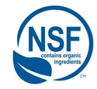

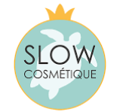

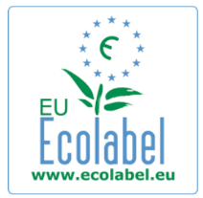


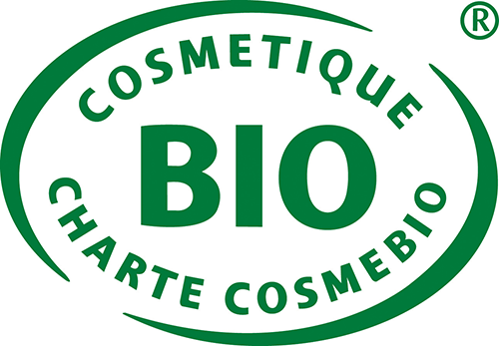
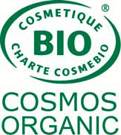
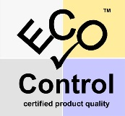


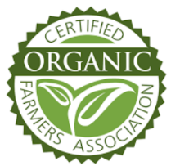
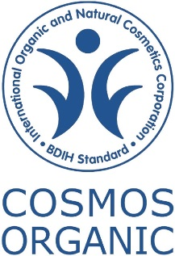






Natural & Organic logos — a jungle!

Slide 4

Consumers believe natural is best
More and more people seek naturally derived beauty products
Certified product launches are a very important feature for consumers
20% don’t know what “natural & organic” means and 18% don’t know which products are, revealing a need for clearer definition and communication from brands…
…Especially as 28% think there should be stricter regulations regarding natural and organic claims and 24% are confused about what certain natural certifications mean
84% of US NOPC consumers say USA certification is important
Source: Mintel Report [Natural and Organic Personal Care Consumer – US – December 2016]
NOPC: Natural Organic Personal Care

Slide 5
“Natural” is the most influential claim
Millennials demand more verification
Presence of natural ingredients and absence of artificial ingredients are the most influential claims for over 86%
Organically grown ingredients and absence of GMO is important for over 77%
Millennials are more demanding regarding every single claim but the biggest differences are seen in verifications and vegan claims
35% place more importance on vegan
15% place more importance on verifications
Consumers need a clear, natural standard with certification
Source: Mintel Report [Natural and Organic Personal Care Consumer – US – December 2016]

Slide 6
Agenda
1
Natural or Organic — consumer expectations
2
ECOCERT / COSMOS / NATRUE / ISO 16128: an overview
3
Organic calculation — examples
4
Natural calculation — examples
5
Guidelines for the use of logos

Slide 7
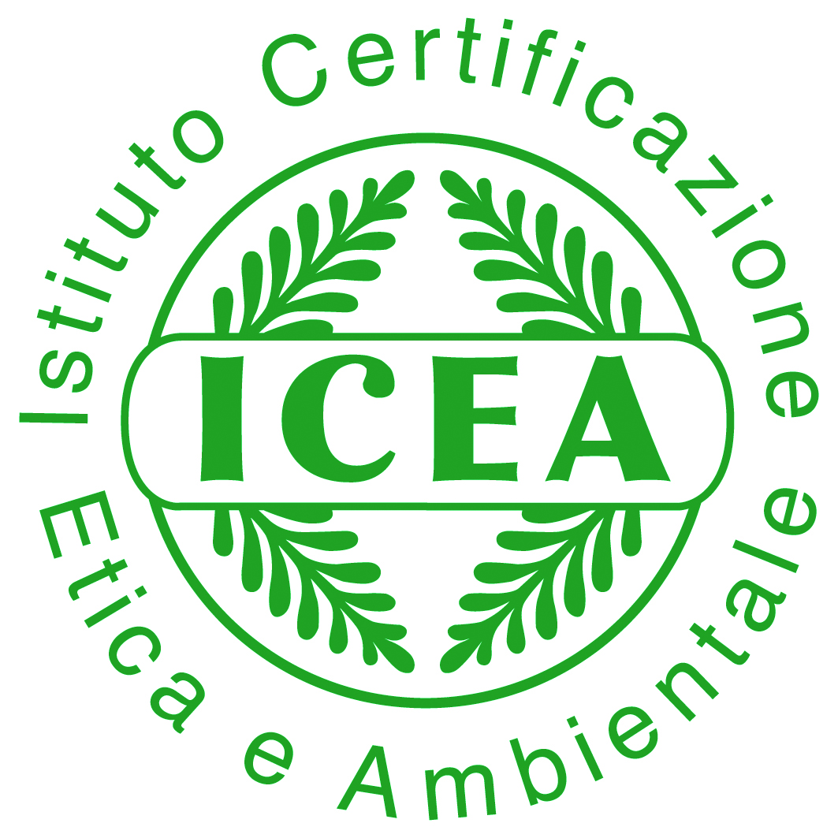
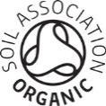

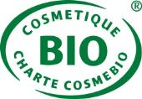



Overview of Certification Standards
ECOCERT: The pioneer, created a standard for natural and organic cosmetics in 2002. Ecocert is present in 80 countries.
Goal: to promote natural and organic substances, respect for the environment and high ethical values
  COSMOS: a step towards a single European standard initiated by the 5 main European organic and natural standard-setting organizations). Standard approved in 2010.
  Goal: to promote the use of products from organic agriculture, respect biodiversity and use clean manufacturing processes that respect human health and the environment
NATRUE: Founded in 2007 by European manufacturers of natural and organic cosmetics.
Goal: to safeguard and promote pure and authentic natural skin care
ISO 16128: International standard released in September 2017.
Goal: providing guidelines on technical definitions and criteria for natural and organic cosmetics ingredients

Slide 8
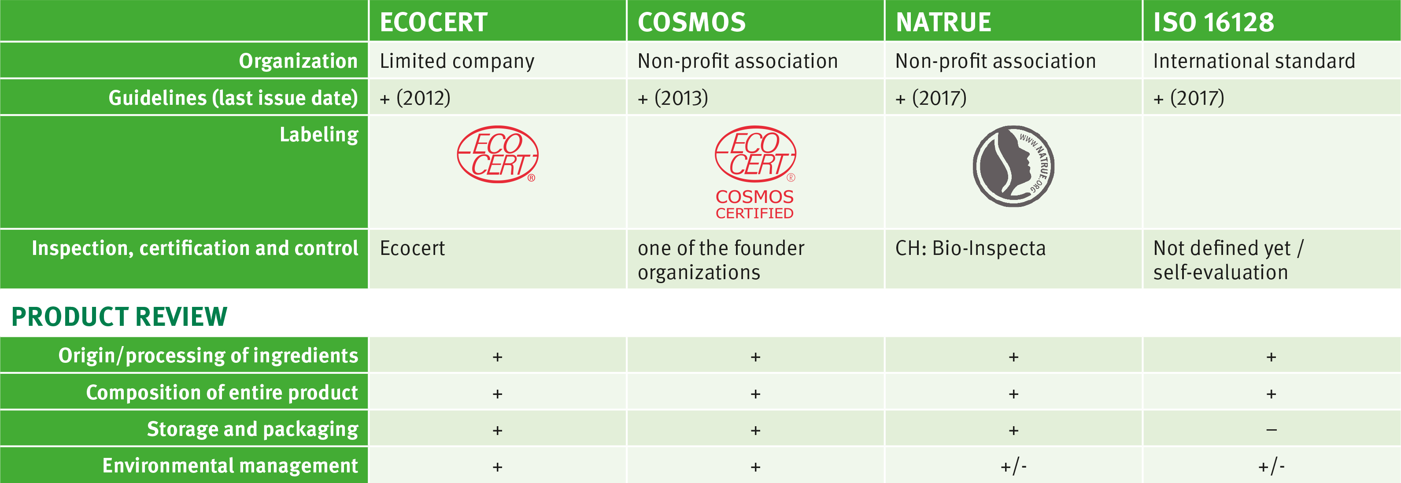
Scope
+/- : has to follow the green chemistry principles
(covering 3 pillars: renewable origin, process, environmental impact)
Links to individual standards:
http://www.ecocert.com/sites/default/files/u3/Natural-and-Organic-Cosmetic-Ecocert-Greenlife-standard-2012-with-TS_1.pdf
https://cosmos-standard.org/the-cosmos-standard/
http://www.natrue.org
https://www.iso.org/standard/62503.html

Slide 9
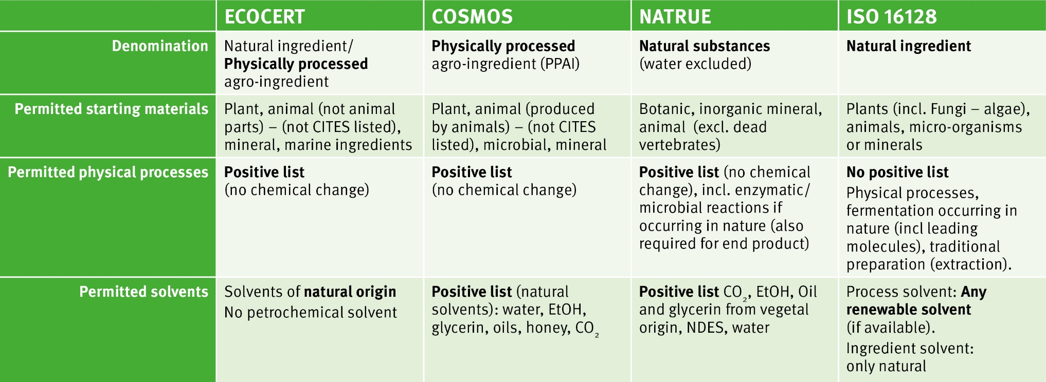
What does “natural” mean ?
Definitions
*
All standards have similar definitions regarding starting materials.
The major difference concerns ISO 16128 permitting solvents.
CITES: Convention on International Trade in Endangered Species of wild fauna and flora
NDES: Natural Deep Eutectic Solvents
* «end product» refers to the result of the enzymatic/microbial reaction

Slide 10
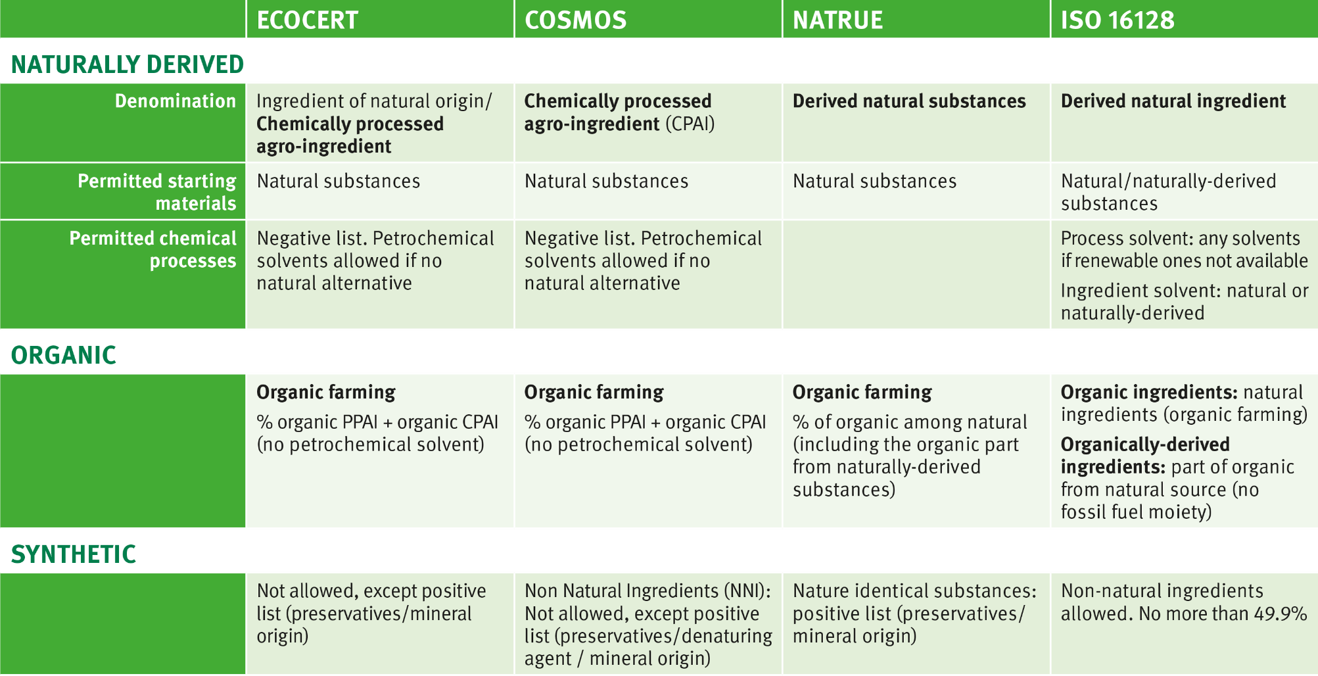
Derived natural / organic / synthetic
Definitions
PPAI: Physically Processed Agro-Ingredient
CPAI: Chemically Processed Agro-Ingredient
NNI: Non Natural Ingredient

Slide 11
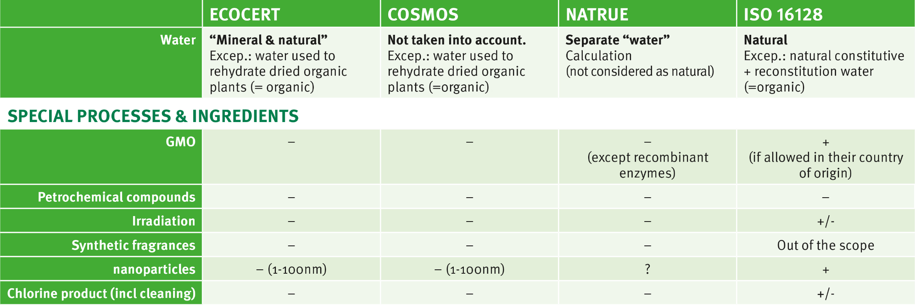
Special cases
+/- : under investigation

Slide 12

Highlights
ECOCERT and COSMOS: Very strict labels especially after the update of ECOCERT in 2012. Focus on organic products, good waste management, energy consumption, preserving ecological balance, biodegradable and limiting contaminants (heavy metals, pesticides, PCB, dioxins, mycotoxins, nitrosamines).
NATRUE: Focus on natural (more than organic) and on the finished cosmetic product. More focus on green chemistry and packaging, than on the environment, but still close to Ecocert and Cosmos even if calculations for ingredients are different.
ISO 16128: Totally different approach, aimed to calculate the various indexes. More flexible and less strict. Not a label. More useful for customers (than for consumers) to compare the naturalness of different ingredients.

Slide 13
Agenda
1
Natural or Organic — consumer expectations
2
ECOCERT / COSMOS / NATRUE / ISO 16128: an overview
3
Organic calculation — examples
4
Natural calculation — examples
5
Guidelines for the use of logos

Slide 14
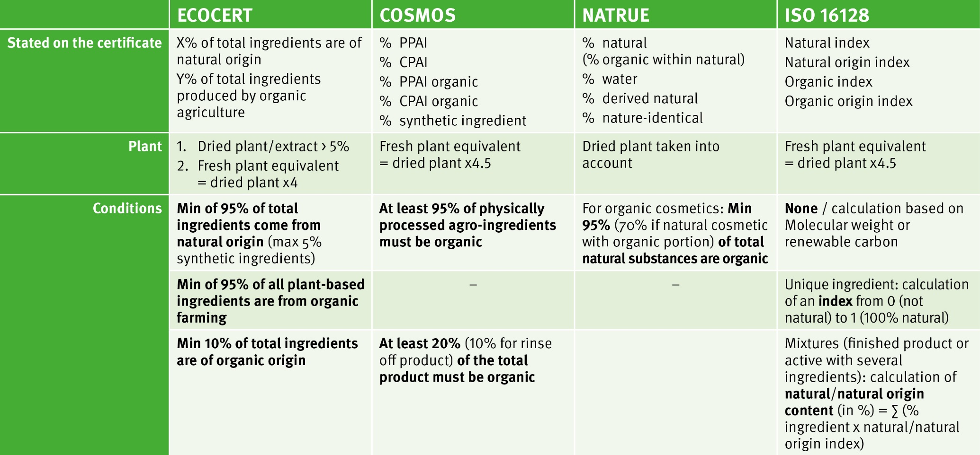
Organic calculation
General overview
*
PPAI: Physically Processed Agro-Ingredient
CPAI : Chemically Processed Agro-Ingredient
* : index for pure compound or content for mix

Slide 15




ECOCERT, COSMOS, NATRUE
Organic calculation
Max 5% of synthetic
ingredients from positive list
Min 95% of total ingredients
are of natural origin
Min 95% of total vegetal + marine ingredients are organic
Min 95% of total natural substances are organic
Min 95% of PPAI (natural ingredients) are organic
Min. content of natural substances & max. content of derived natural substances,
in the finished product,
depending on type of cosmetic (emulsion, sunscreen, soap, etc)
Min 20% of total product is organic (10% for rinse-off products)
Min 10% of total ingredients are organic

Slide 16

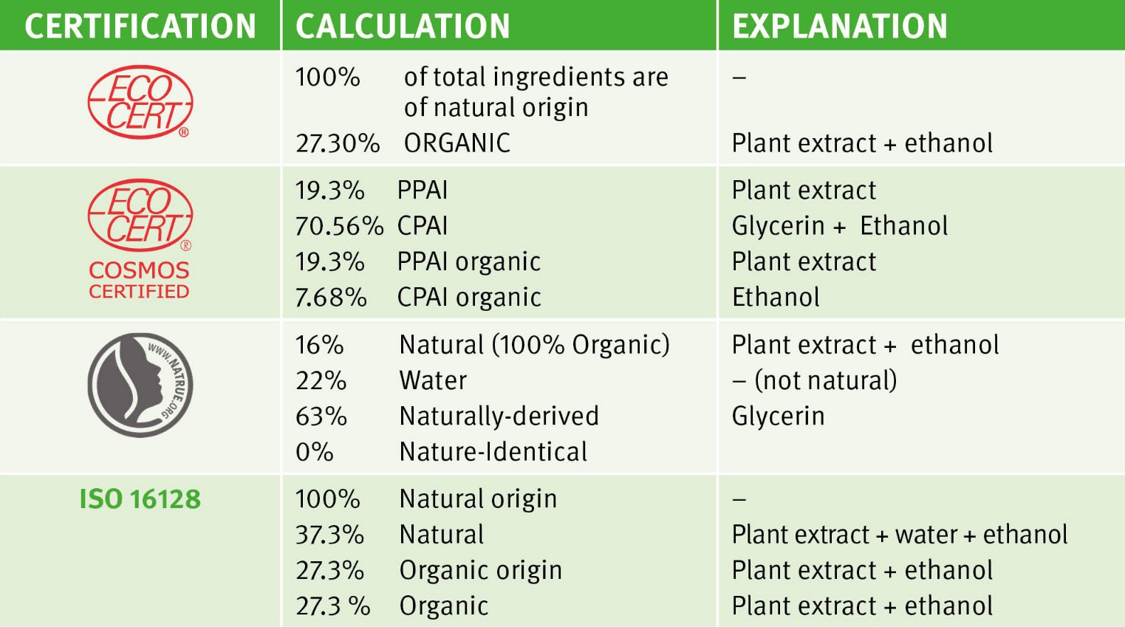
Certification of ingredients: examples
ALPAFLOR® EDELWEISS B (5037123)
Composition
INCI Name
Content
Leontopodium
Alpinum Extract
5-10%
Glycerin
>50%
Aqua
10-25%
Alcohol
5-10%

Slide 17

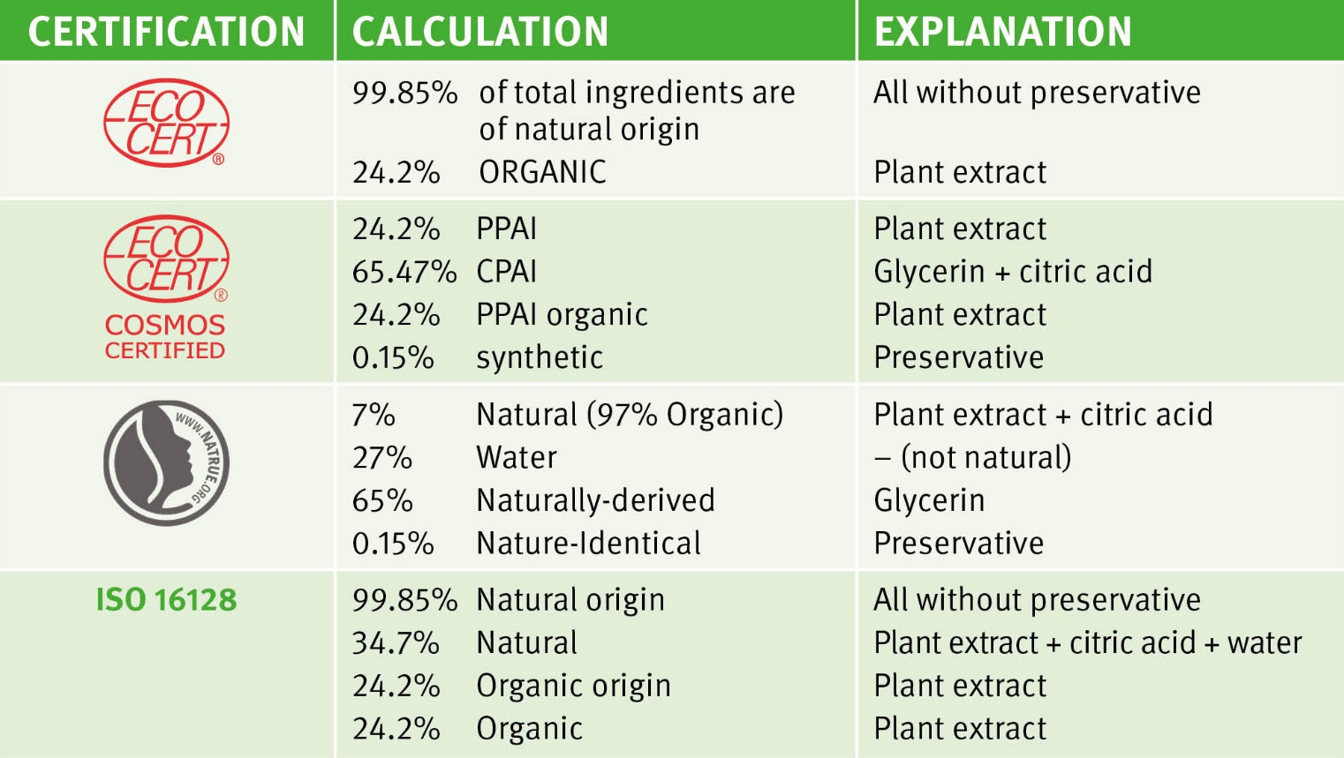
Certification of ingredients: examples
ALPAFLOR® ALP®-SEBUM (5037638)
Composition
INCI Name
Content
Epliobium Fleischeri Exract
5-10%
Glycerin
>50%
Aqua
25-50%
Citric Acid
0.1-1%
Potassium Sorbate
0.1-1%

Slide 18
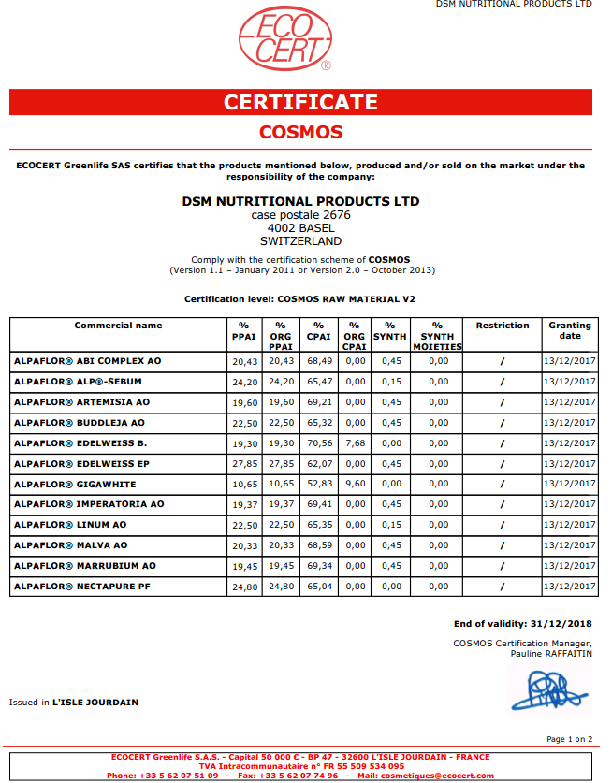
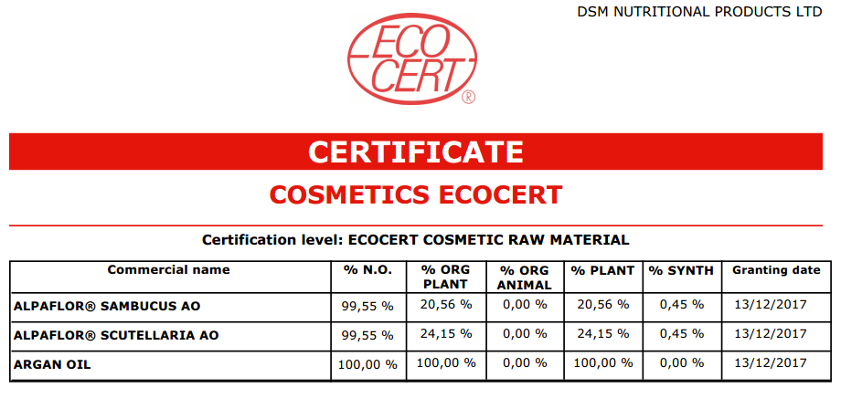
Certificates
ECOCERT & COSMOS certificates valid 1 year

Slide 19
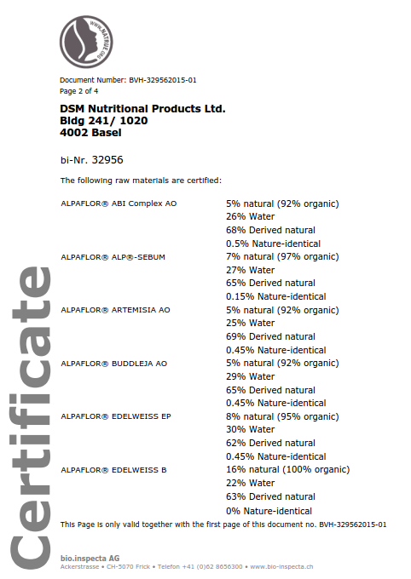
Certificates
NATRUE certificates valid 2 years

Slide 20
Agenda
1
Natural or Organic — consumer expectations
2
ECOCERT / COSMOS / NATRUE / ISO 16128: an overview
3
Organic calculation — examples
4
Natural calculation — examples
5
Guidelines for the use of logos

Slide 21
Natural calculation
General overview
If the starting materials (plants, animals) are not organic, but natural or of natural origin
And if the manufacturing of the ingredient follow the same rules on processes and solvents as those described in previous chapters
☞ the ingredient may comply with ECOCERT/COSMOS/NATRUE requirements for natural ingredients
For finished products:
NATRUE:
Table showing the minimum content of natural substances and maximum content of derived natural substances,
depending on the type of cosmetic
(emulsion, sunscreen, soap, etc).
ECOCERT, COSMOS:
The ingredients have to follow the same rules in terms of processes, solvents, sustainability than the organic certified ones.
ISO16128:
No specific requirement to use organic ingredients, just calculate the natural origin percentage (based on weight).
Stated on certificates for ingredients:
ECOCERT:
natural origin %, vegetable %
COSMOS:
PPAI %, CPAI %, synthetic %
NATRUE:
exactly the same wording as for organic
ISO 16128:
natural origin %, natural %

Slide 22

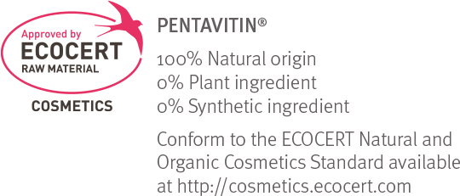

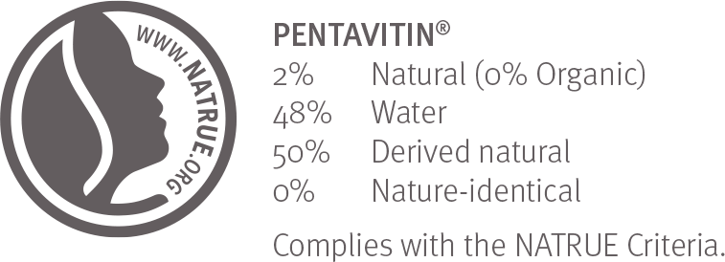
Natural origin: example
PENTAVITIN® (5033152)
ECOCERT: Ecocert approved
100% Natural Origin, 0% vegetable
Composition
INCI Name
Content
Saccharide Isomerate
>50%
Aqua
25-50%
Citric Acid
0.1-1%
Sodium Citrate
0.1-1%
COSMOS: Cosmos approved
NATRUE:

Slide 23
PC verified Natural Ingredients
PRODUCT | ECOCERT* | COSMOS* | NATRUE*
ERYTHRULOSE (5038282) | 100% Nat | Not assessed | Not assessed
HYALURONIC ACID BT (5033462) | 100% Nat | Not assessed | Not assessed
PENTAVITIN® (5033152) | 100% Nat | 67.1% CPAI | 2% Natural (0% organic) 48% Water 50% Derived natural
REGU®-SCENCE (5038306) | Not assessed | 27.7% PPAI 50.2% CPAI 0.5% NNI | Not assessed
STIMU-TEX® AS (5033365) | 100% Nat 67% Veg | Not assessed | 99.95% Natural (20% organic) 0% Water 0.05% Derived natural 0% Nature-identical
VALVANCE™ Look 100 (5015114) | Not assessed | 0%** | 100% Natural (0% organic) 0% Water 0% Derived natural 0% Natural-identical
VALVANCE™ Touch 210 (5015112) | 100% Nat | 0%** | 100% Natural (0% organic) 0% Water 0% Derived natural 0% Natural-identical
* approved to be used in natural & organic formulations.
** ingredients from mineral origin, therefore neither PPAI nor CPAI
ECOCERT: Nat: Natural or from natural origin; Veg: Physically Processed vegetal ingredients; Synth: Synthetic (petrochemical)
COSMOS: PPAI: Physically Processed Agro-Ingredient; CPAI: Chemically Processed Agro-Ingredient, NNI: Non Natural Ingredients

Slide 24
New ISO 16128
A complex landscape
Quality and Sustainability are priorities for DSM Personal Care. In that context, the new standard ISO 16128, which focuses on technical definitions and criteria for natural and organic ingredients, is relevant for our business. However this standard, launched in September 2017, still allows for multiple interpretations. To overcome that, a working group, of which DSM Personal Care is a part, led by the European organization FEBEA, is working in 2018 on a technical report. This report should finally be discussed and approved by the ISO committee. We therefore don’t expect to have a complete clarity before 2020.
In the meantime, according to our best knowledge and understanding of the standard, please find on the next slide our rating for our Personal Care products. Detailed rating available on request.

Slide 25
Natural origin: Recognized by ISO 16128
Many PC products have a natural origin content or natural origin index (excl. ALPAFLOR®)
100%
NATURAL ORIGIN
98-99.9%
NATURAL ORIGIN
90-97.9%
NATURAL ORIGIN
ARGAN OIL
PENTAVITIN®
REGU®-SCENCE
PEPHA®-PROTECT
CEPHALIN NP₂
ERYTHRULOSE
BEAUACTIVE®
PEPHA®-TIGHT
REGU®-AGE PF
DISMUTIN® PF
HYALURONIC ACID-BT
lifesGLA™10’n-6-oil
PHYTALURONATE® PF
PEPHA®-CTIVE
LACTOMIDE
STIMU-TEX® AS
lifesGLA™25’n-6-oil
HYASOL PF
PENTACARE-HP PF
LIPOGARD
VALVANCE® Look 100
Mixed TOCOPHEROLS 95
SERICIN
COLHIBIN PF
REGU®-SEB
VALVANCE® Touch 210
SETAKOL® PF
ELHIBIN® PF
REVITALIN® PF
PARSOL® TX
PREREGEN® PF
OXY 229 PF
According to ISO 16128, a natural origin index and a natural index can be provided, as soon as the natural part of the ingredient/molecule is higher than 50%.
Above table lists DSM’s best-in-class personal care ingredients.

Slide 26
Agenda
1
Natural or Organic — consumer expectations
2
ECOCERT / COSMOS / NATRUE / ISO 16128: an overview
3
Organic calculation — examples
4
Natural calculation — examples
5
Guidelines for the use of logos

Slide 27

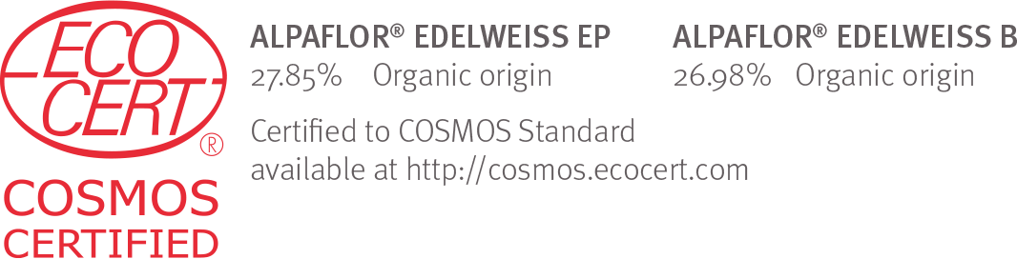

Guidelines for the use of logos (1/2)
ECOCERT: logo with indication of percentages and standard ECOCERT wording
Case 1: organic (certified) products:
The ECOCERT logo can only be used
for a certified (organic) product
Case 2: natural (approved) products:
A different ECOCERT logo must be used
for an approved raw material!
COSMOS: same rules regarding wording and percentages, 2 types of logo
Organic certified ingredients Natural approved ingredients

Slide 28
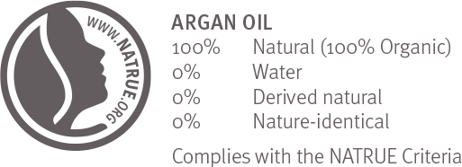
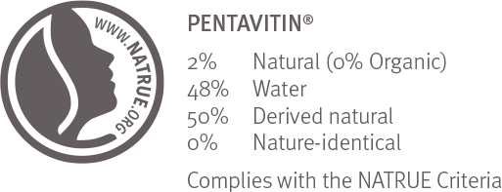
Guidelines for the use of logos (2/2)
NATRUE
Logo and certificates are the same for organic certified products and natural (non-organic) products.
The logo should be used in line with specific rules:
- linked to a certified (organic or natural) product
- indicating the percentages
- with the standard NATRUE wording
Cosmetic finished products: a logo from ECOCERT/COSMOS/NATRUE can only be used when the full formula is certified.
ISO 16128: NO LOGO

Slide 29
Natural & Organic Certifications
Short Summary
ECOCERT / COSMOS / NATRUE
Very strict certification guidelines, but the calculation methods sometimes provide different percentages from one certification to another.
ISO 16128
Very new. Much broader, but with the advantage of a recognized international standard. FEBEA technical report has still to be written and finally approved by the ISO committee.
With this broad range of certifications, including Fair Trade for the ALPAFLOR® Portfolio, DSM :
Provides a recognized guarantee of the natural/organic properties of its ingredients;
Supports its customers globally with their own certifications and sustainability targets;
Offers peace of mind about its ingredients.

Slide 30

Back Up

Slide 31
Goals
ECOCERT: is a limited company. As an inspection and certification body, it was a pioneer for sustainable development, and created a standard for natural and organic cosmetics in 2002. ECOCERT is present in 80 countries
  Goal: to promote natural and organic substances, respect for the environment and high ethical values Linking cosmetics products to organic raw materials and high ethical values
COSMOS: Non-profit international association. Founded in 2002 by the 5 main European bodies for organic and natural standards (BDIH- Germany, Cosmebio and Ecocert Greenlife-France, ICEA-Italy, Soil association- UK). Standard approved in 2010
  Goal: to manage and develop the Cosmos-standard as an international
  standard for organic and natural cosmetics. Its guiding principles are to:
  - Promote the use of products from organic agriculture, and respect biodiversity;
  - Use natural resources responsibly and respect the environment;
  - Use clean manufacturing processes that respect human health and the environment;
  - Integrate and develop the concept of “Green Chemistry”.
NATRUE: Non-profit association. Founded in 2007 by European manufacturers of natural and organic cosmetics. First certification in 2009.
  Goal: to safeguard and promote pure and authentic natural skin care
ISO 16128: International standard released in September 2017. Voluntary basis
  Goal: Providing guidelines on technical definitions and
  criteria for natural and organic cosmetics ingredients

Slide 32
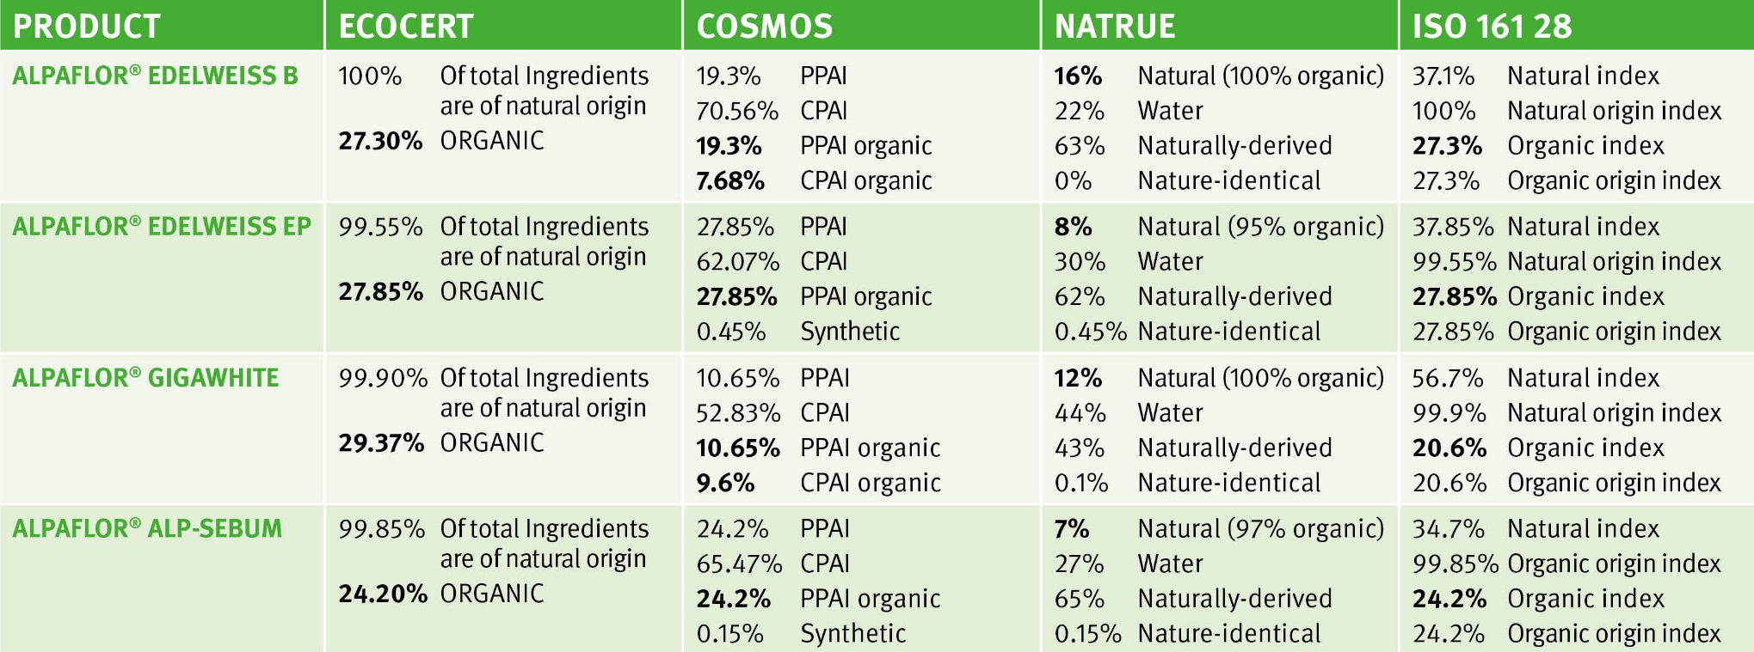
Organic calculations: examples
Glycerin: CPAI or naturally-derived
Ethanol: CPAI organic or natural + organic
Citric acid: natural for Natrue, CPAI for Cosmos
Plant: organic (with reconstitution water except for Natrue)
Water: not natural for Natrue

Slide 33


Naturalness must be reflected in all of the brand’s actions
Consumers are looking for more ethical products and brands that respect the environment.
Brands that truly want to be natural must therefore commit to a “fully natural” approach and
place sustainability at the centre of everything they do, from A to Z.
As well as formulating natural, organic products with sustainably-sourced natural, organic ingredients and packaging using sustainable production methods, it is essential for brands to take a stand for People & the Planet and to incorporate this in their brand identity & communication.
People & Social Empowerment
Planet & Environmental Preservation
Support charities
Fair trade
Help develop local communities
Respect & improve women’s rights
Reduce carbon footprint
Reduce water consumption and recycle water
Use renewable energy sources

Slide 34
ALPAFLOR® fairly traded sustainable crops
CITES*
Plants not listed
NAGOYA & CBD** compliancy
Organic crops
According to Bio Suisse standards. Protection of soils & groundwater.
Protection of Alpine biodiversity. Renewable source.
Direct payment from Helvetic Confederation to farmers who maintain the natural Alpine landscape.
Profitable economic activity
for mountain farmers,
avoiding flight to the cities from the countryside.
DSM assumes all risks involved in the cultivation not the farmers or the cooperative.
Farmers‘ wages paid based on the area cultivated not the yield of dried plant.
DSM’s cultivated land does not take up space which could be used to grow food.
*CITES: Convention on International Trade in Endangered Species
** CBD: Convention on Biological Diversity

Slide 35

ALPAFLOR®
Fair Trade dried alpine supply chain
The same rules are applied for North-North certifications as for North-South ones (developed countries- developing countries)
Long term contract with farmer/cooperative
Small-scale producers
Short and local supply chain /product carbon footprint
Minimum price guarantee /fair wages
Protecting biodiversity/organic farming
Good working conditions
Technical support
Development fund
Long term contract with farmer/cooperative
Small-scale producers
Short and local supply chain /product carbon footprint
Minimum price guarantee /fair wages
Protecting biodiversity/organic farming
Good working conditions
Technical support
Development fund
Fair trade certified according to the Fair For Life standard
For North-based developed countries, there is a major emphasis on environmental impact, in addition to the social improvement components.
Source: www.fairforlife.org

Slide 36
Disclaimer
Copyright © 2018 DSM Nutritional Products, 4002 Basel, Switzerland.
www.dsm.com/personal-care. All rights reserved.
Although DSM has used diligent care to ensure that the information provided herein is accurate and up to date, DSM makes no representation or warranty of the accuracy, reliability, or completeness of the information. This presentation only contains scientific and technical information for business to business use. Country- or region-specific information should also be considered when labeling or advertising to final consumers. This publication does not constitute or provide scientific or medical advice, diagnosis, or treatment and is distributed without warranty of any kind, either expressly or implied. In no event shall DSM be liable for any damages arising from the reader’s reliance upon, or use of, these materials. The reader shall be solely responsible for any interpretation or use of the material contained herein. The content of this document is subject to change without further notice. Please contact your local DSM representative for more details. All trademarks listed in this brochure are either registered trademarks or trademarks of DSM in The Netherlands and/or other countries unless explicitly otherwise stated.

Slide 37


