Slide 1

The Sunny Skin Microbiome 2.0
Reframing daily sun protection for acne‑prone skin
March 2026
Notes:
It has been some time since we launched Sunny Skin Microbiome, the industry’s first exploratory research program to investigate the interaction between UV exposure, UV filters, and the skin microbiome, supported by clinical evidence.
Today, we are excited to take this work further. As an evolution of Sunny Skin Microbiome 1.0, this latest study brings new clinical evidence in acne‑prone skin, deepening our understanding of how everyday UV exposure and sun protection influence the skin’s microbial ecosystem.

Slide 2
How we use ‘Acne’ in this presentation
This presentation is intended for B2B communication only.
All acne‑related terminology reflects scientific insights for professional discussion. Final consumer‑facing claims remain the full responsibility of the finished‑product manufacturer and must comply with local cosmetic regulations in their markets.
Understanding ‘Acne’ in a Cosmetic Context
Acne-prone skin
A skin type that is more likely to develop visible blemishes (breakouts, clogged pores, shine).
Not a medical diagnosis.
Visible acne concerns
Common consumer language describing pimples, blackheads/whiteheads, oily or blemish‑prone skin.
Refers strictly to appearance-level concerns.
Diagnosed acne
A medical condition assessed by a dermatologist using clinical criteria.
Cosmetic products cannot claim to treat, cure, or prevent diagnosed acne.
In this presentation, ‘acne’ refers only to:
Visible concerns associated with acne‑prone skin
UV‑related microbial imbalances linked to blemish‑prone conditions of acne
and does not imply any medical treatment or disease prevention of acne
Notes:
First of all, it’s important to align on terminology of acne — especially from a regulatory perspective.
In this presentation, acne‑prone skin refers to visible acne‑related concerns such as breakouts, clogged pores, blemishes, or shine.
We are not referring to diagnosed acne, which is a medical condition and out of scope for cosmetics.
So whenever we use the word “acne” here, we mean appearance-level concerns commonly observed in acne‑prone skin.
This framing is essential for all B2B discussions.

Slide 3


Beauty is undergoing a fundamental shift
Consumers are moving away from chasing quick fixes and toward maintaining long-term skin health.
Skin Longevity
is gaining growing attention. Moving beyond outdated anti-aging claims toward a philosophy of well-aging, consumers are exploring holistic, long-term strategies that support the skin as an interconnected ecosystem for sustained health and resilience.
Sun Care
has been outperforming the personal care market. This significant growth underscores the global shift toward proactive skin health and prevention.
2026 Global Beauty & Personal Care Predictions - Mintel
Notes:
Let’s begin the story.
In recent years, we’ve seen a significant shift in consumer attitudes — from quick fixes toward long‑term skin health.
For example, “Skin longevity” has emerged as a major theme, highlighting holistic routines that keep the skin resilient over time, beyond traditional anti‑aging.
At the same time, sun care continues to outperform the wider personal care market. As a cornerstone of prevention, consumers are increasingly incorporating SPF into their daily routines.

Slide 4
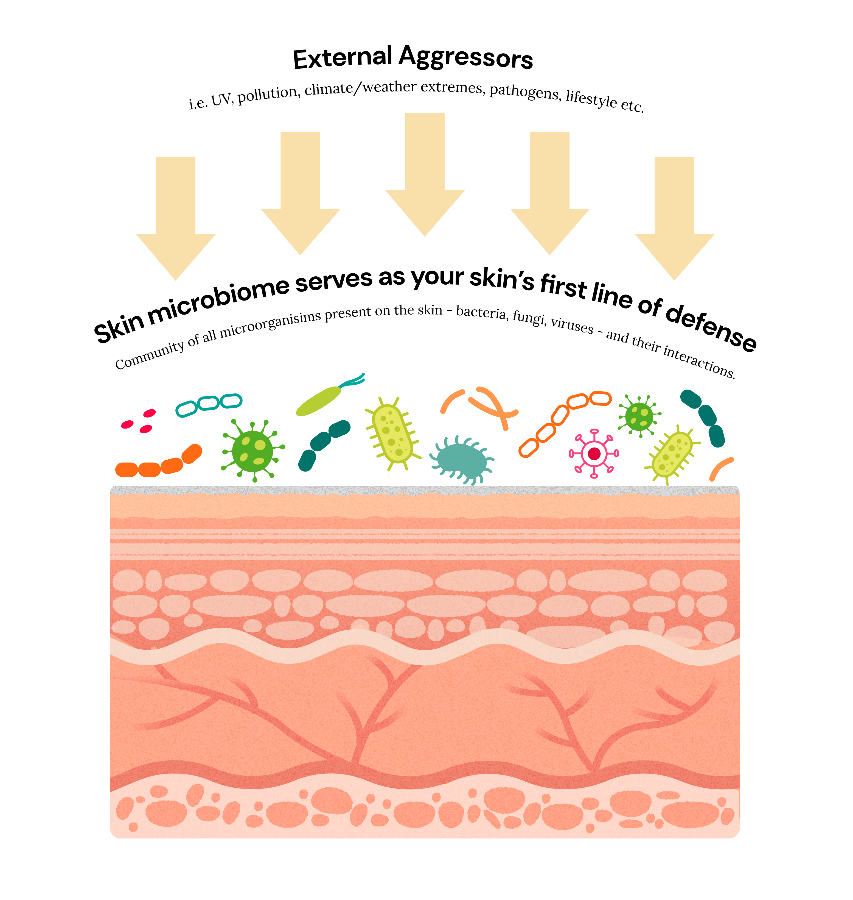
The microscopic guardian is vital to skin resilience
When it comes to ecosystems, few are as vital — or as overlooked — as the billion-strong community thriving on our skin: the microbiome eco-system.
A stable and well-balanced microbiome eco-system is the skin’s first line of defense against external aggressors, helping maintain its barrier and supporting immune responses.
UV exposure stands among the most potent external stressors for skin — an unseen force that shapes both immediate and long‑term skin quality.
In the short term, UV can trigger visible redness, pigmentation, and a momentary weakening of skin’s natural defenses.
But its deeper impact unfolds over time: accelerated photoaging, loss of youthful radiance, and a heightened risk of long‑term damage driven by cumulative exposure i.e. photocarcinogenesis.
Notes:
For many years, the industry has focused heavily on the skin barrier — and rightly so. The idea of strengthening the barrier became mainstream as consumers learned how essential it is for keeping the skin resilient against external stressors.
But in the past decade, our scientific lens has widened. We now understand that the skin microbiome is just as essential as the barrier, because the two systems constantly communicate and work hand in hand. You can think of the microbiome as a living shield — a dynamic ecosystem that helps the skin regulate itself, stay balanced, and respond to environmental challenges.
When this system is stable, it supports a smooth, healthy‑looking complexion. But when it is disturbed — whether by climate, pollution, or UV exposure — certain bacteria can shift out of balance, which may contribute to visible imperfections.
UV is particularly powerful. We all know UV can cause redness or pigmentation on the surface, but what’s less intuitive is how daily‑level UV exposure may subtly influence the microbial communities that live on our skin. And this interaction has not been fully explored.
So the key question becomes:
How exactly does UV exposure affect the microbiome ecosystem?
What are the hidden mechanisms that may lead to visible skin imperfections?
This unknown is what opened the door for deeper scientific investigation.

Slide 5


The interaction between UV exposure and skin microbiome has been explored
In 2023, dsm-firmenich conducted its first exploratory study to uncover the science behind the topic. The findings related to C. acnes has caught our attention.
1.
UV exposure triggers overproduction of C. acnes, a key acne-associated bacteria in vivo.
2.
A combination of PARSOL® EHT, PARSOL® 1789, and PARSOL® Shield can help mitigate acne propagation when included in sunscreen in vitro.
Click here for Sunny Skin Microbiome 1.0 full review.
Schuetz R. et al., IJCS, 2023
Notes:
As a leader in sun care, we initiated our first exploratory microbiome study three years ago. We found that an SPF20 sunscreen strengthened the skin barrier and resilience by protecting a key player Lactobacillus crispatus in skin upon UV stress. In addition, we made two key observations, both highly relevant to C. acne, which is one of the dominant bacteria in oil-rich skin areas especially.
1/ Our in vivo study observed an overproduction of C. acnes triggered by UV exposure.
2/ Our in‑vitro study showed that specific PARSOL® UV filter combinations can help mitigate this UV‑driven increase.
These early observations not only confirmed UV’s role in shifting C. acnes levels, but also highlighted that UV filters themselves may have an influence on maintaining balance. This became an important hint for us — that sunscreen could play a role not only in protecting the skin, but also in supporting a healthier microbial environment under UV stress.

Slide 6



Acne is noticeably rising as a concern
Acne is no longer just a teenage problem.
With around 1 in 5 adults experience acne, the increase of adult acne is confirmed.
Epidemiological research shows particularly sharp increases across Asia — with China, South Korea, Japan, and Southeast Asia reporting some of the fastest-growing rates globally.
Urban density, heat, humidity, pollution, changing diet patterns, and relentless environmental stressors are creating the perfect storm for acne formation. In the cosmetic context, this refers to visible skin concerns such as breakouts, clogged pores, excess sebum, and blemish-prone skin.
The conditions that fuel acne are not only increasing - they’re part of daily life.
“Our study confirmed the increase in adult acne, with approximately 1 out of 5 individuals between 25 and 39 years of age being diagnosed with acne.” (JAAD)
Wang Y. et al., Sec. Dermatology, 2022
Tian L. et al., Skin Research and Technology, 2024
Roengritthidet K. et al., Acta Derm Venereol. 2021
Saurat J. et al., JAAD, 2024
Notes:
Building on these findings, we explored the broader acne landscape. One of the clearest findings is that acne is no longer a skin concern limited to teenagers. In many markets — especially across Asia — adult acne is increasingly common.
According to JAAD, a professional dermatology journal, around 1 in 5 adults between 25 and 39 years old has been clinically diagnosed with acne.
There are several contributing factors: high humidity in megacities, urban pollution, stress, long working hours, changes in diet and lifestyle. These are all real‑life triggers that consumers experience daily. And importantly, they are not going away.
So acne‑prone skin is becoming more of a long‑term condition people live with, rather than a temporary teenage issue. This makes it even more relevant to understand how daily external factors like UV exposure might influence the skin’s behavior — and how sun protection could potentially help break the cycle.
**********Reference publication links*******************************
China
https://doi.org/10.3389/fmed.2022.939584
https://doi.org/10.1111/srt.13693
Thailand
https://pubmed.ncbi.nlm.nih.gov/34806756/
JAAD
https://www.sciencedirect.com/science/article/pii/S0190962224000021

Slide 7

The SPF–acne dilemma
The latest dsm-firmenich survey identified that…
While sunscreen has been very well adopted as daily routine among Asian consumers…
…the perception that a sunscreen can cause acne discourages certain sunscreen users to wear more often.
Among those extremely concerned about acne or blemished skin, 22% don’t use sunscreens more often because of acne barrier.
Global sun care U&A survey, dsm-firmenich 2025
Notes:
Our own sun care user‑attitude survey uncovered an important tension.
On one hand, Asian consumers are more diligent than ever about SPF. They understand protection, prevention, and skin perfection. SPF has become a part of the everyday beauty ritual.
But on the other hand, the fear of acne breakouts remains extremely strong.
This emotional hesitation is powerful. Even though they want to protect their skin, the fear of triggering imperfections holds them back.
And this is exactly where our scientific exploration becomes important. If we can demonstrate that sunscreen — especially SPF 50 — not only doesn’t worsen acne‑prone skin, but actually helps maintain a balanced microbiome under daily UV, we can genuinely shift consumer perception and behavior.
This is a meaningful opportunity for every brand and market represented here.

Slide 8

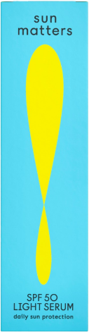
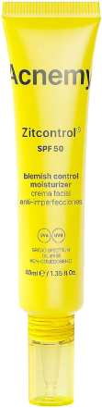
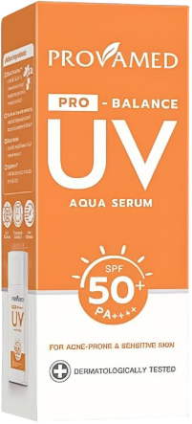
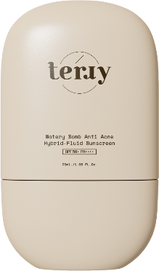
Brands are making efforts to alleviate the dilemma
With anti-acne in the product name, addressing the topic by enriched bioactives.
For acne-prone and sensitive skin with a prebiotic formula, with bioactive ‘helps reduce acne, restore microbial balance to healthy skin’.
Early launches are starting to claim acne-related benefits and encouraging for daily protection.
These are two different brands/products. The comment below only applies to SUN MATTERS.
And pls put this product into the last.
Replace the product image with another package
‘The world's first microbiome-friendly certified sunscreen’, suitable for all skin types including acne-prone skin.
‘Acnemy is the natural enemy of acne.’ This non-comedogenic sunscreen is formulated for acne-prone skin with ‘unique combination of acne-fighting ingredients’.
Notes:
We have seen that some brands have started to address this gap with acne‑related SPF claims and products promoted for daily use.
Examples displayed here are:
Sun Matters, the first microbiome-friendly certified sunscreen
Terry, a Thai brand highlighting “anti-acne” in its product name
Acnemy, a brand dedicated to acne‑prone skin across categories
Provamed, another well‑known Thai brand
This reflects a growing market need — but also shows room for more robust, science‑based differentiation.

Slide 9
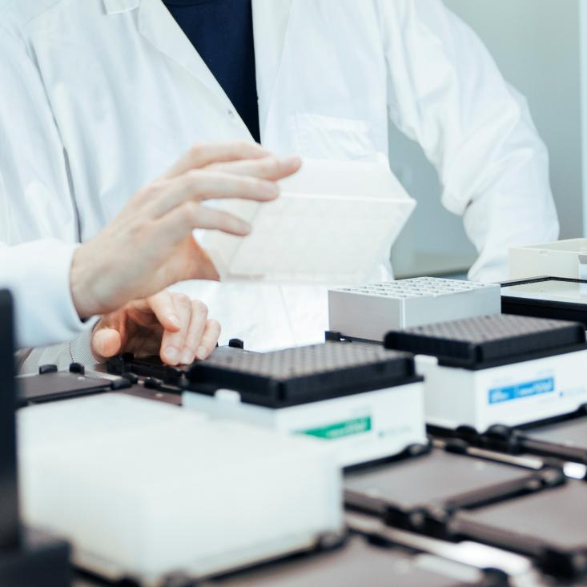
Closing the gap with microbiome insights
Today’s sun care products mostly promise “non-comedogenic” safety—a limited view of acne prevention.
Some go further with bioactives or pre-/postbiotics, but these solutions remain fragmented and incomplete.
The missing piece? A science-driven approach that connects UV protection, microbiome health, and acne risk management for truly holistic skin care.
The Opportunity: lead the next evolution in sun care with formulations powered by real science – combining UV defense, microbiome balance, and acne risk reduction to move beyond single claims to comprehensive solutions that respect and protect the skin ecosystem.
Notes:
While these efforts are encouraging, the solutions remain fragmented.
Majority focus on non‑comedogenic formulations as an important but basic requirement;
Some leverage bioactives to address visible concerns — helpful, but indirect for a SPF product.
What is missing is a science‑driven explanation of how UV filters themselves interact with the skin microbiome.
The microbiome‑friendly angle is a step in the right direction, but deeper scientific clarity on sunscreen–microbiome interactions is still needed.
This gap motivated us to investigate the topic more comprehensively.

Slide 10

The Sunny Skin Microbiome 2.0: targeted daily sun protection for acne-prone skin
Our scientists expanded the frontiers with new evidence to reflect evolving consumer behaviors and market dynamics.
The main goal is to investigate how daily application of an SPF 50 sunscreen influences the skin microbiome of acne‑prone skin under real‑life UV exposure conditions
Notes:
Recognizing the consumer dilemma and the market opportunity, we initiated Sunny Skin Microbiome 2.0.
Our objective:
To investigate how daily application of an SPF 50 sunscreen influences the microbiome of acne‑prone skin under real‑life UV exposure conditions — not extreme sun exposure.

Slide 11

Clinical study on acne-prone Asian skin
This placebo-controlled study explored how UV exposure and sunscreen affect acne-prone Asian skin. We focused on C. acnes balance, overall microbiome diversity, and porphyrin levels, which signal acne-related bacterial activity.
Baseline
w/o UV
Placebo
w/t UV
Control
w/t UV
SPF50
Sunscreen
w/t UV
Study at a glance
32 Asian* subjects with acne-prone skin on face/back
SPF 50 formulation vs. placebo (without UV filters)
4 x 0.5 MED (sub-erythemal) per day for 4 days - comparable to the amount of sun your skin gets during typical daily activities, not extreme sunbathing
Randomized test zones to minimize the bias
Analysis
Holistic skin microbiome diversity
C. acnes abundance
Porphyrin change
Each analysis detailed individually
in the following pages
*In real tests, test zones are randomized per subject to minimize the bias.
Click here for test formulations.
*All participants were of Asian ethnicity, with 69% identifying as Chinese and the remaining 31% as of mixed Asian.
Notes:
Here is a quick overview of the clinical design:
32 Asian subjects with acne‑prone skin on the back or face
Four randomized test zones on the upper back:
baseline (no treatment, no UV exposure)
control (no treatment, with UV exposure)
placebo (treatment with no UV filters, with UV exposure)
SPF 50 sunscreen (treatment with UV filters, with UV exposure)
UV exposure was designed to mimic daily life: 0.5 MED per day for 4 days.
We focused on three key data sets:
Overall microbiome diversity
C. acnes activity and abundance
Porphyrin levels, a biomarker linked to acne‑associated bacterial activity

Slide 12

The results validate that:
For acne-prone skin, daily SPF 50 is a smart and proactive habit that supports a balanced skin microbiome and keeps C. acnes in check for a clearer, healthier-looking complexion.
Notes:
Our high‑level conclusion is clear and compelling:
For acne‑prone skin, daily SPF 50 is a smart and proactive habit.
It supports a balanced microbiome and helps keep C. acnes in check — contributing to a clearer, healthier‑looking complexion.

Slide 13
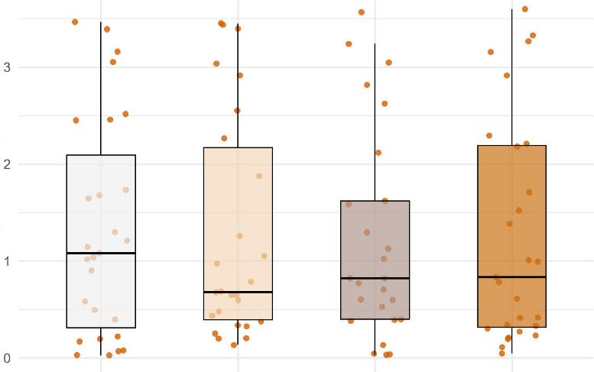
Breaking it down:
1. effects on general microbiome biodiversity
Skin microbiome biodiversity is key to maintain barrier integrity, regulate immune responses, and prevent the overgrowth of pathogenic species. A diverse microbial community strengthens skin resilience and overall health.
Key findings:
Diversity
(Shannon Index)
1.
The skin microbiome biodiversity remains stable under low (suberythemal) repeated UV exposure.
2.
An SPF 50 sunscreen helps maintain the skin’s natural microbiome balance, supporting the original composition.
Baseline
w/o UV
Control
w/t UV
Placebo
w/t UV
Sunscreen
w/t UV
An SPF 50 Sunscreen preserves the overall skin microbiome biodiversity and resilience.
Shannon Index: the quantitative measure for richness and evenness of microbiome composition. Differences n.s. between conditions.
Median value of total counts
Refers to 1 subject data
Notes:
Let’s now take a closer look at the study results.
First with microbiome diversity analysis.
Microbiome diversity essentially reflects how many different bacterial species are present and how evenly they are distributed. A diverse, stable microbiome is typically associated with a more resilient skin ecosystem — one that can regulate itself and better withstand daily external stressors. This is especially meaningful for acne‑prone skin, where microbial imbalance can contribute to visible concerns.
When we look at the Shannon Index graphs, the important observation is this:
Across all four conditions, the overall diversity remains stable.
This tells us two things:
Daily‑level repeated UV exposure alone does not dramatically disturb microbial diversity in this timeframe.
SPF 50 sunscreen does NOT disrupt the microbiome. This is crucial from a safety and formulation perspective, because it confirms the sunscreen is microbiome‑compatible.
Another positive insight is that sunscreen helps preserve the original microbial composition — which means daily SPF use is not interfering with the natural ecosystem of acne‑prone skin. This is an important reassurance for consumers who are afraid SPF might “disturb the skin environment.”

Slide 14
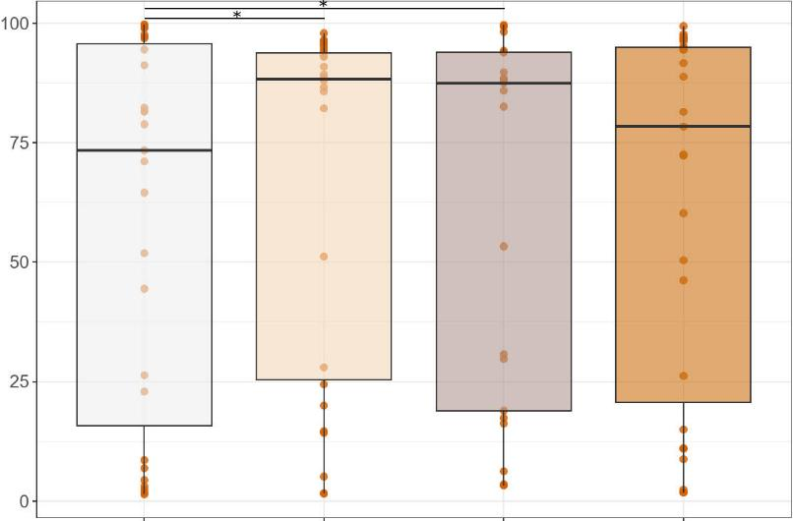
Breaking it down:
2. influences on C. acnes population
UV exposure can trigger an overgrowth of C. acnes, accelerating acne formation. Conversely, reducing C. acnes levels helps minimize the overall risk and supports clearer, healthier-looking skin.
1.
2.
Key findings:
Cutibacterium acnes
(Relative abundance)
1.
C. acnes can be triggered significantly with low-level repeated UV exposure.
2.
An SPF 50 sunscreen prevents such trend helping prevent the risk of getting acne, better than without.
An SPF 50 Sunscreen prevents UV-induced overproduction of C. acnes.
Baseline
w/o UV
Control
w/t UV
Placebo
w/t UV
Sunscreen
w/t UV
Relative abundance: the percent composition of an organism of a particular kind relative to the total number of organisms in the area
Median value of total counts
Refers to 1 subject data
* Significance p<0.05
Notes:
Next let’s focus on C. acnes, the bacteria closely associated with acne‑prone skin.
What we see is clear:
On both the Control and Placebo sites C. acnes levels rise significantly under daily‑like repeated UV exposure.
This confirms our earlier observations from the exploratory study:
UV is a real trigger for C. acnes imbalance.
In contrast, when SPF 50 is applied, C. acnes levels stay much closer to baseline. This means the sunscreen helps mitigate the UV‑induced bacterial shift, acting almost as a stabilizing factor for acne‑prone microbiomes under UV exposure.
This finding is important because it links the effect directly to UV filters. It provides a science‑backed reason to recommend sunscreen as part of acne‑prone skin routines.

Slide 15
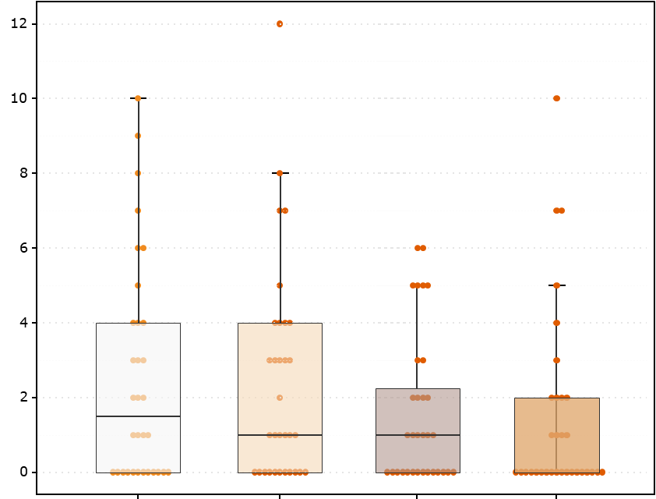
Breaking it down:
3. decoding porphyrins
Porphyrins are metabolic byproducts produced by pathogenic strains of C. acnes and are closely linked to acne-prone skin, particularly in sebaceous glands. These strains have a high pro-inflammatory potential compared to non-pathogenic strains of C. acnes.
*
Key findings:
Porphyrin signal counts
1.
An SPF 50 sunscreen helps limit porphyrin overproduction by keeping UV-induced C. acnes in check.
2.
And it significantly reduces porphyrin signal counts compared to controls, outperforming placebo.
An SPF 50 Sunscreen helps reduce porphyrin significantly, outperforming than without.
Baseline
w/o UV
Control
w/t UV
Placebo
w/t UV
Sunscreen
w/t UV
Median value of total counts
Refers to 1 Porphyrin signal counts
* Significance p < 0.01
Notes:
Porphyrins are another essential piece of the story.
Porphyrins are metabolites produced by certain C. acnes strains that are more active in acne‑prone conditions. Higher porphyrin levels are often associated with clogged pores, shine, and visible blemishes — which is why porphyrin imaging is commonly used in dermatology and facial diagnostics.
In our study, we observed that SPF 50 significantly reduced porphyrin signal counts on UV‑exposed skin compared to the control. Placebo also showed some reduction, but SPF 50 performed clearly better.
This reinforces the idea that sun protection does more than protect against UV.
It may also help prevent UV‑reinforced bacterial activity linked to visible acne concerns.
This is a very strong talking point for both internal audiences and customers.

Slide 16
For acne-prone skin, daily SPF 50 is a smart and proactive habit because…
The latest clinical study by dsm-firmenich proves that daily SPF 50 sunscreen can:
Preserve and maintain the overall microbiome balance.
Keep C. acnes overpopulation in check.
Lower acne risk by reducing porphyrins counts, more effectively than without.
Notes:
Bringing all these together, we can confidently say:
For acne‑prone skin, daily SPF 50 is not only safe — it is beneficial.
It
maintains microbiome balance
helps prevent UV‑triggered increases in C. acnes
reduces porphyrin levels, which are linked to acne‑relevant bacterial activity
This gives us a powerful and differentiated narrative in the suncare market.
Instead of simply saying “non‑comedogenic,” we can now speak about science‑backed microbiome support, validated through a realistic daily‑UV exposure model.
For us internally, and for customers, this is an elevated, credible, and easy‑to‑retell story.

Slide 17


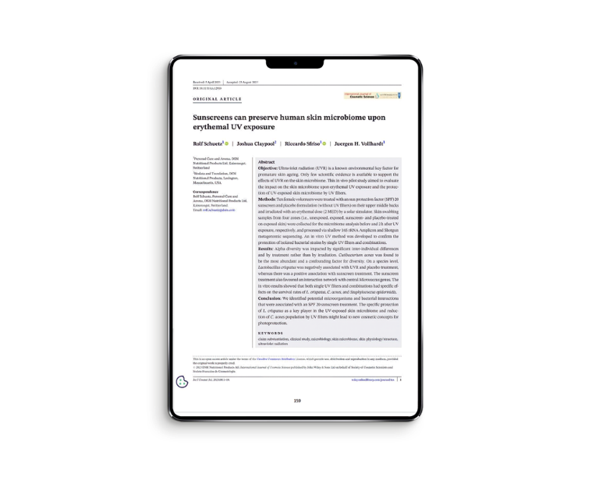
“Be gentle with your microbiome –
it is here to stay and protect your skin.”
Dr. Rolf Schütz
Leading Scientist for Sunny Skin Microbiome Studies
Lead Study Director Photoprotection, Beauty and Care
20+ years of R&D experience in the cosmetic ingredient industry.
Holds a PhD in organic chemistry from the University of Bern and completed postdoctoral studies in genetic engineering at Stanford.
Specializes in connecting chemistry and skin biology for claim substantiation in Sun and Skin Care, particularly in photobiology.
Led product launches in anti-aging, pollution, epigenetics and blue light.
Conducted all clinical studies for US registration of bemotrizinol.
Prolific (co-)author and patent filer, and a member of the Swiss SCC.
Schuetz R. et al., IJCS, 2023
Notes:
None of this would be possible without our scientists.
For the Sunny Skin Microbiome 1.0 and 2.0 studies, special recognition goes to Dr. Rolf Schütz.
Beyond leading the clinical studies, he has also contributed heavily to data interpretation and supported the storytelling behind this work.
In a moment, he will guide us through a deeper, more technical version of the study results — ideal for an in‑depth scientific exchange.

Slide 18

From Sterile Thinking to Symbiotic Beauty:
Advancing the Science of the Skin Microbiome
The skin microbiome has been a major focus in cosmetics for more than a decade. While we now understand much more about its role in skin health, there is still a great deal to uncover.
At dsm-firmenich, we continue to push the frontier by building up the knowledge 35 years ago – advancing research, refining methodologies, and deepening our understanding of the causal links between the microbiome and skin health through inter-omics technologies and beyond.
Our discoveries open new possibilities, strengthening our leadership in shaping the future of skin microbiome science.
2020
Clinical study to evaluate the impacting of cleansing on skin microbiome.
Sfriso R. and Claypool J.,
Microorganisms, 2020
2022
The pioneering clinical exploratory study to understand the interaction among UV exposure, sunscreen and skin microbiome.
Schuetz R. et al., IJCS, 2023
2024
The pioneering clinical study to directly link menopause status to changes in skin microbiome composition.
M. Pagac et al.,
Front Aging, 2024
2025
A novel study approach with 3D visualization framework to predict facial-skin microbial distributions more efficiently without losing accuracy.
IFSCC 2025 Top 10 Poster
Notes:
To close the marketing section, I want to highlight our long‑standing expertise in skin microbiome science.
Our journey began more than 35 years ago in fragrance research. Since then, we have continuously advanced our understanding through targeted studies, new methodologies, and recognized scientific publications.
What is important to know that Skin microbiome remains an evolving field — as the title here said: “from sterile thinking to symbiotic beauty”.
Beyond sun care, we should be proud of the significant contributions we’ve made to the industry as a whole.
Here you can find key publications in the past 5 years cross the segments and topics.
I hope above marketing slides gave you a clear, concise, and compelling version of the “Sunny Skin Microbiome” story — one you can easily retell to your teams, your customers or endusers, and even your family and friends.
Because our mission remains as to provide the highest quality, scientifically backed products and solutions that safeguard consumers’ skin from UV rays, allowing them to enjoy the sun with confidence — a key differentiator for us as the leader in sun care.

Slide 19

The Sunny Skin
Microbiome 2.0
Deep dive into the science and results
Dr. Rolf Schütz
Leading Scientist for Sunny Skin Microbiome Studies
Lead Study Director Photoprotection, Beauty and Care
Notes:
Since we launched our first Sunny Microbiome concept 3 years ago, a lot has happened. We continued our customer support by different customized studies. It included testing customer UV filter combinations in vitro, e.g. for Shiseido and Kolmar or even a clinical study with a customized SPF30 from Mibelle to evaluate microbiome claims. Finally, we concluded the new clinical study with SPF50 on acne-prone skin last year. Higher SPF was a clear request from our customers. For future consultations we will need an individual way that it is beneficial for both us and our customers depending on the needs.
One general conclusion though is that the microbiome topic is very complex - not two individual microbiome are the same - which makes it challenging to find one-size-fits-all solutions. And the need a lot of statistics in the background. We tried to keep the message as simple as possible ☺. This presentation builds on our previous concept – nevertheless let me remind you of some basic features again.

Slide 20
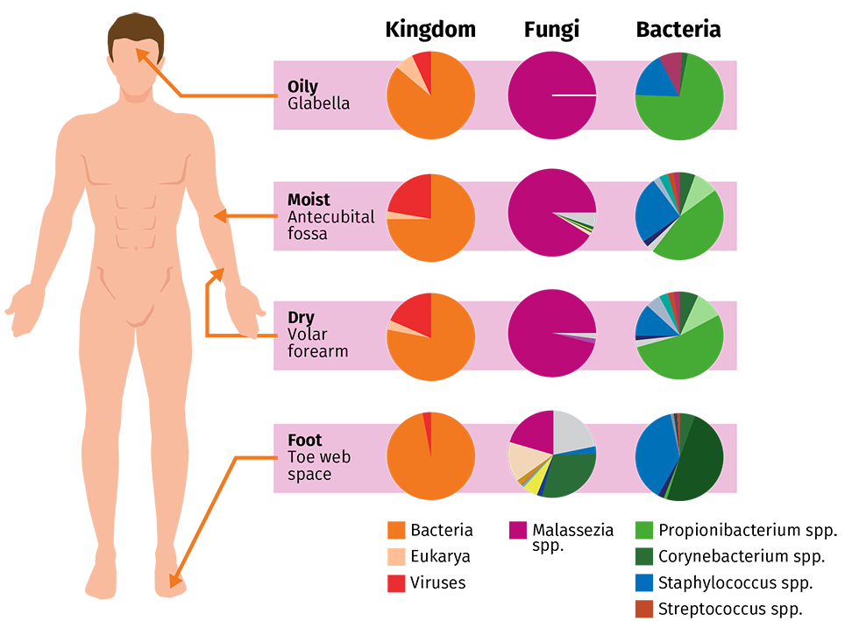
Micro(biome), but MEGA-important!
The Sunny Skin Microbiome 2.0
SCIENTIFIC DEEPDIVE
What is the Skin Microbiome and its role?
The human skin microbiome²
The Skin Microbiome is the community of all microorganisms present on skin (bacteria, fungi, viruses, etc.) and its interactions¹.
It has an important role in the skin health, wellbeing, and protection of the human body.
Bacteria are the most abundant microorganisms in the skin and differ depending on the body sites (moist, dry or oily skin conditions).
Intra-/inter-individual and temporal diversity is observed depending on internal and external factors
Microorganisms may have symbiotic or pathogenic interactions with one another or with the skin cells (e.g., Cutibacterium acnes)
Kingdom
Fungi
Bacteria
Oily
Glabella
Moist
Antecubital
fossa
Dry
Volar
forearm
Foot
Toe web
space
Bacteria
Eukarya
Viruses
Malassezia
spp.
Propionibacterium spp.
Corynebacterium spp.
Staphylococcus spp.
Streptococcus spp.
Important: quantity AND quality of microbiome
1. Berg et al (2020); 2. Byrd et al. (2018)
Notes:
We do not live in a sterile world – it is full of invisible microorganisms such as bacteria, fungi, viruses… the microbiome is not a trend – it is here to stay as integral part of our biology.
The microbiome is an integral part of healthy skin. It protects us against pathogens by supporting our skin barrier and immune response – as a first line of defense.
In the skin microbiome, bacteria are among the most abundant microorganisms. Their composition differs between the body sites, mainly depending on their oily, moist, or dry skin conditions. Apart from these intra-individual differences, the microbiome composition varies from person to person. It is like a fingerprint, but temporal, as the microbiome is adapting to internal and external factors, such as age, lifestyle, and environment (UV).
One thing to remember is that both - quantity, but also quality do matter for the microbiome.
And more and more we realize how important the interactions between the microorganisms and the host cells are. Take the bacteria Cutibacterium acnes is a little bit like “Jekyll and Hyde”, the good or the bad, depending on the microbiome balance. Some C. acnes strains occur as commensals and some as opportunistic pathogens associated with acne.
Byrd AL, Belkaid Y, Segre JA. The human skin microbiome. Nat Rev Microbiol. 2018 Mar;16(3):143-155. doi: 10.1038/nrmicro.2017.157. Epub 2018 Jan 15. PMID: 29332945.
Skin microorganisms provide nutrients, essential protection against pathogens, support of our skin barrier and immune system and therefore impact skin health.

Slide 21
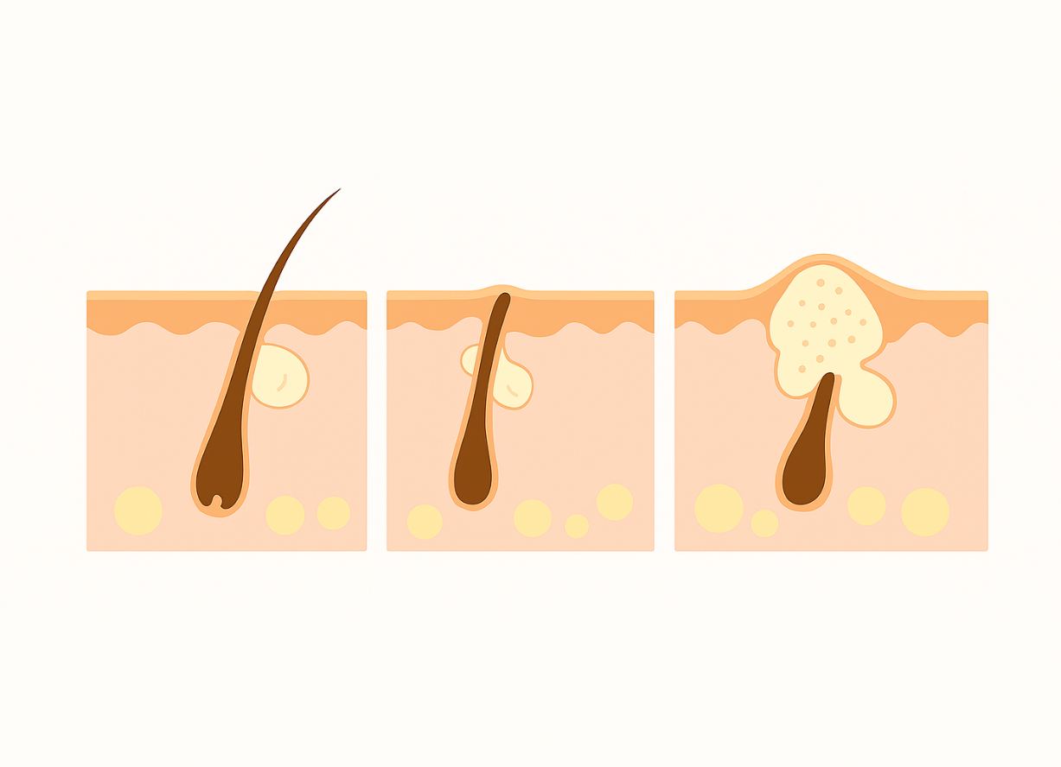
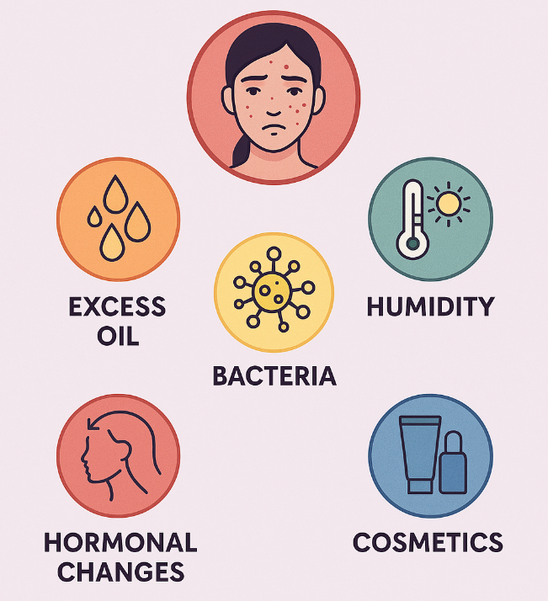

Factors triggering acne-prone skin
The Sunny Skin Microbiome 2.0
SCIENTIFIC DEEPDIVE
From factors… …to skin deep formation of acne
Cutibacterium acnes is an abundant bacteria of
sebum-rich skin microbiome and can trigger acne formation¹⁻⁴
Healthy pore 2) Clogged Pore 3) Inflamed pore
        (Comedon)
Blackhead
Sebaceous gland
Mediators
Hair follicle
Sebum secretion↑ Androgen-dependent
Genetic influence
Occlusion, Hyperkeratinization
Bacterial (C. acnes) colonialization of duct
Bacteria spreading
Dermal inflammation by release of bacterial mediators (e.g. SC-FA) and ruptured comedones
Infographic created by Copilot to illustrate the topic. Do not use it for public promotion or commercial use.
1. Dagnelie et al (2018); 2. Spittaels et al (2020); 3. Conforti et al (2021); 4. Lee YB et al (2019)
SC-FA = Short-Chain Fatty Acids
Notes:
Acne vulgaris is a chronic inflammatory skin condition of our skin pores - the pilosebaceous unit. It is characterized by the formation of comedones (blackheads and whiteheads), papules, pustules, nodules, and sometimes cysts. It results from a multifactorial process involving excess sebum production (e.g. by hormonal input or lifestyle), follicular hyperkeratinization = pore clogging (e.g. by comedogenic cosmetics), colonization by Cutibacterium acnes, and subsequent inflammation.
C. acnes is one of the most abundant microbes on your body, and in most people it causes no problems at all. The bacterium is largely commensal, contributing to the skin’s acidic pH and helping to inhibit colonialization by harmful pathogens like Staphylococcus aureus. But when conditions shift, particularly when oil production increases and pores become blocked, this same bacterium can trigger the inflammation behind acne breakouts. 1) In particular, C. acnes is prominent in sebum-rich skin sties, especially in the sebaceous glands, where there are sufficient lipids to feed. 2) C. acnes thrives in clogged pores and it metabolizes triglycerids in sebum, producing fatty acids and other byproducts when bacterial growth is excessive. These fatty acids irritate the pore lining, cause skin cells to overgrow and harden (a process called hyperkeratinization), and weaken the skin’s local barrier function. 3) These mediators can trigger inflammation and ultimately lead to papules, pustules, and nodules.
To be clear: our target is the bacteria itself – it is not about comedogenicity or the pore clogging! It is about Managing Cutibacterium Acnes Overgrowth.
We have already proven that we can we keep these bacteria in check with smart UV filter combinations.
⁻⁻⁻⁻
SC-FA=Short/chain fatty acids
What Is Propionibacterium Acnes and What Does It Do? – ScienceInsights
Bacteria (Cutibacterium acnes)
C. acnes thrives in clogged pores and breaks down sebum into irritating fatty acids.
This triggers inflammation and leads to papules, pustules, and nodules
1. Dagnelie et al (2018); 2. Spittaels et al (2020); 3. Conforti et al (2021); 4. Lee YB et al (2019)

Slide 22
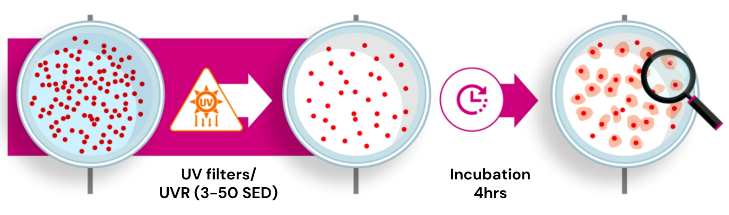
In vitro Bacterial Survival UV-Model
The Sunny Skin Microbiome 2.0
SCIENTIFIC DEEPDIVE
To understand impact of UV filters at the microbial level, we tested UV filter combinations against three key skin bacteria on acne-prone skin
¹
Test Formulations
Solubilized UV filters and combinations calibrated to predicted in vitro SPF 6 and SPF 24, respectively
Non-irradiated and irradiated controls with vehicle (oil solvents) treatment
Microbial strain (Reference²)
Cutibacterium acnes (ATCC 11827): most abundant bacteria in sebaceous skin, opportunistic pathogen
Lactobacillus crispatus (CIP 103604): key species supporting skin barrier, pH, microbiome stability.
Staphylococcus epidermidis (ATCC 12228): skin commensal supporting homeostasis, barrier integrity.
Analysis
Colony forming units (CFU) or dye staining
Survival ratio (%) vs. non-irradiated control
Protection ratio (%) vs. irradiated control
1. SED= Standard Erythema Dose: 1 SED unit = 10 mJ/cm²; 2. CIP (Institut Pasteur Collection, France); ATCC (American type culture collection)
Notes:
We showed in the past that specific microorganisms can benefit from the additional UV protection. We developed an in vitro UV method with isolated bacteria. We have used strains from C. acnes, L. crispatus, and S. epidermidis.
C. acnes – remember the “Jekyll and Hyde” The strain we used here is more likely a pathogenic phylotype (IA).
Lactobacillus crispatus we identified recently as a key player for a resilient microbiome, ensuring an acidic environment for pathogen defense.
Staphylococcus epidermidis is a normal skin commensal – it was used as reference strain here.
Single UV filter or combinations were solubilized in oils and applied before UV irradiation. The use level of the filters was calibrated to the same sun protection factor: for single filters we used expected SPF 6 and for the combinations SPF 24. We analyzed the survival and protection rates compared to the controls.

Slide 23
In Vitro Study results - comprehensive overview
The Sunny Skin Microbiome 2.0
SCIENTIFIC DEEPDIVE
Study Series | Sample | UV filters |  | Wt-%* | Protection* (Survival**) [%]
 |  | Abbrev. | Trade Name |  | C. acnes | L. crispatus | S. epidermidis
I | 1.1 | BMDBM | PARSOL® 1789 | 5 | -70 (20) | +100 (25) | +59 (63)
 | 1.2 | EHS | PARSOL® EHS | 10 | -30 (46) | +59 (20) | +100 (79)
 | 1.3 | OC | PARSOL® 340 | 5 | -15 (56) | +300 (50) | +59 (63)
 | 1.4 | ZnO Tecs | PARSOL® ZX | 3 | +13 (74) | +152 (31) | +26 (50)
 | 1.5 | BEMT | PARSOL® Shield | 2.3 | +13 (74) | +59 (20) | +100 (79)
 | 1.6 | EHT | PARSOL® EHT | 2.3 | +40 (92) | +100 (25) | +59 (63)
 | 1.7 | TiO₂/SiO₂/D | PARSOL® TX | 3 | +23 (81) | +59 (20) | +26 (50)
 | 1.8 | OC/EHS/ BEMT/BMDBM | PARSOL® 340/EHS/Shield/1789 | 7/4/2/4.5 | +25 (82) | +152 (31 ) | +59 (63)
 | 1.9 | EHT/BEMT/ BMDBM | PARSOL® EHT/Shield/1789 | 3/3/3 | -13 (58) | +152 (31) | +26 (50)
 | 1.10 | OC/EHS/EHT | PARSOL® 340/EHS/EHT | 10/5/5 | -65 (23) | +152 (31) | -21 (31)
 | Control | Vehicle | n.d. | n.d. | 0 (66) | 0 (12.5) | 0 (40)
II | 2.1 | DHHB | PARSOL® DHHB | 8.3 | +28 (34) | +152 (79) | +404 (79)
 | 2.2 | MBBT | PARSOL® MAX | 8 | +41 (38) | +152 (79) | +26 (20)
 | 2.3 | PBSA | PARSOL® HS | 3.3 | +134 (63) | +152 (79) | +300 (63)
 | 2.4 | PS-15 | PARSOL® SLX | 6.5 | +60 (43) | +152 (79) | +404 (79)
 | 2.5 | OMC | PARSOL® MCX | 3.3 | +38 (37) | +152 (79) | +404 (79)
 | 2.6 | PS-15/OMC | PARSOL® SLX/MCX | 3/1.7 | +13 (30) | +152 (79) | +404 (79)
 | 2.7 | BEMT/ZnO | PARSOL® Shield/ZX | 5/15 | +100 (54) | +59 (50) | -88 (2)
 | 2.8 | BEMT/EHT/DHHB | PARSOL® Shield/EHT/DHHB | 2.5/3.5/4.5 | +31 (35) | +152 (79) | +534 (100)
 | Control | Vehicle | n.d. | n.d. | 0 (27) | 0 (32) | 0 (16)
Evaluation Criteria
Cutibacterium acnes
→ Keep in check but not to kill
Lactobacillus crispatus
→ Protect and promote
Staphylococcus epidermidis
→ Protect and promote
Specific UV filters protected beneficial skin bacteria such as Lactobacillus crispatus and reduced the proliferation of opportunistic pathogen Cutibacterium acnes
Abbreviation | INCI Name
BMDBM | Butyl Methoxydibenzoylmethane
BEMT | Bis-Ethylhexyloxyphenol Methoxyphenyl Triazine
DHHB | Diethylamino Hydroxybenzoyl Hexyl Benzoate
EHS | Ethylhexyl Salicylate
EHT | Ethylhexyl Triazone
OC | Octocrylene
OMC | Ethylhexyl methoxycinnamate
PBSA | Phenylbenzimidazole Sulfonic Acid
PS-15 | Polysilicone-15
MBBT | Methylene Bis-Benzotriazolyl Tetramethylbutylphenol
ZnO Tecs | Zinc Oxide, Triethoxycaprilylsilane
*Survival ratio (%) vs. non-irradiated control; **Protection ratio (%) vs. irradiated control
Notes:
The list has increased since our first launch. We steadily updated our in vitro data with additional UV filters and combinations. We again observed clear differences of the survival rates between the UV filters.
For Cutibacterium acnes you want to reduce or control the C. acnes abundance rather than to stimulate its propagation.
Some filters nicely reduced C. acnes population, while protecting S. epidermidis such as 1789/avobenzone, EHS/octisalate, and 340/octocrylene. Same was true for the combos and new entries such as DHHB, SLX combined with MCX or Shield/EHT/DHHB. As a result, a smart selection of the UV filters in a sunscreen might reduce C. acnes population and mitigate inflammatory acne breakouts.
On the same time, smart filter combinations will also lead to efficient SPF protection and protect UV-sensitive key players (L. crispatus, S. epidermidis) to maintain a healthy microbiome upon UV exposure. Based on these findings, we designed a new formula for SPF50 sunscreen to be tested on acne-prone skin.

Slide 24
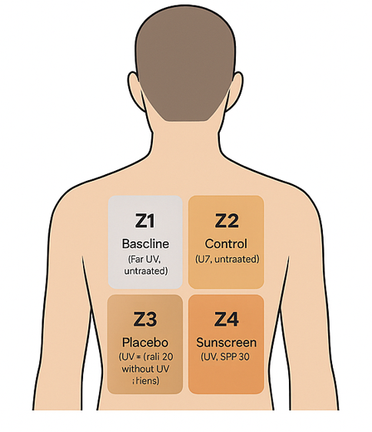
Clinical Study Test Design
The Sunny Skin Microbiome 2.0
SCIENTIFIC DEEPDIVE
Placebo-controlled study for acne-prone Asian skin
TEST PRODUCTS:
SUNSCREEN: Asian SPF 50 formulation (PARSOL® 1798, Shield, EHT, EHS, SLX, HS) PLACEBO: chassis without UV filters
STUDY POPULATION:
Min. 30 participants between 25 and 45 years of age (start n= 33) Asian skin, type II-III (MED determination) Acne-prone skin, manifesting acne on back and/or face
OVERALL STUDY DESIGN:
Wash-out phase: gentle Crème lavante (La Roche Posay Effaclar H IsoBiome), 1x/day, 7 days Standardized application: Test products to be applied on upper mid back, 2 mg/cm² on 2.5 cm x 10 cm dedicated zones (Z1 to Z4, right) Exposure: cumulative 2 MED (Minimal Erythema Dose) UVA/B from solar simulator, 4 x 0.5 MED per day on D0-D3 Time Points: D0 (Baseline), D1, D2, D3 (2-hour post-exposure, microbiome), D4 (lipids/porphyrins) Swabbing/Tape Stripping: 132 samples from 32 participants
SKIN MICROBIOME and BIOPHYSICAL PARAMETERS:
Targeted analysis: Long-read 16S rRNA gene sequencing and Single Locus Sequence typing (SLST) Lipid analysis (Sebutape/D-Squame tape; LC/ESI-MS/MS), Porphyrin analysis (VISIOPOR device), Photos (DSLR camera)
Baseline
(no UV/
no appl.)
Control
(+UV/
no appl.)
Placebo
(+UV/
+appl.)
SPF50
(+UV/
+appl.)
Conditions used for microbiome swabbing and
lipid tape stripping.
Notes:
For the test product we used an expected SPF50 sunscreen formulation adapted to Asian market. Essentially, it was an oil-in-water emulsion without pigments… in the placebo formulation the five UV filters were replaced with a higher oil load.
Setup quite different to our former study: A minimum requirement of 30 participants (instead of 10) with Asian (instead of Caucasian), acne-prone skin (instead of healthy) were recruited. The subjects started a 7-day wash-out phase with a mild cleansing creme for pre-conditioning. Four zones were assigned on their upper middle backs. On the body map you see the conditions used: starting with the baseline untreated/non-exposed; then untreated/exposed, to placebo and sunscreen treatment on the UV-exposed skin.
The amount of test formulation and the detection of the individual minimal erythema dose was adopted from standard SPF testing protocol. We applied the sub-erythemal dose of 0.5 MEDs per day on four consecutive days by a solar simulator (instead of one single dose of 2 MED). The test zones were swabbed two hours after the last UV exposure (on D3) for the targeted microbiome analysis by long-read 16S rRNA and SLST gene sequencing. One day after the last application (D4) tape strips were taken for the lipid analysis as well porphyrins were detected by the VISOPOR device one day after the last application.

Slide 25

Participant Demographics
The Sunny Skin Microbiome 2.0
SCIENTIFIC DEEPDIVE
Demographics (n=32, completed)
Age range | 18-46 years (mean 29±1)
Sex Distribution | Female: 59% (19)/Male: 41% (13)
Ethnicity | Chinese (69%), mixed Asian (31%)
Acne-prone Skin | 100% (face or/and back)
Skin type (Fitzpatrick) | III (66%), II (25%), IV (9%)
Skin Tone range | 20.9–52.3 ITA° (mean 36.6±1.2 intermediate)
Key Observations
All participants successfully completed the study without early termination.
The demographics ensure good representation of the acne-prone Asian cohort relevant to the study.
No observed or reported AE’s in the study
Notes:
A total of 32 participants completed the study. The panel had a mean age of 29 ± 1 years (range: 18–46 years), with a female predominance (59%).
All participants were of Asian ethnicity, with 69% identifying as Chinese and the remaining 31% as of mixed Asian (i.e., at least one parent of Chinese or Indian origin).
All participants had acne-prone skin manifesting on their face and/or back (100%).
The majority of subjects had Fitzpatrick phototype III (66%), followed by phototype II (25%) and IV (9%).
The mean Individual Typology Angle (ITA°), indicative of skin tone, was 36.62 ± 1.22 (range: 20.91–52.30), corresponding to intermediate skin tones.
All subjects completed the study without early termination.

Slide 26
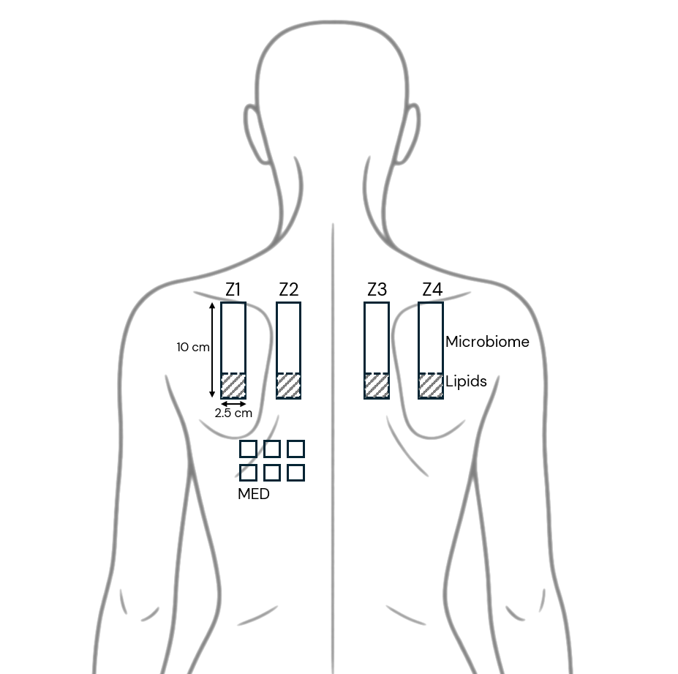
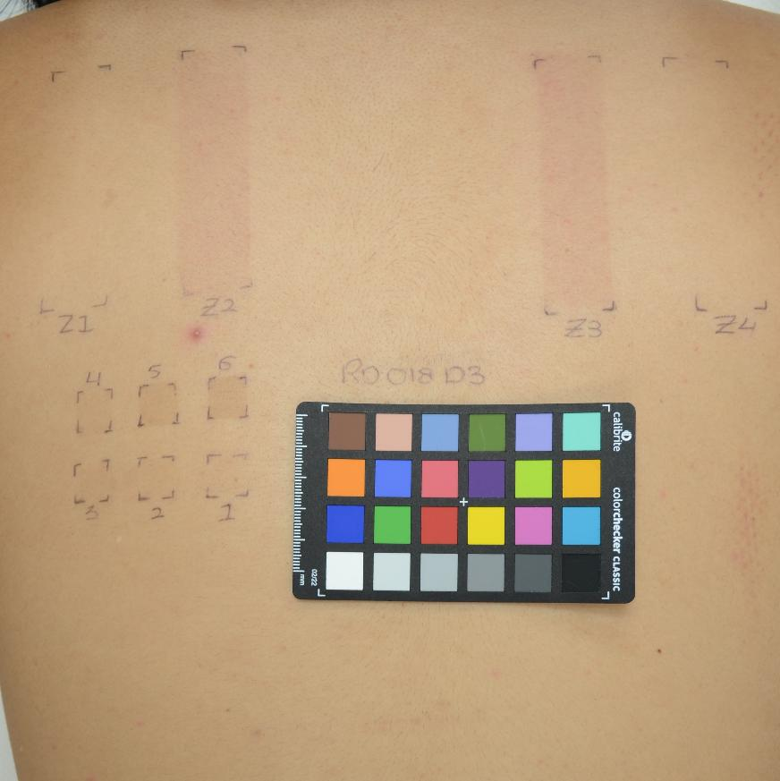
Test Zones and Participant Photo
The Sunny Skin Microbiome 2.0
SCIENTIFIC DEEPDIVE
Z1: Baseline
Z2: UV-Control
Z3: Placebo
Z4: Sunscreen
Porphyrins
Minimal Erythema Dose (MED) was determined individually before treatment.
Erythema can be observed after repetitive, sub-erythemal UV exposure on unprotected skin (irradiated control and placebo treated)
SPF 50 Sunscreen provided effective photoprotection
Dedicated test zones (Z1-Z4) included for microbiome swabbing and lipid tape stripping. Conditions were randomized by zones per subject to minimize local bias. Incremental doses for MED determination were used on 6 separate sites.
Upper back photo of participant RD008 at day 3
Notes:
Here you can see the dedicated test zones (Z1-Z4) included for microbiome swabbing and lipid tape stripping.
Conditions were randomized by zones per subject to minimize local bias.
Incremental doses for MED determination were used on 6 separate sites and was determined individually before treatment.
Photo right: Erythema can be observed after repetitive, sub-erythemal UV exposure on unprotected skin (irradiated control and placebo treated)
SPF 50 Sunscreen ensures effective photoprotection

Slide 27
Microbiome Analysis (1)
The Sunny Skin Microbiome 2.0
SCIENTIFIC DEEPDIVE
Microbiome diversity is stable by treatment and repeated sub-erythemal UV exposure*
Repeated low intensity exposure to UV has a low (non-significant) impact on overall skin microbiome community (alpha diversity)
Sunscreen treatment keeps the resident skin microbiome intact (in vivo evidence!)
Proper sunscreen use keeps UV exposure low, helping protect your skin without noticeably affecting its natural microbiome
Alpha Diversity
(Shannon Index)
Baseline
w/o UV
Control
w/t UV
Placebo
w/t UV
Sunscreen
w/t UV
*Shannon Index: the quantitative measure for richness and evenness of microbiome composition. Differences between conditions non-significant.
Median value of total counts
Refers to single subject data
Notes:
Let us talk about diversity: Alpha diversity refers to the species diversity within a single sample. It quantifies both the number of species (richness) and the distribution of individuals among species (evenness). Both are considered in the so-called Shannon index. High alpha diversity indicates a greater number of species and a more balanced distribution, suggesting a resilient and stable ecosystem.
Repeated low intensity (sub-erythemal) exposure to UV has a low impact on overall skin microbiome community (alpha diversity)
Sunscreen treatment keeps the resident skin microbiome (and lipid metabolites) intact (in vivo evidence for microbiome-friendly!). No alpha and beta diversity effect found
Using sunscreen correctly provides strong UV protection and keeps skin exposure low enough (sub-erythemal) that it doesn’t significantly affect the skin’s natural microbiome.
Microbiome diversity remains stable by treatment and repeated sub-erythemal UV exposure
__
Beta diversity captures differences between communities: Principal Coordinates analysis (PCoA) based on Bray–Curtis dissimilarities among samples no significant differences in Bray-Curtis dissimilarity between treatment groups based on PERMANOVA analysis (P-value > 0.05).
From Sergio:
Repeated low intensity exposure to UV has a low impact on skin microbiota
Differences in skin microbiota between back areas are somewhat consistent between unrelated individuals
Serum treatment does not negatively impact the resident skin microbiota -> Microbiome friendly / What is a ‘change’ and what is relevant/meaningful
Cutibacterium acnes phylotypes are stable per person and largely unaffected by skin site or treatment
Serum treatment might have a protective effect on the limited changes attributed to UV exposure, both at the community level and between C. acnes phylotypes

Slide 28
Microbiome Analysis (2)
The Sunny Skin Microbiome 2.0
SCIENTIFIC DEEPDIVE
Significant upregulation of Cutibacterium acnes population by repeated UV irradiation
can be prevented by SPF 50 sunscreen
Significant increase of C. acnes population with UV exposure
Similar increase of C. acnes abundance by placebo treatment
SPF50 sunscreen treatment decreased overpopulation in the direction of baseline
Sub-erythemal UV irradiation resulted in significant overpopulation of C. acnes that can be controlled by SPF50 treatment
Cutibacterium acnes
(Relative abundance)
Baseline
w/o UV
Control
w/t UV
Placebo
w/t UV
Sunscreen
w/t UV
Relative abundance: the percent composition of an organism of a particular kind relative to the total number of organisms in the area
Median value of total counts
Refers to 1 subject data
* Significance p<0.05, linear mixed model
Notes:
As quality matters too: we checked on the species level - C. acnes:
Significant increase of C. acnes population with UV exposure –important because it leads to a high risk for acne propagation!
Similar increase of C. acnes abundance by placebo treatment
SPF50 sunscreen treatment decreased overpopulation in the direction of baseline
Sub-erythemal UV irradiation resulted in significant overpopulation of C. acnes that can be controlled by SPF50 treatment

Slide 29
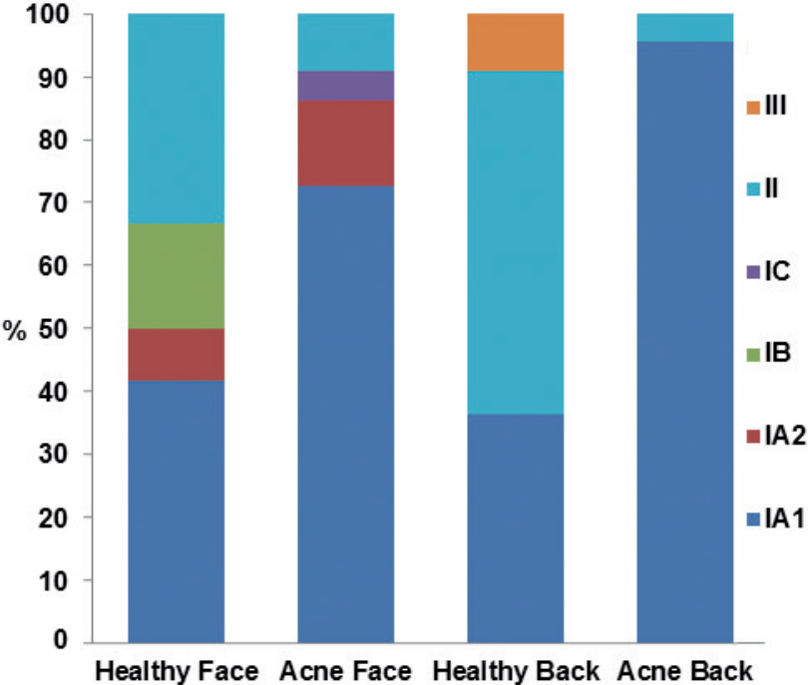
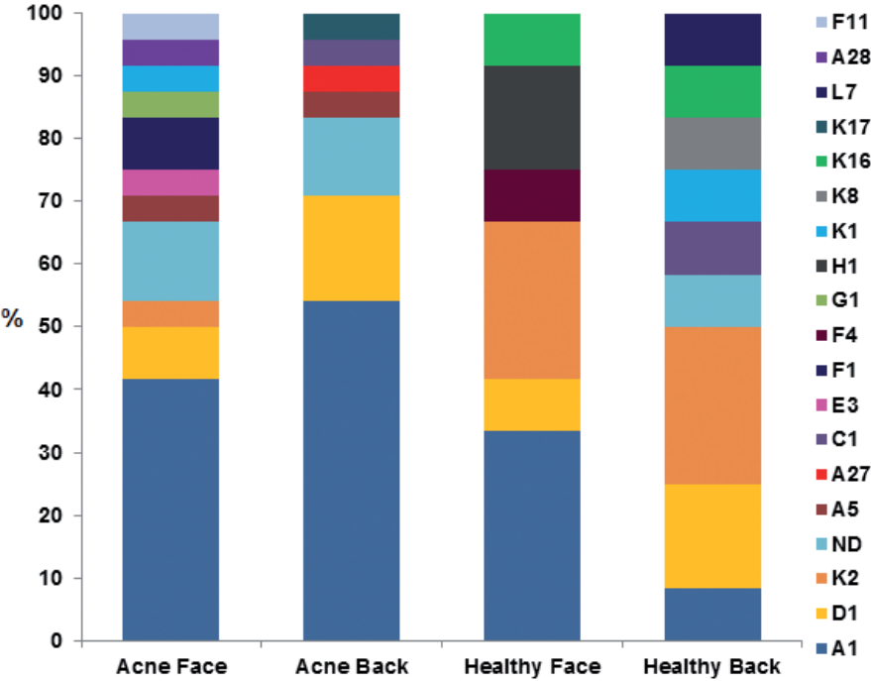
C. acnes subspecies and the correlation with healthy and acneic skin
Publication Reference
The Sunny Skin Microbiome 2.0
SCIENTIFIC DEEPDIVE
Phylotypes: C. acnes is grouped into three phylotypes I–III. Type I is further subdivided by whole-genome sequencing into the major type I clade encompassing IA1, IA2, IB, IC, II and III.
A clinical study by looking into 36 healthy and acne participants, IA1 phylotypes are identified as predominantly in acne lesions, whereas phylotypes II and III mostly present in healthy skin*.
By additional molecular typing methods, a higher diversity of SLST-types associated with known phylotypes (IA1 and II) with new SLST-types was noted:
(phylotype IA2)
(phylotype IA1)
(phylotype III)
(phylotype II)
(phylotype II)
(phylotype IA1)
Cutibacterium acnes phylotype distribution on 2 sites on
healthy volunteers and acne patients (n = 12 and n = 24, respectively).
Categories “Healthy” and “Acne” represent the percentages of phylotypes
found on the back and the face, respectively.
Cutibacterium acnes single-locus sequence typing (SLST) type distribution according to 2 body sites on healthy volunteers and patients with acne (n = 12 and n = 24, respectively). Categories “Healthy” and “Acne” represent the percentages of the different SLST types found on back and on face in either the healthy group or the acne group. “ND” category represents the other species found instead of C. acnes, where typing was not possible.
*Dagnelie, M.-A., et al (2017). Decrease in Diversity of Propionibacterium acnes Phylotypes in Patients with Severe Acne on the Back. Acta Derm.-Vener., 98(2), 262
Notes:
Let us even more deep-dive into C. acnes and their sub-species. Sub-species or strains can be divided in the phylotype classification roman no. I II and III, and I further divided into a total of 6 types.
Interestingly, phylotypes can differ in healthy and acneic skin.
Reference Dagnelie et al (sponsored by Galderma): Left picture - They identified a majority of phylotype IA1 on the backs of severe acne patients – while they observed on the backs of healthy individuals higher phylotype diversity, with phylotypes IA1, II, and III.
Right picture - A more refined classification can be made by so-called single locus sequence typing (SLST) with similar outcomes.
K16 (phylotype II) and L7 (phylotype III) in the healthy group;
A27, A28 (phylotype IA1), F11 (phylotype IA2), and K17 (phylotype II) in the acne group.
C. acnes and Staphylococcus epidermidis together preserve skin
homeostasis; however, skin dysbiosis can be affected by factors such as antibiotic use,
and the ratio of C. acnes phylotypes can change, which may cause diseases such as acne
vulgaris [1].

Slide 30
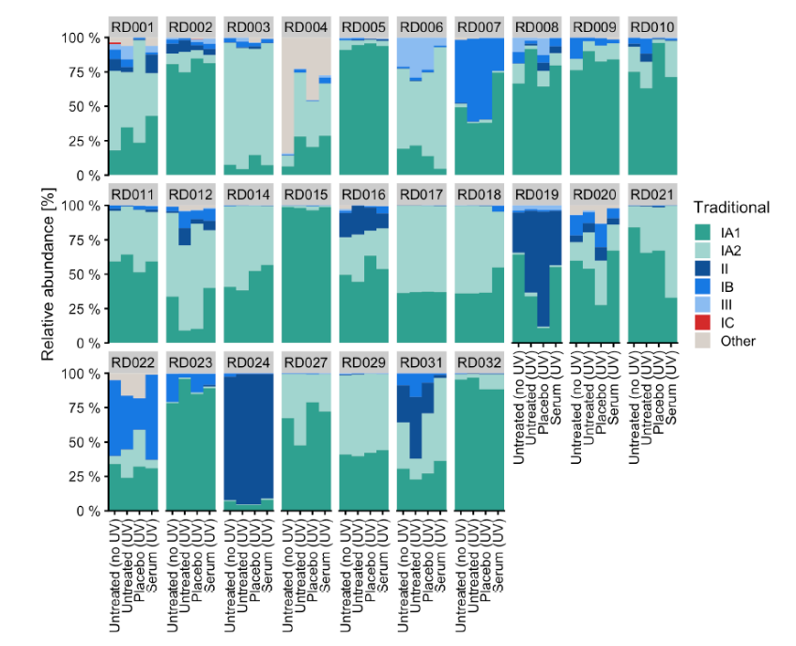
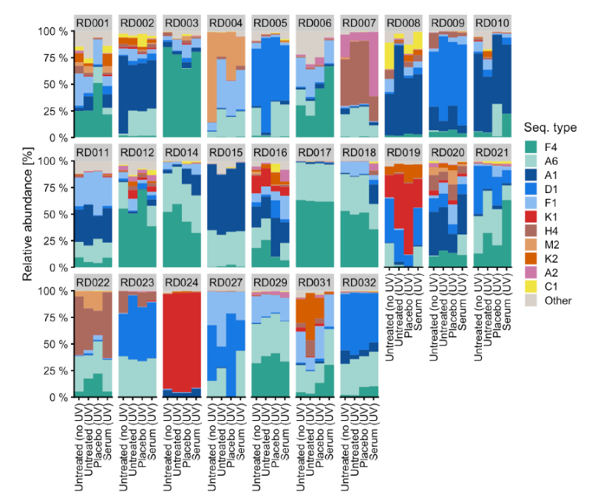
Microbiome Analysis (3)
The Sunny Skin Microbiome 2.0
SCIENTIFIC DEEPDIVE
Is there any shift towards healthy or acneic strains?
C. acnes type distribution is individual and remains stable in the same subject by condition
Cutibacterium acnes sequence type profiles using traditional classification grouped into phylotypes (IA1, IA2, IB, IC, II, III). ASVs not annotated to a known clade are pooled into ‘Other’. Plots are facetted by subject, with the x-axis denoting treatment.
Cutibacterium acnes sequence type profiles. The 11 most abundant sequence types are highlighted.
Notes:
We asked the hypothetical question: Is there any shift towards healthy or acneic strains by UV or sunscreen treatment?
When you look at the patterns each number represent one participant depicting C. acnes type distribution by the four conditions. On the left: phylotype classification – on the right: SLST types. Generally, the distribution look very similar by subject, with minor variations between the conditions, but very different by subjects.
In other words: C. acnes type distribution is individual and remains stable in the same subject by condition

Slide 31
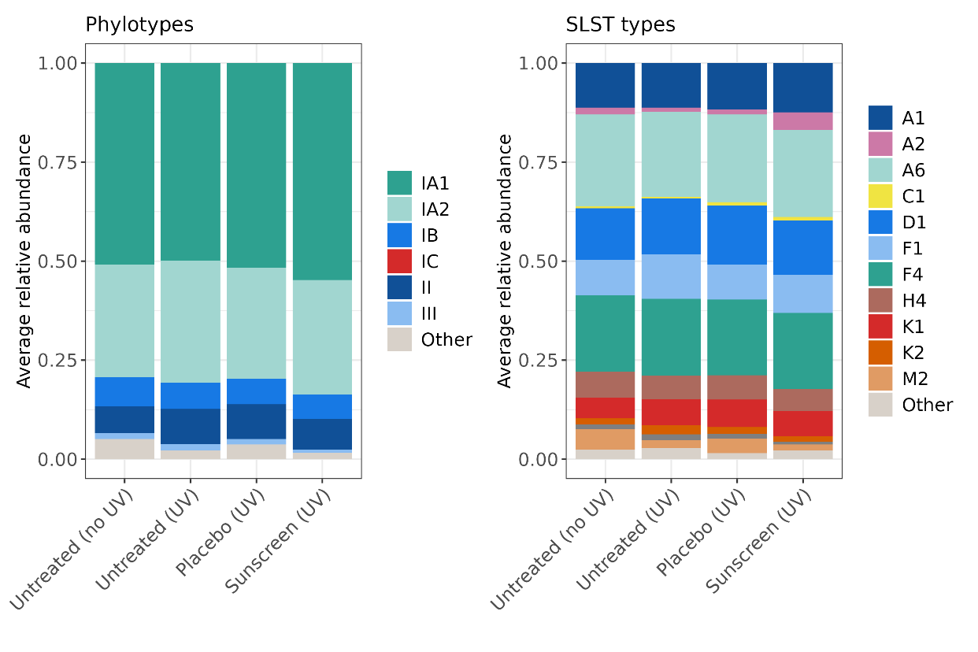
Microbiome Analysis (3)
The Sunny Skin Microbiome 2.0
SCIENTIFIC DEEPDIVE
Conclusion: C. acnes strain composition is very similar to baseline after SPF 50 treatment
Classification:
All conditions show high consistency for strain types in both classifications (phylotype/SLST).
Cutibacterium acnes strains are stable per person and largely unaffected by UV or treatment
SPF50 treatment preserves the original C. acnes strain patterns
No shift towards more acneic strain types detected
Notes:
An even better view we have when we plot the average relative abundances of the C. acnes types on all participants: You can see high consistency between the conditions. Again, with both type classifications.
Cutibacterium acnes strains are largely unaffected by UV or treatment in the same person.
SPF50 treatment preserves the original C. acnes strain patterns
No shift towards more acneic strain types detected

Slide 32
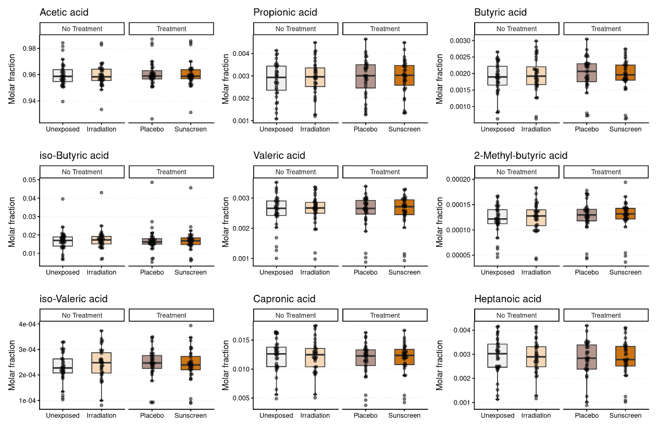
Lipid Analysis
The Sunny Skin Microbiome 2.0
SCIENTIFIC DEEPDIVE
All 9 short-chain fatty acid (SC-FA) degradation products (of C. acnes) are unaffected by UV and sunscreens
Essentially no significant differences between the conditions
Acetic acid by far most abundant
Sunscreen treatment keeps the resident skin microbiome and lipid metabolites intact
*Further study is ongoing about FFA and sebum
Notes:
Furthermore, we looked at the targeted lipid analysis of short-chain fatty acids. These metabolites result when C. acnes degrades lipids from sebum feed.
Essentially no significant differences between the conditions
Acetic acid by far most abundant (different scale)
Sunscreen treatment keeps the resident skin microbiome and lipid metabolites intact
(High background signal from tapes)

Slide 33


Porphyrin Analysis
The Sunny Skin Microbiome 2.0
SCIENTIFIC DEEPDIVE
SPF 50 Sunscreen Treatment shows less Phorphyrin as Biomarker for C. acnes Activity
*
Acne-associated C. acnes strains produce more porphyrins than non-acneic strains, activating inflammation process (Muñoz-Planillo et al., 2013)
Porphyrin signal counts
Porphyrins in skin pores were significantly reduced in counts and intensity by SPF 50 sunscreen vs controls, pointing towards mitigation of C. acnes activity (and abundance)
Baseline
w/o UV
Control
w/t UV
Placebo
w/t UV
Sunscreen
w/t UV
Median value of total counts
Refers to single porphyrin signal counts
*: p < 0.01; odds ratio = 0.15 (SE = 0.59, 95% CI -3.35 to -0.46, P_{adj} = 4.9×10⁻³)
Notes:
Cutibacterium acnes produce another metabolite - porphyrin. Porphyrins can absorb light, resulting in the production of ROS. This process can trigger an inflammatory cascade in the skin, worsening acne. On top, acne-associated C. acnes strains produce more porphyrins than non-acneic strains, and these porphyrins thereby intensifying the inflammatory response.
Results:
Porphyrins in skin pores were significantly reduced in counts and intensity by SPF 50 sunscreen vs controls, pointing towards mitigation of C. acnes activity (and abundance)
[Regional effects are attributed on zones Z1 to Z4 (similar symmetrical zones around spine axis, also observed in microbiome alpha diversity)]
_______
Cutibacterium acnes: The Acne-Causing Bacteria
Cutibacterium acnes is an anaerobic bacterium that naturally lives in the hair follicles and sebaceous glands of human skin. Although it is mostly harmless and part of the skin’s normal microbiota, under certain conditions it can become pathogenic, causing inflammation and contributing to the development of acne.
The bacterium feeds on sebum produced by the sebaceous glands and, as it multiplies, it releases porphyrins, which are an essential part of its metabolism. Porphyrins can absorb light, resulting in the production of ROS. This process can trigger an inflammatory cascade in the skin, worsening acne by damaging surrounding cells and promoting the release of chemicals that attract more immune cells, thereby intensifying inflammation.
The Role of Porphyrins in Acne Development
Porphyrins play a direct role in the inflammation that characterizes acne. When Cutibacterium acnes multiplies in clogged pores and is exposed to light, the porphyrins it releases react by generating ROS, which attack cells and can trigger an inflammatory response.
This process creates a favorable environment for the formation of typical acne lesions such as comedones, papules, pustules, and nodules. The inflammatory response not only worsens acne but also increases the risk of skin scarring.
Porphyrins and Their Relationship with Acne-Causing Bacteria - ekseption
Porphyrins are chemical compounds produced by Cutibacterium acnes, the bacteria responsible for acne. These compounds absorb light and generate reactive oxygen species (ROS) when exposed to UV light, which can damage cellular tissues and contribute to inflammation. The inflammatory response caused by Cutibacterium acnes and its porphyrins can worsen acne lesions such as comedones, papules, pustules, and nodules.
Acne-associated C. acnes strains produce more porphyrins than non-acneic strains, and these porphyrins can interact with the keratinocyte cell membrane resulting in the leakage of K+, thereby activating the NLRP3 inflammasome (Mun˜ oz-Planillo et al., 2013)
Strong evidence (after multiplicity adjustments) for lower counts on the sunscreen treated patches compared to positive control
Moderate evidence (after multiplicity adjustments) for lower counts on the placebo-treated patches compared to positive control

Slide 34

The Sunny Skin Microbiome 2.0
SCIENTIFIC DEEPDIVE
Daily application of an SPF 50 sunscreen provides measurable, science‑backed protection for acne‑prone skin – actively mitigating UV‑induced microbiome disturbances.
The latest clinical study by dsm-firmenich demonstrates that an SPF 50 sunscreen not only preserves the structural integrity of the skin microbiome but also prevents key biological shifts associated with increased acne risk:
This study provides the first in‑vivo evidence that a daily-use high‑SPF sunscreen positioning SPF 50 as a proactive, microbiome‑compatible strategy for managing acne‑prone skin.
Stabilizes overall skin microbiome diversity: SPF 50 preserves diversity (Shannon indices) under repeated sub‑erythemal UV exposure, indicating no disruption of the native microbial community.
Prevents UV‑induced Cutibacterium acnes overgrowth: UV irradiation significantly increased C. acnes abundance in untreated and placebo zones, whereas SPF 50 maintained levels close to baseline, reducing the key acne‑associated microbial shift.
Preserves C. acnes strain‑level and lipid metabolite composition: Novel SLST analysis confirmed that SPF 50 maintains the individual's original C. acnes phylotype profile, supporting the native strain state as well as the short-chain fatty acids.
Reduces porphyrins, biomarkers of (pathogenic) C. acnes activity: Sunscreen‑treated sites showed substantially lower porphyrin signals versus UV‑exposed controls, reflecting decreased metabolic activity of acne‑associated strains.
34
novel – simple - powerful
Notes:
Comprehensive Summary:
Acne‑prone skin actively benefits from daily sun protection:
This study provides the first in‑vivo evidence that high SPF 50 protection can mitigate UV‑related triggers of acne formation while retaining the native skin microbiome…
The daily use of high SPF showed that it:
Stabilizes overall skin microbiome diversity
Prevents UV‑induced Cutibacterium acnes overgrowth
Preserves C. acnes strain‑level and lipid metabolites composition
Reduces porphyrins, biomarkers of (pathogenic) C. acnes activity
In a nutshell, we suggest that UV filters have an active benefit. They do not only protect skin upon UV exposure, but also its microbiome.
Our concept is novel, simple, and powerful: It differs from the common pre-, pro-, postbiotics treatment in industry. Our message is that UV protection can be expanded to the microbiome and is easily understood by consumers: Everybody knows why we apply sunscreens. Sunscreens do not only protect skin but also its microbiome. The rationale is to preserve functional microbiome by inhibiting the temporal environmental effects of UV at the very beginning before any harm has occurred.
It is a proactive, microbiome‑compatible strategy for managing acne‑prone skin – we hope to chase away some of the acne-sunscreen myths.

Slide 35


My sunscreen to protect the skin and microbiome, professionally.​
Science-backed insights
Latest clinical study by dsm-firmenich confirms that wearing an SPF 50 sunscreen helps mitigate the potential of UV-induced acne while maintain an undisturbed skin microbiome.
From insights to innovation
Our research highlights the importance of daily sunscreens as the essential first step in effective skin protection. Building on this evidence, we designed three SPF 50 formulations that fit naturally into everyday routine.
Our formulation philosophy
Broad-spectrum defense
Lightweight textures: light touch without extra burden for the skin, ideal for daily wear
Simplified yet potent targeted bioactives that elevate essential skin benefits
Microbiome-supportive: developed to help in keeping the skin microbiome healthy and balanced
Products are for experimental use only and are not for sale.
dsm-firmenich is not responsible for final products claims
Notes:
Clinical study validated that acne‑prone skin actively benefits from daily sun protection.
Line up was developed to address daily use purpose with different skin benefits.
Full formula certified microbiome friendly at My Microbiome without perfume.
Perfume claim by internal firmenich in vitro method.

Slide 36







confidential
KEY INGREDIENTS
Hydrating Sun Cream SPF 50
Hydration is one of the skin’s most essential needs. This watery yet dry-touch formula provides intense moisture, promoting a fresh, dewy-looking complexion contributed by two complementary hyaluronic acids.
UV FILTERS
PARSOL® DHHB | DIETHYLAMINO HYDROXYBENZOYL HEXYL BENZOATE
PARSOL® Shield | BIS-ETHYLHEXYLOXYPHENOL METHOXYPHENYL TRIAZINE
PARSOL® EHT | ETHYLHEXYL TRIAZONE
PARSOL® SLX | POLYSILICONE-15
PARSOL® MCX | ETHYLHEXYL METHOXYCINNAMATE
PARSOL® EHS | ETHYLHEXYL SALICYLATE
SKIN ACTIVE
HYALLURONIC ACID-BT | SODIUM HYALURONATE
HYA-ACTTM M | SODIUM HYALURONATE
FRAGRANCE
BIOME GENTLE BLOOM
Formulated for daily application
Film-forming technology by PARSOL® SLX for an even UV protection
Dual hyaluronic acids to attract and retain moisture
TOP apple-pear-green
HEART rose-white flowers-muguet
FOND musk-oak-vetiver
Certified Microbiome-Friendly*
An Eco Class B formulation by Sunscreen OptimizerTM
Products are for experimental use only and are not for sale.
dsm-firmenich is not responsible for final products claims
*The certified formulation is identical to the presented formulations, except for the absence of fragrance.
Notes:
Light and silky texture
High SPF without compromising hydratation

Slide 37

MyProBiome | Hydrating Sun Cream SPF 50
 | INGREDIENTS | % w/w
A | PARSOL® MCX (ETHYLHEXYL METHOXYCINNAMATE) | 7.5
 | PARSOL® EHS (ETHYLHEXYL SALICYLATE) | 5
 | PARSOL® SLX (POLYSILICONE-15) | 3
 | PARSOL® DHHB (DIETHYLAMINO HYDROXYBENZOYL HEXYL BENZOATE) | 3
 | PARSOL® Shield (BIS-ETHYLHEXYLOXYPHENOL METHOXYPHENYL TRIAZINE) | 2.5
 | PROPYLENE GLYCOL DICAPRYLATE/DICAPRATE | 2
 | ARACHIDYL ALCOHOL, BEHENYL ALCOHOL, ARACHIDYL GLUCOSIDE | 2.1
 | POLYSORBATE 60 | 0.55
 | VALVANCE® Touch 210 (SILICA) | 2
 | PARSOL® EHT (ETHYLHEXYL TRIAZONE) | 1.5
 | PHENOXYETHANOL, ETHYLHEXYLGLYCERIN | 0.8
 | POLYACRYLATE CROSSPOLYMER-6 | 0.15
B | AQUA | 57.25
C | PROPANEDIOL | 2
 | XANTHAN GUM | 0.25
 | HYALLURONIC ACID-BT (SODIUM HYALURONATE) | 0.15
 | HYA-ACTTM M (SODIUM HYALURONATE) | 0.05
D | CYCLOPENTASILOXANE | 2
 | ALCOHOL | 8
 | BIOME GENTLE BLOOM (PARFUM) | 0.2
My sunscreen to protect the skin and microbiome, professionally.​
SU-E-102757-11
SPF value tested in vivo
The formulation fulfils the 6 weeks stability at 50°C and the 3 months stability at 4°C, room temperature, 40°C.
Products are for experimental use only and are not for sale.
dsm-firmenich is not responsible for final products claims
Notes:
Contains 8% alcohol
In vivo SPF 52.4 PA+++

Slide 38



confidential
KEY INGREDIENTS
Lightening Sun Cream SPF 50
Healthy-looking skin begins with a natural, radiant glow. This formula helps promote a more even skin tone by preventing – and visibly reducing – pigmentation triggered by UV and visible light.
UV FILTERS
PARSOL® DHHB | DIETHYLAMINO HYDROXYBENZOYL HEXYL BENZOATE
PARSOL® Shield | BIS-ETHYLHEXYLOXYPHENOL METHOXYPHENYL TRIAZINE
PARSOL® EHT | ETHYLHEXYL TRIAZONE
PARSOL® SLX | POLYSILICONE-15
PARSOL® TX | TITANIUM DIOXIDE, SILICA, DIMETHICONE
PARSOL® HS | PHENYLBENZIMIDAZOLE SULFONIC ACID
SKIN ACTIVE
NIACINAMIDE PC | NIACINAMIDE
Mixed Tocopherols 95 | TOCOPHEROL
FRAGRANCE
BIOME GENTLE BLOOM
Formulated for daily application
Film-forming technology by PARSOL® SLX for an even UV protection
Vitamin B3 to prevent skin from hyper-pigmentation and encourage an even skin tone even under UV stress
TOP apple-pear-green
HEART rose-white flowers-muguet
FOND musk-oak-vetiver
Certified Microbiome-Friendly*
An Eco Class A formulation by Sunscreen OptimizerTM
Products are for experimental use only and are not for sale.
dsm-firmenich is not responsible for final products claims
*The certified formulation is identical to the presented formulations, except for the absence of fragrance.
Notes:
Same as Biome Protect SPF 50 with perfume
No controversial UV filters
Highlight synergistic effect of Parsol SLX with pigmentary UV filters.
Brightening and age prevention on top of UV protection.

Slide 39
MyProBiome | Lightening Sun Cream SPF 50
 | INGREDIENTS | % w/w
A | PARSOL® DHHB (DIETHYLAMINO HYDROXYBENZOYL HEXYL BENZOATE) | 3
 | PARSOL® Shield (BIS-ETHYLHEXYLOXYPHENOL METHOXYPHENYL TRIAZINE) | 1.5
 | GLYCERYL STEARATE | 1.5
 | GLYCERYL STEARATE SE | 1.5
 | CETYL ALCOHOL | 1.2
 | PARSOL® SLX (POLYSILICONE-15) | 3
 | PARSOL® EHT (ETHYLHEXYL TRIAZONE) | 2
 | C12-15 ALKYL BENZOATE | 3
 | DIBUTYL ADIPATE | 10
 | PHENOXYETHANOL, ETHYLHEXYLGLYCERIN | 0.5
 | CAPRYLYL GLYCOL | 0.2
B | PARSOL® TX (TITANIUM DIOXIDE, SILICA, DIMETHICONE) | 2.7
C | AQUA | 48.8
 | TROMETHAMINE | 1.4
 | PARSOL® HS (PHENYLBENZIMIDAZOLE SULFONIC ACID) | 2.8
 | NIACINAMIDE PC (NIACINAMIDE) | 2
D | BUTYLENE GLYCOL | 9
 | XANTHAN GUM | 0.1
E | AQUA, ACRYLATES COPOLYMER | 1
F | METHYL METHACRYLATE CROSSPOLYMER | 1.5
 | CYCLOPENTASILOXANE | 3
G | Mixed Tocopherols 95 (TOCOPHEROL) | 0.1
 | BIOME GENTLE BLOOM (PARFUM) | 0.2
My sunscreen to protect the skin and microbiome, professionally.​
SU-E-102743-6
SPF value tested in vivo
The formulation fulfils the 6 weeks stability at 50°C and the 3 months stability at 4°C, room temperature, 40°C.
Products are for experimental use only and are not for sale.
dsm-firmenich is not responsible for final products claims
Notes:
In vivo SPF 50.7 PA+++

Slide 40


confidential
KEY INGREDIENTS
Resilience Sun Cream SPF 50+
Tired-looking skin, meet your match. Daily UV and visible light can take their toll on the skin, but with two broad-spectrum filters and the potent dipeptide SYN-UP®, this formula helps skin to bounce back and stay resilient against everyday stressors.
UV FILTERS
PARSOL® 1789 | BUTYL METHOXYDIBENZOYLMETHANE
PARSOL® Shield | BIS-ETHYLHEXYLOXYPHENOL METHOXYPHENYL TRIAZINE
PARSOL® MAX | METHYLENE BIS-BENZOTRIAZOLYL TETRAMETHYLBUTYLPHENOL, AQUA, DECYL GLUCOSIDE, PROPYLENE GLYCOL, XANTHAN GUM
PARSOL® EHT | ETHYLHEXYL TRIAZONE
PARSOL® HS | PHENYLBENZIMIDAZOLE SULFONIC ACID
SKIN ACTIVE
SYN-UP® | AMIDINOBENZYL BENZYLSULFONYL D-SERYL HOMOPHENYLALANINAMIDE ACETATE, GLYCERIN, AQUA, CITRIC ACID, SODIUM HYDROXIDE |
HYA-ACTTM M | SODIUM HYALURONATE
FRAGRANCE
BIOME GENTLE GLOW
Formulated for daily application
Broad spectrum protection thanks to PARSOL® Max & PARSOL® SHIELD
Patented dipeptide SYN-UP® enabling skin longevity by fighting against UV induced stressor – plasmin.
Certified Microbiome-Friendly*
TOP bergamot-orange blossom-lactonic fruits
HEART tiare-white flowers-ylang
FOND musk-sandalwood-tonka
An Eco Class A formulation by Sunscreen OptimizerTM
Products are for experimental use only and are not for sale.
dsm-firmenich is not responsible for final products claims
*The certified formulation is identical to the presented formulations, except for the absence of fragrance.
Notes:
Adaptation of Flor Active SPF 30 without Parsol EHS
Daily use for people who spire for skin longevity

Slide 41
MyProBiome | Resilience Sun Cream SPF 50+
 | INGREDIENTS | % w/w
A | PARSOL® 1789 (BUTYL METHOXYDIBENZOYLMETHANE) | 4.7
 | PARSOL® Shield (BIS-ETHYLHEXYLOXYPHENOL METHOXYPHENYL TRIAZINE) | 3.3
 | C12-15 ALKYL BENZOATE | 7
 | DIBUTYL ADIPATE | 8.5
 | SOLVIENCETM DCC (DICAPRYLYL CARBONATE, TOCOPHEROL) | 7
 | ISOPROPYL LAUROYL SARCOSINATE | 1.5
 | ISOPROPYL PALMITATE | 2
 | PARSOL® EHT (ETHYLHEXYL TRIAZONE) | 4.5
 | BEHENYL ALCOHOL | 1
 | CETEARYL ALCOHOL, GLYCERYL STEARATE, JOJOBA ESTERS, HELIANTHUS ANNUUS SEED CERA, SODIUM STEAROYL GLUTAMATE, AQUA, POLYGLYCERIN-3 | 5
 | CAPRYLYL GLYCOL | 0.20
 | VALVANCE® Touch 210 (SILICA) | 2
 | ETHYLHEXYLGLYCERIN | 0.2
B | AQUA | 41.75
 | SODIUM POLYPHOSPHATE | 0.1
 | PARSOL® HS (PHENYLBENZIMIDAZOLE SULFONIC ACID) | 1
 | SODIUM HYDROXIDE | 0.15
C | XANTHAN GUM | 0.3
 | PROPANEDIOL | 3
 | PENTYLENE GLYCOL | 2
 | HYA-ACTTM M (SODIUM HYALURONATE) | 0.1
D | SYN-UP® (AMIDINOBENZYL BENZYLSULFONYL D-SERYL HOMOPHENYLALANINAMIDE ACETATE, GLYCERIN, AQUA, CITRIC ACID, SODIUM HYDROXIDE) | 1
 | PARSOL® MAX (METHYLENE BIS-BENZOTRIAZOLYL TETRAMETHYLBUTYLPHENOL, AQUA, DECYL GLUCOSIDE, PROPYLENE GLYCOL, XANTHAN GUM) | 3.4
 | BIOME GENTLE GLOW (PARFUM) | 0.3
My sunscreen to protect the skin and microbiome, professionally.​
SU-E-102711-2
Products are for experimental use only and are not for sale.
dsm-firmenich is not responsible for final products claims
SPF value tested in vivo
The formulation fulfils the 6 weeks stability at 50°C and the 3 months stability at 4°C, room temperature, 40°C.
Notes:
Emulium Dolcea for robust emulsion
Ratio of solvent optimized by Tri Pro calculation to get nice sensory and performance.
In vivo SPF 62.8 in vitro UVA-PF 23.7

Slide 42
Disclaimer
Copyright © dsm-firmenich Switzerland AG, 2026, 4002 Basel, Switzerland.
www.dsm-firmenich.com. All rights reserved.
dsm-firmenich has used diligent care to ensure that the information provided herein is accurate and up-to-date to the best of its knowledge. However, dsm-firmenich makes no representation or warranty, either expressly or implied, of the accuracy, reliability, completeness, or suitability thereof. The information provided herein contains scientific and product information for business-to-business use and does not constitute or provide scientific or medical advice, diagnosis or recommendation for treatment options. Country or region-specific information should be considered when labelling or advertising to final consumer. In no event shall dsm-firmenich be liable for any direct or indirect damages arising from or reliance upon, or use of, any information provided herein. The content of this document is subject to change without further notice. Please contact your local dsm-firmenich representative for the latest information. All trademarks listed in this document are either (registered) trademarks of, or trademarks licensed by, the dsm-firmenich group of companies, unless explicitly stated otherwise.
Disclaimer Formulation Guideline
The information provided herein is provided for information purposes only and has been prepared by dsm-firmenich in accordance with its own methodology.
dsm-firmenich has used diligent care to ensure that it is accurate and up-to-date, however, dsm-firmenich makes no representation or warranty, either expressly or implied, of the accuracy, reliability, or completeness thereof. In no event shall dsm-firmenich be liable for any damages arising from or reliance upon, or use of, any information provided herein. Further, dsm-firmenich shall not bear any liability for the application and/or use of any processed material containing its product(s). The formulation of the finished product is the customer’s sole responsibility. It is the customer’s responsibility to determine the suitability of dsm-firmenich’s products regarding user specific purposes, assess compatibility and stability of their finished product(s) and to ensure compliance of their finished product(s) with relevant laws and regulations. Any product, marketing or other claims made by customer are its sole responsibility. The content of this document is subject to change without further notice. Please contact your local dsm-firmenich representative for further details. © dsm-firmenich Switzerland AG, 2026.
© 2026

Slide 44

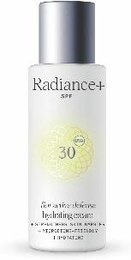

The Sunny Skin Microbiome 1.0 Overview
Go back to continue
In 2023 dsm-firmenich conducted the 1st exploratory study on Skin Microbiome & UV exposure that showed an active benefit of sunscreen application.
Pioneering studies investigate the impact of erythemal UV exposure on the skin microbiome and determine the protective effect of an SPF 20 sunscreen versus placebo on the UV-exposed skin microbiome
PARSOL® EHT
PARSOL® EHT
PARSOL® Shield
PARSOL® 340
Mitigate Acne propagation
in the context
of sunscreen application
PARSOL® 1789
Maintain skin resilience upon UV stress by preserving a healthy Skin Microbiome
PARSOL® 1789
PARSOL® ZX
Conclusion:
UV protection of microbiome by UV filters can result in more resilient cutaneous defense.
Specific UV-filters or combinations protect beneficial skin bacteria such as Lactobacillus crispatus and reduce the proliferation of opportunistic pathogens such as Cutibacterium acnes in vitro.
An SPF 20 sunscreen supports the abundance of Lactobacillus crispatus, a key player for UV-irradiated skin microbiome in vivo.
Microbiome-friendly* Sunscreen
Flor’Active Defense¹ Hydrating Cream SPF 30
Microbiome-friendly* PARSOL® UV Filters
PARSOL® EHT, PARSOL® 1789, PARSOL® Shield
*Certified by MyMicrobiome, www.microbiome-friendly.com a Worldwide leading and only registered certification mark for Microbiome-friendly cosmetics and care products
*Logo usage for final formulation to be requested by customer at MyMicrobiome

Slide 45
Microbiome Strains Recap
Cutibacterium acnes
Lactobacillus crispatus
Staphylococcus epidermidis
C. acnes is the most prevalent bacteria on oily skin, anaerobic and lipophilic commensal
The majority of strains are commensal and non-pathogenic, help to maintain low pH by releasing free fatty acids, blocking pathogens (acts as skin sentinel).
Only few strains are known to be pathogenic related to acne.
L. crispatus has a key function in vaginal microflora (but also present in skin) and is commonly used in probiotic treatment.
It preserves the balance of microbe populations, prevents skin pathogens and infections.
L. crispatus is a component of the innate immune response, protecting the microbiome and skin by fostering skin’s self defense and the symbiosis of microbiome.
A lipophilic commensal bacteria, typically part of healthy human skin microbiome, acts as sentinel of skin microbiota (protects and prevents microbial disequilibrium by fighting pathogens)
Helps to prevent acne and limits inflammation (production of bacteriocin - antimicrobial peptide)

Slide 46
Test Formulations
 |  | PLACEBO SU E 102683 14 | SUNSCREEN SPF 50 SU E 102683 15
 | INGREDIENTS | % w/w
A | PARSOL® EHS (ETHYLHEXYL SALICYLATE) | - | 5
 | PARSOL® EHT (ETHYLHEXYL TRIAZONE) | - | 3
 | PARSOL® SLX (POLYSILICONE-15) | - | 3
 | PARSOL® 1789 (BUTYL METHOXYDIBENZOYLMETHANE) | - | 4
 | PARSOL® Shield (BIS-ETHYLHEXYLOXYPHENOL METHOXYPHENYL TRIAZINE) | - | 2.8
 | C12-15 ALKYL BENZOATE | 10 | 4
 | DIBUTYL ADIPATE | 13 | 12
 | SOLVIENCETM DCC (DICAPRYLYL CARBONATE, TOCOPHEROL) | 20 | 6
 | STEARYL ALCOHOL | 2 | 2
 | AMPHISOL® K (POTASSIUM CETYL PHOSPHATE) | 2 | 2
 | TOCOPHERYL ACETATE | 0.5 | 0.5
 | VALVANCE® Touch 210 (SILICA) | 2 | 2
 | CAPRYLYL GLYCOL | 0.2 | 0.2
 | ETHYLHEXYLGLYCERIN | 0.2 | 0.2
B | AQUA | 24.41 | 24.55
 | ACRYLATES/C10-30 ALKYL ACRYLATE CROSSPOLMER | 0.2 | 0.2
 | SODIUM POLYPHOSPHATE | 0.1 | 0.1
C | XANTHAN GUM | 0.15 | 0.15
 | PENTYLENE GLYCOL | 2 | 2
 | PROPANEDIOL | 3 | 3
D | AQUA | 20 | 20
 | PARSOL® HS (PHENYLBENZIMIDAZOLE SULFONIC ACID) | - | 2
 | TROMETHAMINE | 0.24 | 1.3
Go back to continue
SUNSCREEN SPF 50
in silico SPF 46 (expected to achieve SPF 50)
in silico in vitro UVA-PF 17.6
in silico UVA/SPF 0.35 (0.33)
By dsm-firmenich Sunscreen Optimizer™
(www. sunscreen-optimizer.com)

Slide 47
Microbiome-Friendly Certified PARSOL® UV Filters
PARSOL® 1789 | Face/Body Leave on
PARSOL® Shield | Face/Body Leave on
PARSOL® EHT | Face/Body Leave on
PARSOL® SLX | Face/Body Leave on, Scalp Leave on
PARSOL® DHHB | Face/Body Leave on
PARSOL® HS | Face/Body Leave on
PARSOL® MAX | Face/Body Leave on
*Logo usage for final formulation to be requested by customer at MyMicrobiome
**www.microbiome-friendly.com a Worldwide leading and only registered certification mark for Microbiome-friendly cosmetics and care products

Slide 48

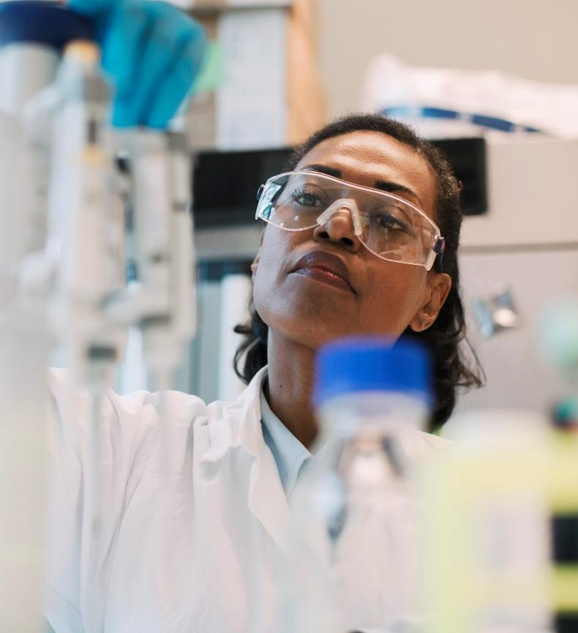




The dsm-firmenich expertise
Strong credentials in bacterial research & extensive capabilities
35 YEARS
OF EXPERTISE
in bacterial understanding
Several patents in the field of bacteria
Microbiological labs in San Diego & China
Leading to
Identification of the
4 MOST COMMON SKIN BACTERIA,
representing >90% OF THE SKIN MICROBIOME
Notes:
dsm-firmenich brings over 35 years of expertise in bacterial research, supported by several patents and advanced S&R labs in San Diego and China. This deep knowledge has allowed us to identify the four main skin bacteria that make up more than 90% of the skin’s microbiome. Thanks to this, we have been able to validate our solutions and prove our fragrance can maintain the skin’s natural balance.
Our scientific foundation is what makes SkinPositive Biome both innovative and reliable.”
Comprehensive bacteria scope
Expanded scope of bacteria strains. Firmenich has now been able to identify the 4 main bacteria representing more than 90% of your microbiome bacteria.
Allowing a comprehensive & accurate in-vitro validation, minimizing impact on them (help to keep the natural balance of your skin microbiome.)

Slide 49
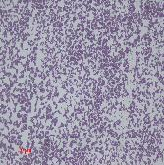
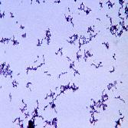


Targeted healthy bacteria for skin balance
Comprehensive skin microbiome knowledge
Skin microbiome includes prokaryotic and eukaryotic unicellular organisms, as well as viruses. Bacteria are however the most abundant
dsm-firmenich’s scientists studied relevant bacterial species
These microorganisms’ role in skin health and disease are beyond “good” or “bad”, it is all about balance.
For microbiome-gentle applications, the aim is to minimize the impact of our fragrances on bacterial populations naturally present on skin
dsm-firmenich has identified the
4 most common skin bacteria,
Representing more than 90% of the skin microbiome
S. epidermidis
C. acnes
C. tuberculostearicum
M. luteus
Supports skin barrier &
immune balance
Controls skin pH and microbial balance
(strain dependent)
Colonization resistance
(deters pathogen colonization)
Environmental protection &
oxidative stress defense
The most abundant in the SKIN MICROFLORA
Most abundant in the
SEBACEOUS GLAND-RICH SITES
(forehead, upper trunk)
Major component of bacteria that colonize
a VARIETY OF SKIN ENVIRONMENTS
(dry, moist, and sebaceous regions)
Most abundant in the REGIONS OF THE HEAD, LEGS, AND ARMS.
Byrd, A., Belkaid, Y. & Segre, J. The human skin microbiome. Nat Rev Microbiol 16, 143–155 (2018). https://doi.org/10.1038/nrmicro.2017.157
Notes:
As you have understood now, the skin microbiome is made up of a diverse community of microorganisms, with bacteria being the most abundant. Our research has focused on understanding which bacterial species are most relevant for skin health. What we’ve learned is that it’s not about labeling bacteria as simply ‘good’ or ‘bad’—it’s about maintaining the right balance.
For microbiome-gentle applications, our goal is to minimize the impact of our fragrances on the natural populations of bacteria present on the skin. By doing so, we help preserve the skin’s natural ecosystem.
Here you can see the 4 most common bacteria. Their abundance depends on the body zone and they all play different roles.

Slide 50







The dsm-firmenich solution
Preserving the balance of the skin microbiome
skinpositive™ biome
dsm-firmenich fragrance design model to create
microbiome-gentle fragrances with 100% confidence
> 900 fragrance ingredients assessed
Allowing perfumers to create fragrances that help keep the natural balance of the skin microbiome while delighting consumers
Minimizing impact on 4 main commensal skin bacteria
representing more than 90% of the skin microbiome
Comprehensive & accurate in-vitro validation
Now available for 3 beauty categories :
SKINCARE
DEO
BATH & SHOWER
Notes:
Out of the 1160 palette ingredients, 900 PRMs have been tested against the 4 selected skin bacteria
PRMs have been classified in 3 categories based on their MIC (Minimum Inhibitory Concentration) results : the amount of the PRM it takes to slow down the bacteria growth
1/3 are Gentle
1/3 are Intermediate
1/3 are Hostile
Again, the ambition is to minimize the impact of our fragrances on the 4 main commensal skin bacteria.
To do so these 900 PRM have been tested against those four bacteria with a method, adapted from recognized standards for MIC determination and published in a peer-reviewed journal.
The results allowed to establish PRM classification into three categories : gentle, intermediate, and hostile.
It is important to understand that there is currently no regulation around Biome so each company is following its own approach. In this context, we have decided to be very conservative with our creation rules to ensure we will be Biome-gentle whatever the testing method followed by our clients.
Those rules apply for Skincare, Deo, B&S

Slide 51



BIOME GENTLE BLOOM
Our fragrance design manager notes:
Biome-gentle scent for suncare cream
A lush green bouquet where creamy white blossoms and rosy petals intertwine with juicy apple and pear. This blooming bouquet unfolding into a sophisticated base of soft woods and white musk.
TOP
APPLE - PEAR - GREEN
HEART
ROSE - WHITE FLOWERS - MUGUET
FOND
MUSK – OAK - MOSS - VETIVER
Claims substantiation
90% Biodegradable
Vegan
Clean label 83
Claims are for inspiration only. Clients are solely responsible
for the use of any proposed marketing claim on their final product.

Slide 52



BIOME GENTLE GLOW
Our fragrance design manager notes:
Biome-gentle scent for suncare cream
A glowing solar bouquet of tiare flowers, ylang and orange blossom enveloped by delicate creamy touches of fruits. The warm base of musk, sandalwood and tonka helps recreate the sensation of summer sunshine.
TOP
BERGAMOT - ORANGE BLOSSOM - LACTONIC FRUITS
HEART
TIARE - WHITE FLOWERS - YLANG
FOND
MUSK - SANDALWOOD - TONKA
Claims substantiation
99.5% Biodegradable, Vegan, Clean label 83
Designed with a scientifically proven technology that activates happy and joyful feelings.
emotiwaves®

Slide 53
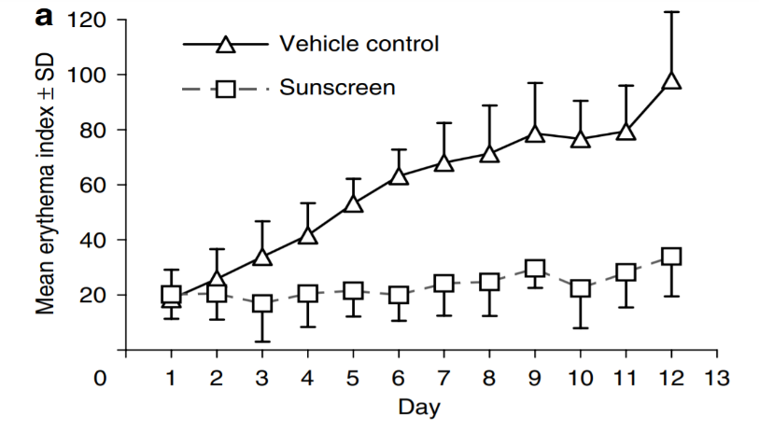
Low doses of UV radiation accumulate over time
Repeated low doses of UV radiation accumulate overtime and lead to sunburn, which can be prevented by the use of sunscreen.
Study by dsm-firmenich
Study description
Objective
To investigate the effects of sub-erythemal UV radiation
Participants and Methods
Six volunteers with skin type I or II
1x / day application of formulation at 2 different sites in lower back
  Control (no UV filters)
  Sunscreen (SPF ~7.5)
11 consecutive days of 0.6 MED Solar Simulated Radiation (SSR)
Quantitative daily assessment of skin reflectance for red light expressed as erythemal index
Reference
Young et al. Journal of Investigative Dermatology (2007) 127, 975–978.
Daily, low doses of UV radiation (sub-erythemal SSR) cause significant clinical, cellular, and molecular damage in skin types I/II.
Erythema Index ~50 =
Level at which erythema (redness) can be preceived with the naked eye
Young et al. The Detrimental Effects of Daily Sub-Erythemal Exposure on Human Skin In Vivo Can be Prevented by a Daily-Care Broad-Spectrum Sunscreen Journal of Investigative Dermatology (2007) 127, 975–978.
Notes:
Main Message: Low doses of UV radiation lead to perceptible damage, but this could be prevented by sunscreen.
Erythema = redness from increased blood flow in superficial capillaries, occurs with skin injury, infection or inflammation.
MEI 20-40, normal value

Slide 54
Targeted Skin Microbiome Analysis Methods
Long-read 16S rRNA sequencing
Single Locus Sequence Typing (SLST)
Long‑read 16S rRNA sequencing captures the entire ~1500 bp 16S rRNA gene, including all nine hypervariable regions (V1–V9), allowing much more accurate bacterial identification than short‑read methods, which sequence only small fragments (usually 150–300 bp). Long‑read platforms such as PacBio and Oxford Nanopore generate continuous, full‑length reads, eliminating the need for computational reconstruction and enabling scientists to distinguish closely related species and sub‑species that short‑read data often merge together.
Why it matters:
Because skin microbiomes contain many bacteria with extremely similar 16S regions, short‑read sequencing often lacks the resolution to separate them, leading to incomplete or ambiguous taxonomic profiles. Full‑length long‑read sequencing provides a much sharper picture of microbial diversity, revealing species‑level shifts linked to health, inflammation, or dysbiosis and offering deeper insights into microbial behavior on skin and wounds.
A high‑resolution method that sequences one carefully selected, highly variable genetic region to distinguish strains within a bacterial species—providing finer discrimination than broad markers like the 16S rRNA gene. Because it captures small but meaningful genetic differences, SLST helps researchers map strain‑level diversity with strong accuracy while remaining far more scalable and cost‑efficient than whole‑genome sequencing.
Why it matters:
Strain‑level differences often determine whether bacteria behave as harmless commensals or contribute to dysbiosis, inflammation, or disease. SLST offers a practical and reproducible way to uncover these functional differences, making it particularly valuable in fields such as dermatology, where different C. acnes strains play distinct roles in healthy vs. acne‑prone skin.
Paetzold B. et al. Microbiome, 2019
Zhang H. et al., ASM Journeys, 2024
Paisleigh Smythe, Holly Wilkinson, British Journal of Dermatology, 2024
Notes:
https://link.springer.com/article/10.1186/s40168-019-0709-3
https://journals.asm.org/doi/10.1128/msystems.00399-24
https://academic.oup.com/bjd/article-abstract/190/6/e92/7675804?redirectedFrom=fulltext

Slide 55
Glossary
Key definitions
Relative abundance: The percent composition of an organism of a particular kind relative to the total number of organisms in the area
Richness: The total number of species in a microbiome
Evenness: How well represented each species is relative to others (relative abundance)
Diversity: How many different species are present in a microbiome and to what extend (richness + evenness)
Shannon Index: A popular metric used in ecology and estimates species diversity. The index considers the number of species living in a habitat (richness) and their relative abundance (evenness).

