Slide 1

The Sunny
Skin Microbiome
The pioneering investigation revealing the impact of UV irradiation on the human skin microbiome and the benefits of UV filters by dsm-firmenich

Slide 2






Executive summary
dsm-firmenich conducted the 1st exploratory clinical study on Skin Microbiome & UV exposure that showed an active benefit of sunscreen application.
We found out that an SPF 20 sunscreen used in test positively influenced the bacterial diversity – on which Lactobacillus crispatus has emerged as a key player in the UV-irradiated Skin Microbiome.
We showed in vitro that specific UV filters protected beneficial skin bacteria such as Lactobacillus crispatus and reduced the proliferation of opportunistic pathogen Cutibacterium acnes.
We concluded that UV protection of microbiome by
UV filters can result in more resilient cutaneous defense. Based on those results we developed respective skin strengthening claims and filed two patent applications.
Besides microbiome claims for an active benefit of UV filters we offer “microbiome-friendly” certifications for our UV filters PARSOL® 1789, PARSOL® EHT, PARSOL® Shield and for a new SPF 30 sunscreen formulation.

Slide 3
01
Agenda
01
Micro(biome) but MEGA-important!
02
UV and Microbiome
03
Study results at a glance
04
Customer benefits & recommendations
05
Key takeaways

Slide 4

Micro(biome),
but MEGA-important!

Slide 5
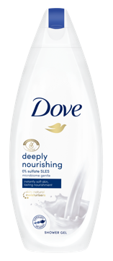
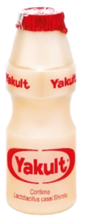
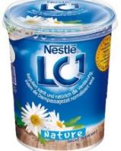
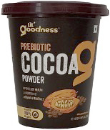
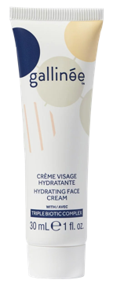
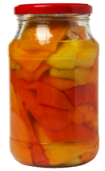
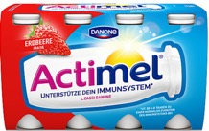
Micro(biome), but MEGA-important!
+27%*
How did it all start?
Food and Gut Health new discoveries inspired Innovative Skin Care solutions
A new generation of skin care ingredients is therefore emerging
Microbiome has been a topic for Health and Nutrition for decades
Several Food products – such as Probiotics Yogurts and Fermented Drinks - contain “food”
for good bacteria, as well as live bacteria and the beneficial compounds resulting from fermentation to facilitate a healthy digestion. Probiotics and fermented foods have become a key element
of the food and drink habits of many people.
More recently, new scientific discoveries proved that similar ingredients are very beneficial
for the skin, opening up the space for new cosmetic products promoting skin health and great appearance.
Microbiome-friendly products help deliver healthy- and good-looking skin by restoring
the biodiversity of the skin ecosystem:
the skin microbiome.
*Source: Mintel GNPD – Growth of product launches within Personal Care category with a link to Skin Microbiome in 2021 vs 2022

Slide 6
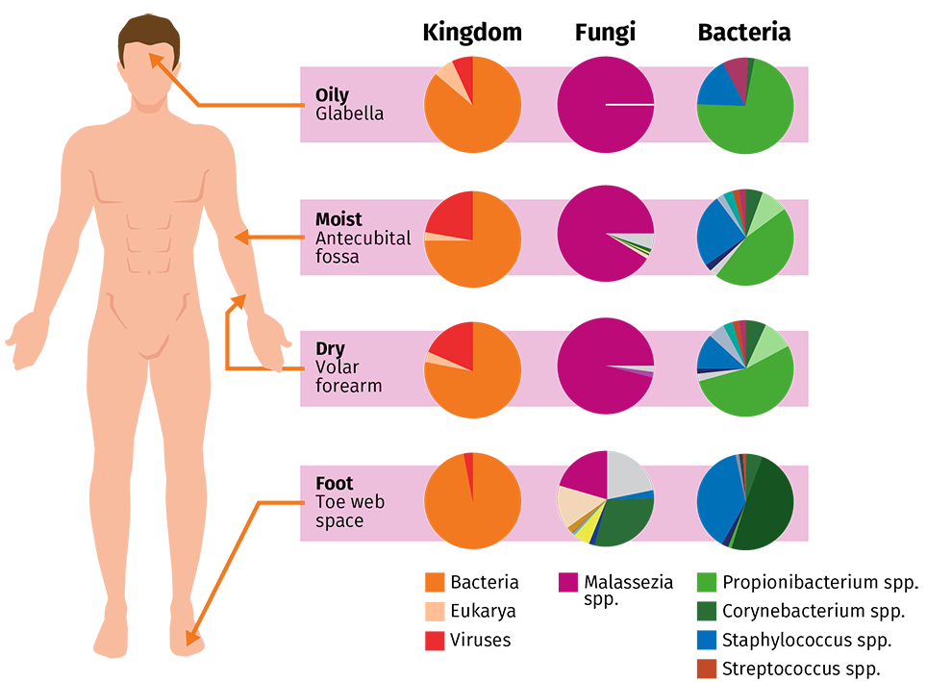
Micro(biome), but MEGA-important!
What is the Skin Microbiome and its role?
The human skin microbiome²
The Skin Microbiome is the community of all microorganisms present on skin (bacteria, fungi, viruses, etc.) and its interactions¹.
Bacteria are the most abundant microorganisms in the skin and differ depending on the body sites (moist, dry or oily skin conditions).
It has an important role in the health, wellbeing, and protection of the human body.
Skin microorganisms provide nutrients, essential protection against pathogens, support of our skin barrier and immune system and therefore impact skin health.
Microorganisms may have symbiotic or pathogenic interactions with one another or with the skin cells
Kingdom
Fungi
Bacteria
Oily
Glabella
Moist
Antecubital
fossa
Dry
Volar
forearm
Foot
Toe web
space
Bacteria
Eukarya
Viruses
Malassezia
spp.
Propionibacterium spp.
Corynebacterium spp.
Staphylococcus spp.
Streptococcus spp.
Both – quantity AND quality
of microbiome is important.
1. Berg et al (2020); 2. Byrd et al. (2018)

Slide 7
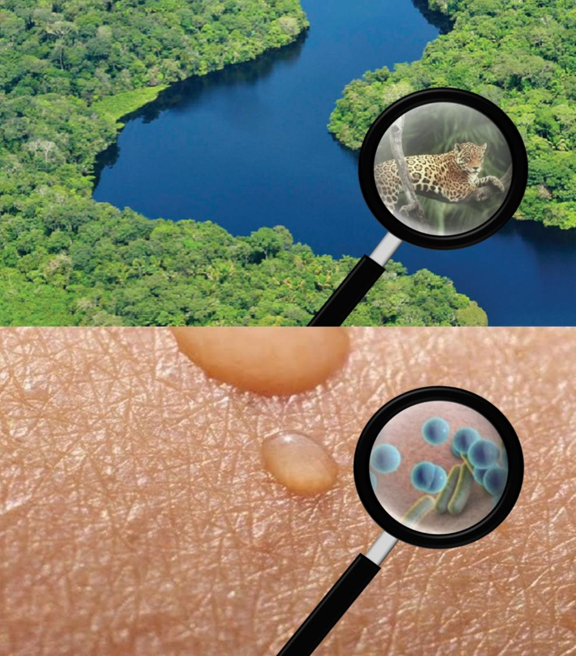
Micro(biome), but MEGA-important!
A diverse ecosystem
An intra-individual and temporal diversity
of the bacteria is observed on the skin.
The Skin Microbiome is constantly adapting depending on age, gender, location, lifestyle
(e.g., stress, Personal Care products) and environment (e.g., UV, pollution).
Individual’s Skin Microbiome composition may
be as unique as a fingerprint.
Image: Aerial view of the Amazon rainforest by Neil Palmer/CIAT​

Slide 8
02
Agenda
01
Micro(biome) but MEGA-important!
02
UV and Microbiome
03
Study results at a glance
04
Customer benefits & recommendations
05
Key takeaways

Slide 9

UV and Microbiome

Slide 10


UV and Microbiome
dsm-firmenich placebo-controlled
clinical pilot trial
Evaluate the impact of erythemal UV exposure on the Skin Microbiome.
Determine the protective effect of a SPF 20 sunscreen versus Placebo on the UV-exposed Skin Microbiome.
By investigating an active benefit of sunscreen for the Skin Microbiome,
dsm-firmenich enters a new ground of research in the industry.

Slide 11
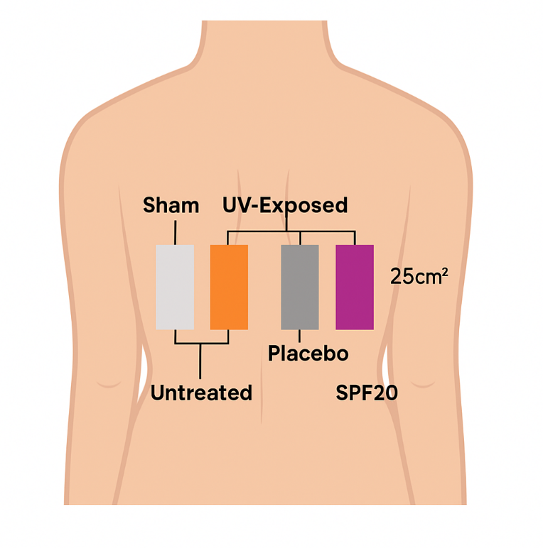
UV and Microbiome
dsm-firmenich clinical study outline
Test products:
SPF 20 SUNSCREEN: light standard emulsion (no pigments)
PLACEBO: chassis w/o UV filters
Study population:
10 female volunteers between 25 and 45 years of age
Skin type II-III (in vivo MED determination)
Overall study design:
Wash-out phase gentle cleansing bar (Gallinée), 1x/day, 7 days
Standardized application: Test products to be applied on upper middle back, 2 mg/cm2 on 2.5 cm x 10 cm
Exposure: 2 MED UVA/B from solar simulator
Time Points: Baseline, 2-hour post-exposure
Swabbing: 36 samples from 9 subjects in total
Skin microbiome and biophysical parameters:
Skin Microbiome analysis: 16S rRNA sequencing
Skin tone: Spectrometer (L* a* values). DSRL camera (back photos)
Body map of back applications
Both – quantity AND quality
of microbiome is important.
1. Berg et al (2020); 2. Byrd et al. (2018)

Slide 12
03
Agenda
01
Micro(biome) but MEGA-important!
02
UV and Microbiome
03
Study results at a glance
04
Customer benefits & recommendations
05
Key takeaways

Slide 13

Study results
at a glance

Slide 14
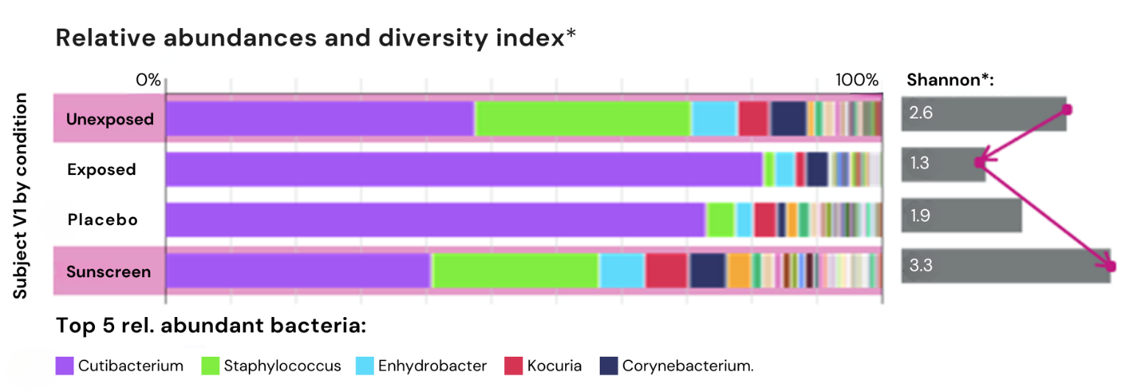
Key results in vivo I/II
UV irradiation and treatment showed an impact on bacterial composition
…
Cutibacterium was found most abundant genus
Did you know?
Cutibacterium acnes is a major component of the Skin Microbiome, especially of oily ecosystems such as back skin.
We observed distinct changes in the global diversity within the Skin Microbiome.
Both – quantity AND quality
of microbiome is important.

Slide 15
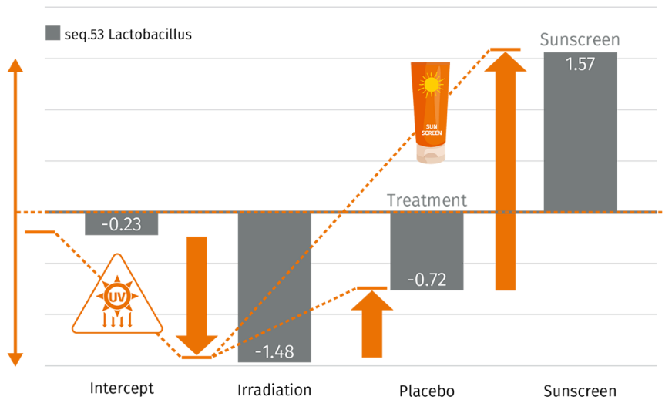
Key results in vivo II/II
SPF 20 Sunscreen prevented UV-induced reduction of Lactobacillus crispatus
L. crispatus identified as a key player in UV-irradiated
Skin Microbiome:
Relative abundance of L. crispatus decreased by irradiation
Active benefit of SPF 20 sunscreen by preventing UV-induced reduction of L. crispatus vs. placebo and by supporting its propagation
Association coefficients by conditions
Seq.53 Lactobacillus
Sunscreen
Baseline of
L. crispatus prior
UV irradiation
Baseline of L. crispatus prior UV irradiation
1
2
Log fold change of abundances
Lactobacillus (crispatus) is known to
preserve balance of microbe populations.¹ ⁻ ⁵
…
Sunscreen supports the abundance of L. crispatus and may lead to a higher skin resilience
Intercept* Irradiation Placebo Sunscreen
*averaged log abundance of the control population
1. Bouslimani et al. (2015) 2. Lebeer et al. (2022) 3. Kim et al. (2022) 4. Lepargneur et al. (2016) 5. Wang et al. (2017)

Slide 16
Key results in vitro I/II
Smart filter combination stimulated Lactobacillus crispatus abundance upon UV exposure
Survival rates of bacterial species upon UV irradiation vs. control
In vitro UV test: survival rate of isolated L. crispatus and S. epidermidis (reference strain)
± UV filters/combinations
UV filters differ in their positive impact on L. crispatus abundance: effective protection by OC, ZnO, BMDBM and EHT
UV filter combinations including effective UV filters support growth of beneficial bacteria:
Sample 8 - protection confirmed with same
combination as in study (SPF 20)
Sample 9 – similar effects with EHT/Shield/1789
SAMPLE | UV FILTERS |  | Wt*-% | Survival (Protection) [%]
 | Abbrev. | Trade Name |  | L. crispatus​ | S. epidermidis
1 | OC | PARSOL® 340 | 5​ | 50 (+300) | 63 (+59)
2 | ZnO Tecs | PARSOL® ZX | 3 | 31 (+152) | 50 (+26)
3 | BMDBM | PARSOL® 1789 | 5 | 25 (+100)​ | 63 (+59)
4 | EHT | PARSOL® EHT | 2.3​ | 25 (+100)​ | 63 (+59)​
5 | EHS | PARSOL® EHS | 10 | 20 (+59) | 79 (+100)
6 | BEMT | PARSOL® Shield | 2.3 | 20 (+59) | 79 (+100)
7 | TiO₂/SiO₂/D | PARSOL® TX | 3 | 20 (+59)​ | 50 (+26)
8 | OC/EHS/BEMT/ BMDBM | PARSOL® 340/EHS/Shield/1789 | 7/4/2/4.5 | 31 (+152)​ | 63 (+59)
9 | EHT/BEMT/BMDBM | PARSOL® EHT/Shield/1789 | 3/3/3 | 331 (+152)​​ | 50 (+26)
Control | Vehicle | n.d. | n.d. | 12.5 (0) | 40 (0)
1
2
Filter
combi.
A smart PARSOL® filter combination allows maximizing SPF while maintaining protection
of symbiotic bacterial species to strengthen
UV-exposed skin resilience
*The use level of single UV filters and combinations in the test formulations was calculated to obtain predicted in vitro SPF values of 6 and 23-24, respectively.
Abbreviations | INCI Name
OC | Octocrylene
BMDBM | Butyl Methoxydibenzoylmethane
ZnO Tecs | Zinc Oxide, Triethoxycaprilylsilane
EHT | Ethylhexyl Triazone
BEMT | Bis-Ethylhexyloxyphenol Methoxyphenyl Triazine
EHS | Ethylhexyl Salicylate
TiO₂/SiO₂/D | Titanium Dioxide, Silica, Dimethicone
1. Bouslimani et al. (2015) 2. Lebeer et al. (2022) 3. Kim et al. (2022) 4. Lepargneur et al. (2016) 5. Wang et al. (2017)

Slide 17
Key results in vitro II/II
Specific UV filters and combinations reduced Cutibacterium acnes upon UV exposure
Survival rates of bacterial species upon UV irradiation vs. control
Cutibacterium acnes is a major component of the
Skin Microbiome and an opportunistic pathogen known to trigger inflammation in acne vulgaris.
In vitro test showed that specific UV filter reduced abundance of C. acnes while maintaining the commensal bacteria S. epidermidis: BMDBM, EHS, and OC
UV filter combinations considering the needs for acne prone skin allows maximizing the SPF while reducing
the C. acnes population
SAMPLE | UV FILTERS |  | Wt*-% | Survival (Protection) [%]
 | Abbrev. | Trade Name |  | C. acnes | S. epidermidis
1 | BMDBM | PARSOL® 1789 | 5​ | 20 (-70) | 63 (+59)
2 | EHS | PARSOL® EHS | 10 | 46 (-30) | 79 (+100)
3 | OC | PARSOL® 340 | 5 | 56 (-15)​ | 63 (+59)
4 | BEMT | PARSOL® Shield | 2.3​ | 74 (+13)​ | 79 (+100)
5 | ZnO Tecs | PARSOL® ZX | 3 | 74 (+13) | 50 (+26)
6 | TiO₂/SiO₂/D | PARSOL® TX | 3 | 81 (+23) | 50 (+26)
7 | EHT | PARSOL® EHT | 2.3 | 92 (+40)​ | 63 (+59)
8 | OC/EHS/ EHT | PARSOL® 340/EHS/EHT | 10/5/5 | 23 (-65)​ | 31 (-21)
9 | EHT/BEMT/BMDBM | PARSOL® EHT/Shield/1789 | 3/3/3 | 58 (-13)​​ | 50 (+26)
Control | Vehicle | n.d. | - | 66 (0) | 40 (0)
1
2
Smart selection of PARSOL® filters in sunscreens might prevent inflammatory acne breakouts triggered by imbalance in the skin microbiota associated with specific types
of Cutibacterium acnes.¹
Filter
combi.
*The use level of single UV filters and combinations in the test formulations was calculated to obtain predicted in vitro SPF values of 6 and 23-24, respectively.
Abbreviations | INCI Name
OC | Octocrylene
BMDBM | Butyl Methoxydibenzoylmethane
ZnO Tecs | Zinc Oxide, Triethoxycaprilylsilane
EHT | Ethylhexyl Triazone
BEMT | Bis-Ethylhexyloxyphenol Methoxyphenyl Triazine
EHS | Ethylhexyl Salicylate
TiO₂/SiO₂/D | Titanium Dioxide, Silica, Dimethicone
1. Conforti et al. (2021)

Slide 18
04
Agenda
01
Micro(biome) but MEGA-important!
02
UV and Microbiome
03
Study results at a glance
04
Customer benefits & recommendations
05
Key takeaways

Slide 19
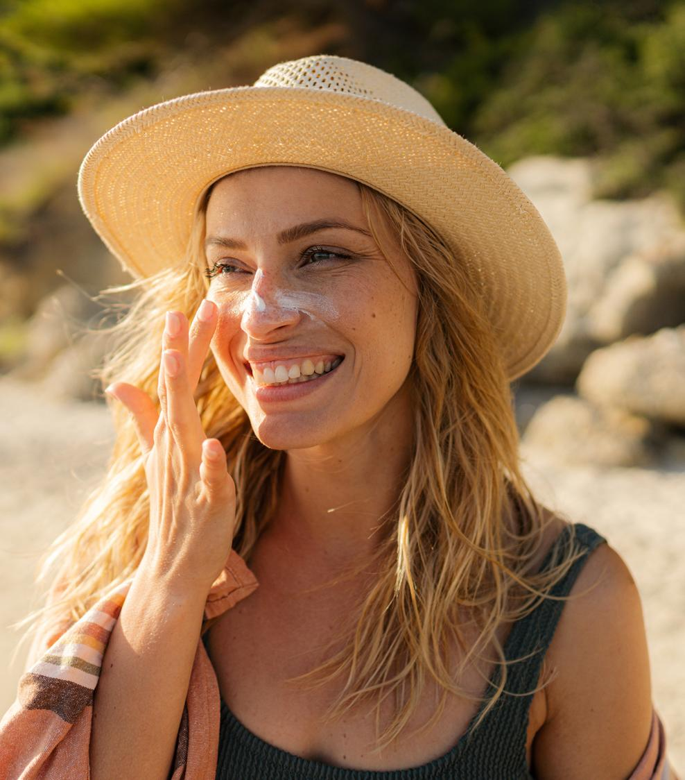
Customer benefits
& recommendations

Slide 20
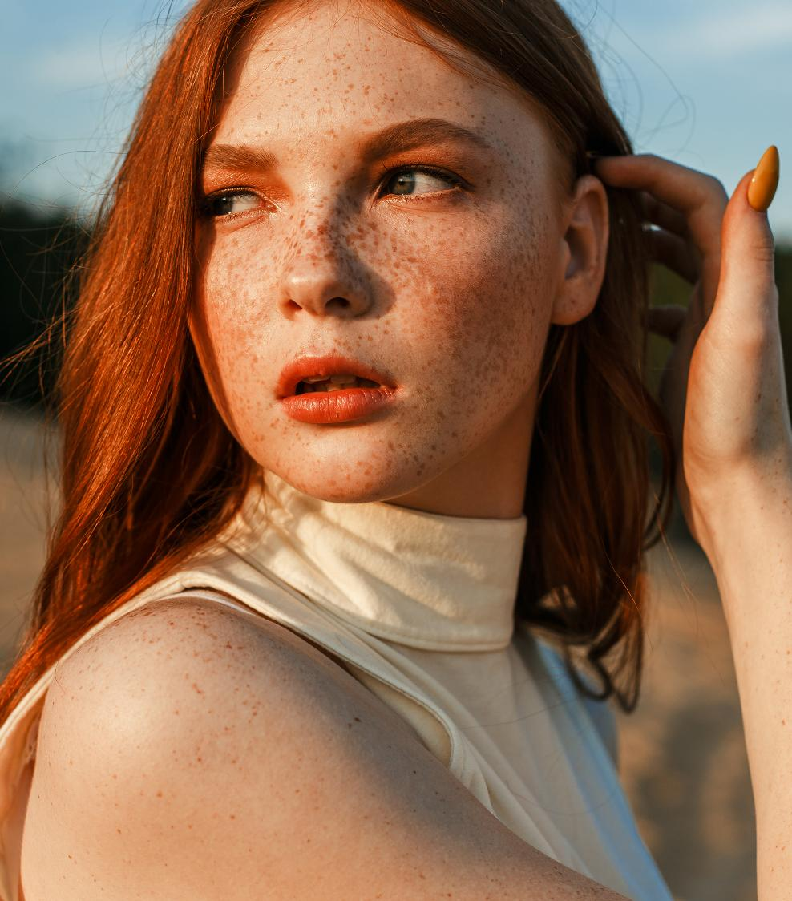

Customer benefits I/III
Study supports patent filings
Study results were translated into
two patent applications (filed June 2022):
Specific protection of genus Lactobacillus from harmful effects of UV radiation by selected UV filters¹
Reducing C. acnes in Skin Microbiome of person
in need by selected UV filters²
Method of protecting bacteria of the genus Lactobacillus from the detrimental effects of UV radiation, said method comprising the step of applying to an external surface of the human body with a Skin Microbiome comprising said bacteria an effective amount of a sunscreen composition comprising one or more UV-filters selected from the group consisting of Octocrylene, Butyl Methoxydibenzoylmethane, Ethylhexyl Triazone and Zinc Oxide prior to exposing said external surface to UV radiation.
Method of reducing C. acnes in a Skin Microbiome of a person in need thereof, said method comprising the step of applying to an external surface of the human body with a skin microbiome comprising C. acnes and optionally S. epidermidis an effective 10 amount of a sunscreen composition comprising one or more UV filters selected from the group consisting of Octocrylene, Ethylhexyl Salicylate and Butyl Methoxydibenzoylmethane prior to exposing said external surface to UV radiation.

Slide 21
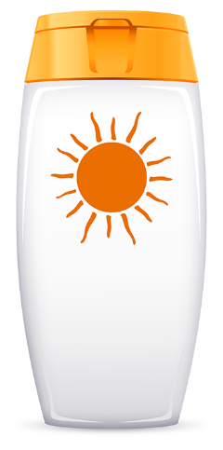
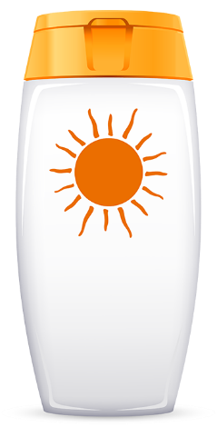

Customer benefits II/III
Study supports consumer benefits
PARSOL® EHT
dsm-firmenich innovative study results may support consumer relevant benefits:
Specific protection of Lactobacillus crispatus
by selected UV filters:
Specific reduction of Cutibacterium acnes by selective UV filters:
PARSOL® 340
PARSOL® 1789
Maintain skin resilience upon UV stress by preserving a healthy Skin Microbiome
PARSOL® ZX
“Extra skin strengthening
properties”
“Strengthening
the skin barrier”
“Strengthening skin’s natural defense/ immune response”
PARSOL® EHT
PARSOL® 1789
“(…) specially tailored for acne prone skin”
“supports an even
complexion”¹
PARSOL® Shield
Mitigate Acne propagation
in the context
of sunscreen application
PARSOL® Shield, PARSOL® EHT & PARSOL® 1789 represents a filter combination that delivers on both claims.
1. Lee et al. (2019)

Slide 22



Customer benefit III/III
Microbiome friendliness
Formulator tools to support a microbiome-friendly claim on active ingredient (1) or formulation (3):
Usage of one or more “Microbiome-friendly” certified* PARSOL® filter:
  PARSOL® 1789
  PARSOL® Shield
  PARSOL® EHT
dsm-firmenich formulation guidance
Full “microbiome-friendly” certified**
sunscreen formulation
Flor’Active Defense
Hydrating Cream SPF 30
*Logo usage for final formulation to be requested by customer at MyMicrobiome
**www.microbiome-friendly.com - Worldwide leading and only registered certification mark for Microbiome-friendly cosmetics and care products

Slide 23
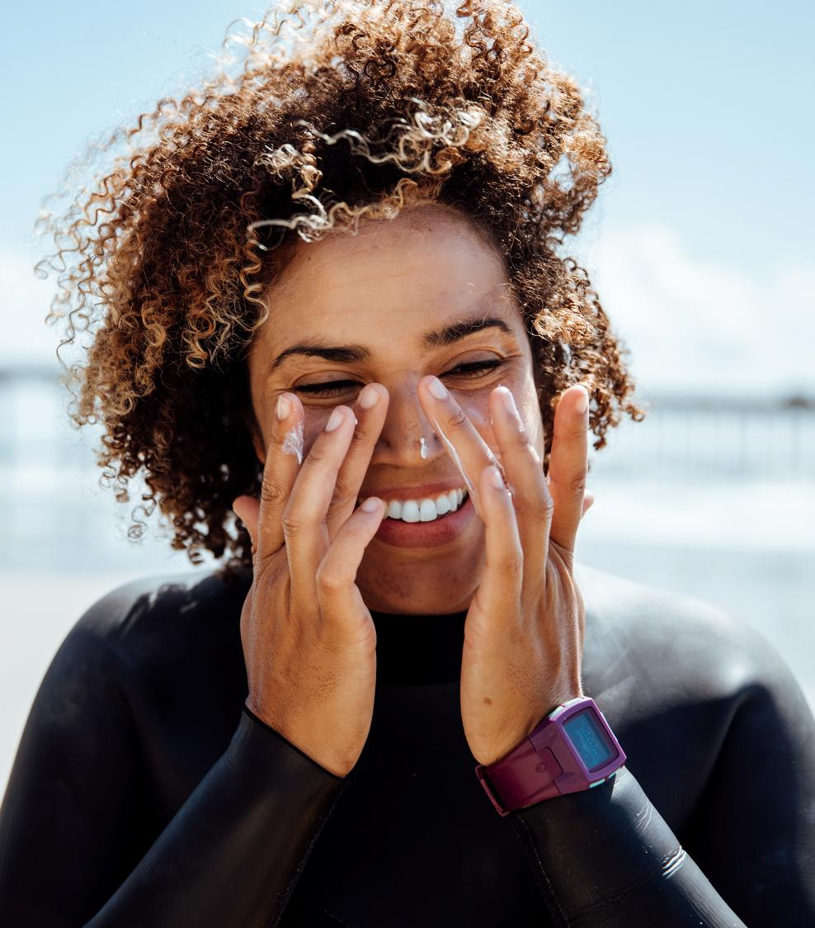

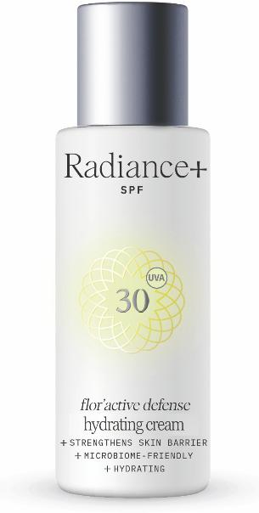
Customer benefit III/III
Flor’Active Defense¹
Hydrating cream SPF 30
Extra mild preservatives
Specifically tailored for acne prone
Supports an even complexion
Outstanding sensory panel test results!
1: Name for non-commercial purpose only

Slide 24
05
Agenda
01
Micro(biome) but MEGA-important!
02
UV and Microbiome
03
Study results at a glance
04
Customer benefits & recommendations
05
Key takeaways

Slide 25

Key takeaways
dsm-firmenich provides the 1st exploratory study showing a beneficial effect on UV-irradiated Skin Microbiome by UV protection.
Lactobacillus crispatus identified as a key player
for skin’s natural defense.
dsm-firmenich provides various tools to promote a beneficial UV protection on Skin Microbiome in final formulations: PARSOL® filter selection, formulation concept, microbiome-friendly certificates, patent-pending claim options.

Slide 26
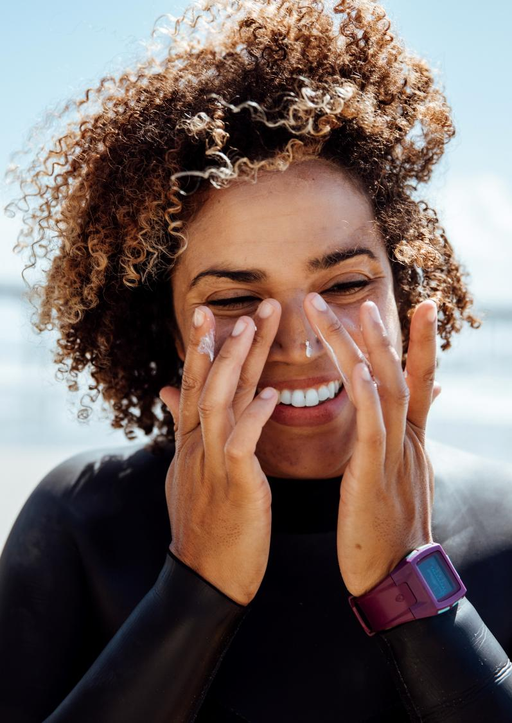








dsm-firmenich, a Partner of Choice in Photoprotection
dsm-firmenich capabilities and expertise to best serve our customers
  UV task force
  Sensory
  dsm-firmenich internal group of experts
  Monitoring concerns and challenges
  related to UV-filters
  Defines strategies to provide best solutions
  Trained expert panelists (bi-weekly evaluations)
  Objective assessments of 28 sensory parameters
  Market mapping and concept improvement
  Product stewardship
  Science & application
  Product quality and safety
  Regulatory compliance
  Toxicology and ecotoxicology
  New claim substantiation (e.g. blue light)
  Compatibilities of ingredients in various chassis
  Inspirational formulations/issue solving
  Advocacy
  Sunscreen Optimizer™
  Defense of ingredients
  Presence at REACH consortium
  Involvement in industry associations
  (IKW, FEBEA, ISO, EFfCI etc.)
  Online simulation tool
  Direct comparison of customized combinations
  Archived searches and additional parameters (eco-profile, blue light, solvent calculator, etc)
  Consumer and market insights
  Intellectual property
  Proprietary consumer surveys
  Analysis of global and local trends
  dsm-firmenich consumer insights hub
Oral assistance on specific patent questions
(no FTO)

Slide 29
Appendix

Slide 30
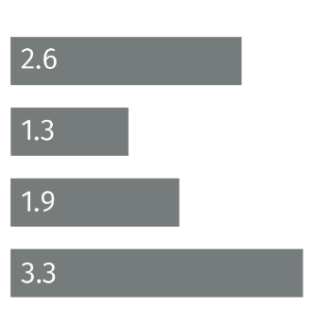
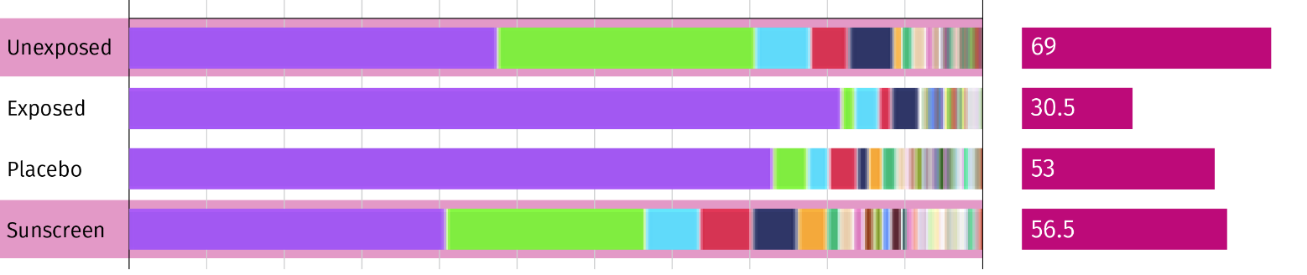
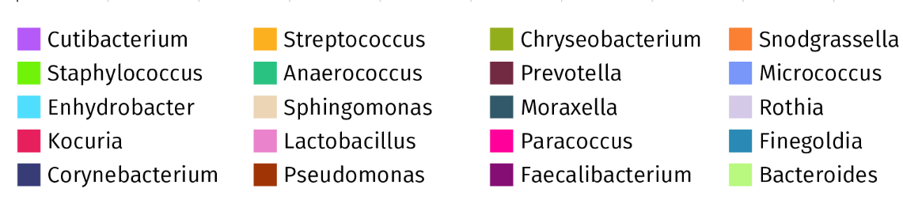
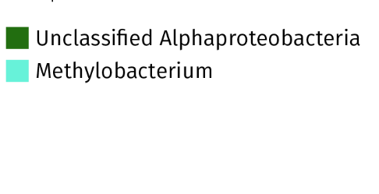

Key results in vivo I/II
Different relative abundance of bacteria by condition – Complete bacteria legend
Relative abundances and diversity index* (Shannon)
*Shannon
Subject V1 by condition
…
Both – quantity AND quality
of microbiome is important.

Slide 31
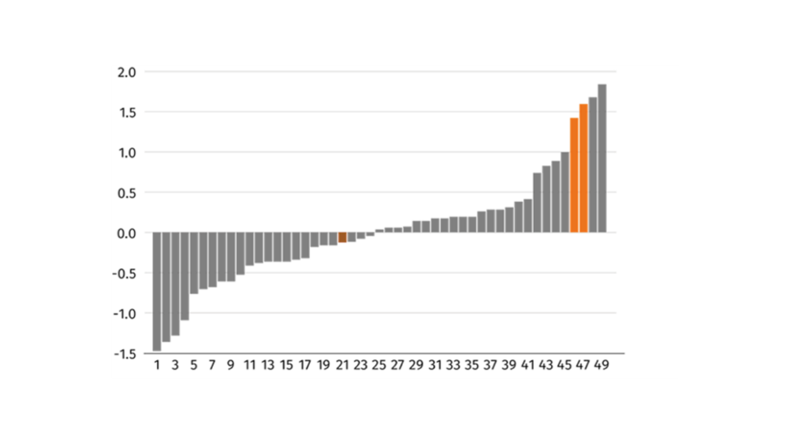
Specific bacteria of interest
Lactobacillus crispatus and Cutibacterium acnes
Lactobacillus genus known to be beneficial bacteria for the skin.^{1, 2,3}
  → It preserves the balance of microbe populations, prevents skin pathogens and infections, by lactic acid production creating an acidic environment.^{1,4}
Songbird analysis has proven L. crispatus to be most abundant Lactobacillus species in our study with a change in test-situation vs. Cutibacterium acnes.
→ Cutibacterium acnes species is a major component of the skin microbiome and an opportunistic pathogen known to trigger inflammation in acne vulgaris but is also found in healthy, oily skin. ^{5, 6}
Lactobacillus crispatus most abundant in the comparison “Treatment vs Placebo” after UV irradiation
Differential: Sunscreen treatments
Feauture Rankings
Songbird analysis Log-Ratio Classification:
None Numerator Denominator
Both – quantity AND quality
of microbiome is important.
1. Delanghe, Lize et al. (2021) 2 Bouslimani et al. (2015) 3. Lebeer et al. (2022)
4 Wang et al. (2017) 5 Dagnelie et al. (2018), 6 Spittaels et al. (2020)

Slide 32
UV and Microbiome
Ingredient list of the SPF 20* and Placebo formulations
 |  |  | SPF20 | Placebo
Trade name | INCI Name | Phase | Weight-% | Weight-%
PARSOL® 340 | OCTOCRYLENE | A | 7 | 0
PARSOL® EHS | ETHYLHEXYL SALICYLATE | A | 4 | 0
PARSOL® Shield | BIS-ETHYLHEXYLOXYPHENOL METHOXYPHENYL TRIAZINE | A | 2 | 0
PARSOL® 1789 | BUTYL METHOXYDIBENZOYLMETHANE | A | 4.5 | 0
AMPHISOL® K | POTASSIUM CETYL PHOSPHATE | A | 1 | 1
Cetiol B | DIBUTYL ADIPATE | A | 9 | 15
Cetiol® CC | DICAPRYLYL CARBONATE | A | 6 | 17.5
Lanette 18 | STEARYL ALCOHOL | A | 0.5 | 0.5
Pemulen TR-2 | ACRYLATES/C10-30 ALKYL ACRYLATE CROSSPOLYMER | A | 0.2 | 0.2
VALVANCE® Touch 210 | SILICA | A | 1 | 1
Euxyl PE 9010 | PHENOXYETHANOL; ETHYLHEXYLGLYCERIN | A | 0.3 | 0.3
Water Dem | AQUA | B | 56.38 | 56.38
Edeta BD | DISODIUM EDTA | B | 0.1 | 0.1
Sodium Hydroxide Pellets Emprove | SODIUM HYDROXIDE | B | 0.02 | 0.02
Ethanol abs. | ALCOHOL | C | 8 | 8
Total |  |  | 100 | 100
Both – quantity AND quality
of microbiome is important.
* SPF calculated from dsm-firmenich Sunscreen Optimizer™ (www. sunscreen-optimizer.com)

Slide 33
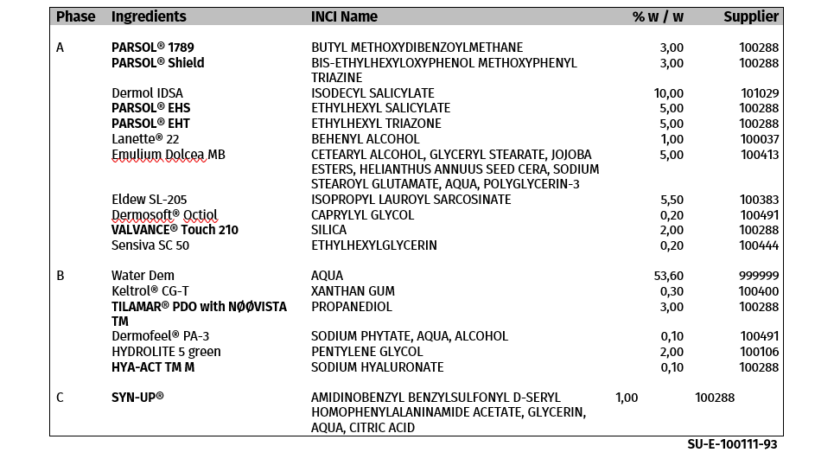
Microbiome friendly certified sunscreen
Flor’Active Defense Hydrating Cream SPF 30*
Key benefits:
SPF 30 (simulated, in-vivo results pending)
UVA acc. to ISO 24443
Microbiome friendly (certified)
Locks in moisture (HYA-ACT™ M)
Boost of hydration (HYA-ACT™ M)
Calming reddened skin (SYN-UP®)
Strengthened skin barrier function for a more resilient skin (SYN-UP®) / PARSOL® Shield/ PARSOL® EHT
New: > Extra mild preservatives
> Specifically tailored for acne prone skin / Extra skin strengthening properties
> Supports an even complexion
Both – quantity AND quality
of microbiome is important.
*simulated SPF, in-vivo SPF results 03/23

Slide 34
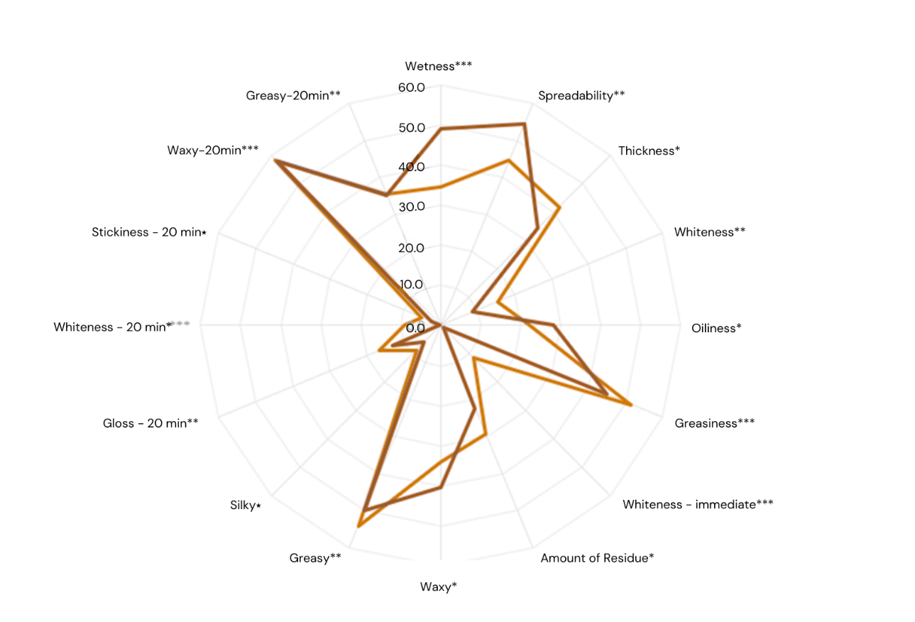
Microbiome friendly sunscreen
Flor’Active SPF 30 / Sensory panel test results 02-2023
Means per attribute dsm-Firmenich
test formulation SU E 100111-93
SPF 30 mattifying sun protection “face”
Star-rating identifies levels of significance:
***<1%; **<5%; *<10%
Both – quantity AND quality
of microbiome is important.

Slide 35
Glossary
Key definitions
Relative abundance: The percent composition of an organism of a particular kind relative to the total number of organisms in the area
Richness: The total number of species in a microbiome
Evenness: How well represented each species is relative to others (relative abundance)
Diversity: How many different species are present in a microbiome and to what extend (richness + evenness)
Shannon Index: A popular metric used in ecology and estimates species diversity. The index considers the number of species living in a habitat (richness) and their relative abundance (evenness).
Chao 1: Is an estimator based on abundance (richness)
Both – quantity AND quality
of microbiome is important.

