Slide 1

Hair Care from
Scalp to Tip
April 2025

Slide 2

Agenda
01
Market & Consumer Insights
02
dsm-firmenich Hair Care Solutions Map
03
ALPAFLOR® EDELWEISS CB
04
PENTAVITIN®
05
BeauPlex® VH
06
Other dsm-firmenich Solutions
Click on the number to get redirected to the chapter

Slide 3

01
Agenda
01
Market & Consumer Insights
02
dsm-firmenich Hair Care Solutions Map
03
ALPHAFLOR® EDELWEISS CB
04
PENTAVITIN®
05
BeauPlex® VH
06
Other dsm-firmenich Solutions
Click on the number to get redirected to the chapter

Slide 4
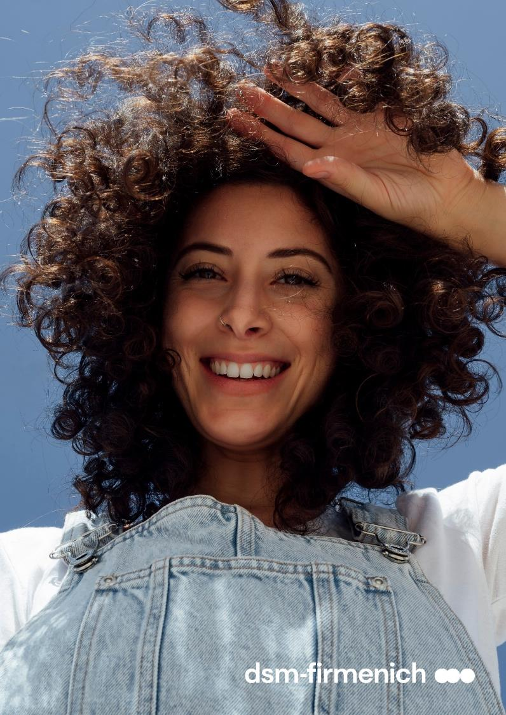
The Hair Care Market
2nd biggest segment within Personal Care, accounting for 15% of the whole market
61% of the sales is behind Shampoo, Conditioners & Treatments
Top 20 Global Companies account for 45% of the market
APAC is the biggest region, accounting for 31% of whole sales, followed by EMEA with 30% of the sales
Source: Euromonitor Global RSP MKT Val, FY 2020

Slide 5


What’s really trending now?
Hair Loss* Treatments, Conditioners and Treatments, are the fastest-growing segments
Premium segment is growing more than 3.5x above the Mass segment
Skinification continues to be a key trend: Consumers are interested in ingredients trending in facial skincare
Of Consumers, when it comes
to purchasing decision, the active ingredient is more important than the brand, packaging and fragrance
56%
*Helps prevent hair loss / Drug claim in some regions
Source: Mintel, dsm-firmenich l Research 2021

Slide 6
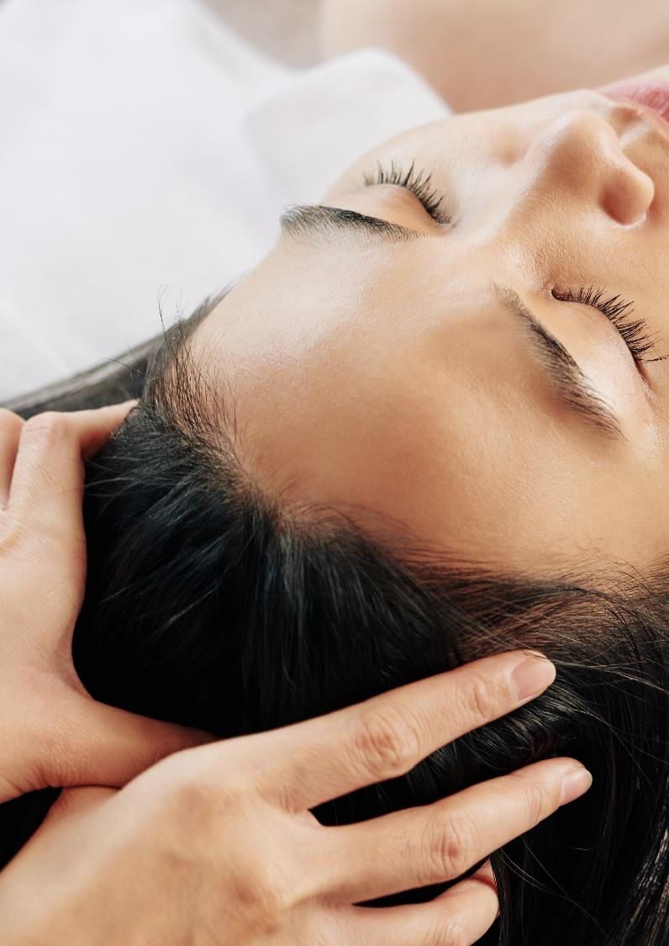
Fastest Growing Benefits & Consumer Intel
Scalp is a growing focus with moisturizing, sensitive scalp, damaged hair, and hair loss* as main claims
Hair Loss*
^{are using scalp care products}
at home to fight their problems
are not satisfied with current solutions provided by companies
are interested in more preventive solutions and would do anything
Scalp Care / Moisturizing
are using scalp cleansing products
at home to fight their problems
believe in moisturizing solutions to fight scalp issues
of consumers who suffer from dandruff also suffer from itchy scalp
*Helps prevent hair loss / Drug claim in some regions
Source: Mintel, dsm-firmenich Research 2021

Slide 7






Top of mind concerns across the Globe
Quite differentiated picture across the countries
Delta values to Global
*Q2: Multiple choice. Total number of respondents: 2100. Countries weighted data Consumers already suffering the issue
Notes:
Top benefits are dandruff and hair loss
Total Participants: 2100
BR : 500
CN: 300
FR: 500
JP: 300
US: 500
See back-up slide 161
Example :Scalp dryness significant concern in NA
Delta is related to the total
e.g: Dandruff for Japan: subtract total (53%) per region (-17%). In Japan dandruff represents 36%. Top claim in Japan is hair dryness (57%)
Brazil top is frizz (51%)

Slide 8
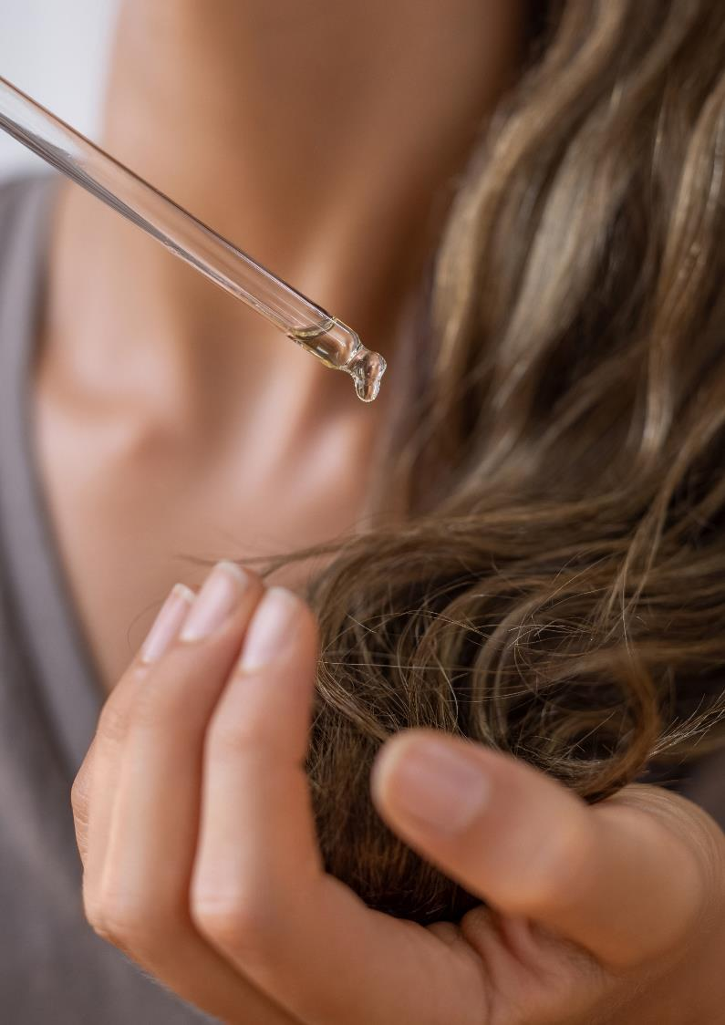

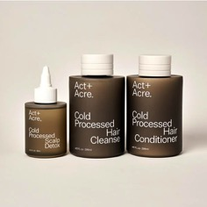
Skinification Messaging
Brands are educating consumers
Hair Care brands are messaging the connection between a healthy scalp and hair loss* with mentions on social media increasing tenfold from 2019 to 2020.
Brands are also trying to educate consumers about managing health as a hair loss* strategy but also suggesting multiple products as a possible solution to help combat the issue.
Skincare for your Scalp - The Essentials:
Scalp Detox: A treatment that rebalances the moisture barrier to support the scalp’s vital role in healthy hair
Hair Cleanse: A nutrient-dense shampoo that gently removes residue without irritation
Hair Conditioner: A silicone-free conditioner made of plant oils that instantly absorb to deliver weightless, lasting hydration
*Helps prevent hair loss / Drug claim in some regions
Source: Mintel

Slide 9
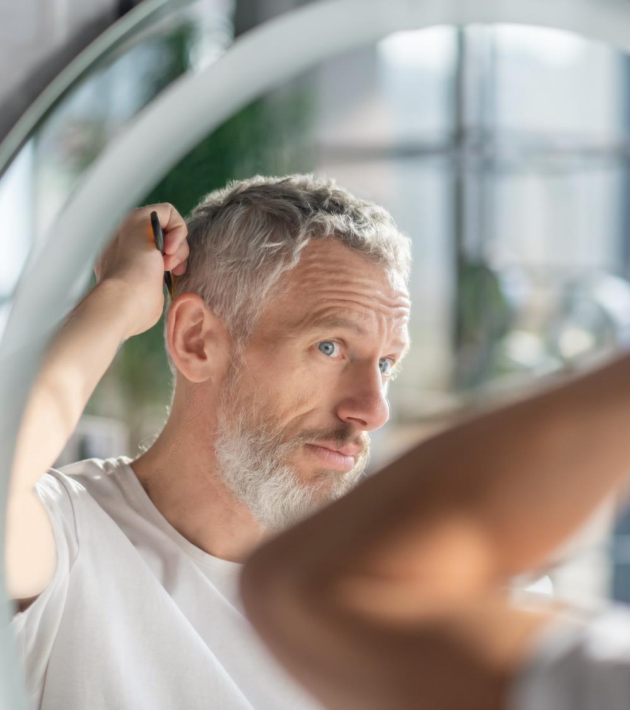
Hair Loss*
To prevent hair loss, the most popular action being taken by consumers is to use hair or scalp care products at home. However, consumers have not been satisfied with these products as they are not effective.
2020 Survey insights
of people with hair loss problems think
the #1 cause is stress/depression
Biggest Symptoms for Hair Loss:
Hair Loss
in the shower
Reduced
Hair Volume
It was found that Gen Z and females blamed hair dyeing and usage of wrong haircare products for
hair loss to a higher extent than other subgroups
of respondents across all subgroups
would do “a lot” or “anything” to prevent themselves from losing their hair
*Helps prevent hair loss / Drug claim in some regions
Source: dsm-firmenich Research 2021

Slide 10


Consumers Express Their Greatest Challenges with Hair Loss*
“I feel really sad when my hair comes out. It's very thin, anyway and I haven't got a lot around the front. A lot came on after I had a child. Every time I wash it, more comes out. Every time I brush it, more comes out.”
Kier, 35
Peterborough, UK
“I do personally take vitamins on top so I would like the product to be enriched in that in whatever form and absorbed into your scalp.”
Jhunette, 35
Sydney, Australia
“The more natural the product is, the more vitamins it has, the better it is for you. I am all for products that offer additional vitamins to support the hair growth and anything like that to just take care of yourself.“
Matt, 42
Corona, USA
*Helps prevent hair loss / Drug claim in some regions
Source: dsm-firmenich Research, 2021, 45 respondents from US, UK, AU (15 per country
Notes:
Hair Loss: 45 respondents from US, UK, AU (15 per country)
Consumer not satisfy with the current solutions
Expressed their frustrations

Slide 11
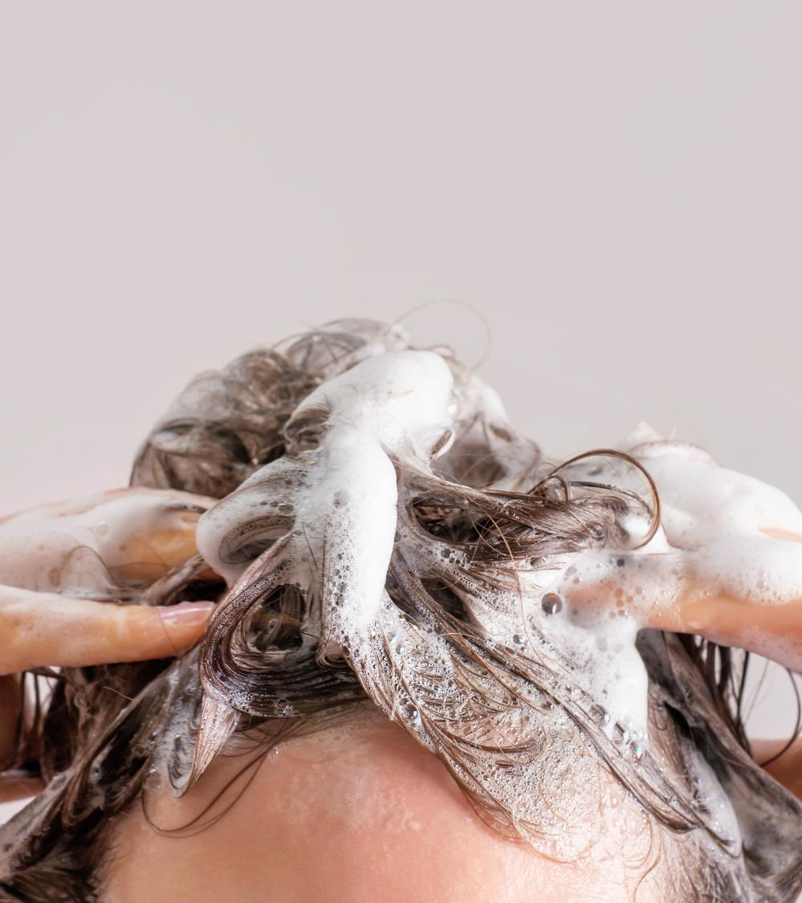
Scalp Care
Consumers are beginning to understand that the scalp should be nurtured in a similar way to facial skin and will be interested in ingredient innovation that crosses from facial care to the scalp.
Survey Insights
of respondents see stress/depression as the #1 cause for scalp issues, followed with some distance by unhealthy diet (48%)
Itchy scalp is the #1 symptom for scalp problems
The claim that sufferers from scalp issues find
most interesting is “moisturizes scalp and hair”
Followed with some distance by “soothes the
scalp, reduces itchiness” - these claims
especially resonate with Gen-Z consumers
Scalp cleansing products are considered as
the first choice for preventing scalp issues
Source: dsm-firmenich Internal Research; Mintel

Slide 12
Consumers Express Their Greatest Challenges with Scalp Care
“When I have dandruff or an itchy head, I get really frustrated and embarrassed because it makes you feel less clean.”
Leah, 38
“My ideal solution would be something like a shampoo, or a cleanser, or something, some kind of moisturizer that you could put on your scalp, that didn't weigh your hair down, that cleansed your hair too, that would be perfect.”
Tabitha, 45
I'm a huge fan of products with vitamins. I believe they can help ease and heal lots of conditions in head or on the skin.
Samuel, 33
Source: dsm-firmenich Research, 2021, 45 respondents from US, UK, AU (15 per country)
Source: Voxpopme with CMI PC Analysis -2021
Notes:
Scalp-care: 45 respondents from US, UK, AU (15 per country)

Slide 13
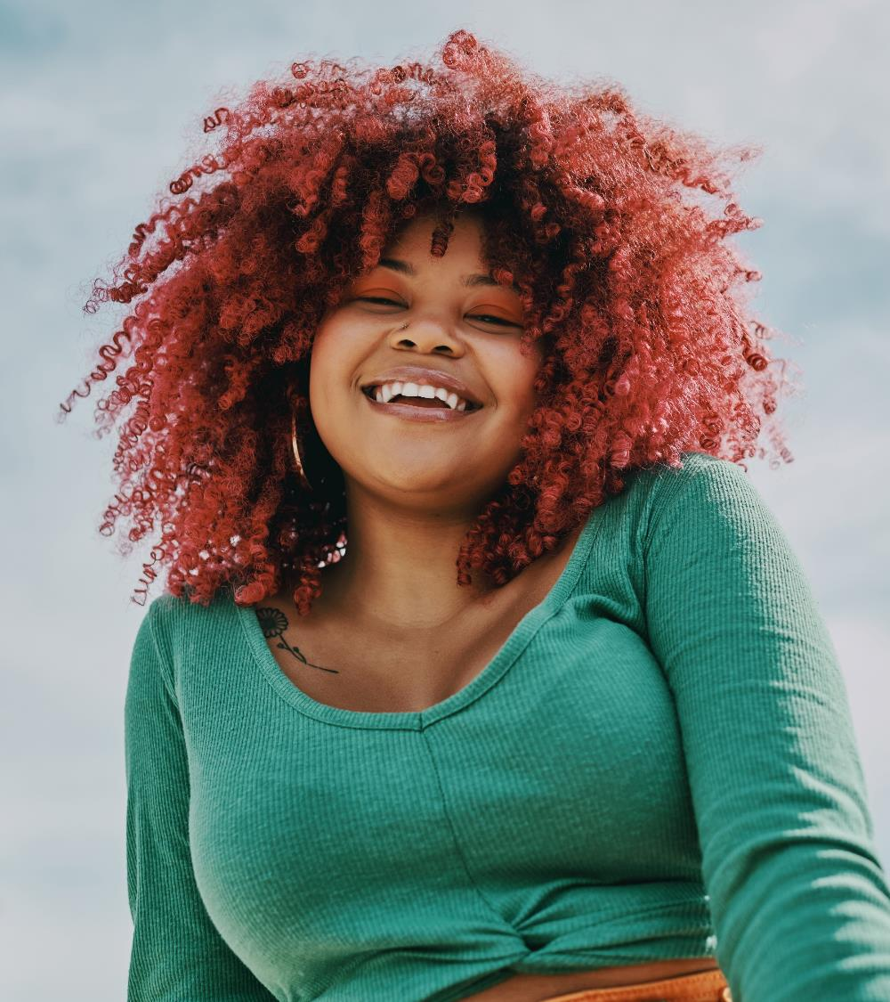
Anti-Grey
Consumers seek anti-greying solutions
Greying Hair is a primary ﻿hair concern
among both men and women
2020 Survey Insights
of respondents were interested in products that claim to prevent / reverse grey hair
Key Performance Claims for Anti-Aging Hair Care:
Shine
Long-Lasting
Moisturizing / Hydrating
Damaged Hair
UV Protection
Protection Against Elements
Source: Mintel
Notes:
According to dsm-firmenich Consumer Insights Hub (Voxpopme Data 2020; PC CMI Analysis), most consumers, regardless of gender, dye their hair. Some of them use other solutions, such as shampoo, to maintain their hair color longer. According to Mintel, greying hair is a primary concern among both men and woman. In a survey conduct in January 2021, 81% of respondents confirm their interest in product that claim prevent/ reverse grey hair. There is also a concern around chemical-free dyes. Consumers are interested in solutions that provide long-lasting color while not staining the skin. These solutions should look natural and not appear like consumers are trying to hide their grey hairs. Root coverage is also an area of concern. Overall, the sentiment of getting older is the key pain point for consumers of all genders that have grey hair.

Slide 14
Consumers Express Their Greatest Challenges with Grey Hair
“You're aging and you’re not as young as what you used to be anymore…”
Zara, 30
“I dye my hair to get rid of the gray hair and I will do this as long as I'm able to”
Amy, 41
“They're specifically for the roots. I feel like the technology is a lot better actually to cover the roots.”
Meagan, 36
Source: dsm-firmenich Research, 2021,105 respondents from US, UK, AU (40, 40, 24)
Notes:
Greying Hair: 104 respondents from US, UK, AU (40, 40, 24)

Slide 15

02
Agenda
01
Market & Consumer Insights
02
dsm-firmenich Hair Care Solutions Map
03
ALPAFLOR® EDELWEISS CB
04
PENTAVITIN®
05
BeauPlex® VH
06
Other dsm-firmenich Solutions
Click on the number to get redirected to the chapter

Slide 16
dsm-firmenich solutions for Hair Care
 |  | Bioactives |  |  |  |  |  |  |  |  |  | Vitamins |  |  |  |  |  |  | Performance |  | UV Filters
BENEFIT | INGREDIENT | ALPAFLOR® ALP-SEBUM CB | ALPAFLOR® EDELWEISS CB | ARGAN OIL | COLHIBIN CB | life’sGLA™ ’10’ n-6 Oil | PENTAVITIN® | PHYTALURONATE PF | Phytantriol | SETAKOL PF | STIMU-TEX® AS | BeauPlex® VH (Vitamins Blend) | Vitamin B3 (Niacinamide PC) | Pro-Vitamin B5 (Panthenol) | Vitamin B6 (Pyridoxine HCl) | Vitamin B7 (D-Biotin) | Vitamin C and STAY-C® 50 | Vitamin E (Tocopherol forms) | TILAMAR® Quat 640 | TILAMAR® Quat 2240 | PARSOL® SLX | PARSOL® MCX
Anti-breakage |  |  |  | • | • | • |  | • |  | • | • |  |  |  |  |  |  |  | • | •
Anti-frizz |  |  |  | • |  | • |  |  |  |  | •
Helps reduce the appearance of greying hair |  |  | • |  |  |  |  |  |  |  |  | •
Color protection |  |  |  |  |  |  |  |  | • |  |  |  |  |  |  |  |  |  |  |  | • | •
Conditioning / ease of combing |  |  |  | • | • | • |  | • |  | • | • |  |  |  |  |  |  |  | • | • | •
Flaking reduction |  |  |  |  |  |  | •
Helps prevent hair loss* |  | • | • |  |  |  |  |  |  |  |  | • |  |  | • | • | • | •
Hair protection |  |  | • |  |  |  |  |  | • |  |  | • |  |  |  |  | • | • |  |  | • | •
Hair strengthening |  |  |  |  |  |  |  |  |  |  |  | • |  | •
Hair thickening |  |  |  |  |  |  |  |  |  |  |  | • | • | • | •
Heat protection |  |  |  |  |  |  |  |  | •
Scalp care |  | • |  |  |  |  | • |  |  |  | • | • | • | • | • | • | • | •
Sebum reduction |  | • |  |  |  |  | • |  |  |  |  |  |  |  | •
Shine |  |  |  | • |  | • |  |  |  |  | • |  |  |  |  |  |  |  |  |  | •
Split-ends reduction |  |  |  | • | • | • |  | • |  | • | •
Volume |  |  |  |  |  |  |  |  |  |  |  | • | •
*Drug claim in some regions

Slide 17

03
Agenda
01
Market & Consumer Insights
02
dsm-firmenich Hair Care Solutions Map
03
ALPAFLOR® EDELWEISS CB
04
PENTAVITIN®
05
BeauPlex® VH
06
Other dsm-firmenich Solutions
Click on the number to get redirected to the chapter

Slide 18


ALPAFLOR® EDELWEISS CB
Beyond Natural
Click to return
to homepage

Slide 19


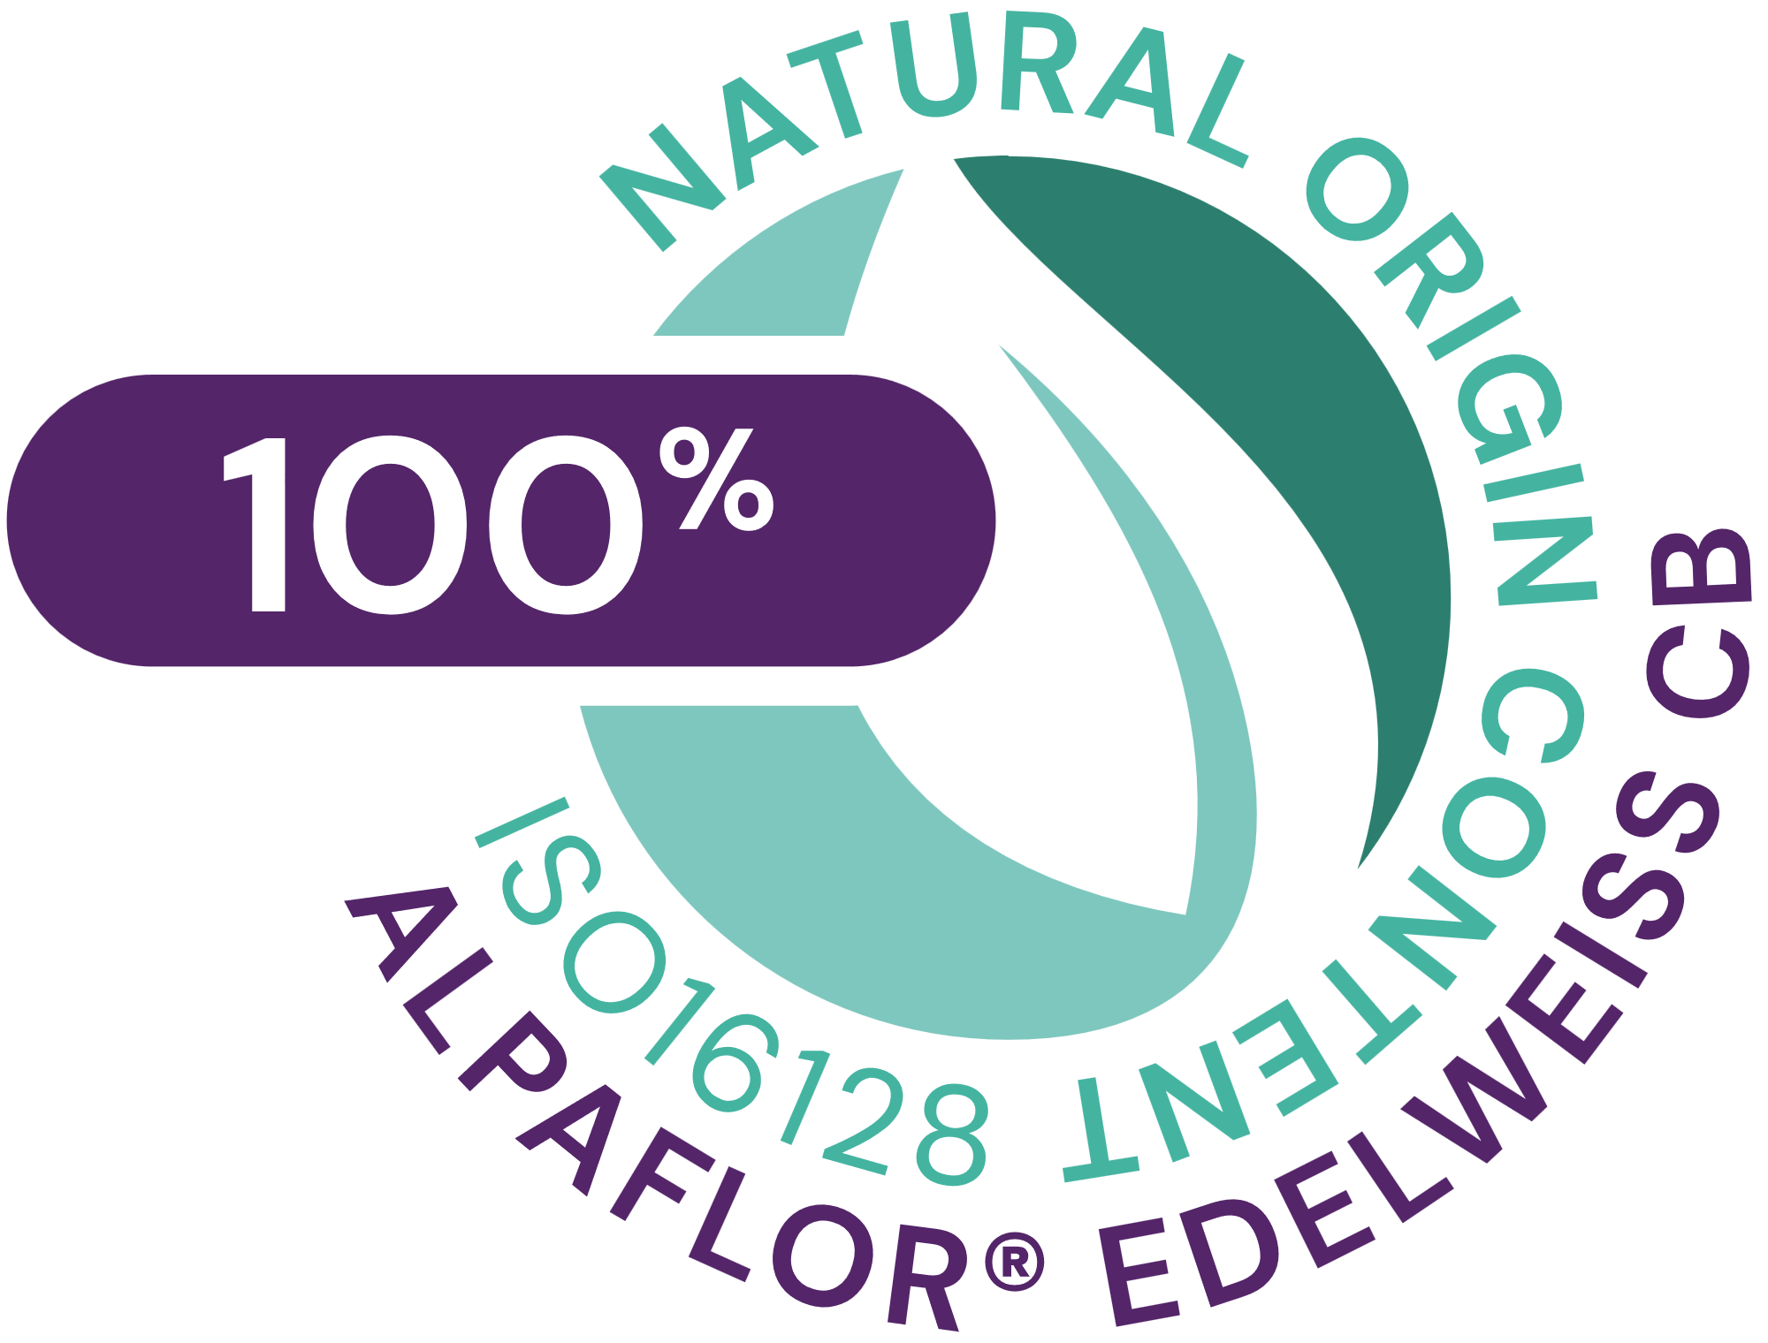

ALPAFLOR® EDELWEISS CB
ID Card
Key benefit:
Helps prevent hair loss* (improves hair density)
Helps reduce the appearance of greying hair
Anti-aging (strong anti-oxidant properties)
INCI name:
(Active)
Leontopodium Alpinum Flower/Leaf Extract
Description:
Plant extract organically cultivated
Technical:
Form: Liquid
Use level: Up to 3%
pH of use: 3.5 to 5.5
Preservative: Free
Solubility: Water soluble
Target: Scalp
Biodegradability: Readily biodegradable
Registration
certification
*Drug claim in some regions

Slide 20
ALPAFLOR® EDELWEISS CB
Hair Loss*
Click to return
to homepage
*Helps prevent hair loss / Drug claim in some regions

Slide 21


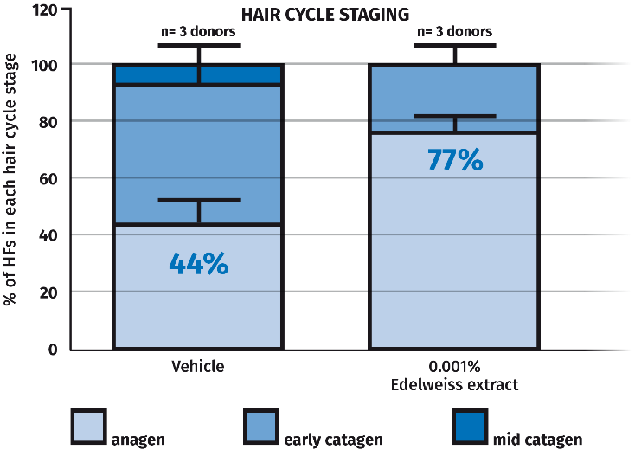
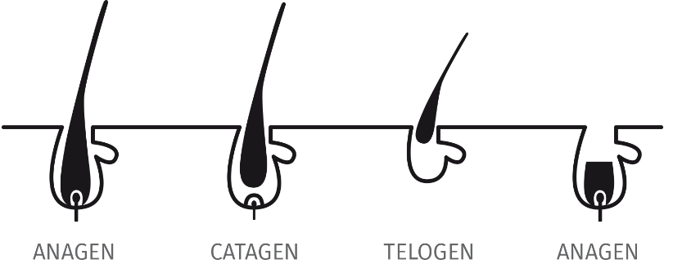
ALPAFLOR® EDELWEISS CB
Ex vivo studies – Hair loss*
The hair growth cycle consists of 3 distinct stages: anagen, catagen and telogen**
Anagen known as "growing” phase
1.8 x more hair follicles in the anagen
phase with Edelweiss than placebo
Edelweiss extract prolongs anagen phase of hair follicles
Based on hair cycle score the difference between vehicle and Edelweiss is significant (p<0.05)
*Helps prevent hair loss / Drug claim in some regions
**https://www.philipkingsley.com

Slide 22
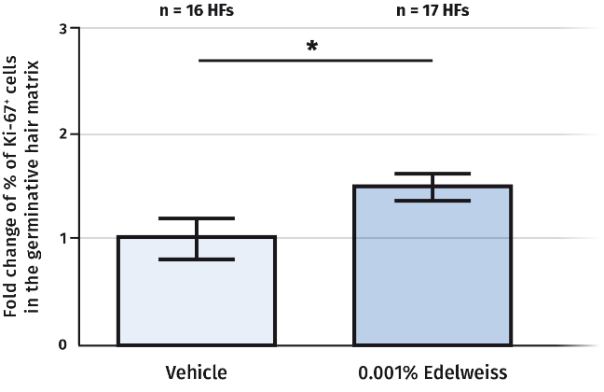
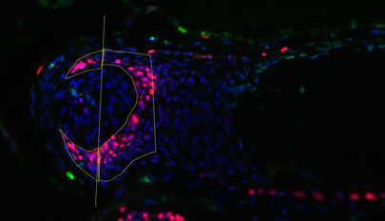
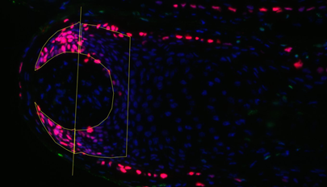
ALPAFLOR® EDELWEISS CB
Ex vivo studies – Hair loss*
Keratinocytes make up the hair shaft and need to proliferate in order to support the hair growth.
Vehicle
0.001% Edelweiss Extract
Ki-67/Tunel/DAPI
Ki-67/Tunel/DAPI
* p<0.05 vs vehicle/ 3 donors
Increased Ki67-staining (red) in Edelweiss treated follicles compared to vehicle.
+50% increase of hair matrix keratinocytes proliferation with Edelweiss extract
*Helps prevent hair loss / Drug claim in some regions

Slide 23
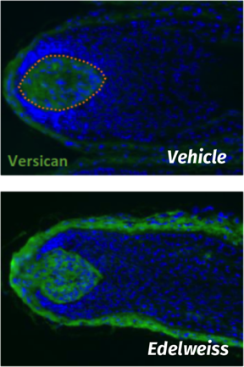
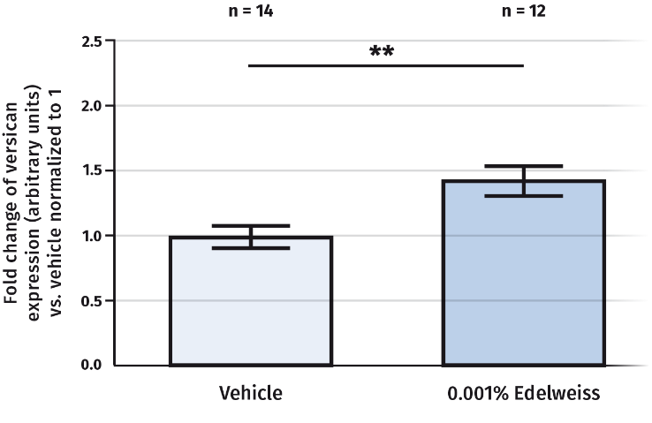
ALPAFLOR® EDELWEISS CB
Ex vivo studies – Hair Loss*
Versican, a large extracellular matrix proteoglycan, in the dermal papilla of the hair follicles.
Versican was shown to be highly associated with growing hair follicles and is a marker for hair growth inductivity
The orange dotted line highlights the dermal papilla where measurement was done.
** p<0.01 vs vehicle / 3 donor
+43% increase of Versican in the dermal papilla thanks to Edelweiss extract.
*Helps prevent hair loss / Drug claim in some regions

Slide 24
ALPAFLOR® EDELWEISS CB
Study Design / Hair Loss*
Target group​​
18-65 y.o. (mean 45 y.o.) ​​
​30 Volunteers per formulation​​
Placebo​​
ALPAFLOR® EDELWEISS CB 3%​
​​Application: 5 month​s​
daily, scalp, leave-on​​
​Double-blind, randomized
*Helps prevent hair loss / Drug claim in some regions

Slide 25
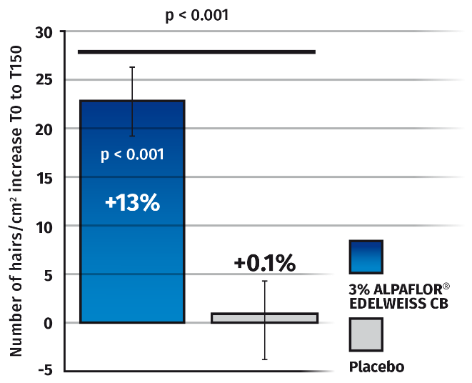
ALPAFLOR® EDELWEISS CB
In vivo studies – Hair density
13% increase in hair density versus T0 with the Edelweiss extract
Significant better performance than Placebo after 5 months
90% of volunteers treated with ALPAFLOR® EDELWEISS CB measured an increase in hair density,​while 57% of volunteers using Placebo
Hair Density after 5 months (number of hairs / cm2)

Slide 26
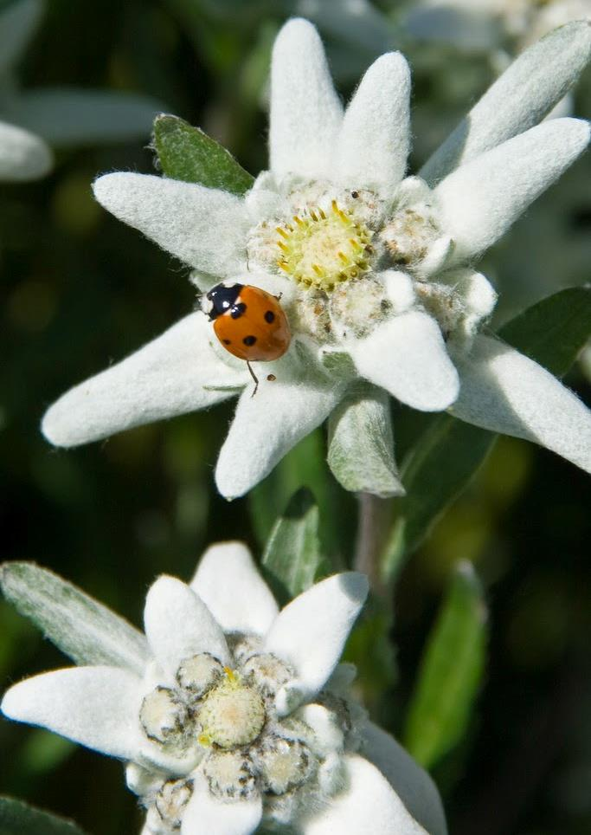
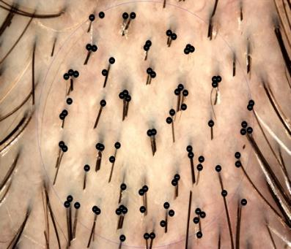
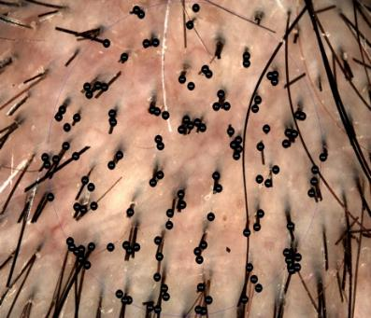
ALPAFLOR® EDELWEISS CB
In vivo studies – Hair density / micro-images
Visible increase of hair density +49% of hair
(example #76)
T0
T150
Volunteer # 76
From 142 to 211 hairs/cm2 (+49%)

Slide 27
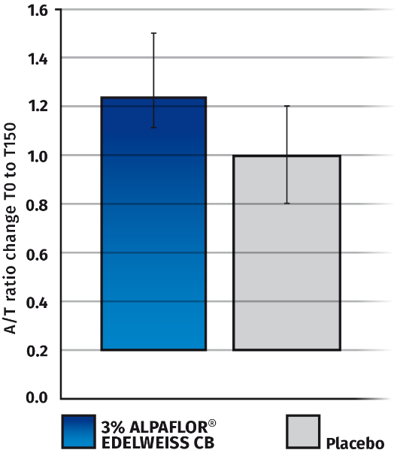
ALPAFLOR® EDELWEISS CB
In vivo anagen / telogen – Hair loss*
Higher proportion of hair in anagen phase using a serum with ALPAFLOR® EDELWEISS CB after 5 months.
20% more hair in the anagen phase with ALPAFLOR® EDELWEISS CB than placebo.
p = 0.060
***
+1.29
***
+0.99
*Helps prevent hair loss / Drug claim in some regions
n= 30 – SEM error bars ***p < 0.001 vs T0
15 to 25 hairs collected per volunteer for trichogram

Slide 28
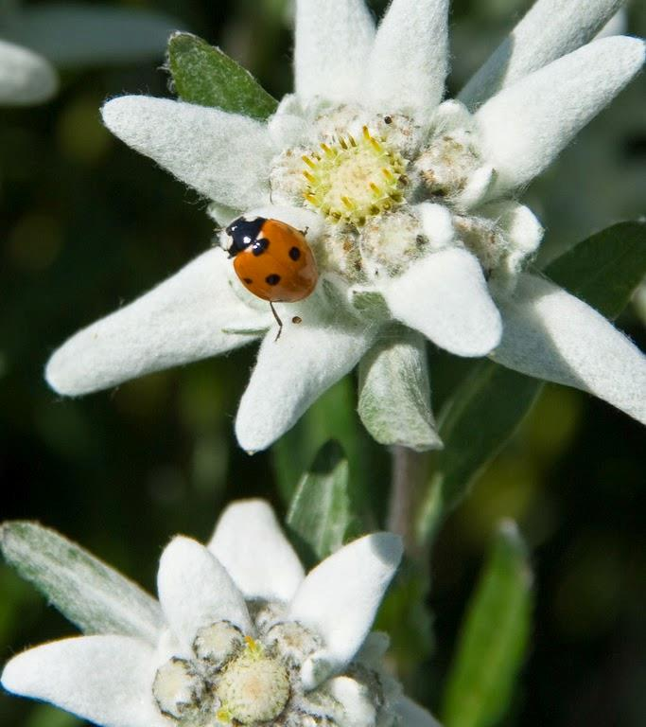

Consumers confirm efficacy
Self assessment
Participants feedback after treatment with ALPAFLOR® EDELWEISS CB
100% liked the product
90% noticed increased speed
of hair growth
Self assessment
Clinical study, 30 volunteers, 18 – 65 years old

Slide 29
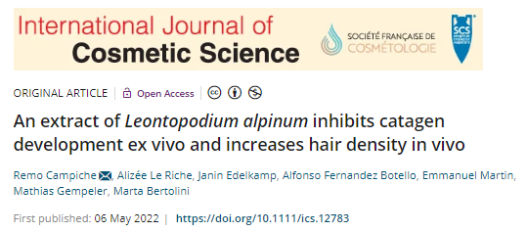
ALPAFLOR® EDELWEISS CB
Publication
https://onlinelibrary.wiley.com/doi/10.1111/ics.12783

Slide 30
ALPAFLOR® EDELWEISS CB
Hair pigmentation*
Click to return
to homepage
*Helps reduce the appearance of greying hair

Slide 31
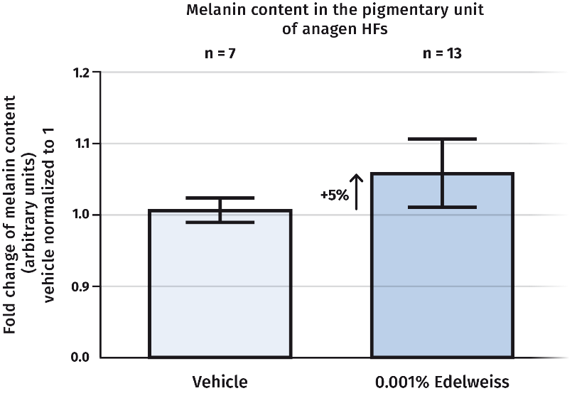
ALPAFLOR® EDELWEISS CB
Ex vivo studies – Hair pigmentation*/ Hair darkening
5% melanin content increase in Edelweiss treated hair follicles compared to vehicle treated follicles
***
+1.29
***
+0.99
*Helps reduce the appearance of greying hair

Slide 32
ALPAFLOR® EDELWEISS CB
Study Design / Hair Pigmentation*
Target group​
    18-45 y.o. (mean 39 y.o.) ​
30 Volunteers per formulation​
    Placebo​
    ALPAFLOR® EDELWEISS CB 3%
​
Application: 4 month​s
daily, scalp, leave-on​
Double-blind, randomized
*Helps reduce the appearance of greying hair

Slide 33
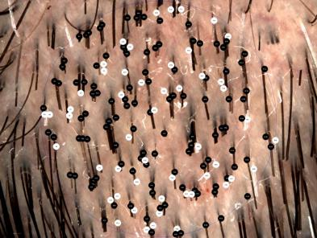
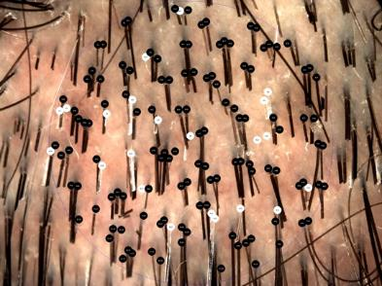
ALPAFLOR® EDELWEISS CB
In vivo studies – Hair pigmentation* / Hair darkening
Results after 4 months - leave-on treatment – 3% ALPAFLOR® EDELWEISS
T0
T120
+ 13% more pigmented hair after 4 months versus T0 (p=0.002)
Significant less grey hair vs. Placebo (p=0.026) after 4 months
63% of volunteers showed improvement in hair pigmentation using ALPAFLOR® EDELWEISS CB, while 47% of the volunteers using placebo.
Volunteer # 29
Evaluation of ratio of non-white hair vs. white hair on micro-images taken at T0 and T120
*Helps reduce the appearance of greying hair

Slide 34
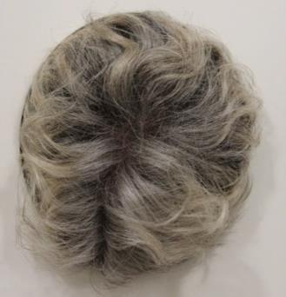
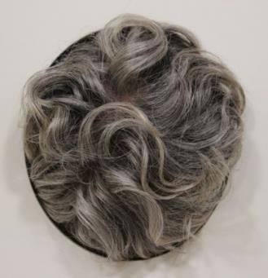
ALPAFLOR® EDELWEISS CB
In vivo studies – Hair pigmentation* / Hair darkening
Results after 4 months - leave-on treatment – 3% ALPAFLOR® EDELWEISS
T0
T120
Evaluation of grey shade of hairs after 4 months
Image of entire head analyzed by software:
Grey scale of pixels from 0 (black) to 255 (white)
Darker hair appearance after 4 months
50% less grey hair versus Placebo
Example: Volunteer #24
Evaluation of ratio of non-white hair vs. white hair on micro-images taken at T0 and T120
*Helps reduce the appearance of greying hair

Slide 35
Consumers confirm efficacy
Self assessment
Participants feedback after treatment with ALPAFLOR® EDELWEISS CB
83% perceived a decrease
in the number of grey hairs
87% thought the color of their hair was more uniform
83% thought their hair looked darker
Self assessment
Clinical study, 30 volunteers, 18 – 45 years old

Slide 36

ALPAFLOR® EDELWEISS CB
Takeaways
Key Features
Sustainably and organically cultivated according to Bio Suisse organic standards and fair-trade principles
Use level 3%
Helps prevent hair loss* (improves hair density)
  Prolongs anagen growing phase of hair. 1.8 x more than placebo - ex vivo
  50% increase of hair follicles keratinocytes proliferation - ex vivo
  Increase by 43% versican expression & alkaline phosphatase activity - ex vivo
  13% increase in hair density after 5 months – in vivo
  Increase Anagen/Telogen ratio – in vivo
Helps reduce the appearance of greying hair
  5% increase in melanin content – ex vivo
  13% darker hair after 4 months – in vivo
  50% less grey hair versus Placebo – in vivo
*Drug claim in some regions

Slide 37

04
Agenda
01
Market & Consumer Insights
02
dsm-firmenich Hair Care Solutions Map
03
ALPAFLOR® EDELWEISS CB
04
PENTAVITIN®
05
BeauPlex® VH
06
Other dsm-firmenich Solutions
Click on the number to get redirected to the chapter

Slide 38
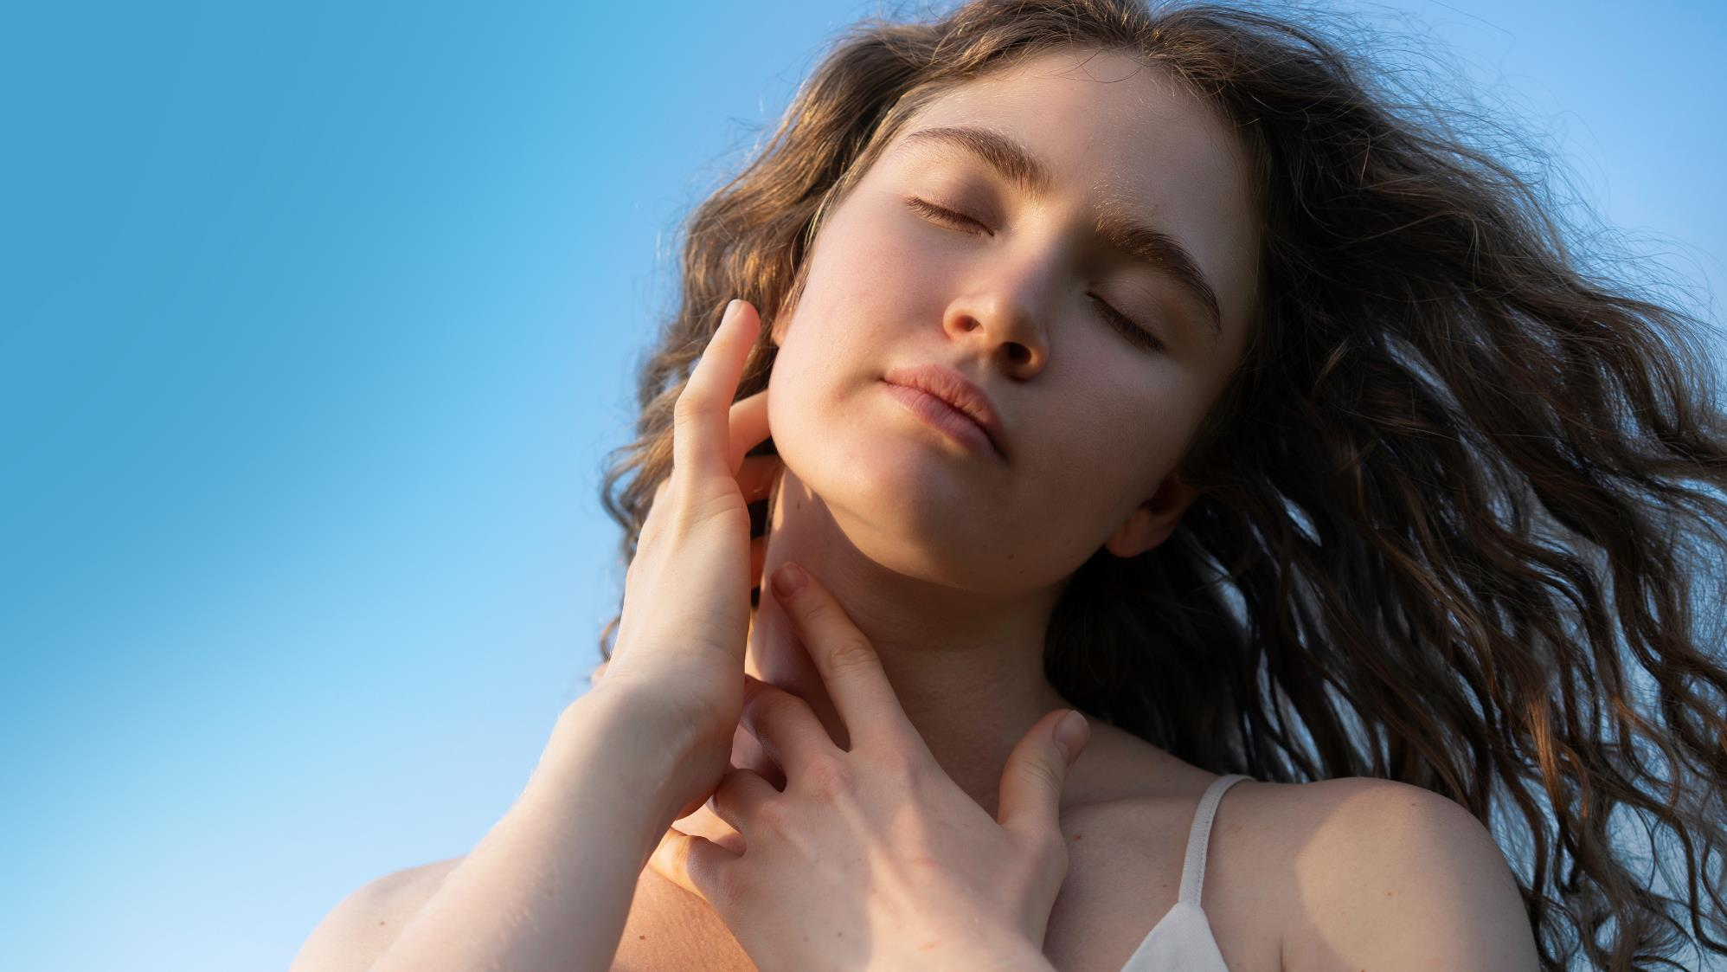
PENTAVITIN®
Visibly reduces scalp
oiliness and flaking
Click to return
to homepage

Slide 39









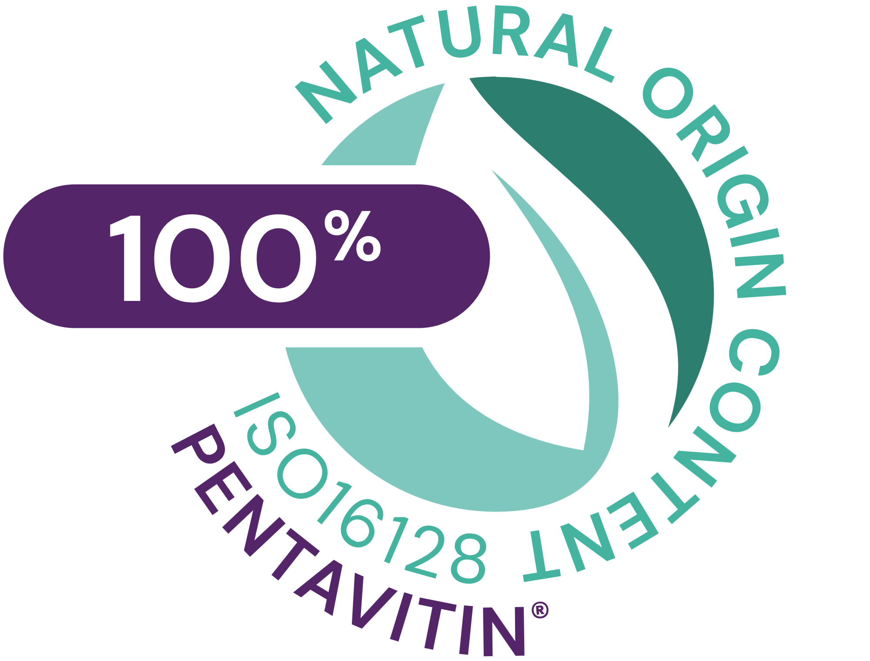
PENTAVITIN®
ID Card
Key benefit:
Moisturizes dry scalp / Strong scalp barrier
Provides visible reduction of scalp flaking
Reduces Sebum
INCI name:
(Active)
Saccharide Isomerate
Description:
100% natural and biodegradable edible maize kernels derived.
It binds to scalp like a magnet.
Technical:
Form: Liquid
Use level: 0.2 - 1%
pH of use: 4 to 9
Preservative: Free
Solubility: Water soluble
Target: Scalp and hair fiber
Biodegradability: Estimated to be biodegradable
Registration
certification

Slide 40


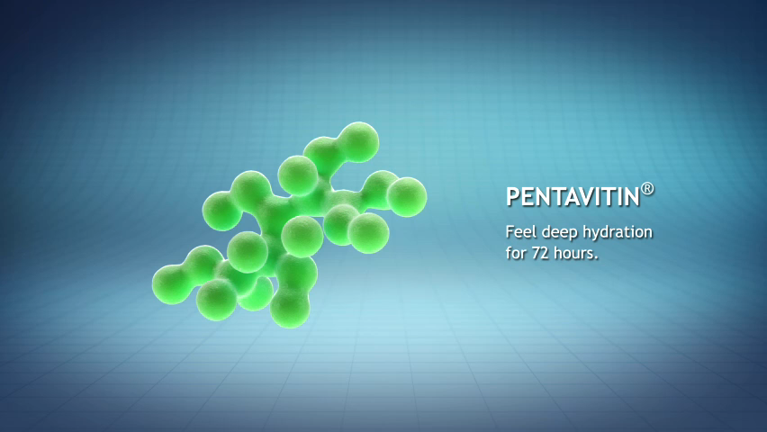


The Science behind the moisturizer – PENTAVITIN®
    Biomimetic ingredient that reproduces the effects of the skin/scalp’s own natural moisturizing factor (NMF).
    Unique skin binding action
    Contributes significantly to skin/scalp’s moisturization.
    It is only removed from scalp/skin by desquamation, providing a long term moisturization and effects under rinse-off conditions
PENTAVITIN®
NMF

Slide 41
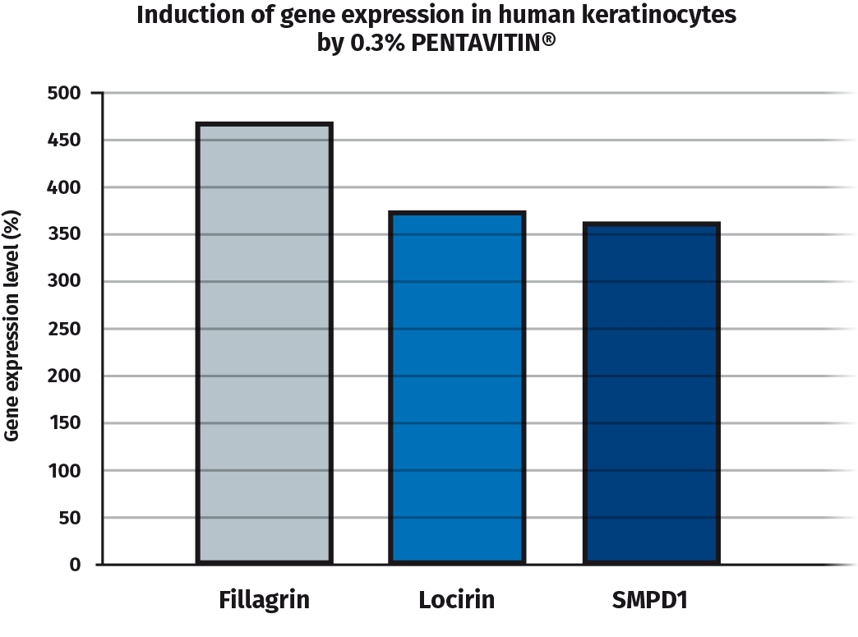



PENTAVITIN® - Moisturizing, protection and strengthening
Moisturizes dry scalp
by boosting filaggrin
Protects scalp barrier
by boosting loricrin
Strong scalp barrier by boosting SMPD1*
Filaggrin
Loricrin
*SMPD1: Sphingomyelin phosphodiesterase 1 converts sphingomyelin to ceramide known to strengthen scalp barrier
Notes:
Extrapolated from skin
Acid sphingomyelinase is responsible for the conversion of a fat (lipid) called sphingomyelin into another type of lipid called ceramide.

Slide 42
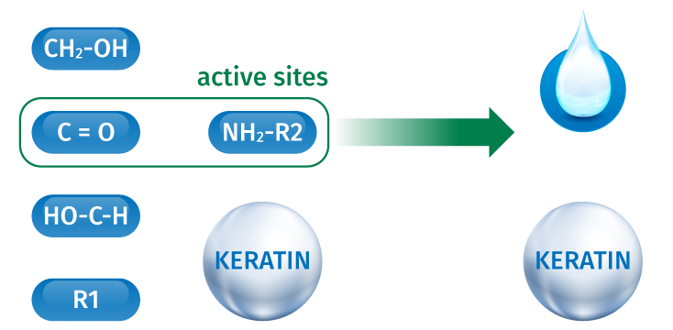

Binds to keratin as magnet power!
Binds to keratin
as magnet power*
Perfectly connects with the skin’s top layers*
Not washed off
PENTAVITIN®
Mode of action
*In vitro

Slide 43
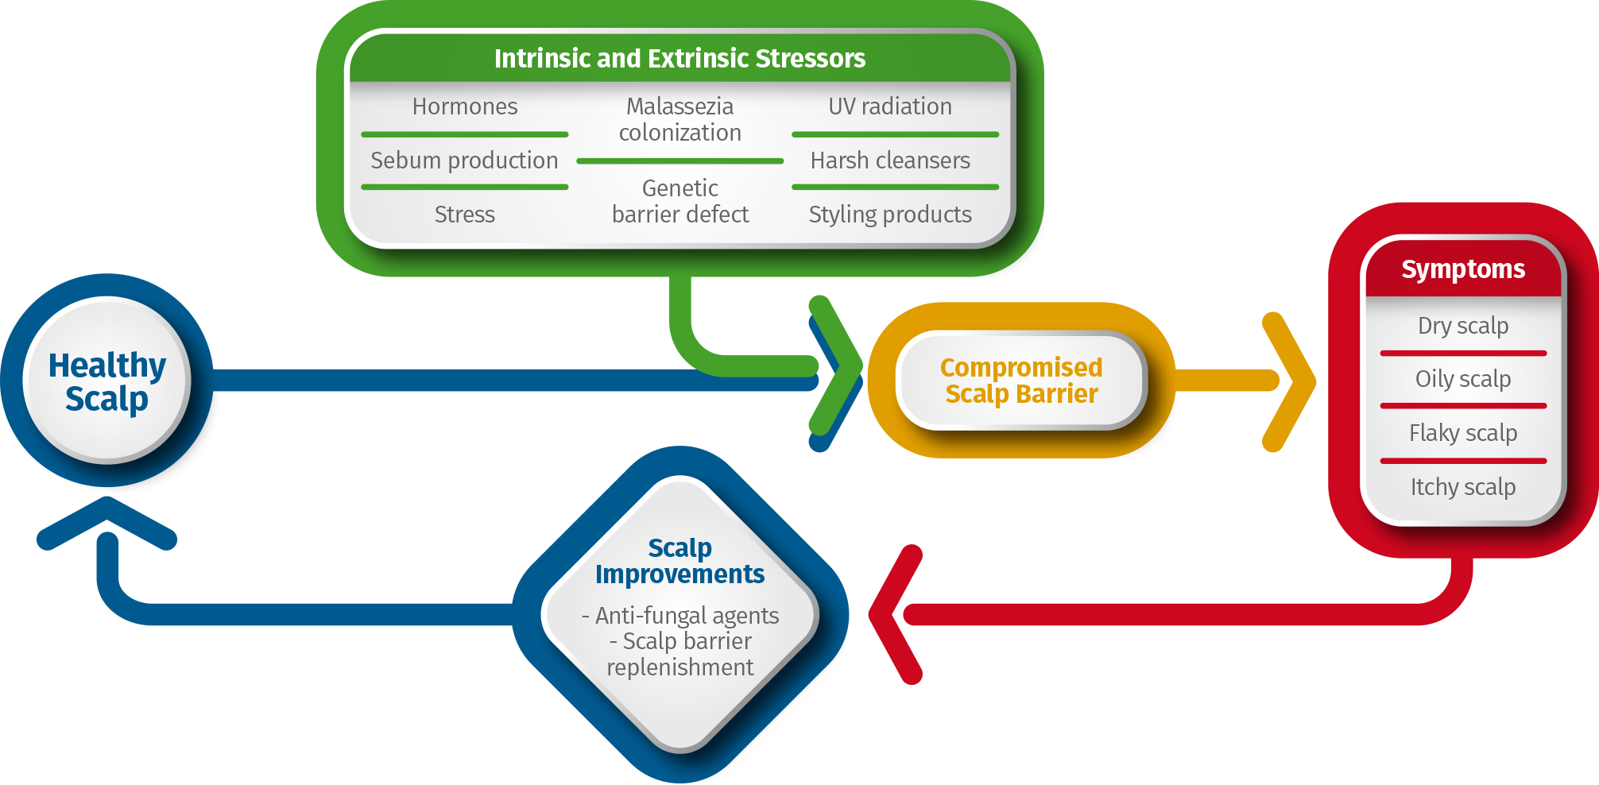
How to get a healthy scalp?
Turner et al. Stratum corneum dysfunction in dandruff. Int J Cosmet Sci 34:298, (2012)

Slide 44
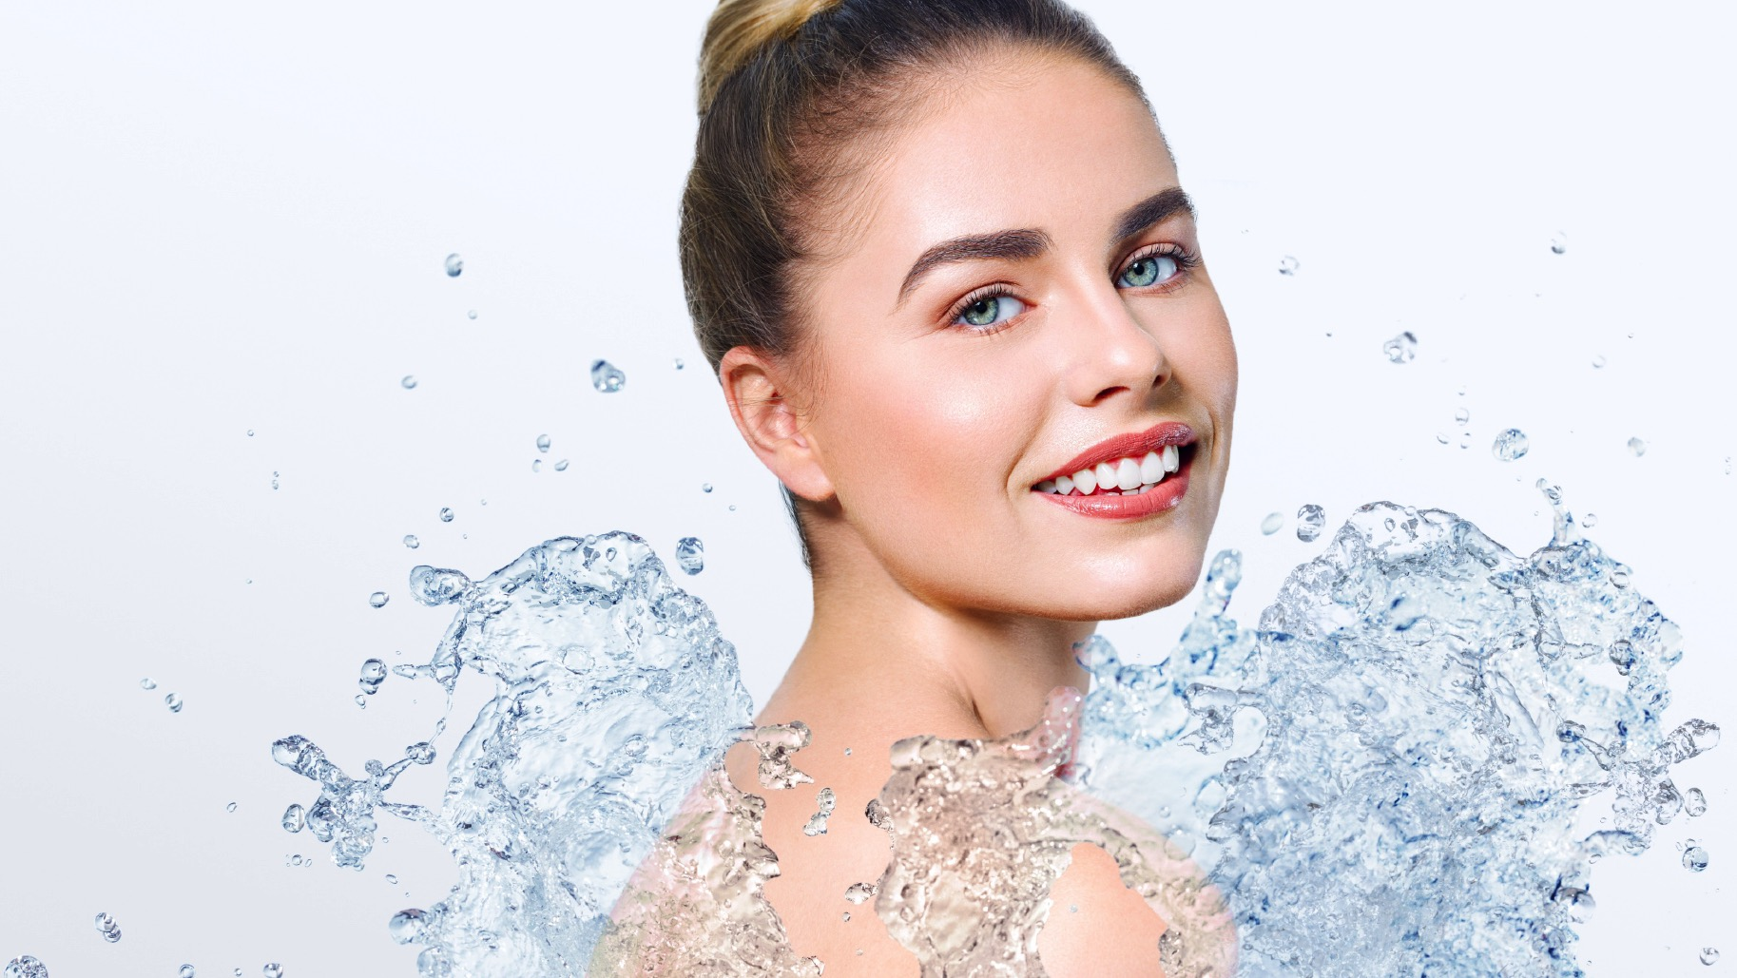
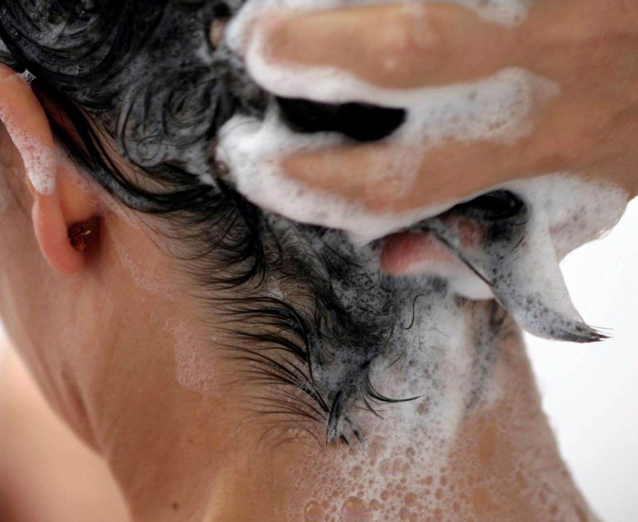
PENTAVITIN®
In vivo studies
Study Design / Scalp Care
Target group​
    18-50 y.o. (mean 39 y.o.) ​+ ASF Score 24-40
30 Volunteers per formulation​
    Placebo​
    PENTAVITIN® 0.2% and 0.5%
​
Application: 28 days​
rinse-off , ​shampoo applied every 2 days
Single-blind, randomized

Slide 45

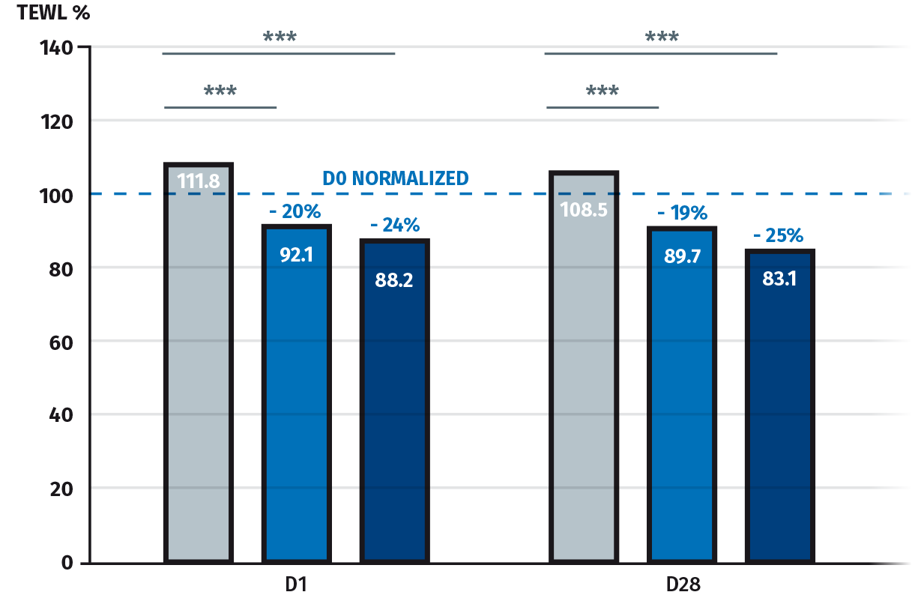
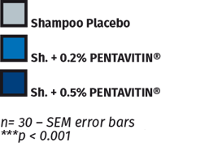
PENTAVITIN® - Reinforced scalp barrier
In vivo studies
24 hour after one single application and frequent showering
Use of the shampoo placebo damages the scalp barrier after showering and it is not recovered even after 28 days.
24 hour (D1) after one single application and even after 28 days of frequent showering, shampoos with 0.2% and 0.5% PENTAVITIN® reinforce the scalp barrier.
PENTAVITIN®’s improvements over the placebo are highly statistically significant.
Tewameter TM nano – Dandruff site
Reduction versus placebo

Slide 46
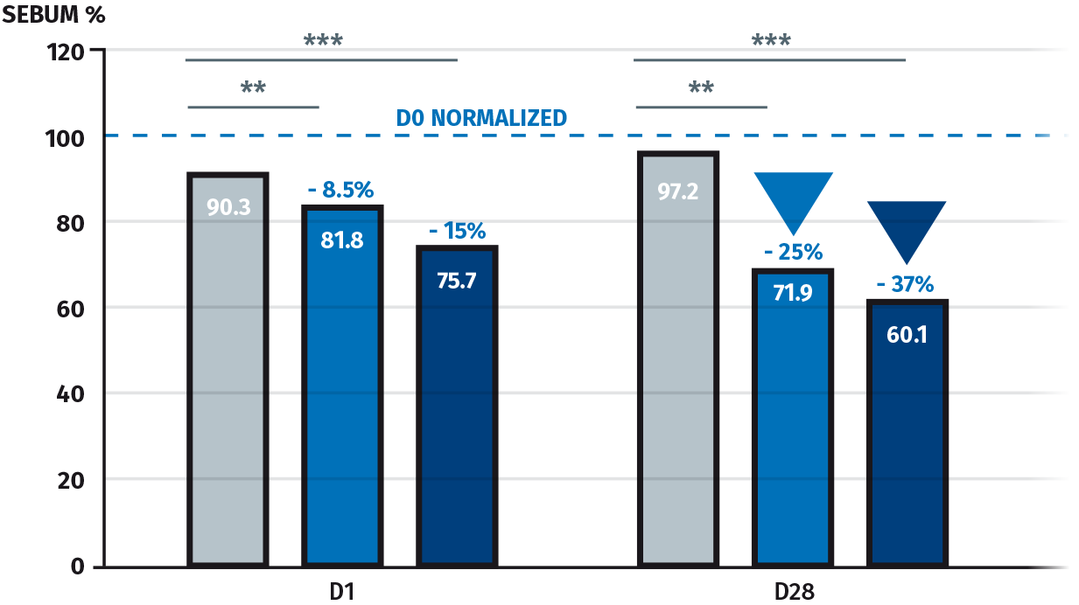

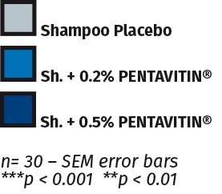
PENTAVITIN® - Sebum Reduction
In vivo studies
24 hour after one single application and frequent showering
15% sebum reduction 24 hour (D1) after one single application with a shampoo containing PENTAVITIN® (0.5%)
37% sebum reduction after frequent showering with a shampoo containing PENTAVITIN® (0.5%)
PENTAVITIN®’s (0.2% and 0.5%) improvements over the placebo are highly statistically significant
Meibometer , MB560– Dandruff site
Reduction versus placebo

Slide 47
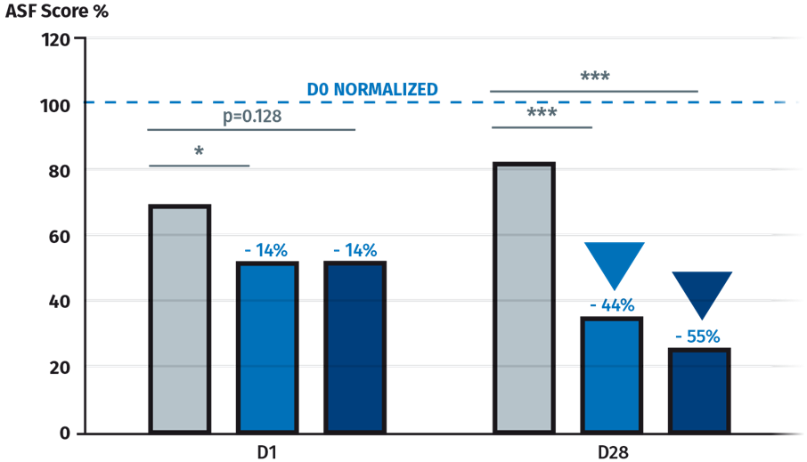
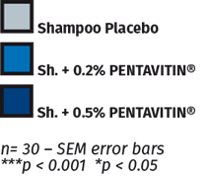
PENTAVITIN® - Anti-Flaking
In vivo studies
24 hour after one single application and frequent showering
14% reduction of scalp flaking 24 hour (D1) after one single application with shampoos containing PENTAVITIN® (0.2% and 0.5%)
Up to 55% reduction of scalp flaking after frequent showering with shampoos containing PENTAVITIN® (0.5%)
PENTAVITIN®’s (0.2% and 0.5%) improvements over the placebo are highly statistically significant
After 28 days of treatment, the placebo increases flaking while PENTAVITIN® reduces it
Grade of ASFS dandruff - Dermatologist
Reduction versus placebo
Notes:
adherent scalp flake (ASF)- grading based on picture

Slide 48
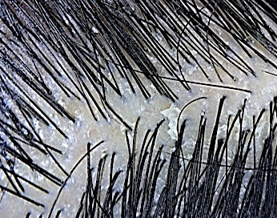
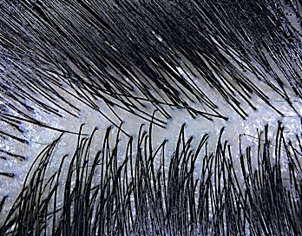
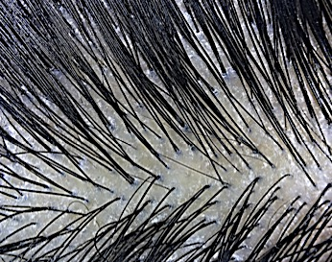
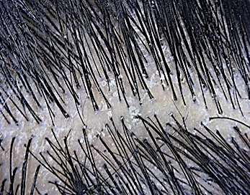
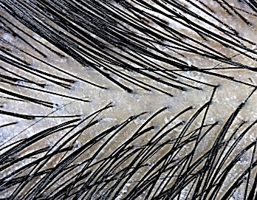
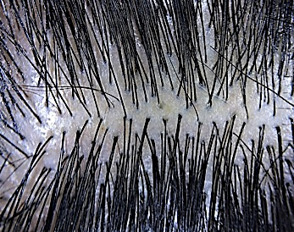
PENTAVITIN® - Flaking Reduction
In vivo studies
Visible reduction of scalp flaking
D0 - Before treatment
D1 - 24 hours, after just one use of a shampoo with PENTAVITIN® (0.2%)
D28 – 28 days, after frequent showering with a shampoo containing PENTAVITIN® (0.2%)
D0 - Before treatment
D1 - 24 hours, after just one use of a shampoo with PENTAVITIN® (0.5%)
D28 – 28 days, after frequent showering with a shampoo containing PENTAVITIN® (0.5%)

Slide 49
Consumers confirm efficacy
Self assessment
Scalp & hair improvements after 28 days
PENTAVITIN® 0.2%
PENTAVITIN® 0.5%
67% stated “my scalp feels itchy-free, soothed”
70% stated “my scalp feels protected from external aggressions.”
80% stated “my scalp feels fresh”
77% stated “my scalp looks healthy”
80% stated “my scalp feels hydrated”
60% stated “my hair feels strong”

Slide 50
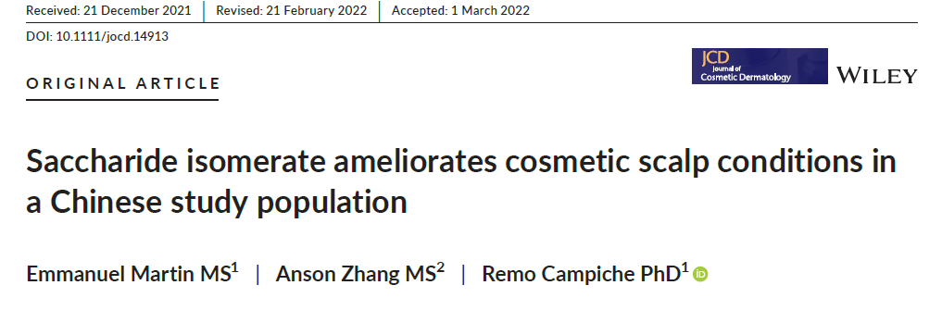
PENTAVITIN®
Publication
https://onlinelibrary.wiley.com/doi/10.1111/jocd.14913

Slide 51
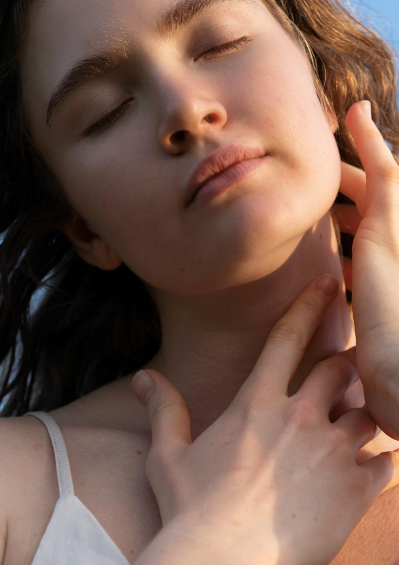
PENTAVITIN®
New discoveries
New
Study Design
Test Institute | TRI Princeton (USA) - Proof of concept scalp hydration and sebum study on two volunteers.
Data collection | Jan. 2022.
Test products | Shampoo placebo vs. Shampoo with 0.5% PENTAVITIN®: Aqua, Sodium laureth sulfate, Glycerin, Coco-betaine, Sodium cocoamphoacetate, Sodium chloride, Sodium lauryl glucose carboxylate, Lauryl glucoside, Sodium cocoyl glutamate, Lactic acid, PENTAVITIN®, Phenoxyethanol, Benzyl alcohol, Potassium sorbate, Tocopherol.
Skin characteristics of the selected volunteers | Scalp hydration study: one healthy female volunteer (Caucasian, 27 years old ). Scalp sebum study: one healthy female volunteer (Caucasian, 24 years old, scalp has dandruff and tends to be on the oilier side).
Study duration | 1 week wash out with shampoo Placebo (Baseline¹). Daily application of Shampoo Placebo for 7 days (day 7¹). 10 days break (personal hair routine). 1 week wash out phase with shampoo Placebo (Baseline¹). Daily application of Shampoo with PENTAVITIN® for 7 days (day 7¹). ¹After each wash out phase and day 7 application, FTIR measurements are performed on 12 predefined sites on scalp.
Rinse-off test procedure | Test products were applied by gentle massage on scalp for 2-3 minutes. Rinse gently and thoroughly the hair and scalp with warm water and drying with a towel.
Measuring sites Time points | Hemi scalp, 12 predefined sites. Baseline and after 7 days.
Evaluation | ATR-FTIR (Fourier-Transform infrared) spectroscopy measurements with REMSpec optical fiber From the IR spectrum, calculation of water and sebum content.
Colour scales & test parameters | Scalp hydration and sebum are visualized with color scales, resp. from white to blue and white to brown, based on FTIR spectrum intensity. Calculation of difference between Baseline and Day 7 results.
NEW

Slide 52
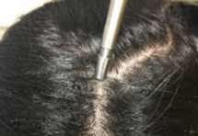







Innovative Scalp Color 3D Mapping Technology
The method…
ATR-FTIR (Fourier-transform infrared) spectroscopy in combination with specific algorithms generates 3D color scalp hydration & sebum mappings
Scalp Analysis
      12 ATR-FTIR spectra are collected at the same specific location on the scalp to evaluate the level of sebum and water
      These measurements are used to generate specific scalp 3D mapping.
Test Instrument
    FTIR spectrometer with REMSpec optical fiber
Specific Algorithms
Test Sites
    12 predefined sites on the hemi scalp are selected
Scalp Hydration
Scalp Sebum
Notes:
FTIR Spectroscopy is a molecular spectroscopy which is used to characterize both organic and inorganic evidence.
The sample is bombarded with infrared light. When the frequency of the infrared radiation matches the natural frequency of the band, the amplitude of the vibration increases and the infrared is absorbed. The output of an infrared spectrometer is a chart.

Slide 53


Fully hydrated scalp after frequent use**
Shampoo Placebo
Shampoo 0.5% PENTAVITIN®
FTIR scalp hydration color 3D mapping
Shampoo placebo / 7 days vs baseline
FTIR scalp hydration color 3D mapping
Shampoo with 0.5% PENTAVITIN® / 7 days vs baseline
Less hydrated
More hydrated
Visible hydration power after 7 days frequent use of PENTAVITIN® (0.5%) in a shampoo compared to placebo.
**In vivo tested

Slide 54


Visible sebum reduction after frequent use**
Shampoo Placebo
Shampoo 0.5% PENTAVITIN®
FTIR scalp sebum color 3D mapping Shampoo placebo / 7 days vs baseline
FTIR scalp sebum color 3D mapping Shampoo placebo / 7 days vs baseline
More sebum
Less sebum
After 7-days frequent use of PENTAVITIN® (0.5%) in a shampoo, visible reduction in sebum observed on scalp.
**In vivo tested

Slide 55


PENTAVITIN®
Takeaways
Key features:
100% natural and biodegradable edible maize kernels derived. It binds to scalp like a magnet.
Use level: 0.2%-0.5%
Key Benefits:
Moisturization (Reinforced scalp barrier)
    24 hour (D1) after one single application and even after 28 days of frequent showering, shampoos with 0.2% and 0.5% PENTAVITIN® reinforce the scalp barrier – in vivo
Sebum and Flaking Reduction
    Significant reduces sebum and flaking after one single application and after frequent showering with a shampoo containing PENTAVITIN® (0.2% -0.5%) - in vivo

Slide 56

05
Agenda
01
Market & Consumer Insights
02
dsm-firmenich Hair Care Solutions Map
03
ALPAFLOR® EDELWEISS CB
04
PENTAVITIN®
05
BeauPlex® VH
06
Other dsm-firmenich Solutions
Click on the number to get redirected to the chapter

Slide 57


BeauPlex® VH
Vitamin Blend
Click to return
to homepage

Slide 58




BeauPlex® VH
ID Card
Key benefit:
Helps prevent hair loss* (improves hair density and thickness)
Helps reduce the appearance of greying hair
Anti-aging (anti-oxidant properties)
Scalp Care (improves scalp barrier and moisturization)
INCI name:
Tocopheryl Acetate, Niacinamide, Sodium Ascorbyl Phosphate, Pyridoxine HCl, Sodium Starch Octenylsuccinate, Silica, Calcium Pantothenate, Maltodextrin
Description:
Vitamin blend (B3, B5, B6, C and E)
Technical:
Form: Powder
Use level: Up to 2%
pH of use: 5 to 9
Preservative: Free
Solubility: Dispersible in water
Target: Scalp and hair fiber
Biodegradability: Not expected to be persistent,
bioaccumulative nor toxic.
Registration
certification
*Drug claim in some regions
Quality for Life™ seal that guarantees the highest standards for Quality, Reliability, Traceability, and Sustainability.

Slide 59
BeauPlex® VH
Hair Loss*
Click to return
to homepage
*Helps prevent hair loss / Drug claim in some regions

Slide 60


BeauPlex® VH
Ex vivo studies
Hair Loss*
The hair growth cycle consists of 3 distinct stages:
Vehicle
0.1% BeauPlex® VH
anagen
catagen
BeauPlex® VH 0.1% prolongs anagen phase of hair follicles
2x more hair follicles in the anagen phase with BeauPlex® VH than placebo
*
*Helps prevent hair loss / Drug claim in some regions
Notes:
Hair cycle staging: 0.1% BPX: 67% of the follicles are in anagen, 33% in catagen. Vehicle: 33% of the follicles are in anagen, 67% in catagen.
Hair matrix keratinocyte proliferation: There is a 1.76fold increase in proliferating hair matrix keratinocytes with 0.1% BPX.

Slide 61


BeauPlex® VH
Ex vivo studies
Hair Loss*
Keratinocytes make up the hair shaft and need to proliferate in order to support the hair growth.
Hair matrix keratinocytes proliferation
Vehicle
0.1% BeauPlex® VH
Increased Ki67-staining (red) in BeauPlex® VH treated follicles compared to vehicle.
Vehicle
BeauPlex® VH
76% increase of hair matrix keratinocytes proliferation with 0.1% BeauPlex® VH
*Helps prevent hair loss / Drug claim in some regions

Slide 62

BeauPlex® VH
In vivo studies
Study Design / Hair Loss*
Target group​
    18-65 y.o. (mean 45 y.o.)
30 Volunteers per formulation​
    Placebo​
    BeauPlex® VH 1.5%
​
Application: 5 month​s
daily, scalp, leave-on​
Randomized single centre Study
Double blind
*Helps prevent hair loss / Drug claim in some regions

Slide 63


BeauPlex® VH
In vivo studies
Increases hair thickness and density
Hair Thickness
Hair Density
^{n= 30 – SEM error bars}
^{n= 30 – SEM error bars}
4% Increase of hair diameter using Vitamin blend BeauPlex® VH , while hair thinning is observed with the Placebo Leave-on after 5 months treatment
7% increase in hair density versus T0 using BeauPlex® VH
Better performance than Placebo after 5 months

Slide 64


BeauPlex® VH - Hair Density
In vivo studies
Increases density after 5 months/ micro-images
T0
T150
Example : Volunteer #49
t0 = 128 hairs/cm2 and at t150 = 164 hairs/cm2
28% increase on hair density after 5-months treatment with BeauPlex® VH (example #49)

Slide 65


In vivo studies
BeauPlex® VH
Prolongates anagen phase of hair follicles
Anagen to Telogen ratio (A/T) - Trichogram
Trend for higher proportion of hair in anagen phase
using a serum with BeauPlex® VH after 5 months
1.5% BeauPlex® VH
Placebo
n= 30 – SEM error bars***p < 0.001 vs T0
15 to 25 hairs collected per volunteer for trichogram

Slide 66
Consumers confirm efficacy
Self assessment
Participants feedback after treatment with BeauPlex® VH
97% like the product
52% agree that the hair roots and scalp is not oily
93% noticed increased speed of hair growth
83% agree that they don’t have dandruff on hair or scalp
Self assessment
Clinical study, 30 volunteers, 18 – 65 years old 5 months treatment with BeauPlex® VH at 1.5%

Slide 67
BeauPlex® VH
Hair pigmentation*
Click to return
to homepage
*Helps reduce the appearance of greying hair

Slide 68

BeauPlex® VH
In vivo studies
Study Design / Hair pigmentation*
Target group​
    18-45 y.o. (mean 39 y.0.)
30 Volunteers per formulation​
    Placebo​
    BeauPlex® VH 1.5%
​
Application: 4 months
daily, leave-on, scalp
Randomized single centre Study
Double blind
*Helps reduce the appearance of greying hair

Slide 69


BeauPlex® VH - Hair Pigmentation*
In vivo studies
Hair pigmentation / Hair darkening
Results after 4 months treatment Leave-on BeauPlex® VH (1.5%)
T0
T120
Darker hair appearance after 4 months
7% reduction of grey hair versus T0
60% of volunteers showed improvement in hair pigmentation* with BeauPlex® VH
Example : Volunteer #60
*Helps reduce the appearance of greying hair

Slide 70
BeauPlex® VH
Vitamin Blend - Takeaways
Key features:
Blend of Vitamins for Hair & Scalp
(Vitamin B3, B5, B6, C and E)
Use level: 1.5%
Key Benefits:
Helps prevent hair loss* (improves hair density and thickness )
  76% Proliferation of hair follicle keratinocytes- ex vivo
  Prolongation of anagen phase of hair follicles.
  2x more than placebo- ex vivo
  Increases hair thickness (4%) and density (+7%) – in vivo
  Increase Anagen to Telogen ratio –in vivo
  Helps prevent the appearance of greying hair (helps recover hair pigmentation)
  7% hair greying reduction after 4 months– in vivo
  60% of volunteers showed improvement in hair pigmentation with BeauPlex® VH
Other benefits: base on individual vitamins results
  Hydration and scalp barrier improvement
  Strong anti-oxidant properties
*Drug claim in some regions
Quality for Life™ seal that guarantees the highest standards for Quality, Reliability, Traceability, and Sustainability.

Slide 71

06
Agenda
01
Market & Consumer Insights
02
dsm-firmenich Hair Care Solutions Map
03
ALPAFLOR® EDELWEISS CB
04
PENTAVITIN®
05
BeauPlex® VH
06
Other dsm-firmenich Solutions
Click on the number to get redirected to the chapter

Slide 72


ALPAFLOR® ALP-SEBUM CB
ID Card
Key benefit:
Sebum Reduction (strong 5-α-reductase inhibitor)
Helps prevent hair loss* (based on literature)
Scalp Care (anti-irritation and soothing properties)
INCI name:
(Active)
Epilobium Fleischeri Flower/Leaf/Stem Extract
Description:
Plant extract organically cultivated
Technical:
Form: Liquid
Use level: Up to 3%
pH of use: 3.5 to 5.5
Preservative: Free
Solubility: Water soluble
Target: Scalp
Biodegradability: Readily biodegradable
Registration
certification
*Drug claim in some regions

Slide 73

ALPAFLOR® ALP-SEBUM CB
Organic and sustainable alpine flower
Key Features
Unique glacier willowherb species, Epilobium fleischeri, sustainably, fairly and organically cultivated
Benefits
Sebum Reduction extrapolation from skin Inhibits formation of DHT via 5-α-reductase (ex vivo)
Significant dose-dependent inhibition of 5-α-reductase activity up to 68% versus control with 0.03% ALPAFLOR® ALP-SEBUM* in human skin fibroblast
68%
56%
less sebum production after 2 months (in vivo)
20%
sebum reduction in 4 weeks (in vivo)
Helps prevent hair loss* based on literature
  Inhibits formation of DHT via 5-α-reductase
  DHT is also known to promote hair Loss
Scalp Care
decrease on production of pro-inflammatory cytokines IL 8 with 0.075% ALPAFLOR® ALP-SEBUM*- in vitro
Control
ALPAFLOR® ALP-SEBUM
(0.006%)
ALPAFLOR® ALP-SEBUM
(0.015%)
ALPAFLOR® ALP-SEBUM
(0.03%)
78%
Measuring the levels of 5-α-dihydrotestosterone (5α-DHT) produced by human skin fibroblasts incubated with testosterone
*Drug claim in some regions
DHT= Dihydrotestosterone.
* = commercial form

Slide 74


ARGAN OIL
ID Card
Key benefit:
Anti-breakage
Anti-Frizz
Conditioning / Ease of Combing
Split-ends Reduction
Shine
INCI name:
Argania Spinosa Kernel Oil
Description:
Organically cultivated and cold extracted without the use of solvents
Technical:
Form: Liquid
Use level: Up to 0.5%
pH of use: 5 to 9
Preservative: Free
Solubility: Oil soluble
Target: Hair fiber
Biodegradability: Expected to be Biodegradable
Registration
certification

Slide 75


ARGAN OIL
Enhances Shine
Shampoo Ranking of paired comparison test
Conditioner Ranking of paired comparison test
Shampoo formulation containing 0.1% ARGAN OIL shows best shine enhancement beating the leading market brand.
Conditioner formulation containing 0.5% ARGAN OIL shows best shine enhancement beating the leading market brand.
Notes:
3 possible answers as result is not suitable for statistical evaluation (statistics compare 2 results with each other)
basis shampoo is adapted according to market brand (pantene ice shine) and sets already a high quality as base line
shampoo with the best performance is dsm-firmenich-SH 1 containing 0.1% ARGAN OIL
this formulation was preferred over the leading market brand dsm-firmenich-SH 5
lower oil levels in the shampoos (dsm-firmenich-SH 1) gives a better shine than using higher oil concentration (dsm-firmenich-SH 2 ) meaning less is better
all tested shampoos improve the shine of the basic formulation.
Why is a lower concentration better for shine:
In the case of leave-on products, the rule "higher levels -> better shine" is true: because the factors surface property and anti-frizz effect are influenced positively with higher amounts of product.
Our tests are with rinse-out products (shampoos, cream conditioner); in that case the surface properties and "Anti-Frizz effect" are influenced from that part of the product which stay on the hair surface after rinsing the product out; that means: Usage of lower concentrations of oils in the products lead to the best shine results.

Slide 76


COLHIBIN CB
ID Card
Key benefit:
Anti-breakage
Conditioning / Ease of Combing
Split-ends reduction
INCI name:
(Active)
Hydrolyzed Rice Protein
Description:
COLHIBIN CB is a highly concentrated mixture of natural peptides with low molecular weights, extracted from edible rice protein
Technical:
Form: Liquid
Use level: Up to 3%
pH of use: 3 to 9
Preservative: Phenoxyethanol-free
Solubility: Water soluble
Target: Hair fiber
Biodegradability: Expected to be Biodegradable
Registration
certification

Slide 77
COLHIBIN CB
Instrumental test
Plant derived peptide
Shampoo
Reduction in Combing Force
Leave-on single application
Hair Breakage Reduction
Split Ends Reduction
(dry combing force at tips)
Wet
-14%
-9%
-28%
-29%
Hair Fibers vs Placebo
1 Cycle
3 Cycles
Dry
Reduction in Combing Force
-19%
-73%
-30%
-35%
78%
78%
1 Cycle
3 Cycles
Wet
Dry
Instron Bleached Caucasian hair Breakage: repeated combing test COLHIBIN CB at 3% as supplied

Slide 78


life’sGLA™ ’10’ n-6 Oil
ID Card
Key benefit:
Anti-breakage
Anti-Frizz
Conditioning / Ease of Combing
Split-ends Reduction
Shine
INCI name:
(Active)
Oenothera Biennis (Evening Primrose) Seed Extract
Description:
Prepared by extraction of oil from seeds of Oenothera plant or
Evening primrose (9% GLA)
Technical:
Form: Liquid
Use level: up to 8%
pH of use: 3 to 9
Preservative: Free
Solubility: Oil soluble
Target: Hair fiber
Biodegradability: Readily biodegradable
Registration
certification

Slide 79

life’sGLA™ ’10’ n-6 Oil (Omega-6 flower oil)
Instrumental test
Prepared by extraction of oil from seeds of Oenothera plant or Evening Primrose (9% GLA)
Hair Fibers vs Placebo Leave-on
Anti-Frizz Solid Shampoo
Shine Shampoo
Hair Breakage Reduction
Split Ends Reduction
(dry combing force at tips)
Bar Sh. +1.5%
life’sGLA™ ’10’ n-6 Oil
-99%
-49%
-99%
+7%
1 Cycle
3 Cycles
Reduction in Combing Force
Increase of Shine
-47%
-41%
78%
78%
Wet
Dry
Instron-Bleached Caucasian/ Breakage: repeated combing test life’sGLA™ ’10’ n-6 Oil at 1%
Bleached Caucasian life’sGLA™ ’10’ n-6 Oil at 1.5%
Bossa Nova -Virgin Asian hair life’sGLA™ ’10’ n-6 Oil at 0.5%

Slide 80

PHYTALURONATE® PF
ID Card
Key benefit:
Anti-breakage
Conditioning / Ease of Combing
Split-ends reduction
INCI name:
(Active)
Ceratonia Siliqua (Carob) Gum
Description:
Derived from the seeds of Carob tree.
Technical:
Form: Liquid
Use level: Up to 3%
pH of use: 3 to 10
Preservative: Phenoxyethanol and Ethyhexylglycerin
Solubility: Water soluble
Target: Hair fiber
Biodegradability: Biodegradable
Registration
certification

Slide 81
PHYTALURONATE® PF
Plant derived from the seeds of Carob tree
Shampoo
Reduction in Combing Force
Leave-on single application
Hair Breakage Reduction
Split Ends Reduction
(dry combing force at tips)
Wet
-19%
-7%
-4%
-21%
Hair Fibers vs Placebo
1 Cycle
3 Cycles
Dry
Reduction in Combing Force
-14%
-13%
-40%
-44%
78%
78%
1 Cycle
3 Cycles
Wet
Dry
Instron/Bleached Caucasian hair Breakage: repeated combing test PHYTALURONATE® PF at 3% as supplied

Slide 82






Phytantriol
ID Card
Key benefit:
Color Protection
Hair Protection
Heat Protection
Deposition (Panthenol, Ethyl-Panthenol and Keratin amino acids)
INCI name:
Product code:
0429082
Phytantriol
Description:
Prepared from Isophytol, one of the central building blocks of vitamin E
Technical:
Form: Viscous Liquid
Use level: 0.1% to 1%
Preservative: Free
Solubility: Oil soluble
Target: Hair fiber
Biodegradability: Biodegradable
Registration
certification

Slide 83

Phytantriol
biodegradable and biomimetic to hair layer
Key Features:
Consist of an anchoring groups for an excellent substantivity to hair (“Glycerin like” head) and a tail that is similar to the 18-MEA layer, a primary lipid of the hair surface
Phytantriol
Tail
Head
Benefits:
Deposition -0.1%
Color Protection -0.2%
Boosts effects of Panthenol, Ethyl-Panthenol and keratin amino acids
Visible prevention of wash-out from various color shades
Heat Protection- 0.1%-0.5%
Protection against heat damage (shampoos and conditioners)
Notes:
18-methyl eicosanoic acid (18-MEA), the primary lipid of the hair surface. Human hair contains a thin, protective layer of lipids covalently bound to the cuticle that is comprised primarily of 18-MEA
Chemical Treatments & UV irradiation are damaging the lipid layer by destroying the chemical bond!

Slide 84


Phytantriol
Deposition
Increases the deposition of Panthenol and Keratin amino acids (Shampoo)
Panthenol
Virgin and damage hair swatches soaked for 10 minutes in a 50% shampoo solution with 0.5% Panthenol. Rinsed 3 times with water (50°C) and air dried. Hair was dissolved, analyzed with a scintillation counter and amounts calculated.
Keratin amino acids
Virgin hair swatches soaked for 10 minutes in a 50% shampoo solution with 0.5% labeled keratin amino acids. Rinsed 3 times with warm water (50°C) and air dried. Hair was dissolved, analyzed with a scintillation counter and amounts calculated.

Slide 85

Phytantriol
Deposition
Increases the deposition of Ethyl-Panthenol on normal and damage hair (Shampoo)
Phytantriol strongly increases the deposition of Ethyl-Panthenol on both normal and damaged hair after cumulative application.

Slide 86

Phytantriol
Improves water content in the hair (Shampoo)
Dilution of shampoo with water at 1:10. Hair soaked in solution, rinsed twice with water and blotted with tissue paper. Analysis of water loss gravimetrically.

Slide 87


Phytantriol
Heat protection
Protects hair from damage caused by blow drying (Shampoo)
Normal Hair
Virgin brown hair swatches (5/group) were pre-treated and hot blow dried for 2min. Assessment of tensile strength (yield slope) with a force of 20gm load setting at a speed of 100mm/min.
Damaged Hair
Bleached brown hair swatches (5/group) were pre-treated and hot blow dried for 2min. Assessment of tensile strength (yield slope) with a force of 20gm load setting
at a speed of 100mm/min.

Slide 88


Phytantriol
Heat protection
Protects hair from damage caused by blow drying (Conditioner)
Normal Hair
Virgin brown hair swatches (5/group) were pre-treated and hot blow dried for 2min. Assessment of tensile strength (yield slope) with a force of 20gm load setting at a speed of 100mm/min.
Damaged Hair
Bleached brown hair swatches (5/group) were pre-treated and hot blow dried for 2min. Assessment of tensile strength (yield slope) with a force of 20gm load setting
at a speed of 100mm/min.

Slide 89

Phytantriol
Heat protection
Protects hair from damage caused by blow drying (Leave on)
Normal Hair
Virgin brown hair swatches (5/group) were pre-treated and hot blow dried for 2min. Assessment of tensile strength (yield slope) with a force of 20gm load setting at a speed of 100mm/min.

Slide 90

Phytantriol
Protects different hair colors from wash-out
Direct dyes commonly used in non-oxidative colorations and color mousses.
Differences in ∆E greater than 2 are visible by eye.

Slide 91

SETAKOL® PF
ID Card
Key benefit:
Anti-breakage
Conditioning / Ease of Combing
Split-ends reduction
INCI name:
(Active)
Hydrolyzed Sericin
Description:
Hydrolyzed silk glycoprotein sericin
Technical:
Form: Viscous Liquid
Use level: Up to 3%
pH of use: 5 to 9
Preservative: Phenoxyethanol and Ethyhexylglycerin
Solubility: Water soluble
Target: Hair fiber
Biodegradability: No data available
Registration
certification

Slide 92
SETAKOL® PF
Hydrolyzed silk glycoprotein sericin
Shampoo
Reduction in Combing Force
Leave-on single application
Hair Breakage Reduction
Split Ends Reduction
(dry combing force at tips)
Wet
-15%
-13%
-16%
-41%
Hair Fibers vs Placebo
1 Cycle
3 Cycles
Dry
Reduction in Combing Force
-19%
-53%
-24%
-23%
78%
78%
1 Cycle
3 Cycles
Wet
Dry
Instron Breakage: repeated combing test Bleached Caucasian hair SETAKOL® PF at 3% as supplied

Slide 93


STIMU-TEX® AS
ID Card
Key benefit:
Anti-breakage
Anti- frizz
Conditioning / Ease of combing
Split-ends reduction
Scalp Care (reduces itchiness and irritation) – extrapolation from skin results
INCI name:
Tocopherol, Argania Spinosa Kernel Oil, Spent Grain Wax, Butyrospermum Parkii Butter Extract
Description:
A unique mixture of high-quality, upcycled spent grain wax, cold-processed argan oil, and shea butter.
With upcycled spent grain wax, a by-product of the beer production
Technical:
Form: Off white to yellow lipidic mas
Use level: Up to 3%
Preservative: Free
Solubility:
Oil soluble
Target: Hair fiber and scalp
Registration
certification

Slide 94

STIMU-TEX® AS
Blend of spent grain wax from upcycling process with argan oil and shea butter
Leave-on single application
Anti-frizz Solid Shampoo
Hair Breakage Reduction
Split Ends Reduction
(dry combing force at tips)
Bar Sh. + 3.0%
STIMU-TEX® AS
Bar Sh.
-99%
-67%
Reduction in Combing Force
-31%
-39%
78%
Wet
Dry
Instron/ Breakage: repeated combing test Bleached Caucasian hair/ STIMU-TEX® AS at 1% as supplied
Bleached Caucasian hair STIMU-TEX® AS at 3% as supplied

Slide 95



Vitamin B3 (Niacinamide PC)
ID Card
Key benefit:
Scalp Care (strengthens scalp barrier / moisturization)
Hair Thickening (helps increase hair diameter)
INCI name:
Niacinamide
Description:
Niacinamide PC has a low guaranteed level of residual nicotinic acid to address any concerns about unpleasant scalp sensations
Technical:
Form: Powder
Use level: Up to 7%
pH of use: 4 to 8
Preservative: Free
Solubility: Water soluble
Target: Scalp and hair fiber
Biodegradability: Readily biodegradable
Registration
certification
Quality for Life™ seal that guarantees the highest standards for Quality, Reliability, Traceability, and Sustainability.

Slide 96



Vitamin B3 (Niacinamide PC)
Penetrates the hair and contributes to thicken & strength the fiber
Significantly increases fibre diameter*
Improves fiber resistance to breakage by ~4%*
4%
Virgin & Fine
textured hair
Bleached Hair
& Coarse hair
56%
6%
White represents Niacinamide penetrated and deposited on the surface of the hair fiber
Blank
Niacinamide
Fiber break stress for CNPDA Treated hair fibers at 60% relative humidity.
Data reported as mean + SEM.
Autoradiographic image with Caucasian, bleached hair.
*Results based in the combination of Caffeine, Niacinamide, Panthenol, Dimethicone and Acrylate polymer (CNPDA)
J.H. Thomas et al., A novel cosmetic approach to treat thinning hair, British Association of Dermatologists, 2011 165 (Suppl. 3), pp24–30

Slide 97


Vitamin B3 (Niacinamide PC)
In vivo studies
Improves resilience for a healthier scalp
Strengthens Scalp Barrier:
-27% water loss reduction improving scalp hydration
56%
TEWL was reduced by 27% when skin was treated twice daily with Niacinamide for 4 weeks
27%
Niacinamide PC helps to keep
the scalp hydrated
2% Niacinamide PC
S. Inoue, Nicotinamide increases biosynthesis of ceramides as well as other stratum corneum lipids to improve the epidermal permeability barrier, British Journal of Dermatology, 2000; 143: 524-531

Slide 98

Pro-Vitamin B5 (Panthenol)
ID Card
Key benefit:
Scalp Care (strengthens scalp barrier / moisturization)
Deposition - see Phytantriol
Hair Thickening (helps increase hair diameter)
INCI name:
Panthenol
Ethyl Panthenol
Description:
D-Panthenol
D-Panthenol 75L min 75% and water
DL-Panthenol 50L min 50% and water/racemic mixture
D- and L- Ethyl Panthenol
Technical:
Form: Liquid
Use level: Up to 5%
pH of use: 4 to 7.5
Preservative: Free
Solubility: Water soluble
Target: Scalp and hair fiber
Biodegradability: Readily biodegradable
Registration
certification*
*D-Panthenol 75L
Quality for Life™ seal that guarantees the highest standards for Quality, Reliability, Traceability, and Sustainability.

Slide 99

Pro-Vitamin B5 (Panthenol)
Penetrates the hair and contributes to thicken & strengthen the fiber
Significantly increases fiber diameter*
Improves fiber resistance to breakage by ~4%*
4%
Virgin & Fine
textured hair
Bleached Hair
& Coarse hair
56%
6%
White represents Panthenol penetrated and deposited on the surface of the hair fiber
Blank
Panthenol
Fiber break stress for CNPDA Treated hair fibers at 60% relative humidity.
Data reported as mean + SEM.
Autoradiographic image with Caucasian, bleached hair.
*Results based in the combination of Niacinamide, caffeine, Vitamin B5, dimethicone and acrylate polymer
J.H. Thomas et al., A novel cosmetic approach to treat thinning hair,
British Association of Dermatologists, 2011 165 (Suppl. 3), pp24–30

Slide 100

Pro-Vitamin B5 (Panthenol)
Improves, dose dependently, long lasting hydration in hair
Improves water retention
Moisturization level is proportional to panthenol content in formulation
Hair soaked in a 10% shampoo solution, rinsed twice with water and blotted with tissue paper
Ref. Dermatech – Roche – dsm-firmenich-firmenich 1990

Slide 101

Pro-Vitamin B5 (Panthenol)
Hair Moisturization in synergy with Phytantriol
Dilution of shampoo with water at 1:10. Hair soaked in solution, rinsed twice with water and blotted with tissue paper.
Analysis of water loss gravimetrically.
Ref. Dermatech – Roche – dsm-firmenich-firmenich 1990

Slide 102

Pro-Vitamin B5 (Panthenol)
Upregulates expression of keratin 4-12 by 4-fold, strengthens hair shaft
Gene |  | Class |  | Function
KRTAP4-12 |  | keratin-associated protein |  | form a matrix of keratin intermediate filaments which contribute to the structure of hair fibers
Heise R. C. et al., Dexpanthenol Modulates Gene Expression in Skin Wound Healing in vivo. Skin Pharmacology and Physiology; 2012, 25: 241-248
Notes:
Keratin related to matrix structure hair fiber
Background: Hair coloring is broadly used by women and men either to change
their natural hair color or to delay the onset of gray hair. Oxidative dyes may damage
the hair, as chemical and physical processes are required to convert the fiber
structure and, consequently, alterations in its mechanical and surface properties.
Objectives: The aim of this study was to evaluate the protective effect of silanetriol
(and) Panthenol, PEG-12 dimethicone, and hydrolyzed silk (and) hydrolyzed milk protein
(and) lactose as conditioner agents on hair treated with oxidative hair dye by
protein loss, combability, and breaking strength.
Methods: In this research, we analyzed the untreated hair (sample I) and the effect
of oxidative hair dye emulsions, with or without conditioner agents (sample II) silanetriol
(and) Panthenol (sample III), PEG-12 dimethicone (sample IV), and hydrolyzed
silk (and) hydrolyzed milk protein (and) lactose (sample V) on Caucasian hair. The
hair samples were submitted to protein loss quantification, breaking strength, and
combing analysis.
Results: For protein loss, the results were: IIa = Va > IVb > IIIc > Id. For the breaking
strength: Ie = IIe
= IIIe = IVe = Ve. For the combing analysis for wet and dry hair, the
results were, respectively: IIa > IIIb = IVb > Vc > Id and IIA > IIIb = Vb > IV c= Ic. Data
classified by different letters presented statistically significant alterations, a = 5,
P ≤ . 05, n = 15.
Conclusions: Based on these results, the incorporation of conditioner agents into
emulsion blond color decreased the damage caused by the coloring process

Slide 103

Pro-Vitamin B5 (Panthenol)
Contributes to protein loss reduction & improves combing on hair treated with oxidative hair dye
da Gama RM, et al. J Cosmet Dermatol 2018, 17, 1090-1095
Notes:
Background: Hair coloring is broadly used by women and men either to change
their natural hair color or to delay the onset of gray hair. Oxidative dyes may damage
the hair, as chemical and physical processes are required to convert the fiber
structure and, consequently, alterations in its mechanical and surface properties.
Objectives: The aim of this study was to evaluate the protective effect of silanetriol
(and) Panthenol, PEG-12 dimethicone, and hydrolyzed silk (and) hydrolyzed milk protein
(and) lactose as conditioner agents on hair treated with oxidative hair dye by
protein loss, combability, and breaking strength.
Methods: In this research, we analyzed the untreated hair (sample I) and the effect
of oxidative hair dye emulsions, with or without conditioner agents (sample II) silanetriol
(and) Panthenol (sample III), PEG-12 dimethicone (sample IV), and hydrolyzed
silk (and) hydrolyzed milk protein (and) lactose (sample V) on Caucasian hair. The
hair samples were submitted to protein loss quantification, breaking strength, and
combing analysis.
Results: For protein loss, the results were: IIa = Va > IVb > IIIc > Id. For the breaking
strength: Ie = IIe
= IIIe = IVe = Ve. For the combing analysis for wet and dry hair, the
results were, respectively: IIa > IIIb = IVb > Vc > Id and IIA > IIIb = Vb > IV c= Ic. Data
classified by different letters presented statistically significant alterations, a = 5,
P ≤ . 05, n = 15.
Conclusions: Based on these results, the incorporation of conditioner agents into
emulsion blond color decreased the damage caused by the coloring process

Slide 104

Vitamin B6
ID Card
Key benefit:
Sebum reduction
Scalp Care (scaling, itch and flaking reduction)
Hair Thickening (helps Increase hair diameter)
INCI name:
Pyridoxine Hydrochloride
Description:
Vitamin
Technical:
Form: Powder
Use level: Up to 0.2%
pH of use: 4.5 to 7
Preservative: Free
Solubility: Water soluble
Target: Hair fiber and Scalp
Biodegradability: Readily biodegradable
Registration
certification*
*Product Code: 5015818
Quality for Life™ seal that guarantees the highest standards for Quality, Reliability, Traceability, and Sustainability.

Slide 105
Vitamin B6
In vivo studies
Regulates lipid synthesis in sebaceous glands- Sebum reduction
Vitamin B6 is able to inhibit the DPPIV enzyme activity in a dose dependent manner.
Inhibition of DPPIV decreases neutral lipids and saturated free fatty acids in a sebocyte cell line suggesting decreased sebum synthesis
0.5%
0.05%
0.005%
DPPIV : Dipeptidyl peptidase IV
Notes:
The activity of the human recombinant DPPIV enzyme was measured in a cell-free assay in the presence of various concentrations of VitB6. The endpoint was measured as follows: The enzyme cleaves an AMP-conjugated substrate. The free AMP gives a fluorescent signal. An inhibitor of the enzyme activity would lower the fluorescent signal.

Slide 106

Vitamin B6
In vivo studies
Promotes healthy scalp
Vitamin B6 at 0.05% reduces sebum by 6% in one single application after 4 hours
Vitamin B6 at 0.02% improves scalp conditions
75%
Scaling reduction
77%
Less itch
85%
Improvement on dry dandruff
  Facial Cream – in vivo
  Half face: treated vs untreated
  Vitamin B6 at 0.025% and 0.05%
  One single application
  After rinsed–off
  Extrapolation to scalp
  162 volunteers with Seborrhea capitis
  0.02% Vitamin B6 in a lotion
Patent: US2000/6403110. Vitamin B6 = Pyridoxin Hydrochloride.
Ohta H. J Soc Cosmetic Chemists, 1965, 16:349-358. Vitamin B6=Pyridoxine-3,4-dipalmitate.

Slide 107

Vitamin B6
Scalp & Microbiome
Bacterial Metabolic Pathways enriched in a Healthy Scalp vs. a scalp with Dandruff
Vitamin B6
Concentration | 0.2% | 1%
M. restricta | ● | ●
M globosa | ● | ●
C. acnes | ⬇ | ⬇
S. capitis | = | ●
S. epidermidis | = | ●
C. acnes : total antimicrobial activity at all concentrations
S. capitis and S. epidermidis : dose dependent antimicrobial performance
M. restricta and M globosa: same performance in different use levels.
M. restricta is associated with dandruff.
Reduction of biosynthesis and metabolism pathways of vitamins was observed in the bacterial microbiome of dandruff scalp (vs. healthy scalp). Enrichment in vitamins via topical application could be a solution to compensate this deficiency.
incubated for 24 hours
Vitamin B6 =pyridoxin hydrochloride
● total antimicrobial activity
⬇ decrease microbial population
= no variation
R. Saxena et al., Comparison of Healthy and Dandruff Scalp Microbiome Reveals the Role of Commensals in Scalp Health, Frontiers in Cellular and Infection Microbiology, 2018, 8-346
Notes:
Vitamin B6 (5015819)
The scalp microbiome: Dandruff - The Secret Life Of Skin
The main bacterial species that have been identified on the healthy scalp are Cutibacterium acnes and Staphylococcus epidermidis, though many others are present. Both C. acnes and S. epidermidis are members of the healthy microbiome and can be both commensal (healthy) and pathogenic (harmful) – as in acne vulgaris or “acne” (1, 2).
The development of both dandruff and seborrheic dermatitis depend on sebum, metabolism of Malassezia fungi, and individual susceptibility
The predominant Malassezia species present on the healthy scalp are M. restricta and M. globosa. While an imbalance of the microbiome (dysbiosis) is associated with the onset of dandruff, this is attributed in particular to an increased ratio of M. restricta to M. globosa. Indeed, a lower M. restricta to M. globosa ratio is characteristic of a healthy scalp

Slide 108
Vitamin B6
In vivo studies
Increases hair diameter
Vitamin B6 increases hair diameter around 40% in 5 weeks
  Assessed by a dermatologist on the basis of magnified hair photographs
  Topically applied on scalp
  Solution with 7.5 % of Vitamin B6
  3-5 weeks, daily use
Patent: US1974/3826834
Vitamin B6 = pyridoxin hydrochloride

Slide 109

Vitamins B7
ID Card
Key benefit:
Scalp Care
Helps prevent hair loss* (based on literature for oral use)
INCI name:
Biotin
Description:
Vitamin
Technical:
Form: Powder
Use level: Up to 0.5%
pH of use: 5.5 to 8
Preservative: Free
Solubility: Very slightly
soluble in Water
Target: Scalp
Biodegradability: Not readily biodegradable
Registration
certification
*Drug claim in some regions
Quality for Life™ seal that guarantees the highest standards for Quality, Reliability, Traceability, and Sustainability.

Slide 110


Vitamins B7
Increased in Healthy Scalp- source of nutrients for the scalp
Illustration of the mechanistic interplay observed between the scalp surface and the bacterial microbiome
Bacterial Metabolic Pathways enriched in a Healthy Scalp vs. a scalp with Dandruff
The vitamins and amino acids synthesized by the microbiome were observed as a useful source of nutrients for the scalp. Biotin was observed to be majorly contributed by Propionibacterium spp. and abundance of biotin metabolism pathway significantly increase after oil-treatment and reduced with the increase in dandruff.
Reduction of biosynthesis and metabolism pathways of vitamins was observed in the bacterial microbiome of dandruff scalp (vs. healthy scalp). Enrichment in vitamins via topical application could be a solution to compensate this deficiency.
R. Saxena et al., Comparison of Healthy and Dandruff Scalp Microbiome Reveals the Role of Commensals in Scalp Health, Frontiers in Cellular and Infection Microbiology, 2018, 8-346
Notes:
Enrichment of Biotin & Vitamin Metabolism Pathways in the Bacterial Microbiome of the Healthy Scalp vs Dandruff Scalp
The scalp microbiome: Dandruff - The Secret Life Of Skin
“Cutibacterium species also carry the genes for biotin synthesis and transport – suggesting it plays a key role in providing the scalp with biotin (2). We ourselves cannot synthesize biotin so need to get it from other sources – such as microbes (including but not limited to Cutibacterium bacteria).”

Slide 111


Vitamin C
ID Card
Key benefit:
Scalp Care (anti-oxidant properties)
Blue light protection (hair fiber)
Helps prevent hair loss*
INCI name:
Ascorbic Acid
Description:
Pure Vitamin C
Technical:
Form: Liquid
Use level: Up to 15%
pH of use: 3.5 to 4
Preservative: Free
Solubility: Water soluble
Target: Hair fiber and scalp
Biodegradability: Well Inherently biodegradable
Registration
certification
*Drug claim in some regions
Quality for Life™ seal that guarantees the highest standards for Quality, Reliability, Traceability, and Sustainability.

Slide 112

STAY-C® 50
ID Card
Key benefit:
Scalp Care (anti-oxidant properties)
Blue light protection (hair fiber)
Helps prevent hair loss*
INCI name:
Sodium Ascorbyl Phosphate
Description:
Monophosphate ester of ascorbic acid (vitamin C derivative with superior stability in formulations compared to straight ascorbic acid)
Technical:
Form: Liquid
Use level: Up to 2%
pH of use: ≥ 6
Preservative: Free
Solubility: Water soluble
Target: Hair fiber and scalp
Biodegradability: Well inherently biodegradable
Registration
certification**
*Drug claim in some regions
**Production site: France (product code 5000858)

Slide 113





Vitamin C
Induces hair follicle growth up to 25%
Vitamin C stimulated the growth of cultured human hair follicle by upregulating IGF-1 up to 11 fold.
  Human hair follicles obtained from scalp biopsies
  Vitamin C #,0.25 and 1 mM/l, 9 days
CTRL
Vit C
IGF expression
IGF expression
Kwack MH et al. Br J Dermatol. 2009 Jun;160(6):1157-62.
*L-Ascorbic acid 2-phosphate
Notes:
IGF-1 (Insulin-like growth factor 1) is well known as a hair growing substance, is also produced in the hair follicle and promotes hair growth by proliferating keratinocytes.
The concentrations of IGF-1 in conditioned media were measured by ELISA. Gene expression was analysed by RT PCR
Isolated human hair follicles incubated in the absence (c) or presence(d) of 0.25 and 1 mM/L of Vitamin C for 12 h and immuno-stained with polyclonal antibodies against IGF1
The stimulation of IGF1 is important to counteract the thinning of hair and a slow hair growth as reported recently (Trueb. Skin Appendage Disord. 2018 Apr;4(2):90-95)"

Slide 114






Vitamin C
Induces hair follicle growth
Human hair follicles were treated
with Vitamin C for 9 days. Hair length increased significantly with Vitamin C.¹
*p<0.05 vs 0mM
Human dermal papilla (DP) cells were incubated with Vitamin C for 5 days. Proliferation increased significantly with Asc 2-P.
*p<0.05 vs 0mM
Asc 2-P induces proliferation in cultured human hair follicles as shown by Ki67 staining (green) (b) which is not seen in vehicle treated follicles (a). (e) and (f) are the respective follicles with DAPI staining (blue) to show all the cells. ²
¹ Sung. et al. Journal of Dermatological Science (2006) 41, 150—152
² Kwack et al. British Journal of Dermatology 2009 160, pp1157–1162

Slide 115

Vitamin C
Induces hair follicle growth
Cultured hair follicles were treated with Asc 2-P for 3 days.
Versican expression was up regulated in the dermal papilla (red staining indicated by red arrow heads) by immunohistochemistry.
Versican is an inducer of hair growth in the dermal papilla.
Control
100 microM Asc-2P
1000 microM Asc-2P
*Asc- 2P: L-Ascorbic acid 2-phosphate
Kim et al. Journal of Dermatological Science (2006) 43, 60—62

Slide 116

Vitamin C
Protects from free radical formation in blue light irradiated black hair
Vitamin C (Ascorbic Acid) clearly decreases free radicals formation induced by blue light irradiation
Control increases free radicals by 4%, while Vitamin C treated hair decreases by 4%.
  Black hair was incubated with a solution containing 100 nM Ascorbic Acid (Test Sample II) and Control Solution (Control I)
  It was then irradiated with blue light (450 nm) and the ESR spectra was measured
Chikvaidze et al. International Journal of Cosmetic Science, 2011, 33, 322–327

Slide 117


Vitamin C
Sustainability
Ascorbic Acid
Notes:
Vitamins are by definition essential to life itself. So how can some vitamins be better than others? At dsm-firmenich we are adding value to our trusted heritage vitamins by investing in sustainability – a core value for our company and a known priority for consumers. Our Quali®-C brand already has the lowest carbon footprint for vitamin C in the industry (Dalry Infographic).

Slide 118


Vitamin E
ID Card
Key benefit:
Hair Protection (protein loss / discoloration)
Scalp Care
INCI name:
Tocopherol
Tocopheryl Acetate
Description:
Synthetic: (1) dl-α-Tocopherol and (2) dl-α-Tocopheryl Acetate
Natural: (3) Mixed Tocopherols 95 and (4) d-α-Tocopheryl Acetate
Technical:
Form: Liquid
Use level: Up to 1%
pH of use: 3.5 to 8
Preservative: Free
Solubility: Oil soluble
Target: Hair fiber and scalp
Biodegradability: Not readily biodegradable
Registration
certification*
Quality for Life™ seal that guarantees the highest standards for Quality, Reliability, Traceability, and Sustainability.
* dl-α-Tocopheryl Acetate

Slide 119

Vitamin E
Protects scalp against oxidative stress
Anti-aging
  Anti-oxidant properties
  Improves skin Barrier function
  Prevents peroxidation of lipids and oxidation of proteins
Anti-greying
  ROS neutralization (literature based)
Notes:
tocopherols can alter membrane properties by protecting oxidizable lipids and thereby modulate receptors and signaling pathways that are dependent upon insertion in specific membrane regions
Traber MG, Free Radic Biol Med. 2007 Jul 1; 43(1): 4–15.
M. Passeri and D. Provvedini, [Vitamin E in Geriatric Physiopathology], Acta Vitaminol Enzymol, 5(1), 1983, p. 53-63
Gensler H.L., Magdaleno M.,Topical vitamin E inhibition of immunosuppression and tumorigenesis induced by ultraviolet irradiation. Nutrition and Cancer. 1991;15(2):97-106.
McVean M., Liebler D.C., Prevention of DNA photodamage by vitamin E compounds and sunscreens: roles of ultraviolet absorbance and cellular uptake. Molecular Carcinogesis. 1999 Mar;24(3):169-76.
Taren D.L., Chvapil M., Weber C.W., Increasing the breaking strength of wounds exposed to preoperative irradiation using vitamin E supplementation. International journal for vitamin and nutrition research. Internationale Zeitschrift für Vitamin- und Ernährungsforschung. Journal international de vitaminologie et de nutrition. 1987;57(2):133-7.
http://www.cremedevie.com/vitamin-e.htm

Slide 120




Vitamin E
In vivo studies
Protects hair from protein loss and discoloration caused by UV and heat
UV and heat-induced protein loss of hair tresses was reduced with Vitamin E-loaded NLCs.
*p<0.05 vs Blank NLC cream
UV and heat-induced discoloration of hair tresses was reduced with Vitamin E-loaded NLCs.
*p<0.05 vs Blank NLC cream
Irradiation Test
Heat Test
Irradiation Test
Heat Test
Prasertpol et al. J Photochem Photobiol B (2010) 21(2), 91—99 - NLCs =nanostructured lipid carriers
Vitamin E Acetate at 0.2% - Irradiaton: UVB and UVA
Notes:
When formulated in nonostructured lipid carriers (NLCs), vitamin E protected hair tresses from UV- and heat-induced damage and discoloration.
Nanostructured lipid carriers (NLC) are a delivery system in which partial-crystallized lipid particles with mean radii ≤ 100 nm are dispersed in an aqueous phase containing emulsifier(s), as a potential delivery system may have some advantages in certain circumstances when compared with other colloidal carriers.

Slide 121
TILAMAR® Quat 640
ID Card
Key benefit:
Ultimate conditioning and weightless feel
Confers excellent wet and dry combability
Imparts excellent lubricity and feel on dry tips
Conditioning / Ease of Combing
INCI name:
(Polymer)
Polyquaternium-6
Description:
Polymer
Technical:
Form: Liquid
Use level: Up to 3%
pH of use: 3 to 12
Preservative: Free
Solubility: Water soluble
Target: Hair fiber
Biodegradability: Not inherently biodegradable
Registration
certification
For more information, access the master presentation

Slide 122
TILAMAR® Quat 2240
ID Card
Key benefit:
Deep conditioning and weightless feel for clear shampoos
Conditioning / Ease of Combing
Delivers superior detangling properties
Gives clear and transparent formulations
INCI name:
(Polymer)
Polyquaternium-22
Description:
Polymer
Technical:
Form: Liquid
Use level: Up to 3%
pH of use: 3 to 12
Clear shampoo: pH: 4.9 to 5.4
Preservative: Sodium Benzoate
Solubility: Water soluble
Target: Hair fiber
Biodegradability: Not readily biodegradable
Registration
certification
For more information, access the master presentation

Slide 123


PARSOL® SLX
ID Card for hair care
Key benefits:
Shine
Conditioning / Ease of Combing
UV Protection
Color Protection
Product code:
Old code: 50 1043 8
New code: 50 1825 6
INCI name:
Polysilicone-15
Description:
Polymeric UVB filter consisting of chromophores attached to a silicone backbone
Technical:
Form: Liquid
Use level: Up to 5%
pH of use: 3 to 9
Preservative: Free
Solubility: Oil soluble
Target: Hair fiber
Biodegradability: Not readily biodegradable
Registration
certification
For more information, access the master presentation

Slide 124

PARSOL® MCX
ID Card
Key benefit:
UV Protection
Color Protection
INCI name:
Ethylhexyl Methoxycinnamate, Bht
Description:
Strong UVB absorber
Technical:
Form: Liquid
Use level: Up to 10%
pH of use: 3 to 9
Preservative: Free
Solubility: Oil soluble
Target: Hair fiber
Biodegradability: Readily biodegradable
Registration
certification

Slide 125
Hair Care from
Scalp to Tip
dsm-firmenich
targeted solutions

Slide 126





dsm-firmenich Solutions
ALPAFLOR® EDELWEISS CB
BeauPlex® VH
Vitamin C
Vitamin E
Hair pigmentation*
Increase in gene expression (TYR, TYRP1, Pmel17 & Melanin content
Proliferation & migration of
melanocytes in ORS
Increase in differentiating
melanocytes in the pigmentary unit
ROS neutralization
*Helps reduce the appearance of greying hair

Slide 127




dsm-firmenich Solutions for Hair Loss*
Multitargeted solutions to help prevent hair loss
ALPAFLOR® EDELWEISS CB:
Increases hair density
Vitamin C:
Increases hair length
    Promotes keratinocytes Ki-67+ proliferation
    Prolongs anagen phase
    Increases Versican expression
    Increases Alkaline phosphatase activity
    Increases FGF7 expression in
    Dermal Papilla
    Increases IGF1 expression in outer root sheath
    Increases Anagen to Telogen (A/T) ratio
    Promotes keratinocytes Ki-67+ proliferation
    Increases Versican activity
    Increases Alkaline phosphatase activity
    Up-regulates IGF1
    Down-regulates TGF2
Niacinamide PC:
Increases hair thickness
    Promotes hair diameter increase
BeauPlex® VH:
Increases hair thickness
Panthenol:
Increases hair strength
    Promotes keratinocytes Ki-67+ proliferation
    Prolongs anagen phase
    increases Anagen to Telogen (A/T) ratio
    Upregulates KAP 4-12
Biotin:
Promotes hair growth
    Promotion in case of Biotin deficiency (oral)
*Helps prevent hair loss / Drug claim in some regions

Slide 128





dsm-firmenich Solutions for Scalp Care
PENTAVITIN®
Vitamin C
Vitamin E
Vitamin B3
Pro-Vitamin B5
Vitamin B6
D-Biotin
Reduction of scalp flaking
Anti-oxidant &
UV protection
Improved scalp barrier properties reduction of TEWL
Support Microbiota in B-vitamins supply
Scalp hydration and moisturization
Sebum reduction & less oily scalp

Slide 129
Disclaimer
Copyright © DSM Nutritional Products Ltd 2025, 4002 Basel, Switzerland.
www.dsm-firmenich.com. All rights reserved.
dsm-firmenich has used diligent care to ensure that the information provided herein is accurate and up-to-date to the best of its knowledge. However, dsm-firmenich makes no representation or warranty, either expressly or implied, of the accuracy, reliability, completeness, or suitability thereof. The information provided herein contains scientific and product information for business-to-business use and does not constitute or provide scientific or medical advice, diagnosis or recommendation for treatment options. Country or region-specific information should be considered when labelling or advertising to final consumer. In no event shall dsm-firmenich be liable for any direct or indirect damages arising from or reliance upon, or use of, any information provided herein. The content of this document is subject to change without further notice. Please contact your local dsm-firmenich representative for the latest information. All trademarks listed in this document are either (registered) trademarks of, or trademarks licensed by, the dsm-firmenich group of companies, unless explicitly stated otherwise.
Disclaimer Formulation Guideline
The information provided herein is provided for information purposes only and has been prepared by dsm-firmenich in accordance with its own methodology.
dsm-firmenich has used diligent care to ensure that it is accurate and up-to-date, however, dsm-firmenich makes no representation or warranty, either expressly or implied, of the accuracy, reliability, or completeness thereof. In no event shall dsm-firmenich be liable for any damages arising from or reliance upon, or use of, any information provided herein. Further, dsm-firmenich shall not bear any liability for the application and/or use of any processed material containing its product(s). The formulation of the finished product is the customer’s sole responsibility. It is the customer’s responsibility to determine the suitability of dsm-firmenich’s products regarding user specific purposes, assess compatibility and stability of their finished product(s) and to ensure compliance of their finished product(s) with relevant laws and regulations. Any product, marketing or other claims made by customer are its sole responsibility. The content of this document is subject to change without further notice. Please contact your local dsm-firmenich representative for further details. © DSM Nutritional Products AG, 2025.

Slide 131
Back-up

Slide 132

ALPAFLOR® EDELWEISS CB
Study Design
    Double-blind, randomized, placebo controlled in-vivo study (Europe)
    Data collection from Sept 2020 to March 2021
    Two groups of 30 volunteers per group, 18 – 65 years old (mean 45 y.) –
    5 months study
    Standard shampoo formulation (SLES based) used by all volunteers of both groups
Test product: Leave-on Formulation Placebo vs Leave-on + 3w/w% ALPAFLOR® EDELWEISS CB
    Apply the product daily (4 mL) in the evening on the scalp (gentle massage, no rinse)
    Parameters at Day 0 & Day 150:
    General photograph of the hair
    Cosmetic Trichogram
    Trichoscan®: hair density & hair thickness

Slide 133

ALPAFLOR® EDELWEISS CB
In vivo studies / Hair Pigmentation*
    Double-blind, randomized, placebo controlled in-vivo study (Europe)
    Data collection from July to Dec. 2020
    Two groups of 30 volunteers per group,
    18 – 45 years old (mean 39 y.) – 4 months study
    Standard shampoo formulation (SLES based) used by all volunteers of both groups
    Test product: Leave-on Formulation Placebo vs Leave-on + 3w/w% ALPAFLOR® EDELWEISS CB
Ingredient | INCI Name | % w/w
Water Dem | AQUA | To 100
Cosphaderm Pentiol natural | PENTYLENE GLYCOL | 5.00
Cosmedia Ultragel 300 | POLYQUATERNIUM-37 | 0.30
ALPAFLOR® EDELWEISS CB | LEONTOPODIUM ALPINUM FLOWER/LEAF EXTRACT, GLYCERIN, AQUA, CITRIC ACID | 3.00
Ethanol abs | ALCOHOL | 30.00
    Apply the product daily (4 mL) in the evening on the scalp
    (gentle massage, no rinse)
    Parameters at Day 0 & Day 120:
    - General photography (grey scale)
    - Hair images with micro-camera (Trichoscan®: ratio white/non-white hairs)
Shampoo: Aqua (Water), Sodium Laureth Sulfate, Laureth-2, PEG-7 Glyceryl Cocoate, Cocamidopropyl Betaine, Decyl Glucoside, Glycerin, Disodium Cocoamphodiacetate, Phenoxyethanol, Sodium Chloride, Sodium Benzoate, Disodium EDTA, Ethylhexylglycerin, Parfum (Fragance), Citric Acid, Avena Sativa (Oat) Kernel Extract, Potassium Sorbate
*Helps reduce the appearance of greying hair

Slide 134

PENTAVITIN®
In vivo studies
In vivo studies
    Single-blind, randomized, placebo controlled in-vivo study (China)
    Data collection from December 2020 to February 2021
    Three groups of 30 volunteers per group, 18 – 50 years old
    (mean 39 y.)
    Main inclusion criterion: ASFS* score between 24 and 40
    (scalp flaking)
    Formulations: Shampoo placebo, Shampoo + 0.2% & 0.5% PENTAVITIN®
    2 weeks wash-out + 28 days study (shampoo applied every 2 days)
    Parameters evaluated at starting point (D0), 24 h (D1) and 28 days (D28)
    Skin TEWL - Tewameter TM Nano (on top of head)
    Skin sebum – Meibometer MB560 (on top of head)
    Grade of ASFS dandruff - Dermatologist (on 8 areas)
    Scalp image by dermatoscope - VEOS HD2 Canfield
    Self questionnaire - Subjects enrolled in this study
Ingredient | INCI Name | % w/w
Water Dem | AQUA | To 100
Texapon NSO - BZ | SODIUM LAURETH SULFATE | 38.00
Dehyton AB-30 | COCO-BETAINE | 4.00
PLANTAPON SF | SODIUM COCOAMPHOACETATE, LAURYL GLUCOSIDE, GLYCERIN, SODIUM COCOYL GLUTAMATE, SODIUM LAURYL GLUCOSE CARBOXYLATE | 5.00
PENTAVITIN® | SACCHARIDE ISOMERATE, AQUA, CITRIC ACID, SODIUM CITRATE | 0.20 to 0.50
L(+) Lactic Acid 90% | LACTIC ACID, AQUA | 0.40
Euxyl K 700 | PHENOXYETHANOL, BENZYL ALCOHOL, POTASSIUM SORBATE, TOCOPHEROL, AQUA | 0.80
Sodium Chloride | SODIUM CHLORIDE | 0.70
*ASFS: Adherent Scalp Flaking Score, Journal of Dermatological Treatment, 25:3, 232-236

Slide 135


BeauPlex® VH
In vivo studies / Hair growth
    Mono-center, Double-blind, randomized, placebo controlled in-vivo study (Europe)
    Data collection from Sept 2020 to March 2021
    Two groups of 30 volunteers per group, 18 – 65 years old (mean 45 y.) – 5 months study
    Standard shampoo formulation (SLES based) used by all volunteers of both groups
    Test product: Leave-on Formulation Placebo vs Leave-on + 1.5w/w% BeauPlex® VH
Ingredient | INCI Name | % w/w
Water Dem | AQUA | To 100
Cosphaderm Pentiol natural | PENTYLENE GLYCOL | 5.00
Cosmedia Ultragel 300 | POLYQUATERNIUM-37 | 0.90
BeauPlex® VH | NIACINAMIDE, CALCIUM PANTOTHENATE, SODIUM ASCORBYL PHOSPHATE, TOCOPHERYL ACETATE, PYRIDOXINE HCL, MALTODEXTRIN, SODIUM STARCH OCTENYLSUCCINATE, SILICA | 1.50
Ethanol abs | ALCOHOL | 30.00
    Apply the product daily (4 mL) in the evening on the scalp
    (gentle massage, no rinse)
    Parameters at Day 0 & Day 150:
    - General photography of the hair
    - Cosmetic Trichogram
    - Trichoscan®: hair density & hair thickness

Slide 136

BeauPlex® VH
In vivo studies / Hair pigmentation*
    Mono-center, Double-blind, randomized, placebo controlled in-vivo study (Europe)
    Data collection from July to Dec. 2020
    Two groups of 30 volunteers per group, 18 – 45 years old (mean 39 y.) – 4 months study
    Standard shampoo formulation (SLES based) used by all volunteers of both groups
    Test product: Leave-on Formulation Placebo vs Leave-on + 1.5w/w% BeauPlex® VH
Ingredient | INCI Name | % w/w
Water Dem | AQUA | To 100
Cosphaderm Pentiol natural | PENTYLENE GLYCOL | 5.00
Cosmedia Ultragel 300 | POLYQUATERNIUM-37 | 0.90
BeauPlex® VH | NIACINAMIDE, CALCIUM PANTOTHENATE, SODIUM ASCORBYL PHOSPHATE, TOCOPHERYL ACETATE, PYRIDOXINE HCL, MALTODEXTRIN, SODIUM STARCH OCTENYLSUCCINATE, SILICA | 1.50
Ethanol abs | ALCOHOL | 30.00
    Apply the product daily (4 mL) in the evening on the scalp (gentle massage, no rinse)
    Parameters at Day 0 & Day 120:
    General photography (grey scale)
*Helps reduce the appearance of greying hair

Slide 137
Vitamin B3 (Niacinamide)
References
Penetration of Niacinamide in Hair & mechanical properties (thickening, break resistance, suppleness)
  J.H. Thomas et al., A novel cosmetic approach to treat thinning hair, British Association of Dermatologists, 2011 165 (Suppl. 3), pp24–30
Skin & Scalp Barrier improvement – Reduction of TEWL
  Z.D. Draelos, Male skin and ingredients relevant to male skin care, British Association of Dermatologists, 2012 166 (Suppl. 1), pp13–16
  S. Inoue, Nicotinamide increases biosynthesis of ceramides as well as other stratum corneum lipids to improve the epidermal permeability barrier, British Journal of Dermatology, 2000; 143: 524-531

Slide 138
Pro-Vitamin B5
References
Biological effect on Keratinocytes
  R. Heise et al., Dexpanthenol Modulates Gene Expression in Skin Wound Healing in vivo, 2012, Skin Pharmacol Physiol; 25: 241–248
Penetration of Panthenol in Hair & mechanical properties (thickening, break resistance, suppleness)
  J.H. Thomas et al., A novel cosmetic approach to treat thinning hair, British Association of Dermatologists, 2011 165 (Suppl. 3), pp24–30
  da Gama RM et al., Protective effect of conditioner agents on hair treated with oxidative hair dye, J Cosmet Dermatol 2018, 17, 1090-1095
  H. Krause et al., Die percutane Absorption von tritium-markiertem Panthenol bei Mensch und Tier, Archiv fuer klinische u. experimentelle Dermatologie, 1960; 209, 578-582
  E. Wagner , Parfumerie und Kosmetik, 1994; 75:260-267
  Eggensperger, Multiaktive Wirkstoffe fuer Kosmetika-Teil II, SOEFW-Journal, 1994, 120/9, 534-538
  Eggensperger, Multiaktive Wirkstoffe fuer Kosmetika-Teil III, SOEFW-Journal, 1994, 120/16, 1013-1015
Skin barrier & hydration properties of skin
  F. Ebner et al., Topical use of Dexpanthenol in skin disorders, 2002, Am J Clin Dermatol; 3 (6): 427-433
  S. Boudon et al., Topical use of dexpanthenol: a 70th anniversary article, 2017, Journal of dermatological treatment, 28, 8, 766–773

Slide 139
Vitamin B6
References
Sebum regulation and skin/scalp benefits
  Ohta H., Pyridoxine-3,4-Diacylates and Their Use in Cosmetics. J Soc Cosmetic Chemists (1965) 16, 349—358
  Saxena et al. Comparison of Healthy and Dandruff Scalp Microbiome Reveals the Role of Commensals in Scalp Health. Front Cel Infect Microbiol (2018) 8:346
  Vialkowitsch B., The treatment of seborrheic disease picture and falling hair with vitamin B6. Med Welt (1962) 22, 1260-1262 (article in German)
  Dobrev H., Clinical and instrumental study of the efﬁcacy of a new sebum control cream. J Cosmet Dermatol (2007) 6, 113-118
  US6403110: Siddiqui et al., 2000 USA. Topical treatment for oily skin
Hair Pigmentation* & Hair thickening
  Shelley et al., Pyridoxine-Dependent Hair Pigmentation in Association With Homocystinuria (1972) 106, 228-230
  D’Agostini et al. Chemoprevention of smoke-induced alopecia in mice by oral administration of L-cystine and vitamin B6. J Dermatol Sci (2007) 46, 189-198
  D’Agostini et al. Chemoprevention of doxorubicin-induced alopecia in mice by dietary administration of L-cystine and vitamin B6. Arch Dermatol Res (2013) 305, 25-34
  US3826834: Reiches et al., filed 1974 in USA. Use of vitamin B6 for enlarging sub-normal hair bulbs and enhancing hair growth therefrom
  Brzezinska-Wcislo L., Evaluation of Vitamin B6 and Calcium Pantothenate Effectiveness on Hair Growth From Clinical and Trichographic Aspects for Treatment of Diffuse Alopecia in Women. Wiad Lek. (2001) 54(1-2):11-18 (only abstract, article in Polish)
*Helps reduce the appearance of greying hair

Slide 140
Vitamin B7
References
Microbiome & Scalp Care
  R. Saxena et al., Comparison of Healthy and Dandruff Scalp Microbiome Reveals the Role of Commensals in Scalp Health, Frontiers in Cellular and Infection Microbiology, 2018, 8-346.
  C-H Chiu, A Review: Hair Health, Concerns of Shampoo Ingredients and Scalp Nourishing Treatments, Current Pharmaceutical Biotechnology, 2015, 16, 1045-1052
Seborrheic dermatitis & Hair Loss*
  RM. Trüeb, Serum biotin levels in women complaining of hair loss, Int J Trichol 2016; 8: 73-77
  B. Piraccini, Biotin: overview of the treatment of diseases of cutaneous appendages and of hyperseborrhea, G Ital Dermatol Venereol, 2019, 154 (5), 557-566
  Biotin, Alternative medicine review : a journal of clinical therapeutic, 2007, 12 (1), 73-78
*Helps prevent hair loss / Drug claim in some regions

Slide 141
Vitamin C
References
Hair growth
  Sung. et al., The hair growth promoting effect of ascorbic acid 2-phosphate, a long-acting Vitamin C derivative. Journal of Dermatological Science (2006) 41, 150—152
  Kim et al. Induction of versican by ascorbic acid 2-phosphate in dermal papilla cells Journal of Dermatological Science (2006) 43, 60—62
  Sung et al. Transcriptional activation of CCN1 and CCN2, targets of canonical Wnt signal, by ascorbic acid 2-phosphate in human dermal papilla cells Journal of Dermatological Science (2008) 49, 256—259
  Kwack et al. L-Ascorbic acid 2-phosphate promotes elongation of hair shafts via the secretion of insulin-like growth factor-1 from dermal papilla cells through phosphatidylinositol 3-kinase British Journal of Dermatology 2009 160, pp1157–1162
  Kwack et al. l-Ascorbic acid 2-phosphate represses the dihydrotestosterone-induced dickkopf-1 expression in human balding dermal papilla cells, 2010, Experimental Dermatology, 19, 1103–1112
  Wang et al. Ascorbigen Induces Dermal Papilla Cell Proliferation in Vitro, but Fails to Modulate Chemotherapy -Induced Alopecia in Vivo, Phytother. Res. 27: 1863–1867 (2013)
  Wakame et al. Transcriptome Analysis of Skin from SMP30/GNL Knockout Mice Reveals the Effect of Ascorbic Acid Deficiency on Skin and Hair, in vivo 31:599-607 (2017)
  Kim et al. Rice bran mineral extract increases the expression of anagen-related molecules in human dermal papilla through wnt/catenin pathway, Food & Nutrition Research, 2017, VOL. 61, 1412792
  WO2006075854: Sung et al., filed 13. January 2005 in Korea
Antioxidant & UV Protection
  Lin et al. UV photoprotection by combination topical antioxidants vitamin C and vitamin E, J AM ACAD DERMATOL, 2003, 48(6):866-874
  Chikvaidze et al. ESR study of photoinduced free radicals by visible light in hair and the effects of ascorbic acid (vitamin C), International Journal of Cosmetic Science, 2011, 33, 322–327

Slide 142
Vitamin E
References
Hair growth- Tocotrienol
  Beoy. et al. Effects of Tocotrienol Supplementation on Hair Growth in Human Volunteers Tropical Life Sciences Research, 2010, 21(2), 91—99
  Kamimura et al. Effect of Topical Application of Vitamin E on the Hair Growth of Rabbits, 1965, J Vitaminol, 11:1-8
Antioxidant & UV protection
  Prasertpol et al. Nanostructured lipid carriers: A novel hair protective product preventing hair damage and discoloration from UV radiation and thermal treatment, 2020, J Photochem Photobiol B, 204:111769
  Packer et al. Antioxidants and the Response of Skin to Oxidative Stress: Vitamin E as a Key Indicator Skin Pharmacol Appl Skin Physiol, 2002, 15:282–290
  Lopez-Torres et al. Topical application of a-tocopherol modulates the antioxidant network and diminishes ultraviolet-induced oxidative damage in murine skin Brit J Dermatol, 1998, 138, 207–215
  Lin et al. UV photoprotection by combination topical antioxidants vitamin C and vitamin E J Am Acad Dermatol, 2003, 48(6):866-874
Notes:
tocopherols can alter membrane properties by protecting oxidizable lipids and thereby modulate receptors and signaling pathways that are dependent upon insertion in specific membrane regions
Traber MG, Free Radic Biol Med. 2007 Jul 1; 43(1): 4–15.
M. Passeri and D. Provvedini, [Vitamin E in Geriatric Physiopathology], Acta Vitaminol Enzymol, 5(1), 1983, p. 53-63
Gensler H.L., Magdaleno M.,Topical vitamin E inhibition of immunosuppression and tumorigenesis induced by ultraviolet irradiation. Nutrition and Cancer. 1991;15(2):97-106.
McVean M., Liebler D.C., Prevention of DNA photodamage by vitamin E compounds and sunscreens: roles of ultraviolet absorbance and cellular uptake. Molecular Carcinogesis. 1999 Mar;24(3):169-76.
Taren D.L., Chvapil M., Weber C.W., Increasing the breaking strength of wounds exposed to preoperative irradiation using vitamin E supplementation.International journal for vitamin and nutrition research. Internationale Zeitschrift für Vitamin- und Ernährungsforschung. Journal international de vitaminologie et de nutrition. 1987;57(2):133-7.
http://www.cremedevie.com/vitamin-e.htm

Slide 143
ALPAFLOR® ALP-SEBUM CB
References
  Sebum reduction for scalp (and skin) 5-α-Reductase-Inhibition
  D. Lesuisse, Determination of Oenothein B as the Active 5-α-Reductase-Inhibiting Principle of the Folk Medicine Epilobium parviflorum, J. Nat. Prod. 1996, 59, 490-492
  B. Ducrey B, Inhibition of 5 alpha-reductase and aromatase by the ellagitannins oenothein A and oenothein B from Epilobium species. Planta Med. 1997, 63(2):111-4.
  Anti inflammatory & anti-oxidant properties
  A. Kiss, Oenothein B’s contribution to the anti-inflammatory and antioxidant activity of Epilobium sp. Phytomedicine. 2011; 18: 557-60.
  T. Yoshida, Chemical and Biological Significance of Oenothein B and Related Ellagitannin Oligomers with Macrocyclic Structure, Molecules 2018, 23, 552
  I. Schepetkin, Therapeutic Potential of Polyphenols from Epilobium Angustifolium (Fireweed), Phytother. Res. (2016), 30: 1287–1297
  Hair Loss*
  R. Hoffmann, Does interleukin-1 induce hair loss?, Dermatology 1995:191:273-275
DHT= Dihydrotestosterone. * = commercial form
*Helps prevent hair loss / Drug claim in some regions

Slide 144
How to get a healthy scalp?
Turner et al. Stratum corneum dysfunction in dandruff. Int J Cosmet Sci 34:298, (2012)

Slide 145
North America: acceptable and unacceptable Cosmetic Claims*
Acceptable (Cosmetic) -subject to substantiation
  Removes loose dandruff flakes from the hair
  Makes hair stronger
  Fortifies the hair
  Looks thicker
  Thickens hair
  Adds body
  Thickens hair shaft
  Repairs split ends/dry/damaged hair
  Revitalizes hair/hair’s beauty
  Nourishes hair/hair nutrient (must qualify in cosmetic sense – moisturize, shine, texture, softness, beauty)
  Healthy hair (in the context of appearance)
  Root penetrating (i.e. thoroughness, root to tip)
  Contains sunscreen
Unacceptable (Drug)
  Controls dandruff
  Eliminates dandruff
  Dandruff shampoo
  Anti-dandruff shampoo
  Stimulates hair follicles
  Alopecia
  Prevents/treats alopecia
  Prevents hair loss/hair thinning
  Replaces thinning hair
  Restores hair cells
  Stimulates hair follicles
  Stimulates hair growth
  Deeply root penetrating (i.e. any action under the scalp)
  SPF
*subject to substantiation

Slide 146

Top 15 of mind concerns across the Globe
Quite differentiated picture across the countries
Source: dsm-firmenich Internal Research 2021

