Slide 1



Perfumery & Beauty Joint Solutions
Updated 08.2024

Slide 2
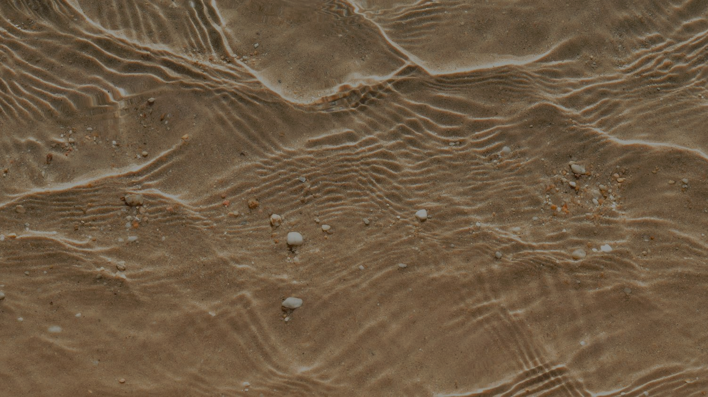
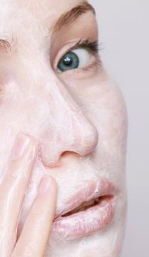
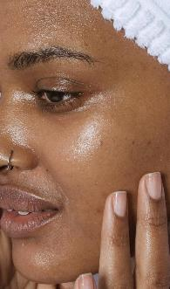

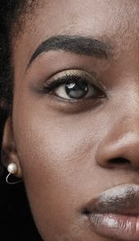

50%* OF YEARLY SUN EXPOSURE IS UNDER PROTECTED
BECAUSE SUNCARE PRODUCTS ARE JUDGED AS…
TOO HEAVY/ GREASY
TOO STICKY
UNPLEASANT SMELL
TOO ASHY
NOT GOOD FOR THE PLANET
* dsm-firmenich R&D estimates based on average MED exposure and SPF usage %

Slide 3





DSM
40 YEARS OF EXPERTISE IN SUN PROTECTION & BROADEST UV PORTFOLIO IN THE MARKET
FIRMENICH
125 YEARS OF FRAGRANCE
EXPERTISE
Eco-design across fragrances and active ingredients *
At dsm-firmenich, we join forces
to deliver the most effective, pleasurable and sustainable
range of sun protection products to turn Sun Protection into
a daily indulgence
  We master fragrance design with exclusive technologies to convey :
  Emotions
  freshness, long lastingness
  odor control or ingredient
  mal odor coverage
  to create memorable
  & memorable moments assets by our olfactive panel
We select & combine UV filters, test SPF and ease your regulatory journey
We optimize formulation adding bioactives to deliver extra skin benefits
We monitor sensoriality with our expert panel
*DSM Eco-Impact Score, Firmenich EcoScent compass ™

Slide 4




Introducing SunSense3:
Sun protection your Senses will love
1
Innovative, lightweight, easily spread textures
TOUCH
SIGHT
SMELL
2
Invisible SPF protection, visible skin results
3
Indulgent Fragrances
We activate all senses to elevate each usage occasion, to finally turn UV Protection into a daily indulgence

Slide 5






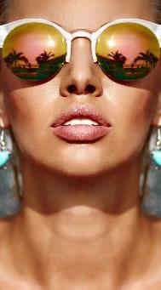


Sun protection your Senses will love
DAILY CARE & SPORT
RECREATIONAL
RELAXING
ENERGIZING
CONFIDENT ENERGY
NATURAL
FRESH
SENSUAL
FUN
5

Slide 6
























Joint Solutions: leveraging a broader Palette of technologies and methodologies
TriPro™ UV
filter technology
Scientifically proven Sun Care technology​, built from a combination of 3 high-powered PARSOL® UV filters​
EmotiWaves®
Mood boosting
fragrances – Enhance
your wellbeing feelings
& uplift your mind (from
relax to energy)
dsm-firmenich Eco-classes
Propriatary methodology to show the eco-friendliness of a UV filter combination based on Persistence, Bioaccumulation and Toxicity
DeodEclyx® R
Odor control technology
to feel confident
TM
dsm-firmenich Imp’ACT cards
Measure the sustainability of our products and provide customers with transparent product information.
Freezeblast®
Experience an instant
cooling & fresh sensation
from nose to skin

Slide 7

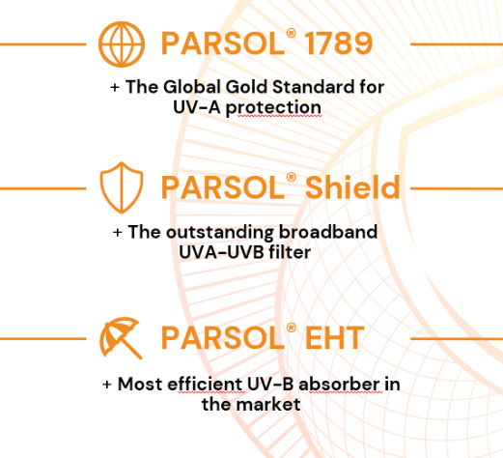


TriPro - Effortlessly Elevating Sun Defence for Unmatched Skin Comfort
TriPro technology - built from a combination of 3 high-powered UV filters
Scientifically proven Sun Care technology

Slide 8










dsm-firmenich Eco-classes
The dsm-firmenich Eco-classes indicate the eco-friendliness of the UV filter combination in a formulation
Based on the dsm-firmenich Eco-scoring, rooted in the assessment of the Persistence, Bioaccumulation and Toxicity impact on marine environment, coupled with a Market analysis of existing products
Ranging from Eco-class A to Eco-class G, where A is a high/good Eco-class and G is the worst Eco-class
TM

Slide 9

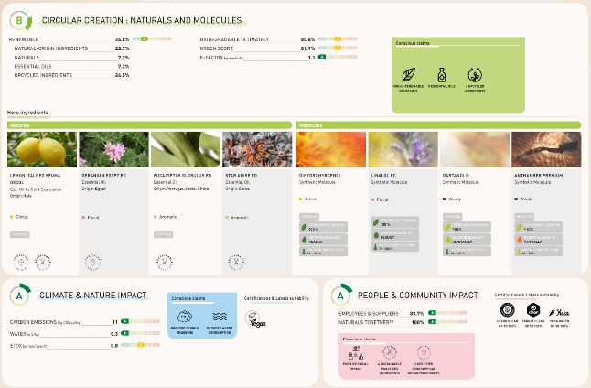
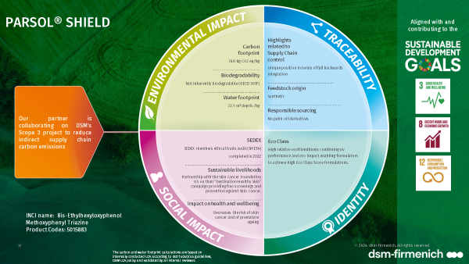
dsm-firmenich Sustainability tools
Sustainability Imp’Act CardsTM
EcoScent Compass®:
create consciously & share transparently
dsm-firmenich‘s integrated science-based impact measurement digital tool for eco-fragrance design & transparent fragrance diagnostic
Making Sustainability tangible for our customers
Imp’Act CardsTM measure the footprint of our products and provide customers with transparent & holistic information.
9

Slide 10

Fragrances developed with high safety requirements
Fragrances Formulated :
without known
phototoxics
Vegan without GMO
Biodegrability > 85%
without Nitromusk
without PCM
without Lilial
without BHT & BHA
without parabens

Slide 11


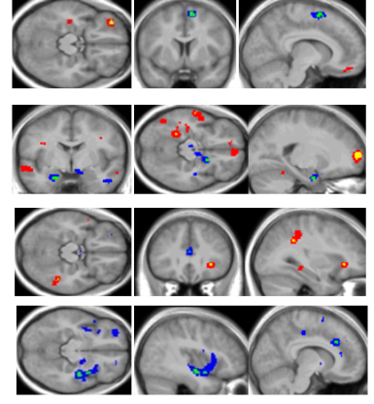

dsm-firmenich Emotion Program
Fragrance technology
That elicit a targeted emotion
With Natural Essential Oils
EmotiWaves®
Fragrance technology designed to elicit the targeted emotion, supported by neurological activity
Link between EmotiWaves® &
Feelings (from ScentMove® validated
by fMRI brain activity)
Tested by fMRI
NEW!
Patented methodology
Certification Supported
Notes:
For many of the sunsense line up product we used our patented methodology: Emotiwave which is part of our program around emotions
How does it work? we added to the fragrance a drop in ingredient specifically chosen to elicit an emotion and this emotion has been proven by FmRI
Fmri (function magnetic resonance imaging) like you see on the screen we trigger the neurological activity with the drop in ingredient present in the fragrance.
We have a set of different emotions or feelings that we can elicit like energizing or relaxing. It is a dsm-firmenich patented technology and we can provide a certificate to support the soft claim on emotion for our clients.

Slide 12




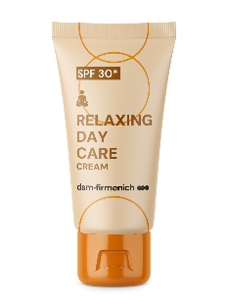
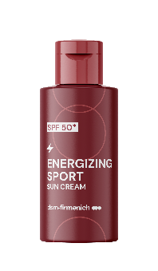
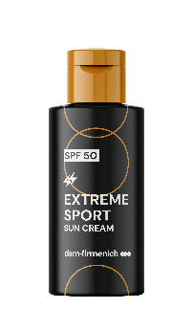
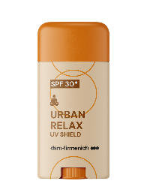



Sun protection your Senses will love
DAILY CARE & SPORT
RELAXING
ENERGIZING
CONFIDENT ENERGY
Sweat / Body Malodours Technology.
relax
relax
energy
energy
Easy-to-use
UV filter technology
UV filter technology
URBAN RELAX
RELAXING
DAY CARE
ENERGIZING
EXTREME SPORT
UV filter technology
ENERGIZING SPORT
UV Shield
Stick SPF 30
Cream
SPF 30*
Sun Cream with
Odour Control
SPF 50*
Sun Cream
SPF 50*
Product concepts are for illustration only and are not for sale. Any claims in this document are for inspiration only and the customer is solely responsible
for any marketing claims used on its product.
12
* Expected SPF / based on In-Silico SPF calculation

Slide 13
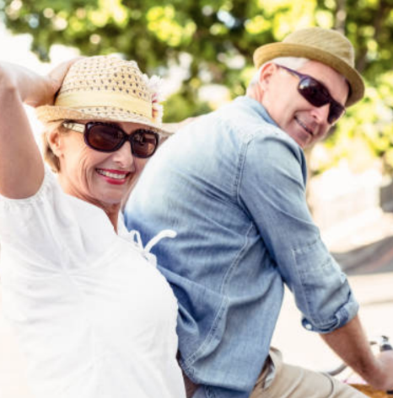
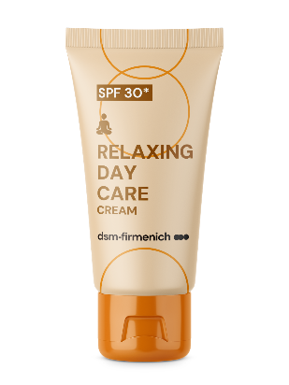

Formula Id card
DAILY CARE & SPORT
RELAXING DAY CARE CREAM - SPF 30
RELAXING
Lightweight, minimalistic formulation with a floral fragrance and modern watery facets
UV FILTER COMPLEX :
PARSOL® Shield
PARSOL® 1789
PARSOL® EHT
POSSIBLE MARKETING CLAIMS:
Minimalistic formulation

Slide 14





Fragrance Id card
DAILY CARE & SPORT
RELAXING
RELAXING DAY CARE CREAM - SPF 30
Fragrance name : Sunsense Relaxing Halo 626700 336
Fragrance descriptive Sentence
A soft aromatic floral fragrance with powdery hints and modern watery facets.
Technology & claims substantiation
Fragrance designed to elicit a RELAXING EMOTION, tested for brain activity using an fMRI methodology and is referred to as dsm-firmenich emotiwaves™.
More than > 98% BIODEGRADABLE

Slide 15
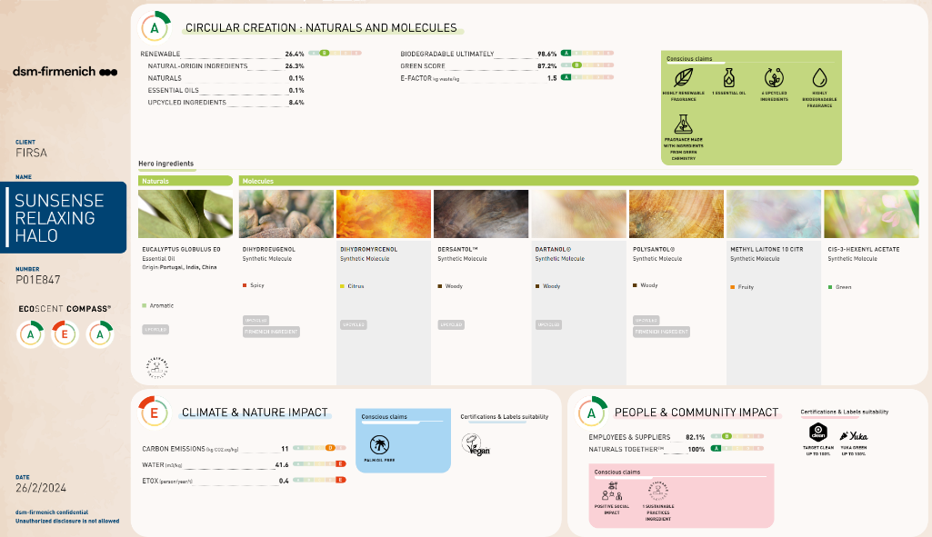
Fragrance Id card
DAILY CARE & SPORT
RELAXING

Slide 16
Formula Id card
DAILY CARE & SPORT
RELAXING
RELAXING DAY CARE CREAM SPF 30
Relaxation inspired by EmotiON
Lightweight, minimalistic formulation with a floral fragrance and modern watery facets
With PARSOL® 1789, PARSOL® Shield, PARSOL® EHT and SUNSENSE RELAXING HALO 626700 336.
PHASE | INGREDIENTS | INCI NAME | % W / W | SUPPLIER
A | PARSOL® 1789 | BUTYL METHOXYDIBENZOYLMETHANE | 3,00 | 100288
 | PARSOL® Shield | BIS-ETHYLHEXYLOXYPHENOL METHOXYPHENYL TRIAZINE | 3,00 | 100288
 | X-Tend 226 | PHENETHYL BENZOATE | 5,50 | 100184
 | PARSOL® EHT | ETHYLHEXYL TRIAZONE | 5,00 | 100288
 | Lanette® 22 | BEHENYL ALCOHOL | 1,00 | 100037
 | Emulium Dolcea MB | CETEARYL ALCOHOL, GLYCERYL STEARATE, JOJOBA ESTERS, HELIANTHUS ANNUUS SEED CERA, SODIUM STEAROYL GLUTAMATE, AQUA, POLYGLYCERIN-3 | 5,00 | 100413
 | Eldew SL-205 | ISOPROPYL LAUROYL SARCOSINATE | 5,50 | 100383
 | Finsolv® TN | C12-15 ALKYL BENZOATE | 7,00 | 100627
 | Dermosoft® GMCY MB | GLYCERYL CAPRYLATE | 0,50 | 100491
B | Water Dem | AQUA | 59,90
 | Dermofeel® PA-3 | SODIUM PHYTATE, AQUA, ALCOHOL | 0,10 | 100491
 | Phenethylalcohol Nat. | PHENETHYL ALCOHOL | 1,00 | 100491
C | Keltrol® CG-T | XANTHAN GUM | 0,30 | 100400
 | Propanediol | PROPANEDIOL | 3,00
D | SUNSENSE RELAXING HALO 626700 336 | PARFUM | 0,20 | 100288
SU-E-102517-2

Slide 17
Formula Id card
DAILY CARE & SPORT
RELAXING
RELAXING DAY CARE CREAM SPF 30
Relaxation inspired by EmotiON
Lightweight, minimalistic formulation with a floral fragrance and modern watery facets
With PARSOL® 1789, PARSOL® Shield, PARSOL® EHT and SUNSENSE RELAXING HALO 626700 336.
Procedure
Technical Data
1 | Weigh Phase A and heat up to 75°C under stirring.
2 | Weigh Phase B and heat up to 75°C under stirring.
3 | Premix Phase C and add it into Phase B under stirring.
4 | Add Phase A into Phase B+C and homogenize.
5 | Cool down to room temperature.
6 | Add Phase D and check the final pH.
pH: | 7 | Viscosity (spindle RV-5 / 10 rpm): | 15000 mPa.s
SPF: | 30 | In vitro UVA-PF | 17,9
In vivo according ISO 24444 |  | According ISO 24443
 |  | UVA-PF/SPF (30 labelled; >= 0.33): | 0,60
 |  | Critical Wavelength: | 379 nm
 |  | (Measurement done with Labsphere equipment)
Supplier
100288 | dsm-firmenich | 100184 | ISP
100037 | BASF | 100413 | GATTEFOSSE S.A.
100383 | AJINOMOTO INC | 100627 | INNOSPEC LIMITED
100491 | DR. STRAETMANS | 100400 | CP KELCO
Regulatory compliance in EU, MERCOSUR, ASEAN, CN, KR for UV filters in formulation.

Slide 18

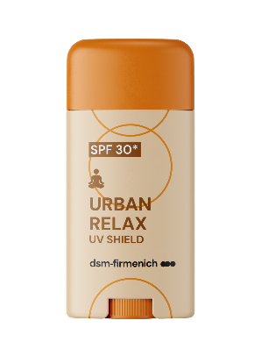
Formula Id card
DAILY CARE & SPORT
RELAXING
URBAN RELAX
UV Shield Stick SPF 30*
Easy to use, on-the-go transparent sun stick with a soft & aromatic floral fragrance
UV FILTER COMPLEX :
PARSOL® Shield
PARSOL® 1789
PARSOL® EHT
POSSIBLE CLAIMS:
Easy to use,
no sticky hands
Transparent on skin
No rub in necessary
* Expected SPF

Slide 19
Fragrance Id card
DAILY CARE & SPORT
RELAXING
RELAXING DAY CARE CREAM - SPF 30
Fragrance name : Sunsense Relaxing Halo 626700 336
Fragrance descriptive Sentence
A soft aromatic floral fragrance with powdery hints and modern watery facets.
Technology & claims substantiation
Fragrance designed to elicit a RELAXING EMOTION, tested for brain activity using an fMRI methodology and is referred to as dsm-firmenich emotiwaves™.
More than > 98% BIODEGRADABLE

Slide 20
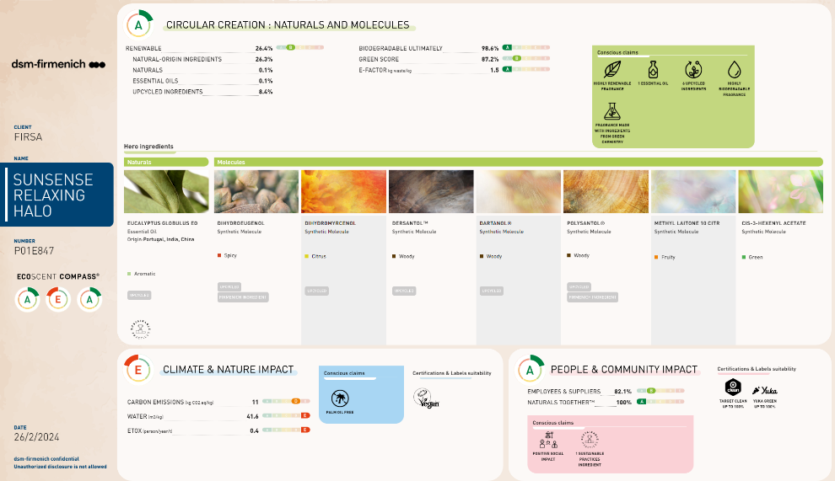
Fragrance Id card
DAILY CARE & SPORT
RELAXING

Slide 21
Formula Id card
DAILY CARE & SPORT
RELAXING
URBAN RELAX
UV SHIELD SPF 30*
Relaxation inspired by EmotiON
Easy to use, on-the-go transparent sun stick with a soft and aromatic floral fragrance
With PARSOL® 1789, PARSOL® Shield, PARSOL® EHT, DL-alpha-Tocopherol and SUNSENSE RELAXING HALO 626700 336.
PHASE | INGREDIENTS | INCI NAME | % W / W | SUPPLIER
A | Eutanol® G | OCTYLDODECANOL | 51,50 | 100037
 | Cetiol® CC | DICAPRYLYL CARBONATE, TOCOPHEROL | 18,70 | 100037
 | DUB DIS | DIISOPROPYL SEBACATE | 8,00 | 100327
 | GP-1 | DIBUTYL LAUROYL GLUTAMIDE | 6,00 | 100383
 | EB-21 | DIBUTYL ETHYLHEXANOYL GLUTAMIDE | 4,00 | 100383
 | PARSOL® 1789 | BUTYL METHOXYDIBENZOYLMETHANE | 3,50 | 100288
 | PARSOL® Shield | BIS-ETHYLHEXYLOXYPHENOL METHOXYPHENYL TRIAZINE | 3,00 | 100288
 | UVAsorb HEB | DIETHYLHEXYL BUTAMIDO TRIAZONE | 2,50 | 100376
 | PARSOL® EHT | ETHYLHEXYL TRIAZONE | 2,00 | 100288
B | DL-alpha-Tocopherol | TOCOPHEROL | 0,50 | 100288
 | SUNSENSE RELAXING HALO 626700 336 | PARFUM | 0,30 | 100288
SU-E-102521-4

Slide 22
Formula Id card
DAILY CARE & SPORT
RELAXING
RELAXING DAY CARE CREAM SPF 30*
Relaxation inspired by EmotiON
Lightweight, minimalistic formulation with a floral fragrance and modern watery facets
With PARSOL® 1789, PARSOL® Shield, PARSOL® EHT, DL-alpha-Tocopherol and SUNSENSE RELAXING HALO 626700 336.
Procedure
Technical Data
1 | Weigh Phase A and heat up to 120°C until getting a clear solution.
2 | Cool down to 80°C under stirring.
3 | Add one by one ingredients of Phase B.
4 | Pour the product into the stick packs at T>70°C.
5 | Let cool down to room temperature.
Ph: | NA | Viscosity (spindle / 0 rpm): | NA
SPF: | 30* | In vitro UVA-PF | 13
 |  | In silico | 30
 |  | UVA-PF/SPF (30 labelled; >= 0.33): | 0,43
 |  | Critical Wavelength: | 379 nm
 |  | In silico
Supplier
100037 | BASF | 100327 | STEARINERIE DUBOIS FILS
100383 | AJINOMOTO INC | 100288 | dsm-firmenich
100376 | 3V SIGMA, SPA
* Expected SPF
Regulatory compliance in EU, MERCOSUR, ASEAN, CN, KR for UV filters in formulation.

Slide 23

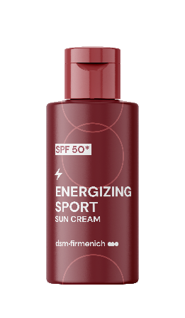

Formula Id card
DAILY CARE & SPORT
ENERGIZING
ENERGIZING SPORT
Sun Cream SPF 50*
Hydrating sun cream with SPF 50* and an energizing citrus aromatic fragrance
UV FILTER COMPLEX :
PARSOL® Shield
PARSOL® 1789
PARSOL® EHT
PARSOL® Max
PARSOL® EHS
BIOACTIVES:
HYA-ACT™ S
ALPAFLOR® EDELWEISS CB
PENTAVITIN®
VALVANCE® Touch 210
POSSIBLE CLAIMS:
Dry touch
Skin moisturization
Contains Edelweiss extract, for anti-pollution, and reduced skin damage caused by blue light and UV
* Expected SPF
Notes:
Pentavitin: Deep hydration for up to 72 hours, 3-HOUR hydration boost to excessively dry skin areas, Used for 28-DAYS, PENTAVITIN® brings dry skin back to life,
Binds to keratin as magnet power and gives back vitality to your skin, Reverse the 5 signs of dehydrated skin: roughness, dullness, flakiness, tightness, redness
Color Mapping visualization, Tested in different skin types, Restores & calms stressed skin that lasts for up to 24 hours
EDELWEISS: Helps slow down the premature aging of skin and protects the skin against oxidative stress, Helps reduce lines and wrinkles with anti-sagging effect on the V-shape and forehead in vivo, for a rejuvenated skin, Minimizes the appearance of aging after exposure to blue light and UV, Reduces skin damage caused by blue light and UV, Delivers even skin tone and overall improved skin appearance.
HYA-ACT S: ts humectant properties draw moisture into the skin, helping to combat dryness and dullness. What many people don’t realize is that hyaluronic acid comes in various molecular sizes. Larger molecules stay on the surface and give the skin a ‘dewy’ look, while smaller molecules penetrate deeper into the skin to deliver their hydration benefits.¹ (Small Molecular Weight of 200–400 KDa) weight is present in the superficial layer of the epidermis to lock in moisture for an even greater hydration boost and calms reddened skin.

Slide 24
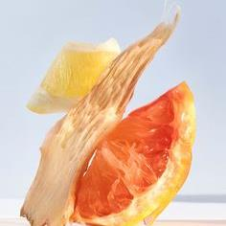



Fragrance Id card
DAILY CARE & SPORT
ENERGIZING
ENERGIZING SPORT Sun Cream SPF 50*
Fragrance name : Sunsense Energizing Blast 681900 044
Fragrance descriptive Sentence
An energizing citrus aromatic fragrance with a fresh & subtil floral signature
Technology & claims substantiation
Fragrance designed to elicit ENERGIZING EMOTION, tested for brain activity using an fMRI methodology and is referred to
as dsm-firmenich emotiwaves™.
* Expected SPF

Slide 25
Formula Id card
DAILY CARE & SPORT
ENERGIZING SPORT
SUN CREAM SPF 50*
Powered by EMOTIWAVE
Hydrating sun cream with an energizing citrus aromatic fragrance
ENERGIZING
With PARSOL® EHS, PARSOL® 1789, PARSOL® EHT, PARSOL® Shield, AMPHISOL® K, DL-alpha-Tocopherol, HYA-ACTTM S, VALVANCE® Touch 210, ALPAFLOR® EDELWEISS CB, PENTAVITIN®, PARSOL® Max and SUNSENSE ENERGIZING BLAST 681900 044.
PHASE | INGREDIENTS | INCI NAME | % W / W | SUPPLIER
A | Cetiol® B | DIBUTYL ADIPATE | 7,00 | 100037
 | Finsolv® TN | C12-15 ALKYL BENZOATE | 8,00 | 100627
 | PARSOL® EHS | ETHYLHEXYL SALICYLATE | 5,00 | 100288
 | PARSOL® 1789 | BUTYL METHOXYDIBENZOYLMETHANE | 4,20 | 100288
 | PARSOL® EHT | ETHYLHEXYL TRIAZONE | 4,00 | 100288
 | PARSOL® Shield | BIS-ETHYLHEXYLOXYPHENOL METHOXYPHENYL TRIAZINE | 3,60 | 100288
 | Tegosoft XC MB | PHENOXYETHYL CAPRYLATE | 3,70 | 101005
 | Eldew SL-205 | ISOPROPYL LAUROYL SARCOSINATE | 3,00 | 100383
 | Cosphaderm® Feel | TRIHEPTANOIN | 3,00 | 101192
 | MONTANOVTM L | C14-22 ALCOHOLS, C12-20 ALKYL GLUCOSIDE | 3,00 | 100313
 | Lexfilm Sun Natural MB | CAPRYLOYL GLYCERIN/SEBACIC ACID COPOLYMER | 2,00 | 100647
 | UVAsorb HEB | DIETHYLHEXYL BUTAMIDO TRIAZONE | 1,00 | 100376
 | Lanette® 16 | CETYL ALCOHOL | 0,50 | 100037
 | Cutina® HR Flakes | HYDROGENATED CASTOR OIL | 0,40 | 100037
 | AMPHISOL® K | POTASSIUM CETYL PHOSPHATE | 0,40 | 100288
B | Water Dem | AQUA | 40,00
 | SymSave H | HYDROXYACETOPHENONE | 0,80 | 100106
 | Carephos N | SODIUM POLYPHOSPHATE | 0,40 | 100045
C | Cosphaderm Magnolia Extract 98 | MAGNOLIA OFFICINALIS BARK EXTRACT | 0,10 | 101192
 | Propanediol | PROPANEDIOL | 2,00
 | RHEOZAN® SH | SUCCINOGLYCAN | 0,30 | 100002
 | HYA-ACTTM S | SODIUM HYALURONATE | 0,10 | 100288
 | Cosphaderm® Hexiol | 1,2-HEXANEDIOL | 0,80 | 101192
 | PemuPur START Polymer | MICROCRYSTALLINE CELLULOSE, SPHINGOMONAS FERMENT EXTRACT, CELLULOSE GUM | 0,15 | 100435
D | VALVANCE® Touch 210 | SILICA | 2,00 | 100288
 | ALPAFLOR® EDELWEISS CB | LEONTOPODIUM ALPINUM FLOWER/LEAF EXTRACT, GLYCERIN, AQUA, CITRIC ACID | 1,00 | 100288
 | PENTAVITIN® | SACCHARIDE ISOMERATE, AQUA, CITRIC ACID, SODIUM CITRATE | 1,00 | 100288
 | DL-alpha-Tocopherol | TOCOPHEROL | 0,15 | 100288
 | PARSOL® Max | METHYLENE BIS-BENZOTRIAZOLYL TETRAMETHYLBUTYLPHENOL, AQUA, DECYL GLUCOSIDE, PROPYLENE GLYCOL, XANTHAN GUM | 2,00 | 100288
 | SUNSENSE ENERGIZING BLAST 681900 044 | PARFUM, TETRAMETHYL ACETYLOCTAHYDRONAPHTALENES, LINALOOL, CITRUS LIMON PEEL OIL, LIMONENE, GERANIOL, GERANYL ACETATE, PINENE, | 0,40 | 100288
SU-E-102520-5

Slide 26
Formula Id card
DAILY CARE & SPORT
ENERGIZING
ENERGIZING SPORT
SUN CREAM SPF 50*
Powered by EMOTIWAVE
Hydrating sun cream with an energizing citrus aromatic fragrance
With PARSOL® EHS, PARSOL® 1789, PARSOL® EHT, PARSOL® Shield, AMPHISOL® K, DL-alpha-Tocopherol, HYA-ACTTM S, VALVANCE® Touch 210, ALPAFLOR® EDELWEISS CB, PENTAVITIN®, PARSOL® Max and SUNSENSE ENERGIZING BLAST 681900 044.
Procedure
Technical Data
1 | Weigh Phase A and het up to 85°C under stirring.
2 | Weigh Phase B and heat up to 85°C under stirring.
3 | Premix Phase C and add it to Phase B while keeping heating under stirring.
4 | When Phase A and B+C are at 85°C, Add Phase B+C to Phase A and homogenize 5 minutes.
5 | Cool down to room temperature under gentle stirring.
6 | Add one by one ingredients of Phase D into the emulsion and check the final pH (min 7).
pH: | NA | Viscosity (spindle / 0 rpm): | NA
SPF: | 30 | In vitro UVA-PF | 13
*Expected |  | In silico
 |  | UVA-PF/SPF (30 labelled; >= 0.33): | 0,43
 |  | Critical Wavelength: | 379 nm
 |  | In silico
Supplier
100037 | BASF | 100327 | STEARINERIE DUBOIS FILS
100383 | AJINOMOTO INC | 100288 | dsm-firmenich
100376 | 3V SIGMA, SPA
Regulatory compliance in EU, MERCOSUR, ASEAN, CN, KR for UV filters in formulation.

Slide 27
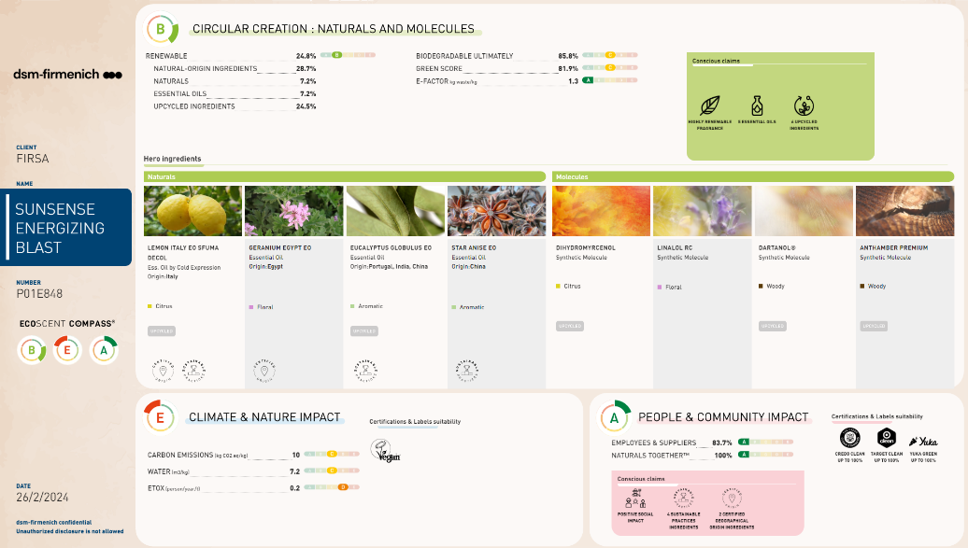
Fragrance Id card
DAILY CARE & SPORT
ENERGIZING

Slide 28

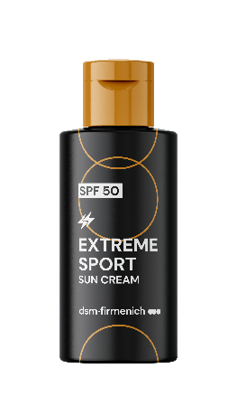
Formula Id card
DAILY CARE & SPORT
ENERGIZING
EXTREME SPORT – SPF 50*
CONFIDENT ENERGY
High protection sun cream
with odor control technology to decrease body malodors
BIOACTIVES:
HYA-ACT™ S
ALPAFLOR® EDELWEISS CB
PENTAVITIN®
VALVANCE® Touch 210
UV FILTER COMPLEX :
PARSOL® Shield
PARSOL ® 1789
PARSOL ® EHT
PARSOL ® EHS
PARSOL ® Max
POSSIBLE CLAIMS:
Odor control technology
Dry touch
Skin moisturization
* Expected SPF

Slide 29


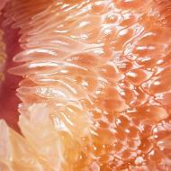
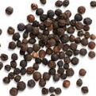
Fragrance Id card
DAILY CARE & SPORT
CONFIDENT ENERGY
ENERGIZING EXTREME SPORT – SPF 50*
Fragrance name : Sunsense Aroma Sport 196198 FB
Fragrance descriptive Sentence
Unisex fragrance with aromatic tonic structure and floral tonalities.
Technology & claims substantiation
Fragrance designed to elicit ENERGIZING EMOTION, tested for brain activity using an fMRI methodology and is referred to as dsm-firmenich Emotiwaves™
In combination with a technology tested against sweat/ body
malodours called DEODECLYX®

Slide 30

Formula Id card
DAILY CARE & SPORT
ENERGIZING EXTREME SPORT
SUN CREAM SPF 50*
With odor control technology
High protection sun cream with odor
technology to decrease body malodors
CONFIDENT ENERGY
With PARSOL® EHS, PARSOL® 1789, PARSOL® EHT, PARSOL® Shield, AMPHISOL® K, DL-alpha-Tocopherol, HYA-ACTTM S, VALVANCE® Touch 210, ALPAFLOR® EDELWEISS CB, PENTAVITIN®, PARSOL® Max and SUNSENSE AROMA SPORT 196198 FB.
Phase | Ingredients | INCI Name | % w / w | Supplier
A | Cetiol® B | DIBUTYL ADIPATE | 7,00 | 100037
 | Finsolv® TN | C12-15 ALKYL BENZOATE | 8,00 | 100627
 | PARSOL® EHS | ETHYLHEXYL SALICYLATE | 5,00 | 100288
 | PARSOL® 1789 | BUTYL METHOXYDIBENZOYLMETHANE | 4,20 | 100288
 | PARSOL® EHT | ETHYLHEXYL TRIAZONE | 4,00 | 100288
 | PARSOL® Shield | BIS-ETHYLHEXYLOXYPHENOL METHOXYPHENYL TRIAZINE | 3,60 | 100288
 | Tegosoft XC MB | PHENOXYETHYL CAPRYLATE | 3,70 | 101005
 | Eldew SL-205 | ISOPROPYL LAUROYL SARCOSINATE | 3,00 | 100383
 | Cosphaderm® Feel | TRIHEPTANOIN | 3,00 | 101192
 | MONTANOVTM L | C14-22 ALCOHOLS, C12-20 ALKYL GLUCOSIDE | 3,00 | 100313
 | Lexfilm Sun Natural MB | CAPRYLOYL GLYCERIN/SEBACIC ACID COPOLYMER | 2,00 | 100647
 | UVAsorb HEB | DIETHYLHEXYL BUTAMIDO TRIAZONE | 1,00 | 100376
 | Lanette® 16 | CETYL ALCOHOL | 0,50 | 100037
 | Cutina® HR Flakes | HYDROGENATED CASTOR OIL | 0,40 | 100037
 | AMPHISOL® K | POTASSIUM CETYL PHOSPHATE | 0,40 | 100288
B | Water Dem | AQUA | 40,00
 | SymSave H | HYDROXYACETOPHENONE | 0,80 | 100106
 | Carephos N | SODIUM POLYPHOSPHATE | 0,40 | 100045
C | Cosphaderm Magnolia Extract 98 | MAGNOLIA OFFICINALIS BARK EXTRACT | 0,10 | 101192
 | Propanediol | PROPANEDIOL | 2,00
 | RHEOZAN® SH | SUCCINOGLYCAN | 0,30 | 100002
 | HYA-ACTTM S | SODIUM HYALURONATE | 0,10 | 100288
 | Cosphaderm® Hexiol | 1,2-HEXANEDIOL | 0,80 | 101192
 | PemuPur START Polymer | MICROCRYSTALLINE CELLULOSE, SPHINGOMONAS FERMENT EXTRACT, CELLULOSE GUM | 0,15 | 100435
D | VALVANCE® Touch 210 | SILICA | 2,00 | 100288
 | ALPAFLOR® EDELWEISS CB | LEONTOPODIUM ALPINUM FLOWER/LEAF EXTRACT, GLYCERIN, AQUA, CITRIC ACID | 1,00 | 100288
 | PENTAVITIN® | SACCHARIDE ISOMERATE, AQUA, CITRIC ACID, SODIUM CITRATE | 1,00 | 100288
 | DL-alpha-Tocopherol | TOCOPHEROL | 0,15 | 100288
 | PARSOL® Max | METHYLENE BIS-BENZOTRIAZOLYL TETRAMETHYLBUTYLPHENOL, AQUA, DECYL GLUCOSIDE, PROPYLENE GLYCOL, XANTHAN GUM | 2,00 | 100288
 | SUNSENSE AROMA SPORT 196198 FB | PARFUM, ACETYL CEDRENE, COUMARIN, TETRAMETHYL ACETYLOCTAHYDRONAPHATELENES, ALPHA-ISOMETHYL-IONONE, CITRONELLOL, | 0,40 | 100288
SU-E-102520-6

Slide 31
Formula Id card
DAILY CARE & SPORT
ENERGIZING EXTREME SPORT
SUN CREAM SPF 50*
With odor control technology
High protection sun cream with odor
technology to decrease body malodors
CONFIDENT ENERGY
With PARSOL® EHS, PARSOL® 1789, PARSOL® EHT, PARSOL® Shield, AMPHISOL® K, DL-alpha-Tocopherol, HYA-ACTTM S, VALVANCE® Touch 210, ALPAFLOR® EDELWEISS CB, PENTAVITIN®, PARSOL® Max and SUNSENSE AROMA SPORT 196198 FB.
Procedure
Technical Data
1 | Weigh Phase A and het uo to 85°C under stirring.
2 | Weigh Phase B and heat up to 85°C under stirring.
3 | Premix Phase C and add it to Phase B while keeping heating under stirring.
4 | When Phase A and B+C are at 85°C, Add Phase B+C to Phase A and homogenize 5 minutes.
5 | Cool down to room temperature under gentle stirring.
6 | Add one by one ingredients of Phase D into the emulsion and check the final pH (min 7).
pH: | 6,7 | Viscosity (spindle 4 / 10 rpm): | 15000 mPa.s
SPF: | 50 | In vitro UVA-PF | 17,8
*Expected |  | In silico
 |  | UVA-PF/SPF (50 labelled; >= 0.33): | 0,36
 |  | Critical Wavelength: | 380 nm
 |  | In silico
Supplier
100037 | BASF | 100627 | INNOSPEC LIMITED
100288 | dsm-firmenich | 101005 | EVONIK INDUSTRIES AG
100383 | AJINOMOTO INC | 101192 | COSPHATEC
100313 | SEPPIC | 100647 | INOLEX CHEMICAL COMPANY
100376 | 3V SIGMA, SPA | 100002 | SOLVAY
100106 | SYMRISE GMBH & CO.KG | 100045 | BK GIULINI CHEMIE
Regulatory compliance in EU, MERCOSUR, ASEAN, CN, KR for UV filters in formulation.

Slide 32
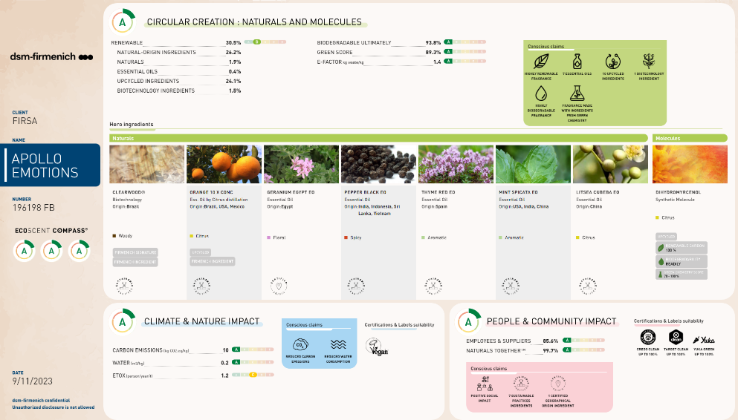
Fragrance Id card
DAILY CARE & SPORT
CONFIDENT ENERGY
SUNSENSE APOLLO XTREME SPORT

Slide 33




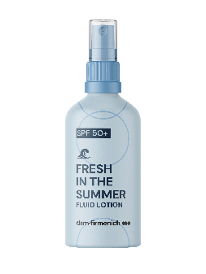
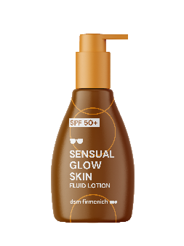
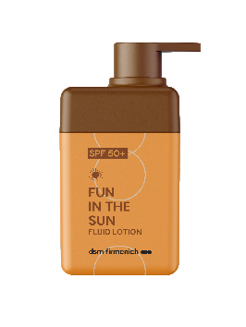
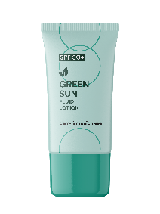


Sun protection your Senses will love
RECREATIONAL
NATURAL
FRESH
SENSUAL
FUN
100% natural fragrance
Fragrance with STT technology
UV filter technology
UV filter technology
UV filter technology
UV filter technology
OEKO TEST compliant
OEKO TEST compliant
OEKO TEST compliant
OEKO TEST
compliant
GREEN SUN
FRESH SUN
SENSUAL
GLOW SKIN
FUN IN THE SUN
High Protection
Fluid Lotion
SPF 50+
with Cooling Effect
Fluid Lotion
SPF 50+
With Shimmer effect Fluid Lotion SPF 50+
Fluid Lotion
SPF 50+
Product concepts are for illustration only and are not for sale. Any claims in this document are for inspiration only and the customer is solely responsible
for any marketing claims used on its product.

Slide 34

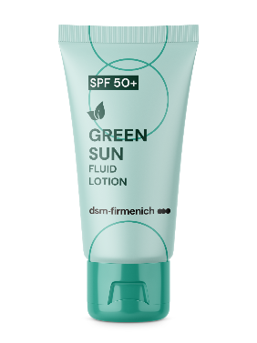

Formula Id card
RECREATIONAL
NATURAL
GREEN SUN
FRESH
High Protection Fluid Lotion SPF 50+
Eco-friendly and hydrating formulation with a 100% natural fragrance
UV FILTER COMPLEX :
PARSOL® Shield
PARSOL® 1789
PARSOL® EHT
PARSOL® EHS
PARSOL® HS
BIOACTIVES:
ALPAFLOR® EDELWEISS CB
PENTAVITIN®
POSSIBLE CLAIMS:
Non-greasy formulation
OEKO TEST compliant

Slide 35
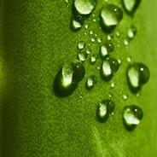


Fragrance Id card
RECREATIONAL
NATURAL
GREEN SUN High Protection Fluid Lotion SPF 50+
Fragrance name : Sunsense Hydra Vegetal 681900 004F
Fragrance descriptive Sentence
A 100% natural fragrance inspired by quenching green notes of aloe vera, bamboo and cactus
Claims
Highly biodegradable fragrance
Fragrance made with ingredients
from green chemistry
Notes:
TOP: Citrus, Bamboo, Watery
MIDDLE: Aloe vera, White Tea
BASE: Woody, Musky

Slide 36
Formula Id card
RECREATIONAL
GREEN SUN FLUID LOTION SPF50+
With a 100% Natural Fragrance
Eco-friendly and hydrating formulation with a 100% natural fragrance
With PARSOL® EHS, PARSOL® 1789, PARSOL® EHT, PARSOL® Shield, PARSOL® HS, PENTAVITIN®, ALPAFLOR® EDELWEISS CB, DL-alpha-Tocopheryl Acetate and SUNSENSE HYDRA VEGETAL 681900 004F.
NATURAL
FRESH
PHASE | INGREDIENTS | INCI NAME | % W / W | SUPPLIER
A | Cetiol® B | DIBUTYL ADIPATE | 8,00 | 100037
 | Finsolv® TN | C12-15 ALKYL BENZOATE | 8,00 | 100627
 | PARSOL® EHS | ETHYLHEXYL SALICYLATE | 5,00 | 100288
 | PARSOL® 1789 | BUTYL METHOXYDIBENZOYLMETHANE | 4,70 | 100288
 | PARSOL® EHT | ETHYLHEXYL TRIAZONE | 4,40 | 100288
 | PARSOL® Shield | BIS-ETHYLHEXYLOXYPHENOL METHOXYPHENYL TRIAZINE | 3,80 | 100288
 | Tegosoft XC MB | PHENOXYETHYL CAPRYLATE | 3,70 | 101005
 | MONTANOVTM L | C14-22 ALCOHOLS, C12-20 ALKYL GLUCOSIDE | 3,00 | 100313
 | Eldew SL-205 | ISOPROPYL LAUROYL SARCOSINATE | 2,60 | 100383
 | Lexfilm Sun Natural MB | CAPRYLOYL GLYCERIN/SEBACIC ACID COPOLYMER | 2,20 | 100647
 | Kahlwax 2811 Rice | ORYZA SATIVA BRAN CERA | 2,00 | 100425
 | Lanette® 16 | CETYL ALCOHOL | 1,00 | 100037
 | Cutina® HR Flakes | HYDROGENATED CASTOR OIL | 0,40 | 100037
 | Dermosoft® Octiol | CAPRYLYL GLYCOL | 0,20 | 100491
 | Sensiva® SC 50 | ETHYLHEXYLGLYCERIN | 0,20 | 100444
B | Cosphaderm® Pentiol natural | PENTYLENE GLYCOL | 3,00 | 101192
 | Kaneka Surfactin | SODIUM SURFACTIN | 0,25 | 101161
C | Propanediol | PROPANEDIOL | 3,00
 | PemuPur START Polymer | MICROCRYSTALLINE CELLULOSE, SPHINGOMONAS FERMENT EXTRACT, CELLULOSE GUM | 0,17 | 100435
 | RHEOZAN® SH | SUCCINOGLYCAN | 0,15 | 100002
D | Water Dem | AQUA | 33,80
 | Carephos N | SODIUM POLYPHOSPHATE | 0,20 | 100045
E | Water Dem | AQUA | 6,00
 | PARSOL® HS | PHENYLBENZIMIDAZOLE SULFONIC ACID | 1,00 | 100288
 | Sodium Hydroxide Pellets Emprove | SODIUM HYDROXIDE | 0,15 | 100230
F | PENTAVITIN® | SACCHARIDE ISOMERATE, AQUA, CITRIC ACID, SODIUM CITRATE | 1,00 | 100288
 | ALPAFLOR® EDELWEISS CB | LEONTOPODIUM ALPINUM FLOWER/LEAF EXTRACT, GLYCERIN, AQUA, CITRIC ACID | 1,00 | 100288
 | DL-alpha-Tocopheryl Acetate | TOCOPHERYL ACETATE | 0,50 | 100288
 | SUNSENSE HYDRA VEGETAL 681900 004F | PARFUM, TETRAMETHYL ACETYLOCTAHYDRONAPHTALENES, TERPINEOL, | 0.50 | 100288
SU-E-102518-4

Slide 37
Formula Id card
RECREATIONAL
GREEN SUN FLUID LOTION SPF50+
With a 100% Natural Fragrance
Eco-friendly and hydrating formulation with a 100% natural fragrance
With PARSOL® EHS, PARSOL® 1789, PARSOL® EHT, PARSOL® Shield, PARSOL® HS, PENTAVITIN®, ALPAFLOR® EDELWEISS CB, DL-alpha-Tocopheryl Acetate and SUNSENSE HYDRA VEGETAL 681900 004F.
NATURAL
FRESH
Procedure
Technical Data
1 | Weigh Phase A and heat up to 80°C under stirring.
2 | Weigh Phase D and heat up to 80°C under stirring.
3 | Weigh Phase B and stir until homogeneous.
4 | Premix Phase C and add it to Phase B while keeping stirring. Add Phase B+C to Phase D and homogenize 2mn.
5 | Add Phase A to Phase B+C+D and homogenize 5mn.
6 | Cool down to 40°C under gentle stirring.
7 | Premix Phase E until getting a clear solution. Add it to the emulsion.
8 | Cool down to room temperature under gentle stirring.
9 | Add one by one ingredients of Phase F into the emulsion and check the final pH (min 7).
pH: | 7,1 | Viscosity (spindle 5 / 10 rpm): | 12000 mPa.s
SPF: | 62,8 | In vitro UVA-PF | 23
In vivo according to ISO 24444 |  | According to ISO 24443
 |  | UVA-PF/SPF (50+ labelled; >= 0.33): | 0,4
 |  | Critical Wavelength: | 378 nm
 |  | (Measurement done with Labsphere equipment)
Supplier
100037 | BASF | 100627 | INNOSPEC LIMITED
100288 | dsm-firmenich | 101005 | EVONIK INDUSTRIES AG
100313 | SEPPIC | 100383 | AJINOMOTO INC
100647 | INOLEX CHEMICAL COMPANY | 100425 | KAHL & CO
100491 | DR. STRAETMANS | 100444 | SCHÜLKE & MAYR GMBH
101192 | COSPHATEC | 101161 | KANEKA CORPORATION
100435 | LUBRIZOL ADVANCED MATERIALS, IN | 100002 | SOLVAY
100230 | MERCK KGAA | 100045 | BK GIULINI CHEMIE
Regulatory compliance in EU, MERCOSUR, ASEAN, CN, KR, AUS for UV filters in formulation.

Slide 38
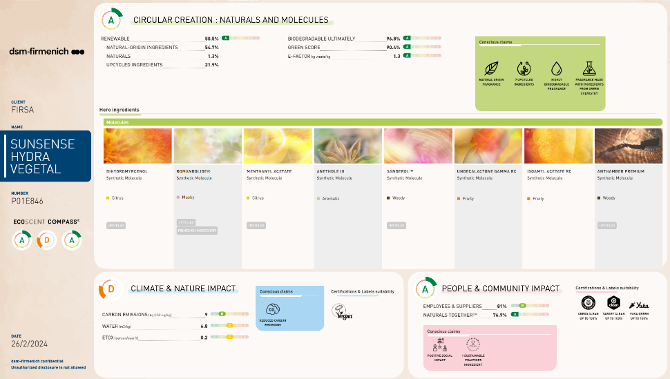
Fragrance Id card
RECREATIONAL
NATURAL
FRESH

Slide 39

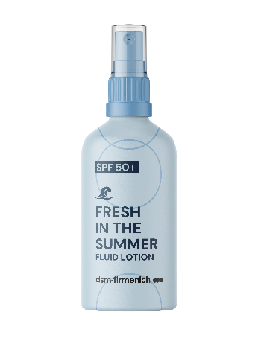
Formula Id card
RECREATIONAL
FRESH IN
THE SUMMER
FRESH
Fluid Lotion SPF 50+
with Cooling Effect
Lightweight sun lotion with a fresh and cooling sensation powered by a patent-pending technology
UV FILTER COMPLEX :
PARSOL® Shield
PARSOL® 1789
PARSOL® EHT
PARSOL® EHS
PARSOL® HS
BIOACTIVES:
ALPAFLOR® EDELWEISS CB
PENTAVITIN®
POSSIBLE CLAIMS:
Extra-hydration,
thanks to PENTAVITIN®
Lightweight Formulation
Water-resistant

Slide 40


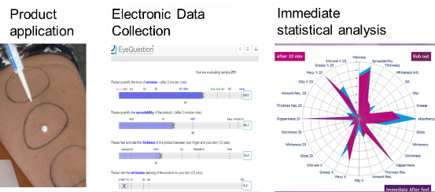
Fragrance Id card
RECREATIONAL
FRESH
FRESH IN THE SUMMER FLUID LOTION SPF 50+
Fragrance name : Sunsense Sea Breeze 681900 098D
Fragrance descriptive Sentence
A cooling unisex fragrance, taking inspiration of long walk by the sea and giving the impression of an oxygen fresh boost.
Technology & claims substantiation
Fragrance designed with a dsm-firmenich technology to enhance cooling sensation called Freezeblast®*
®
+37% cooling sensation**
vs no cooling tech benchmark
*FreezeBlast ®is in the process of being introduced
to PE palette so Fragrance oils with this technology cannot be ordered before Aug-Sept 2024. Please contact Marie Cecile Geslin for early assessment customer need. ** dsm-firmenich sensory pannel evaluation

Slide 41
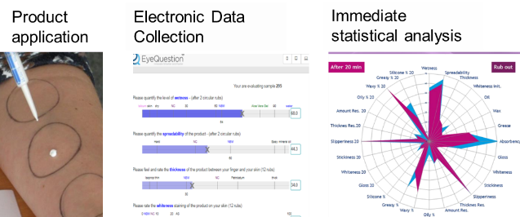

Formula Id card
RECREATIONAL
FRESH
IN THE SUMMER
FRESH
Patent-pending
cooling technology
+37% cooling sensation **
vs no cooling tech benchmark
**Assessed by the dsm-firmenich sensory panel.
Well-trained panelists
29 different parameters evaluated
Scale from 0-100 compared to references
      Application on the forearm volar surface:
              50 microliters of the respective emulsion were applied on a spot with an application area of 20 cm2 (radius is 2.5cm) corresponding to a topical application of 2.5 mg/cm2.
              After application, the respective emulsion was rubbed in until the product was absorbed by the skin.
Sensory evaluation was done during rub out, immediate after feel and after feel after 20 minutes
®

Slide 42
Formula Id card
RECREATIONAL
FRESH IN THE SUMMER FLUID
LOTION SPF 50+
With a Patented Cooling Technology Lightweight sun lotion with a fresh and cooling sensation powered by a patented technology
With PARSOL® EHS, PARSOL® 1789, PARSOL® EHT, PARSOL® Shield, PARSOL® HS, PENTAVITIN®, ALPAFLOR® EDELWEISS CB, DL-alpha-Tocopheryl Acetate, SUNSENSE SEA BREEZE* 681900 098D including FREEZEBLAST® dsm-firmenich patented cooling technology.
FRESH
PHASE | INGREDIENTS | INCI NAME | % W / W | SUPPLIER
A | Cetiol® B | DIBUTYL ADIPATE | 8,00 | 100037
 | Finsolv® TN | C12-15 ALKYL BENZOATE | 8,00 | 100627
 | PARSOL® EHS | ETHYLHEXYL SALICYLATE | 5,00 | 100288
 | PARSOL® 1789 | BUTYL METHOXYDIBENZOYLMETHANE | 4,70 | 100288
 | PARSOL® EHT | ETHYLHEXYL TRIAZONE | 4,40 | 100288
 | PARSOL® Shield | BIS-ETHYLHEXYLOXYPHENOL METHOXYPHENYL TRIAZINE | 3,80 | 100288
 | Tegosoft XC MB | PHENOXYETHYL CAPRYLATE | 3,70 | 101005
 | MONTANOVTM L | C14-22 ALCOHOLS, C12-20 ALKYL GLUCOSIDE | 3,00 | 100313
 | Eldew SL-205 | ISOPROPYL LAUROYL SARCOSINATE | 2,60 | 100383
 | Lexfilm Sun Natural MB | CAPRYLOYL GLYCERIN/SEBACIC ACID COPOLYMER | 2,20 | 100647
 | Kahlwax 2811 Rice | ORYZA SATIVA BRAN CERA | 2,00 | 100425
 | Lanette® 16 | CETYL ALCOHOL | 1,00 | 100037
 | Cutina® HR Flakes | HYDROGENATED CASTOR OIL | 0,40 | 100037
 | Dermosoft® Octiol | CAPRYLYL GLYCOL | 0,20 | 100491
 | Sensiva® SC 50 | ETHYLHEXYLGLYCERIN | 0,20 | 100444
B | Cosphaderm® Pentiol natural | PENTYLENE GLYCOL | 3,00 | 101192
 | Kaneka Surfactin | SODIUM SURFACTIN | 0,25 | 101161
C | Propanediol | PROPANEDIOL | 3,00
 | PemuPur START Polymer | MICROCRYSTALLINE CELLULOSE, SPHINGOMONAS FERMENT EXTRACT, CELLULOSE GUM | 0,17 | 100435
 | RHEOZAN® SH | SUCCINOGLYCAN | 0,15 | 100002
D | Water Dem | AQUA | 33,83
 | Carephos N | SODIUM POLYPHOSPHATE | 0,20 | 100045
E | Water Dem | AQUA | 6,00
 | PARSOL® HS | PHENYLBENZIMIDAZOLE SULFONIC ACID | 1,00 | 100288
 | Sodium Hydroxide Pellets Emprove | SODIUM HYDROXIDE | 0,15 | 100230
F | PENTAVITIN® | SACCHARIDE ISOMERATE, AQUA, CITRIC ACID, SODIUM CITRATE | 1,00 | 100288
 | ALPAFLOR® EDELWEISS CB | LEONTOPODIUM ALPINUM FLOWER/LEAF EXTRACT, GLYCERIN, AQUA, CITRIC ACID | 1,00 | 100288
 | DL-alpha-Tocopheryl Acetate | TOCOPHERYL ACETATE | 0,50 | 100288
 | SUNSENSE SEA BREEZE* 681900 098D including FREEZEBLAST® dsm-firmenich cooling technology | PARFUM | 0,25 | 100288
 | MENTHOL 967786 | MENTHOL | 0,30 | 100037
SU-E-102518-10

Slide 43
Formula Id card
RECREATIONAL
FRESH IN THE SUMMER FLUID
LOTION SPF 50+
With a Patented Cooling Technology Lightweight sun lotion with a fresh and cooling sensation powered by a patented technology
With PARSOL® EHS, PARSOL® 1789, PARSOL® EHT, PARSOL® Shield, PARSOL® HS, PENTAVITIN®, ALPAFLOR® EDELWEISS CB, DL-alpha-Tocopheryl Acetate, SUNSENSE SEA BREEZE* 681900 098D including FREEZEBLASTTM dsm-firmenich patented cooling technology.
FRESH
Procedure
Technical Data
1 | Weigh Phase A and heat up to 80°C under stirring.
2 | Weigh Phase D and heat up to 80°C under stirring.
3 | Weigh Phase B and stir until homogeneous.
4 | Premix Phase C and add it to Phase B while keeping stirring. Add Phase B+C to Phase D and homogenize 2mn.
5 | Add Phase A to Phase B+C+D and homogenize 5mn.
6 | Cool down to 40°C under gentle stirring.
7 | Premix Phase E until getting a clear solution. Add it to the emulsion.
8 | Cool down to room temperature under gentle stirring.
9 | Add one by one ingredients of Phase E into the emulsion and check the final pH (min 7).
pH: | 7,1 | Viscosity (spindle 5 / 10 rpm): | 12000 mPa.s
SPF: | 62,8 | In vitro UVA-PF | 23
In vivo according to ISO 24444 |  | According to ISO 24443
 |  | UVA-PF/SPF (50+ labelled; >= 0.33): | 0,4
 |  | Critical Wavelength: | 378 nm
 |  | (Measurement done with Labsphere equipment)
Supplier
100037 | BASF | 100627 | INNOSPEC LIMITED
100288 | dsm-firmenich | 101005 | EVONIK INDUSTRIES AG
100313 | SEPPIC | 100383 | AJINOMOTO INC
100647 | INOLEX CHEMICAL COMPANY | 100425 | KAHL & CO
100491 | DR. STRAETMANS | 100444 | SCHÜLKE & MAYR GMBH
101192 | COSPHATEC | 101161 | KANEKA CORPORATION
100435 | LUBRIZOL ADVANCED MATERIALS, IN | 100002 | SOLVAY
100230 | MERCK KGAA | 100045 | BK GIULINI CHEMIE
Regulatory compliance in EU, MERCOSUR, ASEAN, CN, KR for UV filters in formulation.

Slide 44
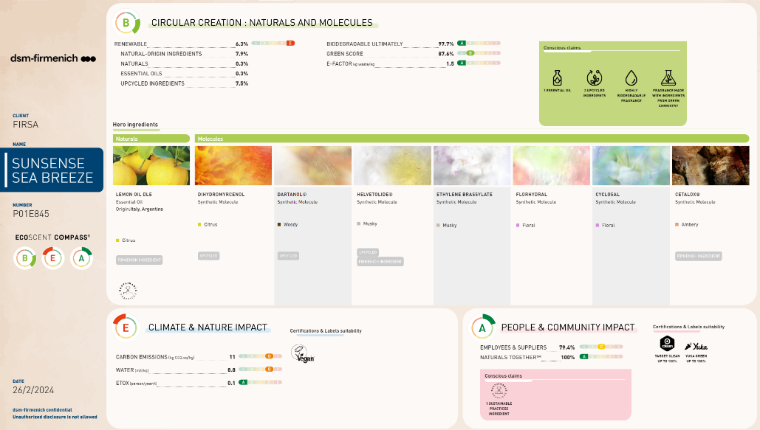
Fragrance Id card
RECREATIONAL
FRESH

Slide 45


Formula Id card
RECREATIONAL
SENSUAL GLOW SKIN
SENSUAL
Shimmer effect Fluid Lotion 50+
Sophisticated sun lotion with
sense pearls and DREAMWOOD for sensually glowing skin
UV FILTER COMPLEX :
PARSOL® Shield
PARSOL® 1789
PARSOL® EHT
PARSOL® EHS
PARSOL® HS
BIOACTIVES:
ALPAFLOR® EDELWEISS CB
PENTAVITIN®
POSSIBLE CLAIMS:
Sunsense pearls for sensually glowing skin

Slide 46
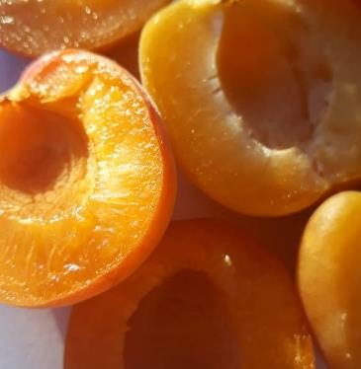
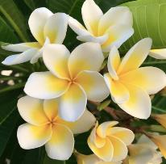
Fragrance Id card
OTHER NAMES :
RADIANT SUNFLOWER ELEGANCE
SOLAR AURA CHIC
SUNNY GLAMOROUS GRACE
SUN-KISSED ELEGANCE
RECREATIONAL
SENSUAL
SENSUAL GLOW SKIN FLUID LOTION SPF 50+
Fragrance name : Sunsense Chic Aura 626700 135E
  Fragrance descriptive Sentence
  An elegant and highly feminine fragrance build around sensual solar notes
  claims
  A fragrance including DREAMWOOD® biotech ingredient
  Highly biodegradable fragrance
TOP: Bergamot, Peach
MIDDLE: Frangipani, Ylang
BASE: Powdery, Dreamwood, Musk

Slide 47
Sun protection your Senses will love
RECREATIONAL
SENSUAL
SENSUAL GLOW SKIN
FLUID LOTION SPF 50+
With DREAMWOOD Technology
Sophisticated and elegant sun lotion with
sense pearls and DREAMWOOD for sensually glowing skin
With PARSOL® EHS, PARSOL® 1789, PARSOL® EHT, PARSOL® Shield, PARSOL® HS, PENTAVITIN®, ALPAFLOR® EDELWEISS CB, DL-alpha-Tocopheryl Acetate and SUNSENSE CHIC AURA 626700 135E.
PHASE | INGREDIENTS | INCI NAME | % W / W | SUPPLIER
A | Cetiol® B | DIBUTYL ADIPATE | 8,00 | 100037
 | Finsolv® TN | C12-15 ALKYL BENZOATE | 8,00 | 100627
 | PARSOL® EHS | ETHYLHEXYL SALICYLATE | 5,00 | 100288
 | PARSOL® 1789 | BUTYL METHOXYDIBENZOYLMETHANE | 4,70 | 100288
 | PARSOL® EHT | ETHYLHEXYL TRIAZONE | 4,40 | 100288
 | PARSOL® Shield | BIS-ETHYLHEXYLOXYPHENOL METHOXYPHENYL TRIAZINE | 3,80 | 100288
 | Tegosoft XC MB | PHENOXYETHYL CAPRYLATE | 3,70 | 101005
 | MONTANOVTM L | C14-22 ALCOHOLS, C12-20 ALKYL GLUCOSIDE | 3,00 | 100313
 | Eldew SL-205 | ISOPROPYL LAUROYL SARCOSINATE | 2,60 | 100383
 | Lexfilm Sun Natural MB | CAPRYLOYL GLYCERIN/SEBACIC ACID COPOLYMER | 2,20 | 100647
 | Kahlwax 2811 Rice | ORYZA SATIVA BRAN CERA | 2,00 | 100425
 | Lanette® 16 | CETYL ALCOHOL | 1,00 | 100037
 | Cutina® HR Flakes | HYDROGENATED CASTOR OIL | 0,40 | 100037
 | Dermosoft® Octiol | CAPRYLYL GLYCOL | 0,20 | 100491
 | Sensiva® SC 50 | ETHYLHEXYLGLYCERIN | 0,20 | 100444
B | Cosphaderm® Pentiol natural | PENTYLENE GLYCOL | 3,00 | 101192
 | Kaneka Surfactin | SODIUM SURFACTIN | 0,25 | 101161
C | Propanediol | PROPANEDIOL | 3,00
 | PemuPur START Polymer | MICROCRYSTALLINE CELLULOSE, SPHINGOMONAS FERMENT EXTRACT, CELLULOSE GUM | 0,17 | 100435
 | RHEOZAN® SH | SUCCINOGLYCAN | 0,15 | 100002
D | Water Dem | AQUA | 33,28
 | Carephos N | SODIUM POLYPHOSPHATE | 0,20 | 100045
E | Water Dem | AQUA | 6,00
 | PARSOL® HS | PHENYLBENZIMIDAZOLE SULFONIC ACID | 1,00 | 100288
 | Sodium Hydroxide Pellets Emprove | SODIUM HYDROXIDE | 0,15 | 100230
F | PENTAVITIN® | SACCHARIDE ISOMERATE, AQUA, CITRIC ACID, SODIUM CITRATE | 1,00 | 100288
 | ALPAFLOR® EDELWEISS CB | LEONTOPODIUM ALPINUM FLOWER/LEAF EXTRACT, GLYCERIN, AQUA, CITRIC ACID | 1,00 | 100288
 | DL-alpha-Tocopheryl Acetate | TOCOPHERYL ACETATE | 0,50 | 100288
 | SUNSENSE CHIC AURA 626700 135E | PARFUM | 0,30 | 100288
 | Colorona® Karat Gold MP-24 | CI 77891, CI 77491, MICA | 0,80 | 100230
SU-E-102518-3

Slide 48
Formula Id card
RECREATIONAL
SENSUAL GLOW SKIN
FLUID LOTION SPF 50+
With DREAMWOOD Technology
Sophisticated and elegant sun lotion with
sense pearls and DREAMWOOD for sensually glowing skin
SENSUAL
With PARSOL® EHS, PARSOL® 1789, PARSOL® EHT, PARSOL® Shield, PARSOL® HS, PENTAVITIN®, ALPAFLOR® EDELWEISS CB, DL-alpha-Tocopheryl Acetate and SUNSENSE CHIC AURA 626700 135E.
Procedure
Technical Data
1 | Weigh Phase A and heat up to 80°C under stirring.
2 | Weigh Phase D and heat up to 80°C under stirring.
3 | Weigh Phase B and stir until homogeneous.
4 | Premix Phase C and add it to Phase B while keeping stirring. Add Phase B+C to Phase D and homogenize 2mn.
5 | Add Phase A to Phase B+C+D and homogenize 5mn.
6 | Cool down to 40°C under gentle stirring.
7 | Premix Phase E until getting a clear solution. Add it to the emulsion.
8 | Cool down to room temperature under gentle stirring.
9 | Add one by one ingredients of Phase F into the emulsion and check the final pH (min 7).
pH: | 7,1 | Viscosity (spindle 5 / 10 rpm): | 12000 mPa.s
SPF: | 62,8 | In vitro UVA-PF | 23
In vivo according to ISO 24444 |  | According to ISO 24443
 |  | UVA-PF/SPF (50+ labelled; >= 0.33): | 0,4
 |  | Critical Wavelength: | 378 nm
 |  | (Measurement done with Labsphere equipment)
Supplier
100037 | BASF | 100627 | INNOSPEC LIMITED
100288 | dsm-firmenich | 101005 | EVONIK INDUSTRIES AG
100313 | SEPPIC | 100383 | AJINOMOTO INC
100647 | INOLEX CHEMICAL COMPANY | 100425 | KAHL & CO
100491 | DR. STRAETMANS | 100444 | SCHÜLKE & MAYR GMBH
101192 | COSPHATEC | 101161 | KANEKA CORPORATION
100435 | LUBRIZOL ADVANCED MATERIALS, IN | 100002 | SOLVAY
100230 | MERCK KGAA | 100045 | BK GIULINI CHEMIE
Regulatory compliance in EU, MERCOSUR, ASEAN, CN, KR for UV filters in formulation.

Slide 49
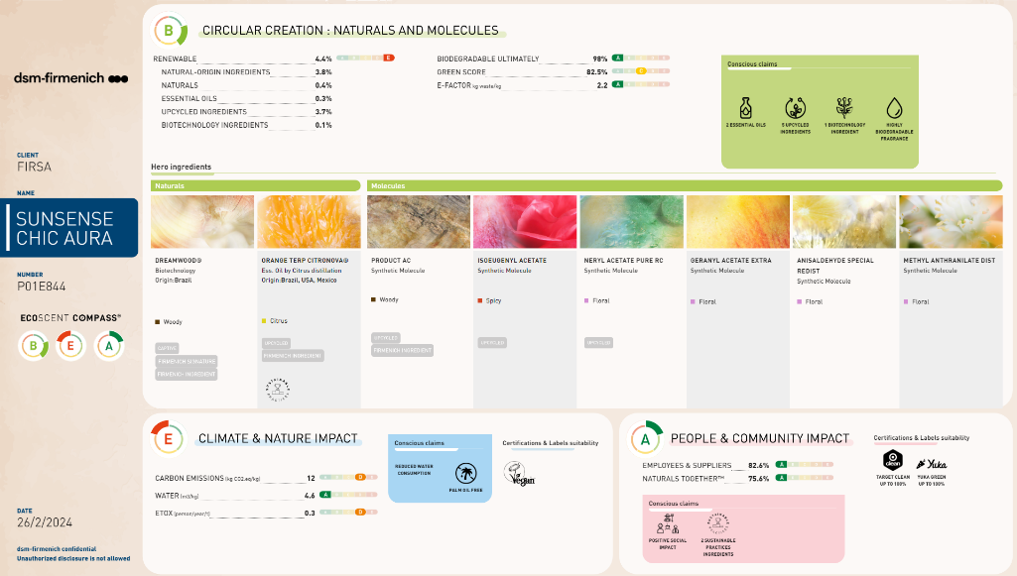
Fragrance Id card
RECREATIONAL
SENSUAL

Slide 50


Formula Id card
RECREATIONAL
FUN
FUN IN THE SUN
Fluid Lotion SPF 50+
Featherlight sun formulation with notes of sweet and tropical fragrance inspired by fun moments on the beach
UV FILTER COMPLEX :
PARSOL® Shield
PARSOL® 1789
PARSOL® EHT
PARSOL® EHS
PARSOL® HS
BIOACTIVES:
ALPAFLOR® EDELWEISS CB
PENTAVITIN®
POSSIBLE CLAIMS:
Innovative, feather-light fluid lotion
OEKO TESTcompliant

Slide 51


Fragrance Id card
RECREATIONAL
OTHER NAMES :
TROPICAL FUN FUSION
PINEAPPLE BEACH ESCAPE
PINEAPPLE SPLASH PARTY
FUN
FUN IN THE SUN FLUID LOTION SPF 50+
Fragrance name : Sunsense pineapple cocktail 630000 080
TOP: Lemon Peel , Pineapple STT
MIDDLE: Jasmine, White peach, Berries Syrup
BASE: Coconut, Sandalwood, Musk
  Fragrance descriptive Sentence
  An inspirational fragrance for genz having fun drinking a cocktail on the beach.
  Technology & claims substantiation
  This fragrance includes a pineapple
  smell – the –taste TM technology.
  This technology expresses tastes into fragrances with a real know how and synergy expertise between flavorists
  and perfumers in dsm-firmenich.

Slide 52
Formula Id card
RECREATIONAL
FUN IN THE SUN FLUID LOTION SPF 50+
Inspire by Fun
Featherlight sun formulation with notes of sweat and tropical fragrance inspired by fun moments on the beach
FUN
With PARSOL® EHS, PARSOL® 1789, PARSOL® EHT, PARSOL® Shield, PARSOL® HS, PENTAVITIN®, ALPAFLOR® EDELWEISS CB, DL-alpha-Tocopheryl Acetate and SUNSENSE PINEAPPLE COCKTAIL 630000 080.
PHASE | INGREDIENTS | INCI NAME | % W / W | SUPPLIER
A | Cetiol® B | DIBUTYL ADIPATE | 8,00 | 100037
 | Finsolv® TN | C12-15 ALKYL BENZOATE | 8,00 | 100627
 | PARSOL® EHS | ETHYLHEXYL SALICYLATE | 5,00 | 100288
 | PARSOL® 1789 | BUTYL METHOXYDIBENZOYLMETHANE | 4,70 | 100288
 | PARSOL® EHT | ETHYLHEXYL TRIAZONE | 4,40 | 100288
 | PARSOL® Shield | BIS-ETHYLHEXYLOXYPHENOL METHOXYPHENYL TRIAZINE | 3,80 | 100288
 | Tegosoft XC MB | PHENOXYETHYL CAPRYLATE | 3,70 | 101005
 | MONTANOVTM L | C14-22 ALCOHOLS, C12-20 ALKYL GLUCOSIDE | 3,00 | 100313
 | Eldew SL-205 | ISOPROPYL LAUROYL SARCOSINATE | 2,60 | 100383
 | Lexfilm Sun Natural MB | CAPRYLOYL GLYCERIN/SEBACIC ACID COPOLYMER | 2,20 | 100647
 | Kahlwax 2811 Rice | ORYZA SATIVA BRAN CERA | 2,00 | 100425
 | Lanette® 16 | CETYL ALCOHOL | 1,00 | 100037
 | Cutina® HR Flakes | HYDROGENATED CASTOR OIL | 0,40 | 100037
 | Dermosoft® Octiol | CAPRYLYL GLYCOL | 0,20 | 100491
 | Sensiva® SC 50 | ETHYLHEXYLGLYCERIN | 0,20 | 100444
B | Cosphaderm® Pentiol natural | PENTYLENE GLYCOL | 3,00 | 101192
 | Kaneka Surfactin | SODIUM SURFACTIN | 0,25 | 101161
C | Propanediol | PROPANEDIOL | 3,00
 | PemuPur START Polymer | MICROCRYSTALLINE CELLULOSE, SPHINGOMONAS FERMENT EXTRACT, CELLULOSE GUM | 0,17 | 100435
 | RHEOZAN® SH | SUCCINOGLYCAN | 0,15 | 100002
D | Water Dem | AQUA | 34,13
 | Carephos N | SODIUM POLYPHOSPHATE | 0,20 | 100045
E | Water Dem | AQUA | 6,00
 | PARSOL® HS | PHENYLBENZIMIDAZOLE SULFONIC ACID | 1,00 | 100288
 | Sodium Hydroxide Pellets Emprove | SODIUM HYDROXIDE | 0,15 | 100230
F | PENTAVITIN® | SACCHARIDE ISOMERATE, AQUA, CITRIC ACID, SODIUM CITRATE | 1,00 | 100288
 | ALPAFLOR® EDELWEISS CB | LEONTOPODIUM ALPINUM FLOWER/LEAF EXTRACT, GLYCERIN, AQUA, CITRIC ACID | 1,00 | 100288
 | DL-alpha-Tocopheryl Acetate | TOCOPHERYL ACETATE | 0,50 | 100288
 | SUNSENSE CHIC AURA 630000 080 | PARFUM, LINALOOL, TETRAMETHYL ACETYLOCTAHYDRONAPHTALENES, LIMONENE, CITRUS AURANTIUM PEEL OIL, CITRONELLOL, VANILIN, COUMARIN | 0.25 | 100288
SU-E-102518-5

Slide 53
Formula Id card
RECREATIONAL
FUN IN THE SUN FLUID LOTION SPF 50+
Inspire by Fun
Featherlight sun formulation with notes of sweat and tropical fragrance inspired by fun moments on the beach
FUN
With PARSOL® EHS, PARSOL® 1789, PARSOL® EHT, PARSOL® Shield, PARSOL® HS, PENTAVITIN®, ALPAFLOR® EDELWEISS CB, DL-alpha-Tocopheryl Acetate and SUNSENSE PINEAPPLE COCKTAIL 630000 080.
Procedure
Technical Data
1 | Weigh Phase A and heat up to 80°C under stirring.
2 | Weigh Phase D and heat up to 80°C under stirring.
3 | Weigh Phase B and stir until homogeneous.
4 | Premix Phase C and add it to Phase B while keeping stirring. Add Phase B+C to Phase D and homogenize 2mn.
5 | Add Phase A to Phase B+C+D and homogenize 5mn.
6 | Cool down to 40°C under gentle stirring.
7 | Premix Phase E until getting a clear solution. Add it to the emulsion.
8 | Cool down to room temperature under gentle stirring.
9 | Add one by one ingredients of Phase F into the emulsion and check the final pH (min 7).
pH: | 7,1 | Viscosity (spindle 5 / 10 rpm): | 12000 mPa.s
SPF: | 62,8 | In vitro UVA-PF | 23
In vivo according to ISO 24444 |  | According to ISO 24443
 |  | UVA-PF/SPF (50+ labelled; >= 0.33): | 0,4
 |  | Critical Wavelength: | 378 nm
 |  | (Measurement done with Labsphere equipment)
Supplier
100037 | BASF | 100627 | INNOSPEC LIMITED
100288 | dsm-firmenich | 101005 | EVONIK INDUSTRIES AG
100313 | SEPPIC | 100383 | AJINOMOTO INC
100647 | INOLEX CHEMICAL COMPANY | 100425 | KAHL & CO
100491 | DR. STRAETMANS | 100444 | SCHÜLKE & MAYR GMBH
101192 | COSPHATEC | 101161 | KANEKA CORPORATION
100435 | LUBRIZOL ADVANCED MATERIALS, IN | 100002 | SOLVAY
100230 | MERCK KGAA | 100045 | BK GIULINI CHEMIE
Regulatory compliance in EU, MERCOSUR, ASEAN, CN, KR for UV filters in formulation.

Slide 54
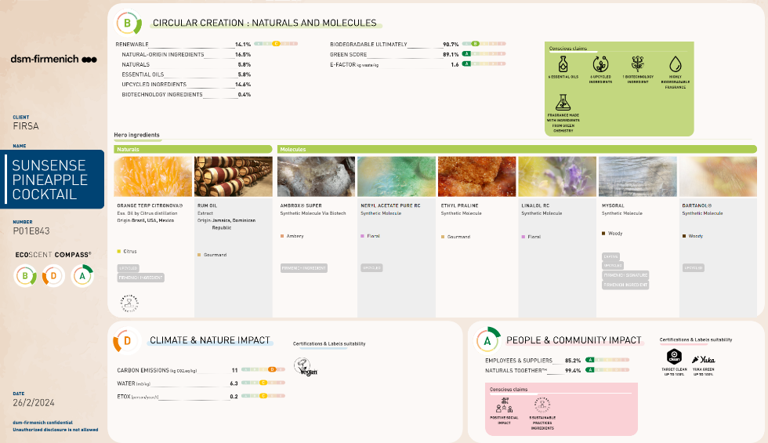
Fragrance Id card
RECREATIONAL
FUN
POSSIBLE CLAIMS:

Slide 55


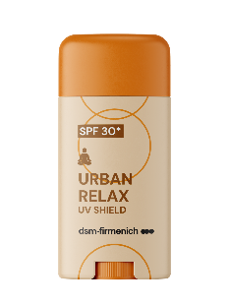




Sun protection your Senses will love
DAILY CARE & SPORT
RECREATIONAL
RELAXING
ENERGIZING
CONFIDENT ENERGY
NATURAL
FRESH
SENSUAL
FUN
UV Shield
Stick SPF 30
Cream
SPF 30
Sun Cream
SPF 50
Sun Cream with
Odour Control
SPF 50
High Protection
Fluid Lotion SPF 50+
with Cooling Effect Fluid Lotion
SPF 50+
With Shimmer effect Fluid Lotion SPF 50+
Fluid Lotion
SPF 50+
OEKO TEST compliant
OEKO TEST compliant
OEKO TEST compliant
OEKO TEST compliant
Easy-to-use
100% natural fragrance
Fragrance
With Dreamwood
Fragrance with STT technology
relax
relax
energy
energy
®

Slide 57



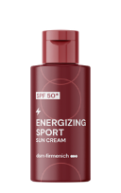
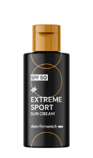
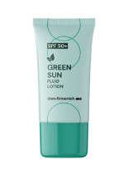
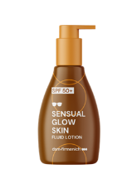
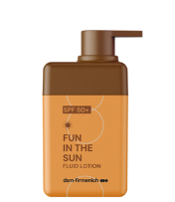
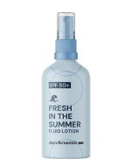
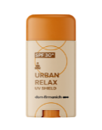
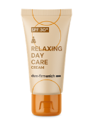
SUN PROTECTION YOUR
SENSES WILL LOVE
URBAN
RELAX
RELAXING DAY CARE
ENERGIZING SPORT
EXTREME SPORT
GREEN
SUN
FRESH IN THE SUMMER
SENSUAL GLOW SKIN
FUN IN THE SUN
INNOVATIVE, LIGHTWEIGHT TEXTURES
INVISIBLE SPF PROTECTION
VISIBLE SKIN RESULTS
INDULGENT FRAGRANES
Products are for illustration only, not for sale. dsm-firmenich is not responsible for final products claims.

Slide 58

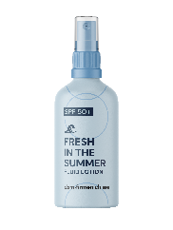







Additional Personal Care Sustainable Solutions
within the Sunsense3 line-up
Green Sun, Fresh Sun, Sensual Glow Skin and Fun in the Sun...
….contain:
ALPAFLOR® Edelweiss, PENTAVITIN® , that are natural ingredients, responsibly produced and with low carbon footprint
DL-alpha tocopheryl acetate: one of the lowest carbon footprint Vitamin E thanks to renewable energy and optimized process
Energizing Sport Sun Care Cream & Energizing Extreme Sport Sun cream & Odor control...
...contain sustainable actives with different green claims including from biotechnology, responsibly produced, naturals and with low carbon footprints; for example, Hya-act is a biotech ingredient
Urban Relax UV
Shield Stick...
...contains dsm-firmenich’s DL alpha tocopherol acetate, one of the lowest carbon footprint Vitamin E thanks to renewable energy and optimized process

Slide 59









PARSOL® 1789
ID Card
INCI & USAN Name
Butyl Methoxydibenzoylmethane
USAN name: Avobenzone
Description & Key Benefits
PARSOL® 1789 is the most-used UVA organic sunscreen in the world. It enables broadband protection when combined with effective UVB filters - and can also contribute to SPF
Technical
λmax: 357 nm
Form: White to pale yellow powder
Use level: 1-5%
pH of use: 3.0 – 10.0
Preservative: Free
Solubility: Slightly soluble in ethanol and soluble in commonly used lipids
Incorporation: Add to oil phase. Dissolve quickly and thoroughly in the oil phase of the formulation, heating will speed up the solubilization process. Dissolve in the appropriate amount of solvents and/or liquid UV-filters. Photostabilization is required: Can be easily photostabilized by Octocrylene (recommended ratio: 1:1) and/or BEMT (recommended ratio: 1:0.7)

Slide 60
PARSOL® Shield
ID Card
INCI & USAN Name
INCI: Bis-Ethylhexyloxyphenol Methoxyphenyl Triazine
USAN: Bemotrizinol
Description & Key Benefits
PARSOL® Shield is a photostable broad-spectrum filter which efficiently contributes to UVB and UVA protection across the full range of application forms at low concentrations
Technical
λmax: 341 nm
Form: Light yellow to yellow coarse to fine powder
Use level: 0.5-4.0%
Preservative: Free
Solubility: Oil soluble
Incorporation: Add to oil phase. Dissolve quickly and thoroughly in the oil phase of the formulation, heating will speed up the solubilization process.

Slide 61
PARSOL® EHT
ID Card
INCI & USAN Name
INCI: Ethylhexyl Triazone
USAN: Octyl Triazone
Description & Key Benefits
PARSOL® EHT is the UV filter that delivers the highest UV-B absorption in the market. It enables to achieve high SPF at low use concentrations, it is photostable and compatible with the main UV solutions in the market
Technical
λmax: 314 nm
Form: White to off-white powder
Use level: 0.5-3%
Preservative: Free
Solubility: Soluble in ethanol and commonly used lipids
Incorporation: Add to oil phase. Dissolve quickly and thoroughly in the oil phase of the formulation, heating will speed up the solubilization process.

Slide 62









PENTAVITIN®
ID Card
INCI Name
Saccharide Isomerate
Binds to keratin as magnet power and gives back vitality to your skin
Reverse the 5 signs of dehydrated skin: roughness, dullness, flakiness, tightness, redness
Color Mapping visualization
Tested in different skin types
Deep hydration for up to 72 hours
Restores & calms stressed skin that lasts for up to 24 hours
3-HOUR hydration boost to excessively dry skin areas
Used for 28-DAYS, PENTAVITIN® brings dry skin back to life
Description & Key Benefits
Technical
Form: Liquid
Use level: 0.2-5%
pH of use: 3.0 – 10.0
Preservative: Free
Solubility: Soluble in water at all ratios, soluble in alcohol, insoluble in lipophilic components
Incorporation: recommended to be added < 40°C
Raw material verified by ECOCERT GREENLIFE, conform to the COSMOS Standard
NATRUE
Approved

Slide 63


ALPAFLOR® EDELWEISS CB
ID Card
INCI Name
Leontopodium Alpinum Flower/Leaf Extract, Glycerin, Aqua, Citric Acid
Description & Key Benefits
Minimizes the appearance of aging after exposure to blue light and UV
Reduces skin damage caused by blue light and UV
Delivers even skin tone and overall improved skin appearance.
Form at 25°C: Clear to slightly opalescent, amber to brown colored, slightly viscous liquid
Use level: 1-5%
pH of use: 3.5 – 5.5
Preservative: Free
Solubility: Soluble in water at all ratios, insoluble in lipophilic components,
Incorporation: recommended to be added < 40°C
Compatibility UV filters: carefully check the combination with the UVB filter PBSA
Technical
Raw material verified by ECOCERT GREENLIFE, conform to the COSMOS Standard
NATRUE
Approved

Slide 64
HYA-ACT™ S
ID Card
INCI Name
INCI: Sodium Hyaluronate
Description & Key Benefits
HYA-ACT™ S is the calming hydration boost for thirsty skin. This small molecular weight hyaluronic acid fortifies skin’s natural barrier and locks in moisture
Technical
Form: White or almost white powder to granules
Use level: 0.01-1%
Preservative: Free
Solubility: Quickly and completely water soluble
Incorporation: Into the aqueous phase. High shear forces are recommended to avoid the formation of lumps. Moderate heating fastens the dissolution

Slide 65



What is the ÖKO-TEST?
Cosmetics and Fashion
Money and Legal rights
We strive for ecologically sound products that are produced in a socially responsible and sustainable manner. The two basic principles to which we are committed: Environmental protection and preventive consumer protection. And in the vast majority of cases, one conditions the other - what is good and healthy for us is usually also good for the environment.
Health and Medicine
Leisure and Recreation
Food and Beverage
Home care and construction
Children and Family

Slide 66


2021 ÖKO-TEST Results for Sun Protection
Deductions included
Contains PEG/PEG derivative
Contains benzophenone
Contains octocrylene
Missing nano declaration
<30% PCR material in packaging
No information on proportion of PCR material
Contains silicone or synthetic polymers
Missing full use instructions and warnings about sun exposure

Slide 67
DSM’s ÖKO-TEST compliant formulations
Our Objective: Develop a high SPF (SPF 50 or 50+) sunscreen in a spray and cream that would achieve a very good rating if tested according to the ÖKO-TEST criteria.
 | ÖKO-TEST Point Deductions | Eco Sun Spray and Eco Sun Cream
2 point deduction | PEG/PEG derivatives | No deductions
 | organohalogen compounds | No deductions
 | more than 100 mg/kg benzophenone | No deductions
 | Silicones and/or other synthetic polymers as plastic compounds | No deductions
1 point deduction | UV filters of concern - Octocrylene MCX HMS SLX (as it is a silicone derivative) | The Eco Sun Spray SPF 50+ and Eco Sun Cream SPF 50 do not contain any of the filters of concern
 | Nano declaration in ingredient list | NA
 | Use instructions and warnings regarding sun exposure for sun protection products | NA
 | Packaging Outer carton that does not protect glass | NA
 | Packaging <30% PCR material or undeclared amount of PCR material | Samples of the Eco Sun Cream SPF 50 are packaged in a 50% PCR airless pump
Very Good (Sehr Gut)
Good (Gut)
Satisfactory (Befriedligend)
Inadequate (Ungenügend)
Notes:
The overall rating is based on the test result Ingredients. A test result Other defects that is "satisfactory" or "sufficient" reduces the overall rating by one grade. by one grade. A test result Other defects that is "poor" reduces the overall rating by two grades. A test result Other deficiencies that is "good" worsens the overall rating by two grades.
the overall rating.
Translated with www.DeepL.com/Translator (free version)

Slide 68








Imp’Act CardTM Example
PARSOL® SHIELD
Aligned with and contributing to the
Highlights
related to
Supply Chain
control
Unique position in terms of full backwards integration
…………………………..…………….………
Feedstock origin
Synthetic
……………………….………………….…….……
Responsible sourcing
No palm oil derivatives
Carbon
footprint
76.9 kg CO2 eq/kg
…………………….……………………
Biodegradability
Not inherently biodegradable (OECD 301F)
………….………………………………………
Water footprint
22.1 m³ depriv./kg
Our partner is collaborating on DSM’s Scope 3 project to reduce indirect supply chain carbon emissions
SEDEX
SEDEX members ethical trade audit (SMETA)
completed in 2022
…….……….……………….…………………………
Sustainable livelihoods
Partnership with the Skin Cancer Foundation US on their “Destination Healthy Skin” campaign providing free screenings and prevention against Skin Cancer.
……………..……………………………………
Eco Class
High relative ecofriendliness combining UV performance and eco impact enabling formulators to achieve high Eco Class Score formulations.
Impact on health and wellbeing
INCI name: Bis-Ethylhexyloxyphenol Methoxyphenyl Triazine
Product Codes: 5015883
Decreases the risk of skin cancer and of premature ageing
The carbon and water footprint calculations are based on internally conducted LCA according to ISO 14040/44 guidelines, DSM LCA policy and validated by an internal reviewer.
© 2024. dsm-firmenich. All rights reserved

Slide 73





TriPro - Effortlessly Elevating Sun Defence for Unmatched Skin Comfort
TriPro technology - built from a combination of 3 high-powered UV filters
+ The outstanding broadband UVA-UVB filter: effectively boosts UVB & UVA protection across various application forms at low concentrations, providing comprehensive sun protection.
+ Versatile Compatibility & Water Resistance: Shows excellent compatibility with organic and inorganic UV filters. Additionally, in holistic formulations, it promotes robust water resistance through good solubility in organic oils.
+ Global Approval and Photostability: Approved in most countries worldwide, PARSOL® Shield ensures broad acceptance for global formulations. Its photostable nature enhances its reliability, maintaining its efficacy even when exposed to light.
+ The Global Gold Standard for UV-A Protection: the preferred choice for formulators seeking efficient and strong UV-A absorption
+ Broadband Protection & SPF Enhancement: when combined with effective UV-B filters, PARSOL 1789 works seamlessly with solubilizers and emollients and can boost SPF values in formulations.
+ Worldwide Approval and Photostability: suitable for global formulations, PARSOL 1789 provides excellent photostability when appropriately solubilized and used with recommended stabilizing agents.
Scientifically proven Sun Care technology
+ Most Efficient UV-B Absorber in the market: its high efficiency makes it a top choice for formulators seeking potent UV-B protection.
+ Global Approval (excl. North America) and Eco-Friendly Profile: a versatile UV filter that can be used across a full range of applications. Its eco-profile enables the development of high Eco-class formulations, aligning with eco-profiling standards..
+ Photostable and Versatile Application: guarantees photostability under light exposure, easily solubilizes in formulations and seamlessly integrates into the oil phase at high temperatures, remaining compatible with major UV solutions.

Slide 74


A Super-Charged Ratio Unlocking Unmatched Synergistic Effects:
TriProTM is an efficient UV filter combination to unlock synergistic effects
0.0
0.25
0.5
0.75
1.0
  PARSOL® 1789 (BMDBM):
1.0
  PARSOL® Shield (BEMT)
>/= 0.7
0.5-1.0
  PARSOL® EHT (EHT):

Slide 75


TriPro™ Technology Boosts The Formulation Process
Delivering Remarkable Benefits
High performance sun care products | Reduced solvent need | Mastering product stability
Efficient UV filter photostabilisation and solubilization Optimized eco-profile* | Anticipating synergetic solubility properties within the UV filter system Efficient UV filter composition | Phase & photostability improved Homogeneous formulations Accelerating internal development process
Noticeable, improved skin feel
Products with innovative, high consumer appeal
AND
* Based on dsm-firmenich Eco-Label methodology

Slide 76






Logo Usage Guidance
Colour options
Sizing
Colour breakdowns
Supporting line
Max size:
infinite
Pantone: 7402 C
R:255 G:222 B:139
C:00 M:14 Y:54 K:00
Pantone: 165 C
R:255 G:99 B:52
C:00 M:77 Y:83 K:00
Pantone: RED 032 C
R:255 G:45 B:55
C:00 M:96 Y:71 K:00
There are three versions of the logo: red gradient (primary), black and reversed.
Min size:
15mm height
TriPro™ Scientifically Proven Sun Care Technology OR
TriPro™ Sun Care Technology
can be used alongside the logo in some instances to sell in the technology eg. packaging. Instances when the logo is used more than once, we do not need to repeat the supporting line eg., presentation decks.
TriPro™ is a trademark by dsm-firmenich.
Easy to understand for consumers, ready to use for customers.
Ask for Trade License !

Slide 77


Slide 78
Disclaimer
Copyright © DSM Nutritional Products Ltd. 2024, 4002 Basel, Switzerland.
www.dsm-firmenich.com. www.dsm.com/personal-care. All rights reserved.
dsm-firmenich has used diligent care to ensure that the information provided herein is accurate and up-to-date, however, dsm-firmenich makes no representation or warranty, either expressly or implied, of the accuracy, reliability, or completeness thereof. The information provided herein contains scientific and product information for business-to-business use and does not constitute or provide scientific or medical advice, diagnosis or recommendation for treatment. Country or region-specific information should be considered when labelling or advertising to final consumer. In no event shall dsm-firmenich be liable for any damages arising from or reliance upon, or use of, any information provided herein. The content of this document is subject to change without further notice. Please contact your local dsm-firmenich representative for further details. All trademarks listed in this document are either (registered) trademarks of, or trademarks licensed by, the dsm-firmenich group of companies, unless explicitly stated otherwise.
Disclaimer Formulation Guideline
This information is for illustration purposes only and based upon our current knowledge and experience at the time of printing. We do not make any representation or warranty of any kind, express or implied, including merchantability or fitness for a particular use, with respect to such information or its application. Use of this information is at your discretion and risk. Nothing herein relieves you from carrying out your own suitability determinations and tests. You are responsible for observing all laws and regulations relevant to your products, uses or processes. We do not assume any liability in connection with your product and its use. The foregoing information and suggestions are also provided without warranty of non-infringement as to the intellectual property rights of third parties and shall not be construed as any inducement to infringe the rights of third parties.

