Slide 1

Feel the pleasure
of unique care
for textured hair.
March 2025

Slide 2
Agenda: Textured hair
01
Textured hair definition
02
      The market
      The texture gap
      Market examples
03
Understanding the consumers
The routine
The needs
04
The science behind textured hair
05
Our solution: ULocks

Slide 3
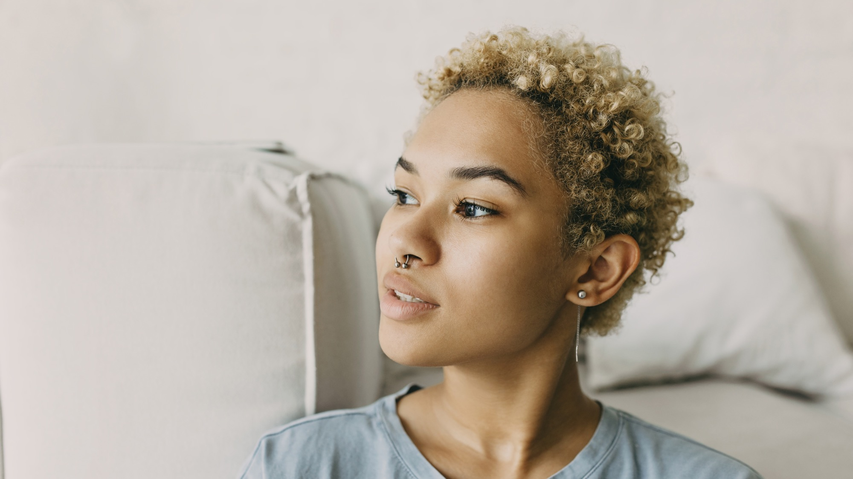

01
Textured hair definition

Slide 4
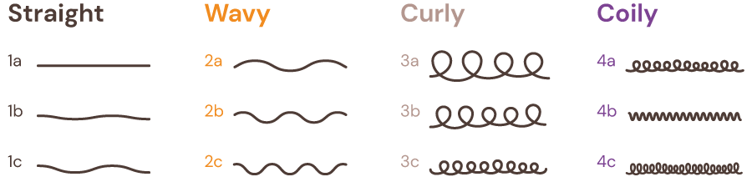
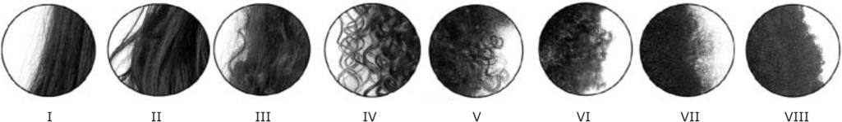
Let’s talk about textured hair
Textured hair classification – know your hair type to find your right solution
Walker Classification:
Texture hair: natural hair that involves a curl pattern.
There are 2 types of classification
Walker classification
The lower the number, the straighter the hair, and the higher the letter in the alphabet, the coarser or more coily strands.
L’Oréal / Loussouarn classification¹
Measurements of four parameters related to hair curliness or kinking of the hair:
Curve diameter
Curl Index
Numbers of waves
Numbers of twists
Our focus
L’Oréal / Loussouarn Classification, Eight curliness types:¹
1. G. Loussouarn, Worldwide diversity of hair curliness: a new method of assessment, International Journal of Dermatology, 2007, 46 (Suppl. 1), 2-6.

Slide 5


02
The market:
The Texture Gap

Slide 6


The Texture Gap
A growing market…
As an example, today, the coily hair/Type 4 (Walker’s classification) market is estimated to
be worth
and is expected to reach
$10 billion¹
$15 billion by 2033¹
1. Carra Labs – June 2021

Slide 7
A growing market that remains an untapped economic potential
…with 60-70% of the world’s population having texture in their hair¹
In Brazil²
In the US²
In France²
79%
68%
53%
of women describe their natural hair as wavy / curly / coily (vs 31% straight)
of women describe their hair as wavy / curly / coily / kinky (vs 44% straight)
of women describe their natural hair as wavy / curly / coily (vs 17% straight)
Re-partitioning of hair into the eight curliness types³
Type IV to VIII (L’Oréal / Loussouarn classification) mapped mainly within African, African-American and Caribbean hair as well as within Brazilian and Caucasian at a lower levels.
1. https://www.cosmeticsdesign-europe.com/Article/2023/11/20/60-70-of-the-world-s-population-has-texture-in-their-hair.-Innovating-in-the-underserved-textured-hair-care-market?utm_source=copyright&utm_medium=OnSite&utm_campaign=copyright. 2. Base: Brazil: 1,500 internet users aged 16+; US: 2,000 internet users aged 18+; France: 977 internet users aged 16+. Source: Kantar Profiles/Mintel, February 2022, January 2022, December 2022. 3. G. Loussouarn, Worldwide diversity of hair curliness: a new method of assessment, International Journal of Dermatology, 2007, 46 (Suppl. 1), 2-6.
Notes:
“60-70% of the world’s population has texture in their hair.” Innovating in the underserved textured hair care market
20-Nov-2023 By Kirsty Doolan
https://www.cosmeticsdesign-europe.com/Article/2023/11/20/60-70-of-the-world-s-population-has-texture-in-their-hair.-Innovating-in-the-underserved-textured-hair-care-market?utm_source=copyright&utm_medium=OnSite&utm_campaign=copyright

Slide 8

And with a limited dedicated offer
People with textured hair feel underserved in hair care
Not enough product choice
Not enough products
61% of female adults in the UK agree a diverse BPC brand is one that creates products for people with different skin tones/hair types²
32% of UK adults agree that there are not enough mainstream hair care brands for people with textured hair¹
Not enough inclusivity
40% of adults in France agree that diversity/inclusion efforts by BPC brands often feel inauthentic²
Not enough services
”Only 5% of hairdressers are trained in textured hair”³
Resulting in hair inequality
Women with coily hair are more likely to spend more money searching for products that work for them⁴
5.2% of women with coily hair in the U.S. spend more than $100 on hair products each month vs 1.7% of women with wavy hair⁴
Women with coily hair are more likely to travel furthest to shop for these products or even have their hair styled⁴
5.2% of women with coily hair have to travel more than three hours, compared to only 0.5% of women with straight hair⁴
1. Base: UK: 1,949 internet users aged 16+ Source: Lightspeed/Mintel. 2. US: 1,773 internet users aged 18+ who use beauty products; UK: 998 female internet users aged 16+; France: 977 internet users aged 16+ Source: Kantar Profiles/Mintel, November 2021, December 2020, December 2022. 3. Jean-Michel Gaudineau, Kérastase educator.
4. www.allthingshair.com/en-us/hairstyles-haircuts/hair-inequality-in-the-united-states/

Slide 9
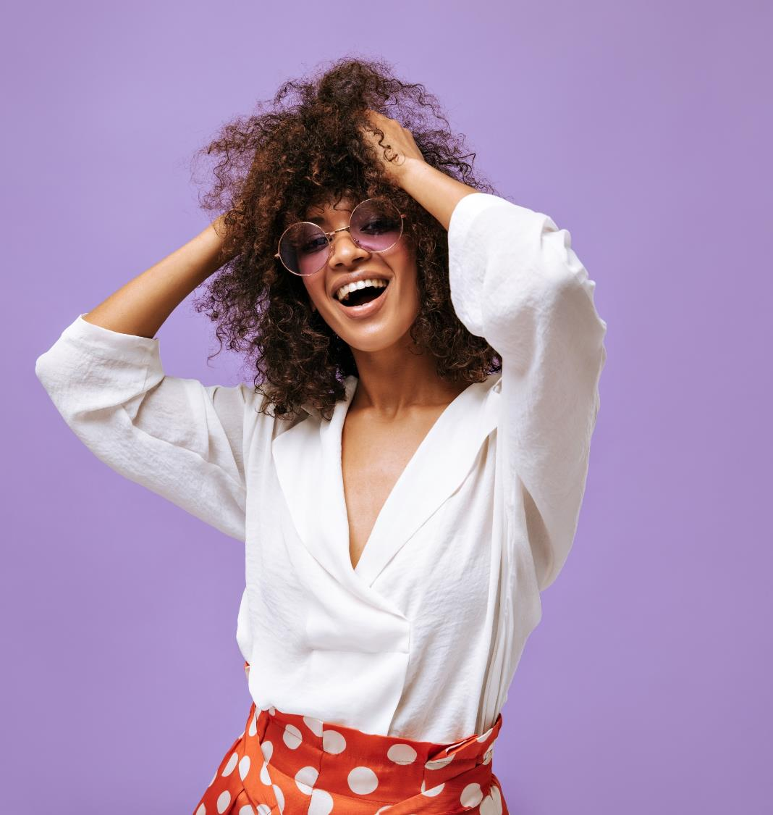
On top, textured hair consumers look for clean/natural products and skin-inspired ingredients
In the US, 55% of textured hair consumers seek natural/clean products⁴
35% of textured hair users in the US would be interested in skincare-inspired ingredients (vs 29% of non-textured hair consumers)⁵
4. Source: Kantar Profiles/Mintel, September 2022 / US
5. Base: US: 949 internet users aged 18+ who use haircare products Source: Kantar Profiles/Mintel; Feb. 2022

Slide 10
02
The market:
Market examples

Slide 11
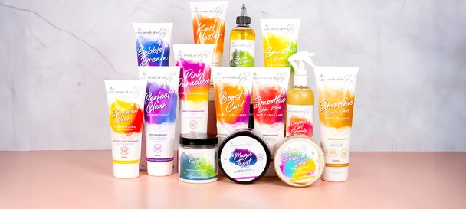
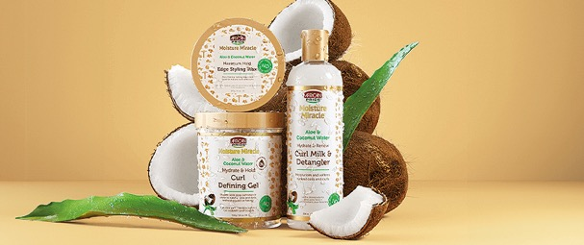
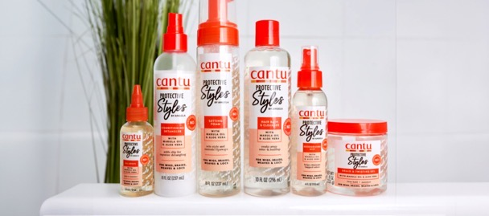
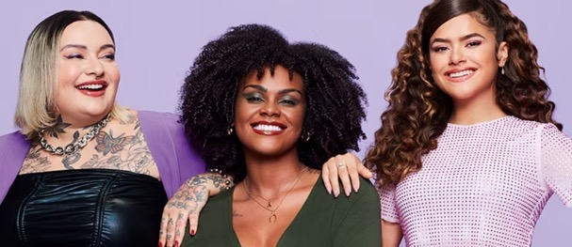
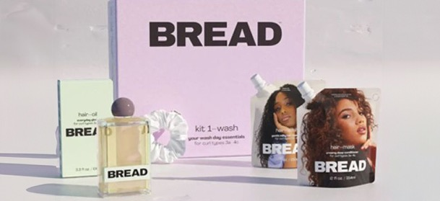
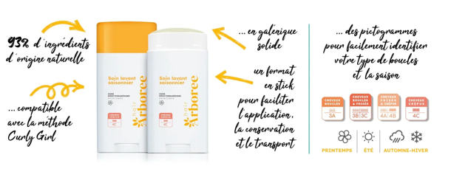
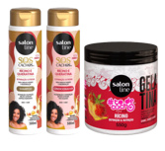
Textured hair: A target on the rise in different regions
Answering specific needs with understanding, scalp care, adaptive cosmetics, positive messages…
Les Secrets de Loly¹ – France
Founded in 2009, for wavy, curly, frizzy or frizzy hair, ECOCERT COSMOS Natural certified.
African Pride⁶ – Ethiopia
Designed for the specific needs of coily and curly textures.
CANTU x Angela Stevens⁵ – US
Wigs, weaves, braids, locks & more.
Salon Line² - LATAM
Designed for all hair types, to promote healthy scalp.
BREAD³ – US
Hair brand BREAD's range is structured around wash day essentials for textured hair, with a positive message.
HairArboree⁴ – France
The first hair care brand for textured hair that adapts to the season and curl type.
Source:
1 Les Secrets de Loly - pour les cheveux texturés, 2. https://www.salonline.com.br/kit-shampoo-e-condicionador-sos-cachos-r%C3%ADcino-e-queratina-gelatina-%C3%B3leo-de-r%C3%ADcino-todecacho-salon-line#sl-details-descriptions, 3. https://www.breadbeautysupply.com, 4. HairArboree – HairArboree, 5. Accueil - Cantu Beauty, 6. African Pride® - Hair Care Products (africanpridehair.com)

Slide 12
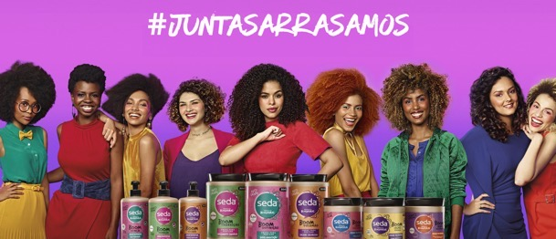
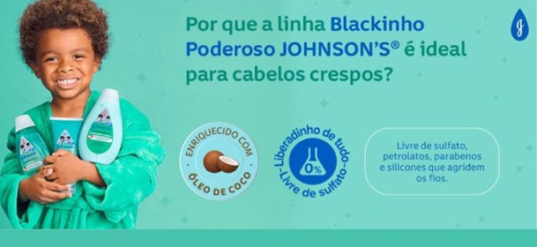
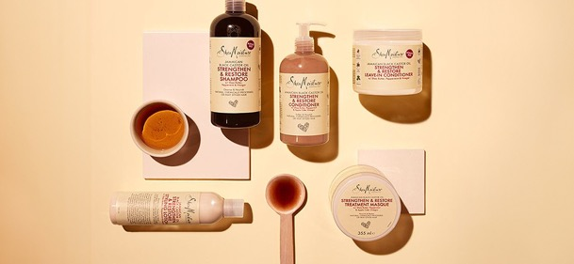
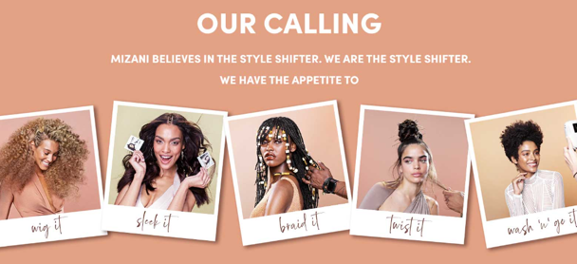
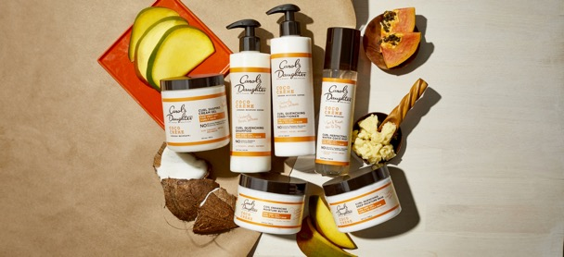
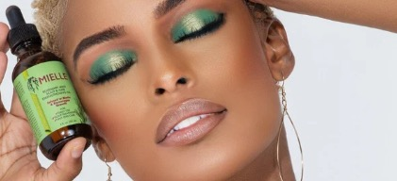
Textured hair: A target on the rise for global players
SUNSILK¹ (Seda) - Unilever
Strong emphasis placed on curly hair products
JOHNSON’S & JOHNSON’S²
Blackinho Poderoso range targets kids in Brazil with textured hair
SHEA MOISTURE³ (Unilever)
Shea Moisture offers hair care products for curly, wavy and straight hair.
MIZANI⁴ (L’Oréal)
The Mizani range offers products for curly, frizzy and wavy hair.
CAROL’S DAUGHTER⁵ (L’Oréal)
MIELLE ORGANICS⁶ (P&G – 2023)
Natural hair products specific to textured hair types
Source:
1. https://www.seda.com.br/dicas-e-tutoriais.html, 2. https://www.johnsonsbaby.com.br/blackinho-poderoso, 3. https://www.sheamoisture.com/, 4. MIZANI- No Matter the Texture We've Got You Covered, 5. Natural Hair Care, Body and Skin Care | Carol's Daughter (carolsdaughter.com), 6. Natural Hair Products, Organic Hair Care Products (mielleorganics.com)

Slide 13
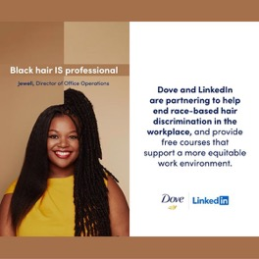

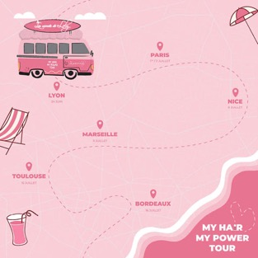
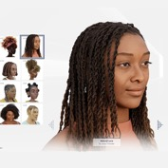
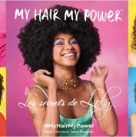
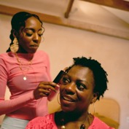
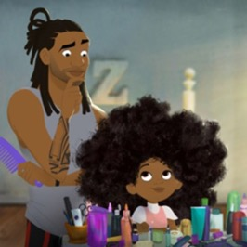
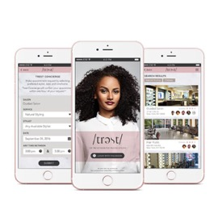
Textured hair: A market being covered in inclusive campaigns
Les secrets
de Loly¹
Magic Van Tour in 6 major French
cities to meet their Lolys and
promote their products
Nearly 200,000 people.
My Hair My Power Tour: hair care
tour in France (secretsdeloly.com)
Unilever promotes textured
hair through its brands³
Dove aims to be inclusive: the brand recently
launched a campaign on LinkedIn aimed at ending
hair discrimination in the workplace; and now offers
a free online guide to coding textured hair. Shea Moisture,
meanwhile, has launched a new mom-led campaign
celebrating textured hair "Same Roots, New Rules”.
Dove co-founded the CROWN Coalition to advance
anti-hair-discrimination legislation The Crown Act
‘Hair Love’ – best short film
at the 92nd academy awards²
Community
inspiration⁴
Hair Love tells the heartwarming story of
an African American father who learns how
to do his little girl's hair for the first time.
YouTube/Sony Pictures AnimationB
﻿Trest operates as something of a salon social
network. The app syncs with the user's Facebook
account to populate salon recommendations
generated by one’s Facebook friends.
Recognize, respect & celebrate identity
Source:
1. Les Secrets de Loly - for textured hair, 2. YouTube/Sony Pictures Animation, 3. Dove & LinkedIn , 4Twitter/Trimit_app﻿

Slide 14
03
Understanding the consumer
The routine
The needs

Slide 15
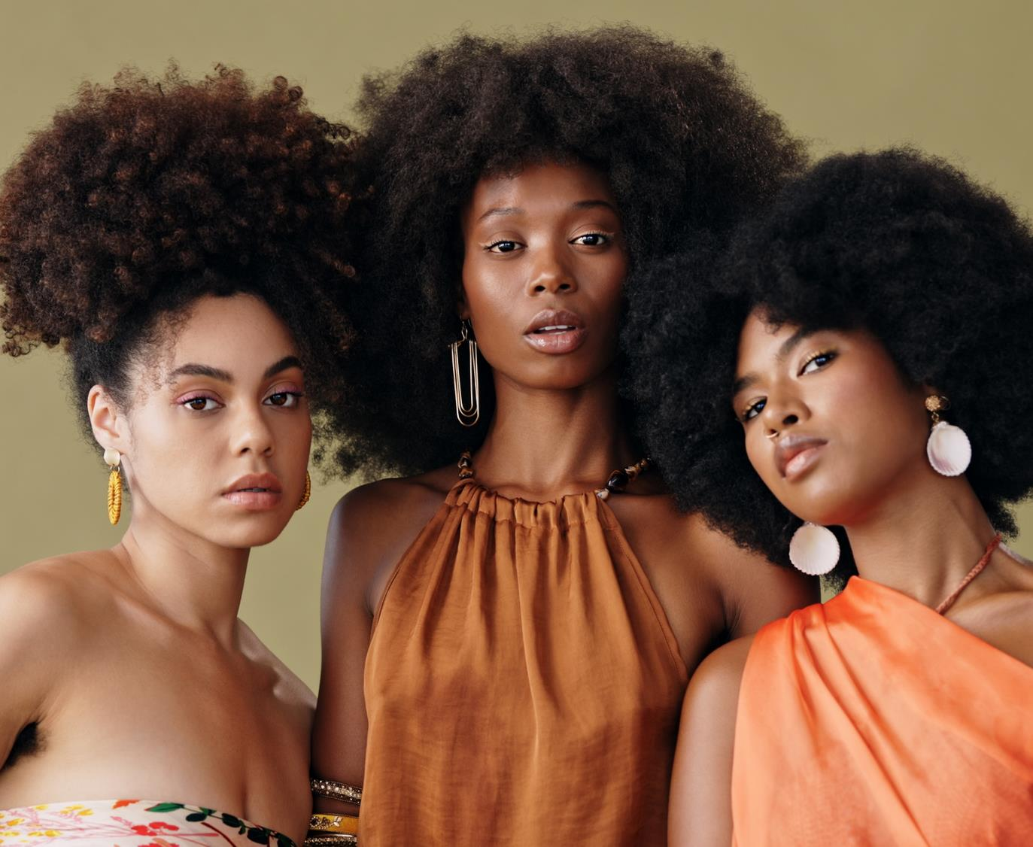


The Texture Gap
Complex and long hair care routine
LOC¹ method | up to >3h²
Demanding hair type
Lower moisture content, tangled and fragile hair, scalp concerns
1. Liquid, oil, cream/conditioner. 2. Hair type routine – dsm-firmenich 2023 – Global online survey USA, France & Brazil - 1500 women

Slide 16
















The routine
CURLY &
COILY HAIR
STRAIGHT
WAVY
CURLY
COILY
Time spent per week | <30min (+) / 30min-1h | <30min (+) / 30min-1h | <30min (+) / 30min-1h | MORE TIME dedicated TO HAIR CARE | >1h / >3h (15%) (+)
Frequency of wash | 3,44 times in a week | 2,87 times in a week | 2,87 times in a week | LOWER WASHING FREQUENCY | 2,40 times in a week
Day of the week | Any time | Any time | Any time |  | Any day / Saturday (+)
Moment of the Day | Any time | Any time | Any time | HAIR CARE PLANNING needed | Anytime / During the day / Evening (--)
Hair Drying | Dry naturally 46% Blow Dry 37% | Dry naturally 47% (2a) & 49% (2b) | Dry naturally 54% | GREATER COMPLEXITY IN DRYING | Dry naturally 45% Dry naturally with a towel 26%
POP | Supermarket/food store Pharmacy/drugstore | Supermarket/food store Pharmacy/drugstore | Hairdresser retailer Cosmetic dept of natural retailer |  | Supermarket/food store Pharmacy/drugstore
Complex & long hair care routine
Washing routine:
TO KEEP IN MIND
67% every
2 weeks
22% up to every 2 months
“Don’t call someone with textured hair to go out at short notice”
* (+) = significantly more important for this hair type
Source: Hair type routine, dsm-firmenich 2023, Global online survey USA, France & Brazil, 1500 women
q3 On average, how much time do you spend on your hair on a typical week in total? / q2 In general, when during the week do you wash your hair...? / q1 In general, at which moment of the day do you wash your hair...? / s6 How do you usually dry your hair? / q10 Where do you most often buy the hair care products that you are using ?

Slide 17




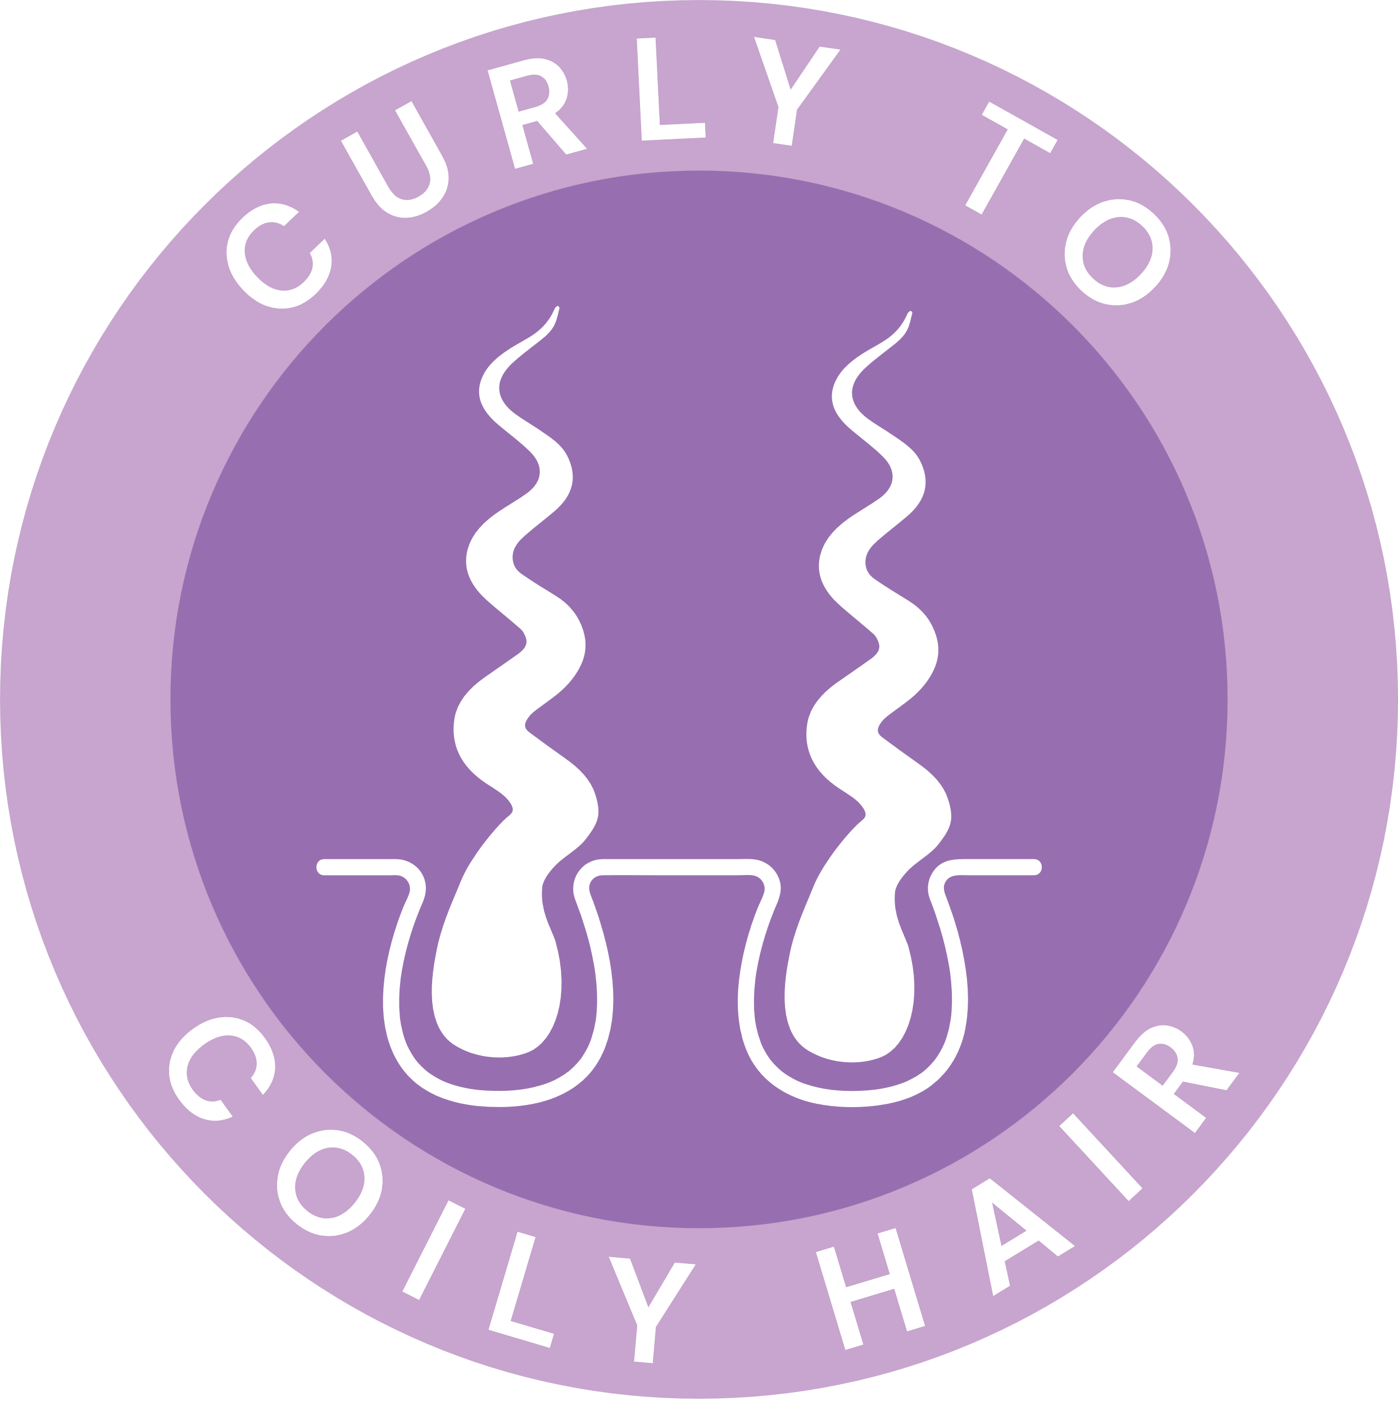
Needs by hair type
TEXTURED HAIR CHALLENGES
STRAIGHT
WAVY
CURLY
COILY
LESS FINE HAIR
LESS DRY HAIR
DETANGLES EASILY
MORE VOLUME
EASIER TO MANAGE
Hair
breakage
Hair
styling
FEWER SPLIT ENDS
TO KEEP IN MIND
LESS OILY HAIR (+)
LESS OILY SCALP (+)
SHINIER HAIR
Dry & dull
hair
More definition
for curls
LESS HAIR FALL (WAVY, CURLY) (+)
LESS FRIZZ (+)
“You need to study
to understand your hair type and how it behaves ​so that
you know how to
look after it.”
MORE DEFINITION (STRAIGHT, WAVY, CURLY) (+)
MORE NOURISHED HAIR (+)
LESS DAMAGED HAIR
* (+) = significantly more important for this hair type
Source: Hair type routine, dsm-firmenich 2023, Global online survey USA, France & Brazil, 1500 women
q4 Here is a list of hair and scalp characteristics. Which of these would you like to have improved for your hair/scalp?

Slide 18









Routines X needs
CURLY &
COILY HAIR
TIME SPENT PER ROUTINE
Hair length
Less damaged
hair
More nourished
hair
More defined curls
++
+
++
++
+
TO KEEP IN MIND
+
FREQUENCY OF WASH
= time-consuming!
+-
+-
+-
+-
“My hair is legit making me depressed; It’s too time consuming & strenuous for me. I spend hours detangling and when I try to style it always ends up looking a mess.”
STRAIGHT
WAVY
CURLY
COILY
Source: Hair type routine, dsm-firmenich 2023, Global online survey USA, France & Brazil, 1500 women
s4 How long is your hair currently? Please look at the pictures and select the one fitting with your current hair length. / q3 On average, how much time do you spend on your hair on a typical week in total? / q2 In general, when during the week do you wash your hair...? / q4 Here is a list of hair and scalp characteristics. Which of these would you like to have improved for your hair/scalp?

Slide 19



Routines X needs
MULTIPLES POST WASH PRODUCTS
STRAIGHT
WAVY
CURLY
COILY
To answer textured hair challenges
+-
Need
nourishment
+-
Need
nourishment
-+
Need
nourishment
-+
Need
nourishment
-+
-+
-+
-+
TO KEEP IN MIND
More
defined curls
More
defined curls
More
defined curls
More
defined curls
Combing &
leave-on cream
5*
3*
10*
2*
Shampoo
Conditioner
Conditioner / mask / cream
Rinse off Conditioner
Rinse off mask / cream
Shampoo
Rinse off Conditioner
Rinse off mask / cream
Mask
Shampoo
Rinse off Conditioner
Cleansing conditioner
Rinse off mask / cream
Leave on cream
Leave on hair oil
Combing cream
Curl Defining cream
Natural oil
Rinse off conditioner
Combing cream
5*
Hair oil
Rinse-off
conditioner
Used exceptionally
Natural oil
Lotion
Mask
Shampoo
Rinse off Conditioner
L: Apply a
water-based liquid
O: Seal the moisture with oil
C: Layer on a water-based cream
* : number of products used regularly at least once a week & exceptionally at least once a month
Source: Hair type routine, dsm-firmenich 2023, Global online survey USA, France & Brazil, 1500 women
Q6-7-8-9 Now we would like to understand more about your hair washing/ hair conditioning/ hair drying/styling/ the day after you have washed your hair routine. Here is a list of hair care products. Which of those hair care products do you personally use at home to wash your hair/ condition your hair/ home when drying or styling your hair/ the day after you have washed your hair and how frequently do you use them?

Slide 20

04
The science behind textured hair

Slide 21










Textured hair: the follicle, the scalp and the fiber
Key textured hair challenges
Hair Loss
Hair Styling Routine
Shorter length, slower hair growth rate & less hair density. Impacted by hair routines e.g. braids (traction alopecia), thermal (straightening) & chemical treatments (relaxer).
Hair Breakage
Difficulty in combing
Elliptical, flattened fiber
shape & twisted along fiber length. Cracks and flaws due
to stress in bending/twist regions. Combing force increased due to entangled hairs. Lower mechanical properties. Impacted by hair routines e.g. braids, thermal
& chemical treatments.
Dry & Dull hair
Porous hair fibers, lower water sorption. Sebum not progressing along hair fiber. Abrasion of cuticle cells with bended scales.
Curly–Coily hair
Curly fibers generated by curved follicles. Final shape of hair shaft prepared and pre-determined in the follicle. Lateral separation of ortho- & para- cortical cells
(with specific IF orientation) drives curl formation. Genetic profile.
Scalp disorders
Oily Scalp
Sebum accumulation at hair roots, not progressing along hair fiber. Itching & dandruff. Impacted by hair routines e.g. braids & chemical treatments.
F.J. Wortmann, Why is hair curly, Experimental Dermatology, 2020, 29, 366–372.
A. Franbourg, Current research on ethnic hair, J. Am. Acad. Dermatol., 2003, S117, 48.
E. Cloete , The what, why and how of curly hair: a review, Proc. R. Soc. A, 2019, 475. 20190516.
G. E. Westgate, The biology and genetics of curly hair, Experimental Dermatology, 2017, 26, 483–490.
R.L. McMullen, Physicochemical Properties of Textured Hair, J. Cosmet. Sci., 2021, 72, 711-731.
A. Salam, Hair and scalp disorders in women of African descent: an overview, British Journal of Dermatology, 2013, 169 (Suppl. 3), 19–32.
M. Marti, The influence of hair lipids in ethnic hair properties, International Journal of Cosmetic Science, 2016, 38, 77–84.
Prevent hair loss is a drug claim in USA to use improves hair density
Notes:
IF: Intermediate Filaments

Slide 22


Where consumer’s voice meets the science
Main textured hair challenges
By combining the consumer’s voice with the science behind the textured hair and working closely with a consultant specialized in textured hair, we have developed and tested with consumers
the dsm-firmenich textured hair care line,
created by you, for you and with you.
Feel the pleasure of unique care for textured hair.
Prevent hair loss is a drug claim in USA to use improves hair density

Slide 23
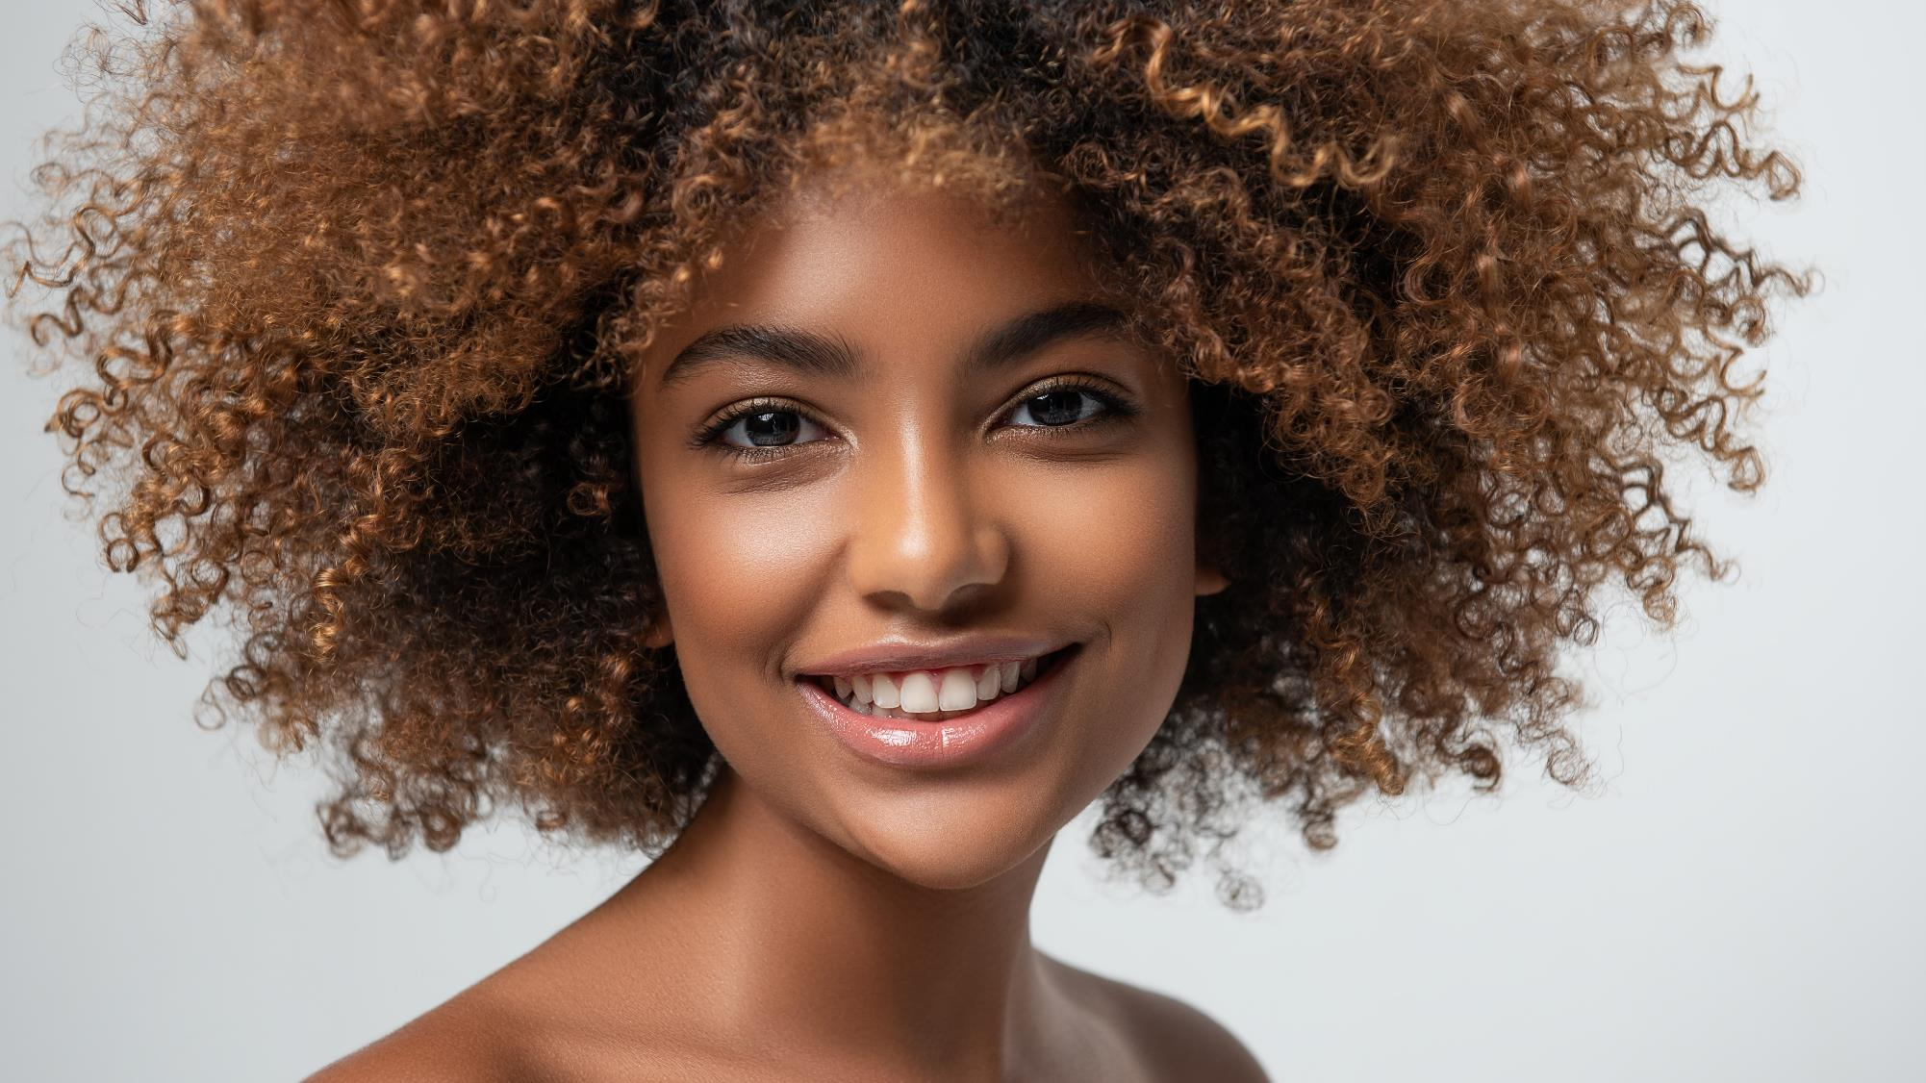
05
Our solution
ULocks
The natural origin actives and vitamins
The signature fragrance

Slide 24
Feel the pleasure
of unique care
for textured hair.

Slide 25
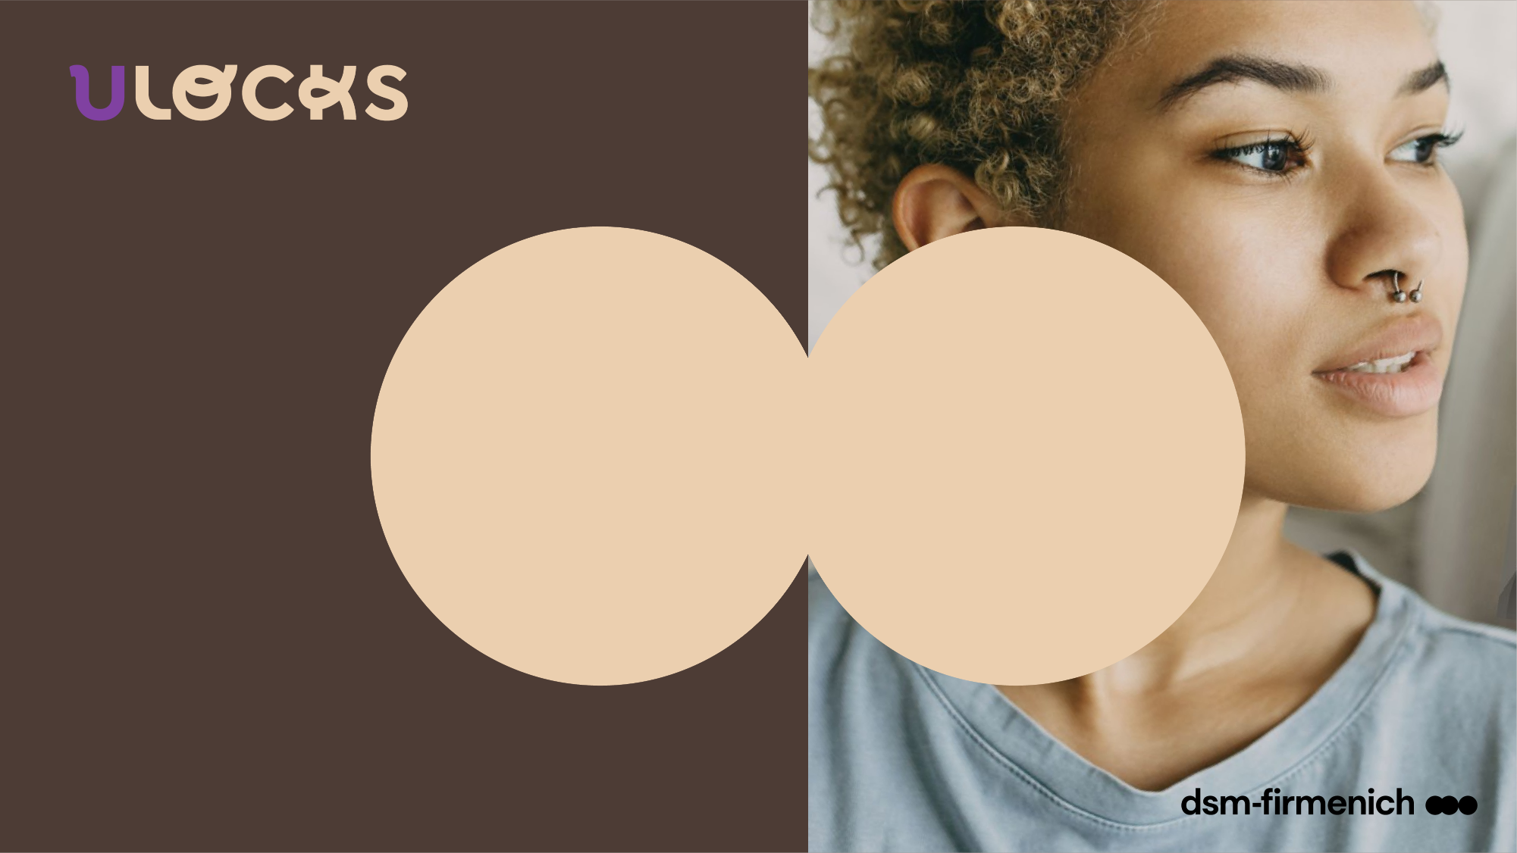




The textured hair care range
PERSONAL CARE
PERFUMERY
SELECTED
LockCare
complexes
UNIQUE
LockScent™
technology
BASES & FRAGRANCE
CONSCIOUSLY DESIGNED
Developed by you¹,
with you²
and for you³
Vitamins and natural origin actives for effective care in sensorial textures
Long-lasting fragrance for continuous freshness until the next wash⁴
with the double
Lock power
1. Range developed with a specialist textured hair consultant
2. External Consumer test – 29 users of textured hair products with Type 4 hair (28 % with 4A hair type, 41 % 4B, and 31 % 4C) – average age between 26-35 years old – 1 month usage test – France - 2023 / U Locks fragrance – dsm-firmenich 2023 - US Home Use Test – 113 women - best tester among women with curls/coils
3. Actives & vitamins carefully selected to fit textured hair needs
4. Sensory test – 2023 – n=30 - overall fragrance intensity of the wash day routine (day 1) versus refreshing routine (day 1 + day 4 + day 7) on Hair Swatches

Slide 26
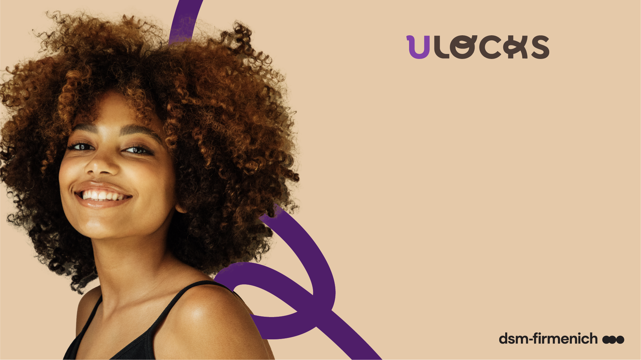

It's very satisfying when we find products that truly care for and enhance the natural beauty of our hair without a lot of effort, right? So, you just found it!
Introducing the dsm-firmenich textured hair care line, created by you, for you and with you. An easy routine with vitamins, natural origin actives and pleasurable fragrance, which ensures deep care and continuous freshness** for textured hair in just a few simple steps. An extraordinary ritual that combines high performance with delightful sensations to celebrate the uniqueness of your hair.
From YOUR roots to the tips of your locks. Because every hair is good hair if it represents who you are, and deserves a self-love moment to become even more gorgeous.
With the double Lock power for a double dose of pleasure:
LockCare complexes: combinations of vitamins and natural origin actives for effective care to enjoy beautiful hair
*
LockScent™ technology to enjoy
your hair care fragrance for days**
* Fragrance tested & loved by textured hair consumers
*External consumer test – 29 users of textured hair products with Type 4 hair (28 % with 4A hair type, 41 % 4B, and 31 % 4C) – average age between 26-35 years old – 1 month usage test – France – 2023
** Sensory test – 2023 – n=30 - overall fragrance intensity of the wash day routine (day 1) versus refreshing routine (day 1 + day 4 + day 7) on Hair Swatches

Slide 27

The pleasure of a care
made for my hair
The dsm-firmenich textured hair line combines high performance with pleasurable sensations
to offer care that celebrates the uniqueness
and natural beauty of coily locks.

Slide 28




A solution designed by you
and for you with impacts
well beyond hair care
Respecting your choice
There is a gap in the hair care market, reducing the purchasing criteria to availability. ULocks offers a new alternative fitting with the consumer expectations for pleasurable, easy to use and natural routines.
Respecting your hair
ULocks brings an inclusive hair care solution enabling to embrace your natural hair texture and its specific needs.
Respecting the planetary boundaries
A natural routine, with consciously designed fragrance and ingredients, responsibly sourced, produced through biotech or upcycled.
* ISO 16128

Slide 29

Feel the pleasure
of unique care
for textured hair.

Slide 30
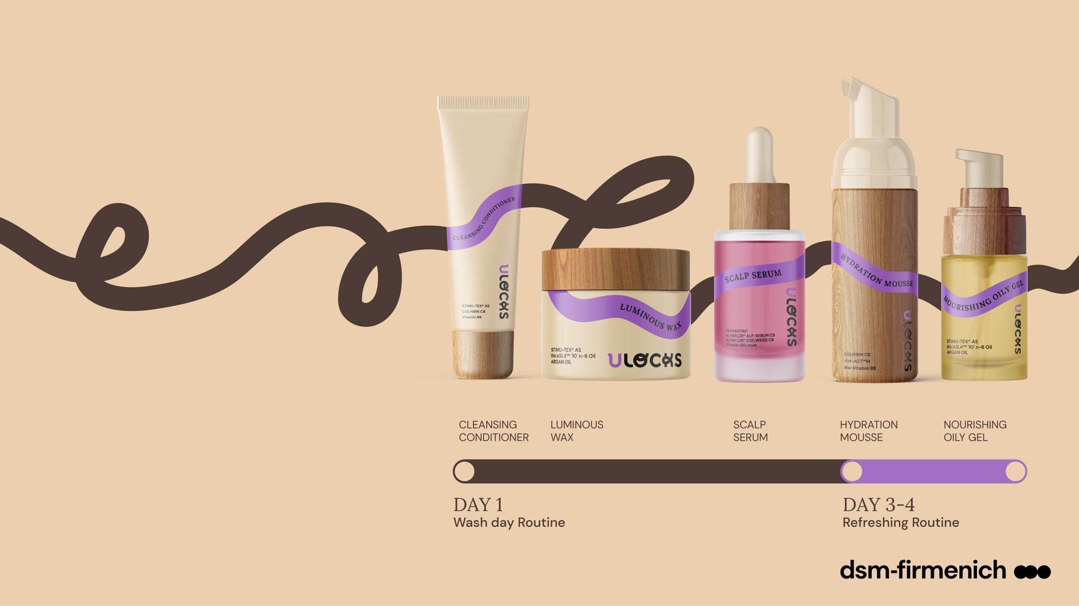

Products are for illustration only, not for sale. dsm-firmenich is not responsible for final products claims.
Feel the pleasure
of unique care
for textured hair.

Slide 31
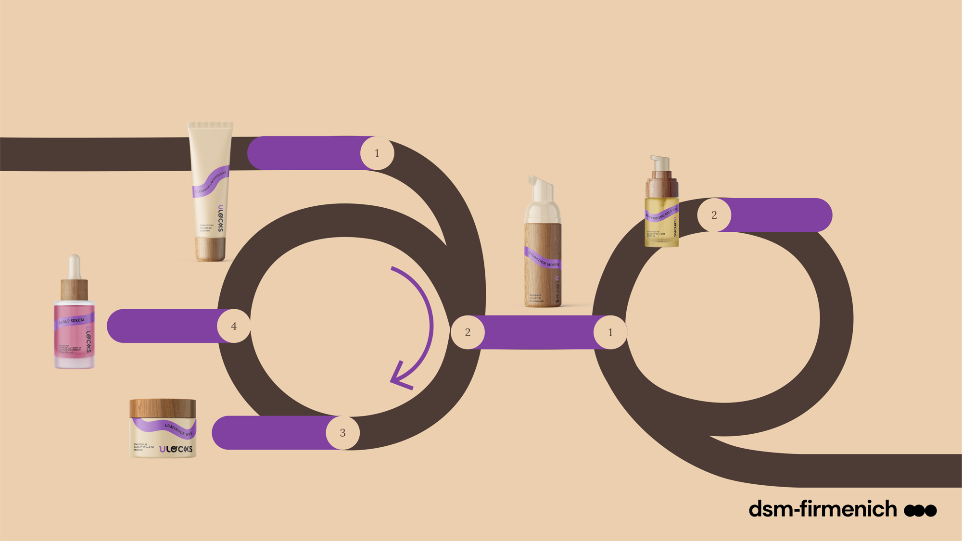



Double LOCK power for an effective
and true pleasurable routine
LockCare
complexes
Combinations of vitamins and natural origin actives for
^{effective care}
LockScent™
technology
Long-lasting fragrance for continuous freshness until the next wash**
4 steps for the wash day and 2 steps for the refreshing day.
Cleanse
Cleansing Conditioner
Lock & Style
Nourishing oily gel
Products are for illustration only, not for sale. dsm-firmenich is not responsible for final products claims.
Scalp Care
Wash day
Routine
DAY 1
4 steps
Refreshing
Routine
DAY 3-4
2 steps
Scalp Serum
Moisture
Hydration Mousse
Lock & Style
Luminous Wax
56 % of the consumers with coily hair completed this wash day routine in less than one hour*
*External consumer test – 29 users of textured hair products with Type 4 hair (28 % with 4A hair type, 41 % 4B, and 31 % 4C) – average age between 26-35 years old – 1 month usage test – France – 2023
** Sensory test – 2023 – n=30 - overall fragrance intensity of the wash day routine (day 1) versus refreshing routine (day 1 + day 4 + day 7) on Hair Swatches

Slide 32

Consumers with coily hair tested the products and the routine for 1 month*
Wash Day Routine*
According to 89% of consumers, the wash day routine allows to keep hair and scalp cleaned for 4 to 5 days after application.
About 70% of consumers reported a noticeable feeling of hair hydration for 4 to 5 days after application and ease of detangling hair.
56% of consumers completed the wash day routine in less than one hour.
72% of consumers agreed that “Products have a long-lasting fragrance that leaves you feeling fresh until your next wash”.
Refreshing routine*
61% of consumers reported a noticeable feeling of hair hydration 2 to 3 days after the refreshing routine application, and silky hair directly after use.
67% of consumers agreed that “products have a fragrance that lasts and refreshes your curls between 2 shampoos while delivering a sensation of freshness”.
“A fairly simple and quick routine, I really like the smell of the products and afterwards I don't feel like my hair is heavy with products. And my hair feels moisturized.”
Dienaba, Type 4 hair
*External consumer test – 29 users of textured hair products with Type 4 hair (28 % with 4A hair type, 41 % 4B, and 31 % 4C) – average age between 26-35 years old – 1 month usage test – France – 2023

Slide 33


Slide 34
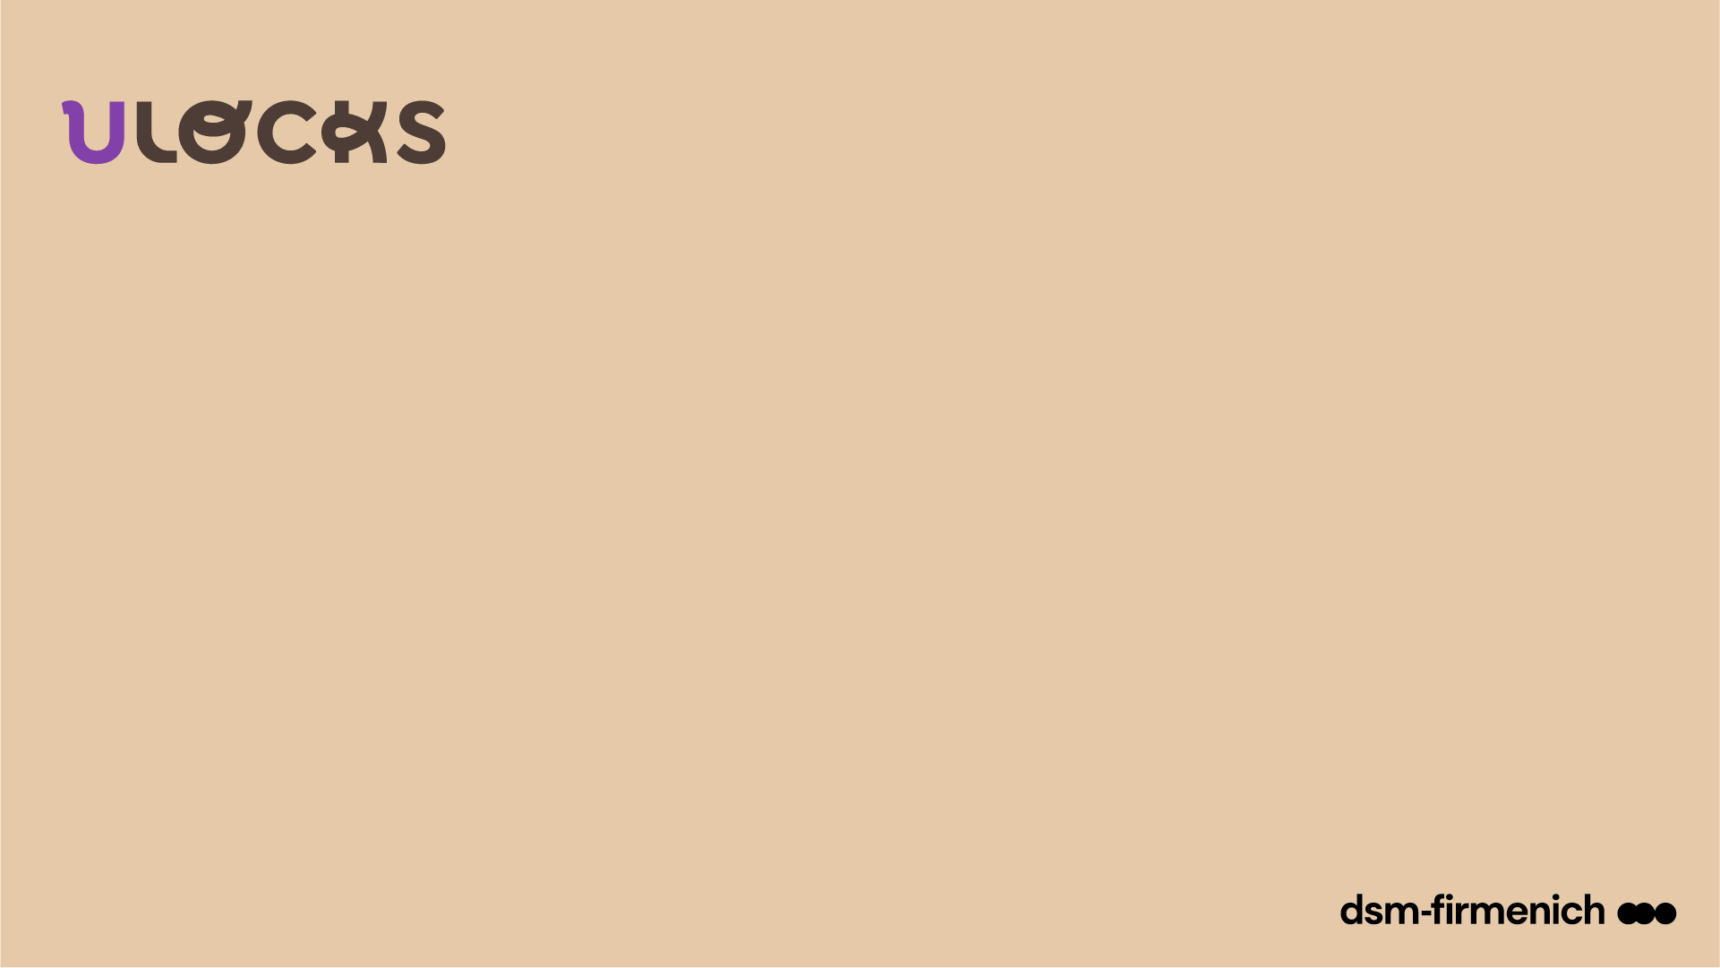
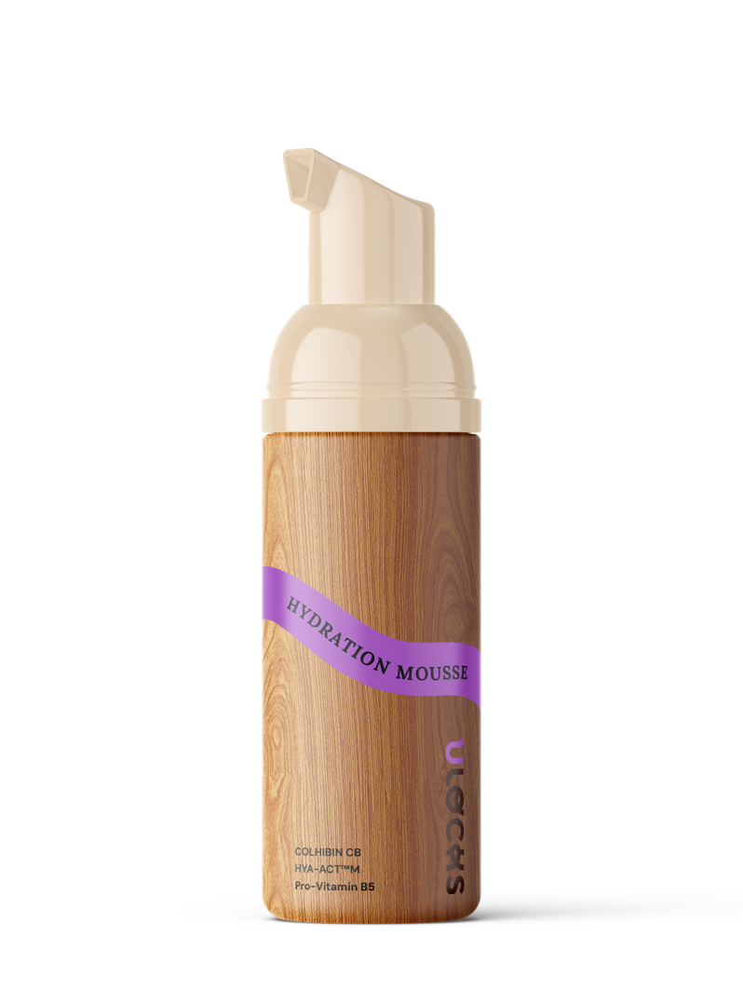
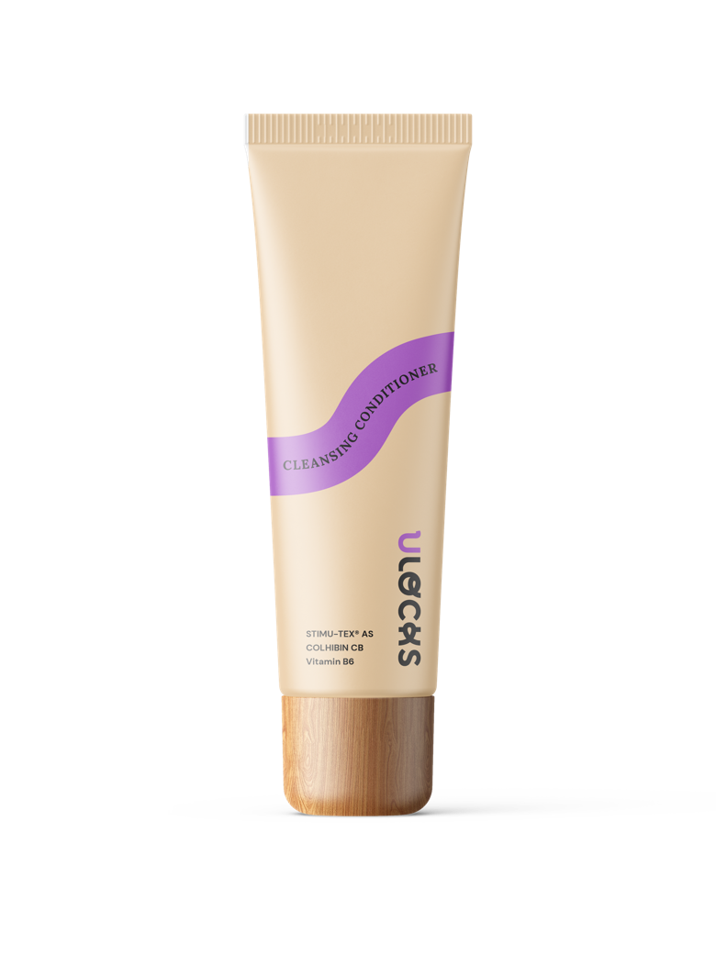
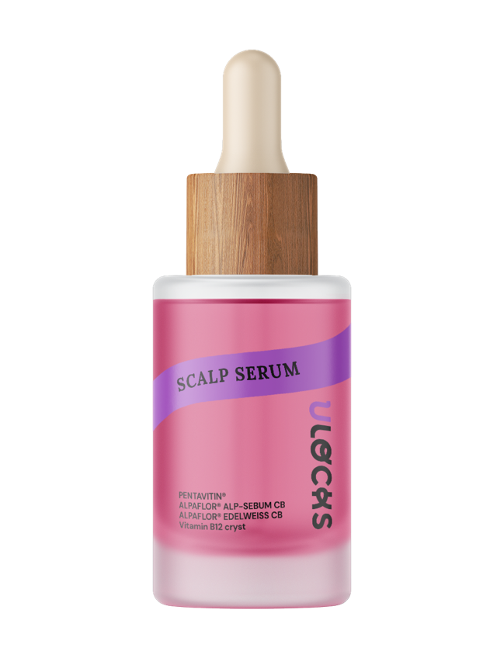
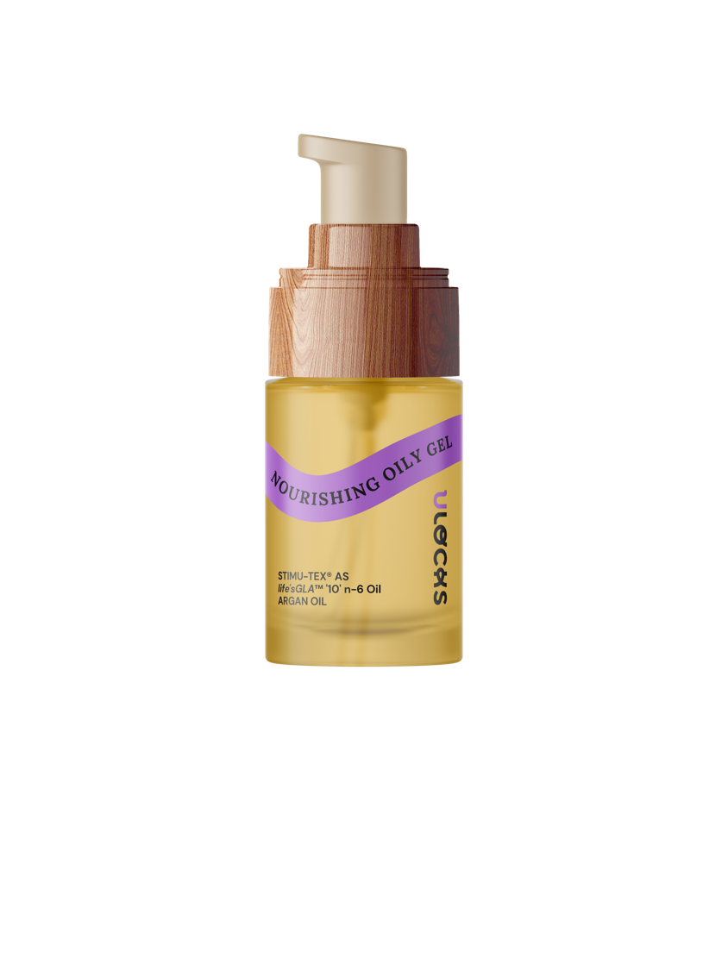
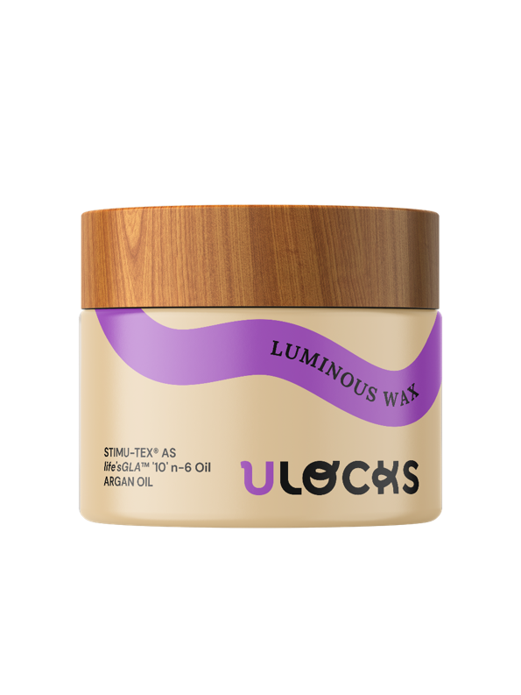
Products are for illustration only, not for sale. dsm-firmenich is not responsible for final products claims.

Slide 35

Feel the pleasure
of unique care
for textured hair.

Slide 36
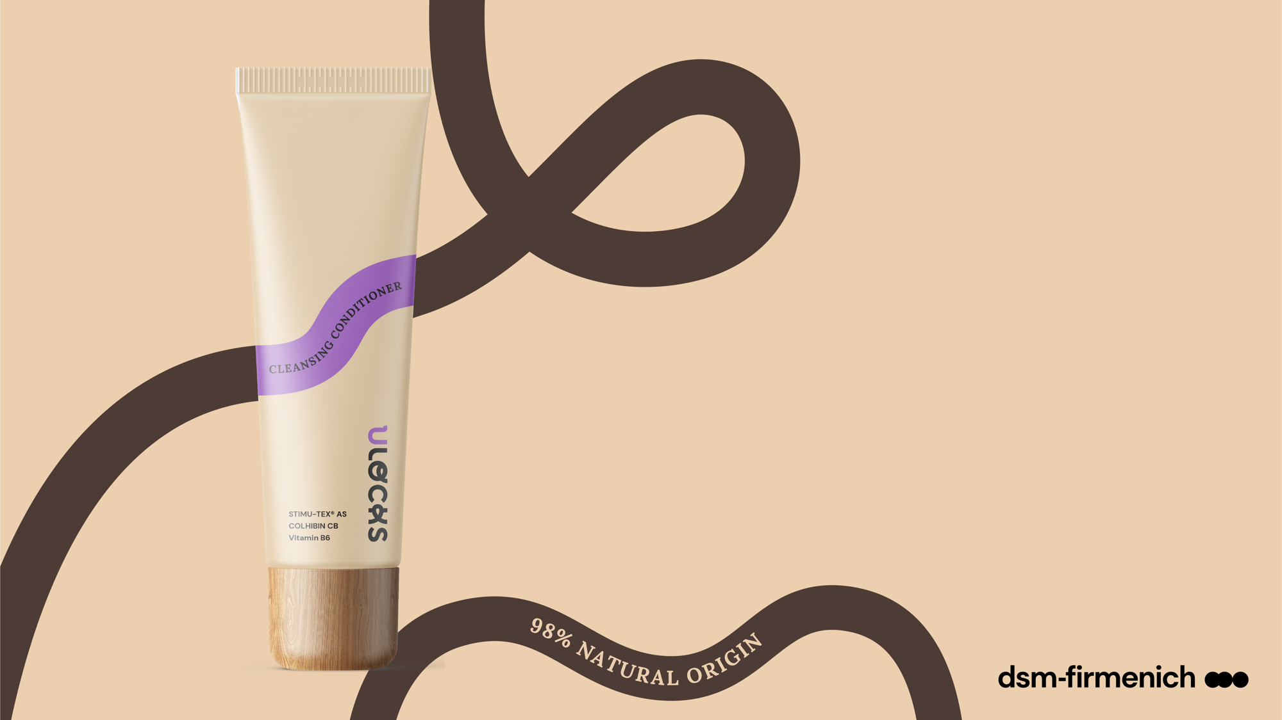

Wash Day
Routine
DAY 1
1
Cleanse
For 75 % of consumers with coily hair, it left soft, nourished and shiny hair after application*
Cleansing
Conditioner
A cleanser specially developed for your hair that gently removes impurities without stripping the hair fiber. With its soft texture and a LockCare complex containing spent grain wax, shea butter, argan oil, hydrolyzed rice protein and Vitamin B6, it not only deeply conditions each strand but also helps to promote a healthy scalp, reduce breakage and split ends, leaving your hair full of shine. Long-lasting fragrance for continuous freshness until the next wash. **
Products are for illustration only, not for sale. dsm-firmenich is not responsible for final products claims.
LockCare
complex
STIMU-TEX® AS: Argania Spinosa Kernel Oil, Butyrospermum Parkii (Shea Butter) Extract, Spent Grain Wax²
COLHIBIN CB: Hydrolyzed Rice Protein²
Vitamin B6: Pyridoxine Hydrochloride²
LockScent™
technology
*External consumer test – 29 users of textured hair products with Type 4 hair (28 % with 4A hair type, 41 % 4B, and 31 % 4C) – average age between 26-35 years old – 1 month usage test – France – 2023
** Sensory test – 2023 – n=30 - overall fragrance intensity of the wash day routine (day 1) versus refreshing routine (day 1 + day 4 + day 7) on Hair Swatches
¹
  ISO 16128
  INCI (Active)

Slide 37
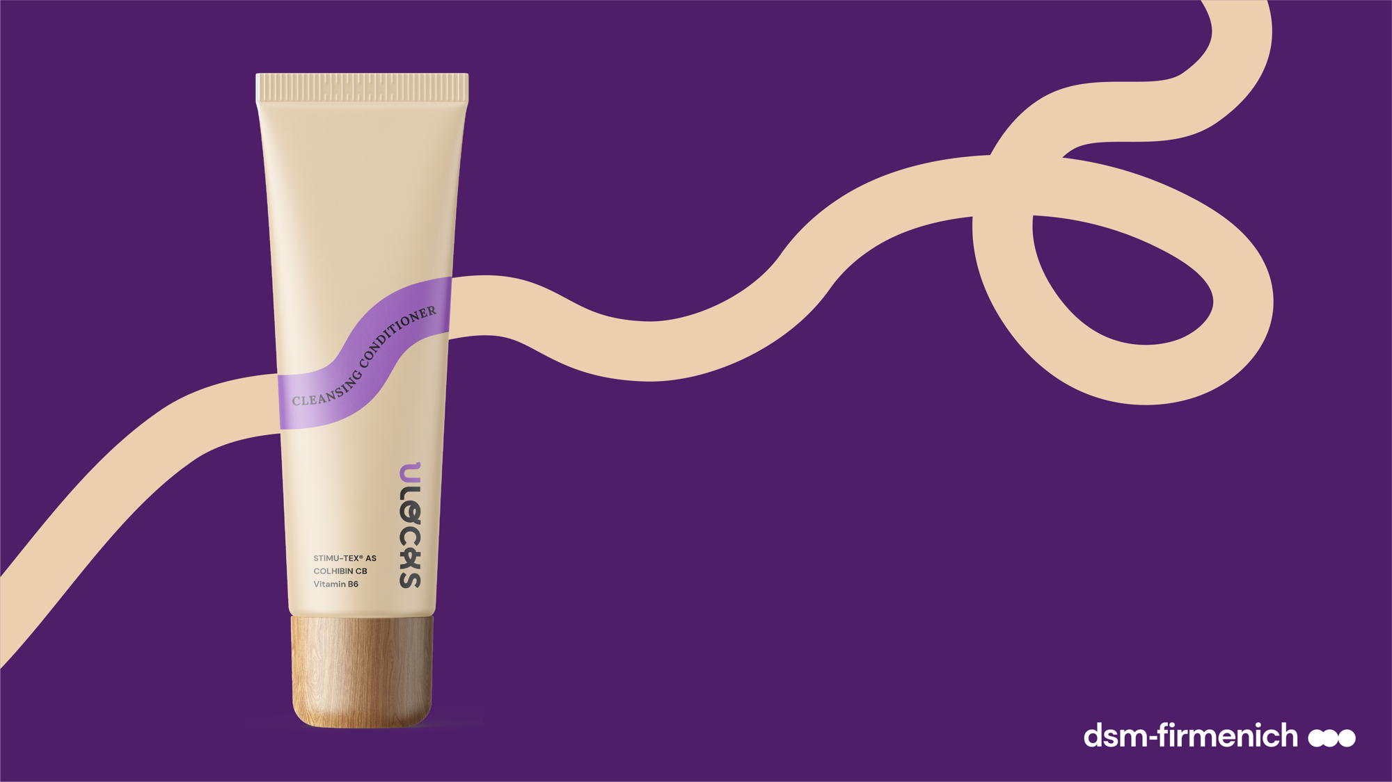



Wash Day
Routine
DAY 1
Products are for illustration only, not for sale. dsm-firmenich is not responsible for final products claims.
The expert tip:
The cleansing conditioner is a non foaming rinse off formulation which is compatible with the ”Curly Girl” method.
How to use
Apply the cleansing conditioner to your wet hair, covering the scalp and the lengths of the hair.
Massage your scalp enjoying the moment.
Rinse your scalp and hair thoroughly.
Rinse-off product

Slide 38
Wash Day
Routine
DAY 1
“It's so creamy and easy to apply, I feel like I'm applying a conditioner (I don't want to use anything else afterwards). It smells super mega good, plus, the smell remains in the hair after rinsing.”
Sarah, Type 4 hair
Consumer test results*
Products are for illustration only, not for sale. dsm-firmenich is not responsible for final products claims.
For 75 % of consumers, it left soft, nourished and shiny hair after application.*
95 % of consumers found that it did not leave any residue.*
90 % of consumers found their hair pretty clean 5 days after application.*
“A perfect mix between a shampoo and a conditioner that gently cleanses my scalp and conditions my hair.”
Flora, Type 4 Hair
Globally, the rich texture was appreciated and easy to apply.*
80 % of consumers would recommend it to a friend.*
*External consumer test– 29 users of textured hair products with Type 4 hair (28 % with 4A hair type, 41 % 4B, and 31 % 4C) – average age between 26-35 years old – 1 month usage test – France - 2023

Slide 39



Cleansing Conditioner
PHASE | INGREDIENTS | INCI NAME | % W / W
A | Water Dem | AQUA | 49,45
 | L(+) Lactic Acid 90% | LACTIC ACID, AQUA | 1,00
 | PUROX® S | SODIUM BENZOATE | 0,60
 | PYRIDOXINE HYDROCHLORIDE | PYRIDOXINE HCL | 0,20
 | Amisoft® LS-11 | SODIUM LAUROYL GLUTAMATE | 8,00
 | Propanediol | PROPANEDIOL | 5,00
 | Prebiulin C90 | CELLULOSE GUM, XANTHAN GUM, INULIN, CELLULOSE, GLUCOSE, FRUCTOSE | 0,20
 | COLHIBIN CB | HYDROLYZED RICE PROTEIN, GLYCERIN, AQUA, SODIUM BENZOATE, PENTYLENE GLYCOL | 3,00
 | QUATIN® 350 UP-DP POWDER | HYDROXYPROPYLTRIMONIUM INULIN | 1,00
 | PuraBeet | BETAINE | 2,00
 | Plantacare® 2000 UP | DECYL GLUCOSIDE, AQUA | 3,00
 | L-Arginine Ph Eur, JP, USP | ARGININE | 0,20
B | Kokosoel nativ kbA DE-OEKO- 001 | COCOS NUCIFERA OIL | 5,00
 | ARGAN OIL | ARGANIA SPINOSA KERNEL OIL | 1,00
 | EMOGREEN™ L19 | C15-19 ALKANE | 1,20
 | Rheopearl KL2 | DEXTRIN PALMITATE | 0,80
 | STIMU-TEX® AS | ARGANIA SPINOSA KERNEL OIL, TOCOPHEROL, BUTYROSPERMUM PARKII (SHEA BUTTER) EXTRACT, SPENT GRAIN WAX | 3,00
 | Phytantriol | PHYTANTRIOL | 0,25
 | Lanette® 16 | CETYL ALCOHOL | 3,00
 | Lanette® 18 | STEARYL ALCOHOL | 3,00
 | Mixed Tocopherols 95 | TOCOPHEROL | 0,50
 | AminoSensyl HC | BRASSICA ALCOHOL, BRASSICYL VALINATE ESYLATE | 3,00
 | Rizinusöl | RICINUS COMMUNIS SEED OIL | 5,00
C | U Locks P01B839 | PARFUM, COUMARIN, HEXYL CINNAMAL , BENZYL SALICYLATE | 0,80
Products are for illustration only, not for sale. dsm-firmenich is not responsible for final products claims.
Technical Data:
pH: 5,6
Viscosity (HR-10/ plate 40mm/ shear rate 1/s):
12000 mPa.s
HC-E-102422-14

Slide 40
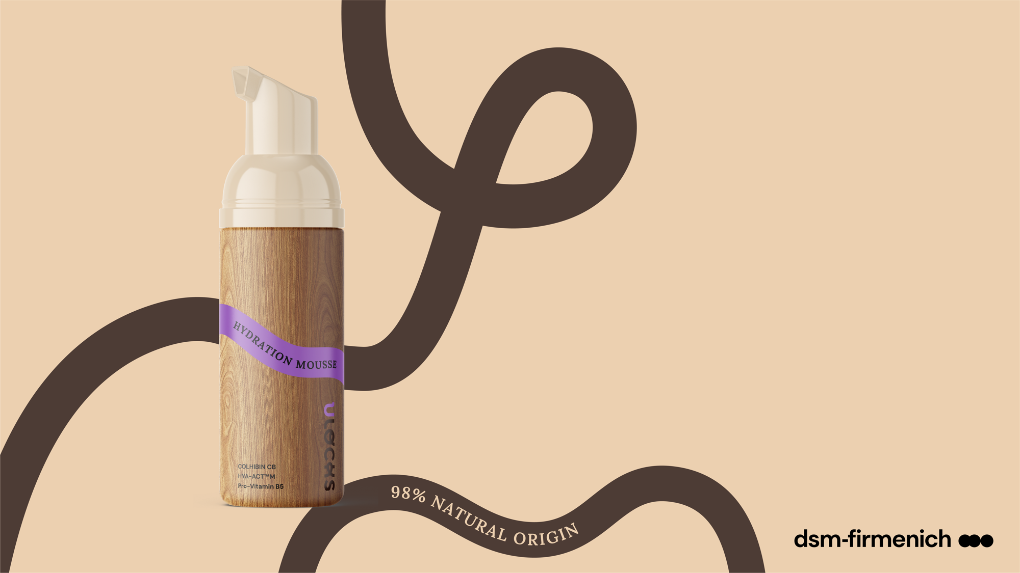
Wash Day
Routine
DAY 1
1 out of 2 consumers with coily hair reported a feeling of hair hydration directly after application.*
2
Moisture
Hydration Mousse
With an unbelievably light texture, this mousse provides an extra dose of moisture thanks to its LockCare complex containing hydrolyzed rice protein, hyaluronic acid and
Pro-Vitamin B5 without leaving a residue. Long-lasting fragrance for continuous freshness until the next wash.**
Products are for illustration only, not for sale. dsm-firmenich is not responsible for final products claims.
COLHIBIN CB: Hydrolyzed Rice Protein²
HYA-ACT™M: Sodium Hyaluronate²
Pro-Vitamin B5: Panthenol²
LockCare
complex
LockScent™
technology
*External consumer test – 29 users of textured hair products with Type 4 hair (28 % with 4A hair type, 41 % 4B, and 31 % 4C) – average age between 26-35 years old – 1 month usage test – France – 2023
** Sensory test – 2023 – n=30 - overall fragrance intensity of the wash day routine (day 1) versus refreshing routine (day 1 + day 4 + day 7) on Hair Swatches
¹
  ISO 16128
  INCI (Active)

Slide 41
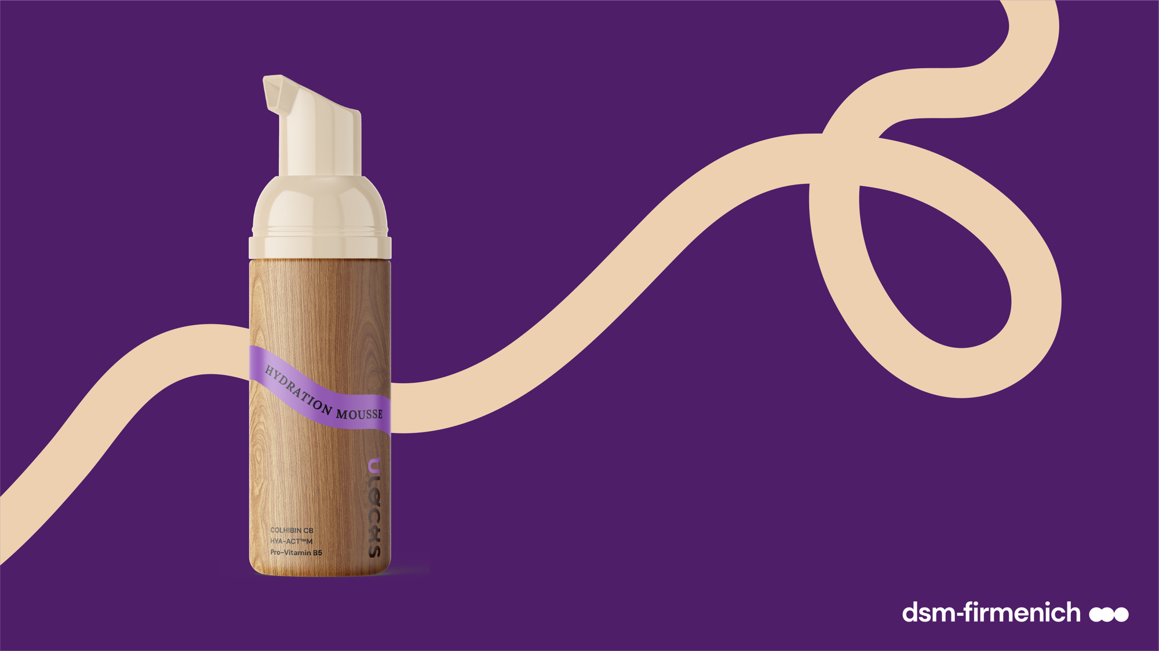




Wash Day
Routine
DAY 1
The expert tip:
The Hydration mousse is a must-to-have to create a qualitative braid-out.
Products are for illustration only, not for sale. dsm-firmenich is not responsible for final products claims.
How to use
Divide your clean hair into 6 or more sections.
Apply the foam to each section of the hair and massage with the fingertips.
For long-lasting definition, lock in the moisture of each section by applying the luminous wax.
Leave-on product

Slide 42
Wash Day
Routine
DAY 1
“My favourite. The moisturising foam concept is very original. Great hydration. I love it!”
Aurelia, Type 4 hair
Consumer test results*
Products are for illustration only, not for sale. dsm-firmenich is not responsible for final products claims.
1 out of 2 consumers reported a feeling of hair hydration directly after application.*
The light Mousse texture was found to be easy to apply by 70 % of consumers.*
The product did not leave any residue according to 95 % of consumers.*
*External consumer test – 29 users of textured hair products with Type 4 hair (28 % with 4A hair type, 41 % 4B, and 31 % 4C) – average age between 26-35 years old – 1 month usage test – France - 2023

Slide 43


Hydration Mousse
PHASE | INGREDIENTS | INCI NAME | % W / W
A | STEPAN-MILD GCC/MB | GLYCERYL CAPRYLATE/CAPRATE | 6,00
 | Hostapon CLG | SODIUM LAUROYL GLUTAMATE, AQUA, SODIUM CHLORIDE | 8,00
 | U Locks P01B839 | PARFUM, COUMARIN, HEXYL CINNAMAL, BENZYL SALICYLATE | 0,10
 | TEGO Betain F50 | COCAMIDOPROPYL BETAINE | 2,00
 | D-Biotin | BIOTIN | 0,10
B | Phytantriol | PHYTANTRIOL | 0,20
 | ARGAN OIL | ARGANIA SPINOSA KERNEL OIL | 0,10
 | Avocadoöl raff kbA DE-ÖKO-001 | PERSEA GRATISSIMA OIL | 0,50
 | Mixed Tocopherols 95 | TOCOPHEROL | 0,20
 | life'sGLA™ '10' n-6 Oil | OENOTHERA BIENNIS SEED EXTRACT, ASCORBYL PALMITATE, TOCOPHEROL | 0,40
 | Rizinusoel kaltgepresst kbA EU und NOP | RICINUS COMMUNIS SEED OIL | 0,80
 | MIGLYOL® 829 ECO | CAPRYLIC/CAPRIC/SUCCINIC TRIGLYCERIDE | 2,00
C | Water Dem | AQUA | 64,50
 | D-Panthenol 75 L | PANTHENOL, AQUA, PANTOLACTONE | 0,50
 | COLHIBIN CB | HYDROLYZED RICE PROTEIN, GLYCERIN, AQUA, SODIUM BENZOATE, PENTYLENE GLYCOL | 0,20
D | HYA-ACT™ M | SODIUM HYALURONATE | 0,10
 | MAIZE-STYLE ORGANIC 21.510 | HYDROLYZED CORN STARCH | 0,60
 | Glycerine CremerGLYC 86.5% | GLYCERIN | 5,00
 | Propanediol | PROPANEDIOL | 8,00
E | Sensiva® SC 50 | ETHYLHEXYLGLYCERIN | 0,70
 | L(+) Lactic Acid 90% | LACTIC ACID, AQUA | Qs to pH 6.0
Products are for illustration only, not for sale. dsm-firmenich is not responsible for final products claims.
HC-E-102305-16
Technical Data:
pH: 6,1
Viscosity (HR-10/plate 40mm/ shear rate 1/s): 914 mPa.s

Slide 44
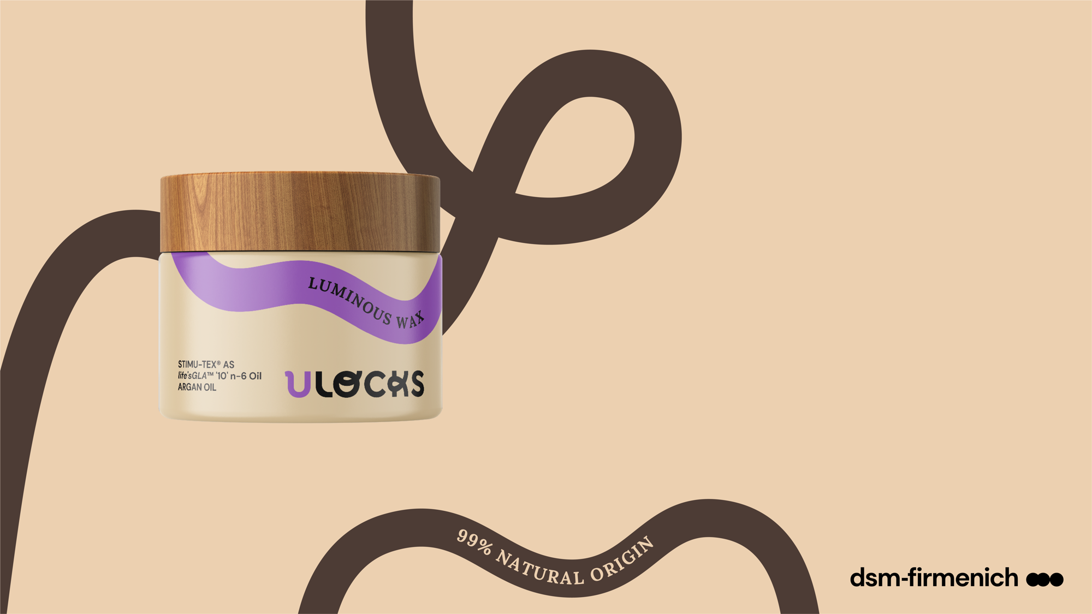
Wash Day
Routine
DAY 1
More than 85 % of consumers with coily hair noticed silky and shiny hair after application.*
3
Lock & Style
Luminous
Wax
Get naturally gorgeous, shiny and defined curls with this silky, delightfully wax that ensures deep conditioning with its LockCare complex containing shea butter, spent grain wax, argan oil & oenothera biennis seed extract . It also helps reduce breakage and split ends. Long-lasting fragrance for continuous freshness until the next wash.**
Products are for illustration only, not for sale. dsm-firmenich is not responsible for final products claims.
STIMU-TEX® AS: Argania Spinosa Kernel Oil, Butyrospermum Parkii (Shea Butter) Extract, Spent Grain Wax²
life’sGLA™ ’10’ n-6 oil: Oenothera Biennis Seed Extract²
ARGAN OIL: Argania Spinosa Kernel Oil²
LockCare
complex
LockScent™
technology
*External consumer test – 29 users of textured hair products with Type 4 hair (28 % with 4A hair type, 41 % 4B, and 31 % 4C) – average age between 26-35 years old – 1 month usage test – France – 2023
** Sensory test – 2023 – n=30 - overall fragrance intensity of the wash day routine (day 1) versus refreshing routine (day 1 + day 4 + day 7) on Hair Swatches
¹
  ISO 16128
  INCI (Active)

Slide 45
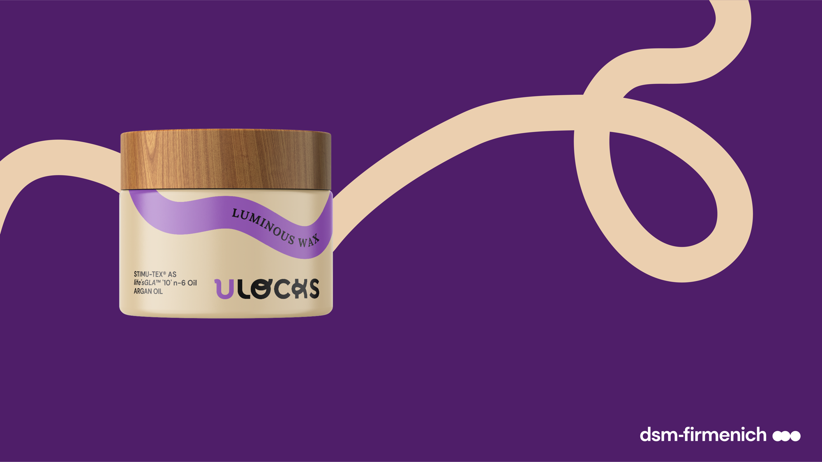



Wash Day
Routine
DAY 1
Products are for illustration only, not for sale. dsm-firmenich is not responsible for final products claims.
How to use
The expert tip:
For optimal use, it can be combined with the Hydration mousse to create a beautiful style for braid-out or to define natural curls. The Luminous wax is compatible with the LOC method, at the "Oil" stage.
Divide your hair into 6 or more sections.
Apply the luminous wax to each section of the hair and massage with the fingertips.
Style your hair by braiding for example.
Leave-on product

Slide 46
“You only need a small amount, and the butter lasts a very long time, smells great and the texture is incredibly soft, almost like butter. I highly recommend it because it's really great! “
Krisna, Type 4 hair
Wash Day
Routine
DAY 1
Consumer test results*
“This is my favourite product! It smells good, it's nourishing, it's shaping, it keeps the moisture in (in an LOC method routine) for a very long time.”
Daniela, Type 4 hair
Products are for illustration only, not for sale. dsm-firmenich is not responsible for final products claims.
According to 95 % of consumers, the Luminous Wax left nourished hair without a sticky effect.*
75 % of consumers found that the Luminous Wax has good properties in holding curls.*
More than 85 % of consumers noticed silky and shiny hair after application.*
95% of consumers mentioned that the Luminous wax was easy to apply.*
*External consumer test – 29 users of textured hair products with Type 4 hair (28 % with 4A hair type, 41 % 4B, and 31 % 4C) – average age between 26-35 years old – 1 month usage test – France - 2023

Slide 47


Luminous Wax
PHASE | INGREDIENTS | INCI NAME | % W / W
A | Kahlwax 6279L | MYRICA CERIFERA FRUIT WAX | 9,00
 | Kahlwax 2811 Rice | ORYZA SATIVA BRAN CERA | 7,00
 | KahlWax 6290 Berry | RHUS VERNICIFLUA PEEL CERA | 8,00
 | Kakaobutter raffiniert | THEOBROMA CACAO SEED BUTTER | 3,00
 | Kesterwax K24 | LAURYL LAURATE | 6,00
 | ARGAN OIL | ARGANIA SPINOSA KERNEL OIL | 2,00
 | life'sGLA™ '10' n-6 Oil | OENOTHERA BIENNIS SEED EXTRACT, ASCORBYL PALMITATE, TOCOPHEROL | 3,00
 | Rheopearl KL2 | DEXTRIN PALMITATE | 1,60
 | EMOGREEN™ L19 | C15-19 ALKANE | 2,40
 | STIMU-TEX® AS | ARGANIA SPINOSA KERNEL OIL, TOCOPHEROL, BUTYROSPERMUM PARKII (SHEA BUTTER) EXTRACT, SPENT GRAIN WAX | 3,00
 | Macadamianussöl raff kbA DE- ÖKO-001 | MACADAMIA INTEGRIFOLIA/TETRAPHYLLA SEED OIL | 13,70
 | Rizinusöl | RICINUS COMMUNIS SEED OIL | 6,00
 | Traubenkernöl raffiniert | VITIS VINIFERA SEED OIL | 12,00
 | Mixed Tocopherols 95 | TOCOPHEROL | 0,50
 | Huile de DATTIER du DESERT | BALANITES ROXBURGHII SEED OIL | 10,00
 | Cutina® CP | CETYL PALMITATE | 12,00
B | U Locks P01B839 | PARFUM, COUMARIN, HEXYL CINNAMAL, BENZYL SALICYLATE, D-LIMONENE, ALPHA-ISOMETHYL IONONE, HYDROXYCITRONELLAL. | 0,80
Products are for illustration only, not for sale. dsm-firmenich is not responsible for final products claims.
HC-E-102423-2
Technical Data:
Viscosity (HR-10/ plate 40mm/ shear rate 1/s): 52.000 mPa.s

Slide 48
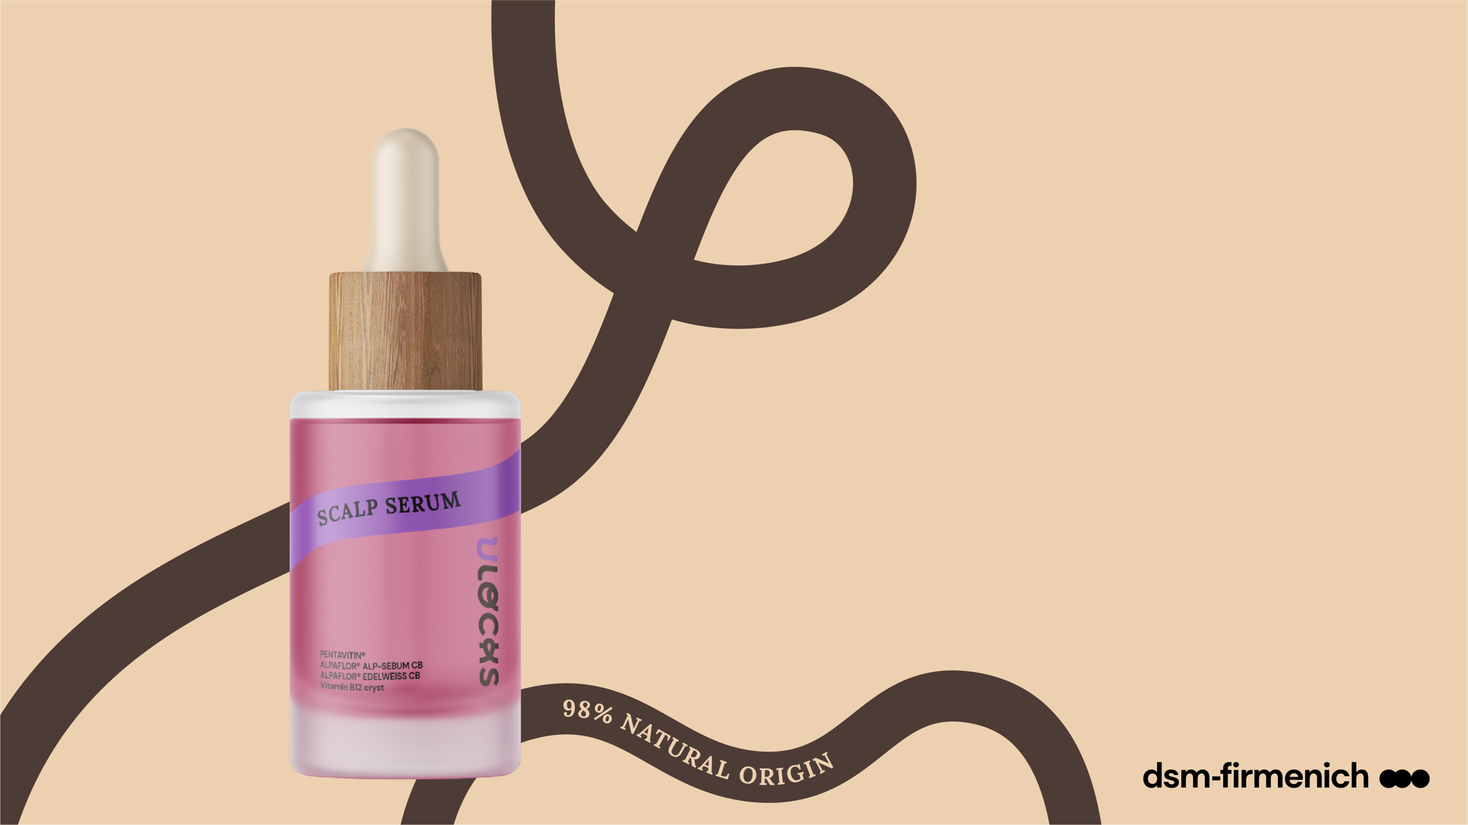
Wash Day
Routine
DAY 1
4
Scalp care
The product has good properties in scalp hydration according to 84 % of consumers with coily hair.*
Scalp
Serum
Sure, you already know this, but it's worth mentioning again: beautiful hair is also healthy scalp. The LockCare complex with alpine flowers, saccharide isomerate & vitamin B12 cryst in this lightweight, water-like serum provides the care your scalp needs for visible improved hydration while also helping to reduce sebum. Plus, it helps improve hair density and soothe skin. Long-lasting fragrance for continuous freshness until the next wash.**
Products are for illustration only, not for sale. dsm-firmenich is not responsible for final products claims.
LockCare
complex
PENTAVITIN®: Saccharide Isomerate²
ALPAFLOR® ALP-SEBUM CB: Epilobium Fleischeri Flower /Leaf / Stem Extract²
ALPAFLOR® EDELWEISS CB: Leontopodium Alpinum Flower / Leaf Extract²
Vitamin B12 cryst: Cyanocobalamin²
LockScent™
technology
*External consumer test – 29 users of textured hair products with Type 4 hair (28 % with 4A hair type, 41 % 4B, and 31 % 4C) – average age between 26-35 years old – 1 month usage test – France – 2023
** Sensory test – 2023 – n=30 - overall fragrance intensity of the wash day routine (day 1) versus refreshing routine (day 1 + day 4 + day 7) on Hair Swatches
¹
  ISO 16128
  INCI (Active)
Prevent hair loss is a drug claim in USA to use improves hair density

Slide 49
Wash Day
Routine
DAY 1
Products are for illustration only, not for sale. dsm-firmenich is not responsible for final products claims.
How to use
Apply the scalp serum on your scalp and massage gently

Slide 50
“I wasn't familiar with the scalp serum at all. I loved the hydrating and light effect. I wasn't expecting that.”
Alison, Type 4 hair
Consumer test results*
Products are for illustration only, not for sale. dsm-firmenich is not responsible for final products claims.
The product had good properties in scalp hydration according to 84 % of consumers.*
For 95 % of consumers, it did not leave any sticky hair effect.*
With an overall score of 4.53/5, this scalp serum is appreciated by the consumers who would add this new product type in their routines.*
*External consumer test – 29 users of textured hair products with Type 4 hair (28 % with 4A hair type, 41 % 4B, and 31 % 4C) – average age between 26-35 years old – 1 month usage test – France - 2023

Slide 51
Scalp Serum
PHASE | INGREDIENTS | INCI NAME | % W / W
A | Water Dem | AQUA | 74,46
 | Natrosol 250 HR PC | HYDROXYETHYLCELLULOSE | 1,00
B | D-Biotin | BIOTIN | 0,02
 | PENTAVITIN® | SACCHARIDE ISOMERATE, AQUA, CITRIC ACID, SODIUM CITRATE | 0,80
 | Niacinamide PC | NIACINAMIDE | 0,50
 | Sodium Gluconate Granular | SODIUM GLUCONATE | 0,20
 | ALPAFLOR® EDELWEISS CB | LEONTOPODIUM ALPINUM FLOWER/LEAF EXTRACT, GLYCERIN, AQUA, CITRIC ACID | 1,00
 | Vitamin B12 cryst Food Grade | CYANOCOBALAMIN | 0,02
 | ALPAFLOR® ALP-SEBUM CB | EPILOBIUM FLEISCHERI FLOWER / LEAF / STEM EXTRACT, GLYCERIN, AQUA, CITRIC ACID | 1,50
 | Propanediol | PROPANEDIOL | 5,00
C | ALCOHOL DENAT | ALCOHOL DENAT | 12,00
 | U Locks P01B839 | PARFUM, COUMARIN, HEXYL CINNAMAL,BENZYL SALICYLATE, D-LIMONENE, ALPHA-ISOMETHYL IONONE, HYDROXYCITRONELLAL | 0,40
 | ARGAN OIL | ARGANIA SPINOSA KERNEL OIL | 0,10
 | Dermosoft Hexiol | 1,2-HEXANEDIOL | 0,30
Products are for illustration only, not for sale. dsm-firmenich is not responsible for final products claims.
HC-E-102436-14
Technical Data:
pH: 4.9
Viscosity (HR-10/ plate 40mm/ shear rate 1/s): 1200 mPa.s

Slide 52

Refreshing
Routine
DAY 3-4
1 out of 2 consumers with coily hair
reported a feeling of hair hydration directly after application.*
1
Moisture
Hydration Mousse
With an unbelievably light texture, this mousse provides an extra dose of moisture thanks to its LockCare complex containing hydrolyzed rice protein, hyaluronic acid and vitamin B5 without leaving a residue. Long-lasting fragrance for continuous freshness until the next wash.**
Products are for illustration only, not for sale. dsm-firmenich is not responsible for final products claims.
LockCare
complex
COLHIBIN CB: Hydrolyzed Rice Protein²
HYA-ACT™M: Sodium Hyaluronate²
Pro-Vitamin B5: Panthenol²
LockScent™
technology
*External consumer test – 29 users of textured hair products with Type 4 hair (28 % with 4A hair type, 41 % 4B, and 31 % 4C) – average age between 26-35 years old – 1 month usage test – France – 2023
** Sensory test – 2023 – n=30 - overall fragrance intensity of the wash day routine (day 1) versus refreshing routine (day 1 + day 4 + day 7) on Hair Swatches
¹
  ISO 16128
  INCI (Active)

Slide 53
Refreshing
Routine
DAY 3-4
The expert tip:
The Hydration mousse is a must-to-have to create a qualitative braid-out.
Products are for illustration only, not for sale. dsm-firmenich is not responsible for final products claims.
How to use
Divide your hair in 6 or more sections
Apply the foam to each section of the hair and massage with the fingertips
For long-lasting definition, lock in the moisture of each section by applying the luminous wax
Leave-on product

Slide 54
Refreshing
Routine
DAY 3-4
“My favourite. The moisturising foam concept is very original. Great hydration.
I love it!”
Aurelia, Type 4 hair
Consumer test results*
Products are for illustration only, not for sale. dsm-firmenich is not responsible for final products claims.
1 out of 2 consumers reported a feeling of hair hydration directly after application.*
The light Mousse texture was found to be easy to apply by 70 % of consumers.*
The product did not leave any residue according to 95 % of consumers.*
*External consumer test – 29 users of textured hair products with Type 4 hair (28 % with 4A hair type, 41 % 4B, and 31 % 4C) – average age between 26-35 years old – 1 month usage test – France - 2023

Slide 55
Hydration Mousse
PHASE | INGREDIENTS | INCI NAME | % W / W
A | STEPAN-MILD GCC/MB | GLYCERYL CAPRYLATE/CAPRATE | 6,00
 | Hostapon CLG | SODIUM LAUROYL GLUTAMATE, AQUA, SODIUM CHLORIDE | 8,00
 | U Locks P01B839 | PARFUM, COUMARIN, HEXYL CINNAMAL, BENZYL SALICYLATE | 0,10
 | TEGO Betain F50 | COCAMIDOPROPYL BETAINE | 2,00
 | D-Biotin | BIOTIN | 0,10
B | Phytantriol | PHYTANTRIOL | 0,20
 | ARGAN OIL | ARGANIA SPINOSA KERNEL OIL | 0,10
 | Avocadoöl raff kbA DE-ÖKO-001 | PERSEA GRATISSIMA OIL | 0,50
 | Mixed Tocopherols 95 | TOCOPHEROL | 0,20
 | life'sGLA™ '10' n-6 Oil | OENOTHERA BIENNIS SEED EXTRACT, ASCORBYL PALMITATE, TOCOPHEROL | 0,40
 | Rizinusoel kaltgepresst kbA EU und NOP | RICINUS COMMUNIS SEED OIL | 0,80
 | MIGLYOL® 829 ECO | CAPRYLIC/CAPRIC/SUCCINIC TRIGLYCERIDE | 2,00
C | Water Dem | AQUA | 64,50
 | D-Panthenol 75 L | PANTHENOL, AQUA, PANTOLACTONE | 0,50
 | COLHIBIN CB | HYDROLYZED RICE PROTEIN, GLYCERIN, AQUA, SODIUM BENZOATE, PENTYLENE GLYCOL | 0,20
D | HYA-ACT™ M | SODIUM HYALURONATE | 0,10
 | MAIZE-STYLE ORGANIC 21.510 | HYDROLYZED CORN STARCH | 0,60
 | Glycerine CremerGLYC 86.5% | GLYCERIN | 5,00
 | Propanediol | PROPANEDIOL | 8,00
E | Sensiva® SC 50 | ETHYLHEXYLGLYCERIN | 0,70
 | L(+) Lactic Acid 90% | LACTIC ACID, AQUA | Qs to pH 6.0
Products are for illustration only, not for sale. dsm-firmenich is not responsible for final products claims.
Technical Data:
pH: 6,1
Viscosity (HR-10/ plate 40mm/ shear rate 1/s): 914 mPa.s
HC-E-102305-16

Slide 56
Refreshing
Routine
DAY 3-4
2
Lock & Style
The nourishing effect was satisfying for 90 % of consumers with coily hair and they did not find any or a slight sticky hair effect after application.*
Nourishing Oily Gel
A super-nourishing oily gel that refreshes
the naturally beautiful, defined look of your curls by ensuring conditioning and shine, as well as helping to reduce breakage and split ends thanks to its LockCare complex containing shea butter, spent grain wax, argan oil & oenothera biennis seed extract. Long-lasting fragrance for continuous freshness until the next wash.**
Products are for illustration only, not for sale. dsm-firmenich is not responsible for final products claims.
LockCare
complex
STIMU-TEX® AS: Argania Spinosa Kernel Oil, Butyrospermum Parkii (Shea Butter) Extract, Spent Grain Wax²
life’sGLA™ ’10’ n-6 oil: Oenothera Biennis Seed Extract²
ARGAN OIL: Argania Spinosa Kernel Oil²
LockScent™
technology
¹
*External consumer test – 29 users of textured hair products with Type 4 hair (28 % with 4A hair type, 41 % 4B, and 31 % 4C) – average age between 26-35 years old – 1 month usage test – France – 2023
** Sensory test – 2023 – n=30 - overall fragrance intensity of the wash day routine (day 1) versus refreshing routine (day 1 + day 4 + day 7) on Hair Swatches
  ISO 16128
  INCI (Active)

Slide 57

Refreshing
Routine
DAY 3-4
The expert tip:
The nourishing oil is lighter than
the Luminous Wax. It prepares the hair and helps reduce breakage until
the next shampoo. For optimal
use, it can be combined with the Hydration mousse to create a beautiful style for braid-out or to define natural curls. The Nourishing Oil is compatible with the LOC method, at the "Oil" stage.
Products are for illustration only, not for sale. dsm-firmenich is not responsible for final products claims.
How to use
Divide your hair into 6 or more sections
Apply the Nourishing Oily Gel to each section of hair and massage with the fingertips
Style your hair by braiding for example
Leave-on product

Slide 58
With an overall score of 4.62/5, most of consumers prefer this Oily Gel to the one they are used to use.*
Refreshing
Routine
DAY 3-4
Consumer test results*
“I found the oil rich but not too much, it left a thin film, just what was needed to seal in the moisture. I have no negative points.”
Alison, Type 4 hair
Products are for illustration only, not for sale. dsm-firmenich is not responsible for final products claims.
More than 85 % of consumers had silky and shiny hair after the application of the Nourishing Oily Gel.*
The nourishing effect was satisfying for 90 % of consumers, and they did not find any or a slight sticky hair effect after application.*
Curls retention properties were evaluated to be good by 55 % of consumers.*
The rich texture was judged as pleasant and easy to apply by 95% of consumers, and it did not leave residues.*
*External consumer test – 29 users of textured hair products with Type 4 hair (28 % with 4A hair type, 41 % 4B, and 31 % 4C) – average age between 26-35 years old – 1 month usage test – France - 2023

Slide 59
Nourishing Oily Gel
PHASE | INGREDIENTS | INCI NAME | % W / W
A | ARGAN OIL | ARGANIA SPINOSA KERNEL OIL | 2,00
 | Kurbiskernol kaltgepresst | CUCURBITA PEPO SEED OIL | 5,00
 | Rizinusoel kaltgepresst kbA EU und NOP | RICINUS COMMUNIS SEED OIL | 12,00
 | Mango Butter, refined | MANGIFERA INDICA SEED BUTTER | 5,00
 | Rheopearl KL2 | DEXTRIN PALMITATE | 3,52
 | EMOGREEN™ L19 | C15-19 ALKANE | 5,28
 | Kokosoel raffiniert Ph. Eur. | COCOS NUCIFERA OIL | 8,00
 | Jojobaöl raff kbA Kiwa BCS Öko- Garantie | SIMMONDSIA CHINENSIS SEED OIL | 6,00
 | Mixed Tocopherols 95 | TOCOPHEROL | 0,40
 | life’sGLA™ '10' n-6 Oil | OENOTHERA BIENNIS SEED EXTRACT, ASCORBYL PALMITATE, TOCOPHEROL | 2,00
 | DL-alpha-Tocopheryl Acetate | TOCOPHERYL ACETATE | 1,00
 | Avocadoöl raff kbA DE-ÖKO-001 | PERSEA GRATISSIMA OIL | 8,00
 | Cegesoft® PFO | PASSIFLORA INCARNATA SEED OIL | 8,00
 | Aprikosenkernöl raff kbA DE- ÖKO-001 | PRUNUS ARMENIACA KERNEL OIL | 8,00
 | Macadamianussöl raff kbA DE- ÖKO-001 | MACADAMIA INTEGRIFOLIA/TETRAPHYLLA SEED OIL | 8,00
 | STIMU-TEX® AS | ARGANIA SPINOSA KERNEL OIL, TOCOPHEROL, BUTYROSPERMUM PARKII (SHEA BUTTER) EXTRACT, SPENT GRAIN WAX | 1,50
 | Cosphaderm® Feel | TRIHEPTANOIN | 16,00
B | U Locks P01B839 | PARFUM, COUMARIN, HEXYL CINNAMAL, BENZYL SALICYLATE, D-LIMONENE, ALPHA-ISOMETHYL IONONE, HYDROXYCITRONELLAL | 0,30
Products are for illustration only, not for sale. dsm-firmenich is not responsible for final products claims.
HC-E-102166-10
Technical Data:
Viscosity (HR-10/ plate 40mm/ shear rate 1/s): 1200 mPa.s

Slide 60
Products are for illustration only, not for sale. dsm-firmenich is not responsible for final products claims.
CLEANSE
To cleanse without stripping the hair fiber
To restore shine
To help reduce hair breakage and split-ends
To help promote a healthy scalp
LOCK & STYLE
Conditioning and shine
To ensure curls definition
To help reduce hair breakage and split-ends
SCALP CARE
To help improve hair density
To visibly improve scalp hydration and help reduce sebum
To help soothe skin
MOISTURE
To replenish moisture
LOCK & STYLE
Conditioning and shine
To ensure curls definition
To help reduce hair breakage and split-ends
LONG-LASTING FRAGRANCE FOR CONTINUOUS FRESHNESS UNTIL THE NEXT WASH*
LockCare
complexes
LockScent™
technology
* Sensory test – 2023 – n=30 - overall fragrance intensity of the wash day routine (day 1) versus refreshing routine (day 1 + day 4 + day 7) on Hair Swatches

Slide 61
Feel the pleasure
of unique care
for textured hair.

Slide 62
05
Our solution
ULocks
The vitamins and natural origin actives
The signature fragrance

Slide 63







STIMU-TEX® AS
Blend of spent grain wax from upcycling process with argan oil and shea butter
Argania Spinosa Kernel Oil, Tocopherol, Butyrospermum parkii (Shea butter) Extract, Spent grain wax
^{INCI NAME}
^{ACTIVE}
A unique mixture of high-quality, upcycled spent grain wax,
cold-processed argan oil, and shea butter.
With upcycled spent grain wax, a by-product of the beer production
^{DESCRIPTION}
1
^{Anti-breakage}
^{Anti- frizz}
^{Conditioning / Ease of combing}
^{Split-ends reduction}
Scalp Care (reduces itchiness and irritation) – extrapolation from skin results
^{KEY BENEFIT}
Form: Off white to yellow lipidic mas
^{Use level: Up to 3%}
^{Preservative: Free}
^{Solubility:}
^{Oil soluble}
^{Target: Hair fiber}
^{and scalp}
^{TECHNICAL}
^{REGISTRATION}
^{CERTIFICATION}
1. See “Hair Care from Scalp to Tip” master presentation for more information

Slide 64






COLHIBIN CB
Hydrolyzed rice protein
^{INCI NAME}
^{ACTIVE}
^{Hydrolyzed Rice Protein}
COLHIBIN CB is a highly concentrated mixture of natural peptides with low molecular weights, extracted from edible rice protein
^{DESCRIPTION}
1
^{Anti-breakage}
^{Conditioning/ Ease of Combing}
^{Split-ends reduction}
^{KEY BENEFIT}
^{Form: Liquid}
^{Use level: Up to 3%}
^{pH of use: 3 to 9}
^{Preservative:}
^{Solubility:}
^{Water soluble}
^{Target: Hair fiber}
^{Biodegradability:}
^{Expected to be}
^{biodegradable}
^{Sodium Benzoate}
^{TECHNICAL}
^{REGISTRATION}
^{CERTIFICATION}
1. See “Hair Care from Scalp to Tip” master presentation for more information

Slide 65




Vitamin B6
^{INCI NAME}
^{Pyridoxine Hydrochloride}
^{DESCRIPTION}
^{Vitamin}
1
^{Sebum reduction}
Scalp Care (scaling, itch and flaking reduction)
Hair Thickening (helps Increase hair diameter)
^{KEY BENEFIT}
^{Form: Powder}
^{Use level: Up to 0.2%}
^{pH of use: 3 to 5.5}
^{Preservative: Free}
^{Solubility:}
^{Water soluble}
^{Target: Hair fiber and scalp}
^{Biodegradability:}
^{Readily biodegradable}
^{TECHNICAL}
^{REGISTRATION}
^{CERTIFICATION}
1. See “Hair Care from Scalp to Tip” master presentation for more information
Quality for Life™ seal that guarantees the highest standards for Quality, Reliability, Traceability, and Sustainability.

Slide 66

life’sGLA™ ‘10’ n-6 Oil
Prepared by extraction of oil from seeds of Oenothera plant or Evening Primrose (9% GLA)
^{INCI NAME}
^{ACTIVE}
,^{Oenothera Biennis Seed Extract}
^{DESCRIPTION}
Prepared by extraction of oil from seeds of Oenothera plant or
^{Evening primrose (9% GLA)}
1
^{Anti-breakage}
^{Anti- frizz}
^{Conditioning/ Ease of Combing}
^{Split-ends reduction}
^{Shine}
^{KEY BENEFIT}
^{Form: Liquid}
^{Use level: Up to 8%}
^{Preservative: Free}
^{Solubility:}
^{Oil soluble}
^{Target: Hair fiber}
^{Biodegradability:}
^{Readily biodegradable}
^{TECHNICAL}
^{REGISTRATION}
^{CERTIFICATION}
1. See “Hair Care from Scalp to Tip” master presentation for more information
Notes:
GLA: gamma linolenic acid

Slide 67


Argan Oil
^{INCI NAME}
^{Argania Spinosa Kernel Oil}
^{DESCRIPTION}
Organically cultivated and cold extracted without the use of solvents
^{Anti-breakage}
^{Anti-Frizz}
^{Conditioning/ Ease of Combing}
^{Split-ends Reduction}
^{Shine}
1
^{KEY BENEFIT}
^{Form: Liquid}
^{Preservative: Free}
^{Solubility:}
^{Oil soluble}
^{Target: Hair fiber}
^{Biodegradability:}
^{Expected to be}
^{biodegradable}
^{TECHNICAL}
^{REGISTRATION}
^{CERTIFICATION}
1. See “Hair Care from Scalp to Tip” master presentation for more information

Slide 68



PENTAVITIN®
100% natural & biodegradable edible maize kernels derived
^{INCI NAME}
^{ACTIVE}
^{Saccharide Isomerate}
^{DESCRIPTION}
100% natural & biodegradable edible maize kernels derived
It binds to scalp like a magnet.
1
Moisturizes dry scalp / Strong scalp barrier
Provides visible reduction of scalp flaking
^{Reduces Sebum}
^{KEY BENEFIT}
^{Form: Liquid}
^{Use level: 0,2 - 1%}
^{pH of use: 3 to 10}
^{Preservative-Free}
^{Solubility:}
^{Water soluble}
^{Target: Scalp}
^{Biodegradable:}
^{Expected to be biodegradable}
^{TECHNICAL}
^{REGISTRATION}
^{CERTIFICATION}
1. See “Hair Care from Scalp to Tip” master presentation for more information

Slide 69
ALPAFLOR® EDELWEISS CB
Organic alpine plant extract power
^{INCI NAME}
^{ACTIVE}
Leontopodium Alpinum Flower/Leaf Extract
^{DESCRIPTION}
Plant extract organically cultivated
1
Helps prevent hair loss* (improves hair density)
Helps reduce the appearance of greying hair
Anti-aging (strong anti-oxidant properties)
^{KEY BENEFIT}
^{Form: Liquid}
^{Use level: Up to 3%}
^{pH of use: 3,5 to 5,5}
^{Preservative: Free}
^{Solubility:}
^{Water soluble}
^{Target: Scalp}
^{Biodegradability:}
Organic components biodegradable.
^{TECHNICAL}
^{REGISTRATION}
^{CERTIFICATION}
* Prevent hair loss is a drug claim in USA to use improves hair density
1. See “Hair Care from Scalp to Tip” master presentation for more information

Slide 70
ALPAFLOR® ALP SEBUM CB
Organic alpine plant extract power
^{INCI NAME}
^{ACTIVE}
Epilobium Fleischeri Flower/Leaf/Stem Extract
^{DESCRIPTION}
Plant extract organically cultivated
1
Sebum Reduction (strong 5-α-reductase inhibitor)
Helps prevent hair loss* (based on literature)
Scalp Care (anti-irritation and soothing properties)
^{KEY BENEFIT}
^{Form: Liquid}
^{Use level: Up to 3%}
^{pH of use: 3.5 to 5.5}
^{Preservative: Free}
^{Solubility:}
^{Water soluble}
^{Target: Scalp}
^{Biodegradability:}
Active not readily biodegradable; Main component readily biodegradable
^{TECHNICAL}
^{REGISTRATION}
^{CERTIFICATION}
* Prevent hair loss is a drug claim in USA to use improves hair density
1. See “Hair Care from Scalp to Tip” master presentation for more information

Slide 71
Vitamin B12 cryst
The biotech pink vitamin for sensitive skin
^{INCI NAME}
Cyanocobalamin
^{DESCRIPTION}
Vitamin B12 is made by non-GMO bacterial fermentation
Relieves sensitive and stressed skin
Helps prevent photo-damaged skin
Protects the skin barrier damage induced by inflammation
Maintains healthy skin microbiome
Skin looks more vibrant
1
^{KEY BENEFIT}
Form: Powder
Use level:
0,001–0,5%
pH of use: 3,5–7,5
Preservative: Free
Solubility:
In water
^{TECHNICAL}
^{REGISTRATION}
^{CERTIFICATION}
1. See product master presentation for more information
Quality for Life™ seal that guarantees the highest standards for Quality, Reliability, Traceability, and Sustainability.

Slide 72
HYA-ACT™ M
Obtained by bio-fermentation
^{INCI NAME}
^{Sodium Hyaluronate}
^{DESCRIPTION}
Obtained by bio-fermentation, derived from sweet corn seeds
HYA-ACT™ M: Medium molecular weight - 1.0–1.3 MDa.
1
Provides immediate hydration and strengthens the skin barrier
^{KEY BENEFIT}
Solubility:
Water soluble
Biodegradability:
Biodegradable
Form: Pure Powder
Use level: 0,01-1%
pH of use: 4 - 11
Preservative: Free
^{TECHNICAL}
*
^{REGISTRATION}
^{CERTIFICATION}
1. See product master presentation for more information

Slide 73
Pro-Vitamin B5
^{INCI NAME}
^{ACTIVE}
^{Panthenol}
^{DESCRIPTION}
D-Panthenol 75L min 75% and water
1
Scalp Care (strengthens scalp barrier / moisturization)
^{Deposition - see Phytantriol}
^{KEY BENEFIT}
^{Form: Liquid}
^{Use level: up to 5%}
^{pH of use: 4 to 7.5}
^{Preservative: Free}
^{Solubility:}
^{Water soluble}
^{Target: Hair fiber and scalp}
^{TECHNICAL}
^{Biodegradability:}
^{Readily biodegradable}
^{REGISTRATION}
^{CERTIFICATION}
1. See “Hair Care from Scalp to Tip” master presentation for more information
Quality for Life™ seal that guarantees the highest standards for Quality, Reliability, Traceability, and Sustainability.

Slide 74
05
Our solution
ULocks
The natural origin actives and vitamins
The signature fragrance

Slide 75
Pleasure & care
Through the fragrance
KEY FRAGRANCE EXPECTATIONS FOR CURLY & COILY HAIR
 | While washing | While conditioning | Drying / Styling | At the end of the day | The day after
Top 5 fragrances | Fresh / Clean, Indulgent & pleasurable, Natural, Feminine | Indulgent & pleasurable, Moisturizing (-), Soothing & comforting, Long-lasting, Mild | Clean , Fresh, Natural, Long-lasting, Moisturizing | Clean, Soapy (+), Fresh Feminine, Soothing & comforting | Long-lasting, Clean, Fresh, Feminine, Natural
Other specific expectations | Moisturizing (-) | Caring (-), Herbal (-)
Top 5 fragrances | Clean / Fresh, Feminine, Moisturizing (2a), Fruity (2a) (+), Soothing & comforting (2b) (+), Soapy (2b), | Moisturizing, Long-lasting, Fresh / Clean, Creamy (+), Mild (2b), Indulgent & pleasurable (2b) | Natural (2a), Feminine, Fresh, Clean, Long-lasting, Indulgent & pleasurable (2b) | Clean, Long-lasting (+), Feminine (+), Fresh, Indulgent & pleasurable (2a), Natural (2b) | Long-lasting, Clean, Fresh, Feminine, Mild (2a), Indulgent & pleasurable (2b)
Other specific expectations | Antibacterial (2b) (+) | Fruity (+) | Premium (2a) (+) | Sophisticated (2b) (+)
Top 5 fragrances | Clean / Fresh, Soothing & comforting (+), Soapy, Moisturizing, Indulgent & pleasurable (+) | Moisturizing, Clean (+), Mild, Soothing & comforting, Feminine (+) | Clean (+), Long-lasting (+), Feminine (+), Indulgent & pleasurable (+), Mild (+) | Long-lasting (+), Clean, Fresh, FF inspired (+), Feminine | Long-lasting, Clean, Feminine (+), Indulgent & pleasurable, Fresh
Other specific expectations | Antibacterial (+) | Fruity (+), Floral (+), Functional (+) | Caring (+), Moisturizing, (+) Fruity (+), FF inspired (+), Floral (+), Sophisticated (+), Creamy (+) | Sophisticated (+), Premium (+), New & different (+), Soapy (+), Strong (+), Antibacterial (+) | FF inspired (+)
Top 5 fragrances | Moisturizing, Clean / Fresh, Herbal / Natural, Soapy | Moisturizing, Soothing & comforting, Long-lasting, Feminine, Natural, | Fresh, Moisturizing, Natural, Smells ingredients I know (+), Strong (+) | Fresh, Simple (+), Feminine, Clean (-), Mild | Long-lasting, Clean, Mild, Moisturizing, New & different (+)
Other specific expectations | Antibacterial (+) |  |  | Unisex (+), Strong (+) | Antibacterial (+)
Clean & Fresh =
must have
Indulgence & Pleasurable
Long-Lasting
Moisturizing, Soothing & Comforting
while washing
& conditioning
STRAIGHT
TO KEEP IN MIND
WAVY
“Textured hair really is difficult and time-consuming to look after, but them comes the pleasure. When you start to see the results, it gives you pleasure, and you want to look after it even more. Taking care of my hair brings me well-being.”
CURLY
COILY
(+) = significantly more important for this hair type
(-) = significantly less important for this hair type
Source: Hair type routine, dsm-firmenich 2023, Global online survey USA, France & Brazil, 1500 women

Slide 76
A signature, tailor-made perfume to delight you with a beautiful fragrance on your hair
creamy
natural
fresh
Notes:
Our signature fragrance is a tailormade fragrance to bring pleasure & delight to coily / curly hair consumers.
We’ve highlighted & illustrated 3 facets highlighted by textured hair consumers in the CI test :
creamy
fresh
& natural
It is also described as Clean, Moisturizing, Sweet, Caring & Fruity

Slide 77
U Locks signature fragrance
Tested & loved by
coily & curly consumers*
From memory, shampoo shp & conditioner roc | Golden hair care benchmark | U Locks signature fragrance
Left my hair fresh and clean | 35% | 44%
Was pleasurable to use | 18% | ++ 37%
Nourished and moisturized my hair | 28% | 37%
Cleaned my hair well | 34% | 35%
Boosted my mood | 31% | 29%
Made my hair healthy | 26% | 29%
Made my hair beautiful | 24% | 28%
Made my hair soft and smooth | 26% | 28%
U Locks hair range signature fragrance
Fragrance Liking
Golden hair care
benchmark
Neat
SHP
During wash
SHP
Later on
SHP + ROC
* Proprietary DSM Firmenich fragrance test - February 2023 - USA – women with curly/coily hair (18-55yo)
Significant differences: +++/××× @99%, ++/×× @95%, +/× @90%, ° @80%

Slide 78
U Locks signature fragrance
LockScent™ technology
Fragrance technology bonding* with hair keratin to enjoy your hair care fragrance for days
Consciously designed
Highly biodegradable fragrance
>97%
Consumer test – Feeling fresh until your next wash
Wash day routine :
72% of consumers agreed that “Products have a long-lasting fragrance that leaves you feeling fresh until your next wash”.**
Highly renewable
fragrance
44.5% natural-origin ingredients
Sensory test – Fragrance lasts for 7 days
Fragrance intensity after 7 days remains as high as day 1 with the refreshing routine***
6.39
6.43
Day 1
Wash day
routine
Day 7
Refreshing
routine
* Interactions with hair proteins, by polar interaction (e.g. hydrogen bonding) or dispersion forces (e.g. van der Waals interactions)
** External consumer test – 29 users of textured hair products with Type 4 hair (28 % with 4A hair type, 41 % 4B, and 31 % 4C) – average age between 26-35 years old – 1 month usage test – France – 2023
*** Sensory test – 2023 – n=30 - overall fragrance intensity of the wash day routine (day 1) versus refreshing routine (day 1 + day 4 + day 7) on Hair Swatches

Slide 79
Disclaimer
Copyright © DSM Nutritional Products Ltd 2025, 4002 Basel, Switzerland.
www.dsm-firmenich.com. All rights reserved.
dsm-firmenich has used diligent care to ensure that the information provided herein is accurate and up-to-date to the best of its knowledge. However, dsm-firmenich makes no representation or warranty, either expressly or implied, of the accuracy, reliability, completeness, or suitability thereof. The information provided herein contains scientific and product information for business-to-business use and does not constitute or provide scientific or medical advice, diagnosis or recommendation for treatment options. Country or region-specific information should be considered when labelling or advertising to final consumer. In no event shall dsm-firmenich be liable for any direct or indirect damages arising from or reliance upon, or use of, any information provided herein. The content of this document is subject to change without further notice. Please contact your local dsm-firmenich representative for the latest information. All trademarks listed in this document are either (registered) trademarks of, or trademarks licensed by, the dsm-firmenich group of companies, unless explicitly stated otherwise.
Disclaimer Formulation Guideline
The information provided herein is provided for information purposes only and has been prepared by dsm-firmenich in accordance with its own methodology.
dsm-firmenich has used diligent care to ensure that it is accurate and up-to-date, however, dsm-firmenich makes no representation or warranty, either expressly or implied, of the accuracy, reliability, or completeness thereof. In no event shall dsm-firmenich be liable for any damages arising from or reliance upon, or use of, any information provided herein. Further, dsm-firmenich shall not bear any liability for the application and/or use of any processed material containing its product(s). The formulation of the finished product is the customer’s sole responsibility. It is the customer’s responsibility to determine the suitability of dsm-firmenich’s products regarding user specific purposes, assess compatibility and stability of their finished product(s) and to ensure compliance of their finished product(s) with relevant laws and regulations. Any product, marketing or other claims made by customer are its sole responsibility. The content of this document is subject to change without further notice. Please contact your local dsm-firmenich representative for further details. © DSM Nutritional Products AG, 2025.

Slide 81
The textured hair care range
Developed by you, with you and for you for double dose of love.
FEEL THE PLEASURE OF UNIQUE CARE FOR TEXTURED HAIR
LockCare
complexes
Combinations of vitamins and natural origin actives for effective care
LockScent™
technology
Long-lasting fragrance for continuous freshness until the next wash*
*Sensory test – 2023 – n=30 - overall fragrance intensity of the wash day routine (day 1) versus refreshing routine (day 1 + day 4 + day 7) on Hair Swatches​
Products are for illustration only, not for sale. dsm-firmenich is not responsible for final products claims.

Slide 82
External consumer test design & protocol
Consumers group
29 volunteers
French females with Type 4 hair (28 % with 4A hair type, 41 % 4B, and 31 % 4C)
Average age between 26 – 35 years old
Users of textured hair products, familiar with the routine concept
18 consumers tested the full routine
Test on a single use without any other product interactions: Cleansing Conditioner, Hydration Mousse, Luminous Wax, Scalp Serum (2 consumers for each product) / Nourishing Oily Gel (3 consumers)
Test methodology
“Monadic" method enabling consumers to evaluate products in a natural way, just as they usually do everyday, without comparing products, but based on their own personal experience.
Duration
1 month usage test
Routine protocol
Wash Day at Day 1 according to the ULocks routine and use of instructions (1st step: Cleansing Conditioner, 2^{d} step: Hydration Mousse, 3rd step: Luminous Wax, 4th step: Scalp Serum)
Refreshing routine at Day 4 according to the ULocks routine and use of instructions. (1st step: Hydration Mousse, 2^{d} step: Nourishing Oily Gel)
After 1 month of testing, consumers were asked to complete evaluation forms.
Date: December 2023.

Slide 83
Sensory test design & protocol
Objective
Assess overall fragrance intensity of the wash day routine (day 1) versus refreshing routine (day 1 + day 4 + day 7) on Hair Swatches.
Routines:
Wash day routine
Refreshing routine
Sample preparation
Day 1 (Wash day routine)
10g Caucasian Hair swatches washed with unperfumed shampoo.
1g of Cleansing Conditioner applied on wet hair, then Rinsed.
1g Hydration Mousse applied on the hair swatch.
1g of Luminous Wax applied on the hair swatch..
Hair swatches left to dry.
Day 4 & Day 7 (Refreshing routine)
1g Hydration Mousse applied on the hair swatch.
1g of Nourishing Oil Gel applied on the hair swatch.
Hair swatches left to dry.
Evaluation procedure
Fragrance overall intensity
Evaluated on anchored linear line scale, where 0 = No odour, and 10 = Extremely strong odour
Steps & dates of evaluation
Dry 6h; 11/01/2024
# Panelists - 30
10
T-test/Wilcoxon · p=0.8264
Significant differences: * 5%, ** 1%,
*** 0.1%; values with the same letter
are not significantly different
(α=0.05)
8
6.39
6.43
A
A
Confidence interval
6
Error bars show 95% confidence
interval
Base size
n=30
4
2
0
Wash day routine
Refreshing routine
Conclusion: Based on the results, there is no significant difference in overall fragrance intensity between the wash day routine and the refreshing routine.

Slide 84
Consumer test design & methodology
Test country
USA, 8 different locations: California, Colorado, Texas, Florida, Ohio, Illinois, New York, New Jersey
Respondent’s profile
Women with curly/coily hair
Aged 18-55yo (50% 18-36yo / 50% 37-55yo)
Decision Makers on shampoo & conditioner brand used at home
Shampoo & Conditioner users / Use Shampoo and Rinse-off Conditioner at least 3 times/week
Minimum shoulder length hair
Non-users of anti-dandruff or pharmaceutical brands most often
Test methodology & Sample size
Sequential Monadic home use test, 3 out of 5 design (balanced / incomplete block)
Blind, not branded
Sample size (women with curly/coily hair) = 113 respondents in total => about 68 readings per fragrance
Duration
1 wash per products set (Shampoo & Rinse-off conditioner)
Evaluation steps
Day 1 –for all tested shampoos : Neat, out of the bottle
From Day 2 –for each products set : During Wash (SHP), While Drying (SHP+ROC), Later On (SHP+ROC), Overall/Out of memory
Date: February 2023

Slide 85
Online survey design
Countries
USA, Brazil, France
Respondent’s profile
Women
Aged 18-60yo (with quotas on age groups)
Responsible or co-responsible for buying Hair Care products
Use at least one Hair Care product regularly
Test methodology & Sample size
Online survey
1500 respondents in total => 500 respondents per country
Quotas
Quotas set up on Hair types per country to ensure a minimum reading on Straight hair, Slightly wavy & Wavy hair types (= not natural fallout)
Date: May 2023
Final readings on hair types
 | USA | Brazil | France
Straight | N=115 | N=117 | N=128
Slightly wavy | N=115 | N=118 | N=129
Wavy | N=115 | N=118 | N=128
Curly/very curly | N=105 | N=117 | N=90
Coily | N=50 | N=30 | N=25

Slide 86
Textured hair literature
F.J. Wortmann, Why is hair curly?—Deductions from the structure and the biomechanics of the mature hair shaft, Experimental Dermatology, 2020, 29,
366–372. doi: 10.1111/exd.14048.
A. Franbourg, Current research on ethnic hair, J. Am. Acad. Dermatol., 2003, S117, 48. doi:10.1067/mjd.2003.277.
E. Cloete , The what, why and how of curly hair: a review, Proc. R. Soc. A, 2019, 475. 20190516. doi.org/10.1098/rspa.2019.0516.
G. E. Westgate, The biology and genetics of curly hair, Experimental Dermatology, 2017, 26, 483–490. doi: 10.1111/exd.13347
R.L. McMullen, Physicochemical Properties of Textured Hair, J. Cosmet. Sci., 2021, 72, 711-731.
A. Salam, Hair and scalp disorders in women of African descent: an overview, British Journal of Dermatology, 2013, 169 (Suppl. 3), 19–32. doi: 10.1111/bjd.12534
M. Marti, The influence of hair lipids in ethnic hair properties, International Journal of Cosmetic Science, 2016, 38, 77–84. doi: 10.1111/ics.12261.
J. Van Wyk, Textured hair? Exploring hair diversity in a black and white world, TRI Princeton Conferences, 2019.

Slide 88
The Texture Gap.
Complex and long hair care routine
LOC¹ method | up to >3h²
Demanding hair type
Lower moisture content, tangled
and fragile hair, scalp concerns
Limited dedicated offer
32% of UK consumers agree that there are not enough mainstream haircare brands for people with textured hair³
55% of US textured hair consumers seek natural/clean products⁴
More likely to spend more money searching for the products that work for them ⁵
1. Liquid, oil, cream/conditioner
2. Hair type routine – dsm-firmenich 2023 – Global survey 3 countries - 1500 women
3. Base: UK: 1,949 internet users aged 16+ Source: Lightspeed/Mintel
4. Source: Kantar Profiles/Mintel, September 2022 / US
5. www.allthingshair.com/en-us/hairstyles-haircuts/hair-inequality-in-the-united-states/

Slide 89
Feel the pleasure
of unique care
for textured hair.

