Slide 1


Feel the pleasure
of unique care
for textured hair.
March 2025

Slide 2




The Texture Gap.
Complex and long hair care routine
LOC¹ method | up to >3h²
Demanding hair type
Lower moisture content, tangled
and fragile hair, scalp concerns
Limited dedicated offer
32% of UK consumers agree that there are not enough mainstream haircare brands for people with textured hair³
55% of US textured hair consumers seek natural/clean products⁴
More likely to spend more money searching for the products that work for them ⁵
1. Liquid, oil, cream/conditioner
2. Hair type routine – dsm-firmenich 2023 – Global survey 3 countries - 1500 women
3. Base: UK: 1,949 internet users aged 16+ Source: Lightspeed/Mintel
4. Source: Kantar Profiles/Mintel, September 2022 / US
5. www.allthingshair.com/en-us/hairstyles-haircuts/hair-inequality-in-the-united-states/

Slide 3
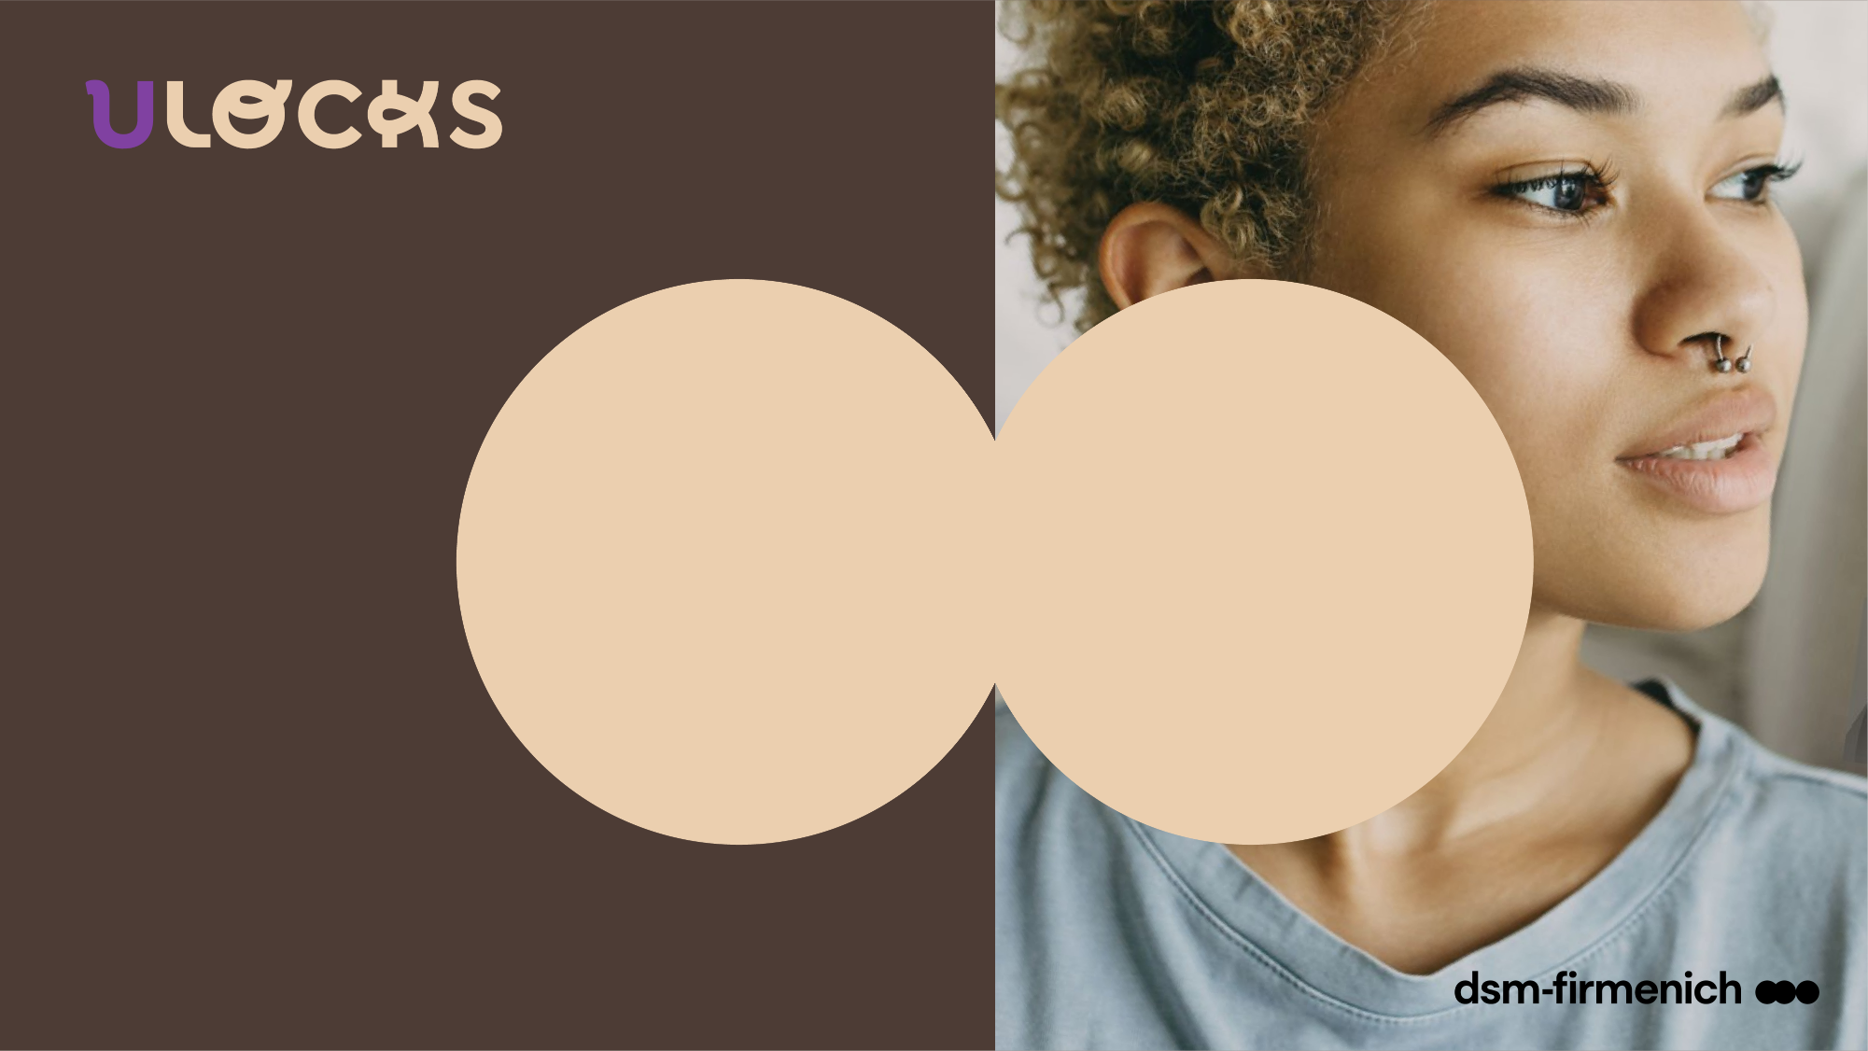





The textured hair care range
PERSONAL CARE
PERFUMERY
SELECTED
LockCare
complexes
UNIQUE
LockScent™
technology
BASES & FRAGRANCE
CONSCIOUSLY DESIGNED
Developed by you¹,
with you²
and for you³
Vitamins and natural origin actives for effective care in sensorial textures
Long-lasting fragrance for continuous freshness until the next wash⁴
with the double
Lock power
1. Range developed with a specialist textured hair consultant
2. External Consumer test – 29 users of textured hair products with Type 4 hair (28 % with 4A hair type, 41 % 4B, and 31 % 4C) – average age between 26-35 years old – 1 month usage test – France - 2023 / U Locks fragrance – dsm-firmenich 2023 - US Home Use Test – 113 women - best tester among women with curls/coils
3. Actives & vitamins carefully selected to fit textured hair needs
4. Sensory test – 2023 – n=30 - overall fragrance intensity of the wash day routine (day 1) versus refreshing routine (day 1 + day 4 + day 7) on Hair Swatches

Slide 4

The dsm-firmenich textured hair range combines high performance with pleasurable sensations to offer care that celebrates the uniqueness and natural beauty of your hair.

Slide 5
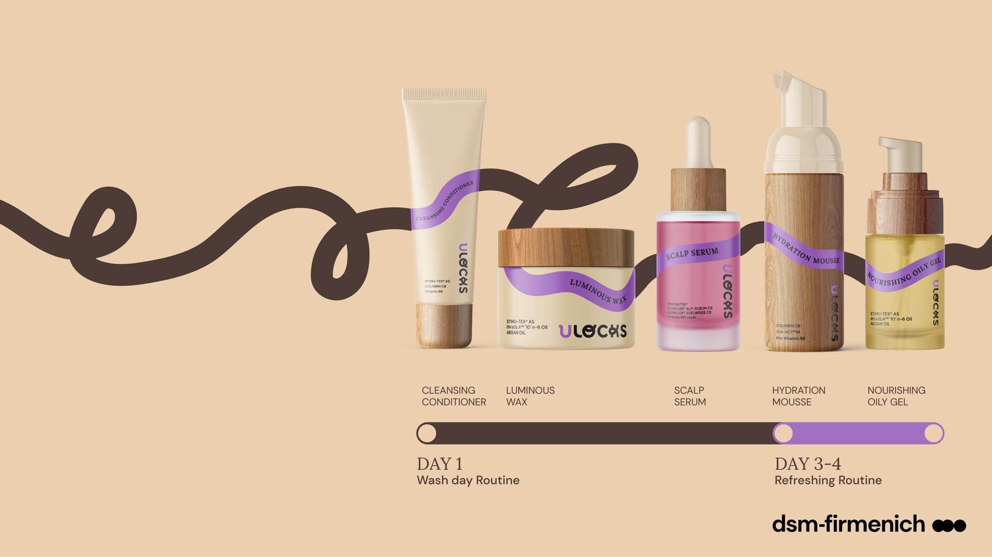

Products are for illustration only, not for sale. dsm-firmenich is not responsible for final products claims.
Feel the pleasure
of unique care
for textured hair.
External consumer test – 29 users of textured hair products with Type 4 hair (28 % with 4A hair type, 41 % 4B, and 31 % 4C) – average age between 26-35 years old – 1 month usage test – France – 2023
Fragrance – best tester among curls/coils US 2023
* ISO 16128

Slide 6


Slide 7
Disclaimer
Copyright © DSM Nutritional Products Ltd 2025, 4002 Basel, Switzerland.
www.dsm-firmenich.com. All rights reserved.
dsm-firmenich has used diligent care to ensure that the information provided herein is accurate and up-to-date to the best of its knowledge. However, dsm-firmenich makes no representation or warranty, either expressly or implied, of the accuracy, reliability, completeness, or suitability thereof. The information provided herein contains scientific and product information for business-to-business use and does not constitute or provide scientific or medical advice, diagnosis or recommendation for treatment options. Country or region-specific information should be considered when labelling or advertising to final consumer. In no event shall dsm-firmenich be liable for any direct or indirect damages arising from or reliance upon, or use of, any information provided herein. The content of this document is subject to change without further notice. Please contact your local dsm-firmenich representative for the latest information. All trademarks listed in this document are either (registered) trademarks of, or trademarks licensed by, the dsm-firmenich group of companies, unless explicitly stated otherwise.
Disclaimer Formulation Guideline
The information provided herein is provided for information purposes only and has been prepared by dsm-firmenich in accordance with its own methodology.
dsm-firmenich has used diligent care to ensure that it is accurate and up-to-date, however, dsm-firmenich makes no representation or warranty, either expressly or implied, of the accuracy, reliability, or completeness thereof. In no event shall dsm-firmenich be liable for any damages arising from or reliance upon, or use of, any information provided herein. Further, dsm-firmenich shall not bear any liability for the application and/or use of any processed material containing its product(s). The formulation of the finished product is the customer’s sole responsibility. It is the customer’s responsibility to determine the suitability of dsm-firmenich’s products regarding user specific purposes, assess compatibility and stability of their finished product(s) and to ensure compliance of their finished product(s) with relevant laws and regulations. Any product, marketing or other claims made by customer are its sole responsibility. The content of this document is subject to change without further notice. Please contact your local dsm-firmenich representative for further details. © DSM Nutritional Products AG, 2025.

