Slide 1

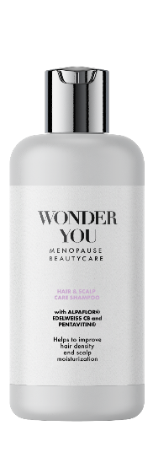
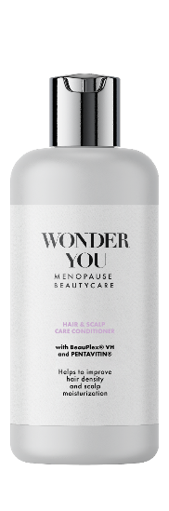
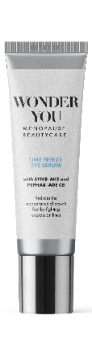
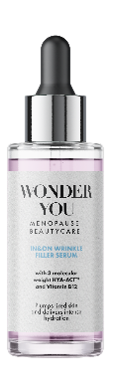

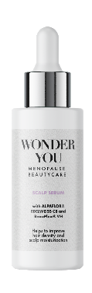
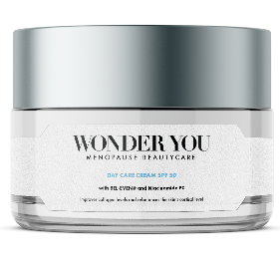
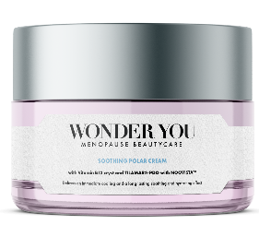
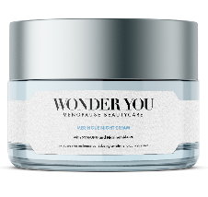
WONDER YOU
Menopause BeautyCare
Products are for illustration only, not for sale. dsm-firmenich is not responsible for final products claims.

Slide 2
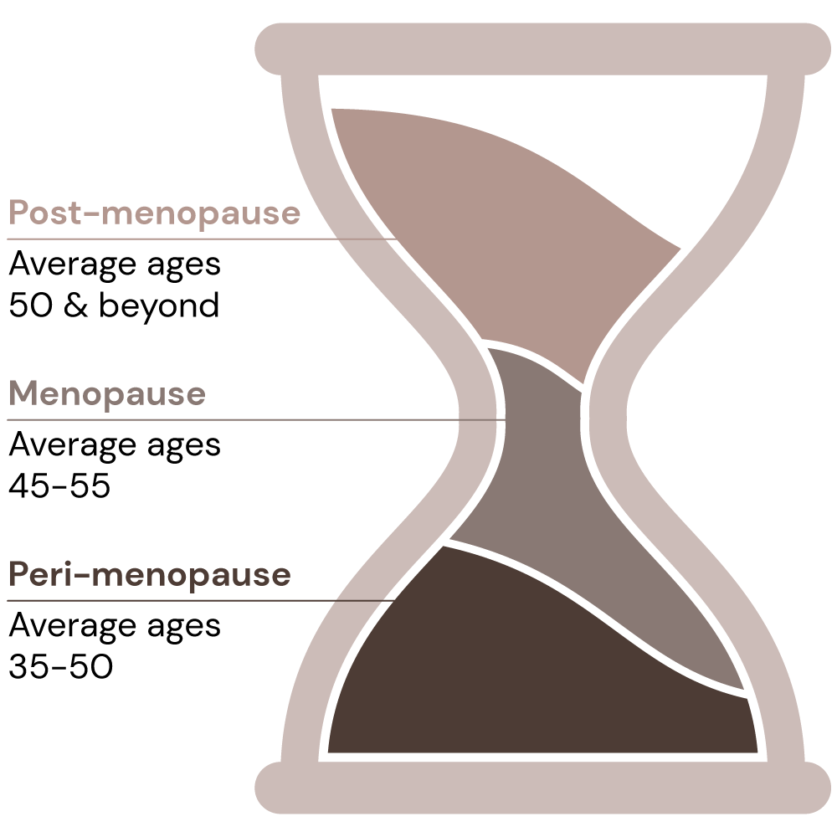
Let’s talk about menopause
Menopause vocabulary
Peri-menopause
The initial signs of peri-menopause usually begin with menstrual cycle changes. Some women might notice much longer cycles and heavier periods, while others might notice cycles that are shorter than usual.¹
Menopause
It is the experience of no longer having menstrual periods. Menopause marks the end of the reproductive years.¹
Post-menopause
It is the time after menopause has occurred when women have been without a menstrual period for 12 months. Once this happens, women are in post-menopause for the rest of their life.¹
Source:
1. The American College of Obstetricians and Gynecologists. FAQ047: The Menopause Years [internet]. Washington DC: American College of Obstetricians and Gynecologists; 2018. [cited 2021 Feb 10]. Available from https://www.acog.org/womens-health/faqs/the-menopause-years and helloclue.com
Notes:
1): The American College of Obstetricians and Gynecologists. FAQ047: The Menopause Years [internet]. Washington DC: American College of Obstetricians and Gynecologists; 2018. [cited 2021 Feb 10]. Available from https://www.acog.org/womens-health/faqs/the-menopause-years
Pre-menopause is the time between a woman's first period and the onset of perimenopause. In other words, the term premenopause is only used to describe the phase in a women's life where menstrual cycles are normal.
Peri-menopause is the transition phase into menopause that typically lasts about six years.

Slide 3
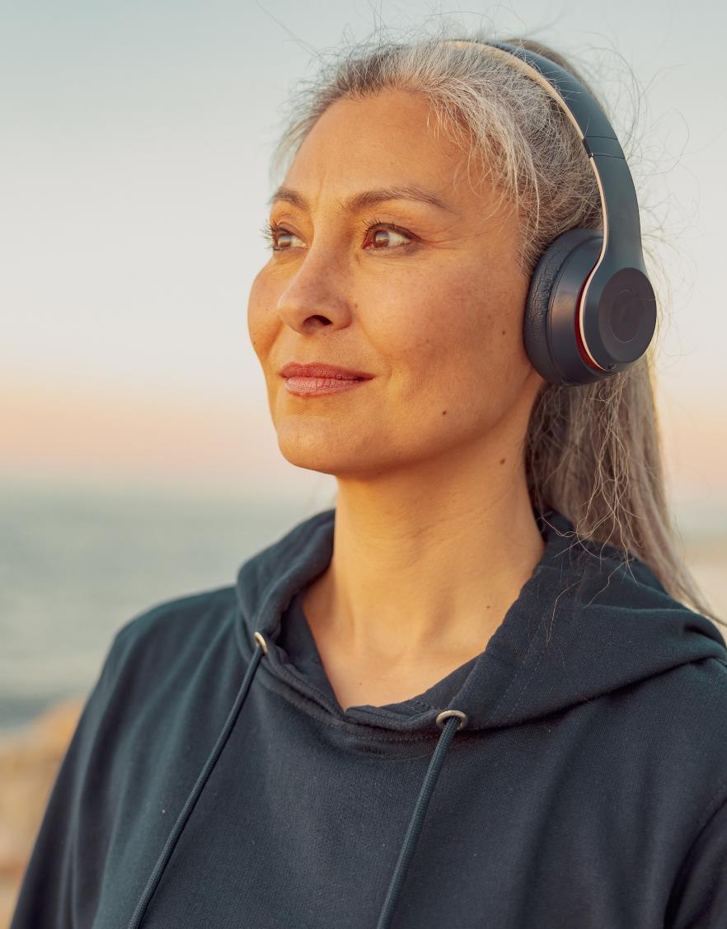

Agenda
Menopause journey
Why Menopause?
      Demographic
      Touching half of world population
      Market view
        A taboo some are starting to smash
Understanding the menopause consumers
      The voice of consumers
    Diverse life changing experience
      The skin and hair science behind menopause
        A significant transformation
Our solution WONDER YOU
    Menopausal BeautyCare solutions
3

Slide 4

Silver global population: the longevity economy
Growing population category with high purchasing power…
AARP’s new print and online campaign emphasizes the purchasing power of the organization’s audience of people over 50.
  The elderly global population
  will reach 1.6 billion in 2050.
  22% of projected global population²
  They will be living 10 years
  more than they live today³
  They are set to control
  around 70% of disposable
  income worldwide⁴
70%
Source:
2. https://www.who.int/news-room/fact-sheets/detail/ageing-and-health; 3. https://www.statista.com/statistics/672546/projected-world-population-distribution-by-age-group/ (82 years old); 4. https://mailchimp.com/courier/article/older-adults-buying-power/; USA 50%, Japan 67%, Germany 86% in 2030
Notes:
Adapted from:
1. https://www.who.int/news-room/fact-sheets/detail/ageing-and-health;
2. https://www.statista.com/statistics/672546/projected-world-population-distribution-by-age-group/ (82 years old)
3. https://mailchimp.com/courier/article/older-adults-buying-power/; USA 50%, Japan 67%, Germany 86% in 2030
4. https://www.pewresearch.org/fact-tank/2022/01/13/share-of-those-65-and-older-who-are-tech-users-has-grown-in-the-past-decade/: smartphone from 13% to 61%, tablet 6% to 44%; social media 11% to 45%;
5. https://www.fastcompany.com/90341477/why-marketing-to-seniors-is-so-terrible#:~:text=According%20to%20Havas%20Group%2C%20only,growth%20between%202015%20and%202030.
6. https://www.aarp.org/work/age-discrimination/ageism-in-advertising/
Other references
https://www.pewresearch.org/fact-tank/2022/01/13/share-of-those-65-and-older-who-are-tech-users-has-grown-in-the-past-decade/
https://academic.oup.com/gerontologist/article/59/1/34/5108474
https://www.sciencedirect.com/science/article/pii/S2405844022000536
https://www.aarp.org/work/age-discrimination/ageism-in-advertising/

Slide 5



Silver global population
Have high digital adoption but feel not represented
Their digitalization adoption* has tripled over the last 10 years⁵…
but… only 5% of advertisement is aimed at the elderly⁶… therefore…
    2 in 3 do not feel included
    1 in 2 concur that ads reinforce outdated stereotypes⁷
Source:
5. https://www.pewresearch.org/fact-tank/2022/01/13/share-of-those-65-and-older-who-are-tech-users-has-grown-in-the-past-decade/: smartphone from 13% to 61%, tablet 6% to 44%; social media 11% to 45%; 6. https://www.fastcompany.com/90341477/why-marketing-to-seniors-is-so-terrible#:~:text=According%20to%20Havas%20Group%2C%20only,growth%20between%202015%20and%202030;
7. https://www.aarp.org/work/age-discrimination/ageism-in-advertising/
Notes:
Adapted from:
1. https://www.who.int/news-room/fact-sheets/detail/ageing-and-health;
2. https://www.statista.com/statistics/672546/projected-world-population-distribution-by-age-group/ (82 years old)
3. https://mailchimp.com/courier/article/older-adults-buying-power/; USA 50%, Japan 67%, Germany 86% in 2030
4. https://www.pewresearch.org/fact-tank/2022/01/13/share-of-those-65-and-older-who-are-tech-users-has-grown-in-the-past-decade/: smartphone from 13% to 61%, tablet 6% to 44%; social media 11% to 45%;
5. https://www.fastcompany.com/90341477/why-marketing-to-seniors-is-so-terrible#:~:text=According%20to%20Havas%20Group%2C%20only,growth%20between%202015%20and%202030.
6. https://www.aarp.org/work/age-discrimination/ageism-in-advertising/
Other references
https://www.pewresearch.org/fact-tank/2022/01/13/share-of-those-65-and-older-who-are-tech-users-has-grown-in-the-past-decade/
https://academic.oup.com/gerontologist/article/59/1/34/5108474
https://www.sciencedirect.com/science/article/pii/S2405844022000536
https://www.aarp.org/work/age-discrimination/ageism-in-advertising/

Slide 6

Menopause: a taboo to smash
Who is the next generation of women approaching menopause?
  1.2 billion women (nearly the Indian population) worldwide will be menopausal or postmenopausal by the year 2030¹
  of women don’t treat their menopause symptoms²
  Most women from Generation X, who are now in their late 40s and approaching menopause, are technologically proficient and digitally literate²
  1 in 4 women says they struggle to cope with life due to symptoms of the menopause and 1 in 3 significantly loses self-confidence³
  Being ridiculed, harassed, or stereotyped are some of the fears towards not speaking up⁴
73%
Menopause: unmuted is a podcast sponsored by Pfizer series exploring first-hand experiences of this life stage.
Source:
1. https://bmcwomenshealth.biomedcentral.com/articles/10.1186/s12905-015-0217-y#:~:text=With%20the%20aging%20of%20the,the%20year% 202030%20%5B1%5D.;
2. https://www.forbes.com/sites/debgordon/2021/07/13/73-of-women-dont-treat-their-menopause-symptoms-new-survey-shows/?sh=d269e67454f1;
3. https://www.openaccessgovernment.org/menopause-the-last-great-taboo/100976/; 4. https://hbr.org/2020/02/is-menopause-a-taboo-in-your-organization
Notes:
Adapted from:
1. https://bmcwomenshealth.biomedcentral.com/articles/10.1186/s12905-015-0217-y#:~:text=With%20the%20aging%20of%20the,the%20year%202030%20%5B1%5D.
2. https://www.forbes.com/sites/debgordon/2021/07/13/73-of-women-dont-treat-their-menopause-symptoms-new-survey-shows/?sh=d269e67454f1
3. https://www.openaccessgovernment.org/menopause-the-last-great-taboo/100976/
4. https://hbr.org/2020/02/is-menopause-a-taboo-in-your-organization
Other references
https://www.mckinsey.com/industries/healthcare-systems-and-services/our-insights/the-dawn-of-the-femtech-revolution

Slide 7


Menopause: a taboo addressed through 2 SDGs
The Impact of Menopausal Symptoms on Women's Health and Gender Equity
The symptoms of menopause vary among women, impacting their physical, emotional, mental, and social well-being(1). Some commonly experienced symptoms include(2,3):
Hot flushes and night sweats
Insomnia
Mood changes
Weight gain
Low energy levels
Difficulty with memory/concentration
Skin changes
Hair changes
Menopause extends beyond individual health concerns and has far-reaching impacts.
Taking place typically between the ages of 45 and 55, menopause coincides with a critical period for women's career development and their pursuit of top leadership positions.
Menopause remains a taboo subject, leading many women to feel uncomfortable discussing their symptoms openly at work. Additionally, menopausal women may be unfairly perceived as lacking confidence and emotional stability (4).
Women often experience negative consequences such as diminished motivation, reduced working hours, reluctance to seek promotion, and, in some cases, even leaving their jobs due to the challenges posed by menopausal symptoms (5).
(1): Menopause, WHO (Menopause (who.int))
(2): National institute on ageing (What Is Menopause? | National Institute on Aging (nih.gov))
(3): My menopause centre (Menopause signs and symptoms | My Menopause Centre)
(4): HBR (Research: Workplace Stigma Around Menopause Is Real (hbr.org) )
(5): Menopause and the workplace (https://www.fawcettsociety.org.uk/Handlers/Download.ashx?IDMF=9672cf45-5f13-4b69-8882-1e5e643ac8a6 )
Notes:
(1): Menopause, WHO (Menopause (who.int))
(2): National institute on ageing (What Is Menopause? | National Institute on Aging (nih.gov))
(3): My menopause centre (Menopause signs and symptoms | My Menopause Centre)
(4): HBR (Research: Workplace Stigma Around Menopause Is Real (hbr.org) )
(5): Menopause and the workplace (https://www.fawcettsociety.org.uk/Handlers/Download.ashx?IDMF=9672cf45-5f13-4b69-8882-1e5e643ac8a6 )
(5).

Slide 8




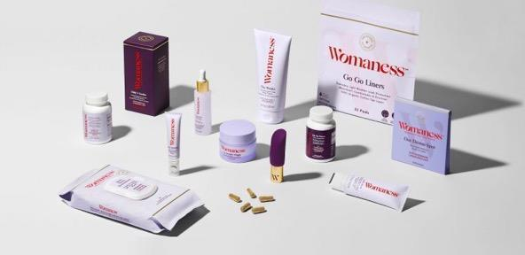
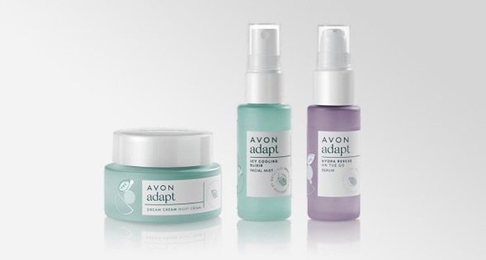
From products to campaigns, the taboo is being spoken up
Innovations tapping into menopause worldwide
Bia Care: Menopause-focused company extends NHS partnership and expands digital clinic
L’Oréal partnered with period-tracking app Clue to research how the skin is affected by the menstrual cycle
In partnership with Allbright, a club created by women, for women, Vichy hosted Let’s not Pause for two days in May 2021
In Arabic, menopause means “the age of despair”. Tena launched campaign addressing this stigma #DespairNoMore
‘Menopositive’ products for menopausal women debut at US supermarket giant, Target
Avon announce the launch of adapt Sync: a skincare collection for women experiencing menopause and perimenopause
Source: trendwatching.com
Notes:
Source: trendwatching.com
A menopause-focused health company announced in February 2022 that it has extended its partnership with the UK’s NHS to help expand its digital clinic for women’s health. Bia Care was the first of its kind to partner with the NHS in 2021; additional funding will allow the company to expand the availability of its digitally-enabled women’s health clinic. Bia Care connects women to menopause specialist doctors using group consultations, which improves the doctor to patient ratio and means up to six times more patients are treated. Results from the NHS pilot trial showed that the service model delivered clinically effective services at a fraction of the cost of a traditional menopause clinic. https://linktr.ee/biacare
In August 2021, France-based L’Oréal partnered with period-tracking app Clue to research how the skin is affected by the menstrual cycle. With over 12 million users in 190 countries, Clue will deploy voluntary surveys to be studied by L’Oréal’s research and development teams and Active Cosmetic Division. L’Oréal will share its findings in Clue’s reproductive health encyclopedia, found on Clue’s website, and hopes to develop science-backed personalized skincare routines that take into account menstrual cycles from puberty to menopause. Clue is based in Germany.
France-based skincare brand Vichy is aiming to alleviate the stigma surrounding working women’s menopause. In partnership with Allbright, a club created by women, for women, Vichy hosted Let’s not Pause for two days in May 2021. The virtual summit discussed the impact of menopause on working women’s lives, ways to address under-reporting of the topic, and how businesses can be demystified to its influence. Four women hosted the panel, sharing details of their experiences.
In Arabic, menopause literally translates as “the age of despair”. Upon discovering that 81% of Saudi Arabian women believe the phrase needed changing, the incontinence brand Tena launched a video campaign with the hashtag #DespairNoMore. The video depicts women sharing their positive experiences of menopause in a bid to destigmatize it and, ultimately, eradicate the Arabic translation for good. Consumers are invited to share their suggestions for a replacement phrase via Tena’s website.
Womaness is a consumer products brand created to serve the needs of women at all stages of the menopause. In Q1 2021 it launched its first range of products at US supermarket giant, Target. The products include a dietary supplement, a sexual wellness kit, and cosmetics designed to target menopause-induced skincare issues, with prices starting at USD 8.99 for a packet of sanitary towels. The brand’s overarching aim is to promote ‘menopositivity’ and to address the needs of a largely underserved demographic.
August 2020 saw UK-headquartered beauty brand Avon announce the launch of adapt Sync: a skincare collection for women experiencing menopause and perimenopause. The range was created in response to Avon’s Too Little Information report, which revealed approximately 44% of women globally were unaware of perimenopause and the effects on the body. Offering holistic solutions for menopausal skin issues, the collection is formulated with soothing botanical adaptogens, such as turmeric, with anti-inflammatory and antioxidant properties, and Avon’s patented tiliacora, helping to cool the skin and increase hydration and firmness. Included in the range, which are an Icy Cooling Elixir Facial Mist, Dream Cream Night Cream and Hydra Rescue On The Go Serum.

Slide 9
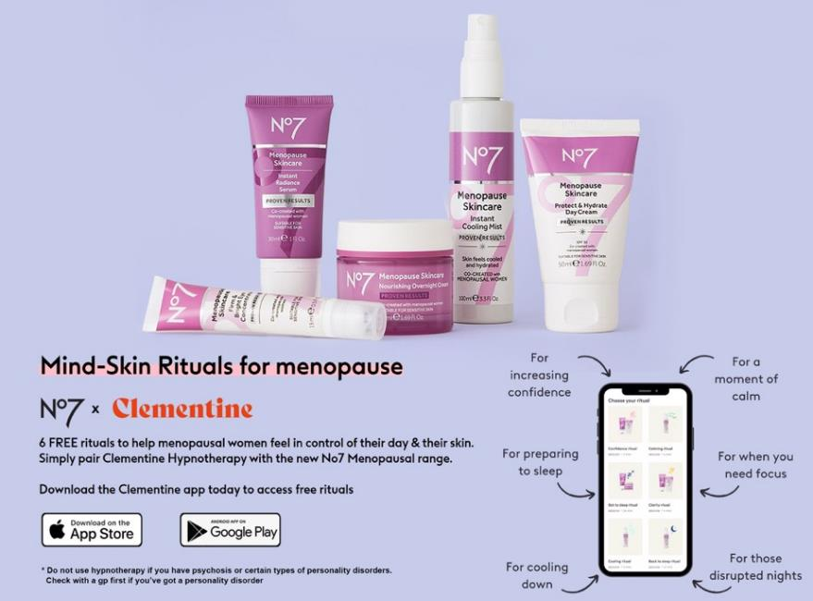
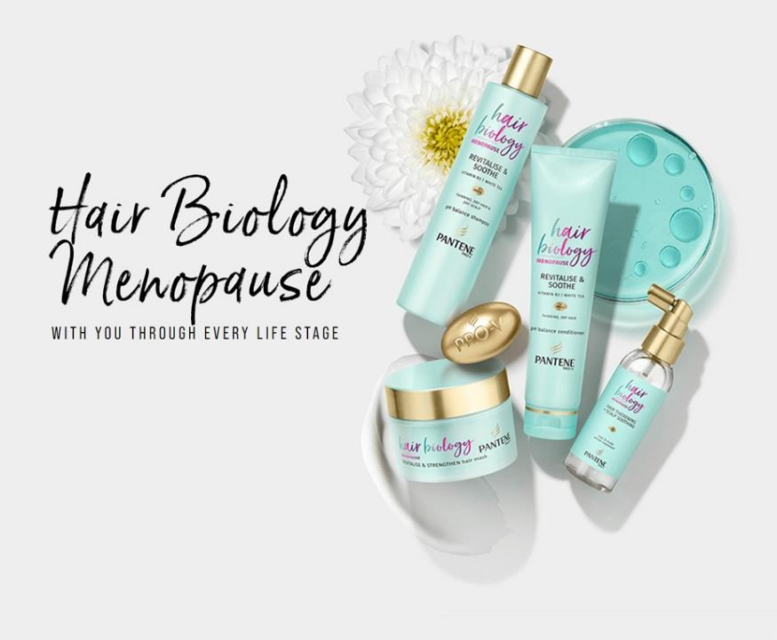
From products to campaigns, the taboo is being spoken up
Innovations tapping into menopause worldwide
Boots N°7 Menopause Skincare co-created with over 7,000 menopausal women and dermatologist approved for menopausal skin. *
Pantene Pro V Hair Biology Menopause: a range to help manage the changes brought about by age and hormone imbalance.**
Source:
*No7 | NEW No7 Menopause Skincare – Boots; ** Menopause Revitalize Care Series | Pantene UK

Slide 10
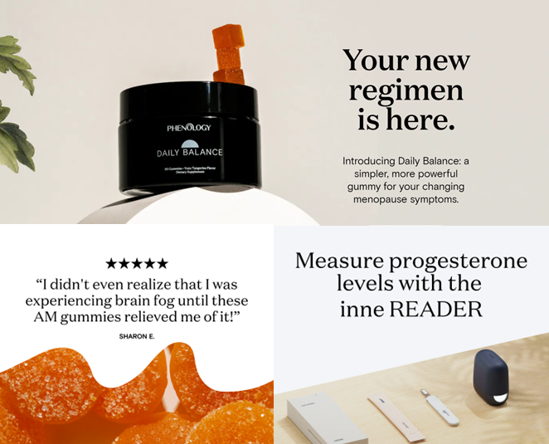
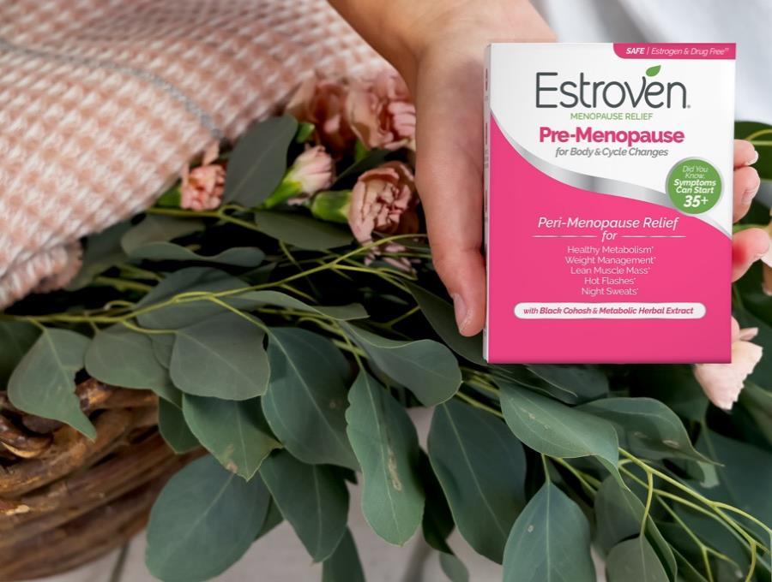

From products to campaigns, the taboo is being spoken up
As well in the supplements area
Phenology: gummies for changing menopause symptoms*
Inne Reader: at-home hormone monitoring system to give an easy, convenient way to measure the progesterone levels with a few drops of saliva.
Estroven® Menopause Relief**: Multi-symptoms and Targeted symptoms relief.
Ex: Pre-Menopause for Body and Cycle changes – “Meet our expert” link
Source:
* Homepage | Phenology (myphenology.com)
The PhenologyTM brand is owned by Hologram Sciences, an independent subsidiary of dsm-firmenich.
** https://estroven.com/
Estroven® is a brand from i-Health, Inc. – a wholly owned subsidiary of dsm-firmenich

Slide 11
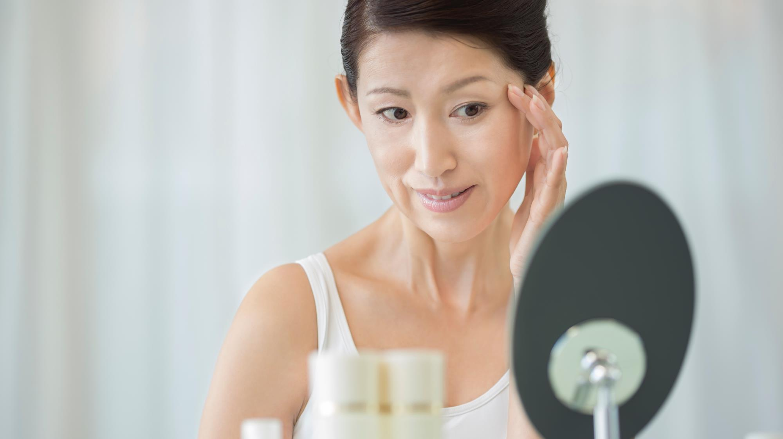
Menopause: The voice of Consumers
Symptoms and effects on the skin and hair

Slide 12
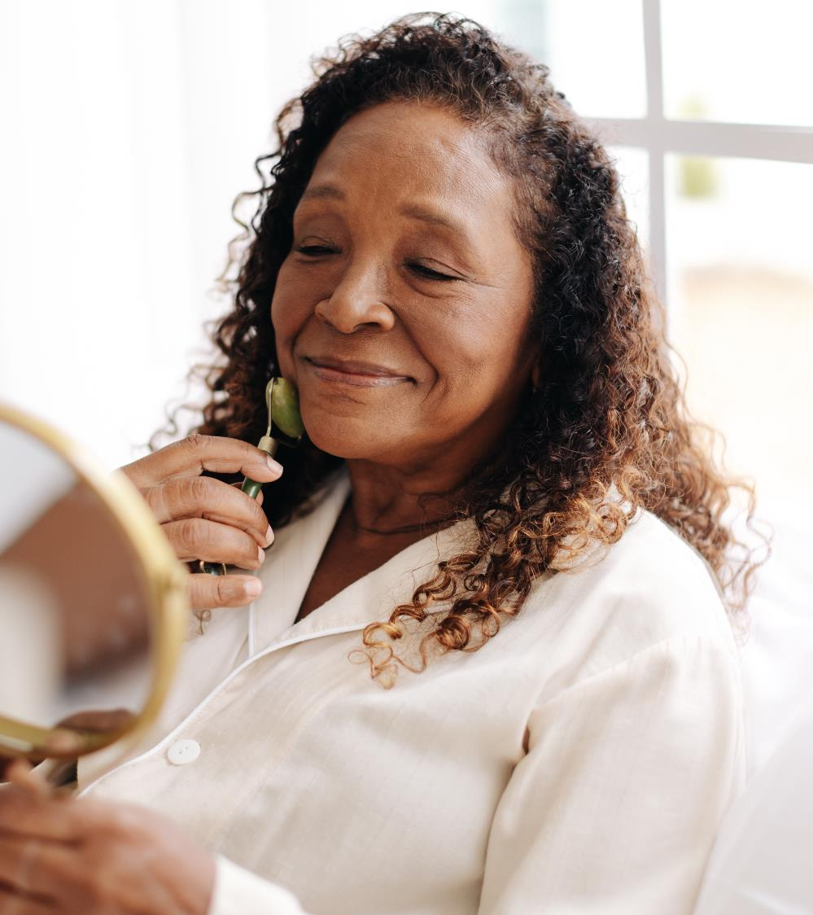






Skin care consumer survey
Online survey scope and key concerns
600 participants
Self-identified in a menopausal stage
Countries: USA, China and France
Age: 45 to 60 years old
Revealing 5 main concerns on skin experimented by women
And confirming the will to smash the taboo with their gynecologist remaining their most trusted advisor
12

Slide 13





Skin care consumer survey
Key take aways
Menopause is a very personal experience and each women experiments and deserves her own skincare solution.
Although we can still underline some key insights:
  Change in skin is a key symptom experimented during menopause by 60% of women (Up to 80% in China)
  58% of consumers experiment hot flushes (Top 1 concern in France / 76%)
  Women are willing to speak about menopause across the world, their gynecologist remaining their first trusted source of information
  Consumers are using high variety of skincare solutions, with preference for moisturizers (USA) and aging related solutions (France and China)
  Regarding menopause-related skin symptoms, wrinkles and sagging are top concern in USA and France although secondary in China focusing on skin pigmentation and skin sensitivity
  Acne and oily skin is a concern for specific consumers (15%)

Slide 14
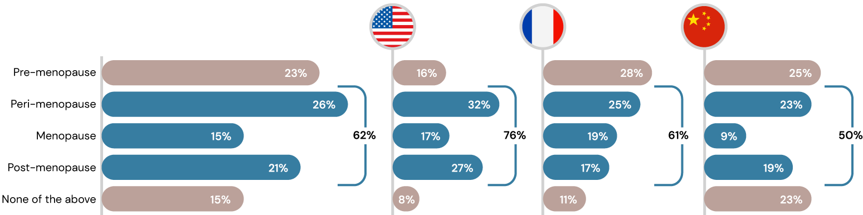
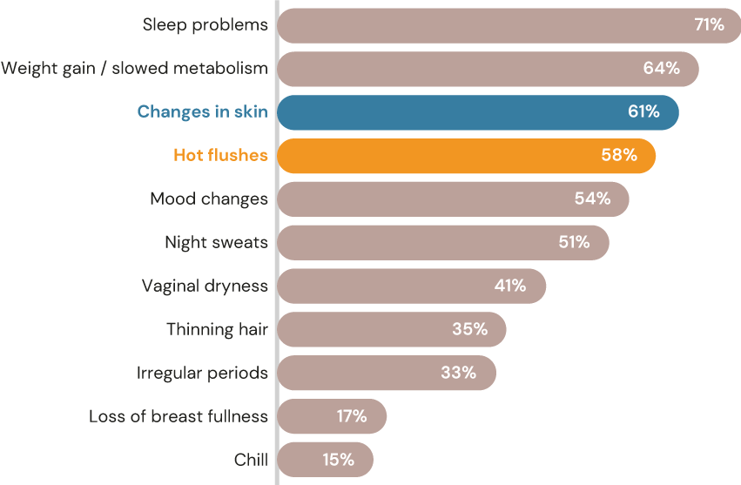
Do you relate to listed menopause symptoms?
“Changes in Skin” are within Top 3 main perceived symptoms of Menopause globally, with over 60% of women concerned
Focusing on the voice of the 600 participants self-identified in a menopausal stage
61%
Experimented changes in skin
Top 1 concern in China / 80%
58%
Experimented hot flushes
Top 1 concern in France / 76%
Q. Would you relate to any of the stages below?
Notes:
Pre-menopause is the time between a woman's first period and the onset of perimenopause. In other words, the term premenopause is only used to describe the phase in a women's life where menstrual cycles are normal.
Peri-menopause is the transition phase into menopause that typically lasts about six years.

Slide 15




Who is your go-to person for menopause information?
Women are ready to smash the taboo with their most trusted advisor being their gynecologist
Ranking
 | Global | USA | France | China
Gynecologist | 1 | 1 | 1 | 1
Friends | 2 | 2 | 2 | 4
Companion | 3 | 3 | 4 | 2
Family members nearby | 4 | 4 | 3 | 5
Endocrinologist | 5 | 7 | 6 | 3
Communication vehicles (sites, programs...) | 6 | 6 | 5 | 10
Nutritionist | 7 | 9 | 7 | 7
Dermatologist | 8 | 5 | 9 | 6
Brands (sites, social media...) | 9 | 11 | 8 | 8
Psychologist | 10 | 10 | 11 | 9
Prefer not to talk with others about the topic | 11 | 8 | 10 | 12
Influencers or social media pages | 12 | 13 | 12 | 11
Q: Who do you talk to and/or search for menopause information? Please rank them in order of importance from the most important to the least important. SurveyMonkey

Slide 16
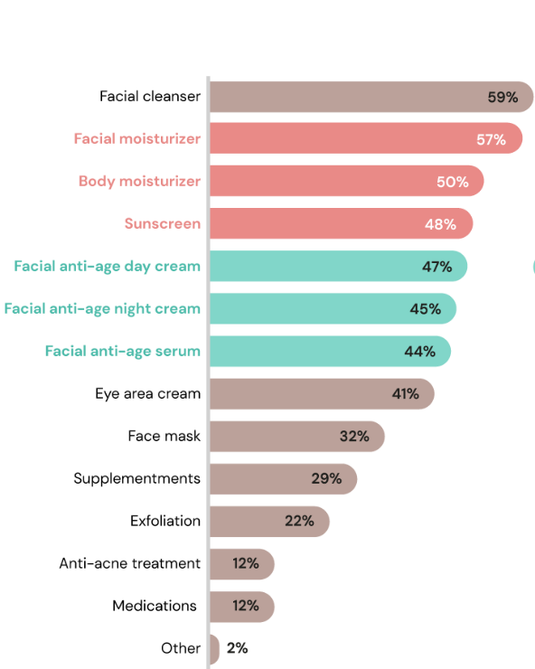
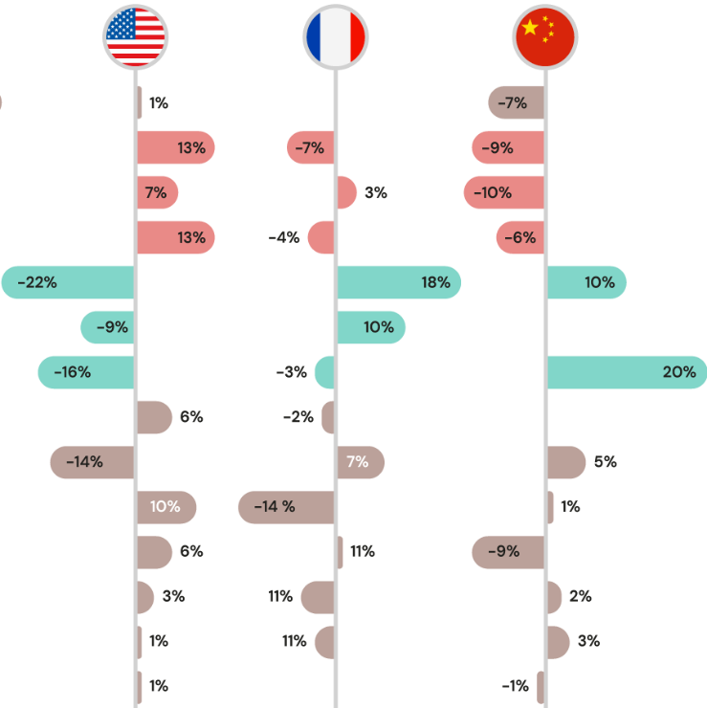
Which products are part of your skincare routine?
Consumers are using high variety of skincare solutions…
…with preference for moisturizers (USA) and aging related solutions (France and China)
Global average answer for 600 participants
Country average difference versus Global average
Q: Now let's talk about your skincare routine. Which of the products below have you used in the last 30 days? Please choose at most 5 options. SurveyMonkey

Slide 17
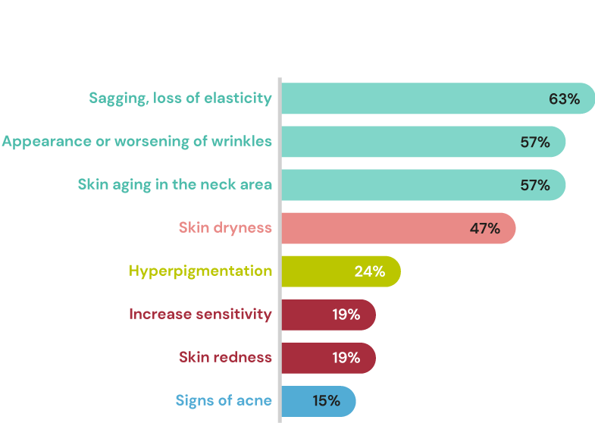
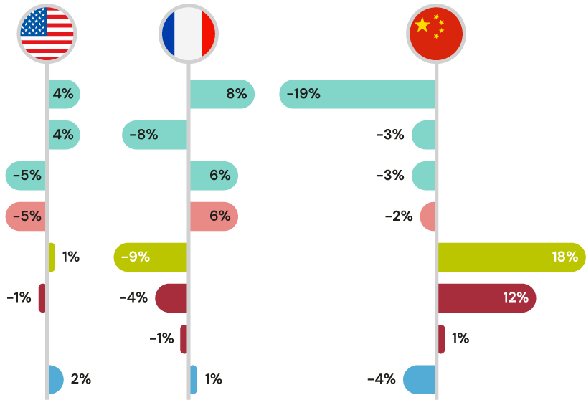
Which menopause related skin symptoms bother you?
Wrinkles and sagging are top concern in USA and France …
… although secondary in China focusing on skin pigmentation and skin sensitivity
Global average answer for 600 participants
Country average difference versus Global average
Q: Now, thinking about menopause-related skin symptoms, which of them most bother you? Please choose the top 3 ones.

Slide 18
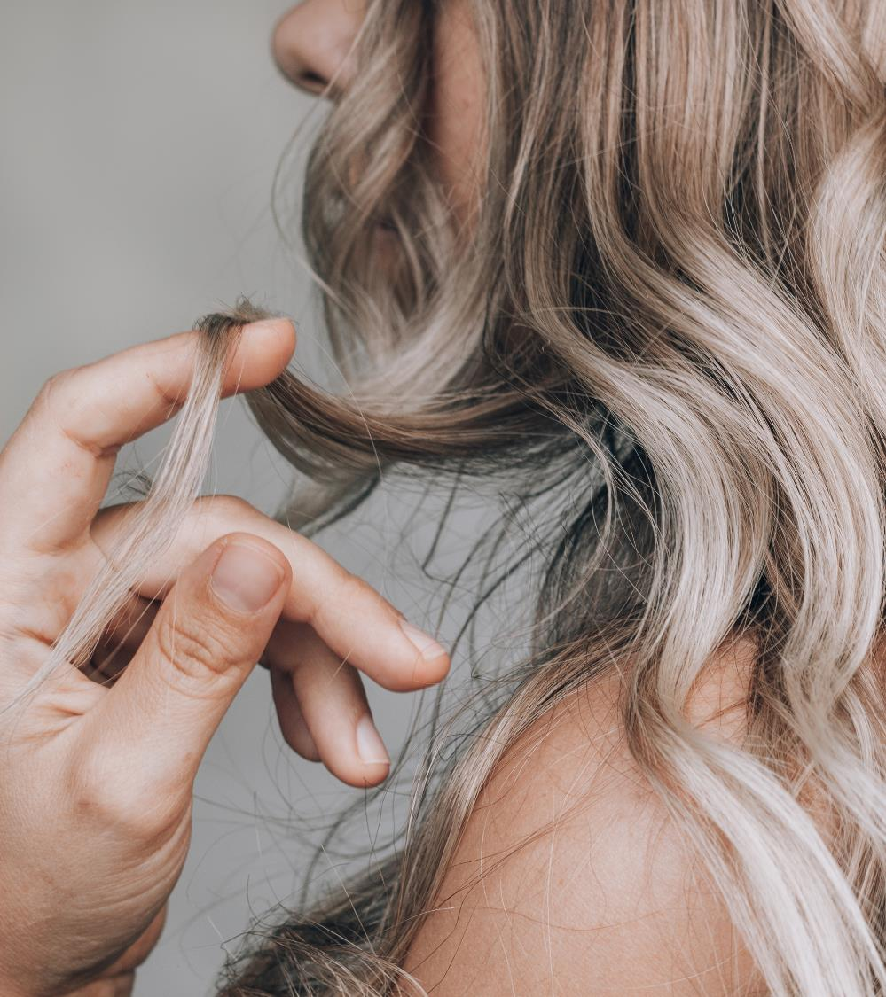
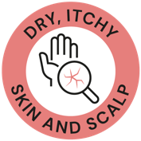




Hair Care
Consumer survey
dsm-firmenich Consumer Insights Hub*
113-115 consumers
Countries: Australia, USA, and UK
Age: 45 to 60 years old
Revealing 3 main concerns on the
hair and scalp experimented by women
Key partner: the hairdresser
Key dedicated
products:
*Q4 2022

Slide 19



Hair care consumer survey
Key take aways
Menopause is a very personal experience and each women experiments and deserves her own hair care solution.
Although we can still underline some key insights:
  The main hair symptoms related to menopause are hair loss for 29% of the consumers* and hair thinning (25% of the consumers*) followed by scalp and hair dryness sensation.
  The hair concerns related to menopause are very emotional and can lead to a loss of self-confidence and to sadness.
  Hairdresser is the most preferred partner to talk to when it comes to hair and scalp symptoms related to menopause for 43% of the consumers*.
  When consumers experience hair concerns related to menopause, they start to look for dedicated solutions to their own symptoms. Shampoo is the main preferred product for 58% of the consumers* followed by conditioner and leave-on for the scalp.
* From the dsm-firmenich Consumer Insights Hub survey Q4 2022

Slide 20
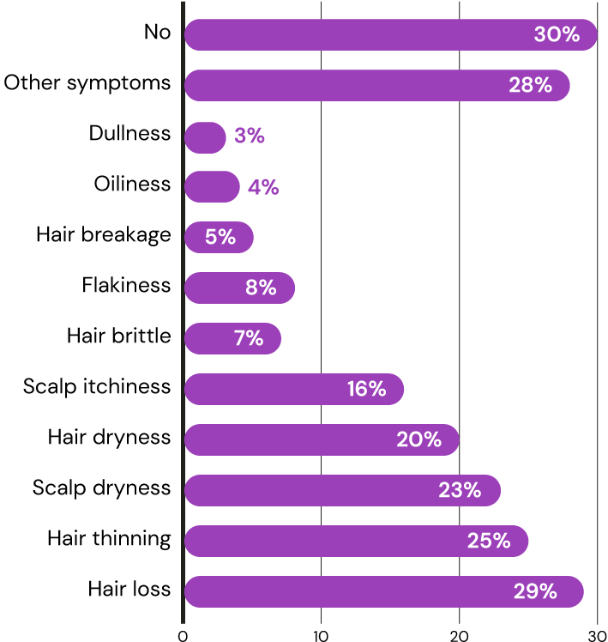

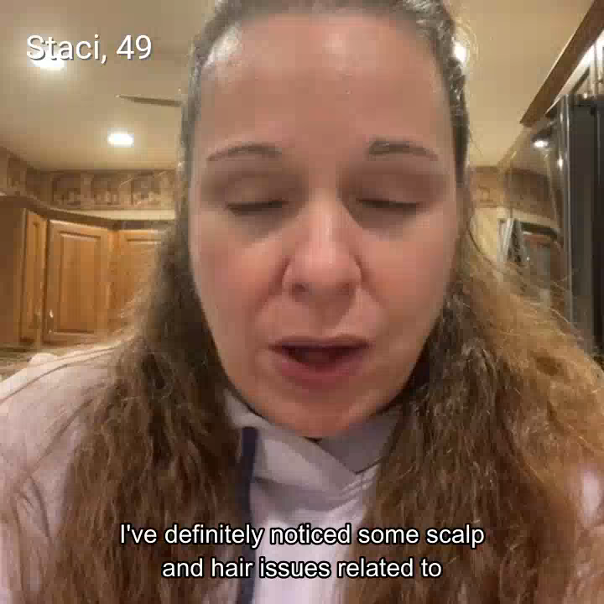
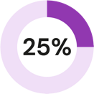
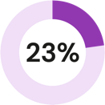

Did you notice any scalp and hair symptoms related to menopause?
Hair loss and hair thinning as well as scalp and hair dryness sensation are the main symptoms
My scalp is getting more dried out, getting more dandruff, and my hair is getting brittle…. a load of hair in my brush… My hair is thinning, and my scalp is itchy and irritated all because I'm going through menopause.
Experienced
hair loss
Experienced hair thinning
Experienced scalp dryness
Experienced
‘hair dryness’ sensation

Slide 21
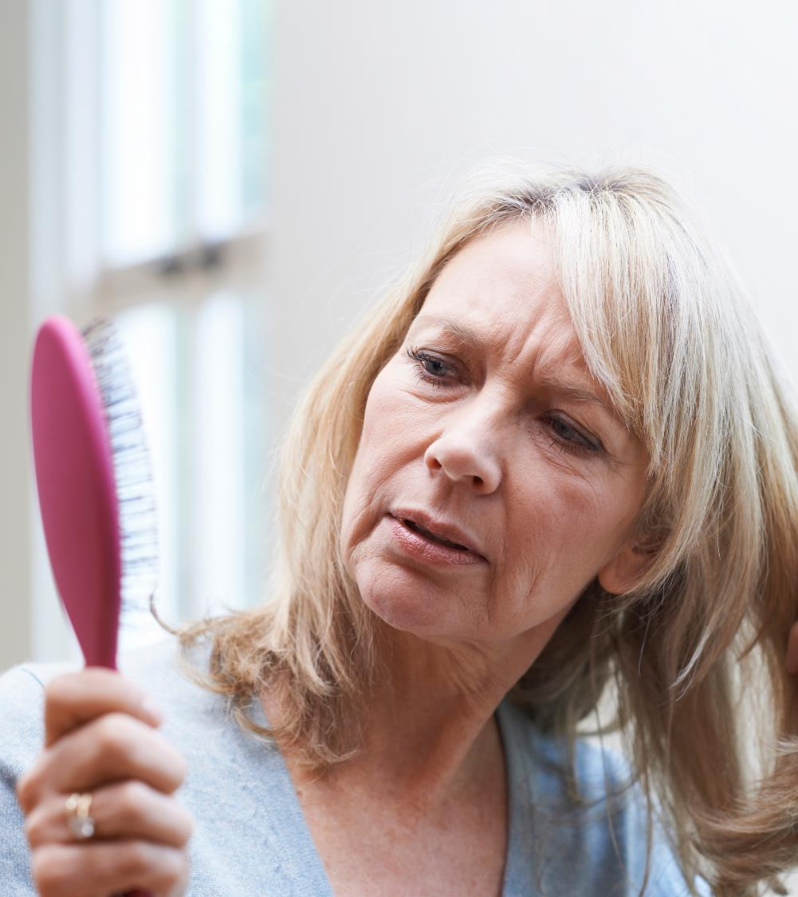

If thinning hair is one of your symptoms, could you explain us more what it means for you?
The hair physical symptoms related to Menopause also lead to a loss of self-confidence and to sadness.

Slide 22
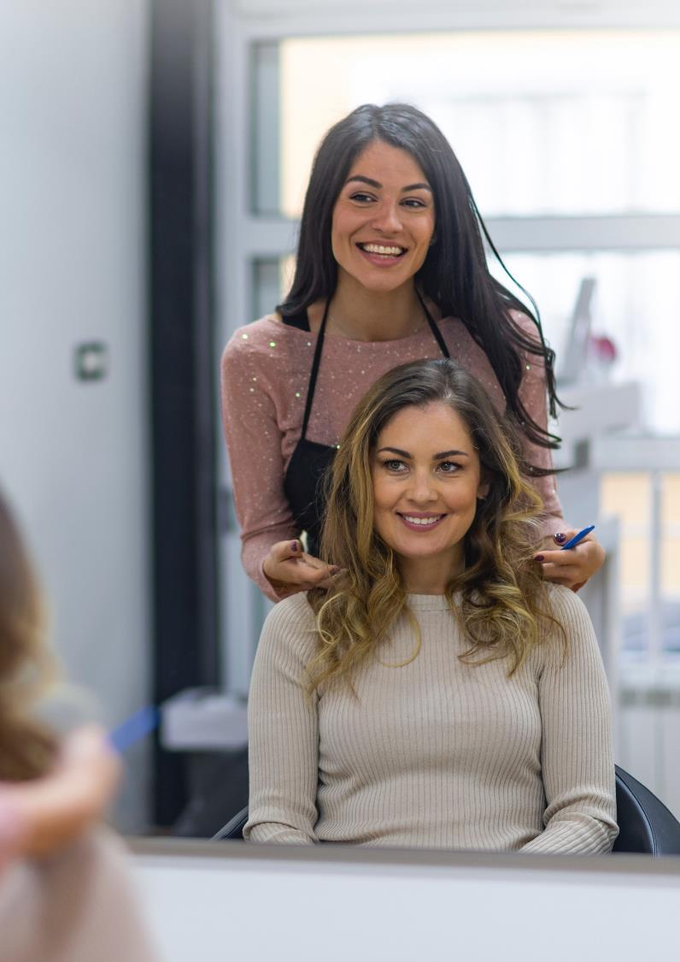
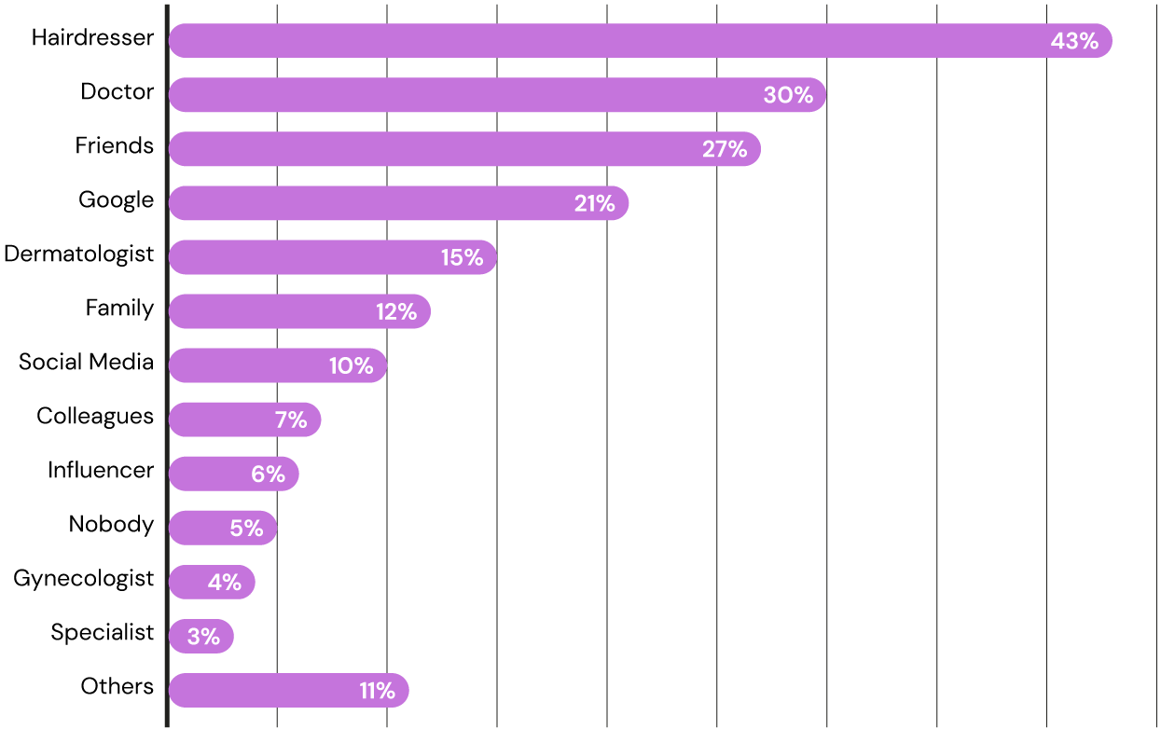
Who is the most trusted source of information that you talk to when it comes to hair/scalp symptoms due to menopause?
Hairdresser, doctor and friends play a key role
43%
of the consumers in our panel test will talk to their hairdresser about their hair menopause symptoms and will consider them a trusted source of information
22

Slide 23
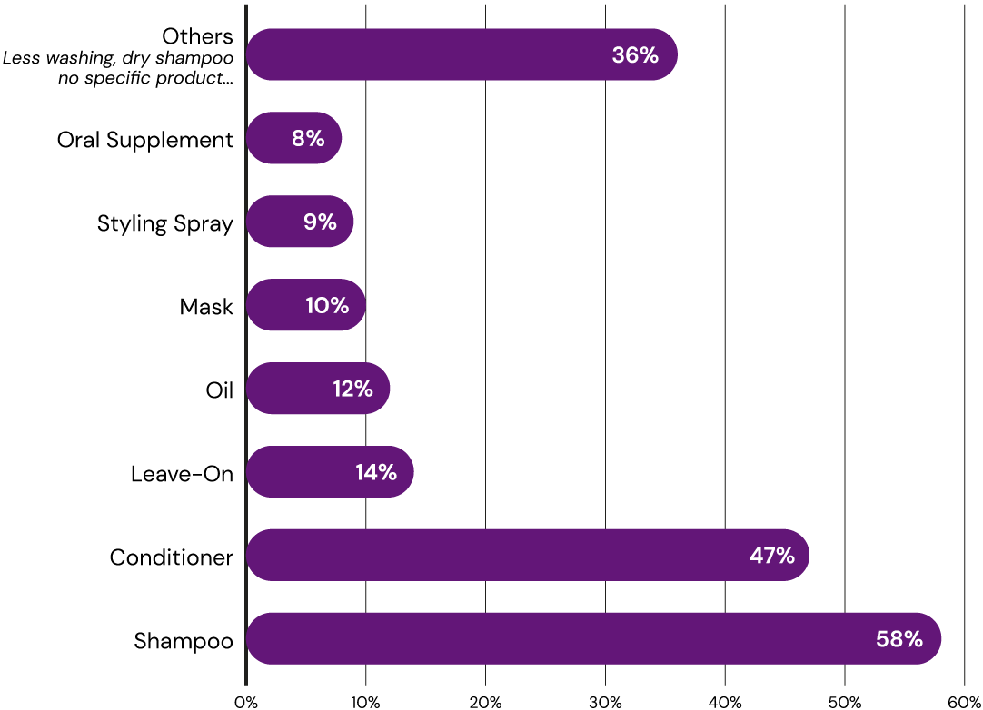



What type of hair/scalp care products do you prefer to use to tackle the menopause effects?
Dedicated shampoo and conditioners are the main preferred products followed by an additional special treatment like leave-on, oil or mask..
I'd just use maybe a shampoo and a conditioner; I always find that starting at the beginning will help.
I use a topical hair loss liquid serum that I applied directly onto my head, my scalp.
I do think it's a good idea to use products that are meant for menopausal hair.

Slide 24
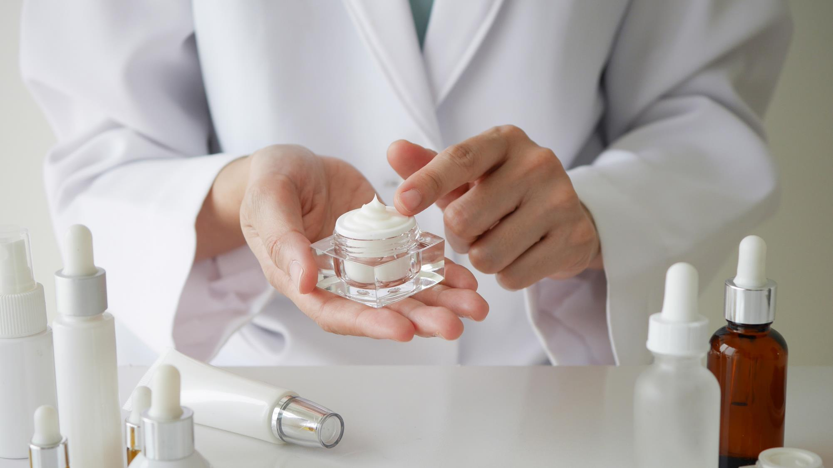
The science behind Menopause:
Symptoms and effects on the skin and hair

Slide 25
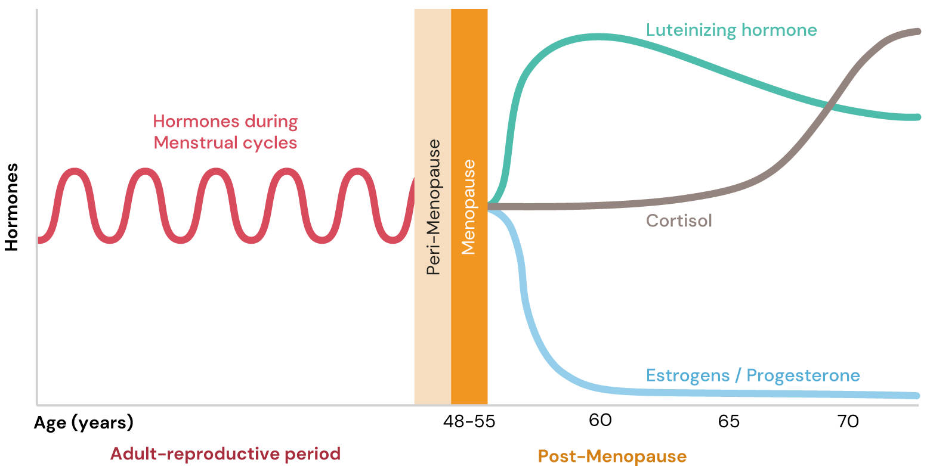
Menopause: Hormonal Changes
Natural loss of Estrogens and Progesterone, and in increase in Cortisol
The drop in Estrogen and Progesterone levels, in addition to high Cortisol levels, lead to important changes in the body.
Notes:
Luteinizing hormone:
LH helps control the menstrual cycle and triggers the ovulation.
LH levels in menopause increase because estrogen levels decrease.
Cortisol:
The stress hormone and has many damaging effects.
Cortisol levels rise in menopause due to the decline of estrogens
Estrogens:
For the menstrual cycle, they regulate the build up of the endometrium preparing the uterus for pregnancy along with a variety of additional functions.
Estrogen dramatically decreases in menopause. The decrease in estrogen levels is one reason for hot flashes.
Progesterone:
Similar function in menstrual cycle as estrogen.
The decline of progesterone in menopause is also one of the main reasons for menopause symptoms, such as hot flashes, night sweats etc.
Progesterone and estrogens can be prescribed to lower the symptoms of menopause.

Slide 26

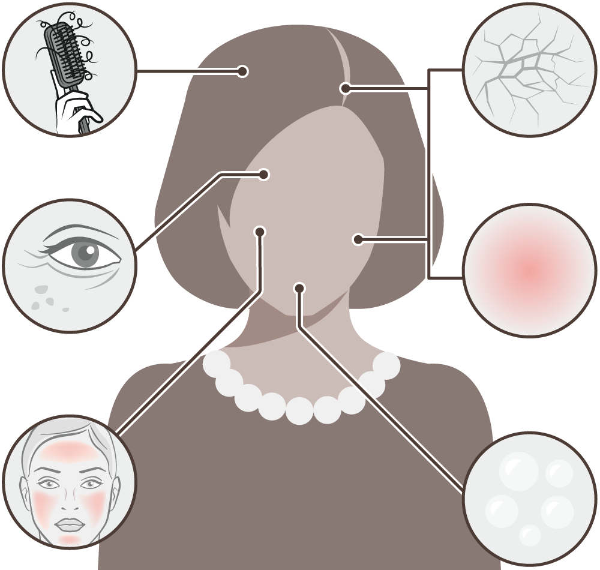






Menopause: Symptoms and effects on the skin and hair
The natural loss of estrogen and progesterone, and an increase in cortisol during the menopause has an effect on skin and hair cell function leading to visible signs of aging.
Thinning scalp hair
Hair grows slower and becomes thinner due to increased hair fall. Hair becomes to look drier, too. On the opposite, there may be an increase in facial hair due to menopause.
Dry skin and scalp
Thinning of the skin and impaired barrier. Hyaluronic acid levels also decrease. Skin becomes visibly drier. The main symptom of menopause skin. Consumers can also experience dry scalp.*
Wrinkles and age spots
Due to age & lower estrogen levels:
Collagen synthesis is reduced. Collagen and elastin levels decrease about 30% in the first five years of menopause. Skin also loses elasticity.
Overall melanin synthesis is reduced making its transfer to skin cells less efficient ultimately leading to uneven complexion and age spots.
Itchy or red skin and scalp
Due to hormonal changes and becoming drier, skin gets itchy and slightly inflamed leading to skin redness. Consumers can also experience itchy scalp.*
Hot flushes
Can go along with heavy sweating. They can lead to sleepless nights. Lack of sleep hampers the skin's ability to repair itself.
Oily skin
Some women experience oily skin and acne breakouts. This is due to decreased estrogen levels unmasking testosterone.
Reference: Zouboulis et al. (2022) Skin, hair and beyond: the impact of menopause. Climacteric 25(5):424-442
* dsm-firmenich Consumer Insights Hub
Notes:
Age spots:
Due to age & lower estrogen levels:
Vitamin D synthesis, skin natural photoprotection is reduced.
Overall melanin synthesis decreases, transfer to skin cells becomes less efficient.
Both leading to uneven complexion and localized hyperpigmentation.
Hot flushes :
It is linked to the change in hormonal status, specifically the decline in estrogens and progesterone.
Most research suggests that hot flashes occur when decreased estrogen levels cause body's thermostat (hypothalamus) to become more sensitive to slight changes in body temperature.
When the hypothalamus thinks the body is too warm, it starts a chain of events — a hot flash — to cool down.
See for example Freedman 2014: Menopausal hot flashes: Mechanisms, endocrinology, treatment - ScienceDirect

Slide 27
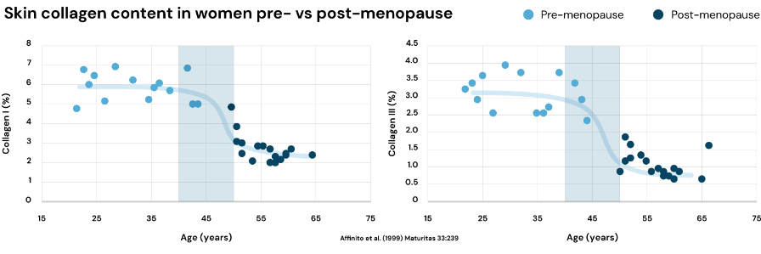
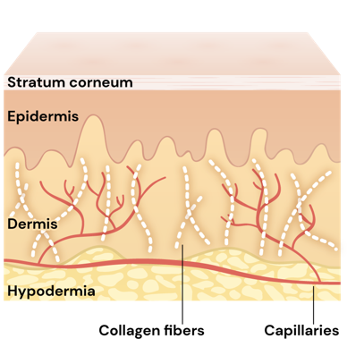
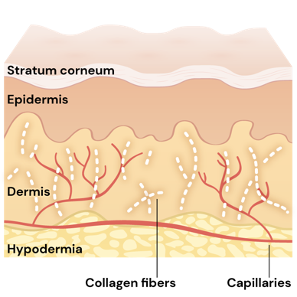
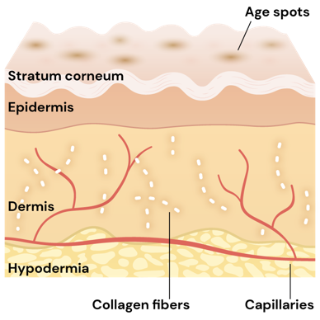
Menopause
Focus on skin changes
Major drop in collagen I and III levels levels during menopause
20s
40s (pre-menopause)
50s+ (post-menopause)
Up to our 40s, signs of collagen and elastin degradation become visible. Environmental stressors take their toll, we see the first appearance of fine lines and skin starts showing an uneven tone.
In our 50s and beyond, skin becomes even thinner. Hormonal decline such as in menopause takes its toll drastically on the skin. Collagen is now significantly degraded; deep wrinkles and age spots form and skin loses water and becomes dry. Skin microbial composition does change, too.

Slide 28
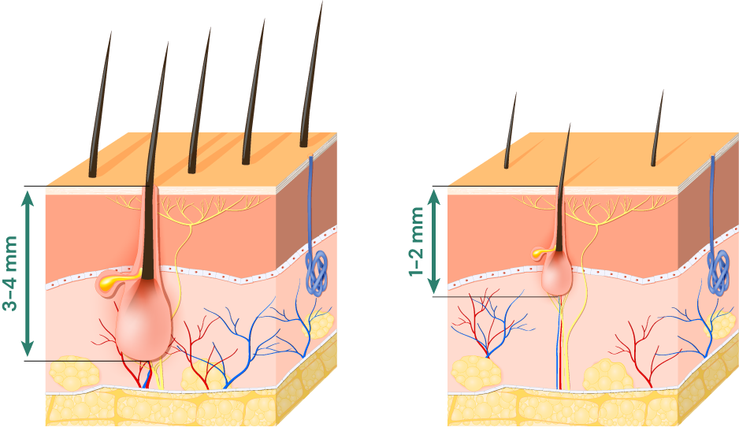
Menopause
Focus on hair changes
During the menopause, hair grows slower and becomes thinner due to increased hair fall. Woman can experience as well dry and itchy scalp.
Normal hair follicle
Small hair follicle
resulting in baldness
Menopause
Follicles continue
to shrink leaving hair thinner and thinner
Notes:
References:
Grymowicz et al. (2020) Hormonal Effects on Hair Follicles: Int J Mol Sci 21:5342
Kamp et al. (2022) Menopause, skin and common dermatoses. Part 1. hair disorders. Clinical and Experimental Dermatology 47:2110-2116
Duvel et al. (2019) Age, lifestyle and self-perceptions of hair: Is there an association with hair diameter and tensile properties? Int J Cosmet Sci 41:509-515

Slide 29
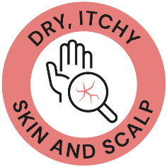






Where consumer’s voice meets the science
Main Skin and Hair menopause concerns
We recognize that menopause is a transformative stage that brings about changes in both body and mind, and we are here to support and empower women every step of the way.
By tackling possible skin, scalp and hair discomforts, we seek to encourage women to embrace their beauty and celebrate their individuality.
Introducing Wonder You, a palette of solutions designed exclusively for menopausal women, understanding and embracing their unique emotional, skin and hair journey.

Slide 30


Slide 31
So many stages, so many changes ...
The passing of the years brings many challenges, but it also brings one thing that makes all the difference: Maturity to deal with all that comes ahead.
That is why menopause goes far beyond from being another phase of physical transformation, to become one of the best chapters of women’s lives.
Introducing Wonder You, a pallet of solutions designed with an exclusive combination of technological assets backed by skin & hair science.
dsm-firmenich has developed innovative solutions helping to better deal with the effects of menopause on skin and hair and empowering you to embrace everything that makes you a unique woman.
31

Slide 32
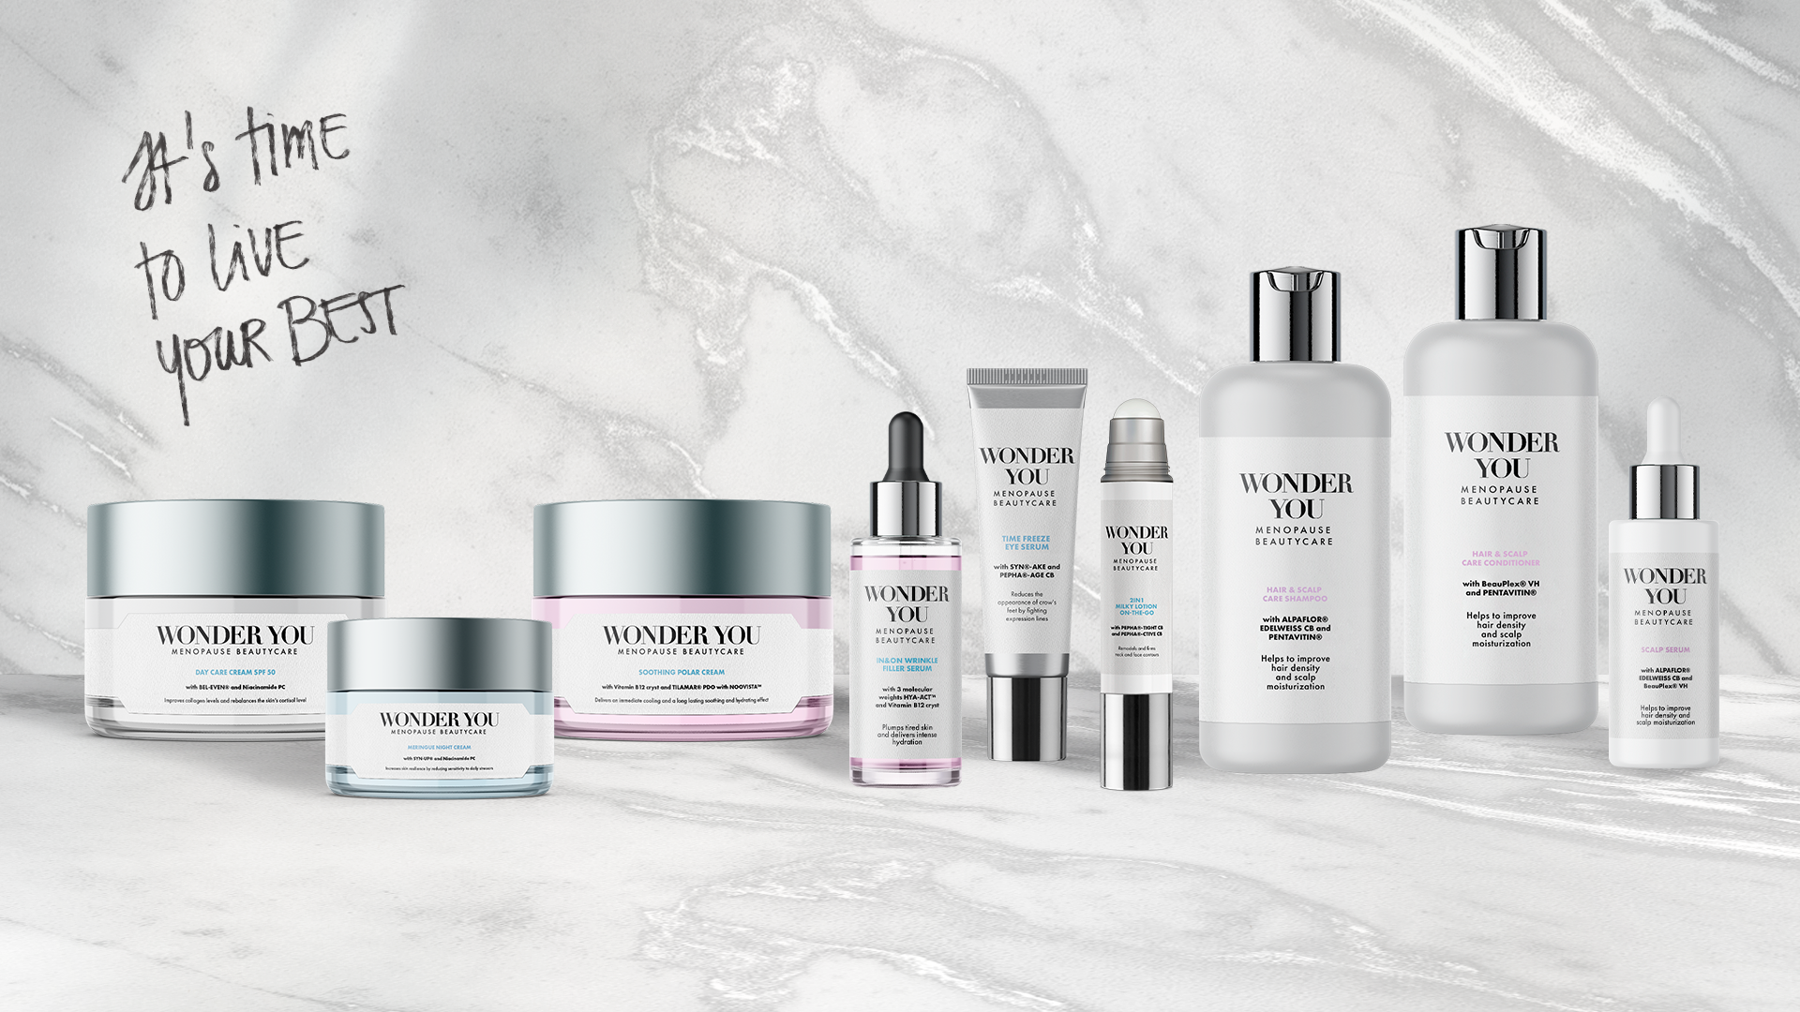
Move WONDER YOU to black
Products are for illustration only, not for sale. dsm-firmenich is not responsible for final products claims.
FACIAL LINE
CAPILLARY LINE
Notes:
TIME FREEZE EYE SERUM formulation removed due to phase out of VALVANCE® Look 100. SYN®-AKE & PEPHA®-AGE CB are still fitted solutions for menopause concerns you can find in the back-up slides

Slide 33







Formula | Highlighted Ingredients | Claim | Formulation helping to better deal with…
DAY CARE CREAM SPF 50 | BEL-EVEN® Niacinamide PC | Improves collagen levels and rebalances the skin’s cortisol level
MERINGUE NIGHT CREAM | SYN-UP® Niacinamide PC | Increases skin resilience by reducing sensitivity to daily stressors
SOOTHING POLAR CREAM | Vitamin B12 cryst | Delivers an immediate cooling and a long-lasting soothing and hydrating effect
IN&ON WRINKLE FILLER SERUM | 3 molecular weights HYA-ACT™ Vitamin B12 cryst | Plumps tired skin and delivers intense hydration
2IN1 MILKY LOTION ON-THE-GO | PEPHA®-TIGHT CB PEPHA®-CTIVE CB | Remodels and firms neck and face contours
HAIR & SCALP CARE SHAMPOO | ALPAFLOR® EDELWEISS CB PENTAVITIN® | Helps to improve hair density and scalp moisturization
HAIR & SCALP CARE CONDITIONER | BeauPlex® VH PENTAVITIN® | Helps to improve hair density and scalp moisturization
SCALP SERUM | ALPAFLOR® EDELWEISS CB BeauPlex® VH | Helps to improve hair density
33

Slide 34






Ingredients helping to better deal with… | DRY, ITCHY SKIN AND SCALP | AGE SPOTS SKIN TONE | LINES, WRINKLES & SAGGING | SKIN SENSITIVITY & REDNESS | HAIR THINNING | HAIR LOSS
BEL-EVEN®
Niacinamide PC
SYN-UP®
Vitamin B12 cryst
HYA-ACT™
PEPHA®-TIGHT CB
PEPHA®-CTIVE CB
ALPAFLOR® EDELWEISS CB
PENTAVITIN®
BeauPlex® VH
34

Slide 35

DAY CARE CREAM SPF 50
with BEL-EVEN® and Niacinamide PC
Eco Class B
During menopause, the increase in cortisol impacts skin cell functions leading to visible signs of aging and lower skin resilience to daily stress factors .
The Wonder You Day Care Cream SPF 50 provides a complete hollistic solution for your daily protection.
It combines BEL-EVEN® technology that will rebalance your skin’s cortisol level and improve collagen levels for a firmer and strengthened skin along with the powerhouse Vitamin B3 (Niacinamide PC) for a flawless, resilient skin.
This daily cream SPF 50 also provides a high solar protection for your daily exposure.
Products are for illustration only, not for sale. dsm-firmenich is not responsible for final products claims.
35

Slide 36
DAY CARE CREAM SPF 50
^{SK-E-102455-1}
PHASE | INGREDIENTS | INCI NAME | % W / W
A | PARSOL® EHS | ETHYLHEXYL SALICYLATE | 5,00
 | UVAsorb HEB | DIETHYLHEXYL BUTAMIDO TRIAZONE | 1,80
B | Cetiol® B | DIBUTYL ADIPATE | 7,00
 | Tegosoft XC MB | PHENOXYETHYL CAPRYLATE | 4,00
 | Finsolv® TN | C12-15 ALKYL BENZOATE | 4,00
 | Eldew SL-205 | ISOPROPYL LAUROYL SARCOSINATE | 2,00
 | MIGLYOL® Coco 810 | COCO-CAPRYLATE/CAPRATE | 1,00
 | Xiameter PMX-200 Sil Fluid 100 CS | DIMETHICONE | 1,00
 | PARSOL® EHT | ETHYLHEXYL TRIAZONE | 2,90
 | PARSOL® 1789 | BUTYL METHOXYDIBENZOYLMETHANE | 4,50
 | PARSOL® Shield | BIS-ETHYLHEXYLOXYPHENOL METHOXYPHENYL TRIAZINE | 2,50
 | AMPHISOL® K | POTASSIUM CETYL PHOSPHATE | 1,80
 | TEGO CARE PBS 6 MB | POLYGLYCERYL-6 STEARATE, POLYGLYCERYL-6 BEHENATE | 3,00
 | VALVANCE® Touch 210 | SILICA | 1,00
 | Dermosoft® Octiol | CAPRYLYL GLYCOL | 0,50
 | Lanette® 18 | STEARYL ALCOHOL | 1,50
C | Water Dem | AQUA | 33,05
 | Dermofeel® PA-3 | SODIUM PHYTATE, AQUA, ALCOHOL | 0,10
 | Niacinamide PC | NIACINAMIDE | 1,00
 | Sensiva SC 50 | ETHYLHEXYLGLYCERIN | 0,50
D | Sucrathix VX | MICROCRYSTALLINE CELLULOSE, CELLULOSE GUM, XANTHAN GUM | 1,50
 | SEPIMAX ZENTM | POLYACRYLATE CROSSPOLYMER-6 | 0,25
 | Cosphaderm® Pentiol natural | PENTYLENE GLYCOL | 3,00
 | HYA-ACTTM XS | HYDROLYZED HYALURONIC ACID | 0,05
 | Propanediol | PROPANEDIOL | 2,00
E | Water Dem | AQUA | 10,00
 | PARSOL® HS | PHENYLBENZIMIDAZOLE SULFONIC ACID | 1,50
 | Sodium Hydroxide Pellets Emprove | SODIUM HYDROXIDE | 0,40
F | PARSOL® Max | METHYLENE BIS-BENZOTRIAZOLYL TETRAMETHYLBUTYLPHENOL, AQUA, DECYL GLUCOSIDE, PROPYLENE GLYCOL, XANTHAN GUM | 2,00
G | BEL-EVEN® | BIPHENYL AZEPANYL METHANONE, PROPANEDIOL | 1,00
H | PARFUM | PARFUM | 0,15
Products are for illustration only, not for sale. dsm-firmenich is not responsible for final products claims.
Technical Data
pH: 7.4 | Viscosity (spindle 4 / 10 rpm): 8000 mPa.s | In vivo SPF according to ISO 24444
This information is for illustration purposes only and based upon our current knowledge and experience at the time of printing. We do not make any representation or warranty of any kind, express or implied, including merchantability or fitness for a particular use, with respect to such information or its application. Use of this information is at your discretion and risk. Nothing herein relieves you from carrying out your own suitability determinations and tests. You are responsible for observing all laws and regulations relevant to your products, uses or processes. We do not assume any liability in connection with your product and its use. The foregoing information and suggestions are also provided without warranty of non-infringement as to the intellectual property rights of third parties and shall not be construed as any inducement to infringe the rights of third parties.
36

Slide 37
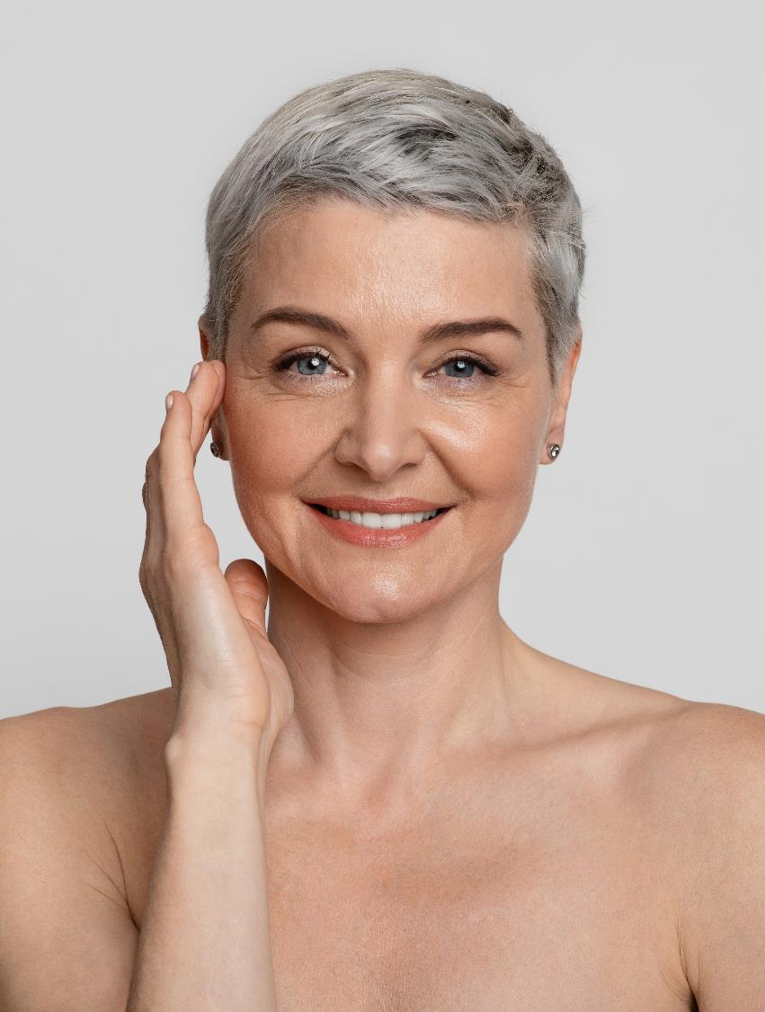
BEL-EVEN®
Key benefits to help better deal with the effects of the menopause on skin
BEL-EVEN® is a patented low molecular weight synthetic molecule, produced in a sustainable way.
Skin Cortisol levels regulation - Inhibits conversion of cortisone into cortisol rebalancing Cortisol levels*
Stress negative impact prevention
Prevents from UV-induced Collagen degradation**
Prevents from Cortisol induced Collagen degradation**
Visibly relieves the premature signs of stress-induced skin ageing***
Firming and smoothing
Significantly improves skin elasticity and strengthens skin barrier functionality***
Visibly relieves the premature signs of stress-induced skin ageing***
*In-Vitro **Ex-Vivo ***In-Vivo

Slide 38










BEL-EVEN®
Future-proof your skin from the effects of daily stress
INCI NAME
Propanediol (and) Biphenyl Azepanyl Methanone
Patented low molecular weight synthetic molecule, produced in a sustainable way
Visualized with molecular modelling BEL-EVEN® reversibly inhibits 11β-HSD1 that builds cortisol in skin.
DESCRIPTION
Rebalances the negative impact of daily stress on skin
Prevents from UV- and Cortisol induced Collagen degradation
Visibly relieves the premature signs of stress-induced skin ageing
Significantly improves skin elasticity and strengthens skin barrier functionality
Visible effects on the reduction of wrinkles
KEY
BENEFITS
TECHNICAL
Form: Liquid
Use level: 1%
pH of use: 3,5 – 7,5
Preservative: Free
Solubility:
Miscible in water
*
*
REGISTRATION
CERTIFICATION
* Halal HFCE, Halal BPJPH, Halal HCS

Slide 39

Niacinamide PC
Key benefits to help better deal with the effects of the menopause on skin
Vitamin B3 cosmetic grade guaranteed to contain max 100 ppm residual nicotinic acid, making it exceptionally well tolerated. Fully raw material backward integrated (Intermediate picoline from natural origin)
Skin Resilience - Strengthens skin barrier, stimulates ceramides and lipids in stratum corneum***, increases hydration***
Environmental stress protection
Protection from urban pollutants damage * & **
Helps protect from UV and blue light damage* & ***
Even skin tone - Rebalances uneven skin tone ** & ***
Lines and wrinkles improvement
Stimulates collagen synthesis*
Improves the appearance of lines, wrinkles and skin elasticity***
*In-Vitro **Ex-Vivo ***In-Vivo

Slide 40




Niacinamide PC
For flawless, resilient skin
and a radiant complexion
INCI NAME
Niacinamide
Niacinamide PC (Vitamin B3) is a special cosmetic proprietary grade of DSM, which has a low guaranteed level of residual nicotinic acid to address any concerns about unpleasant skin sensations.
DESCRIPTION
For flawless, resilient skin and a radiant complexion
Helps protect from UV and blue light damage
Helps protect from urban pollutants damage
Skin is more resilient to external damage + reduced skin sensitivity
Rebalances uneven skin tone
Reduces the appearance of lines and wrinkles
Prevents UV-induced ATP decline
KEY
BENEFITS
TECHNICAL
Form: Powder
Use level: 1 to 10%
pH of use: 4,0– 8,0
Preservative: Free
Solubility:
Soluble in water
*
REGISTRATION
CERTIFICATION
Quality for Life™ seal that guarantees the highest standards for Quality, Reliability, Traceability, and Sustainability.
* Halal HFCE, Halal MUI

Slide 41
MERINGUE NIGHT CREAM
with SYN-UP® and Niacinamide PC
96,8% natural origin ISO 16128
Going though your menopause journey, you and your skin also deserves pampering moments to build resilience against the challenges of the day ahead.
We invite you to a recovering gourmet experience with the Wonder You Meringue Night Cream that will leave you with a unique feeling of comfort and wellbeing.
This lush cream will restore and build your skin resilience thanks to the selected combination of a peptide (SYN-UP®) and a vitamin (Niacinamide PC) that will strengthen your skin’s barriers, making it more resilient while preparing your skin against daily stressors like UV rays, pollution and chemicals.
Products are for illustration only, not for sale. dsm-firmenich is not responsible for final products claims.
41

Slide 42
MERINGUE NIGHT CREAM
^{SK-E-102019-27}
PHASE | INGREDIENTS | INCI NAME | % W / W
A | Water Dem | AQUA | 67,35
 | Dermosoft® Octiol | CAPRYLYL GLYCOL | 0,50
 | STRUCTURE® XL | HYDROXYPROPYL STARCH PHOSPHATE | 3,00
B | Propanediol | PROPANEDIOL | 5,00
 | Keltrol® CG-T | XANTHAN GUM | 0,30
C | Olivem® 1000 MB | CETEARYL OLIVATE, SORBITAN OLIVATE | 5,00
 | Cetiol® LC | COCO-CAPRYLATE/CAPRATE | 5,00
 | Cosphaderm® Feel | TRIHEPTANOIN | 5,00
 | Cutina® FS 45 | STEARIC ACID, PALMITIC ACID | 0,75
 | Dermosoft® GMCY MB | GLYCERYL CAPRYLATE | 0,25
 | DL-alpha-Tocopheryl Acetate | TOCOPHERYL ACETATE | 0,50
 | Mixed Tocopherols 95 | TOCOPHEROL | 0,10
D | Water Dem | AQUA | 3,00
 | SYN-UP® | AMIDINOBENZYL BENZYLSULFONYL D-SERYL HOMOPHENYLALANINAMIDE ACETATE, GLYCERIN, AQUA, CITRIC ACID | 1,00
 | D-Panthenol 75 L | PANTHENOL, AQUA | 1,00
 | Niacinamide PC | NIACINAMIDE | 1,00
 | ALPAFLOR® EDELWEISS CB | LEONTOPODIUM ALPINUM FLOWER/LEAF EXTRACT, GLYCERIN, AQUA, CITRIC ACID | 1,00
E | PARFUM | PARFUM | 0,25
Products are for illustration only, not for sale. dsm-firmenich is not responsible for final products claims.
Technical Data
pH: 5.5 | Viscosity (spindle RV-5 / 10 rpm): 31480 mPa.s
This information is for illustration purposes only and based upon our current knowledge and experience at the time of printing. We do not make any representation or warranty of any kind, express or implied, including merchantability or fitness for a particular use, with respect to such information or its application. Use of this information is at your discretion and risk. Nothing herein relieves you from carrying out your own suitability determinations and tests. You are responsible for observing all laws and regulations relevant to your products, uses or processes. We do not assume any liability in connection with your product and its use. The foregoing information and suggestions are also provided without warranty of non-infringement as to the intellectual property rights of third parties and shall not be construed as any inducement to infringe the rights of third parties.
42

Slide 43

SYN-UP®
Key benefits to help better deal with the effects of the menopause on skin
The smart dipeptide to long term healthy & youthful looking skin. Unlock skin’s longevity thanks to one biological target (Plasmin) to drive improvement across all skin layers
Promotes healthy-looking skin*** - Inhibits Plasmin and Urokinase* activities and balancing key bacteria S. Aureus* and S. Epidermidis***
Reduces skin sensitivity*** and redness - Modulates MMP 9, CXCL5 and IL-8 activities*
Increases skin barrier functionality
Up-regulation of Transglutaminase 1 (TGase1)*
Visible improvement of dry skin conditions***
Smooth and firm the skin*** - Prevents degradation of type IV Collagen** and by stimulating type I Collagen*
*In-Vitro **Ex-Vivo ***In-Vivo

Slide 44


SYN-UP®
Unlock your skin’s longevity
INCI NAME
Glycerin (and) Aqua (and) Amidinobenzyl Benzylsulfonyl
D-Seryl Homophenylalaninamide Acetate
Low-molecular-weight dipeptide derivative, made by cutting-edge technology based on two amino acids D-Serine and Homophenylalanine
Artificial intelligence (AI) and molecular modelling approach provides accurate prediction of the mode of action
DESCRIPTION
Promotes healthy-looking skin for longer by inhibiting Plasmin activities and by interacting with the skin microbiome
Makes the skin more resilient against stress attacks day- by- day
Real, significant prevention of dry skin conditions
Reduces redness and unpleasant skin sensations
Helps to smooth and firm the skin
KEY
BENEFITS
TECHNICAL
Form: Liquid
Use level: 1%
pH of use: 3,0–7,5
Preservative: Free
Solubility:
Water soluble
*
REGISTRATION
CERTIFICATION
* SYN-UP® is now allowed to be used in skincare formulations in the China market with its successful notification as a New Cosmetic Ingredient (NCI) under the country’s new cosmetic legislation
Notes:
SYN-UP® is now allowed to be used in skincare formulations in the China market with its successful notification as a New Cosmetic Ingredient (NCI) under the country’s new cosmetic legislation

Slide 45
SOOTHING POLAR CREAM
with Vitamin B12 cryst
89,8% natural origin ISO 16128
While maturity helps you navigate though the changes of menopause, hot flushes and an enhanced skin sensitivity might generate uncontrollable visible skin redness.
The Wonder You Soothing Polar Cream is a precious ally with its innovative trendy pink texture providing its efficacy along with an immediate cooling effect..
Also bringing you a long-lasting effect, thanks to the pink Vitamin B12 cryst helping to sooth and hydrate dry, itchy, irritated, and cracked skin.
Products are for illustration only, not for sale. dsm-firmenich is not responsible for final products claims.
45

Slide 46
SOOTHING SOFT POLAR CREAM
^{SK-E-101731-9}
PHASE | INGREDIENTS | INCI NAME | % W / W
A | Water Dem | AQUA | 42,46
 | SODIUM GLUCONATE GRANULAR | SODIUM GLUCONATE | 0,20
 | Biomer | POTATO STARCH MODIFIED | 0,50
 | Propanediol | PROPANEDIOL | 30,00
 | Dermosoft® Octiol | CAPRYLYL GLYCOL | 0,20
B | TEGO® CARE 450 MB | POLYGLYCERYL-3 METHYLGLUCOSE DISTEARATE | 3,00
 | TEGIN® M Pellets MB | GLYCERYL STEARATE | 2,00
 | Lanette® 18 | STEARYL ALCOHOL | 1,00
 | Cetiol® 868 | ETHYLHEXYL STEARATE | 7,00
 | Cetiol® SN | CETEARYL ISONONANOATE | 7,00
 | ARGAN OIL | ARGANIA SPINOSA KERNEL OIL | 0,50
 | Xiameter PMX-200 Sil Fluid 100 CS | DIMETHICONE | 2,00
 | AMPHISOL® K | POTASSIUM CETYL PHOSPHATE | 0,50
C | D-Panthenol 75 L | PANTHENOL, AQUA | 3,00
 | Vitamin B12 cryst Food Grade | CYANOCOBALAMIN | 0,01
 | PARFUM | PARFUM | 0,50
D | Citric Acid 10% Solution | CITRIC ACID, AQUA | 0,13
Products are for illustration only, not for sale. dsm-firmenich is not responsible for final products claims.
Technical Data
pH: 5.8 | Viscosity (spindle RV-5 / 10 rpm): 26600 mPa.s
This information is for illustration purposes only and based upon our current knowledge and experience at the time of printing. We do not make any representation or warranty of any kind, express or implied, including merchantability or fitness for a particular use, with respect to such information or its application. Use of this information is at your discretion and risk. Nothing herein relieves you from carrying out your own suitability determinations and tests. You are responsible for observing all laws and regulations relevant to your products, uses or processes. We do not assume any liability in connection with your product and its use. The foregoing information and suggestions are also provided without warranty of non-infringement as to the intellectual property rights of third parties and shall not be construed as any inducement to infringe the rights of third parties.
46

Slide 47
Vitamin B12 cryst
Key benefits to help better deal with the effects of the menopause on skin
Biotech naturally derived pink vitamin. Cobalamin is one of the most complex vitamin, with Cobalt structure
Relieves sensitive and stressed skin
Prevents inflammation**: significant and strong reduction of inflammasome and inflammatory cytokines such IL1-ß
Epigenetic regulation of inflammasome: over-expression by 61% of miR-22-3p with vitamin B12 at 0.01% leads to a reduction of inflammasome**
Significantly reduction of Mast cell degranulation by 27%, drops the histamine release*
Relieves dermatological skin conditions (itchy, dry, inflamed, red and cracked skin) - Active on atopic dermatitis, reducing erythema and pruritus***
Maintains healthy skin microbiome - Reducing pathogenic S. aureus vs beneficial bacteria*
*In-Vitro **Ex-Vivo ***In-Vivo

Slide 48

Vitamin B12 cryst
The biotech pink vitamin for sensitive and stressed skin
INCI NAME
Cyanocobalamin
DESCRIPTION
Vitamin B12 is made by non-GMO bacterial fermentation
Relieves sensitive and stressed skin Helps prevent photo-damaged skin
Protects the skin barrier damage induced by inflammation
Maintains healthy skin microbiome
Skin looks more vibrant
KEY
BENEFITS
Form: Powder
Use level:
0,001–0,5%
pH of use: 3,5–7,5
Preservative: Free
Solubility:
In water
TECHNICAL
REGISTRATION
CERTIFICATION
*
Quality for Life™ seal that guarantees the highest standards for Quality, Reliability, Traceability, and Sustainability.
* Halal HFCE

Slide 49
IN&ON WRINKLE FILLER SERUM
with 3 molecular weights HYA-ACT™ and Vitamin B12 cryst
99,2% natural origin ISO 16128
As you go through menopause, the hyaluronic acid within your skin will deplete and enhance moisture depletion, loss in elasticity and appearance of fine lines and wrinkles.
Bringing you the ultimate beauty boost IN&ON WRINKLE FILLER SERUM, hyaluronic acid concentrate that will melt into your skin with a subtle sheen and a vibrant pink color.
This serum contains a highly concentrated, well-balanced mix of HYA-ACT™ M, HYA-ACT™ S and HYA-ACT™ XS working to plumps fine wrinkles and provide intense and immediate hydration.
This serum is boosted with the pink Vitamin B12 cryst to sooth and hydrate dry & itchy skin.
Products are for illustration only, not for sale. dsm-firmenich is not responsible for final products claims.
49

Slide 50
IN&ON WRINKLE FILLER SERUM
^{SK-E-101690-14}
PHASE | INGREDIENTS | INCI NAME | % W / W
A | Water Dem | AQUA | 88,78
 | SODIUM GLUCONATE GRANULAR | SODIUM GLUCONATE | 0,20
 | Dermosoft® Octiol | CAPRYLYL GLYCOL | 0,20
 | Eumulgin CO 60 | PEG-60 HYDROGENATED CASTOR OIL | 0,30
B | Propanediol | PROPANEDIOL | 3,00
 | Cosphaderm Pentiol natural | PENTYLENE GLYCOL | 3,00
 | SYN®-HYCAN | GLYCERIN, AQUA, MAGNESIUM CHLORIDE, TETRADECYL AMINOBUTYROYLVALYLAMINOBUTYRIC UREA TRIFLUOROACETATE | 2,50
C | HYA-ACT™ XS | HYDROLYZED HYALURONIC ACID | 0,50
 | HYA-ACT™ S | SODIUM HYALURONATE | 0,50
 | HYA-ACT™ M | SODIUM HYALURONATE | 0,50
D | Vitamin B12 cryst Food Grade | CYANOCOBALAMIN | 0,005
 | Water Dem | AQUA | 0,495
E | Citric Acid 10% Solution | CITRIC ACID, AQUA | 0,02
Products are for illustration only, not for sale. dsm-firmenich is not responsible for final products claims.
Technical Data
pH: 5.5 | Viscosity (spindle RV-3 / 10 rpm): 1800 mPa.s
This information is for illustration purposes only and based upon our current knowledge and experience at the time of printing. We do not make any representation or warranty of any kind, express or implied, including merchantability or fitness for a particular use, with respect to such information or its application. Use of this information is at your discretion and risk. Nothing herein relieves you from carrying out your own suitability determinations and tests. You are responsible for observing all laws and regulations relevant to your products, uses or processes. We do not assume any liability in connection with your product and its use. The foregoing information and suggestions are also provided without warranty of non-infringement as to the intellectual property rights of third parties and shall not be construed as any inducement to infringe the rights of third parties.
50

Slide 51
HYA-ACT™
Key benefits to help better deal with the effects of the menopause on skin
The Hyaluronic acid line for the ultimate beauty boost. Obtained by bio-fermentation, derived from sweet corn seeds
HYA-ACT™ M - Medium Molecular Weight
Provides immediate hydration and strengthens the protective skin barrier by building a superior protecting film
HYA-ACT™ XS -Very Small Molecular Weight
Retains moisture from the inside: Provides intense hydration and prevents water loss
Plumps out fine wrinkles: Makes wrinkles inconspicuous & improves skin elasticity
HYA-ACT™ S - Small Molecular Weight
Lock in moisture for an even greater hydration boost and calms reddened skin
*In-Vitro **Ex-Vivo

Slide 52





HYA-ACT™
The Hyaluronic acid line for the ultimate beauty boost
HYA-ACT™ M: Sodium Hyaluronate
HYA-ACT™ S: Sodium Hyaluronate
HYA-ACT™ XS: Hydrolyzed Hyaluronic acid
INCI NAME
Obtained by bio-fermentation, derived from sweet corn seeds
HYA-ACT™ M: Medium molecular weight - 1.0–1.3 MDa.
HYA-ACT™ S: Small molecular weight - 200 – 400 KDa
HYA-ACT™ XS: Very small molecular weight - 37 – 56 KDa
DESCRIPTION
HYA-ACT™ M: Provides immediate hydration and strengthens the skin barrier
HYA-ACT™ S: Locks in moisture for an even greater hydrating boost
HYA-ACT™ XS: Retains moisture from the inside and plumps
out fine wrinkles
KEY
BENEFITS
TECHNICAL
Form: Pure Powder
Use level: 0,01-1%
pH of use: 4 - 11
Preservative: Free
Solubility:
Water soluble
REGISTRATION
CERTIFICATION
*
* Halal HFCE

Slide 53
2IN1 MILKY LOTION ON-THE-GO
with PEPHA®-TIGHT CB and PEPHA®-CTIVE CB
99,4% natural origin ISO 16128
Menopause won’t hinder your ability to conquer a busy day! With your wealth of experience, you’ve learned to listen to your body and can still thrive while embracing life.
Wonder You 2in1 Milky Lotion On-The-Go will bring to your skin an extra boost of nourishment on the go packed with a convenient dual application system: roll it over targeted zones for precision tightening or spray it for a fresh mist feeling.
Discover the hidden power of blue technology with 2 algae: PEPHA®-TIGHT CB for an immediate and long-lasting lifting effect and PEPHA®-CTIVE CB for a perfect luminous skin.
Products are for illustration only, not for sale. dsm-firmenich is not responsible for final products claims.
53

Slide 54
2IN1 MILKY LOTION ON-THE-GO
^{SK-E-102022-36}
PHASE | INGREDIENTS | INCI NAME | % W / W
A | Water Dem | AQUA | 88,23
 | Cosphaderm® Pentiol natural | PENTYLENE GLYCOL | 3,00
 | Dermosoft® Octiol | CAPRYLYL GLYCOL | 0,20
 | Sucrathix VX | MICROCRYSTALLINE CELLULOSE, CELLULOSE GUM, XANTHAN GUM | 1,00
 | SOLAGUM™ AX | ACACIA SENEGAL GUM, XANTHAN GUM | 0,20
 | SUCRABLEND SP V2 | SUCROSE STEARATE, SUCROSE PALMITATE | 1,00
B | Myritol® 331 | COCOGLYCERIDES | 2,75
 | Kokosoel raffiniert Ph. Eur. | COCOS NUCIFERA OIL | 1,00
 | ARGAN OIL | ARGANIA SPINOSA KERNEL OIL | 1,00
 | Lanette® O | CETEARYL ALCOHOL | 0,25
 | Mixed Tocopherols 95 | TOCOPHEROL | 0,10
C | PEPHA®-TIGHT CB | NANNOCHLOROPSIS OCULATA EXTRACT, PULLULAN, AQUA, PENTYLENE GLYCOL, CITRIC ACID | 0,35
 | SYN®-COLL | PALMITOYL TRIPEPTIDE-5, GLYCERIN, AQUA | 0,46
 | PEPHA®-CTIVE CB | DUNALIELLA SALINA EXTRACT, AQUA, PENTYLENE GLYCOL, CITRIC ACID | 0,30
 | D-Panthenol 75 L | PANTHENOL, AQUA | 0,10
D | Citric Acid 10% Solution | CITRIC ACID, AQUA | 0,06
Products are for illustration only, not for sale. dsm-firmenich is not responsible for final products claims.
Technical Data
pH: 5.4 | Viscosity (spindle RV-3 / 10 rpm): 1080 mPa.s
This information is for illustration purposes only and based upon our current knowledge and experience at the time of printing. We do not make any representation or warranty of any kind, express or implied, including merchantability or fitness for a particular use, with respect to such information or its application. Use of this information is at your discretion and risk. Nothing herein relieves you from carrying out your own suitability determinations and tests. You are responsible for observing all laws and regulations relevant to your products, uses or processes. We do not assume any liability in connection with your product and its use. The foregoing information and suggestions are also provided without warranty of non-infringement as to the intellectual property rights of third parties and shall not be construed as any inducement to infringe the rights of third parties.
54

Slide 55

PEPHA®-TIGHT CB
Key benefits to help better deal with the effects of the menopause on skin
Powerful combination of lifting effects, based on biological sources, processed with biotechnology and fitting in a net zero climate change policy
Short-term tightening effect
With just 1 application, flawless skin within minutes**
Instant and long-lasting perceptible skin smoothing & lifting effect up to 12hrs .**
Long-term well-aging effect
After multiple applications, long-term well-aging effect with wrinkles reduction by over -20%.**
*In-Vitro **In-Vivo
Notes:
Long lasting 12h
Long term after 2-month treatment
For China “quick or fast”, better than immediate. may be regarded as exaggerate wording

Slide 56

PEPHA®-TIGHT CB
The power of algae for superior skin tightening
INCI NAME (ACTIVE)
Nannochloropsis Oculata Extract, Pullulan
Produced from microalgae grown in closed photobioreactor and extracted by hot water
Polysaccharides obtained from natural fermentation
of starch syrup
DESCRIPTION
Flawless skin within minutes
With just 1 application, skin surface appears smoother and texture more homogeneous
Long-lasting lifting effect, up to 12hrs from last application
Skin gains elasticity in critical facial areas
After multiple applications, long-term well-aging effect with wrinkles reduction by over -20%
KEY
BENEFITS
TECHNICAL
Form: Liquid
Use level: 1–5%
pH of use: 3,5 – 7,5
Preservative: Free
Solubility:
Water soluble
*
REGISTRATION
CERTIFICATION
* Halal HFCE
Notes:
Long lasting 12h
Long term after 2-month treatment
For China “quick or fast”, better than immediate. may be regarded as exaggerate wording

Slide 57
PEPHA®-CTIVE CB
Key benefits to help better deal with the effects of the menopause on skin
Highly purified extract from the powerful microalgae Dunaliella salina with unique composition in minerals, amino acids, carbohydrates, and vitamins
Skin rejuvenation – Energized skin
Protects mitochondria against oxidative stress*
Significantly increases ATP production in mitochondria by up to 40%*
4- to 5-day acceleration of epithelial renewal** due to improved cell turnover – for fresh looking skin
Revived, glowing skin complexion
Visible improvement in skin brightness and luminosity**
Significant improvement in skin complexion**
*In-Vitro **In-Vivo

Slide 58


PEPHA®-CTIVE CB
Perfect luminous skin with the power of microalgae
INCI NAME (ACTIVE)
Dunaliella Salina Extract
DESCRIPTION
Marine derived from microalgae known to survive in the extreme environment of salt lakes. Produced via fermentation process.
KEY
BENEFITS
Protects and stimulates mitochondria to recharge skin
Antioxidant properties
Increases cell turnover for a more luminous skin
TECHNICAL
Form: Liquid
Use level: 1–3%
pH of use: 3,0 – 6,0
Preservative: Free
Solubility:
Water soluble
*
REGISTRATION
CERTIFICATION
* Halal HFCE

Slide 59
HAIR & SCALP CARE SHAMPOO
with ALPAFLOR® EDELWEISS CB and PENTAVITIN®
86,5% natural origin ISO 16128
In menopause, hair grows slower and becomes thinner due to increased hair fall. You can experience as well dry and itchy scalp.
It’s time to live your best Hair with the Wonder You Hair & Scalp care Shampoo.
It contains ALPAFLOR® EDELWEISS CB, a 100% natural, sustainably and organically cultivated alpine flower which helps improve your hair density as well as PENTAVITIN®, a 100% natural and biodegradable edible maize kernels derived, to visibly increase your scalp moisturization and reduce flaking.
Products are for illustration only, not for sale. dsm-firmenich is not responsible for final products claims.
59

Slide 60
HAIR & SCALP CARE SHAMPOO
^{HC-E-100300-22}
PHASE | INGREDIENTS | INCI NAME | % W / W
A | Water Dem | AQUA | 43,28
 | D-Biotin | BIOTIN | 0,02
 | PENTAVITIN® | SACCHARIDE ISOMERATE, AQUA, CITRIC ACID, SODIUM CITRATE | 0,25
 | Ethyl Panthenol | PANTHENYL ETHYL ETHER | 0,50
 | FD&C Blue No.1 | CI 42090 | 0,00
 | D&C Red No.33 (K7057) | CI 17200 | 0,00
B | TILAMAR® Quat 2240 | POLYQUATERNIUM-22 | 1,25
C | Texapon NSO® BZ | SODIUM LAURETH SULFATE | 40,00
 | Hostapon CCG | SODIUM COCOYL GLUTAMATE | 4,50
 | AMPHOSOL® CDB SPECIAL | CETYL BETAINE, AQUA, SODIUM CHLORIDE | 6,00
 | PARFUM | PARFUM | 0,70
 | ALPAFLOR® EDELWEISS CB | LEONTOPODIUM ALPINUM FLOWER/LEAF EXTRACT, GLYCERIN, AQUA, CITRIC ACID | 1,00
D | Ninol CAA | DIMETHYL LAURAMIDE/MYRISTAMIDE | 1,50
 | Euxyl®K 900 | BENZYL ALCOHOL, ETHYLHEXYLGLYCERIN, TOCOPHEROL | 1,00
Products are for illustration only, not for sale. dsm-firmenich is not responsible for final products claims.
Technical Data
pH: 6.4 | Viscosity (Rheometer, Parallel Plate, 40 mm, 10 s⁻¹, 25°C ): 1400 mPa*s
This information is for illustration purposes only and based upon our current knowledge and experience at the time of printing. We do not make any representation or warranty of any kind, express or implied, including merchantability or fitness for a particular use, with respect to such information or its application. Use of this information is at your discretion and risk. Nothing herein relieves you from carrying out your own suitability determinations and tests. You are responsible for observing all laws and regulations relevant to your products, uses or processes. We do not assume any liability in connection with your product and its use. The foregoing information and suggestions are also provided without warranty of non-infringement as to the intellectual property rights of third parties and shall not be construed as any inducement to infringe the rights of third parties.
60

Slide 61


ALPAFLOR® EDELWEISS CB
Key benefits to help better deal with the effects of the menopause on hair
Sustainably and organically cultivated according to Bio Suisse organic standards and fair-trade principles
Helps prevent hair loss* (improves hair density)
Prolongs anagen growing phase of hair. 1.8 x more than placebo - ex vivo
50% increase of hair follicles keratinocytes proliferation - ex vivo
Increase by 43% versican expression & alkaline phosphatase activity - ex vivo
13% increase in hair density after 5 months – in vivo
Increase Anagen/Telogen ratio – in vivo
Consumers confirm efficacy**
90% noticed an increase in hair density
* Prevent hair loss is a drug claim in USA to use improves hair density
**Clinical study, 30 Volunteers, 18-65 years old, 3% ALPAFLOR® EDELWEISS CB applied daily in a leave-on

Slide 62








ALPAFLOR® EDELWEISS CB
Organic alpine plant extract power
^{INCI NAME}
Leontopodium Alpinum Flower/Leaf Extract
^{DESCRIPTION}
Plant extract organically cultivated
Helps prevent hair loss* (improves hair density)
Helps reduce the appearance of greying hair
Anti-aging (strong anti-oxidant properties)
^{KEY BENEFIT}
^{Form: Liquid}
^{Use level: Up to 3%}
^{pH of use: 3,5 to 5,5}
^{Preservative: Free}
^{Solubility:}
^{Water soluble}
^{Target: Scalp}
^{Biodegradability:}
Organic components are biodegradable.
^{TECHNICAL}
**
^{REGISTRATION}
^{CERTIFICATION}
** Halal HFCE
* Prevent hair loss is a drug claim in USA to use improves hair density

Slide 63
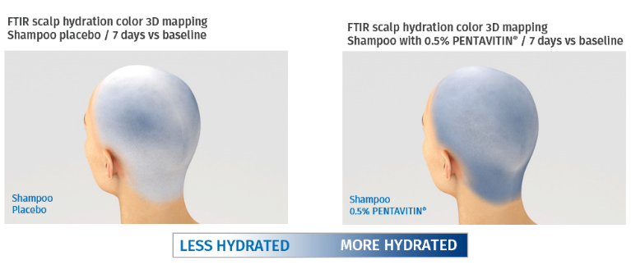
PENTAVITIN®
Key benefits to help better deal with the effects of the menopause on hair
100% natural and biodegradable edible maize kernels derived.
It binds to scalp like a magnet.
Moisturization (Reinforced scalp barrier)
24 hour (D1) after one single application and even after 28 days of frequent showering, shampoos with 0.2% and 0.5% PENTAVITIN® reinforce the scalp barrier – in vivo
Flaking Reduction
Significant reduces flaking after one single application and after frequent showering with a shampoo containing PENTAVITIN® (0.2% -0.5%) - in vivo
Balances scalp microbiome
Helps control Malassezia furfur known as a common cause of flaky scalp - in vitro
Consumers confirm efficacy**
60% of consumers stated “my scalp feels hydrated and healthy”
**Clinical study, 30 volunteers, 18 – 50 years old, self assessment, 0.5% PENTAVITIN®, 28 days​, rinse-off,
​standard liquid shampoo applied every 2 days

Slide 64




PENTAVITIN®
Sugar derived power
^{INCI NAME}
^{Saccharide Isomerate}
^{DESCRIPTION}
100% natural & biodegradable edible maize kernels derived
It binds to scalp like a magnet.
Moisturizes dry scalp / Strong scalp barrier
Provides visible reduction of scalp flaking
^{Reduces Sebum}
^{KEY BENEFIT}
^{Form: Liquid}
^{Use level: 0,2 - 1%}
^{pH of use: 4 to 9}
^{Preservative-Free}
^{Solubility:}
^{Water soluble}
^{Target:}
^{Scalp and hair fiber}
^{Biodegradable:}
Estimated to be biodegradable according to OECD classification
^{TECHNICAL}
*
^{REGISTRATION}
^{CERTIFICATION}
* Halal HFCE, MUI, BPJPH

Slide 65
HAIR & SCALP CARE CONDITIONER
with BeauPlex® VH and PENTAVITIN®
96,0% natural origin ISO 16128
In menopause, your hair grows slower and becomes thinner due to increased hair fall. You can experience as well dry and itchy scalp.
It’s time to live your best Hair with the Wonder You Hair
& Scalp care Conditioner.
It contains BeauPlex® VH, a selected blend of vitamins which helps improve your hair density and thickness as well as PENTAVITIN®, a 100% natural and biodegradable edible maize kernels derived, to visibly increase your scalp moisturization and reduce flaking.
Products are for illustration only, not for sale. dsm-firmenich is not responsible for final products claims.
65

Slide 66
HAIR & SCALP CARE CONDITIONER
^{HC-E-100114-6}
PHASE | INGREDIENTS | INCI NAME | % W / W
A | Water Dem | AQUA | 76,05
 | L-Arginine Ph Eur, JP, USP | ARGININE | 0,20
 | TILAMAR® Quat 2240 | POLYQUATERNIUM-22 | 2,00
 | Propanediol | PROPANEDIOL | 5,00
 | D-Biotin | BIOTIN | 0,10
 | STRUCTURE® XL | HYDROXYPROPYL STARCH PHOSPHATE | 1,50
 | Emulsense HC | BRASSICYL ISOLEUCINATE ESYLATE, BRASSICA ALCOHOL | 6,50
B | LexFeel(TM) N5 MB | CAPRYLOYL GLYCERIN/SEBACIC ACID COPOLYMER, DIHEPTYL SUCCINATE | 3,00
 | Phytantriol | PHYTANTRIOL | 0,25
C | PENTAVITIN® | SACCHARIDE ISOMERATE, AQUA, CITRIC ACID, SODIUM CITRATE | 0,50
 | PHYTALURONATE®PF | CERATONIA SILIQUA GUM, AQUA, CITRIC ACID, PHENOXYETHANOL, ETHYLHEXYLGLYCERIN | 2,20
 | PARFUM | PARFUM | 1,20
 | BeauPlex® VH | NIACINAMIDE, CALCIUM PANTOTHENATE, SODIUM ASCORBYL PHOSPHATE, TOCOPHERYL ACETATE, PYRIDOXINE HCL, MALTODEXTRIN, SODIUM STARCH OCTENYLSUCCINATE, SILICA | 0,50
 | Euxyl®K 900 | BENZYL ALCOHOL, ETHYLHEXYLGLYCERIN, TOCOPHEROL | 1,00
Products are for illustration only, not for sale. dsm-firmenich is not responsible for final products claims.
Technical Data
pH: 4,7 | Viscosity (Rheometer, Parallel Plate 40 mm, 10 s⁻¹, 25°C): 5000 mPa*s
This information is for illustration purposes only and based upon our current knowledge and experience at the time of printing. We do not make any representation or warranty of any kind, express or implied, including merchantability or fitness for a particular use, with respect to such information or its application. Use of this information is at your discretion and risk. Nothing herein relieves you from carrying out your own suitability determinations and tests. You are responsible for observing all laws and regulations relevant to your products, uses or processes. We do not assume any liability in connection with your product and its use. The foregoing information and suggestions are also provided without warranty of non-infringement as to the intellectual property rights of third parties and shall not be construed as any inducement to infringe the rights of third parties.
66

Slide 67

BeauPlex® VH
Key benefits to help better deal with the effects of the menopause on hair
Blend of Vitamins for Hair & Scalp
(Vitamin B3, B5, B6, C and E)
Helps prevent hair loss* (improves hair density and thickness )
76% Proliferation of hair follicle keratinocytes- ex vivo
Prolongation of anagen phase of hair follicles. 2x more than placebo- ex vivo
Increases hair thickness (4%) and density (+7%) – in vivo
Increase Anagen to Telogen ratio –in vivo
Other benefits: base on individual vitamins results
Hydration and scalp barrier improvement
Strong anti-oxidant properties
Consumers confirm efficacy**
93% noticed increased speed of hair growth
* Prevent hair loss is a drug claim in USA to use improves hair density
** Self assessment - Clinical study, 30 volunteers, 18 – 65 years old - 5 months treatment with BeauPlex® VH at 1.5%

Slide 68

BeauPlex® VH
Vitamins Blend
Niacinamide, Calcium Pantothenate, Sodium Ascorbyl Phosphate,
Tocopheryl Acetate, Pyridoxine Hydrochloride, Maltodextrin,
Sodium Starch Octenylsuccinate, Silica
^{INCI NAME}
^{DESCRIPTION}
Vitamin blend (B3, B5, B6, C and E)
Helps prevent hair loss* (improves hair density and thickness)
Helps reduce the appearance of greying hair
Anti-aging (anti-oxidant properties)
Scalp Care (improves scalp barrier and moisturization)
^{KEY BENEFIT}
^{Form: Powder}
^{Use level: Up to 2%}
^{pH of use: 5 to 9}
^{Preservative: Free}
^{Solubility:}
^{Dispersible in water}
^{Target: Scalp and hair fiber}
^{Biodegradability:}
^{Not expected to be persistent,}
^{bioaccumulative}
^{nor toxic.}
^{TECHNICAL}
**
^{REGISTRATION}
^{CERTIFICATION}
Quality for Life™ seal that guarantees the highest standards for Quality, Reliability, Traceability, and Sustainability.
** Halal HFCE
* Prevent hair loss is a drug claim in USA to use improves hair density

Slide 69
SCALP SERUM
with ALPAFLOR® EDELWEISS CB and BeauPlex® VH
98,5% natural origin ISO 16128
In menopause, your hair grows slower and becomes thinner due to increased hair fall. You can experience as well dry and itchy scalp.
It’s time to live your best Hair with the Wonder You
Scalp Serum combining a powerful dual technology based on BEAUPLEX® VH, a selected blend of vitamins and ALPAFLOR® EDELWEISS CB, a sustainable and organic alpine flower, to help to improve your hair density and thickness.
Products are for illustration only, not for sale. dsm-firmenich is not responsible for final products claims.
69

Slide 70
SCALP SERUM
^{HC-E-100900-6}
PHASE | INGREDIENTS | INCI NAME | % W / W
A | Water Dem | AQUA | 73,62
 | D-Biotin | BIOTIN | 0,02
 | BeauPlex® VH | NIACINAMIDE, CALCIUM PANTOTHENATE, SODIUM ASCORBYL PHOSPHATE, TOCOPHERYL ACETATE, PYRIDOXINE HCL, MALTODEXTRIN, SODIUM STARCH OCTENYLSUCCINATE, SILICA | 1,50
B | SILIGEL | XANTHAN GUM,SCLEROTIUM GUM,LECITHIN,PULLULAN | 1,10
C | ALPAFLOR® EDELWEISS CB | LEONTOPODIUM ALPINUM FLOWER/LEAF EXTRACT, GLYCERIN, AQUA, CITRIC ACID | 3,00
 | Dermosoft Hexiol | 1,2-HEXANEDIOL | 0,30
 | Ethanol abs. | ALCOHOL | 12,00
D | Propanediol | PROPANEDIOL | 5,00
 | PARFUM | PARFUM | 0,45
 | MIGLYOL 829 ECO | CAPRYLIC/CAPRIC/SUCCINIC TRIGLYCERIDE | 3,00
E | TIMICA RADIANT GOLD 222G | MICA,CI 77491,CI 77891 | 0,01
Products are for illustration only, not for sale. dsm-firmenich is not responsible for final products claims.
Technical Data
pH: 6.5 | Viscosity (Brookfield RV5/10rpm): 200-300 mPa*s
This information is for illustration purposes only and based upon our current knowledge and experience at the time of printing. We do not make any representation or warranty of any kind, express or implied, including merchantability or fitness for a particular use, with respect to such information or its application. Use of this information is at your discretion and risk. Nothing herein relieves you from carrying out your own suitability determinations and tests. You are responsible for observing all laws and regulations relevant to your products, uses or processes. We do not assume any liability in connection with your product and its use. The foregoing information and suggestions are also provided without warranty of non-infringement as to the intellectual property rights of third parties and shall not be construed as any inducement to infringe the rights of third parties.
70

Slide 71
Move WONDER YOU to black
Products are for illustration only, not for sale. dsm-firmenich is not responsible for final products claims.
FACIAL LINE
CAPILLARY LINE
Notes:
TIME FREEZE EYE SERUM formulation removed due to phase out of VALVANCE® Look 100. SYN®-AKE & PEPHA®-AGE CB are still fitted solutions for menopause concerns you can find in the back-up slides

Slide 75
SYN-AKE®
Key benefits to help better deal with the effects of the menopause on skin
SYN®-AKE is a patented tripeptide, with unique amino acid sequence (Beta-Ala-Pro-Dab-NH-Bzl) mimicking Waglerin-1 functionality, for Botox-like efficacy
Wrinkles reduction - Stop wrinkling – keep laughing
Helps your face to relax without losing the ability to express yourself
Visibly reduces deep wrinkles in just 4 weeks*
Wrinkles prevention - Unlock your skin’s longevity
When used earlier in time, helps delaying the appearance of wrinkles, with age-freezing effects**
Applied for 1 month can delay the appearance of mimic wrinkles up to 5 years**
*In-Vivo **In-Vivo - Assumption based on linear extrapolation of study results

Slide 76

SYN-AKE®
Stop wrinkling – keep laughing
INCI NAME
Glycerin (and) Aqua (and)
Dipeptide Diaminobutyroyl Benzylamide Diacetate
Highly potent patented biomimetic tripeptide
Proven in vitro to reduce muscle cell contractions: immediately, long-lasting and fully reversibly
DESCRIPTION
Visibly reduces deep wrinkles in just 4 weeks
Improves skin smoothness
Can delay wrinkles’ appearance up to 5 years
Mattifies skin, visibly reducing shine look
KEY
BENEFITS
TECHNICAL
Form: Liquid
Use level: 1-4%
pH of use: 3,0–7,5
Preservative: Free
Solubility:
Water soluble
*
REGISTRATION
CERTIFICATION
* Halal HFCE, MUI, BPJPH

Slide 77
PEPHA®-AGE CB
Key benefits to help better deal with the effects of the menopause on skin
Extract of freshwater microalgae Scenedesmus rubescens (green algae) produced with a sustainable biotech process in state-of-the art photo-bioreactors
Stimulates skin resistance (UV & Blue light)
Stimulates skin’s own defense against UV and blue light**
Reduces number of sunburn cells and oxidative stress**
Photo-ageing protection (UV & Blue light)
Minimizes the appearance of ageing after exposure to the UV and blue light. **
Strong stimulation of Collagen III (youth collagen)**
Age Spots & Skin tone
Reduces blue light induced hyperpigmentation (dark spots) & evens skin tone* & ***
*In-Vitro **Ex-Vivo ***In-Vivo
Notes:
Long lasting 12h
Long term after 2-month treatment
For China “quick or fast”, better than immediate. may be regarded as exaggerate wording

Slide 78

PEPHA®-AGE CB
Stimulates skin’s own defense against UV & blue light
INCI NAME (ACTIVE)
Scenedesmus Rubescens Extract
Extract of freshwater microalgae Scenedesmus rubescens (green algae) produced by using a sustainable biotech process in state-of-the art photo-bioreactors.
DESCRIPTION
Stimulates skin’s own defense against UV and blue light
Reduces number of sunburn cells and oxidative stress
Minimizes the appearance of ageing after exposure to the UV and blue light
Strong stimulation of Collagen III (youth collagen)
Helps to reduce blue light induced hyperpigmentation to achieve an even skin tone
KEY
BENEFITS
TECHNICAL
Form: Liquid
Use level: 1–3%
pH of use: 3,0 – 7,5
Preservative: Free
Solubility:
Water soluble
REGISTRATION
CERTIFICATION
*
* Halal HFCE

Slide 79

ULTIMATE LOOSE POWDER
with ALPAFLOR® ALP-SEBUM CB and VALVANCE® Touch 210
99,0% natural origin ISO 16128
Although dryness is generally experienced during menopause, acne and oily skin could still be part of your skin experience as a result of the hormonal changes you experiment.
We also have a solution for you with Wonder You Ultimate Loose Powder. This powder applied on top of foundation or BB cream fixes make-up avoiding any product transfer.
This loose powder with ALPAFLOR® ALP-SEBUM CB and VALVANCE® Touch 210 is ideal to combat shiny skin, absorbing excess oil, blurs the appearance of pores and other skin imperfections. It provides a dry, silky veil with the perfect even matte and flawless finish.
Products are for illustration only, not for sale. dsm-firmenich is not responsible for final products claims.

Slide 80
ULTIMATE LOOSE POWDER
^{SK-E-101660-2}
PHASE | INGREDIENTS | INCI NAME | % W / W
A | Red Montmorillonite Clay | MONTMORILLONITE | 6,00
 | VALVANCE® Touch 210 | SILICA | 82,00
 | Amidon de mais MST | ZEA MAYS STARCH | 8,30
B | ALPAFLOR® ALP-SEBUM CB | EPILOBIUM FLEISCHERI FLOWER / LEAF / STEM EXTRACT, GLYCERIN, AQUA, CITRIC ACID | 3,00
 | PARFUM | PARFUM | 0,70
Products are for illustration only, not for sale. dsm-firmenich is not responsible for final products claims.
Technical Data
pH: N/A | Viscosity: Powder
This information is for illustration purposes only and based upon our current knowledge and experience at the time of printing. We do not make any representation or warranty of any kind, express or implied, including merchantability or fitness for a particular use, with respect to such information or its application. Use of this information is at your discretion and risk. Nothing herein relieves you from carrying out your own suitability determinations and tests. You are responsible for observing all laws and regulations relevant to your products, uses or processes. We do not assume any liability in connection with your product and its use. The foregoing information and suggestions are also provided without warranty of non-infringement as to the intellectual property rights of third parties and shall not be construed as any inducement to infringe the rights of third parties.

