Slide 1

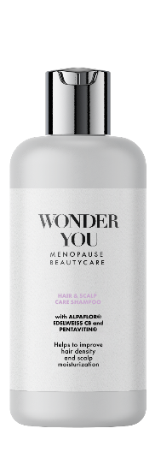
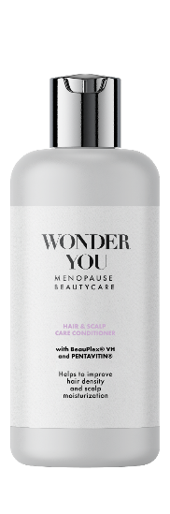
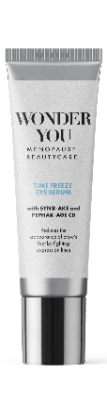
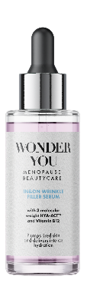

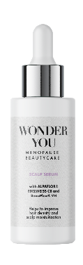
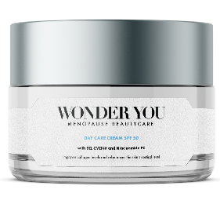
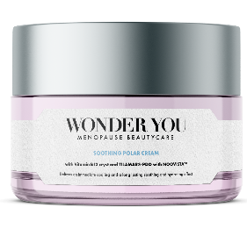
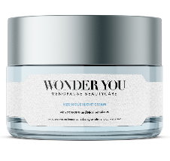
WONDER YOU
Menopause BeautyCare
Products are for illustration only, not for sale. dsm-firmenich is not responsible for final products claims.

Slide 2
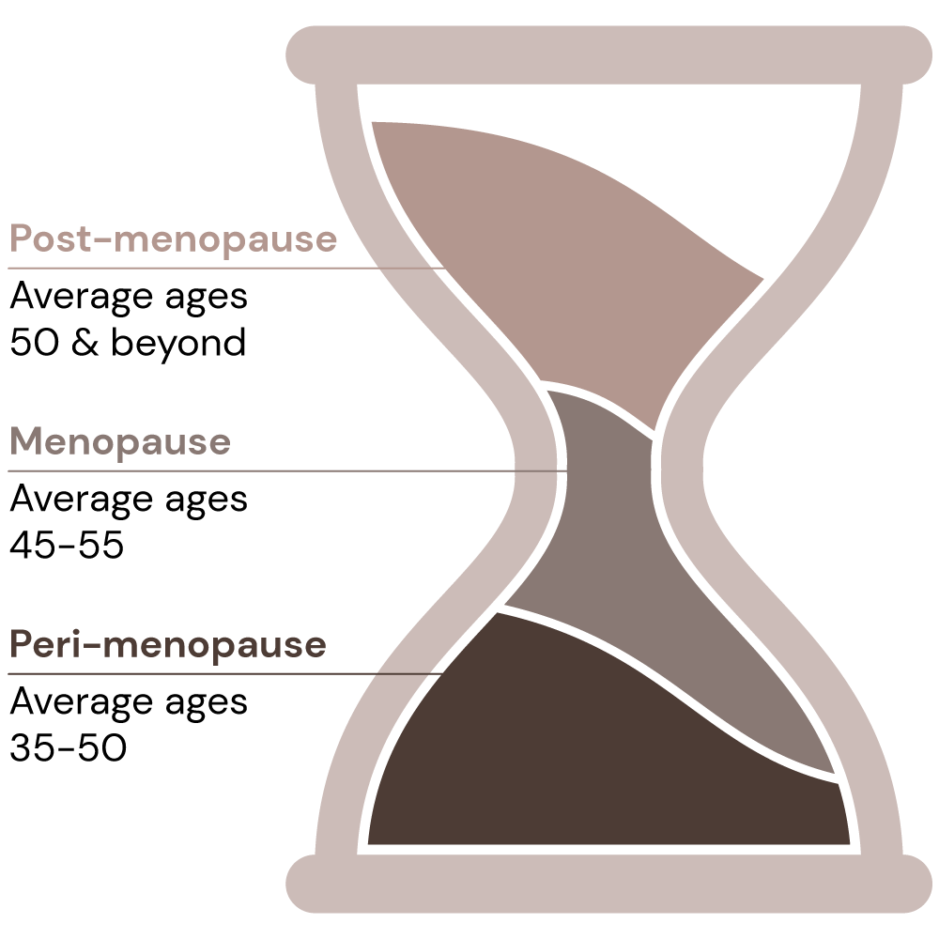
Let’s talk about menopause
Menopause vocabulary
Peri-menopause
The initial signs of peri-menopause usually begin with menstrual cycle changes. Some women might notice much longer cycles and heavier periods, while others might notice cycles that are shorter than usual.¹
Menopause
It is the experience of no longer having menstrual periods. Menopause marks the end of the reproductive years.¹
Post-menopause
It is the time after menopause has occurred when women have been without a menstrual period for 12 months. Once this happens, women are in post-menopause for the rest of their life.¹
Source:
1. The American College of Obstetricians and Gynecologists. FAQ047: The Menopause Years [internet]. Washington DC: American College of Obstetricians and Gynecologists; 2018. [cited 2021 Feb 10]. Available from https://www.acog.org/womens-health/faqs/the-menopause-years and helloclue.com
Notes:
1): The American College of Obstetricians and Gynecologists. FAQ047: The Menopause Years [internet]. Washington DC: American College of Obstetricians and Gynecologists; 2018. [cited 2021 Feb 10]. Available from https://www.acog.org/womens-health/faqs/the-menopause-years
Pre-menopause is the time between a woman's first period and the onset of perimenopause. In other words, the term premenopause is only used to describe the phase in a women's life where menstrual cycles are normal.
Peri-menopause is the transition phase into menopause that typically lasts about six years.

Slide 3
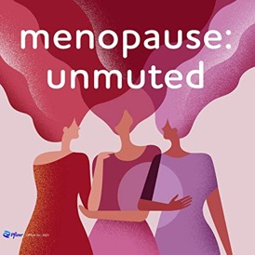
Menopause: a taboo to smash
Who is the next generation of women approaching menopause?
  1.2 billion women (nearly the Indian population) worldwide will be menopausal or postmenopausal by the year 2030¹
  of women don’t treat their menopause symptoms²
  Most women from Generation X, who are now in their late 40s and approaching menopause, are technologically proficient and digitally literate²
  1 in 4 women says they struggle to cope with life due to symptoms of the menopause and 1 in 3 significantly loses self-confidence³
  Being ridiculed, harassed, or stereotyped are some of the fears towards not speaking up⁴
73%
Menopause: unmuted is a podcast sponsored by Pfizer series exploring first-hand experiences of this life stage.
Source:
1. https://bmcwomenshealth.biomedcentral.com/articles/10.1186/s12905-015-0217-y#:~:text=With%20the%20aging%20of%20the,the%20year% 202030%20%5B1%5D.;
2. https://www.forbes.com/sites/debgordon/2021/07/13/73-of-women-dont-treat-their-menopause-symptoms-new-survey-shows/?sh=d269e67454f1;
3. https://www.openaccessgovernment.org/menopause-the-last-great-taboo/100976/; 4. https://hbr.org/2020/02/is-menopause-a-taboo-in-your-organization
Notes:
Adapted from:
1. https://bmcwomenshealth.biomedcentral.com/articles/10.1186/s12905-015-0217-y#:~:text=With%20the%20aging%20of%20the,the%20year%202030%20%5B1%5D.
2. https://www.forbes.com/sites/debgordon/2021/07/13/73-of-women-dont-treat-their-menopause-symptoms-new-survey-shows/?sh=d269e67454f1
3. https://www.openaccessgovernment.org/menopause-the-last-great-taboo/100976/
4. https://hbr.org/2020/02/is-menopause-a-taboo-in-your-organization
Other references
https://www.mckinsey.com/industries/healthcare-systems-and-services/our-insights/the-dawn-of-the-femtech-revolution

Slide 4

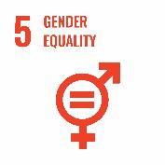
Menopause: a taboo addressed through 2 SDGs
The Impact of Menopausal Symptoms on Women's Health and Gender Equity
The symptoms of menopause vary among women, impacting their physical, emotional, mental, and social well-being(1). Some commonly experienced symptoms include(2,3):
Hot flushes and night sweats
Insomnia
Mood changes
Weight gain
Low energy levels
Difficulty with memory/concentration
Skin changes
Hair changes
Menopause extends beyond individual health concerns and has far-reaching impacts.
Taking place typically between the ages of 45 and 55, menopause coincides with a critical period for women's career development and their pursuit of top leadership positions.
Menopause remains a taboo subject, leading many women to feel uncomfortable discussing their symptoms openly at work. Additionally, menopausal women may be unfairly perceived as lacking confidence and emotional stability (4).
Women often experience negative consequences such as diminished motivation, reduced working hours, reluctance to seek promotion, and, in some cases, even leaving their jobs due to the challenges posed by menopausal symptoms (5).
(1): Menopause, WHO (Menopause (who.int))
(2): National institute on ageing (What Is Menopause? | National Institute on Aging (nih.gov))
(3): My menopause centre (Menopause signs and symptoms | My Menopause Centre)
(4): HBR (Research: Workplace Stigma Around Menopause Is Real (hbr.org) )
(5): Menopause and the workplace (https://www.fawcettsociety.org.uk/Handlers/Download.ashx?IDMF=9672cf45-5f13-4b69-8882-1e5e643ac8a6 )
Notes:
(1): Menopause, WHO (Menopause (who.int))
(2): National institute on ageing (What Is Menopause? | National Institute on Aging (nih.gov))
(3): My menopause centre (Menopause signs and symptoms | My Menopause Centre)
(4): HBR (Research: Workplace Stigma Around Menopause Is Real (hbr.org) )
(5): Menopause and the workplace (https://www.fawcettsociety.org.uk/Handlers/Download.ashx?IDMF=9672cf45-5f13-4b69-8882-1e5e643ac8a6 )
(5).

Slide 5
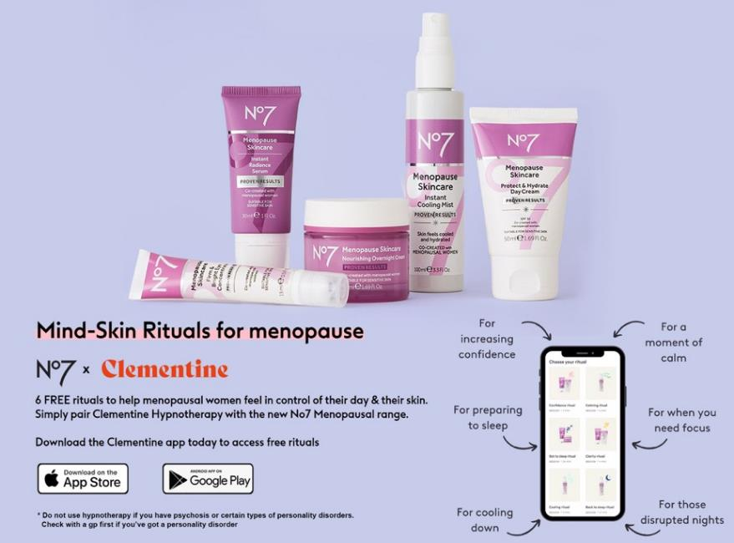
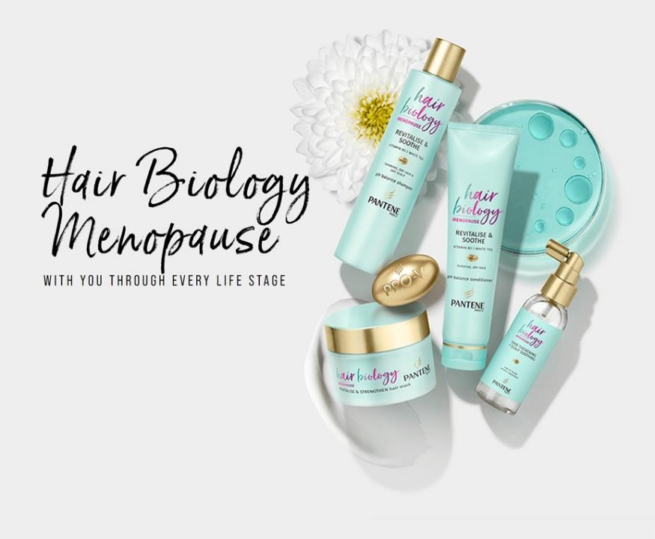
From products to campaigns, the taboo is being spoken up
Innovations tapping into menopause worldwide
Boots N°7 Menopause Skincare co-created with over 7,000 menopausal women and dermatologist approved for menopausal skin. *
Pantene Pro V Hair Biology Menopause: a range to help manage the changes brought about by age and hormone imbalance.**
Source:
*No7 | NEW No7 Menopause Skincare – Boots; ** Menopause Revitalize Care Series | Pantene UK

Slide 6
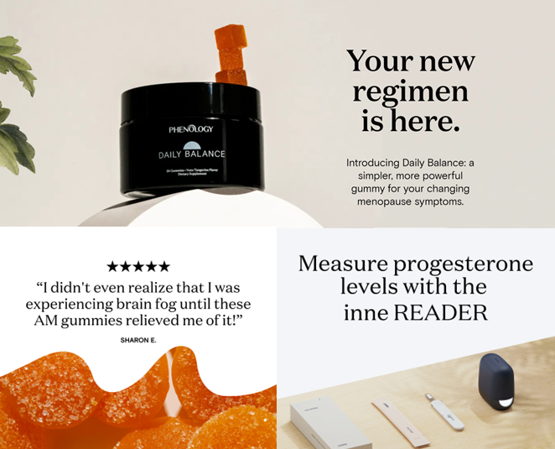
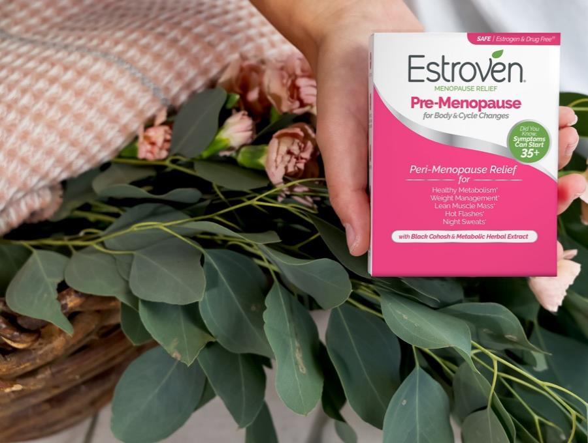

From products to campaigns, the taboo is being spoken up
As well in the supplements area
Phenology: gummies for changing menopause symptoms*
Inne Reader: at-home hormone monitoring system to give an easy, convenient way to measure the progesterone levels with a few drops of saliva.
Estroven® Menopause Relief**: Multi-symptoms and Targeted symptoms relief.
Ex: Pre-Menopause for Body and Cycle changes – “Meet our expert” link
Source:
* Homepage | Phenology (myphenology.com)
The PhenologyTM brand is owned by Hologram Sciences, an independent subsidiary of dsm-firmenich.
** https://estroven.com/
Estroven® is a brand from i-Health, Inc. – a wholly owned subsidiary of dsm-firmenich

Slide 7
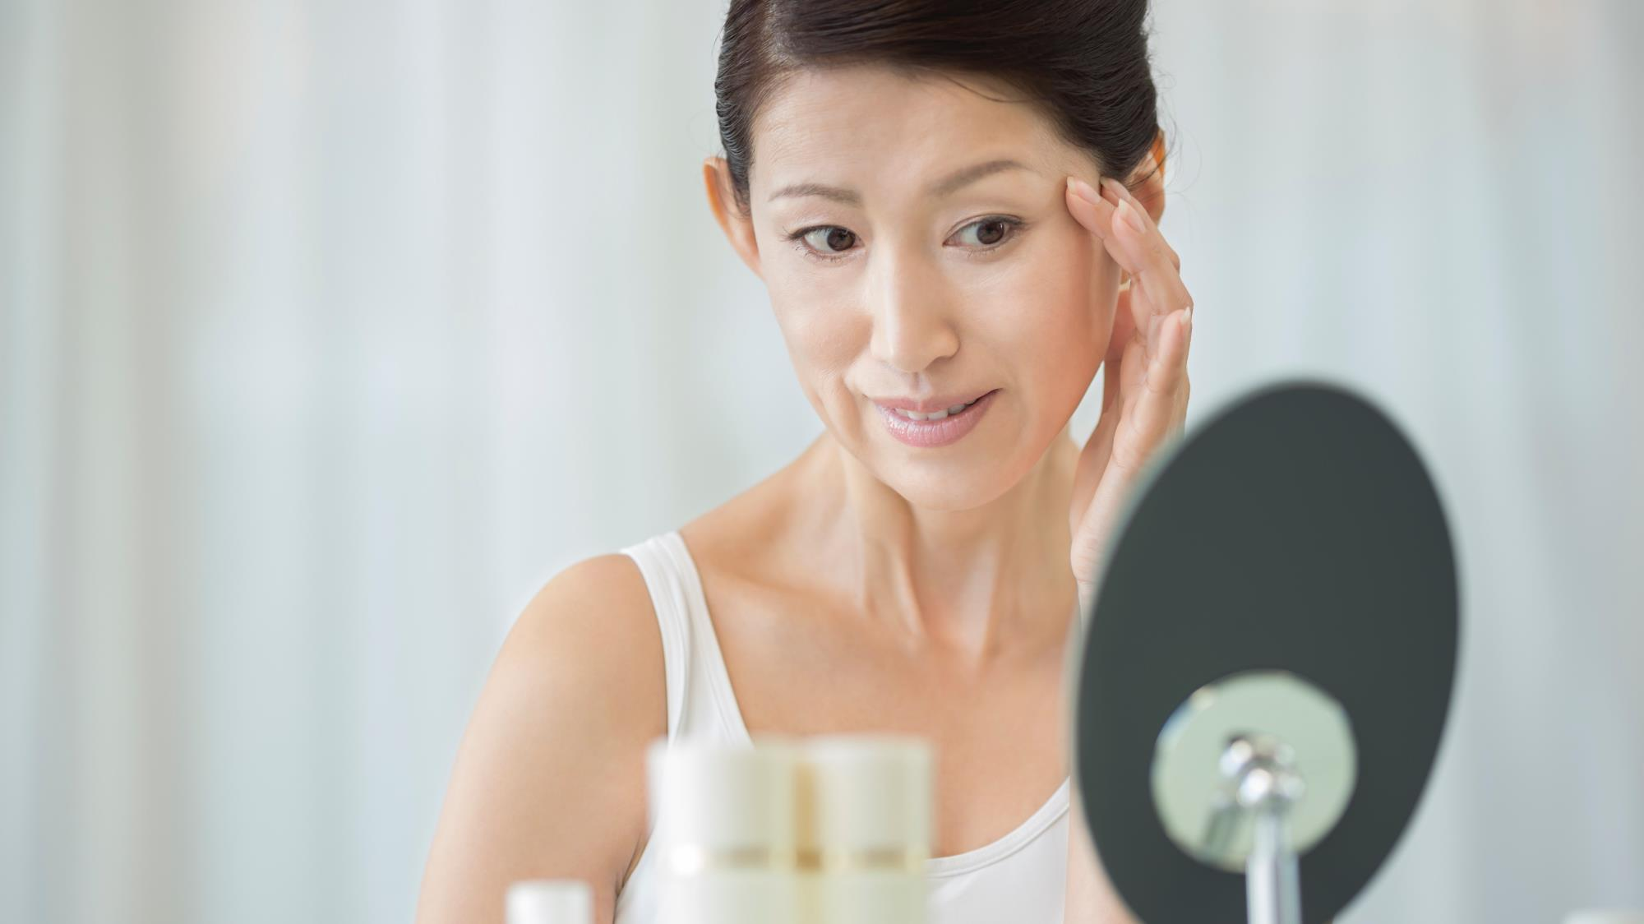
Menopause: The voice of Consumers
Symptoms and effects on the skin and hair

Slide 8
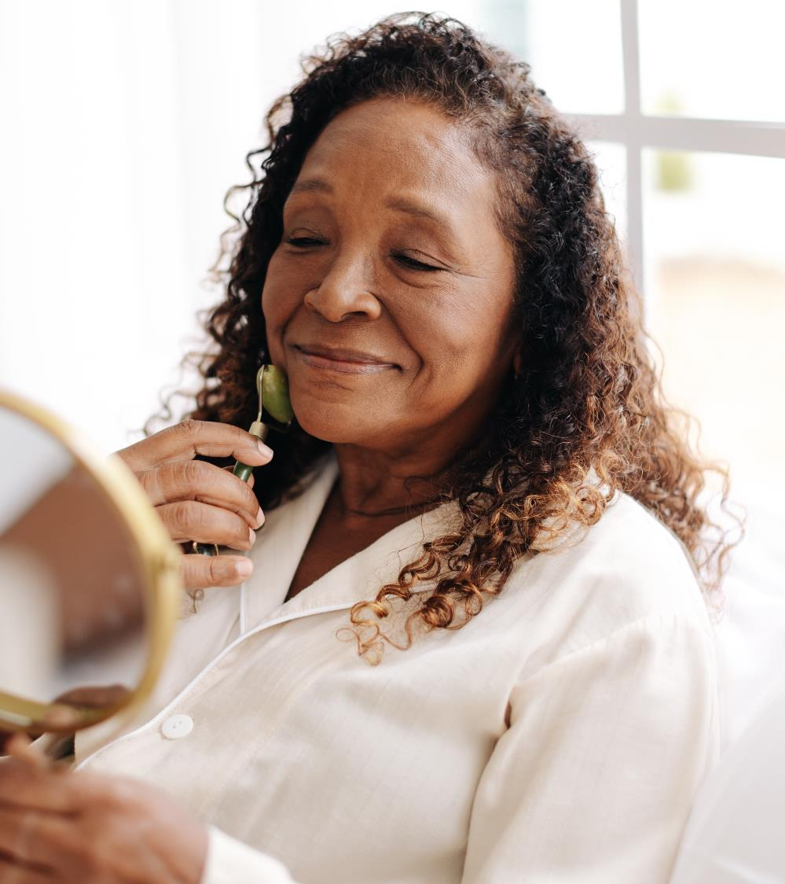
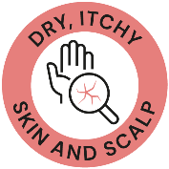





Skin care consumer survey
Online survey scope and key concerns
600 participants
Self-identified in a menopausal stage
Countries: USA, China and France
Age: 45 to 60 years old
Revealing 5 main concerns on skin experimented by women
And confirming the will to smash the taboo with their gynecologist remaining their most trusted advisor
8

Slide 9
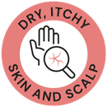




Skin care consumer survey
Key take aways
Menopause is a very personal experience and each women experiments and deserves her own skincare solution.
Although we can still underline some key insights:
  Change in skin is a key symptom experimented during menopause by 60% of women (Up to 80% in China)
  58% of consumers experiment hot flushes (Top 1 concern in France / 76%)
  Women are willing to speak about menopause across the world, their gynecologist remaining their first trusted source of information
  Consumers are using high variety of skincare solutions, with preference for moisturizers (USA) and aging related solutions (France and China)
  Regarding menopause-related skin symptoms, wrinkles and sagging are top concern in USA and France although secondary in China focusing on skin pigmentation and skin sensitivity
  Acne and oily skin is a concern for specific consumers (15%)

Slide 10
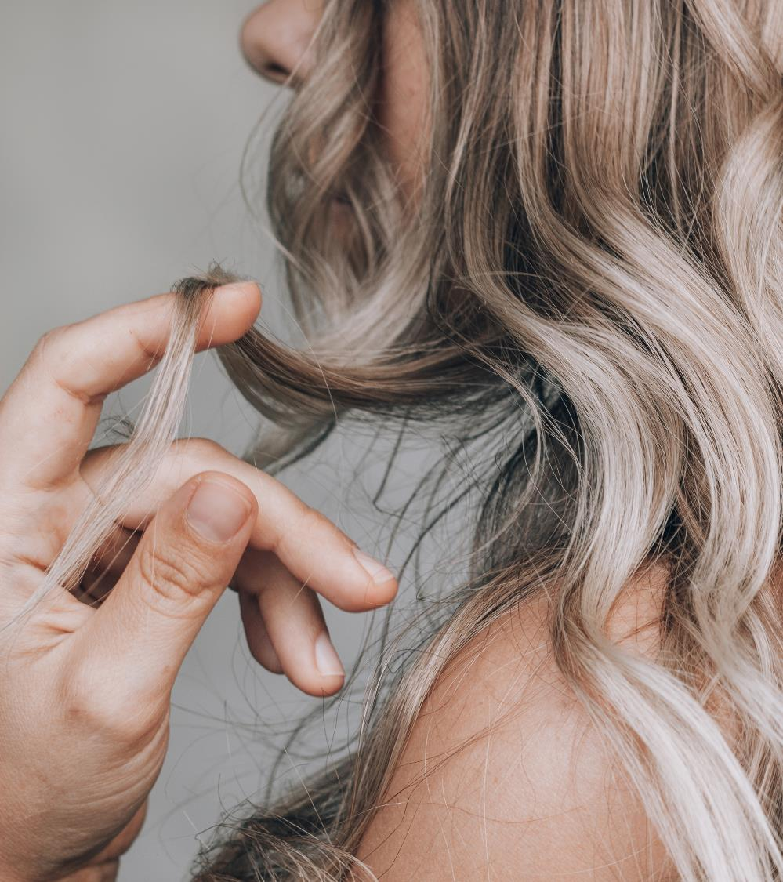
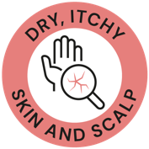
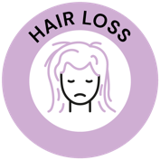




Hair Care
Consumer survey
dsm-firmenich Consumer Insights Hub*
113-115 consumers
Countries: Australia, USA, and UK
Age: 45 to 60 years old
Revealing 3 main concerns on the
hair and scalp experimented by women
Key partner: the hairdresser
Key dedicated
products:
*Q4 2022

Slide 11
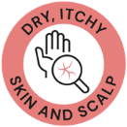
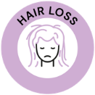

Hair care consumer survey
Key take aways
Menopause is a very personal experience and each women experiments and deserves her own hair care solution.
Although we can still underline some key insights:
  The main hair symptoms related to menopause are hair loss for 29% of the consumers* and hair thinning (25% of the consumers*) followed by scalp and hair dryness sensation.
  The hair concerns related to menopause are very emotional and can lead to a loss of self-confidence and to sadness.
  Hairdresser is the most preferred partner to talk to when it comes to hair and scalp symptoms related to menopause for 43% of the consumers*.
  When consumers experience hair concerns related to menopause, they start to look for dedicated solutions to their own symptoms. Shampoo is the main preferred product for 58% of the consumers* followed by conditioner and leave-on for the scalp.
* From the dsm-firmenich Consumer Insights Hub survey Q4 2022

Slide 12
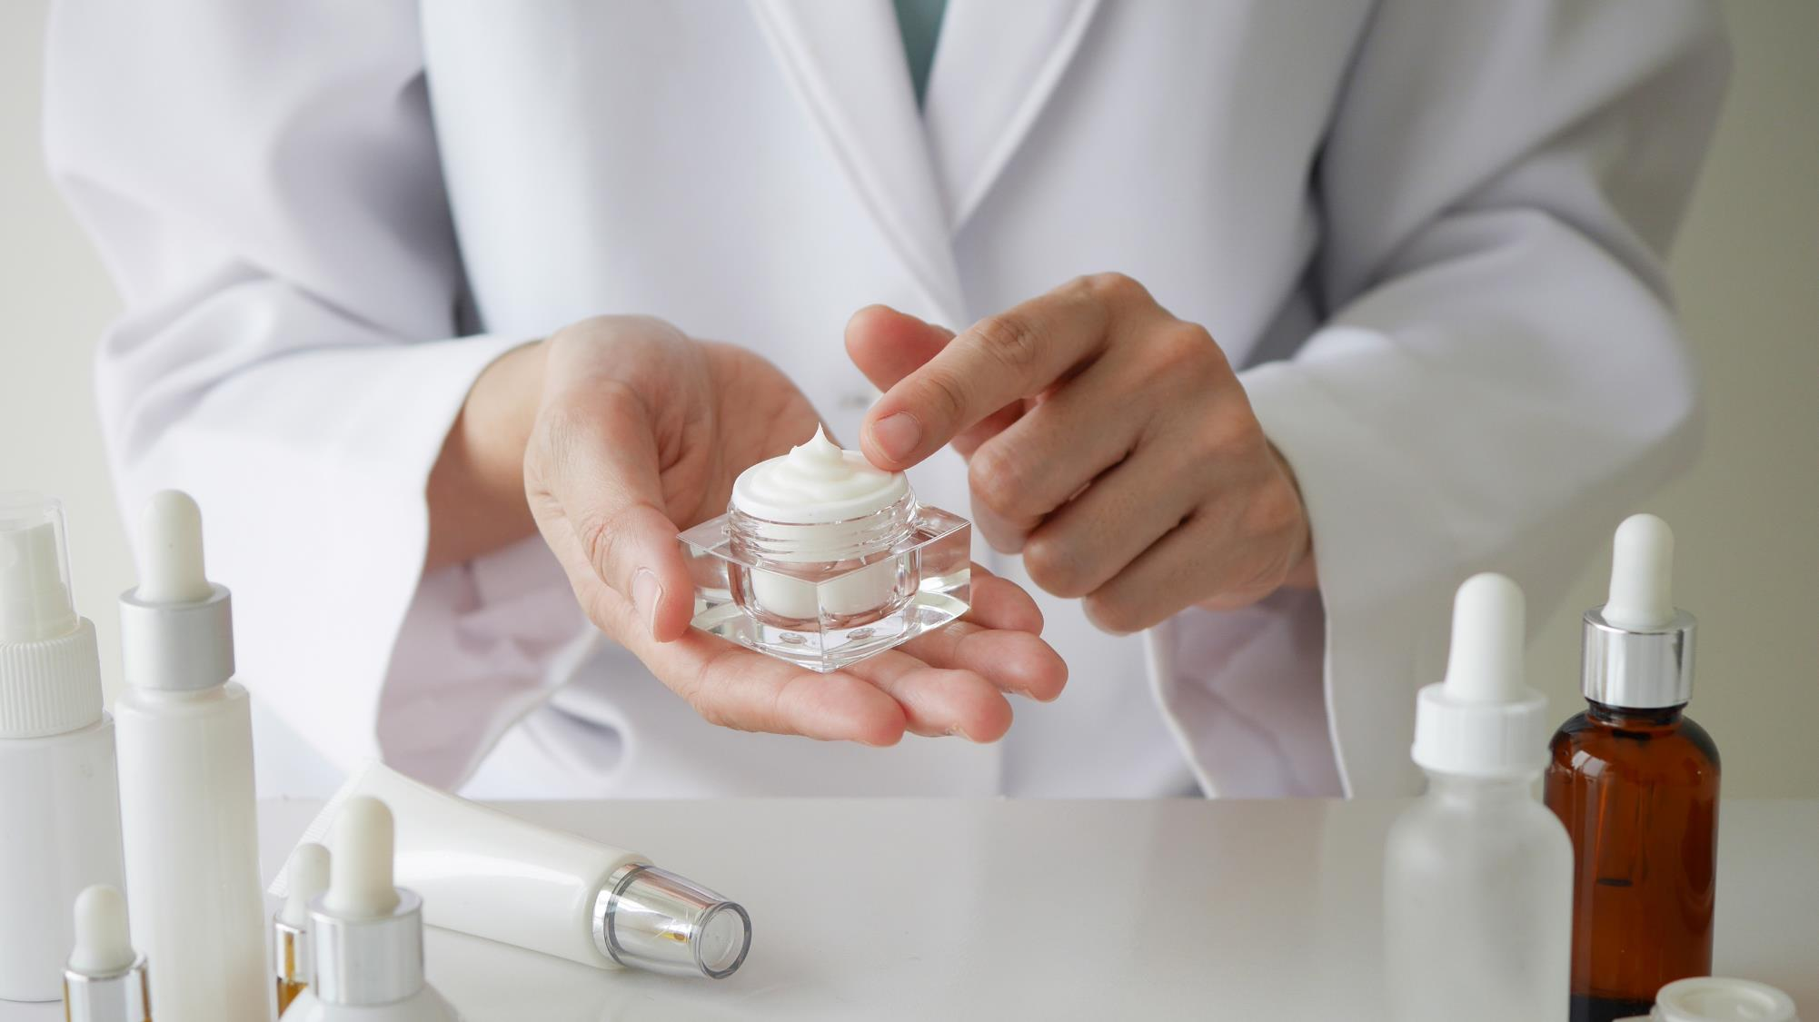
The science behind Menopause:
Symptoms and effects on the skin and hair

Slide 13
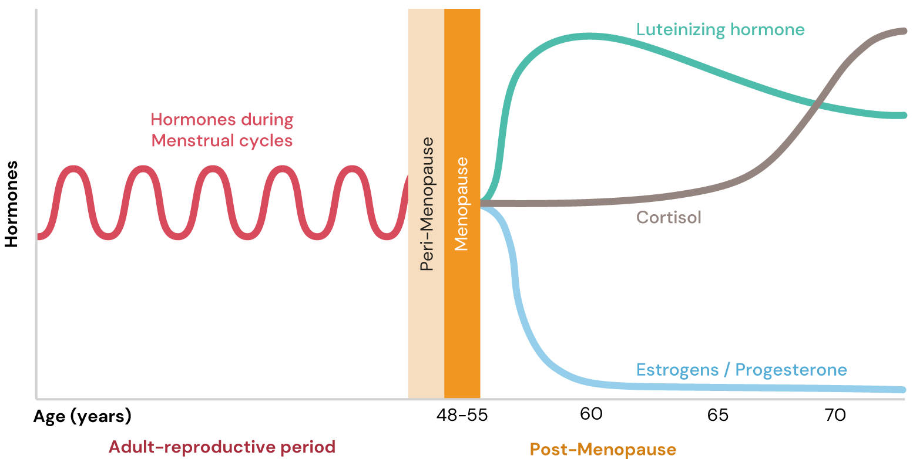
Menopause: Hormonal Changes
Natural loss of Estrogens and Progesterone, and in increase in Cortisol
The drop in Estrogen and Progesterone levels, in addition to high Cortisol levels, lead to important changes in the body.
Notes:
Luteinizing hormone:
LH helps control the menstrual cycle and triggers the ovulation.
LH levels in menopause increase because estrogen levels decrease.
Cortisol:
The stress hormone and has many damaging effects.
Cortisol levels rise in menopause due to the decline of estrogens
Estrogens:
For the menstrual cycle, they regulate the build up of the endometrium preparing the uterus for pregnancy along with a variety of additional functions.
Estrogen dramatically decreases in menopause. The decrease in estrogen levels is one reason for hot flashes.
Progesterone:
Similar function in menstrual cycle as estrogen.
The decline of progesterone in menopause is also one of the main reasons for menopause symptoms, such as hot flashes, night sweats etc.
Progesterone and estrogens can be prescribed to lower the symptoms of menopause.

Slide 14

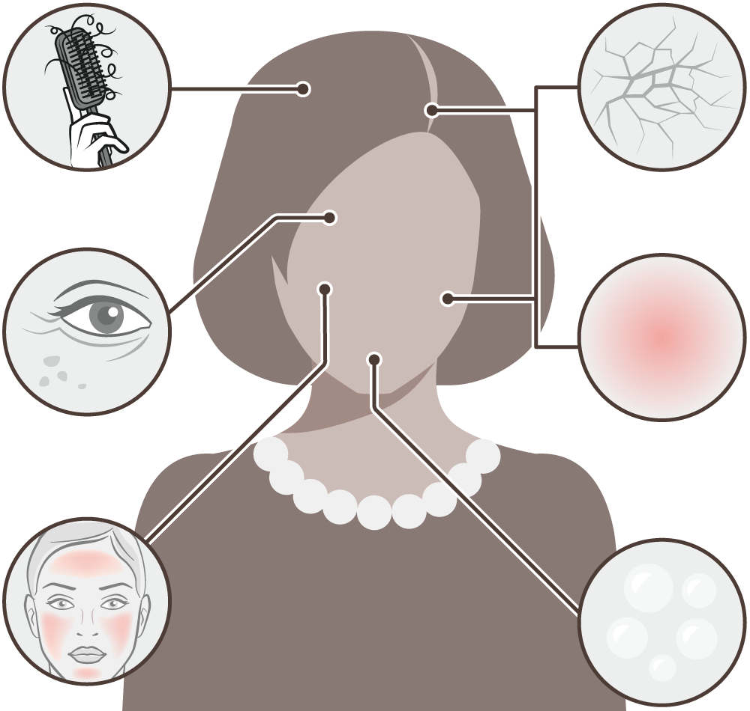






Menopause: Symptoms and effects on the skin and hair
The natural loss of estrogen and progesterone, and an increase in cortisol during the menopause has an effect on skin and hair cell function leading to visible signs of aging.
Thinning scalp hair
Hair grows slower and becomes thinner due to increased hair fall. Hair becomes to look drier, too. On the opposite, there may be an increase in facial hair due to menopause.
Dry skin and scalp
Thinning of the skin and impaired barrier. Hyaluronic acid levels also decrease. Skin becomes visibly drier. The main symptom of menopause skin. Consumers can also experience dry scalp.*
Wrinkles and age spots
Due to age & lower estrogen levels:
Collagen synthesis is reduced. Collagen and elastin levels decrease about 30% in the first five years of menopause. Skin also loses elasticity.
Overall melanin synthesis is reduced making its transfer to skin cells less efficient ultimately leading to uneven complexion and age spots.
Itchy or red skin and scalp
Due to hormonal changes and becoming drier, skin gets itchy and slightly inflamed leading to skin redness. Consumers can also experience itchy scalp.*
Hot flushes
Can go along with heavy sweating. They can lead to sleepless nights. Lack of sleep hampers the skin's ability to repair itself.
Oily skin
Some women experience oily skin and acne breakouts. This is due to decreased estrogen levels unmasking testosterone.
Reference: Zouboulis et al. (2022) Skin, hair and beyond: the impact of menopause. Climacteric 25(5):424-442
* dsm-firmenich Consumer Insights Hub
Notes:
Age spots:
Due to age & lower estrogen levels:
Vitamin D synthesis, skin natural photoprotection is reduced.
Overall melanin synthesis decreases, transfer to skin cells becomes less efficient.
Both leading to uneven complexion and localized hyperpigmentation.
Hot flushes :
It is linked to the change in hormonal status, specifically the decline in estrogens and progesterone.
Most research suggests that hot flashes occur when decreased estrogen levels cause body's thermostat (hypothalamus) to become more sensitive to slight changes in body temperature.
When the hypothalamus thinks the body is too warm, it starts a chain of events — a hot flash — to cool down.
See for example Freedman 2014: Menopausal hot flashes: Mechanisms, endocrinology, treatment - ScienceDirect

Slide 15
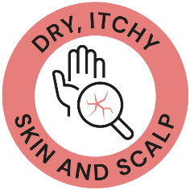

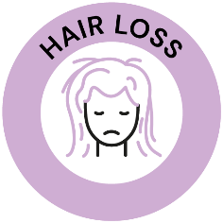

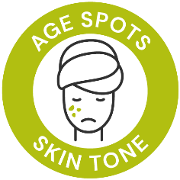


Where consumer’s voice meets the science
Main Skin and Hair menopause concerns
We recognize that menopause is a transformative stage that brings about changes in both body and mind, and we are here to support and empower women every step of the way.
By tackling possible skin, scalp and hair discomforts, we seek to encourage women to embrace their beauty and celebrate their individuality.
Introducing Wonder You, a palette of solutions designed exclusively for menopausal women, understanding and embracing their unique emotional, skin and hair journey.

Slide 16


Slide 17

So many stages, so many changes ...
The passing of the years brings many challenges, but it also brings one thing that makes all the difference: Maturity to deal with all that comes ahead.
That is why menopause goes far beyond from being another phase of physical transformation, to become one of the best chapters of women’s lives.
Introducing Wonder You, a pallet of solutions designed with an exclusive combination of technological assets backed by skin & hair science.
dsm-firmenich has developed innovative solutions helping to better deal with the effects of menopause on skin and hair and empowering you to embrace everything that makes you a unique woman.
17

Slide 18

Move WONDER YOU to black
Products are for illustration only, not for sale. dsm-firmenich is not responsible for final products claims.
FACIAL LINE
CAPILLARY LINE
Notes:
TIME FREEZE EYE SERUM formulation removed due to phase out of VALVANCE® Look 100. SYN®-AKE & PEPHA®-AGE CB are still fitted solutions for menopause concerns you can find in the back-up slides

Slide 19







Formula | Highlighted Ingredients | Claim | Formulation helping to better deal with…
DAY CARE CREAM SPF 50 | BEL-EVEN® Niacinamide PC | Improves collagen levels and rebalances the skin’s cortisol level
MERINGUE NIGHT CREAM | SYN-UP® Niacinamide PC | Increases skin resilience by reducing sensitivity to daily stressors
SOOTHING POLAR CREAM | Vitamin B12 cryst | Delivers an immediate cooling and a long-lasting soothing and hydrating effect
IN&ON WRINKLE FILLER SERUM | 3 molecular weights HYA-ACT™ Vitamin B12 cryst | Plumps tired skin and delivers intense hydration
2IN1 MILKY LOTION ON-THE-GO | PEPHA®-TIGHT CB PEPHA®-CTIVE CB | Remodels and firms neck and face contours
HAIR & SCALP CARE SHAMPOO | ALPAFLOR® EDELWEISS CB PENTAVITIN® | Helps to improve hair density and scalp moisturization
HAIR & SCALP CARE CONDITIONER | BeauPlex® VH PENTAVITIN® | Helps to improve hair density and scalp moisturization
SCALP SERUM | ALPAFLOR® EDELWEISS CB BeauPlex® VH | Helps to improve hair density
19

Slide 20






Ingredients helping to better deal with… | DRY, ITCHY SKIN AND SCALP | AGE SPOTS SKIN TONE | LINES, WRINKLES & SAGGING | SKIN SENSITIVITY & REDNESS | HAIR THINNING | HAIR LOSS
BEL-EVEN®
Niacinamide PC
SYN-UP®
Vitamin B12 cryst
HYA-ACT™
PEPHA®-TIGHT CB
PEPHA®-CTIVE CB
ALPAFLOR® EDELWEISS CB
PENTAVITIN®
BeauPlex® VH
20

