Slide 1
AMPHISOL® A
The right choice for “medical” products at a low pH level
Master Presentation

Slide 2
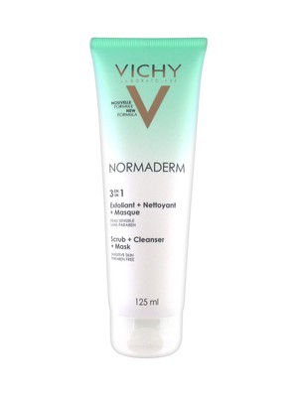
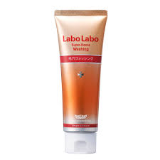
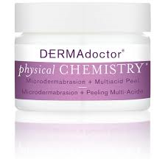
NEW application for AMPHISOL® A
Dermatological products
Constant need for speciality cosmetic and dermatoligical products containing α-hydroxy acids
Europe is the dominating market after APAC and NAA
Key types are leave-on face care products (min 80%) and cleanser products (up to 20%)
GNPD search with full text search matches exfolient in the Sub-Category Face/Neck Care and Date Published is within the last three complete years and Ingredient Search matches one or more of [Glycolic Acid, Lactic Acid] as the Ingredients

Slide 3

NEW application for AMPHISOL® A
Facial exfoliation is quickly becoming a daily skincare practice
Gentler daily exfoliants take over traditional scrubs and peels and can replace or support aggressive treatments by dermatologists
These exfoliants could be toners, serums and overnight creams meeting consumers' needs and will increase usage frequency with lesser irritation
Additional potential as a specialised at-home treatment.
75%
of female South Korean consumers aged in their 20's and 30's regularly use facial peels
Mintel, August 2016
3

Slide 4
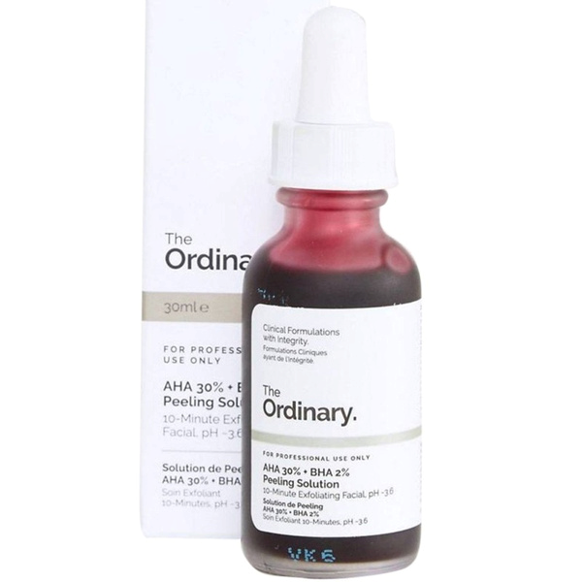
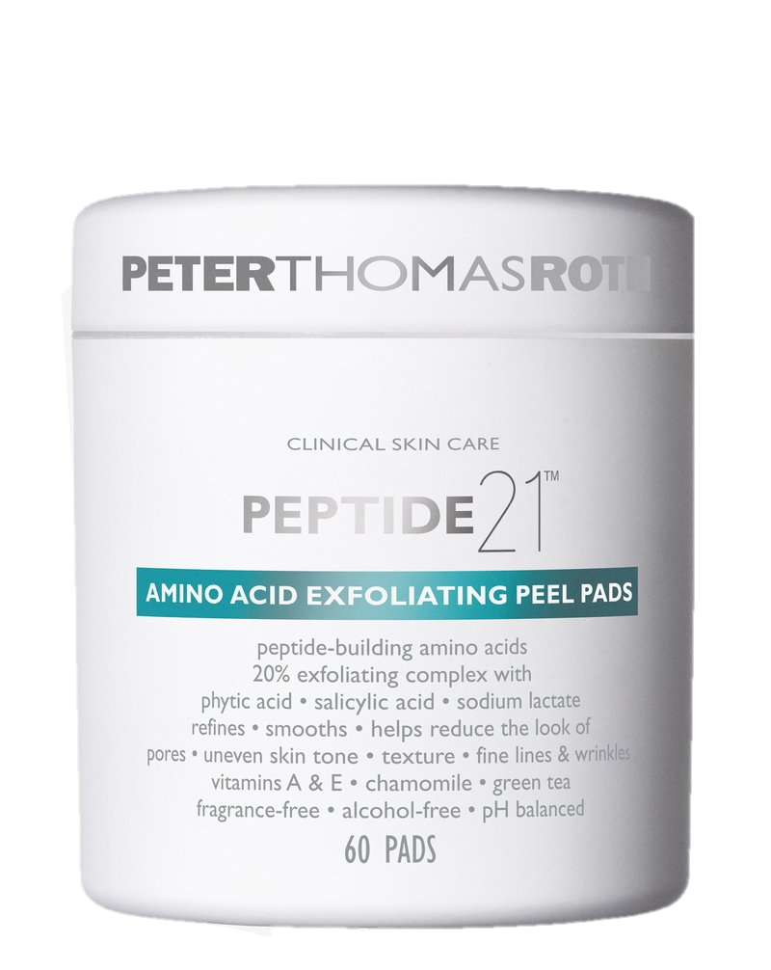
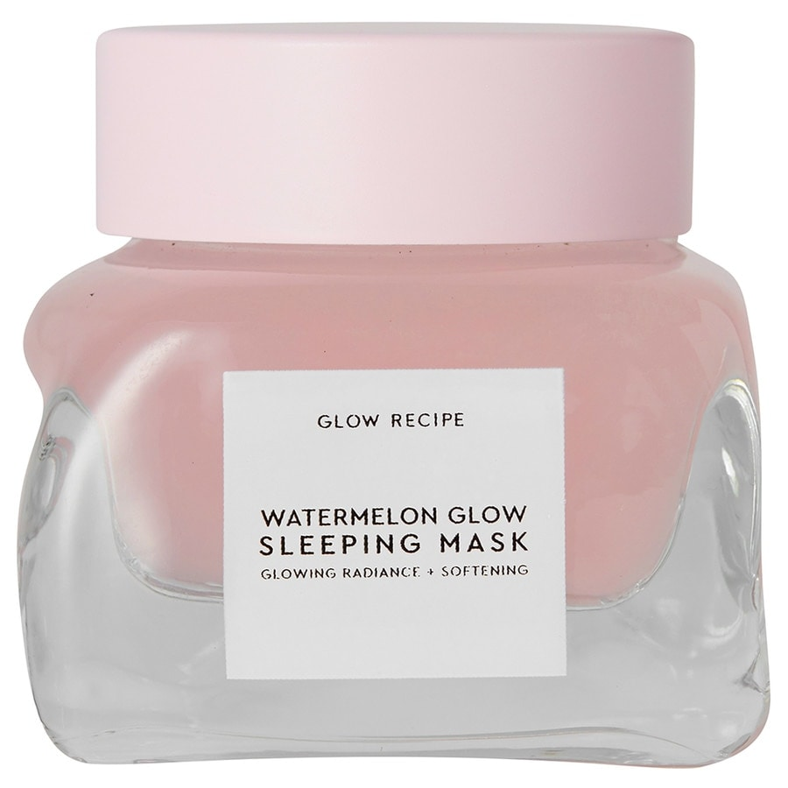
Leave-in exfoliating skincare with beauty functionality
10-minute exfoliating serum
The Ordinary: AHA 30%+ BHA 2% Peeling Solution
“
Exfoliating overnight mask
Glow Recipe: Watermelon Glow Sleeping Mask
Chemical peel pads for daily use
Peter Thomas Roth: PEPTIDE 21 AMINO ACID EXFOLIATING PEEL PADS
Source: Mintel, 2020

Slide 5
NEW application for AMPHISOL® A
Do YOU have …
Dry and flaky skin up to xerosis or ichtyosis,
Uneven skin tone up to melasma,
Acne-prone skin and/or acne scars
➡ SOLUTION BY THE USE of alpha hydroxy acids (AHAs) formulated in specialty or dermatologial products such as facial cleansers, peels, and leave-on creams can help.
THE WHY is that most effective and well-researched AHAs are glycolic acid and lactic acid. Malic acid, citric acid, and tartaric acid may also be effective, but are considered less stable and less skin-friendly. AHAs in concentrations greater than 4% and in a base with an typical acid pH of 3 to 4 work exfoliant. Products at such a low pH are not easy to stabilize, but AMPHISOL® A can make it happen ☺
?

Slide 6
NEW application for AMPHISOL® A
Cosmetic application forms at low pH value:
Tanning products: ~pH 4-4.5
Anti-Acne products: below pH 4.5; mainly pH 4.0-4.5
AHA based products: mostly adjusted between 3-4
Commonly used actives in low pH products:
Salicylic acid (up to 2%),
Zinc PCA (~1%),
Glycolic acids and alpha hydroxy acids (AHA): up ~10% for treating skin wrinkled/aged by UV
AHA: up to 50% for peeling and special acne products

Slide 7
pH Compatibility
Emulsifiers in general have pH optimums where to stabilize the best. But broad pH compatibility is of advantage for extensive usage.
Special
applications
Mostly used pH range
for cosmetic emulsions
No pH
adjustment
Testing procedure
Basic formulation to test emulsifier performance
Emulsifiers at 2%
Cetyl Alcohol at 2.0%
Neutralization done with different neutralizing agents at defined pH values
Emulsion integrity and crystal formation evaluated after 8 weeks at 40°C
Neutralization with Amines
Neutralization with commonly
used neutralizing agents
NaOH, TEA, KOH, Tromethamine
No pH
adjustment
pH
AMPHISOL® K shows broad pH compatibility,
AMPHISOL® A even covers cosmetic application < pH 5

Slide 8
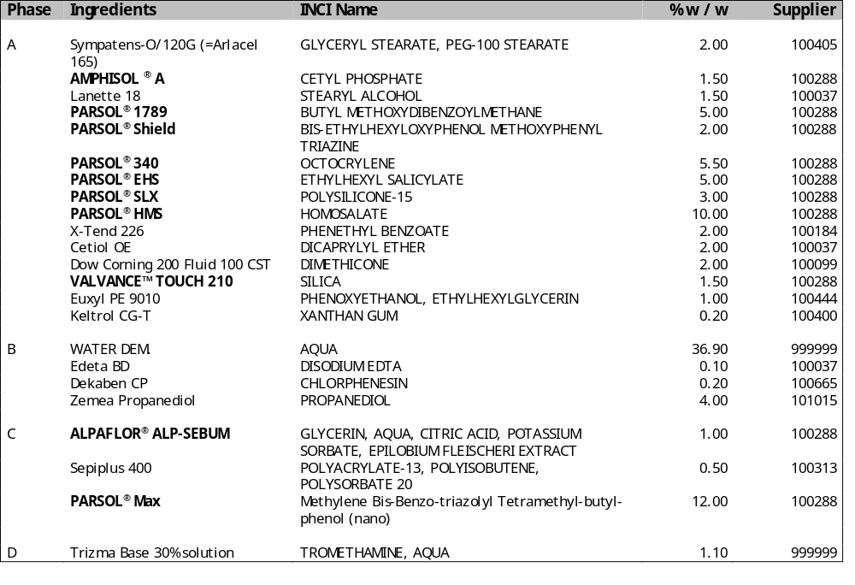
AMPHISOL® A – NEW concept
Extra light emulsion for acne prone and oily skin with SPF 50 at low pH
Please note DSM formulation disclaimer at the end of the presentation
SU-E-101210-2

Slide 9
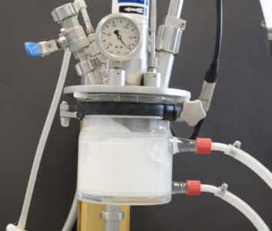
AMPHISOL® A- Formulation guidelines Important to know
AMPHISOL® A dissolves completely in the heated oil phase. Heat up AMPHISOL ® A to 85-90°C to ensure its best long-term stability.
When combining water and oil phase: both the water or the oil phase can be put in first and the other phase can be added with or without stirring.
After combining both phases we recommend a homogenization step
AMPHISOL A is not sensitive to shear forces and doesn`t need strong shearing. But adapt shear force accordingly to production scale and shearing equipment.
During cooling keep stirring.
We recommend a second but shorter homogenization step below 40°C.
Stir while cooling down further.
AMPHISOL® A will form during the emulsification liquid crystalline structures in the oil phase and at the interphase of oil and water droplets in the first 24 - 48 hours
The formulations need 24-48h for ripening and to adjust themselves to the final viscosity

Slide 10
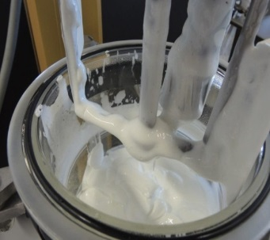
AMPHISOL® A - Formulation guidelines
Neutralization and pH range
AMPHISOL® A is the non-neutralized Cetyl Phosphate. The resulting pH of a standard emulsion based on AMPHISOL® A without any base is around pH 2-2.5.
When neutralized AMPHISOL® A acts as an anionic emulsifier. The pH can easily be adjusted to the desired value with any neutralizing agent (NaOH, KOH, Triethanolamine, Tromethamine, AMP, etc.).
The neutralizing agent can be added during the manufacturing process at any time although we recommended adding it before one of the homogenization steps. The neutralizing agent can be even added (as a 10% premix in water) to the hot oil phase containing Amphisol® A shortly before combining with the water phase.
AMPHISOL® A forms stable emulsion in a pH range from 2-8 when neutralized with Amines.
When neutralized with strong bases like KOH or NaOH the preferred pH range is 5-8.
Knowing a few tricks, AMPHISOL® A is easy to handle and delivers very stable emulsions

Slide 11
DISCLAIMER
Copyright © 2020 DSM Nutritional Products, 4002 Basel, Switzerland.
www.dsm.com/personal-care. All rights reserved.
Although DSM has used diligent care to ensure that the information provided herein is accurate and up to date, DSM makes no representation or warranty of the accuracy, reliability, or completeness of the information. This presentation only contains scientific and technical information for business to business use. Country- or region-specific information should also be considered when labeling or advertising to final consumers. This publication does not constitute or provide scientific or medical advice, diagnosis, or treatment and is distributed without warranty of any kind, either expressly or implied. In no event shall DSM be liable for any damages arising from the reader’s reliance upon, or use of, these materials. The reader shall be solely responsible for any interpretation or use of the material contained herein. The content of this document is subject to change without further notice. Please contact your local DSM representative for more details. All trademarks listed in this brochure are either registered trademarks or trademarks of DSM in The Netherlands and/or other countries unless explicitly otherwise stated.
DISCLAIMER FORMULATION GUIDELINES
This information is for illustration purposes only and based upon our current knowledge and experience at the time of printing. We do not make any representation or warranty of any kind, express or implied, including merchantability or fitness for a particular use, with respect to such information or its application. Use of this information is at your discretion and risk. Nothing herein relieves you from carrying out your own suitability determinations and tests. You are responsible for observing all laws and regulations relevant to your products, uses or processes. We do not assume any liability in connection with your product and its use. The foregoing information and suggestions are also provided without warranty of non-infringement as to the intellectual property rights of third parties, and shall not be construed as any inducement to infringe the rights of third parties.
11

