Slide 1
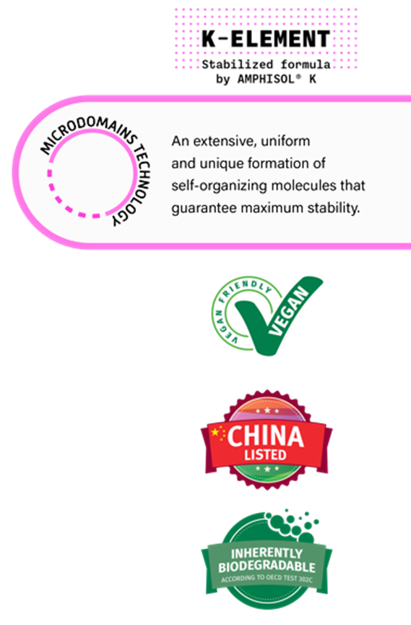

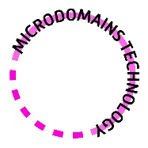








AMPHISOL® K
Ultimate stability for multi formulations
An extensive, uniform and unique formation of self-organizing molecules that guarantee maximum stability.
Multi textures and product types
Multi applications
Pump sprays
Dispensers
Bottles
Tubes
Jars
Skin
Sun
Make-up
Thanks to the unique microdomains technology capable of stabilizing the most challenging combination of ingredients
April 2025

