Slide 1
Multiple textures, multifunctional products and consumers increasingly in search of unique and innovative experiences
In a world where people increasingly value experiences through the products they consume, the variety of cosmetic formulations grows. Creams, sprays, mousses, among others with considerable quantity
of pigments and skin actives like make-up and products with high
SPF bring a series of technical challenges, especially when it comes
to stabilization.
April 2025
1

Slide 2
But how can we get completely stable formulations in less time and with the best cost-in-use?
dsm-firmenich, a pioneer in potassium
phosphate technology, presents a definitive
emulsifying solution.
2

Slide 3

AMPHISOL® K
Ultimate stability for multi formulations

Slide 4

AMPHISOL® K
Ultimate stability for multi formulations
A high-performance PCP emulsifier for the most challenging formulations. A unique solution for the creation of innovative textures and applications, which place you and your company in a leading position in an increasingly competitive market.
This is possible through the exclusive microdomains technology, capable of stabilizing the most versatile combinations of ingredients with high amounts of pigments, electrolytes, ethanol and oil, from sunscreens to makeup.
AMPHISOL® K can also be used as a co-emulsifier, making processing easier whilst keeping costs under control.
An extensive, uniform and unique formation of self-organizing molecules that guarantee maximum stability.
4

Slide 5
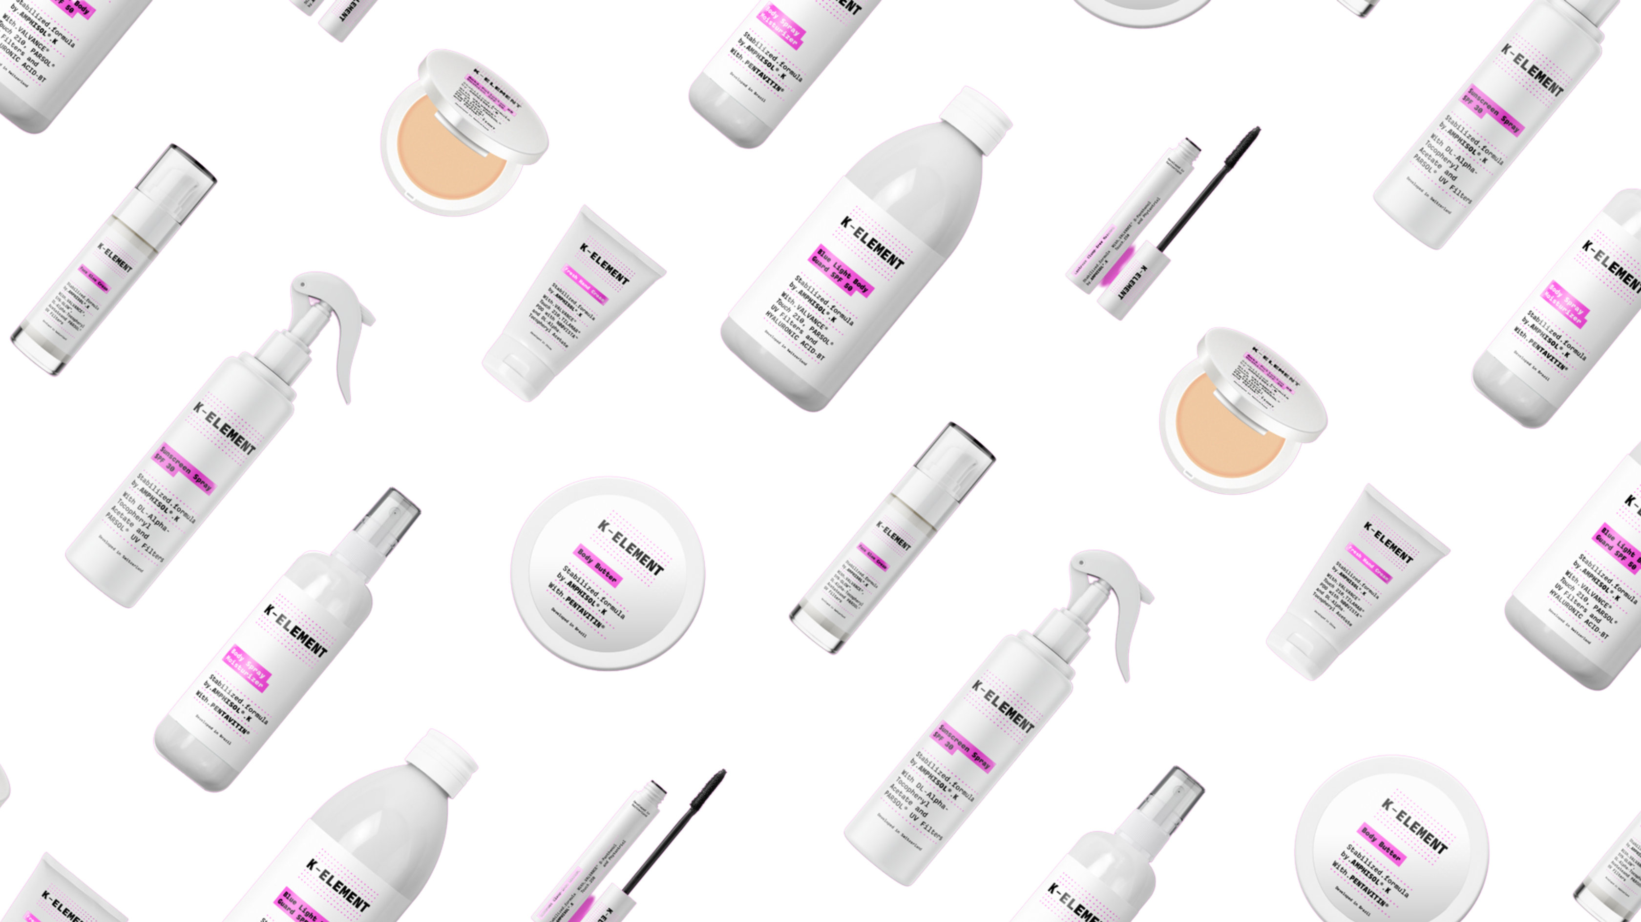

K-ELEMENT
Stabilized formula by AMPHISOL® K
Ultimate stability for multi formulations
Products are for illustration only, not for sale.
dsm-firmenich is not responsible for final product claims.
5

Slide 6
Products are for illustration only, not for sale.
dsm-firmenich is not responsible for final product claims.
6

Slide 7





K-ELEMENT
With AMPHISOL® K, the ultimate emulsifying solution
for innovative skin care formulations, K-ELEMENT provides a unique sensory experience through maximizing balance and stability between ingredients.
A versatile line, with multiple textures and applications, offering the highest performance to the last drop of the product.
Ultimate stability for multi formulations
Products are for illustration only, not for sale.
dsm-firmenich is not responsible for final product claims.
7

Slide 8

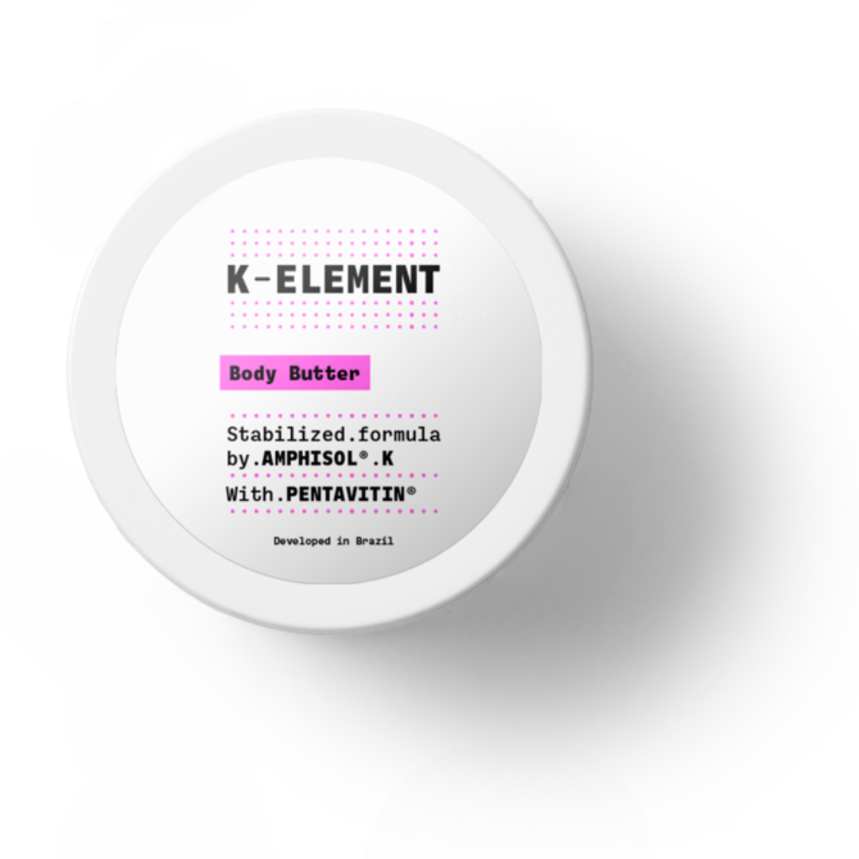

Body Butter
Stabilized formula by AMPHISOL® K
With PENTAVITIN®
An extensive, uniform and unique formation of self-organizing molecules that guarantee maximum stability.
A feeling of comfort with a buttery yet non-sticky texture and,
which envelops the skin with a velvety and comforting touch.
Phase | Ingredients | INCI Name | % w/w
A | Water Dem | AQUA | 75,60
 | Edeta BD | DISODIUM EDTA | 0,10
 | Carbopol Ultrez 10 | CARBOMER | 0,30
 | Tris Amino Ultra PC | TROMETHAMINE | 0,50
 | Glycerin 99.5% | GLYCERIN | 2,00
B | DUB MCT 5545 | CAPRYLIC/CAPRIC TRIGLYCERIDE | 8,00
 | DUB B1215 | C12-15 ALKYL BENZOATE | 2,00
 | BELSIL DM 100 | DIMETHICONE | 2,00
 | Shea butter | BUTYROSPERMUM PARKII BUTTER | 2,00
 | DUB SHOREA T | SHOREA ROBUSTA SEED BUTTER | 1,00
 | AMPHISOL® K | POTASSIUM CETYL PHOSPHATE | 2,00
 | Lanette D | CETEARYL ALCOHOL | 2,00
C | Euxyl PE 9010 | PHENOXYETHANOL, ETHYLHEXYLGLYCERIN | 1,00
D | PENTAVITIN® | SACCHARIDE ISOMERATE, AQUA, CITRIC ACID, SODIUM CITRATE | 1,00
E | SHP Ambree Silver Prada | PARFUM | 0,50
Procedure
In water phase, make Carbopol dispersion, and then add the Tromethamine. Heat up to 80°C under stirring.
Heat phase B up to 85°C under stirring. Add phase B to A and homogenize the emulsion.
Cool down to 40°C under gentle stirring. Add preservative, PENTAVITIN®, fragrance and homogenize.
Technical Data
pH: 7.0
^{SK-L-101679-3}
Products are for illustration only, not for sale.
dsm-firmenich is not responsible for final product claims.
8

Slide 9
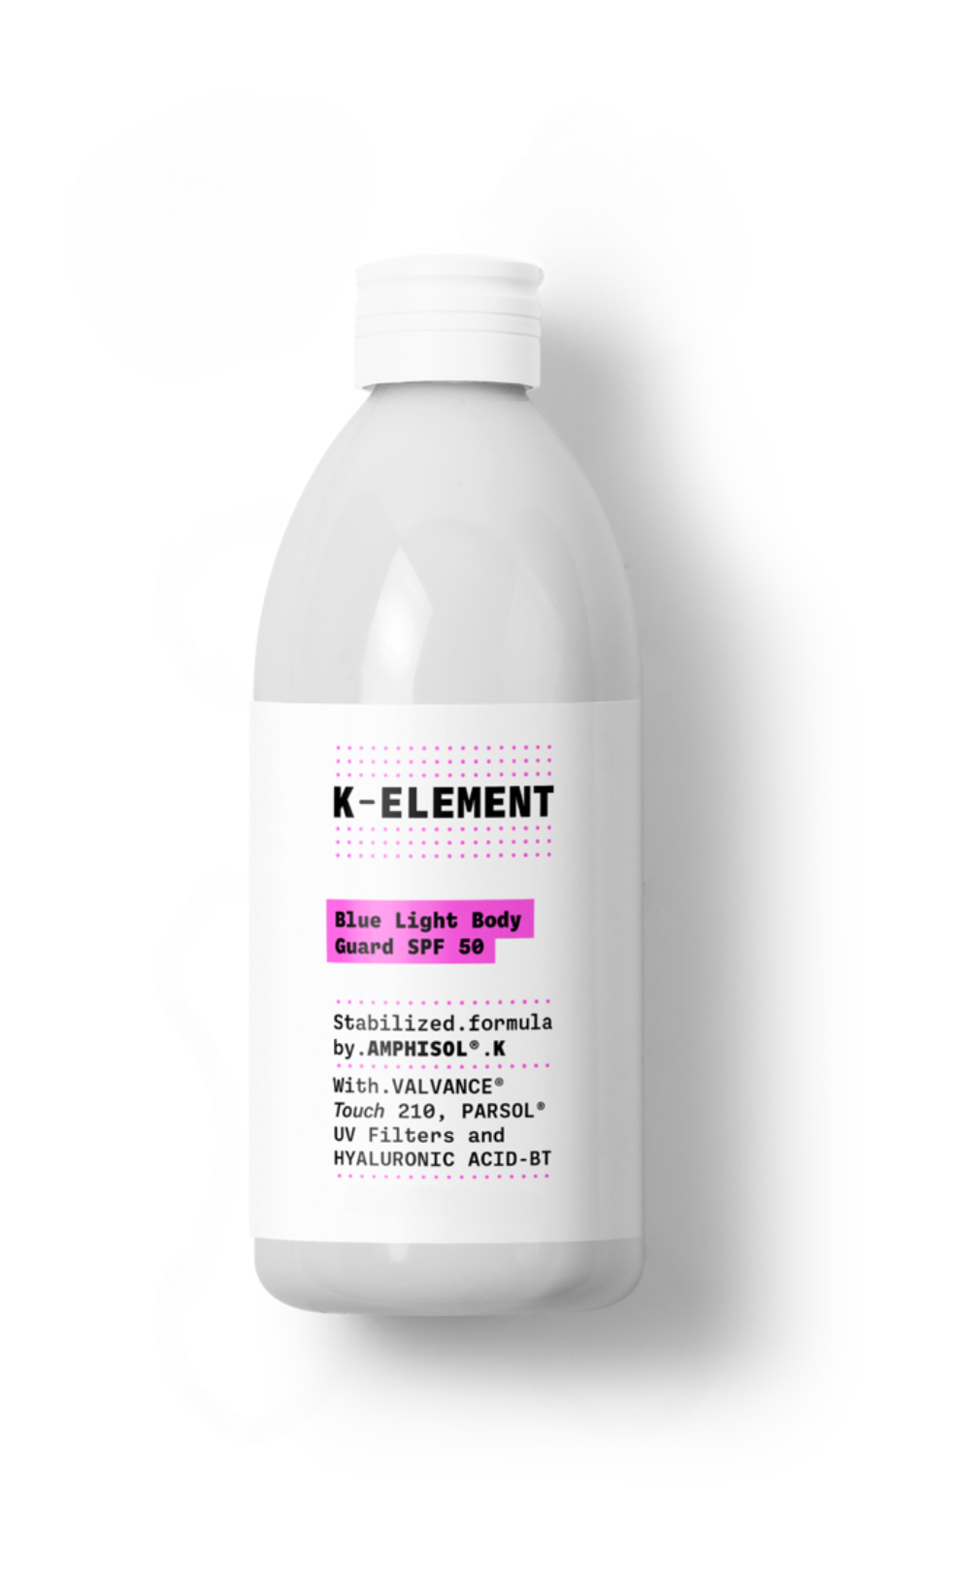
Blue Light Body Guard SPF 50
Stabilized formula by AMPHISOL® K
With VALVANCE ® Touch 210, PARSOL® UV Filters, and HYALURONIC ACID-BT
An extensive, uniform and unique formation of self-organizing molecules that guarantee maximum stability.
Your skin is totally protected from sunlight as well as blue light with this soft texture protector, dry to the touch and with all the hydrating power of hyaluronic acid.
Phase | Ingredients | INCI Name | % w / w
A | PARSOL® EHS | ETHYLHEXYL SALICYLATE | 5,00
 | PARSOL® HMS | HOMOSALATE | 10,00
 | Finsolv TN | C12-15 ALKYL BENZOATE | 5,00
 | Lexfeel WOW | C13-16 ISOPARAFFIN, TRIHEPTANOIN | 2,00
B | UVAsorb HEB | DIETHYLHEXYL BUTAMIDO TRIAZONE | 4,00
C | Lanette 18 | STEARYL ALCOHOL | 0,40
 | AMPHISOL® K | POTASSIUM CETYL PHOSPHATE | 0,80
 | Emulium Mellifera MB | POLYGLYCERYL-6 DISTEARATE, JOJOBA ESTERS, POLYGLYCERYL-3 BEESWAX, CETYL ALCOHOL | 4,00
 | Eldew SL-205 | ISOPROPYL LAUROYL SARCOSINATE | 5,00
 | PARSOL® Shield | BIS-ETHYLHEXYLOXYPHENOL METHOXYPHENYL TRIAZINE | 4,00
 | PARSOL® 1789 | BUTYL METHOXYDIBENZOYLMETHANE | 5,00
 | VALVANCE® Touch 210 | SILICA | 3,00
D | Sepinov EMT 10 | HYDROXYETHYL ACRYLATE/SODIUM ACRYLOYLDIMETHYL TAURATE COPOLYMER | 0,50
E | Keltrol CG-T | XANTHAN GUM | 0,20
 | 1,3 Butylene Glycol cos grade | BUTYLENE GLYCOL | 3,00
F | Edeta BD | DISODIUM EDTA | 0,10
 | WATER DEM. | AQUA | 42,95
 | PARSOL® MAX | METHYLENE BIS-BENZOTRIAZOLYL TETRAMETHYLBUTYLPHENOL, AQUA, DECYL GLUCOSIDE, PROPYLENE GLYCOL, XANTHAN GUM | 4,00
 | HYALURONIC ACID-BT | SODIUM HYALURONATE | 0,05
 | ADEKA NOL NHG | HEXYLGLYCERIN | 0,50
 | SymSave H | HYDROXYACETOPHENONE | 0,50
Procedure
Mix Phase A
Add B to A under stirring to avoid aggregates and heat up to 85°C until a clear solution is obtained.
Add one by one ingredients of Phase C to A+B under stirring.
Add D to A+B+C under stirring.
Mix Phase E.
Mix Phase F and heat up to 85°C. Add E to F under stirring.
Add E+F to A+B+C+D and homogenize.
Cool down to room temperature under gentle stirring.
Technical Data
pH: 6.0 +/- 0.5
SPF*:50
Viscosity (Brookfield RV5/10rpm): 25000 mPa.s
In vitro UVAPF* (Colipa 2011): 19.8
UVAPF/SPF* (50 labeled); >= 0.33: 0.40
Critical Wavelength*: 380 nm
(Measurement done with Labsphere equipment)
^{SU-E-100116-55}
UV filter combination does not comply with applicable EU Cosmetic Regulation
Products are for illustration only, not for sale.
dsm-firmenich is not responsible for final product claims.
9

Slide 10
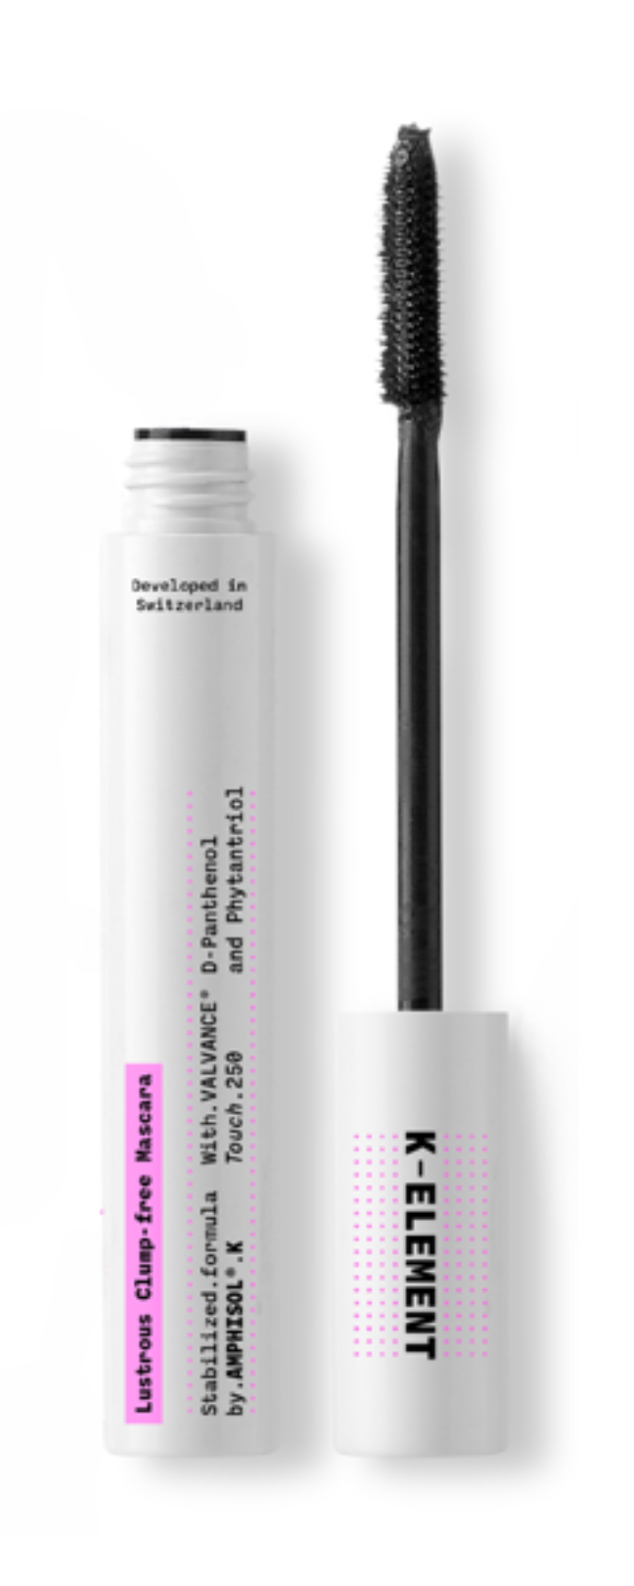
Lustrous Clump-free Mascara
Stabilized formula by AMPHISOL® K
With VALVANCE® Touch 250, D-Panthenol 75 L and Phytantriol
An extensive, uniform and unique formation of self-organizing molecules that guarantee maximum stability.
Powerful eyes with this great coverage pigment mask for high-definition eyelashes.
Phase | Ingredients | INCI Name | % w / w
A | Huile de Paraffine Codex AAB2 | PARAFFINUM LIQUIDUM | 5.00
 | CERAUBA T1 Bio | COPERNICIA CERIFERA CERA | 3.50
 | Kahlwax 8104 | CERA ALBA | 5.00
 | Tego® Alkanol 16 | CETYL ALCOHOL | 5.00
 | AMPHISOL® K | POTASSIUM CETYL PHOSPHATE | 3.00
B | Water dem. | AQUA | 45.15
 | Natrosol™ 250 HR | HYDROXYETHYLCELLULOSE | 0.50
 | Glycerin 99.5% | GLYCERIN | 3.00
 | SOLAGUM™ AX | ACACIA SENEGAL GUM, XANTHAN GUM | 0.20
 | Water dem. | AQUA | 15.00
 | Eastman AQ™ Polymer 55 S | POLYESTER-5, SODIUM ACETATE | 5.00
 | Unipure Black LC989 SGP | CI 77499, SODIUM GLYCEROPHOSPHATE | 6.00
C | VALVANCE® Touch 250 | SILICA, METHICONE | 1.50
D | D-Panthenol 75 L | PANTHENOL, AQUA | 0.50
E | Phytantriol | PHYTANTRIOL | 0.50
 | Euxyl® PE 9010 | PHENOXYETHANOL, ETHYLHEXYLGLYCERIN | 1.00
 | Emprove® Sodium Hydroxide Pellets | SODIUM HYDROXIDE | 0.15
Procedure
Weight components of phase A. Stir and heat up to 85°C until homogenous.
Weight water of phase B. Start stirring and heating. At 60°C, add slowly the hydroxyethlcellulose 250 HR while stirring for 20 minutes and heat up. At 75°C add premix Glycerine + Acacia Senegal Gum, Xanthan Gum and stir for 10 minutes.
Weigh water of phase B, stir and heat to 80°C. Solubilize Eastman AQ™ Polymer 55 S in water.
Then add C to B.
Add D to B+C, homogenize.
At 80°C, add A to B+C+D under stirring and homogenize strongly for 1 minute.
Start cooling down under gentle stirring.
At 50°C, introduce one by one components of phase E. Check the homogeneity between each step.
Homogenize for 30 seconds.
Cool down to RT, check the pH (5.0-6.0) and adjust if necessary.
75L
^{SU-E-101219-01}
Products are for illustration only, not for sale.
dsm-firmenich is not responsible for final product claims.
10

Slide 11
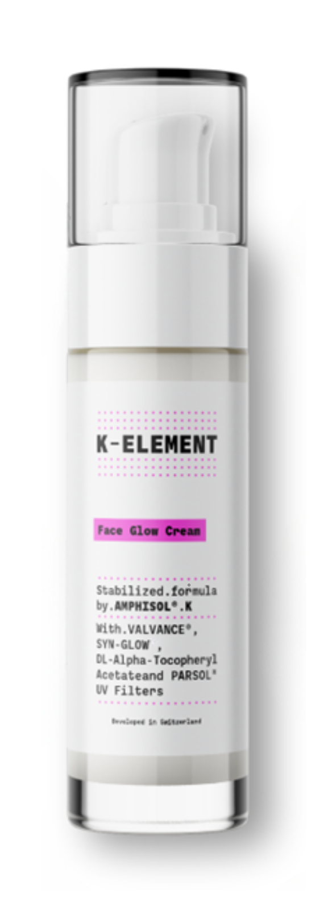
Face Glow Cream
Stabilized formula by AMPHISOL® K
With VALVANCE®, SYN-GLOW®, DL-alpha-Tocopheryl Acetate, and PARSOL® UV Filters
An extensive, uniform and unique formation of self-organizing molecules that guarantee maximum stability.
For naturally tanned and healthy skin from the inside out, with a long-lasting effect, soft to the touch and high in hydration.
Phase | Ingredients | INCI Name | % w / w
A | WATER DEM. | AQUA | 50,10
 | Edeta BD | DISODIUM EDTA, AQUA | 0,10
B | Makilene GC | BUTYLENE GLYCOL | 3,00
 | SILIGEL | XANTHAN GUM, SCLEROTIUM GUM, LECITHIN, PULLULAN | 0,80
C | AMPHISOL® K | POTASSIUM CETYL PHOSPHATE | 1,80
 | PARSOL® HMS | HOMOSALATE | 5,00
 | PARSOL® EHS | ETHYLHEXYL SALICYLATE | 5,00
 | PARSOL® 1789 | BUTYL METHOXYDIBENZOYLMETHANE | 3,00
 | PARSOL® 340 | OCTOCRYLENE | 6,00
 | PARSOL® SLX | POLYSILICONE-15 | 0,90
 | PARSOL® MCX | ETHYLHEXYL METHOXYCINNAMATE | 3,00
 | EMOGREEN L19 | C15-19 ALKANE | 2,50
 | DL-alpha-Tocopheryl Acetate | TOCOPHERYL ACETATE | 1,00
 | Lanette O | CETEARYL ALCOHOL | 2,00
 | Aristoflex Silk | SODIUM POLYACRYLOYLDIMETHYL TAURATE | 0,50
 | Hallbrite BHB | BUTYLOCTYL SALICYLATE | 5,00
D | VALVANCE® Touch 250 | SILICA, DIMETHICONE | 1,00
 | VALVANCE® Touch 210 | SILICA | 1,00
E | Euxyl PE 9010 | PHENOXYETHANOL, ETHYLHEXYLGLYCERIN | 1,00
 | Perfume Vanille douce RS86015 | PARFUM | 0,30
 | SYN-GLOW® | GLYCERIN, AQUA, BENZOYL DIPEPTIDE-18 D-PHENYLALANYL ARGINYL D-TRYPTOPHAN DIPROPYLAMIDE MESYLATE | 3,00
F | Cameleon Yellow | CELLULOSE ACETATE, TITANIUM DIOXIDE, CI 77492, PROPYLENE GLYCOL STEARATE, ACRYLATES/AMMONIUM METHACRYLATE COPOLYMER, MAGNESIUM STEARATE | 2,250
 | Cameleon Black | CELLULOSE ACETATE, TITANIUM DIOXIDE, CI 77499, PROPYLENE GLYCOL STEARATE, ACRYLATES/AMMONIUM METHACRYLATE COPOLYMER, MAGNESIUM STEARATE | 0,075
 | Cameleon Red | CELLULOSE ACETATE, TITANIUM DIOXIDE, CI 77491, PROPYLENE GLYCOL STEARATE, ACRYLATES/AMMONIUM METHACRYLATE COPOLYMER, MAGNESIUM STEARATE | 0,675
 | Cameleon White | CELLULOSE ACETATE, TITANIUM DIOXIDE, PROPYLENE GLYCOL STEARATE, ACRYLATES/AMMONIUM METHACRYLATE COPOLYMER, BORON NITRIDE | 1,000
Procedure
Premix phase A under stirring.
Premix phase B and add it to phase A under stirring.
Heat phase A+B up to 85°C.
Mix phase C and heat it up to 85°C under stirring.
Add phase C into phase A+B and homogenize with high shear.
Cool the formulation down to room temperature under stirring.
Add phase D under stirring.
Below 40°C add the ingredients of phase E under stirring.
Premix phase F and carefully add it to the formulation under stirring.
Adjust the pH around 5.50 if necessary.
Technical Data
pH: 7 – 7.5
Viscosity (Brookfield RV6/10rpm): 29 000 mPa.s
SPF expected: 30
®
®
^{SK-E-101343-19}
Products are for illustration only, not for sale.
dsm-firmenich is not responsible for final product claims.
11

Slide 12
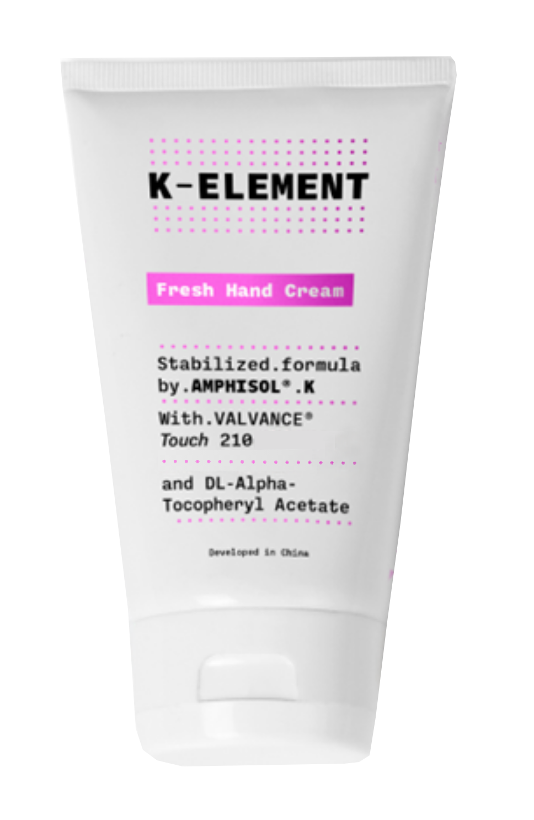
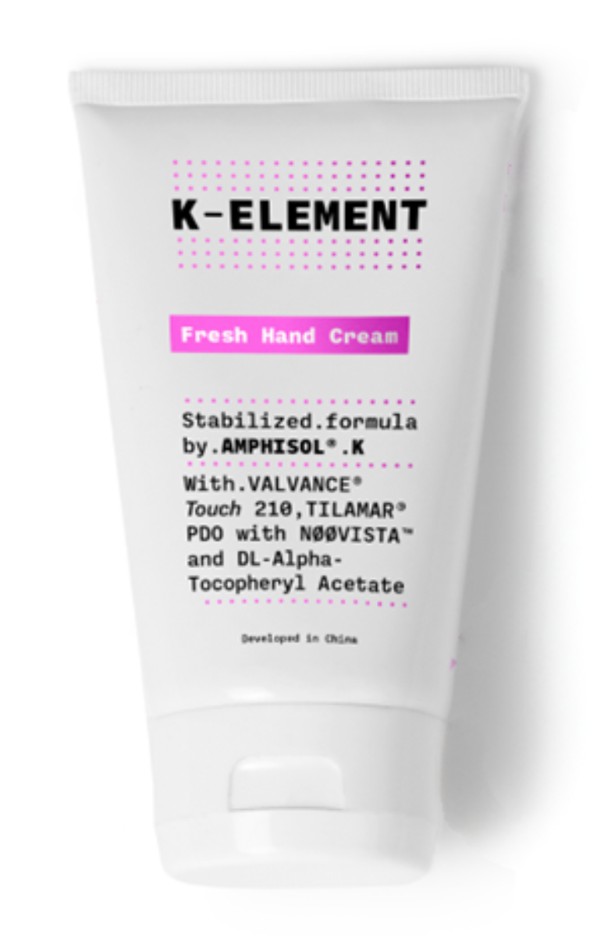
Fresh Hand Cream
Stabilized formula by AMPHISOL® K
With VALVANCE ® Touch 210 and DL-alpha-Tocopheryl Acetate
An extensive, uniform and unique formation of self-organizing molecules that guarantee maximum stability.
A touch of softness for your hands with this refreshing cream.
Fast in absorption and high in nourishing power.
Phase | Ingredients | INCI Name | % w/w
A | Tego Care 450 MB | POLYGLYCERYL-3 METHYLGLUCOSE DISTEARATE | 1,20
 | JNA-CS50 | CETEARYL ALCOHOL | 1,00
 | Arlacel 165 | GLYCERYL STEARATE, PEG-100 STEARATE | 1,00
 | SALACOS 816T | CETYL ETHYLHEXANOATE | 8,00
 | Shea butter | BUTYROSPERMUM PARKII BUTTER | 2,00
 | AMPHISOL® K | POTASSIUM CETYL PHOSPHATE | 1,00
B | XIAMETER PMX-0345 | CYCLOPENTASILOXANE, CYCLOHEXASILOXANE | 5,00
C | Water Dem | AQUA | 32,11
 | Tris Amino Ultra PC | TROMETHAMINE | 0,19
 | Glycerin 99.5% | GLYCERIN | 5,00
 | Phenoxyethanol | PHENOXYETHANOL | 0,35
 | Sensiva SC 50 | ETHYLHEXYLGLYCERIN | 0,05
 | Propanediol | PROPANEDIOL | 1,00
 | Edeta BD | DISODIUM EDTA | 0,05
D | Gransil PSQ | POLYMETHYLSILSESQUIOXANE | 0,70
 | VALVANCE® Touch 210 | SILICA | 1,00
E | Water Dem | AQUA | 35,00
 | Flogel FG 700 | CARBOMER | 0,35
F | DL-alpha-Tocopheryl Acetate | TOCOPHERYL ACETATE | 5,00
Procedure
Mix all ingredients of phase A and heat up to 75°C.
Mix all ingredients of phase C and heat up to 75°C.
Add phase C into phase A under homogenize with the speed of 5000rpm for 3min Add phase B into product under homogenize with the speed of 5000rpm for 1min.
Add each ingredient of phase D into product under homogenize with the speed of 5000rpm for 1min.
Mix all ingredients of phase E into product under stirring until uniform Add phase E into product under homogenize with the speed of 5000rpm for 2min.
Cool down under stirring add phase F into product below 40 °C.
Technical Data
pH: 6.2
Viscosity (Brookfield LV3/12rpm, 22,8°C): 8499 mPa.s
^{SK-E-800040-1}
Products are for illustration only, not for sale.
dsm-firmenich is not responsible for final product claims.
12

Slide 13
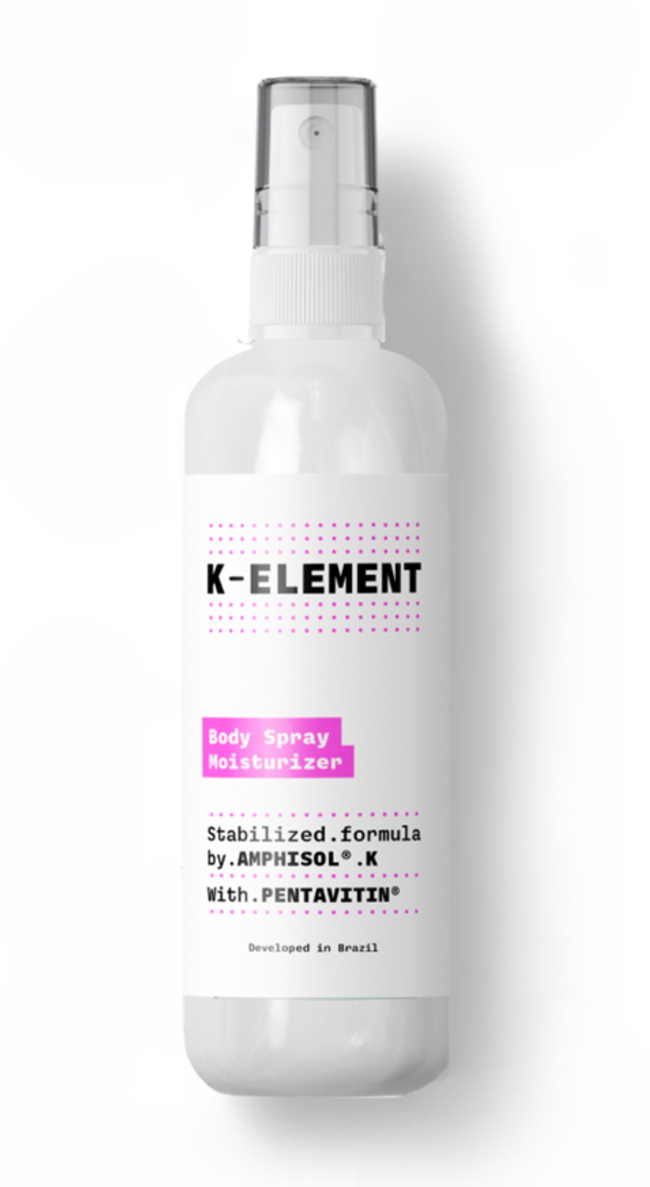
Body Spray Moisturizer
Stabilized formula by AMPHISOL® K
With PENTAVITIN®
An extensive, uniform and unique formation of self-organizing molecules that guarantee maximum stability.
A revitalizing touch for your day-to-day with this ultralight texture moisturizer with fast absorption, providing a wonderfully soft skin feeling.
Phase | Ingredients | INCI Name | % w/w
A | WATER DEM. | AQUA | 80,40
 | Glycerin 99.5% | GLYCERIN | 2,00
 | Edeta BD | DISODIUM EDTA | 0,10
B | DUB MCT 5545 | CAPRYLIC/CAPRIC TRIGLYCERIDE | 8,00
 | DUB B1215 | C12-15 ALKYL BENZOATE | 2,00
 | Phytosqualan | SQUALANE | 2,00
 | CETYL ALCOHOL PS | CETYL ALCOHOL | 1,00
 | AMPHISOL® K | POTASSIUM CETYL PHOSPHATE | 1,00
C | Euxyl PE 9010 | PHENOXYETHANOL, ETHYLHEXYLGLYCERIN | 1,00
 | SIMULGEL INS 100 | HYDROXYETHYL ACRYLATE/SODIUM ACRYLOYLDIMETHYL TAURATE COPOLYMER, ISOHEXADECANE, POLYSORBATE 60 | 1,00
D | PENTAVITIN® | SACCHARIDE ISOMERATE, AQUA, CITRIC ACID, SODIUM CITRATE | 1,00
E | SHP0407 Elixir Extreme | PARFUM | 0,50
Procedure
Heat phase A up to 80°C.
Heat phase B up to 85°C under stirring. Add phase B to A and homogenize the emulsion.
Cool down to 40°C under gentle stirring. Add phase C and homogenize.
Add PENTAVITIN®, fragrance and homogenize again.
Technical Data
pH: 6.0
^{SK-L-101677-5}
Products are for illustration only, not for sale.
dsm-firmenich is not responsible for final product claims.
13

Slide 14
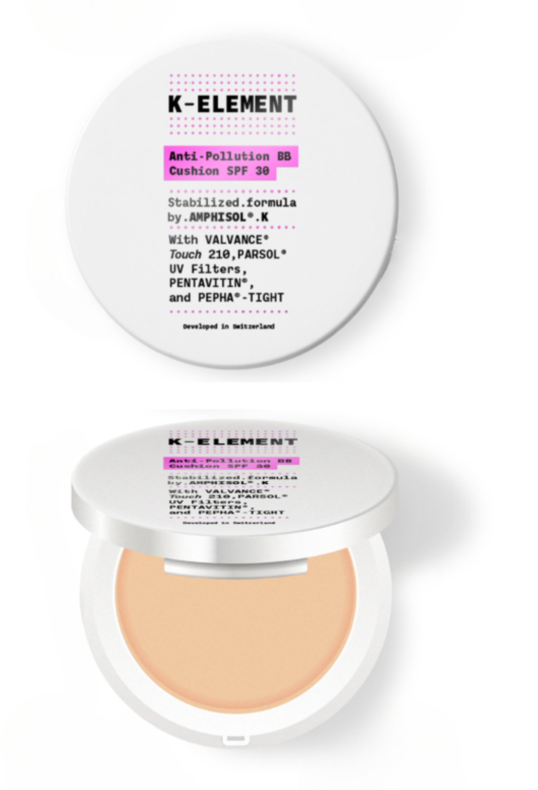
Anti-Pollution BB Cushion SPF 30
Stabilized formula by AMPHISOL® K
With VALVANCE ® Touch 210, PARSOL® UV Filters, PENTAVITIN®, and PEPHA®-TIGHT CB
An extensive, uniform and unique formation of self-organizing molecules that guarantee maximum stability.
Reveal your natural beauty with this BB Cushion that provides lightweight coverage and effective oil control.
Phase | Ingredients | INCI Name | % w / w
A | X-Tend 226 | PHENETHYL BENZOATE | 6.00
 | PARSOL® EHS | ETHYLHEXYL SALICYLATE | 3.00
 | KAK TCIN | TRICYCLODECANEMETHYL ISONONANOATE | 2.00
 | Finsolv TN | C12-15 ALKYL BENZOATE | 1.00
 | Tego Alkanol 1618 | CETEARYL ALCOHOL | 0.80
 | PARSOL® SLX | POLYSILICONE-15 | 1.50
 | PARSOL® Shield | BIS-ETHYLHEXYLOXYPHENOL METHOXYPHENYL TRIAZINE | 2.00
 | PARSOL® TX | TITANIUM DIOXIDE, SILICA, DIMETHICONE | 2.50
 | AMPHISOL® K | POTASSIUM CETYL PHOSPHATE | 3.00
 | Cutina GMS V | GLYCERYL STEARATE | 2.00
B | WATER DEM. | AQUA | 51.99
 | Edeta BD | DISODIUM EDTA | 0.10
 | Rhodicare T | XANTHAN GUM | 0.30
 | Structure XL | HYDROXYPROPYL STARCH PHOSPHATE, AQUA | 2.00
 | Unipure White LC981 SGP | CI 77891, SODIUM GLYCEROPHOSPHATE | 6.00
 | Unipure Yellow LC 182 SGP | CI 77492, SODIUM GLYCEROPHOSPHATE | 0.75
 | Unipure Black LC989 SGP | CI 77499, SODIUM GLYCEROPHOSPHATE | 0.10
 | Unipure Red LC 381 SGP | CI 77491, SODIUM GLYCEROPHOSPHATE | 0.18
C | Chlorphenesin BP 73 | CHLORPHENESIN | 0.20
D | Spectrastat PHL | CAPRYLHYDROXAMIC ACID, 1,2-HEXANEDIOL, PROPANEDIOL | 1.00
 | PENTAVITIN® | SACCHARIDE ISOMERATE, AQUA, CITRIC ACID, SODIUM CITRATE | 1.50
 | PEPHA®-TIGHT CB | NANNOCHLOROPSIS OCULATA EXTRACT, PULLULAN, PENTYLENE GLYCOL, CITRIC ACID, AQUA | 1.00
 | Forever RS67550 | PARFUM | 0.30
 | Sodium Hydroxide 20% Solution | SODIUM HYDROXIDE | 0.55
E | VALVANCE® Touch 210 | SILICA | 0.50
 | DUB HELIOPTIMA | DIISOPROPYL ADIPATE, PROPYLENE GLYCOL DICAPRYLATE/DICAPRATE, C12-15 ALKYL BENZOATE, DIISOPROPYL SEBACATE | 1.20
F | WATER DEM. | AQUA | 5.00
 | Sodium Hydroxide 20% Solution | SODIUM HYDROXIDE | 2.03
 | PARSOL® HS | PHENYLBENZIMIDAZOLE SULFONIC ACID | 1.50
Procedure
Phase A: Introduce ingredients until Tego Alkanol included and heat up to 85°C.
Add one by one the rest of the ingredients.
Homogenize 2 minutes at 9500 rpm.
Phase B: Introduce Water, EDTA and heat to 50°C.
Add slowly Rhodicare T and heat to 75°C.
Add Structure XL, keep stirring until homogenous and heat to 80°C.Add one by one the pigments and homogenize 5 minutes at 9500 rpm.
Emulsification: Add A to B under stirring and start cooling down. At 75°C, add C and homogenize 2 minutes at 9500 rpm. Keep cooling down under gentle stirring. At 35°C, add one by one ingredients of phase D and adjust if necessary, the pH to 7.0 minimum.
Phase E: Disperse VALVANCE™ Touch 210 in Dub Helioptima, homogenize if needed.
Add E to A+B+C+D and homogenize if necessary.
Phase F: Mix at RT and add it to A+B+C+D+E.
Check the pH (>7.0).
Technical Data
pH: 7 – 7.5
Viscosity (Brookfield RV5/20rpm): 5200 mPa.s
SPF in vivo: 47.2
(According to ISO SPF Test Method)
In vitro UVAPF (Colipa 2011): 11.0
UVAPF/SPF (30 labeled) >= 0.33: 0.37
Critical Wavelength (>370nm) : 382
(Measurement done with Labsphere equipment)
CB
^{SU-E-101220-2}
Products are for illustration only, not for sale.
dsm-firmenich is not responsible for final product claims.
14

Slide 15
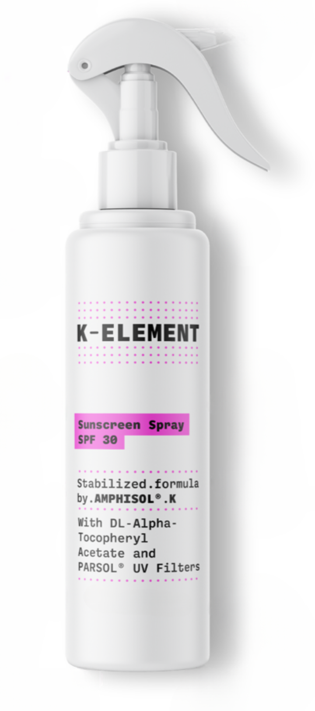
Sunscreen Spray
Stabilized formula by AMPHISOL® K
and DL-alpha-Tocopheryl Acetate and PARSOL® UV Filters
An extensive, uniform and unique formation of self-organizing molecules that guarantee maximum stability.
A gentle and light sunscreen spray with an immediately invisible finish.
Phase | Ingredients | INCI Name | % w/w
A | PARSOL® 1789 | BUTYL METHOXYDIBENZOYLMETHANE | 3,00
 | PARSOL® 340 | OCTOCRYLENE | 8,00
 | PARSOL® EHS | ETHYLHEXYL SALICYLATE | 5,00
 | PARSOL® HMS | HOMOSALATE | 10,00
 | AMPHISOL® K | POTASSIUM CETYL PHOSPHATE | 0,75
 | Ecorol 16/98P | CETYL ALCOHOL | 0,30
 | Antaron V-220 | VP/EICOSENE COPOLYMER | 1,00
 | Cetiol C5 | COCO-CAPRYLATE | 2,50
 | Cetiol CC | DICAPRYLYL CARBONATE | 3,00
 | dl-alpha-Tocopheryl Acetate | TOCOPHERYL ACETATE | 0,50
B | Pemulen TR-2 | ACRYLATES/C10-30 ALKYL ACRYLATE CROSSPOLYMER | 0,20
C | WATER DEM. | AQUA | 5,45
 | 1,3-Butylenglycol | BUTYLENE GLYCOL | 5,00
 | Edeta BD | DISODIUM EDTA | 0,10
D | Triethanolamine Care | TRIETHANOLAMINE | 0,20
E | Euxyl PE 9010 | PHENOXYETHANOL, ETHYLHEXYLGLYCERIN | 1,00
F | Ethanol abs. | ALCOHOL | 5,00
Procedure
Heat part A to 90°C while stirring. Add part B.
Heat part C to 85°C and add to part AB while stirring and homogenizing the emulsion with high shear.
Cool down the emulsion <30°C and add part D, E and F. Homogenize again.
Keep stirring till RT.
Technical Data
pH: 6.5-6.7
Viscosity (Brookfield RV4/10rpm): 4000 mPa.s
SPF in vivo: 37.1
In vitro UVAPF (Colipa 2011): > 10.0
(According to FDA SPF Test Method) UVAPF/SPF (30 labeled); > 0.33: > 0.33
Critical Wavelength: < 370 nm
(Measurement done with Labsphere equipment)
^{SU-E-101084-68}
UV filter combination does not comply with applicable EU Cosmetic Regulation
Products are for illustration only, not for sale.
dsm-firmenich is not responsible for final product claims.
15

Slide 16
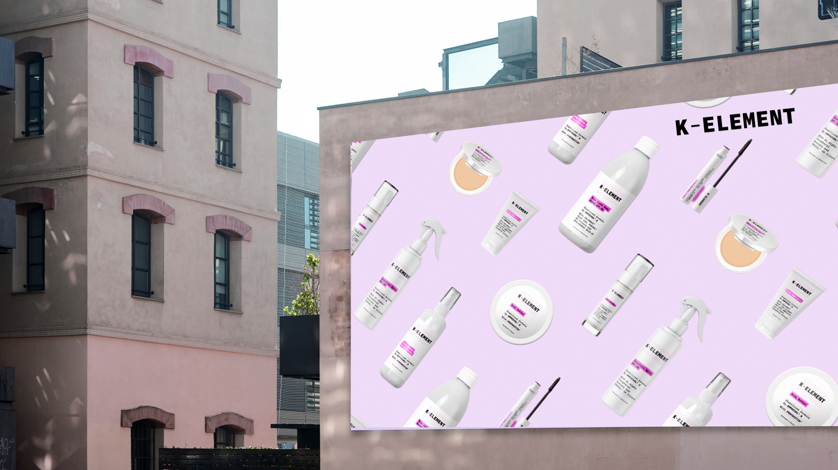
Products are for illustration only, not for sale.
dsm-firmenich is not responsible for final product claims.

Slide 17
Disclaimer
Copyright © DSM Nutritional Products Ltd 2025, 4002 Basel, Switzerland.
www.dsm-firmenich.com. All rights reserved.
dsm-firmenich has used diligent care to ensure that the information provided herein is accurate and up-to-date to the best of its knowledge. However, dsm-firmenich makes no representation or warranty, either expressly or implied, of the accuracy, reliability, completeness, or suitability thereof. The information provided herein contains scientific and product information for business-to-business use and does not constitute or provide scientific or medical advice, diagnosis or recommendation for treatment options. Country or region-specific information should be considered when labelling or advertising to final consumer. In no event shall dsm-firmenich be liable for any direct or indirect damages arising from or reliance upon, or use of, any information provided herein. The content of this document is subject to change without further notice. Please contact your local dsm-firmenich representative for the latest information. All trademarks listed in this document are either (registered) trademarks of, or trademarks licensed by, the dsm-firmenich group of companies, unless explicitly stated otherwise.
Disclaimer Formulation Guideline
The information provided herein is provided for information purposes only and has been prepared by dsm-firmenich in accordance with its own methodology.
dsm-firmenich has used diligent care to ensure that it is accurate and up-to-date, however, dsm-firmenich makes no representation or warranty, either expressly or implied, of the accuracy, reliability, or completeness thereof. In no event shall dsm-firmenich be liable for any damages arising from or reliance upon, or use of, any information provided herein. Further, dsm-firmenich shall not bear any liability for the application and/or use of any processed material containing its product(s). The formulation of the finished product is the customer’s sole responsibility. It is the customer’s responsibility to determine the suitability of dsm-firmenich’s products regarding user specific purposes, assess compatibility and stability of their finished product(s) and to ensure compliance of their finished product(s) with relevant laws and regulations. Any product, marketing or other claims made by customer are its sole responsibility. The content of this document is subject to change without further notice. Please contact your local dsm-firmenich representative for further details. © DSM Nutritional Products AG, 2025.

