Slide 1

AMPHISOL® K
K-ELEMENT
Ultimate stability for
multi formulations
April 2025

Slide 2
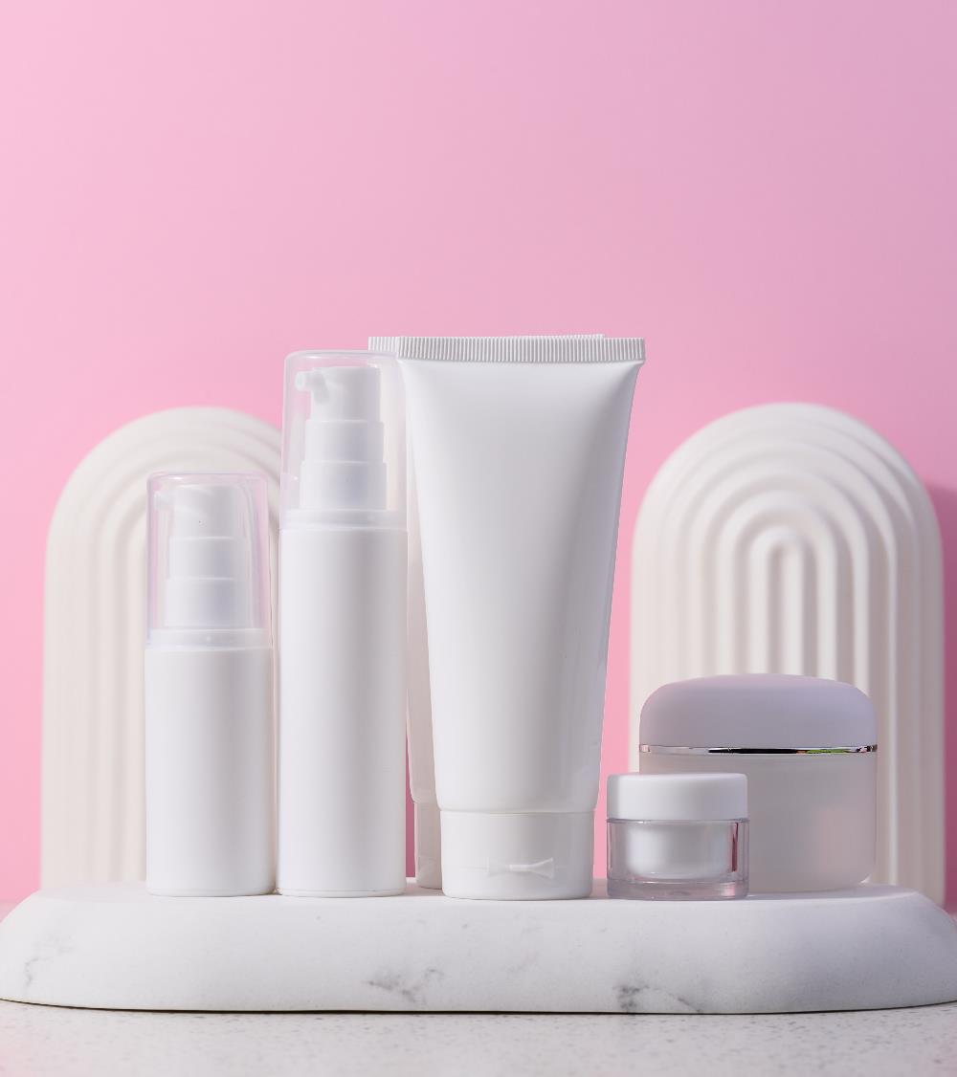
Multiple textures, multifunctional products
and consumers increasingly in search of unique and innovative experiences.
In a world where people increasingly value experiences through the products they consume, the variety of cosmetic formulations grows.
Creams, sprays, mousses, among others with considerable quantity of pigments and skin actives like make-up and products with high SPF bring a series of technical challenges, especially when it comes to stabilization.

Slide 3

The importance of high quality and stable formulation until the last drop
Voice of consumers*
“Foundation and moisturizer separated a lot”
“I did not buy that brand again”
“It totally puts me off”
*dsm-firmenich Consumer Insights Hub - 2021

Slide 4

But how can we get completely stable formulations in less time?
How introducing a new emulsifier without jeopardizing the performance of the product and the image of the brand?
How to make sure that even most challenging formulations remain stable whatever the conditions?

Slide 5

dsm-firmenich, a pioneer in potassium cetyl phosphate technology, presents a definitive emulsifying solution
AMPHISOL® K
Ultimate stability for
multi formulations

Slide 6
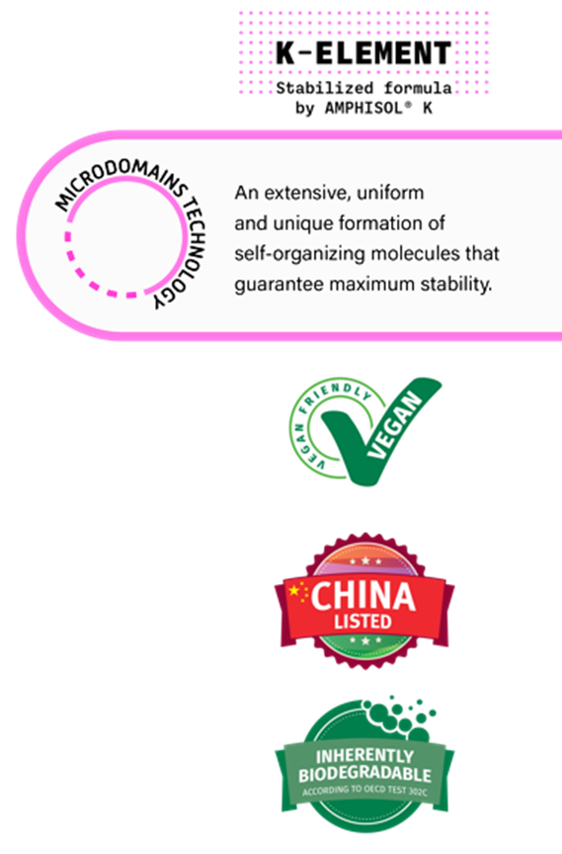


AMPHISOL® K
Ultimate stability for multi formulations.
An extensive, uniform and unique formation of self-organizing molecules that guarantee maximum stability.
A high performing Potassium Cetyl Phosphate (PCP) emulsifier for the most challenging formulations with higher proven performance vs main benchmarks.
A unique solution for the creation of innovative textures and applications which place you and your company in a leading position in an increasingly competitive market.
This is possible through the unique microdomains technology capable of stabilizing the most versatile combination of ingredients with high amounts of pigments, electrolytes, ethanol and oil from sunscreens to skin care and make-up.
AMPHISOL® K can also be used as a co-emulsifier to rescue and beautify your formulations, making processing easier.
AMPHISOL® K brings additional benefits to your products such as improved moisturization, SPF boosting and remarkable sensory signature.

Slide 7


AMPHISOL® K is 3x MORE likely to be recommended by formulators than its main competitors*
Low dosage and yet very effective, no residue on the skin
High flexibility to formulate various products
Low use level
fixes unstable formulations
It's the best
choice to use as a
second emulsifier
especially in sun
care formulations
It gives emulsion stability in
hopeless cases
Easy to work, low concentration and
good stability, and helps the viscosity too
* Source: Internal survey with current AMPHISOL® K users and formers – Total of 114 responses - Net Promoter Score comparison – NPS main competitors = 5
Notes:
Total of 114 responses (72 current/42 formers)

Slide 8

AMPHISOL® K ID card
A unique composition
INCI: | Potassium Cetyl Phosphate
Type: | Anionic O/W emulsifier
Appearance: | White to beige powder
Cetyl alcohol: | Max 2%
Potassium: | 7.0 – 12.0%
Theoretical HLB value: | 9.6
Unique performance driver: | Typical phosphate content up to almost 100 times lower than competition

Slide 9
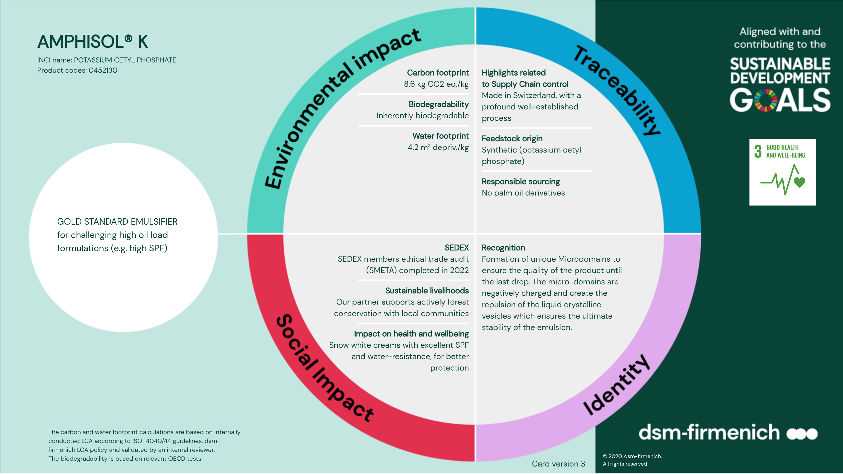

Slide 10
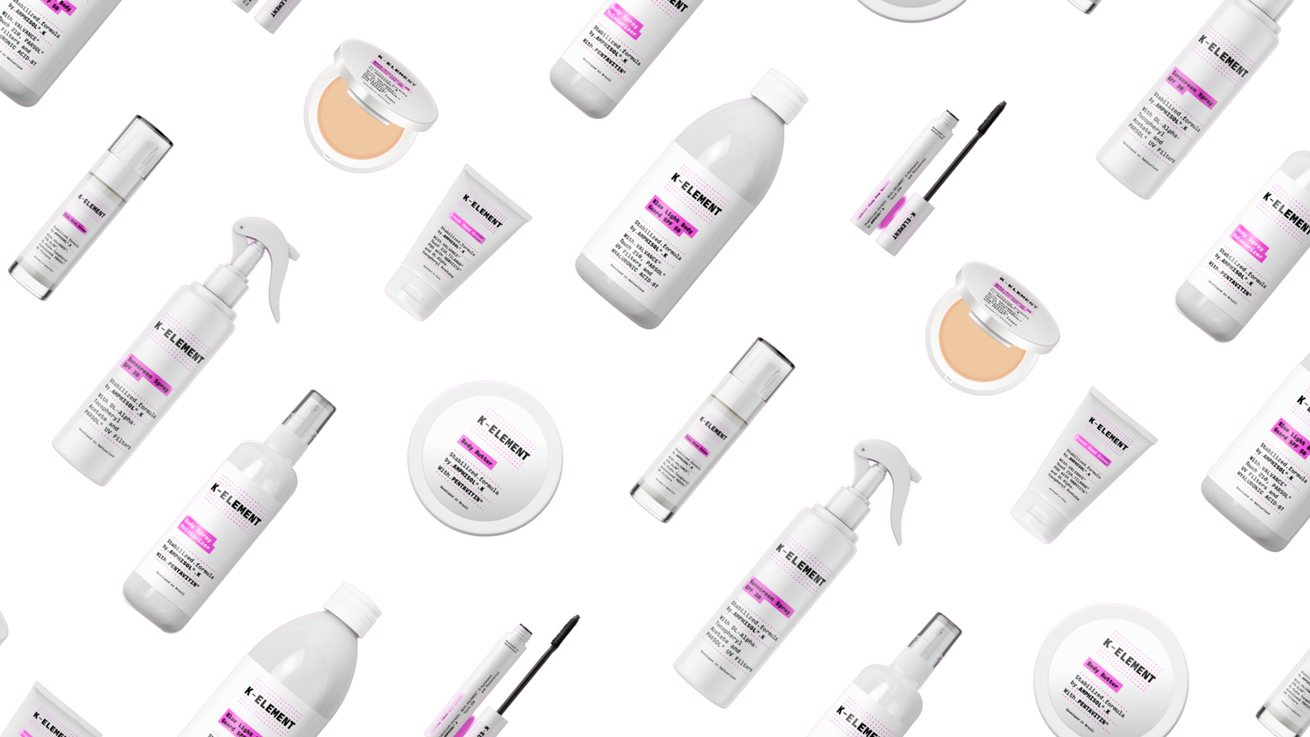

K-ELEMENT
Stabilized formula by AMPHISOL® K
Ultimate stability for multi formulations
Products are for illustration only, not for sale.
dsm-firmenich is not responsible for final product claims.
10

Slide 11
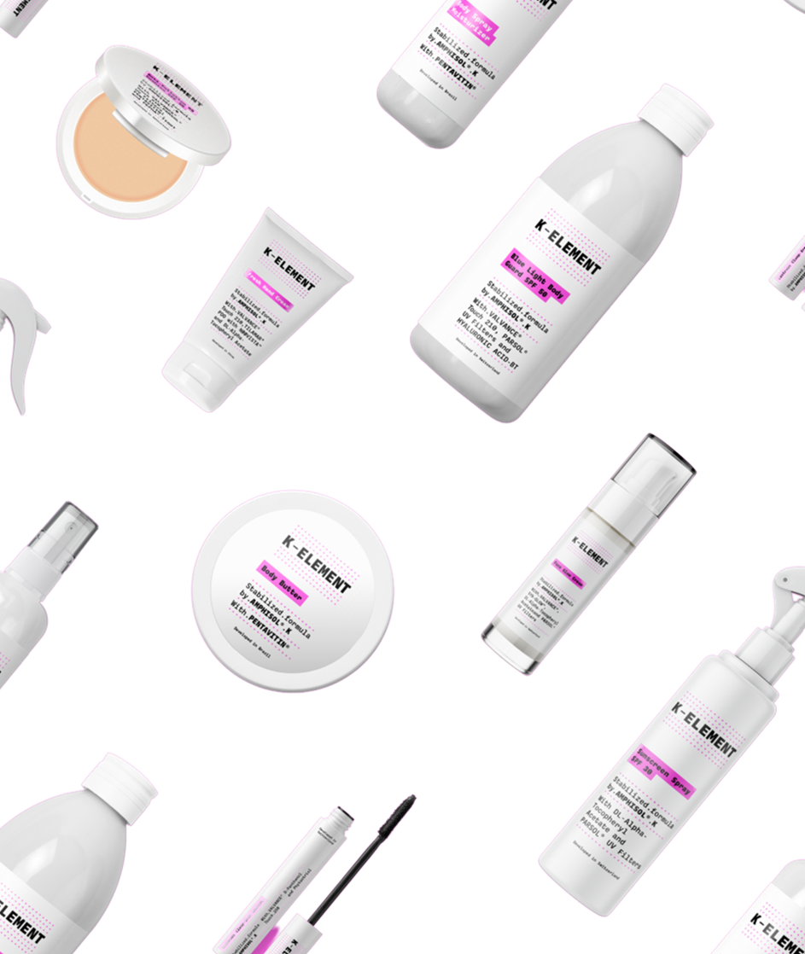








AMPHISOL® K
Ultimate stability for multi formulations
Multi textures and product types
Multi applications
Pump sprays
Dispensers
Bottles
Tubes
Jars
Skin
Sun
Make-up
Thanks to the unique microdomains technology capable of stabilizing the most challenging combination of ingredients
Products are for illustration only, not for sale.
dsm-firmenich is not responsible for final product claims.

Slide 12



AMPHISOL® K - Agenda
Discover the ultimate stability for multi formulations
An extensive, uniform and unique formation of self-organizing molecules that guarantee maximum stability.
The K-Element: High versatility from spray to cream for skin, sun and make-up application
  Powerful co-emulsifier to rescue and secure your challenging formulations
  The proof with high electrolytes content, high temperature, in spray application
  The proof in O/W and gel cream examples
Unique microdomains technology to guarantee maximum stability
Additional benefits: SPF booster, moisturizer, sensory signature
  High performance emulsifier for the most challenging formulations proven vs both benchmarks and PCP’s
  The proof with high oil content
  The proof with high electrolyte content
  The proof with high pigment content including mascara formulations
  The proof in spray formulations
Formulation tips and tricks

Slide 13
Liquid crystal structure and…
Unique presence of microdomains for unique quality and experience until the last drop

Slide 14
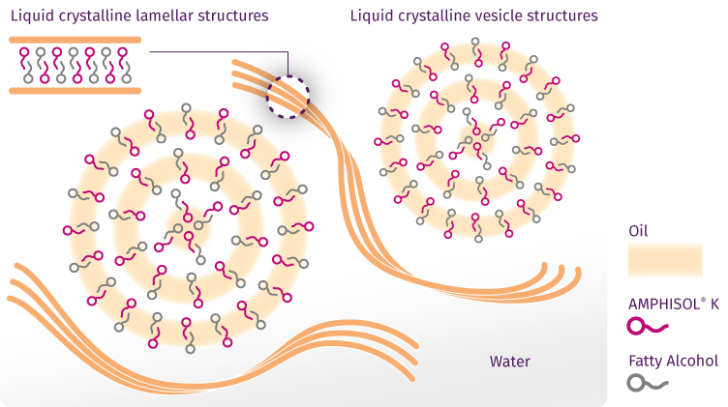
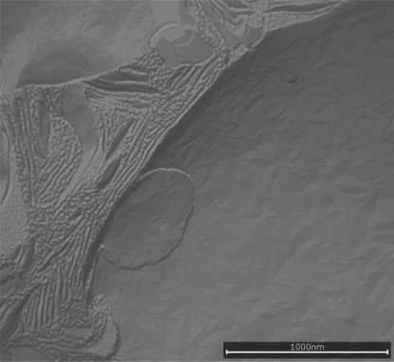
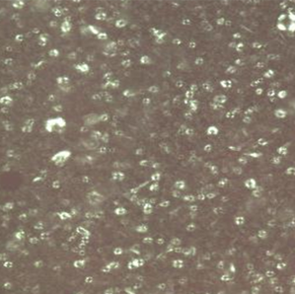

AMPHISOL® K does not only form both liquid crystalline lamellar and vesicle structures in your formulation…
Proven liquid crystalline structures under polarized light
Proven liquid crystalline structures
with freeze fracture TEM
Formulation SK-E-101710-04
under polarizer light
Liquid crystalline
lamellar structures
Liquid crystalline
vesicle structures
LCV
  AMPHISOL® K forms a liquid crystalline gel network with both:
  Vesicle structures stabilizing oil droplets.
  Lamellar structures, which are membrane-like structures throughout the aqueous phase.
  These Liquid crystals structures are essential to stabilize high oil content.
Proven high amount of liquid crystalline structures to guarantee better stability of your formulation and to bring additional benefits. (see slide 49 & 50)
Notes:
THE THEORY:
A stable emulsion consists of
an aqueous bulk phase,
a dispersed liquid oil phase and
a liquid crystalline (LC) gel network structure
The liquid crystalline gel network can form vesicle structures stabilizing oil droplets or lamellar structures, which are membrane-like structures throughout the aqueous phase
The LC structure is formed by hydrophilic emulsifier (HLB >8) and lipophilic co-emulsifier (HLB < 7)
TEM = Trans Electronic Microscopy
AMPHISOL® K showed higher amount of vesicular structures vs benchmarks 1,2 and 3 in a complex sunscreen formulation at 1% in combination with 1.5% Glyceryl Stearate / PEG-100 Stearate.

Slide 15
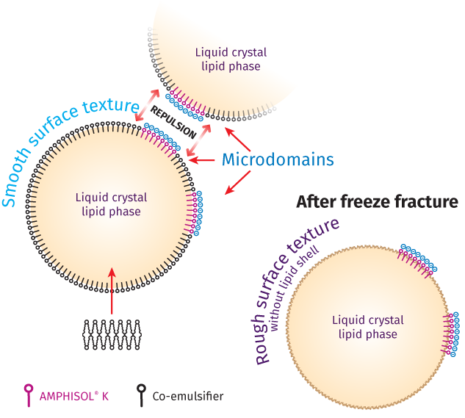
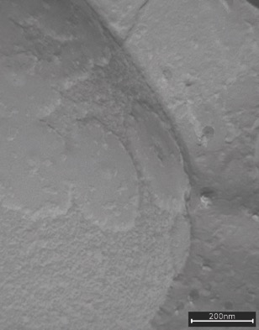
AMPHISOL® K will also form unique microdomains to ensure the quality of your product until the last drop!
Sunscreen with
1% AMPHISOL® K
How does it work?
The surface of the liquid crystalline vesicles is made of a mix of AMPHISOL® K and the co-emulsifiers.
At some areas only AMPHISOL® K
is present and forms clusters = microdomains.
These microdomains made of AMPHISOL® K are negatively charged and create the repulsion of the vesicles (avoid the coalescence) which ensures the ultimate stability of the emulsion.
Clearly defined microdomains
Unique microdomains technology by AMPHISOL® K: an extensive, uniform and unique formation of self-organizing molecules that guarantee maximum stability.
Notes:
Sunscreen formulations with 4% PARSOL® 1789, 8% PARSOL® 340, 2% PARSOL® HS, 2% PARSOL® SLX
What are microdomains:
The surface of the liquid crystal vesicles is made of a mix of AMPHISOL® K and the co-emulsifiers. At some area only AMPHISOL® K is present and forms clusters that are negatively charged (micro domains) and therefore responsible for the repulsion of the vesicles which ensures the stability of the emulsion.
TEM = Trans Electronic Microscopy
After freeze fraction lipid structures could appear as rough.

Slide 16
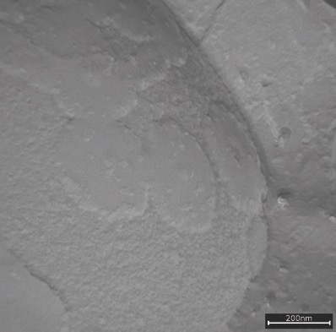
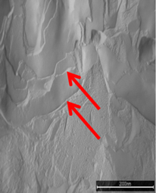
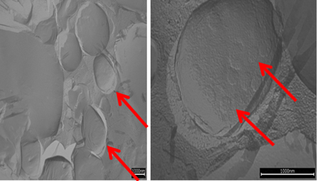
Proven unique microdomains presence to stabilize the most challenging formulation as main & co-emulsifier
Microdomains formed by AMPHISOL® K for ultimate stability
As a main emulsifier
As a secondary emulsifier
Sunscreen with 1% AMPHISOL® K
PEG-100 Stearate/
Glyceryl Stearate
PEG-100 Stearate/Glyceryl Stearate+ AMPHISOL® K
+ AMPHISOL® K
Clearly defined microdomains
Lamellar structures
Liquid crystalline vesicles with microdomains
AMPHISOL® K as main emulsifier forms microdomains that makes possible the stabilization of the most challenging formulation.
The addition of AMPHISOL® K as a co-emulsifier will create unique microdomains for ultimate stability.
Notes:
What are microdomains:
The surface of the liquid crystal vesicles is made of a mix of AMPHISOL® K and the co-emulsifiers. At some area only AMPHISOL® K is present and forms clusters that are negatively charged (micro domains) and therefore responsible for the repulsion of the vesicles which ensures the stability of the emulsion.
TEM = Trans Electronic Microscopy

Slide 17
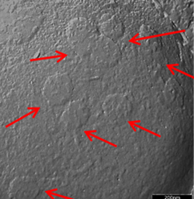
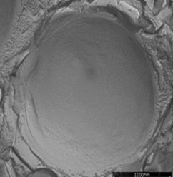
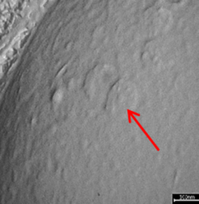
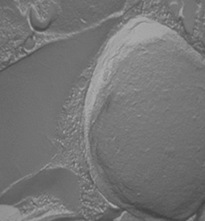
Proven unique microdomains presence for stronger emulsification performance vs PCP’s
Microdomains formed by AMPHISOL® K visualized by freeze fracture TEM
AMPHISOL® K
Competitor 1
Competitor 2
Competitor 3
Testing procedure to visualize
micro domains
Comparing different PCP’s in a complex sunscreen formulation
PEG-100 Stearate & Glyceryl Stearate at 1.5% and all PCP’s at 1%
High amount and clearly defined microdomains
NO microdomains
Only few and
slightly defined
microdomains
NO microdomains
Unlike competitors, AMPHISOL® K shows a high amount of microdomains that makes possible the stabilization of the most challenging formulations.
Notes:
Competitor 1: EverMAP™ 160K (Sino Lion)
Competitor 2: Crodafos™ MCK (Croda)
Competitor 3: Romol AFSK (Eleco)
What are microdomains:
The surface of the liquid crystal vesicles is made of a mix of AMPHISOL® K and the co-emulsifiers. At some area only AMPHISOL® K is present and forms clusters that are negatively charged (micro domains) and therefore responsible for the repulsion of the vesicles which ensures the stability of the emulsion.
TEM = Trans Electronic Microscopy

Slide 18
Higher performance in challenging conditions vs benchmarks and PCP

Slide 19
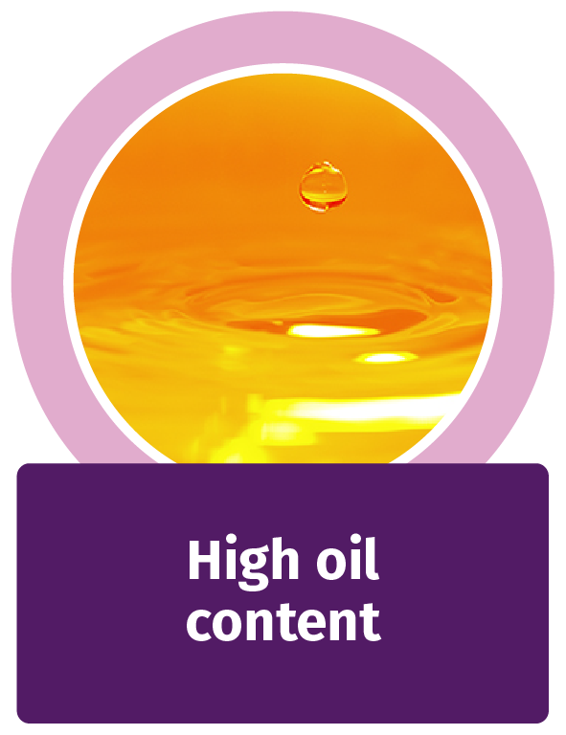
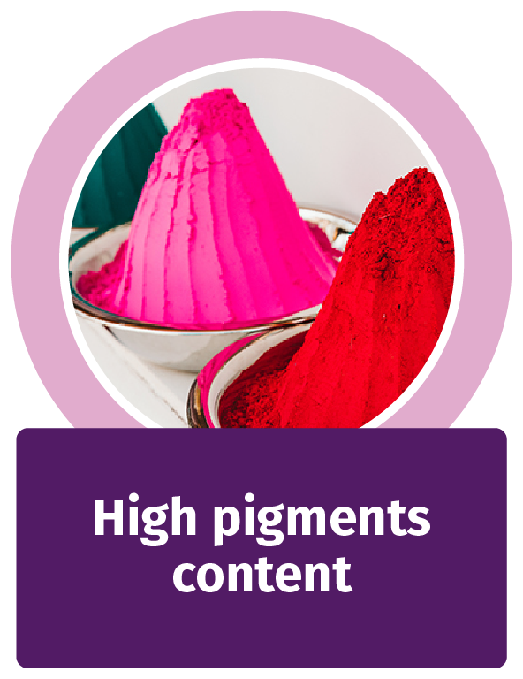


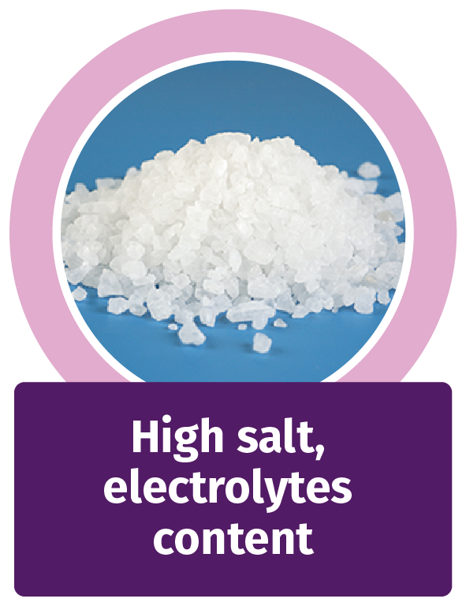
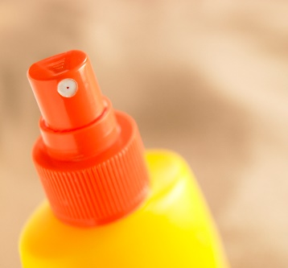
AMPHISOL® K overcomes each formulation challenge
Performance proof against:
Emulsifier competitors
PCP competitors
High oil
content
High salt,
electrolyte
content
High pigment
content
High ethanol
content
Spray
Spray

Slide 20
Skin care, make-up and sun care with high oil content like
An extensive, uniform and unique formation of self-organizing molecules that guarantee maximum stability.
High SPF products, balm, butter cream, BB & CC creams,…
High oil
content

Slide 21
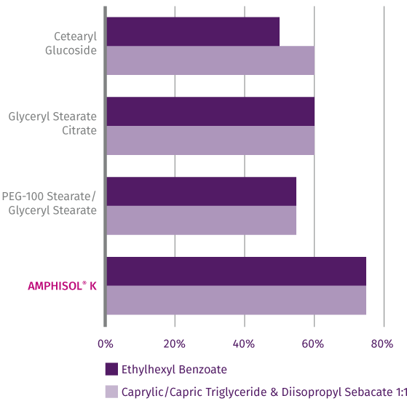
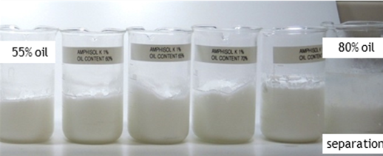
Overcome the challenge with high oil content
AMPHISOL® K allows stable emulsion with the highest oil content vs benchmarks
1% emulsifier - increased concentrations of oil, water ad 100% - evaluation after 48h
Peace of mind for the following types of formulations, where the oil or emollient content is high and critical for the stability:
High SPF formulations
BB or CC creams
Butter cream
Balm, etc…
55% oil
80% oil
Separation
AMPHISOL® K allows stable emulsion with the highest oil content vs benchmarks.

Slide 22
Skin care, make-up and suncare formulations with high electrolytes content like
An extensive, uniform and unique formation of self-organizing molecules that guarantee maximum stability.
Actives with high salt residual content
Actives with charges (AHA, DHA, STAY-C® 50)
High presence of NaOH, NaCl,…
High salt,
electrolyte
content

Slide 23
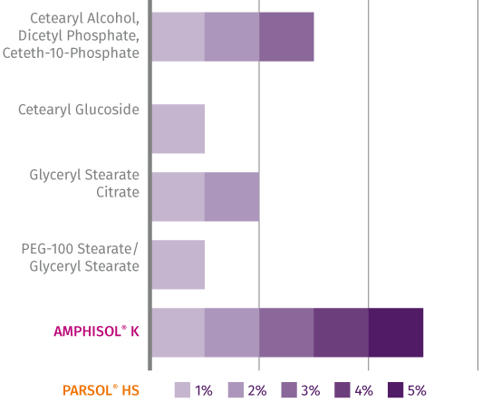
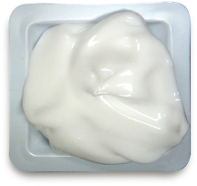
Overcome the challenge with high electrolyte content vs benchmarks
AMPHISOL® K allows stable emulsion with the highest electrolyte content
vs benchmarks
Testing procedure
All emulsifiers at 1%
Cetearyl Alcohol as stabilizer at 2.3%
PARSOL® HS neutralized with triethanolamine, final pH 7.5
Emulsion integrity evaluated after 48h at room temperature
Peace of mind for the following types of formulations, where the electrolyte content is high and critical for the stability:
High SPF formulation with organic acids as PARSOL® HS
Skin care or hybrid products containing
  Actives with high salt residual content
  Vitamin C, STAY-C® 50
  AHA, DHA
  NaOH, NaCl, etc…
AMPHISOL® K at 1% is superior in stabilizing electrolytes (such as neutralized PARSOL® HS for example) compared to alternative emulsifiers.
Notes:
Actives with high salt residual contents are for example skin care actives preserved with sodium benzoate and/or potassium sorbate.

Slide 24
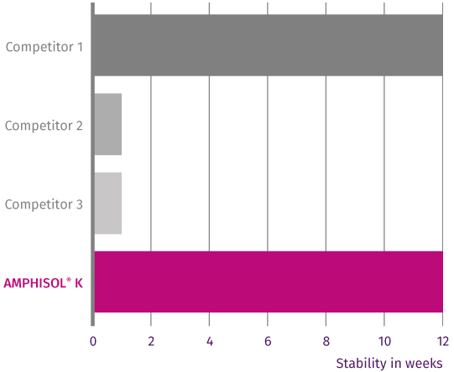
Overcome the challenge with high electrolyte content vs PCP benchmarks
AMPHISOL® K allows stable emulsion with high electrolyte content vs PCP benchmarks
Testing procedure
Basic formulation containing 3% PARSOL® HS neutralized with NaOH
Emulsifiers at 2%
Cetearyl Alcohol at 2.3%
Emulsion integrity evaluated after 12 weeks at RT
Peace of mind for the following types of formulations, where the content of electrolytes is high and critical for the stability:
High SPF formulation with organic acids as PARSOL® HS
Skin care or hybrid products containing
  Actives with high salt residual content
  Vitamin C, STAY-C® 50
  AHA, DHA
  NaOH, NaCl, etc…
AMPHISOL® K at 2% is superior in stabilizing electrolytes (such as neutralized PARSOL® HS for example) compared to PCP benchmarks.
Notes:
Competitor 1: EverMAP™ 160K (Sino Lion)
Competitor 2: Crodafos™ MCK (Croda)
Competitor 3: Romol AFSK (Eleco)

Slide 25
Skin care, make-up and suncare application with high pigment content like
An extensive, uniform and unique formation of self-organizing molecules that guarantee maximum stability.
BB, CC cream, foundation, mascara
High SPF product and Mineral Sunscreen
Decorative make-up with pigments and glitters
High pigment
content

Slide 26
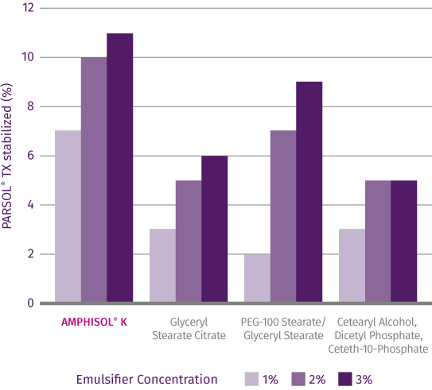
Overcome the challenge with high TiO2 pigment content
AMPHISOL® K allows stable emulsion with the highest pigment (such as TiO2) content vs benchmarks
Testing procedure
All emulsions contain cetearyl alcohol as stabilizer
Oil phase: 17.5% diisopropyl sebacate, 17.5% caprylic capric triglyceride + increasing concentrations of TiO2
Evaluation after 2 months
Peace of mind for the following types of formulations, where the inorganic particle content is high and critical for the stability:
High SPF formulations including mineral UV filters
Mineral sunscreens
BB, CC creams, Highlighters including
  Colored pigments
  Glitters
  Dyes
Decorative make-up
AMPHISOL® K best ensures emulsion stability at high pigment concentrations such as TiO2 (Mineral UV filters or inorganic pigments for make-up). .
Notes:
Emulsifier 1: Imwitor 372P
Emulsifier 2: Arlacel 165
Emulsifier 3: Crodaphos CES (Cetearyl Alcohol, Dicetyl Phosphate, Ceteth-10-Phosphate)

Slide 27
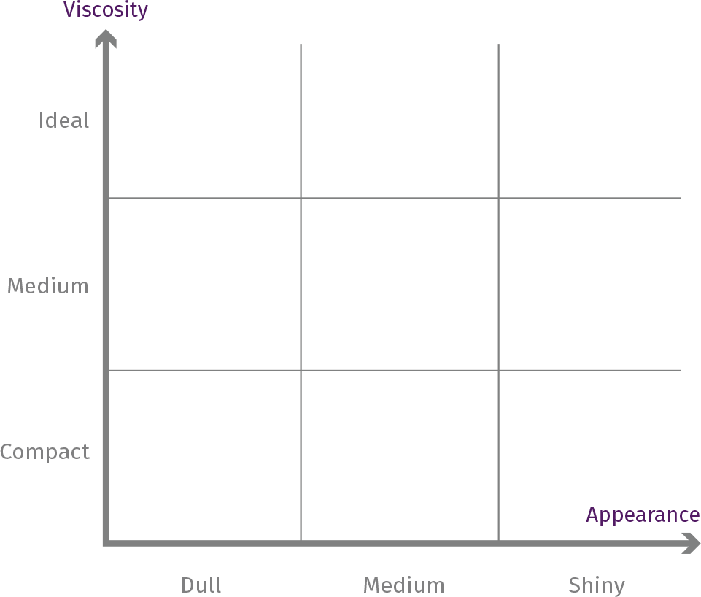





Overcome the challenge with Titanium Dioxide
High compatibility vs PCP benchmarks
Testing procedure
Basic emulsion containing 6% PARSOL® TX
Emulsifiers at 2%
Cetyl Alcohol at 2.3%
Emulsions are stable after the test period of 12 weeks at RT (except competitor 3)
Viscosity and appearance has been evaluated after 12 weeks
Peace of mind for the following types of formulations, where the inorganic particle content is high and critical for the stability:
High SPF formulations including mineral UV filters
Mineral sunscreens
BB, CC creams, Highlighters including
  Colored pigments
  Glitters
  Dyes
Decorative make-up
Unstable
AMPHISOL® K outperforms competition in terms of stability, viscosity and appearance.
Notes:
Competitor 1: EverMAP™ 160K (Sino Lion)
Competitor 2: Crodafos™ MCK (Croda)
Competitor 3: Romol AFSK (Eleco)

Slide 28

Overcome the challenge with high colored pigment content Higher performance vs PCP benchmarks
AMPHISOL® K allows stable emulsion with the highest pigment (such as colored pigment) content vs benchmarks
Testing procedure
Basic emulsion containing 10% white pigment (CI 77891 (and) Triethoxycaprylylsilane)
Emulsifiers at 8%
All emulsions are stable after the test period of 12 weeks at RT
Viscosity and appearance have been evaluated after 12 weeks
Peace of mind for the following types of formulations, where the inorganic particle content is high and critical for the stability:
BB, CC cream with mineral sunscreens
Colored pigments
Dyes
Decorative make-up
AMPHISOL® K shows the best viscosity and appearance with colored pigment in emulsion vs PCP benchmarks.
Notes:
Competitor 1: EverMAP™ 160K (Sino Lion)
Competitor 2: Crodafos™ MCK (Croda)
Competitor 3: Romol AFSK (Eleco)

Slide 29
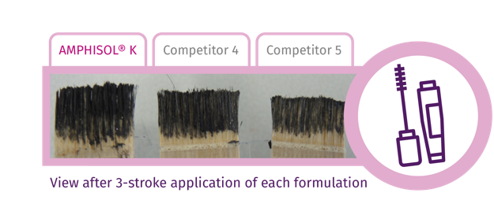



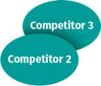
Overcome the challenge of mascara formulation Higher performance vs PCP benchmarks
Mascara in general contains a high concentration of pigments that are difficult to stabilize
Testing procedure
Mascara formulation 1 contains 10% black iron oxides and emulsifiers at 8%
Mascara formulation 2 contains 6% black iron oxides and emulsifiers at 3%
All emulsions are stable after the test period of 12 weeks at RT and 40°C
Viscosity and appearance have been evaluated after 12 weeks
Wax crystallization
View after 3-stocke applications of each formulation on hair
Wax crystallization
Higher color homogeneity and intensity with AMPHISOL® K vs competitors.
AMPHISOL® K shows the best viscosity and appearance at mascara vs PCP benchmarks.
Notes:
Competitor 1: EverMAP™ 160K (Sino Lion)
Competitor 2: Crodafos™ MCK (Croda)
Competitor 3: Romol AFSK (Eleco)
Competitor 4: Cola®Fax CPE-K (Colonial Chemical)
Competitor 5: Amplimul K (Brazil)

Slide 30
Skin care, make-up or sun care with high alcohol content used to
An extensive, uniform and unique formation of self-organizing molecules that guarantee maximum stability.
Reduce greasiness and tackiness
Bring a fresh effect
Improve the preservative properties
High ethanol
content

Slide 31
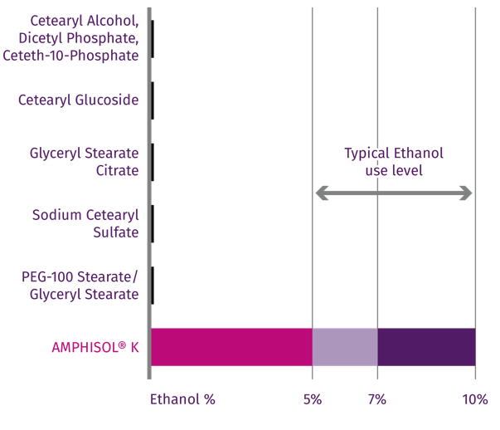
Overcome the challenge with alcohol content Higher performance vs benchmarks
Ethanol is often used to get a light and refreshing effect but could lead
to some instability
Testing procedure
All emulsifiers at 1%
Cetearyl Alcohol as Stabilizer
Emulsion integrity evaluated
after 8 weeks at 40°C
Peace of mind for the following types of formulations, where alcohol content is high and critical for the stability:
Sun care, skin care and make-up products where alcohol will reduce the greasiness and tackiness
Products where alcohol is used to create a fresh effect
Slimming products
AMPHISOL® K already at 1% succeeds to stabilize up to 10% ethanol.
Notes:
Emulsifier 1: Crodafos™ CES
Emulsifier 2: TEGO® Care CG90
Emulsifier 3: IMWITOR® 372P
Emulsifier 4: LANETTE® E
Emulsifier 5: ARLACEL 165
Cetearyl Alcohol is used at optimal ratio (for AMPHISOL® K): 2.3%. The same concentration of Cetearyl Alcohol was used for the other emulsifiers.
Typical Ethanol concentration used to get a light and refreshing effect is between 5 and 10%.

Slide 32
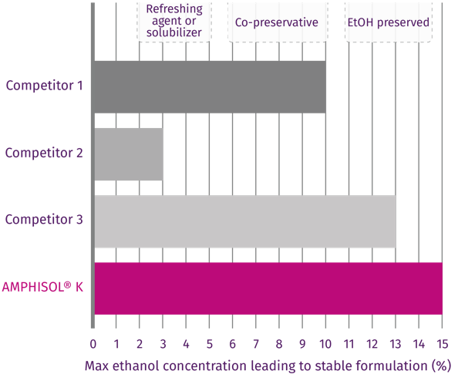
Overcome the challenge with alcohol content Higher performance vs PCP benchmarks
Ethanol is often used to get a light and refreshing effect or as a preservative but could lead to some formulation instabilities
Testing procedure
Test with a basic formulation to evaluate emulsifying performance
Emulsifiers at 2%
Cetearyl Alcohol at 2.3%
Emulsion integrity evaluated after 12 weeks at RT
Peace of mind for the following types of formulations, where alcohol content is high and critical for the stability:
Sun care, skin care and make-up products where alcohol will reduce the greasiness and tackiness
Products where alcohol is used to create a fresh effect
Slimming products
AMPHISOL® K stabilizes the highest amount of ethanol among tested PCP benchmarks.
Notes:
Competitor 1: EverMAP™ 160K (Sino Lion)
Competitor 2: Crodafos™ MCK (Croda)
Competitor 3: Romol AFSK (Eleco)

Slide 33
Skin care, make-up or sun care in spray application
An extensive, uniform and unique formation of self-organizing molecules that guarantee maximum stability.
Spray
Spray

Slide 34
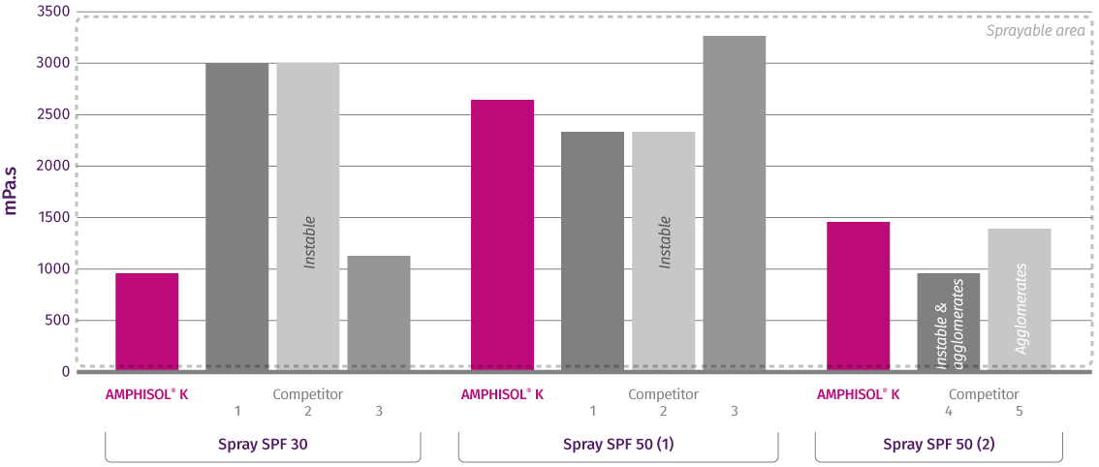
Overcome the challenge of spray application
AMPHISOL® K is able to stabilize challenging formulation at low viscosity
vs PCP benchmarks
Testing procedure
Spray SPF 50 (1):
  Emulsifiers at 2.5%
  Cetearyl Alcohol at 0.2%
  Glyceryl Myristate at 0.2%
Spray SPF50 (2):
  Emulsifier at 2.5%
  Cetearyl Alcohol at 0.2%
  Glyceryl Behenate at 0.2%
Spray SPF 30:
  Emulsifiers at 0.75%
  Cetyl Alcohol at 0.3%
Different UV filters combination
Emulsion integrity and viscosity evaluated after 12 weeks at 40°C
AMPHISOL® K is best in stabilizing low viscosity sprays with SPF.
Notes:
Competitor 1: EverMAP™ 160K (Sino Lion)
Competitor 2: Crodafos™ MCK (Croda)
Competitor 3: Romol AFSK (Eleco)
Competitor 4: Cola®Fax CPE-K (Colonial Chemical)
Competitor 5: Amplimul K (Brazil)

Slide 35
Summary of higher performance in challenging conditions vs other PCPs
An extensive, uniform and unique formation of self-organizing molecules that guarantee maximum stability.

Slide 36
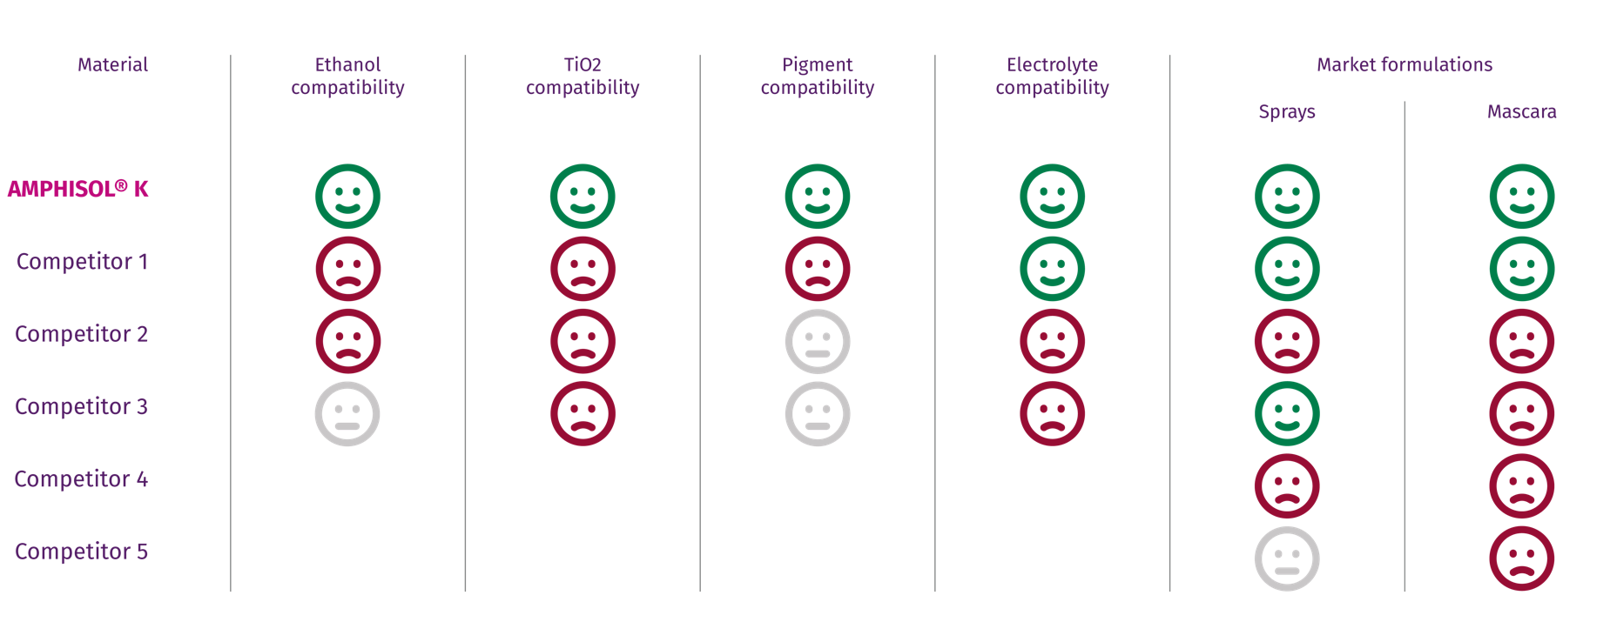
AMPHISOL® K outperforms PCP competition across cosmetic applications
Notes:
Competitor 1: EverMAP™ 160K (Sino Lion)
Competitor 2: Crodafos™ MCK (Croda)
Competitor 3: Romol AFSK (Eleco)
Competitor 4: Cola®Fax CPE-K (Colonial Chemical)
Competitor 5: Amplimul K (Brazil)

Slide 37
AMPHISOL® K: the co-emulsifier of choice to secure your formulation making process easier

Slide 38

Rescue and secure your formulation until the last drop by adding
0.5% AMPHISOL® K
High performance to rescue challenging formulations:
The proof with high electrolyte content, at high temperature & in spray application.
The proof in O/W and gel cream examples.
High performance to create and beautify different types of formulation:
The proof in O/W (polyglyceryl mixture, cetearyl glucoside, sorbitan derivative mixture…) and in gel cream (acrylate-based polymer).
How does it work?
The addition of AMPHISOL® K will reduce the emulsion droplet size and optimize the particle distribution.
Its microdomains technology will lock the stability of the formulation.
The formulation is creamier and shinier.
AMPHISOL® K used as a co-emulsifier makes processing easier (minimal temperature of introduction 60°C to 85°C, following the main emulsifier recommendation).
Save your time, rescue and secure your unstable emulsion until the last drop by adding 0.5% AMPHISOL® K in your emulsifying system.
Notes:
Alternative slide page 74

Slide 39
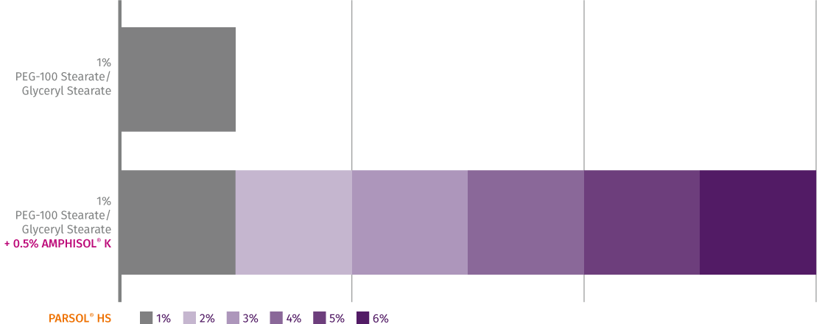
AMPHISOL® K as a co-emulsifier ensures the formulation stability with high electrolyte content
Alternative emulsifier system reaching their stability limits
Testing procedure
Emulsifier at 1% or combined with 0.5% AMPHISOL® K
Cetearyl Alcohol as Stabilizer at 2.3%
PARSOL® HS neutralized (pH 7.5) with triethanolamine
Evaluated after 48h at RT
The addition of 0.5% AMPHISOL® K allows formulation with high electrolyte content.
Notes:
PEG-100 Stearate + Glyceryl Stearate, eg. ARLACEL 165

Slide 40
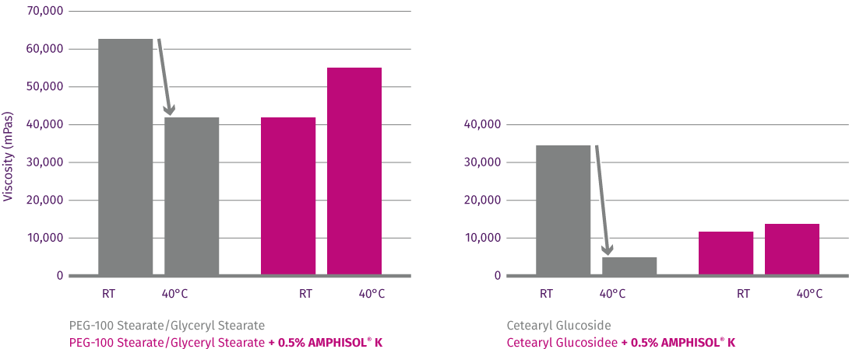
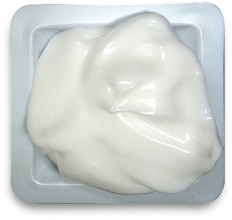
AMPHISOL® K as a co-emulsifier ensures the formulation stability at high temperature
Add 0.5% of AMPHISOL® K in your emulsifying system to avoid the viscosity drop at high temperature and increase the long-term stability
Testing procedure
2 different emulsifier systems were formulated with and without 0.5% AMPHISOL® K
SPF 30 sunscreen used as basis
Assessment at RT and 40°C over 6 months
Viscosity drop
Viscosity drop
The addition of 0.5% AMPHISOL® K ensures the thermal (long-term) stability of the emulsions.
Notes:
Emulsifier 1: ARLACEL 165
Emulsifier 2: TEGO® Care CG90
Combination with PEG fatty acid surfactant : WO2016/046210

Slide 41
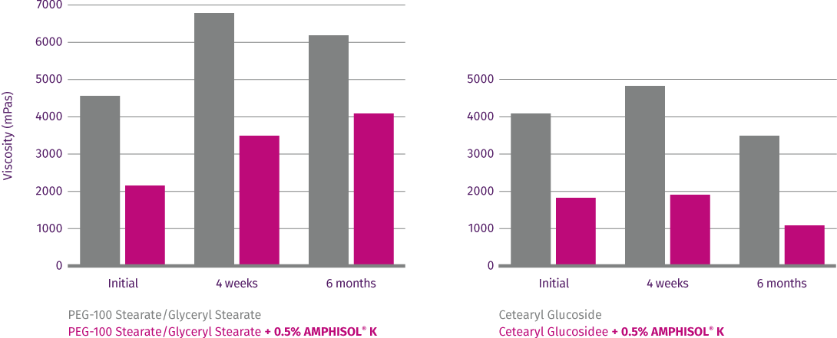
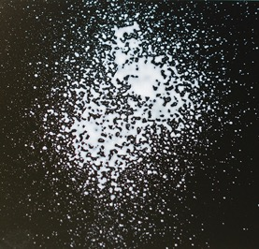
AMPHISOL® K as a co-emulsifier allows to create stable spray
Add 0.5% of AMPHISOL® K in your emulsifying system to decrease the viscosity without compromising on stability
Testing procedure
2 different emulsifier systems were formulated with and without 0.5% AMPHISOL® K
SPF 30 sunscreen used as basis
Assessment at RT up to 6 months
The addition of 0.5% AMPHISOL® K allows to decrease the viscosity of your emulsion and to create stable spray.
Notes:
Combination with PEG fatty acid surfactant : WO2016/046210

Slide 42
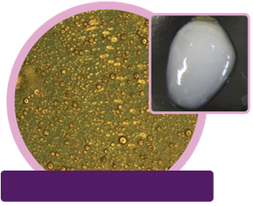
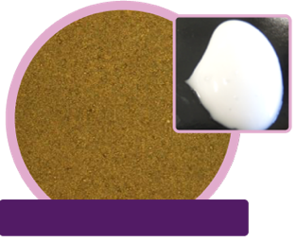
Rescue and beautify gel cream formulation
With the addition of AMPHISOL® K as co-emulsifier
Gel Cream 1 based on polyacrylate crosspolymer-11
Smaller droplet size and better distribution for higher stability
Better creamy appearance
with the addition
of 0.3% AMPHISOL® K in the emulsifying system of a gel cream
+0.3% AMPHISOL® K in the
emulsifier system at 60°C
Microscopy with polarizer x50
Microscopy with polarizer x50
Inhomogeneous droplets distribution
Not shiny white emulsion
Droplet size reduction and homogenous droplets distribution for improved stability
Snow white cream
Notes:
Aristoflex Velvet: POLYACRYLATE CROSSPOLYMER-11;

Slide 43
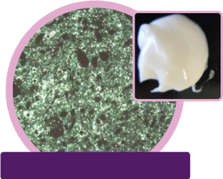
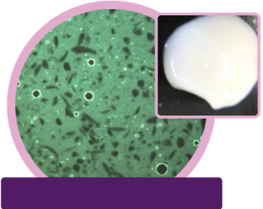
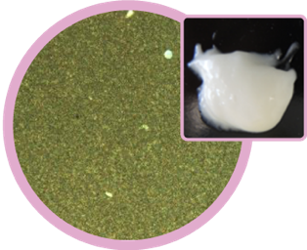
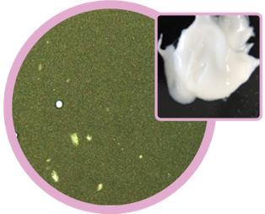
Rescue and beautify skin care O/W emulsion
With the addition of AMPHISOL® K as co-emulsifier
Emulsion 2 based on Polyglyceryl-6 distearate, jojoba esters, polyglyceryl-3 beeswax, cetyl alcohol
Higher stability (no oil release)
Smoother and shinier cream
Reduction of the yellowish effect and wax crystallization
No agglomeration
with the addition of 0.5% AMPHISOL® K in the emulsifying system of a O/W emulsion in our test conditions
+0.5% AMPHISOL® K in the
emulsifier system at 70°C
Microscopy without polarizer x50
Microscopy without polarizer x50
Strong wax crystallization
Yellowish cream
Oil release after 1 month at 50C
Reduction of waxes crystallization
Snow white cream
Droplets size distribution for improved stability
Emulsion 3 based on Cetearyl olivate, sorbitan olivate
+0.5% AMPHISOL® K in the
emulsifier system at 70°C
Regular droplets with few agglomerates
Grainy cream
Regular droplets distribution
No agglomerate
Smooth and shiny cream
Notes:
Emulium® Mellifera MB : POLYGLYCERYL-6 DISTEARATE; JOJOBA ESTERS; POLYGLYCERYL-3 BEESWAX; CETYL ALCOHOL;
Olivem® 1000 MB: CETEARYL OLIVATE; SORBITAN OLIVATE;

Slide 44
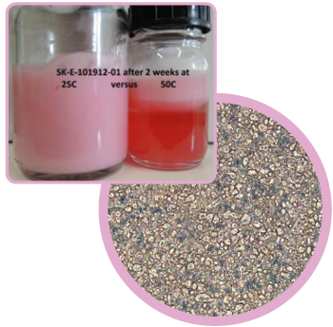
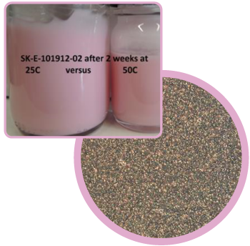
Rescue and beautify O/W emulsion for higher stability at high and low temperature
With the addition of AMPHISOL® K as co-emulsifier
Frozen Cream based on Polyglyceryl-3 Methylglucose Distearate from -18°C to RT (stability at 50°C)
No phase separation
Smaller droplet size and better distribution for higher stability
Thermal stability at high (50°C) and low temperature (-18°C)
Smoother and shinier aspect of the cream
with the addition of 0.5% AMPHISOL® K in the frozen cream
+0.5% AMPHISOL® K in the
emulsifier system at 75 °C
Inhomogeneous droplets distribution
Phase separation at 50C after 2 weeks
Very fine droplets distribution
Notes:
TEGO® Care 450 MB : POLYGLYCERYL-3 METHYLGLUCOSE DISTEARATE;

Slide 45
Additional benefits:
SPF boosting
Moisturizing properties
Sensory profile

Slide 46
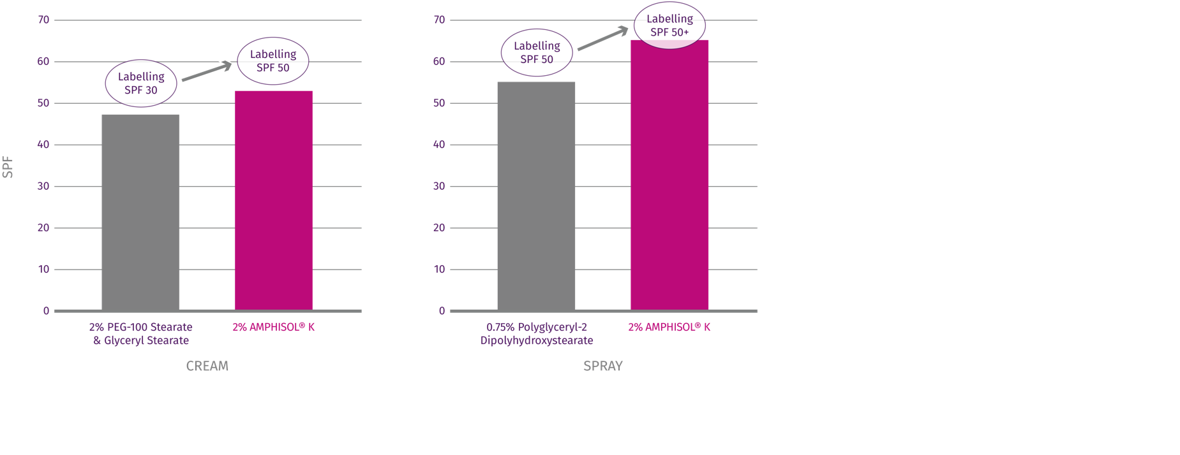
SPF Boosting effect
Upgrade your suncare label
Testing procedure
In vivo SPF tests with 10 volunteers
The cream contains Cetearyl Alcohol/ Behenyl Alcohol as stabilizers
The spray contains Cetearyl Alcohol/Glyceryl Myristate as stabilizers for AMPHISOL® K versus Decyl Glucoside/Lauryl Glucoside /Polyglyceryl-2 Dipolyhydroxystearate (PGPH) for the other one
65,2
53,5
54,6
47,6
1% Lauryl Glucoside, 0.75% PGPH, 0.5% Decyl Glucoside
AMPHISOL® K upgrades your SPF to reach the next protection level.
Notes:
Cream:
PEG-100 Stearate & Glyceryl Stearate: ARLACEL 165
Both formulations have the same UV filters combination
Both formulations have been tested at the same test institute
Spray:
Decyl Glucoside , and Lauryl Glucoside (and) Polyglyceryl-2 Dipolyhydroxystearate based on Eumulgin® VL 75 (non-ionic emulsifier)
Both formulations have the same UV filters combination
Both formulations have been tested at the same test institute
The cream and the spray have different UV filter combinations.
SPF boosting effect differs depending on formulations. This is what we could observe with the formulations presented on this slide.

Slide 47
Moisturizing properties thanks to the proven liquid crystals structure of AMPHISOL® K
Liquid crystals have an impact on stability and rheology of the formulations but also on the skin. ⁽³⁾ ⁽⁴⁾
Liquid crystal's structure reduce the TEWL, due to their specific organization: liquid crystals form multilayers ordered with oil components and hydrophilic groups of AMPHISOL® K. ⁽¹⁾ ⁽³⁾
Liquid crystals network and skin structure are similar leading to a good affinity that extends the hydration and optimizes the action of functional actives like UV filters. ⁽²⁾ ⁽³⁾
Reference:
⁽¹⁾ Liquid Crystal O/W Emulsions to Mimic Lipids and Strengthen Skin Barrier Function, July 18, 2013 Contact Author In-Young Kim, PhD; Sayaka Nakagawa; Kinka Ri, PhD; Satoru Hashimoto, PhD; and Hitoshi Masaki, PhD, Nikkol Group
⁽²⁾ Liquid Crystals and the Skin by STEVE HERMAN Chemical Reaction GCI February 2010
⁽³⁾ Study on the Formation and Properties of Liquid Crystal Emulsion in Cosmetic, Wanping Zhang*, Lingyan Liu, journal of Cosmetics, Dermatological Sciences and Applications, 2013, 3, 139-144
⁽⁴⁾ Role of liquid crystal in the emulsiﬁcation of a gel emulsion with high internal phase fraction, Yihan Liu a,*, Stig E. Friberg b,a The Dow Corning Corporation, Midland, MI 48686, USA,b
Chemistry Department, Clarkson University, Potsdam, NY 13676, USA , Journal of Colloid and Interface Science 340 (2009) 261–268

Slide 48
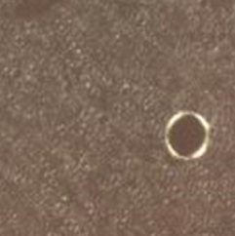

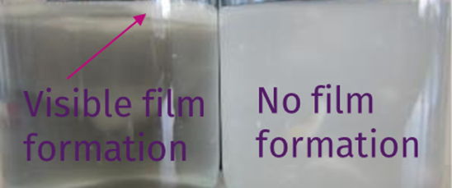


Visible higher film forming formation for higher moisturizing properties with visible liquid crystals versus benchmark
Formulation SK-E-101767 -1 & 2
Many liquid
crystals
No liquid
crystals
1% AMPHISOL® K
3% Benchmark
AMPHISOL® K with
liquid crystals
Benchmark
no liquid crystals
AMPHISOL® K with
liquid crystals
Benchmark
no liquid crystals
Microcopy under polarizer light x125
0.5g of cream in 50ml water
No diffusion of the
water droplet on the
product film
Immediate diffusion
of the water droplet
on the product film
Liquid crystals structure of AMPHISOL® K allows a film forming effect for higher moisturizing properties.
Test done on PMMA plate HD6
Notes:
Benchmark: Polysorbate-60
Test on PMMA plate HD6
Each formulation are applied to the roughened PMMA plate (roughened side uppermost) by weight, at an application rate of 1.3mg/cm² (actual quantity applied to the plate).
Sample should then be allowed to equilibrate for at least 15 minutes in the dark at ambient temperature to help facilitate formation of a standard stabilized product film.
Poor a droplet of deionized water (25µl) on each plate

Slide 49

AMPHISOL® K sensory signature in a challenging daily cream
High wetness, spreadability, absorbency, slipperiness (immediate and after-feel) combined with a dry touch
Sensory profile of a Daily Cream with STAY®C 50 and UV Filters
Good to know
With a sensory signature close to Cetearyl Glucoside, AMPHISOL® K is a good alternative to use where the formulation isn’t stable. It will give your formulation higher stability without modifying the sensory profile recognized by consumers.
Validated by the
dsm-firmenich Expert Sensory Panel
Pure Lightening Complex Daily
Cream based on SU_E_101049-xx

Slide 50

AMPHISOL® K sensory signature in a BB cream SPF 25 with pigments and UV filters
High wetness, spreadability, absorbency, slipperiness (immediate and after-feel) combined with a dry touch
BB cream sensory profile
High stability with color pigments and UV filters with great sensory profile.
Validated by the
dsm-firmenich Expert Sensory Panel
Skin perfector BB cream SPF 25
SU E 101889 3

Slide 51
Key formulation tips

Slide 52

We recommend the combination with fatty alcohol
AMPHISOL® K (1%) is your main emulsifier, how much stabilizer should you add at the start?
Relation between AMPHISOL® K emulsion viscosity and selected stabilizers with optimal ratio
Tested in a basic system gel network
Depending on the choice of stabilizer, AMPHISOL® K formulations can be liquid
to cream.
Combination within optimal emulsifier /
stabilizer range ensures best long-term stability.
Stable emulsions with typically use levels of 0.75 - 2.5% AMPHISOL® K.
% of stabilizer to combine with 1% AMPHISOL® K
Save your time with AMPHISOL® K and selected stabilizers map.
Notes:
How to read the table?
If the stabilizer is Cetyl Alcohol: 1% AMPHISOL® K for 1 - 2.3% of Cetyl Alcohol
If the stabilizer is Cetearyl Alcohol: 1% AMPHISOL® K for 2,3% of Cetearyl Alcohol

Slide 53


Formulation tips & tricks
See video
AMPHISOL® K needs to be dispersed under stirring at the following temperatures:
  80-85°C in water phase, 85-90°C in oil phase. (min 60°C when used as a co-emulsifier, see next slides).
Neither in the heated oil phase nor in the water phase* AMPHISOL® K dissolves completely.
Despite not completely dissolved in either phase, AMPHISOL® K will be oriented to form during the emulsification, liquid crystalline structures around the oil phase and at the oil/water interphase droplets in the first 24 hours.
After combining both phases, we recommend a homogenization step and a second shorter one below 40°C.
Below 40°C add neutralizing agents and temperature sensitive agent.
AMPHISOL® K is not sensitive to shear forces and doesn’t need strong shearing. But adapt shear force accordingly to production scale and shearing equipment.
Stir while cooling down further.
The formulations need 24-48h for ripening and to adjust themselves to the final viscosity.
* Avoid filtration process with the phase containing AMPHISOL® K before emulsification, as main consequence would be the lost of part of the emulsifier.
See video
dsm-firmenich recommendation: add AMPHISOL® K to the oil phase

Slide 54

Additional special tips
pH range and other parameters
AMPHISOL® K forms stable emulsion in a pH range from 5– 8.
The resulting pH of a standard emulsion based on AMPHISOL® K without any base
or acid is around pH 5 – 5.5.
The pH can easily be adjusted to the desired value with any neutralizing agent (NaOH, KOH, Triethanolamine, Tromethamine, etc.).
AMPHISOL® K can form insoluble salts in presence of calcium/magnesium salts, a chelating agent is recommended, and/or combine AMPHISOL® K with fatty alcohols to avoid the formation of insoluble crystals.
Polyacrylate based thickeners can be added to the same phase as AMPHISOL® K. Neutralization will partly occur due to the potassium ion present and lead to slight thickening of the phase.

Slide 55

AMPHISOL® K as co-emulsifier:
Formulation tricks
Typical use level as co-emulsifier: 0.3-0.5% AMPHISOL® K
To be added before the emulsification step
No need to heat at high temperature: adjust the temperature to the main emulsifier with a minimum at 60°C
As a co-emulsifier, AMPHISOL® K will:
Reduce yellowing effect by reducing the droplet size
Increase the shine and the smoothness of the emulsion
Increase the stability (no oil and pigments release)
Improve the thermal stability (low and high) / cyclo test

Slide 56
K-Element Line-up

Slide 57
K-ELEMENT
Stabilized formula by AMPHISOL® K
Ultimate stability for multi formulations
Products are for illustration only, not for sale.
dsm-firmenich is not responsible for final product claims.
57

Slide 58



Body Butter
Stabilized formula by AMPHISOL® K
With PENTAVITIN®
An extensive, uniform and unique formation of self-organizing molecules that guarantee maximum stability.
A feeling of comfort with a buttery yet non-sticky texture and,
which envelops the skin with a velvety and comforting touch.
Phase | Ingredients | INCI Name | % w/w
A | Water Dem | AQUA | 75,60
 | Edeta BD | DISODIUM EDTA | 0,10
 | Carbopol Ultrez 10 | CARBOMER | 0,30
 | Tris Amino Ultra PC | TROMETHAMINE | 0,50
 | Glycerin 99.5% | GLYCERIN | 2,00
B | DUB MCT 5545 | CAPRYLIC/CAPRIC TRIGLYCERIDE | 8,00
 | DUB B1215 | C12-15 ALKYL BENZOATE | 2,00
 | BELSIL DM 100 | DIMETHICONE | 2,00
 | Shea butter | BUTYROSPERMUM PARKII BUTTER | 2,00
 | DUB SHOREA T | SHOREA ROBUSTA SEED BUTTER | 1,00
 | AMPHISOL® K | POTASSIUM CETYL PHOSPHATE | 2,00
 | Lanette D | CETEARYL ALCOHOL | 2,00
C | Euxyl PE 9010 | PHENOXYETHANOL, ETHYLHEXYLGLYCERIN | 1,00
D | PENTAVITIN® | SACCHARIDE ISOMERATE, AQUA, CITRIC ACID, SODIUM CITRATE | 1,00
E | SHP Ambree Silver Prada | PARFUM | 0,50
Procedure
In water phase, make Carbopol dispersion, and then add the Tromethamine. Heat up to 80°C under stirring.
Heat phase B up to 85°C under stirring. Add phase B to A and homogenize the emulsion.
Cool down to 40°C under gentle stirring. Add preservative, PENTAVITIN®, fragrance and homogenize.
Technical Data
pH: 7.0
^{SK-L-101679-3}
Products are for illustration only, not for sale.
dsm-firmenich is not responsible for final product claims.
58

Slide 59

Blue Light Body Guard SPF 50
Stabilized formula by AMPHISOL® K
With VALVANCE ® Touch 210, PARSOL® UV Filters, and HYALURONIC ACID-BT
An extensive, uniform and unique formation of self-organizing molecules that guarantee maximum stability.
Your skin is totally protected from sunlight as well as blue light with this soft texture protector, dry to the touch and with all the hydrating power of hyaluronic acid.
Phase | Ingredients | INCI Name | % w / w
A | PARSOL® EHS | ETHYLHEXYL SALICYLATE | 5,00
 | PARSOL® HMS | HOMOSALATE | 10,00
 | Finsolv TN | C12-15 ALKYL BENZOATE | 5,00
 | Lexfeel WOW | C13-16 ISOPARAFFIN, TRIHEPTANOIN | 2,00
B | UVAsorb HEB | DIETHYLHEXYL BUTAMIDO TRIAZONE | 4,00
C | Lanette 18 | STEARYL ALCOHOL | 0,40
 | AMPHISOL® K | POTASSIUM CETYL PHOSPHATE | 0,80
 | Emulium Mellifera MB | POLYGLYCERYL-6 DISTEARATE, JOJOBA ESTERS, POLYGLYCERYL-3 BEESWAX, CETYL ALCOHOL | 4,00
 | Eldew SL-205 | ISOPROPYL LAUROYL SARCOSINATE | 5,00
 | PARSOL® Shield | BIS-ETHYLHEXYLOXYPHENOL METHOXYPHENYL TRIAZINE | 4,00
 | PARSOL® 1789 | BUTYL METHOXYDIBENZOYLMETHANE | 5,00
 | VALVANCE® Touch 210 | SILICA | 3,00
D | Sepinov EMT 10 | HYDROXYETHYL ACRYLATE/SODIUM ACRYLOYLDIMETHYL TAURATE COPOLYMER | 0,50
E | Keltrol CG-T | XANTHAN GUM | 0,20
 | 1,3 Butylene Glycol cos grade | BUTYLENE GLYCOL | 3,00
F | Edeta BD | DISODIUM EDTA | 0,10
 | WATER DEM. | AQUA | 42,95
 | PARSOL® MAX | METHYLENE BIS-BENZOTRIAZOLYL TETRAMETHYLBUTYLPHENOL, AQUA, DECYL GLUCOSIDE, PROPYLENE GLYCOL, XANTHAN GUM | 4,00
 | HYALURONIC ACID-BT | SODIUM HYALURONATE | 0,05
 | ADEKA NOL NHG | HEXYLGLYCERIN | 0,50
 | SymSave H | HYDROXYACETOPHENONE | 0,50
Procedure
Mix Phase A
Add B to A under stirring to avoid aggregates and heat up to 85°C until a clear solution is obtained.
Add one by one ingredients of Phase C to A+B under stirring.
Add D to A+B+C under stirring.
Mix Phase E.
Mix Phase F and heat up to 85°C. Add E to F under stirring.
Add E+F to A+B+C+D and homogenize.
Cool down to room temperature under gentle stirring.
Technical Data
pH: 6.0 +/- 0.5
SPF*:50
Viscosity (Brookfield RV5/10rpm): 25000 mPa.s
In vitro UVAPF* (Colipa 2011): 19.8
UVAPF/SPF* (50 labeled); >= 0.33: 0.40
Critical Wavelength*: 380 nm
(Measurement done with Labsphere equipment)
^{SU-E-100116-55}
UV filter combination does not comply with applicable EU Cosmetic Regulation
Products are for illustration only, not for sale.
dsm-firmenich is not responsible for final product claims.
59

Slide 60


Lustrous Clump-free Mascara
Stabilized formula by AMPHISOL® K
With VALVANCE® Touch 250, D-Panthenol 75 L and Phytantriol
An extensive, uniform and unique formation of self-organizing molecules that guarantee maximum stability.
Powerful eyes with this great coverage pigment mask for high-definition eyelashes.
Phase | Ingredients | INCI Name | % w / w
A | Huile de Paraffine Codex AAB2 | PARAFFINUM LIQUIDUM | 5.00
 | CERAUBA T1 Bio | COPERNICIA CERIFERA CERA | 3.50
 | Kahlwax 8104 | CERA ALBA | 5.00
 | Tego® Alkanol 16 | CETYL ALCOHOL | 5.00
 | AMPHISOL® K | POTASSIUM CETYL PHOSPHATE | 3.00
B | Water dem. | AQUA | 45.15
 | Natrosol™ 250 HR | HYDROXYETHYLCELLULOSE | 0.50
 | Glycerin 99.5% | GLYCERIN | 3.00
 | SOLAGUM™ AX | ACACIA SENEGAL GUM, XANTHAN GUM | 0.20
 | Water dem. | AQUA | 15.00
 | Eastman AQ™ Polymer 55 S | POLYESTER-5, SODIUM ACETATE | 5.00
 | Unipure Black LC989 SGP | CI 77499, SODIUM GLYCEROPHOSPHATE | 6.00
C | VALVANCE® Touch 250 | SILICA, METHICONE | 1.50
D | D-Panthenol 75 L | PANTHENOL, AQUA | 0.50
E | Phytantriol | PHYTANTRIOL | 0.50
 | Euxyl® PE 9010 | PHENOXYETHANOL, ETHYLHEXYLGLYCERIN | 1.00
 | Emprove® Sodium Hydroxide Pellets | SODIUM HYDROXIDE | 0.15
Procedure
Weight components of phase A. Stir and heat up to 85°C until homogenous.
Weight water of phase B. Start stirring and heating. At 60°C, add slowly the hydroxyethylcellulose 250 HR while stirring for 20 minutes and heat up. At 75°C add premix Glycerin + Acacia Senegal Gum, Xanthan Gum and stir for 10 minutes.
Weigh water of phase B, stir and heat to 80°C. Solubilize Eastman AQ™ Polymer 55 S in water.
Then add C to B.
Add D to B+C, homogenize.
At 80°C, add A to B+C+D under stirring and homogenize strongly for 1 minute.
Start cooling down under gentle stirring.
At 50°C, introduce one by one components of phase E. Check the homogeneity between each step.
Homogenize for 30 seconds.
Cool down to RT, check the pH (5.0-6.0) and adjust if necessary.
75L
^{SU-E-101219-01}
Products are for illustration only, not for sale.
dsm-firmenich is not responsible for final product claims.
60

Slide 61

Face Glow Cream
Stabilized formula by AMPHISOL® K
With VALVANCE®, SYN-GLOW®, DL-alpha-Tocopheryl Acetate, and PARSOL® UV Filters
An extensive, uniform and unique formation of self-organizing molecules that guarantee maximum stability.
For naturally tanned and healthy skin from the inside out, with a long-lasting effect, soft to the touch and high in hydration.
Phase | Ingredients | INCI Name | % w / w
A | WATER DEM. | AQUA | 50,10
 | Edeta BD | DISODIUM EDTA, AQUA | 0,10
B | Makilene GC | BUTYLENE GLYCOL | 3,00
 | SILIGEL | XANTHAN GUM, SCLEROTIUM GUM, LECITHIN, PULLULAN | 0,80
C | AMPHISOL® K | POTASSIUM CETYL PHOSPHATE | 1,80
 | PARSOL® HMS | HOMOSALATE | 5,00
 | PARSOL® EHS | ETHYLHEXYL SALICYLATE | 5,00
 | PARSOL® 1789 | BUTYL METHOXYDIBENZOYLMETHANE | 3,00
 | PARSOL® 340 | OCTOCRYLENE | 6,00
 | PARSOL® SLX | POLYSILICONE-15 | 0,90
 | PARSOL® MCX | ETHYLHEXYL METHOXYCINNAMATE | 3,00
 | EMOGREEN L19 | C15-19 ALKANE | 2,50
 | DL-alpha-Tocopheryl Acetate | TOCOPHERYL ACETATE | 1,00
 | Lanette O | CETEARYL ALCOHOL | 2,00
 | Aristoflex Silk | SODIUM POLYACRYLOYLDIMETHYL TAURATE | 0,50
 | Hallbrite BHB | BUTYLOCTYL SALICYLATE | 5,00
D | VALVANCE® Touch 250 | SILICA, DIMETHICONE | 1,00
 | VALVANCE® Touch 210 | SILICA | 1,00
E | Euxyl PE 9010 | PHENOXYETHANOL, ETHYLHEXYLGLYCERIN | 1,00
 | Perfume Vanille douce RS86015 | PARFUM | 0,30
 | SYN-GLOW® | GLYCERIN, AQUA, BENZOYL DIPEPTIDE-18 D-PHENYLALANYL ARGINYL D-TRYPTOPHAN DIPROPYLAMIDE MESYLATE | 3,00
F | Cameleon Yellow | CELLULOSE ACETATE, TITANIUM DIOXIDE, CI 77492, PROPYLENE GLYCOL STEARATE, ACRYLATES/AMMONIUM METHACRYLATE COPOLYMER, MAGNESIUM STEARATE | 2,250
 | Cameleon Black | CELLULOSE ACETATE, TITANIUM DIOXIDE, CI 77499, PROPYLENE GLYCOL STEARATE, ACRYLATES/AMMONIUM METHACRYLATE COPOLYMER, MAGNESIUM STEARATE | 0,075
 | Cameleon Red | CELLULOSE ACETATE, TITANIUM DIOXIDE, CI 77491, PROPYLENE GLYCOL STEARATE, ACRYLATES/AMMONIUM METHACRYLATE COPOLYMER, MAGNESIUM STEARATE | 0,675
 | Cameleon White | CELLULOSE ACETATE, TITANIUM DIOXIDE, PROPYLENE GLYCOL STEARATE, ACRYLATES/AMMONIUM METHACRYLATE COPOLYMER, BORON NITRIDE | 1,000
Procedure
Premix phase A under stirring.
Premix phase B and add it to phase A under stirring.
Heat phase A+B up to 85°C.
Mix phase C and heat it up to 85°C under stirring.
Add phase C into phase A+B and homogenize with high shear.
Cool the formulation down to room temperature under stirring.
Add phase D under stirring.
Below 40°C add the ingredients of phase E under stirring.
Premix phase F and carefully add it to the formulation under stirring.
Adjust the pH around 5.50 if necessary.
Technical Data
pH: 7 – 7.5
Viscosity (Brookfield RV6/10rpm): 29 000 mPa.s
SPF expected: 30
®
®
^{SK-E-101343-19}
Products are for illustration only, not for sale.
dsm-firmenich is not responsible for final product claims.
61

Slide 62



Fresh Hand Cream
Stabilized formula by AMPHISOL® K
With VALVANCE ® Touch 210 and DL-alpha-Tocopheryl Acetate
An extensive, uniform and unique formation of self-organizing molecules that guarantee maximum stability.
A touch of softness for your hands with this refreshing cream.
Fast in absorption and high in nourishing power.
Phase | Ingredients | INCI Name | % w/w
A | Tego Care 450 MB | POLYGLYCERYL-3 METHYLGLUCOSE DISTEARATE | 1,20
 | JNA-CS50 | CETEARYL ALCOHOL | 1,00
 | Arlacel 165 | GLYCERYL STEARATE, PEG-100 STEARATE | 1,00
 | SALACOS 816T | CETYL ETHYLHEXANOATE | 8,00
 | Shea butter | BUTYROSPERMUM PARKII BUTTER | 2,00
 | AMPHISOL® K | POTASSIUM CETYL PHOSPHATE | 1,00
B | XIAMETER PMX-0345 | CYCLOPENTASILOXANE, CYCLOHEXASILOXANE | 5,00
C | Water Dem | AQUA | 32,11
 | Tris Amino Ultra PC | TROMETHAMINE | 0,19
 | Glycerin 99.5% | GLYCERIN | 5,00
 | Phenoxyethanol | PHENOXYETHANOL | 0,35
 | Sensiva SC 50 | ETHYLHEXYLGLYCERIN | 0,05
 | Propanediol | PROPANEDIOL | 1,00
 | Edeta BD | DISODIUM EDTA | 0,05
D | Gransil PSQ | POLYMETHYLSILSESQUIOXANE | 0,70
 | VALVANCE® Touch 210 | SILICA | 1,00
E | Water Dem | AQUA | 35,00
 | Flogel FG 700 | CARBOMER | 0,35
F | DL-alpha-Tocopheryl Acetate | TOCOPHERYL ACETATE | 5,00
Procedure
Mix all ingredients of phase A and heat up to 75°C.
Mix all ingredients of phase C and heat up to 75°C.
Add phase C into phase A under homogenize with the speed of 5000rpm for 3min Add phase B into product under homogenize with the speed of 5000rpm for 1min.
Add each ingredient of phase D into product under homogenize with the speed of 5000rpm for 1min.
Mix all ingredients of phase E into product under stirring until uniform Add phase E into product under homogenize with the speed of 5000rpm for 2min.
Cool down under stirring add phase F into product below 40 °C.
Technical Data
pH: 6.2
Viscosity (Brookfield LV3/12rpm, 22,8°C): 8499 mPa.s
^{SK-E-800040-1}
Products are for illustration only, not for sale.
dsm-firmenich is not responsible for final product claims.
62

Slide 63

Body Spray Moisturizer
Stabilized formula by AMPHISOL® K
With PENTAVITIN®
An extensive, uniform and unique formation of self-organizing molecules that guarantee maximum stability.
A revitalizing touch for your day-to-day with this ultralight texture moisturizer with fast absorption, providing a wonderfully soft skin feeling.
Phase | Ingredients | INCI Name | % w/w
A | WATER DEM. | AQUA | 80,40
 | Glycerin 99.5% | GLYCERIN | 2,00
 | Edeta BD | DISODIUM EDTA | 0,10
B | DUB MCT 5545 | CAPRYLIC/CAPRIC TRIGLYCERIDE | 8,00
 | DUB B1215 | C12-15 ALKYL BENZOATE | 2,00
 | Phytosqualan | SQUALANE | 2,00
 | CETYL ALCOHOL PS | CETYL ALCOHOL | 1,00
 | AMPHISOL® K | POTASSIUM CETYL PHOSPHATE | 1,00
C | Euxyl PE 9010 | PHENOXYETHANOL, ETHYLHEXYLGLYCERIN | 1,00
 | SIMULGEL INS 100 | HYDROXYETHYL ACRYLATE/SODIUM ACRYLOYLDIMETHYL TAURATE COPOLYMER, ISOHEXADECANE, POLYSORBATE 60 | 1,00
D | PENTAVITIN® | SACCHARIDE ISOMERATE, AQUA, CITRIC ACID, SODIUM CITRATE | 1,00
E | SHP0407 Elixir Extreme | PARFUM | 0,50
Procedure
Heat phase A up to 80°C.
Heat phase B up to 85°C under stirring. Add phase B to A and homogenize the emulsion.
Cool down to 40°C under gentle stirring. Add phase C and homogenize.
Add PENTAVITIN®, fragrance and homogenize again.
Technical Data
pH: 6.0
^{SK-L-101677-5}
Products are for illustration only, not for sale.
dsm-firmenich is not responsible for final product claims.
63

Slide 64

Anti-Pollution BB Cushion SPF 30
Stabilized formula by AMPHISOL® K
With VALVANCE ® Touch 210, PARSOL® UV Filters, PENTAVITIN®, and PEPHA®-TIGHT CB
An extensive, uniform and unique formation of self-organizing molecules that guarantee maximum stability.
Reveal your natural beauty with this BB Cushion that provides lightweight coverage and effective oil control.
Phase | Ingredients | INCI Name | % w / w
A | X-Tend 226 | PHENETHYL BENZOATE | 6.00
 | PARSOL® EHS | ETHYLHEXYL SALICYLATE | 3.00
 | KAK TCIN | TRICYCLODECANEMETHYL ISONONANOATE | 2.00
 | Finsolv TN | C12-15 ALKYL BENZOATE | 1.00
 | Tego Alkanol 1618 | CETEARYL ALCOHOL | 0.80
 | PARSOL® SLX | POLYSILICONE-15 | 1.50
 | PARSOL® Shield | BIS-ETHYLHEXYLOXYPHENOL METHOXYPHENYL TRIAZINE | 2.00
 | PARSOL® TX | TITANIUM DIOXIDE, SILICA, DIMETHICONE | 2.50
 | AMPHISOL® K | POTASSIUM CETYL PHOSPHATE | 3.00
 | Cutina GMS V | GLYCERYL STEARATE | 2.00
B | WATER DEM. | AQUA | 51.99
 | Edeta BD | DISODIUM EDTA | 0.10
 | Rhodicare T | XANTHAN GUM | 0.30
 | Structure XL | HYDROXYPROPYL STARCH PHOSPHATE, AQUA | 2.00
 | Unipure White LC981 SGP | CI 77891, SODIUM GLYCEROPHOSPHATE | 6.00
 | Unipure Yellow LC 182 SGP | CI 77492, SODIUM GLYCEROPHOSPHATE | 0.75
 | Unipure Black LC989 SGP | CI 77499, SODIUM GLYCEROPHOSPHATE | 0.10
 | Unipure Red LC 381 SGP | CI 77491, SODIUM GLYCEROPHOSPHATE | 0.18
C | Chlorphenesin BP 73 | CHLORPHENESIN | 0.20
D | Spectrastat PHL | CAPRYLHYDROXAMIC ACID, 1,2-HEXANEDIOL, PROPANEDIOL | 1.00
 | PENTAVITIN® | SACCHARIDE ISOMERATE, AQUA, CITRIC ACID, SODIUM CITRATE | 1.50
 | PEPHA®-TIGHT CB | NANNOCHLOROPSIS OCULATA EXTRACT, PULLULAN, PENTYLENE GLYCOL, CITRIC ACID, AQUA | 1.00
 | Forever RS67550 | PARFUM | 0.30
 | Sodium Hydroxide 20% Solution | SODIUM HYDROXIDE | 0.55
E | VALVANCE® Touch 210 | SILICA | 0.50
 | DUB HELIOPTIMA | DIISOPROPYL ADIPATE, PROPYLENE GLYCOL DICAPRYLATE/DICAPRATE, C12-15 ALKYL BENZOATE, DIISOPROPYL SEBACATE | 1.20
F | WATER DEM. | AQUA | 5.00
 | Sodium Hydroxide 20% Solution | SODIUM HYDROXIDE | 2.03
 | PARSOL® HS | PHENYLBENZIMIDAZOLE SULFONIC ACID | 1.50
Procedure
Phase A: Introduce ingredients until Tego Alkanol included and heat up to 85°C.
Add one by one the rest of the ingredients.
Homogenize 2 minutes at 9500 rpm.
Phase B: Introduce Water, EDTA and heat to 50°C.
Add slowly Rhodicare T and heat to 75°C.
Add Structure XL, keep stirring until homogenous and heat to 80°C.Add one by one the pigments and homogenize 5 minutes at 9500 rpm.
Emulsification: Add A to B under stirring and start cooling down. At 75°C, add C and homogenize 2 minutes at 9500 rpm. Keep cooling down under gentle stirring. At 35°C, add one by one ingredients of phase D and adjust if necessary the pH to 7.0 minimum.
Phase E: Disperse VALVANCE™ Touch 210 in Dub Helioptima, homogenize if needed.
Add E to A+B+C+D and homogenize if necessary.
Phase F: Mix at RT and add it to A+B+C+D+E.
Check the pH (>7.0).
Technical Data
pH: 7 – 7.5
Viscosity (Brookfield RV5/20rpm): 5200 mPa.s
SPF in vivo: 47.2
(According to ISO SPF Test Method)
In vitro UVAPF (Colipa 2011): 11.0
UVAPF/SPF (30 labeled) >= 0.33: 0.37
Critical Wavelength (>370nm) : 382
(Measurement done with Labsphere equipment)
CB
^{SU-E-101220-2}
Products are for illustration only, not for sale.
dsm-firmenich is not responsible for final product claims.
64

Slide 65


Sunscreen Spray
Stabilized formula by AMPHISOL® K
and DL-alpha-Tocopheryl Acetate and PARSOL® UV Filters
An extensive, uniform and unique formation of self-organizing molecules that guarantee maximum stability.
A gentle and light sunscreen spray with an immediately invisible finish.
Phase | Ingredients | INCI Name | % w/w
A | PARSOL® 1789 | BUTYL METHOXYDIBENZOYLMETHANE | 3,00
 | PARSOL® 340 | OCTOCRYLENE | 8,00
 | PARSOL® EHS | ETHYLHEXYL SALICYLATE | 5,00
 | PARSOL® HMS | HOMOSALATE | 10,00
 | AMPHISOL® K | POTASSIUM CETYL PHOSPHATE | 0,75
 | Ecorol 16/98P | CETYL ALCOHOL | 0,30
 | Antaron V-220 | VP/EICOSENE COPOLYMER | 1,00
 | Cetiol C5 | COCO-CAPRYLATE | 2,50
 | Cetiol CC | DICAPRYLYL CARBONATE | 3,00
 | dl-alpha-Tocopheryl Acetate | TOCOPHERYL ACETATE | 0,50
B | Pemulen TR-2 | ACRYLATES/C10-30 ALKYL ACRYLATE CROSSPOLYMER | 0,20
C | WATER DEM. | AQUA | 5,45
 | 1,3-Butylenglycol | BUTYLENE GLYCOL | 5,00
 | Edeta BD | DISODIUM EDTA | 0,10
D | Triethanolamine Care | TRIETHANOLAMINE | 0,20
E | Euxyl PE 9010 | PHENOXYETHANOL, ETHYLHEXYLGLYCERIN | 1,00
F | Ethanol abs. | ALCOHOL | 5,00
Procedure
Heat part A to 90°C while stirring. Add part B.
Heat part C to 85°C and add to part AB while stirring and homogenizing the emulsion with high shear.
Cool down the emulsion <30°C and add part D, E and F. Homogenize again.
Keep stirring till RT.
Technical Data
pH: 6.5-6.7
Viscosity (Brookfield RV4/10rpm): 4000 mPa.s
SPF in vivo: 37.1
In vitro UVAPF (Colipa 2011): > 10.0
(According to FDA SPF Test Method) UVAPF/SPF (30 labeled); > 0.33: > 0.33
Critical Wavelength: < 370 nm
(Measurement done with Labsphere equipment)
^{SU-E-101084-68}
UV filter combination does not comply with applicable EU Cosmetic Regulation
Products are for illustration only, not for sale.
dsm-firmenich is not responsible for final product claims.
65

Slide 66

Secure your brand image with AMPHISOL® K
Unique microdomains technology capable of stabilizing the most challenging formulations with high amounts of pigments, electrolytes, ethanol and oil from sunscreens to skin care and make-up.
Unique PCP emulsifier offering the highest emulsifying performance until the last drop where other benchmarks and PCP’s fail.
Particularly effective in spray formulations.
AMPHISOL® K at 0.5% can also be used as a co-emulsifier to rescue and beautify your different types of formulation, making processing easier.
AMPHISOL® K brings additional benefits to your products, such as improved moisturization, SPF boosting and remarkable sensory signature.

Slide 67



Products are for illustration only, not for sale.
dsm-firmenich is not responsible for final product claims.

Slide 68
Disclaimer
Copyright © DSM Nutritional Products Ltd 2025, 4002 Basel, Switzerland.
www.dsm-firmenich.com. All rights reserved.
dsm-firmenich has used diligent care to ensure that the information provided herein is accurate and up-to-date to the best of its knowledge. However, dsm-firmenich makes no representation or warranty, either expressly or implied, of the accuracy, reliability, completeness, or suitability thereof. The information provided herein contains scientific and product information for business-to-business use and does not constitute or provide scientific or medical advice, diagnosis or recommendation for treatment options. Country or region-specific information should be considered when labelling or advertising to final consumer. In no event shall dsm-firmenich be liable for any direct or indirect damages arising from or reliance upon, or use of, any information provided herein. The content of this document is subject to change without further notice. Please contact your local dsm-firmenich representative for the latest information. All trademarks listed in this document are either (registered) trademarks of, or trademarks licensed by, the dsm-firmenich group of companies, unless explicitly stated otherwise.
Disclaimer Formulation Guideline
The information provided herein is provided for information purposes only and has been prepared by dsm-firmenich in accordance with its own methodology.
dsm-firmenich has used diligent care to ensure that it is accurate and up-to-date, however, dsm-firmenich makes no representation or warranty, either expressly or implied, of the accuracy, reliability, or completeness thereof. In no event shall dsm-firmenich be liable for any damages arising from or reliance upon, or use of, any information provided herein. Further, dsm-firmenich shall not bear any liability for the application and/or use of any processed material containing its product(s). The formulation of the finished product is the customer’s sole responsibility. It is the customer’s responsibility to determine the suitability of dsm-firmenich’s products regarding user specific purposes, assess compatibility and stability of their finished product(s) and to ensure compliance of their finished product(s) with relevant laws and regulations. Any product, marketing or other claims made by customer are its sole responsibility. The content of this document is subject to change without further notice. Please contact your local dsm-firmenich representative for further details. © DSM Nutritional Products AG, 2025.

Slide 70







Rescue your formulation with just
0.5% AMPHISOL® K
Consumers’ expectation for multiple textures and multifunctional products​ brings a series of technical challenges, especially when it comes to stabilization.
How AMPHISOL® K works:
It reduces the emulsion droplets and optimize the particle size distribution.
Secure your brand image
Ensure even your most challenging formulations remain stable and maintain your consumers’ trust.
Its microdomains technology will lock the stability of the formulation.
Being used as a co-emulsifier makes processing easier (lower temperature of introduction 60–85°C).
Save your time & costs and secure every last drop of your unstable emulsion by adding 0.5% AMPHISOL® K to your emulsifying system.​
The formulation is creamier and shinier.

Slide 71
Back up slide
Gel Cream 1
Phase | Ingredients | INCI | SK E 101873 1 | SK E 101873 2
A | SODIUM GLUCONATE GRANULAR | SODIUM GLUCONATE; | 0.2 | 0.2
A | Water Dem | AQUA; | 88.8 | 88.5
A | Aristoflex® Velvet | POLYACRYLATE CROSSPOLYMER-11; | 1.5 | 1.5
B | AMPHISOL® K | POTASSIUM CETYL PHOSPHATE; |  | 0.3
B | Lanol 99 | ISONONYL ISONONANOATE; | 3 | 3
B | Euxyl PE 9010 | PHENOXYETHANOL; ETHYLHEXYLGLYCERIN; | 0.8 | 0.8
B | LexFeel 7 | NEOPENTYL GLYCOL DIHEPTANOATE; | 2.5 | 2.5
C | SYN®-TACKS | GLYCERIN; AQUA; PALMITOYL DIPEPTIDE-5 DIAMINOBUTYROYL HYDROXYTHREONINE; PALMITOYL DIPEPTIDE-5 DIAMINOHYDROXYBUTYRATE; | 3 | 3
C | HYALURONIC ACID-BT | SODIUM HYALURONATE; | 0.2 | 0.2

Slide 72
Back up slide
Emulsion 2
Phase | Ingredients | INCI | SK E 101874 1 | SK E 101874 2
A | Water Dem | AQUA; | 71.55 | 71.05
A | Euxyl PE 9010 | PHENOXYETHANOL; ETHYLHEXYLGLYCERIN; | 1 | 1
A | Dekaben CP | CHLORPHENESIN; | 0.25 | 0.25
A | SODIUM GLUCONATE GRANULAR | SODIUM GLUCONATE; | 0.3 | 0.3
B | Keltrol CG-T | XANTHAN GUM; | 0.2 | 0.2
B | CremerGlyc Refined Glycerine Organic | GLYCERIN; | 6 | 6
B | COVACRYL MV 60 | SODIUM POLYACRYLATE; | 0.5 | 0.5
C | Lanette O | CETEARYL ALCOHOL; | 1 | 1
C | Eutanol G | OCTYLDODECANOL; | 4 | 4
C | AMPHISOL® K | POTASSIUM CETYL PHOSPHATE; |  | 0.5
C | Mixed Tocopherols 95 | TOCOPHEROL; | 0.05 | 0.05
C | Sepinov EMT 10 | HYDROXYETHYL ACRYLATE/SODIUM ACRYLOYLDIMETHYL TAURATE COPOLYMER; | 0.9 | 0.9
C | Cetiol C5 | COCO-CAPRYLATE; | 5 | 5
C | Emulium Mellifera MB | POLYGLYCERYL-6 DISTEARATE; JOJOBA ESTERS; POLYGLYCERYL-3 BEESWAX; CETYL ALCOHOL; | 3 | 3
C | ACTICIRE MB | JOJOBA ESTERS; ACACIA DECURRENS FLOWER CERA; HELIANTHUS ANNUUS SEED CERA; POLYGLYCERIN-3; | 1 | 1
D | SERICIN | SERICIN; AQUA; POTASSIUM SORBATE; CITRIC ACID; | 3 | 3
D | ALPAFLOR® SCUTELLARIA AO | GLYCERIN; AQUA; CITRIC ACID; SODIUM BENZOATE; POTASSIUM SORBATE; SCUTELLARIA ALPINA FLOWER/LEAF/STEM EXTRACT; | 2 | 2
F | Citric Acid 10% Solution | CITRIC ACID; AQUA; | 0.25 | 0.25

Slide 73
Back up slide
Emulsion 3
Phase | Ingredients | INCI | SK E 101876 1 | SK E 101876 2
A | SODIUM GLUCONATE GRANULAR | SODIUM GLUCONATE; | 0.2 | 0.2
A | Water Dem | AQUA; | 64.45 | 63.95
A | Euxyl PE 9010 | PHENOXYETHANOL; ETHYLHEXYLGLYCERIN; | 1 | 1
A | Dekaben CP | CHLORPHENESIN; | 0.2 | 0.2
A | CremerGLYC Refined 99.5% Kosher | GLYCERIN; | 6 | 6
C | Lanette O | CETEARYL ALCOHOL; | 1 | 1
C | XIAMETER PMX-200 Silicone Fluid 100 CST | DIMETHICONE; | 2 | 2
C | AMPHISOL® K | POTASSIUM CETYL PHOSPHATE; |  | 0.5
C | Mixed Tocopherols 95 | TOCOPHEROL; | 0.15 | 0.15
C | Myritol 318 | CAPRYLIC/CAPRIC TRIGLYCERIDE; | 12 | 12
C | Sepinov EMT 10 | HYDROXYETHYL ACRYLATE/SODIUM ACRYLOYLDIMETHYL TAURATE COPOLYMER; | 0.5 | 0.5
C | Olivem 1000 MB | CETEARYL OLIVATE; SORBITAN OLIVATE; | 3.5 | 3.5
C | STIMU-TEX® AS | ARGANIA SPINOSA KERNEL OIL; TOCOPHEROL; BUTYROSPERMUM PARKII BUTTER EXTRACT; SPENT GRAIN WAX; | 3 | 3
C | Cetiol C5 | COCO-CAPRYLATE; | 5 | 5
D | PENTAVITIN® | SACCHARIDE ISOMERATE; AQUA; CITRIC ACID; SODIUM CITRATE; | 1 | 1

Slide 74
Back up slide
Frozen cream
Phase | Ingredients | INCI | SK E 101912 1 | SK E 101912 2
A | Propanediol | PROPANEDIOL | 30 | 30
A | Biomer | POTATO STARCH MODIFIED; | 0.5 | 0.5
A | Water Dem | AQUA; | 39.91 | 39.59
A | Dermosoft® Octiol | CAPRYLYL GLYCOL; | 0.2 | 0.2
A | SODIUM GLUCONATE GRANULAR | SODIUM GLUCONATE; | 0.2 | 0.2
B | Cetiol SN | CETEARYL ISONONANOATE; | 7 | 7
B | Lanette 18 | STEARYL ALCOHOL; | 1 | 1
B | Tegin M Pellets MB | GLYCERYL STEARATE; | 2 | 2
B | Tego Care 450 MB | POLYGLYCERYL-3 METHYLGLUCOSE DISTEARATE; | 3 | 3
B | AMPHISOL® K | POTASSIUM CETYL PHOSPHATE; | 0 | 0.5
B | Cetiol 868 | ETHYLHEXYL STEARATE; | 7 | 7
B | ARGAN OIL | ARGANIA SPINOSA KERNEL OIL; | 0.5 | 0.5
B | Xiameter PMX-200 Sil Fluid 100 CS | DIMETHICONE; | 2 | 2
C | D-Panthenol 75 L | PANTHENOL; AQUA; | 3 | 3
C | PENTAVITIN® | SACCHARIDE ISOMERATE; AQUA; CITRIC ACID; SODIUM CITRATE; | 3 | 3
C | Perfume Sail Away 49454695 | PARFUM; | 0.5 | 0.5
C | Vitamin B12 Cryst Food Grade | CYANOCOBALAMIN | 0.01 | 0.01
D | Citric Acid 10% Solution | CITRIC ACID; AQUA; | 0.18 | 0

Slide 75




Ultimate stability for multi formulations
A unique solution for the creation of unique textures and applications
Formulation No.:
101084-70
Brookfield:
RV4/10rpm/16000mPas
Easily meet various viscosities with AMPHISOL® K
AMPHISOL® K is suitable for emulsions at a broad viscosity range
Such as for various packaging types:
  Pump sprays
  Dispensers
  Bottles
  Tubes
  Jars
Formulation No.:
101084-68
Brookfield:
RV4/10rpm/4800mPas
Formulation No.:
101084-64
Brookfield:
RV3/10rpm/750mPas
Formulation No.:
101084-5
Brookfield:
RV3/10rpm/780mPas
The right candidate to achieve stable SPRAY (stable formulation with low viscosity with
the addition of 0.5% AMPHISOL® K)
AMPHISOL® K shows best viscosity and appearance at mascara
Products are for illustration only, not for sale.
dsm-firmenich is not responsible for final product claims.

Slide 76

From sun care to skin care and make-up all over the world
The recent launches with Potassium Cetyl Phosphate

