Slide 1

AMPHISOL® K
K-ELEMENT
Ultimate stability for
multi formulations
April 2025

Slide 2
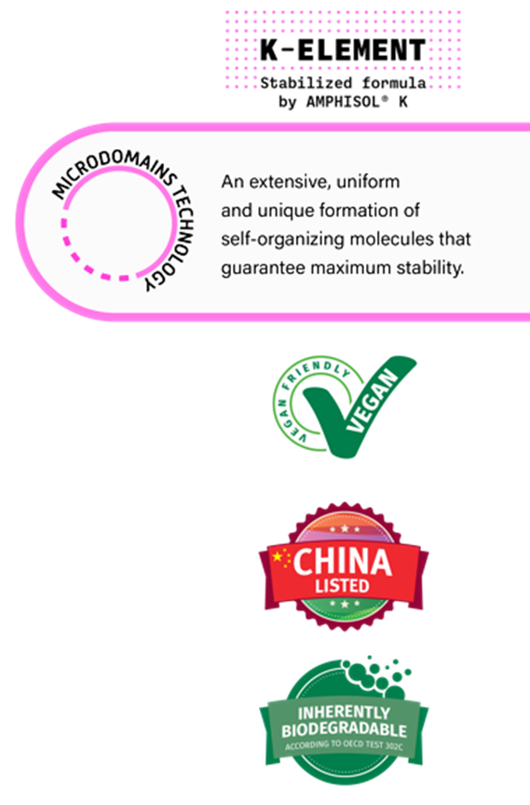


AMPHISOL® K
Ultimate stability for multi formulations.
An extensive, uniform and unique formation of self-organizing molecules that guarantee maximum stability.
A high performing Potassium Cetyl Phosphate (PCP) emulsifier for the most challenging formulations with higher proven performance vs main benchmarks.
A unique solution for the creation of innovative textures and applications which place you and your company in a leading position in an increasingly competitive market.
This is possible through the unique microdomains technology capable of stabilizing the most versatile combination of ingredients with high amounts of pigments, electrolytes, ethanol and oil from sunscreens to skin care and make-up.
AMPHISOL® K can also be used as a co-emulsifier to rescue and beautify your formulations, making processing easier.
AMPHISOL® K brings additional benefits to your products such as improved moisturization, SPF boosting and remarkable sensory signature.

Slide 3


AMPHISOL® K is 3x MORE likely to be recommended by formulators than its main competitors*
Low dosage and yet very effective, no residue on the skin
High flexibility to formulate various products
Low use level
fixes unstable formulations
It's the best
choice to use as a
second emulsifier
especially in sun
care formulations
It gives emulsion stability in
hopeless cases
Easy to work, low concentration and
good stability, and helps the viscosity too
* Source: Internal survey with current AMPHISOL® K users and formers – Total of 114 responses - Net Promoter Score comparison – NPS main competitors = 5
Notes:
Total of 114 responses (72 current/42 formers)

Slide 4

AMPHISOL® K ID card
A unique composition
INCI: | Potassium Cetyl Phosphate
Type: | Anionic O/W emulsifier
Appearance: | White to beige powder
Cetyl alcohol: | Max 2%
Potassium: | 7.0 – 12.0%
Theoretical HLB value: | 9.6
Unique performance driver: | Typical phosphate content up to almost 100 times lower than competition

Slide 5
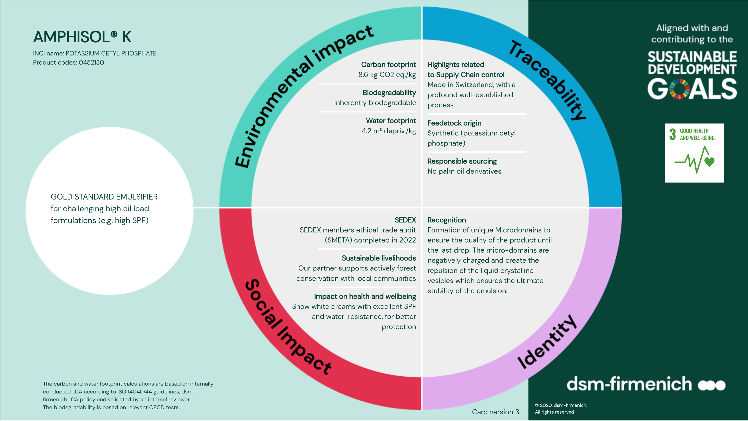

Slide 6
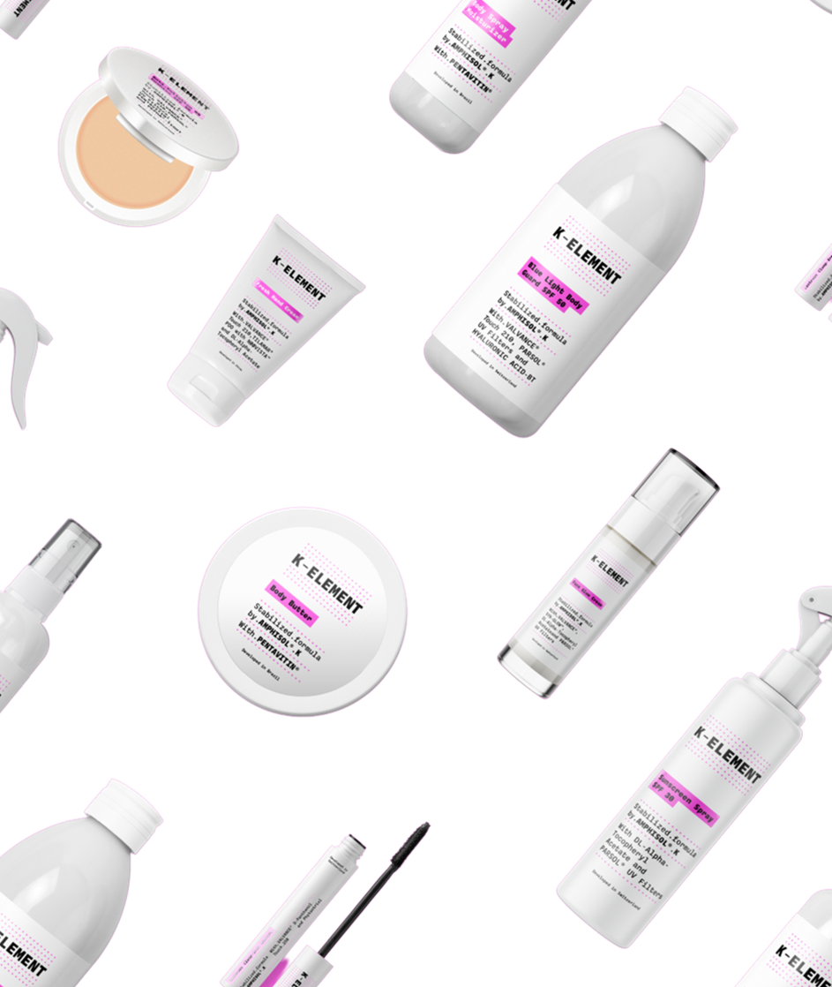








AMPHISOL® K
Ultimate stability for multi formulations
Multi textures and product types
Multi applications
Pump sprays
Dispensers
Bottles
Tubes
Jars
Skin
Sun
Make-up
Thanks to the unique microdomains technology capable of stabilizing the most challenging combination of ingredients
Products are for illustration only, not for sale.
dsm-firmenich is not responsible for final product claims.

Slide 7

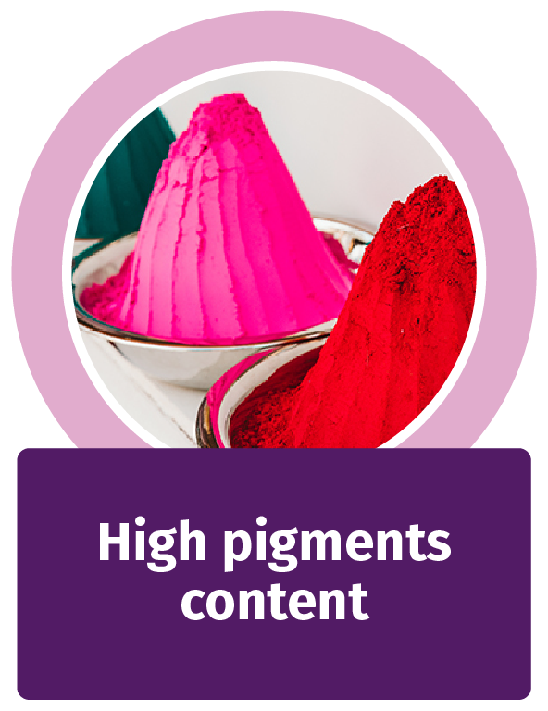


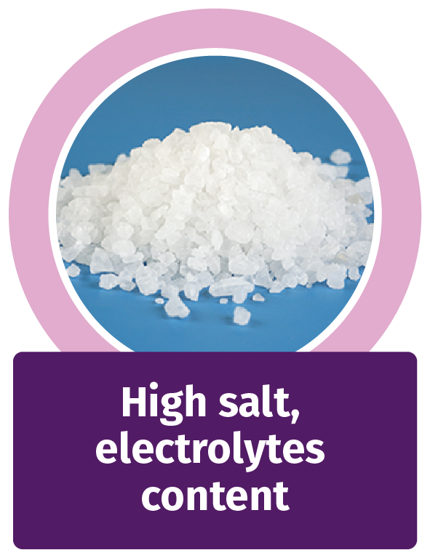
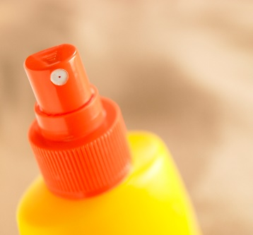

AMPHISOL® K overcomes each formulation challenge
Performance proof against:
Emulsifier competitors
PCP competitors
High oil
content
High salt,
electrolyte
content
High pigment
content
High ethanol
content
Spray
Spray

Slide 8







Rescue your formulation with just
0.5% AMPHISOL® K
Consumers’ expectation for multiple textures and multifunctional products​ brings a series of technical challenges, especially when it comes to stabilization.
How AMPHISOL® K works:
It reduces the emulsion droplets and optimize the particle size distribution.
Secure your brand image
Ensure even your most challenging formulations remain stable and maintain your consumers’ trust.
Its microdomains technology will lock the stability of the formulation.
Being used as a co-emulsifier makes processing easier (lower temperature of introduction 60–85°C).
Save your time & costs and secure every last drop of your unstable emulsion by adding 0.5% AMPHISOL® K to your emulsifying system.​
The formulation is creamier and shinier.

Slide 9
Disclaimer
Copyright © DSM Nutritional Products Ltd 2025, 4002 Basel, Switzerland.
www.dsm-firmenich.com. All rights reserved.
dsm-firmenich has used diligent care to ensure that the information provided herein is accurate and up-to-date to the best of its knowledge. However, dsm-firmenich makes no representation or warranty, either expressly or implied, of the accuracy, reliability, completeness, or suitability thereof. The information provided herein contains scientific and product information for business-to-business use and does not constitute or provide scientific or medical advice, diagnosis or recommendation for treatment options. Country or region-specific information should be considered when labelling or advertising to final consumer. In no event shall dsm-firmenich be liable for any direct or indirect damages arising from or reliance upon, or use of, any information provided herein. The content of this document is subject to change without further notice. Please contact your local dsm-firmenich representative for the latest information. All trademarks listed in this document are either (registered) trademarks of, or trademarks licensed by, the dsm-firmenich group of companies, unless explicitly stated otherwise.
Disclaimer Formulation Guideline
The information provided herein is provided for information purposes only and has been prepared by dsm-firmenich in accordance with its own methodology.
dsm-firmenich has used diligent care to ensure that it is accurate and up-to-date, however, dsm-firmenich makes no representation or warranty, either expressly or implied, of the accuracy, reliability, or completeness thereof. In no event shall dsm-firmenich be liable for any damages arising from or reliance upon, or use of, any information provided herein. Further, dsm-firmenich shall not bear any liability for the application and/or use of any processed material containing its product(s). The formulation of the finished product is the customer’s sole responsibility. It is the customer’s responsibility to determine the suitability of dsm-firmenich’s products regarding user specific purposes, assess compatibility and stability of their finished product(s) and to ensure compliance of their finished product(s) with relevant laws and regulations. Any product, marketing or other claims made by customer are its sole responsibility. The content of this document is subject to change without further notice. Please contact your local dsm-firmenich representative for further details. © DSM Nutritional Products AG, 2025.

