Slide 1
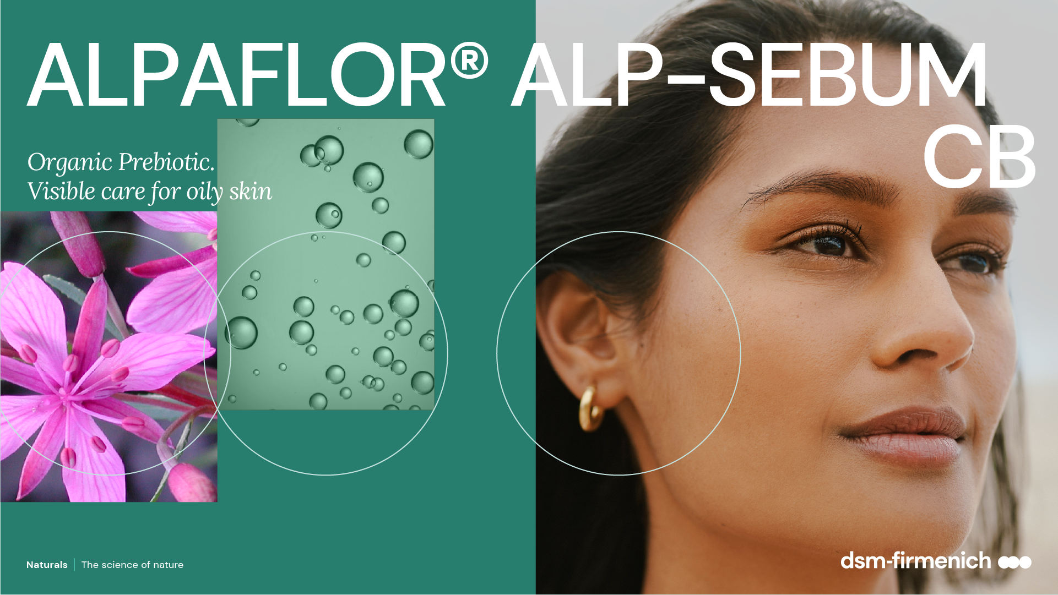
April 2025

Slide 2
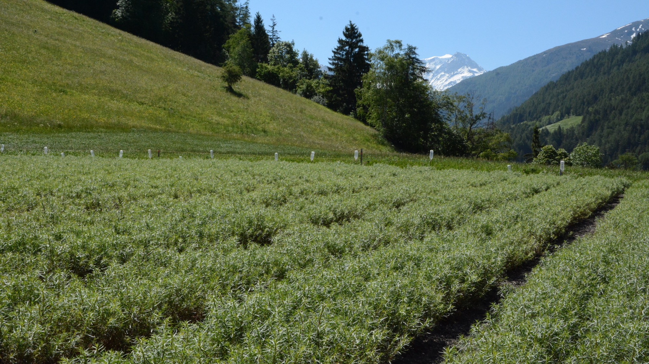
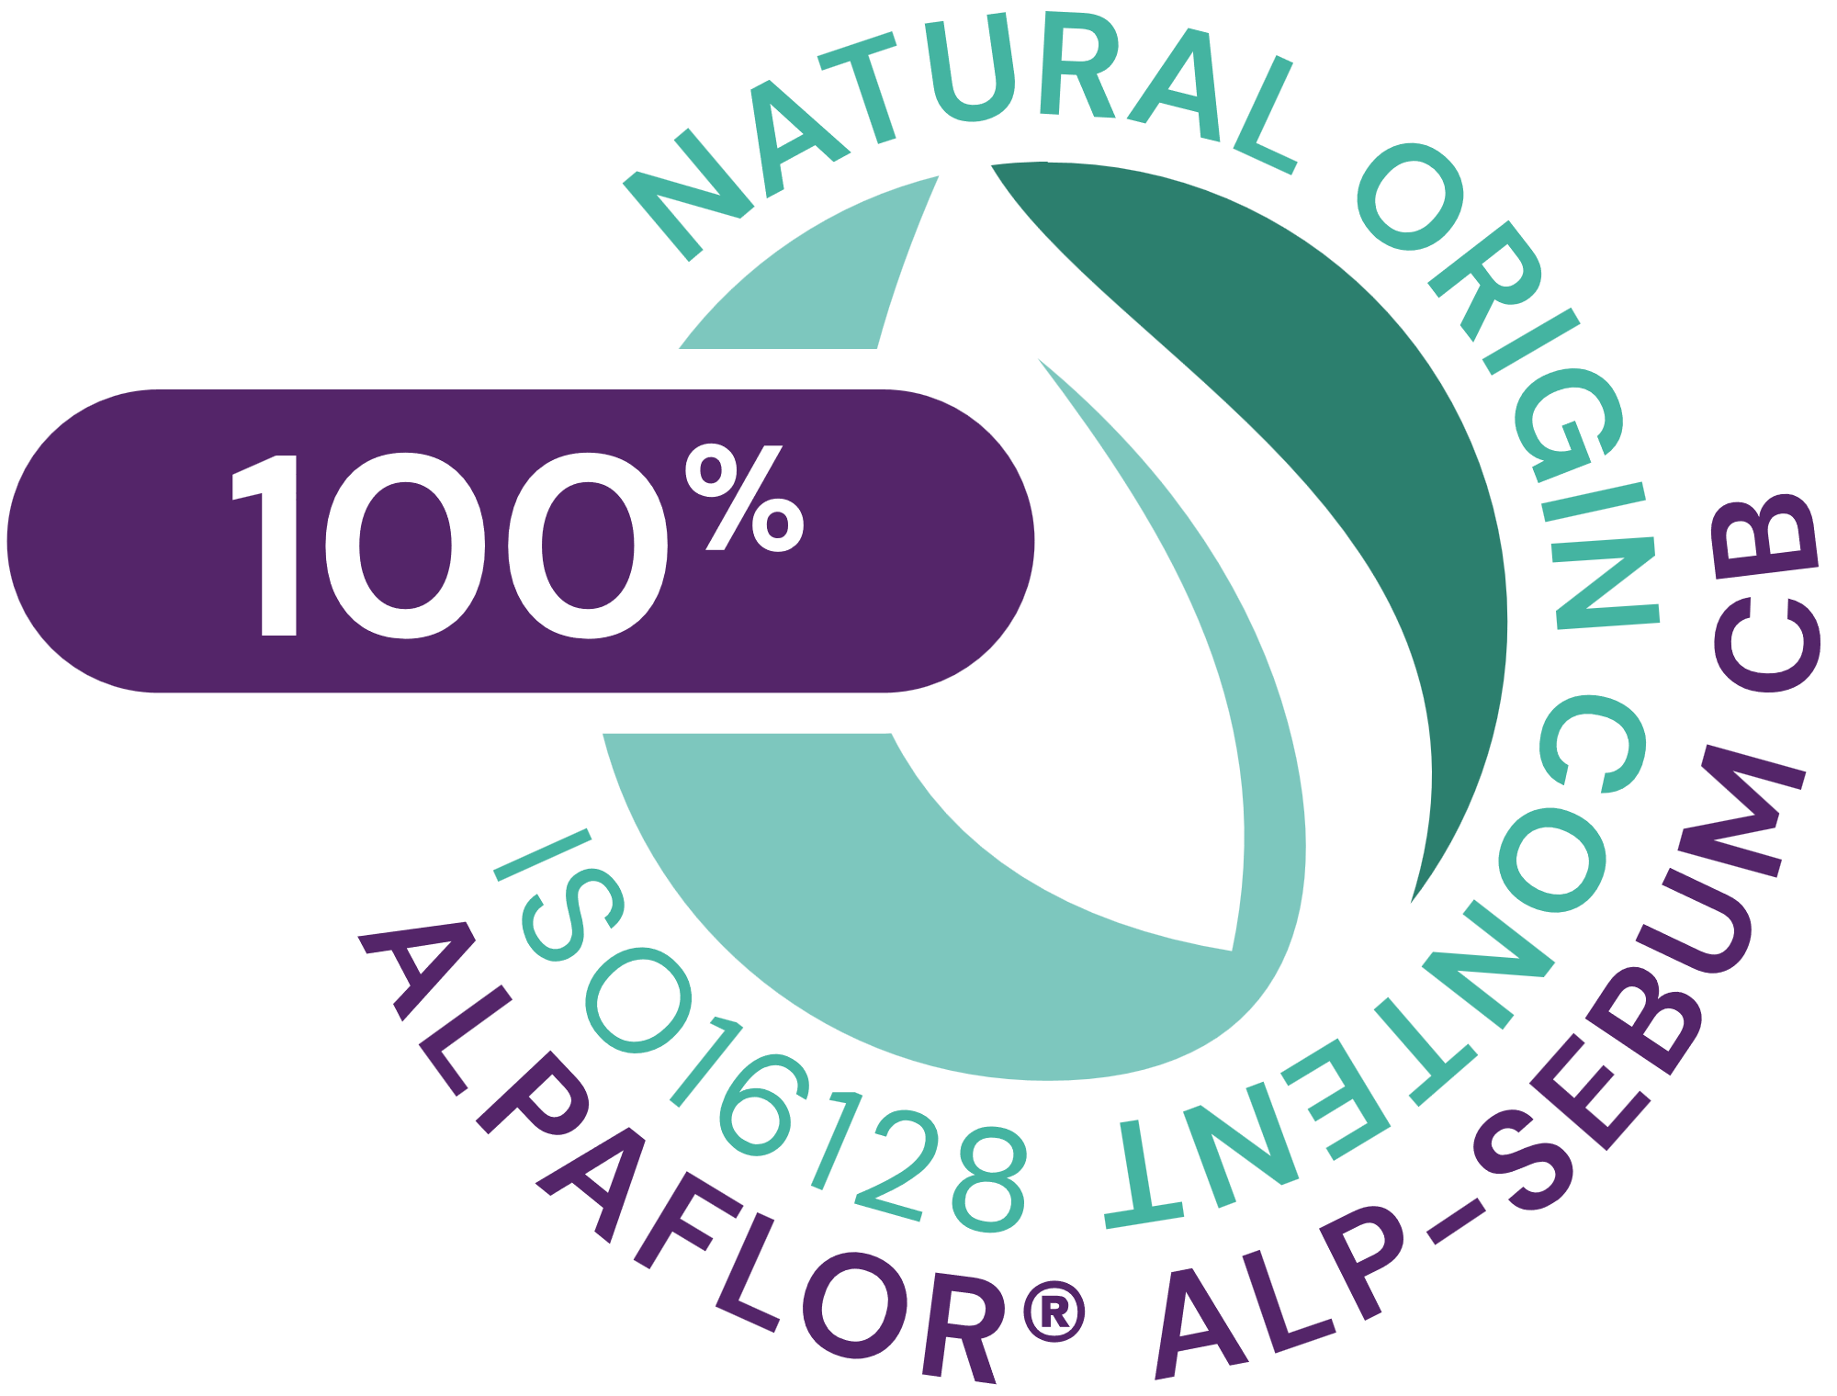







ALPAFLOR® ALP-SEBUM CB
ID card
5037861
INCI NAME:
Epilobium Fleischeri Flower/Leaf/Stem Extract (and glycerin, water, citric acid)
SUSTAINABILITY:
Organic cultivation, ethical and traceable sourcing, supporting alpine biodiversity with low impact on the environment
TECHNOLOGY:
Gentle ethanolic extraction of alpine willowherb plant (early blooming stage) following green chemistry principles
Standardization in oenotheins (as gallic acid)
100% of natural origin according to ISO16128– no preservative
TECHNICAL:
pH of use: 3.5- 5.5 Form: Liquid
Use level: 1–3%
Preservative: Free
Solubility: Water
Biodegradable: main components readily biodegradable
BENEFITS:
Delivers sustainable visible mattified skin with less sebum**
Reduces spots, leads to a visible clearer and cleaner skin, for blemish care, rebalance the microbiome**
Restores the skin’s healthy appearance**
Helps sooth the skin *
REGISTRATION
CERTIFICATION
* in vitro ** in vivo

Slide 3

Our solution:
ALPAFLOR® ALP-SEBUM CB
Unique Product Features
Outstanding facial colour mapping showing a Sebum production decrease in all facial areas, with a strong focus on forehead and cheek, after 4 weeks
Microbiome balancing activities, downregulating troublesome bacteria such as Staphylococcus capitis and stimulating beneficial skin bacteria like Staphylococcus epidermidis and Micrococcus yunnanensis
Inhibition of 5-α-reductase is the most efficient way to decrease
sebum production (-56% after 2 months in vivo study)
Strong inhibition of pro-inflammatory markers such as Interleukin 8
Unique rare glacier willowherb species, Epilobium fleischeri, sustainably, fairly and organically cultivated
Benefits
Delivers sustainable visible mattified skin with less oil and sebum
Organic prebiotic bioactive (against oily skin, enlarged pores, sensitive skin and
acne-prone skin)
Restores the skin’s healthy appearance
Soothes the skin
Reduces spots, leads to visibly clearer
and cleaner skin, for blemish care
Helps to solve Maskne issue while
wearing mask
Cosmetic Application
Products that target oily, shiny skin
Skin care products for young skin
Blemish care
Colour cosmetic with mattifying biological effect

Slide 4
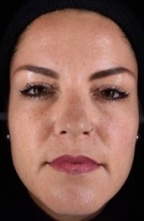
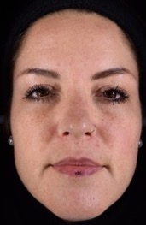
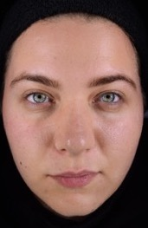
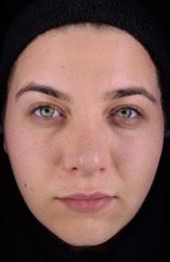

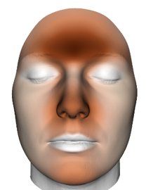
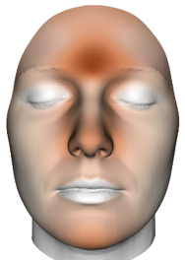

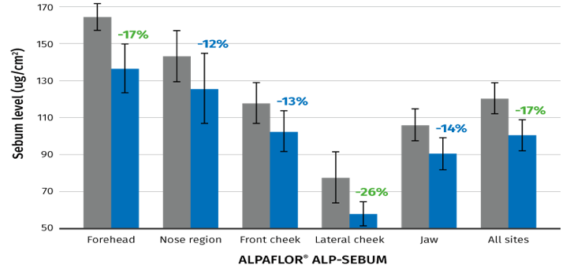
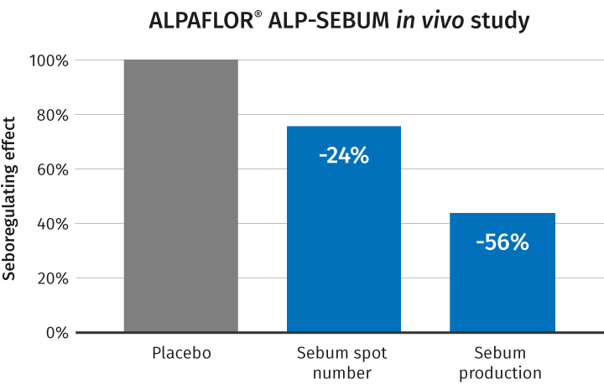
ALPAFLOR® ALP-SEBUM CB innovative sebum mapping
Impressive and significant reduction of sebum on all facial areas by 17%, especially on forehead and cheek after 4 weeks in vivo
Clear and visible mattifying effect with pores reduction after 4 weeks in vivo after 4 weeks at 3%
3D facial color sebum mapping with 3% ALPAFLOR® ALP-SEBUM CB
Volunteer #2
Volunteer #24
56% decrease in sebum production after 2 months, and 18% of volunteers noticed a pore size reduction demonstrated by a clinical scoring
Sebum content (µg/cm²)
T0
T4 weeks

Slide 5
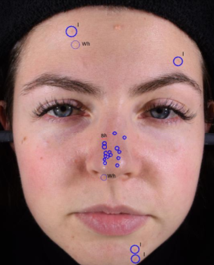
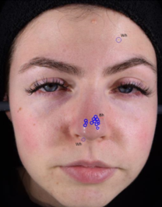
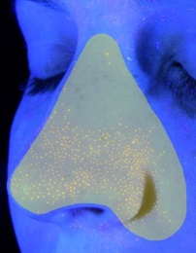
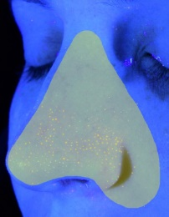
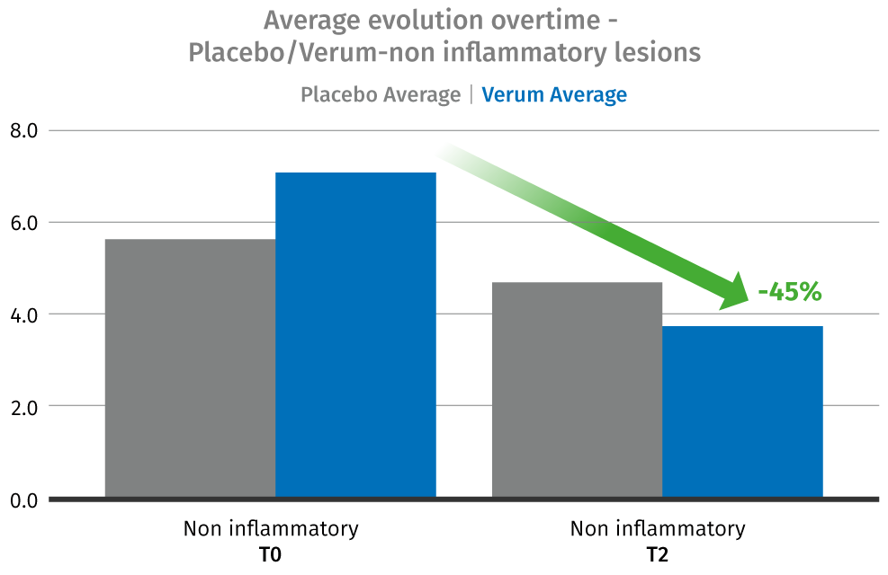
ALPAFLOR® ALP-SEBUM CB
Oily skin imperfections activity – in vivo
T0
T1
T0
T1
Porphyrins: % Orange fluorescence
Volunteer #6
-65%
Volunteer #30
Black and whiteheads*
Porphyrins, bio-markers of acne**
Sebum spots & pore size reduction***
ALPAFLOR® ALP-SEBUM CB reduces strongly number of black and whiteheads.
Strong decrease (45%) of number of black and whiteheads through the assessment of non-inflammatory lesions (black and white heads) by grading software under medical control after 1 month
ALPAFLOR® ALP-SEBUM CB reduces pro-inflammatory acne bio-markers.
Reduction by 65% of porphyrins after 1 month. Porphyrins are a specific marker for Cutibacterium acnes type I (acne associated strains with high pro-inflammatory potential) and mostly associated with sebaceous glands «skin pores»
ALPAFLOR® ALP-SEBUM CB reduces sebum production and associated imperfections (pore size, sebum spots).
Reduces by 56% sebum production and by 24% spots number. 18% of volunteers noticed a pore size reduction demonstrated by a clinical scoring after 2 months
* p<0.01 (paired t test)
*In vivo, 23 Female Caucasian volunteers (average age: 33.7 ± 9.8), 3% ALPAFLOR® ALP-SEBUM CB 28 days study
** In vivo, selection of 5 subjects with a minimum threshold of orange fluorescence from in vivo study*
*** In vivo, 21 Female Caucasian volunteers (aged 18-40 with greasy skin ), 3% ALPAFLOR® ALP-SEBUM CB 56 days study
Notes:
1/black and whiteheads
Volunteer #30 (23 years old) Reduction from 17 non inflammatory lesions to 12 after 4 weeks
5 subjects with a minimum threshold of orange fluorescence were selected
Coproporphyrin III produced by Cutibacterium acnes
2/ Porphyrin
5 subjects with a minimum threshold of orange fluorescence were selected Coproporphyrin III produced by Cutibacterium acnes
Volunteer 6 (27 yo) Mir Ha, left profile, with ROI and segmented porphyrins at D0 and D28
Facial images under UV light acquisition showing porphyrins as orange fluorescence on the most prominent porphyrin fluorescence site: the nose-wings
The specific pathogenic Cutibacterium acnes type I strain produce large amount of porphyrins and are the acne associated strains with high pro-inflammatory potential (much more than non-pathogenic strain II and III of C. acnes)
3/Pore size
Pore size:
Clinical Scoring (visual evaluation) by a dermatologist demonstrated a reduction of the pore size in 18% of the volunteers and the non-comedogenic activity of ALPAFLOR® ALP-SEBUM CB.
No pore size reduction was found with the placebo.
seboregulating effect of ALPAFLOR® ALP®- SEBUM was evaluated by measuring the reduction of the sebum spot number and of the sebum production by means of a Sebutape®.
A reduction of 24% in spot number and a decrease of 56% in sebum production were shown after 56 days of treatment.
Additionally, a clinical scoring by a dermatologist demonstrated a reduction of the pore size in 18% of the volunteers with the ALP-SEBUM cream, whereas no pore size reduction was found with the placebo.

Slide 6
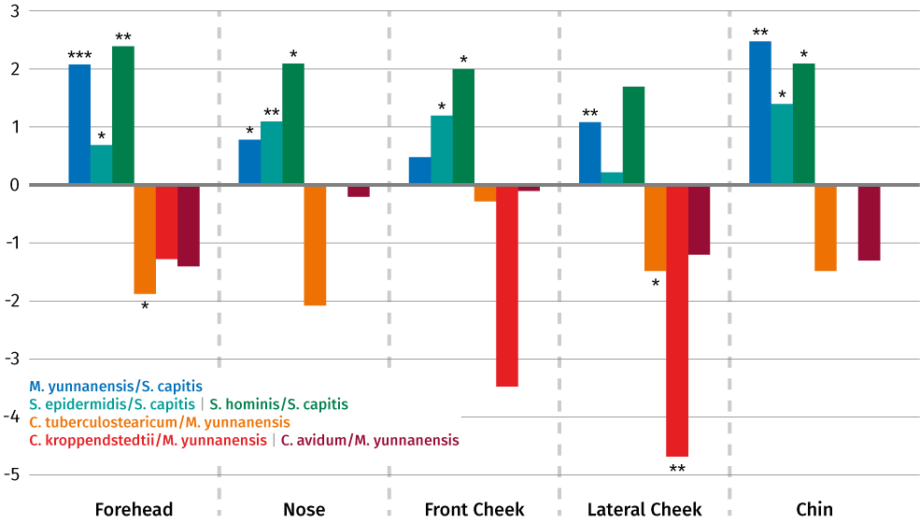
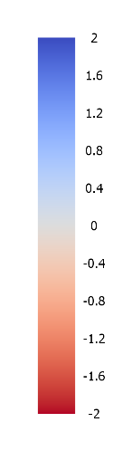
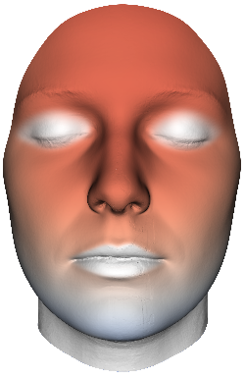
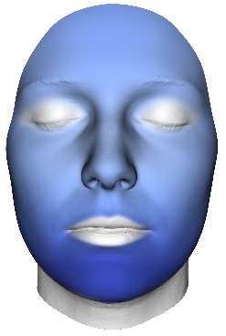
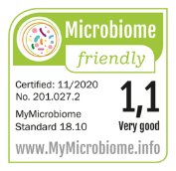
ALPAFLOR® ALP-SEBUM CB
Prebiotic & microbiome friendly activity – in vivo
Prebiotic activity*
Rebalanced facial microbiome*
Facial color microbiome mapping*
ALPAFLOR® ALP-SEBUM CB acts as prebiotic modulating key bacteria for healthy looking skin.
The overall skin condition is improved by strong modulating effect on key bacteria on all facial sites providing a balanced facial microbiome
ALPAFLOR® ALP-SEBUM CB significantly downregulates troublesome bacteria (S. capitis, C. tuberculostearicum and C. kroppenstedtii) reducing the risk of enlarged pores, skin inflammation, irritation and redness.
ALPAFLOR® ALP-SEBUM CB significantly upregulates the beneficial bacteria (S. epidermidis, S. hominis and M. yunnanensis) promoting the microbial skin self-defense.
C. acnes is not affected by ALPAFLOR® ALP-SEBUM CB. The majority of C. acnes strains are non-pathogenic and an essential part of the facial microbiome, they help to block pathogens. Only few strains are pathogens and associated with acne
Placebo
Verum
Log scale verum vs placebo
* p<0.05
** p<0.01
*** p<0.001
Facial mapping to visualize positive change from placebo (reddish color) to verum (bluish) when comparing S. epidermidis/S. capitis ratio which increased after 4 weeks treatment
Microbiome friendly
ALPAFLOR® ALP-SEBUM CB doesn’t affect the microbiome diversity and is microbiome friendly certified.
*In vivo: 3% ALPAFLOR® ALP-SEBUM CB vs placebo after 4 weeks on each facial area
Notes:
S. capitis and M. yunnanensis were chosen as denominator on the ratio to check to which extent the other bacteria are modulated
.Capitis was chosen as reference frame as it ranked very low and far from the other bacteria of interest in our differential ranking graph (example reported in slide 27).
Capitis and yunnanensis have very low and high rank respectively meaning that they are the ones that are increasing/decreasing the most relative to each other.
ALPAFLOR® ALP-SEBUM CB after 4 weeks doesn’t affect the microbiome diversity as the Shannon index doesn’t change significantly at any facial site.

Slide 7
Disclaimer
Copyright © DSM Nutritional Products Ltd 2025, 4002 Basel, Switzerland.
www.dsm-firmenich.com. All rights reserved.
dsm-firmenich has used diligent care to ensure that the information provided herein is accurate and up-to-date to the best of its knowledge. However, dsm-firmenich makes no representation or warranty, either expressly or implied, of the accuracy, reliability, completeness, or suitability thereof. The information provided herein contains scientific and product information for business-to-business use and does not constitute or provide scientific or medical advice, diagnosis or recommendation for treatment options. Country or region-specific information should be considered when labelling or advertising to final consumer. In no event shall dsm-firmenich be liable for any direct or indirect damages arising from or reliance upon, or use of, any information provided herein. The content of this document is subject to change without further notice. Please contact your local dsm-firmenich representative for the latest information. All trademarks listed in this document are either (registered) trademarks of, or trademarks licensed by, the dsm-firmenich group of companies, unless explicitly stated otherwise.
Disclaimer Formulation Guideline
The information provided herein is provided for information purposes only and has been prepared by dsm-firmenich in accordance with its own methodology.
dsm-firmenich has used diligent care to ensure that it is accurate and up-to-date, however, dsm-firmenich makes no representation or warranty, either expressly or implied, of the accuracy, reliability, or completeness thereof. In no event shall dsm-firmenich be liable for any damages arising from or reliance upon, or use of, any information provided herein. Further, dsm-firmenich shall not bear any liability for the application and/or use of any processed material containing its product(s). The formulation of the finished product is the customer’s sole responsibility. It is the customer’s responsibility to determine the suitability of dsm-firmenich’s products regarding user specific purposes, assess compatibility and stability of their finished product(s) and to ensure compliance of their finished product(s) with relevant laws and regulations. Any product, marketing or other claims made by customer are its sole responsibility. The content of this document is subject to change without further notice. Please contact your local dsm-firmenich representative for further details. © DSM Nutritional Products AG, 2025.

