Slide 1


ALPAFLOR®
ALP-SEBUM
Organic Prebiotic
Visible care for oily skin
Line up
November 2020

Slide 2


From the purest air and water in the Swiss Alps, Epilobium fleischeri blossom; a delicate flower organically, sustainably and ethically cultivated. A rare combination of elements that give rises to a natural ingredient capable of rebalancing oily skin’s microbiome for a beautiful and healthy appearance.
With four products that complete your skin care routine, the Balanseen line works to visibly reduce excess of sebum, irritations and spots, bringing about a look of smooth and matte skin

Slide 3
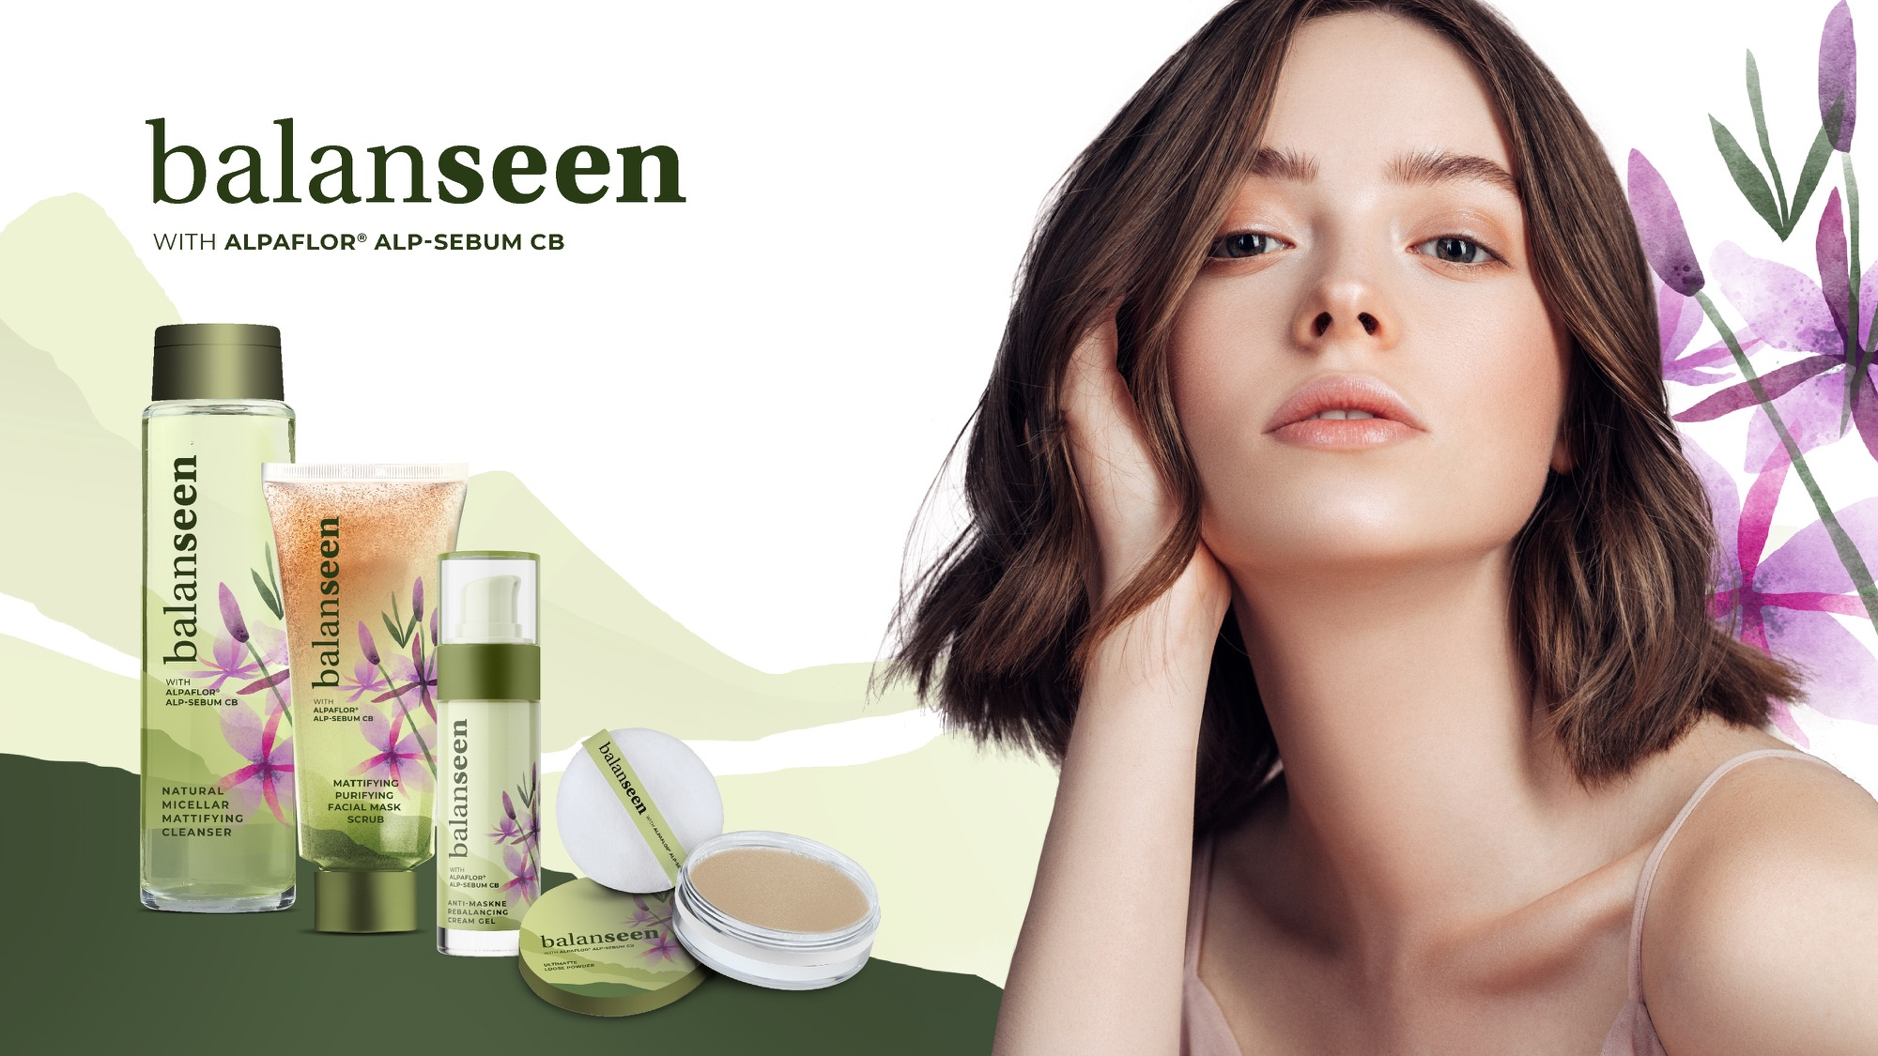

Slide 4
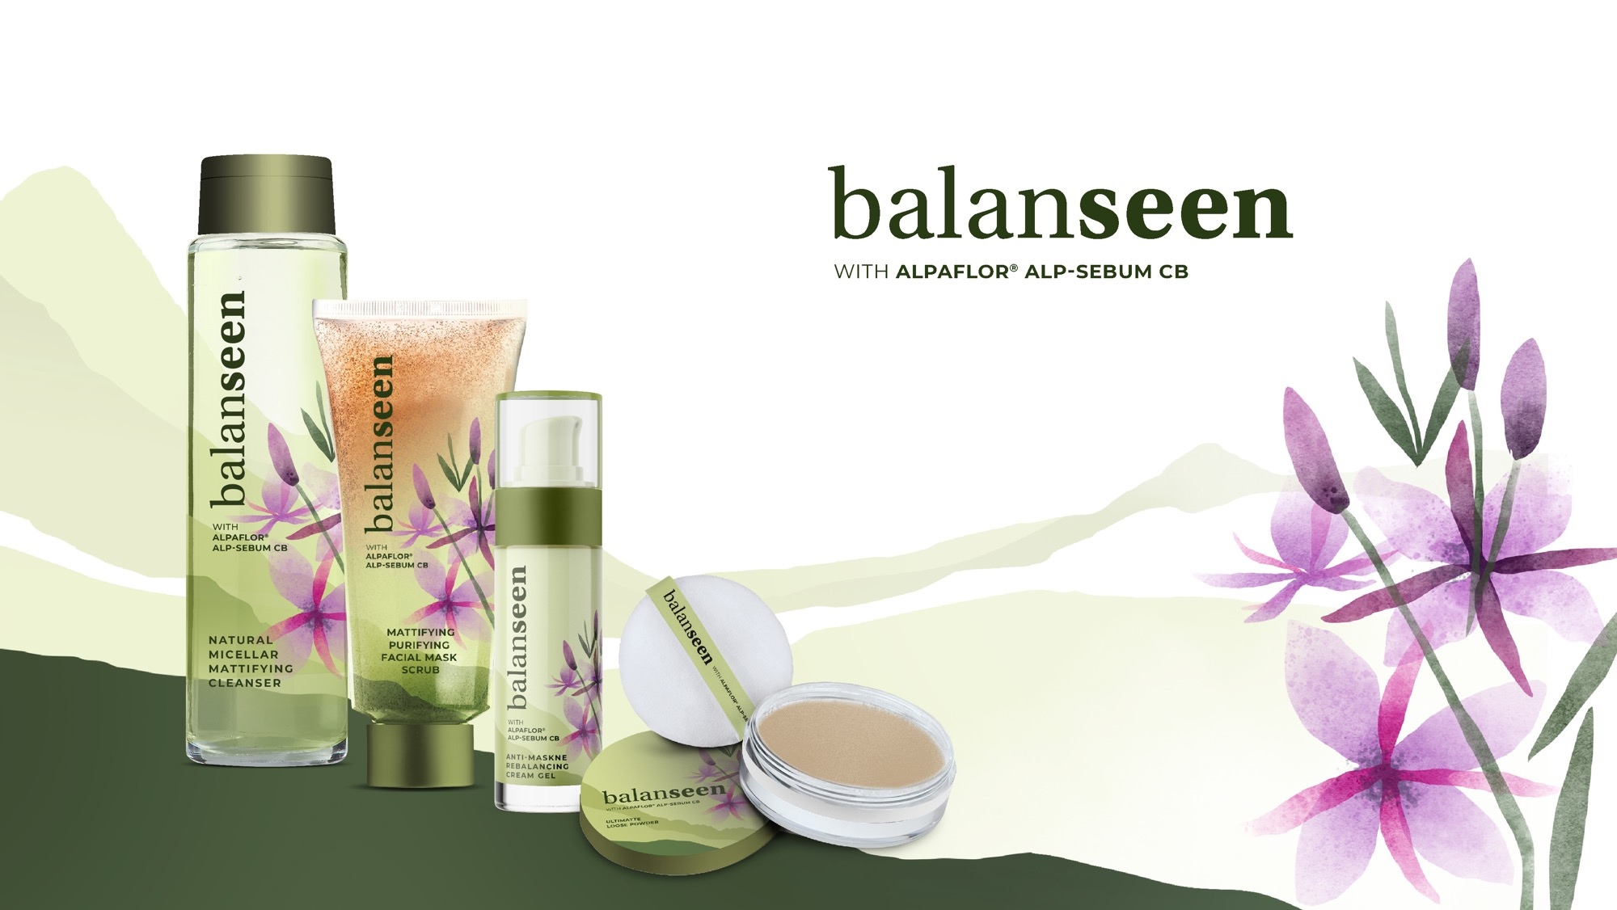

Purifying and Mattiﬁed: this beauty routine reduces shine, rebalances the facial microbiome and puriﬁes the skin. The skin is perfectly clean, the pores are less visible, leaving a mattiﬁed even skin complexion. Ideally built to combat acne prone-skin and to soothe the skin especially while wearing mask.
The natural formulation made with more than 99% naturally derived ingredients is compliant with Cosmos Natural standards.

Slide 5
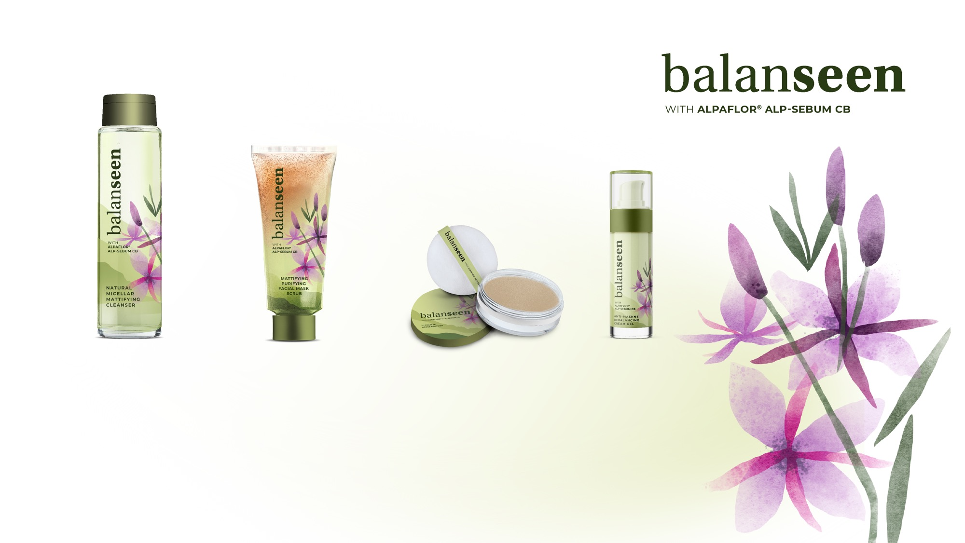
Natural formulations made with more than 99% naturally derived ingredients
Natural Miscellar
mattifying Cleanser
Mattifying Purifying
facial scrub mask
UltiMatte
Loose Powder
Anti-Maskne
Rebalancing Cream Gel
This micellar water gently cleanses, effectively removes make-up and other impurities while regulating the excess of sebum. The skin is purified allowing the skin to breathe, leaving the skin perfectly clean with a matte finish.
This facial mask scrub, delivers
an immediate physical mattifying and purifying effect with the clay, VALVANCE® Touch 210 with a
long-lasting mattifying, calming biological effect with ALPAFLOR® ALP-SEBUM CB., improving appearance of the skin.
This loose powder with ALPAFLOR® ALP-SEBUM CB and VALVANCE® Touch 210, is ideal to combat shiny skin, absorbing excess oil. It provides a dry, silky veil with the perfect even matte and flawless finish.
Mask friendly powder.
This cream gel counteracts the problem of impure, oily, acne-prone skin. Our formula contains ARGAN OIL to soften the skin and ALPAFLOR® ALP-SEBUM CB and VALVANCE® Touch 210, to normalize the production of sebum and rebalance the facial microbiome. This product is ideal to prevent Maskne.

Slide 6
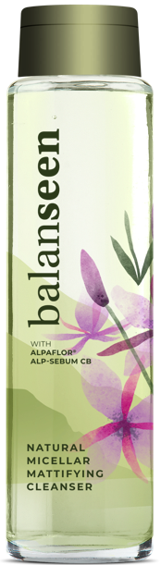
Natural Micellar Mattifying Cleanser
With ALPAFLOR® ALP-SEBUM CB
 | INGREDIENTS | INCI NAME | % W/W
A | Water Dem | AQUA | 93,03
 | Cosphaderm Pentiol natural | PENTYLENE GLYCOL | 3,00
 | SODIUM GLUCONATE GRANULAR | SODIUM GLUCONATE | 0,10
 | Dermosoft 700 B | LEVULINIC ACID, SODIUM LEVULINATE, GLYCERIN, AQUA | 1,00
 | PUROX S | SODIUM BENZOATE | 0,25
 | ALPAFLOR® ALP-SEBUM CB | GLYCERIN, AQUA, EPILOBIUM FLEISCHERI FLOWER / LEAF / STEM EXTRACT, CITRIC ACID | 0,50
B | Oramix CG 110 | CAPRYLYL/CAPRYL GLUCOSIDE | 1,50
 | Perfume | PARFUM | 0,10
C | Sodium Hydroxide 10% Solution | SODIUM HYDROXIDE, AQUA | 0,52
This micellar water gently cleanses, effectively removes make-up and other impurities while regulating the excess of sebum. The skin is purified allowing the skin to breathe, leaving the skin perfectly clean with a matte finish.
The natural formulation, made with very few and more than 99% naturally derived ingredients, compliant with Cosmos Natural standards.
Use this Natural Micellar Mattifying Cleanser in the morning before applying your day care products, and in the evening to remove them with dirt and oil that has accumulated during the day. There is no need to rinse it.
Add each ingredient of phase A and stir until a solution is obtained
Premix phase B and add it to phase A under stirring
Adjust the pH to 5.0 with phase C
SK-E-101659-5

Slide 7
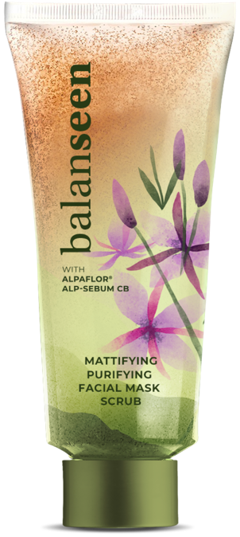
Mattifying Purifying Facial Mask Scrub
With ALPAFLOR® ALP-SEBUM CB and VALVANCE® Touch 210
 | INGREDIENTS | INCI NAME | % W/W
A | Water Dem | AQUA | 54,65
 | PUROX S | SODIUM BENZOATE | 0,25
 | SODIUM GLUCONATE GRANULAR | SODIUM GLUCONATE | 0,20
 | Dermosoft® GMCY MB | GLYCERYL CAPRYLATE | 0,30
 | Glycerine CremerGLYC 86.5% | GLYCERIN | 3,00
 | Cosphaderm Pentiol natural | PENTYLENE GLYCOL | 3,00
 | AMIGUM | SCLEROTIUM GUM | 1,50
B | Oramix NS 10 | DECYL GLUCOSIDE | 1,00
 | Amisoft CS-22 | SODIUM COCOYL GLUTAMATE, DISODIUM COCOYL GLUTAMATE, AQUA | 2,00
C | Cutina FS 45 | STEARIC ACID, PALMITIC ACID | 8,00
 | Lanette 16 | CETYL ALCOHOL | 1,00
D | VALVANCE® Touch 210 | SILICA | 3,00
 | Unipure White LC 981 | CI 77891 | 2,00
E | Perfume | PARFUM | 0,10
 | ALPAFLOR® ALP-SEBUM CB | GLYCERIN, AQUA, EPILOBIUM FLEISCHERI FLOWER / LEAF / STEM EXTRACT, CITRIC ACID | 3,00
F | Argan BioEXFOLIATOR 500 | ARGANIA SPINOSA SHELL POWDER | 2,00
 | Beige Montmorillonite Clay | MONTMORILLONITE | 15,00
This facial mask scrub, delivers an immediate physical mattifying and purifying effect with the clay, VALVANCE® Touch 210 and argan shell, with a long-lasting mattifying, calming biological effect with ALPAFLOR® ALP-SEBUM CB. It gently polishes and removes dead skin, clogged pores, draws out impurities from deeper within pores, absorbs greasy residue, improving appearance of the skin.
The natural formulation, made with more than 99% naturally derived ingredients, compliant with Cosmos Natural standards.
Apply and rub slowly this mask on face, let it dry for 5 min, and rinse-off with water.
SK-E-101648-18
Premix phase A, adding ingredients one by one into water. Stir with dispersing stirrer at 2000 rpm until a homogenous thick gel is obtained
Add ingredients of phase B one by one and heat up to 75-80°C
Heat phase C up to 75-80°C and add it to AB at 75-80°C. Stir until it’s homogenous
Add ingredients of phase D. Cool down to room temperature under stirring
Below 40°C, add ingredients of phase E. Change the stirrer for an Anchor one
Add ingredients of phase F and stir until it’s homogenous

Slide 8
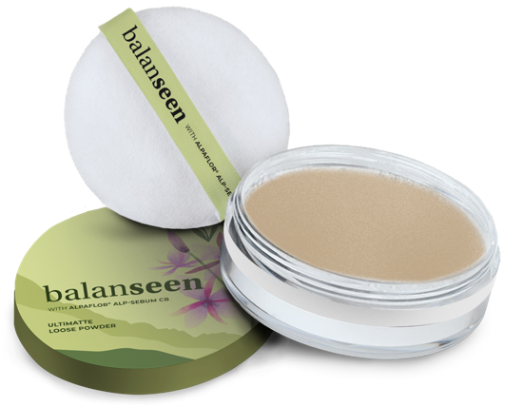
UltiMatte Loose Powder
With ALPAFLOR® ALP-SEBUM CB and VALVANCE® Touch 210
 | INGREDIENTS | INCI NAME | % W/W
A | Red Montmorillonite Clay | MONTMORILLONITE | 6,00
 | VALVANCE® Touch 210 | SILICA | 82,00
 | Amidon de mais MST | ZEA MAYS STARCH | 8,30
B | ALPAFLOR® ALP-SEBUM CB | GLYCERIN, AQUA, EPILOBIUM FLEISCHERI FLOWER / LEAF / STEM EXTRACT, CITRIC ACID | 3,00
 | Perfume | PARFUM | 0,70
This loose powder with ALPAFLOR® ALP-SEBUM CB and VALVANCE® Touch 210, is ideal to combat shiny skin, absorbing excess oil, blurs the appearance of pores and other skin imperfections. It provides a dry, silky veil with the perfect even matte and flawless finish.
Mask friendly make-up: this powder applied on top of foundation or BB cream fixes your make-up
avoiding any product
transfer to the mask.
The natural
formulation made with
very few and more
than 99% naturally
derived ingredients
is compliant with
Cosmos Natural
standards.
Premix the powders with a dispersing stirrer and stir until it’s homogenous.
Add ingredients of phase B and stir until it's homogenous and dry.
SK-E-101660-2

Slide 9
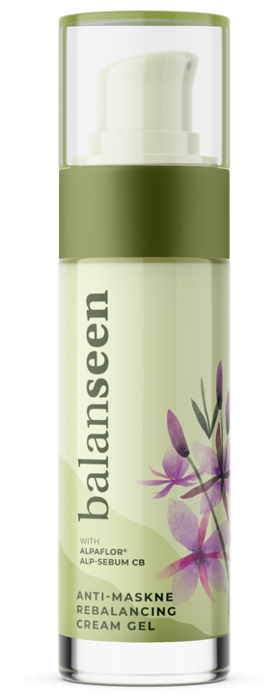
Antimaskne Rebalancing Cream Gel
With ALPAFLOR® ALP-SEBUM CB and Argan Oil
 | INGREDIENTS | INCI NAME | % W/W
A | Water Dem | AQUA | 77,48
 | CremerGlyc Refined Glycerine Organic | GLYCERIN | 3,00
 | Cosphaderm Pentiol natural | PENTYLENE GLYCOL | 3,00
 | SODIUM GLUCONATE GRANULAR | SODIUM GLUCONATE | 0,20
 | VANATURAL | BENTONITE | 1,00
 | Ecogel | LYSOLECITHIN, SCLEROTIUM GUM, PULLULAN, XANTHAN GUM | 2,00
B | ARGAN OIL | ARGANIA SPINOSA KERNEL OIL | 2,00
 | Cetiol C5 | COCO-CAPRYLATE | 3,00
 | Imwitor 372 P | GLYCERYL STEARATE CITRATE | 0,20
C | VALVANCE® Touch 210 | SILICA | 2,00
 | VALVANCE® Look 100 | SILICA, TITANIUM DIOXIDE | 1,00
D | Dermosoft 700 B | LEVULINIC ACID, SODIUM LEVULINATE, GLYCERIN, AQUA | 1,00
 | ALPAFLOR® ALP-SEBUM CB | GLYCERIN, AQUA, EPILOBIUM FLEISCHERI FLOWER / LEAF / STEM EXTRACT, CITRIC ACID | 3,00
 | Perfume | PARFUM | 0,10
E | Sodium Hydroxide 10% Solution | SODIUM HYDROXIDE, AQUA | 1,02
This cream gel counteracts the problem of impure, oily, acne-prone skin, restoring the skin’s balance.
Our formula contains ARGAN OIL to soften the skin and ALPAFLOR® ALP-SEBUM CB and VALVANCE® Touch 210, to purify the skin, normalize the production of sebum and rebalance the facial microbiome. The appearance of the imperfection is reduced, the pores are less visible, with a mattified, even skin complexion.
This product is ideal to prevent Maskne, which occurs when the combination of sweat, skin oils and bacteria are trapped on the skin and can clog the pores, while wearing a mask. The cream gel provides a fresh, purified skin feeling, and can be applied in the morning and all day around when wearing mask.
The natural formulation made with more than 99% naturally derived ingredients is compliant with Cosmos Natural standards.
Suspend Vanatural in the glycols, heat up under stirring to 75°C and hold the temp for 15 min, then add the rest of the water phase and keep the mixture at 75°C under stirring for 30 min.
Premix phase B and add it to phase A, then carefully add phase C and homogenize shortly by stirring with an anchor. Then homogenize with the Ultra Turrax for 3 min at 15000 rpm.
Let cool down under stirring to room temperature.
Below 40°C, add ingredients of phase D under stirring.
Adjust the pH around 5.50 with phase E.
SK-E-101662-11

Slide 10
DISCLAIMER
Copyright © 2020 DSM Nutritional Products, 4002 Basel, Switzerland.
www.dsm.com/personal-care. All rights reserved.
Although DSM has used diligent care to ensure that the information provided herein is accurate and up to date, DSM makes no representation or warranty of the accuracy, reliability, or completeness of the information. This presentation only contains scientific and technical information for business to business use. Country- or region-specific information should also be considered when labeling or advertising to final consumers. This publication does not constitute or provide scientific or medical advice, diagnosis, or treatment and is distributed without warranty of any kind, either expressly or implied. In no event shall DSM be liable for any damages arising from the reader’s reliance upon, or use of, these materials. The reader shall be solely responsible for any interpretation or use of the material contained herein. The content of this document is subject to change without further notice. Please contact your local DSM representative for more details. All trademarks listed in this brochure are either registered trademarks or trademarks of DSM in The Netherlands and/or other countries unless explicitly otherwise stated.
DISCLAIMER FORMULATION GUIDELINES
This information is for illustration purposes only and based upon our current knowledge and experience at the time of printing. We do not make any representation or warranty of any kind, express or implied, including merchantability or fitness for a particular use, with respect to such information or its application. Use of this information is at your discretion and risk. Nothing herein relieves you from carrying out your own suitability determinations and tests. You are responsible for observing all laws and regulations relevant to your products, uses or processes. We do not assume any liability in connection with your product and its use. The foregoing information and suggestions are also provided without warranty of non-infringement as to the intellectual property rights of third parties, and shall not be construed as any inducement to infringe the rights of third parties.

