Slide 1
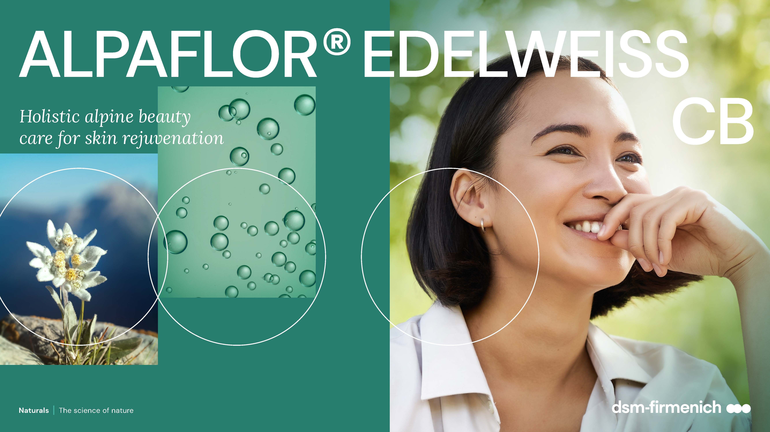
April 2025
April 2025

Slide 2
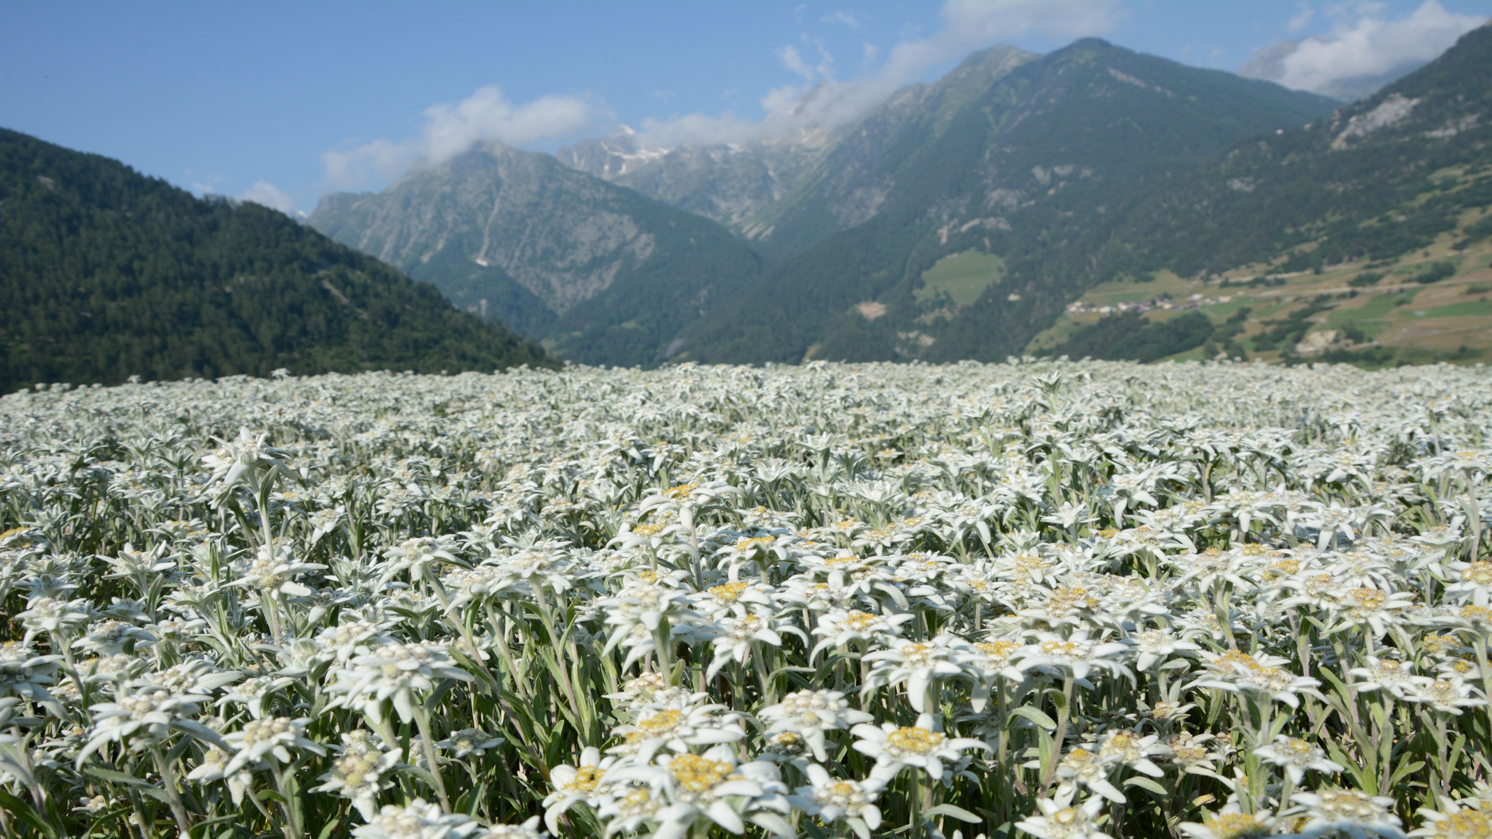
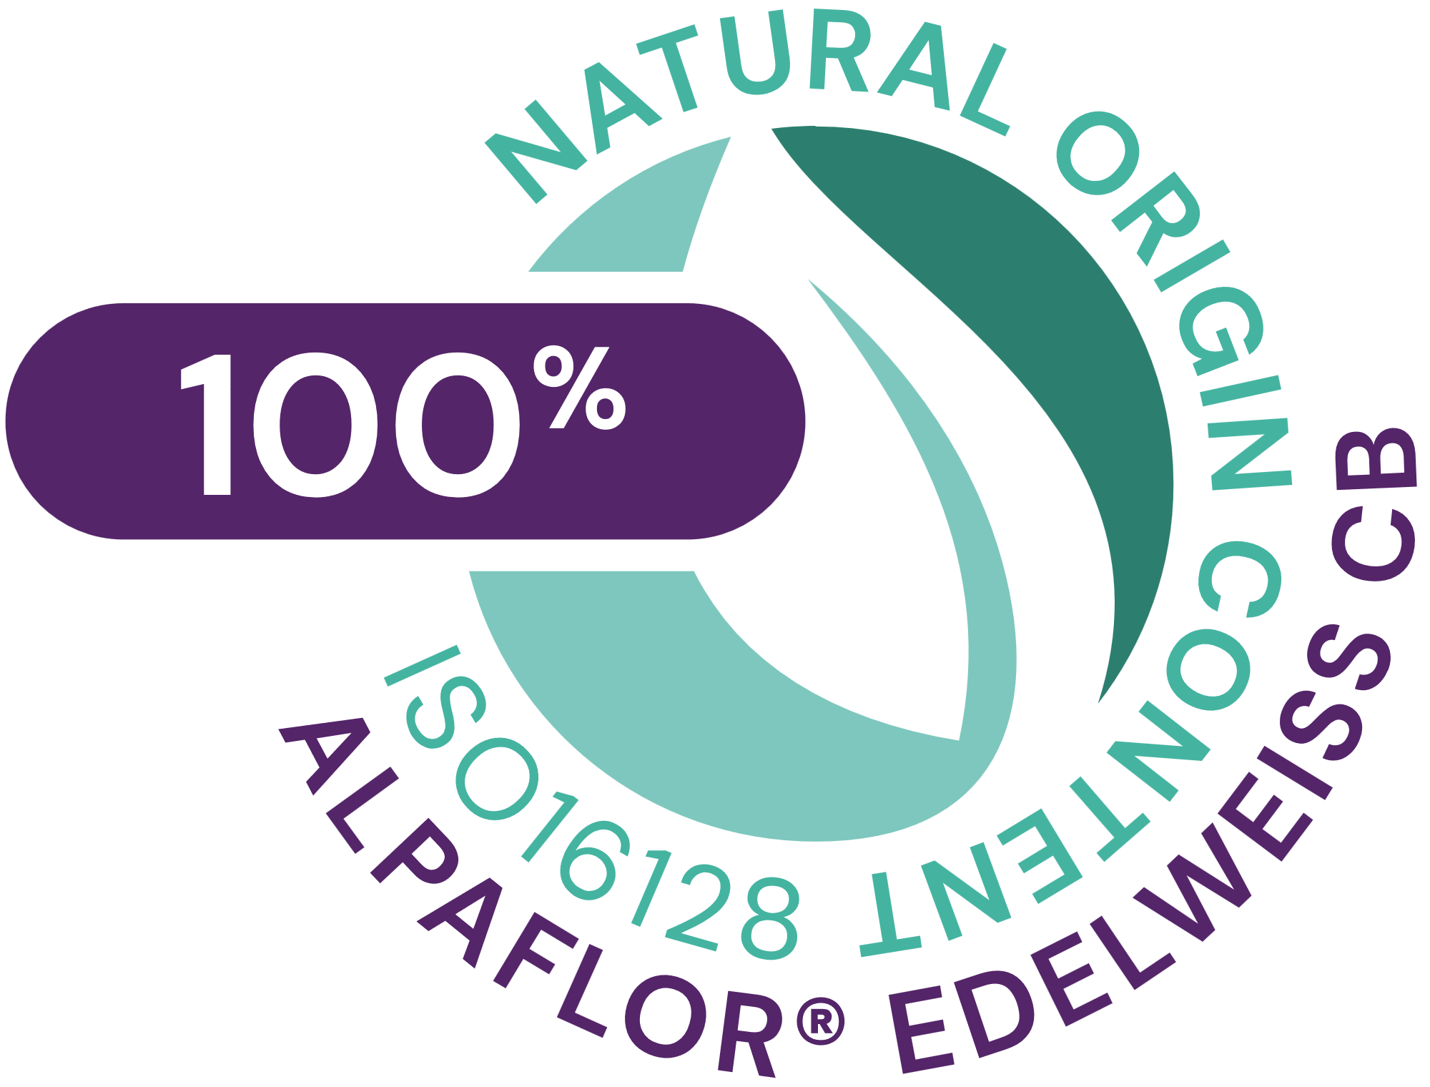








ALPAFLOR® EDELWEISS CB
ID card
5037860
INCI NAME:
Leontopodium Alpinum Flower/Leaf Extract (and glycerin, water, citric acid)
SUSTAINABILITY:
Organic cultivation, ethical and traceable sourcing, supporting alpine biodiversity with low impact on the environment
TECHNOLOGY:
Gentle ethanolic extraction of dried edelweiss plant (early blooming stage) following green chemistry principles
Standardization in phenolic acids (as chlorogenic acid)
100% of natural origin according to ISO16128– no preservative
TECHNICAL:
pH of use: 3.5- 5.5 Form: Liquid
Use level: 1–3%
Preservative: Free
Solubility: Water
Biodegradable: main components readily biodegradable
BENEFITS:
Helps slow down the premature aging of skin and protects the skin against glycation and oxidative stress**
Helps reduce lines and wrinkles with anti-sagging effect on the V-shape and forehead**
Supports skin’s crucial protective barrier*, maintaining the microbiome balance**, for healthy looking skin
Helps reduce skin sensitivity and protect against pollution**
REGISTRATION
CERTIFICATION
* in vitro ** in vivo

Slide 3

ALPAFLOR® EDELWEISS CB
Holistic alpine beauty for skin rejuvenation
Unique Product Features
Unique Edelweiss variety Leontopodium alpinum ‘Helvetia’, sustainably, fairly and organically cultivated
Antiglycation 3D facial color mapping in vivo with reduction of AGEs.
Reduces the fine lines, 3 times better than placebo on glabella
Prevents and reverses glycation: reduction of AGEs, glycated collagen IV, detoxifies and repairs after glycation stress*
Strongly and significantly boosts Collagen I and V*
Maintains healthy skin by preserving stem cells against oxidative stress*
Protects the skin against urban dust particles induced stress*
stimulates key proteins responsible for an optimal epidermal protection*
Benefits
Protects the skin against oxidative stress, helps to slow down the premature aging of skin
helps reduce lines and wrinkles with anti-sagging effect on the V-shape and forehead in vivo, for a rejuvenated skin
Supports skin’s crucial protective barrier, maintaining the microbiome balance, for healthy looking skin
Perceptibly reduces skin sensitivity and protects the skin against pollution
Provides a multi-level of protection for better aging with an ultimate skin sensation
Cosmetic applications
Anti-aging/sagging skin care products
Day care protecting formulations
for sensitive skin
Sun and after-sun formulations
Protective formulation against pollution and external stresses
* in vitro

Slide 4
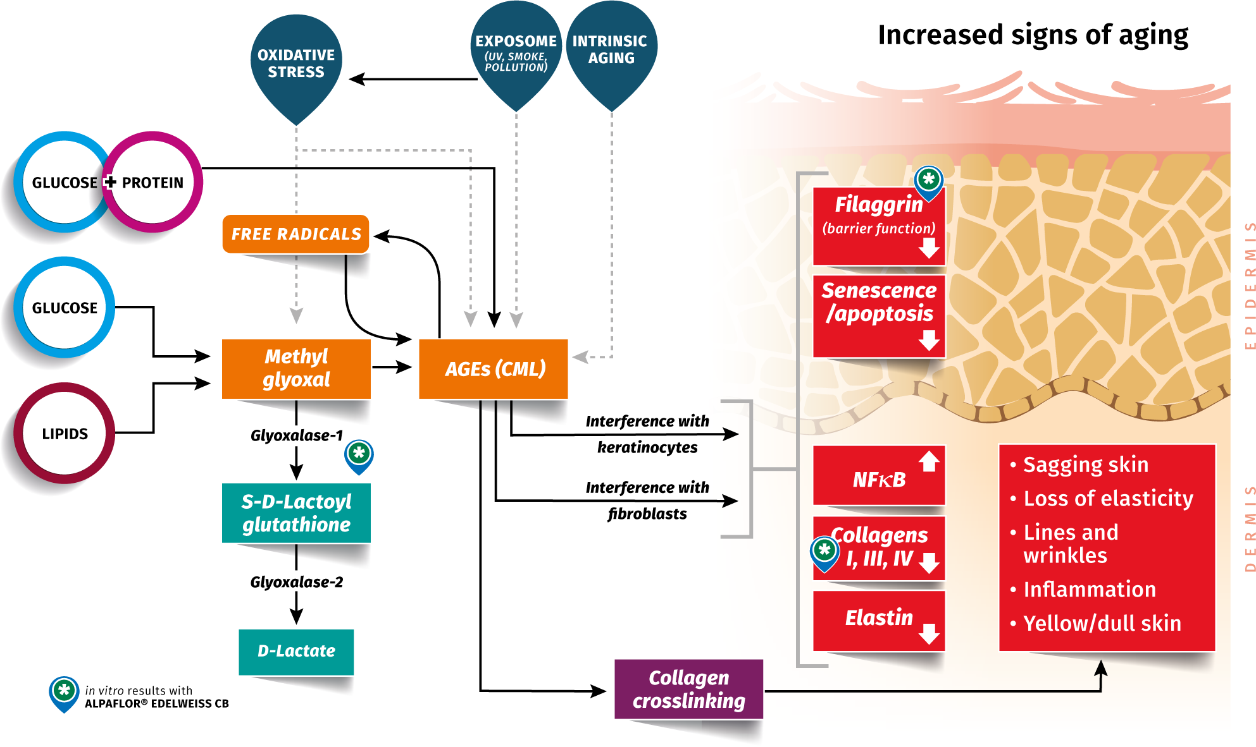

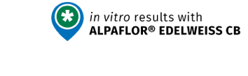
Glycation increases signs of ageing
Vicious circle between free radicals and glycation
Glycation is a basic mechanism involved in aging in humans.
It is a non-enzymatic reaction that occurs spontaneously between sugars and proteins, leading to the formation of Advanced Glycation End Products (AGEs).
AGEs bind with collagen or elastin, decreasing skin elasticity, lead to sagging and appearance of lines.
Accumulation of glycated proteins makes the skin dull and yellowish.
In the epidermis, AGEs disrupt the proliferation of keratinocytes slow down the skin repairs processes, impairing the skin barrier
Glycation starts around 35yo and increases rapidly with intrinsic aging
CML: Nε-(carboxymethyl) lysine

Slide 5
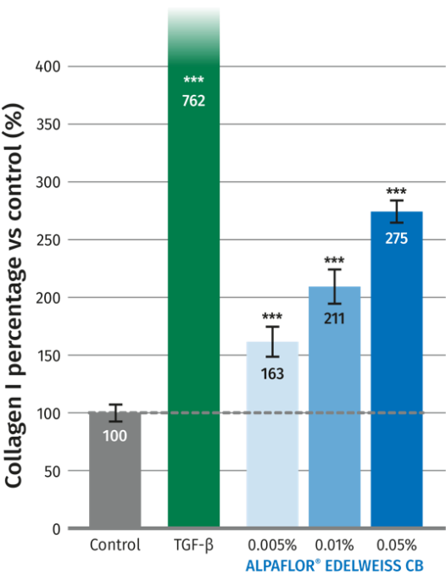
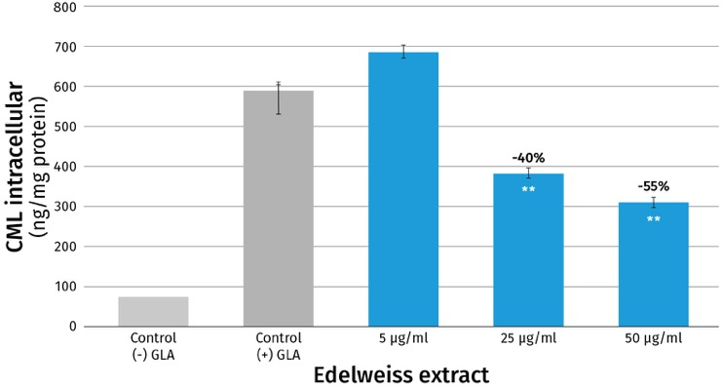
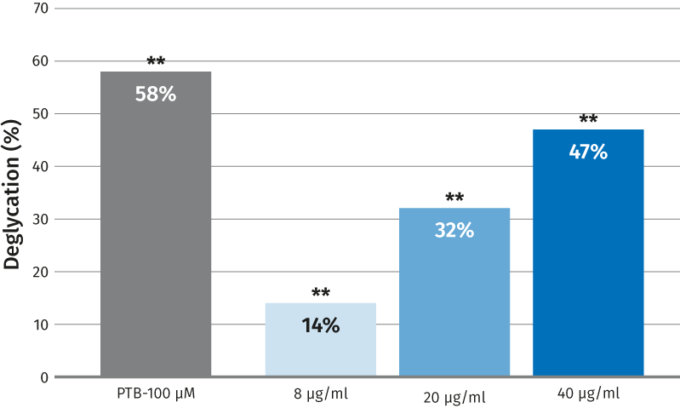
ALPAFLOR® EDELWEISS CB
Anti-glycation activity – in vitro
Anti-glycation activity:
AGEs formation*
Collagen I booster*
Repairs glycation:
Deglycation*
ALPAFLOR® EDELWEISS CB strongly decreases the AGEs, expressed as CML,
by 55% at 0.005% dry extract
Strongly restores skin barrier function and protects against glycated collagen
ALPAFLOR® EDELWEISS CB boosts dose dependently and significantly Collagen I by 111% and Collagen V by 171% at 0.01% dry extract in NHDF*
ALPAFLOR® EDELWEISS CB, introduced after induction by Glyoxal (200uM), reverses the glycation by 47% at 0.004% dry extract
*In vitro
Notes:
AGEs formation:
In vitro data in NHEK, incubated under stress condition with DL-glyceraldehyde for 48h
CML
CML: Nε-(carboxymethyl) lysine
50ug/ml = 0,005% dry extract = 0,25% ALPAFLOR® EDELWEISS CB
Deglycation:
40ug/ml = 0,004% dry extract = 0,20% ALPAFLOR® EDELWEISS CB

Slide 6
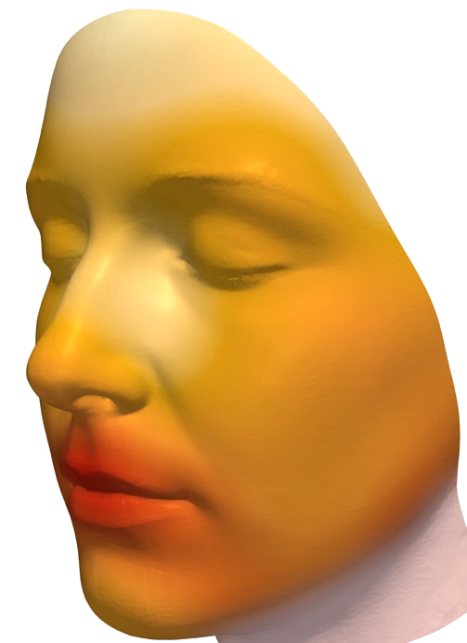
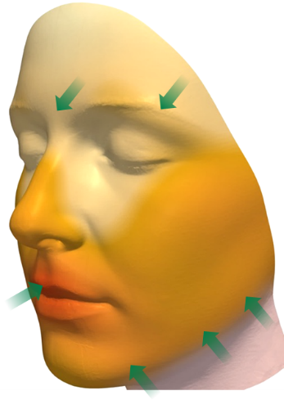
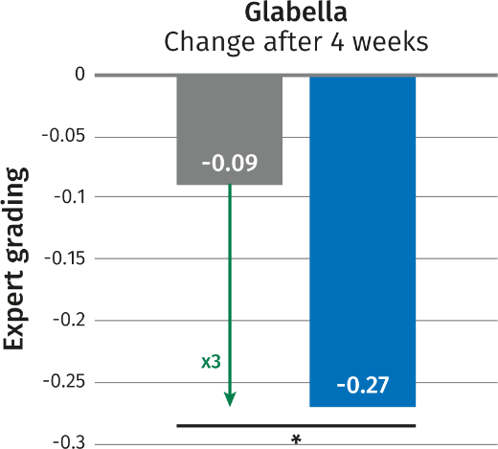
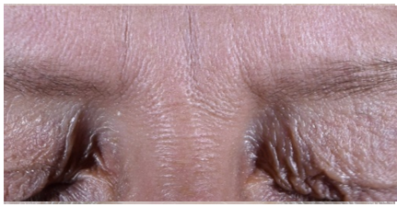
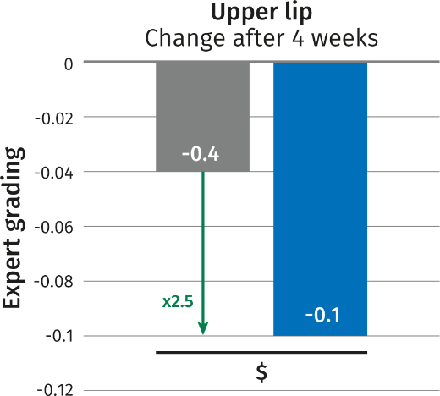
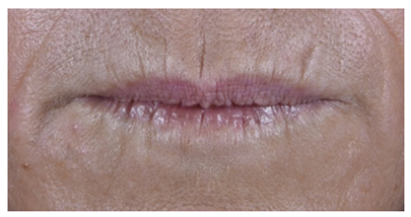
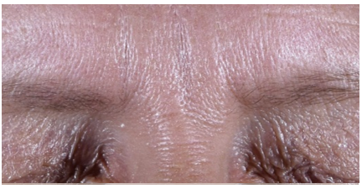
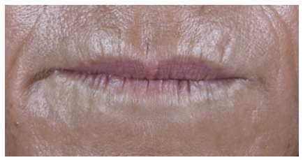
ALPAFLOR® EDELWEISS CB
Anti-glycation activity – Confirmation in vivo that AGEs reduction leads to less fine lines
T0
T0
Δ 1.25
Δ 0.75
T1
T1
Baseline
28 days
Volunteer 34 – 56 yo
Volunteer 38 – 48 yo
Improvement
Facial antiglycation mapping: AGEs measurement*
Protects against glycation:
Glycated Collagen IV*
Repairs glycation:
Deglycation*
Strong reduction of AGEs in all face areas with ALPAFLOR® EDELWEISS CB after 4 weeks compared to baseline (T0).
Significant reduction: 2.5 times on full face, 5 times on forehead, 3 times on jaw-line, all vs placebo
We can expect clear improvement of sagging effect on jaw line and forehead
Reduction of fine lines and wrinkles on forehead (glabella).
Reduction of wrinkles on glabella: ALPAFLOR® EDELWEISS CB 3 times better than placebo (p<0.05), -11% vs T0.
Reduction of fine lines and wrinkles on upper lip.
Reduction of wrinkle on upper lip: ALPAFLOR® EDELWEISS CB 2.5 times better than placebo (p<0.10).
*In vivo, 2 groups (active, placebo): 2x33 females (42 to 60 yo), 3% ALPAFLOR® EDELWEISS CB 28 days study, AGEs read directly by fluorescence on the skin, wrinkle assessment by expert grading
Notes:
Clinical:
Volunteers: Caucasian skin
2 groups (active, placebo): 2x33 females (42 to 60 yo)
Full face application - Twice daily
Emulsion with 3% ALPAFLOR® EDELWEISS CB 28 days study
AGEs read: new tool developed to read AGEs by fluorescence directly on the face – 21 sites.
Wrinkle assessment by expert grading (5 points scale)
Full face: 2.5 times for effective than placebo
Forehead: 5.3x (p<0.05)
Jawline: 2.2 x (p<0.05)
Cheek: 1,4X (p<0.10)
Upper lip: 3 x

Slide 7
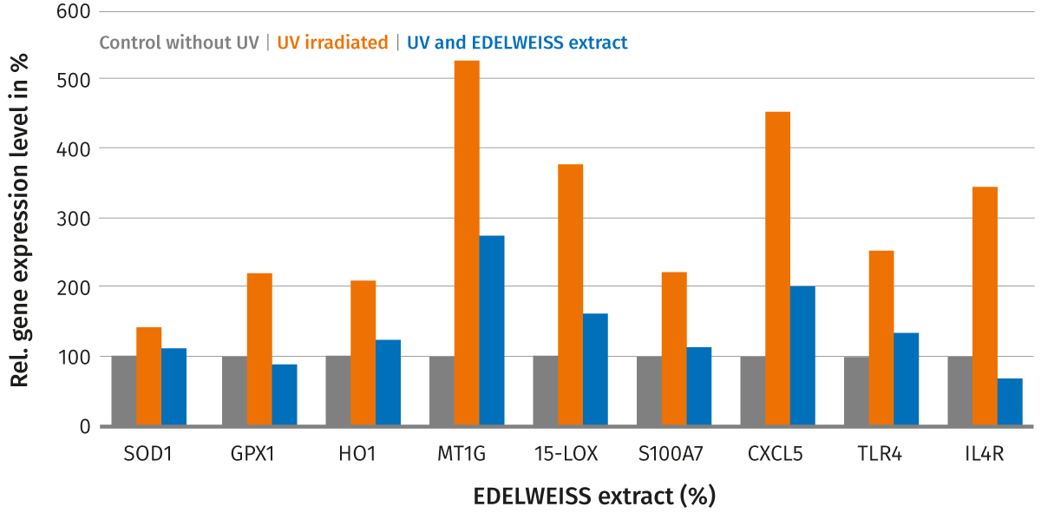
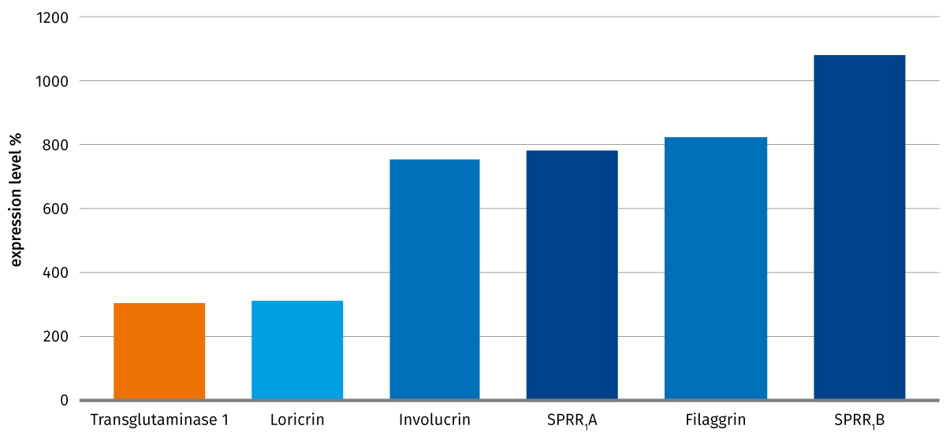
ALPAFLOR® EDELWEISS CB provides better skin protection
Reduces UV-induced oxidative stress markers: skin natural defense mechanism
Stimulates key genes of the cornified envelope
Reduces UV-induced stress markers: skin natural defense mechanism
Induction of gene expression in human epidermal keratinocytes by 0.001% Edelweiss extract
SOD1
GPX1
H01
MT1G
15-LOX 1
S100A7
CXCL5
TLR4
IL4R
Oxidative stress markers*
Inflammatory stress markers*
Immune stress markers*
in epidermal skin model at 0.02% Edelweiss dry extract after UVA (3.5J/cm2) / UVB irradiation (250mJ/cm2)
Strong stimulation of key proteins:
Involucrin (x8), Loricrin (x3) and Keratins (X41) give the strength of the skin against external stress factors
Filaggrin (x8) improves the skin moisturization
Trans-glutaminase 1 (x3) links all these proteins to generate a protection shell
EDELWEISS extract has a positive effect on all parameters (oxidative stress markers, inflammatory stress markers and immune stress markers), it rebalances the skin stress level comparable to a situation with no UV exposure
Notes:
Skin tends to react to UV exposure with the release of oxidative and pro-inflammatory stress markers as its natural defense mechanism.
This slide shows the list of all the genes which were tested in this assay: oxidative stress markers, inflammatory stress markers, and immune stress markers.
Reduced activity of these molecules is a clear indication of a well-protected skin status.
UV stress markers
Gene expression level
Epidermal skin models

Slide 8
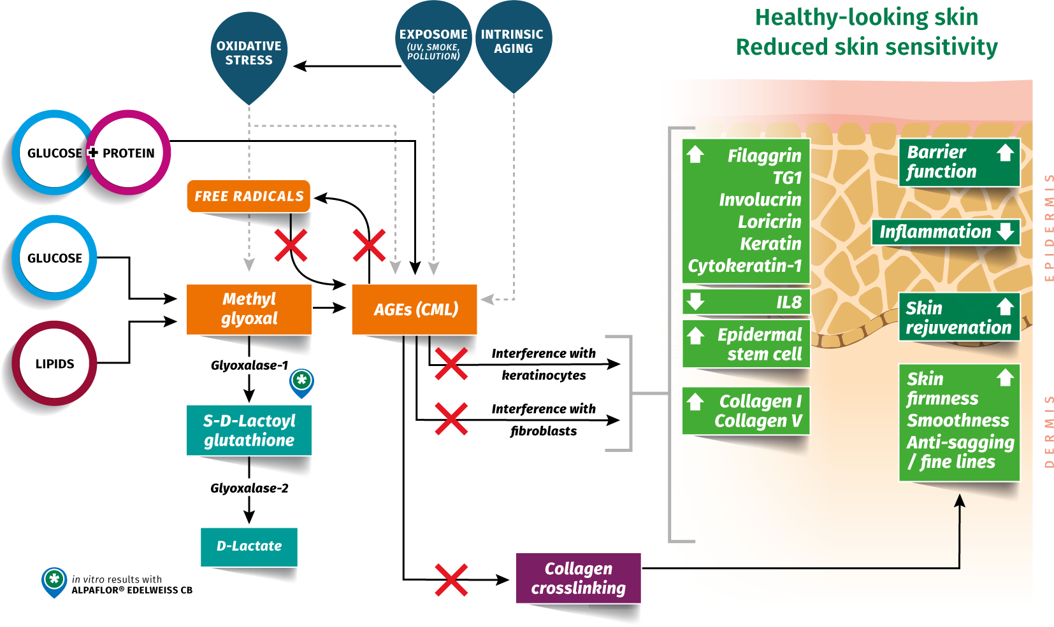

Benefits of ALPAFLOR® EDELWEISS CB
Holistic alpine beauty care for skin rejuvenation
Anti-glycation
Slows signs of aging
Smooths wrinkles
Sensitive skin
Anti-pollution
Skin comfort
Healthy looking skin

Slide 9
Disclaimer
Copyright © DSM Nutritional Products Ltd 2025, 4002 Basel, Switzerland.
www.dsm-firmenich.com. All rights reserved.
dsm-firmenich has used diligent care to ensure that the information provided herein is accurate and up-to-date to the best of its knowledge. However, dsm-firmenich makes no representation or warranty, either expressly or implied, of the accuracy, reliability, completeness, or suitability thereof. The information provided herein contains scientific and product information for business-to-business use and does not constitute or provide scientific or medical advice, diagnosis or recommendation for treatment options. Country or region-specific information should be considered when labelling or advertising to final consumer. In no event shall dsm-firmenich be liable for any direct or indirect damages arising from or reliance upon, or use of, any information provided herein. The content of this document is subject to change without further notice. Please contact your local dsm-firmenich representative for the latest information. All trademarks listed in this document are either (registered) trademarks of, or trademarks licensed by, the dsm-firmenich group of companies, unless explicitly stated otherwise.
Disclaimer Formulation Guideline
The information provided herein is provided for information purposes only and has been prepared by dsm-firmenich in accordance with its own methodology.
dsm-firmenich has used diligent care to ensure that it is accurate and up-to-date, however, dsm-firmenich makes no representation or warranty, either expressly or implied, of the accuracy, reliability, or completeness thereof. In no event shall dsm-firmenich be liable for any damages arising from or reliance upon, or use of, any information provided herein. Further, dsm-firmenich shall not bear any liability for the application and/or use of any processed material containing its product(s). The formulation of the finished product is the customer’s sole responsibility. It is the customer’s responsibility to determine the suitability of dsm-firmenich’s products regarding user specific purposes, assess compatibility and stability of their finished product(s) and to ensure compliance of their finished product(s) with relevant laws and regulations. Any product, marketing or other claims made by customer are its sole responsibility. The content of this document is subject to change without further notice. Please contact your local dsm-firmenich representative for further details. © DSM Nutritional Products AG, 2025.

