Slide 1
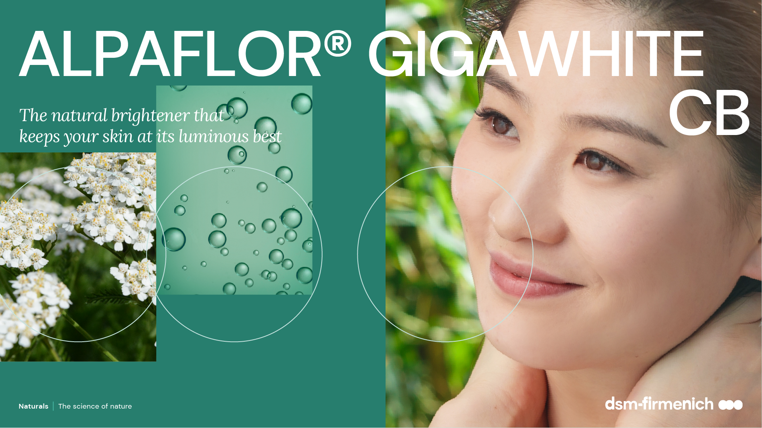
April 2025

Slide 2
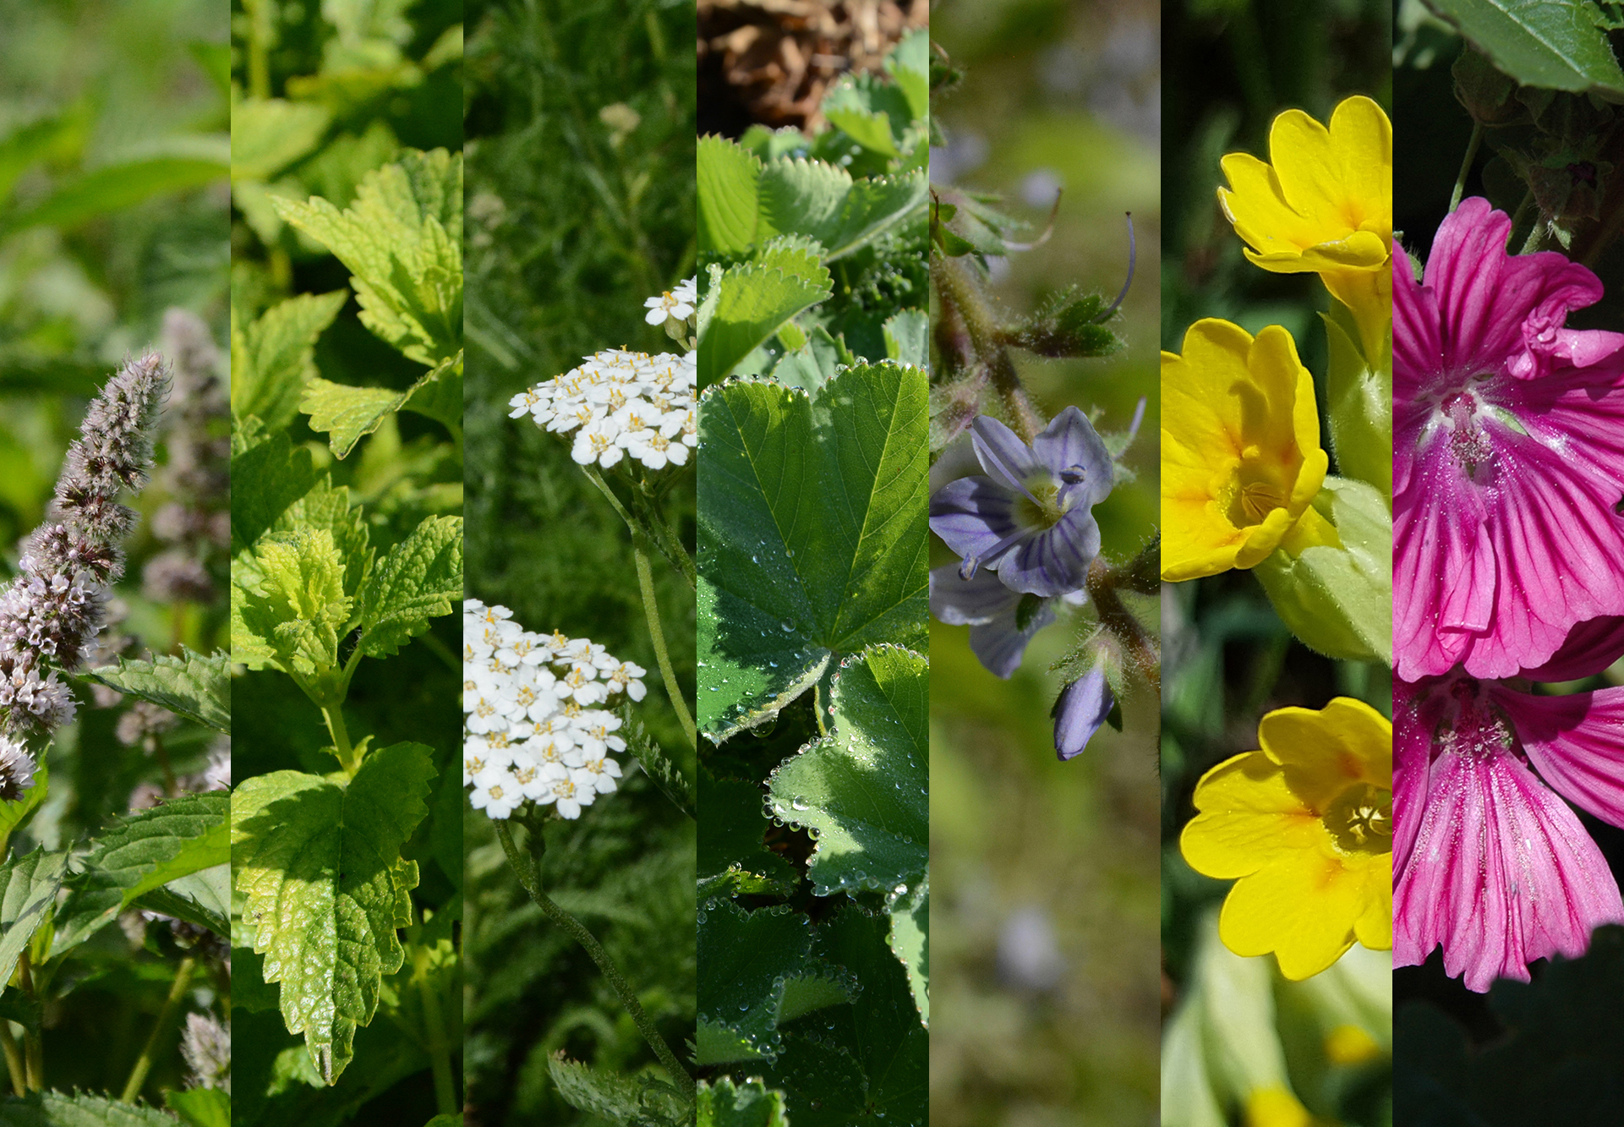
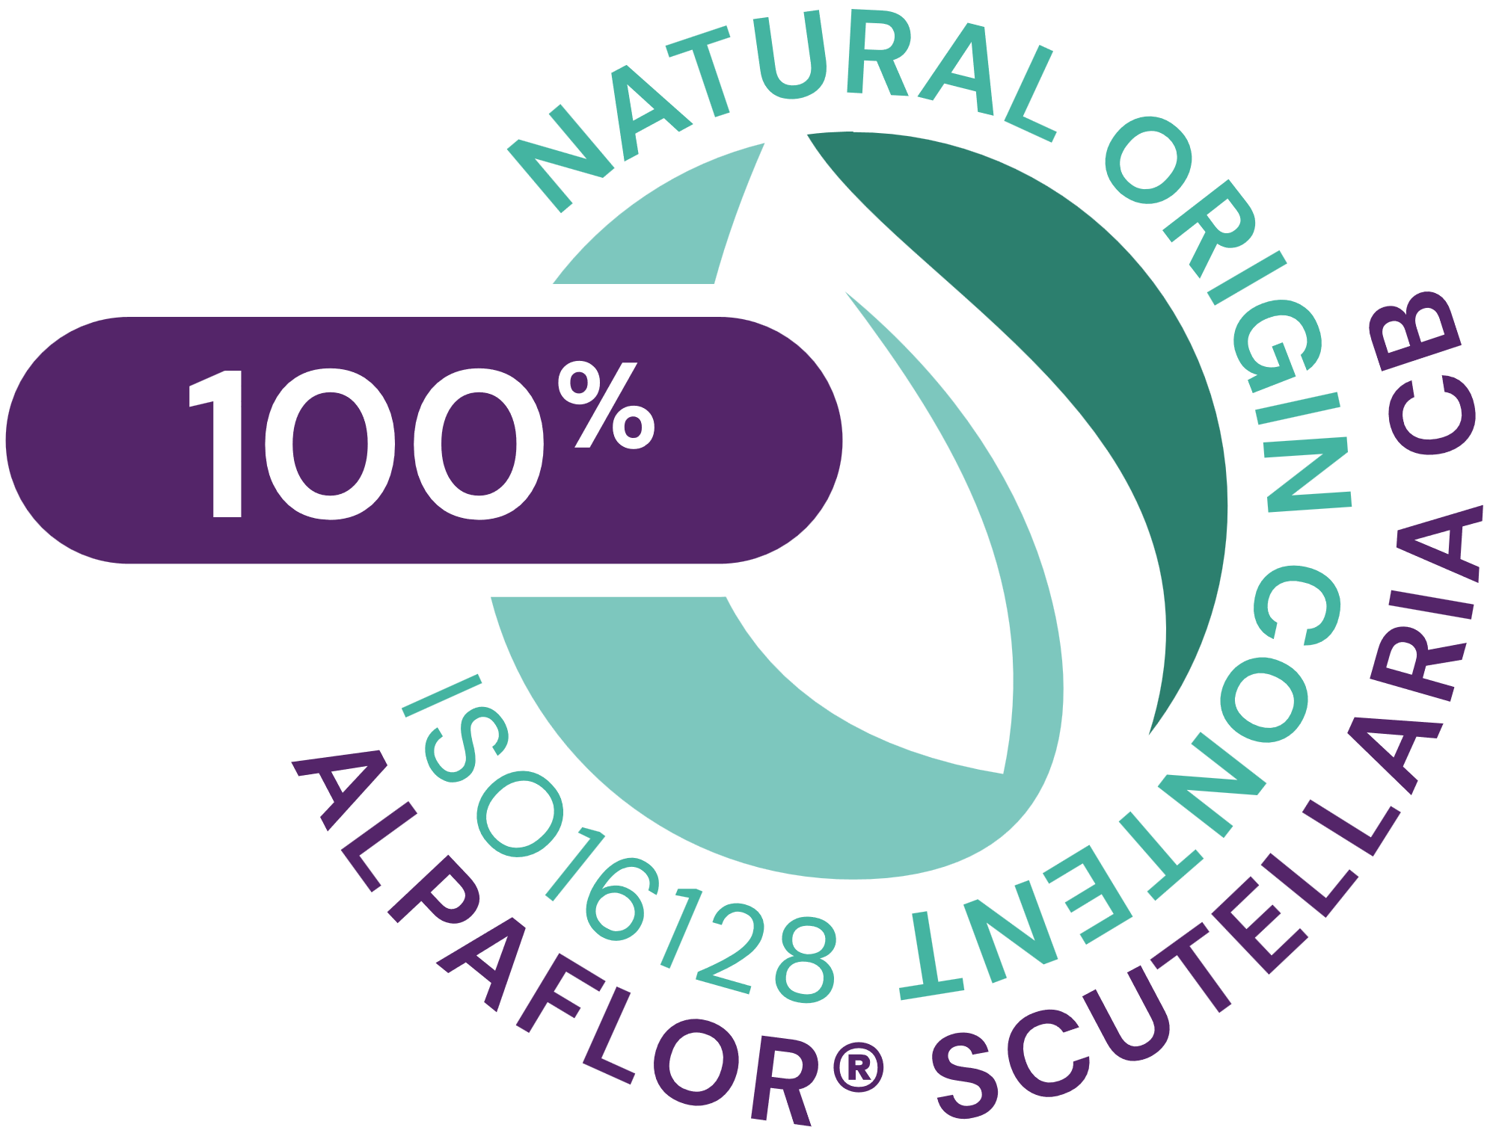







ALPAFLOR® GIGAWHITE CB
ID card
5037862
INCI NAME:
Malva Sylvestris (Mallow) Flower/Leaf/Stem Extract , Mentha Piperita (Peppermint) Leaf Extract, Primula Veris Flower Extract*, Alchemilla Vulgaris Flower/Leaf/Stem Extract*, Veronica Officinalis Flower/Leaf/Stem Extract, Melissa Officinalis Leaf Extract , Achillea Millefolium Flower/Leaf/Stem Extract* (and glycerin, water, citric acid)
SUSTAINABILITY:
Organic cultivation, ethical and traceable sourcing, supporting alpine biodiversity with low impact on the environment
TECHNOLOGY:
Gentle ethanolic extraction of dried aerial part of 7 plants following green chemistry principles
100% of natural origin according to ISO16128– no preservative
TECHNICAL:
pH of use: 3.5- 5.5 Form: Liquid
Use level: 1–5%
Preservative: Free
Solubility: Water
Biodegradable: main components readily biodegradable
BENEFITS:
Down-regulating key genes involved in skin pigmentation (tyrosinase, PLM17, Melanoregulin, DCT)**
Melanin synthesis reduced by 24% on NHMelanocyte**
Significant improvement in skin tone (24% lighter after 3 months)***
Significant reduction of hyperpigmentation (age spot color intensity)***
REGISTRATION
CERTIFICATION
* : for China, not a new cosmetic ingredient as the general INCI name is already IECIC listed
* *in vitro *** in vivo

Slide 3

ALPAFLOR® GIGAWHITE CB
The natural brightener that keeps your skin at its luminous best
Unique Product Features
A unique combination of seven Alpine plant extracts organically cultivated at high altitude
Sustainable, organic and fair-trade certified bio-active allowing transparency and traceability
Targets multiple steps of pigmentation
Impacting in vitro the production of melanin by modulating key enzymes such as tyrosinase, Dopachrome tautomerase
Down-regulating in vitro the melanosome maturating key gene (PML17)
Intercepting in vitro the migration of melanin to the upper layer of the skin (melanoregulin)
Skin color lighter (+15%) after 12 weeks with 3% ALPAFLOR® GIGAWHITE CB
Reduction of age spot color intensity (-28%)
Benefits
Keeps your skin at its luminous best
Outstanding brightening action gradually enhances the skin’s natural glow
Resulting in luminous complexion with a beautifully even tone
Helps reduce skin hyperpigmentation (age spots color intensity)

Slide 4
The naturally potent fusion of plants reducing discoloration of the skin
Biological concepts
All-natural, completely organic brightener with proven efficacy
In vitro down-regulates several key genes involved in melanin biosynthesis and in the transfer of melanin to the upper layer of the skin
Reduces in vitro the melanin content in the melanocytes
Provides a significant improvement in skin tone brightening
Significant reduction of age spots color intensity
  Consumer Benefits
Outstanding brightening action gradually enhances the skin’s natural glow
Keeps your skin at its luminous best
Resulting in brighter looking skin with a beautifully even tone

Slide 5
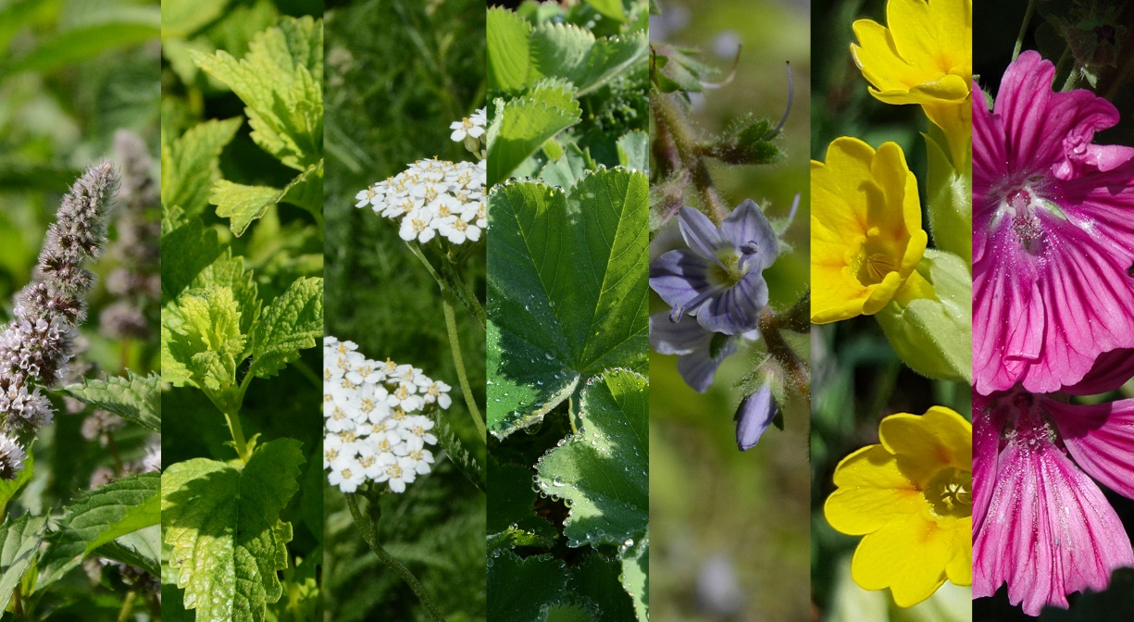
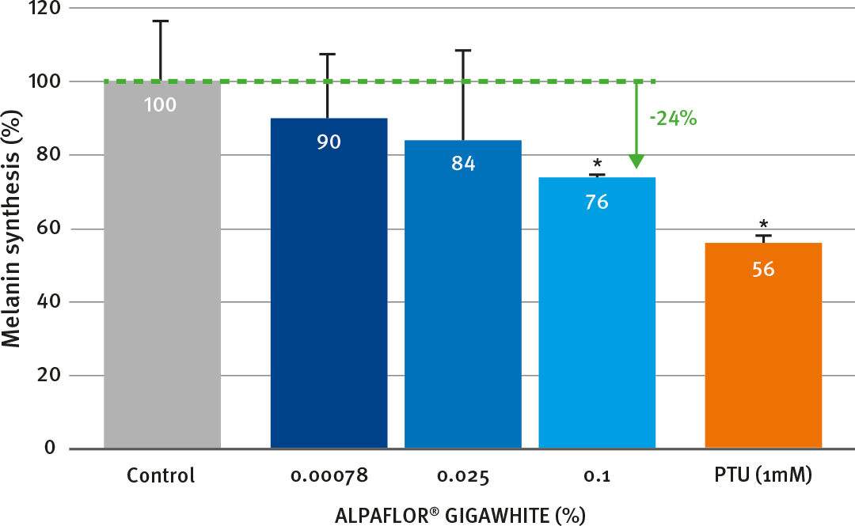
Unique and efficient
Very effective inhibitor on melanogenesis key markers, providing a reduction of melanin synthesis
ALPAFLOR® GIGAWHITE CB significantly reduces by 24% the melanin content on normal human melanocyte at a concentration of 0.1 %
dsm-firmenich research has investigated some 100 alpine plants, growing in the heart of the Swiss Alps, in unspoiled high-altitude location, nourished by pristine glacier water.
dsm-firmenich has uncovered the secret of a unique and naturally-potent combination of 7 plants with the most powerful brightening activities.
ALPAFLOR® GIGAWHITE CB targets multiple steps of skin pigmentation:
inhibits production of melanin by downregulating melanin-generating enzymes Tyrosinase TYR (-50%) and Dopachrome tautomerase DCT (-37%)
down-regulates the melanosomes maturing by reduction of the expression of PMEL-17 (-44%)
prevents melanosome distribution to the upper layer of the skin by reducing Melanoregulin MREG (-39%)

Slide 6
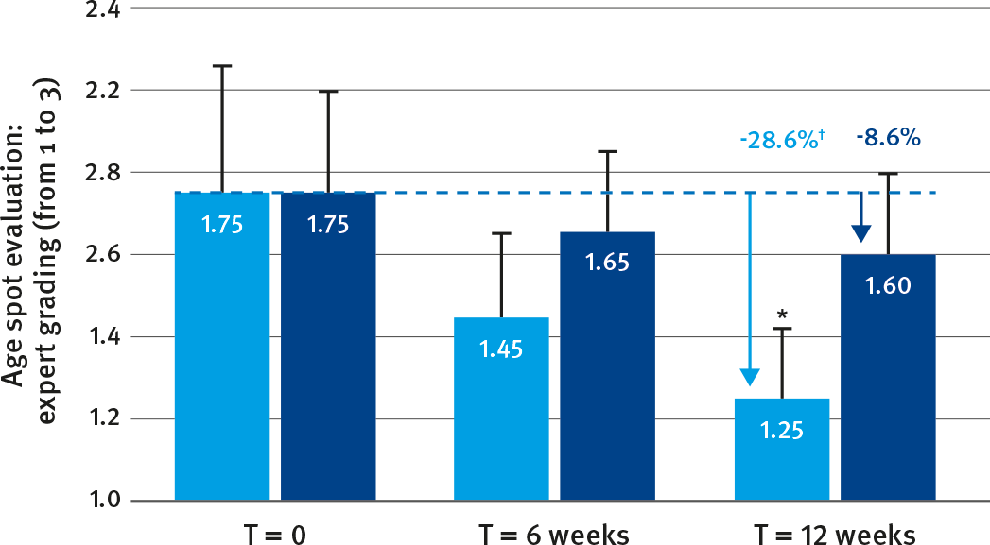
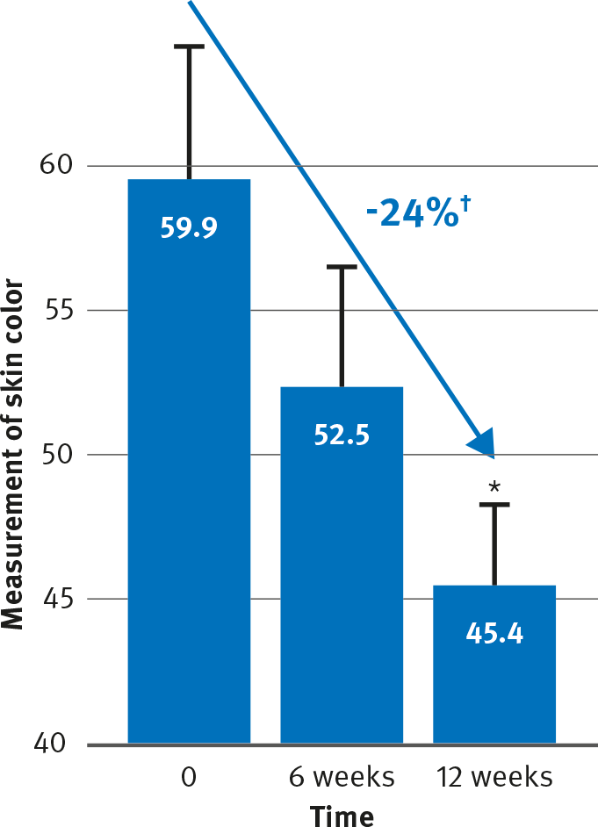
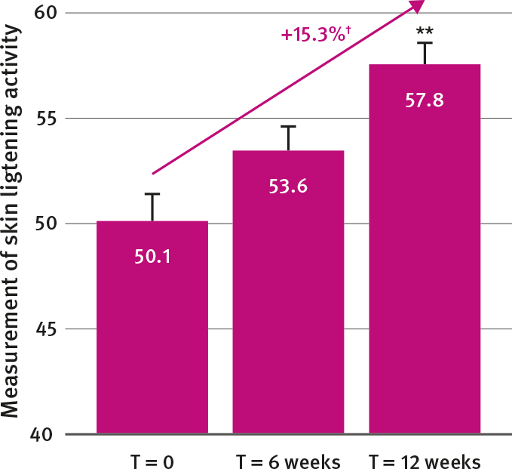
ALPAFLOR® GIGAWHITE CB: clinical study on Asian skin
Excellent skin brightening efficacy and reduction of hyperpigmentation
Color | Size
Color (clinical reading)
L-Value
† Statistically significant; * p≤0.01
† Statistically significant; * p≤0.01; ** p≤0.001
ALPAFLOR® GIGAWHITE CB at 5% shows significant reduction of age spots color intensity (-28.6%) after 12 weeks of treatment
ALPAFLOR® GIGAWHITE CB at 5% shows excellent skin brightening activity (24% lighter) after 12 weeks on Asian skin

Slide 7
Disclaimer
Copyright © DSM Nutritional Products Ltd 2025, 4002 Basel, Switzerland.
www.dsm-firmenich.com. All rights reserved.
dsm-firmenich has used diligent care to ensure that the information provided herein is accurate and up-to-date to the best of its knowledge. However, dsm-firmenich makes no representation or warranty, either expressly or implied, of the accuracy, reliability, completeness, or suitability thereof. The information provided herein contains scientific and product information for business-to-business use and does not constitute or provide scientific or medical advice, diagnosis or recommendation for treatment options. Country or region-specific information should be considered when labelling or advertising to final consumer. In no event shall dsm-firmenich be liable for any direct or indirect damages arising from or reliance upon, or use of, any information provided herein. The content of this document is subject to change without further notice. Please contact your local dsm-firmenich representative for the latest information. All trademarks listed in this document are either (registered) trademarks of, or trademarks licensed by, the dsm-firmenich group of companies, unless explicitly stated otherwise.
Disclaimer Formulation Guideline
The information provided herein is provided for information purposes only and has been prepared by dsm-firmenich in accordance with its own methodology.
dsm-firmenich has used diligent care to ensure that it is accurate and up-to-date, however, dsm-firmenich makes no representation or warranty, either expressly or implied, of the accuracy, reliability, or completeness thereof. In no event shall dsm-firmenich be liable for any damages arising from or reliance upon, or use of, any information provided herein. Further, dsm-firmenich shall not bear any liability for the application and/or use of any processed material containing its product(s). The formulation of the finished product is the customer’s sole responsibility. It is the customer’s responsibility to determine the suitability of dsm-firmenich’s products regarding user specific purposes, assess compatibility and stability of their finished product(s) and to ensure compliance of their finished product(s) with relevant laws and regulations. Any product, marketing or other claims made by customer are its sole responsibility. The content of this document is subject to change without further notice. Please contact your local dsm-firmenich representative for further details. © DSM Nutritional Products AG, 2025.

