Slide 1
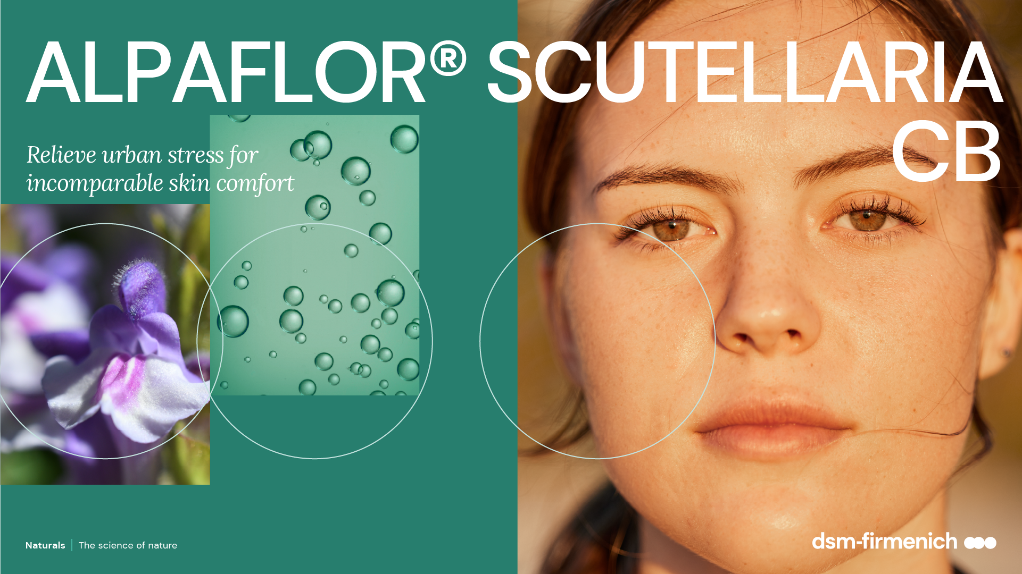
April 2025

Slide 2
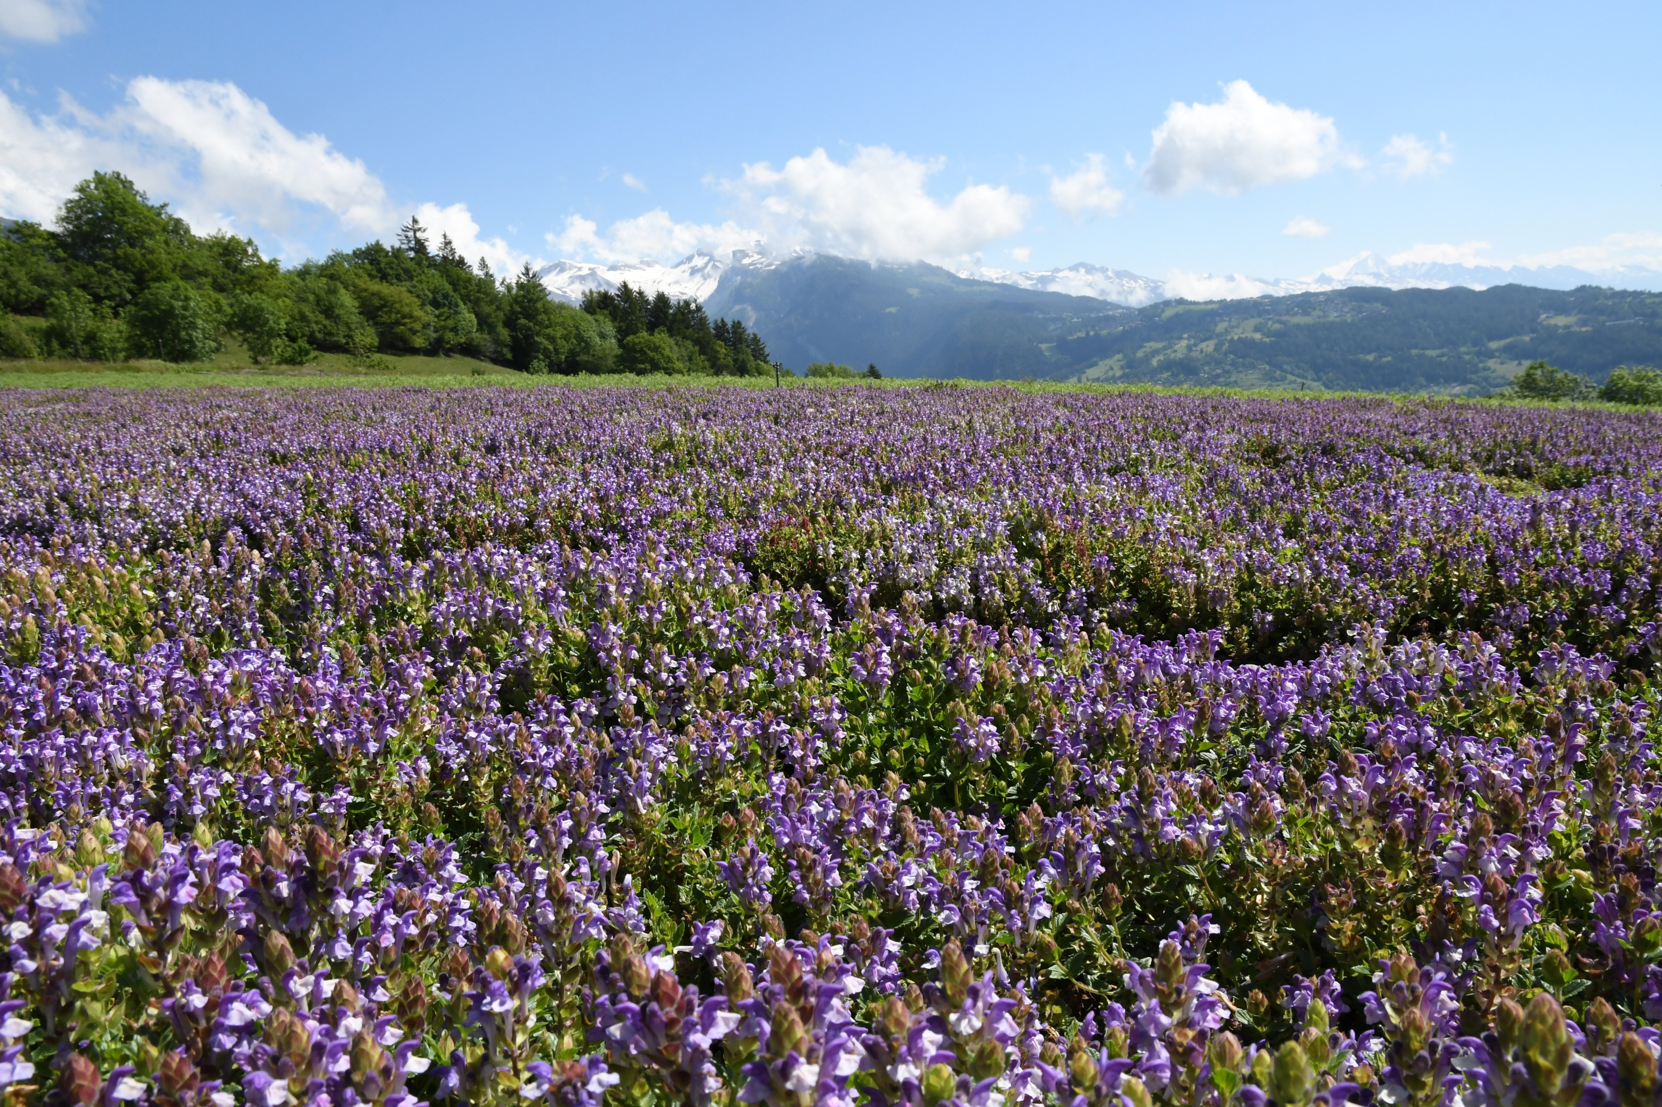
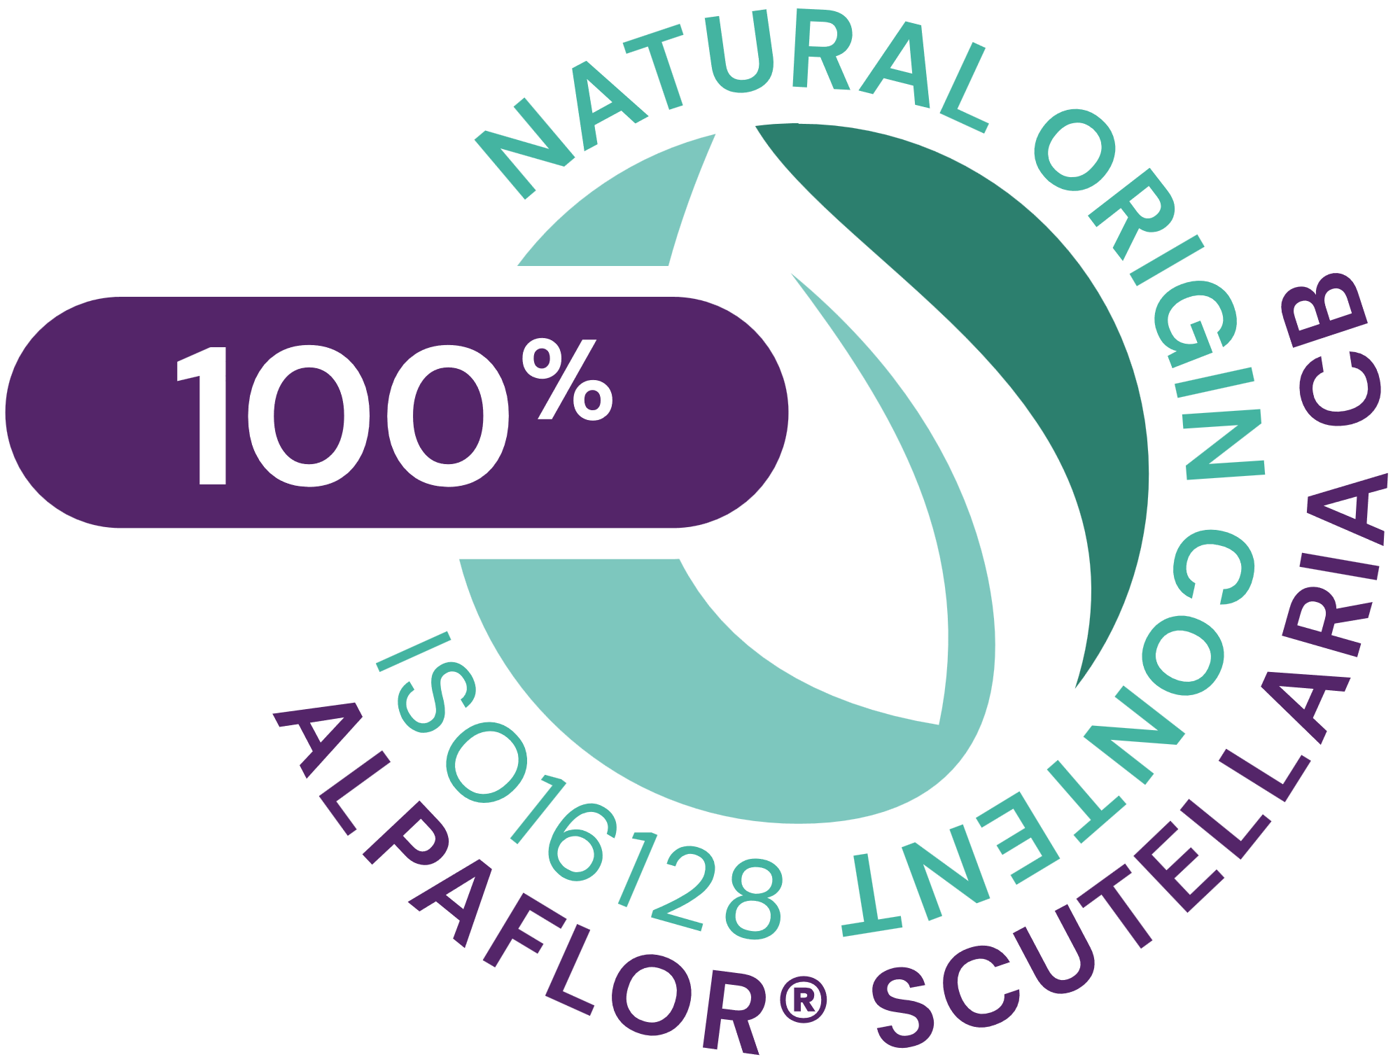







ALPAFLOR® SCUTELLARIA CB
ID card
5037863
INCI NAME:
Scutellaria Alpina Flower/Leaf/Stem Extract (and glycerin, water, citric acid)
SUSTAINABILITY:
Organic cultivation, ethical and traceable sourcing, supporting alpine biodiversity with low impact on the environment
TECHNOLOGY:
Gentle ethanolic extraction of dried aerial part of alpine skullcap following green chemistry principles
Standardization in flavonoids (as scutellarin)
100% of natural origin according to ISO16128– no preservative
TECHNICAL:
pH of use: 3.5- 5.5 Form: Liquid
Use level: 1–3%
Preservative: Free
Solubility: Water
Biodegradable: main components readily biodegradable
BENEFITS:
Activates neurotransmitters: GABA_{B} receptors and β-endorphin to relieve unpleasant sensation of sensitive skin*
Reduces the oxidative stress generated by pollution and lifestyle*
Protects the skin barrier function under very polluted environment with better hydration vs placebo**
Alleviate skin dull complexion and lightens the skin (+21% vs placebo)**
REGISTRATION
CERTIFICATION
* in vitro ** in vivo

Slide 3
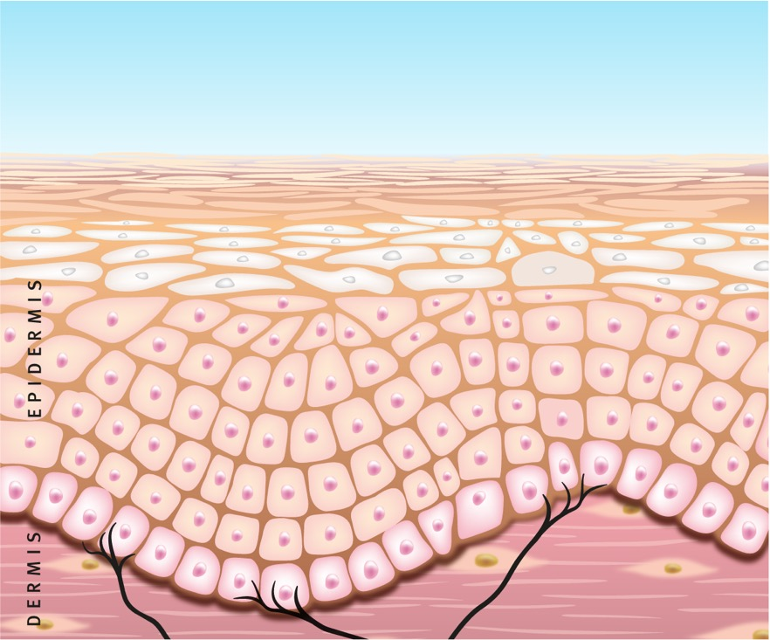
ALPAFLOR® SCUTELLARIA CB
what’s in it for the consumer
  Unique product features
  Rare alpine Scutellaria alpina extract with unique composition
  Sustainable, organic and fair bioactive allowing transparency and traceability
  Activates GABA_{B} receptors (indirectly inhibiting TRPV1) and enhances production of β-endorphin
  Strong free radical scavenger (5x more powerful than green tea), protects in vitro the epidermal lipids peroxidation, reduces the oxidative stress generated by pollution or lifestyle
  Stimulates in vitro key genes involved in the skin barrier and detoxification for fully protected skin
  Protects in vivo the skin barrier function under very aggressive environment with better hydration compared with a placebo, alleviating dull complexion
  Benefits
  Relieves unpleasant sensations and hydrates the skin for incomparable comfort
  Keeps healthy looking skin and improves skin appearance
  Alleviates skin dull complexion, lightens the skin
  Protects, soothes and calms irritated and sensitive skin
ALPAFLOR®
SCUTELLARIA CB
• Skin hydrated
• Comfortable skin
• Radiant complexion
Free Radicals Captured
Skin Barrier Repaired
Inflammation
Cascade Stopped
GABA_{B} Receptors ↑
TRPV1
β-Endorphin ↑
Nerve Endings

Slide 4
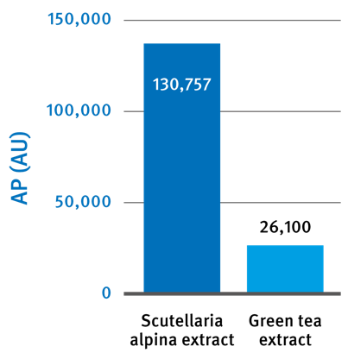
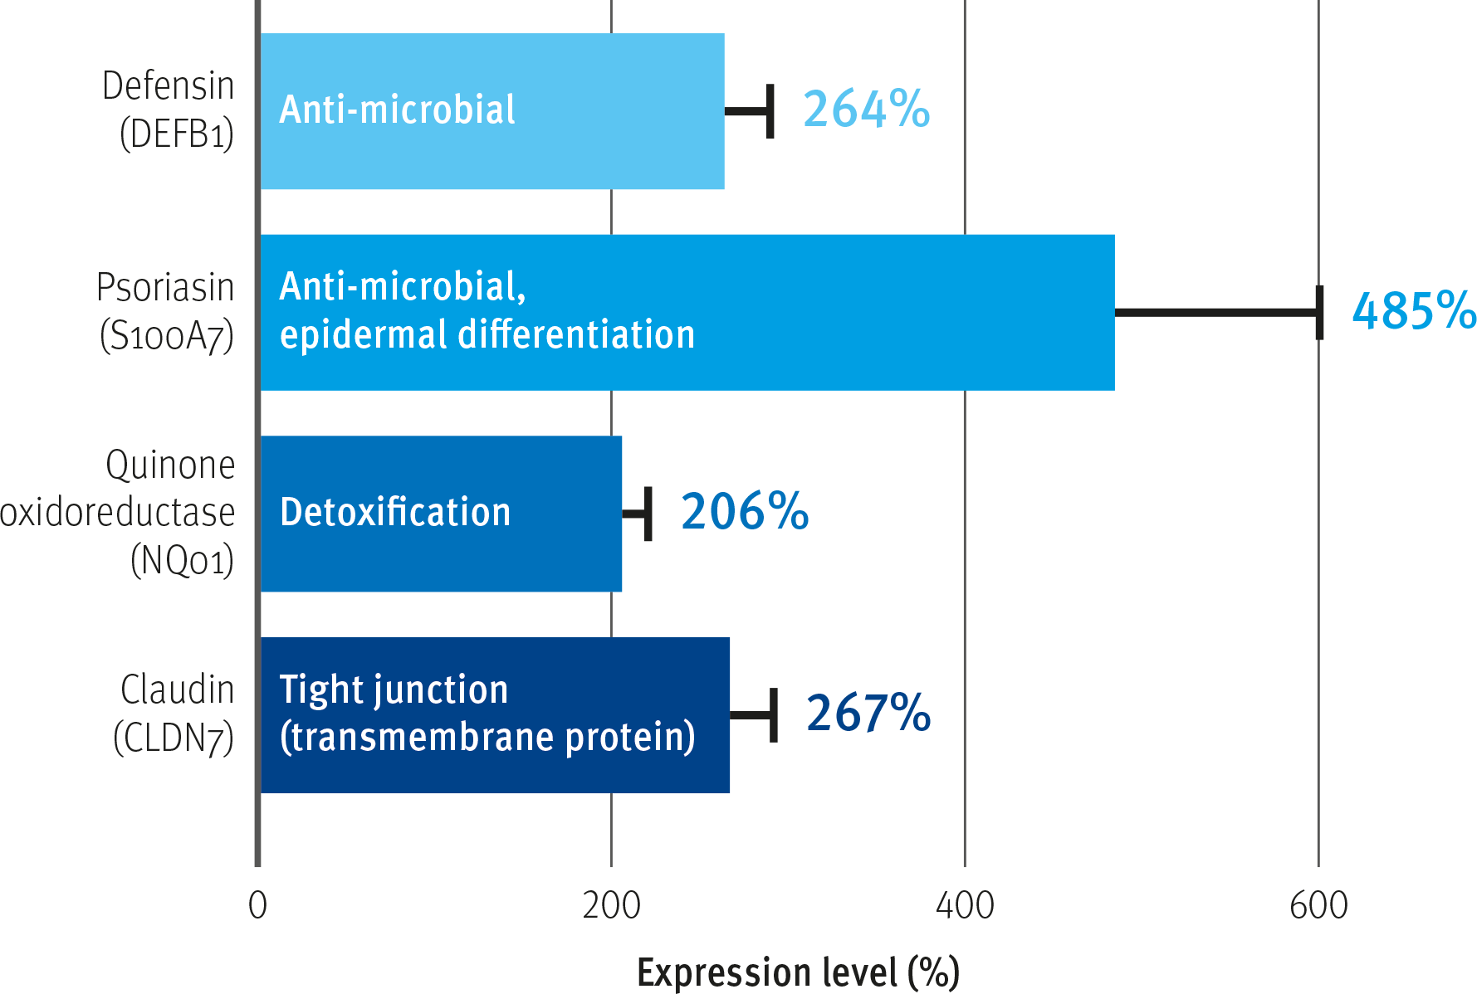
Strong anti-oxidant and barrier function improvement
Proves upregulation of barrier-relevant genes by ALPAFLOR® SCUTELLARIA CB
Induction of gene expression in human epidermal keratinocytes by 0.01% ALPAFLOR® SCUTELLARIA CB dry extract*
Anti-oxidative properties AP
Beta-defensin and psoriasin: peptides, located in keratinocytes, that protect sensitive skin from infection and inflammation
Claudin-7: membrane protein in the tight junction that seals the space between the keratinocytes, assuring barrier function, reducing the infiltration of inflammatory cells.
Quinone oxidoreductase: enzyme that captures superoxidase radicals and reduces oxidative stress.
Oxidative Stress
Anti-oxidative properties (AP) are measured from the number of captured free radicals (DPPH) per mg of active per minute, expressed as an anti-oxidative unit (AU) where 1 AU corresponds to the activity of a 1 ppm solution of pure vitamin C (ascorbic acid).
Inflammation Cascade
Skin Barrier Impaired
*One concentration with 2 different cell donors in triplicate
Notes:
upregulated, at gene level, the defense mechanism with detoxification and barrier function enhancing properties for a better protection.
Gene chip analysis of normal human epidermal keratinocytes under standard conditions treated vs untreated cells
The extract is tested at one concentration with 2 different cell donors in triplicate which helps to consider specific genetic variability to increase robustness of data related to biological activity expression level data after 72h incubation
Claudin7 is a tight junction protein so helps to build TJ. TJ are important part of the skin barrier below the stratum corneum. Important to prevent infection, protect from pollution and improving sensitive skin.
Beta defensin and psoriasin are both antimicrobial peptides (AMP) also important to protect sensitive skin from infection (sensitive skin is more prone to infection by pathogens) but both AMP also help to improve the TJ and skin barrier
T. Akiyama, F. Niyonsaba, C. Kiatsurayanon, T.T. Nguyen, H. Ushio, T. Fujimura, T. Ueno, K. Okumura, H. Ogawa, S. IkedaThe human cathelicidin LL-37 host defense peptide upregulates tight junction-related proteins and increases human epidermal keratinocyte barrier function J. Innate Immun. (2014)
F. Hattori, C. Kiatsurayanon, K. Okumura, H. Ogawa, S. Ikeda, K. Okamoto, F. NiyonsabaThe antimicrobial protein S100A7/psoriasin enhances expression of keratinocyte differentiation markers and strengthens the skin tight junction barrier Br. J. Dermatol. (2014)
C. Kiatsurayanon, F. Niyonsaba, R. Smithrithee, T. Akiyama, H. Ushio, M. Hara, K. Okumura, S. Ikeda, H. OgawaHost defense (antimicrobial) peptide, human beta-defensin-3, improves the function of the epithelial tight-junction barrier in human keratinocytes J. Invest. Dermatol., 134 (2014), pp. 2163-2173
NADPH-quinone oxydoreductase (NQO-1) is detoxifying and a xenobiotic metabolizing enzyme and can help to cope with the consequences of PM from air pollution
Only biological processes with p-value ≤ 0.05 were taken into account. Results finally focused on the main processes.

Slide 5

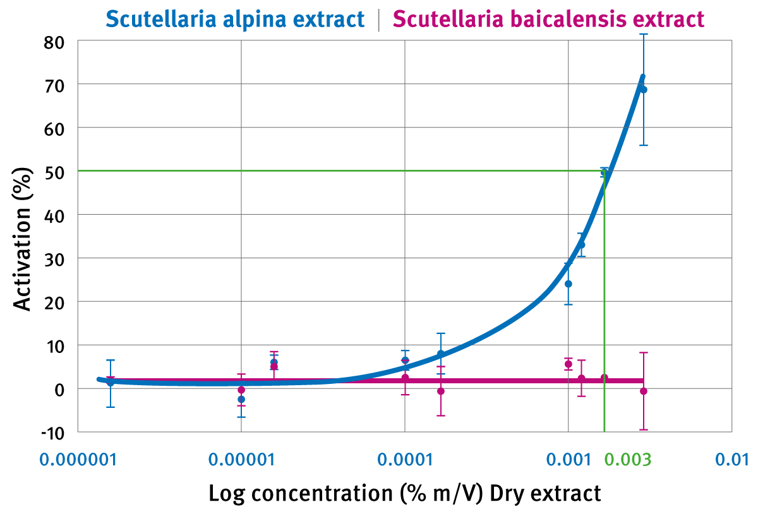
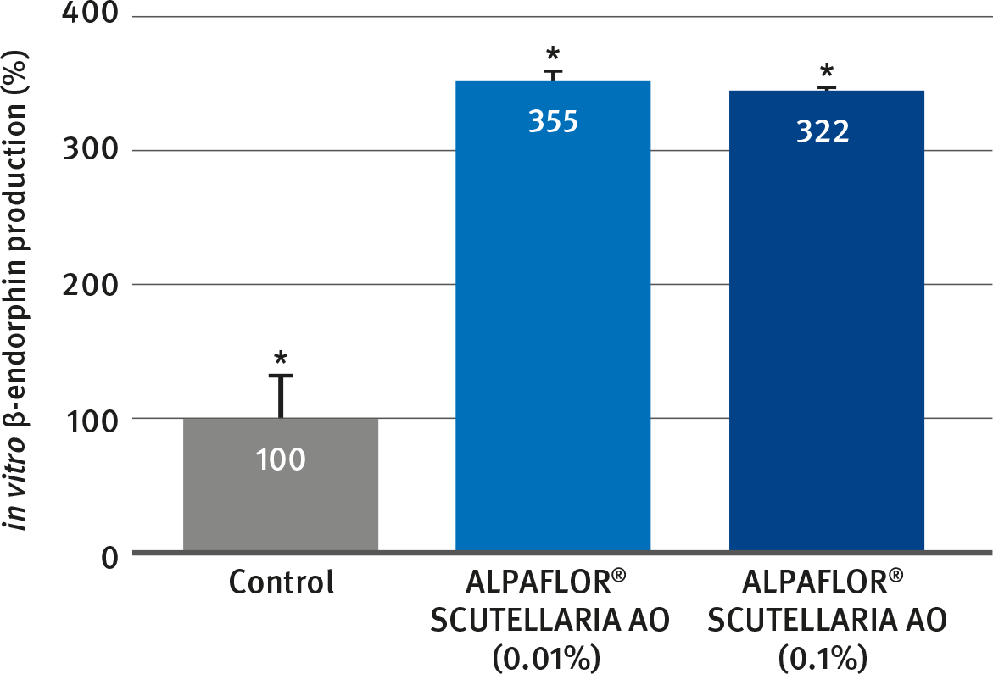
ALPAFLOR® SCUTELLARIA CB
β-Endorphin and GABA_{B} receptors: strong stimulation
providing relaxing and calming actions on the skin
Stimulation of the GABA_{B} receptors in vitro at very low concentration
Strong stimulation of β-endorphin in vitro at 0.01% Scutellaria extract
ALPAFLOR® SCUTELLARIA CB stimulates the GABA_{B} receptors at very low concentration* (EC50 at 0.003%) while Scutellaria Baicalensis doesn’t show any activity.
ALPAFLOR® SCUTELLARIA CB stimulates the production of β-endorphin by more than 300%*.
The modulation of these 2 neurotransmitters produces a relaxing, soothing and calming effect on the skin,
EC50: represents the concentration of Scutellaria alpina extract at which 50% of GABA_{B} receptors are stimulated
*: in vitro, 0.003% dry extract corresponds to 0.18% ALPAFLOR® SCUTELLARIA CB)

Slide 6
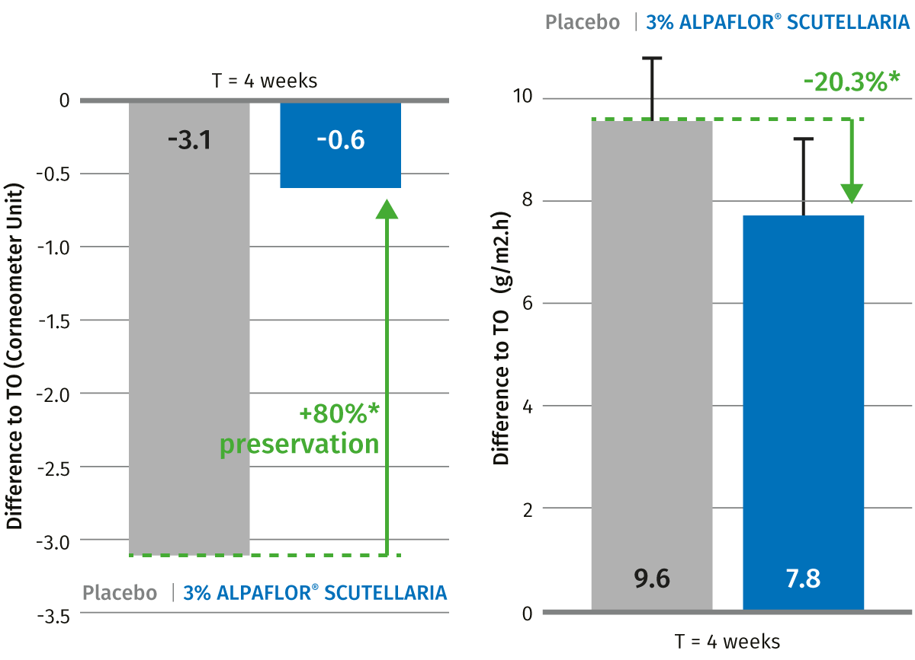
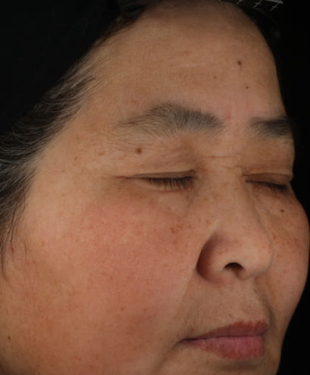
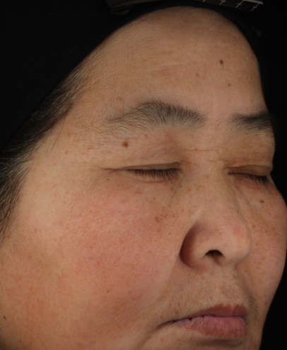
ALPAFLOR® SCUTELLARIA CB
Preserves skin hydration, mitigates the weakening of the skin barrier, relieves the dullness after strong environmental stress for 4 weeks
BEFORE
AFTER 4 WEEKS
ALPAFLOR® SCUTELLARIA CB restores 80% of skin hydration and reduces TEWL by 20% compared to placebo
With ALPAFLOR® SCUTELLARIA CB the skin is 14% less yellow and 21% lighter compared to placebo
Study design: 36 Chinese female from 36 to 57 yo (phototype II to III), being at least 6 hours per day outside in Beijing. Half face application twice a day of 3% ALPAFLOR® SCUTELLARIA CB vs placebo

Slide 7
Disclaimer
Copyright © DSM Nutritional Products Ltd 2025, 4002 Basel, Switzerland.
www.dsm-firmenich.com. All rights reserved.
dsm-firmenich has used diligent care to ensure that the information provided herein is accurate and up-to-date to the best of its knowledge. However, dsm-firmenich makes no representation or warranty, either expressly or implied, of the accuracy, reliability, completeness, or suitability thereof. The information provided herein contains scientific and product information for business-to-business use and does not constitute or provide scientific or medical advice, diagnosis or recommendation for treatment options. Country or region-specific information should be considered when labelling or advertising to final consumer. In no event shall dsm-firmenich be liable for any direct or indirect damages arising from or reliance upon, or use of, any information provided herein. The content of this document is subject to change without further notice. Please contact your local dsm-firmenich representative for the latest information. All trademarks listed in this document are either (registered) trademarks of, or trademarks licensed by, the dsm-firmenich group of companies, unless explicitly stated otherwise.
Disclaimer Formulation Guideline
The information provided herein is provided for information purposes only and has been prepared by dsm-firmenich in accordance with its own methodology.
dsm-firmenich has used diligent care to ensure that it is accurate and up-to-date, however, dsm-firmenich makes no representation or warranty, either expressly or implied, of the accuracy, reliability, or completeness thereof. In no event shall dsm-firmenich be liable for any damages arising from or reliance upon, or use of, any information provided herein. Further, dsm-firmenich shall not bear any liability for the application and/or use of any processed material containing its product(s). The formulation of the finished product is the customer’s sole responsibility. It is the customer’s responsibility to determine the suitability of dsm-firmenich’s products regarding user specific purposes, assess compatibility and stability of their finished product(s) and to ensure compliance of their finished product(s) with relevant laws and regulations. Any product, marketing or other claims made by customer are its sole responsibility. The content of this document is subject to change without further notice. Please contact your local dsm-firmenich representative for further details. © DSM Nutritional Products AG, 2025.

