Slide 1
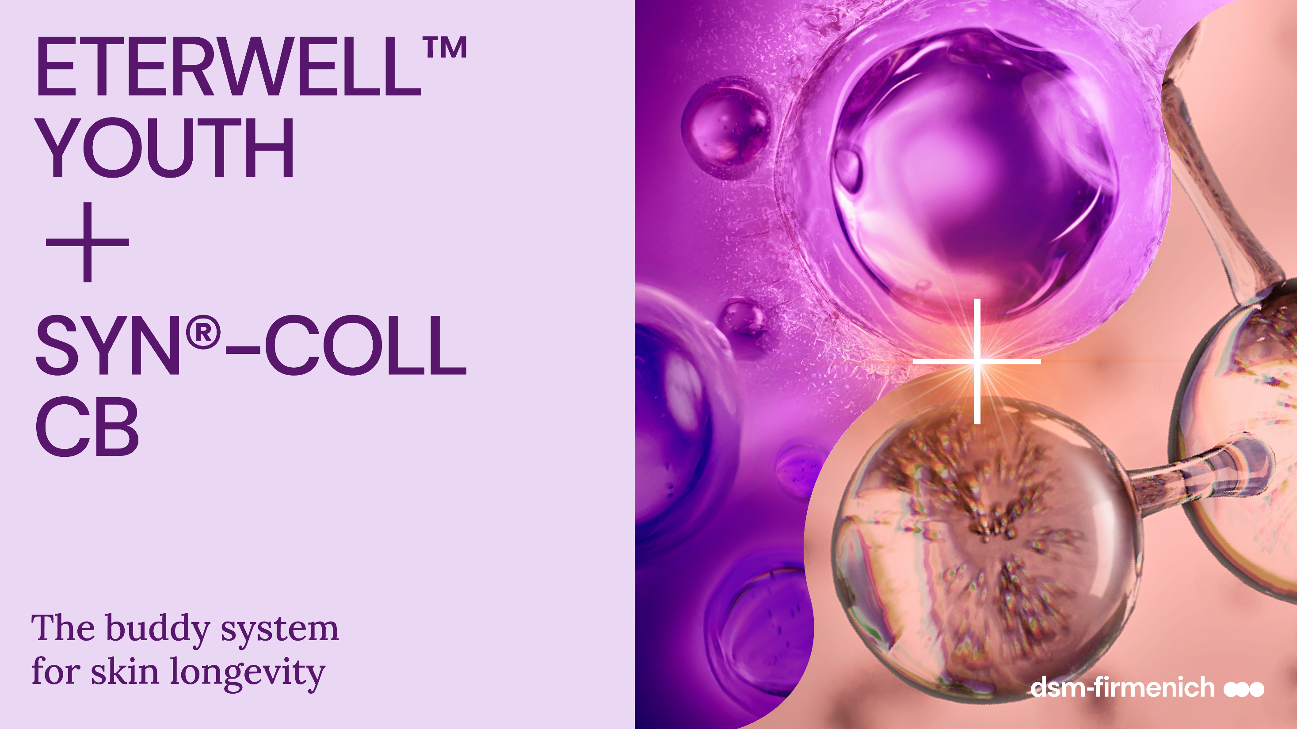
April 2026

Slide 2
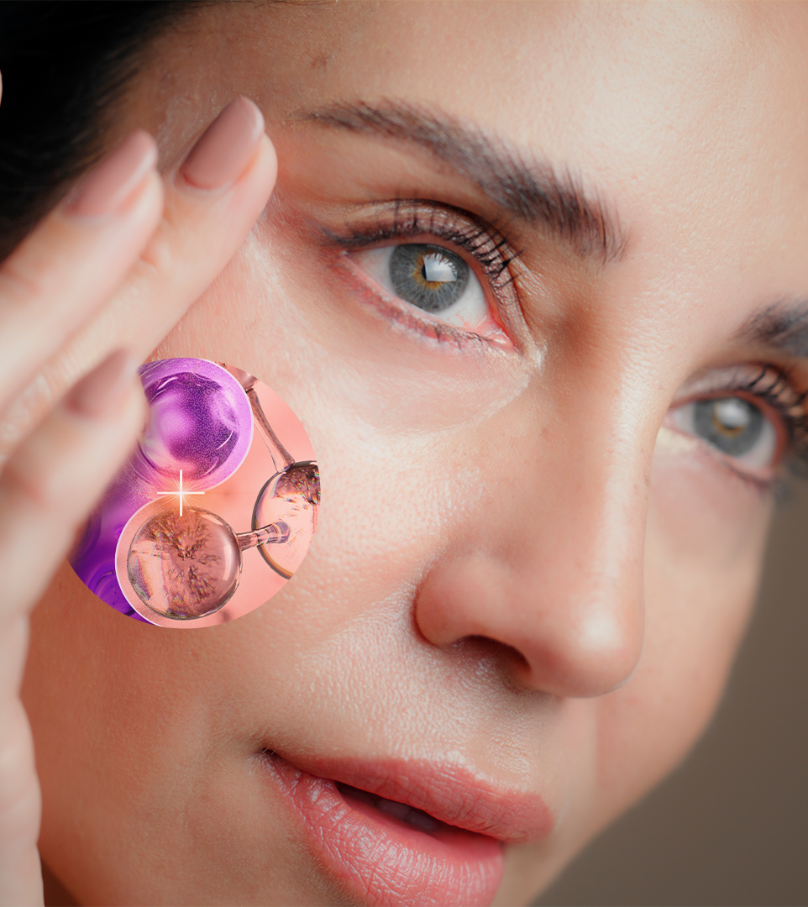

In the era of skin longevity,
holistic scientific strategies lead the way.
When advance skincare science meets skin biology,
targeted, intelligent and personalized solutions emerge.
By clearing senescent cells and optimizing the skin’s cellular environment, ETERWELL™ YOUTH creates the ideal conditions for SYN®-COLL CB to perform at its peak.
The result?
A more responsive, rejuvenated skin matrix — and outstanding visible effects.
A complementary, multi-targeted approach to skin rejuvenation, the future of smart formulation design.
2

Slide 3


Combining our pharma-inspired skincare technologies
Senolytic Science targets
cellular senescence, a fundamental
hallmark of aging.
Inspired by pharmaceutical strategies, Senolytic Skincare selectively remove the dermo-destructive senescent cells that accumulate over time within the
skin, enabling the skin’s natural renewal processes, such as
collagen production, to thrive.
A pharma-inspired approach
to skincare that supports skin longevity by maintaining healthier, more youthful skin.
Transforming Growth Factor Beta (TGF-β) emerges in regenerative medicine, offering exciting possibilities for tissues repair,
from wound healing to long-term maintenance of skin structure, including the regulation
of Collagen. ​
A healthy Collagen network requires fully functioning TGF-β. ​ TGF-β’s active amount in the
skin is reduced as we age.
By biomimicking TGF-β’s activation SYN®-COLL CB helps
to support Collagen network
for lifelong slow aging.
3

Slide 4









ETERWELL® YOUTH
ID Card
INCI NAME:
Epilobium Fleischeri Leaf/Stem Extract (and glycerin, water, citric acid)
SUSTAINABILITY:
Organic cultivation, ethical and traceable sourcing, supporting alpine biodiversity with low impact on the environment
TECHNOLOGY:
Gentle ethanolic extraction of dried rare alpine Willowherb plant following green chemistry principles
Standardization in Flavonoids (as myricitrin)
100% of natural origin – no preservative
TECHNICAL:
Form: Liquid
pH of use: 3.5- 5.5
Use level: 1-3%
Preservative: Free
Solubility: Water
Biodegradable: Main components readily biodegradable
BENEFITS:
Helps revert skin damage induced by zombie cells in excess*
Boost collagen*
Appearance of wrinkles are significantly reduced**
Restores the skin structure with improved skin elasticity and smoothness**
Increases skin resilience with skin texture rebirth**
Helps slow down the premature ageing of skin**
Provides a rejuvenated skin appearance with vibrant healthy looking-skin**
REGISTRATION
CERTIFICATION:
* in vitro ** in vivo

Slide 5
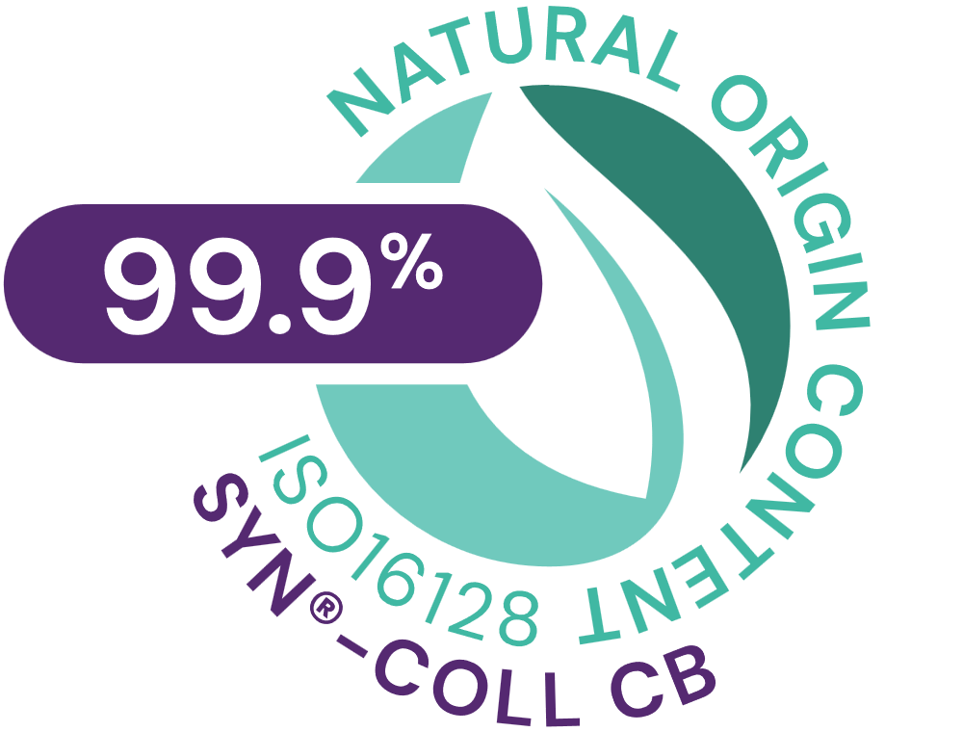
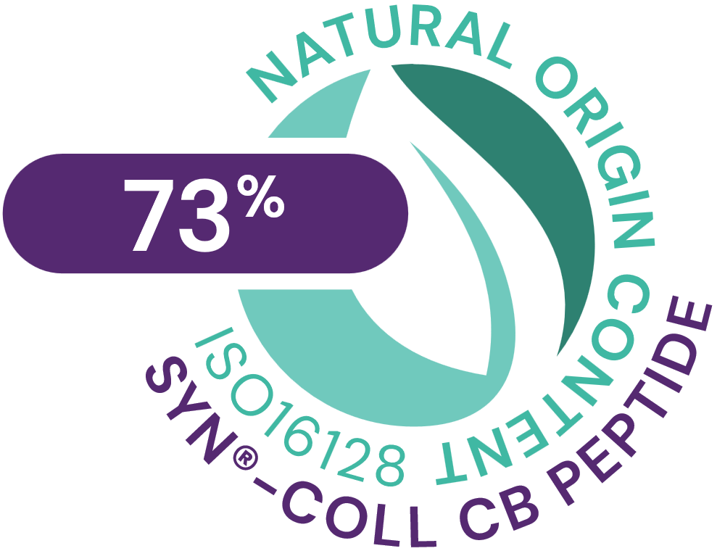


SYN®-COLL CB
ID Card
INCI NAME:
Palmitoyl Tripeptide-5, Aqua, Glycerin
Pharma-inspired skincare solution, taking skin health ambition to the next level.
Targeted design and molecular modeling supported by green chemistry
Natural origin tripeptide with unique sequence Palm-Lys-Val-Lys, produced in Europe, TFA-free¹,
Original SYN®‑COLL peptide generation patented; CB version patent application pending
Low carbon footprint of 5.2 kg CO₂ eq./kg
99.9% natural origin (ISO 16128), 73% natural origin for the pure peptide
TECHNOLOGY:
TECHNICAL:
Form: Liquid
pH of use: 3.0-7.0
Use level: 1-5%
Preservative: Free
Solubility: Soluble in water
Biodegradability: Readily biodegradable
New – Slow down the aging process from within**
New – Significantly supports skin’s Collagen reserves, with age-personalized action**
New – Protects from UV-induced Collagen degradation already at 1% **
Sculpts face and neck for a firmer, more lifted appearance**
Refines skin appearance with less visible pores**
BENEFITS:
Collagen Science Pioneer
First TGF-β booster on the market*
Mimics the skin’s own mechanism to produce and protect Collagen*
Rebalances inflammation by inhibiting cytokines (TNFα, IL-8)*
REGISTRATION
CERTIFICATION:
1. Non-intentionally added TFA
* in vitro ** in vivo

Slide 6


ETERWELL™
YOUTH
+
SYN®-COLL
CB
Type of study | Single-blind, randomized, half-face, baseline-controlled study
Study panel | 55 Chinese females, age 45 – 65
Formulation | Test product (SK-E-103282-2) with 1.5% SYN®-COLL CB Test product (SK-E-103282-3) with 1.5% SYN®-COLL CB + 1.0% ETERWELL™ YOUTH
Application area | According to randomization table, one side of the face was randomly selected to be defined as the test product with 1.5% SYN®-COLL CB according to the product instructions; the other side of the face was defined as the test product with 1.5% SYN-COLL CB + 1.0% ETERWELL™ YOUTH according to the product instructions
Frequency of product usage | Twice a day, each morning and evening
Measuring time points | Baseline (Before applying the test products) 4 weeks 8 weeks
Test
parameters
details
Parameter | Method | Test site
Face image | Visia-CR image capture | Whole face
Skin ultrasound analysis | DermaLab® Combo, Ultrasound dermal intensity measurement, reflects the collagen content | Both sides of cheek
Skin pores analysis | Antera 3D Image acquisition and analysis of the skin pore number and volume changes | Both sides of cheek
Crow's feet wrinkle analysis | Primos CR Image acquisition and analysis of the crows’s feet wrinkle volume changes | Both sides of crow's feet
Forehead wrinkles analysis | Primos CR Image acquisition and analysis of the forehead wrinkle volume changes | Forehead
6

Slide 7

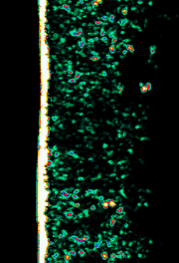
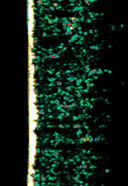
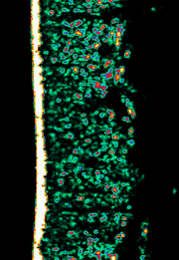
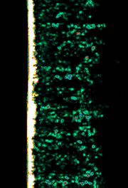
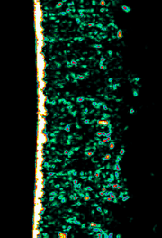
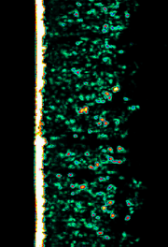

1% ETERWELL™ YOUTH + 1.5% SYN®-COLL CB
ETERWELL™ YOUTH + SYN®-COLL CB restores skin structure
Volunteer 6
Cheek Left
(age 50)
+13% more Collagen in 4 weeks, +21% in 8 weeks
2x significantly better than SYN®-COLL CB alone after 8 weeks
Skin ultrasound images
BASELINE
4 WEEKS
8 WEEKS
*
°°°
°°°
1.5% SYN®-COLL CB
°°°
°°
Volunteer 6
Cheek Right
(age 50)
4 weeks
8 weeks
1.5% SYN®-COLL CB alone is significantly better than baseline
BASELINE
4 WEEKS
8 WEEKS
°p < 0.05, °° p < 0.01, °°°p < 0.001 compared to baseline
*p < 0.05, ** p < 0.01, ***p < 0.001 compared to 1.5% SYN®-COLL CB formulation
7

Slide 8
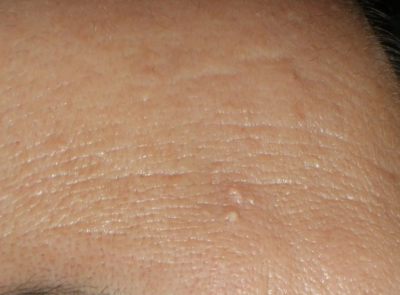
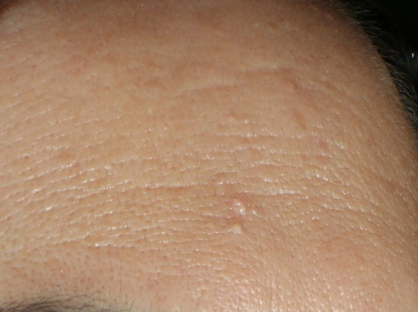
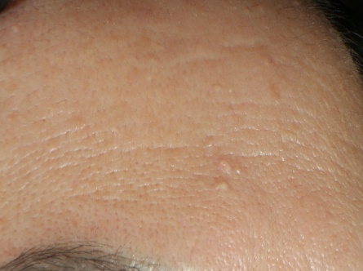
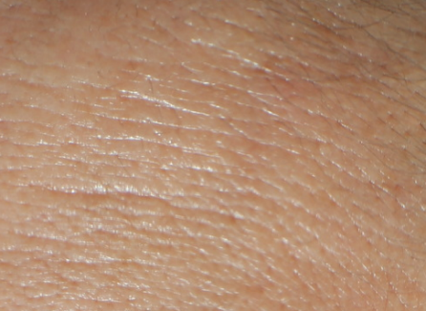
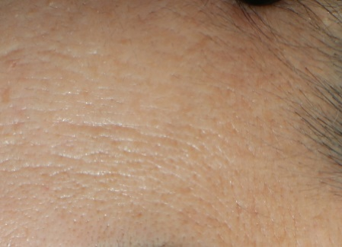
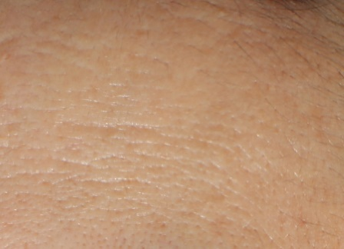
1% ETERWELL™ YOUTH + 1.5% SYN®-COLL CB
ETERWELL™ YOUTH + SYN®-COLL CB smoothens forehead wrinkles
Volunteer 11
Forehead Right (age 52)
-11% forehead wrinkle volume in 4 weeks
2x significantly better than SYN®-COLL CB alone
BASELINE
4 WEEKS
8 WEEKS
°°°
Skin Visia images
°°°
1.5% SYN®-COLL CB
°°°
**
Volunteer 11
Forehead Left (age 52)
°°°
**
**
4 weeks
8 weeks
1.5% SYN®-COLL CB alone is significantly better than baseline
BASELINE
4 WEEKS
8 WEEKS
°p < 0.05, °° p < 0.01, °°°p < 0.001 compared to baseline
*p < 0.05, ** p < 0.01, ***p < 0.001 compared to 1.5% SYN®-COLL CB formulation
8

Slide 9
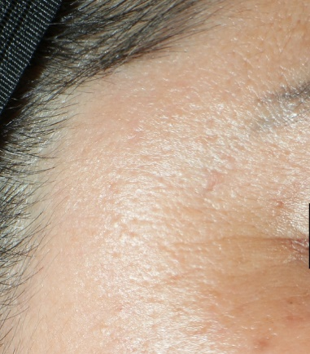
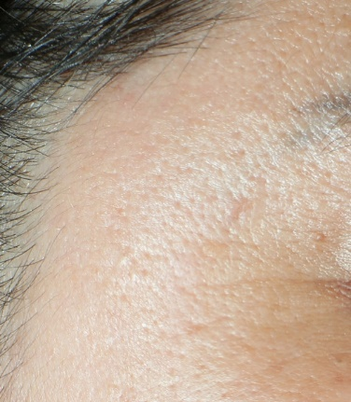
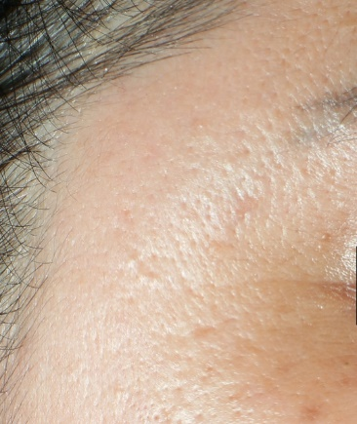
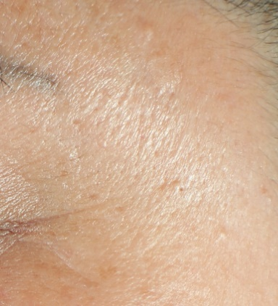
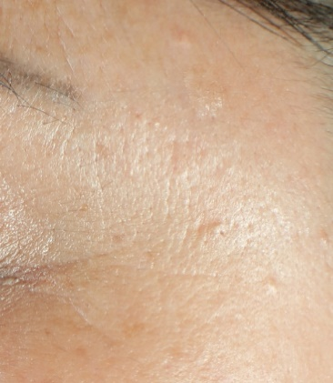
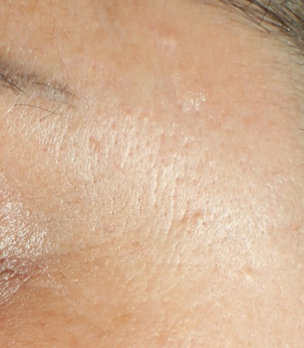
1% ETERWELL™ YOUTH + 1.5% SYN®-COLL CB
ETERWELL™ YOUTH + SYN®-COLL CB reduces crows’ feet wrinkles’ volume
Volunteer 11
Forehead Right
(age 57)
-13% crows’ feet wrinkles’ volume in 4 weeks
2x significantly better than SYN®-COLL CB alone
BASELINE
4 WEEKS
8 WEEKS
Skin Visia images
°°°
°°°
1.5% SYN®-COLL CB
°°°
Volunteer 11
Forehead Left
(age 57)
*
°°°
**
4 weeks
8 weeks
1.5% SYN®-COLL CB alone is significantly better than baseline
BASELINE
4 WEEKS
8 WEEKS
°p < 0.05, °° p < 0.01, °°°p < 0.001 compared to baseline
*p < 0.05, ** p < 0.01, ***p < 0.001 compared to 1.5% SYN®-COLL CB formulation
9

Slide 10
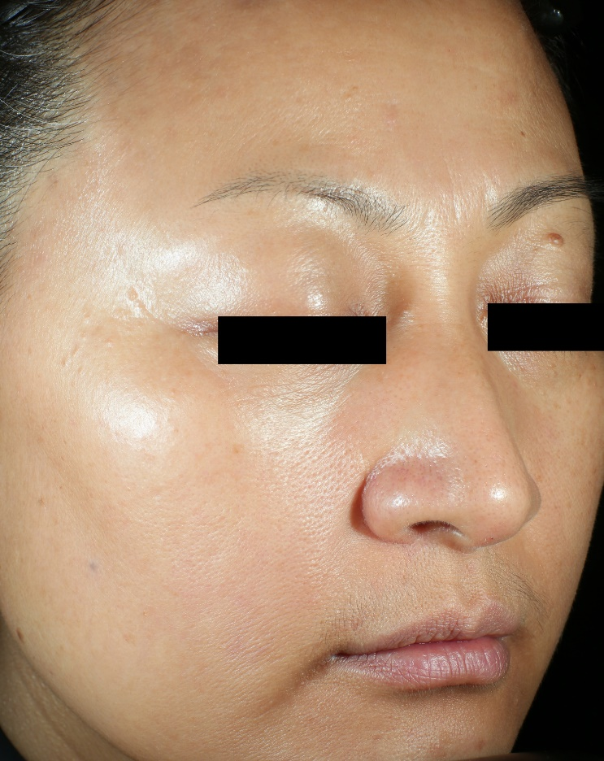
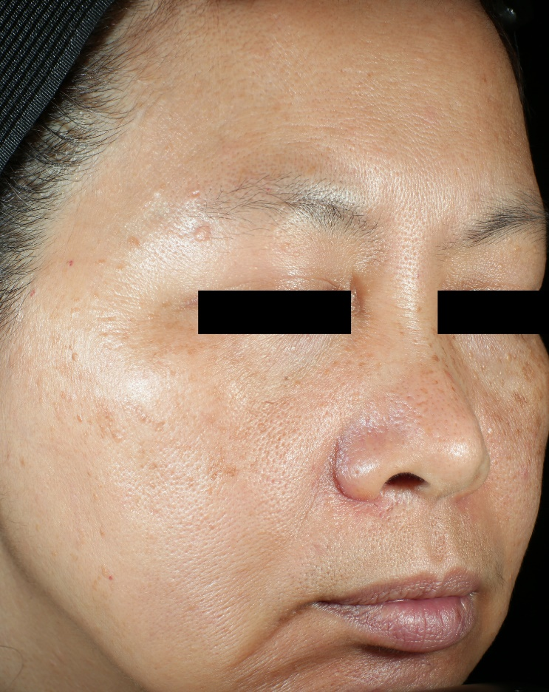
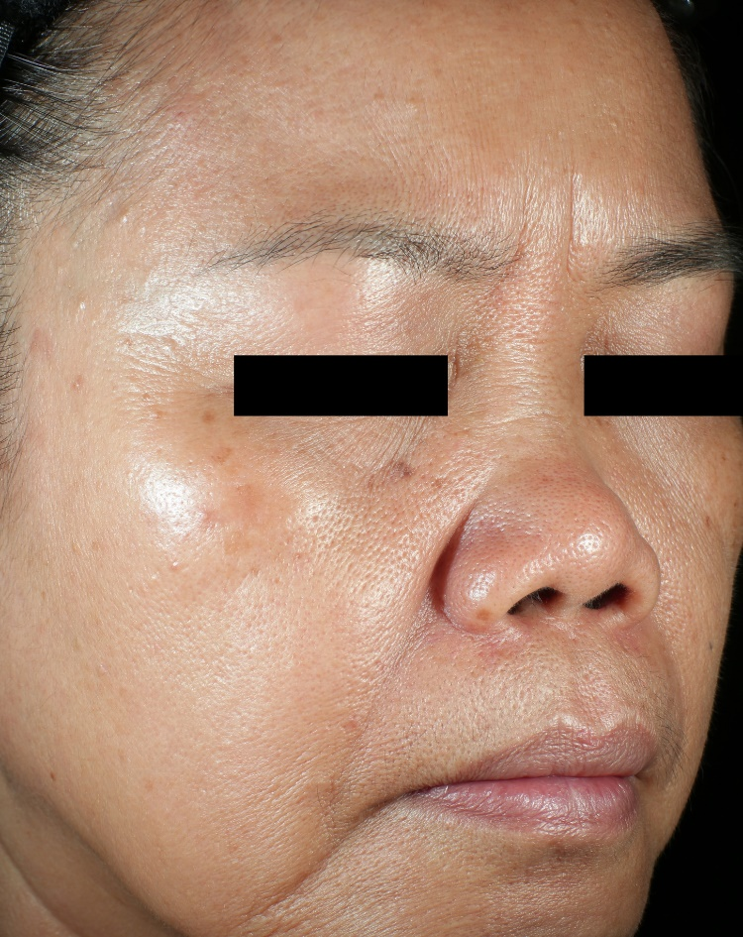
Pore size: a visible readout of dermal matrix fatigue
Pores size is one of the most challenging signs of aging to reverse. As skin sags, pores stretch and become more visible.
Reduced collagen and skin elasticity are key contributors to enlarged pores.
The visibility of facial pores emerges as a highly influential trigger of age perception among Asian populations ¹.
AGE 47
AGE 54
AGE 61
Pictures from dsm-firmenich 2025 ETERWELL™ YOUTH + SYN®-COLL CB clinical study show increased visibility of pores over lifetime
¹ Source: "Facial skin aging and perceived age: A multiethnic and multidisciplinary study“ by Rainer Voegeli et al., published in the International Journal of Cosmetic Science
10

Slide 11
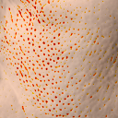
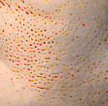
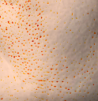
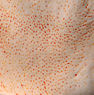
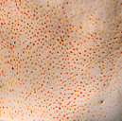
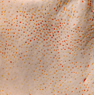
1% ETERWELL™ YOUTH + 1.5% SYN®-COLL CB
ETERWELL™ YOUTH + SYN®-COLL CB
refines pores
Volunteer 4
Cheek Left
(age 52)
- 14% pore number, -16% pore volume after 4 weeks
2x significantly better than SYN®-COLL CB alone
°°
°°
°°°
BASELINE
4 WEEKS
8 WEEKS
*
°°°
*
Skin Antera images
4 weeks
8 weeks
°°°
1.5% SYN®-COLL CB
°°°
°°°
Volunteer 4
Cheek Right
(age 52)
°°°
*
°°
°°°
*
°°°
**
°°°
**
4 weeks
8 weeks
BASELINE
4 WEEKS
8 WEEKS
1.5% SYN®-COLL CB alone is significantly better than baseline
°p < 0.05, °° p < 0.01, °°°p < 0.001 compared to baseline
*p < 0.05, ** p < 0.01, ***p < 0.001 compared to 1.5% SYN®-COLL CB formulation
11

Slide 12

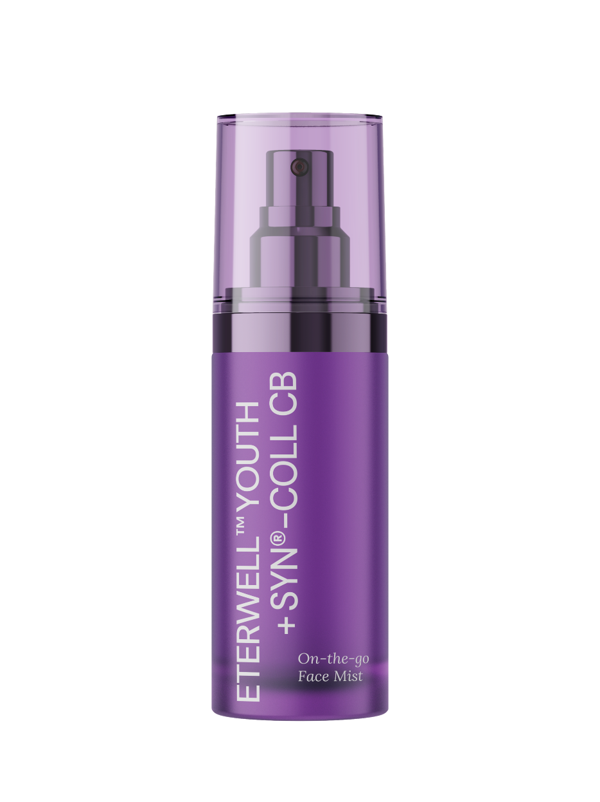

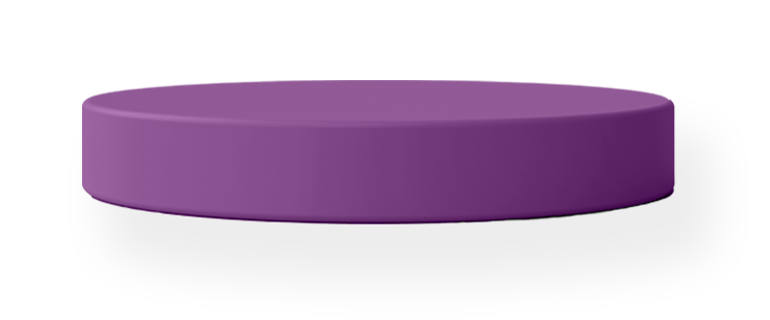
ON-THE-GO
FACE MIST
99.88% Natural Origin
1.5% SYN®-COLL CB + 1% ETERWELL™ YOUTH
with Mixed Tocopherols 95 and ARGAN OIL
Extra care anytime, anywhere?
Enjoy a light refreshing boost when
your skin needs it most.
Advanced slow-aging science on demand:
SYN®-COLL CB, a powerful pro-collagen tripeptide, supercharged by cutting-edge
senolytic active ETERWELL™ YOUTH
for optimal skin longevity.
Get plumper, firmer and smoother skin… for longer!
Responsibly and fairly produced,
with minimal environmental impact
and maximum results. A compromise-free sustainable solution, transforming skin
while respecting people and planet.
12
SK-E-102825-5

Slide 13
Disclaimer
Copyright © dsm-firmenich Switzerland AG, 2026, 4002 Basel, Switzerland.
www.dsm-firmenich.com. All rights reserved.
dsm-firmenich has used diligent care to ensure that the information provided herein is accurate and up-to-date to the best of its knowledge. However, dsm-firmenich makes no representation or warranty, either expressly or implied, of the accuracy, reliability, completeness, or suitability thereof. The information provided herein contains scientific and product information for business-to-business use and does not constitute or provide scientific or medical advice, diagnosis or recommendation for treatment options. Country or region-specific information should be considered when labelling or advertising to final consumer. In no event shall dsm-firmenich be liable for any direct or indirect damages arising from or reliance upon, or use of, any information provided herein. The content of this document is subject to change without further notice. Please contact your local dsm-firmenich representative for the latest information. All trademarks listed in this document are either (registered) trademarks of, or trademarks licensed by, the dsm-firmenich group of companies, unless explicitly stated otherwise.
Disclaimer Formulation Guideline
The information provided herein is provided for information purposes only and has been prepared by dsm-firmenich in accordance with its own methodology.
dsm-firmenich has used diligent care to ensure that it is accurate and up-to-date, however, dsm-firmenich makes no representation or warranty, either expressly or implied, of the accuracy, reliability, or completeness thereof. In no event shall dsm-firmenich be liable for any damages arising from or reliance upon, or use of, any information provided herein. Further, dsm-firmenich shall not bear any liability for the application and/or use of any processed material containing its product(s). The formulation of the finished product is the customer’s sole responsibility. It is the customer’s responsibility to determine the suitability of dsm-firmenich’s products regarding user specific purposes, assess compatibility and stability of their finished product(s) and to ensure compliance of their finished product(s) with relevant laws and regulations. Any product, marketing or other claims made by customer are its sole responsibility. The content of this document is subject to change without further notice. Please contact your local dsm-firmenich representative for further details. © dsm-firmenich Switzerland AG, 2026.
© 2026

Slide 14
© 2026

