Slide 1
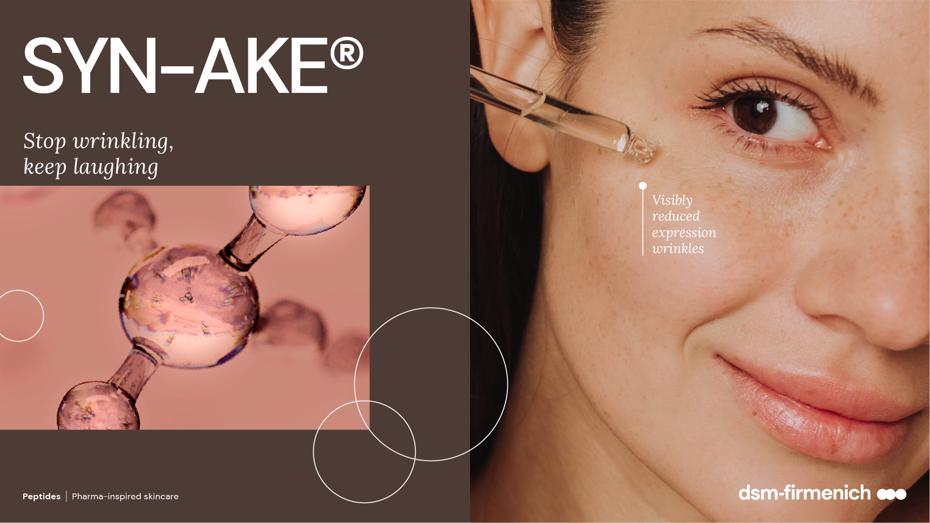
February 2026

Slide 2

Agenda
1
Market background
2
SYN-AKE® all-in-one solution
3
Mode of action & in vitro proof
4
In vivo validation
5
Products Line-up

Slide 3
01
Market background
3

Slide 4

Well-aging solutions’ consumer base keeps expanding
The population is aging
65+ will more than double globally by 2050, representing up to 20% of the entire population
The new generation of mature consumers is more empowered and in control than in the past
The fight against aging starts younger
Millennials started using anti-aging products in
their 20s, more than 20 years earlier than previous
generations - focusing on preventing, rather than reversing, the signs of aging.
Source: DSM Trend Landscape

Slide 5
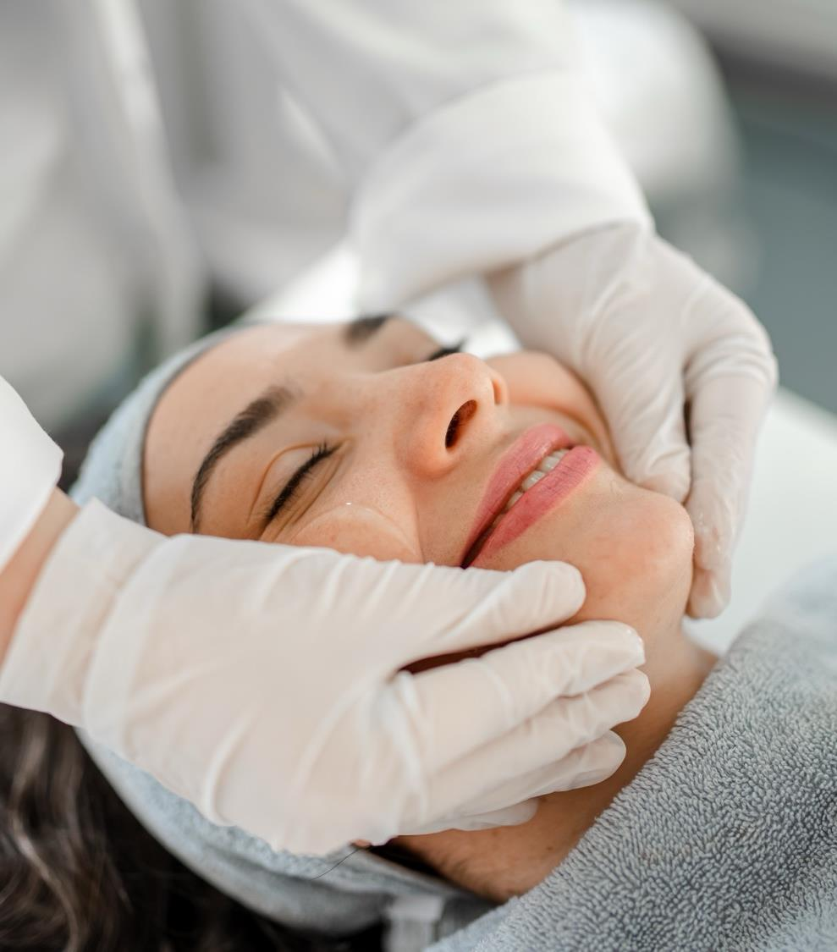
“Medical Beauty”
A fast-growing trend
Growing acceptance of cosmetic surgery with opportunities for skincare products to support pre- and
post-procedures or to mimic surgical results without the pain and cost.
Surgery and beyond:
Clinics’ patients can choose from a wide range of options like surgery and minimally-invasive fillers, peels, devices and treatments. “Preventive Botox” amongst 20-29 y.o. has increased double digit in the past years.
Topical products:
High-efficacy skincare is booming
Source: DSM Trend Landscape

Slide 6
02
SYN-AKE®,
all-in-one medical beauty solution

Slide 7
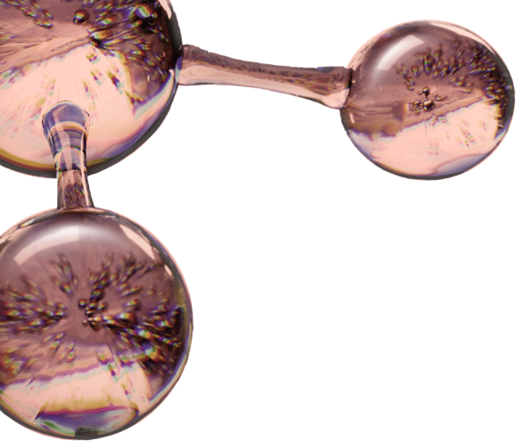
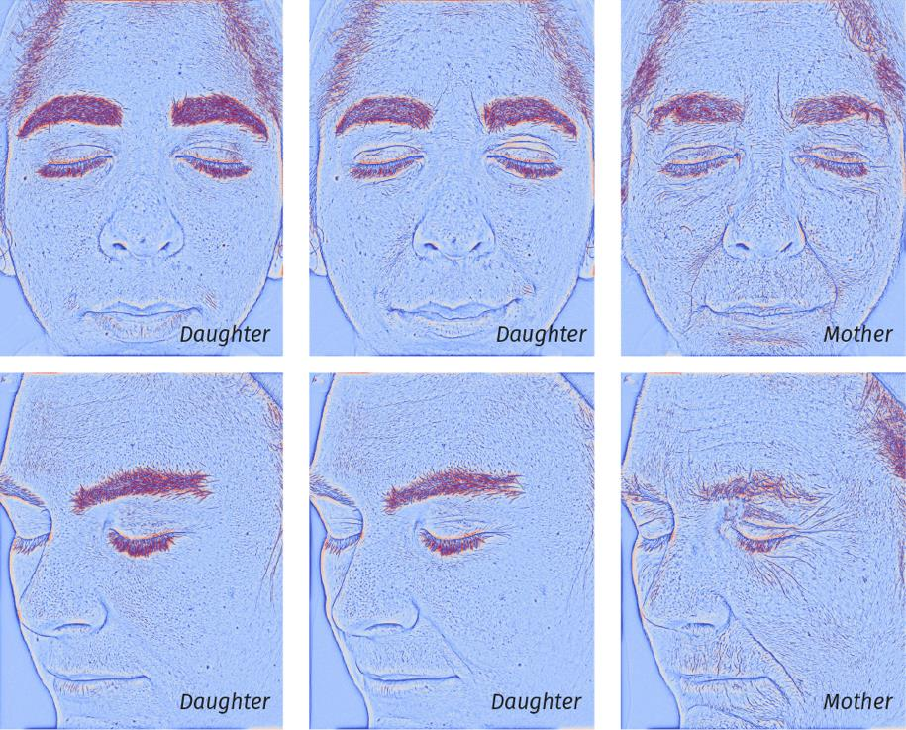
Wrinkles can originate from facial expressions
SKIN CONCERN
Mimic wrinkles
Over time, repetitive facial movements can lead to visible, persistent wrinkles
Relaxed
Expressive
Relaxed
Mimic wrinkles progression
Image transition of relaxed-face daughter to angry-face daughter to relaxed-face mother shows that where daughter only has expression lines related to momentaneous facial contraction, mother already shows persistent mimic wrinkles in relaxed-face mode in the same areas
Front
Volunteer #90 (age 24), Volunteer #89 (age 60)
Left
Volunteer #37, age 21, Volunteer #38, age 56

Slide 8
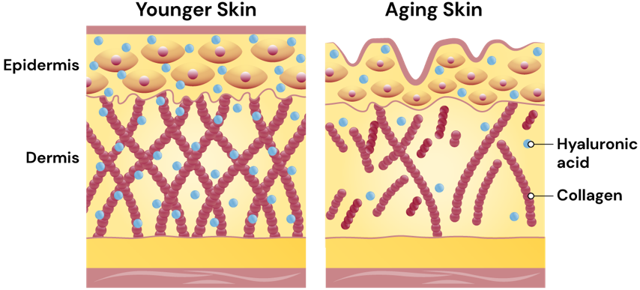
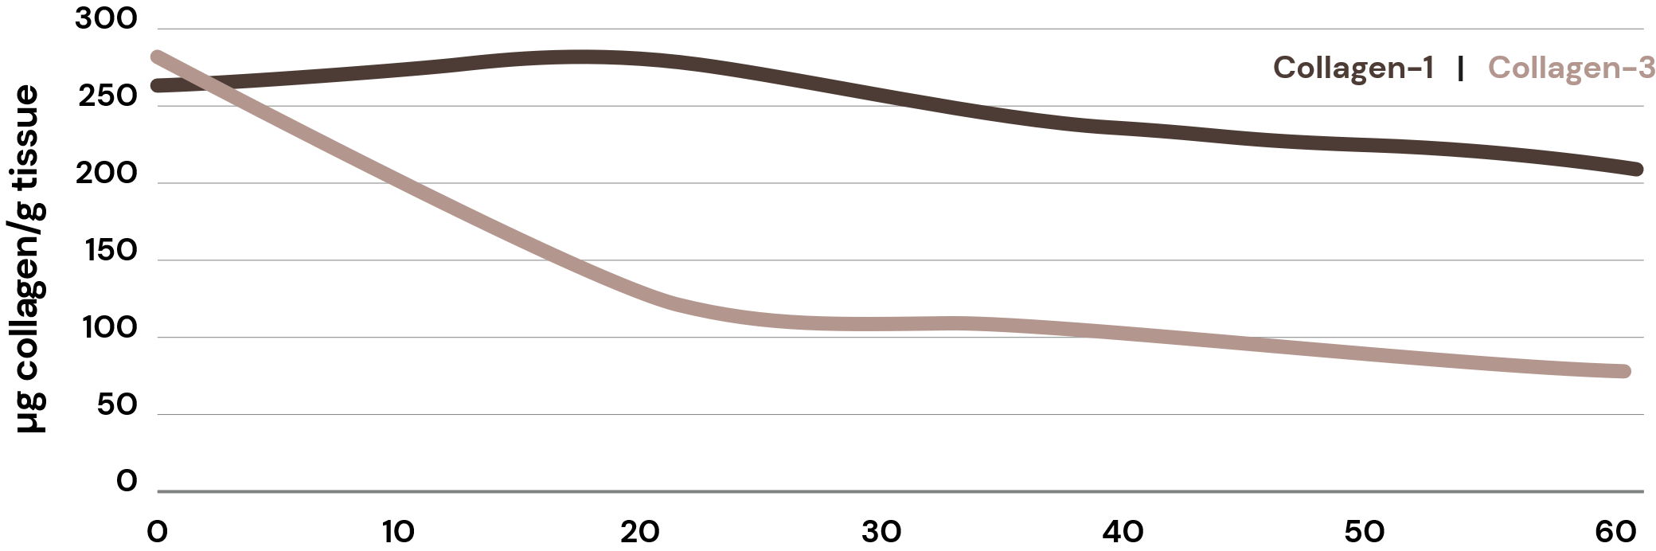
The appearance of deep wrinkles also relates to compromised dermis structure
SKIN CONCERN
Deep wrinkles
Over time skin works less efficiently
Profound changes occur in the structure of the dermis and epidermis over time, through processes of intrinsic and extrinsic aging, leading to deep wrinkle appearance and dry skin:
With age, the Collagen density in the Dermis decreases and its network becomes increasingly fragmented, presenting shorter and less organized fibers. At the same time, Hyaluronic Acid is degraded. This is also associated with a reduction in dermal thickness.
An increase in matrix metalloproteinase (MMP) expression accelerates the Collagen degradation. In parallel, the synthesis of new extracellular matrix components by dermal fibroblasts slows down, failing to adequately replace the degraded matrix.
Asserin et al. (2015) J Cosmet Dermatol, 14, 291-301
Papakonstantinou et al. (2012) Dermato-Endocrinol 4:3, 253–258

Slide 9

Sebum imbalance can trigger blemishes and inflammation
SKIN CONCERN
Sebum imbalance
The face has many sebaceous glands that produce sebum or oil.
Sebum exists to help protect the surface of the skin and helping to retain moisture in the deeper layers.
However, excessive sebum production can result in oily or greasy skin and can cause congestion and enlargement of pores, inflammation, and ultimately lead to skin conditions like acne and breakouts.

Slide 10
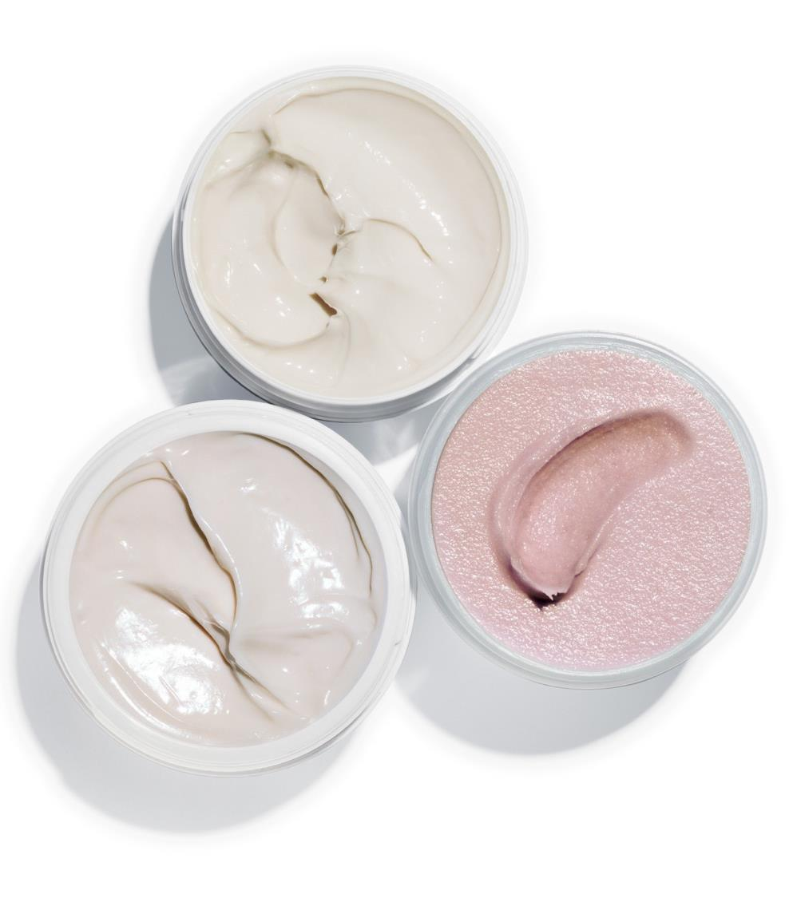
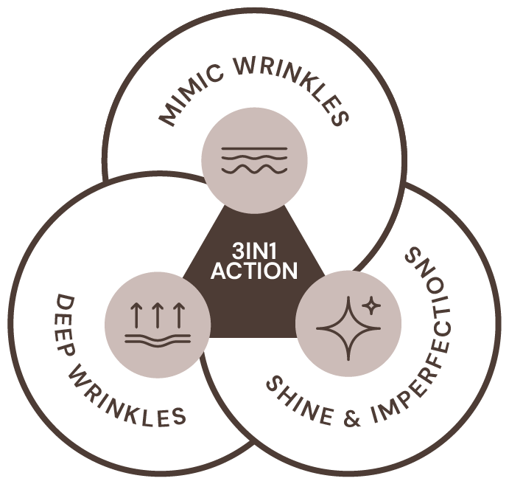
SYN®-AKE
The all-in-one medical beauty solution
Highly potent patented biomimetic tripeptide:
Helps skin to look relaxed, visibly reducing and preventing mimic wrinkles (botox-inspired efficacy)
Re-densifies skin from within, smoothening
deep wrinkles (filler-inspired efficacy)
Mattifies skin and improves texture
For healthy-looking skin and confidence boost!

Slide 11
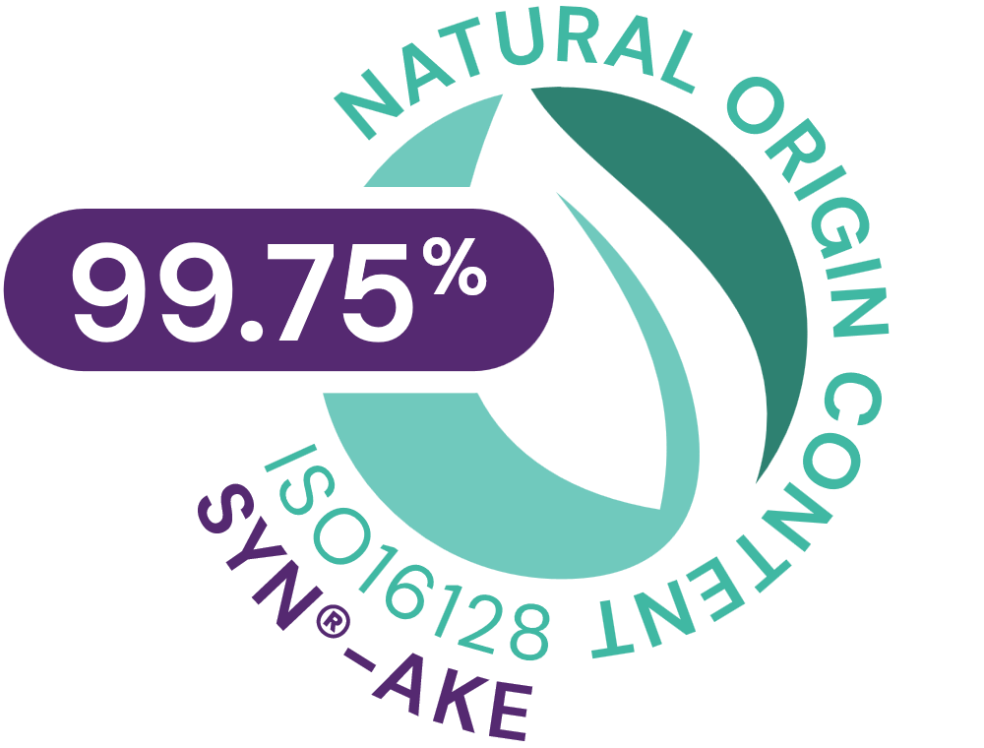






SYN®-AKE
ID Card
INCI NAME:
Dipeptide Diaminobutyroyl Benzylamide Diacetate, Glycerin, Aqua
Inspired by the power of nature
Highly potent biomimetic tripeptide, made by cutting-edge SYN®-Peptide technology to mimic the essential amino acid sequence of Waglerin-1, a natural occurring polypeptide with a strong ability to relax muscle contraction
In silico model shows that SYN®-AKE peptide is able to fit into the catalytic binding site of DPP4 (Dipeptidylpeptidase 4)
TFA-free¹
99.75% of natural origin (according to ISO 16128)
TECHNOLOGY:
TECHNICAL:
Form: Liquid
pH of use: 3.0-7.5
Use level: 1-4%
Preservative: Free
Solubility: Miscible in water
BENEFITS:
Reduces muscle cell contractions: immediately, long-lasting and fully reversibly*
Up to 47% inhibition of muscle nicotinic acetylcholine receptor (maAChR)*
Stimulates PLOD3² activity, important for the stability of intermolecular collagen crosslinks*
Controls DPP4, a potential target linked to sebaceous gland activity*
Helps skin to relax without losing the ability to express**
Visibly reduce lines and wrinkles on three different skin tones**
Wrinkles reduction across age groups**
Can delay wrinkles’ appearance up to 5 years**
Mattifies skin and improves texture **
REGISTRATION
CERTIFICATION:
1. Non-intentionally added TFA; 2. procollagen-lysine, 2-oxoglutarate 5-dioxygenase 3
* in vitro ** in vivo

Slide 12
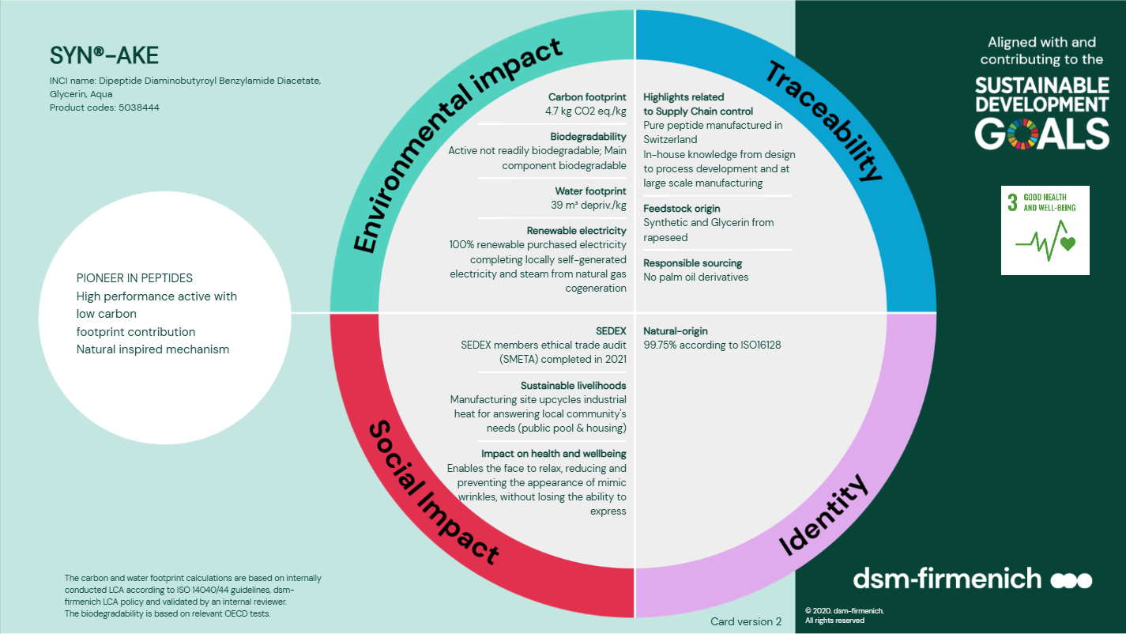

Slide 13
03
Mode of action
& in vitro proof

Slide 14

Inspired by the power of nature
Scientific mode of action
Found in Temple Viper Venom, Waglerin-1 is naturally occurring polypeptide with a strong ability to relax muscle contraction
SYN®-AKE is a biomimetic tripeptide, with unique amino acid sequence (Beta-Ala-Pro-Dab-NH-Bzl) mimicking Waglerin-1 functionality, for Botox-like efficacy
Scientific evidences not intended to be final product claim.

Slide 15

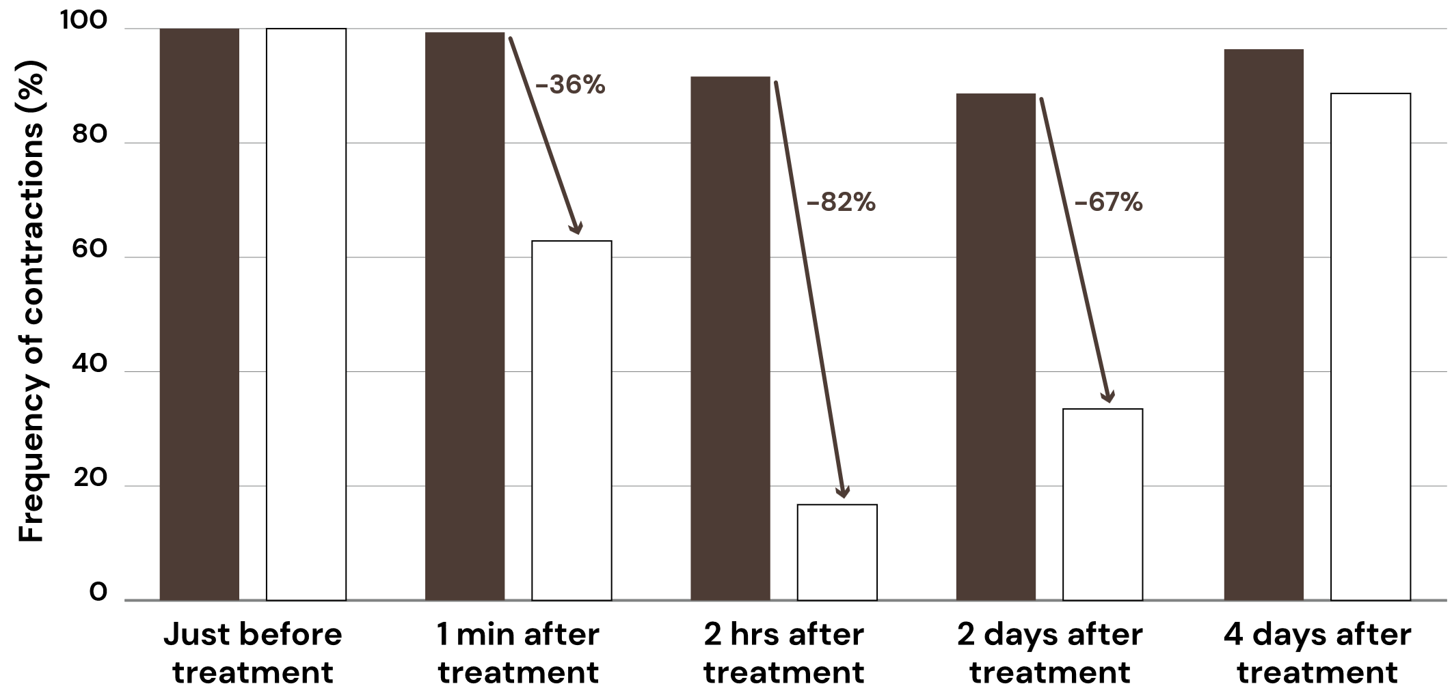
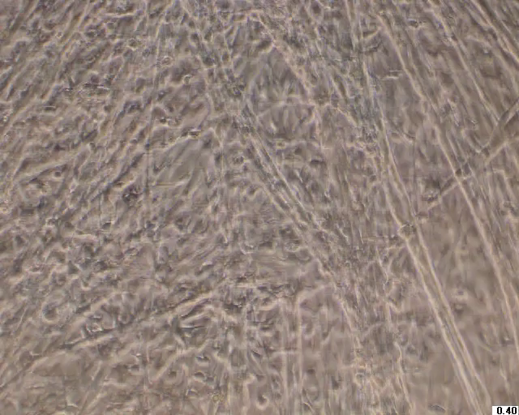
SYN®-AKE helps skin to look relaxed
In
vitro
Proven in vitro to reduce muscle cell contractions: immediately, long-lasting and fully reversibly
In vitro muscle cell culture, the frequency
of the muscle cell contractions
Peptide concentration: 0.5 mM
*
SYN®-AKE (0.5 mM) visibly reduces muscle
cell contractions after 1 min
*p<0.05
Cell contraction action is related to scientific evidences (in vitro) and is not intended to be final product claim

Slide 16
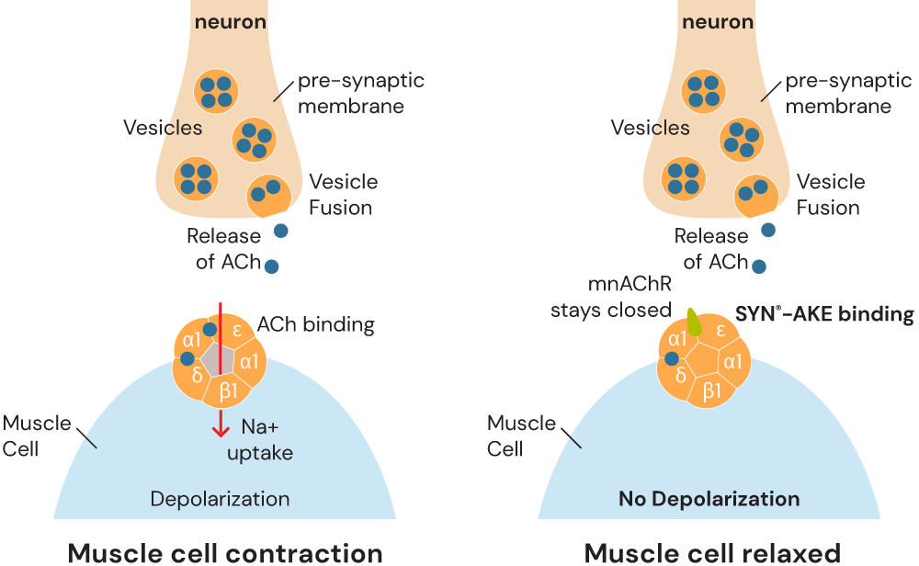

SYN®-AKE mode of action
In
vitro
A muscle nicotinic acetylcholine receptor (maAChR)
  SYN®-AKE peptide binds to Acetylcholine receptor and inhibits the uptake of Acetylcholine leading to muscle relaxation.
  Up to 47% inhibition of
  Nicotinic Acetylcholine receptor

Slide 17
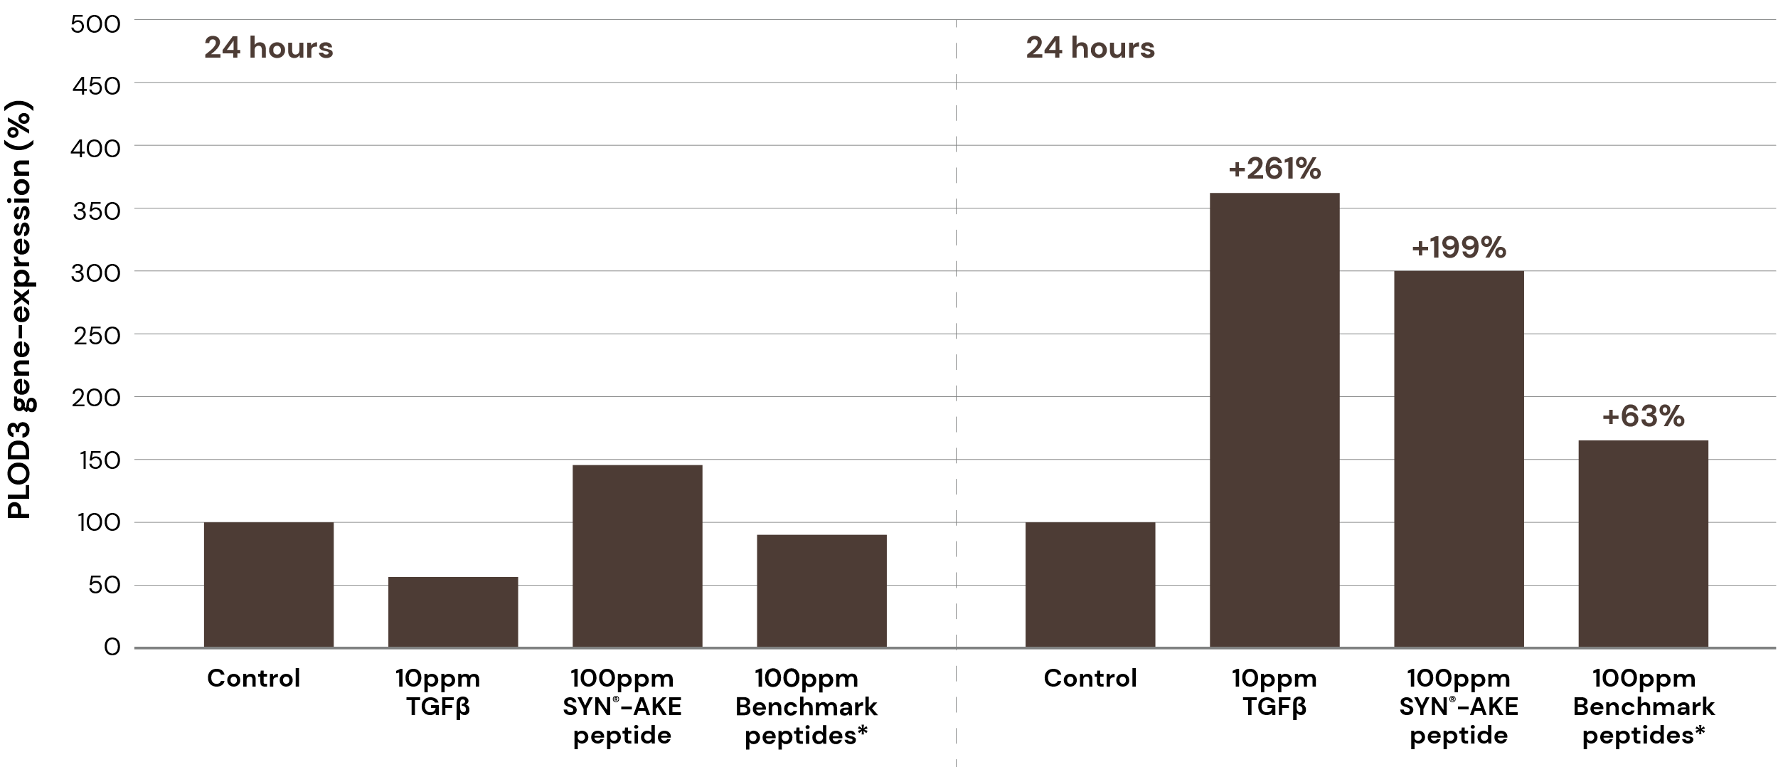

SYN®-AKE improves collagen fiber quality
In
vitro
It helps skin to auto-repair and look replenished, outperforming competition
Relative PLOD3 gene-expression in dermal fibroblasts of a 18-year-old female donor
Relative PLOD3 gene-expression in dermal fibroblasts of a 63-year-old female donor
Dermal & DEJ
Collagen fibres quality
+387%
positive PLOD3
induction in vitro
PLOD3 key biological entity
to assemble Collagen
Patent publication discloses to the use of
SYN®-AKE peptide for revitalizing, strengthening and increasing the integrity of collagen fibres, increasing skin elasticity and resiliency, improving skin moisturization and skin firmness and reducing skin pore size.
Tests performed on human dermal fibroblasts young (18) and old donor (63), in partnership with GLP external Institute
Measured by rt-PCR on a LightCycler Device (Roche Molecular Diagnostics Inc). Experiment was done in duplicates.
* Palmitoyl Oligopeptide and Palmitoyl Tetrapeptide-7
Notes:
Why PLOD3? Our work, and research related to the structure of collagens, led to the discovery of a potential new cosmetic target PLOD3, a key biological entity to assemble collagen. DSM research detected positive induction of PLOD3 gene-expression by SYN-AKE peptide in dermal fibroblast of a 63-year-old female donor.
Target found by bibliographies and gene-expression screening for SYN-AKE peptide on markers of extra cellular matrix synthesis. The screening was done on dermal fibroblasts of a young (18-year-old) and old (63-year-old) female donor. Gene-expression was measured by rt-PCR on a LightCycler device. Specific induction of PLOD3 by SYN-AKE peptide compared to main anti-aging benchmark peptide mix.
SYN-AKE was subjected to dermal fibroblasts of an 18-year-old and a 63-year-old female donor. Gene-expression of genes involved in extracellular matrix formation was studied. We identified an age-specific induction of gene PLOD3 by SYN-AKE. PLOD3 and its protein product LH3 (Lysyl hydroxylase 3) is responsible for the formation and processing of pro-collagen molecules. It hence improves the quality of collagen fibres. SYN-STAR therefore complements our range of peptides involved in extracellular matrix formation like SYN-COLL which acts on the amount of collagen.
SYN-AKE peptide hence regulates the formation and processing of pro-collagen molecules in therefore improves collagen fibre quality. This should lead to a cosmetically relevant improvement of wrinkles and lead to smoother skin.
Figure 1.
Gene-expression analysis of PLOD3 on dermal fibroblasts from a 63-year-old female donor (right) and an 18-year-old female donor (left). SYN-AKE peptide did induce PLOD3 in fibroblasts of a 63-year-old donor up to 387% in a dose-dependent manner. This induction was specific to the 63-year-old donor because it was not seen in fibroblasts from an 18-year-old donor (The decrease in expression at 500ppm in the 18-year-old donor is here considered background variation). TGF-beta served as positive control. The “benchmark”- mixture Palmitoyl oligopeptide and palmitoyl-tetrapeptide-7 had almost no effect on PLOD3 gene-expression. Measurements were done in duplicates. All measurements were done at non-cytotoxic concentrations of the compounds previously assessed by MTT-assay.
10 ppm = 0.001%
100 ppm = 0.01%
500 ppm = 0.05%

Slide 18
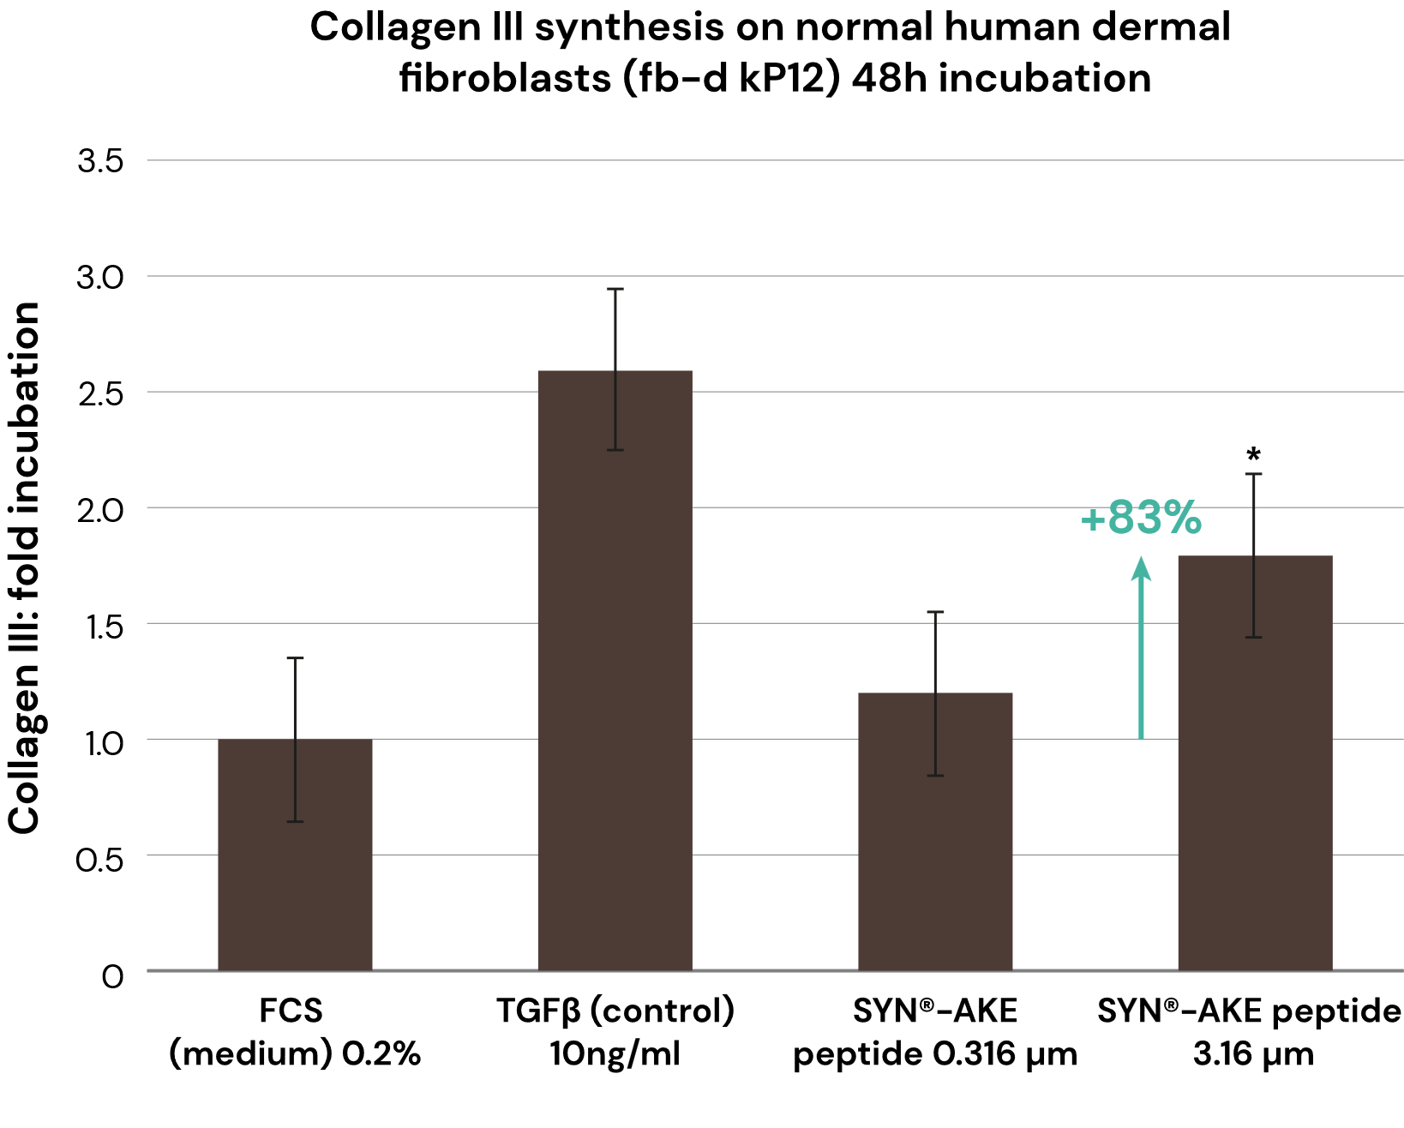
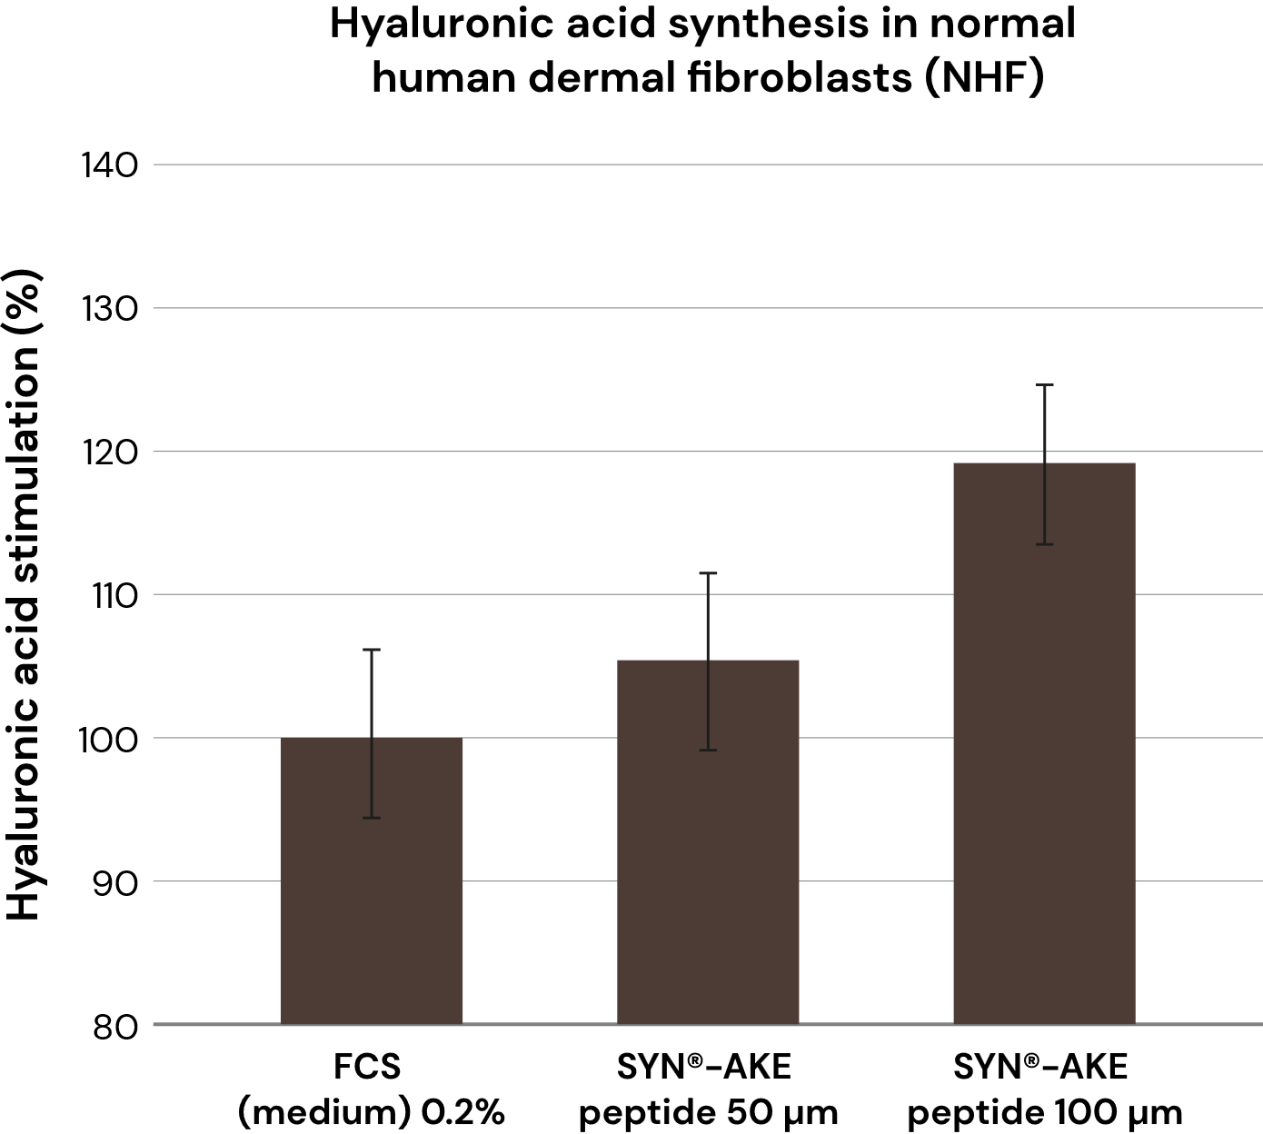
SYN®-AKE re-plumps skin from within
In
vitro
It stimulates Collagen III and Hyaluronic acid synthesis
+20%
*p<0.05 vs FCS 0.2%
Notes:
Human dermal fibroblasts were treated with test compounds or controls as indicated and incubated for 48 hours. Collagen III was detected using an antibody directed to collagen III in fixed cells. Hyaluronic acid was measured in the supernatant using an ELISA kit (Echelon K-1200).
100 uM = 0.005%
50 uM = 0.0025%
3.16 uM = 0.000158%
10 ng/ml = 0.001%

Slide 19
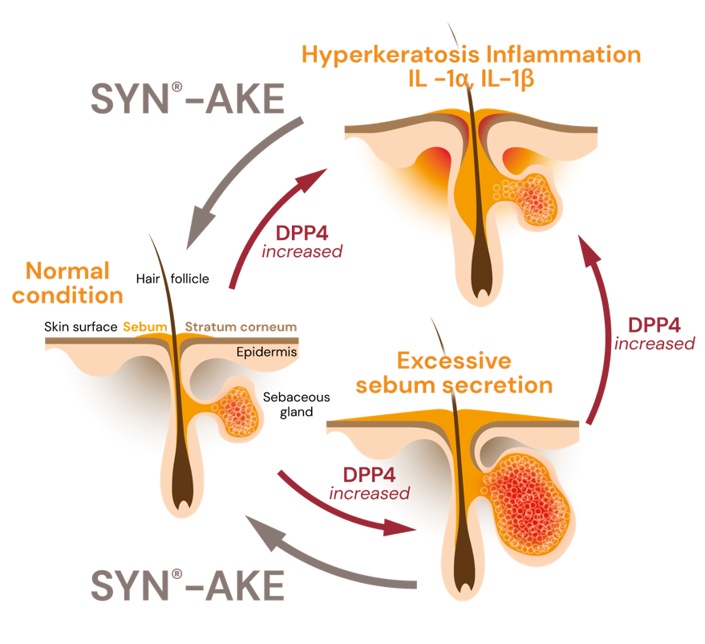
SYN®-AKE inhibits DPP4 activity
In
vitro
DPP4 (dipeptidylpeptidase 4) identified as a novel potential target linked to sebaceous gland activity and skin inflammation
DPP4 is a key enzyme in various skin-based biological processes and its excess activity can result in sebum over-production, inflammation, keratinocyte hyper-proliferation and delayed wound healing.
Visible effects of DPP4 overactivity include greasy, shiny skin, irritation, redness, pimples and small lesions in skin.
These skin imperfections are further impaired by pollution and accelerate the aging process.
Notes:
Why DPP4?
DPP4 (dipeptidylpeptidase 4) identified as a novel potential target linked to sebaceous gland activity.
It is a key protease in various skin-based biological processes and its excess activity can result in sebum over-production, inflammation, keratinocyte hyper-proliferation and delayed wound healing.
Visible effects of DPP4 overactivity include: greasy, shiny skin, irritation, redness, pimples and small lesions in skin. These skin imperfections are further impaired by pollution and finally accelerate the aging process.

Slide 20
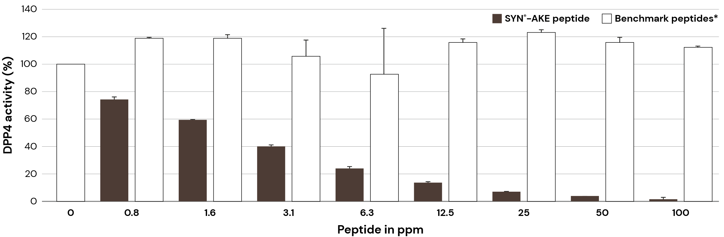
SYN®-AKE inhibits DPP4 activity
In
vitro
Experimental data from DPP4 activity assay kit with comparison of SYN®-AKE peptide to the anti-aging peptides. Dose dependent inhibition is observed with SYN®-AKE peptide whereas the anti-aging peptides were ineffective.
Tests performed in tubo DPP4 assay kit.
DPP4 Control
High specific activity
Novel potential
target linked to
sebaceous activity
Patent publication discloses the use of
SYN®-AKE peptide as DPP4 inhibitor for treatment of disorders of sebaceous glands
such as acne, sebaceous hyperplasia, seborrheic/atopic dermatitis and rosacea.
* Palmitoyl Oligopeptide and Palmitoyl Tetrapeptide-7
**p<0.01 vs benchmark peptide
Notes:
100 ppm = 0.01%
50 ppm = 0.005%
etc.
DPP4 activity and inhibition was measured using a kit (Abnova, KA1311) containing human recombinant DPP4. The assay uses the fluorogenic substrate, Gly-Pro-Aminomethylcoumarin (AMC), to measure
DPP (IV) activity. Cleavage of the peptide bond by DPP releases the free AMC group, resulting in fluorescence that can be analyzed using an excitation wavelength of 350-360 nm and an emission wavelength of 450-465 nm.
**p<0.01 vs benchmark peptide

Slide 21
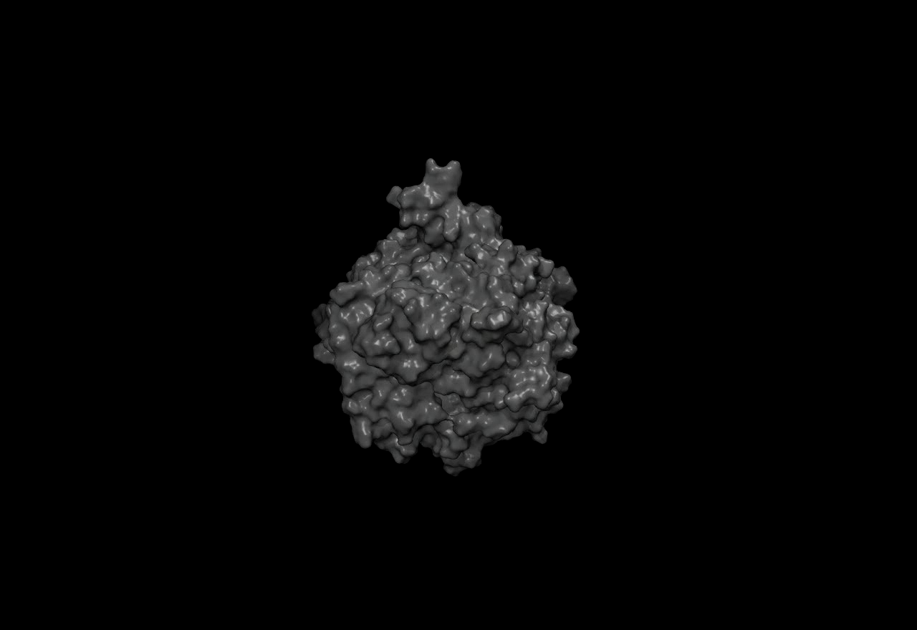
Computational chemistry
Understanding the activity at a molecular level
In silico docking results
In silico docking of SYN®-AKE to the DPP4 protein structure used to predict potential mode of binding (see figure)
The proposed binding mode of SYN®-AKE shows the DAB positively charge NH₃⁺ moiety forming a tight hydrogen bond network around the Glu205 and Glu206 residues and the Benzyl residue occupies the S1 pocket, similarly to other DPP4 inhibitors. The S2 pocket is occupied by the Proline-Beta-Alanine moiety of SYN®-AKE. The Proline group sits above Phe357 forming hydrophobic interactions with this residue. The terminal Beta Alanine extends deep into the S2 pocket forming two favorable H-bond interactions with Arg669 and Ser209.

Slide 22
04
In vivo validation

Slide 23

Proven results across multiple focus areas
In
vivo
Forehead
Glabella
Crow’s feet
Nasolabial
Upper lip
Marionette lines

Slide 24



3 major previous Clinical Studies
In
vivo
Collecting compelling substantiation
Clinical study #1
4-week study
Clinical study #2
4-week study
Clinical study #3
4-week study
Target group:
Females 41-60 y.o.
Application:
2x per day, full face
15 volunteers per group:
Placebo
SYN®-AKE (4%)
Double-blind study
Target group:
Females 41-64 y.o.
3 different skin tones
Application:
2x per day, full face
50 volunteers
per skin tone:
25 Placebo
25 SYN®-AKE (4%)
Double-blind study
Two target groups:
50-65 y.o. (‘Mothers’)
21-35 y.o. (‘Daughters’)
Application:
2x per day, full face
25 volunteers per group:
Placebo
SYN®-AKE (4%)
Double-blind study
Notes:
Study design:
Double blind and intra-individual study
Before / After measurements
15 volunteers per group (female, age 41-60)
28 days applied twice daily on face
Evaluation of anti-wrinkle effect with Primos 3D®.
Crow‘s feet and forehead
SYN®-AKE (4%) compared to Acetyl hexapeptide-3 solution (10%) - equals the commercial product-, and Placebo

Slide 25




SYN®-AKE Satisfaction Test
Volunteers’
assessment
Consistent beauty improvements for all women
Results on 40+
SYN®-AKE makes my skin visibly smoother
SYN®-AKE makes my skin visibly
less shiny
SYN®-AKE makes my skin visibly more beautiful
83%
“totally agree”/“rather agree”
“totally agree”/“rather agree”
“totally agree”/“rather agree”
of women feel
more
confident
Clinical study No. 2: Results on 41-64 y.o. group

Slide 26

Skin feel & perceptions
Volunteers’ self-assessment
Results on 20-35 y.o.
“After the application…”
96%
92%
88%
My skin
feels relaxed
I feel relaxed
My skin
feels smooth
84%
84%
My skin feels supple
Healthy skin look
Study
Notes:
Result of the self-assessment questionnaire as returned by the daughter group for the SYN®-AKE formulation.

Slide 27
In vivo efficacy on
mimic wrinkles
40+ y.o.

Slide 28
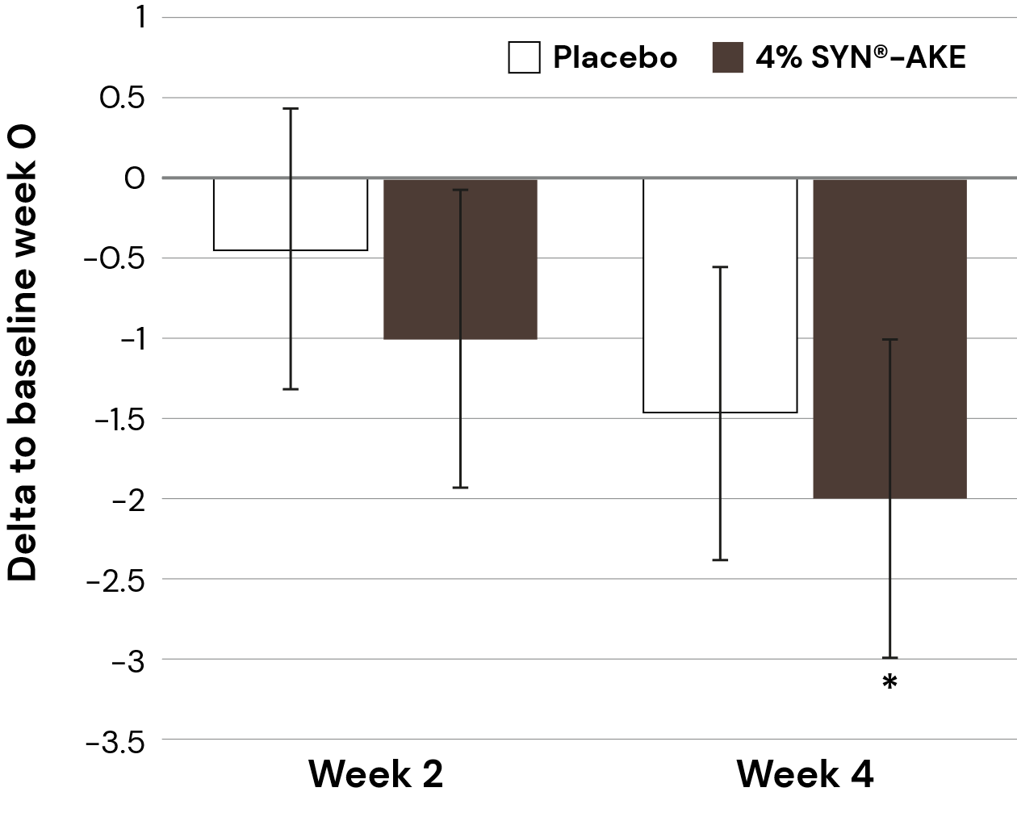
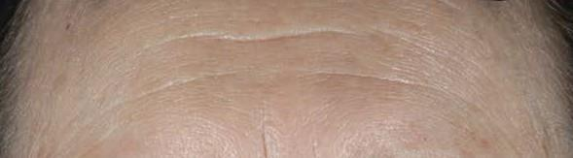
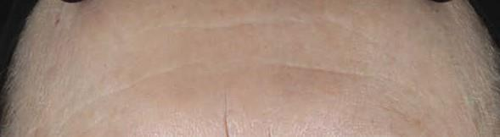
“Worry-less” forehead with SYN®-AKE
In
vivo
-1 wrinkle in 2 weeks, -2 wrinkles in 4 weeks
Forehead
Forehead wrinkle count
Volunteer #139, age 62
Baseline
After
4 weeks
Clinical study No. 2: Wrinkle analysis with Primos^{lite} after 2 and 4 weeks of treatment with 4% SYN®-AKE
* P<0.1 vs baseline
Notes:
Wrinkles in the mother group were measured on the forehead using Primos^{lite} 3D imaging device. Average forehead wrinkle count decreases by 1 after 2 weeks, and 2 wrinkles after 4 weeks in the 4% SYN®-AKE group. The VISIA images on the left shows a before and after of a distinct volunteer.

Slide 29
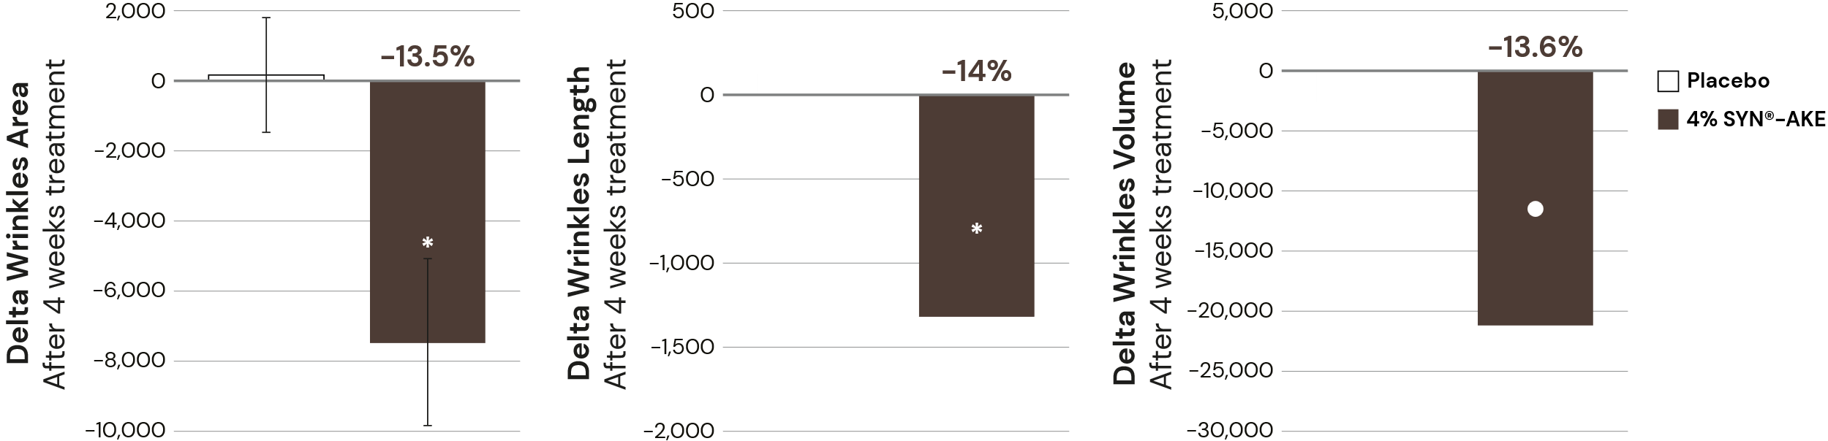
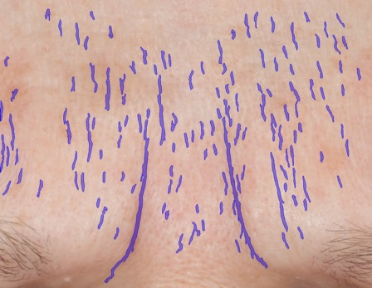
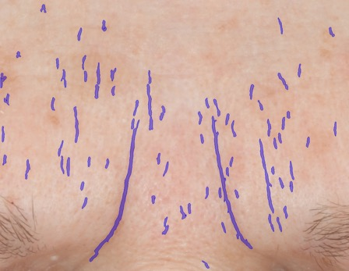
SYN®-AKE helps skin to look relaxed
In
vivo
Without losing the ability to express
Glabella
Glabella wrinkles,
expressive face
Before
After
Computer-based wrinkle segmentation shows a decrease in wrinkle formation after 4 weeks application of the 4% SYN®-AKE formulation on the glabella.
Images show a representative volunteer.
Clinical study No. 3: Results on 41-64 y.o. group - Graphs: Mean delta for all volunteers is shown
* p<0.05 vs placebo p=0.076 vs placebo
Notes:
At baseline and week 4, mothers were asked to assume an angry face as much as possible.
Graphs: Wrinkles on images were measured using a dedicated algorithm. Mean delta of baseline to 4 weeks for all volunteers is shown. A significant decrease in wrinkle severity compared to placebo is seen in the 4% SYN®-AKE group.
Images: computer based wrinkle segmentation shows a decrease in wrinkle formation after 4 weeks application of the 4% SYN®-AKE formulation on the glabella. Images show a representative volunteer.

Slide 30
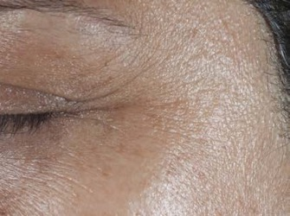
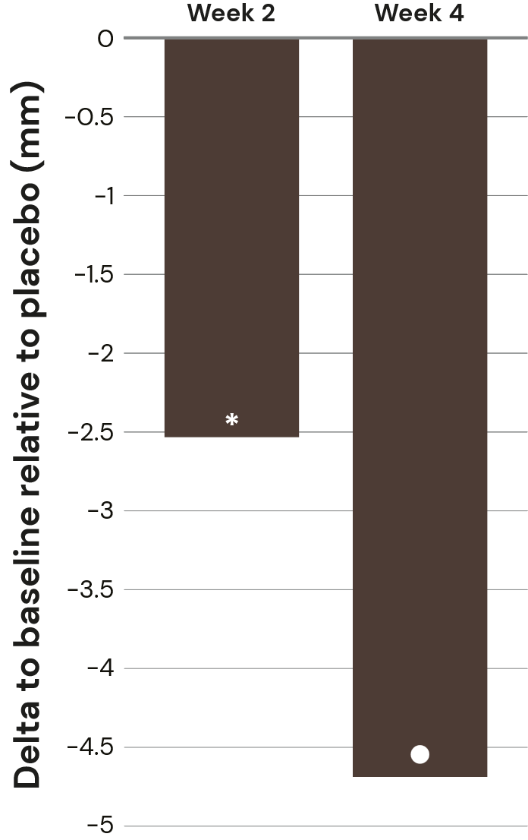
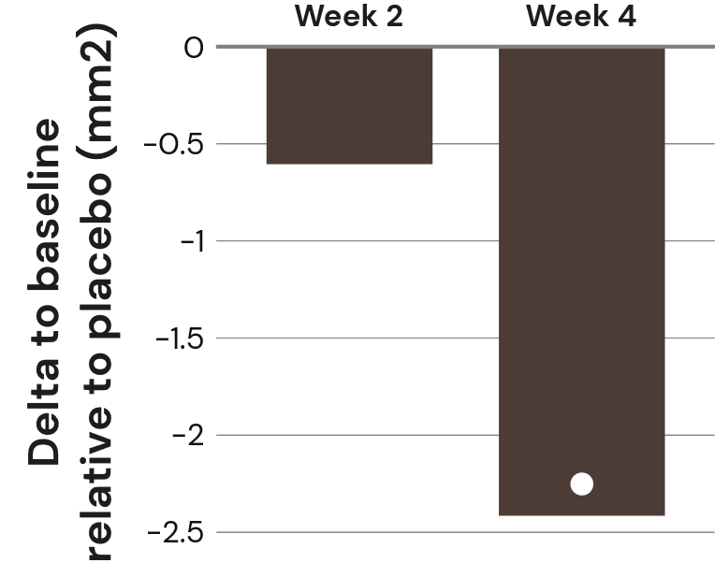
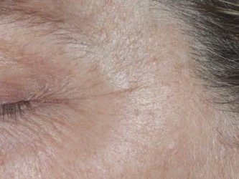
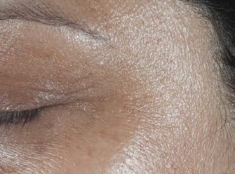
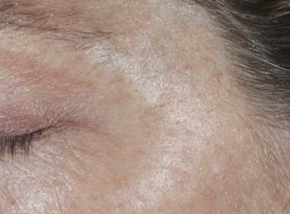
SYN®-AKE smoothens crow’s feet
In
vivo
Outstanding length reduction, cumulatively close to ½ cm
Crow’s feet
Crow’s feet length
Crow’s feet area
Volunteer #8, age 59
Volunteer #52, age 50
Baseline
Baseline
Week 4
Week 4
Clinical study No. 3: Results on 41-64 y.o. group. Wrinkle analysis with Primos^{lite} after 2 and 4 weeks of treatment with 4% SYN®-AKE
* p<0.05 vs baseline p<0.1 vs baseline
Notes:
Wrinkles in the mother group were measured on the crow’s feet using Primos^{lite} 3D imaging device. Average crow’s feet wrinkle lenght decreases by almost half a centimeter after 4 weeks in the 4% SYN®-AKE group. The VISIA images on show before and after of a distinct volunteer.

Slide 31
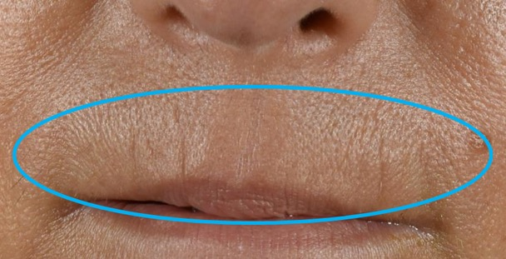
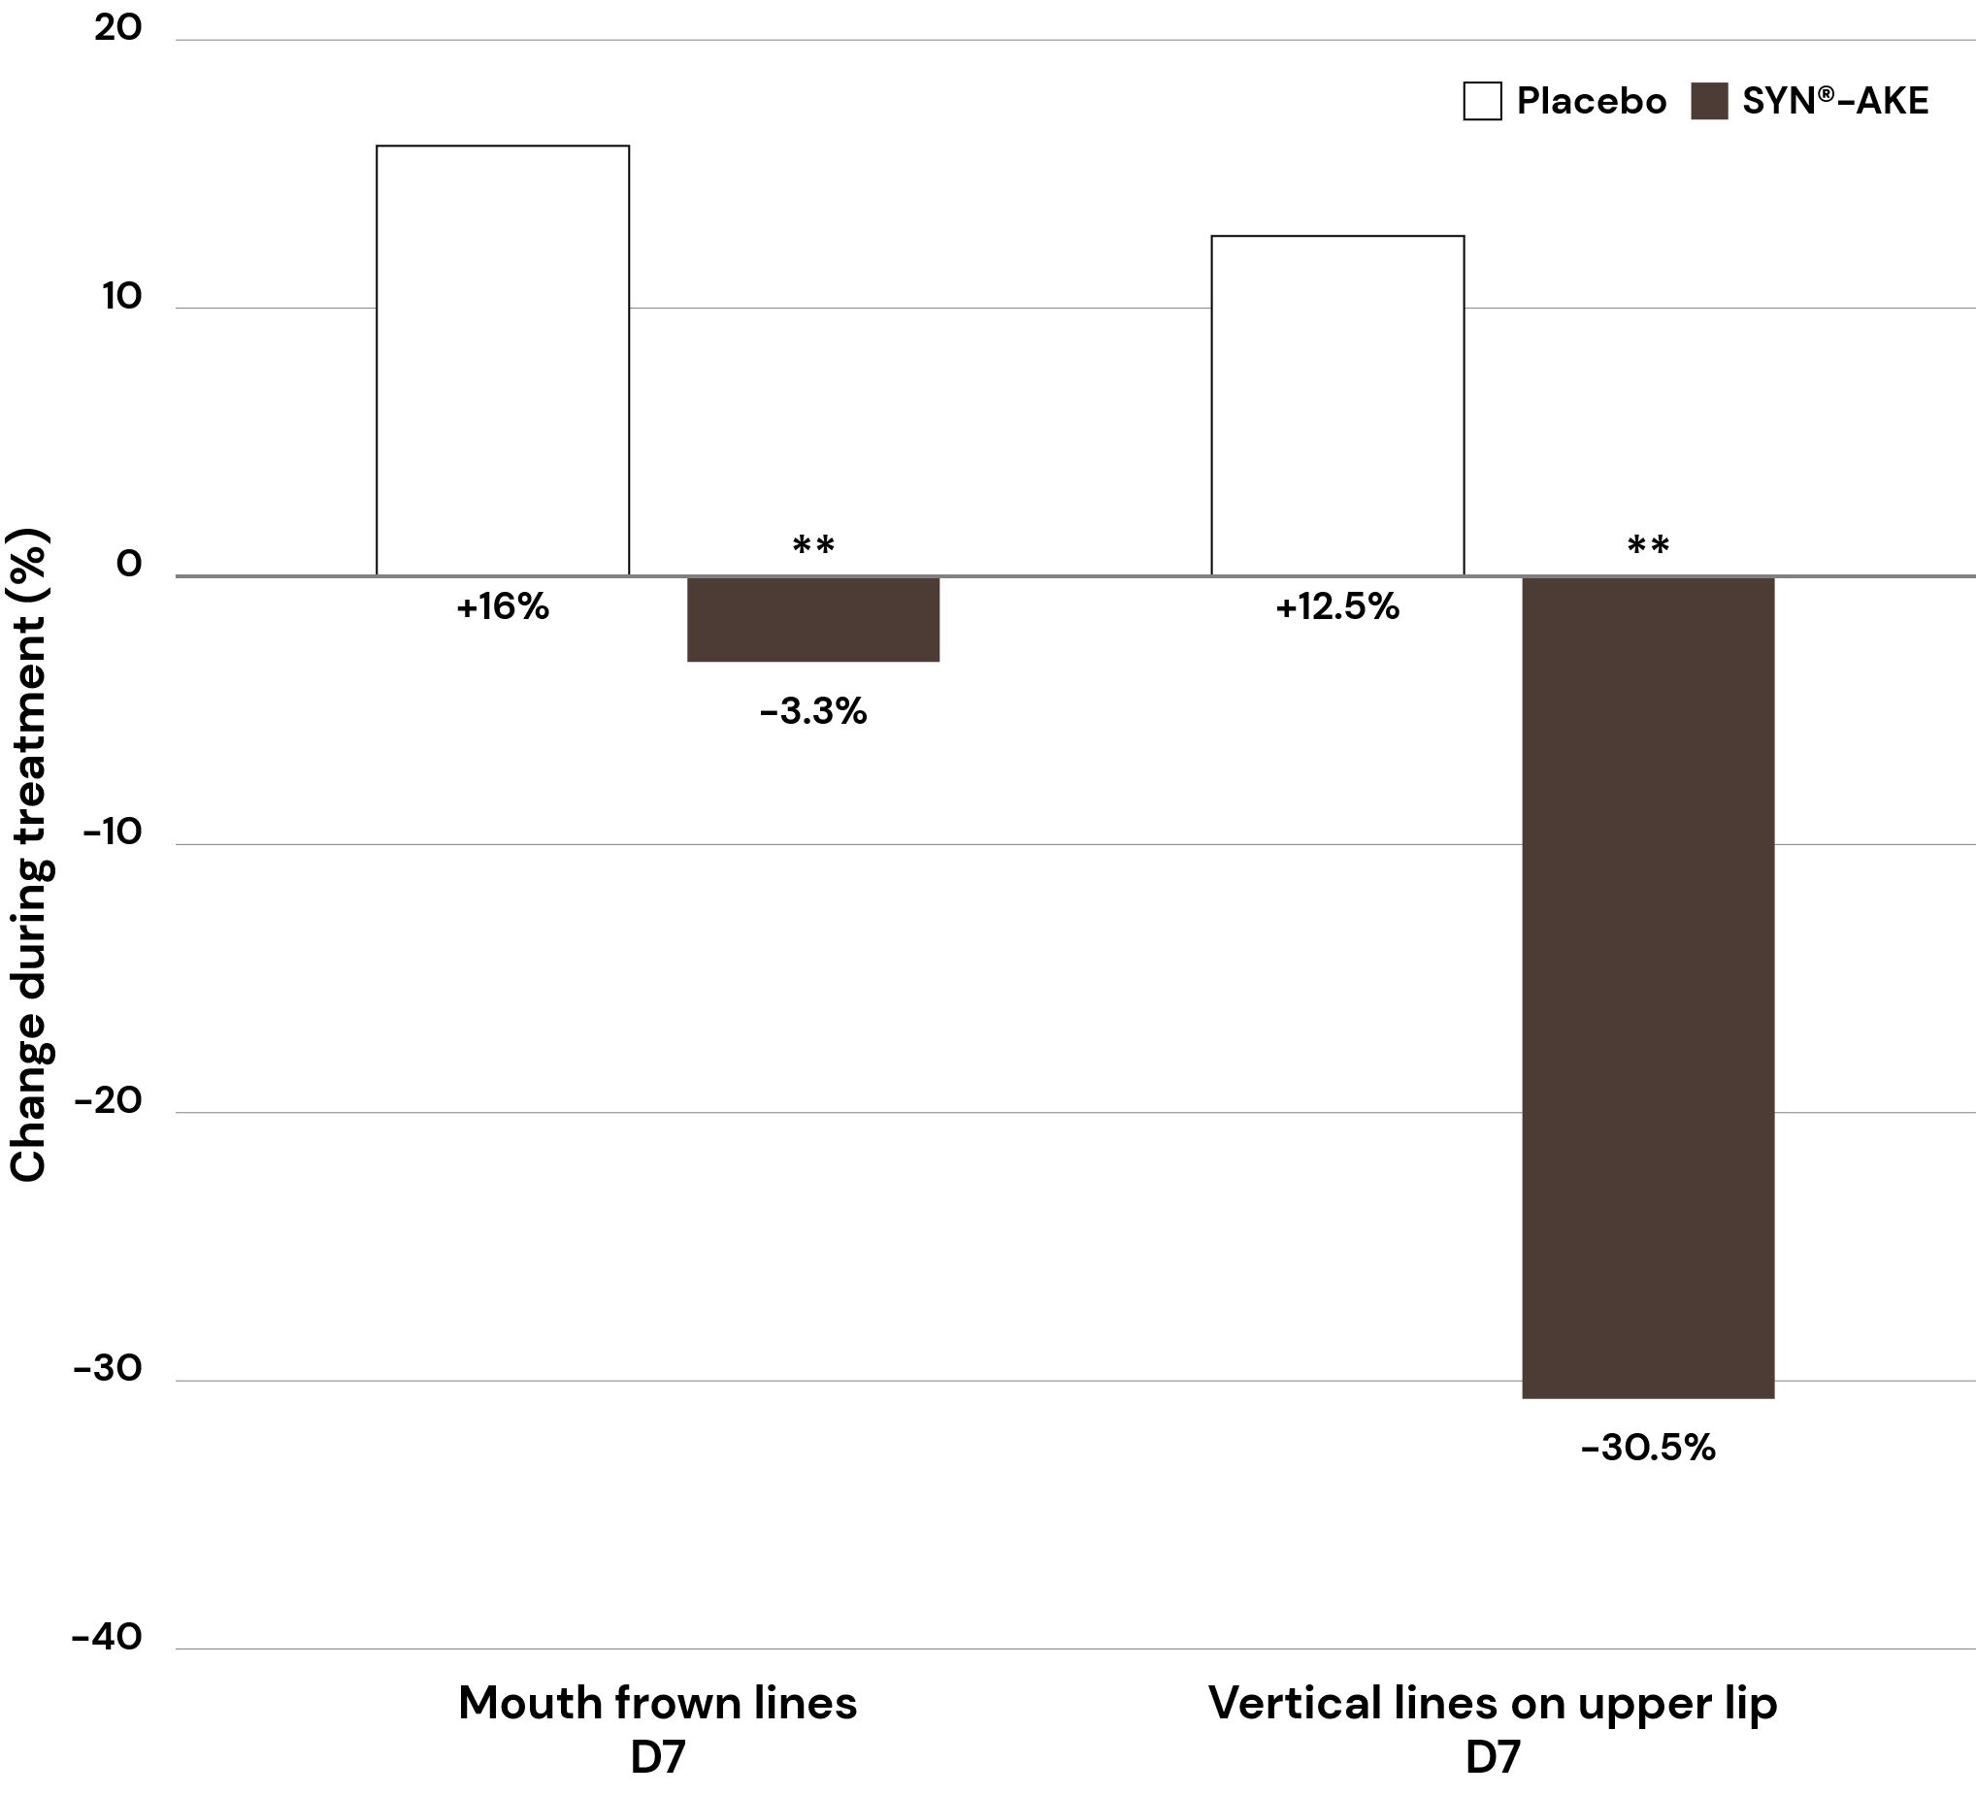
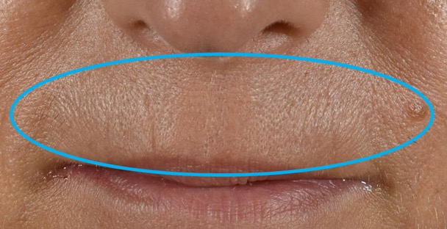
Significantly reduces the appearance of upper-lip vertical lines
In
vivo
Upper lip
Day 0
Day 28
Volunteers had to apply their respective product on full face twice daily in the morning and in the evening. The graph shows clinical study mean values in percent.
Clinical study No. 2: Test on 3 different skin tones In the picture, volunteer n.29
* p<0.05 compared to Placebo
Notes:
Shown are mean values in percentages. Wrinkles on forehead are day 0 to day 28. Mouth frown lines, vertical lines on upper lip and shine on forehead are day0 to day 7. All wrinkle parameters were on Caucasian skin (fair skin). Gloss was on Asian skin (dark skin).
On mouth frown lines and vertical lines SYN-STAR was significantly better than placebo. (Mann-Whiteney test)
On wrinkles on forehead and shine SYN-STAR was significantly changed against day 0.

Slide 32

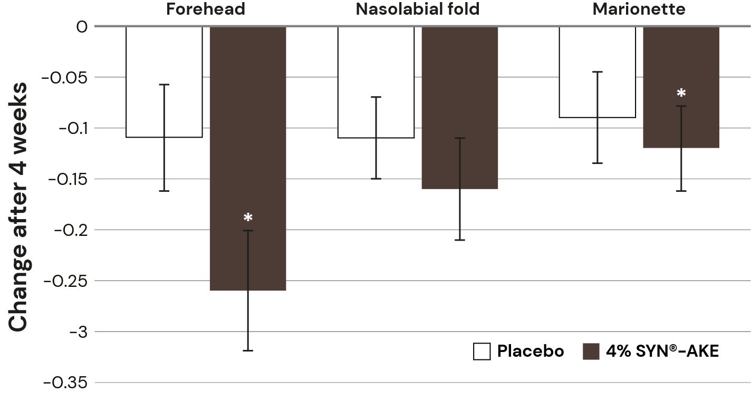
Skin expert diagnoses visible improvement with SYN®-AKE
In
vivo
Several facial areas
Expert grading
Clinical study No. 3: Results on 41-64 y.o. group – Expert grading results on the forehead, the nasolabial folds and the marionette lines (smiling lines in the corner of the mouth).
*p<0.05 vs baseline
Notes:
Expert grading results on the forehead, the nasolabial folds and the marionette lines (smiling lines in the corner of the mouth).
Expert grading: The volunteers sit in front of an expert grader (dermatologist or similar) which grades wrinkles according to a wrinkle grading scale of 0 (no wrinkles) to 9 (severe wrinkles).

Slide 33
Mimic-wrinkles prevention
on younger volunteers
20+ y.o.

Slide 34
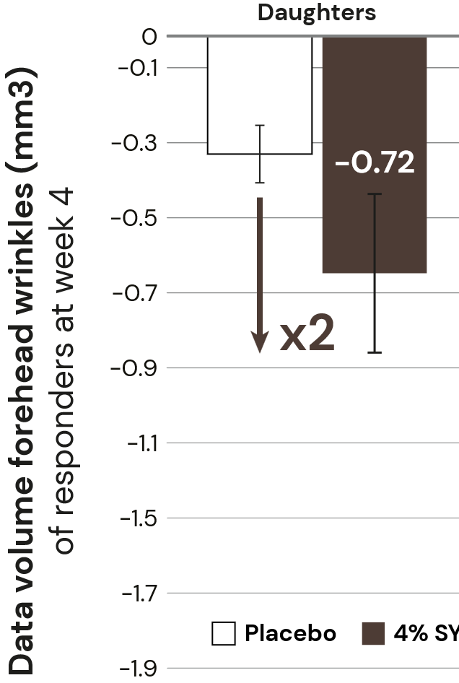

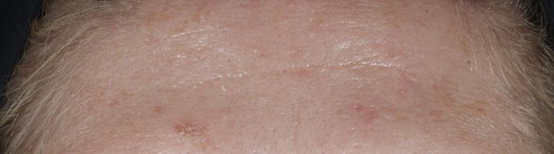


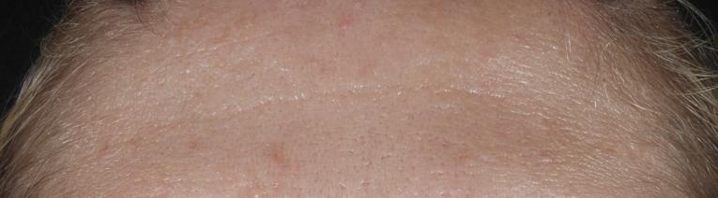
With SYN®-AKE, fine lines smoothing on younger volunteers
In
vivo
2X more effective than placebo on forehead wrinkles for 21-35 y.o.
Forehead
Volunteer #91, age 31
Baseline
After
4 weeks
Clinical study No. 3: Results on 21-35 y.o. group - Graphs: Mean delta for all volunteers is shown

Slide 35
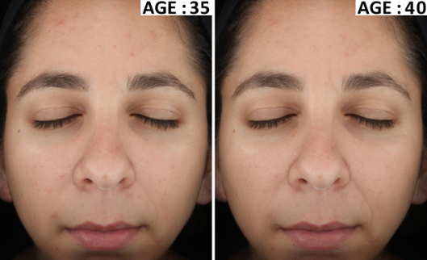
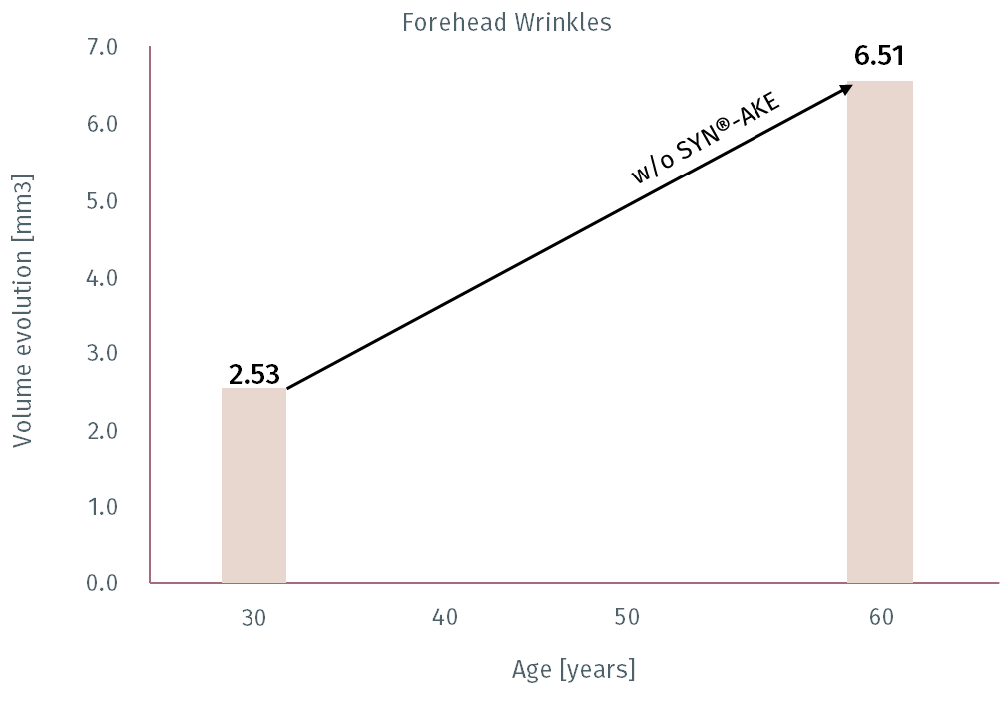

Stay younger for longer!
SYN®-AKE can delay wrinkles’ appearance up to 5 years, for tangible visible improvements
Quantification of 1 month of product application
Assumption: linear yearly wrinkles’ progression (simplification)
Above threshold:
wrinkles
are
visible
w/ 4% SYN®-AKE
5 Years
Visibility threshold
Below threshold:
wrinkles
are measurable but not visible
35
Assumption based on linear extrapolation of dsm-firmenich in vivo study results
Notes:
Interpolating daughter and mother data, we assume a linear aging progression for wrinkle formation.
Average decrease in wrinkle volume of the responders of the daughter and mother group are displayed. After 4 weeks using SYN®-AKE, the linear age progression line crosses the visibility threshold at about 40 years of age, thus 5 years later.

Slide 36
Efficacy on deep wrinkles
40+ y.o.

Slide 37
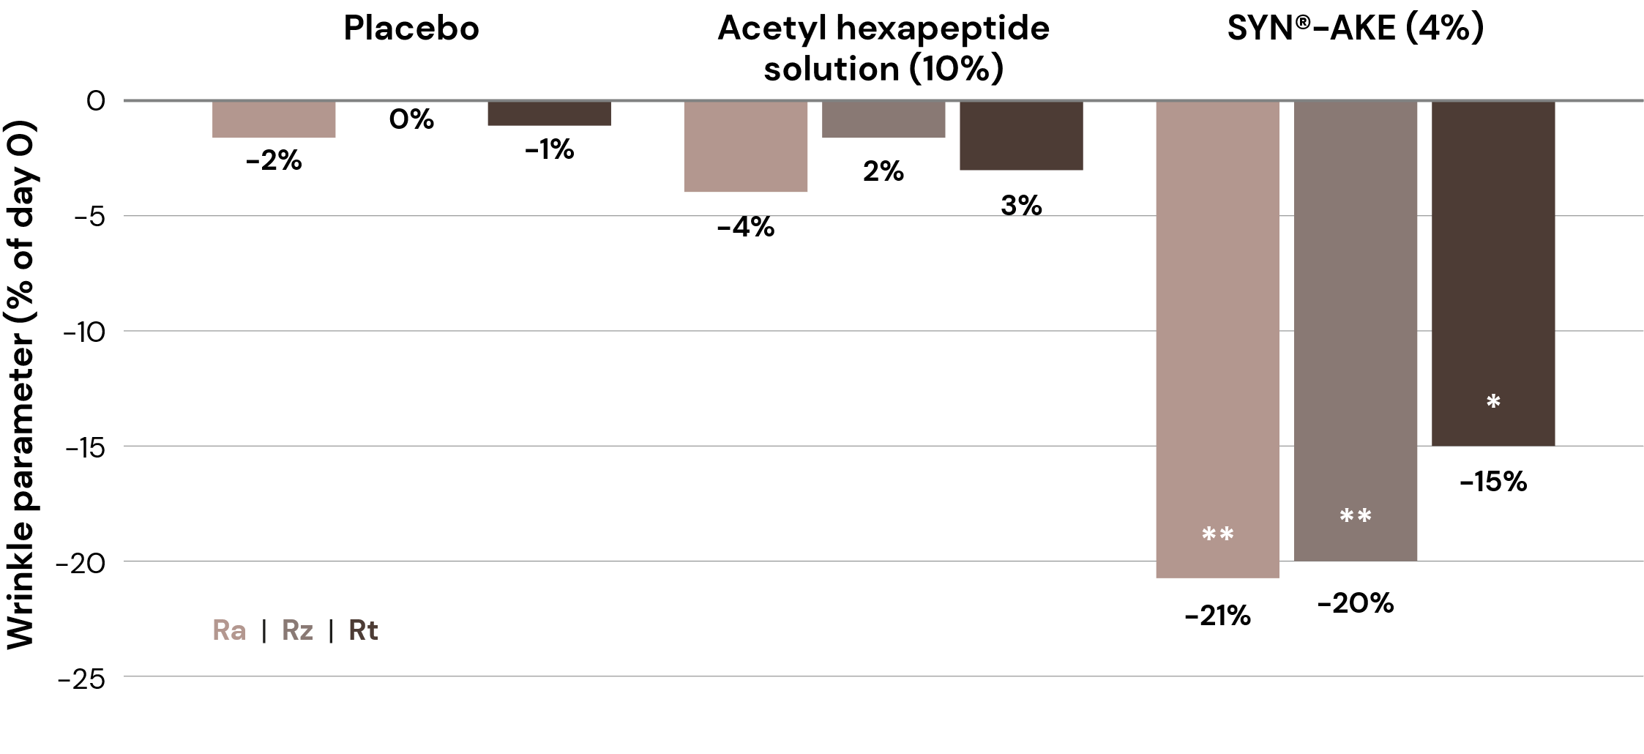
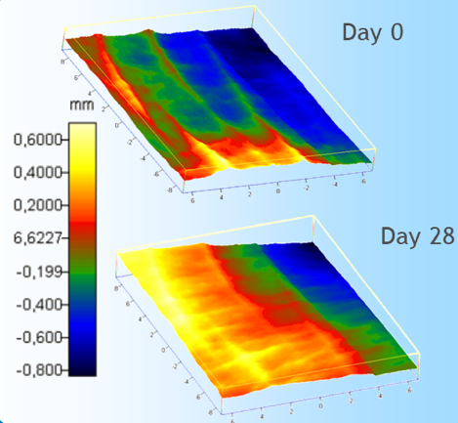
SYN®-AKE visibly reduces deep wrinkles in 4 weeks
In
vivo
-20% on forehead wrinkles, significantly outperforming competitive hexapeptide
Forehead
Benchmark (10%)
Clinical study No. 1: With Primos 3D®, evaluation of SYN®-AKE (4%) anti-wrinkles effect, measured on the forehead after 28 days application
*p<0.05 **p<0.01
Notes:
Benchmark: Acetyl Hexapeptide Solution
Study design:
Double blind and intra-individual study
Before / After measurements
15 volunteers per group (female, age 41-60)
28 days applied twice daily on face
Evaluation of anti-wrinkle effect with Primos 3D®.
Crow‘s feet and forehead
SYN®-AKE (4%) compared to Acetyl hexapeptide-3 solution (10%) - equals the commercial product-, and Placebo

Slide 38
Shine & texture

Slide 39
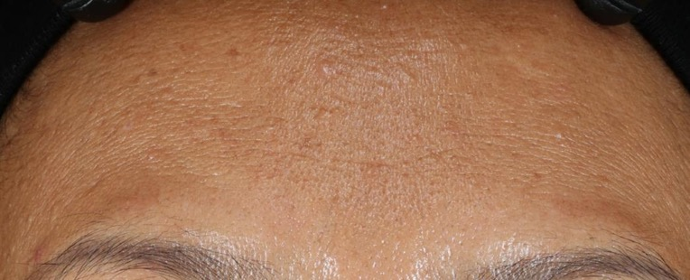
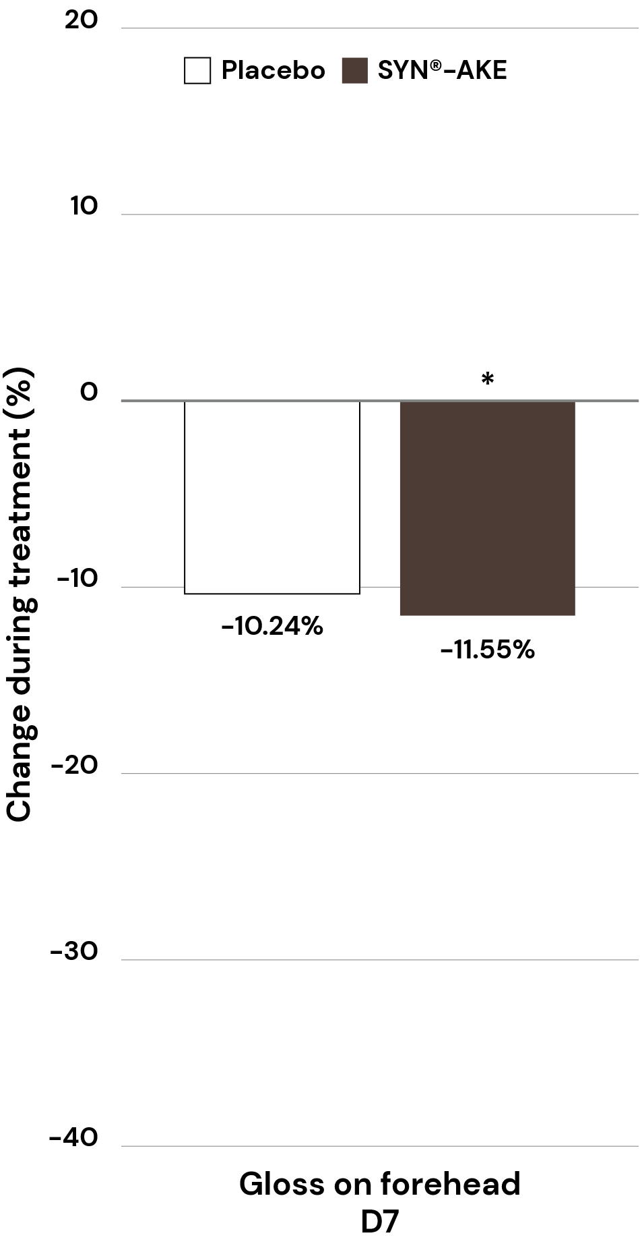
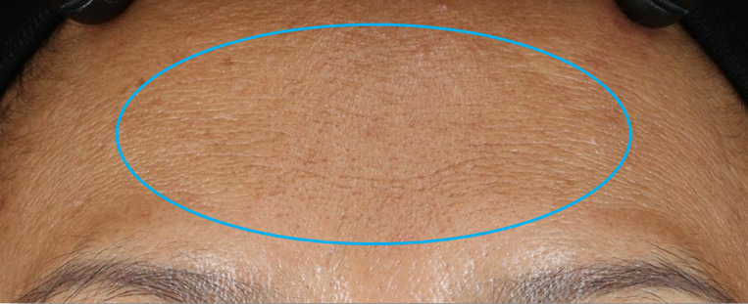
Shine reduction and flawless looking skin
In
vivo
Forehead
Day 0
Day 28
Patent publication discloses the use of
SYN®-AKE peptide for evening out skin tone, brightening of skin, reducing inflammation-related discoloration, erythema and pigmentation of skin and for reducing dark circles under the eye area.
Volunteers had to apply their respective product on full face twice daily in the morning and in the evening. The graph shows clinical study mean values in percent.
Clinical study No. 2: Test on 3 different skin tones In the picture, volunteer n.29
* p<0.05 compared to Day 0

Slide 40

SYN®-AKE
Substantiated product claims
It helps your face to look relaxed without losing the ability to express yourself
It visibly reduces deep wrinkles in just
4 weeks
When used earlier in time, it helps
delaying the appearance of wrinkles,
with age-freezing effects
It mattifies skin, visibly reducing shine look
It improves skin smoothness and flawless complexion for healthy looking skin

Slide 41
05
Products Line-up
41

Slide 42
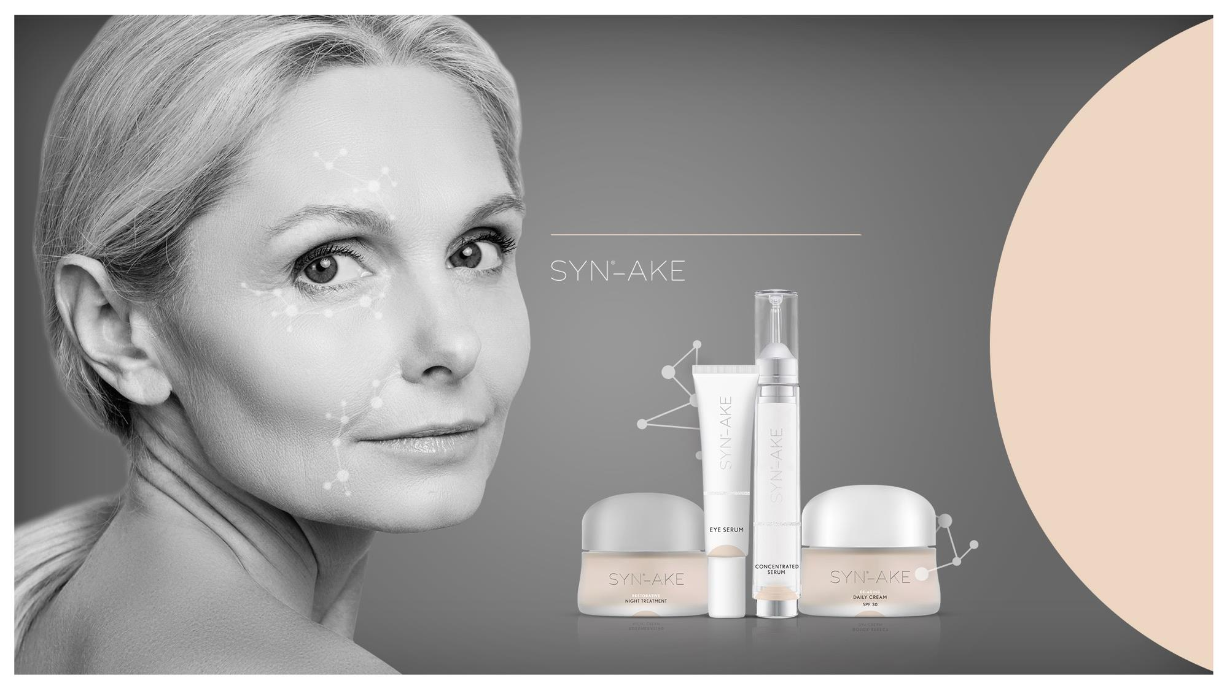
The highly potent, biomimetic tripeptide
3-in-1 “Medical Beauty”
Solution
For internal use only. Products are for experimental use only and are not for sale.

Slide 43
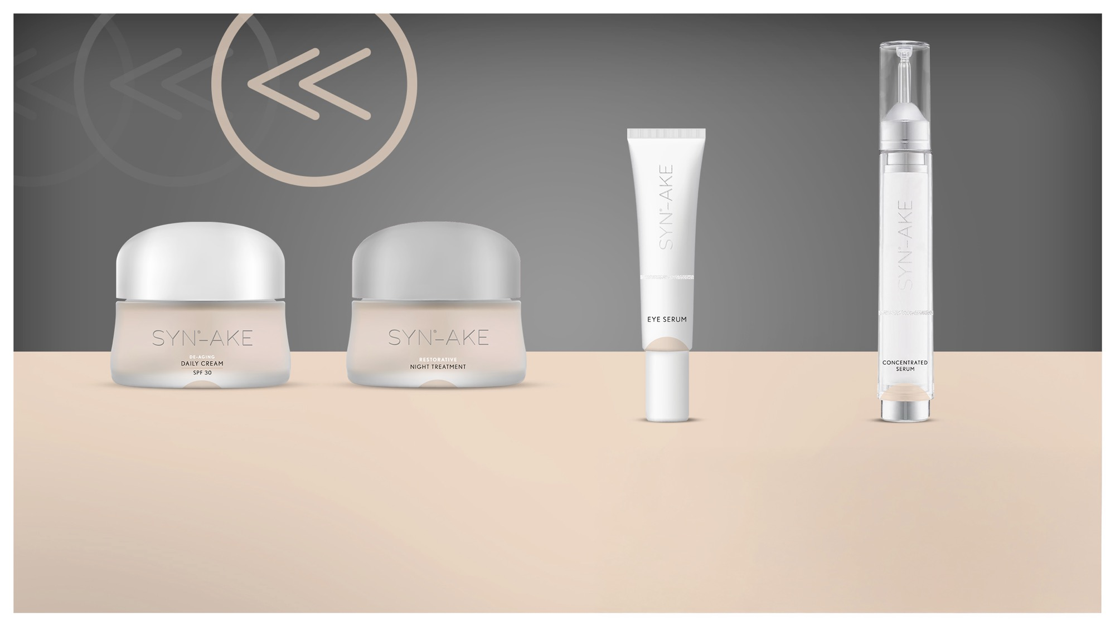

rewind & regenerate
De-aging daily cream SPF 30
Restorative night treatment
Eye serum
Concentrated serum
WITH 4% SYN®-AKE,
HYALURONIC ACID-BT
WITH 4% SYN®-AKE, SYN®-COLL CB, PENTAVITIN®
WITH 4% SYN®-AKE, SYN-EYE® CB,
PEPHA®-AGE CB
WITH 4% SYN®-AKE, SYN®-HYCAN CB, HYALURONIC ACID-BT
It plumps with hydration and relaxes skin, smoothing the appearance of deep wrinkles for a youthful complexion.
This intensively nourishing formula works overnight to relax skin and restore moisture and elasticity.
It reduces the appearance of crow’s feet, while its unique texture provides an instant flawless look.
High-tech formula and
targeted application to visibly reduce deep wrinkles.
SK-E-101544-3
SK-E-101456-12
SK-E-101456-10
SK-E-101480-4
For internal use only. Products are for experimental use only and are not for sale. DSM is not responsible for final products claims

Slide 44
Disclaimer
Copyright © DSM Nutritional Products Ltd 2026, 4002 Basel, Switzerland.
www.dsm-firmenich.com. All rights reserved.
dsm-firmenich has used diligent care to ensure that the information provided herein is accurate and up-to-date to the best of its knowledge. However, dsm-firmenich makes no representation or warranty, either expressly or implied, of the accuracy, reliability, completeness, or suitability thereof. The information provided herein contains scientific and product information for business-to-business use and does not constitute or provide scientific or medical advice, diagnosis or recommendation for treatment options. Country or region-specific information should be considered when labelling or advertising to final consumer. In no event shall dsm-firmenich be liable for any direct or indirect damages arising from or reliance upon, or use of, any information provided herein. The content of this document is subject to change without further notice. Please contact your local dsm-firmenich representative for the latest information. All trademarks listed in this document are either (registered) trademarks of, or trademarks licensed by, the dsm-firmenich group of companies, unless explicitly stated otherwise.
Disclaimer Formulation Guideline
The information provided herein is provided for information purposes only and has been prepared by dsm-firmenich in accordance with its own methodology.
dsm-firmenich has used diligent care to ensure that it is accurate and up-to-date, however, dsm-firmenich makes no representation or warranty, either expressly or implied, of the accuracy, reliability, or completeness thereof. In no event shall dsm-firmenich be liable for any damages arising from or reliance upon, or use of, any information provided herein. Further, dsm-firmenich shall not bear any liability for the application and/or use of any processed material containing its product(s). The formulation of the finished product is the customer’s sole responsibility. It is the customer’s responsibility to determine the suitability of dsm-firmenich’s products regarding user specific purposes, assess compatibility and stability of their finished product(s) and to ensure compliance of their finished product(s) with relevant laws and regulations. Any product, marketing or other claims made by customer are its sole responsibility. The content of this document is subject to change without further notice. Please contact your local dsm-firmenich representative for further details. © DSM Nutritional Products AG, 2026.

Slide 45
Confidential

