Slide 1
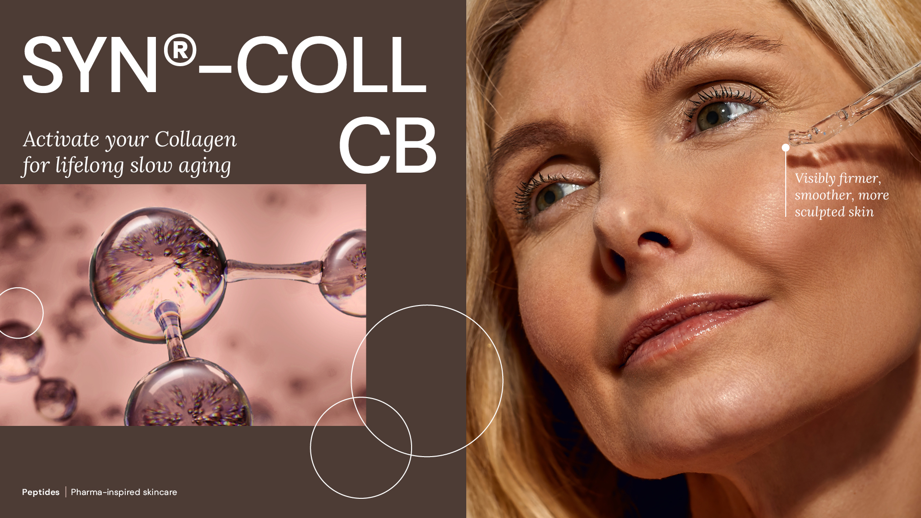
08.2026

Slide 2
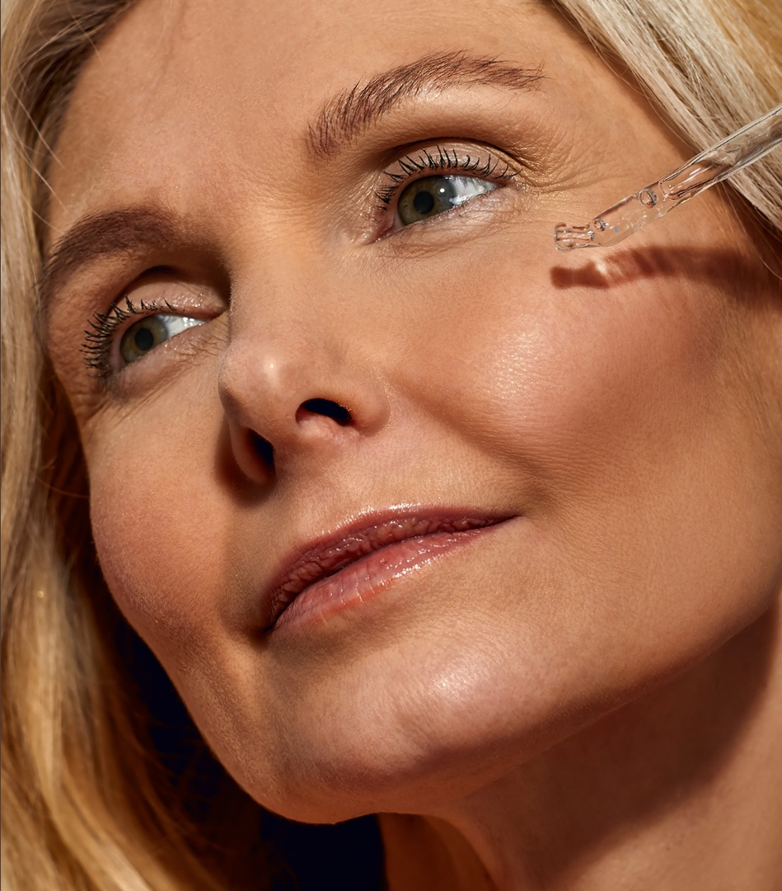
Agenda
1
The longevity era
Collagen: the foundation
of healthy-looking skin
2
3
Introducing SYN®-COLL CB
4
The science behind the tripeptide
5
SYN®-COLL CB in vitro efficacy
6
SYN®-COLL CB in vivo efficacy
7
SYN®-COLL CB product summary

Slide 3
01
The longevity era
3

Slide 4



Approach to Skincare is evolving
More Authenticity
More Proactivity
More Personalization
  The idea of perfection is over. We see a move away from ‘augmentation’ towards ‘skin acceptance’. Healthy-looking skin is now the ambition - heralding a diversion from wrinkle reduction and anti-aging.
  Today’s consumers understand that beautiful skin, starts with healthy skin. This is driving proactive engagement in skin care, seeking preventative solutions that empower them to age well and thrive in their own skin.
  People seek solutions that meet the needs of different life stages and lifestyles. In an era of empowered individualism, skin health is intuitively personal, and ever-changing. It’s where science meets self.

Slide 5



New conversations emerge
Consumers’ focus today diverts from simply addressing the visible signs of aging to a more sustained beauty and wellness, with aim to identify and target the root causes to slow down the overall process.
Skincare should use advance science to support skin’s natural regenerative processes from within. “Biohacking” plays a key role and ingredients like peptides gain traction for boosting the skin’s own ability to restore.
Source: from “dsm-firmenich Beauty & Care Trend Framework”
Notes:
In this context, we identify some trending conversations/hot topics:
- “cellular beauty” → where the focus is on addressing the roots causes of aging at cellular level, helping the cells to resist and regenerate
The exposome beyond UV as a trigger of premature aging
Blurred lines between beauty and well being with the expectation that skincare could also have an impact on mood-enhancing
Medical Beauty, there since some time and to stay. Growing acceptance and penetration of cosmetic procedures offers opportunities for skincare to support pre- and post or to mimic without the pain and cost
Ultimately “longevity” is buzzword, and ambition is to slow down biological aging

Slide 6


Redefining the “slow-aging” benefits’ spectrum
Opportunities behind:
Retention (Gen X in focus)
65+ will more than double globally by 2050, having fundamental economic impact, more empowered and in control. 75% of women this age say they are willing to pay more for quality.¹
Prevention (Gen Z in focus)
New generations enter the category already in their 20s, focusing on preventing rather than just reversing signs.
1. WGSN 2023 report
Notes:
“aging” is the most potential mkt space, growing by retention of elder consumers for longer…LATAM team presented a nice concept yesterday for 60-80 y.o. consumers…but also with younger generations willing to enter the mkt space already in their 20s from the angle of prevention there are opportunities behind recruiting earlier. Of course this implies that the definition of “aging” is also evolving and broadening in terms of benefits. Also on average consumers are more willing to pay for aging solutions, and this is where we have more room to play with our portfolio.

Slide 7
02
Collagen: the foundation
of healthy-looking skin

Slide 8

Collagen
Major building block of the skin (~80%), it has multiple roles:
It keeps skin firm, plumped and supple
It gives the skin strength and structure
It’s vital for maintaining elasticity
Produced by cells called fibroblasts, predominantly found in the dermis.
Collagen I is the main type, widely believed to have major role into well-aging process.
Chung et al. 2001
8

Slide 9
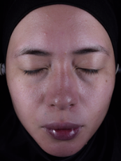
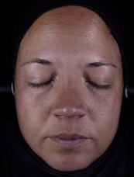
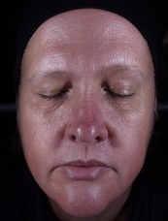
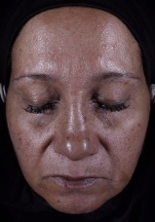
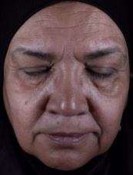
Over time Collagen’s reserves slow down
Resulting into visible signs of aging
The intrinsic process
Collagen production slows naturally with age as
pro-Collagen synthesis decreases, and degradation increases. As early as our 20s, Collagen levels drop by about 1% per year, accelerating after 40.
This leads to reduced skin elasticity, sagging, fine lines, and wrinkles, resulting in skin losing its youthful radiance.
The exposome’s detrimental action
Factors such as sun exposure and
pollution, along with chronic stress
can speed up such decline.
Collagen content¹
Difference in collagen I amount between non-photo- and
photo-aged skin²
1. Affinito et al. (1999) Maturitas 33:239. Pictures from dsm-firmenich 2024 clinical study
2. Chung et al. 2001. *p<0.05. **p<0.01
25 y.o.
34 y.o.
48 y.o.
51 y.o.
62 y.o.
9
Notes:
The graph on the left shows data from body skin (stomach area), published by Affinito et al, 1999, Maturitas 33:239
Each dot represents a volunteer. The line just highlights the drop in collagen I after the age of 40.
Other references for text:
Fisher et al. ARCH DERMATOL, VOL 138, NOV 2002
Fisher et al. Aging Cell (2016) 15, pp67–76
Fisher et al. Arch Dermatol. 2008;144(5):666-672
Varani et al. American Journal of Pathology, Vol. 168, No. 6, June 2006
Shuster et al. British Journal of Dermatology (1975) 93, 639
Exposome graph:
Photo-exposed from forearm
Photo-protected from upper inner arm
Type I pro-collagen protein was measured
Chung et al. J Invest Dermatol 117:1218-1224, 2001

Slide 10
Introducing SYN®-COLL CB

Slide 11


We create groundbreaking sustainable solutions that support skin health and empower individuals to maximize their own skin potential, at every stage of their life journey.
At dsm-firmenich

Slide 12
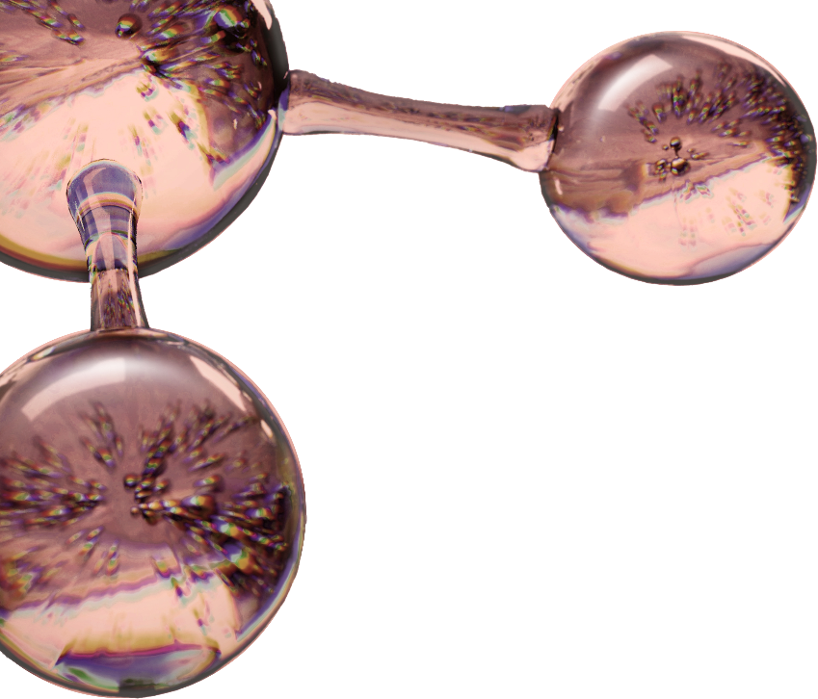
SYN®-COLL CB
dsm-firmenich’s
SYN®-PEPTIDES
  The product
  Patented tripeptide with unique sequence
  It mimics the skin’s own mechanism to produce
  and protect Collagen, slowing-down the aging
  process from within
  Clinically-proven:
    New – It significantly supports skin’s Collagen reserves, with age-personalized action
    New – It protects from UV-induced Collagen degradation already at 1%
    Skin is visibly firmer, smoother and more sculpted with inclusive results across different ethnicities/phototypes
  Natural-origin peptide. Improved optimized synthesis,
  TFA-free*, readily biodegradable. Produced according to green-chemistry science
  Pharma-inspired skincare solutions, taking skin health ambition to the next level.
  Our targeted approach, enhanced by molecular modeling, is supported by green chemistry science to generate groundbreaking, sustainable solutions proven to deliver the highest levels of efficacy towards well-aging
*non-intentionally added TFA
Notes:
Another area of expertise is Peptides synthesis.

Slide 13




SYN®-COLL CB
ID Card
INCI NAME:
Palmitoyl Tripeptide-5, Aqua, Glycerin
Pharma-inspired skincare solution, taking skin health ambition to the next level.
Targeted design and molecular modeling supported by green chemistry
Natural origin tripeptide with unique sequence Palm-Lys-Val-Lys, produced in Europe, TFA-free¹,
Original SYN®‑COLL peptide generation patented; CB version patent application pending
Low carbon footprint of 5.2 kg CO₂ eq./kg
99.9% natural origin (ISO 16128), 73% natural origin for the pure peptide
TECHNOLOGY:
TECHNICAL:
Form: Liquid
pH of use: 3.0-7.0
Use level: 1-5%
Preservative: Free
Solubility: Soluble in water
Biodegradability: Readily biodegradable
New – Slow down the aging process from within**
New – Significantly supports skin’s Collagen reserves, with age-personalized action**
New – Protects from UV-induced Collagen degradation already at 1% **
Sculpts face and neck for a firmer, more lifted appearance**
Refines skin appearance with less visible pores**
BENEFITS:
Collagen Science Pioneer
First TGF-β booster on the market*
Mimics the skin’s own mechanism to produce and protect Collagen*
Rebalances inflammation by inhibiting cytokines (TNFα, IL-8)*
REGISTRATION
CERTIFICATION:
NATRUE
Approved
1. Non-intentionally added TFA
* in vitro ** in vivo

Slide 14
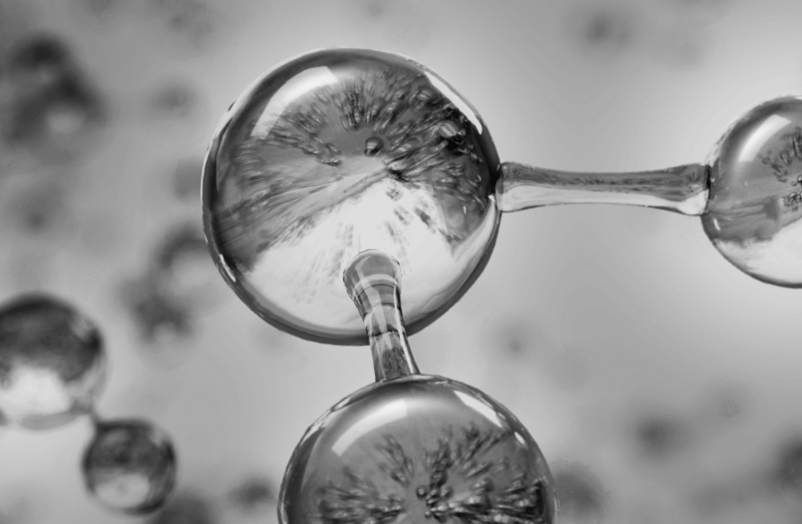
SYN®-COLL CB
Next generation peptide,
for sustainable aging
Production without any CMR solvents or reagents, prioritizing the safety of workers. TFA-free¹
Carbon footprint of 5.2 kg CO₂ eq./kg. High efficiency allowing a low carbon footprint in use²
Natural-origin peptide. SYN®-COLL CB suitable for Clean-Beauty with more than 99.9% naturality according to ISO 16128, 73% natural origin for the pure peptide
Green chemistry science with an optimized synthesis reducing the number of steps
Manufactured in Europe with 100% purchased renewable electricity
1 non-intentionally added TFA
2 considering a 1-3% concentration of SYN®-COLL CB in final formulation, 50-150g CO₂ per kg of final formulation.
Notes:
Activity profile allows for very low use levels, thus allowing for a minimal CO2 footprint in the final formulation
Calculation for the carbon footprint in use of SYN®-COLL CB:
If 1% use level (minimum): 0.01kg/kg*5.2 kg CO2/kg = 0.052 kg CO2 / kg formulation = 50 grams CO2 / kg formulation
If 3% use level (maximum): 0.03kg/kg*5.2 kg CO2/kg = 0.152 kg CO2 /kg formulation = 150 grams CO2 / kg formulation

Slide 15
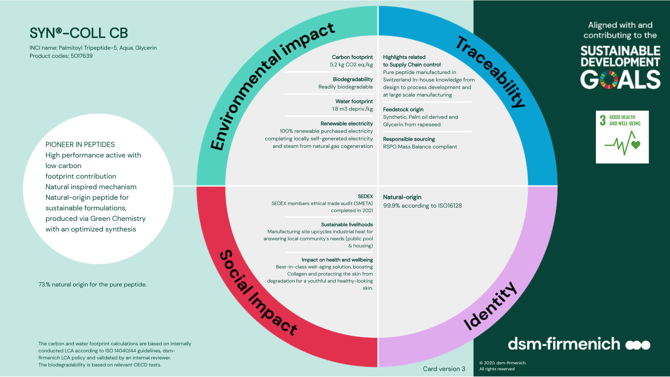

Slide 16
SYN®-COLL CB
Formulation Guidelines
SYN®-COLL CB is offered as a glycerine-based aqueous solution, the content of active material is approximately 1000 ppm
Optimal pH range in formulation from 3.0–7.0
SYN®-COLL CB is stable at elevated temperature
(80°C) for up to 2 hours
Easy to blend with other SYN®-PEPTIDES
SYN®-COLL CB does not contain any preservative nor any solubilizer, PEG free
Suggested concentration: 1-5%; formulation guidelines are available upon request
16
Notes:
SYN®-COLL CB is very easy to formulate.

Slide 17
04
The science behind
the tripeptide

Slide 18
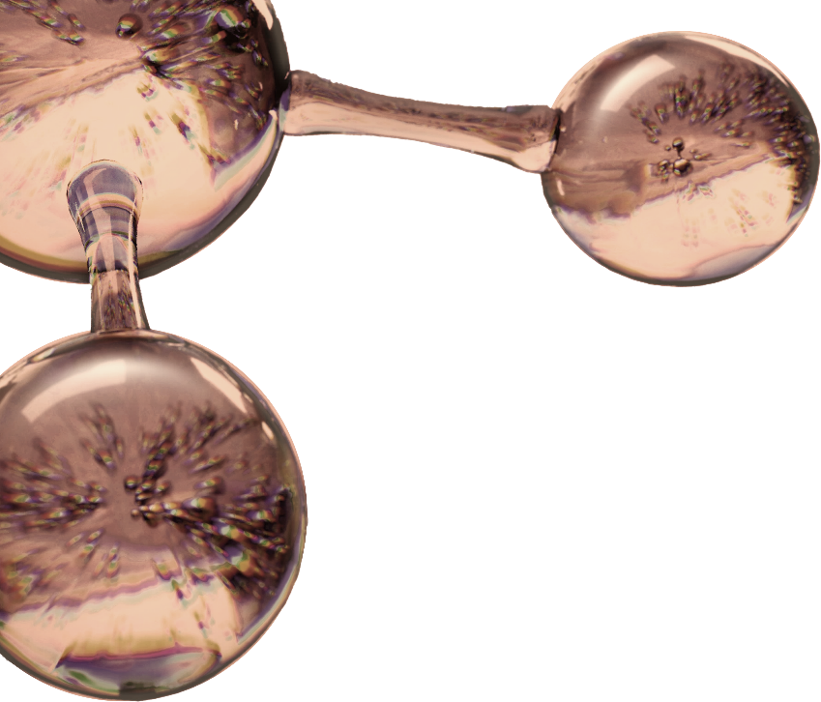
Pioneering Collagen-science
“A healthy collagen network requires fully functioning TGF-β.
TGF-β’s active amount in the skin is reduced as we age, biomimicking its activation helps to support collagen network. Here is where SYN®-COLL CB steps in.
“At dsm-firmenich, we pioneered this approach to skin aging, establishing new scientific standards in the industry.”
Mathias Gempeler
Global Head Science &Promotion Skin Care
Notes:
Another area of expertise is Peptides synthesis.

Slide 19

Our biological target: the Tissue Growth Factor-β (TGF-β)
The dermal aging master switch
TGF-β emerges in regenerative medicine, offering exciting possibilities for tissues repair, from wound healing to long-term maintenance of skin structure, including the regulation of Collagen.
TGF-β
stimulates collagen and hyaluronic acid
stimulates the synthesis of basal layer proteins (e.g. laminin, collagen type IV …)
inhibits collagen degradation by decreasing MMP-1, MMP-3 expression
Over time, TGF-β activity is reduced provoking the degeneration of the skin structure.
TGF-β is complex and inappropriate as active ingredient.
Notes:
MMP: matrix metalloproteinases

Slide 20


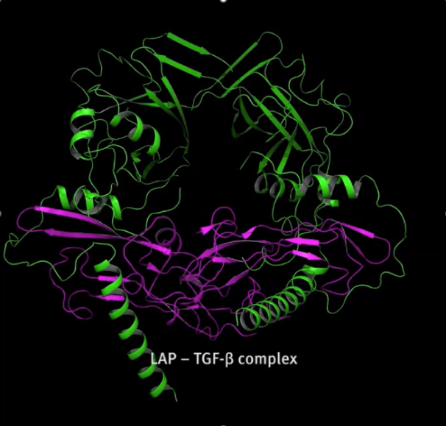
The small peptide sequence that activates TGF-β
TGF-β is secreted by the cells as inactive complex - latent TGF-beta (LAP-TGF-β)
Non-active LAP-TGF-β needs to be activated by TSP (Thrombospondin)
TSP binds to the non-active LAP-TGF-β and induces activation of TGF-β
Small peptide sequence “Arginine-Phenylalanine-Lysine” (Arg-Phe-Lys)
within TSP is the main contributor to activate TGF-β
Non active LAP-TGF-β
TSP -Arg-Phe-Lys-
Active
TGF-β
LAP
Multi actions

Slide 21

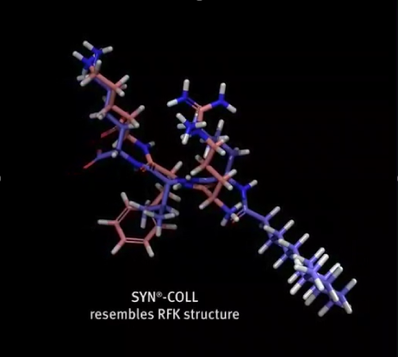
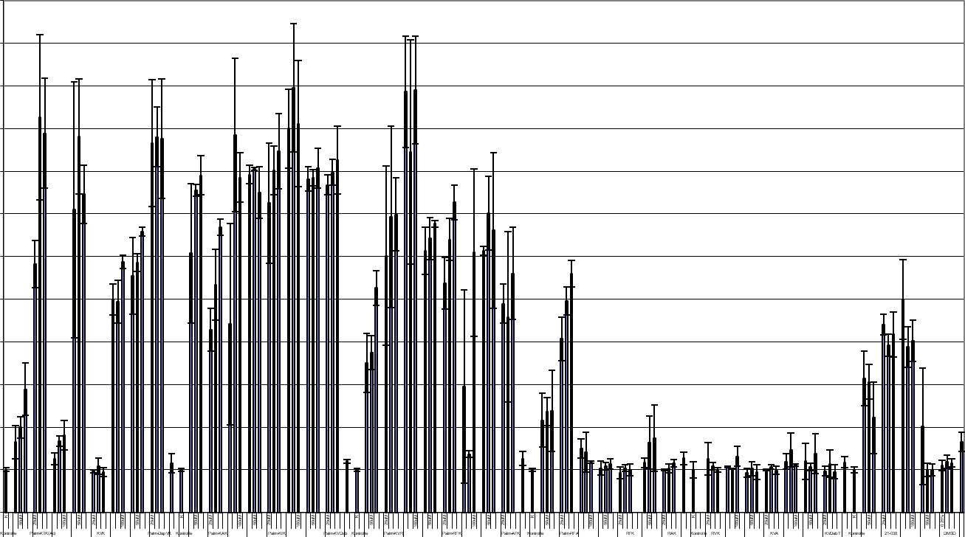
Crafting SYN®-COLL CB peptide
More than 150 small peptides synthesized and tested with a LAP-TGF-β activation assay
Tripeptide Lysine-Valine-Lysine resembles the peptide sequence Arg-Phe-Lys (RFK) within the TSP structure at its best
It shows the most efficient activation of LAP-TGF-β
The tripeptide is linked to a palmitic chain to enable bioavailability.
The result is SYN®-COLL CB
LAP-TGF-β activation
1200
1100
1000
900
800
700
600
500
400
300
200
100
0
Palm-Arg-Phe-Lys
Palm –Lys-Val-Lys (SYN®-COLL CB)
% LAP-TGFβ activity

Slide 22
05
SYN®-COLL CB in vitro efficacy
22

Slide 23
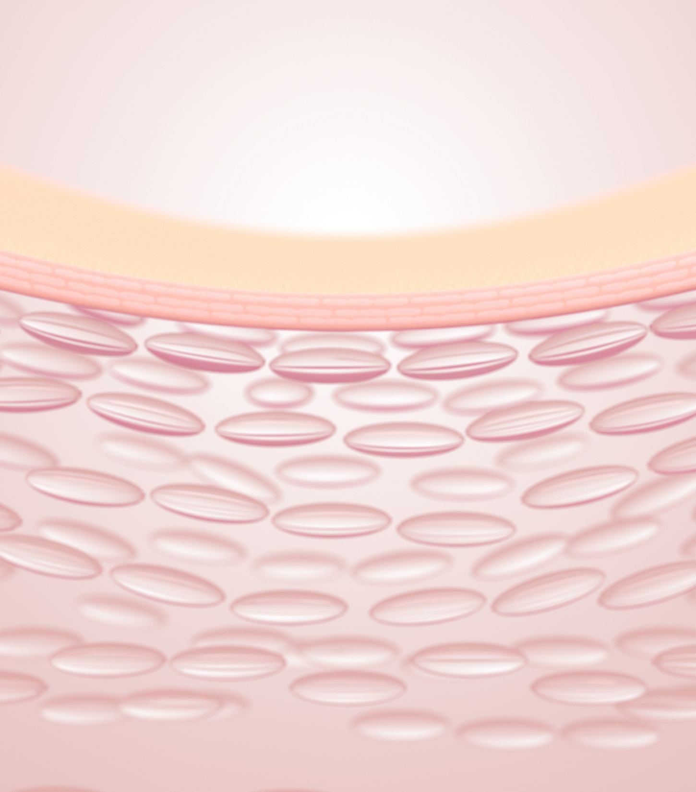
SYN®-COLL CB peptide boosts Collagen up to 174% in skin
For the SYN®-COLL CB peptide, the following applies:
1 µM = 0.00007% = 0.7 ppm
10 µM = 0.0007% = 7 ppm
25 µM = 0.00175% = 17.5 ppm
In
vitro
Synthesis of Collagen I – test performed on human dermal fibroblasts
Dose dependant stimulation
* p< 0.05 compared to untreated cells (ctrl). *** p<0.001 compared to untreated cells (ctrl)

Slide 24
SYN®-COLL CB peptide reduces inflammation
In
vitro
Protection of Collagen in stressed keratinocytes
The expression of cytokines and MMPs after chemically induced (PMA) stress (24 h) in normal human keratinocytes (NHK)
The fold increase in fluorescence intensity is compared to control cells (=1.00)
MMPs and pro-inflammatory cytokines were analysed in the cell culture supernatant with a multiplex bead array system (Luminex¹⁰⁰ xMAP) using a Procarta Cytokine Assay Kit (Panomics)
* p< 0.01 compared to untreated cells
24
Notes:
Test performed on stressed keratinocytes - these cell have a stronger response in expressing (TNFalpha, MMP) than fibroblasts. In vivo there is a biochemical cross talk between epidermis and dermis which means if there is a proinflammatory condition in the epidermis it will also harm to the dermis
The expression of cytokines and MMPs after chemically induced (PMA) stress (24 h) in normal human keratinocytes (NHK). The fold increase in fluorescence intensity is compared to control cells (=1.00).
PMA: phorbol 12-myristate 13-acetate (PMA), is diester of phorbol and a potent tumor promoter often employed in biomedical research to activate the signal transduction enzyme protein kinase C (PKC).
Material & Method:
Keratinocyte cell culture and treatment phorbol-12myristate 13acetate (PMA) experiments: Normal Human Keratinocytes from foreskin grew in CnT-07 Keratinocyte Growth Medium (CELLnTEC, Switzerland) at 37ºC in a humidified 5% CO₂ in air atmosphere for two days.
We challenged the cells with 0.1uM phorbol-12 myristate 13acetate (PMA). Test substances were administered immediately after PMA stimulation in CnT-07 at the following concentrations: TGF-β 12.5ng/ml, palm-KVK 10uM. Supernatants with secreted Cytokines and MMPs were frozen over night at -20ºC before analysis.
Quantitation of Cytokines and MMPs: Two Cytokines and two Matrix Metallo Proteinases (MMPs) were quantitated simultaneously in the supernatant of the keratinocyte cell cultures with a multiplex bead array system (Luminex¹⁰⁰ xMAP) using a Procarta Cytokine Assay Kit (Panomics Fremont USA).

Slide 25
06
SYN®-COLL CB
in vivo efficacy
25

Slide 26

2.5% SYN®-COLL CB is already proven effective on multiple signs of aging
In vivo supported claims
Middle aged 40+ y.o.
2.5% SYN®-COLL CB
On diverse ethnicities
Reverses visible signs of
photo-aging
Smooths skin & visibly reduces wrinkles
Sculpts face for more lifted look
Refines skin appearance with less visible pores

Slide 27


SYN®-COLL CB - Activate your Collagen for lifelong slow aging
Addressing the needs of multiple skin types & ages
Young skin
30+ y.o.
Middle aged 40+ y.o.
Mature skin 60+ y.o.
PREVENT
REVERT
RESTORE
1% SYN®-COLL CB
On diverse ethnicities
Boosts Collagen on face & neck, up to +13% NEW
Protect from UV-induced degradation NEW
2.5% SYN®-COLL CB
On diverse ethnicities
Boosts Collagen on face & neck, up to +22% NEW
Reverses visible signs of
photo-aging
Smooths skin & visibly reduces wrinkles
Sculpts face for more lifted look
Refines skin appearance with less visible pores
5% SYN®-COLL CB
On diverse ethnicities
Boosts Collagen on face & neck, up to +26% NEW
27
IN VIVO SUPPORTED CLAIMS

Slide 28



NEW dsm-firmenich in vivo data expand the proposition
Across multiple age groups
Young: avg 30 y.o.
Middle aged: avg 40 y.o.
Mature skin: avg 60 y.o.

Slide 29


Slide 30



NEW in vivo study design
In
vivo
SYN®-COLL CB %
1% applied to young panel
2.5% applied to middle aged panel
5% mature skin panel
Application of formulation twice daily
(morning and evening) full face & neck
AGE GROUPS
Young panel, 25-35 y.o
Middle aged panel, 36-50 y.o.
Mature skin panel, 51-65 y.o.
25 female volunteers per group.
Mixed ethnicities, skin phototype 2 to 5
Placebo: entire age range, 25-65 y.o. 30 volunteers
D -7
D0
D14
D28
Wash-out
with placebo
Home use of
respective formulation
Home use of
respective formulation
DERMASCAN
across groups
DERMASCAN
across groups
DERMASCAN
across groups

Slide 31
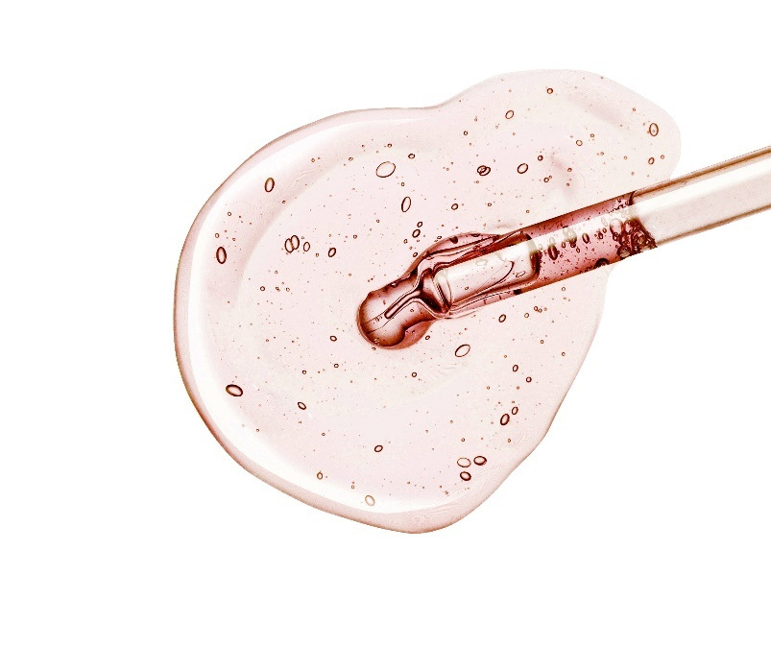
Measurement: DERMASCAN
In
vivo
Collagen stimulation in vivo
by ultrasound
Figure 1: All age groups were
measured on 3 test sites
Figure 2: The elder group was measured on 7 test sites

Slide 32
Age-personalized Collagen boosting
In
vivo
Extra efficacy triggered by higher SYN®-COLL CB concentration (%)
FACE
FACE
1% SYN®-COLL CB boosts Collagen on young volunteers by +7% already after
2 weeks. +13% increase in 4 weeks.
*
*
*p<0.05.
*
*
2.5% SYN®-COLL CB boosts Collagen on middle aged volunteers by +11% already after 2 weeks. +22% increase in 4 weeks.
*
*
5% SYN®-COLL CB boosts Collagen on mature skin volunteers by +14% already after 2 weeks. +26% increase in 4 weeks.
*
*
*
*
All changes are significant over time and between groups at all timepoints.
All comparisons between active formulations and age-matched placebo are significant.

Slide 33
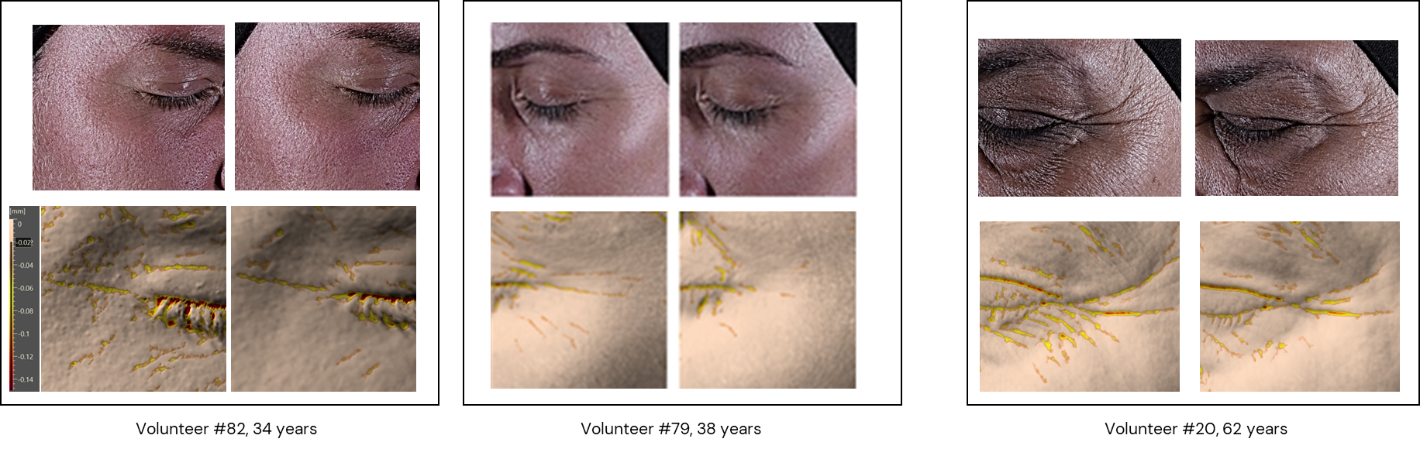
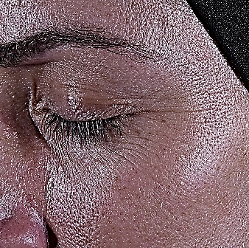
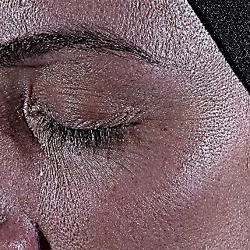

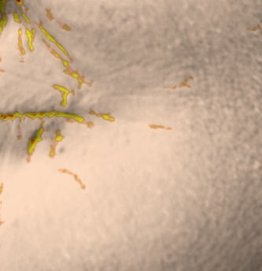
Before/After product application
In
vivo
Fine lines & wrinkles are visibly reduced with SYN®-COLL CB
PREVENT
1% SYN®-COLL CB
REVERT
2.5% SYN®-COLL CB
RESTORE
5% SYN®-COLL CB
BEFORE (D0)
AFTER (D28)
BEFORE (D0)
AFTER (D28)
BEFORE (D0)
AFTER (D28)
ColorFace image,
parallel polarized light
Antera 3D image

Slide 34
SYN®-COLL CB boosts Collagen also in neck area
In
vivo
Extra efficacy triggered by higher SYN®-COLL CB concentration (%)
NECK
*
*p<0.05.
*
5% SYN®-COLL CB boosts collagen production in the neck area of mature skin volunteers by +14% already after
2 weeks. Increase of +26% in 4 weeks.
*
*
*
*
*
All changes are significant over time and between groups, except for 5% vs 2.5% which is not significant.
All comparisons between active formulations and age-matched placebo are significant.

Slide 35
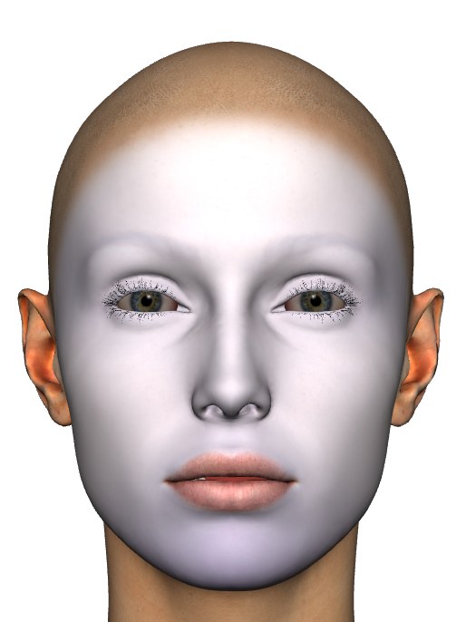
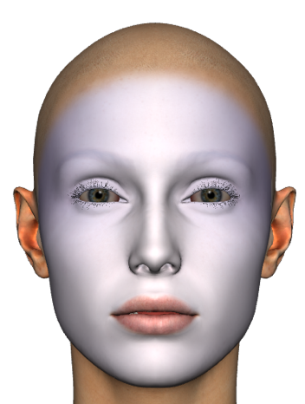
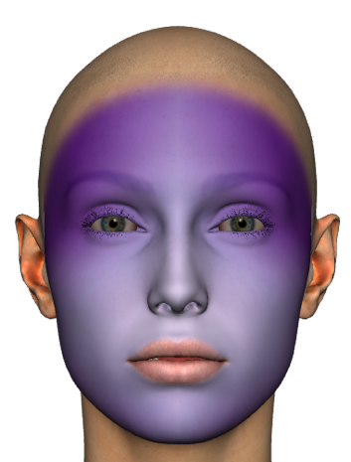
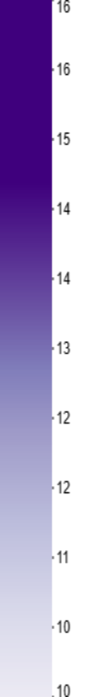
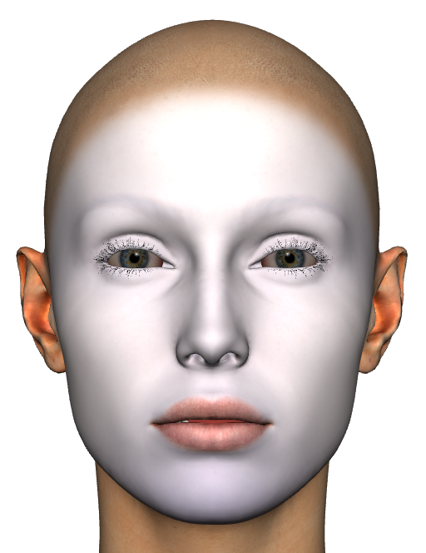
Before/after Collagen mapping visualization
In
vivo
Mature skin panel, avg values
Placebo
5%
SYN®-COLL
CB
Collagen
D0
D28
D0
D28
Ultrasound intensity
Facial collagen mapping makes SYN®-COLL CB benefits visible.
Collagen is boosted on all facial areas particularly on the forehead and eyes zone.
35

Slide 36



Volunteers' self-evaluation
In
vivo
Perceived visible improvements over time
>90%
would buy
the product
100%
noticed
smoother & firmer skin
>85%
noticed
fewer
facial wrinkles
>95%
noticed
fewer
facial wrinkles
≈90%
noticed
pores
no. & size reduced
≈90%
noticed
neck
winkles reduced
All
Average 40 y.o.
Average 60 y.o.

Slide 37
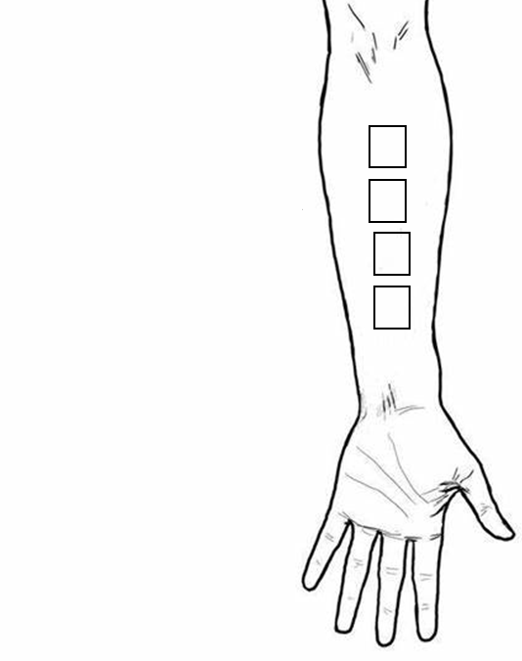
NEW in vivo study design
Zones were randomized
Young panel
25 female volunteers
Mixed ethnicities
skin phototype II-V
1% SYN®-COLL CB
UV irradiation and application of formulation twice daily on inner forearm
No product, UVA
Placebo, UVA
1% SYN®-COLL CB, UVA
No product, no UVA
D -7
D0
D1
D2
D3
D4
Conditioning phase with test formulations –
daily application
Daily use of respective formulation before UVA
Measurement
Measurement
Measurement
UVA
10 J/cm²

Slide 38
1% SYN®-COLL CB prevents Collagen from UV-induced degradation
In
vivo
2.5x better protection vs UV-exposed untreated skin
Young age group, 1% SYN®-COLL CB
* p<0.05
*
*
*
*
*
*
*
*
Notes:
The prevention phase leads to in increase in dermis thickness and intensity with 1% SYN®-COLL CB (grey). UV-irradiation leads to a time-dependen decrease in dermis thickness and intensity (red), whereas this is a protection seen with the active formulation (grey).

Slide 39
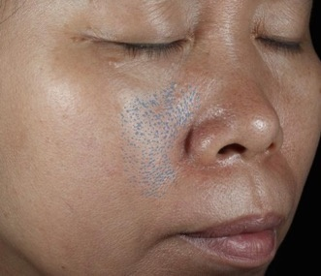
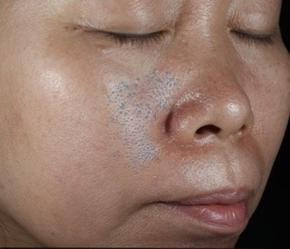
Study design
ASIAN SKIN
In
vivo
Early spring break in China
characterized by:
Trend to expose to spring sun
Increasing UV radiation
Fast temperature rise
UV-induced stress on the skin
4-week skin conditioning phase
Day 0
Day 28
+9.4% ∆E in just 1 month
Visible, moderate skin darkening
39

Slide 40
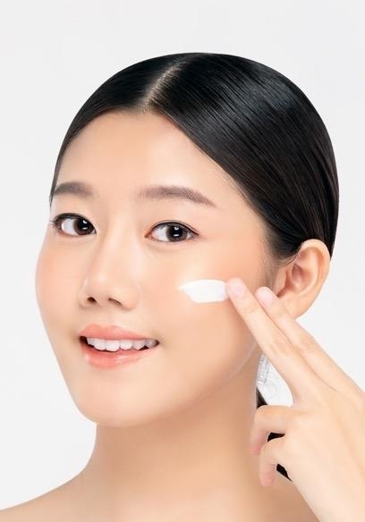
Study design
ASIAN SKIN
In
vivo
4-week wrinkle measurement
1
Visia cr
2
Foits
3
Cutometry
4
Volunteer self-assessment
Placebo
33 female
Chinese volunteers
volunteers claiming to have sensitive skin
Average age of 43 y.o.
79%
2.5%
SYN®-COLL CB
40
Notes:
FOITS: Fast Optical In vivo Topometry of human Skin

Slide 41
SYN®-COLL CB reverses visible signs of photo-aging in just 4 weeks
In
vivo
All subjects
35-43 y.o.
44-53 y.o
SYN®-COLL CB significantly reverses the photo-aging damage for better results in the older age group
*
Skin roughness
Mean wrinkle depth
Skin roughness
Mean wrinkle depth
Skin roughness
Mean wrinkle depth
* p< 0.05 compared to untreated cells
41

Slide 42

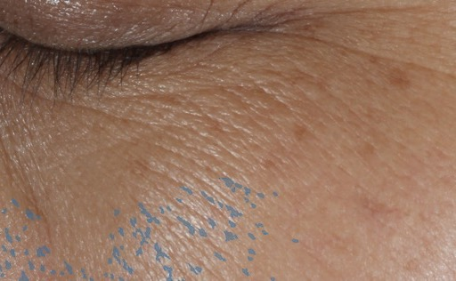

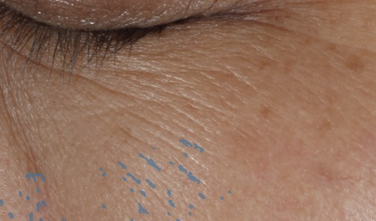

SYN®-COLL CB smooths texture and visibly reduces wrinkles’ depth
In
vivo
1
2
VISIA CR Digital imaging analysis
Eye area
FOITS reconstructed 3D skin relief
Cheek area
AFTER CONDITIONING
AFTER 4 WEEKS
Reduces wrinkle depth
Reduces roughness
With 2.5% SYN®-COLL CB
With 2.5% SYN®-COLL CB
42

Slide 43
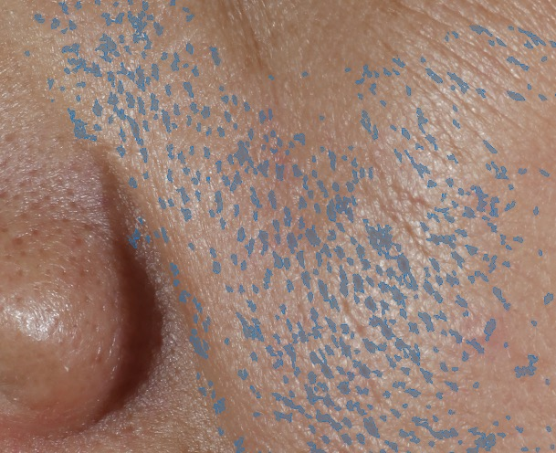
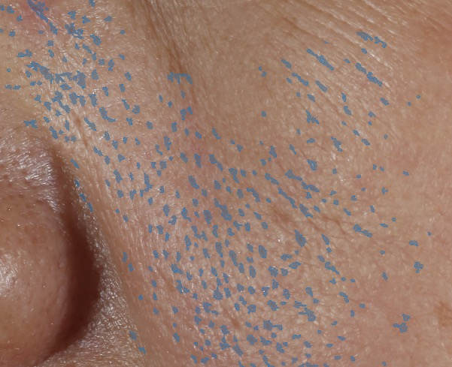
Visible pore reduction in just 4 weeks with SYN®-COLL CB
In
vivo
Volunteer #28, 47 y.o.
After
conditioning
After
4 weeks
VISIA CR Digital imaging,
pore area highlighted
with 2.5% SYN®-COLL CB
1
43

Slide 44
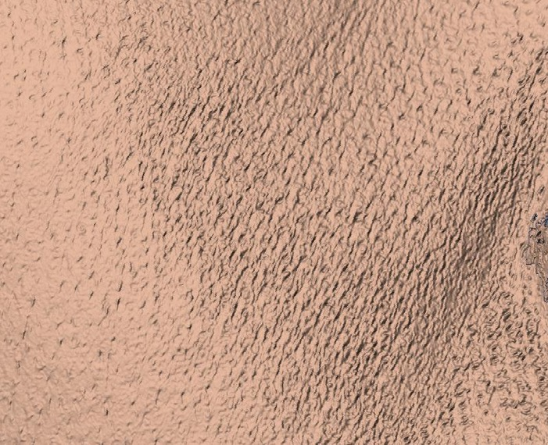

Visible pore reduction in just 4 weeks with SYN®-COLL CB
In
vivo
Volunteer #19, 46 y.o.
After
conditioning
After
4 weeks
60%
60% of volunteers noticed visible pore size reduction in just 4 weeks
3D skin relief, graphically reconstructed
form the FOITS data on the cheek area
with 2.5% SYN®-COLL CB
2
44
Notes:
With aging, loss of ECM proteins in the follicular regions leads to fragility and instability of the dermal matrix

Slide 45
SYN®-COLL CB visibly improves facial contours
In
vivo
+7%
Skin firmness improvement in just 4 weeks
+5%
Skin elasticity improvement in just 4 weeks
3
Cutometry
of in vivo study participants felt the formula with
SYN®-COLL CB visibly improved the firmness of their skin
77%
4
Volunteer self-assessment
45

Slide 46
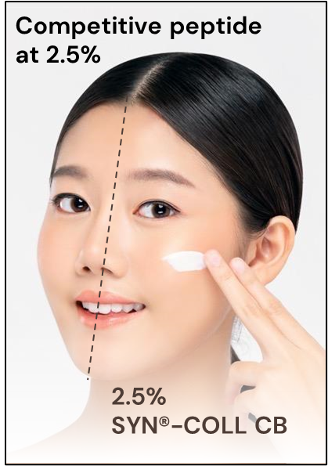
Study design
ASIAN SKIN
In
vivo
4-week wrinkle measurement
Difference after…
…conditioning phase
…4-week
treatment
+15% better efficacy
in just 1 month!
SYN®-COLL CB proved to be significantly better in fighting the appearance of lines comparing to a market available peptide product
+15%
31 female
Chinese volunteers
volunteers claiming to have sensitive skin
Average age of 46 y.o.
65%
46
Notes:
After 4 treatment weeks deepest wrinkles appeared to be significantly smaller (2.6 mm) for the SYN®-COLL CB treated sides compared to Matrixyl 3000 treated areas

Slide 47

Long-term in vivo study design
CAUCASIAN SKIN
In
vivo
12 weeks wrinkle measurement
15 female French volunteers per group. Average age at 53 y.o.
1%
SYN®-COLL
CB
2.5%
SYN®-COLL
CB
Placebo
Primos®
Primos®
Primos®
47
Notes:
The in vivo study was performed by the skin institute “Laboratoire BIO-EC” in France.

Slide 48
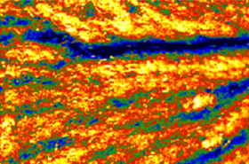
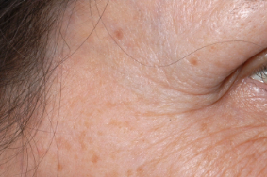
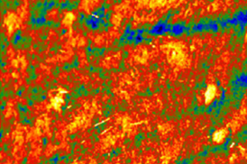
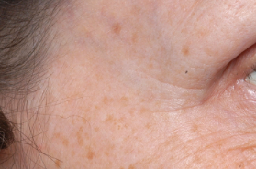
SYN®-COLL CB shows significant wrinkle reduction vs placebo
In
vivo
Placebo
1% SYN®-COLL CB
2.5% SYN®-COLL CB
3D Skin relief
Digital imaging
Before
After
12 weeks
*
with 2.5% SYN®-COLL CB
* p < 0.05 compared to placebo
48

Slide 49
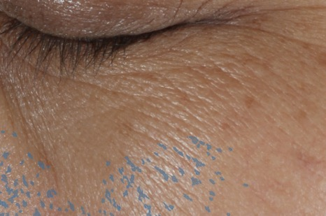
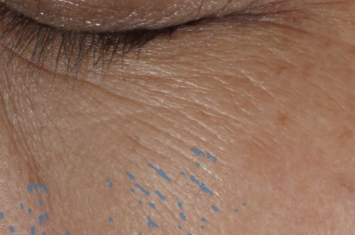
SYN®-COLL CB reduces the appearance of lines and wrinkles on diverse ethnic groups over time
In
vivo
Caucasian volunteer # 18, age 60
Asian volunteer #28, aged 47
Before
Before
After
12 weeks
After
4 weeks
with 2.5% SYN®-COLL CB
49

Slide 50
SYN®-COLL CB - Activate your Collagen for lifelong slow aging
Addressing the needs of multiple skin types & ages
Young skin
30+ y.o.
Middle aged 40+ y.o.
Mature skin 60+ y.o.
PREVENT
REVERT
RESTORE
1% SYN®-COLL CB
On diverse ethnicities
Boosts Collagen on face & neck, up to +13% NEW
Protect from UV-induced degradation NEW
2.5% SYN®-COLL CB
On diverse ethnicities
Boosts Collagen on face & neck, up to +22% NEW
Reverses visible signs of
photo-aging
Smooths skin & visibly reduces wrinkles
Sculpts face for more lifted look
Refines skin appearance with less visible pores
5% SYN®-COLL CB
On diverse ethnicities
Boosts Collagen on face & neck, up to +26% NEW
Peptides | Pharma-inspired skincare
IN VIVO SUPPORTED CLAIMS
50

Slide 51
SYN®-COLL CB
Product summary
1st TGF-β booster on the market: biohacking the skin to supports collagen’s reserves
Boosts collagen & protect from UV-induced degradation
Reverses visible signs of photo-aging in just 4 weeks
Smooths skin and reduces wrinkles’ depth
Refines skin appearance with less visible pores
Sculpts face for a firmer, more lifted appearance
Peptides | Pharma-inspired skincare
51

Slide 52
Featuring
SYN®-COLL CB
Lifelong authentic beauty

Slide 53

Lifelong authentic beauty
Feeling good in our skin is not about perfection…
it’s rather about realizing skin’s full potential.
TRUE COLL Skincare Range works with skin’s
natural processes to promote a healthy appearance
from within...at every stage of life journey.
In its formulations SYN®-COLL CB, natural-origin
tripeptide that supports skin’s Collagen reserves
with age-personalized action, for lifelong slow-aging.
Skin looks firmer, smoother, and more sculpted.
Next generation peptide,
for sustainable aging.

Slide 54

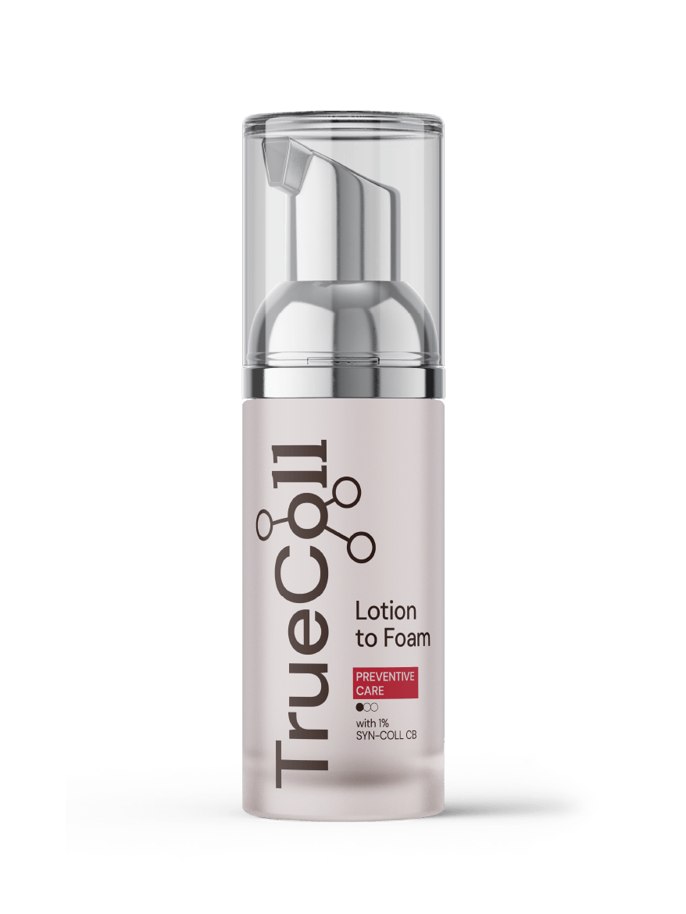
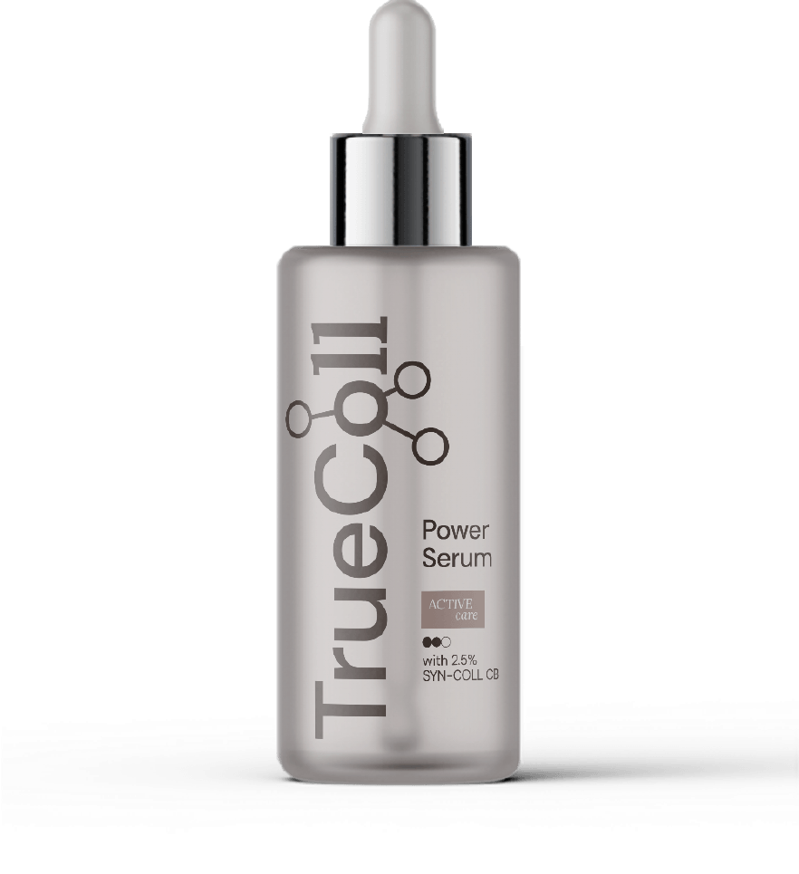
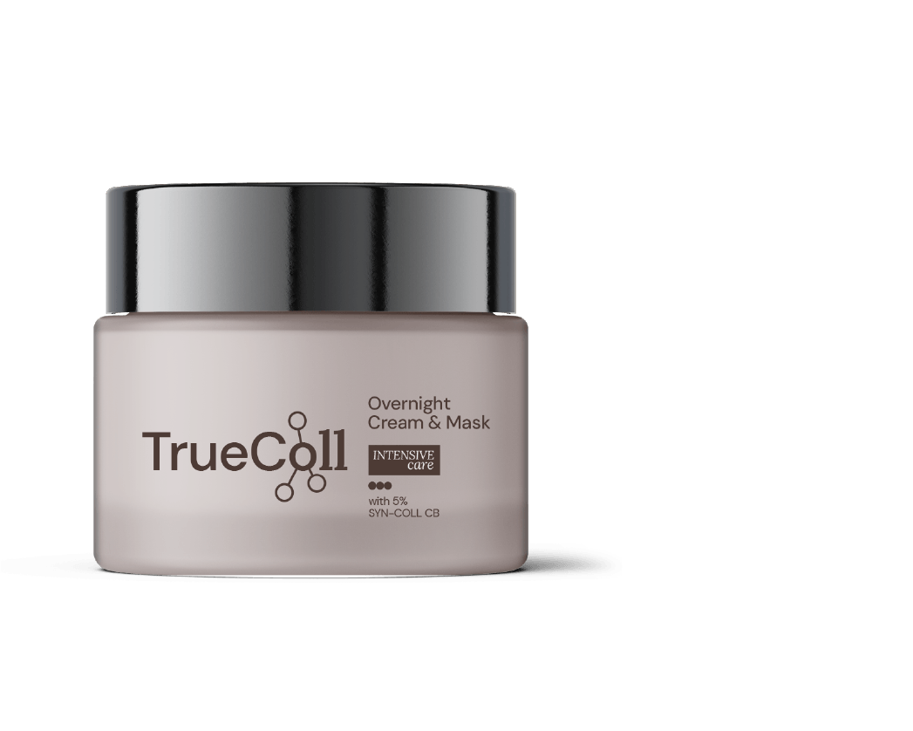
Age
personalized
action
30+
40+
60+

Slide 55
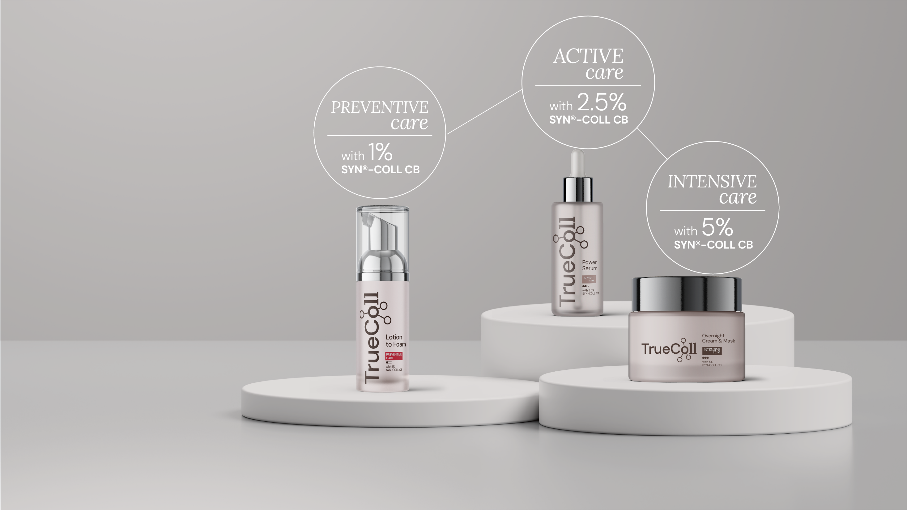
Featuring
SYN®-COLL CB
Lifelong authentic beauty

Slide 56
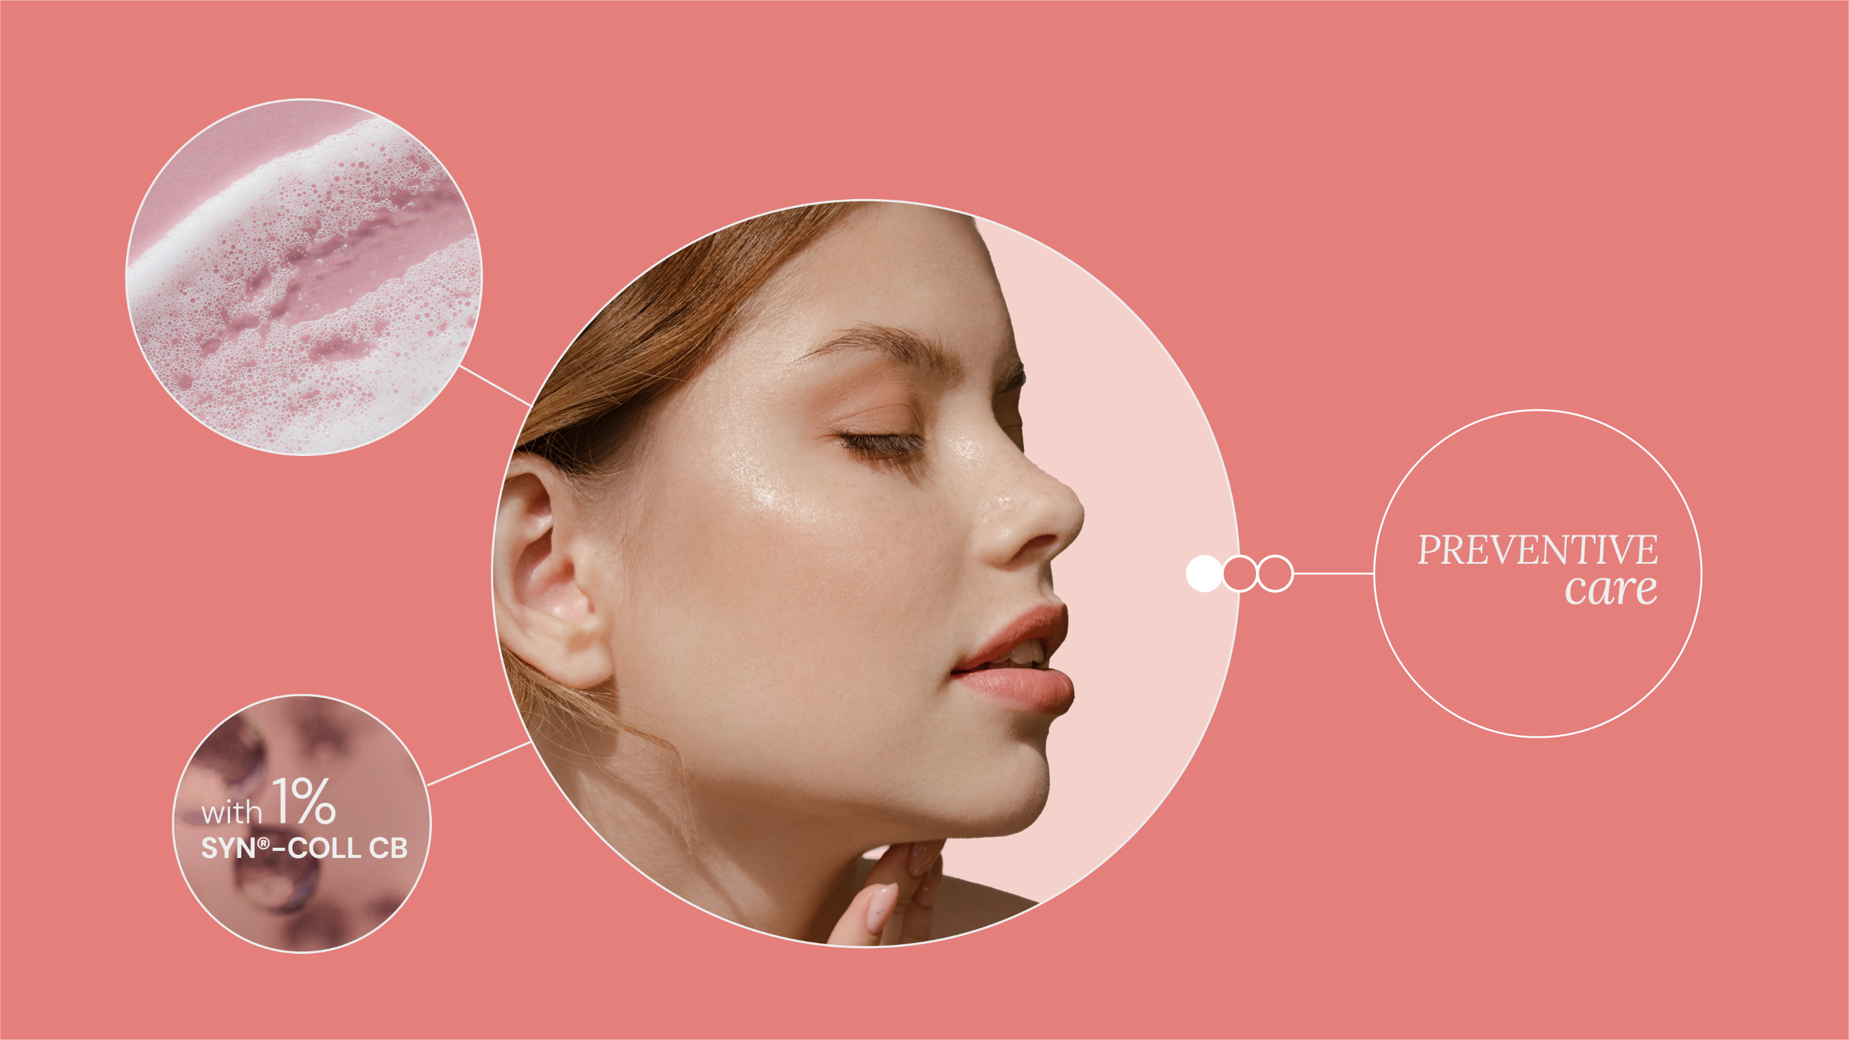
Lifelong authentic beauty

Slide 57
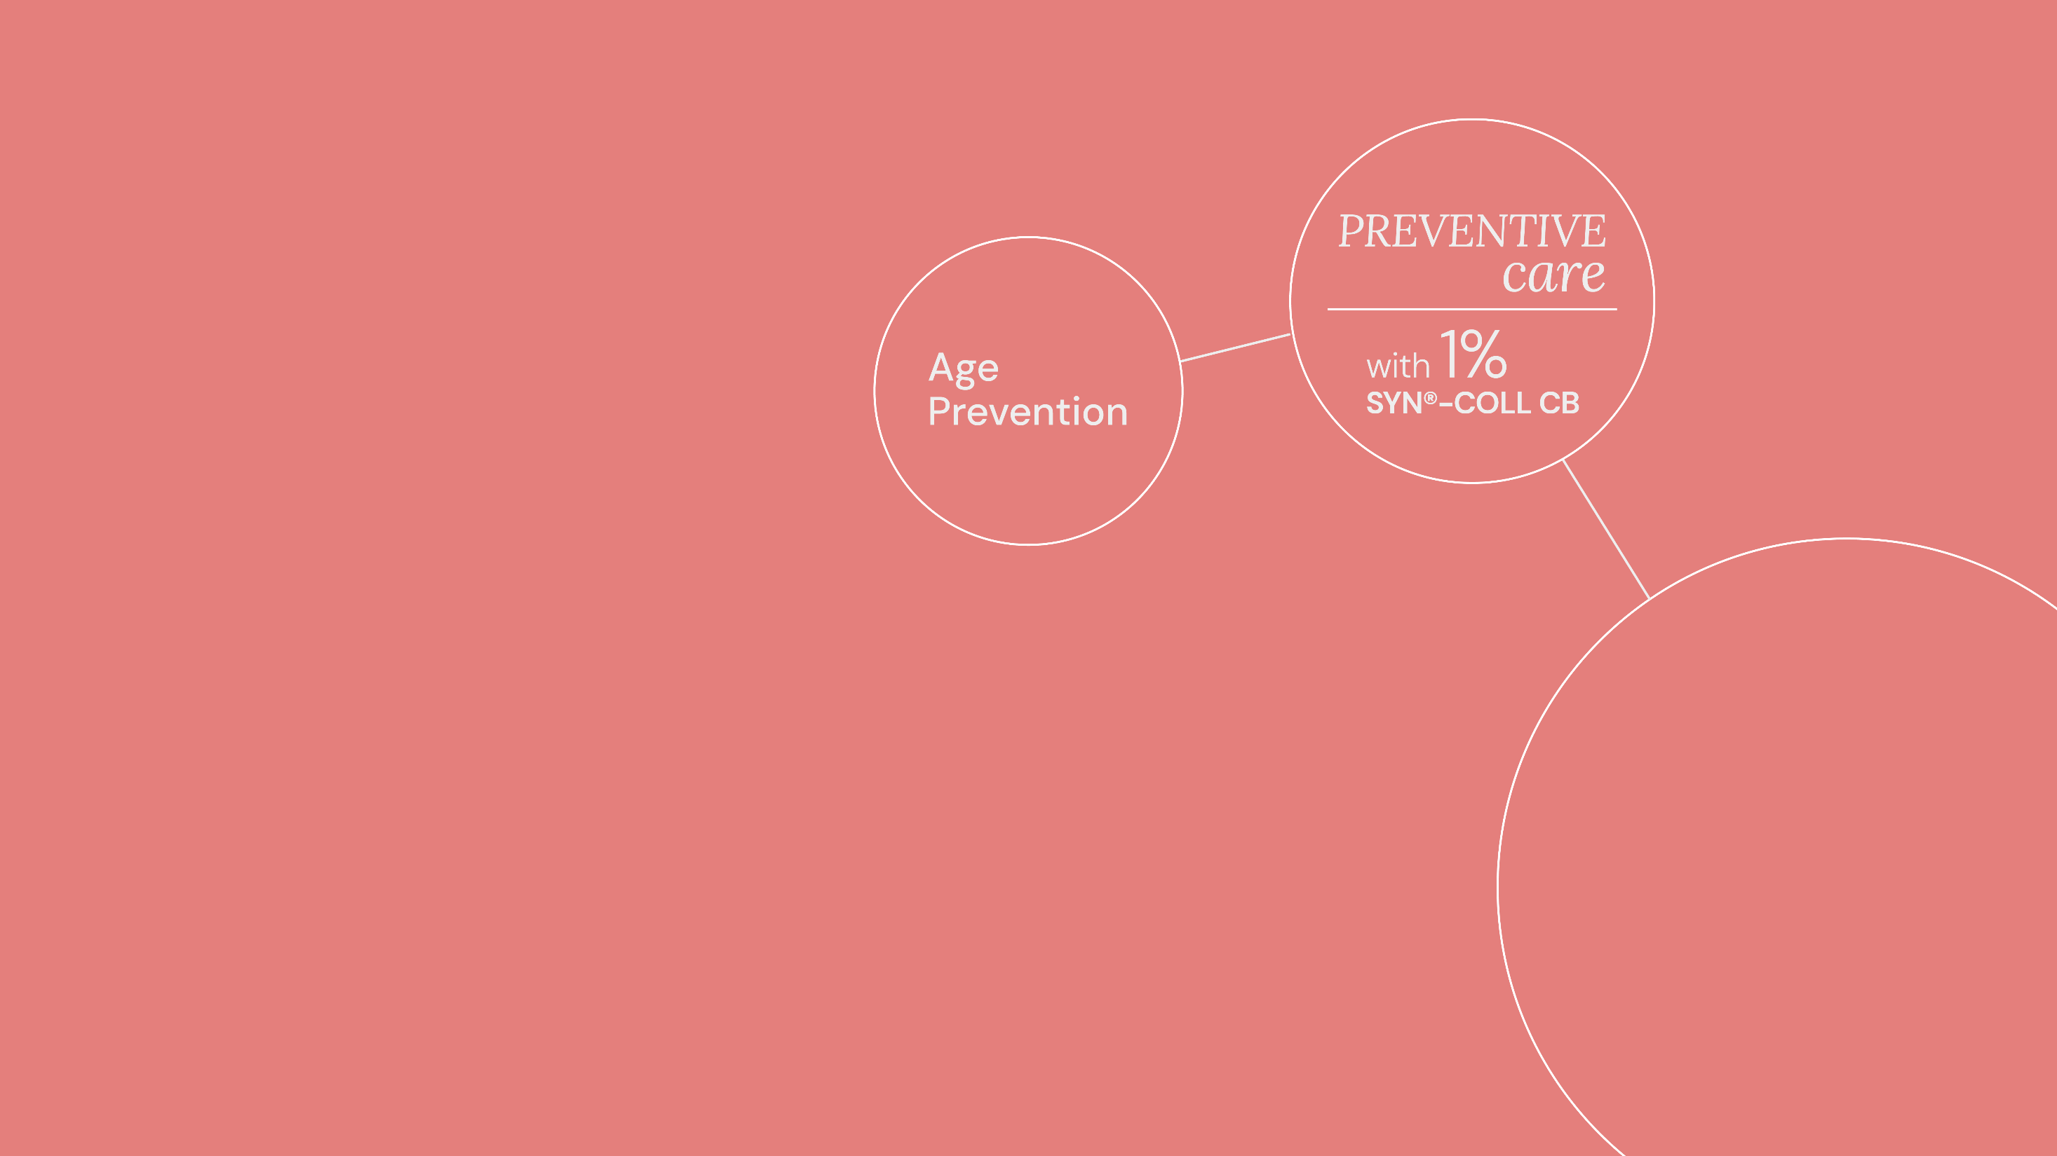

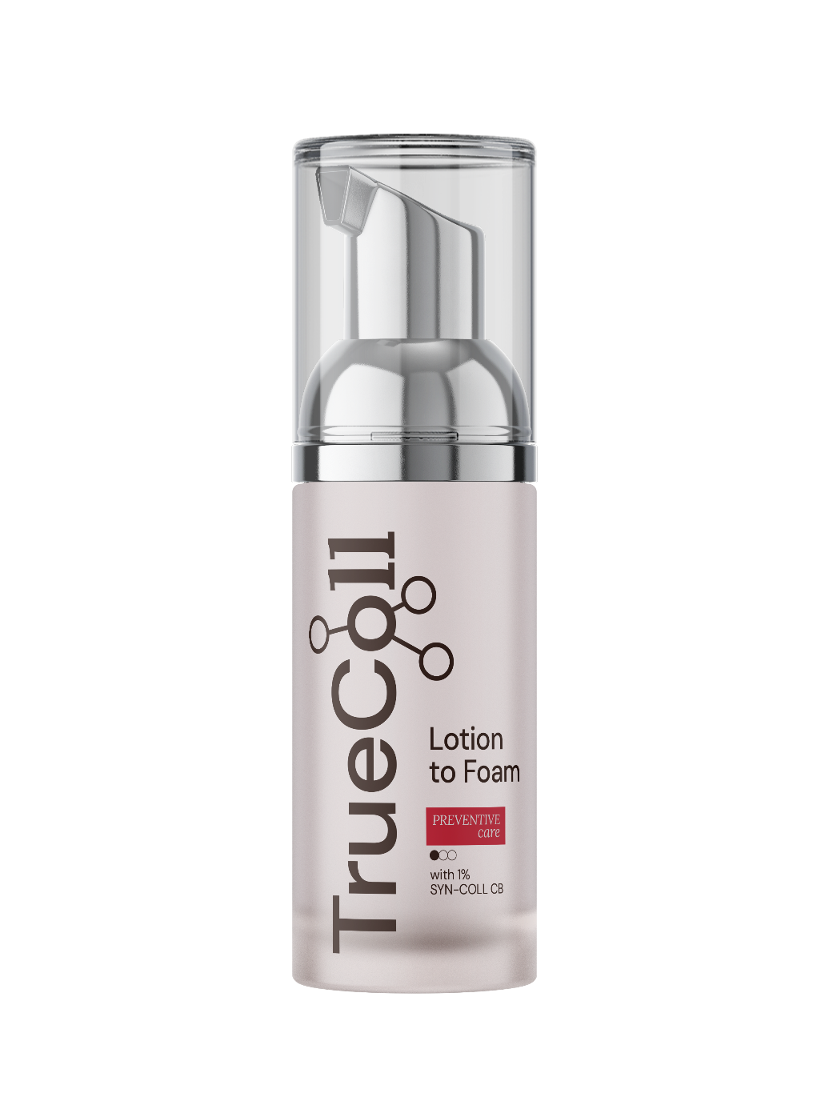
Lifelong authentic beauty
Lotion to Foam
Enriched with 1% SYN®-COLL CB,
next-generation, highly effective
and eco-conscious tri-peptide,
this formula works in harmony with your skin’s natural processes to protect & maintain Collagen reserves, promoting skin’s slow-aging.
For a unique sensory experience, this light, velvety mousse transforms upon touch
and easily melts into your skin.
Physical sample available | Products are for experimental use only and are not for sale

Slide 58
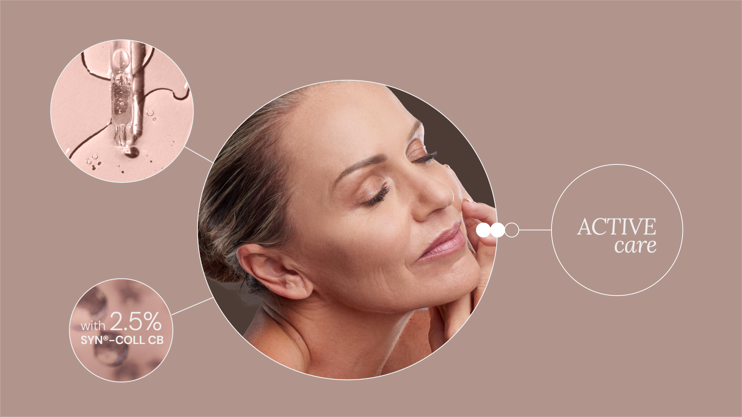
Lifelong authentic beauty

Slide 59


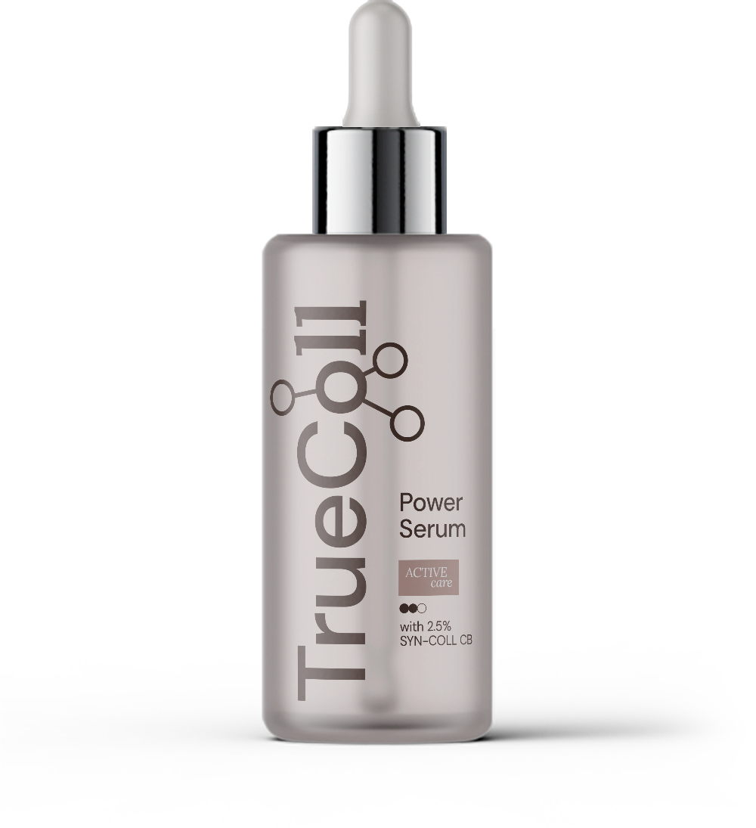
Lifelong authentic beauty
Power Serum
Lightweight texture, powerful performance. This fast-absorbing serum is enriched with 2.5% SYN®-COLL CB to boost natural Collagen reserves, promoting visibly revitalized skin with improved firmness and fewer fine lines. Unlock your skin’s full potential from within.
Products are for experimental use only and are not for sale

Slide 60



PEACH GLOW - P02J942
Fragrance in the formulas
Claims substantiation
Noticeable ingredients
Safe for skincare applications
(at recommended dosage)
Globally compliant
Clean Label 83
95% Biodeg/50% Carbon Renewable
Emotiboost™ apple bw fe sb
Emotiboost™ vanilla ac
Nirvanol captive
Dihydromyrcenol upcycled
Dersantol upcycled
Lotion to Foam / Serum
A fresh top with a juicy blend
of fruits paired with a bouquet of rose, delicate lily of the valley, and jasmine. The light floral heart is overwhelmed by a rich and warm base of ambery notes, creamy sandalwood,
and a soft, musky finish.
Pyramid
TOP
PEACH APPLE PLUM
Light top notes
HEART
ROSE MUGUET JASMINE
Light floral heart
FOND
AMBERY SANDALWOOD MUSKY
Creamy drydowns

Slide 61

Lifelong authentic beauty

Slide 62



Lifelong authentic beauty
Overnight Cream & Mask
Let your skin absorb the deep nourishment
of this rich velvety cream, crafted to work overnight to restore the skin's vitality.
Loaded with a high concentration of SYN®-COLL CB peptide, this intensive care formula is specifically developed for extra efficacy.
It restores collagen reserves, so you wake up to smoother and firmer skin. Apply the cream every night after cleansing as a face cream
or use it in a thicker layer as a mask.
Physical samples available | Products are for experimental use only and are not for sale

Slide 63



DOLCE ROSE P02J939
Fragrance in the formula
Claims substantiation
Noticeable ingredients
Safe for skincare applications (at recommended dosage)
Globally compliant
Clean Label 83
95% Biodeg/50% Carbon Renewable
Emotiboost™ apple bw fe sb
Emotiboost™ vanilla ac fe
Cedarwood virginia eo usa upcycled
Mysoral captive
Cream
An opulent and elegant floral bouquet with a light burst of apple, citrus, and aldehydes.
The heart reveals a harmonious blend of rose paired with delicate white flowers, and geranium. The floralcy is grounded by a warm and comforting base of creamy woods, and soft white musks.
Pyramid
TOP
APPLE CITRUS ALDEHYDES
Light top notes
HEART
ROSE WHITE FLOWERS GERANIUM
Opulent floral bouquet
FOND
CEDARWOOD SANDALWOOD MUSKY
Creamy drydowns

Slide 64




Slide 65
Disclaimer
Copyright © dsm-firmenich Switzerland AG, 2026, 4002 Basel, Switzerland.
www.dsm-firmenich.com. All rights reserved.
dsm-firmenich has used diligent care to ensure that the information provided herein is accurate and up-to-date to the best of its knowledge. However, dsm-firmenich makes no representation or warranty, either expressly or implied, of the accuracy, reliability, completeness, or suitability thereof. The information provided herein contains scientific and product information for business-to-business use and does not constitute or provide scientific or medical advice, diagnosis or recommendation for treatment options. Country or region-specific information should be considered when labelling or advertising to final consumer. In no event shall dsm-firmenich be liable for any direct or indirect damages arising from or reliance upon, or use of, any information provided herein. The content of this document is subject to change without further notice. Please contact your local dsm-firmenich representative for the latest information. All trademarks listed in this document are either (registered) trademarks of, or trademarks licensed by, the dsm-firmenich group of companies, unless explicitly stated otherwise.
Disclaimer Formulation Guideline
The information provided herein is provided for information purposes only and has been prepared by dsm-firmenich in accordance with its own methodology.
dsm-firmenich has used diligent care to ensure that it is accurate and up-to-date, however, dsm-firmenich makes no representation or warranty, either expressly or implied, of the accuracy, reliability, or completeness thereof. In no event shall dsm-firmenich be liable for any damages arising from or reliance upon, or use of, any information provided herein. Further, dsm-firmenich shall not bear any liability for the application and/or use of any processed material containing its product(s). The formulation of the finished product is the customer’s sole responsibility. It is the customer’s responsibility to determine the suitability of dsm-firmenich’s products regarding user specific purposes, assess compatibility and stability of their finished product(s) and to ensure compliance of their finished product(s) with relevant laws and regulations. Any product, marketing or other claims made by customer are its sole responsibility. The content of this document is subject to change without further notice. Please contact your local dsm-firmenich representative for further details. © dsm-firmenich Switzerland AG, 2026.
© 2026

Slide 66
© 2026

