Slide 1
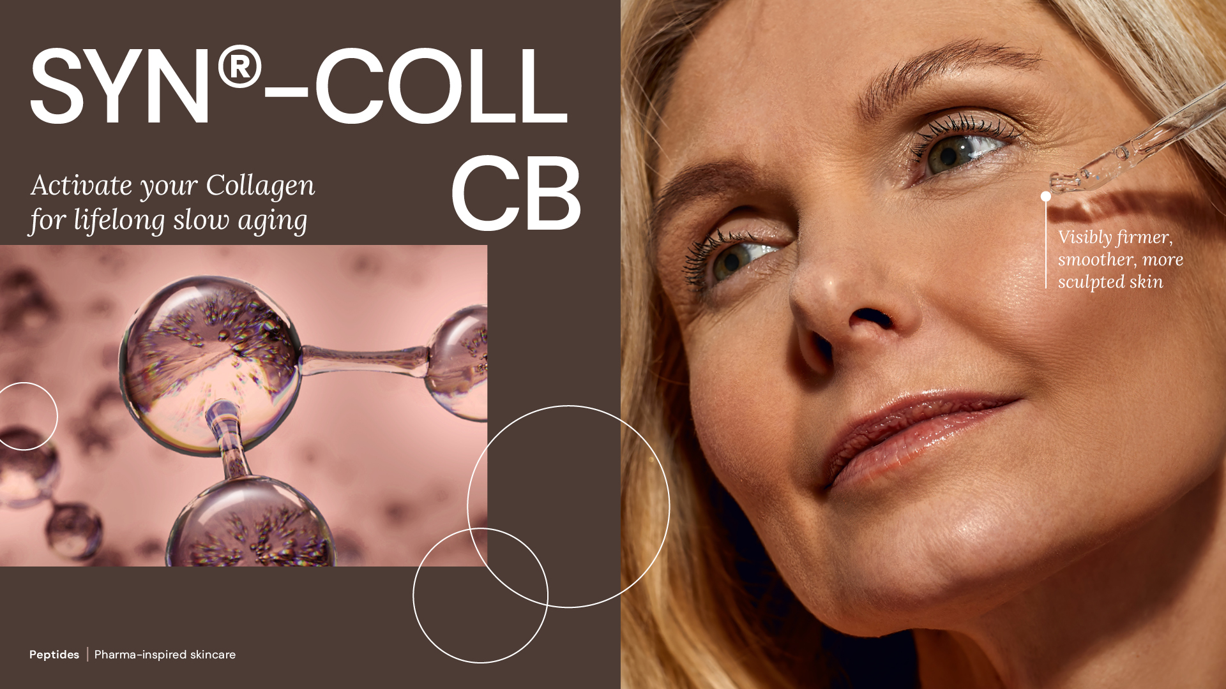
08.2026

Slide 2

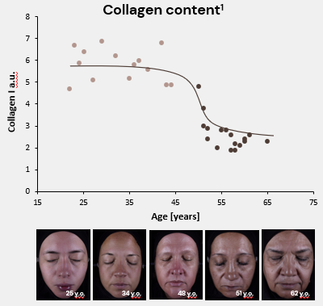
Collagen: the foundation of healthy-looking skin
Major building block of the skin (~80%):
It keeps skin firm, plumped & supple
It gives the skin strength and structure
Over time Collagen’s reserves slow down, resulting in visible signs of aging
Chung et al. 2001
1. Affinito et al. (1999) Maturitas 33:239. Pictures from dsm-firmenich 2024 clinical study
2

Slide 3



SYN®-COLL CB - Activate your Collagen for lifelong slow aging
Addressing the needs of multiple skin types & ages
Young skin
30+ y.o.
Middle aged 40+ y.o.
Mature skin 60+ y.o.
PREVENT
REVERT
RESTORE
1% SYN®-COLL CB
On diverse ethnicities
Boosts Collagen on face & neck, up to +13% NEW
Protect from UV-induced degradation NEW
2.5% SYN®-COLL CB
On diverse ethnicities
Boosts Collagen on face & neck, up to +22% NEW
Reverses visible signs of
photo-aging
Smooths skin & visibly reduces wrinkles
Sculpts face for more lifted look
Refines skin appearance with less visible pores
5% SYN®-COLL CB
On diverse ethnicities
Boosts Collagen on face & neck, up to +26% NEW
3
IN VIVO SUPPORTED CLAIMS

Slide 4
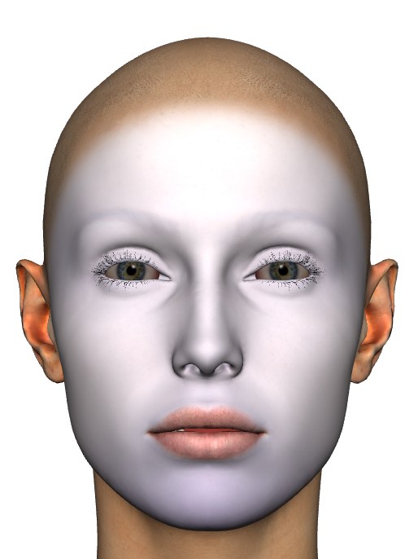
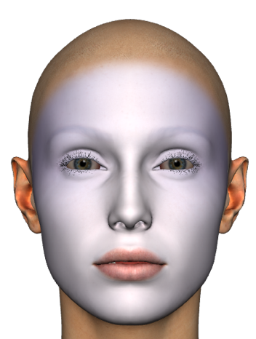
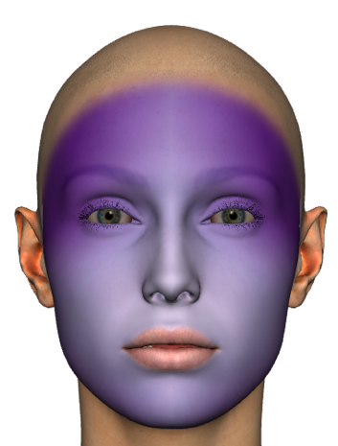

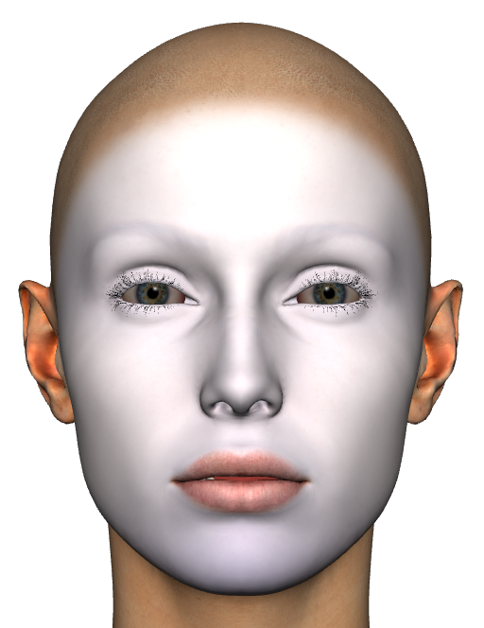
Before/after Collagen mapping visualization
In
vivo
Mature skin panel, avg values
Placebo
5%
SYN®-COLL
CB
Collagen
D0
D28
D0
D28
Ultrasound intensity
Facial collagen mapping makes SYN®-COLL CB benefits visible.
Collagen is boosted on all facial areas particularly on the forehead and eyes zone.
4

Slide 5




SYN®-COLL CB
ID Card
INCI NAME:
Palmitoyl Tripeptide-5, Aqua, Glycerin
Pharma-inspired skincare solution, taking skin health ambition to the next level.
Targeted design and molecular modeling supported by green chemistry
Natural origin tripeptide with unique sequence Palm-Lys-Val-Lys, produced in Europe, TFA-free¹,
Original SYN®‑COLL peptide generation patented; CB version patent application pending
Low carbon footprint of 5.2 kg CO₂ eq./kg
99.9% natural origin (ISO 16128), 73% natural origin for the pure peptide
TECHNOLOGY:
TECHNICAL:
Form: Liquid
pH of use: 3.0-7.0
Use level: 1-5%
Preservative: Free
Solubility: Soluble in water
Biodegradability: Readily biodegradable
New – Slow down the aging process from within**
New – Significantly supports skin’s Collagen reserves, with age-personalized action**
New – Protects from UV-induced Collagen degradation already at 1% **
Sculpts face and neck for a firmer, more lifted appearance**
Refines skin appearance with less visible pores**
BENEFITS:
Collagen Science Pioneer
First TGF-β booster on the market*
Mimics the skin’s own mechanism to produce and protect Collagen*
Rebalances inflammation by inhibiting cytokines (TNFα, IL-8)*
REGISTRATION
CERTIFICATION:
NATRUE
Approved
1. Non-intentionally added TFA
* in vitro ** in vivo

Slide 6

SYN®-COLL CB
Next generation peptide,
for sustainable aging
Production without any CMR solvents or reagents, prioritizing the safety of workers. TFA-free¹
Carbon footprint of 5.2 kg CO₂ eq./kg. High efficiency allowing a low carbon footprint in use²
Natural-origin peptide. SYN®-COLL CB suitable for Clean-Beauty with more than 99.9% naturality according to ISO 16128, 73% natural origin for the pure peptide
Green chemistry science with an optimized synthesis reducing the number of steps
Manufactured in Europe with 100% purchased renewable electricity
1 non-intentionally added TFA
2 considering a 1-3% concentration of SYN®-COLL CB in final formulation, 50-150g CO₂ per kg of final formulation.
Notes:
Activity profile allows for very low use levels, thus allowing for a minimal CO2 footprint in the final formulation
Calculation for the carbon footprint in use of SYN-COLL CB:
If 1% use level (minimum): 0.01kg/kg*5.2 kg CO2/kg = 0.052 kg CO2 / kg formulation = 50 grams CO2 / kg formulation
If 3% use level (maximum): 0.03kg/kg*5.2 kg CO2/kg = 0.152 kg CO2 /kg formulation = 150 grams CO2 / kg formulation

Slide 7

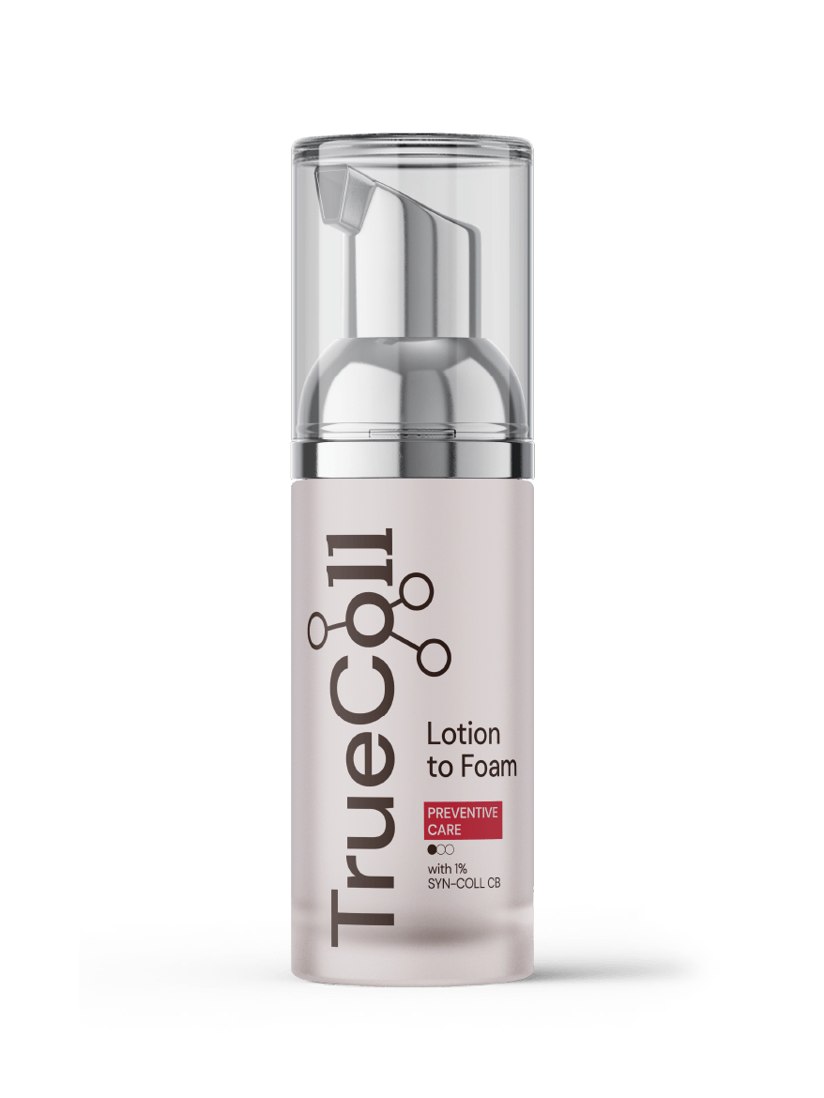
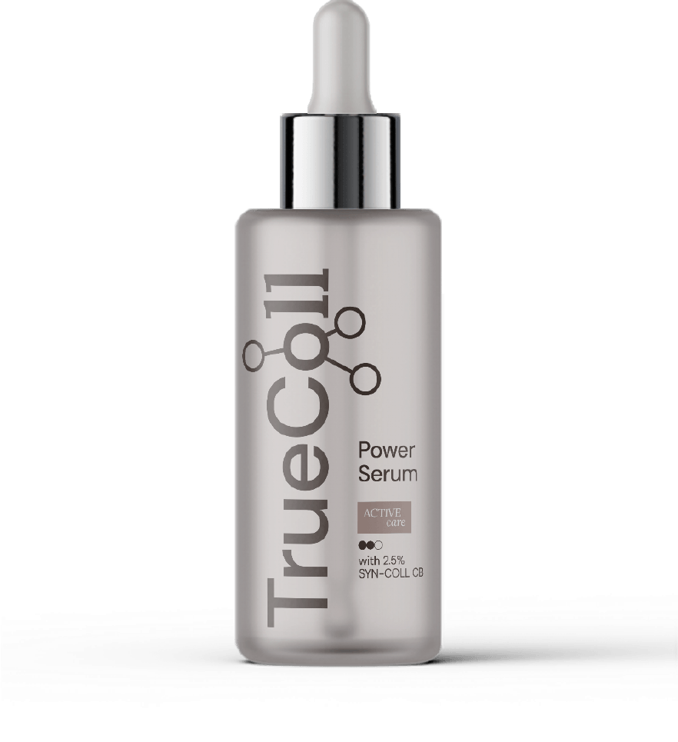
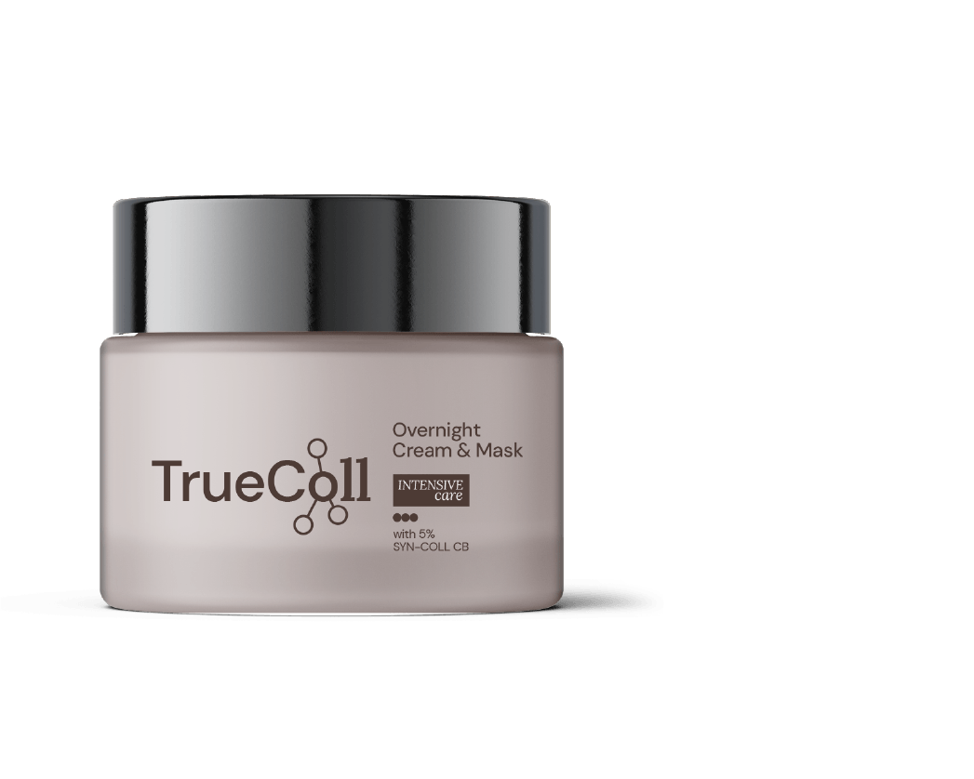
Age
personalized
action
30+
40+
60+

Slide 8
Disclaimer
Copyright © dsm-firmenich Switzerland AG, 2026, 4002 Basel, Switzerland.
www.dsm-firmenich.com. All rights reserved.
dsm-firmenich has used diligent care to ensure that the information provided herein is accurate and up-to-date to the best of its knowledge. However, dsm-firmenich makes no representation or warranty, either expressly or implied, of the accuracy, reliability, completeness, or suitability thereof. The information provided herein contains scientific and product information for business-to-business use and does not constitute or provide scientific or medical advice, diagnosis or recommendation for treatment options. Country or region-specific information should be considered when labelling or advertising to final consumer. In no event shall dsm-firmenich be liable for any direct or indirect damages arising from or reliance upon, or use of, any information provided herein. The content of this document is subject to change without further notice. Please contact your local dsm-firmenich representative for the latest information. All trademarks listed in this document are either (registered) trademarks of, or trademarks licensed by, the dsm-firmenich group of companies, unless explicitly stated otherwise.
Disclaimer Formulation Guideline
The information provided herein is provided for information purposes only and has been prepared by dsm-firmenich in accordance with its own methodology.
dsm-firmenich has used diligent care to ensure that it is accurate and up-to-date, however, dsm-firmenich makes no representation or warranty, either expressly or implied, of the accuracy, reliability, or completeness thereof. In no event shall dsm-firmenich be liable for any damages arising from or reliance upon, or use of, any information provided herein. Further, dsm-firmenich shall not bear any liability for the application and/or use of any processed material containing its product(s). The formulation of the finished product is the customer’s sole responsibility. It is the customer’s responsibility to determine the suitability of dsm-firmenich’s products regarding user specific purposes, assess compatibility and stability of their finished product(s) and to ensure compliance of their finished product(s) with relevant laws and regulations. Any product, marketing or other claims made by customer are its sole responsibility. The content of this document is subject to change without further notice. Please contact your local dsm-firmenich representative for further details. © dsm-firmenich Switzerland AG, 2026.
© 2026

Slide 9
© 2026

