Slide 1
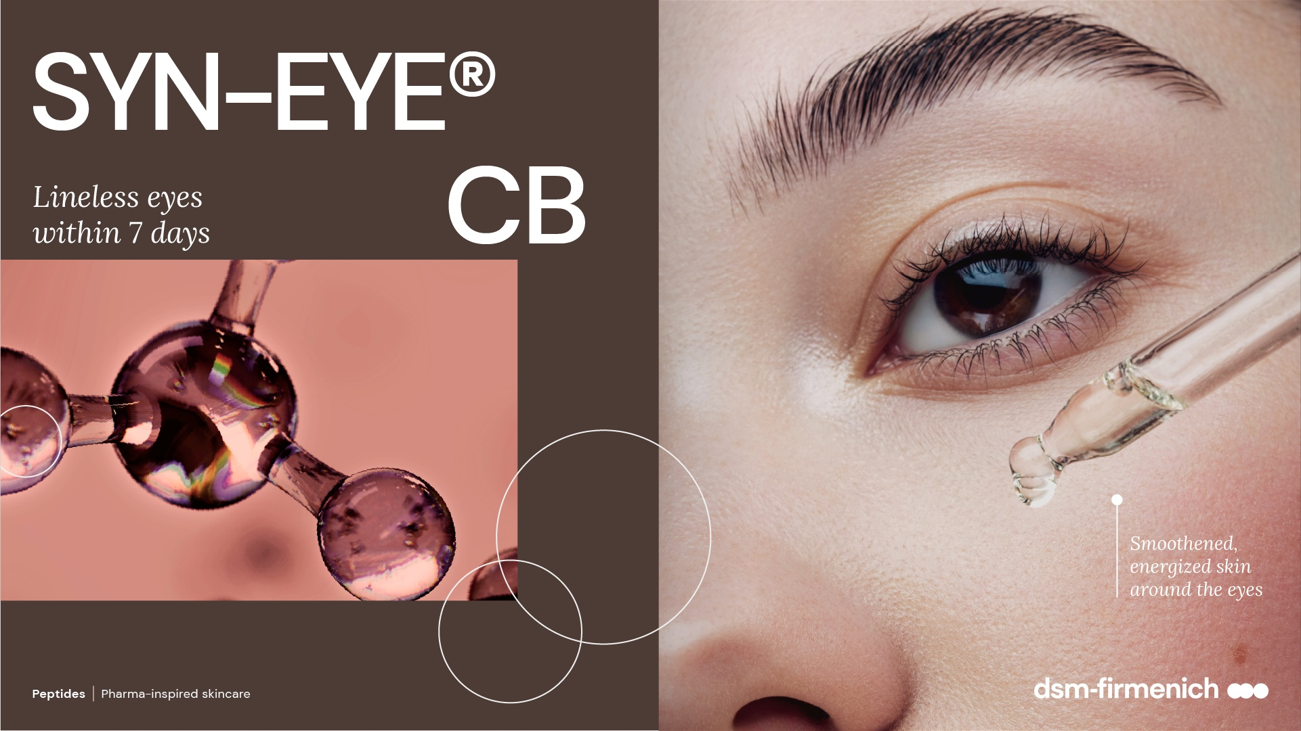
April 2025

Slide 2
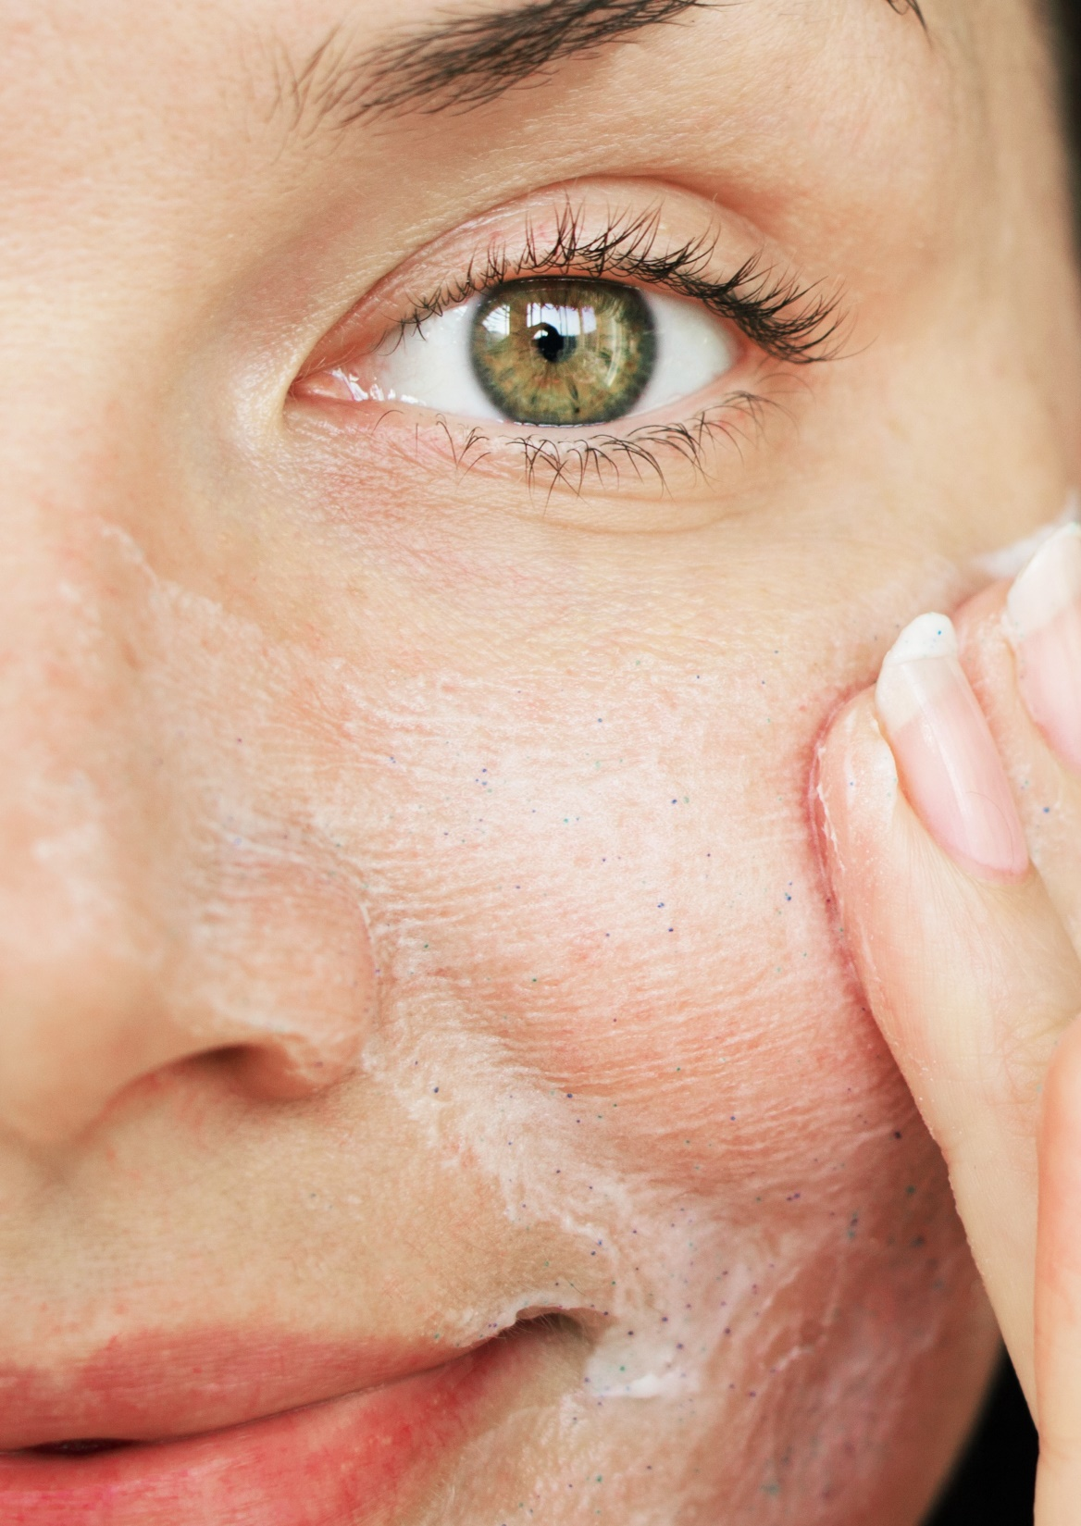
Consumer and Customer insights
The area around the eye is the first part of your face to show signs of ageing.
Eye area worries is by far one the biggest consumer concern across all markets.¹
Eye Care products that target multiple concerns, such as fine lines & wrinkles, dark circles, and puffiness are gaining traction in the market.²
The cosmetics industry is seeing a rise in peptide-based eye care products that offer multi-faceted benefits, catering to consumer demand for more effective results.²
1 dsm-firmenich survey
2 https://www.trendhunter.com/trends
2

Slide 3
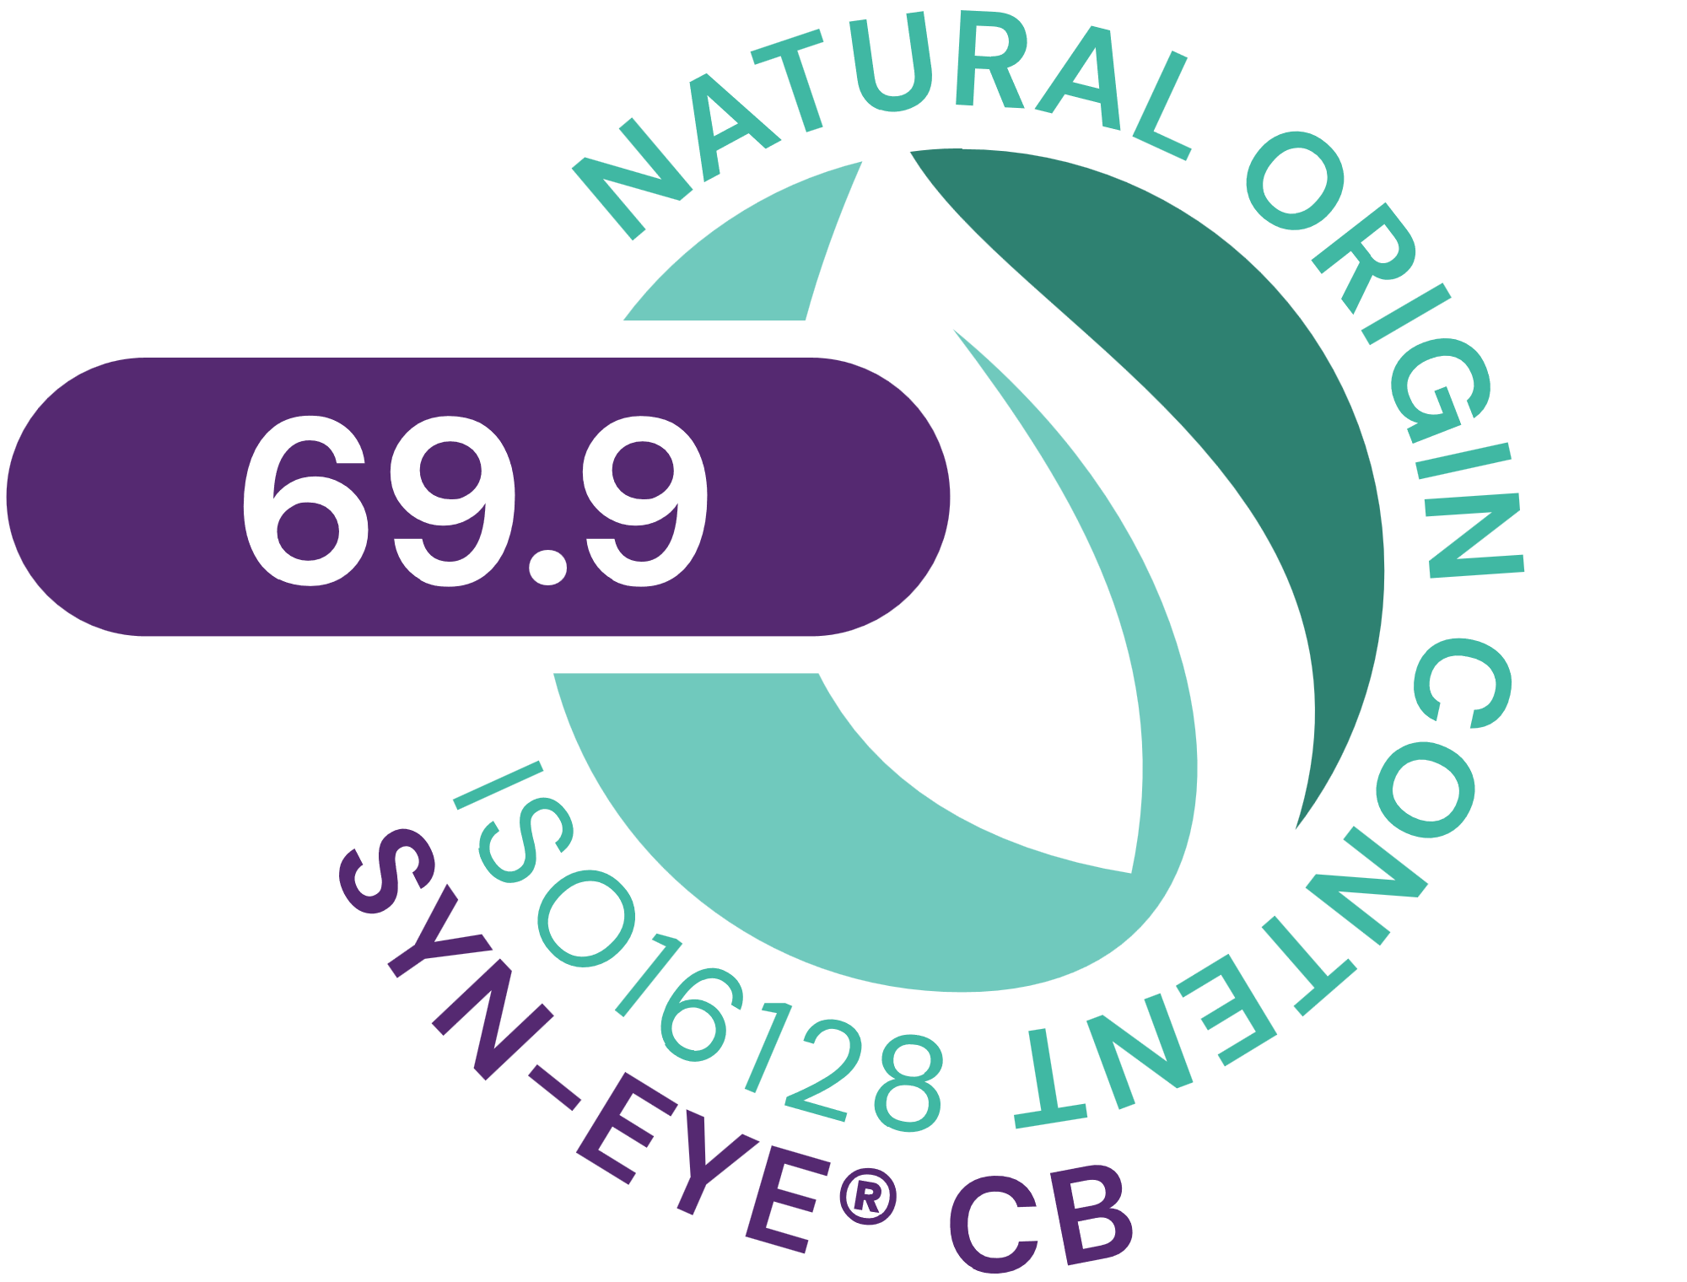



SYN-EYE® CB
ID Card
INCI NAME:
Aqua, Palmitoyl Tripeptide-5, Panthenol, Sodium Hyaluronate, Dunaliella Salina Extract, Pentylene Glycol, Citric Acid
Combines the latest cutting-edge SYN®-Peptide technology, produced via Green Chemistry Science with superior bioactives in a multifunctional eye care formula
TFA-free¹
69.9% of natural origin (according to ISO 16128)
TECHNOLOGY:
TECHNICAL:
Form: Liquid
pH of use: 4.5-6.0
Use level: Up to 1%
Preservative: no Phenoxyethanol
Solubility: Miscible in water
BENEFITS:
Visibly reduces the appearance of lines and wrinkles around the eye within 7 days **
Shows a visibly brighter skin color in dark circle area after only 14 days **
Helps to reduce skin roughness, making the delicate skin around the eye look smoother and fresher. **
REGISTRATION
CERTIFICATION
* in vitro ** in vivo
¹ Non-intentionally added TFA

Slide 4
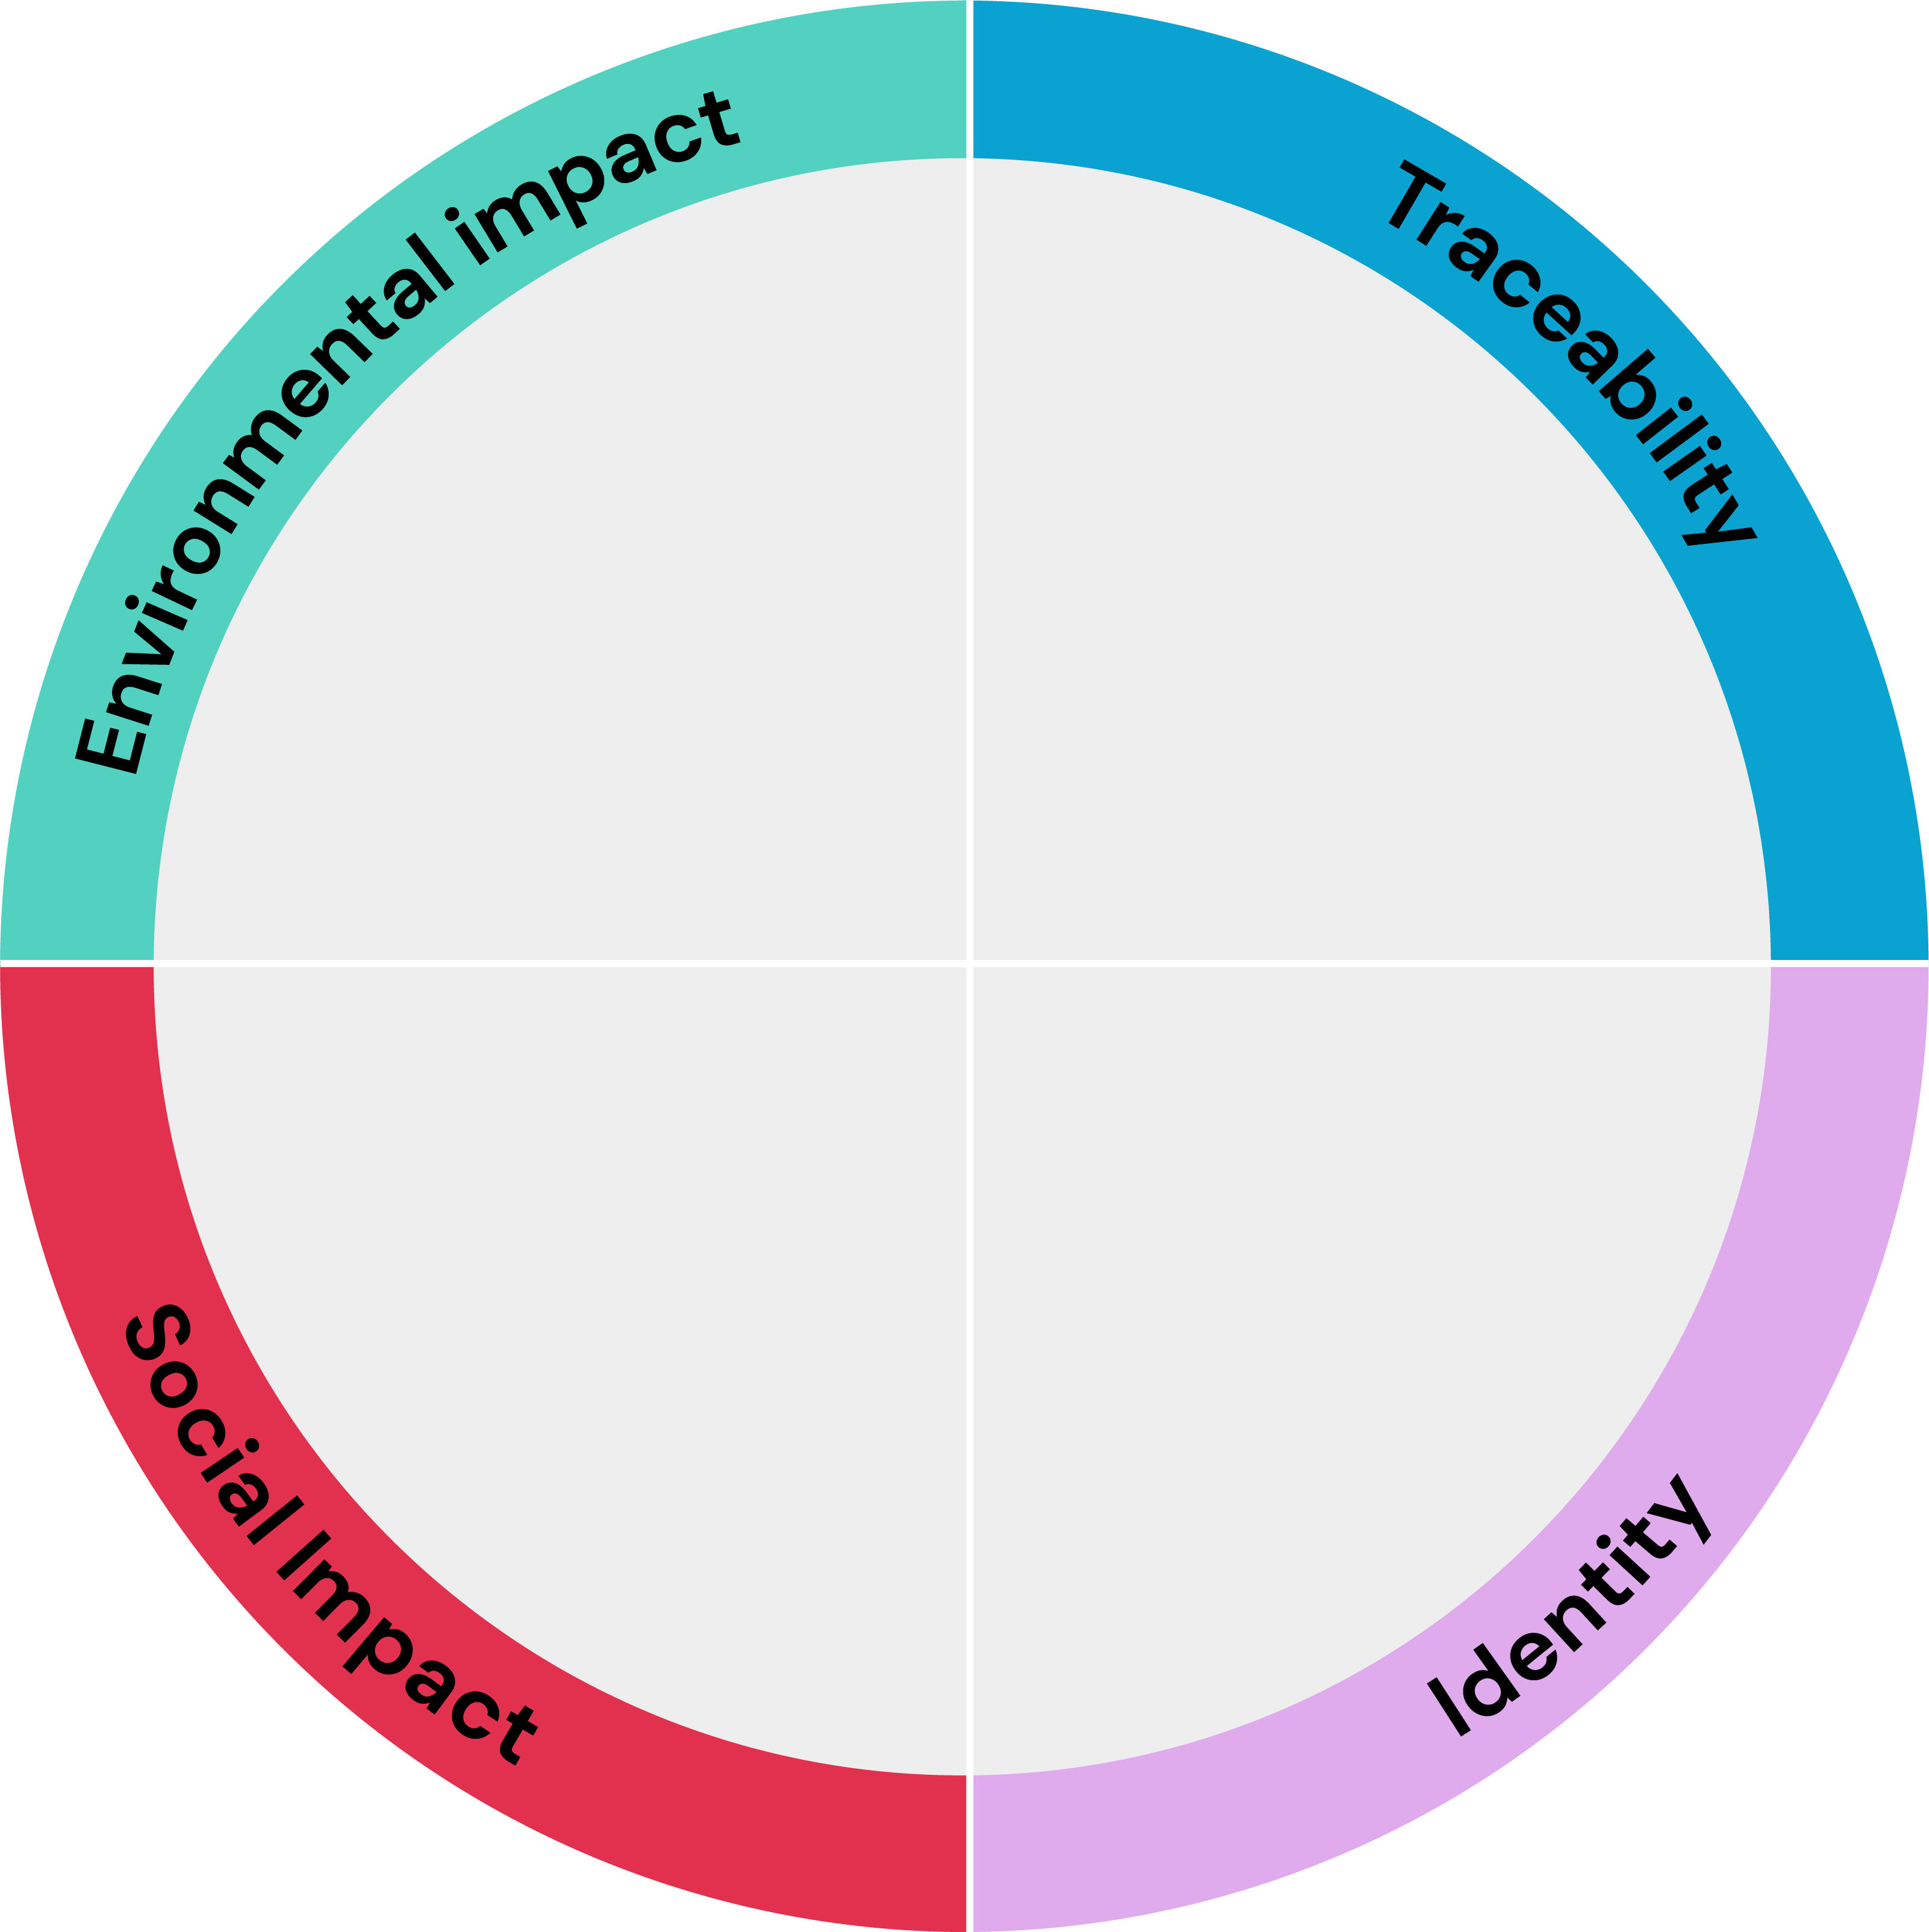





SYN-EYE® CB
Aligned with and contributing to the
Carbon
footprint*
18.5 kg CO2 eq/kg
Biodegradability
Estimated to be biodegradable
Water footprint
5.2 m³ depriv./kg
Renewable electricity
100% purchased renewable electricity
Highlights
related to Supply
Chain control
Full ownership of the production,
Feedstock origin
INCI name: Aqua, Palmitoyl Tripeptide-5, Panthenol, Sodium Hyaluronate, Dunaliella Salina Extract, Pentylene Glycol, Citric Acid Product Code: 5038465
Palmitoyl Tripeptide-5 (synthetic, palm
oil and petroleum derived); Panthenol
(synthetic); Sodium Hyaluronate
(fermentation); Dunaliella Salina Extract
(vegetable from cultivated microalgae)
SYN-EYE® CB
combines the latest SYN®-Peptide technology with superior bioactives in a multifunctional eye care formula
Responsible sourcing
Palmitic acid is RSPO Mass Balance
Impact on health and well-being
Natural-origin
69.9% according to ISO16128
SYN-EYE® CB targets sensitive, dry, dull-looking skin, wrinkles and fine lines, dark circles and puffiness around the delicate eye area.
Within 7 days, SYN-EYE® CB visibly reduces the appearance of lines and wrinkles around the eye.
The carbon and water footprint calculations are based on internally conducted LCA according to ISO 14040/44 guidelines, dsm-firmenich LCA policy and validated by internal reviewers.
© 2020. DSM.
All rights reserved
Card version 2
Notes:
Renewable electricity: Always mention «purchased renewable electricity» and add «completing» or «with a majority of» to ensure that we are not greenwashing.

Slide 5







SYN-EYE® CB
A natural peptide for sustainable formulations
Carbon footprint of 18.5 kg CO2 eq./kg. High efficiency allowing a low carbon footprint in use(1).
Natural-origin peptide. SYN®-EYE CB suitable for Clean-Beauty with 69.9% naturality according to ISO 16128
Green chemistry reaction type(2) with an optimized synthesis reducing the number of steps
Manufactured in Europe with 100% purchased renewable electricity(3)
Production without any CMR solvents or reagents, prioritizing the safety of workers
(1) considering a 1-3% concentration of SYN®-EYE CB in final formulation, 185-555g CO2 per kg of final formulation.
(2) Main reaction type is amidation
(3) The last production step in Pentapharm. Peptide production in Switzerland.
Notes:
Activity profile allows for very low use levels, thus allowing for a minimal CO2 footprint in the final
Calculation for the carbon footprint in use of SYN EYE CB:
If 1% use level (minimum): 0.01kg/kg*18.5 kg CO2/kg = 0.185 kg CO2 / kg formulation = 185 grams CO2 / kg formulation
If 3% use level (maximum): 0.03kg/kg*18.5 kg CO2/kg = 0.555 kg CO2 /kg formulation = 555 grams CO2 / kg formulation
TFA replaced with mandelic acid. Mandelic acid is a alpha hydroxy acid which are often used in skin care. Among the alpha hydroxy acids, mandelic acid seems to have attracted particular attention in the last years. It is particularly suitable for sensitive skin, antibacterial, removes layers of dead and dull skin (“exfoliant”), accelerates cell turnover, unclogs pores, … Our mandelic acid is nature identical, meaning that it is a natural product but that we currently have to rely on petrochemical sources.
Major reaction type is amidation, specifically mentioned in ISO 16128 as green chemistry
Streamlined synthesis (5 vs 7 steps previously)
Manufactured in Pentapharm, with 100% purchased renewable electricity still completing self-generating electricity from natural gas
No CMR solvents. Dominating solvents are ethyl acetate (non-toxic and environmental friendly solvent made from ethanol and acetic acid) and water
No CMR reagents
Estimated to be biodegradable

Slide 6
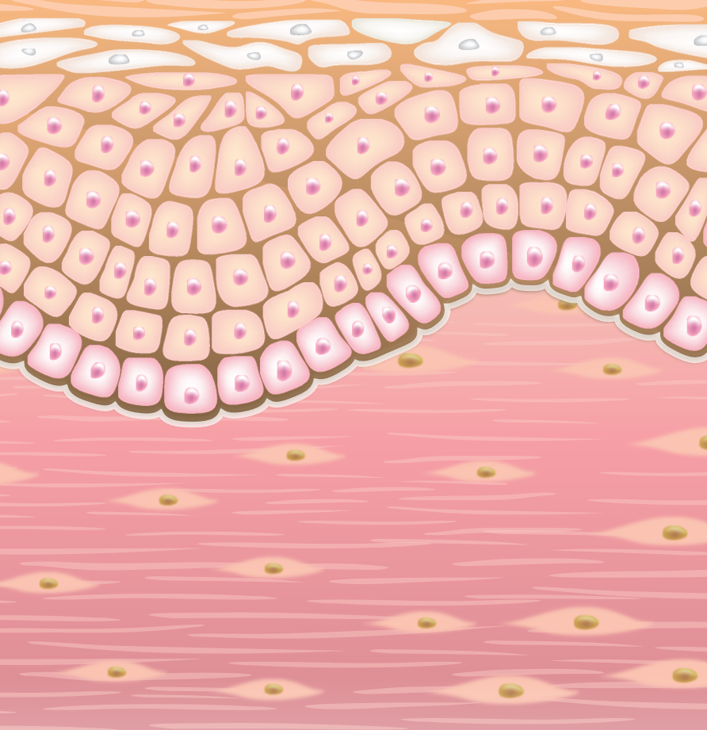
SYN-EYE® CB
4 actives for various mode of actions
Panthenol
Increased stratum corneum hydration and reduced TEWL*
Soothes irritated skin by reduction of various inflammatory cytokines*
Sodium Hyaluronate (200 – 400Da)
Calms reddened skin by inhibition of inflammatory cytokine IL-1α**
Acts as a hydration booster and fortifies the skin’s natural barrier**
Dunaliella salina extract*
Cellular energy activation (ATP) up to 140%**
5 days faster skin renewal **
Palmitoyl Tripeptide-5
Rebalances inflammatory cytokines (TNFα, IL-8)**
Boosts collagen in skin, up to +76%**
* Journal of Dermatological Treatment 2017
** dsm-firmenich internal studies

Slide 7
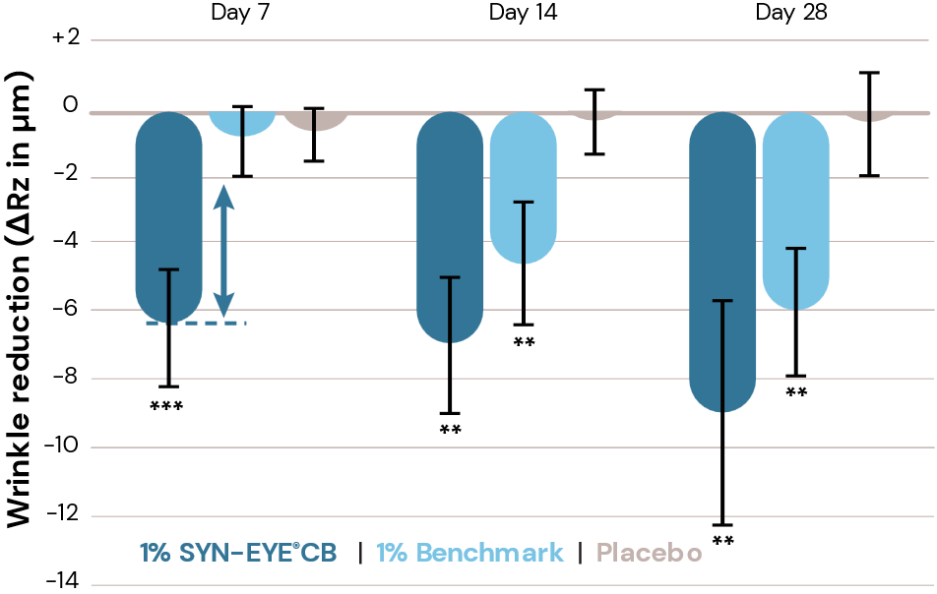
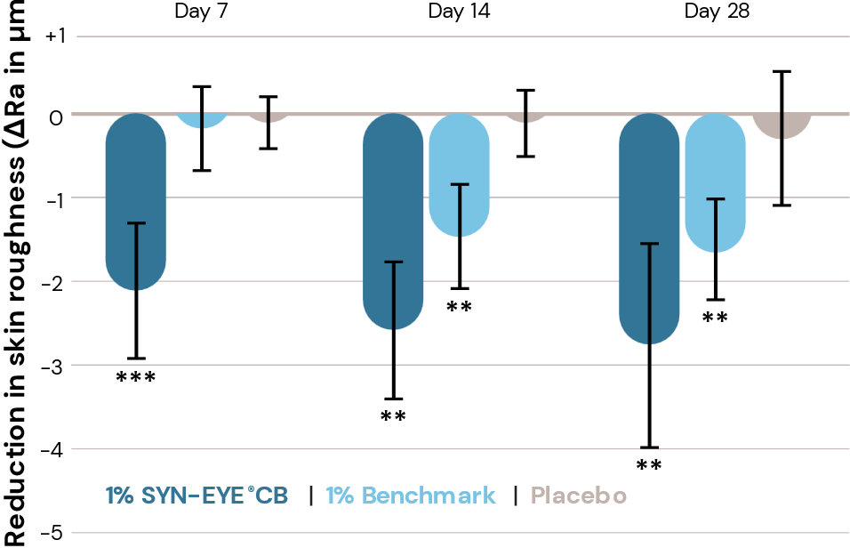
Significant reduction in the appearance of wrinkles and roughness
Within 7 days SYN-EYE® CB reduces the appearance fine lines and wrinkles around the eye area
Significant compared to benchmark and placebo.
Reduced skin roughness, making the delicate skin around the eye look smoother
Significant compared to Day 0
** vs. day 0 & placebo. *** vs. day 0, benchmark & placebo. p<0.05

Slide 8

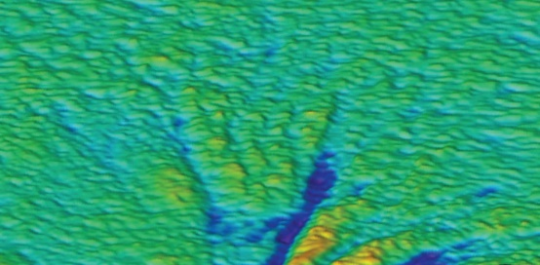
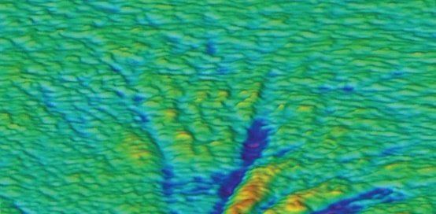
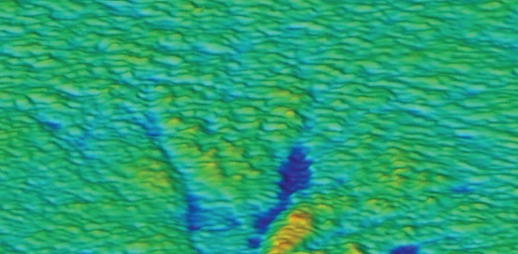
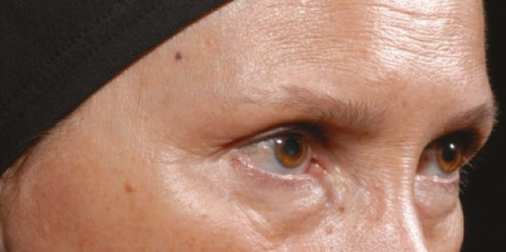
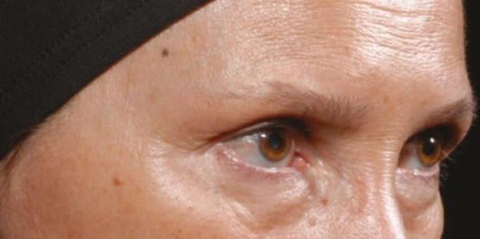
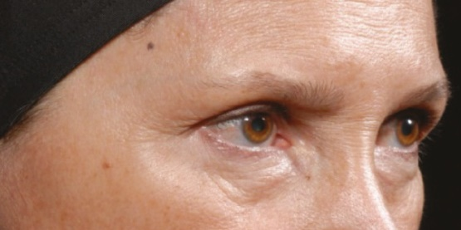
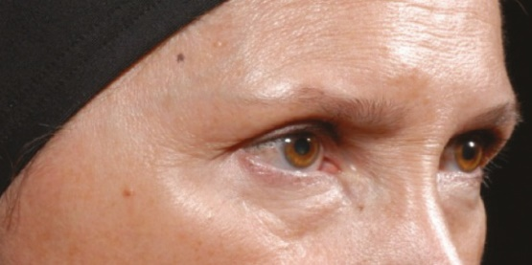
Continuous visible improvement of fine lines and wrinkles
Day 0
After 7 days with 1% SYN-EYE® CB
After 14 days with 1% SYN-EYE® CB
After 28 days with 1% SYN-EYE® CB
Within 7 days, SYN-EYE® CB visibly reduces the appearance of lines and wrinkles around the eye

Slide 9
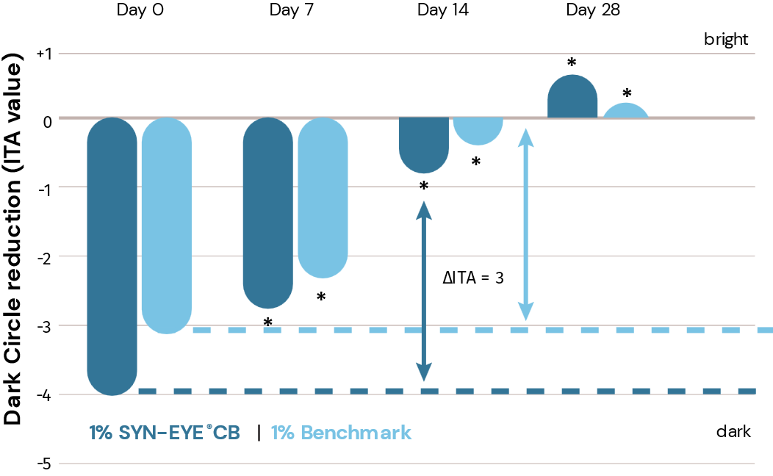
Reduces the appearance of dark circles
SYN-EYE® CB shows a visibly
lighter skin color in dark circle area after only 14 days.
Significant in 7 days
p<0.05. *vs. day 0. ΔITA ≥ 3 is visible

Slide 10
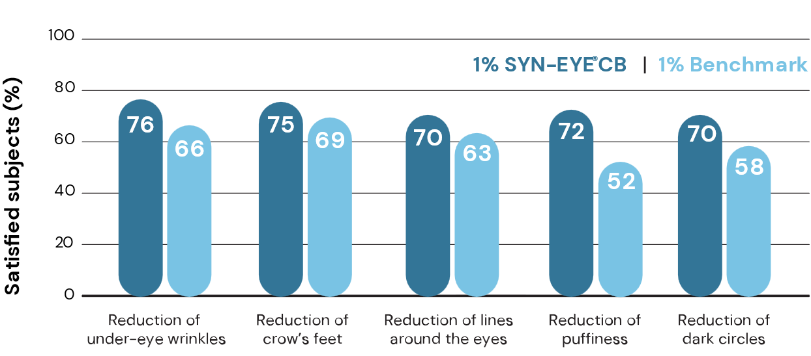
Let’s ask the consumer!
Consumer questionnaire: products efficacy on wrinkles
Higher consumer acceptance in all key aspects compared
to benchmark

Slide 11
Disclaimer
Copyright © DSM Nutritional Products Ltd 2025, 4002 Basel, Switzerland.
www.dsm-firmenich.com. All rights reserved.
dsm-firmenich has used diligent care to ensure that the information provided herein is accurate and up-to-date to the best of its knowledge. However, dsm-firmenich makes no representation or warranty, either expressly or implied, of the accuracy, reliability, completeness, or suitability thereof. The information provided herein contains scientific and product information for business-to-business use and does not constitute or provide scientific or medical advice, diagnosis or recommendation for treatment options. Country or region-specific information should be considered when labelling or advertising to final consumer. In no event shall dsm-firmenich be liable for any direct or indirect damages arising from or reliance upon, or use of, any information provided herein. The content of this document is subject to change without further notice. Please contact your local dsm-firmenich representative for the latest information. All trademarks listed in this document are either (registered) trademarks of, or trademarks licensed by, the dsm-firmenich group of companies, unless explicitly stated otherwise.
Disclaimer Formulation Guideline
The information provided herein is provided for information purposes only and has been prepared by dsm-firmenich in accordance with its own methodology.
dsm-firmenich has used diligent care to ensure that it is accurate and up-to-date, however, dsm-firmenich makes no representation or warranty, either expressly or implied, of the accuracy, reliability, or completeness thereof. In no event shall dsm-firmenich be liable for any damages arising from or reliance upon, or use of, any information provided herein. Further, dsm-firmenich shall not bear any liability for the application and/or use of any processed material containing its product(s). The formulation of the finished product is the customer’s sole responsibility. It is the customer’s responsibility to determine the suitability of dsm-firmenich’s products regarding user specific purposes, assess compatibility and stability of their finished product(s) and to ensure compliance of their finished product(s) with relevant laws and regulations. Any product, marketing or other claims made by customer are its sole responsibility. The content of this document is subject to change without further notice. Please contact your local dsm-firmenich representative for further details. © DSM Nutritional Products AG, 2025.

