Slide 1
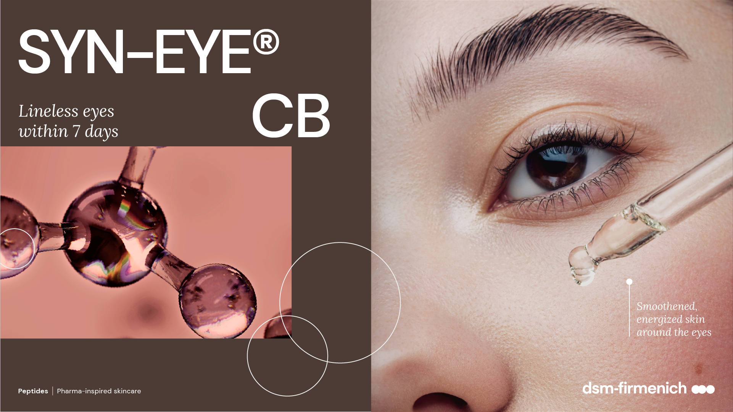
June 2025

Slide 2
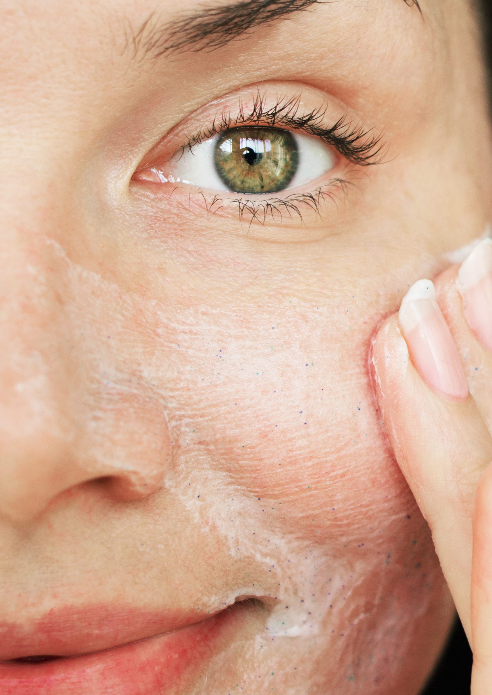
Consumer and Customer insights
The area around the eye is the first part of your face to show signs of ageing.
Eye area worries is by far one the biggest consumer concern across all markets.¹
Eye Care products that target multiple concerns, such as fine lines & wrinkles, dark circles, and puffiness are gaining traction in the market.²
The cosmetics industry is seeing a rise in peptide-based eye care products that offer multi-faceted benefits, catering to consumer demand for more effective results.²
1 dsm-firmenich survey
2 https://www.trendhunter.com/trends
Peptides | Pharma-inspired skincare

Slide 3

The delicate area around the eyes needs extra special care
The area around the eyes is one of the most sensitive parts of the face due to its extremely delicate skin.
It is five times thinner than the rest of the face. This makes the skin particularly susceptible to drying out and to irritation.
The skin on our eyelids and under our eyes is very vascular, meaning that a lot of blood flows through the vessels around the eyes.
With tiredness or age, blood and lymph microcirculation around the eyes may slow. This is what provokes the appearance of signs of dark circles or puffiness.
Over the years the production of collagen slows down and an extensive muscle contraction contributes to the formation
of lines and wrinkles.
  For these reasons, this area of your skin is worth taking
  extra special care.
Peptides | Pharma-inspired skincare

Slide 4
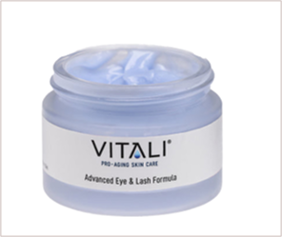
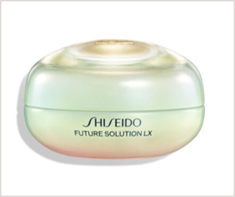
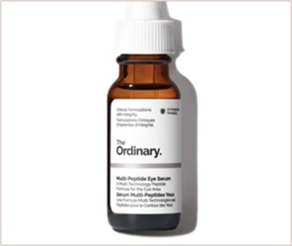
Market products that address various concerns around the delicate eye area
Advanced Eye and
Lash Formula
Ultimate Brilliance
Eye Cream
Multi-Peptide
Eye Serum
As a multi-faceted solution, the product targets the appearance of fine lines, dark circles, and puffiness.
High-performance eye cream that addresses issues such as dullness, dark circles, sagging, wrinkles, and muscle tension between the eyebrows..
This serum utilizes multiple peptide technologies help reduce the appearance of crow’s feet and under eye wrinkles, eye bags, puffiness, and dark circles, leaving the eye area looking brighter, smoother and less puffy.

Slide 5
Our solution: SYN-EYE® CB
SYN-EYE® CB targets sensitive, dry, dull-looking skin, wrinkles and fine lines, dark circles and puffiness around the delicate eye area.
Look fresher and younger longer in just a few applications dsm-firmenich combines 4 ACTIVES
& 4 TECHNOLOGIES for intense, multiple effects.
Delivers results in 7 days!

Slide 6
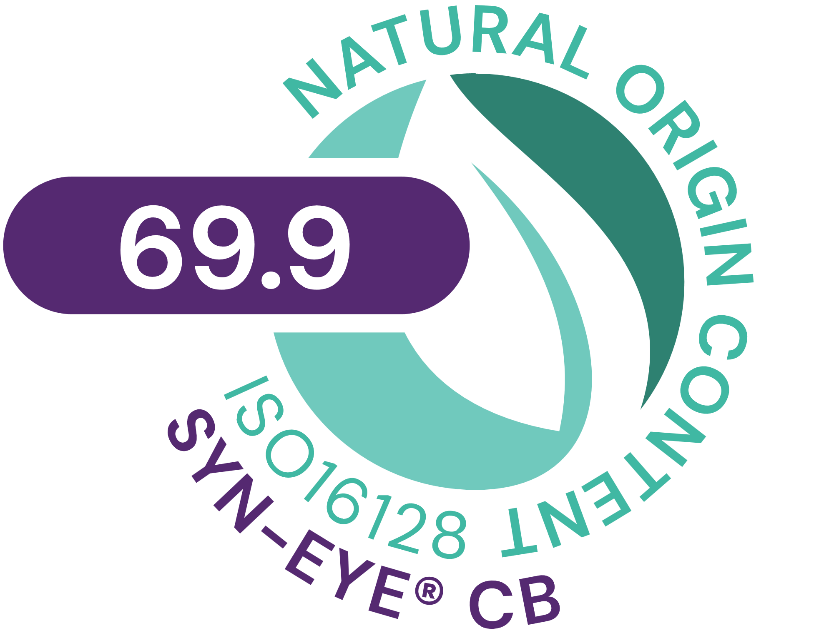



SYN-EYE® CB
ID Card
INCI NAME:
Aqua, Palmitoyl Tripeptide-5, Panthenol, Sodium Hyaluronate, Dunaliella Salina Extract, Pentylene Glycol, Citric Acid
Combines the latest cutting-edge SYN®-Peptide technology, produced via Green Chemistry Science with superior bioactives in a multifunctional eye care formula
TFA-free¹
69.9% of natural origin (according to ISO 16128)
TECHNOLOGY:
TECHNICAL:
Form: Liquid
pH of use: 4.5-6.0
Use level: Up to 1%
Preservative: no Phenoxyethanol
Solubility: Miscible in water
BENEFITS:
Visibly reduces the appearance of lines and wrinkles around the eye within 7 days **
Shows a visibly brighter skin color in dark circle area after only 14 days **
Helps to reduce skin roughness, making the delicate skin around the eye look smoother and fresher. **
REGISTRATION
CERTIFICATION
¹ Non-intentionally added TFA
* in vitro ** in vivo

Slide 7
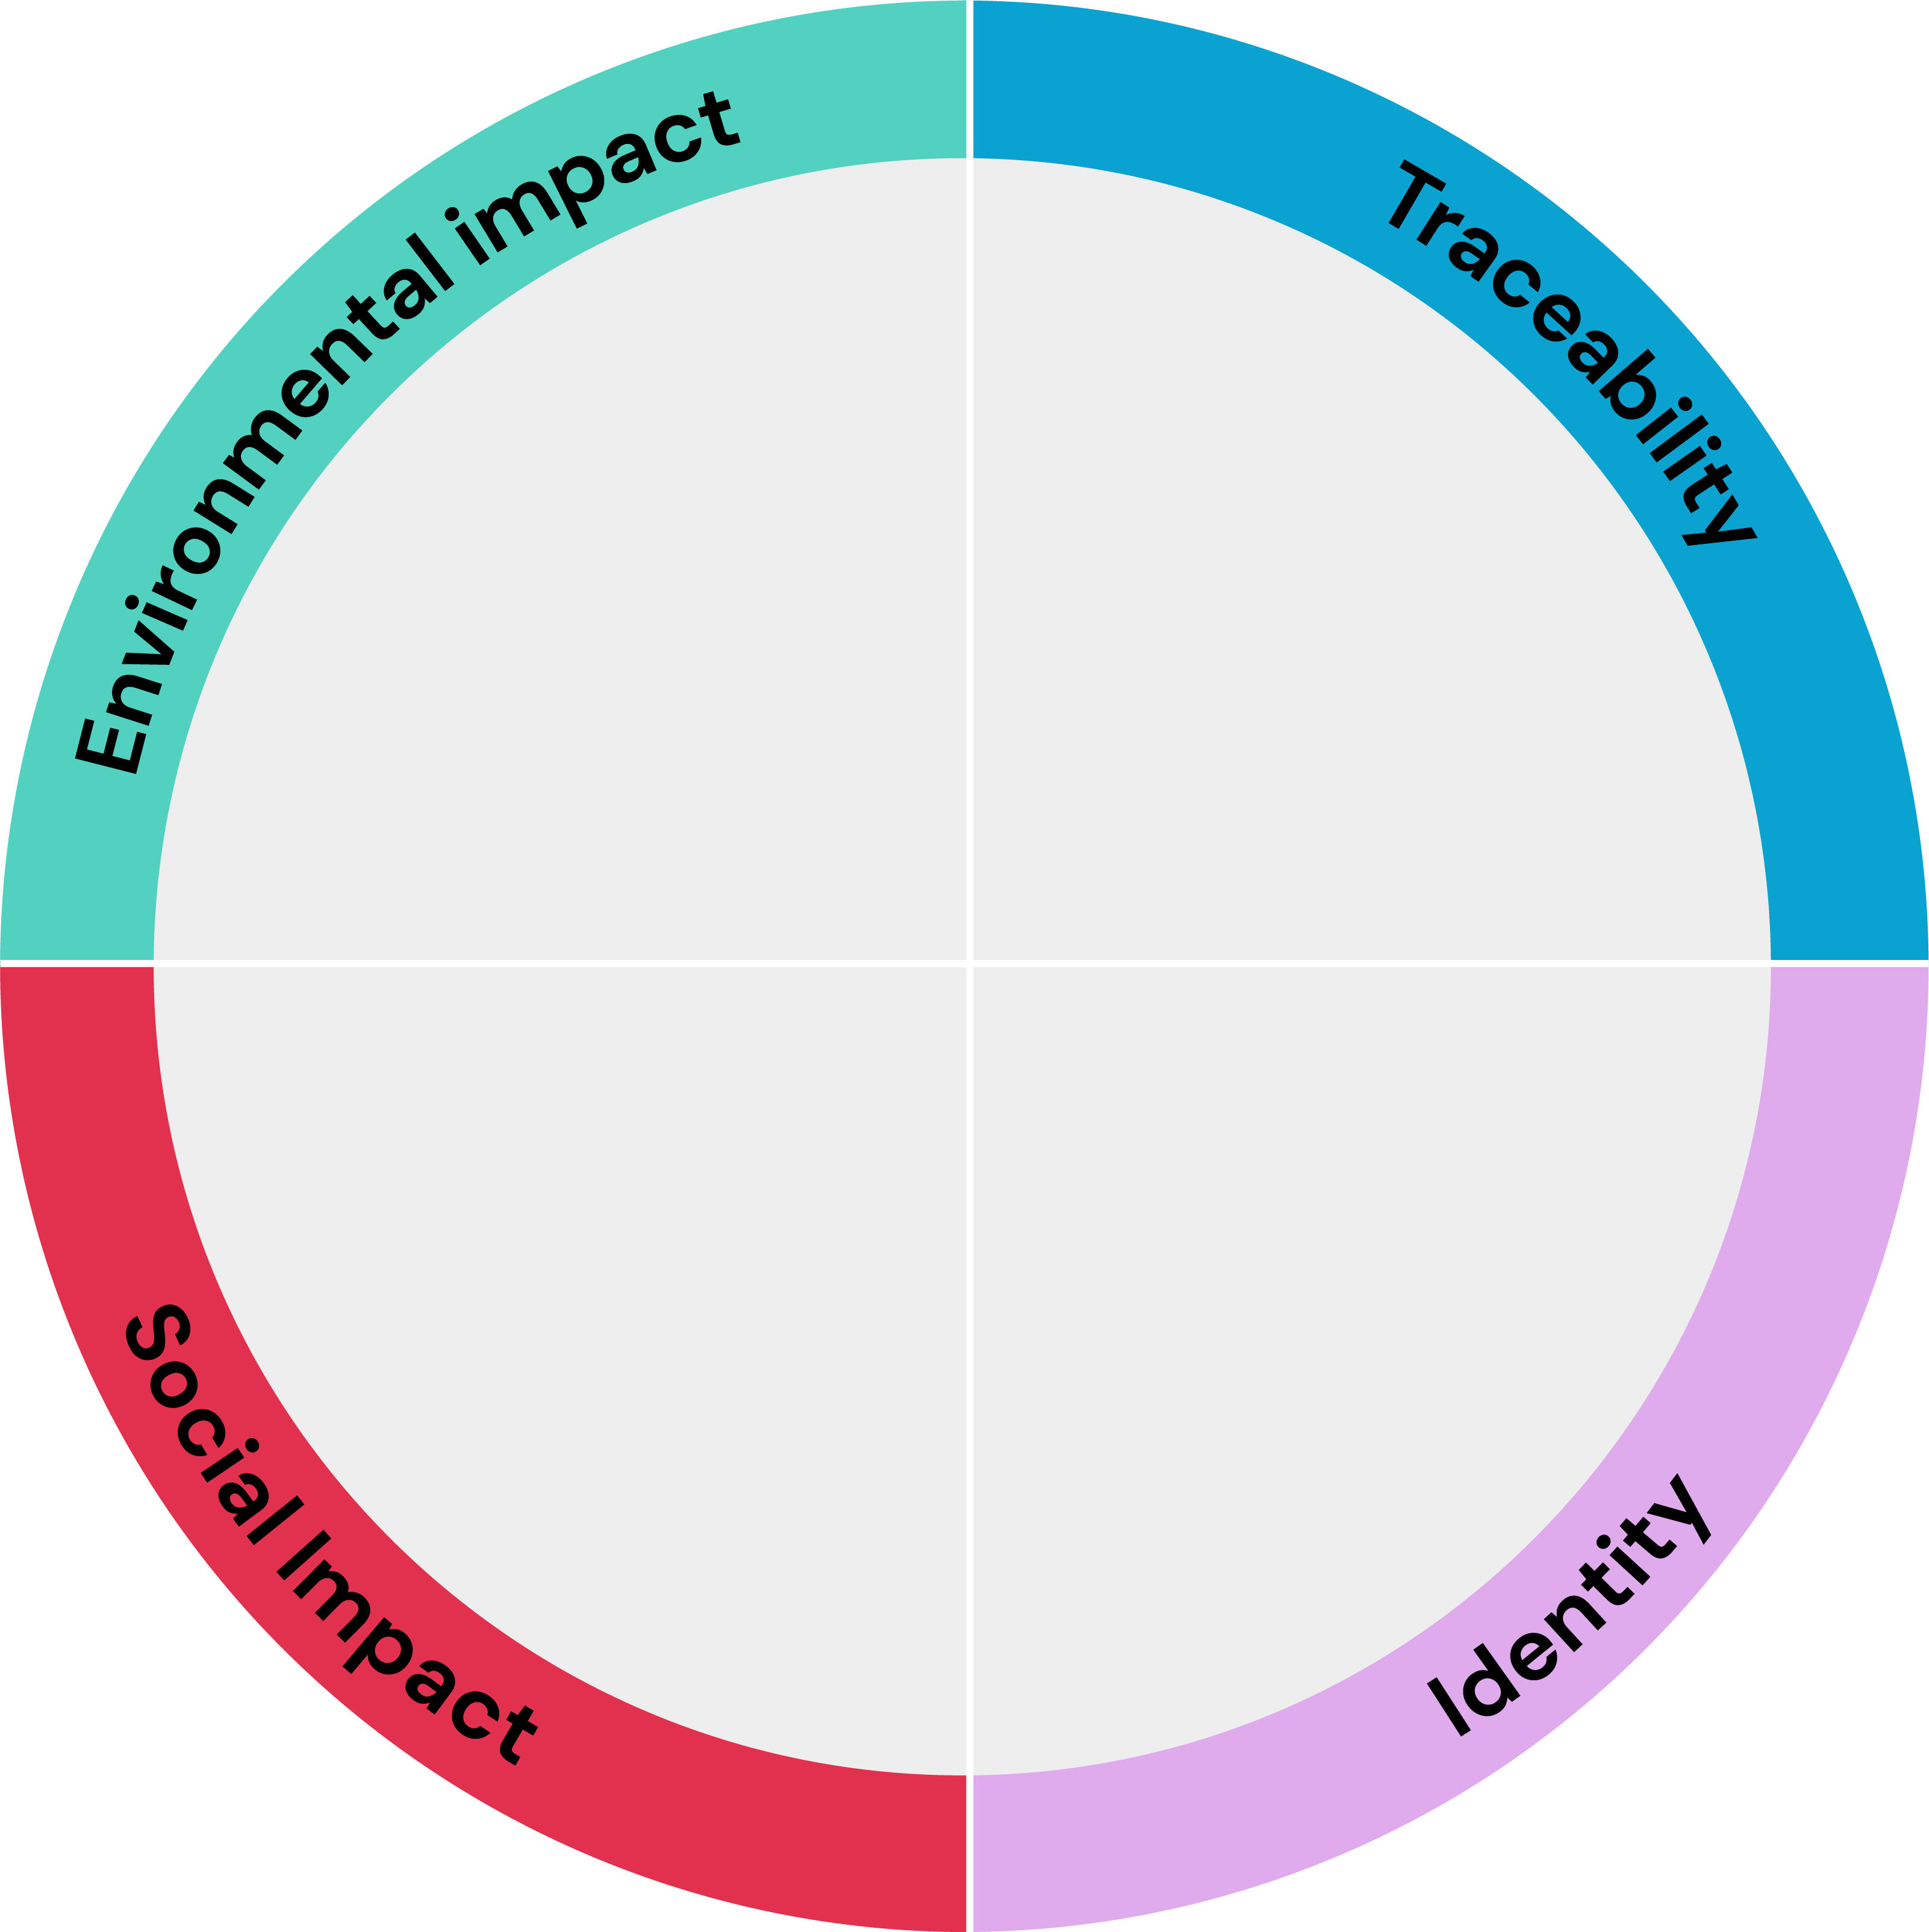





SYN-EYE® CB
Aligned with and contributing to the
INCI name: Aqua, Palmitoyl Tripeptide-5, Panthenol, Sodium Hyaluronate, Dunaliella Salina Extract, Pentylene Glycol, Citric Acid Product Code: 5038465
Carbon
footprint*
18.5 kg CO2 eq/kg
Biodegradability
Estimated to be biodegradable
Water footprint
5.2 m³ depriv./kg
Renewable electricity
100% purchased renewable electricity
Highlights
related to Supply
Chain control
Full ownership of the production,
Feedstock origin
Palmitoyl Tripeptide-5 (synthetic, palm
oil and petroleum derived); Panthenol
(synthetic); Sodium Hyaluronate
(fermentation); Dunaliella Salina Extract
(vegetable from cultivated microalgae)
SYN-EYE® CB
combines the latest
SYN®-Peptide technology with superior bioactives in a multifunctional eye care formula
Responsible sourcing
Palmitic acid is RSPO Mass Balance
Impact on health and well-being
Natural-origin
69.9% according to ISO16128
SYN-EYE® CB targets sensitive, dry, dull-looking skin, wrinkles and fine lines, dark circles and puffiness around the delicate eye area.
Within 7 days, SYN-EYE® CB visibly reduces the appearance of lines and wrinkles around the eye.
The carbon and water footprint calculations are based on internally conducted LCA according to ISO 14040/44 guidelines,
dsm-firmenich LCA policy and validated by internal reviewers.
© 2025 dsm-firmenich group.
All rights reserved
Card version 2
Notes:
Renewable electricity: Always mention «purchased renewable electricity» and add «completing» or «with a majority of» to ensure that we are not greenwashing.

Slide 8






SYN-EYE® CB
A natural peptide for sustainable formulations
Carbon footprint of 18.5 kg CO2 eq./kg. High efficiency allowing a low carbon footprint in use¹
Natural-origin peptide. SYN®-EYE CB suitable for Clean-Beauty with 69.9% naturality according to ISO 16128
Green chemistry reaction type² with an optimized synthesis reducing the number of steps
Manufactured in Europe with 100% purchased renewable electricity³
Production without any CMR solvents or reagents,
prioritizing the safety of workers
(1) considering a 1-3% concentration of SYN®-EYE CB in final formulation, 185-555g CO2 per kg of final formulation.
(2) Main reaction type is amidation
(3) The last production step in Pentapharm. Peptide production in Switzerland.
Peptides | Pharma-inspired skincare

Slide 9
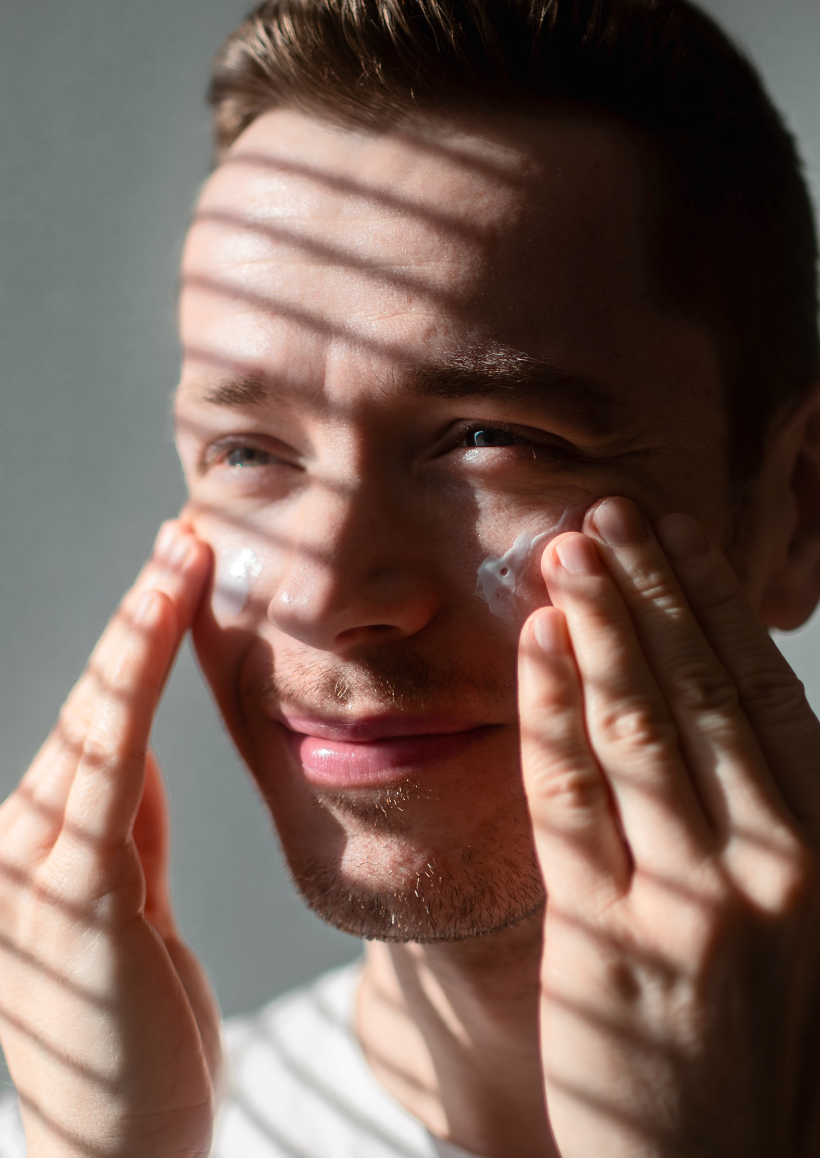
SYN-EYE® CB
4 Technologies & Actives
Vitamin
Panthenol - Pro-Vitamin B5
Panthenol is produced with the highest standards in a world-class dsm-firmenich-owned facility
Bio-fermentation
Sodium Hyaluronate
Highly purified HA with a molecular weight of 200-400 kDa
Obtained by bio-fermentation
Blue biotechnology
Dunaliella salina extract
Highly purified extract of the biotechnologically produced microalgae Dunaliella, which is known to survive in the extreme environment of salt lakes
Peptide
Palmitoyl Tripeptide-5
Made by latest cutting-edge dsm-firmenich peptide technology
Patented tripeptide with a unique amino acid sequence
Peptides | Pharma-inspired skincare

Slide 10
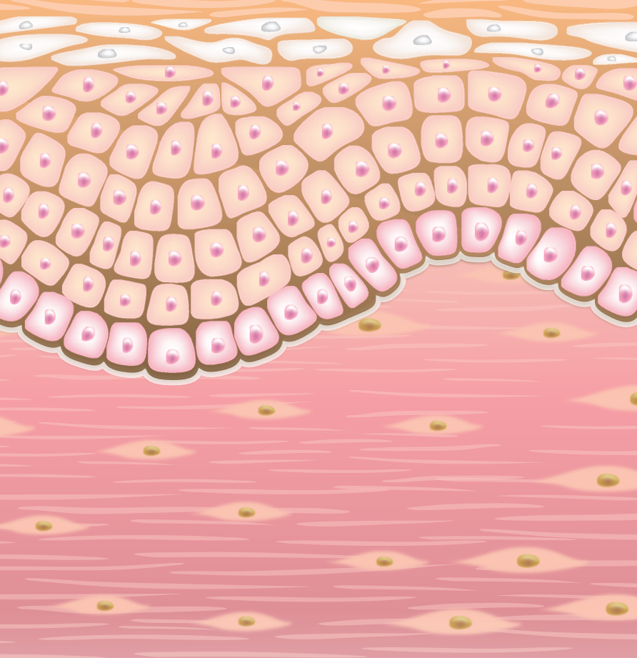
SYN-EYE® CB
4 actives for various mode of actions
Panthenol
Increased stratum corneum hydration and reduced TEWL*
Soothes irritated skin by reduction of various inflammatory cytokines*
Sodium Hyaluronate (200 – 400Da)
Calms reddened skin by inhibition of inflammatory cytokine IL-1α**
Acts as a hydration booster and fortifies the skin’s natural barrier**
Dunaliella salina extract*
Cellular energy activation (ATP) up to 140%**
5 days faster skin renewal **
Palmitoyl Tripeptide-5
Rebalances inflammatory cytokines (TNFα, IL-8)**
Boosts collagen in skin, up to +76%**
* Journal of Dermatological Treatment 2017
** dsm-firmenich internal studies

Slide 11
SYN-EYE® CB
In vivo study

Slide 12

SYN-EYE® CB
In vivo study
Type of study | Half side facial comparison of cosmetic effects for SYN-EYE® CB resp. market benchmark vs. placebo
Study panel | 30 Caucasian females per group, age: 35-55
Formulation | Placebo formulation Active formulation with 1% SYN-EYE® CB Active formulation with 1% Benchmark (INCI: Glycerin, Albizia Julibrissin Bark Extract, Darutoside)
Application | Application twice daily in the morning and in the evening,
Time points | Day 0 (D0, the day before applying the test products) Day 7 (the 7th day after applying the test products) Day 14 (the 14th day after applying the test products) Day 28 (the 28th day after applying the test products)
Assessment criteria | Measurement of different parameters on wrinkle and dark circles has been conducted by Primos or DermaTop; image analysis has been performed by Newtone. Illustrations using macrophotographs Subjective evaluation with a questionnaire
Peptides | Pharma-inspired skincare

Slide 13

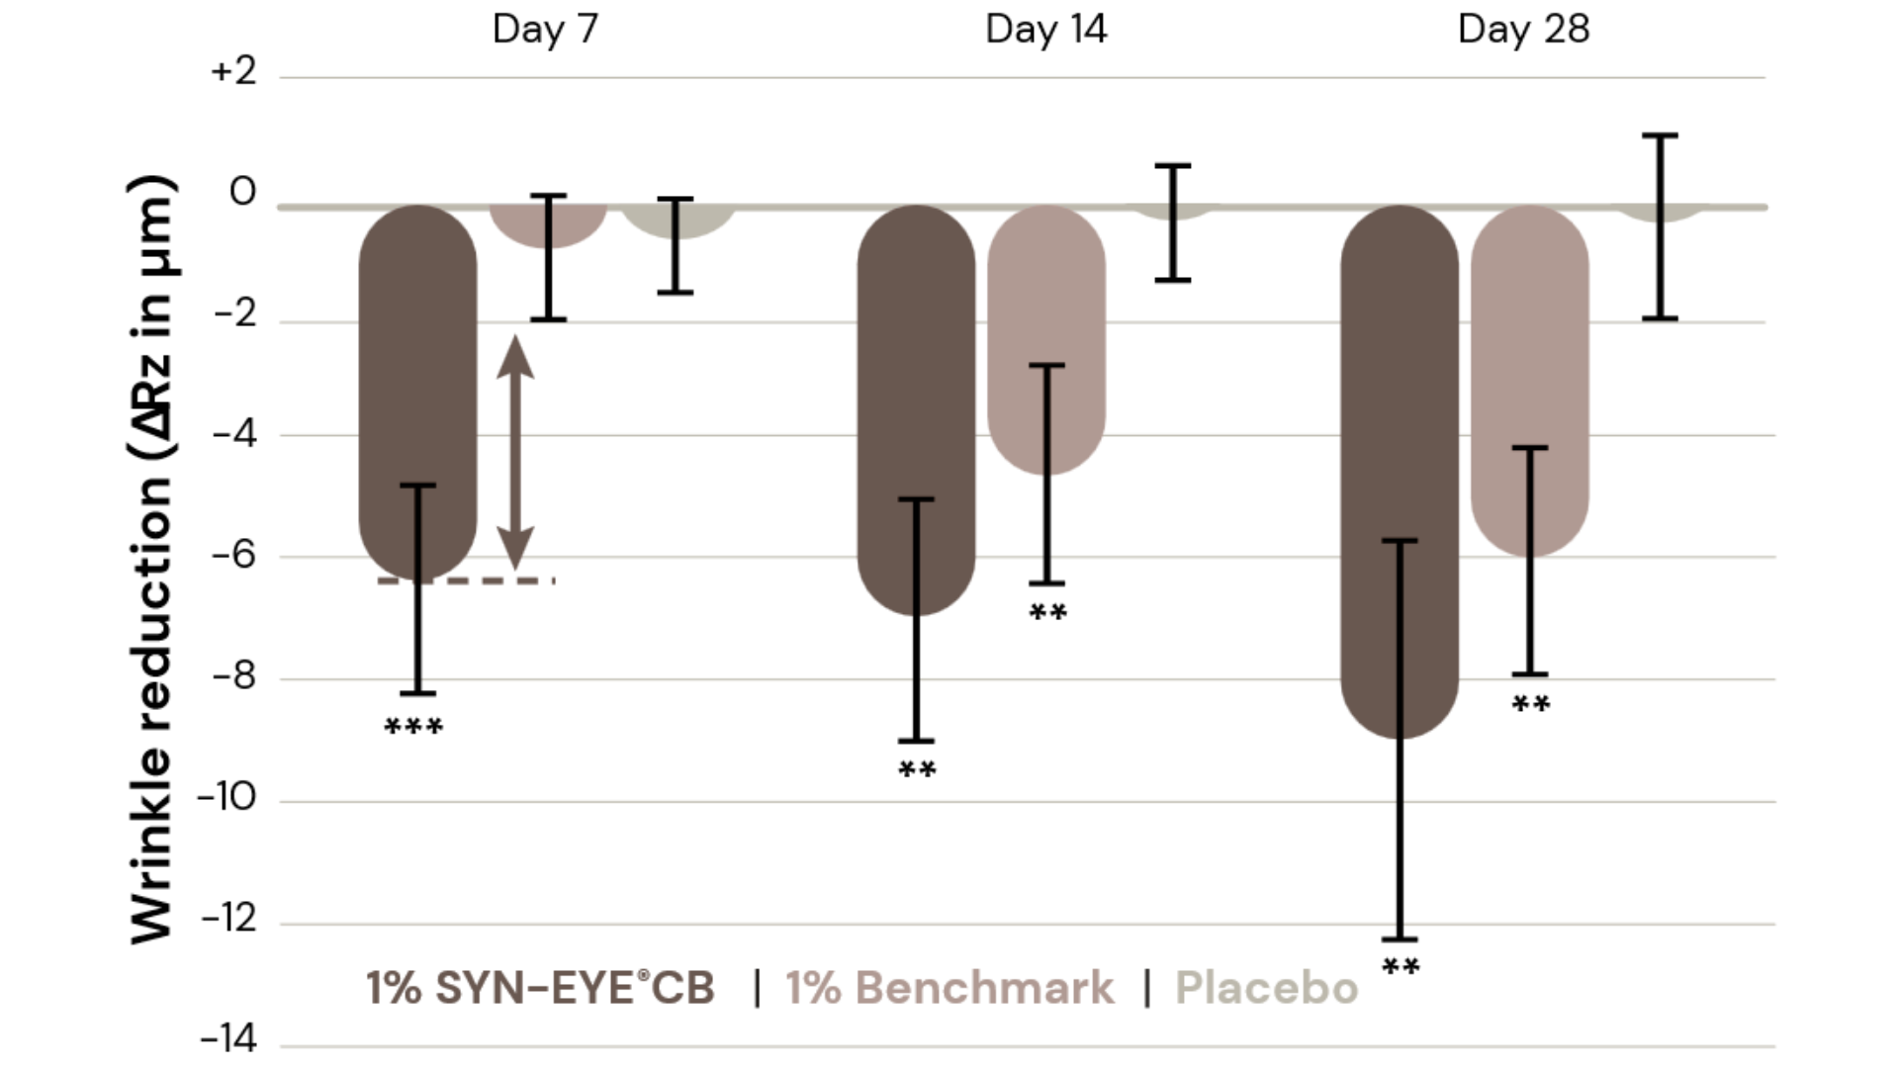

Significant reduction in the appearance of wrinkles
Within 7 days SYN-EYE® CB reduces
the appearance fine lines and wrinkles around the eye area.
Significant compared to benchmark
and placebo.
** vs. day 0 & placebo. *** vs. day 0, benchmark & placebo. p<0.05

Slide 14
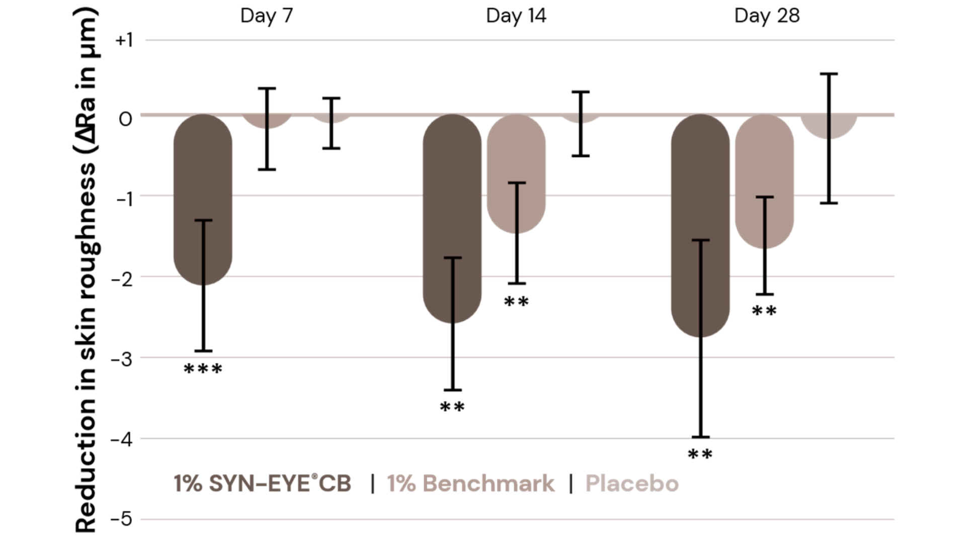
Significant skin smoothing in 7 days
SYN-EYE® CB helps to reduce skin roughness, making the delicate skin around the eye look smoother.
Significant compared to Day 0.
** vs. day 0 & placebo. *** vs. day 0, benchmark & placebo. p<0.05

Slide 15
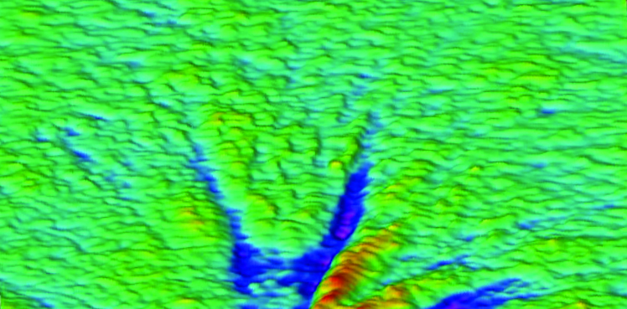
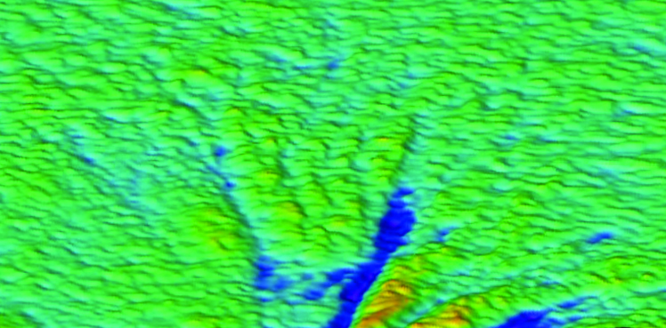
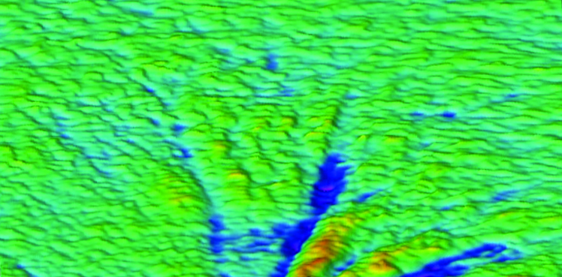
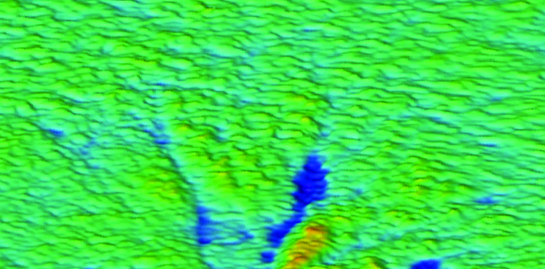
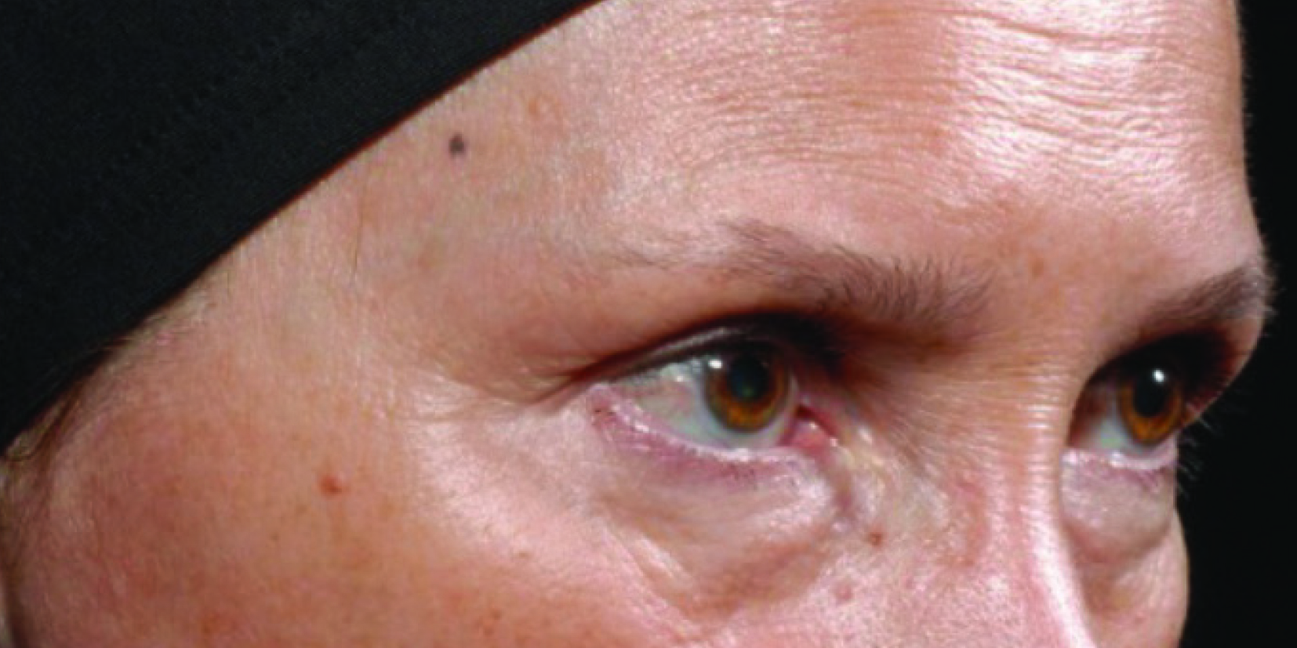
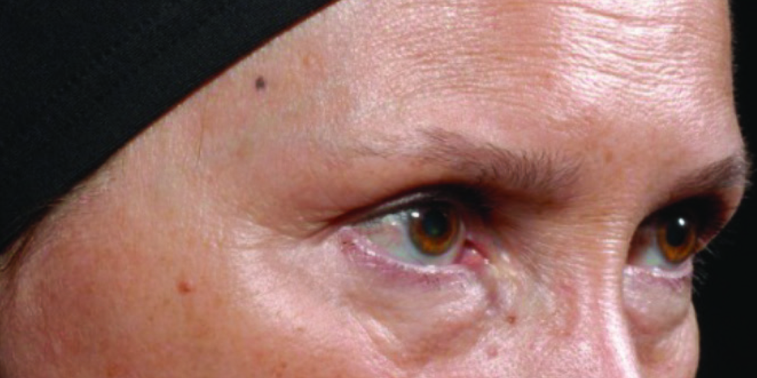
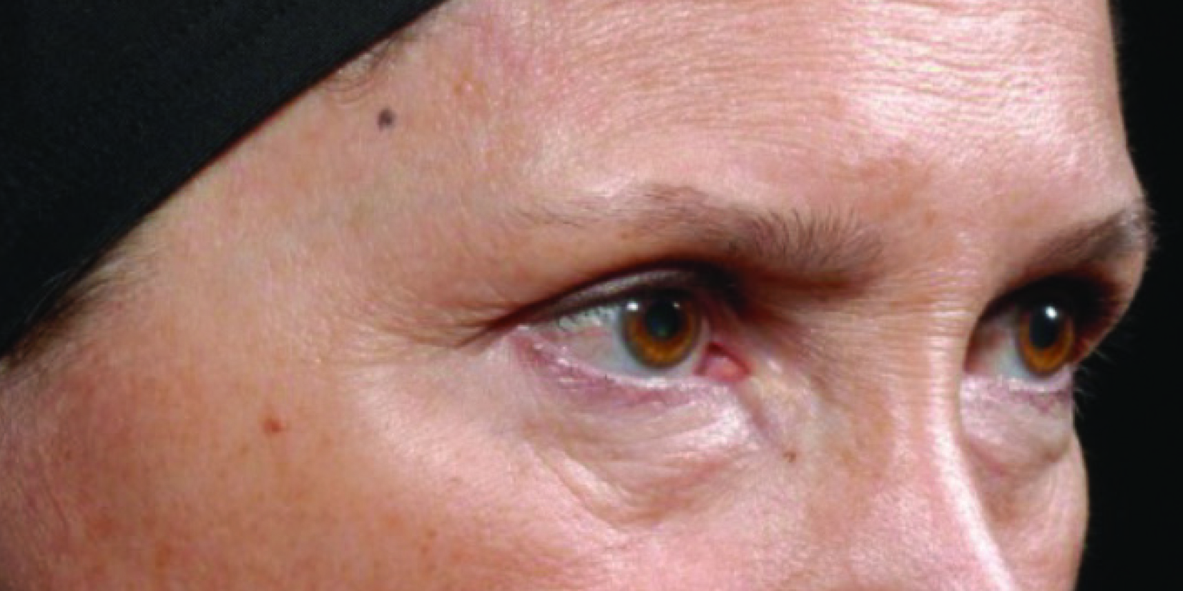
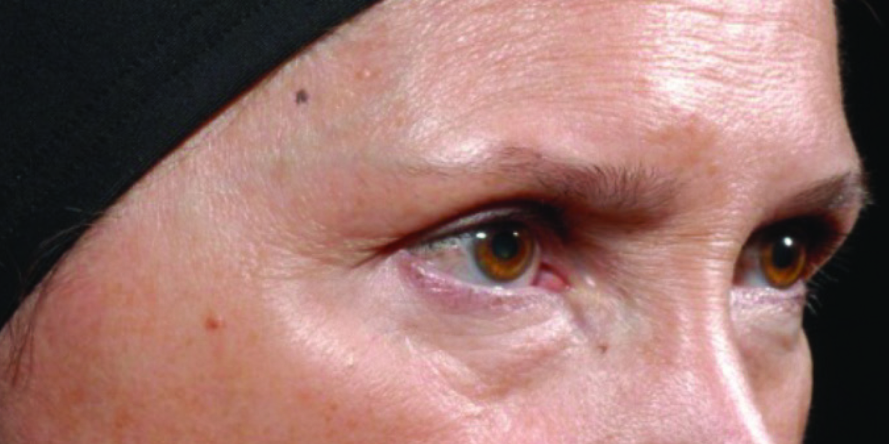
Continuous visible improvement of fine lines and wrinkles
Within 7 days, SYN-EYE® CB visibly reduces the appearance of lines and wrinkles around the eye
Day 0
After 7 days with 1% SYN-EYE® CB
After 14 days with 1% SYN-EYE® CB
After 28 days with 1% SYN-EYE® CB

Slide 16
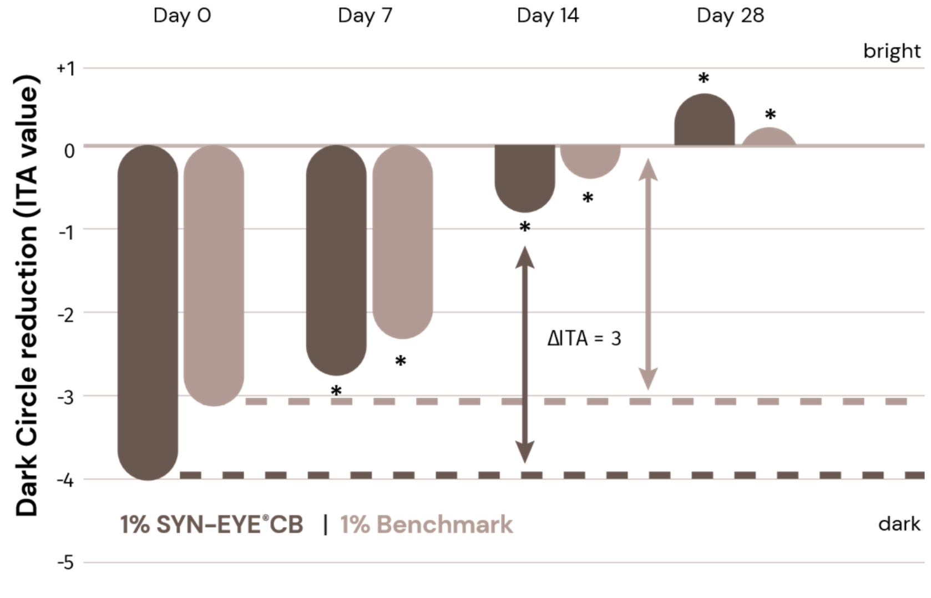
Reduces the appearance of dark circles
SYN-EYE® CB shows a visibly lighter skin color in dark circle area after only 14 days.
Significant in 7 days.
p<0.05. *vs. day 0. ΔITA ≥ 3 is visible

Slide 17
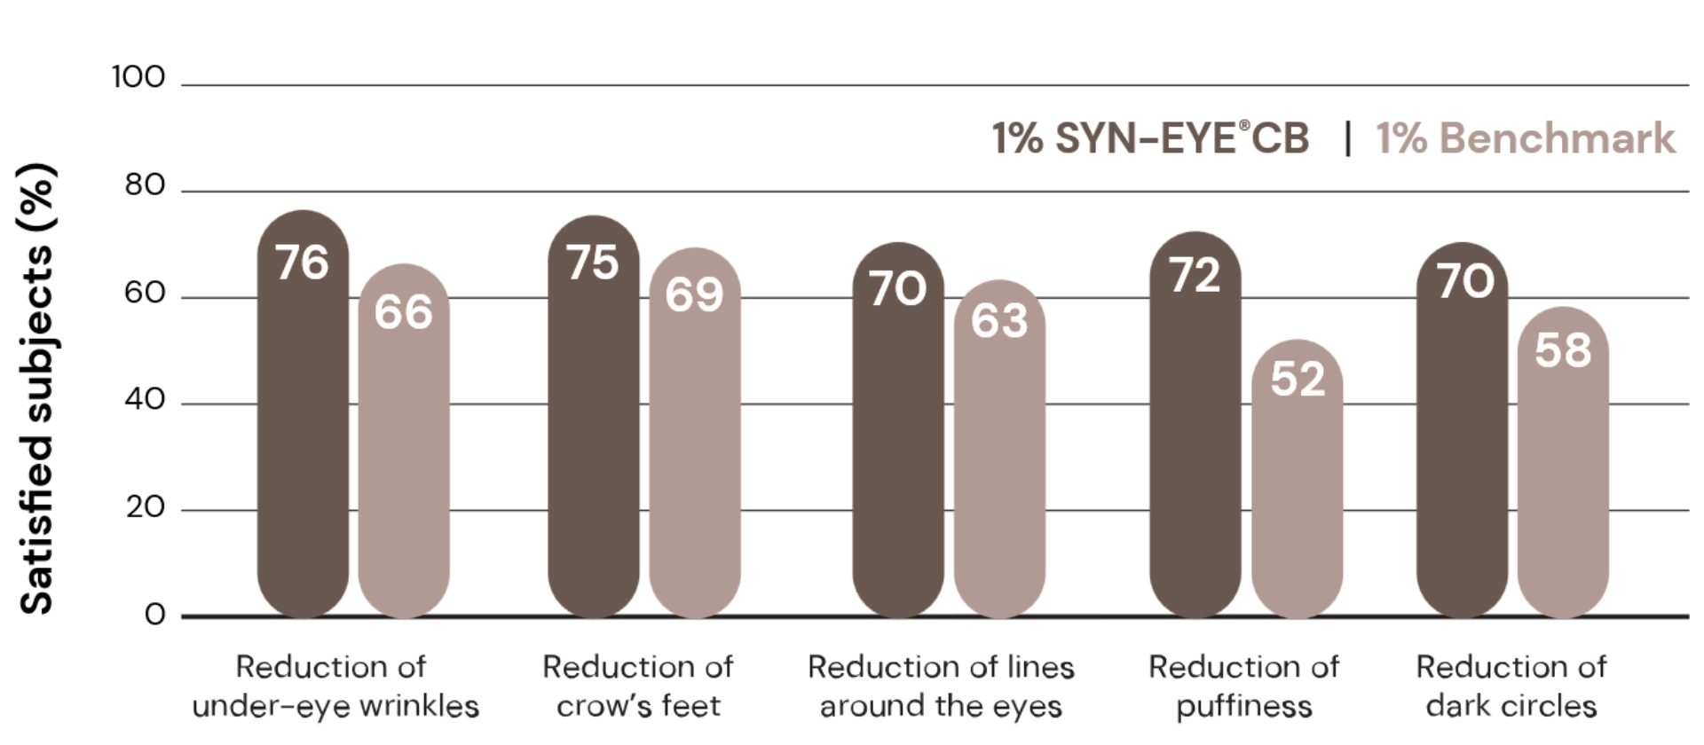
Let’s ask the consumer!
Consumer questionnaire:
products efficacy on wrinkles
Higher consumer acceptance
in all key aspects compared
to benchmark.

Slide 18
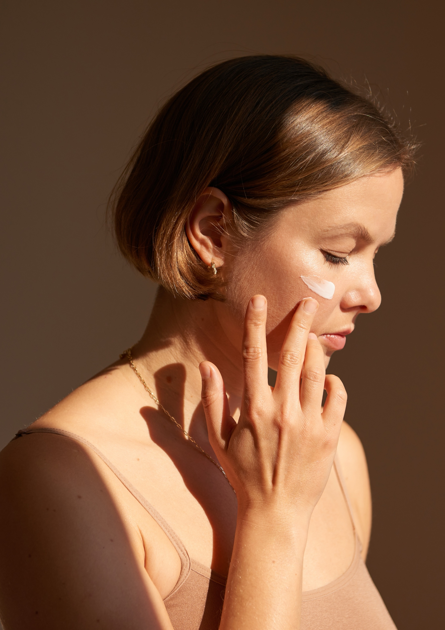
Formulation Guidelines
INCI name: Aqua, Palmitoyl Tripeptide-5, Panthenol, Sodium Hyaluronate, Dunaliella Salina Extract, Pentylene Glycol,
Citric Acid
Completely miscible with water
Stable at pH ranges from 4.5 – 6.0
It should be processed cold by addition to the formulation at a temperature below 40°C
Should be stored at a temperature between 2 and 8 C°
Suggested concentration: 1%
Peptides | Pharma-inspired skincare

Slide 19
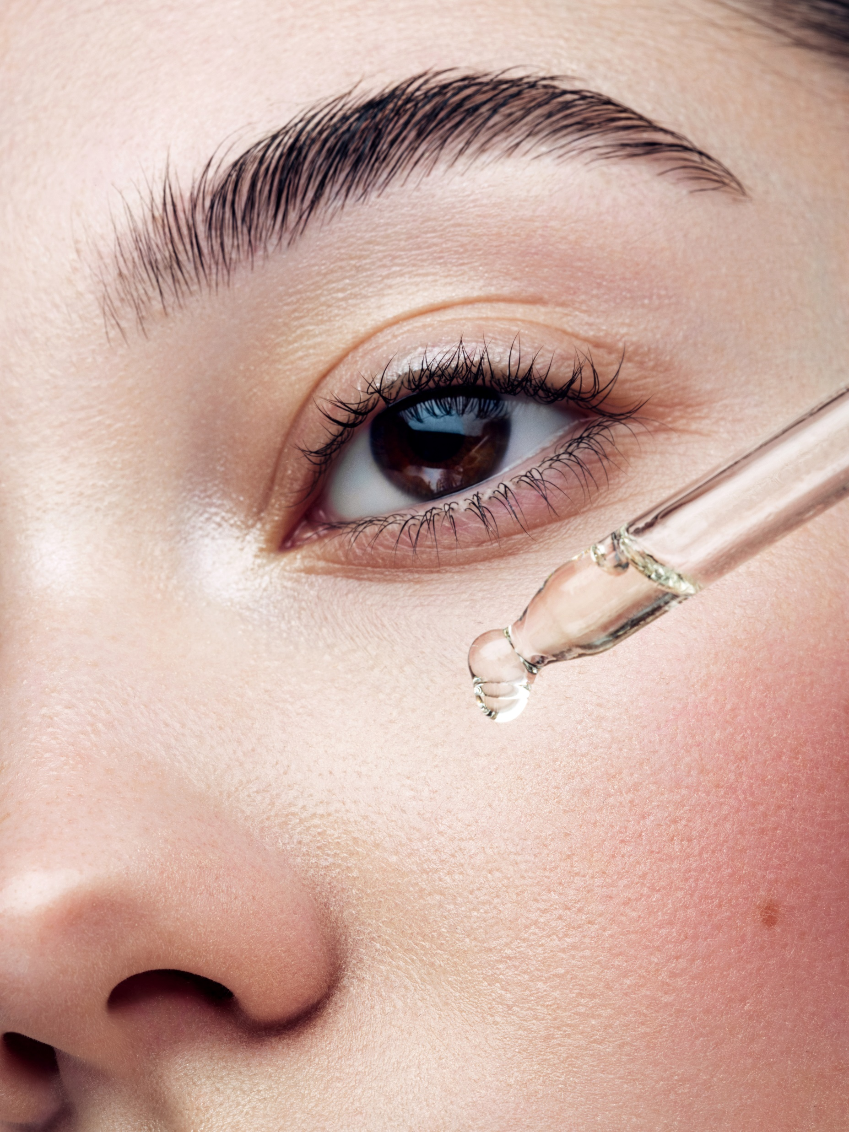
At a glance
Lineless eyes within 7 days
Powerful combination delivers results in 7 days
Shows better activity than tested benchmark product
Reduces the appearance of dark circles
Improve skin texture and smoothens the delicate skin eye area
Moisturizes, protects, and energizes the skin around the eyes
Peptides | Pharma-inspired skincare

Slide 20

Disclaimer
Copyright © DSM Nutritional Products Ltd 2025, 4002 Basel, Switzerland.
www.dsm-firmenich.com. All rights reserved.
dsm-firmenich has used diligent care to ensure that the information provided herein is accurate and up-to-date to the best of its knowledge. However, dsm-firmenich makes no representation or warranty, either expressly or implied, of the accuracy, reliability, completeness, or suitability thereof. The information provided herein contains scientific and product information for business-to-business use and does not constitute or provide scientific or medical advice, diagnosis or recommendation for treatment options. Country or region-specific information should be considered when labelling or advertising to final consumer. In no event shall dsm-firmenich be liable for any direct or indirect damages arising from or reliance upon, or use of, any information provided herein. The content of this document is subject to change without further notice. Please contact your local dsm-firmenich representative for the latest information. All trademarks listed in this document are either (registered) trademarks of, or trademarks licensed by, the dsm-firmenich group of companies, unless explicitly stated otherwise.
Disclaimer Formulation Guideline
The information provided herein is provided for information purposes only and has been prepared by dsm-firmenich in accordance with its own methodology.
dsm-firmenich has used diligent care to ensure that it is accurate and up-to-date, however, dsm-firmenich makes no representation or warranty, either expressly or implied, of the accuracy, reliability, or completeness thereof. In no event shall dsm-firmenich be liable for any damages arising from or reliance upon, or use of, any information provided herein. Further, dsm-firmenich shall not bear any liability for the application and/or use of any processed material containing its product(s). The formulation of the finished product is the customer’s sole responsibility. It is the customer’s responsibility to determine the suitability of dsm-firmenich’s products regarding user specific purposes, assess compatibility and stability of their finished product(s) and to ensure compliance of their finished product(s) with relevant laws and regulations. Any product, marketing or other claims made by customer are its sole responsibility. The content of this document is subject to change without further notice. Please contact your local dsm-firmenich representative for further details. © 2025 dsm-firmenich group.

