Slide 1
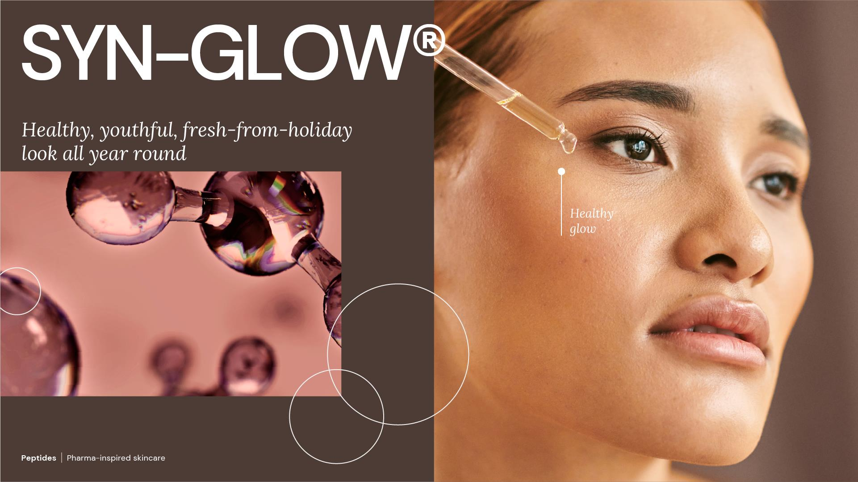
April 2025

Slide 2

We all love that natural sun-kissed glow that we get from a summer holiday.
Naturally bronzed skin makes us feel beautiful and confident, healthier and revitalised.
But summer holidays only come around once a year, and in the meantime, everyday busy life can leave us feeling tired and our skin looking dull.
Quick-fixes, like make-up or self-tanners, are only superficial and sometimes even artificial.
How to get a natural healthy glow, all year round?

Slide 3

Consumer insights

Slide 4
Consumers value having some tan to look good & healthy
consumer insights
Beauty standards evolved towards a more natural effect, diverting from deep tanning
Q:
Think about your skin complexion, how tanned
or neutral or pale it
is and its role in your
grooming/ beauty habits
or personal look.
What's your general
attitude towards it?
I do not care at all about how tanned or pale I look, it is
irrelevant to me 30 .1%, 1264
I want to be as tanned as
possible, in order to look good and healthy 14.67%, 616
I want to avoid getting tanned, as I believe I look more handsome/beautiful when my skin is bright 9.52%, 400
I want to get some tan in order not to look too pale, as I want
to look healthy 45.71%, 1920
Consumer insights
Source: dsm-firmenich Sun Protection and Skin Cancer Survey, 2017/2018. Global Data excluding Asian Countries

Slide 5
...and this is true across age groups
consumer insights
With bigger relevance below 55 y.o.
Consumer insights
Source: dsm-firmenich Sun Protection and Skin Cancer Survey, 2017/2018. Global Data excluding Asian Countries

Slide 6

How does having a tan make you look & feel?
Consumer question

Slide 7

With a just back from holiday look, people feel…
More youthful, beautiful & confident to wear less make-up
“I definitely think having a tan makes me feel and look younger and more confident”.
Staci, 35
“…my preference is to have a tan, because it can affect the evenness on my face”.
Ashley, 30
“I think when I’m more tanned I probably do wear less make-up because I feel a bit more confident in my skin tone”.
Kirsten, 34
“When I’ve got a tan, my skin definitely looks healthier. It looks younger, more even, and smoother. Having a tan definitely makes me feel younger. I feel more confident, and I feel like I can go out without wearing as much make-up, or any make-up”.
Lucy, 31
Consumer insights
Source: dsm-firmenich Consumers Insights Hub – 2019 Survey

Slide 8

What does glowing skin mean to you?
Consumer question

Slide 9
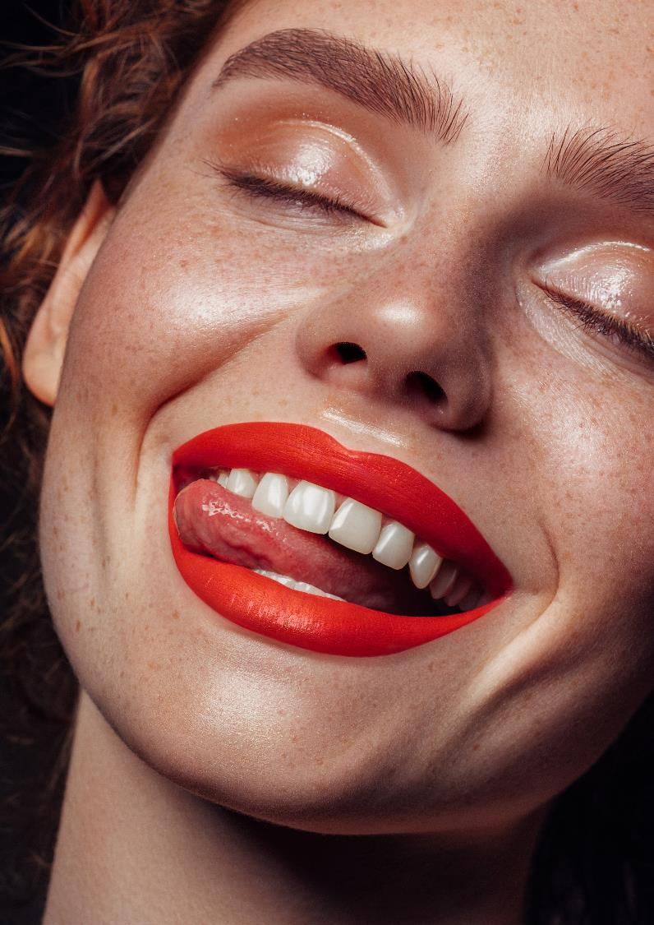
In consumers’ words…
Skin with “some tan, good colour or not pale” means… “glowing”
“For me glowing skin is skin that has a really good pigment, really good light creating properties. I wouldn’t say my skin was glowing because quite pale. I think skin that has some colour, whether it be tan or fake tan does tend to appear more glowing”.
Nicola, 33
“To me glowing skin is synonymous with health, the skin looks fresh and alive, not covered in makeup, not pale and pallid, good colour, good tone and not spotty.”
Stephanie, 49
“To me glowing skin means a nice crisp, dark looking skin that when you are out in the sun and people see you they can tell that you have a tan”.
Penny, 48
“I think that glowing skin means your skin has healthy colour and shine, and it’s like free of blemishes or any other issues. It’s just like sort of looking sun-kissed but not sun damaged I guess.”
Michelle, 29
Consumer insights
Source: dsm-firmenich Consumers Insights Hub – 2019 Survey

Slide 10





Ultimately glowing skin ​
means healthy looking​
Q:
How would you most want your skin to look like if it is glowing?​
Healthy looking - 44%
Radiant - 22% Luminous - 12%
Radiant - 29%
Luminous - 18%
Healthy looking - 15%
Healthy looking - 33% Even skin tone - 14% Peachy - 12%
Healthy looking - 33%
Peachy - 20%
Brightened - 16%
Source: dsm-firmenich Global Glow exploration - Global N= 1005, US N=201, France N= 201, Russia N=200, Brazil N= 202
10

Slide 11
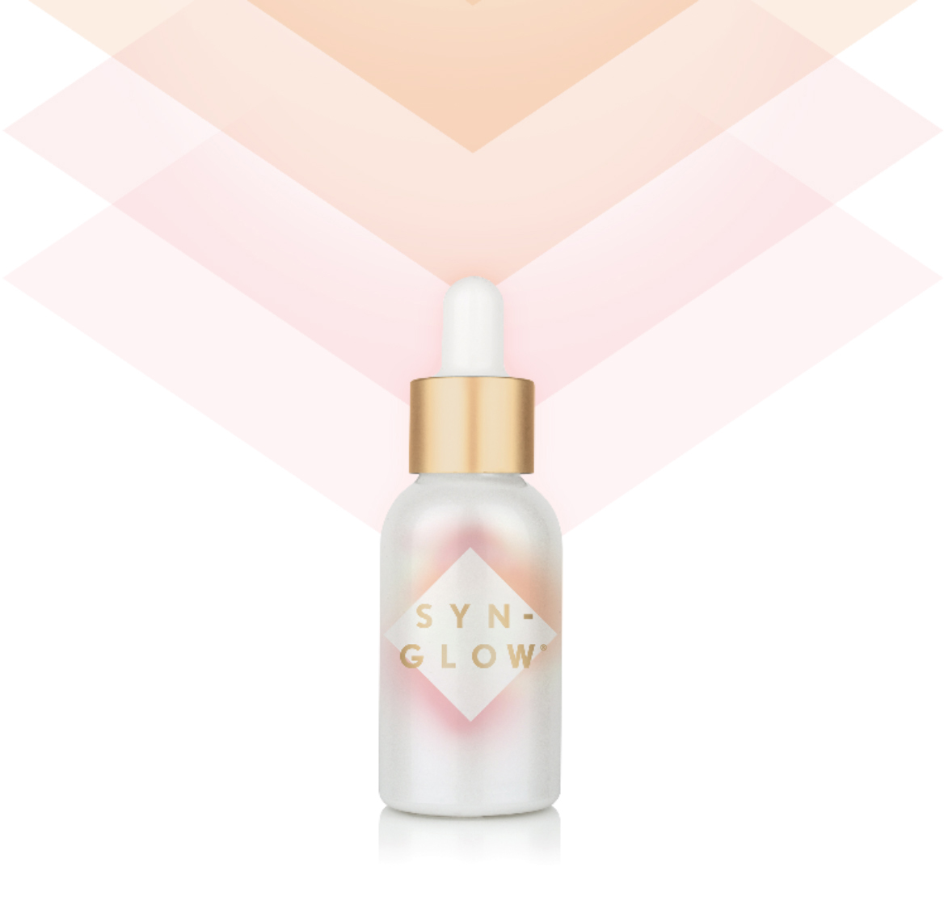
dsm-firmenich proudly introduces the perfect solution for this market context
NEW Glow-Boosting Peptide
It works with skin to bring out its natural healthy glow
…all year round, as if you were just back from holidays!

Slide 12
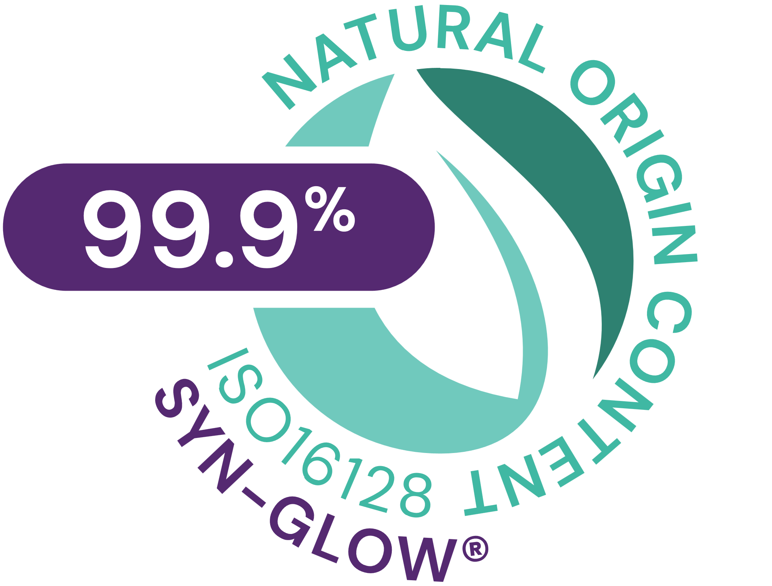




SYN-GLOW®
ID Card
INCI NAME:
Benzoyl Dipeptide-18 D-Phenylalanyl Arginyl D-Tryptophan Dipropylamide Mesylate, Aqua, Glycerin
Highly potent patented pentapeptide, made by cutting-edge SYN®-Peptide technology, designed to highly selectively boost MC1R (Melanocortin-1 receptor), a biochemical switch (off/on) of the Melanin synthesis
From a library of more than 100 peptides, SYN-GLOW® has been identified to be the best candidate to activate MC1R
In silico structure-based peptide design and artificial intelligence (AI), visualized with molecular modelling
TFA-free¹
99.9% of natural origin (according to ISO 16128)
TECHNOLOGY:
TECHNICAL:
Form: Liquid
pH of use: 4.0-7.5
Use level: 1-3%
Preservative: Free
Solubility: Water miscible
Highly selectively MC1R booster*
Significantly boosting key regulators of Melanin synthesis​ MITF, TYR, TRP1*
Stimulates anti-oxidant defense factor (Nrf2) after UVA-irradiation*
Healthy, youthful, fresh-from-holiday look all year long**
Promotes a visible healthy glow in just 5 days, with long lasting result and natural personalized effect**
BENEFITS:
REGISTRATION
CERTIFICATION
* in vitro ** in vivo

Slide 13
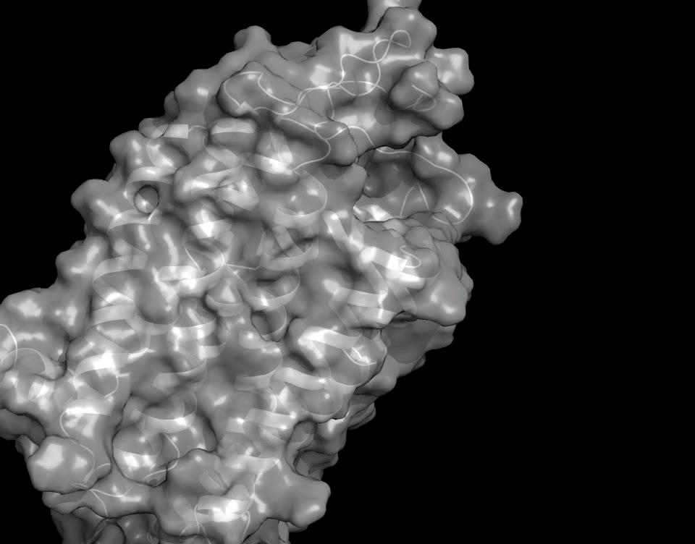

SYN-GLOW® is a pentapeptide
Designed to highly selectively boost MC1R (or Melanocortin-1 receptor)
MC1R is the biochemical switch (off/on) of the Melanin synthesis.
MC1R is a transmembrane protein, integrated into the cellular membrane and, in this role, it’s the unique gate to biological tanning.
Melanin is the pigment that gives skin its unique sun-kissed tone.
In vitro: from a library of more than 100 peptides, SYN-GLOW® has been identified to be the best candidate to activate MC1R. Results published in Int. J. of Molecular Sciences: https://www.ncbi.nlm.nih.gov/pubmed/31817532
Mode of action: Mc1R activation, related to scientific evidences. This is not intended to be final product claim
Notes:
The MC1R is the biochemical switch to keep melanin synthesis off or on. The signal to switch on is triggered by alphaMSH or SYNGLOW.
MC1R is a transmembrane protein so it is integrated into the cellular membrane (stabilized by seven helical structures crossing the cell membrane). This type of membrane protein structure belongs to a huge class of regulating proteins the so called G protein coupled receptors. The specificity of the biochemical signal is achieved by specific ligand binding properties
In this role the MC1R is the unique gate to the melanogenesis pathway (= melanin synthesis or biological tanning)

Slide 14

Let’s get to know MC1R better...

Slide 15
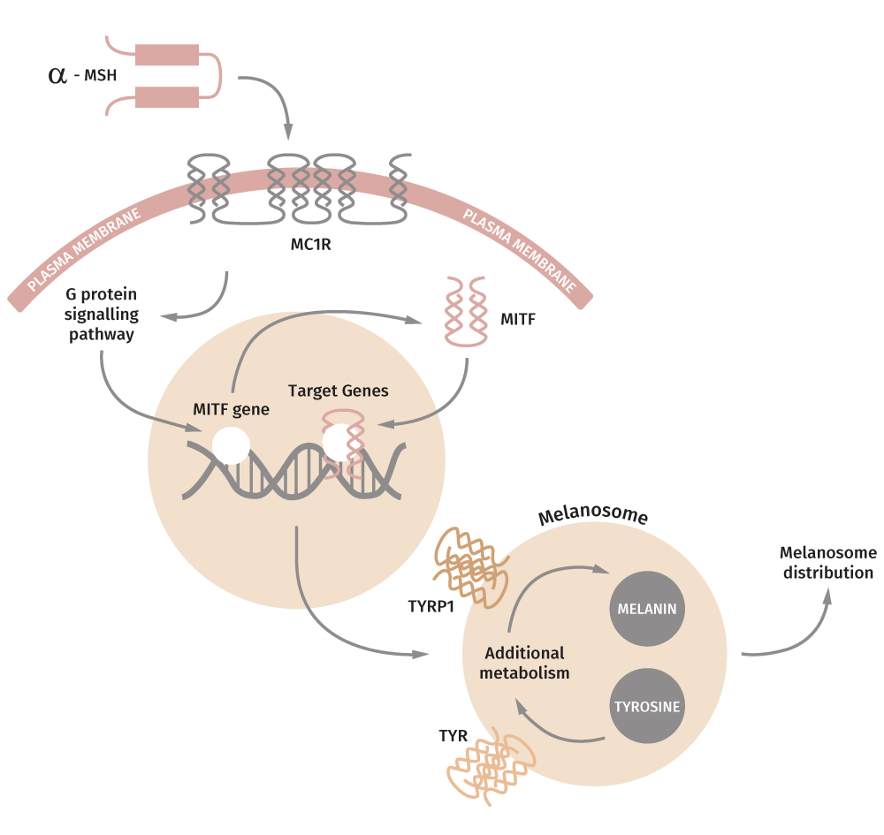
MC1R is the master regulator of skin tanning.
MC1R is a transmembrane protein so it is integrated into the cellular membrane: in this role the MC1R is the unique gate to the melanogenesis pathway.
The signal to switch on is triggered by alphaMSH or by SYN-GLOW®.
MC1R = Melanocortin 1 Receptor
Alfa-MSH = peptide of 13 amino acids, the natural agonist of MC1R
MITF = Microphthalmia-associated transcription factor
TYR = Tyrosinase
TYRP1 = Tyrosinase related protein 1
G protein = GTP (Guanintriphosphate) binding protein
Notes:
Our biological target was MC1R which controls the pigment production
The melanogenesis pathway is shown in the picture:
Melanin synthesis is induced when the alphaMSH binds to MC1R.
MC1R is transmitting the signal from outside into the cellular space of the melanocytes and turns on the machinery for melanin synthesis.
Within this pathway MITF is produced in the cell and itself binds (as transcription factor) to the DNA.
This triggers the production of proteins involved in melanin synthesis such as tyrosinase and tyrp1 etc
Melanin is produced and packed into melanosomes, small vesicles for the transportation of melanin. Within melanosomes the melanin is secreted from the melanocytes and further distributed within the epidermis (finally melanin arrives inside of keratinocytes and shields the cell nuclei from UV irradiation)
MSH = Melanocyte stimulating hormone it is a natural peptide of 13 amino acids and the natural ligand (or agonist) of MC1R
MC1R = Melanocortin 1 Receptor (at least four more MC2-, 3-, 4-, 5R are known with slightly different roles)
MITF = Microphthalmia-associated transcription factor, this protein is in the cell nucleus and binds to the DNA to trigger the expression of genes involved in melanin production e.g. tyrosinase and tyrosinase related protein1
TYR = Tyrosinase (key enzyme involved in melanin synthesis)
TYRP1 = Tyrosinase related protein 1 also involved in melanin synthesis
G protein = G stands for GTP binding protein (GTP = Guanintriphosphate), MC1R is a G protein they are a huge class of regulating proteins and integrated in the cell membrane. They can transfer a biochemical signal from outside the cell to inside the cell

Slide 16

Strengthening skin’s defences from within
MC1R is also known for reducing
oxidative stress and promoting
DNA repair
MCR1
Oxidative Stress
Reduction
DNA-repair
p53*
(A major sensor of DNA damage)
Source: Alpha-Melanocyte–Stimulating Hormone Suppresses Oxidative Stress through a p53-Mediated Signaling, Pathway in Human Melanocytes; Kadekaro, Chen et al, Mol Cancer Res; 10(6) June 2012.
Notes:
Beside triggering the signal to induce melanin synthesis the MC1R also modulates the defense against oxidative stress (normally issued by UV irradiation) and enhances the DNA repair machinery of the cells (to fight against UV induced DNA damages). So we can say it help strengthening skin defences from within.

Slide 17
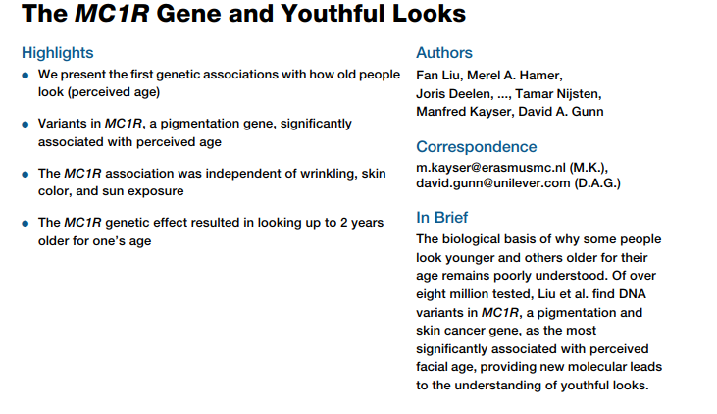
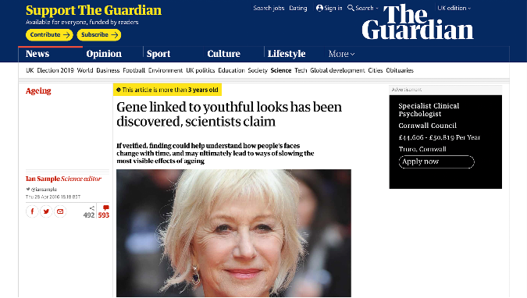
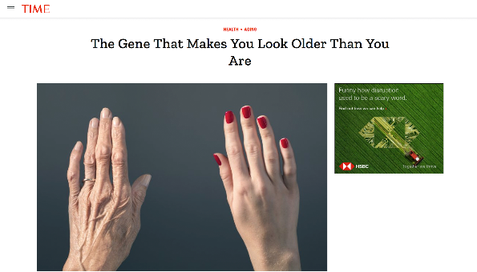
Is MC1R a youth gene?...
It seems MC1R can affect age appearance
The Guardian
https://www.theguardian.com/science/2016/apr/28/gene-linked-to-youthful-looks-has-been-discovered-scientists-claim
TIME Magazine
https://time.com/4311822/gene-aging/
Scientific publication about an interesting observation: people with non-functional MC1R gene appear older than people with functional MC1R.
Notes:
MC1R is a very interesting target not only due to the tanning effect.
Is MC1R a youth gene?
Scientific publication about an interesting observation: People with non-functional MC1R gene appear older than people with functional MC1R!
The reason for this is not yet fully understood by one hypothesis is that the consequences of MC1R activity (not just it’s existence) help to skin to appear in better shape (younger appearance independently from wrinkles).
Further it can be speculated that targeted activation of MC1R also helps for younger appearance. Potentially SYNGLOW could help to the anti aging effect!!

Slide 18

The efficacy of SYN-GLOW® has been proven ex vivo and in vivo with amazing results

Slide 19
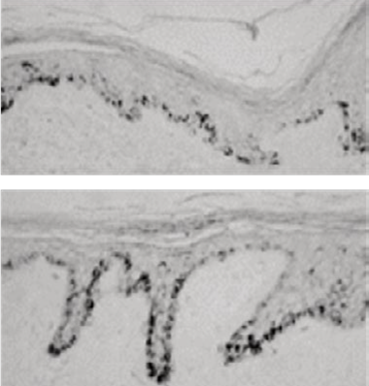
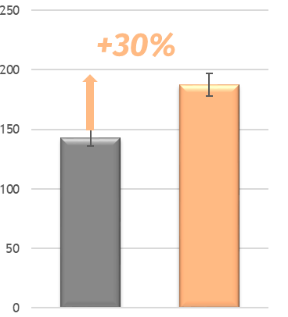
Significant ex vivo activity for SYN-GLOW®
Untreated
Pigmentation assay
ex vivo
*
Up to +30% significant
more pigmentation
Pigmentation score
Untreated
30 µg SYN-GLOW®
peptide
* p < 0.05 vs Untreated
SYN-GLOW®
Scientific Validation EX VIVO
Ex-vivo sample shown is from 47y.o female donor abdominal skin (ITA angle 18) with no light exposure
Notes:
Melanin production was directly measured ex vivo in human skin after topical treatment by the SYN GLOW peptide. The treatment time was 6 days
The skin was obtained from a Caucasian volunteer aged 47
After histological preparation a Fontana Mosson staining was performed to visualize and quantify the melanin
The melanin increased by 30% with 30micromolar of SG peptide and was statistically significant

Slide 20
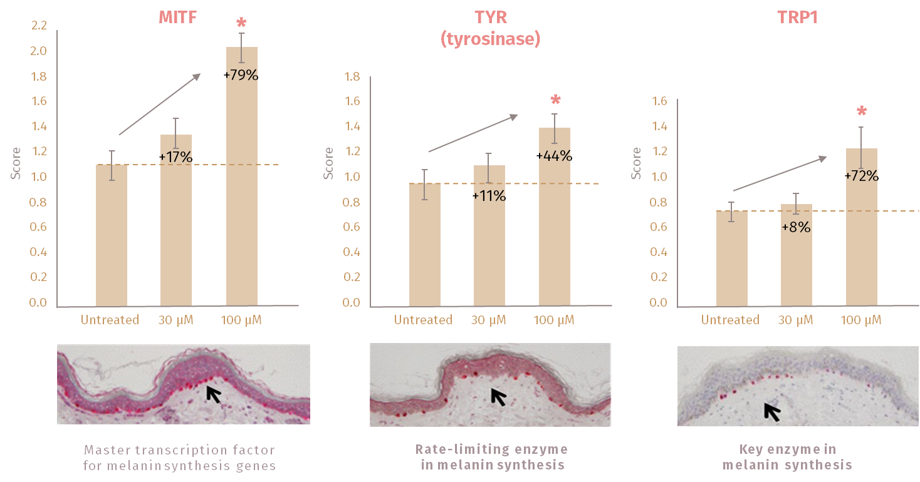
Significant ex vivo activity for SYN-GLOW®
Significantly boosting key regulators of Melanin synthesis
Scientific Validation EX VIVO
Melanin synthesis activation is related to scientific evidences (ex vivo) and is not intended to be final product claim
Notes:
Proof of concept results ex vivo on human skin with the SYNGLOW peptide (applied topically on the skin)
After treating the skin with SYNGLOW peptide some histological investigations on specific melanogenesis markers were performed
Immunostaining (using specific antibodies) for MITF, Tyrosinase (TYR) and tyrosinase related protein1 (TYRP1) were performed
After SYNGLOW treatment the staining intensity of the markers (MITF, TYR and TYRP1) were clearly increased which confirmed the specific activation of the melanogenesis pathway

Slide 21
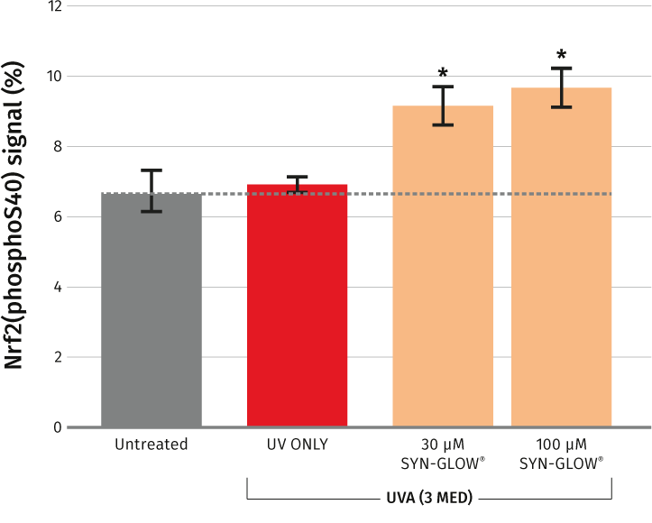
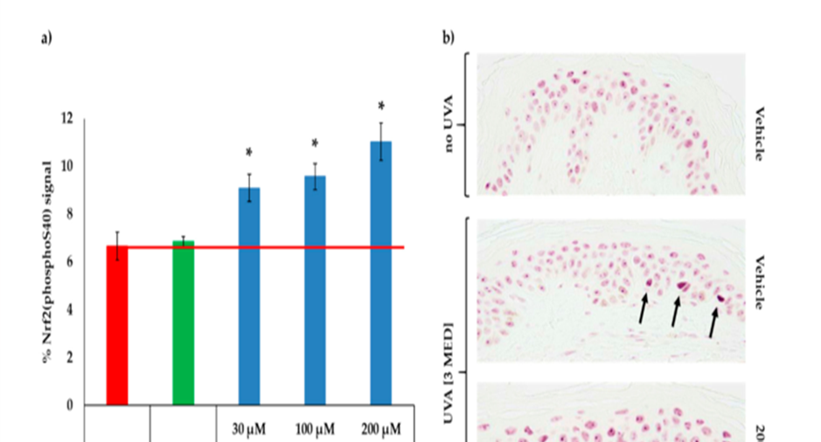
Proved to strengthen skin’s defenses from within
SYN-GLOW® stimulates anti-oxidant defense factor (Nrf2) after UVA-irradiation
Scientific Validation EX VIVO
* p < 0.05 vs UVA-irradiated vehicle by unpaired Student’s t-test.

Slide 22

In vivo study
29 Volunteers application at inner forearm of 3% SYN-GLOW®
Product application phase (2 times per day) |  |  |  |  |  |  |  |  |  |  |  |  |  |  |  |  |  | Post application phase
Day |  | 0 | 1 | 2 | 3 | 4 | 5 | 6 | 7 | 8 | 9 | 10 | 11 | 12 | 13 | 14 | 15 | 16 | 17 | 18 | 19 | 20 | 21 | 22
ITA Measure & Photo |  | ITA | «Real life» simulation* |  |  |  | ITA |  |  |  |  | ITA |  |  |  |  | ITA & Photo |  |  |  |  |  |  | ITA
Overall set-up
Pre-conditioning phase: product application, no UV exposure
Day 1-4: product application, UV exposure
Day 5-15: product application, no UV exposure
Day 15-22: no application, no UV exposure
Scientific Validation IN VIVO
*We exposed skin to some UV light, in order to simulate “real life”. UV exposure was done with a sunlight simulator, 40% below the minimal erythemal dose (MED): this roughly corresponds to 15-30min outdoor, during avg Spring day in mid-European Country

Slide 23
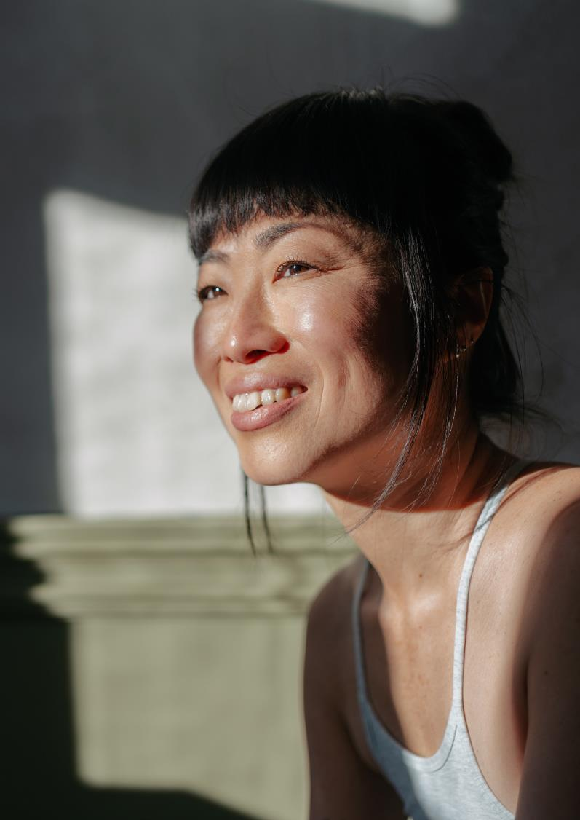

Outstanding in-vivo results!
SYN-GLOW® delivers visible healthy tone in just 5 days with long-lasting effect
-deltaITA
Control group
3% SYN-GLOW™
Control group
3% SYN-GLOW®
-4.5
-4
-3.5
*
Visible effects
**
-3
*
**
-2.5
+100%
+90%
+90%
-2
+333%
-1.5
-1
-0.5
0
Day 5
Day 10
Day 15
Day 22
Control group= UV only
* p<0.05 against Untreated skin «significant»
** p<0.01 against Untreated skin «highly significant»

Slide 24
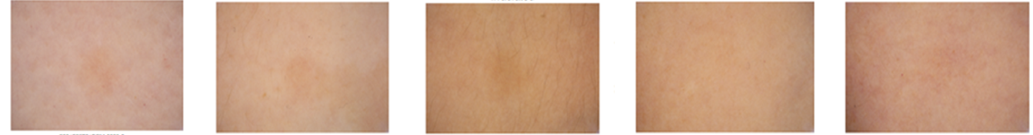
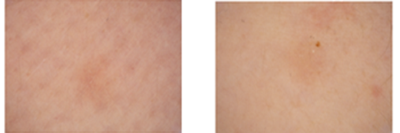
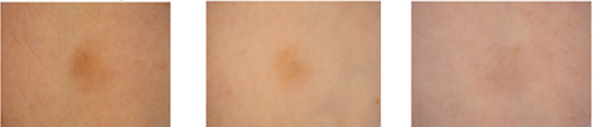
Personalized glow boost with SYN-GLOW®
Skin images taken from test area, at Day 15
Subject 1
Subject 2
Subject 3
Subject 6
Subject 14
Control group, UV only
3% SYN-GLOW®

Slide 25

Amazing feedback after application
Consumer’s feedback:
100% of consumers
noticed their skin looking fresher and more revitalized
Over 90% of consumers
noticed their skin looking less dull and tired
Over 80% of consumers , 3X more
noticed a facial healthy glow
Close to 70% of consumers
noticed their skin tone more even and homogeneous
Over 80% of consumers
would use this product again
Qualitative questionnaire
Clinical study, 16 female volunteers, 20-55 y.o., phototype II – IV, with planned outdoor activities. SYN-GLOW® containing formulation was applied on the face twice per day

Slide 26

Finished product concepts featuring SYN-GLOW® showed significantly higher purchase intent versus simple moisturiser benchmark (w/o SYN-GLOW®)
(Source: DSM Global Survey via Tuluna - 6.000 responders)
SYN-GLOW®
Speeding up time to market

Slide 27
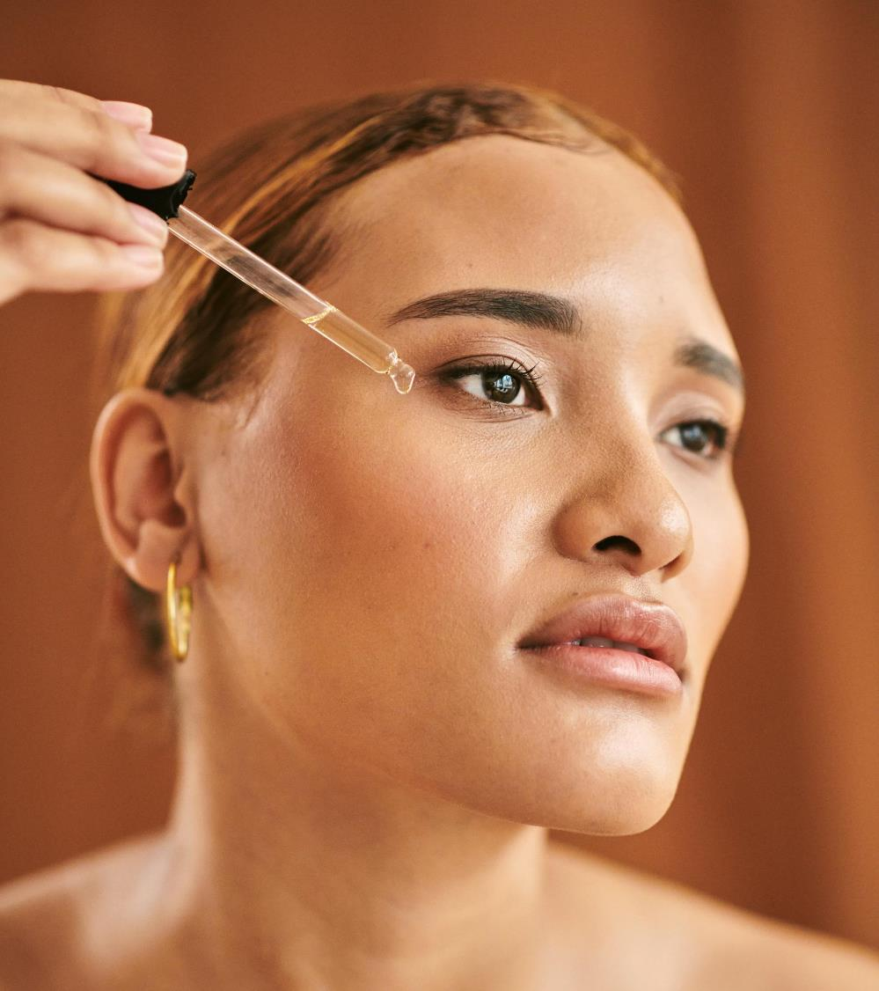
Supported claims
Natural healthy glow in just 5 days
Prolonged summer bronze
Personalized result, bespoke complexion
Strengthened skin natural defenses from within

Slide 28
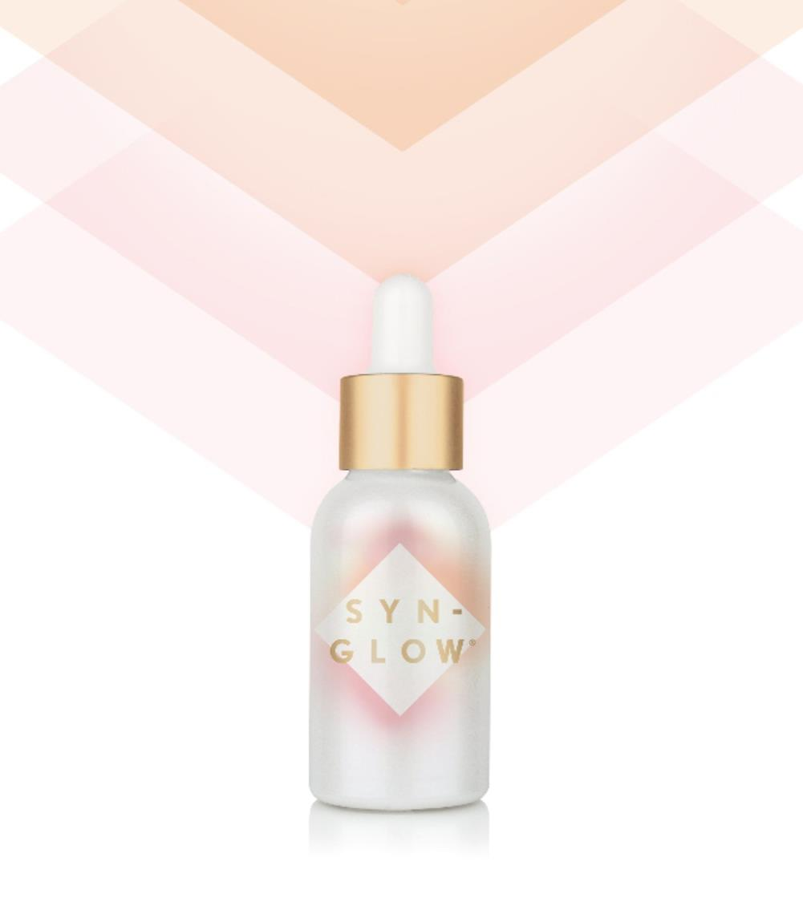
Technical details
Origin
Synthetic pentapeptide with a unique amino acid sequence
Composition
INCI name (active): Benzoyl Dipeptide-18
D-Phenylalanyl Arginyl D-Tryptophan Dipropylamide Mesylate
Content of active material: approx. 1000 ppm
Vegetable glycerin-based aqueous solution
No preservatives
PEG free
Vegan friendly
Manufacturing process
Made by cutting-edge pentapeptide technology
Recommended dosage
1 – 3%

Slide 29
Disclaimer
Copyright © DSM Nutritional Products Ltd 2025, 4002 Basel, Switzerland.
www.dsm-firmenich.com. All rights reserved.
dsm-firmenich has used diligent care to ensure that the information provided herein is accurate and up-to-date to the best of its knowledge. However, dsm-firmenich makes no representation or warranty, either expressly or implied, of the accuracy, reliability, completeness, or suitability thereof. The information provided herein contains scientific and product information for business-to-business use and does not constitute or provide scientific or medical advice, diagnosis or recommendation for treatment options. Country or region-specific information should be considered when labelling or advertising to final consumer. In no event shall dsm-firmenich be liable for any direct or indirect damages arising from or reliance upon, or use of, any information provided herein. The content of this document is subject to change without further notice. Please contact your local dsm-firmenich representative for the latest information. All trademarks listed in this document are either (registered) trademarks of, or trademarks licensed by, the dsm-firmenich group of companies, unless explicitly stated otherwise.
Disclaimer Formulation Guideline
The information provided herein is provided for information purposes only and has been prepared by dsm-firmenich in accordance with its own methodology.
dsm-firmenich has used diligent care to ensure that it is accurate and up-to-date, however, dsm-firmenich makes no representation or warranty, either expressly or implied, of the accuracy, reliability, or completeness thereof. In no event shall dsm-firmenich be liable for any damages arising from or reliance upon, or use of, any information provided herein. Further, dsm-firmenich shall not bear any liability for the application and/or use of any processed material containing its product(s). The formulation of the finished product is the customer’s sole responsibility. It is the customer’s responsibility to determine the suitability of dsm-firmenich’s products regarding user specific purposes, assess compatibility and stability of their finished product(s) and to ensure compliance of their finished product(s) with relevant laws and regulations. Any product, marketing or other claims made by customer are its sole responsibility. The content of this document is subject to change without further notice. Please contact your local dsm-firmenich representative for further details. © DSM Nutritional Products AG, 2025.

