Slide 1
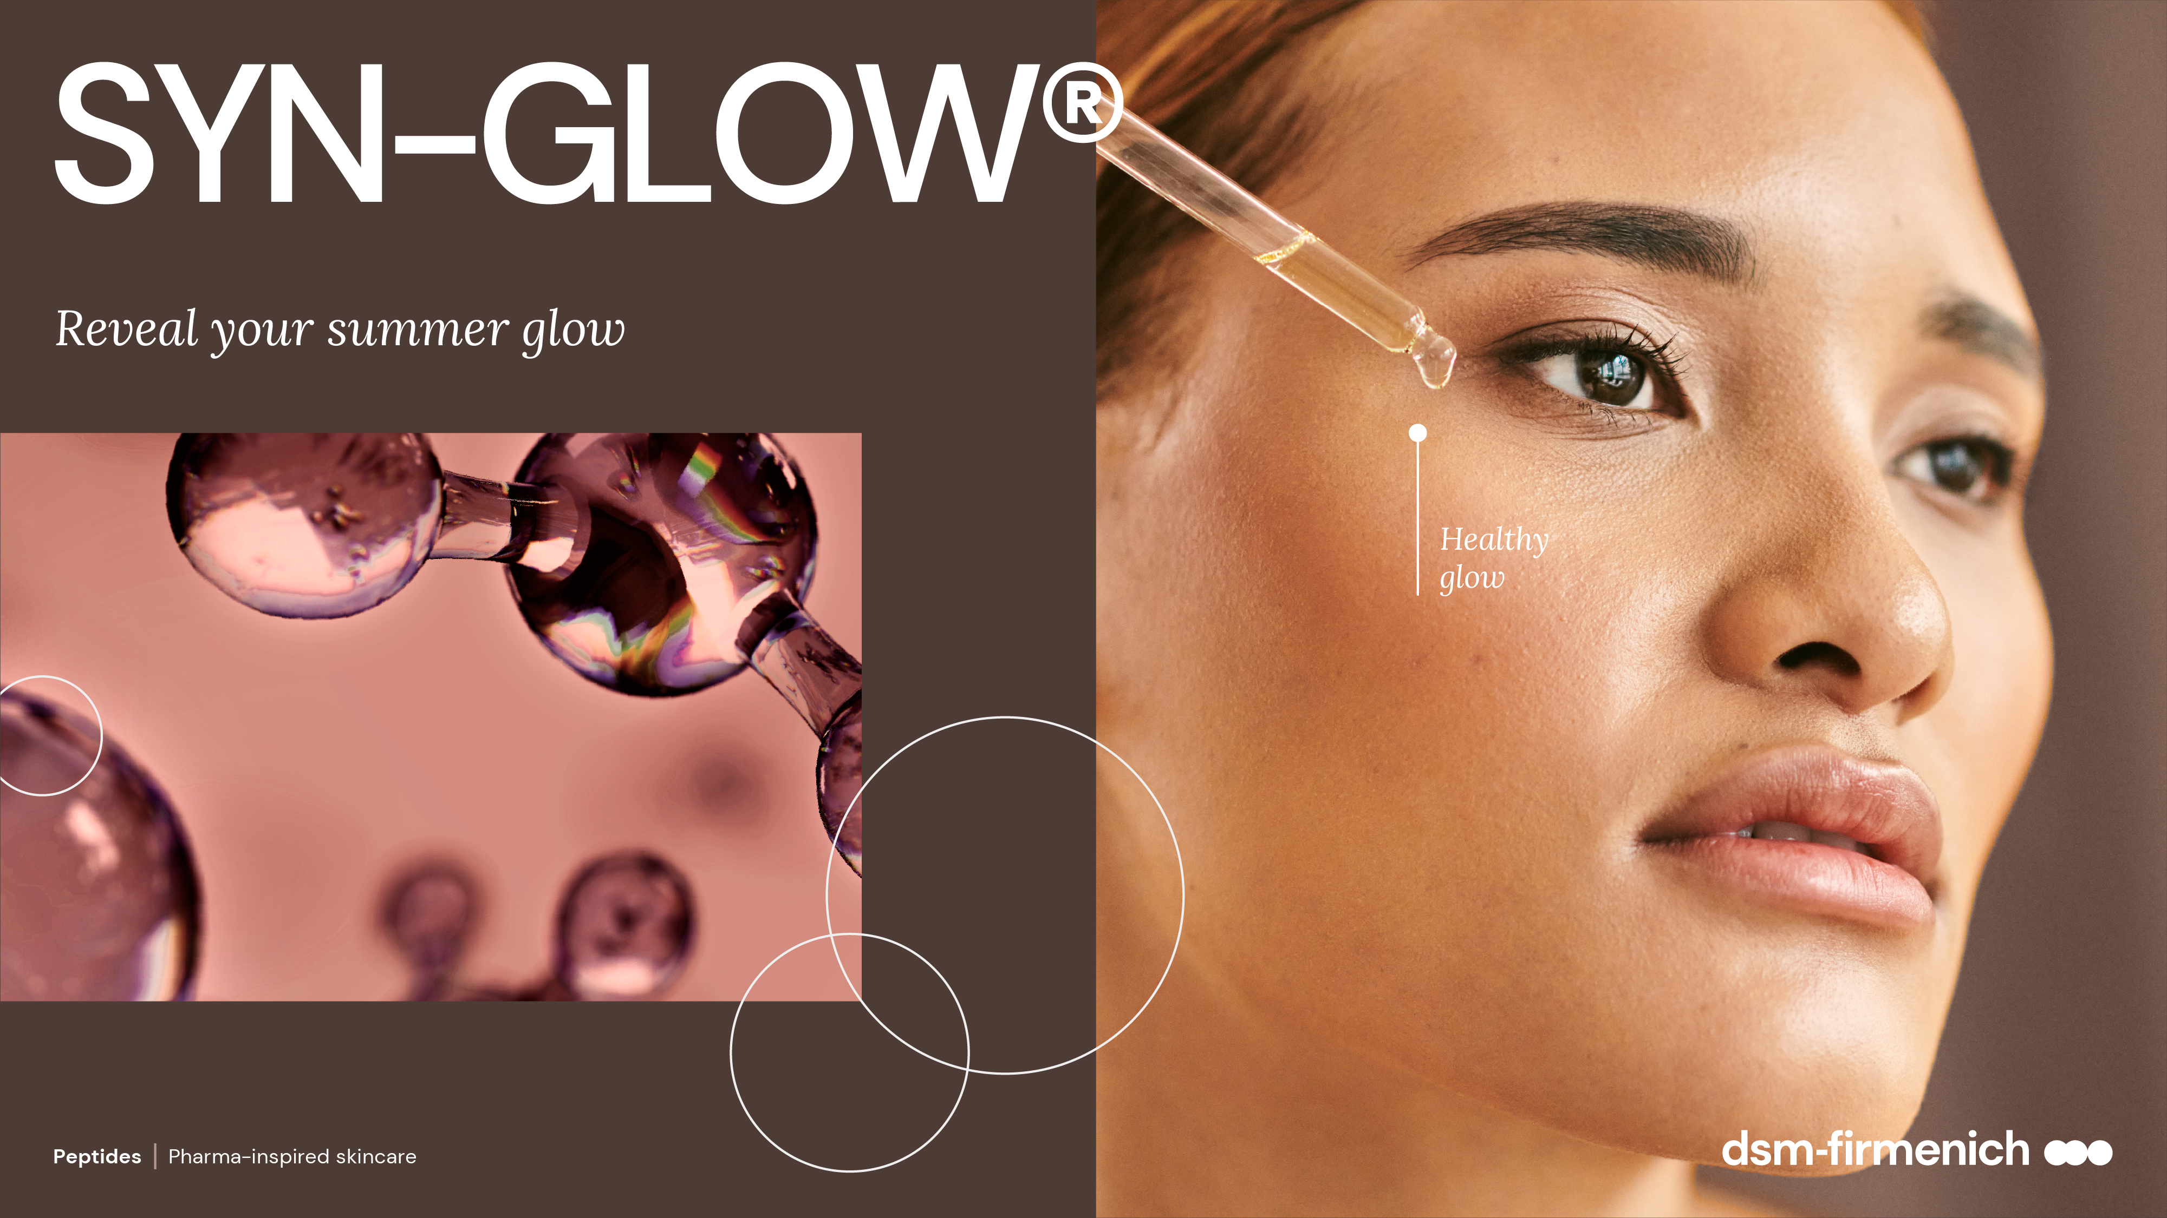
April 2025
April 2025

Slide 2
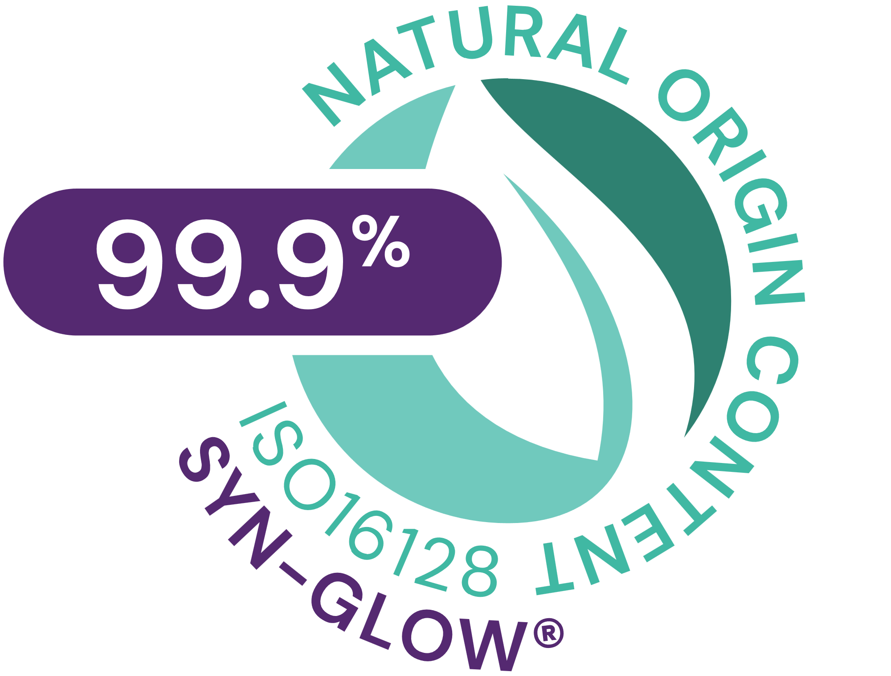




SYN-GLOW®
ID Card
INCI NAME:
Benzoyl Dipeptide-18 D-Phenylalanyl Arginyl D-Tryptophan Dipropylamide Mesylate, Aqua, Glycerin
Highly potent patented pentapeptide, made by cutting-edge SYN®-Peptide technology, designed to highly selectively boost MC1R (Melanocortin-1 receptor), a biochemical switch (off/on) of the Melanin synthesis
From a library of more than 100 peptides, SYN-GLOW® has been identified to be the best candidate to activate MC1R
In silico structure-based peptide design and artificial intelligence (AI), visualized with molecular modelling
TFA-free¹
99.9% of natural origin (according to ISO 16128)
TECHNOLOGY:
TECHNICAL:
Form: Liquid
pH of use: 4.0-7.5
Use level: 1-3%
Preservative: Free
Solubility: Water miscible
Highly selectively MC1R booster*
Significantly boosting key regulators of Melanin synthesis​ MITF, TYR, TRP1*
Stimulates anti-oxidant defense factor (Nrf2) after UVA-irradiation*
Healthy, youthful, fresh-from-holiday look all year long**
Promotes a visible healthy glow in just 5 days, with long lasting result and natural personalized effect**
BENEFITS:
REGISTRATION
CERTIFICATION
* in vitro ** in vivo

Slide 3
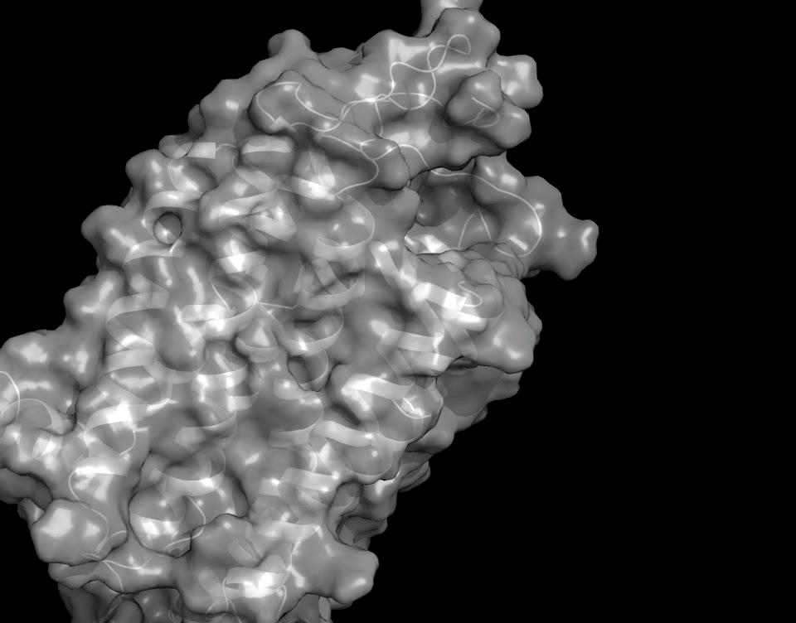

SYN-GLOW® is a pentapeptide
Designed to highly selectively boost MC1R (or Melanocortin-1 receptor)
MC1R is the biochemical switch (off/on) of the Melanin synthesis.
MC1R is a transmembrane protein, integrated into the cellular membrane and, in this role, it’s the unique gate to biological tanning.
Melanin is the pigment that gives skin its unique sun-kissed tone.
In vitro: from a library of more than 100 peptides, SYN-GLOW® has been identified to be the best candidate to activate MC1R. Results published in Int. J. of Molecular Sciences: https://www.ncbi.nlm.nih.gov/pubmed/31817532
Mode of action: Mc1R activation, related to scientific evidences. This is not intended to be final product claim
Notes:
The MC1R is the biochemical switch to keep melanin synthesis off or on. The signal to switch on is triggered by alphaMSH or SYNGLOW.
MC1R is a transmembrane protein so it is integrated into the cellular membrane (stabilized by seven helical structures crossing the cell membrane). This type of membrane protein structure belongs to a huge class of regulating proteins the so-called G protein coupled receptors. The specificity of the biochemical signal is achieved by specific ligand binding properties
In this role the MC1R is the unique gate to the melanogenesis pathway (= melanin synthesis or biological tanning)

Slide 4
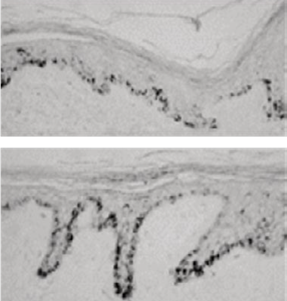
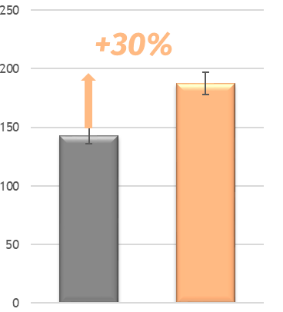
Significant ex vivo activity for SYN-GLOW®
Untreated
Pigmentation assay
ex vivo
*
Up to +30% significant
more pigmentation
Pigmentation score
Untreated
30 µg SYN-GLOW®
peptide
* p < 0.05 vs Untreated
SYN-GLOW®
Scientific Validation EX VIVO
Ex-vivo sample shown is from 47y.o female donor abdominal skin (ITA angle 18) with no light exposure
Notes:
Melanin production was directly measured ex vivo in human skin after topical treatment by the SYN GLOW peptide. The treatment time was 6 days
The skin was obtained from a Caucasian volunteer aged 47
After histological preparation a Fontana Mosson staining was performed to visualize and quantify the melanin
The melanin increased by 30% with 30micromolar of SG peptide and was statistically significant

Slide 5
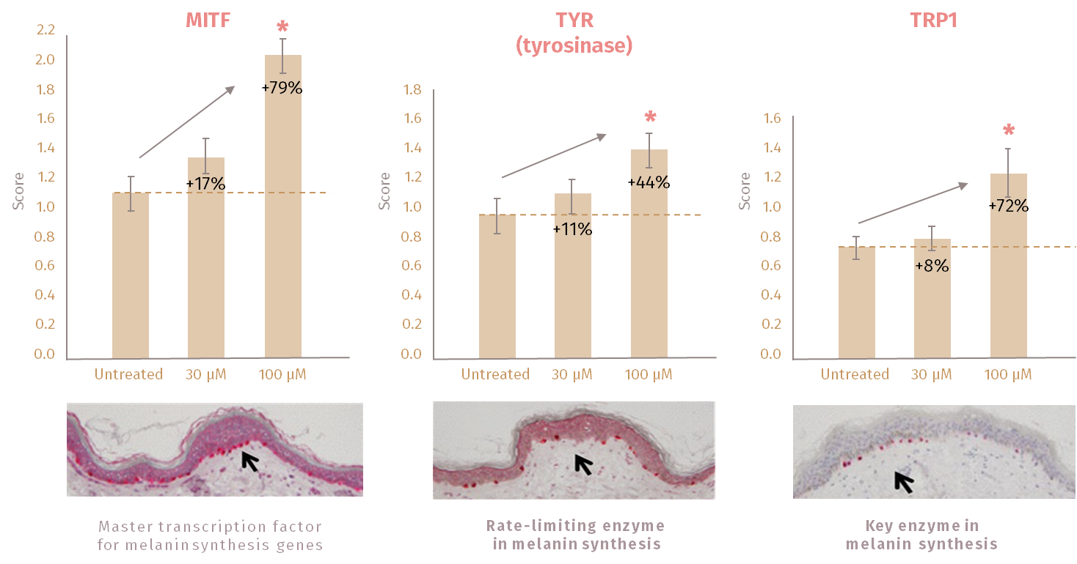
Significant ex vivo activity for SYN-GLOW®
Significantly boosting key regulators of Melanin synthesis
Scientific Validation EX VIVO
Melanin synthesis activation is related to scientific evidences (ex vivo) and is not intended to be final product claim
Notes:
Proof of concept results ex vivo on human skin with the SYNGLOW peptide (applied topically on the skin)
After treating the skin with SYNGLOW peptide some histological investigations on specific melanogenesis markers were performed
Immunostaining (using specific antibodies) for MITF, Tyrosinase (TYR) and tyrosinase related protein1 (TYRP1) were performed
After SYNGLOW treatment the staining intensity of the markers (MITF, TYR and TYRP1) were clearly increased which confirmed the specific activation of the melanogenesis pathway

Slide 6

In vivo study
29 Volunteers application at inner forearm of 3% SYN-GLOW®
Product application phase (2 times per day) |  |  |  |  |  |  |  |  |  |  |  |  |  |  |  |  |  | Post application phase
Day |  | 0 | 1 | 2 | 3 | 4 | 5 | 6 | 7 | 8 | 9 | 10 | 11 | 12 | 13 | 14 | 15 | 16 | 17 | 18 | 19 | 20 | 21 | 22
ITA Measure & Photo |  | ITA | «Real life» simulation* |  |  |  | ITA |  |  |  |  | ITA |  |  |  |  | ITA & Photo |  |  |  |  |  |  | ITA
Overall set-up
Pre-conditioning phase: product application, no UV exposure
Day 1-4: product application, UV exposure
Day 5-15: product application, no UV exposure
Day 15-22: no application, no UV exposure
Scientific Validation IN VIVO
*We exposed skin to some UV light, in order to simulate “real life”. UV exposure was done with a sunlight simulator, 40% below the minimal erythemal dose (MED): this roughly corresponds to 15-30min outdoor, during avg Spring day in mid-European Country

Slide 7
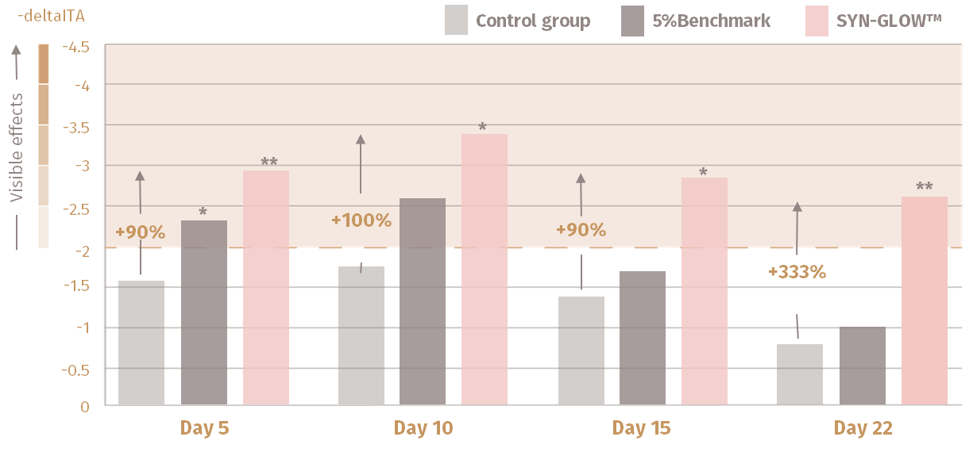
Outstanding in vivo results!
With SYN-GLOW®, a visible healthy glow in just 5 days with long-lasting effect
Control group
5% Benchmark
SYN-GLOW® 3%
* p<0.05 against Untreated skin «significant»
** p<0.01 against Untreated skin «highly significant»
Control group= UV only
Benchmark = Hexapeptide-1

Slide 8
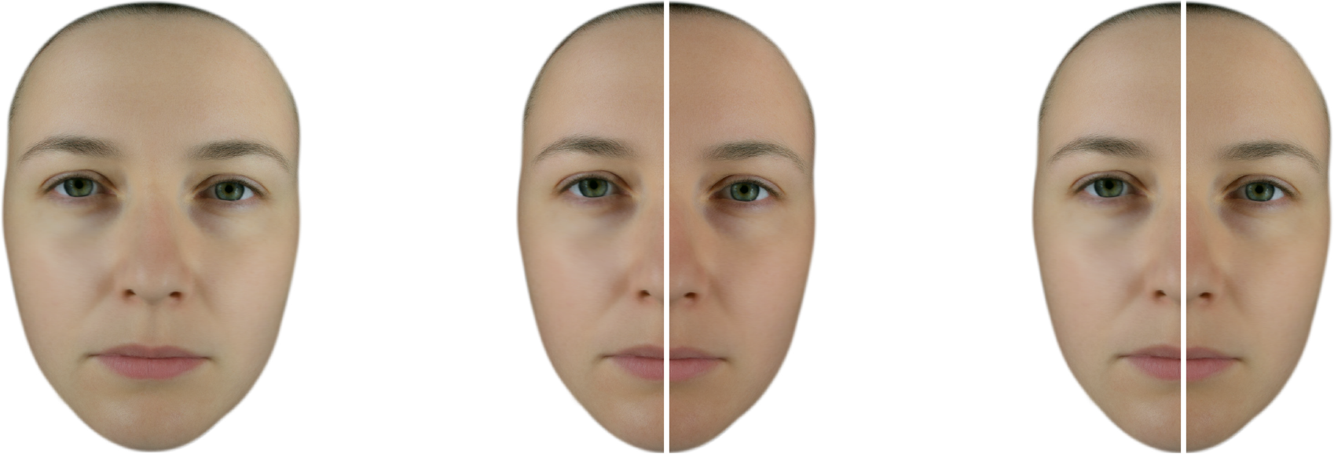
Personalized glow boost with SYN-GLOW®
Day 0 Baseline
Day 10 Glow peak
Day 22 Long lasting effect
Subject 6
UV only
3%
SYN-GLOW®
UV only
3%
SYN-GLOW®
Facial visualization. L* a* b* values from SYN-GLOW® Clinical Study – Subject n3

Slide 9

Outstanding in-vivo results!
With SYN-GLOW®, a visible healthy glow in just 5 days with long-lasting effect
Consumers’ feedback:
100% of consumers noticed their skin looking fresher and more revitalized
Over 90% of consumers noticed their skin looking less dull and tired
Over 80% of consumers , 3X more noticed a facial healthy glow
Close to 70% of consumers noticed their skin tone more even and homogeneous
Over 80% of consumers would use this product again
Qualitative questionnaire
Clinical study, 16 female volunteers, 20-55 y.o., phototype II – IV, with planned outdoor activities. SYN-GlOW® containing formulation was applied on the face twice per day

Slide 10

Supported claims
Natural healthy glow in just 5 days
Prolonged summer bronze
Personalized result, bespoke complexion
Strengthened skin natural defenses from within
Qualitative questionnaire
Clinical study, 16 female volunteers, 20-55 y.o., phototype II – IV, with planned outdoor activities. SYN-GlOW® containing formulation was applied on the face twice per day

Slide 11
Disclaimer
Copyright © DSM Nutritional Products Ltd 2025, 4002 Basel, Switzerland.
www.dsm-firmenich.com. All rights reserved.
dsm-firmenich has used diligent care to ensure that the information provided herein is accurate and up-to-date to the best of its knowledge. However, dsm-firmenich makes no representation or warranty, either expressly or implied, of the accuracy, reliability, completeness, or suitability thereof. The information provided herein contains scientific and product information for business-to-business use and does not constitute or provide scientific or medical advice, diagnosis or recommendation for treatment options. Country or region-specific information should be considered when labelling or advertising to final consumer. In no event shall dsm-firmenich be liable for any direct or indirect damages arising from or reliance upon, or use of, any information provided herein. The content of this document is subject to change without further notice. Please contact your local dsm-firmenich representative for the latest information. All trademarks listed in this document are either (registered) trademarks of, or trademarks licensed by, the dsm-firmenich group of companies, unless explicitly stated otherwise.
Disclaimer Formulation Guideline
The information provided herein is provided for information purposes only and has been prepared by dsm-firmenich in accordance with its own methodology.
dsm-firmenich has used diligent care to ensure that it is accurate and up-to-date, however, dsm-firmenich makes no representation or warranty, either expressly or implied, of the accuracy, reliability, or completeness thereof. In no event shall dsm-firmenich be liable for any damages arising from or reliance upon, or use of, any information provided herein. Further, dsm-firmenich shall not bear any liability for the application and/or use of any processed material containing its product(s). The formulation of the finished product is the customer’s sole responsibility. It is the customer’s responsibility to determine the suitability of dsm-firmenich’s products regarding user specific purposes, assess compatibility and stability of their finished product(s) and to ensure compliance of their finished product(s) with relevant laws and regulations. Any product, marketing or other claims made by customer are its sole responsibility. The content of this document is subject to change without further notice. Please contact your local dsm-firmenich representative for further details. © DSM Nutritional Products AG, 2025.

