Slide 1
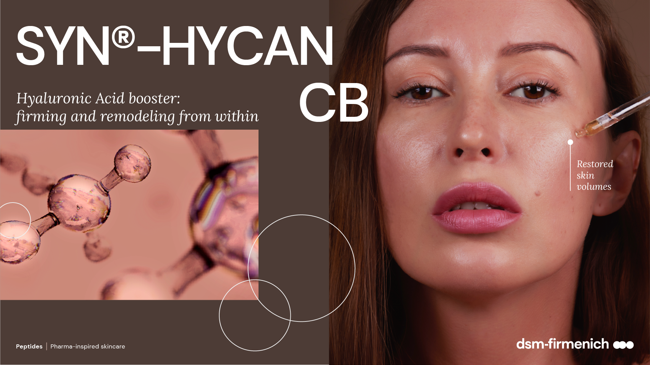
0. 2026

Slide 2

Restoring Lost Volume
A New Focus in Beauty Care
In cosmetic dermatology, wrinkles and sagging skin are no longer viewed
in isolation.
The new focus includes how loss of volume in one area of the face impacts the appearance of other areas.
Over time, facial skin loses volume in key areas, including the cheeks, under eyes, the jawline and around the mouth.
Fillers counteract this process by adding fullness to needed areas, restoring skin to its original position.
The New York Times, “The Filler Effect” , Huffington Post, “What is a Non-Surgical Face Lift?”

Slide 3
Hyaluronic Acid: The Rising Queen of Fillers
Their reversible and natural-looking effects make HA fillers highly desirable
Different facial zones that can be augmented by dermal fillers
  5.5 millions
  Hyaluronic acid procedures performed in globally in 2023
  40%
  share of dermal filler procedures
  using hyaluronic acid
Creases between eyebrows
Droopy eyebrows
Hollow temples
Loss of volume in cheeks
Ear lobe correction
Hollowness under eyes
Laugh lines
Thin lips
Chin wrinkles
Marionette lines
Undefined jawline
Sagging corners of mouth
Lipstick lines
Undefined nose or tip
  #2 non-invasive
  procedure
  hyaluronic acid were second most frequently performed procedure
  after Botox®
  Fastest growing
  procedure
  +29,1% vs. 2022
  HA procedure growth outpaced Botox®, chemical peels, laser hair removal,
  and microdermabrasion²
Source: International Society of Aesthetic Plastic Surgery International Survey 2023

Slide 4
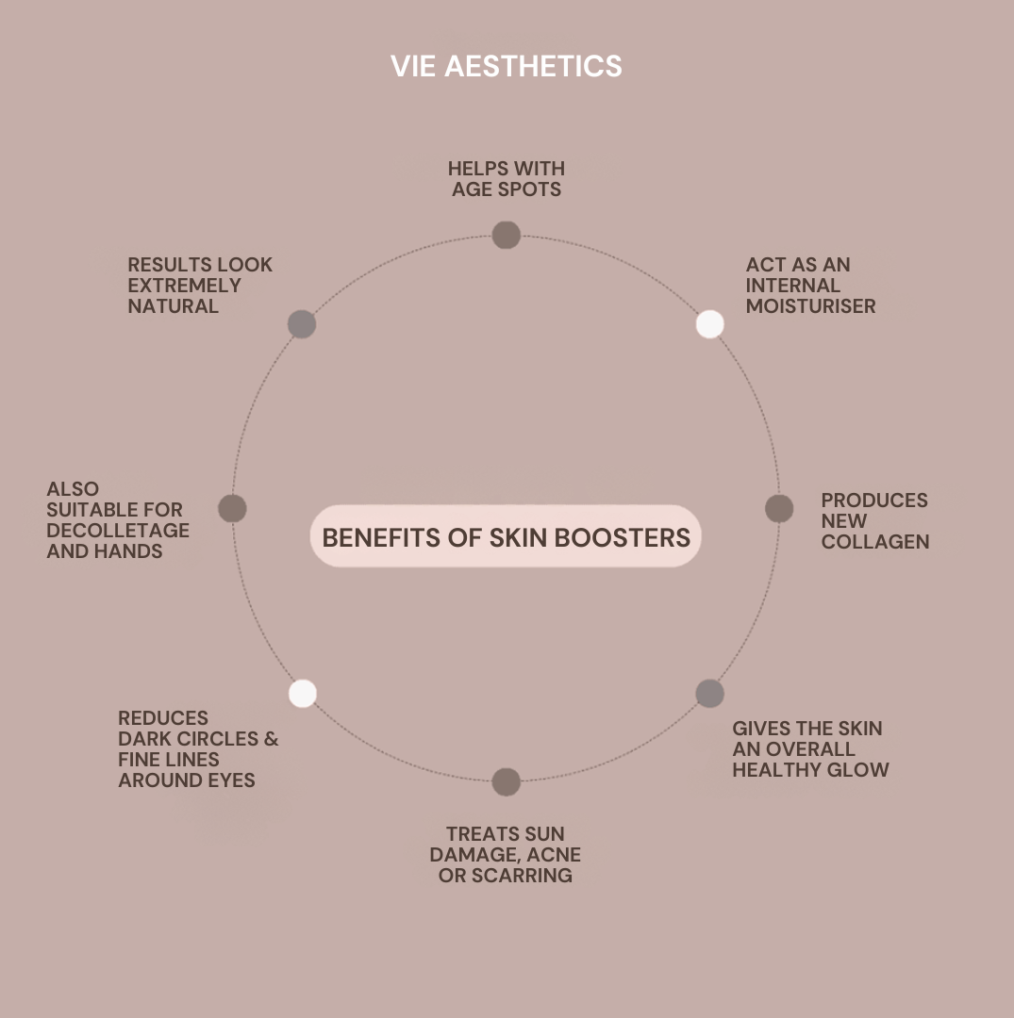
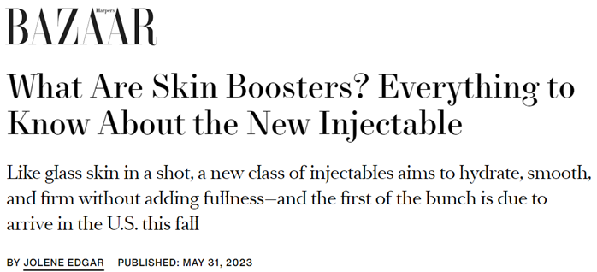

Hyaluronic Acid still on hype
New methods and consumer interest
also remains strong
Latest trend: Skin Boosters
New method of hyaluronic acid. It involves the application of HA’s microinjections aiming boosting hydration, glow and and collagen production, following recent consumer needs for more healthier and natural-look skin for longer.
It has HA as the primary substance and can also combine other actives.
BENEFITS OF SKIN BOOSTERS
What are skin boosters & do they work? | Our Blog | Eason Aesthetics (dermalfillersbromley.co.uk)
Skin Booster Injectables Explained: What Is Skinvive, Profhilo? Experts Weigh In (harpersbazaar.com)
Skin Boosters: Why the Hype? - Vie Aesthetics (vie-aesthetics.com)

Slide 5
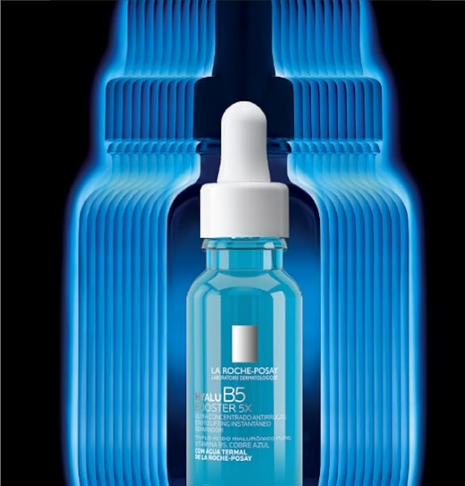
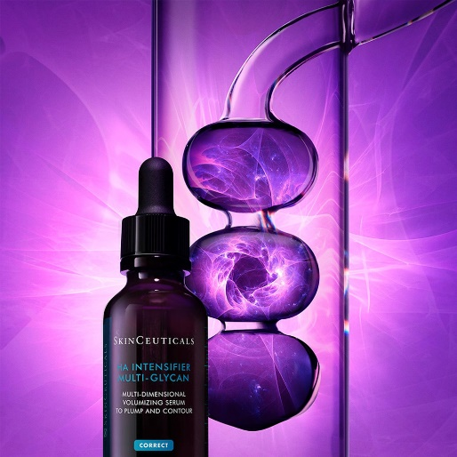
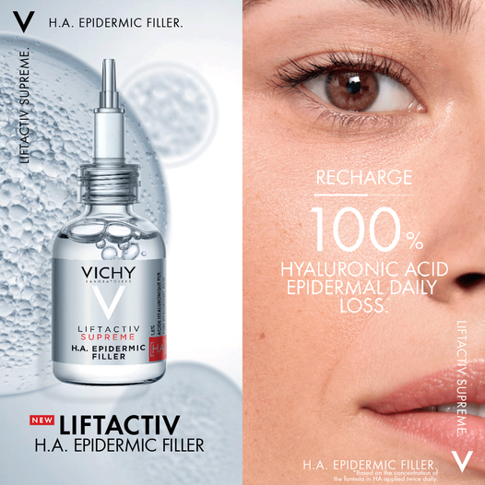
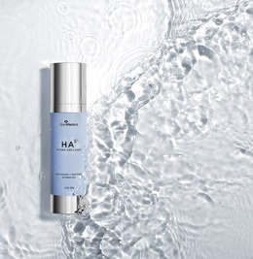
HA-Inspired Cosmetics Continue to Rise
New Hyaluronic Acid products continue to evolve and sophisticating
LA ROCHE-POSAY
Hyalu B5 Booster 5x
SKINCEUTICALS
H.A. Intensifier Multi-Glycan
VICHY LABORATORIES
LIFTACTIV H.A. EPIDERMIC FILLER
SKINMEDICA
LIFTACTIV H.A. EPIDERMIC FILLER
Immediate lifting and boosts.
Intensively repairs skin in 1h.
Anti-wrinkles results in 1 week.
Tested as post-procedure
Instantly plumps skin and also boosts skin glycans for even higher volumizing results.
Claims to rechard 100% of Hyaluronic Acid Epidermal Daily loss, providing intense volumizing benefits on skin.
Developed by the creators
of BOTOX® , this serum uses a proprietary complex of hyaluronic acid providing deeper hydration for visible plumpness and radiance.
Sources: ¹ Lancome-USA.com ² Mintel GNPD 2018 ³ Barneys.com ⁴ Skinceuticals.com

Slide 6
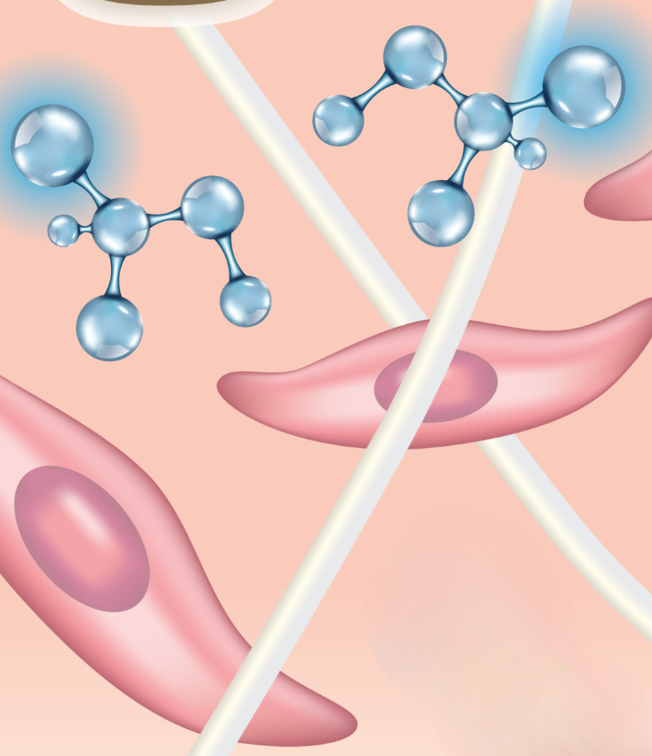

Hyaluronic Acid in skin
Skin contains the majority of the body’s HA
Key Facts About Hyaluronic Acid
Hyaluronic Acid belong to the Extracellular Matrix
(ECM) molecules and is the most predominant
component of the ECM.
In humans, HA is the most abundant in skin,
accounting for 50% of the body’s HA.
Hyaluronic acid is co-located with CD44, a prominent
HA cell receptor, which is found on virtually all cells and
acts as an HA anchor.
Functions of HA:
Hydration
A space filling capacity
Framework through which cells migrate
Depiction of hyaluronic acid dispersed
through the skin’s extracellular matrix

Slide 7
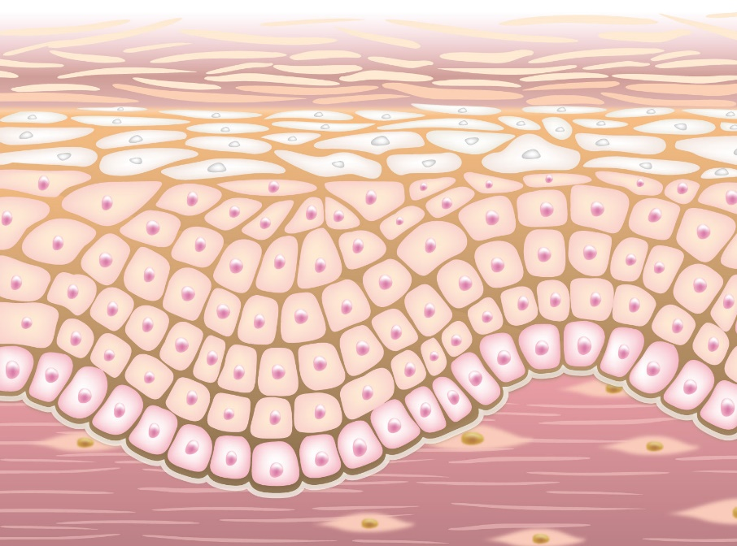
The Purpose of Hyaluronic Acid in Skin
Hydration and Skin Structuring are the main roles of HA
Skin Moisture: Epidermal HA
Impact of Lost
Epidermal HA
With age, there is a marked decrease of epidermal HA, the principal molecule responsible for binding and retaining water molecules, resulting in loss of skin moisture
Skin Volume: Dermal HA
Impact of Lost Dermal HA
Dermal HA serves as a framework for structural proteins (e.g. collagen, elastin) and skin cells. Loss of dermal HA leads to less volume and mechanical cushioning and loss of skin moisture.
The true volumizing effect of hyaluronic
acid can only come from within

Slide 8
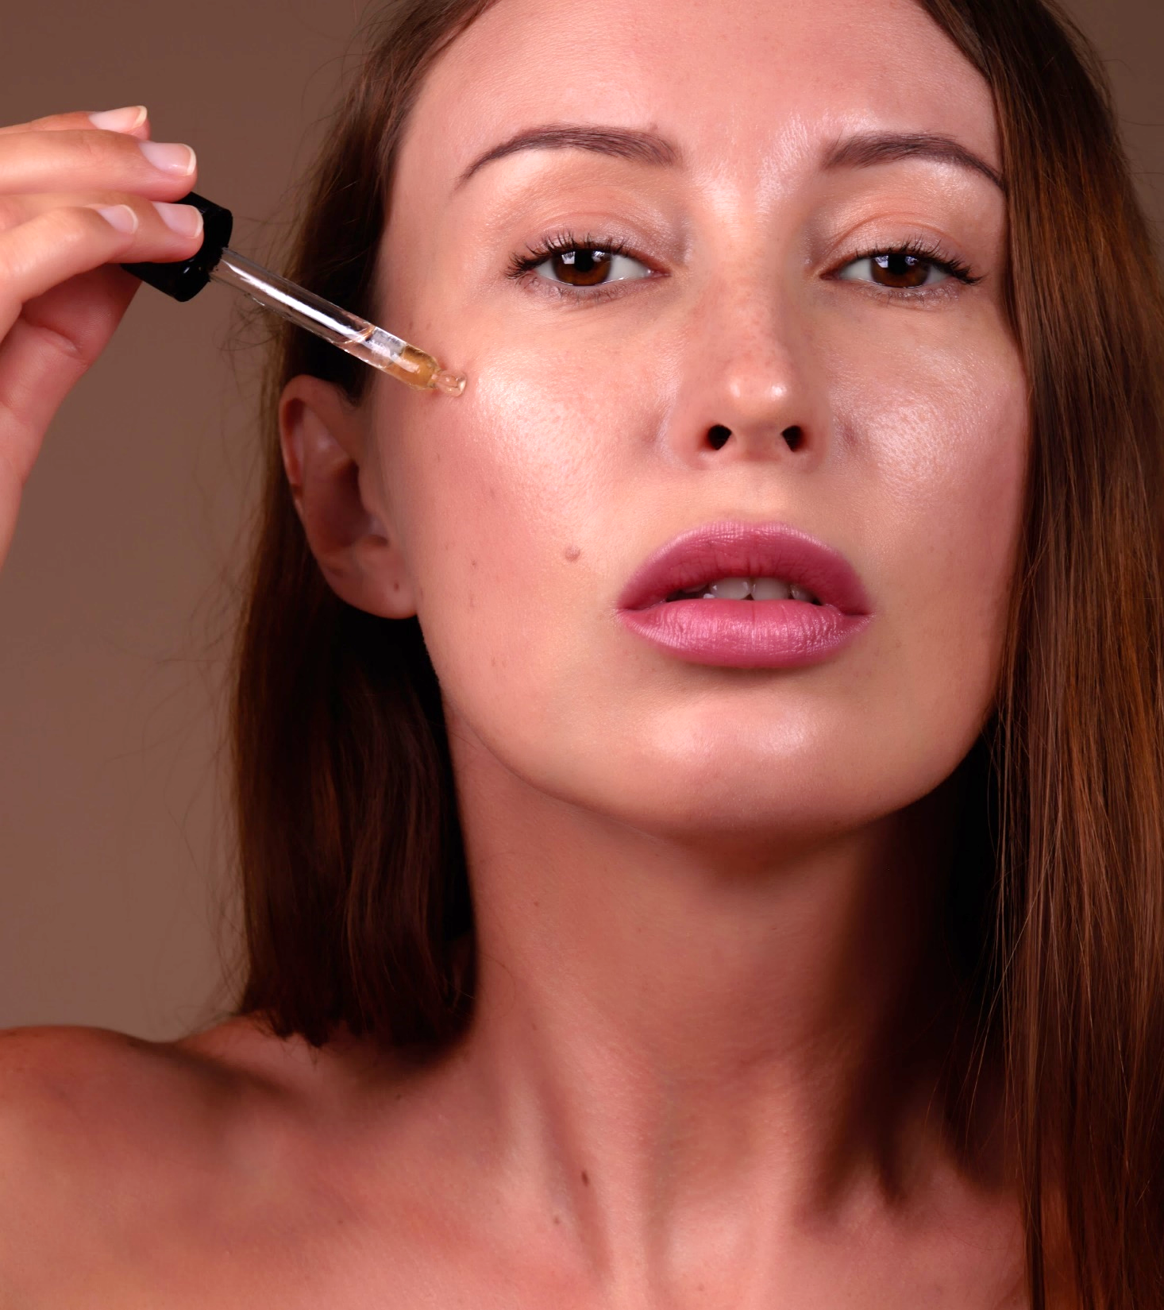
SYN®-HYCAN CB
Hyaluronic acid booster: firming
and remodelling from within
Boosts skin’s own production of hyaluronic acid, with proven benefits on multiple skin zones, leading to fuller, firmer skin in weeks

Slide 9
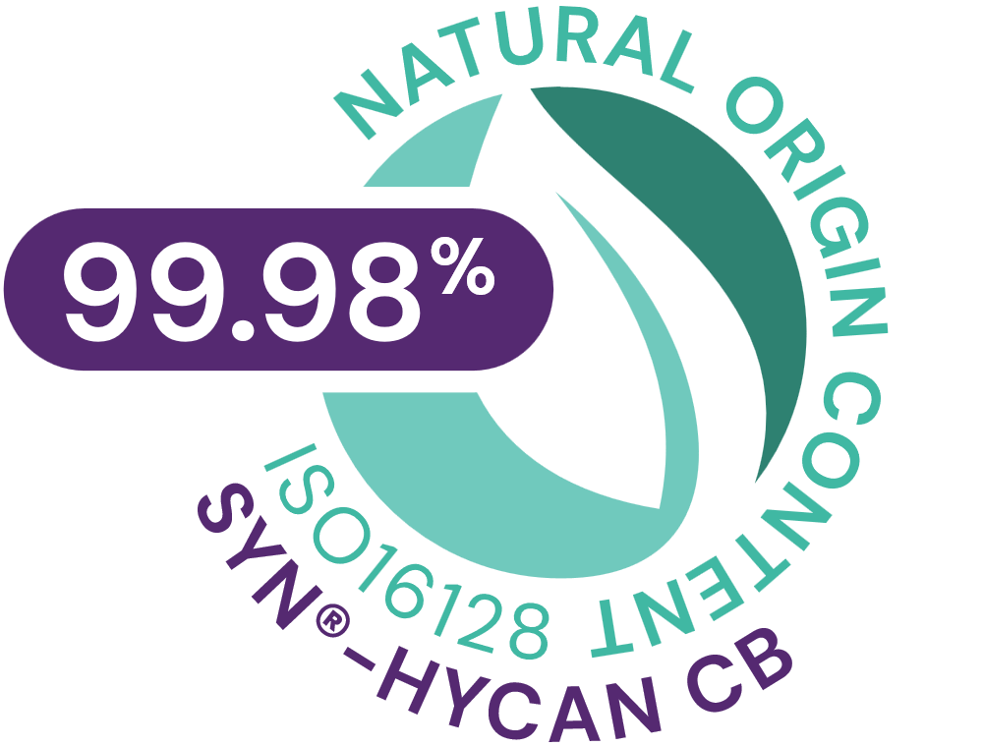
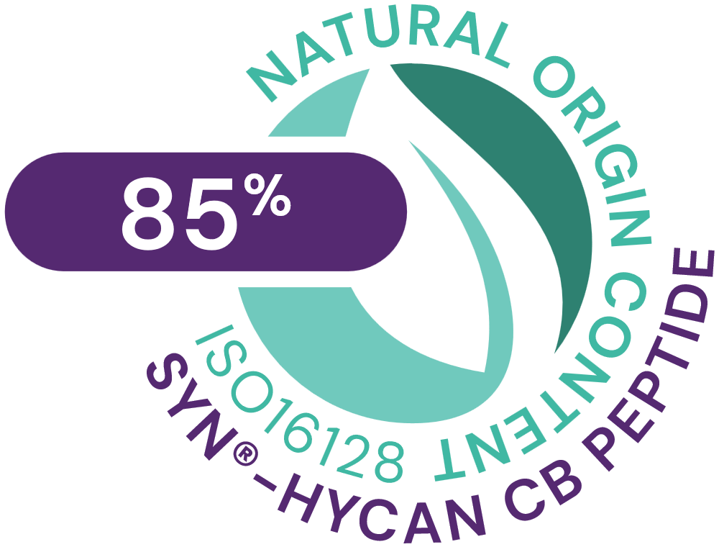



SYN®-HYCAN CB
ID Card
INCI NAME:
Tetradecyl Aminobutyroylvalylaminobutyric Urea Acetate, Glycerin, Aqua, Magnesium Chloride
Original SYN®‑HYCAN peptide generation patented; CB version patent application pending
TFA-free¹
99.98% natural origin (ISO 16128) for SYN®-HYCAN CB - 85% natural origin (ISO 16128) for the pure SYN®-HYCAN peptide²
TECHNOLOGY:
Highly potent, natural origin tripeptide, suitable for Clean-Beauty, produced via Green Chemistry Science with an optimized SYN®-Peptide technology, designed to stimulate hyaluronic acid from within
TECHNICAL:
Form: Liquid
pH of use: 3.0-5.5
Use level: 2-5%
Preservative: Free
Solubility: Miscible in water
BENEFITS:
Boosts hyaluronic acid (HA) synthesis in both keratinocytes and dermal fibroblasts*
Increases CD44 expression, a key cellular anchor of HA*
Increases collagen type 1, lumican and decorin levels, important for collagen support & organization*​
Provides visible filling effect in just 2 weeks
Lifts even the most difficult areas, such as the neck
Benefits on multiple skin zones (under eye, upper- and mid-cheek, jawline, neck, lip)
Increases skin firmness +200% on cheek area.
REGISTRATION
CERTIFICATION:
1. Non-intentionally added TFA
* in vitro ** in vivo

Slide 10





SYN®-HYCAN CB
Aligned with and contributing to the
Highlights
related to Supply
Chain control
Full ownership of the production,
INCI name: Tetradecyl Aminobutyroylvalylaminobutyric Urea Acetate, Magnesium Chloride, Aqua, Glycerin Product Code: 5017794
Carbon footprint*
9.7 kg CO2 eq/kg
Biodegradability
Biodegradability test ongoing
Feedstock origin
Synthetic and Glycerin from
rapeseed
PIONEER IN PEPTIDES
High performance active with low carbon footprint contribution.
Natural origin peptide suitable for Clean-Beauty, produced via Green Chemistry with an optimized synthesis
Water footprint
4.07 m³ depriv./kg
Renewable electricity
100% purchased renewable electricity
Responsible sourcing
No palm oil derivatives
Impact on health and well-being
Natural-origin
99.98% natural origin content according to ISO 16128 for SYN®-HYCAN CB
85% natural origin for the pure peptide*
SYN-HYCAN® CB offers a non-invasive cosmetic alternative for restoring skin volume. It helps firming and remodeling skin from within, by helping maintain the Hyaluronic acid content.
The carbon and water footprint calculations are based on internally conducted LCA according to ISO 14040/44 guidelines, dsm-firmenich LCA policy and validated by internal reviewers.
The natural origin Index is at 0.85 according to the ISO 16128 standard
© 2020. DSM.
All rights reserved
Card version 2

Slide 11
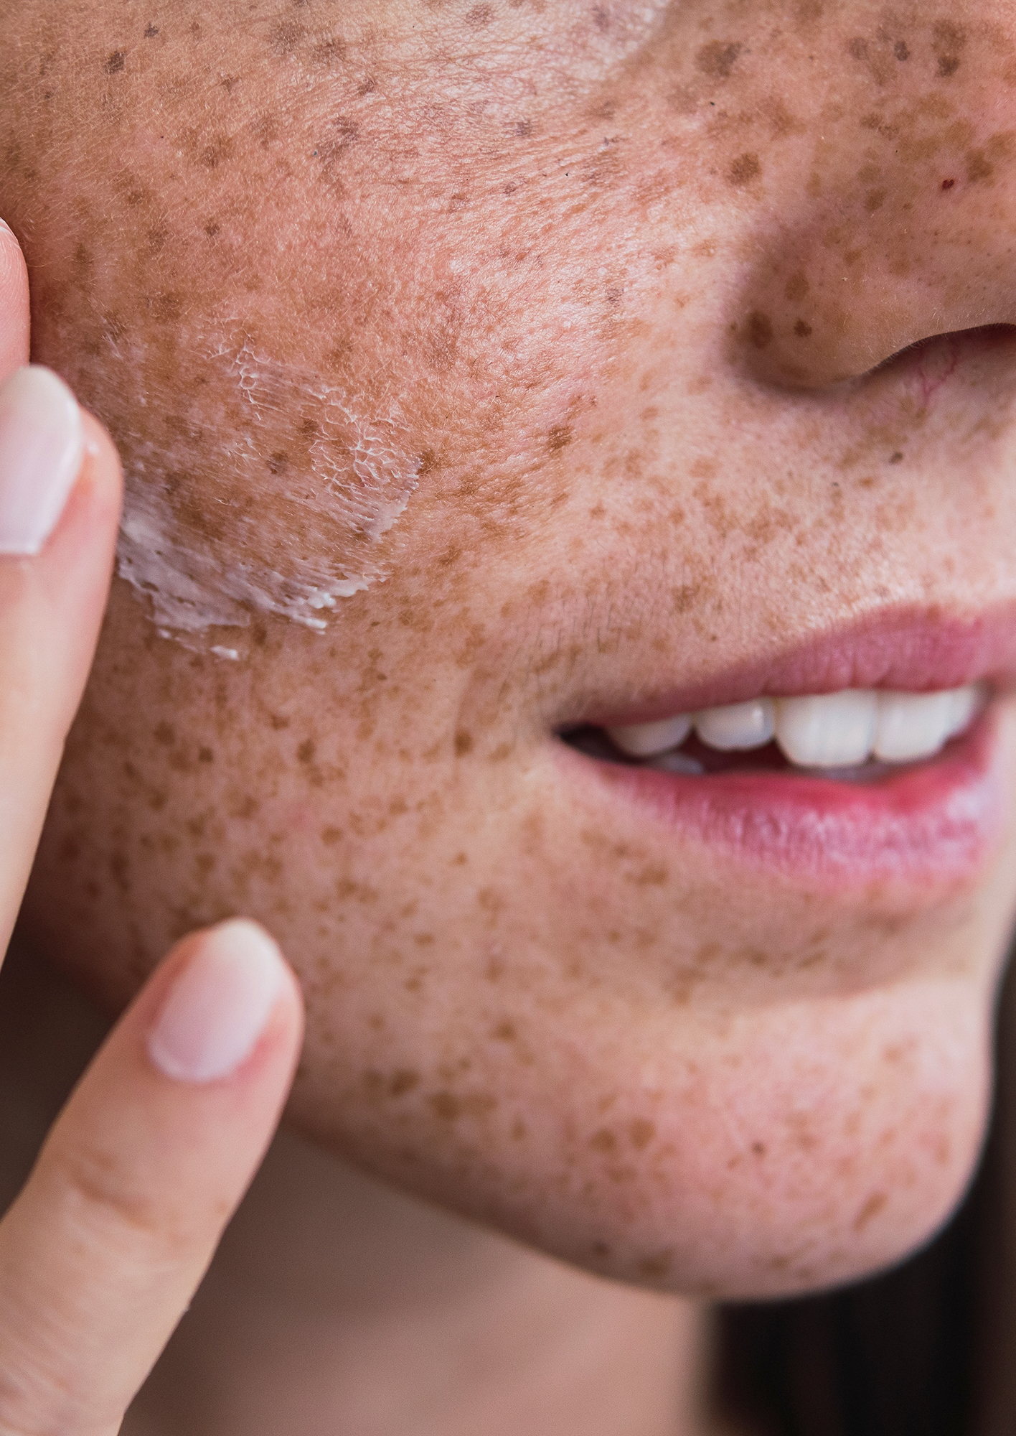





SYN®-HYCAN CB
A natural peptide for sustainable formulations
Carbon footprint of 9.7 kg CO2 eq./kg. High efficiency allowing a low carbon footprint in use¹
SYN-HYCAN® CB suitable for Clean-Beauty with TFA free process². Natural-origin peptide (0.85 natural origin Index according to ISO 16128).
Green chemistry reaction type³ with an optimized synthesis reducing the number of steps (8 vs 14 steps previously).
Switch from a solid phase to a liquid phase process, allowing for significantly reducing amounts of solvents and for including greener solvents.
Production with no CMR solvents and no CMR reagents
Considering a 1-3% concentration of SYN-HYCAN® CB in final formulation, 97-291g CO2 per kg in final formulation.
TFA replaced with acetic acid.
Main reaction type is amidation
Peptides | Pharma-inspired skincare

Slide 12

dsm-firmenich peptides technology core principles
Mimicking body’s own key biological pathways
with synthetic peptides
Target specific modification of existing structures
to improve selectivity and activity
Key success factors
Small peptide size (tri-, tetra peptides) for best efficacy
Fully substantiated, visible results on the skin
Chemically well-defined structure
Extended safety dossier
High purity and stability
No preservative

Slide 13
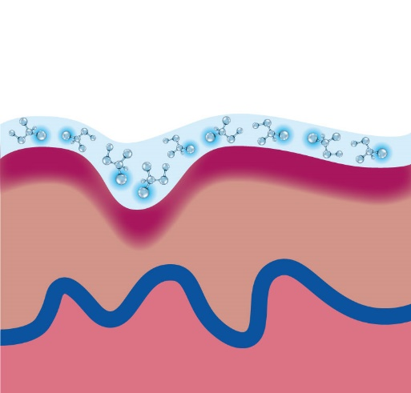
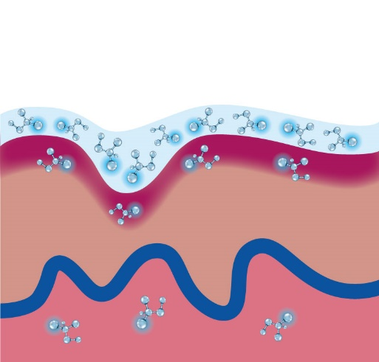
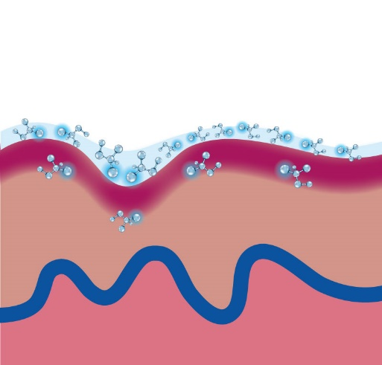
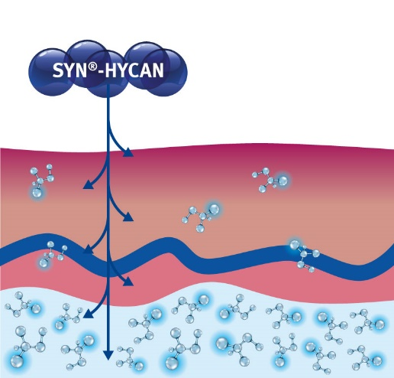
SYN®-HYCAN CB
The advantage of building from within
SYN®-HYCAN CB
See dsm-firmenich’s HA BT
Topical long chain HA
ultra-short chain HA
Topical short chain HA
SYN®-HYCAN CB
Excellent humectant
Very limited effect
on skin’s intrinsic HA
Natural chain length similar to skin (2-3 mda)
Good humectant
Limited effect on skin’s intrinsic HA, with limited penetration
Much smaller than
body own HA
Good humectant
Limited effect on skin’s intrinsic HA
No similarity in length
with skin‘s HA (50kda)
Excellent hydrating
effect plus skin firming
Boost skin’s own HA production
Natural HA composition and location
Notes:
Make use of the skin‘s own capacity to produce its own molecules. Use a small molecule to trigger the cell’s synthesis activity. (SYN®-COLL, SYN®-TACKS, SYN-TC® also trigger the cell’s synthesis activity.)

Slide 14
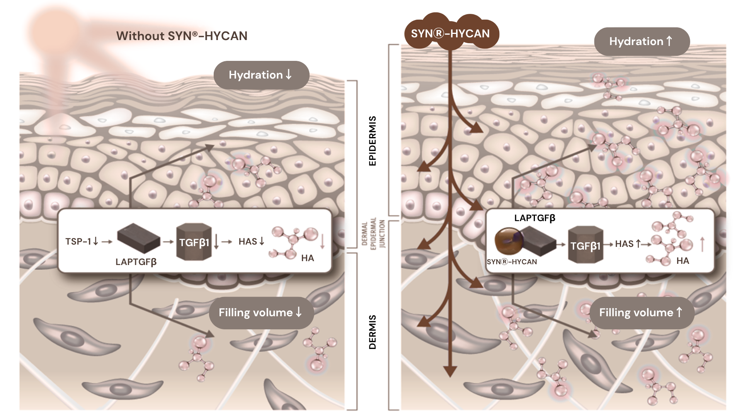
SYN®-HYCAN CB Mimicking TGF-Beta activation for Increased HA Synthesis
Mature or Photoaged Skin
Revitalized Skin with SYN®-HYCAN CB
Low Thrombospondin
Low TGFβ1 activation
Less hyaluronic acid
Less volume
Dry skin
SYN®-HYCAN CB mimics Thrombospondin
TGFβ1 activation
More hyaluronic acid
More volume
Hydrated skin
CB
Notes:
In mature or photo-aged skin thrombospondin-1 (TSP-1) is low. Thus, only little activation of TGFb1 takes place. As a consequence, there is only little hyaluronic acid (HA) synthesis). Dermis has a low volume (due to atrophy) and epidermis is dry and rough.
SYN®-HYCAN mimics TSP-1 and activate TGFb1. This leads to increased HA synthesis, and thus to more dermal volume and hydrated epidermis.

Slide 15

SYN®-HYCAN CB – in vitro efficacy
Study details
Hyaluronic Acid Synthesis
Epidermal Keratinocytes, dose response
Dermal Fibroblasts, versus benchmark peptide
Skin explants analysis, ex vivo
Hyaluronic Acid Cellular Anchoring
3D Microsphere HA analysis, visual assessment
CD44 Hyaluronic Acid Receptor expression assay
Collagen Support & Organization
Proteoglycan synthesis
Collagen synthesis

Slide 16
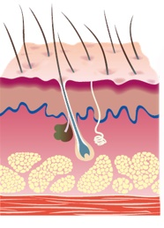
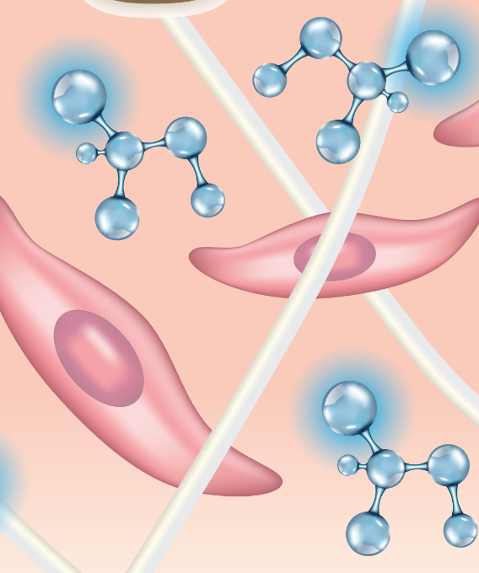

HA Synthesis boost in Keratinocyte & Fibroblast Cell Culture
bFGF | SYN®-HYCAN CB | Peptide
TGFβ₁ | Competitor | SYN®-HYCAN CB | Peptide
+78%
+75%*
+52%*
+213%*
+160%
+77%
+0%
+21%
+0%
+0%
Control
10
ng/ml
6.25 µM
25 µM
*p<0.05 vs control
Normal human keratinocytes were incubated without FCS for 3 days.
SYN®-HYCAN CB peptide provides moisturizing from within by HA synthesis in the epidermis.
SYN®-HYCAN CB peptide increases hyaluronic acid synthesis by a factor of 3!
Normal human fibroblasts (NHF) were incubated without FCS for 3 days.
SYN®-HYCAN CB peptide can boost hyaluronic acid synthesis in both keratinocytes and dermal fibroblasts
3x better than a competitor peptide after three days treatment.
Peptides | Pharma-inspired skincare
16
Notes:
bFGF is basic Fibroblast Growth Factor. It’s a positive stimulator of hyaluronan in skin both in fibroblasts as well as in keratinocytes.
Method: Normal human keratinocytes were incubated in defined keratinocyte proliferation medium (CnT-07, CELLnTEC, Bern, Switzerland) and stimulated with SYN®-HYCAN peptide for three days. After three days hyaluronan concentration in the medium was measured using the Hyaluronan Assay Kit from Echelon (Salt Lake City, UT).
This is how we could explain the benefits of HA in the epidermis:
Hyaluronan also plays an important roles in the epidermis. It has been suggested to support epidermal homeostasis by maintaining the narrow extracellular space to facilitate the exchange of nutrients and waste products, but it also has signaling effects on the keratinocytes to stimulate proliferation and migration capabilities. It is strongly expressed around the basal and spinous cells, whereas in the terminally differentiated cells and in the stratum corneum usually hyaluronan is also present but reduced to smaller fragments. Hyaluronan is highly upregulated during skin injury and stimulates the keratinocytes motility and proliferation for wound healing.
Benefits of HA in the epidermis in general and mild stimulation of HA in the epidermis:
Important for the homeostasis of the epidermis
Improves the cell turnover and renewal of the epidermis
Enhances epidermal thickness in particular in aged or atrophic skin (often seen in aged but sun protected skin)
Helps to keep the skin moisturization from within up to the stratum corneum as an alternative to topical HA application
Palmitoyl oligopeptide & palmitoyl tetrapeptide-7 is Matrixyl 3000.

Slide 17

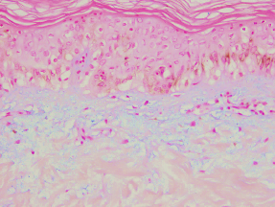
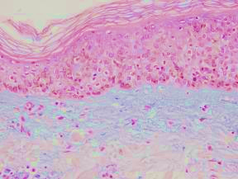
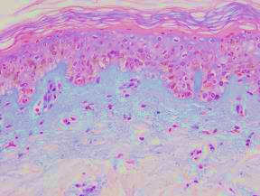
The Advantage of Building from Within
SYN®-HYCAN CB peptide boosts hyaluronic acid
synthesis in skin ex-vivo by 3x
  Epidermis DEJ
  Dermis
*
Vehicle treated control, 3 J/cm² UVR
10 ppm palmGHK,
3 J/cm² UVR
10 ppm
SYN®-HYCAN CB peptide, 3 J/cm² UVR
Hyaluronic acid synthesis (blue staining) is significantly increased in human skin explants treated with UV-radiation after six days topical incubation with the SYN®-HYCAN CB peptide.
SYN®-HYCAN CB
peptide
UVR 3 J/cm²

Slide 18
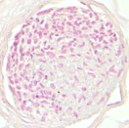
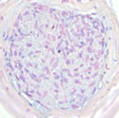
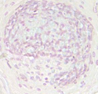
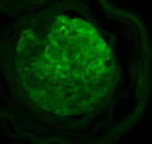
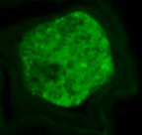
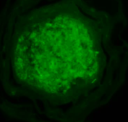
Hyaluronic Acid Cellular Anchoring
CD44 (HA Receptor) Expression Assay
Control
2.5 %
SYN®-HYCAN CB
50 ng/ml bFGF
Alcian Blue staining
(Hyaluronic acid)
SYN®-HYCAN CB enhances CD44 expression,
a key cellular anchor of HA, in skin microspheres
CD44 is the most prominent hyaluronic acid (HA) receptor in skin and found on virtually all cells. In the dermis and epidermis, HA is co-localized with CD44.
Skin microspheres, a novel cutaneous model with
a dermal core and an epidermal outer layer, was incubated with 2.5% SYN®-HYCAN CB or a control growth factor (bFGF) for 10 days. HA was visualized by alcian blue (blue staining), and CD44 was measured by antibody staining (green fluorescence).
CD44 staining
Midgley et al. 2013 JBC 288 (21):14824 –14838
Simpson et al. 2010 AJP 176 (3):1215 - 1228
Notes:
Left side: Hyaluronic acid was detected by Alcian blue staining in skin tissue microspheres (InSphero, Schlieren, Switzerland). Tissues were incubated with compounds for 10 days. CD44 (a proteoglycan and the main receptor for hyaluronic acid) was detected by antibody staining. Semi-quantitative analysis was done using Image J software. Basic fibroblast growth factor (bFGF) served as positive control. CD44 is down-regulated (at mRNA level) in photoaged skin (Tzellos et al 2009, 2011).

Slide 19

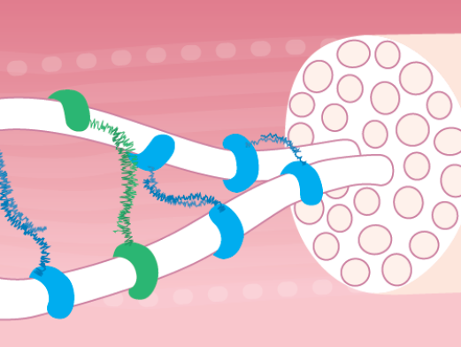
Collagen Organization
Proteoglycan Synthesis
Normal human fibroblasts (NHF) were incubated without FCS for 3 days. Detection: enzyme linked immunoassay (EIA)
Lower decorin and lumican levels in aging skin
Irregular collagen fibril structure
Weak fibers
Healthy skin with increased decorin and lumican levels
SYN®-HYCAN CB Peptide
SYN®-HYCAN CB Peptide
Lumican
Decorin
Smaller width of collagen fibrils
SYN®-HYCAN CB peptide increases lumican and decorin levels
Strong fibers
19

Slide 20
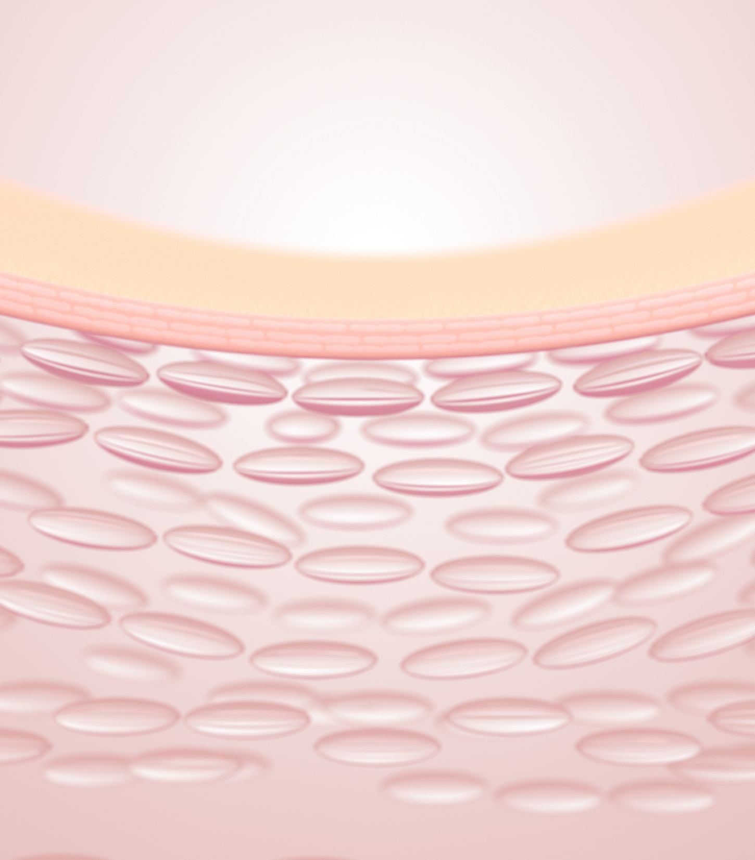
Collagen Support
Collagen 1 Synthesis
in vitro efficacy
Test performed on human dermal fibroblasts
**
+216%
For the SYN®-HYCAN CB peptide, the following applies:
*
+121%
**
+48%
2
µM
=
0.00012%
=
1.2
ppm
10
µM
=
0.0006%
=
6
ppm
25
µM
=
0.0015%
=
15
ppm
SYN®-HYCAN CB peptide increases
Collagen 1 levels
* p< 0.05 compared to untreated cells (ctrl).
** p<0.005 compared to untreated cells (ctrl)

Slide 21


SYN®-HYCAN CB – in vivo efficacy
Study details
Skin Firmness and Remodeling
AEVA-HE 3D facial volume analysis
DynaSKIN firmness analysis
PRIMOS Body neck and double
chin contour analysis
Skin Hydration
Corneometer analysis
Consumer-Perceivable Benefits
Volunteer Self-Assessment

Slide 22
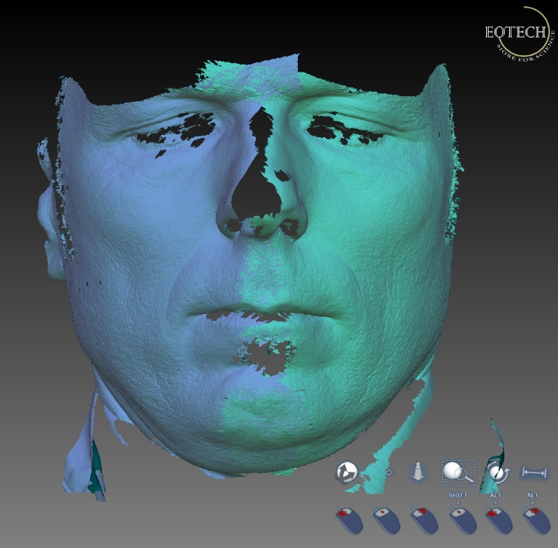

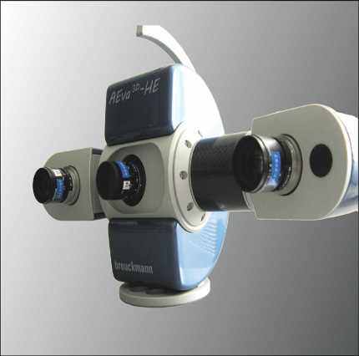
Skin Firming and Remodeling
Positive Volume Assessment, AEVA-HE, Eotech, France
High resolution 3D image capture software which measures skin topography, face topology and body morphology changes. From the capture of the three-dimensional structure, the parameter positive volume was measured at various points of the face.
A positive volume indicates a filling effect, where the facial area is fuller
at the final test point versus the beginning of the study.
Images: http://www.eotech-sa.com

Slide 23

Skin Firming and Remodeling
Positive Volume Assessment, AEVA-HE, Eotech, France
Instrumental Evaluation
Twice daily application for 1 month of a formulation with or without 2.5% SYN®-HYCAN CB or 3% of a competitor on full face. Caucasian female volunteers (30 per group) were between ages 40-60 with visible skin sagging on the face. Double-blind, placebo-controlled, randomized. Groups run in parallel. Measurement of skin distance change done on multiple facial sites.
Skin filling assessment, area below eyes (Zone 1)
Skin filling assessment, jawline (Zone 4)
*
*
Base Formula
Base Formula
+300%
Competitor
100% increase
Competitor
+200%
SYN®-HYCAN CB
SYN®-HYCAN CB
*p<0.05 vs base formula
*p<0.05 vs base formula
*p<0.05 vs baseline
Positive Volume | SYN®-HYCAN CB
 | T 15 Days | T 29 Days
Positive Responders | 72% | 78%
Positive Volume | SYN®-HYCAN CB
 | T 15 Days | T 29 Days
Positive Responders | n/a | 76%
SYN®-HYCAN CB provides visible filling effect up to 3x better than competitor in just 2 weeks.
Peptides | Pharma-inspired skincare
23

Slide 24
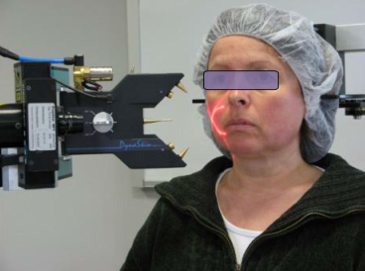
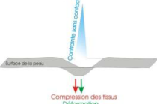
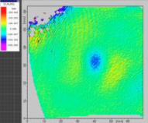
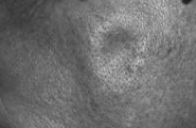
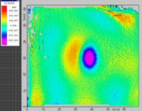
Skin Firming and Remodeling
Firmness Assessment, DynaSKIN
A complete non-contact method to assess skin firmness before and after treatments under very reproducible conditions. The device utilizes air pressure to create a deformational in the skin area of interest, with an air stream perpendicular to the skin surface. T parameter volume was measured on the cheek area. A decrease in volume indicates a firming effect here, as skin is more resistant to deformation.
Young Volunteer
High degree of firmness
Very little deformation
High resistance to stress
Elder Volunteer
Low degree of firmness
Significant deformation
Low resistance to stress
Images: http://www.eotech-sa.com

Slide 25
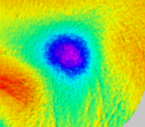
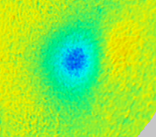

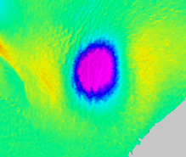
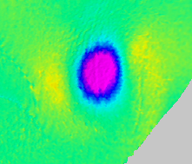
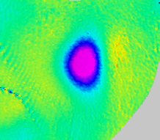
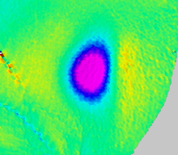
Skin Firming and Remodelling
Firmness Assessment, DynaSKIN
Instrumental Evaluation
Twice daily application for 1 month of a formulation with or without 2.5% SYN®-HYCAN CB or 3% of a competitor on full face. Caucasian female volunteers (30 per group) were between ages 40-60 with visible skin sagging on the face. Double-blind, placebo-controlled, randomized. Groups run in parallel. Measurement of firming effect performed on the cheek area.
Increasing firmness
Depth
2.5% SYN®-HYCAN CB
Volunteer #13
Left side
  SYN®-HYCAN CB restores
  firmness for mature skin
Base Formulation
Volunteer #26
Left side
3% Competitor Volunteer #72
Left side
Less firmness
Day 0
Day 29

Slide 26
Skin Firming and Remodelling
Firmness Assessment, DynaSKIN
Instrumental Evaluation
Twice daily application for 1 month of a formulation with or without 2.5% SYN®-HYCAN CB or 3% of a competitor on full face. Caucasian female volunteers (30 per group) were between ages 40-60 with visible skin sagging on the face. Double-blind, placebo-controlled, randomized. Groups run in parallel. Measurement of firming effect performed on the cheek area.
Volume, cheek area (Zone 3)
Depth, cheek area (Zone 3)
Circumference, cheek area (Zone 3)
*
*
*
*
ns
+200%
increase
ns
improve
improve
improve
worsen
worsen
ns
ns
worsen
Base Formula
Competitor
SYN®-HYCAN CB
Base Formula
Competitor
SYN®-HYCAN CB
Base Formula
Competitor
SYN®-HYCAN CB
Volume (Firmness) Improvement:
-9.6% p<0.05 vs baseline, up to -53%
Responders 72%
*p<0.05 vs competitor
*p<0.05 vs baseline
Depth Improvement:
-4.1% vs baseline, up to -37%
Responders 62%
Circumference Improvement:
-3.5% p<0.05 vs baseline, up to -22%
Responders 72%
Only SYN®-HYCAN CB significantly increases skin firmness +200%
Peptides | Pharma-inspired skincare

Slide 27
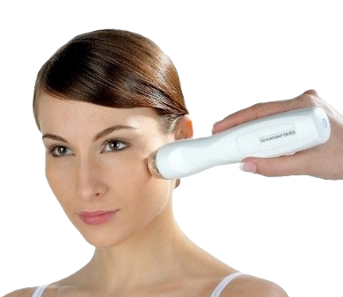
Skin Hydration
Skin Capacitance Assessment, Corneometer
Instrumental Evaluation
Twice daily application for 1 month of a formulation with or without 2.5% SYN®-HYCAN CB on full face. Caucasian female volunteers (30 per group) were between ages 40-60 with visible skin sagging on the face. Double-blind, placebo-controlled, randomized. Groups run in parallel. The device measures the dielectricity of the skin. Since dielectricity varies as a function of skin’s water content, stratum corneum hydration can be measured. Test done on upper cheeks.
*
**
24x
greater hydration
Base Formula
SYN®-HYCAN CB Capacitance
*p<0.05 vs base formula
**p<0.01 vs baseline
2.5% SYN®-HYCAN CB
Panelists using SYN®-HYCAN CB showed significant increase in skin hydration
Image: http://www.courage-khazaka.de
Notes:
error bars = sem (standard error of the mean)

Slide 28
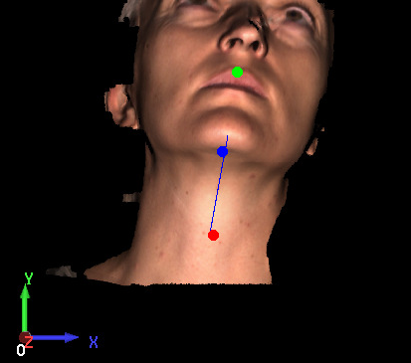
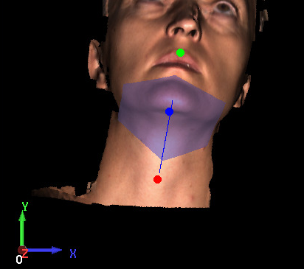
Skin Firming and Remodelling
Skin Contour Assessment, PRIMOS Body, Dermscan, France
This device measures the change in the skin contour. A decrease in contour indicates a lifting effect.
Profile 1 and profile 2 are superposed and the distance observed between these two profiles was calculated.
A decrease shows an improvement of this zone thus a less prominent (reduced) double chin.
-40
-30
-20
-10
10
10
20
30
40
0
10
20
30
40
Profile 1
D₀t₀ Image
Profile 2
D_{i} Image
50
Example curve
60

Slide 29
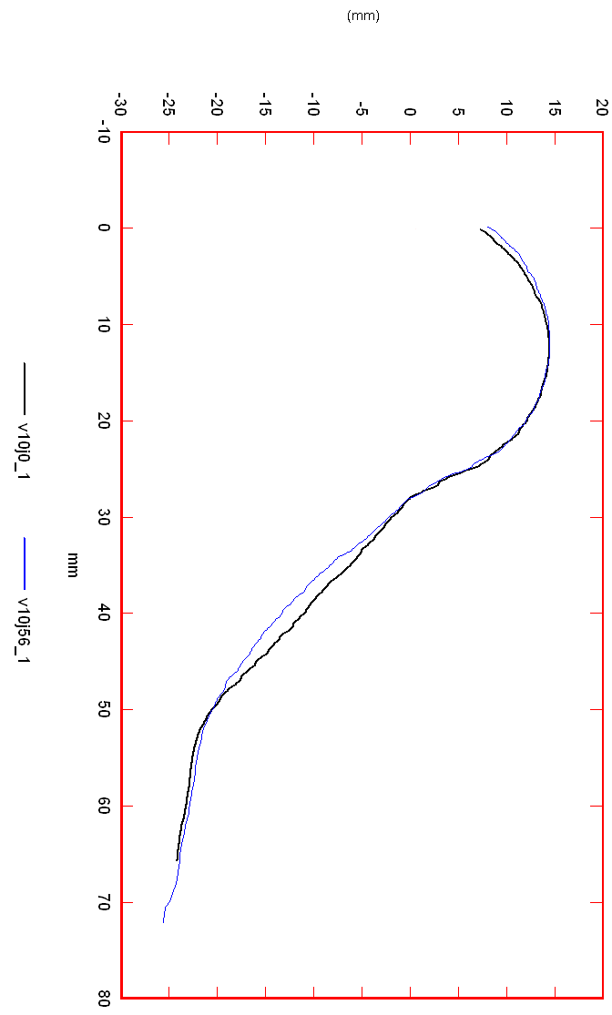
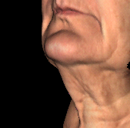
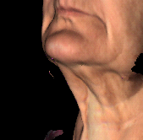




Skin Firming and Remodelling
Skin Contour Assessment, PRIMOS Body, Dermscan, France
Instrumental Evaluation
Twice daily application for 3 months of a formulation with or without 2.5% SYN®-HYCAN CB on face. Female volunteers (20 per group) were between ages 55-65 with visible skin sagging on the face. Double-blind, placebo-controlled. Groups run in parallel. Measurement of skin contour remodelling effect was done on neckline.
D0
D84
SYN®-HYCAN CB
SYN®-HYCAN CB
*
*
D56 - D0
*p<0.05
Compared to D0
SYN®-HYCAN CB significantly decreases the double-chin profile by improved skin firmness. Visible face contour remodeling!
Visual assessment volunteer #10, Firmness
D84 - D0
contour change [mm]

Slide 30

Consumer-Perceivable Benefits
Volunteer Self-Evaluation
Panellist Self-Assessment – Subjective Evaluation – End of Study
Twice daily application of a formulation with 2.5% SYN®-HYCAN CB on full face. 30 Caucasian female volunteers were between ages
40-60 with visible skin sagging on the face. Panellists asked to rate agreement with the following statements.
“ Using this product gave my skin…”
90%
87%
78%
63%
63%
90%
87%
78%
63%
Suppleness
Smoothness
Moisture
Elasticity
Healthy look
Suppleness
Smoothness
Healthy look
The product provides a supple skin feeling
The product provides a smooth skin feeling
The product provides the skin with more moisture
The skin has more elasticity
The product gives the skin
a healthy look
Notes:
Survey taken after 2 months of use of SYN®-HYCAN formulation

Slide 31


SYN®-HYCAN CB Summary of Benefits
INCI: Tetradecyl Aminobutyroylvalylaminobutyric Urea Acetate
Unique product features
Potent TGF-Beta activating peptide with proven HA synthesis action
Proven to enhances skin firmness to support the new benefit of a “volumizing” effect
Boosts production of dermal and epidermal hyaluronic acid, in-vitro and ex-vivo
Boosts CD44, a key cellular receptor for hyaluronic acid
Increases collagen 1, lumican and decorin levels, important for collagen organization & support*
Outperforms competitive peptide technology in skin volumizing effect
Benefits
Multi-zonal filling and firming effect on skin
Skin is fuller and firmer in as early as 4 weeks
Delivers substantial increase in skin hydration
Skin is noticeably more supple, smooth and moisturized
Cosmetic applications
Firming and volumizing skin care
Regenerative night care
Anti aging, anti-sagging
Skin moisturizers
Suggested use level
2-5% SYN®-HYCAN CB for face, eye and neck applications

Slide 32

SYN®-HYCAN CB Formulation Guidelines
Solubility
SYN®-HYCAN CB is miscible with water
Use level
For skin care preparations, the addition of a concentration of 2-5% SYN®-HYCAN CB is recommended
Incorporation
SYN®-HYCAN CB is easy to use, unpreserved, colorless and odorless
SYN®-HYCAN CB can be incorporated into the aqueous phase of a cosmetic formulation
SYN®-HYCAN CB can be processed either warm (for maximum 2 hours at 80°C) or cold.
The incorporation at the end of the production process at T< 40°C is still recommended to avoid unnecessary heating of the active
Compatibilities
In general, SYN®-HYCAN CB shows a very good compatibility with all groups of raw materials like emulsifier systems, emollients and waxes, preservatives, hydrocolloids, sunscreens, detergents, and other commonly used substances, e.g. Phytantriol, for enhanced compound availability or boosting compound activity
Recommended pH of the final formulation: 3.0 – 5.5, it can be adjusted with commonly used neutralizing agents
Compatible with up to 50% ethanol (max. concentration tested)

Slide 33
Disclaimer
Copyright © dsm-firmenich Switzerland AG, 2026, 4002 Basel, Switzerland.
www.dsm-firmenich.com. All rights reserved.
dsm-firmenich has used diligent care to ensure that the information provided herein is accurate and up-to-date to the best of its knowledge. However, dsm-firmenich makes no representation or warranty, either expressly or implied, of the accuracy, reliability, completeness, or suitability thereof. The information provided herein contains scientific and product information for business-to-business use and does not constitute or provide scientific or medical advice, diagnosis or recommendation for treatment options. Country or region-specific information should be considered when labelling or advertising to final consumer. In no event shall dsm-firmenich be liable for any direct or indirect damages arising from or reliance upon, or use of, any information provided herein. The content of this document is subject to change without further notice. Please contact your local dsm-firmenich representative for the latest information. All trademarks listed in this document are either (registered) trademarks of, or trademarks licensed by, the dsm-firmenich group of companies, unless explicitly stated otherwise.
Disclaimer Formulation Guideline
The information provided herein is provided for information purposes only and has been prepared by dsm-firmenich in accordance with its own methodology.
dsm-firmenich has used diligent care to ensure that it is accurate and up-to-date, however, dsm-firmenich makes no representation or warranty, either expressly or implied, of the accuracy, reliability, or completeness thereof. In no event shall dsm-firmenich be liable for any damages arising from or reliance upon, or use of, any information provided herein. Further, dsm-firmenich shall not bear any liability for the application and/or use of any processed material containing its product(s). The formulation of the finished product is the customer’s sole responsibility. It is the customer’s responsibility to determine the suitability of dsm-firmenich’s products regarding user specific purposes, assess compatibility and stability of their finished product(s) and to ensure compliance of their finished product(s) with relevant laws and regulations. Any product, marketing or other claims made by customer are its sole responsibility. The content of this document is subject to change without further notice. Please contact your local dsm-firmenich representative for further details. © dsm-firmenich Switzerland AG, 2026.
© 2026

Slide 34
© 2026

