Slide 1
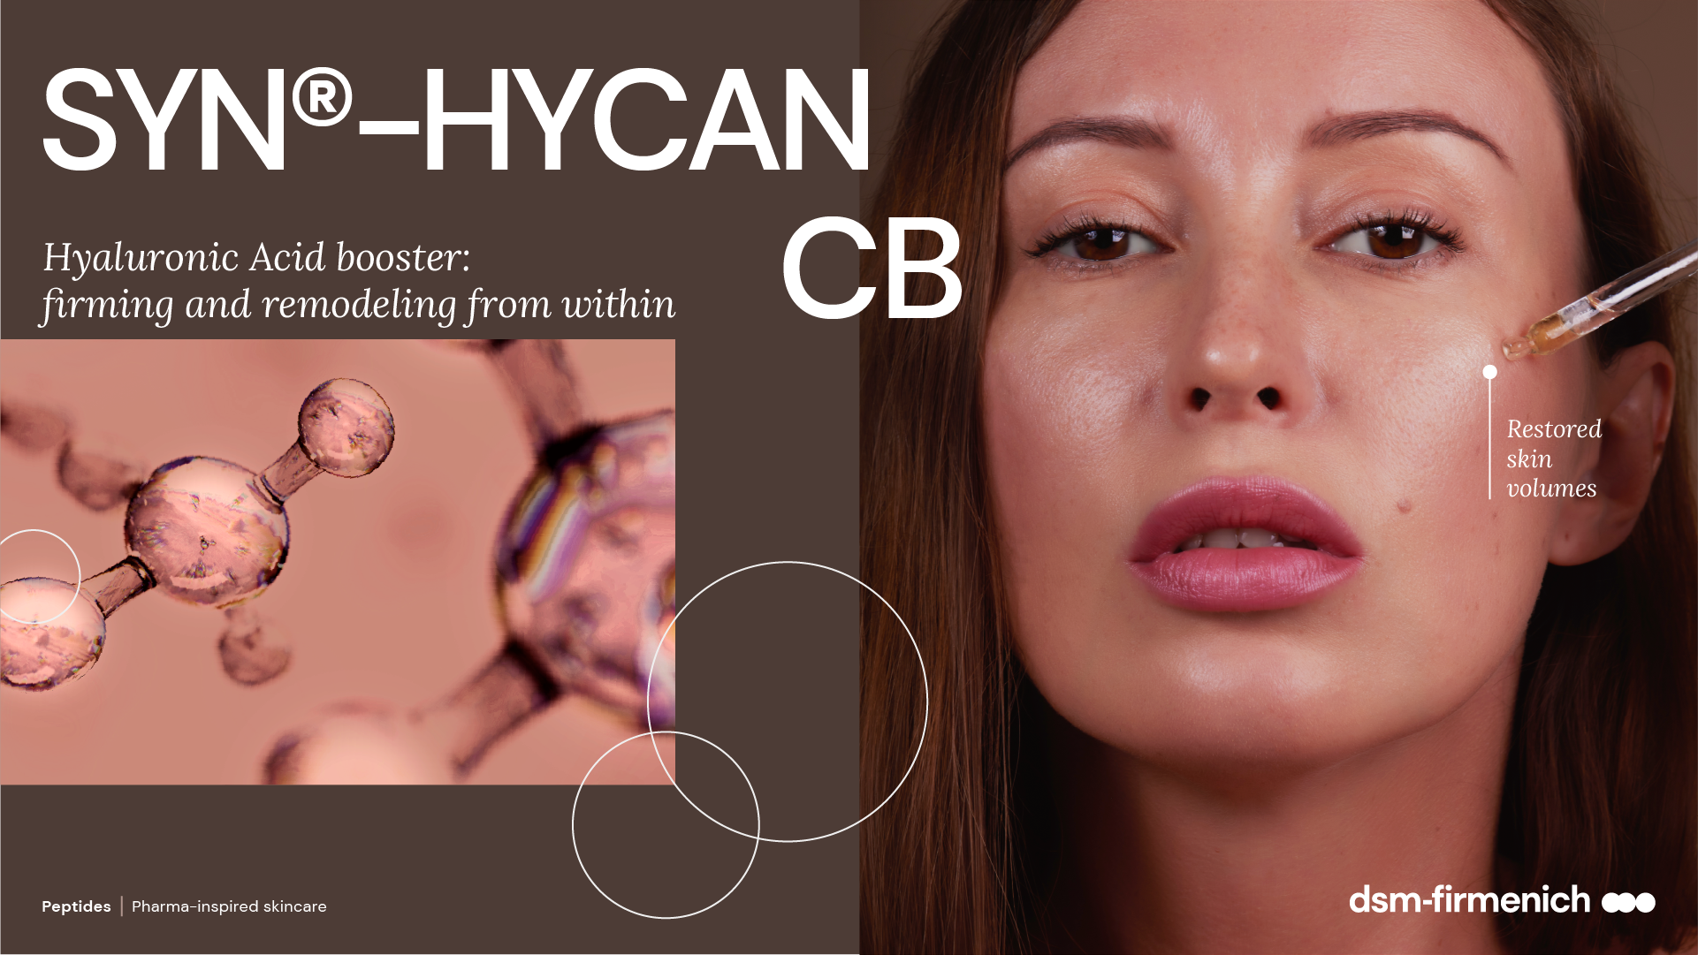
04.2026

Slide 2
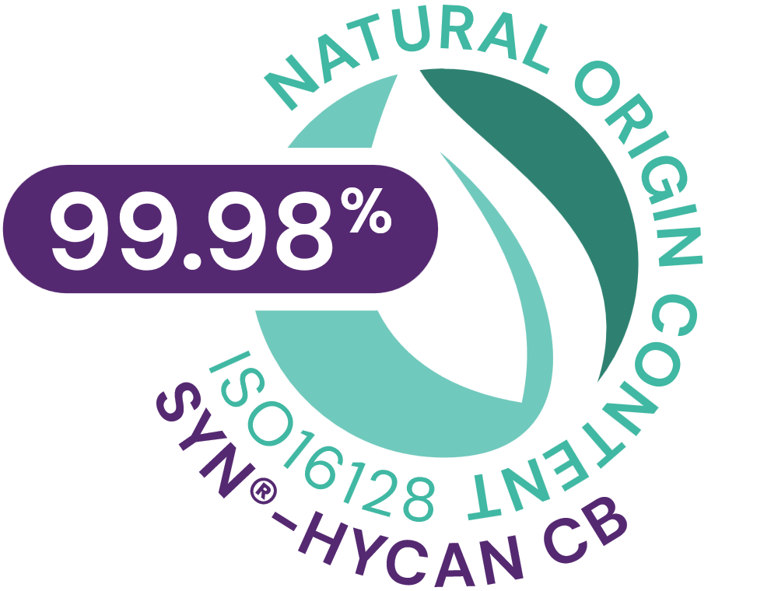
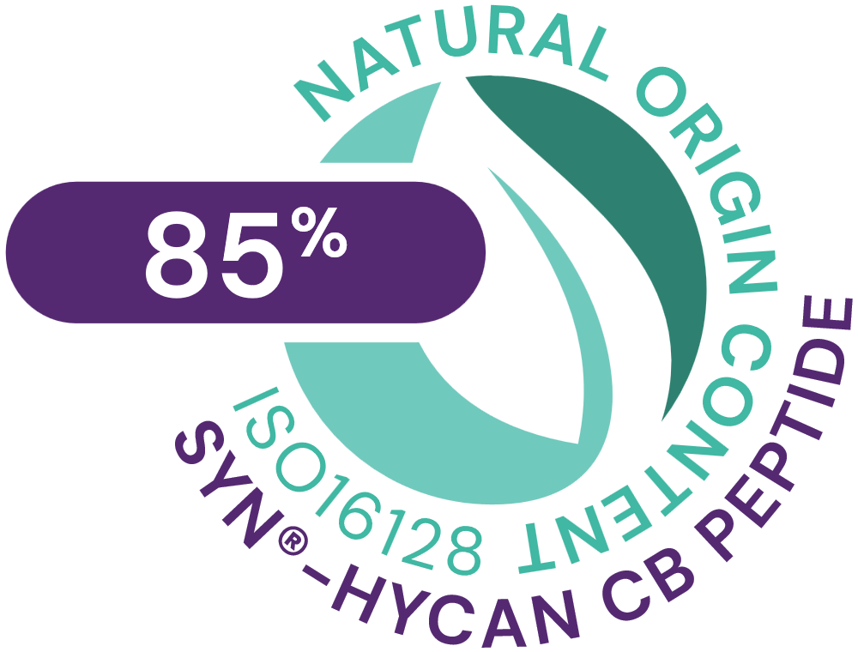



SYN®-HYCAN CB
ID Card
INCI NAME:
Tetradecyl Aminobutyroylvalylaminobutyric Urea Acetate, Glycerin, Aqua, Magnesium Chloride
Original SYN®‑HYCAN peptide generation patented; CB version patent application pending
TFA-free¹
99.98% natural origin (ISO 16128) for SYN®-HYCAN CB - 85% natural origin (ISO 16128) for the pure SYN®-HYCAN peptide²
TECHNOLOGY:
Highly potent, natural origin tripeptide, suitable for Clean-Beauty, produced via Green Chemistry Science with an optimized SYN®-Peptide technology, designed to stimulate hyaluronic acid from within
TECHNICAL:
Form: Liquid
pH of use: 3.0-5.5
Use level: 2-5%
Preservative: Free
Solubility: Miscible in water
BENEFITS:
Boosts hyaluronic acid (HA) synthesis in both keratinocytes and dermal fibroblasts*
Increases CD44 expression, a key cellular anchor of HA*
Increases collagen type 1, lumican and decorin levels, important for collagen support & organization*​
Provides visible filling effect in just 2 weeks
Lifts even the most difficult areas, such as the neck
Benefits on multiple skin zones (under eye, upper- and mid-cheek, jawline, neck, lip)
Increases skin firmness +200% on cheek area.
REGISTRATION
CERTIFICATION:
1. Non-intentionally added TFA
* in vitro ** in vivo

Slide 3
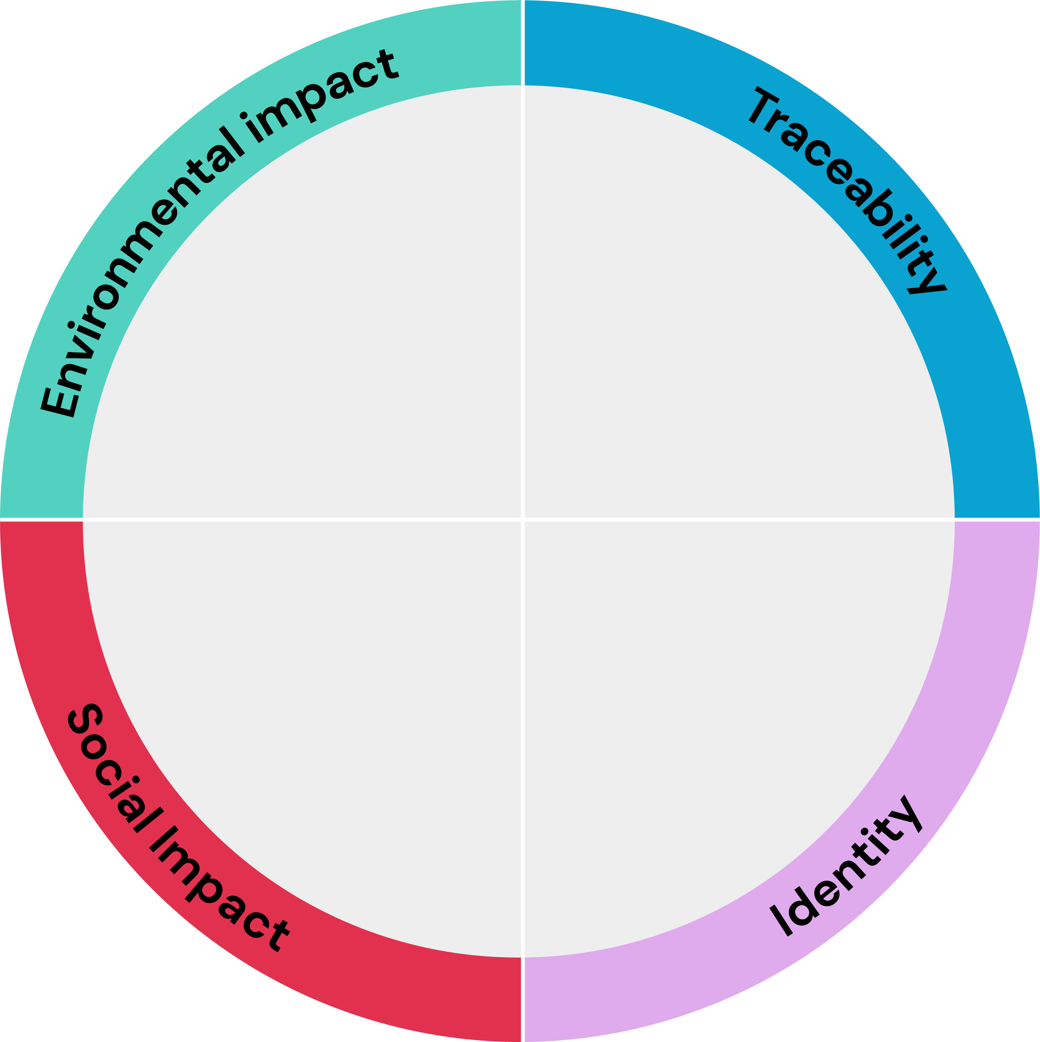




SYN®-HYCAN CB
Aligned with and contributing to the
Highlights
related to Supply
Chain control
Full ownership of the production,
INCI name: Tetradecyl Aminobutyroylvalylaminobutyric Urea Acetate, Magnesium Chloride, Aqua, Glycerin Product Code: 5017794
Carbon footprint*
9.7 kg CO2 eq/kg
Biodegradability
Biodegradability test ongoing
Feedstock origin
Synthetic and Glycerin from
rapeseed
PIONEER IN PEPTIDES
High performance active with low carbon footprint contribution.
Natural origin peptide suitable for Clean-Beauty, produced via Green Chemistry with an optimized synthesis
Water footprint
4.07 m³ depriv./kg
Renewable electricity
100% purchased renewable electricity
Responsible sourcing
No palm oil derivatives
Impact on health and well-being
Natural-origin
99.98% natural origin content according to ISO 16128 for SYN®-HYCAN CB
85% natural origin for the pure peptide*
SYN-HYCAN® CB offers a non-invasive cosmetic alternative for restoring skin volume. It helps firming and remodeling skin from within, by helping maintain the Hyaluronic acid content.
The carbon and water footprint calculations are based on internally conducted LCA according to ISO 14040/44 guidelines, dsm-firmenich LCA policy and validated by internal reviewers.
The natural origin Index is at 0.85 according to the ISO 16128 standard
© 2020. DSM.
All rights reserved
Card version 2
Notes:
Renewable electricity: Always mention «purchased renewable electricity» and add «completing» or «with a majority of» to ensure that we are not greenwashing.

Slide 4





SYN®-HYCAN CB
A natural peptide for sustainable formulations
Green chemistry reaction type (3) with an optimized synthesis reducing the number of steps (8 vs 14 steps previously.
Carbon footprint of 9.7 kg CO2 eq./kg. High efficiency allowing a low carbon footprint in use(1).
SYN-HYCAN® CB suitable for Clean-Beauty with TFA free process (2).
Natural-origin peptide (0.85 natural origin Index according to ISO 16128).
Switch from a solid phase to
a liquid phase process, allowing for significantly reducing amounts of solvents and for including greener solvents.
Production with no CMR solvents and no CMR reagents.
Considering a 1-3% concentration of SYN-HYCAN® CB in final formulation, 97-291g CO2 per kg in final formulation.
TFA replaced with acetic acid.
Main reaction type is amidation
© 2020. DSM.
All rights reserved
Notes:
Renewable electricity: Always mention «purchased renewable electricity» and add «completing» or «with a majority of» to ensure that we are not greenwashing.

Slide 5
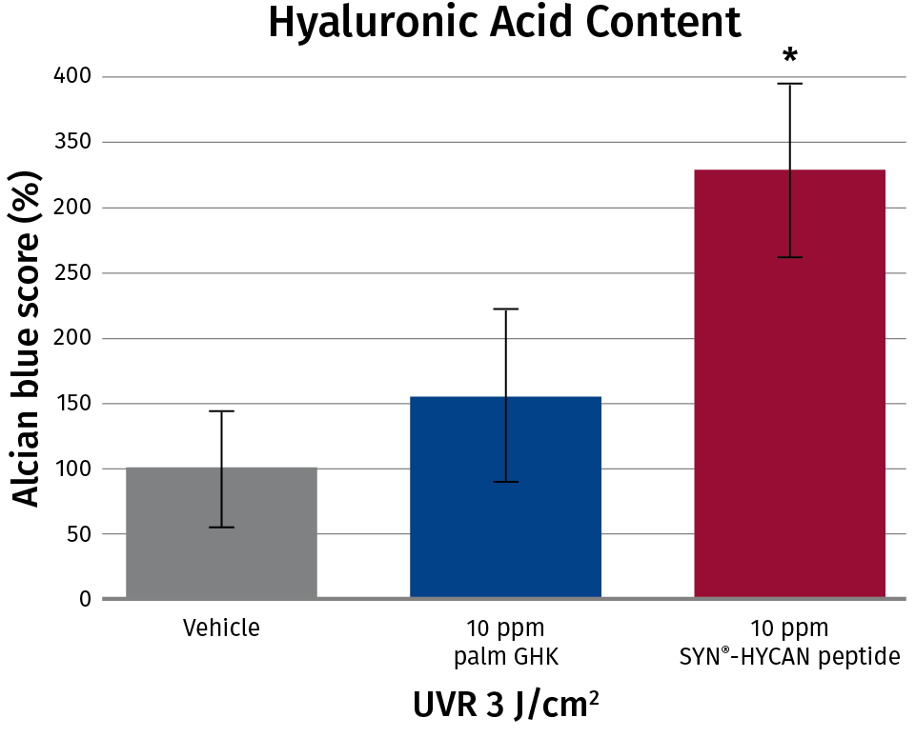
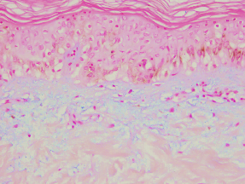
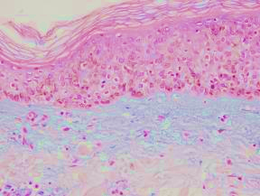
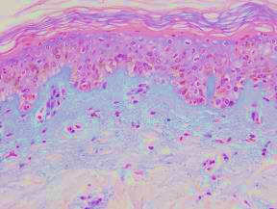
The Advantage of Building from Within
ex-vivo efficacy
SYN®-HYCAN CB peptide
boosts hyaluronic acid
synthesis in skin ex-vivo by 3x
  Epidermis DEJ
  Dermis
Vehicle treated control, 3 J/cm2 UVR | 10 ppm palmGHK, 3 J/cm² UVR | 10 ppm SYN®-HYCAN CB peptide, 3 J/cm² UVR
Hyaluronic acid synthesis (blue staining) is significantly increased in human skin explants treated with UV-radiation after six days topical incubation with the SYN®-HYCAN CB peptide.
SYN®-HYCAN CB
peptide

Slide 6
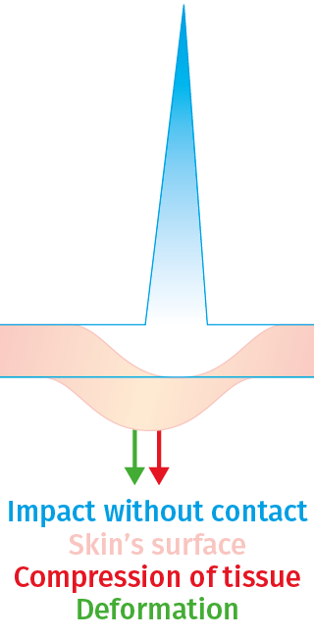
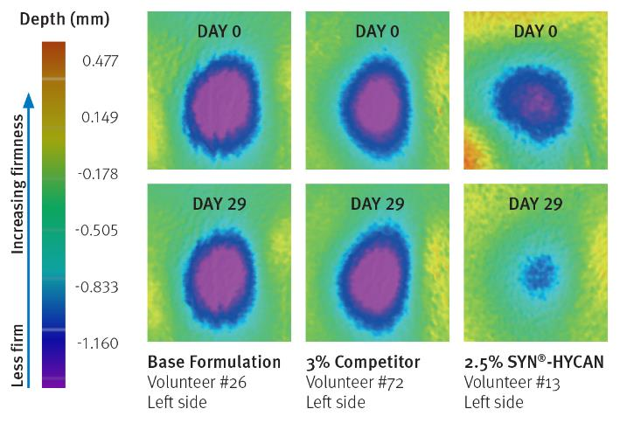
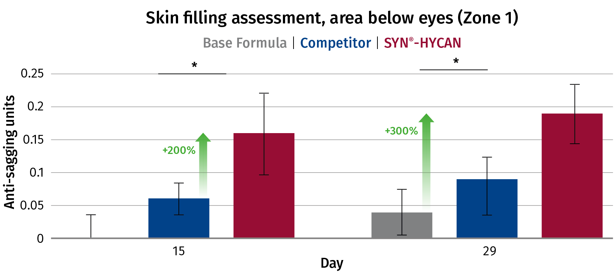
Boosts Skin’s Own Renewal of Hyaluronic Acid
in-vitro efficacy
in-vivo efficacy
Boosts Hyaluronic Acid synthesis in skin up to 3 times
Enhances CD44 expression, a key cellular anchor of Hyaluronic Acid
Provides visible filling effect up to 3x better than competitor in just 2 weeks
Provides visible firming effect, significantly increasing skin firmness up to +200%
DynaSkin device assessment of skin firmness: visible effect
SYN®-HYCAN CB
SYN®-HYCAN CB
Negative Volume Assessment - Device utilizing air pressure to create a deformation in the skin area allowing to assess skin firmness before and after treatments

Slide 7
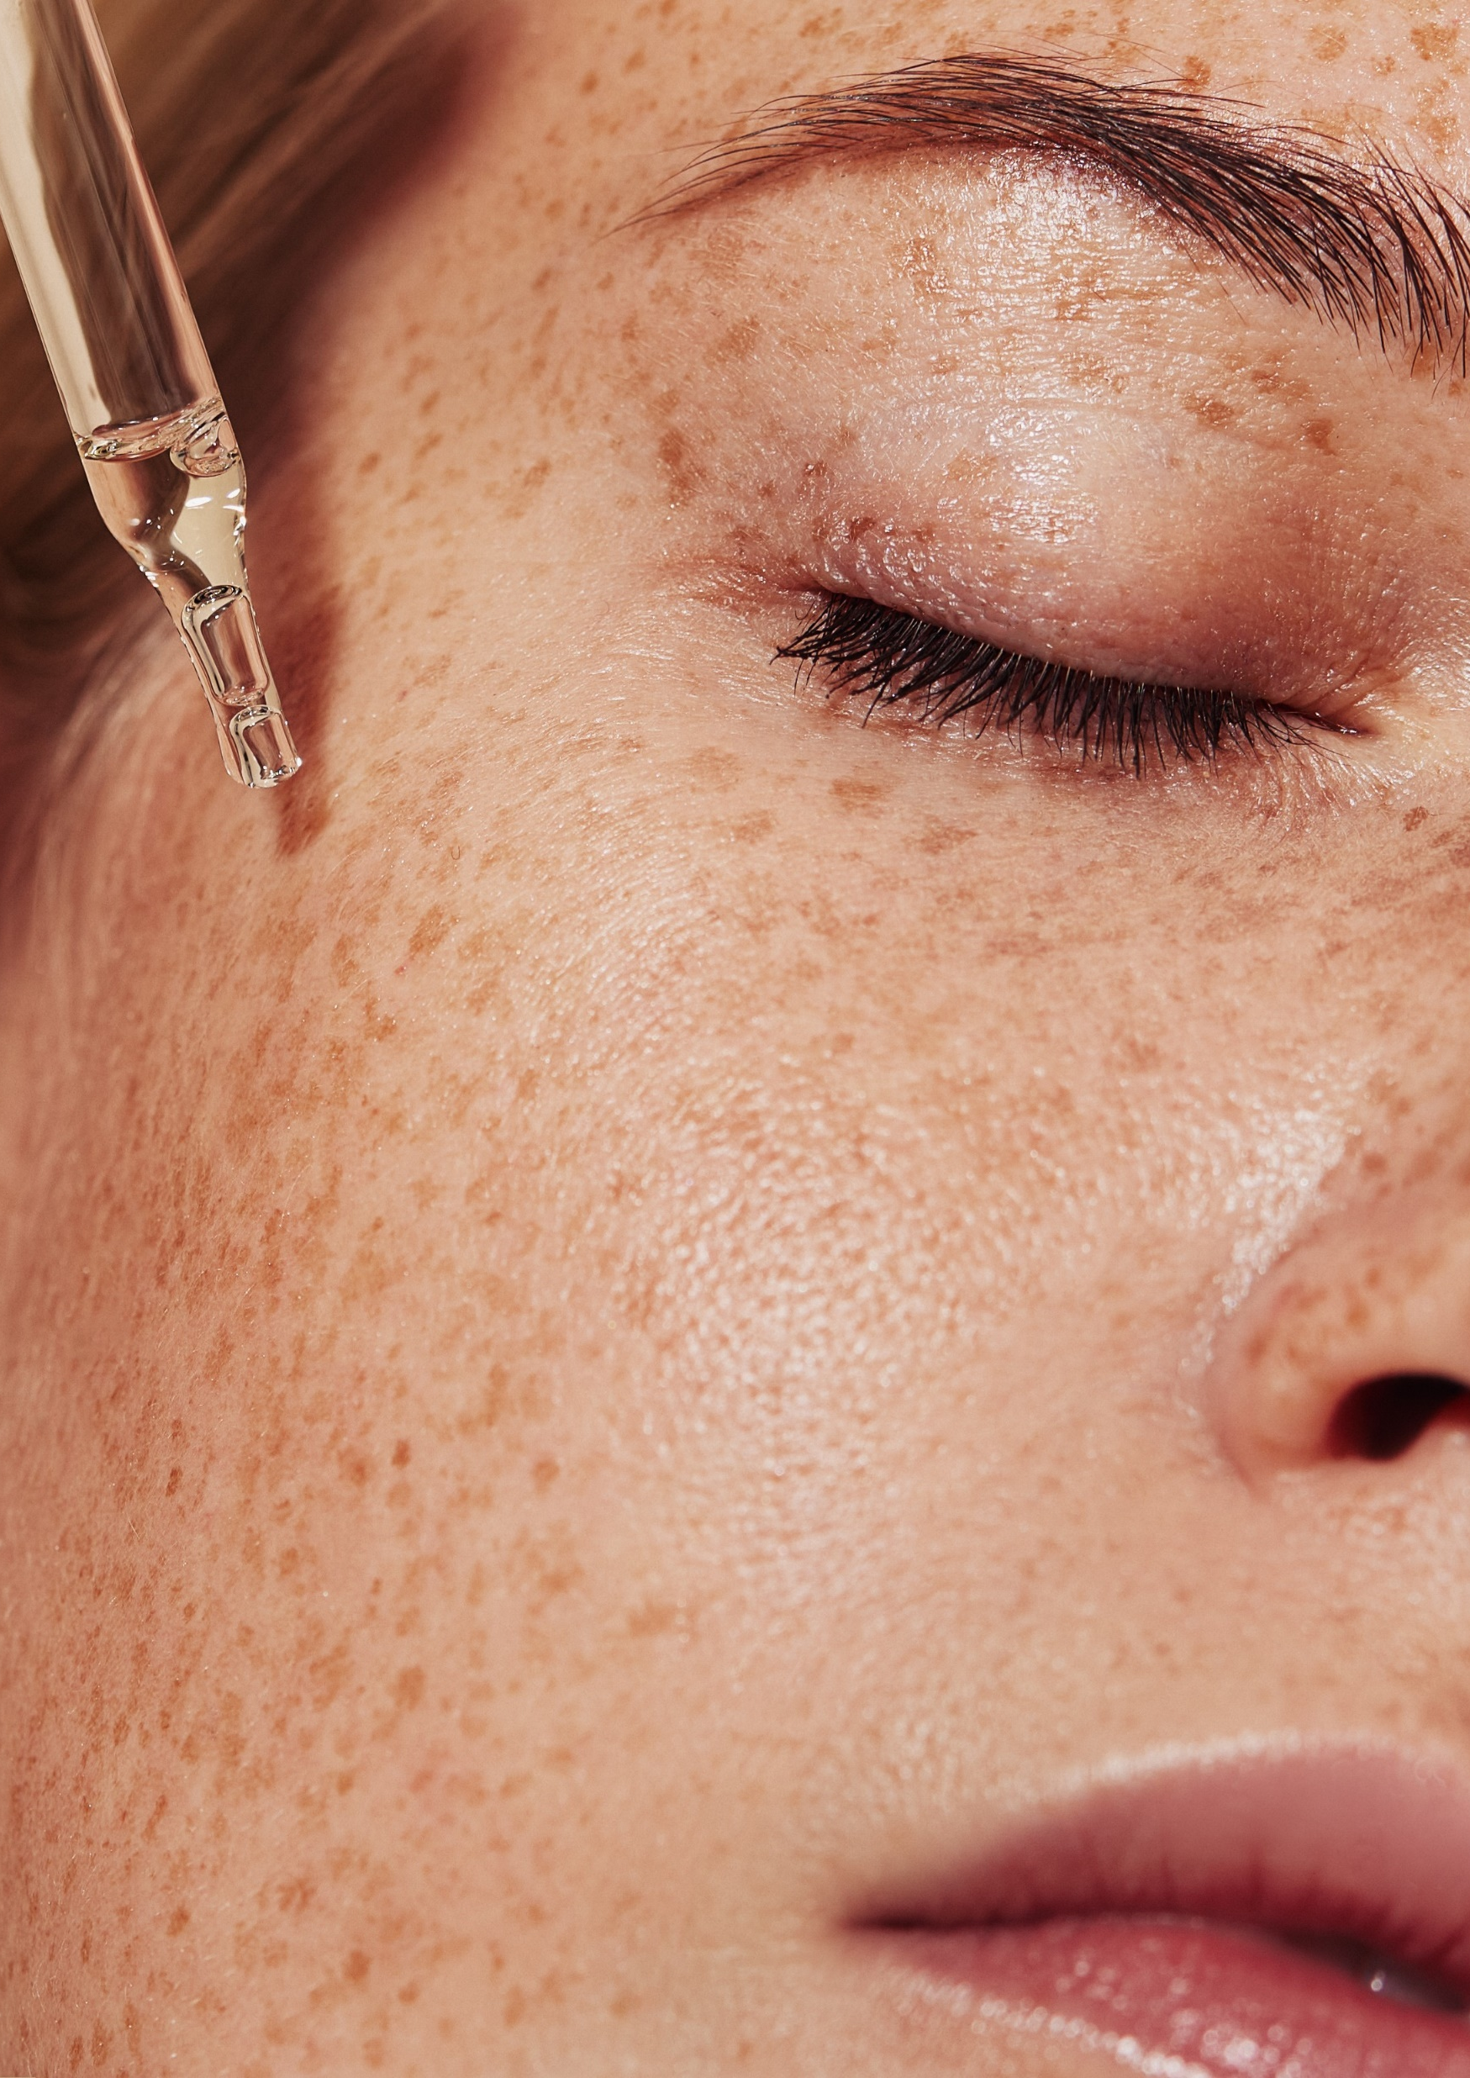
Summary of Benefits
Biological concepts
Potent TGF-Beta activating peptide with proven HA synthesis action
Proven to enhances skin firmness to support the new benefit of a “volumizing” effect
Boosts production of dermal and epidermal hyaluronic acid, in-vitro and ex-vivo
Boosts CD44, a key cellular receptor for hyaluronic acid
Increases collagen 1, lumican and decorin levels, important for collagen support & organization
Outperforms competitive peptide technology in skin volumizing effect
Consumer benefits
Provides visible filling effect in just 2 weeks
Lifts even the most difficult areas, such as the neck
Benefits on multiple skin zones (under eye, upper- and mid-cheek, jawline, neck, lip)
Increases skin firmness +200% on cheek area.

Slide 8
Disclaimer
Copyright © dsm-firmenich Switzerland AG, 2026, 4002 Basel, Switzerland.
www.dsm-firmenich.com. All rights reserved.
dsm-firmenich has used diligent care to ensure that the information provided herein is accurate and up-to-date to the best of its knowledge. However, dsm-firmenich makes no representation or warranty, either expressly or implied, of the accuracy, reliability, completeness, or suitability thereof. The information provided herein contains scientific and product information for business-to-business use and does not constitute or provide scientific or medical advice, diagnosis or recommendation for treatment options. Country or region-specific information should be considered when labelling or advertising to final consumer. In no event shall dsm-firmenich be liable for any direct or indirect damages arising from or reliance upon, or use of, any information provided herein. The content of this document is subject to change without further notice. Please contact your local dsm-firmenich representative for the latest information. All trademarks listed in this document are either (registered) trademarks of, or trademarks licensed by, the dsm-firmenich group of companies, unless explicitly stated otherwise.
Disclaimer Formulation Guideline
The information provided herein is provided for information purposes only and has been prepared by dsm-firmenich in accordance with its own methodology.
dsm-firmenich has used diligent care to ensure that it is accurate and up-to-date, however, dsm-firmenich makes no representation or warranty, either expressly or implied, of the accuracy, reliability, or completeness thereof. In no event shall dsm-firmenich be liable for any damages arising from or reliance upon, or use of, any information provided herein. Further, dsm-firmenich shall not bear any liability for the application and/or use of any processed material containing its product(s). The formulation of the finished product is the customer’s sole responsibility. It is the customer’s responsibility to determine the suitability of dsm-firmenich’s products regarding user specific purposes, assess compatibility and stability of their finished product(s) and to ensure compliance of their finished product(s) with relevant laws and regulations. Any product, marketing or other claims made by customer are its sole responsibility. The content of this document is subject to change without further notice. Please contact your local dsm-firmenich representative for further details. © dsm-firmenich Switzerland AG, 2026.
© 2026

Slide 9
© 2026

