Slide 1
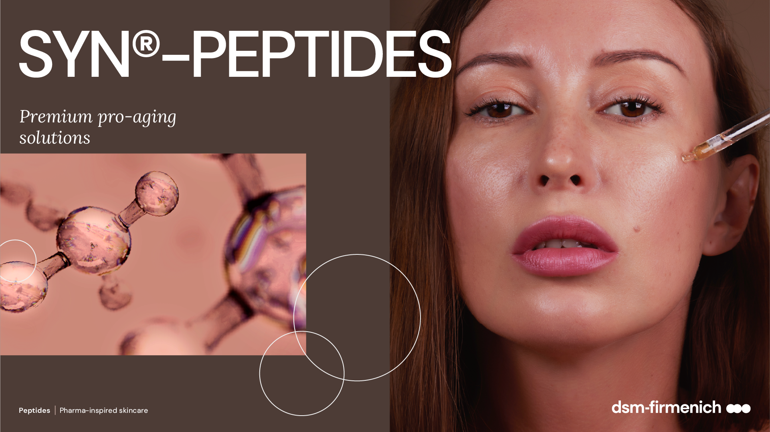
08.2026

Slide 2
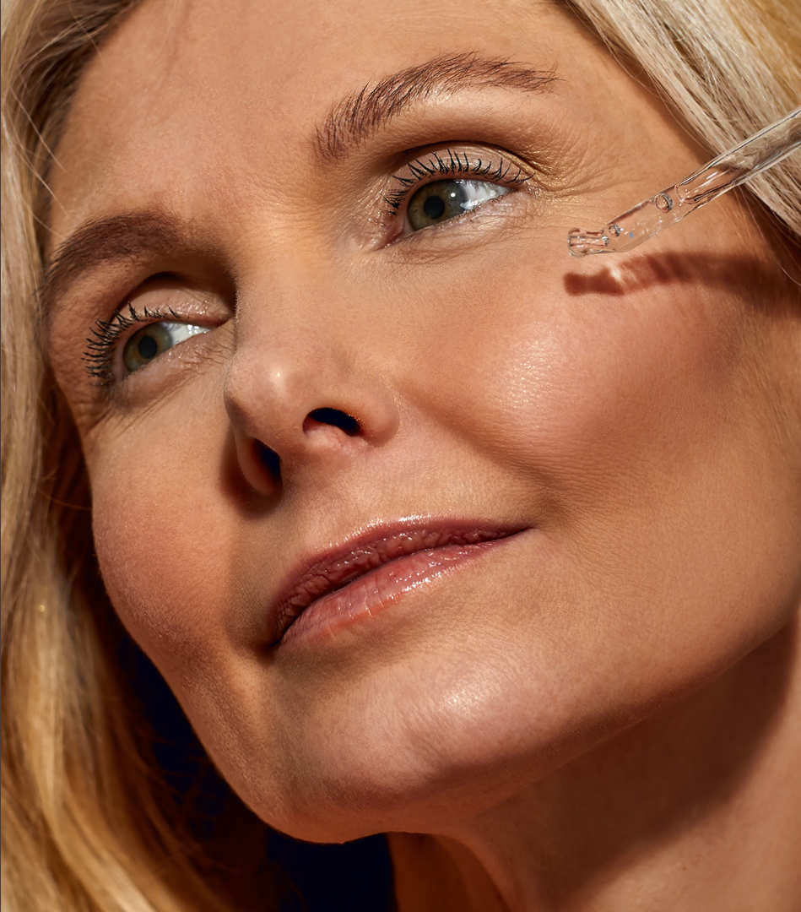
Agenda
1
Market background
2
SYN®-PEPTIDES by dsm-firmenich
3
The products range

Slide 3
01
Market background
3

Slide 4



In the “longevity era” approach to Skincare is evolving
More Authenticity
More Proactivity
More Personalization
  The idea of perfection is over. We see a move away from ‘augmentation’ towards ‘skin acceptance’. Healthy-looking skin is now the ambition - heralding a diversion from wrinkle reduction and anti-aging.
  Today’s consumers understand that beautiful skin, starts with healthy skin. This is driving proactive engagement in skin care, seeking preventative solutions that empower them to age well and thrive in their own skin.
  People seek solutions that meet the needs of different life stages and lifestyles. In an era of empowered individualism, skin health is intuitively personal, and ever-changing. It’s where science meets self.

Slide 5

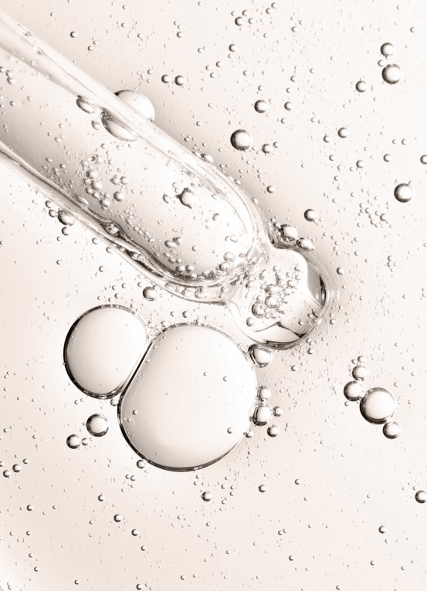
Science-backed is the expectation
Efficacy and Results: Consumers expect beauty products that are scientifically proven to be effective. They want to see real and tangible results.
Safety and Transparency: There is a growing demand for transparency in the ingredients and processes used to create beauty products. Consumers want to know that the products are safe and free from harmful chemicals.
Trust and Credibility: Products backed by scientific research and clinical trials tend to earn more trust from consumers.
This leads to medical beauty, also known as "cosmeceuticals" or "medico-aesthetic beauty," which refers to products and treatments that bridge the gap between cosmetics and pharmaceuticals. These products often contain active ingredients at higher concentrations and are designed to deliver therapeutic benefits as well as aesthetic improvements.
dsm-firmenich 2024 Beauty & Care Trends Framework

Slide 6

Smart science and technologies center stage
Beautification of science
Skincare has renewed respect and rigor,
beyond the surface level
Innovative
Ingredients
Science is more accessible
and engaging than ever
Medicalization of skincare
Increasing the focus on distinctive active ingredients and
new solutions that add value and can adapt to different needs.

Slide 7
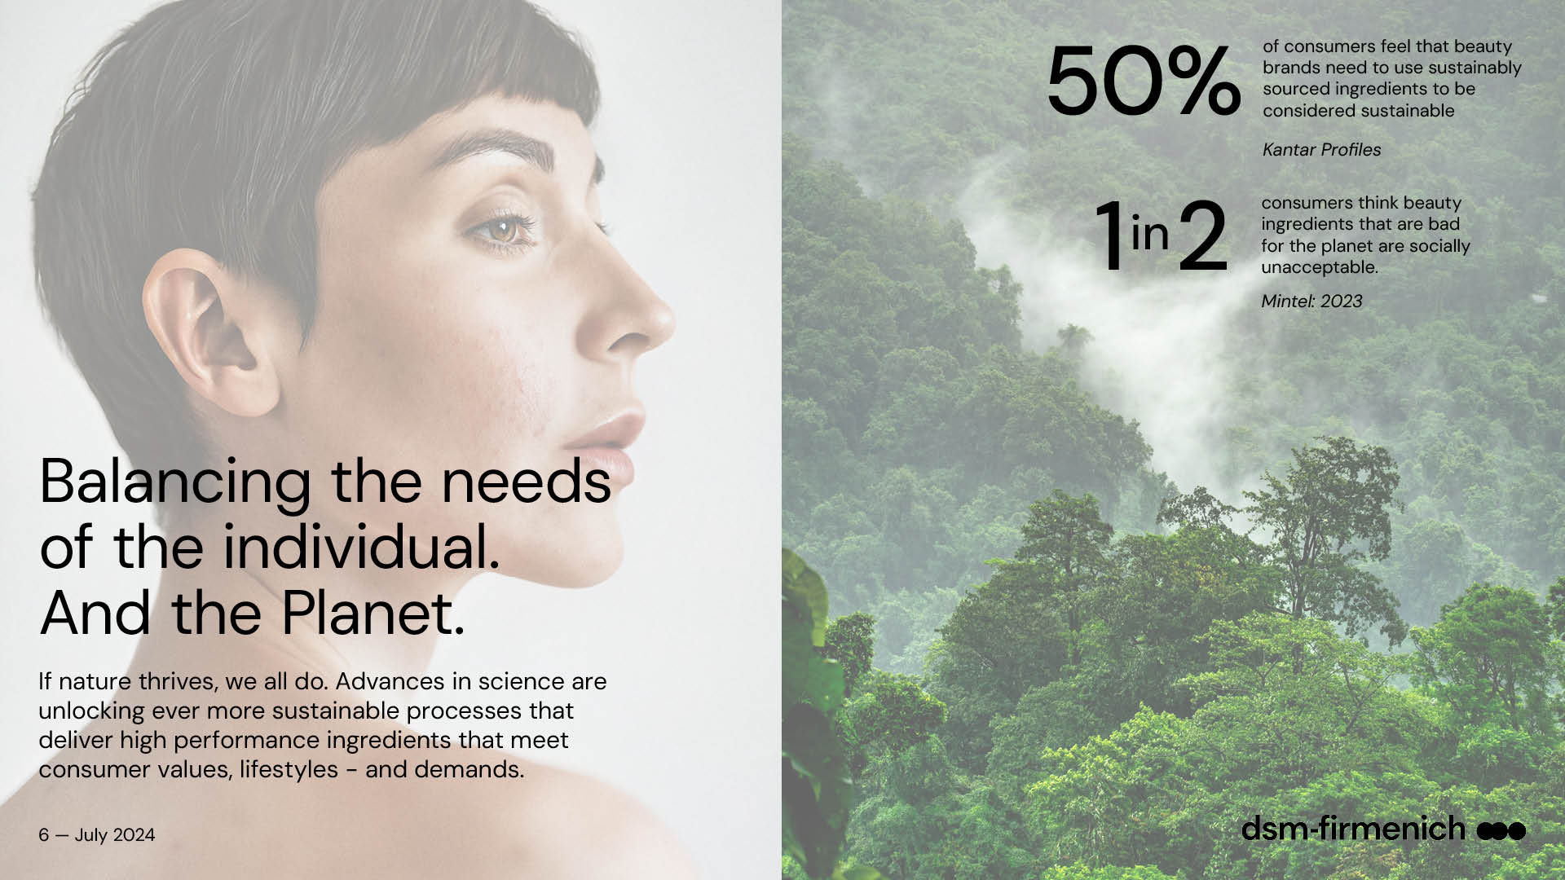



Balancing the needs of the individual.
And the planet.
50%
of consumers feel that beauty brands need to use sustainably sourced ingredients to be considered sustainable
Kantar Profiles
1 2
consumers think beauty ingredients that are bad for the planet are socially unacceptable.
Mintel: 2023
in
If nature thrives, we all do. Advances in science are
unlocking ever more sustainable processes that
deliver high performance ingredients that meet
consumer demands and values.

Slide 8
02
SYN®-PEPTIDES by dsm-firmenich

Slide 9
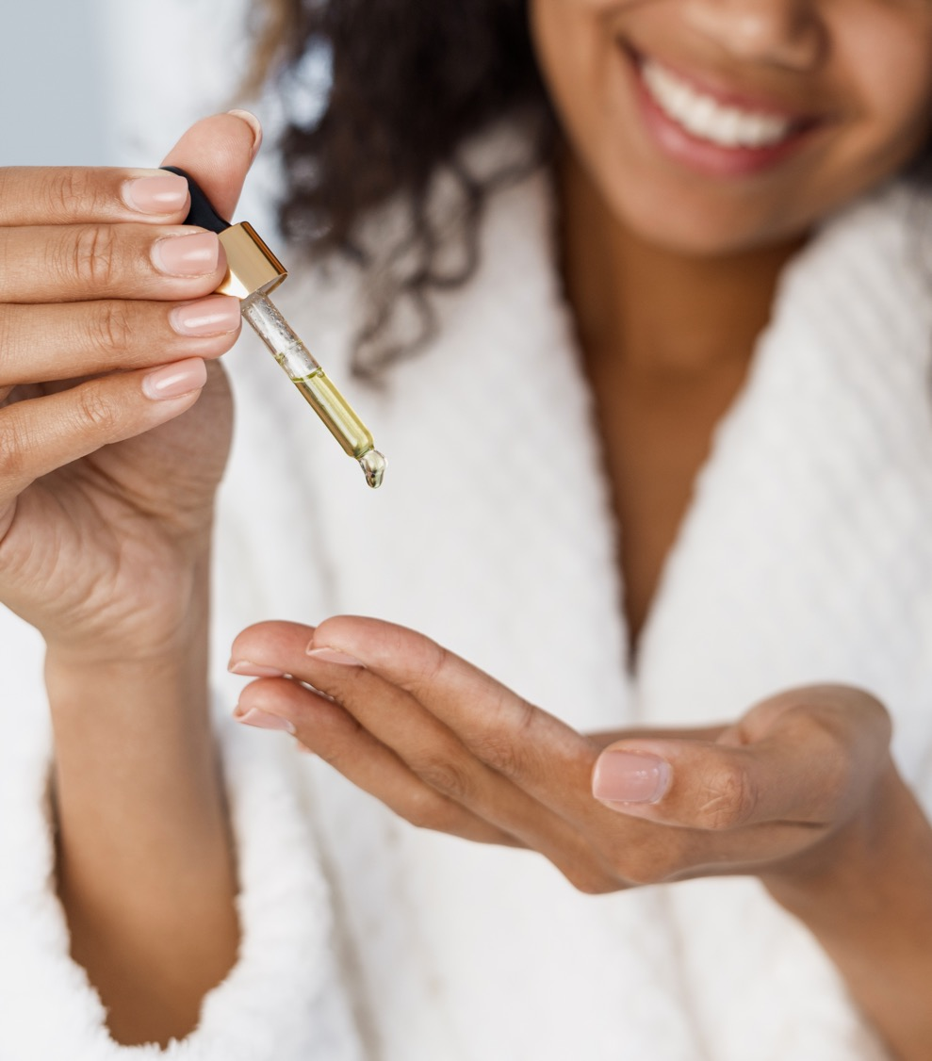
SYN®-PEPTIDES
Winning proposition for the market framework
Defined active compounds: small chemical structured with known mode of action for measurable benefits & maximum efficacy
Mimicking specific skin pathways: to enhance appearance from within
Fragmented portions of proteins: fundamental building blocks of skin, recognized safe and accepted by consumers
Next generation of eco-conscious, high-performance skincare peptides powered by dsm-firmenich Green Chemistry Science

Slide 10
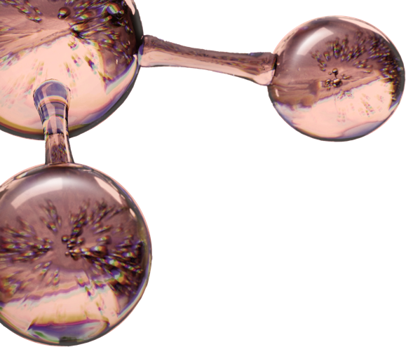
dsm-firmenich’s
SYN®-PEPTIDES
A unique proposal
60+
Over 60 years of experience in the field
  Pharma-inspired skincare solutions, taking skin health ambition to the next level.
  Our targeted approach, enhanced by AI and molecular modeling, is supported by green chemistry to generate groundbreaking, sustainable solutions proven to deliver the highest levels of efficacy towards well-aging
Best efficacy. Small peptides, chemically well-defined structures
Fully substantiated,
visible results on skin
High purity and stability
Extended safety dossier
No preservatives, vegan-friendly, suitable for clean beauty
Notes:
Another area of expertise is Peptides synthesis.

Slide 11
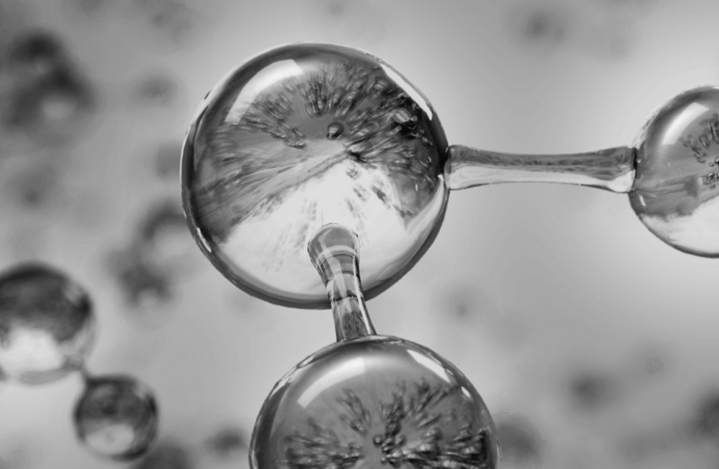
Futureproof peptides
Next generation,
eco-conscious & high performing
Powered by dsm-firmenich Green Chemistry Science and designed for sustainable formulations
Natural-origin peptides making it suitable for clean beauty formulations
Free from trifluoroacetic acid (TFA)*
High efficiency allowing a low carbon footprint contribution
Produced in Europe with 100% purchased renewable electricity
*non-intentionally added TFA

Slide 12
The Rational Design Process
Design
Make
Design compounds to fit active site of relevant biological target
1
2
Synthesize focused libraries
Analyze
Test
Lead candidate(s)
4a
3
Design compounds to fit active site of relevant biological target
Analyze structure-activity data and refine model
4b

Slide 13
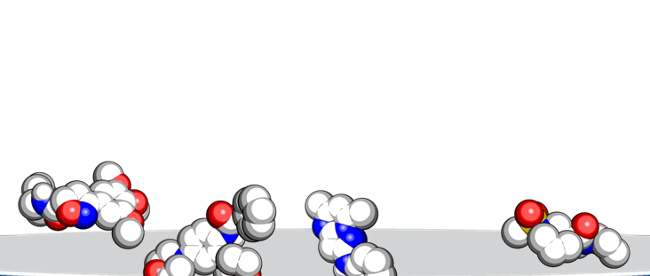
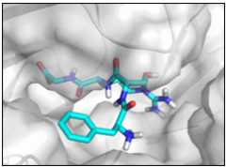
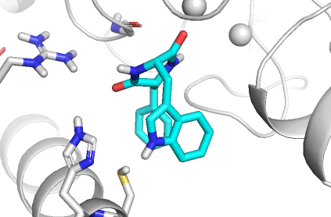
Designing highly potent peptides
Natural compounds library (30k entries)
Peptide library (millions entries)
Virtual library
Based on project goal
Example of molecular docking
Physicochemical descriptors (e.g. molecular weight)
3D Shape of molecule
Chemical substructures
Undesired motifs (e.g. toxicity concerns or solubility)
Chemical properties
Based on prior knowledge
As a guidance for biological activity
Trained models with experimental data
Artificial intelligence
Predicting orientation of molecule within the binding site of the skin biological target and estimating the binding energy
(based on 3D structure)
Molecular docking
Life to a static view
Time-evolved picture of molecular interactions allows to better estimate binding energies as biology is dynamic
Molecular
dynamic
simulation
dsm-firmenich scientists prioritize the molecules
Experts in computational chemistry, synthesis and biological testing select the final molecules for chemical synthesis
Example of molecular dynamic simulation (MD)
Experts

Slide 14
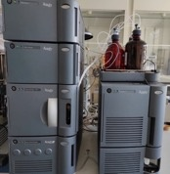
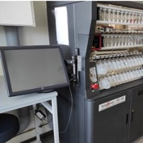

In-house peptide synthesis and process development
Part of dsm-firmenich’s
R&D manufacturing network
Special laboratories (pressure, safety)
Analytical services and quality control
Process implementation
Scale-up and manufacturing
Tox and regulatory expertise
State-of-the-art technologies
Dedicated equipment
High-capacity reactors for process optimization
High tech analytics instrumentation
Highly experienced
team of peptide chemists
Long-term experience in cosmetic peptides development
Leading SYN®-Peptides brand

Slide 15
03
The products range

Slide 16
SYN®-PEPTIDES Range / Pharma-inspired skincare
SYN®-AKE
SYN®-COLL CB
SYN®-TACKS CB
SYN-EYE® CB
The all-in-one medical beauty solution
Activate your Collagen for lifelong slow-aging
Boosting beauty through the dermal-epidermal junction
Lineless eyes
within 7 days
SYN® HYCAN CB
SYN-TC® CB
SYN-UP®
SYN-GLOW®
Hyaluronic acid booster: firming and remodelling from within
A new dimension in skin smoothing in just 28 days
Unlock your skin’s longevity
Healthy, youthful,
fresh-from-holiday look...
all year round

Slide 17
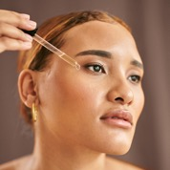
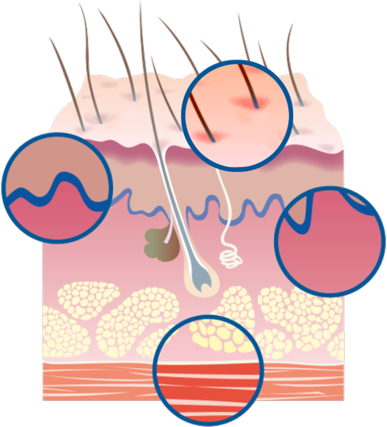
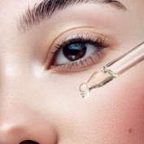
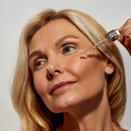
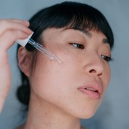
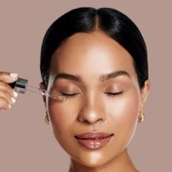
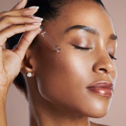
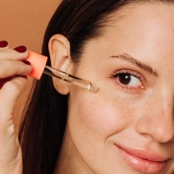
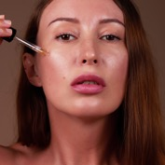
Revealing the power of targeted mode-of-action
SYN®-PEPTIDES’ skin focus
EPIDERMIS
SYN-GLOW®
MC1R booster
Increases key regulators of Melanin synthesis​ MITF, TYR, TRP1
Stimulates anti-oxidant defense factor (Nrf2)
DERMAL EPIDERMAL JUNCTION
SYN-EYE® CB
Hydration booster
Fortifies the skin’s natural barrier
Reduces various inflammatory cytokines
Improves cellular energy activation (ATP) and skin renewal
Boosts collagen
DERMIS
SYN®-COLL CB
SYN-UP®
TGF-β booster
Produces and protects collagen
Rebalances inflammation by inhibiting cytokines (TNFα, IL-8)
Inhibits Plasmin and Urokinase levels
Up-regulates Transglutaminase 1
Reduces MMP 9, CXCL5 and IL-8 activities
Prevents the degradation of collagen type IV
Stimulates collagen type 1
Reduces Tyrosinase activities
MUSCLE
SYN®-HYCAN CB
Boosts hyaluronic acid (HA) synthesis
Increases CD44 expression
Increases collagen type 1, lumican and decorin levels
SYN-TC® CB
Stimulates collagen type I, III, IV, VII and XVII
SYN®-TACKS CB
Stimulates Integrin β4, Laminin V, collagen type IV, VII and XVII
SYN®-AKE
Inhibits muscle nicotinic acetylcholine receptor (maAChR)
Stimulates PLOD32 activity, important for the stability of intermolecular collagen crosslinks
Stimulates Collagen III and Hyaluronic acid synthesis
Controls DPP4, a potential target linked to sebaceous gland activity

Slide 18


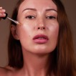

SYN®-PEPTIDES Range / Pharma-inspired skincare
Product |  | Dedicated performance for visible results | Claims
SYN-AKE® |  | All in one | Helps skin to relax, visibly reducing and preventing mimic wrinkles. Re-densifies skin from within, smoothening deep wrinkles. Mattifies and improves texture.
SYN®-COLL CB |  | For wrinkles and fine lines | Slow down the aging process from within Significantly supports skin’s Collagen reserves, with age-personalized action Protects from UV-induced Collagen degradation already at 1% Sculpts face and neck for a firmer, more lifted appearance. Refines skin appearance with less visible pores
SYN®-HYCAN CB |  | For contour remodeling | Provides visible filling effect in just 2 weeks Lifts even the most difficult areas, such as the neck Benefits on multiple skin zones (under eye, upper- and mid-cheek, jawline, neck, lip) Increases skin firmness +200% on cheek area.
SYN-UP® |  | Address the signs of sensitive skin and premature aging | Makes the skin day- by- day more resilient against external stressors Significant effective prevention of skin dryness Reduces redness and unpleasant skin sensations Visibly smoother and firmer skin Hyperpigmentation reduction in just 2 weeks

Slide 19


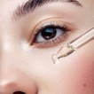

SYN®-PEPTIDES Range
Product |  | Dedicated performance for visible results | Effect
SYN®-TACKS CB |  | For firm and compact skin | Helps to visibly improve skin tonicity, firmness, and suppleness. Appearance of fine lines and wrinkles is visibly reduced
SYN-TC® CB |  | For smooth skin | Skin is smoother with a softer touch Overall younger- looking appearance Skin appears plumped and firmer Appearance of fine lines and wrinkles is visible reduced
SYN-EYE® CB |  | For lineless eyes | Visibly reduces the appearance of lines and wrinkles around the eye within 7 days Shows a visibly brighter skin color in dark circle area after only 14 days Helps to reduce skin roughness, making the delicate skin around the eye look smoother and fresher
SYN-GLOW® |  | For a natural, healthy glow | Healthy, youthful, fresh-from-holiday look all year long Promotes a visible healthy glow in just 5 days, with long lasting result and natural personalized effect

Slide 20
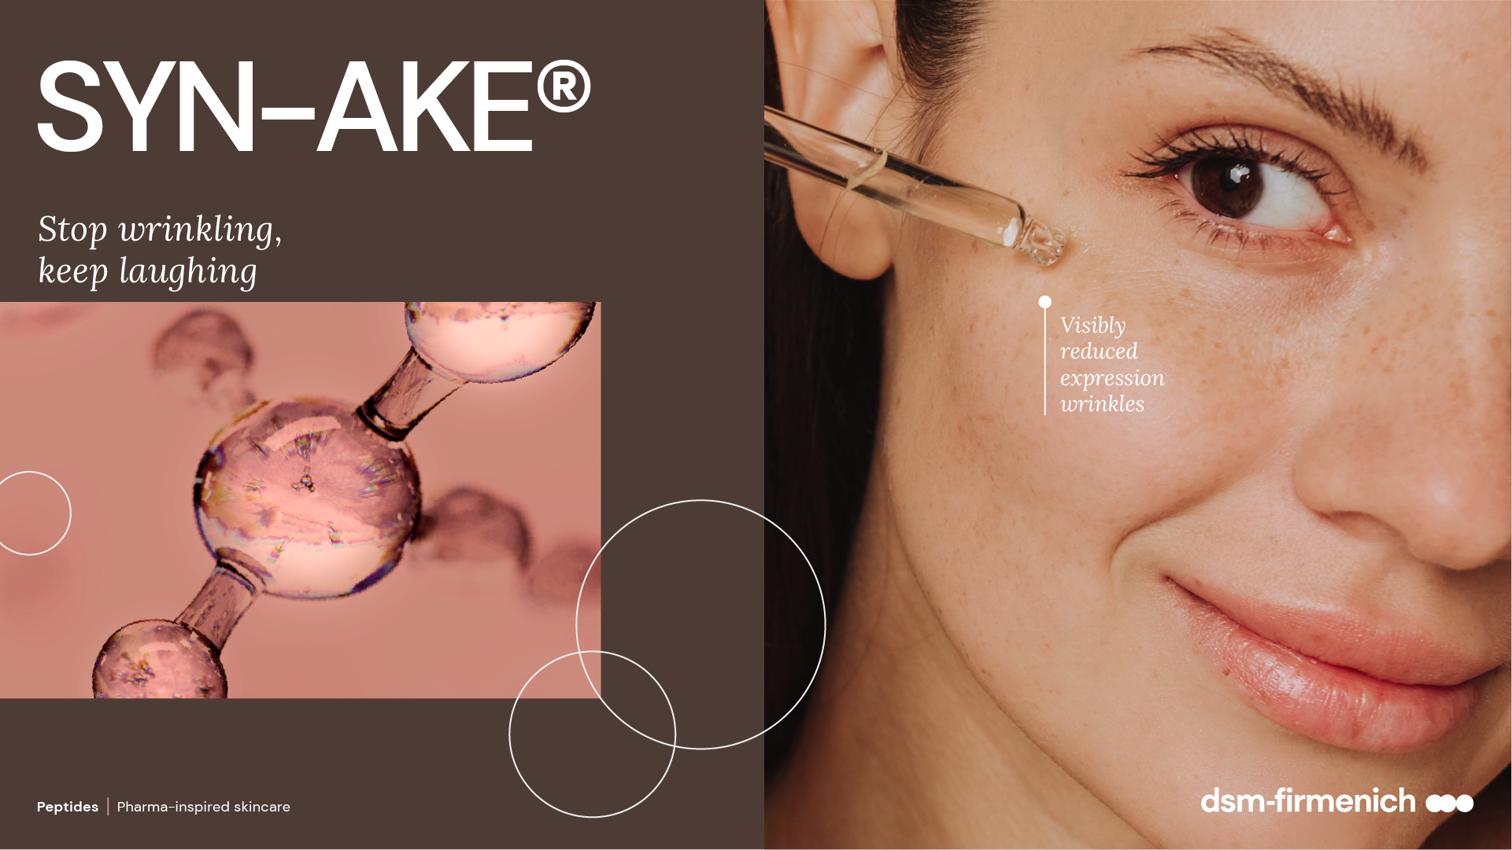

Slide 21






SYN®-AKE
ID Card
INCI NAME:
Dipeptide Diaminobutyroyl Benzylamide Diacetate, Glycerin, Aqua
TECHNOLOGY:
Highly potent biomimetic tripeptide, made by cutting-edge SYN®-Peptide technology to mimic the essential amino acid sequence of Waglerin-1, a natural occurring polypeptide which has a strong ability to relax muscle contraction
In silico model shows that SYN®-AKE peptide is able to fit into the catalytic binding site of DPP4 (Dipeptidylpeptidase 4)
TFA-free¹
99.8% of natural origin (according to ISO 16128)
TECHNICAL:
Form: Liquid
pH of use: 3.0-7.5
Use level: 1-4%
Preservative: Free
Solubility: Miscible in water
BENEFITS:
Reduces muscle cell contractions: immediately, long-lasting and fully reversibly*
Up to 47% inhibition of muscle nicotinic acetylcholine receptor (maAChR)*
Stimulates PLOD3² activity, important for the stability of intermolecular collagen crosslinks*
Controls DPP4, a potential target linked to sebaceous gland activity*
Helps skin to relax without losing the ability to express**
Visibly reduce lines and wrinkles on three different skin tones**
Wrinkles reduction across age groups**
Can delay wrinkles’ appearance up to 5 years**
Mattifies skin**
REGISTRATION
CERTIFICATION:
1. Non-intentionally added TFA; 2. procollagen-lysine, 2-oxoglutarate 5-dioxygenase 3
* in vitro ** in vivo

Slide 22
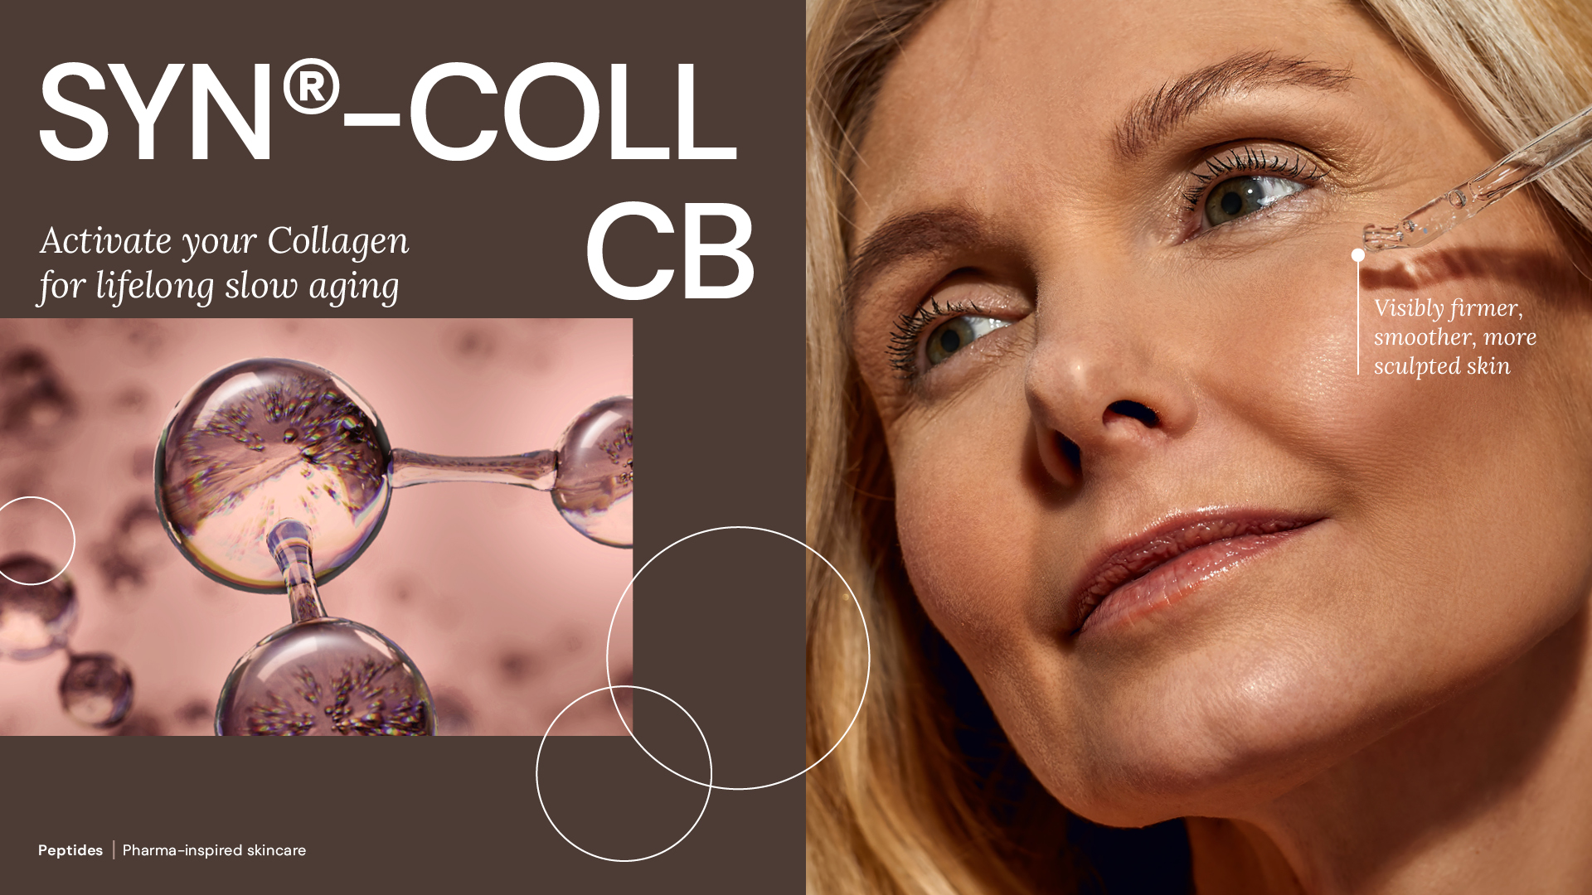

Slide 23

SYN®-COLL CB
ID Card
INCI NAME:
Palmitoyl Tripeptide-5, Aqua, Glycerin
Pharma-inspired skincare solution, taking skin health ambition to the next level.
Targeted design and molecular modeling supported by green chemistry
Natural origin tripeptide with unique sequence Palm-Lys-Val-Lys, produced in Europe, TFA-free¹,
Original SYN®‑COLL peptide generation patented; CB version patent application pending
Low carbon footprint of 5.2 kg CO₂ eq./kg
99.9% natural origin (ISO 16128), 73% natural origin for the pure peptide
TECHNOLOGY:
TECHNICAL:
Form: Liquid
pH of use: 3.0-7.0
Use level: 1-5%
Preservative: Free
Solubility: Soluble in water
Biodegradability: Readily biodegradable
New – Slow down the aging process from within**
New – Significantly supports skin’s Collagen reserves, with age-personalized action**
New – Protects from UV-induced Collagen degradation already at 1% **
Sculpts face and neck for a firmer, more lifted appearance**
Refines skin appearance with less visible pores**
BENEFITS:
Collagen Science Pioneer
First TGF-β booster on the market*
Mimics the skin’s own mechanism to produce and protect Collagen*
Rebalances inflammation by inhibiting cytokines (TNFα, IL-8)*
REGISTRATION
CERTIFICATION:
1. Non-intentionally added TFA
* in vitro ** in vivo

Slide 24
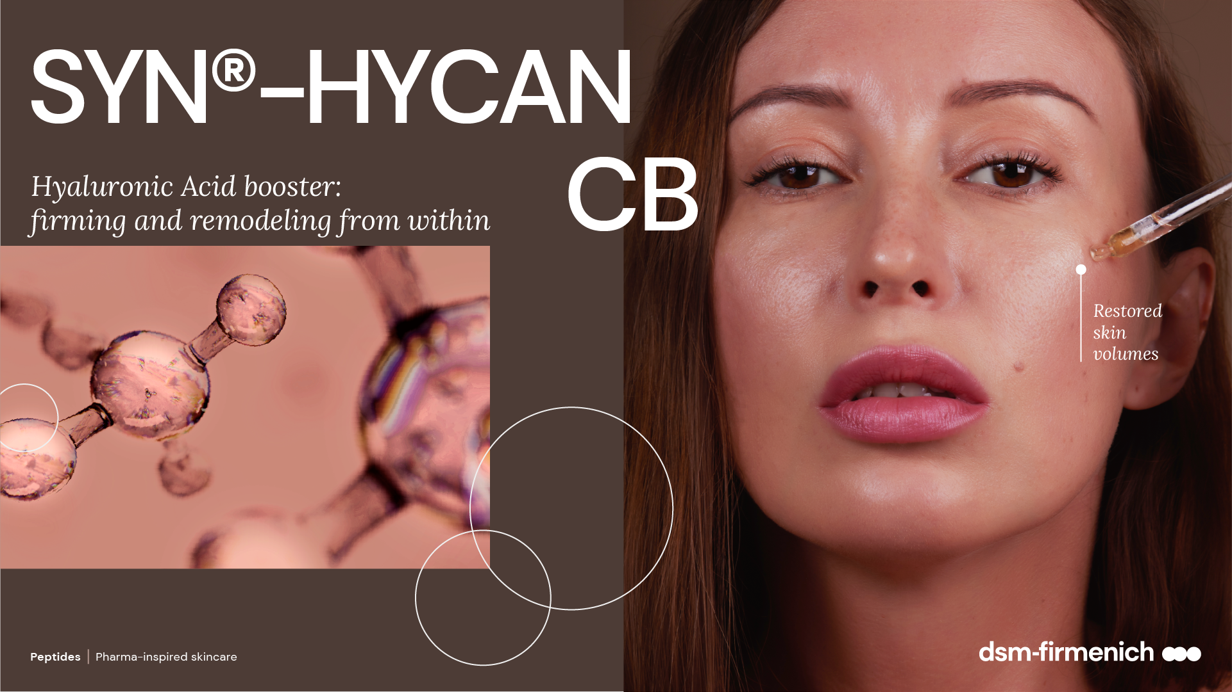

Slide 25
SYN®-HYCAN CB
ID Card
INCI NAME:
Tetradecyl Aminobutyroylvalylaminobutyric Urea Acetate, Glycerin, Aqua, Magnesium Chloride
Original SYN®‑HYCAN peptide generation patented; CB version patent application pending
TFA-free¹
99.98% natural origin (ISO 16128) for SYN®-HYCAN CB - 85% natural origin (ISO 16128) for the pure SYN®-HYCAN peptide²
TECHNOLOGY:
Highly potent, natural origin tripeptide, suitable for Clean-Beauty, produced via Green Chemistry Science with an optimized SYN®-Peptide technology, designed to stimulate hyaluronic acid from within
TECHNICAL:
Form: Liquid
pH of use: 3.0-5.5
Use level: 2-5%
Preservative: Free
Solubility: Miscible in water
BENEFITS:
Boosts hyaluronic acid (HA) synthesis in both keratinocytes and dermal fibroblasts*
Increases CD44 expression, a key cellular anchor of HA*
Increases collagen type 1, lumican and decorin levels, important for collagen support & organization*​
Provides visible filling effect in just 2 weeks
Lifts even the most difficult areas, such as the neck
Benefits on multiple skin zones (under eye, upper- and mid-cheek, jawline, neck, lip)
Increases skin firmness +200% on cheek area.
REGISTRATION
CERTIFICATION:
1. Non-intentionally added TFA
* in vitro ** in vivo

Slide 26
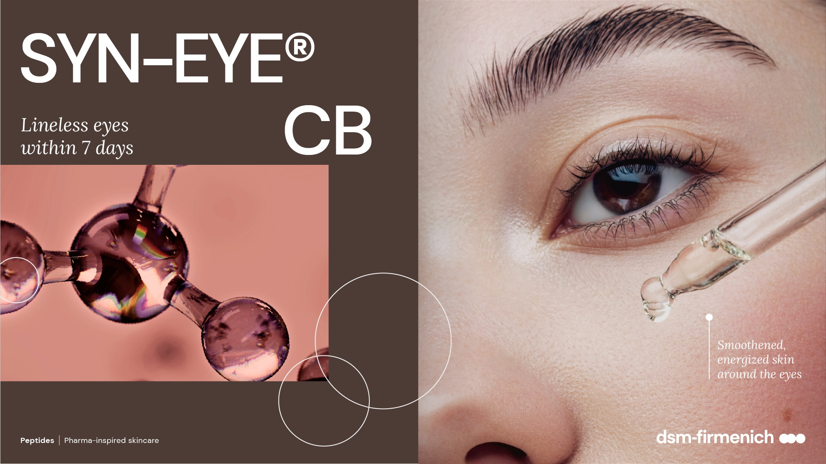

Slide 27
SYN-EYE® CB
ID Card
INCI NAME:
Aqua, Palmitoyl Tripeptide-5, Panthenol, Sodium Hyaluronate, Dunaliella Salina Extract, Pentylene Glycol, Citric Acid
TECHNOLOGY:
Combines the latest cutting-edge SYN®-Peptide technology, produced via Green Chemistry Science with superior bioactives in a multifunctional eye care formula
TFA-free¹
69.9% of natural origin (according to ISO 16128)
TECHNICAL:
Form: Liquid
pH of use: 4.5-6.0
Use level: Up to 1%
Preservative: no Phenoxyethanol
Solubility: Miscible in water
BENEFITS:
Visibly reduces the appearance of lines and wrinkles around the eye within 7 days**
Shows a visibly brighter skin color in dark circle area after only
14 days**
Helps to reduce skin roughness, making the delicate skin around the eye look smoother and fresher**
REGISTRATION
CERTIFICATION:
1. Non-intentionally added TFA
* in vitro ** in vivo

Slide 28
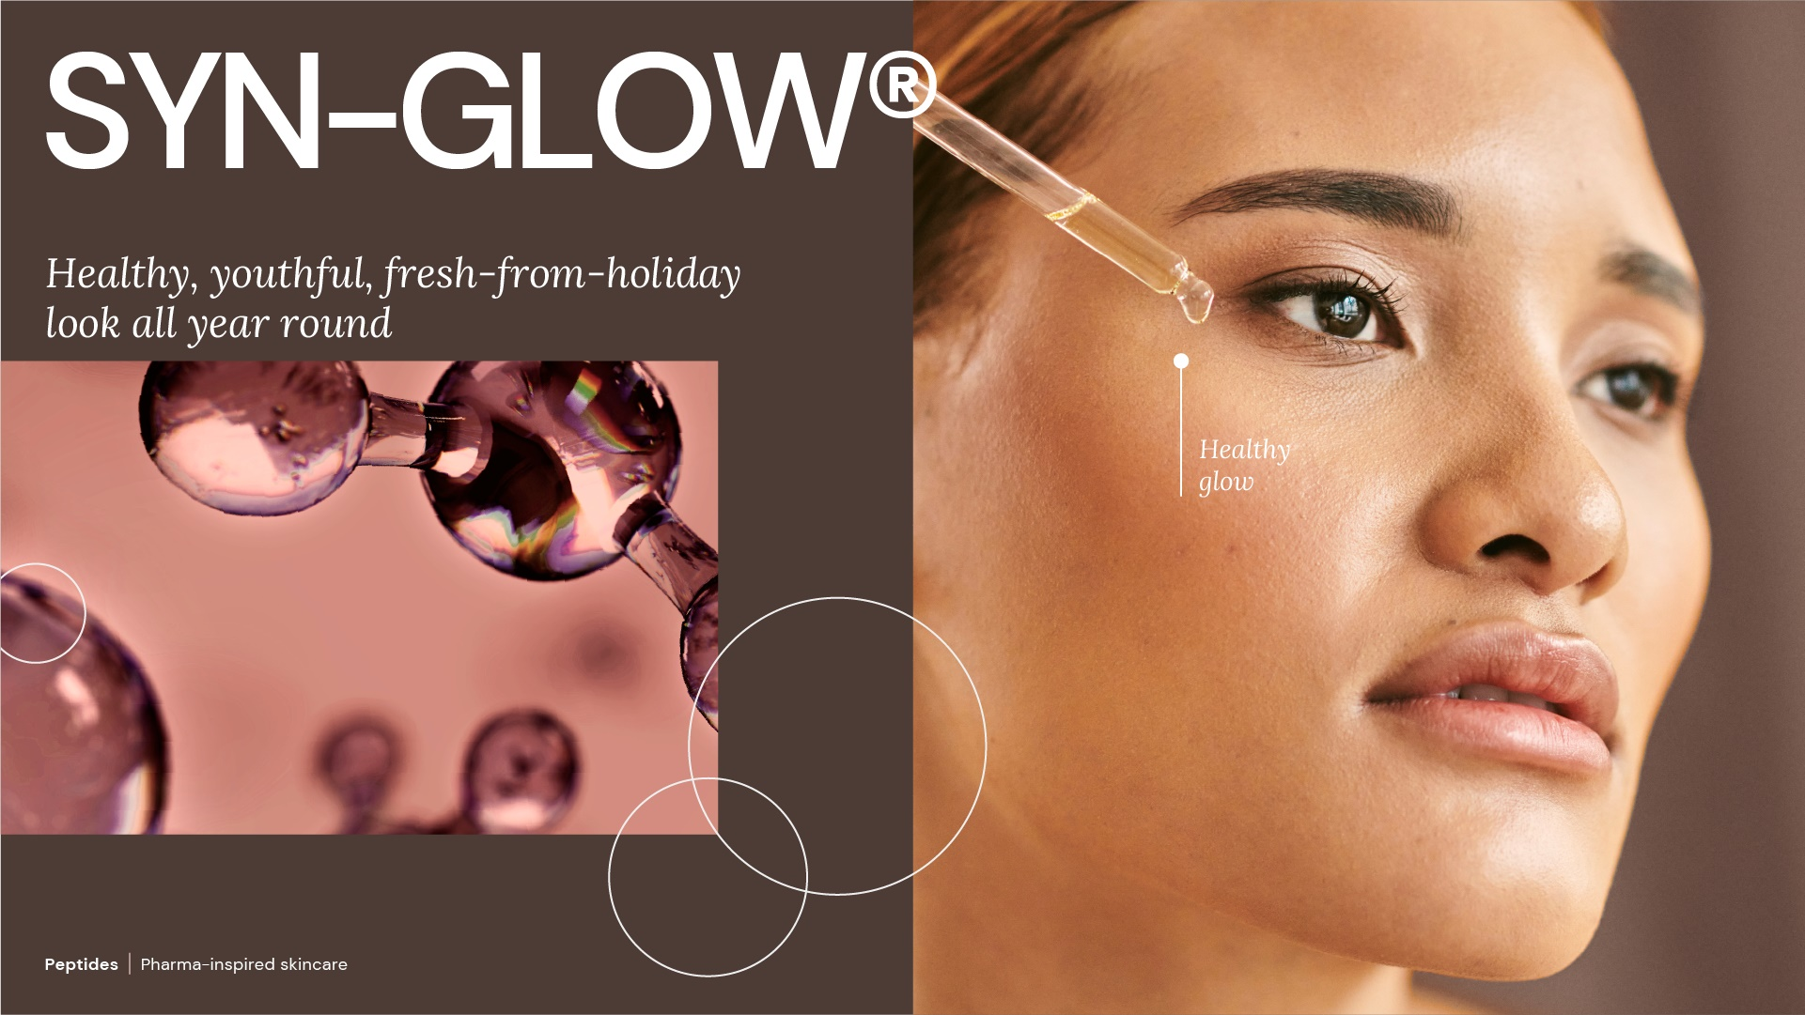

Slide 29
SYN-GLOW®
ID Card
INCI NAME:
Benzoyl Dipeptide-18 D-Phenylalanyl Arginyl D-Tryptophan Dipropylamide Mesylate, Aqua, Glycerin
TECHNOLOGY:
Highly potent patented pentapeptide, made by cutting-edge SYN®-Peptide technology, designed to highly selectively boost MC1R (Melanocortin-1 receptor), a biochemical switch (off/on) of the Melanin synthesis
From a library of more than 100 peptides, SYN-GLOW® has been identified to be the best candidate to activate MC1R
In silico structure-based peptide design and artificial intelligence (AI), visualized with molecular modelling
TFA-free¹
99.9% of natural origin (according to ISO 16128)
TECHNICAL:
Form: Liquid
pH of use: 3.0-7.5
Use level: 1%
Preservative: Free
Solubility: Miscible in water
BENEFITS:
Highly selectively MC1R booster*
Significantly boosting key regulators of Melanin synthesis​ MITF, TYR, TRP1*
Stimulates anti-oxidant defense factor (Nrf2) after UVA-irradiation*
Healthy, youthful, fresh-from-holiday look all year long**
Promotes a visible healthy glow in just 5 days, with long lasting result and natural personalized effect**
REGISTRATION
CERTIFICATION:
1. Non-intentionally added TFA
* in vitro ** in vivo

Slide 30


Slide 31
SYN®-TACKS CB
ID Card
INCI NAME:
Palmitoyl Dipeptide-5 Diaminobutyroyl Hydroxythreonine, Palmitoyl Dipeptide-5 Diaminohydroxybutyrate, Aqua, Glycerin
TECHNOLOGY:
Combination of two highly active tri- and tetrapeptides, made by latest cutting-edge SYN®-Peptide technology, designed to support the dermal-epidermal junction (DEJ)
TFA-free¹
99.9% of natural origin (according to ISO 16128)
TECHNICAL:
Form: Liquid
pH of use: 3.0-5.5
Use level: 1-3%
Preservative: Free
Solubility: Miscible in water
BENEFITS:
Improves overall DEJ functionality by significantly stimulating Integrin β4, Laminin V, Collagens IV, VII and XVII, and all at once*
Improves molecular communication and structural integrity skin**
Smoother skin and visible reduction of wrinkle appearance **
Rejuvenated, more compact skin**
Increased skin suppleness by +35%**
Increased skin tonicity by +31%**
Increased skin firmness by +17%**
REGISTRATION
CERTIFICATION:
1. Non-intentionally added TFA
* in vitro ** in vivo

Slide 32
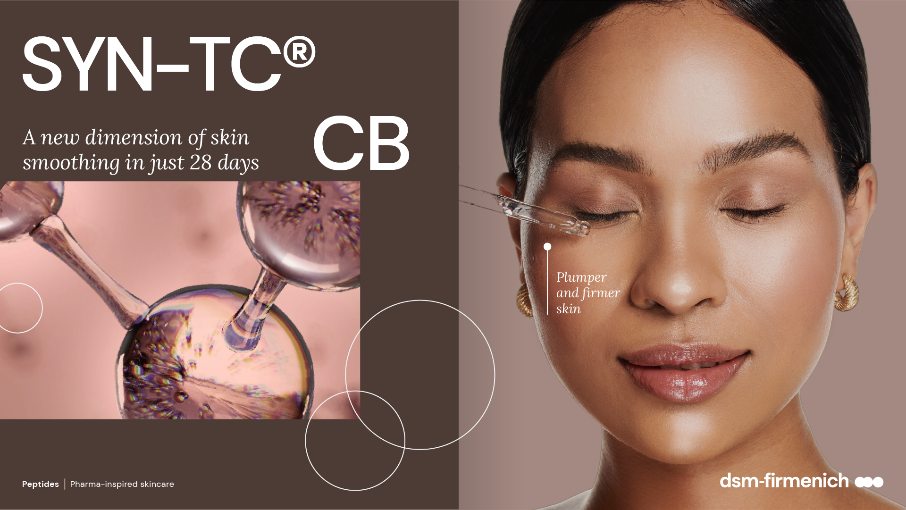

Slide 33
SYN-TC® CB
ID Card
INCI NAME:
Tetradecyl Aminobutyroylvalylaminobutyric Urea Acetate, Palmitoyl Dipeptide-5 Diaminobutyroyl Hydroxythreonine,
Palmitoyl Tripeptide-5, Aqua, Glycerin, Magnesium Chloride
TECHNOLOGY:
Combination of three highly active tri- and tetrapeptides, made by the latest cutting-edge SYN®-Peptide technology, designed to increases the number of collagens
TFA-free¹
100% of natural origin (according to ISO 16128)
TECHNICAL:
Form: Liquid
pH of use: 3.0-7.0
Use level: 1–2.5%
Preservative: Free
Solubility: Miscible in water
BENEFITS:
Significantly stimulates Collagens I, III, IV, VII and XVII all at once*
Skin is smoother with a softer touch and improved overall young- looking appearance**
Skin appears plumper**
Skin appears firmer**
Appearance of fine lines and wrinkles is visible reduced** ​
REGISTRATION
CERTIFICATION:
1. Non-intentionally added TFA
* in vitro ** in vivo

Slide 34
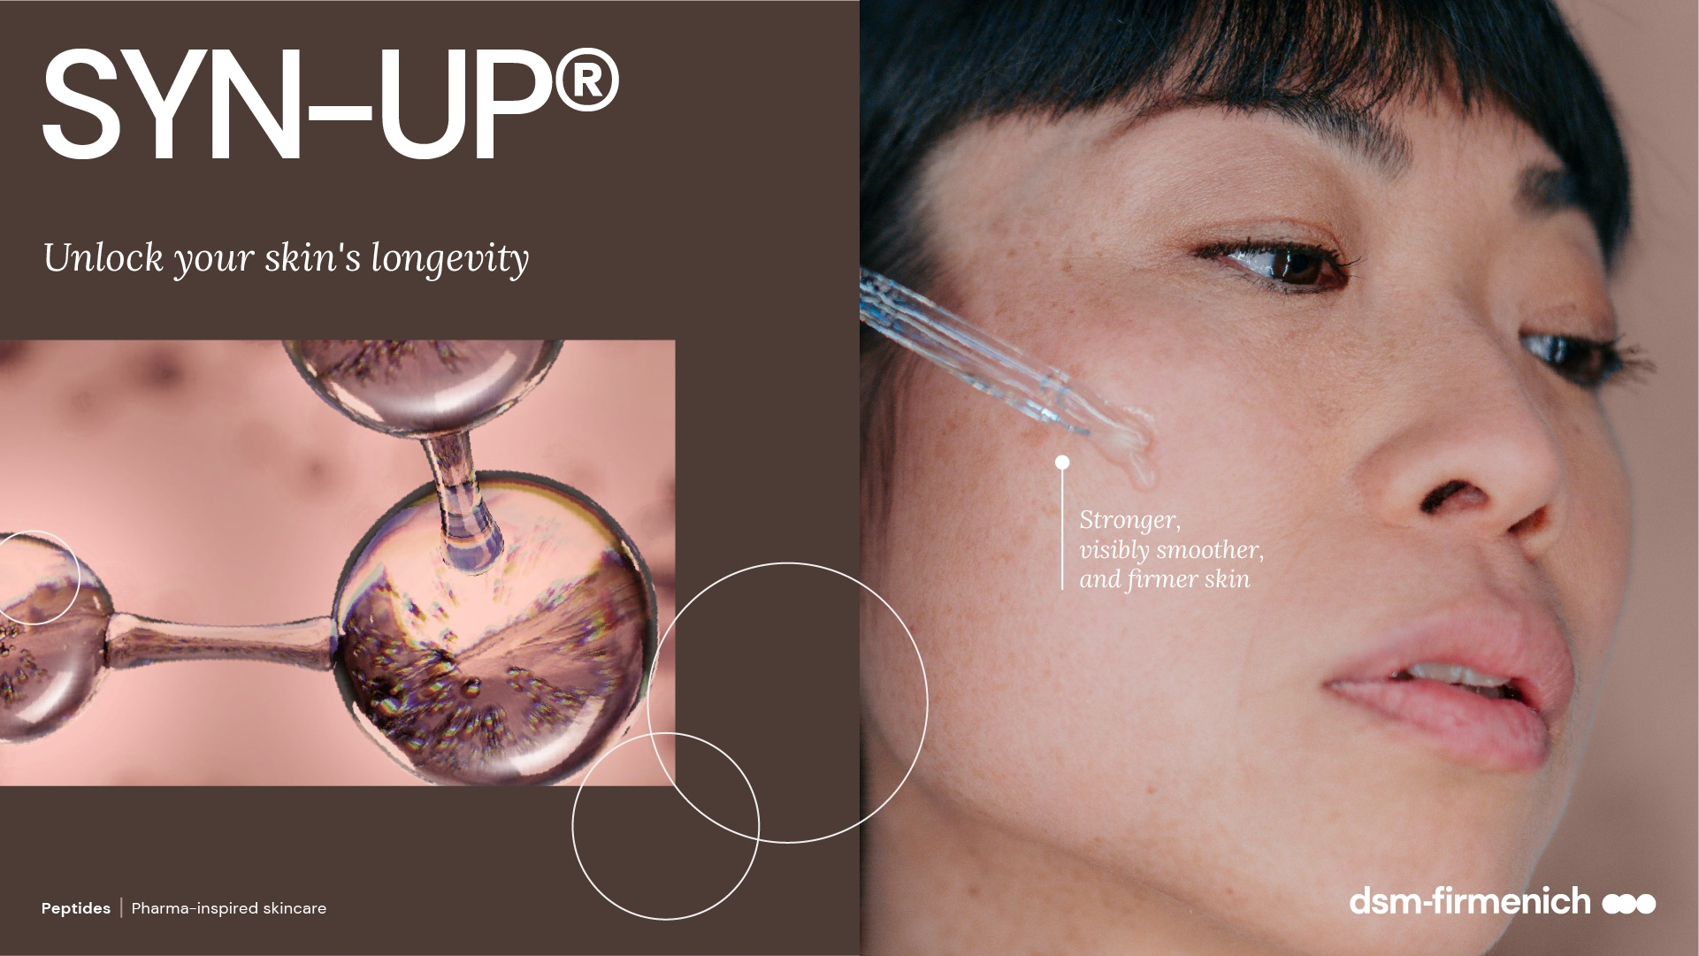

Slide 35
SYN-UP®
ID Card
INCI NAME:
Amidinobenzyl Benzylsulfonyl D-Seryl Homophenylalaninamide Acetate, Aqua, Glycerin, Citric Acid, Sodium Hydroxide
TECHNOLOGY:
Highly potent patented dipeptide derivative, made by cutting-edge SYN®-Peptide technology via Green Chemistry Science to rebalance Plasmin activities, which is important for healthy-looking skin
In silico structure-based peptide design and artificial intelligence (AI), visualized with molecular modelling
TFA-free¹
99.9% of natural origin (according to ISO 16128)
TECHNICAL:
Form: Liquid
pH of use: 3.0-7.5
Use level: 1%
Preservative: Free
Solubility: Miscible in water
BENEFITS:
Promotes healthy-looking skin by inhibiting Plasmin levels* and rebalancing key bacteria S. Aureus and S. Epidermidis**​
Reduces skin sensitivity and redness by modulation MMP 9*/***, CXCL5* and IL-8 activities*​
Helps to smooth the skin by preventing the degradation of type IV Collagen*/*** and by stimulating type I Collagen* ​
Down-regulates melanin synthesis* ​
Makes the skin more resilient against stress attacks day-by-day**
Real, significant prevention of dry skin conditions**
Reduces redness and unpleasant skin sensations**
Visibly smoother and firmer skin**
Lighter age spots in just 2 weeks **
REGISTRATION
CERTIFICATION:
1. Non-intentionally added TFA
* in vitro ** in vivo *** ex vivo

Slide 36
Key take-outs
Peptides find good resonance with modern skincare consumers
With more than 60 years of experience, SYN®-PEPTIDES are core technology and key focus area in dsm-firmenich Beauty & Care
Computer based modelling and Green Chemistry Science offer new opportunities for next generation peptides
SYN®-PEPTIDES are fully substantiated, safe and tested for efficacy

Slide 37
Disclaimer
Copyright © dsm-firmenich Switzerland AG, 2026, 4002 Basel, Switzerland.
www.dsm-firmenich.com. All rights reserved.
dsm-firmenich has used diligent care to ensure that the information provided herein is accurate and up-to-date to the best of its knowledge. However, dsm-firmenich makes no representation or warranty, either expressly or implied, of the accuracy, reliability, completeness, or suitability thereof. The information provided herein contains scientific and product information for business-to-business use and does not constitute or provide scientific or medical advice, diagnosis or recommendation for treatment options. Country or region-specific information should be considered when labelling or advertising to final consumer. In no event shall dsm-firmenich be liable for any direct or indirect damages arising from or reliance upon, or use of, any information provided herein. The content of this document is subject to change without further notice. Please contact your local dsm-firmenich representative for the latest information. All trademarks listed in this document are either (registered) trademarks of, or trademarks licensed by, the dsm-firmenich group of companies, unless explicitly stated otherwise.
Disclaimer Formulation Guideline
The information provided herein is provided for information purposes only and has been prepared by dsm-firmenich in accordance with its own methodology.
dsm-firmenich has used diligent care to ensure that it is accurate and up-to-date, however, dsm-firmenich makes no representation or warranty, either expressly or implied, of the accuracy, reliability, or completeness thereof. In no event shall dsm-firmenich be liable for any damages arising from or reliance upon, or use of, any information provided herein. Further, dsm-firmenich shall not bear any liability for the application and/or use of any processed material containing its product(s). The formulation of the finished product is the customer’s sole responsibility. It is the customer’s responsibility to determine the suitability of dsm-firmenich’s products regarding user specific purposes, assess compatibility and stability of their finished product(s) and to ensure compliance of their finished product(s) with relevant laws and regulations. Any product, marketing or other claims made by customer are its sole responsibility. The content of this document is subject to change without further notice. Please contact your local dsm-firmenich representative for further details. © dsm-firmenich Switzerland AG, 2026.
© 2026

Slide 38
© 2026

