Slide 1

April 2026

Slide 2
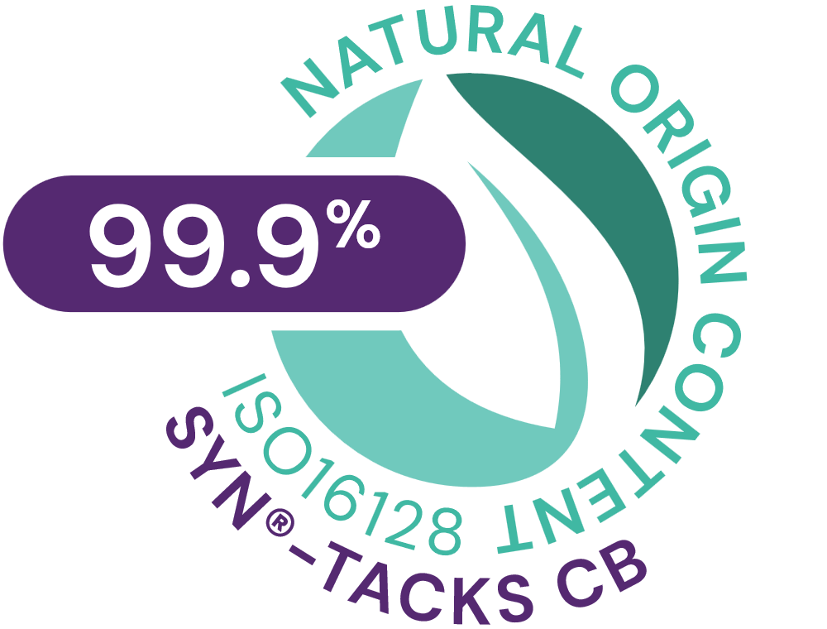



SYN®-TACKS CB
ID Card
INCI NAME:
Palmitoyl Dipeptide-5 Diaminobutyroyl Hydroxythreonine, Palmitoyl Dipeptide-5 Diaminohydroxybutyrate, Aqua, Glycerin
TECHNOLOGY:
Combination of two highly active tri- and tetrapeptides, made by latest cutting-edge SYN®-Peptide technology, designed to support the dermal-epidermal junction (DEJ)
TFA-free¹
99.9% of natural origin (according to ISO 16128)
TECHNICAL:
Form: Liquid
pH of use: 3.0-5.5
Use level: 1-3%
Preservative: Free
Solubility: Miscible in water
BENEFITS:
Improves overall DEJ functionality by significantly stimulating Integrin β4, Laminin V, Collagens IV, VII and XVII, and all at once*
Improves molecular communication and structural integrity skin**
Smoother skin and visible reduction of wrinkle appearance **
Rejuvenated, more compact skin**
Increased skin suppleness by +35%**
Increased skin tonicity by +31%**
Increased skin firmness by +17%**
REGISTRATION
CERTIFICATION:
1. Non-intentionally added TFA
* in vitro ** in vivo

Slide 3
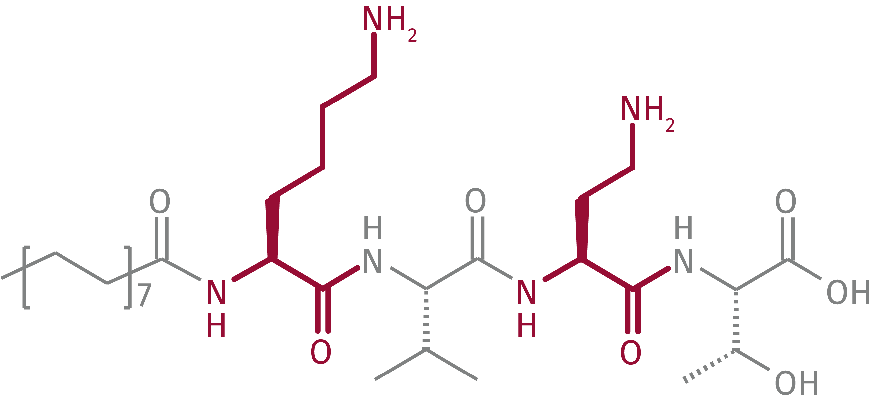
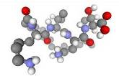
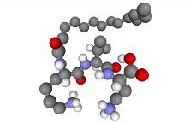
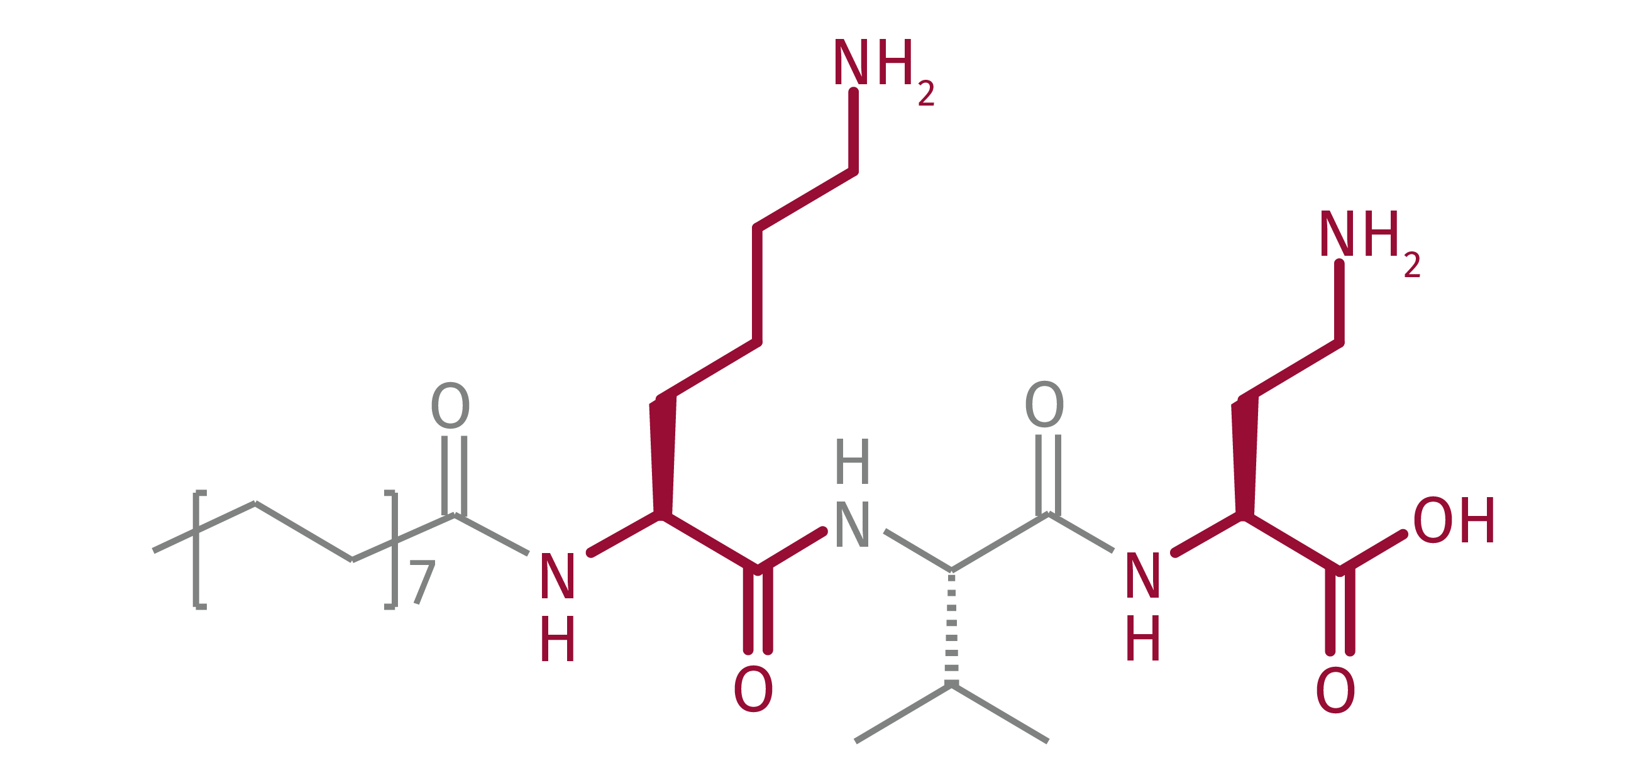
SYN®-TACKS CB
Patented innovation
For maximal efficacy SYN®-TACKS CB comprises two peptides for synthesis stimulation of major : Dermal-Epidermal Junction (DEJ)-proteins
  SYN®-TACKS CB’ patented complex and peptides:
Palm-Lys-Val-Dab-Thr-OH
INCI: Palmitoyl Dipeptide-5 Diaminobutyloyl Hydroxythreonine
Palm-Lys-Val-Dab-OH
INCI: Palmitoyl Dipeptide-5 Diaminohydroxybutyrate
SYN®-TACKS CB is a specified and patented combination of two highly active peptides

Slide 4
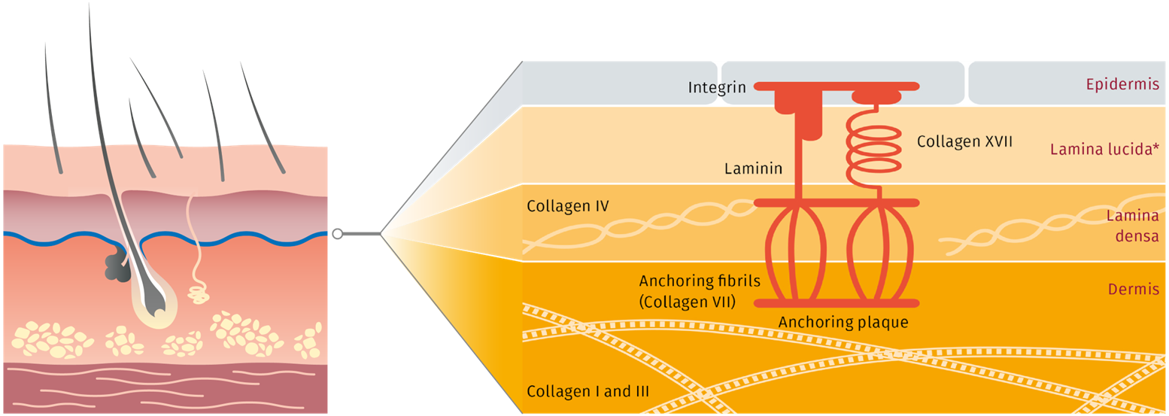
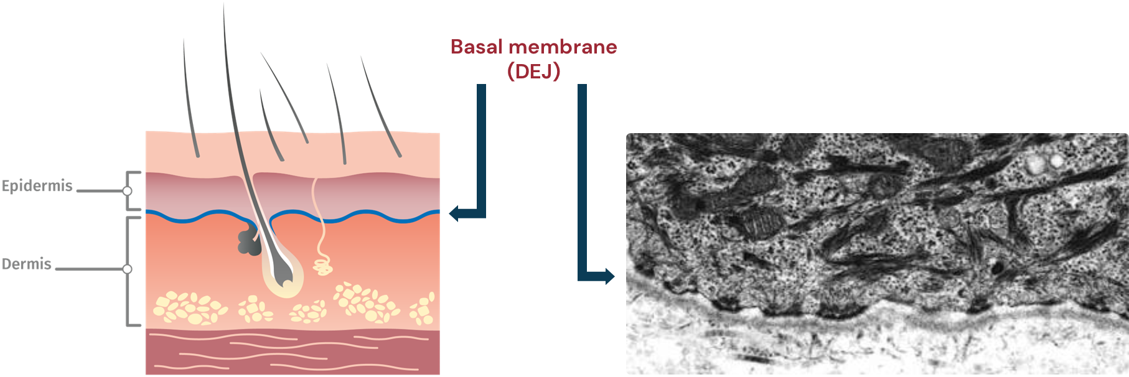
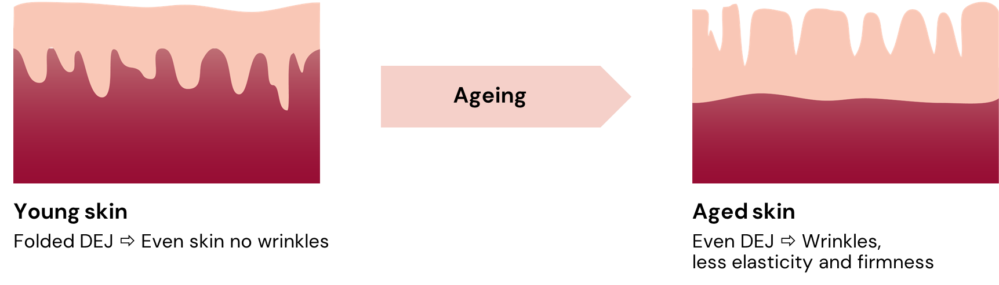
SYN®-TACKS CB
Target: Dermal-Epidermal Junction (DEJ)
Function of DEJ | Main components of the DEJ
DEJ is the anchor and communication layer between epidermis and dermis DEJ is only a thin structure (800-1000 nm) Young skin: folded DEJ – Aged skin: even DEJ A well folded membrane indicates good DEJ health and organization | The complex DEJ structure includes an interacting network of several proteins to ensure its functionality and integrity Collagen: Collagen IV; Collagen VII (anchoring fibrils); Collagen XVII Laminin V: major non-collagenous component of the basal lucida, important for cell attachment and differentiation Integrins: cell adhesion and inter-cellular communication
Notes:
The basement membrane is a connecting cell structure between morphologically different tissues (epidermis and dermis). It separates the epidermis and its appendages from the dermis and, accordingly, is known as a dermal/epidermal junction (DEJ). The DEJ has a complex structure consisting of hemidesmosomes, intermediate filaments, anchoring filaments, lamina densa and anchoring fibrils. The biochemical components mainly occurring therein include laminin-V in the lamina lucida; type IV collagen in the lamina densa and the proteoglycan type VII collagen as a constituent of the anchoring fibrils in the sub-lamina densa. These components form an interacting network.

Slide 5

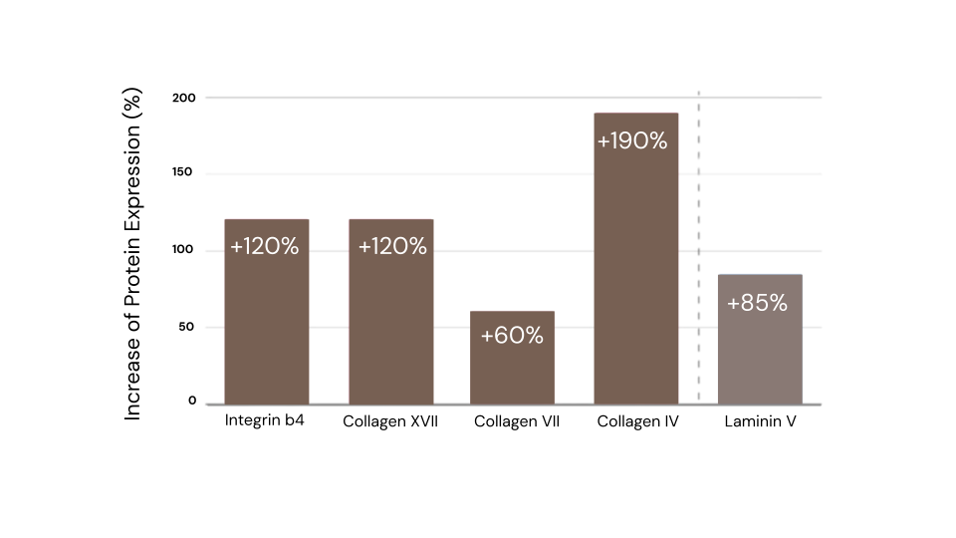
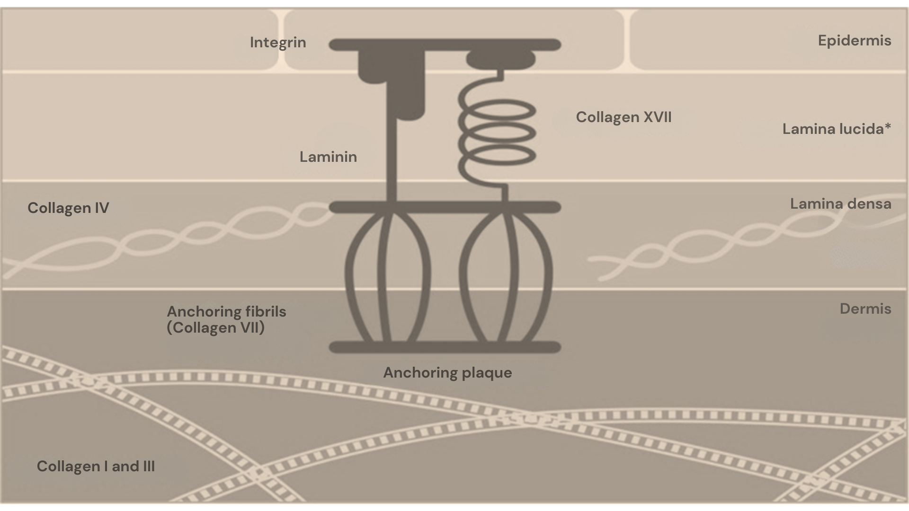

SYN®-TACKS CB – in vitro efficacy
Stimulation of DEJ protein expression (RNA)
Stimulation of DEJ protein expression by:
Palm-Lys-Val-Dab-Thr-OH (50 μM, in brown, mRNA level)
and Palm-Lys-Val-Dab-OH (100 μM, in light brown, Protein level).
  Major DEJ proteins are significantly upregulated
in vitro efficacy
Notes:
Palm-Lys-Val-Dab-Thr-OH (50 μM, in red, mRNA level) : EXTERNAL MEASUREMENTS, one concentration
Palm-Lys-Val-Dab-OH (100 μM, in orange, Protein level).: INHOUSE MEASUREMENTS
Isolation of total RNA and Gene Expression Analysis
Abstract: Human Keratinocytes (HaCaT) have been cultured in appropriate media. Test substances have been added and the amount of messenger RNA has been analyzed by means of Polymerase chain reaction (PCR).
Details: HaCaT cells between passage 10-15 were seeded at 6x10^4/cm2 in DMEM 10% fetal calf serum and antibiotics. Cells were grown to subconfluency and test substances were added for 16h in growth medium. Total RNA was isolated using the RNeasy Mini Kit (Qiagen) according to manufacturer’s instructions. Subsequently cDNA was prepared using the First Strand cDNA Synthesis Kit (Roche) according to manufacturer’s instructions.
Gene expression analysis was done by Biolytics AG (Witterswil, Switzerland) using a TaqMan® real time PCR-system. Four different targets have been used for the tests: Integrin b4, Collagen IV, VII and XVII. All gene expressions are referenced to the internal control hGAPDH.
---------------------------------------------------------
Laminin type V and Collagen type IV determination in Human Keratinocytes
Abstract: Human Keratinocytes (HaCaT) have been cultured in appropriate media. Test substances have been added and the amount of Laminin V has been analyzed by means of ELISA.
Details: Determination of the stimulation of Laminin type V synthesis in Human HaCaT keratinocyten:
Laminin type V production per cell of in-vitro cultured Human HaCaT keratinocyten was detected with an ELISA (Enzyme-Linked Immunosorbent Assay). The increase in the protein production of the cells was quantified in the presence of the peptidic actives by using this method.
Human HaCaT keratinocyten were a gift made by Prof. Fusening from the German Cancer Research Centre in Heidelberg. They were cultivated according to standard cell culture methods.
After 72 h of incubation with the corresponding peptides (actives) the quantitative determination was performed using an antibody specific for Laminin type V. After determination of the Laminin type V content the cell number is detected by means of the CyQUANT from the company Molecular Probes. The Laminin type V content per cell is calculated as units from the single values.
Method:
Keratinocytes are incubated until confluent at a density of approx. 5000 cells per well in 96 well-plates in culture medium (37°C/ 10% CO2) for 3 days. The medium is replaced with test medium at three different concentrations of test substance (n=3).
After incubation of the plates for further 72 hours, the precipitated Laminin type V is detected and quantified with two according to the following protocol:
the 1st and 2nd Antibody incubated with substrate solution and measured at 492 nm, the cell number is measured by means of CyQUANT Assay according to manufacturer’s instruction.
The Laminin type V production per cell is calculated in accord to the following formula: (value ODlaminin V/value RFUcell number) x 100.
Palm-Lys-Val-Dab-Thr-OH (50 μM, in red, mRNA level) : EXTERNAL MEASUREMENTS, one concentration
Palm-Lys-Val-Dab-OH (100 μM, in orange, Protein level).: INHOUSE MEASUREMENTS
Isolation of total RNA and Gene Expression Analysis
Abstract: Human Keratinocytes (HaCaT) have been cultured in appropriate media. Test substances have been added and the amount of messenger RNA has been analyzed by means of Polymerase chain reaction (PCR).
Details: HaCaT cells between passage 10-15 were seeded at 6x10^4/cm2 in DMEM 10% fetal calf serum and antibiotics. Cells were grown to subconfluency and test substances were added for 16h in growth medium. Total RNA was isolated using the RNeasy Mini Kit (Qiagen) according to manufacturer’s instructions. Subsequently cDNA was prepared using the First Strand cDNA Synthesis Kit (Roche) according to manufacturer’s instructions.
Gene expression analysis was done by Biolytics AG (Witterswil, Switzerland) using a TaqMan® real time PCR-system. Four different targets have been used for the tests: Integrin b4, Collagen IV, VII and XVII. All gene expressions are referenced to the internal control hGAPDH.
---------------------------------------------------------
Laminin type V and Collagen type IV determination in Human Keratinocytes
Abstract: Human Keratinocytes (HaCaT) have been cultured in appropriate media. Test substances have been added and the amount of Laminin V has been analyzed by means of ELISA.
Details: Determination of the stimulation of Laminin type V synthesis in Human HaCaT keratinocyten:
Laminin type V production per cell of in-vitro cultured Human HaCaT keratinocyten was detected with an ELISA (Enzyme-Linked Immunosorbent Assay). The increase in the protein production of the cells was quantified in the presence of the peptidic actives by using this method.
Human HaCaT keratinocyten were a gift made by Prof. Fusening from the German Cancer Research Centre in Heidelberg. They were cultivated according to standard cell culture methods.
After 72 h of incubation with the corresponding peptides (actives) the quantitative determination was performed using an antibody specific for Laminin type V. After determination of the Laminin type V content the cell number is detected by means of the CyQUANT from the company Molecular Probes. The Laminin type V content per cell is calculated as units from the single values.
Method:
Keratinocytes are incubated until confluent at a density of approx. 5000 cells per well in 96 well-plates in culture medium (37°C/ 10% CO2) for 3 days. The medium is replaced with test medium at three different concentrations of test substance (n=3).
After incubation of the plates for further 72 hours, the precipitated Laminin type V is detected and quantified with two according to the following protocol:
the 1st and 2nd Antibody incubated with substrate solution and measured at 492 nm, the cell number is measured by means of CyQUANT Assay according to manufacturer’s instruction.
The Laminin type V production per cell is calculated in accord to the following formula: (value ODlaminin V/value RFUcell number) x 100.

Slide 6


SYN®-TACKS CB - in vivo efficacy
Study design
Main study Preliminary study
15 volunteers, 2 months, age group 40-45
Cream with 1% SYN®-TACKS CB
Cutometer®: tonicity, firmness, suppleness;
macro photographs
Two age groups 40-45 and 60-65 with
15 volunteers each; duration 3 months
Cream with 1% SYN®-TACKS CB
Reviscometer®: anisotropy;
Tape strips and scanning electron microscopy (SEM) to inspect cellular cohesion
Macrophotographs, questionnaire
in vivo efficacy

Slide 7
SYN®-TACKS CB - in vivo efficacy
Cutometer®
  After 56 days of use 15 volunteers (age 40-45)
  present a significant increase in:
  Skin suppleness
P=0.006
effect on 88% of volunteers
  Skin tonicity
P=0.016
effect on 74% of volunteers
  Skin firmness
P=<0.001
effect on 94% of volunteers
140
140
140
120
120
120
+35%
+31%
+17%
Compared to day 0 (%)
Compared to day 0 (%)
Compared to day 0 (%)
100
100
100
80
80
80
Day 0
Day 56
Day 0
Day 56
Day 0
Day 56
in vivo efficacy
Notes:
Tonicity: Measurement is done with a SEM 575 Cutometer (Courage & Khazaka).
Tonicity: if the residual elongation decreases, skin is more tonic ( x-value)

Slide 8
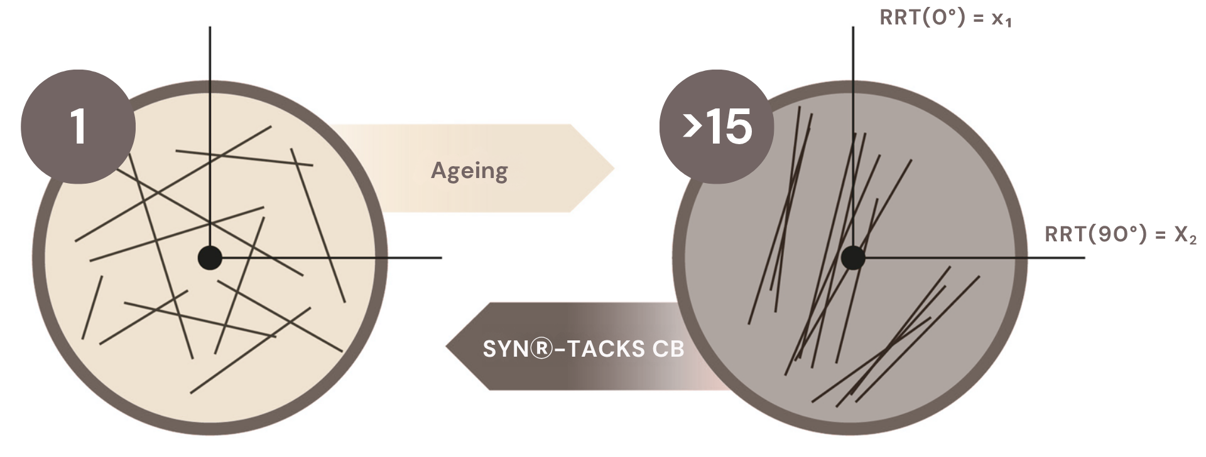
SYN®-TACKS CB - in vivo efficacy
Anisotropy: Degree of collagen fiber alignment
  Young skin
Randomly oriented
RRT_{max}/RRT_{min}=1
  Aged skin
Formed bundles
RRT_{max}/RRT_{min}>>10
in vivo efficacy
Notes:
SYN®-TACKS CB (at least partially) reverts the signs of ageing. Formed bundles are degraded with their normal rate by time, but the collagen provided by stimulated synthesis is randomly oriented, so the Anisotropy decreases.
Explanation of Anisotropy parameter determination: see next slides notes
RRT = Resonance Running Time

Slide 9
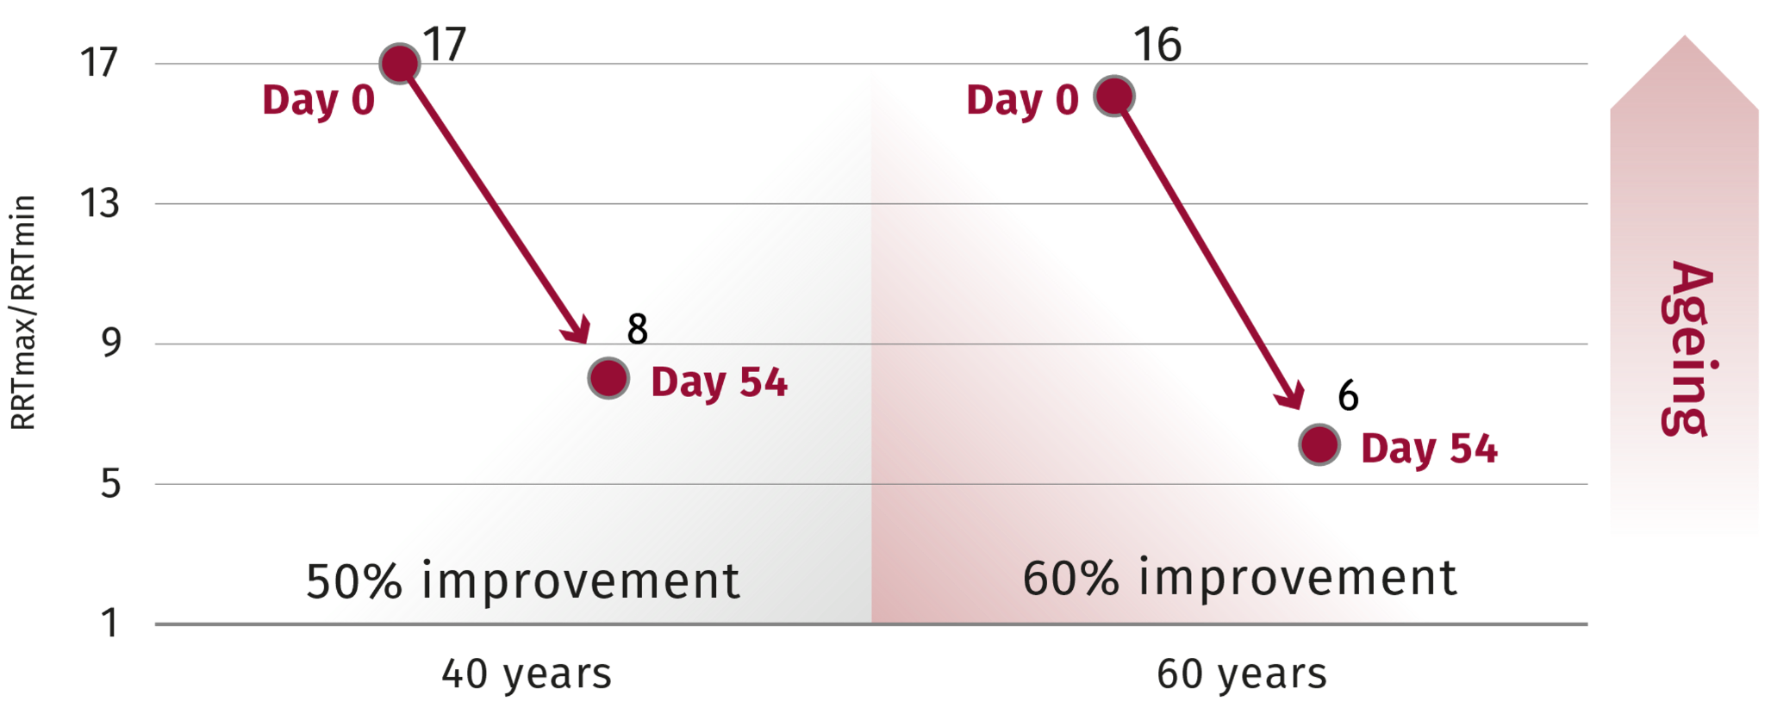
SYN®-TACKS CB – in vivo efficacy
Anisotropy parameter
Three months study, n = 30, age 40-45 and 60-65
17
17
16
Day 0
Day 0
13
RRTmax/RRTmin
Ageing
9
8
6
Day 54
Day 54
5
50% improvement
60% improvement
1
40 years
60 years
  The anisotropy of collagen fibers increases with age.
  SYN®-TACKS CB treatment leads to a “younger” collagen anisotropy.
in vivo efficacy
Notes:
The Reviscometer® (Courage & Khazaka) is a device which generates an acoustic pulse. The time that it takes to go from transmitter to receiver is called Resonance Running Time (RRT). The RRT depends on skin elasticity and on the collagen fibre orientation. The more the RRT is high, the less the skin is elastic.
RRT was measured at 18 different angles, from 0° to 170°. The anisotropy parameter is the ratio between the maximum RRT and the minimum RRT. According to E. Ruvolo and N. Kollias (Johnson&Johnson), the anisotropy parameter increases with age.
The Elasticity parameter was calculated with the RRT obtained at the 0° angle.

Slide 10
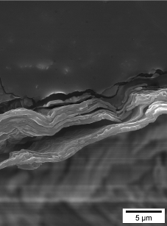
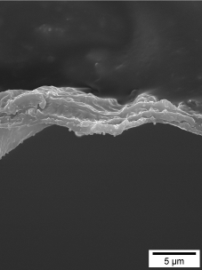
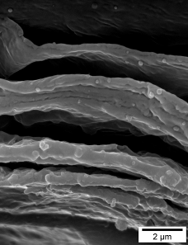
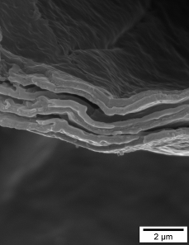
SYN®-TACKS CB – in vivo efficacy
Stratum Corneum Tape Strips
Scanning electron microscopy of tape strips
Volunteer 77, age 44, 1% SYN®-TACKS CB
Volunteer 88, age 62, 1% SYN®-TACKS CB
Day 0
Day 84
Day 0
Day 84
SYN®-TACKS CB improves cellular cohesion:
  Fewer layers are stripped off by tapes
  Layers show increased compactness
in vivo efficacy
Notes:
Cellular cohesion: a) fewer layers were torn off by tape strips, b) distance between layers is reduced

Slide 11
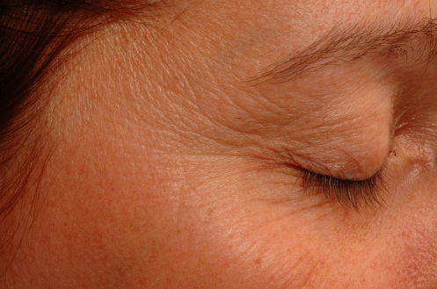
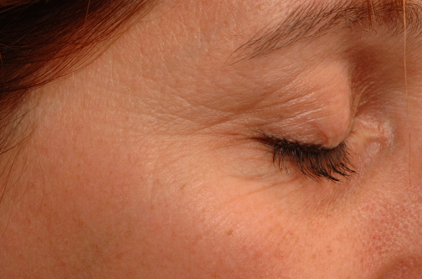
SYN®-TACKS CB – in vivo efficacy
Macrophotographs
Volunteer 73, age 43, 1% SYN®-TACKS CB, 56 days
Day 0
Day 56
  Visible aspects are clearly improved, less wrinkles and better overall improved skin appearance
in vivo efficacy

Slide 12
SYN®-TACKS CB – in vivo efficacy
Evaluation questionnaire: Summary
n =30, 3 months, 1% SYN®-TACKS CB
  About 90% report improved skin state and would purchase
  the product
in vivo efficacy
Notes:
Supple skin: overall skin appearance is improved, the skin has a healthy look with improved elasticity, tonicity and firmness.
The skin feels smooth and could have a silky feeling or even silky touch.

Slide 13

SYN®-TACKS CB - in vivo efficacy
Clinical investigation: Summary
Improved Dermal-Epidermal Junction organization by SYN®-TACKS CB
Improves skin tonicity, firmness, and suppleness after only two months.
Skin anisotropy parameter is rejuvenated.
Cellular cohesion is improved.
Macro photographs show the overall improved appearance.
SYN®-TACKS CB got excellent ratings in the evaluation questionnaire
in vivo efficacy

Slide 14

SYN®-TACKS CB
Easy to formulate with
Offered as a glycerine-based aqueous solution
Preservative- and PEG-free
Optimal pH range in formulation from 3 to 5.5
Stable at elevated temperature (80°C)
for up to 2 hours
Recommended concentration: 1%
Guide formulations are available upon request
Notes:
SYN®-TACKS CB has a total peptide content of 4000 ppm (2000ppm per peptide = 0.02%). This high concentration results in a very low recommended dosage and sometimes a turbid appearance of the samples.
The samples may even gelatinize during storage, which is no quality problem nor is there a problem to formulate with such SYN®-TACKS CB samples.
The product becomes liquid again after vigorous shaking.

Slide 15
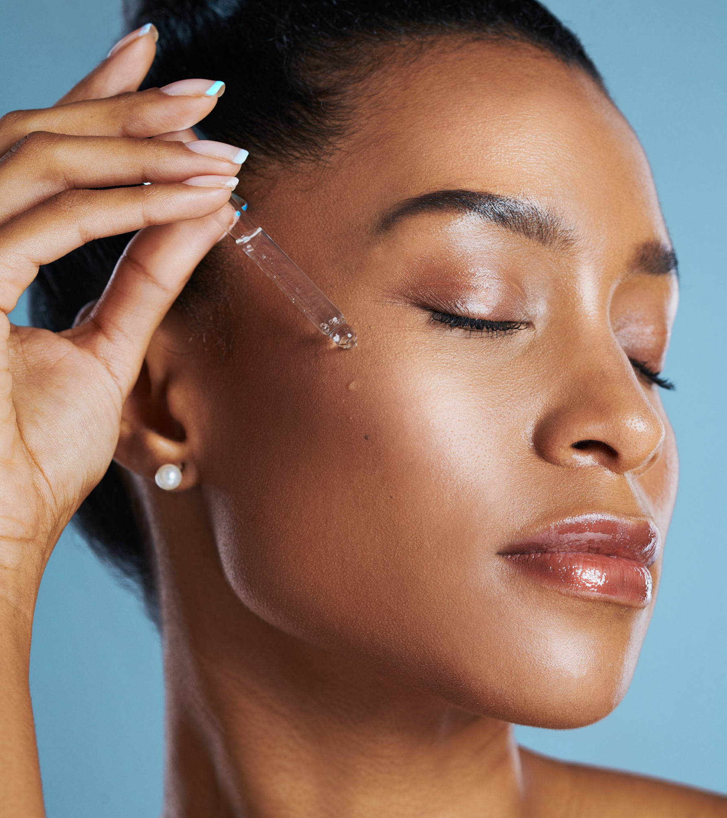
SYN®-TACKS CB
“Top of beauty”
For a well-organized, younger looking skin
The first complex to improve overall DEJ functionality
Optimizes cellular communication
of the skin
Offers structural benefits to the skin
Is safe for cosmetic use
Easy to formulate with
  SYN®-TACKS CB for a well-organized,
  healthy and beautiful skin!

Slide 16
Disclaimer
Copyright © dsm-firmenich Switzerland AG, 2026, 4002 Basel, Switzerland.
www.dsm-firmenich.com. All rights reserved.
dsm-firmenich has used diligent care to ensure that the information provided herein is accurate and up-to-date to the best of its knowledge. However, dsm-firmenich makes no representation or warranty, either expressly or implied, of the accuracy, reliability, completeness, or suitability thereof. The information provided herein contains scientific and product information for business-to-business use and does not constitute or provide scientific or medical advice, diagnosis or recommendation for treatment options. Country or region-specific information should be considered when labelling or advertising to final consumer. In no event shall dsm-firmenich be liable for any direct or indirect damages arising from or reliance upon, or use of, any information provided herein. The content of this document is subject to change without further notice. Please contact your local dsm-firmenich representative for the latest information. All trademarks listed in this document are either (registered) trademarks of, or trademarks licensed by, the dsm-firmenich group of companies, unless explicitly stated otherwise.
Disclaimer Formulation Guideline
The information provided herein is provided for information purposes only and has been prepared by dsm-firmenich in accordance with its own methodology.
dsm-firmenich has used diligent care to ensure that it is accurate and up-to-date, however, dsm-firmenich makes no representation or warranty, either expressly or implied, of the accuracy, reliability, or completeness thereof. In no event shall dsm-firmenich be liable for any damages arising from or reliance upon, or use of, any information provided herein. Further, dsm-firmenich shall not bear any liability for the application and/or use of any processed material containing its product(s). The formulation of the finished product is the customer’s sole responsibility. It is the customer’s responsibility to determine the suitability of dsm-firmenich’s products regarding user specific purposes, assess compatibility and stability of their finished product(s) and to ensure compliance of their finished product(s) with relevant laws and regulations. Any product, marketing or other claims made by customer are its sole responsibility. The content of this document is subject to change without further notice. Please contact your local dsm-firmenich representative for further details. © dsm-firmenich Switzerland AG, 2026.
© 2026

Slide 17
© 2026

