Slide 1
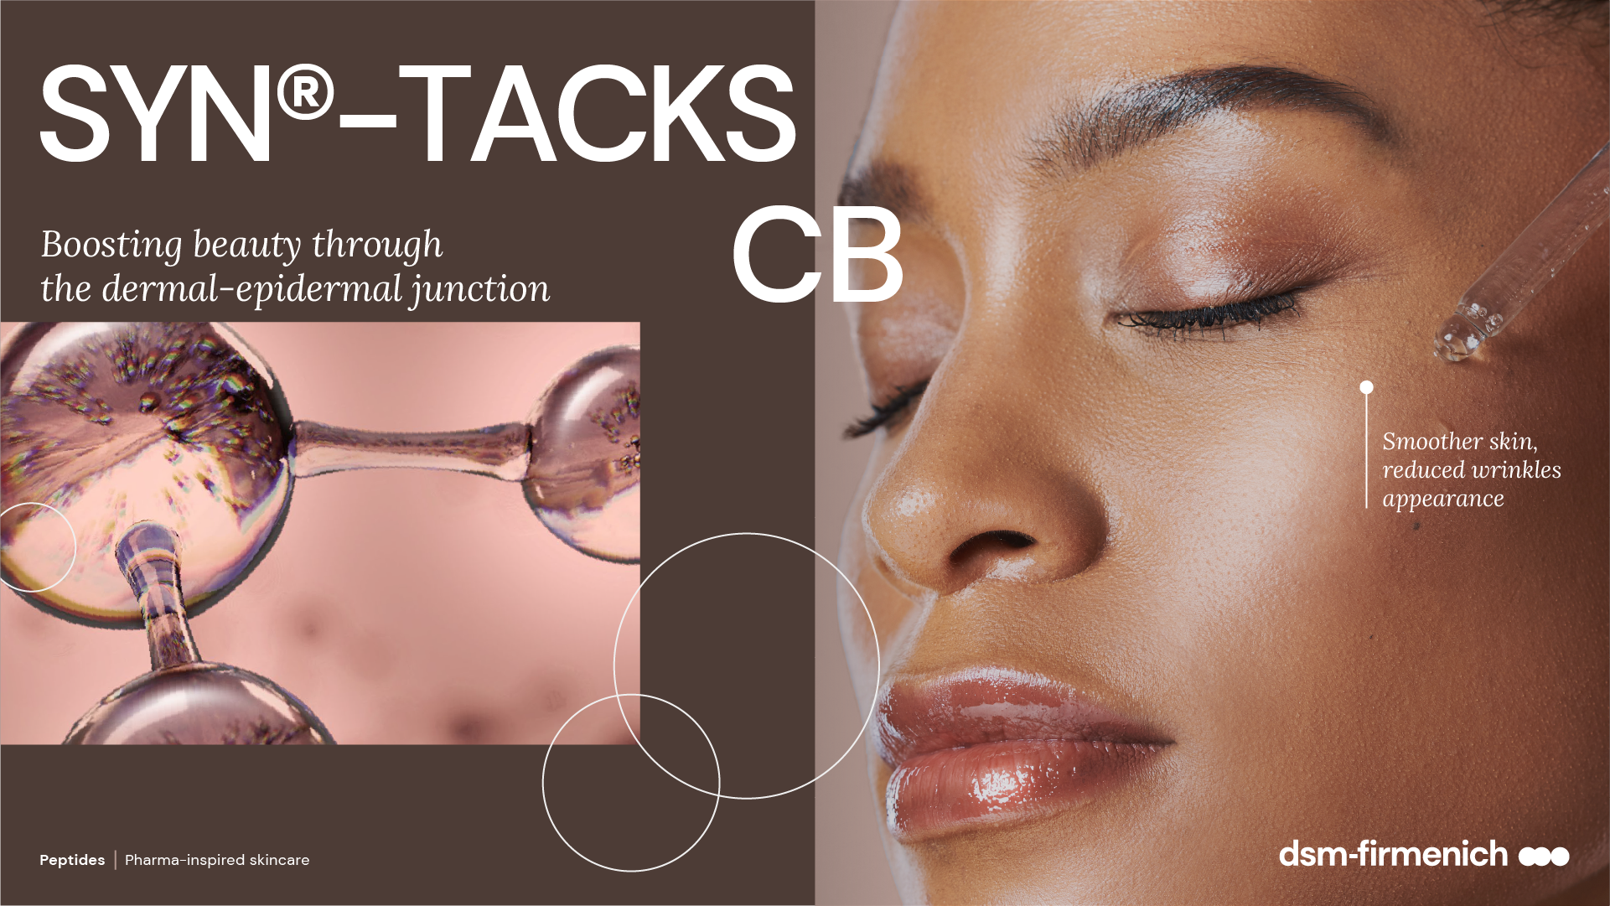
April 2025

Slide 2
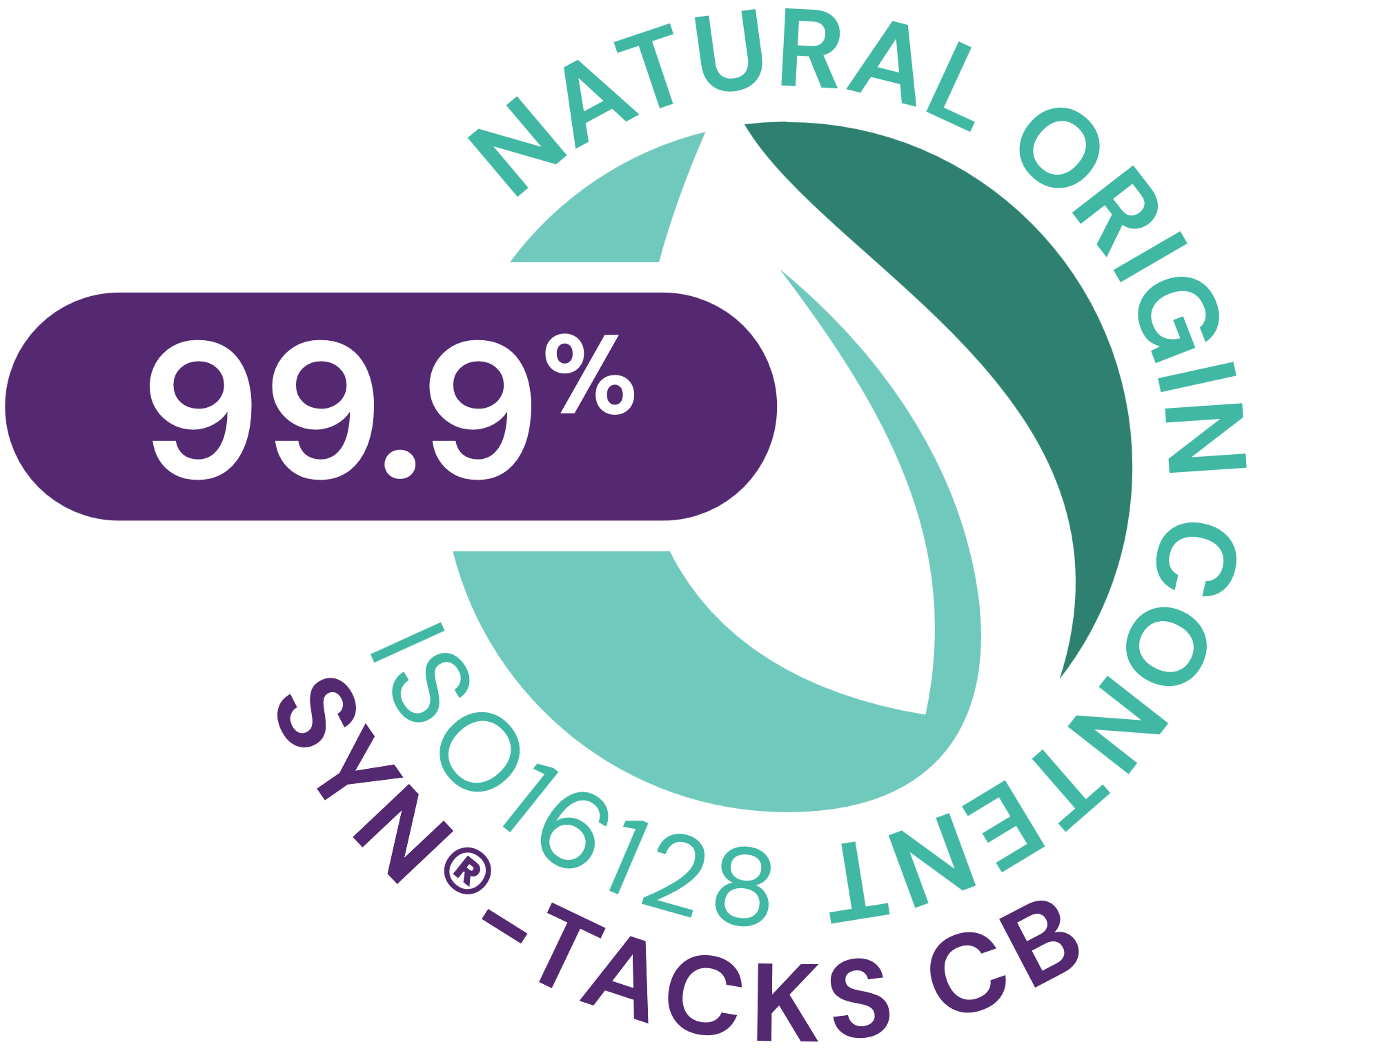



SYN®-TACKS CB
ID Card
INCI NAME:
Palmitoyl Dipeptide-5 Diaminobutyroyl Hydroxythreonine, Palmitoyl Dipeptide-5 Diaminohydroxybutyrate, Aqua, Glycerin
TECHNOLOGY:
Combination of two patented highly active tri- and tetrapeptides, made by latest cutting-edge SYN®-Peptide technology, designed to support the dermal-epidermal junction (DEJ)
TFA-free¹
99.9% of natural origin (according to ISO 16128)
TECHNICAL:
Form: Liquid
pH of use: 3.0-5.5
Use level: 1-3%
Preservative: Free
Solubility: Miscible in water
BENEFITS:
Improves overall DEJ functionality by significantly stimulating Integrin β4, Laminin V, Collagens IV, VII and XVII, and all at once*
Improves molecular communication and structural integrity skin**
Smoother skin and visible reduction of wrinkle appearance **
Rejuvenated, more compact skin**
Increased skin suppleness by +35%**
Increased skin tonicity by +31%**
Increased skin firmness by +17%**
REGISTRATION
CERTIFICATION:
1. Non-intentionally added TFA
* in vitro ** in vivo

Slide 3
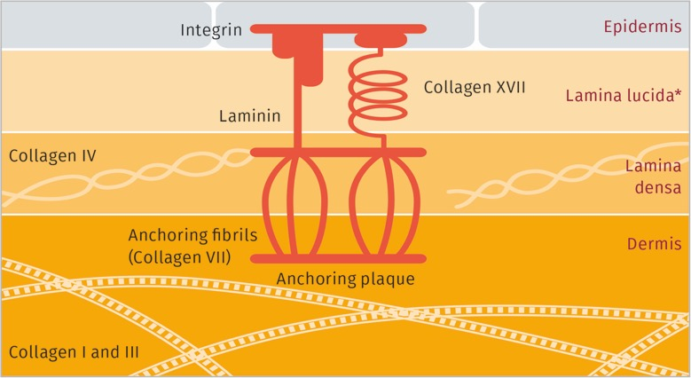
Re-designing the Dermal-Epidermal Junction (DEJ) to reach the “Top of Beauty”
  Biological concepts
  Improves overall DEJ functionality by significantly stimulating Integrin β4, Laminin V, Collagens IV, VII and XVII, and all at once
  Improves molecular communication and structural integrity
  Consumer benefits
  Smoother skin and reduced appearance of wrinkles
  Rejuvenated, more
  compact skin
  Increased skin suppleness by +35%
  Increased skin tonicity
  by +31%
  Increased skin firmness
  by +17%
  Integrin β4 plays an important role in
  inter-cellular communication
  Laminin V is essential to epidermal cell attachment
  Collagen type IV is a key molecule that ensures functionality of the Dermal-Epidermal Junction (DEJ). It forms a sheet to which the anchoring peptides are connected.
  Collagen type VII forms anchoring fibrils in the dermal epidermal junction. Connects the dermis to the DEJ.
  Collagen type XVII plays a major role in holding the layers of skin together as it anchors the epidermis to the DEJ

Slide 4
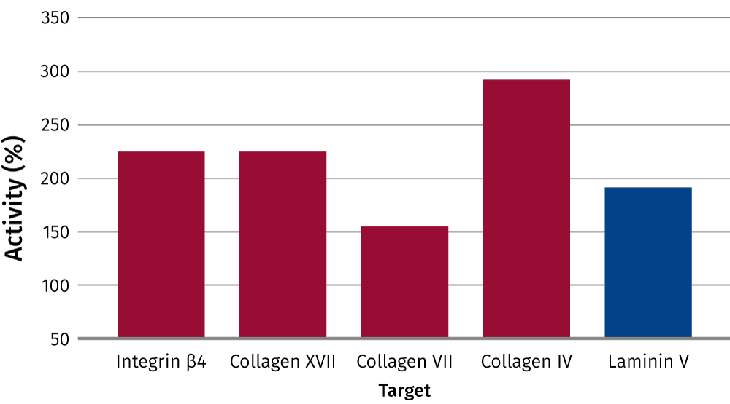
Unique and efficient
  For maximum efficacy SYN®-TACKS CB comprises two peptides to stimulate synthesis of major dermal-epidermal junction (DEJ) proteins.
  Patented tripeptide with an unique amino acid sequence Palm-Lys-Val-Dab.
  Patented tetrapeptide with an unique amino acid sequence Palm-Lys-Val-Dab-Thr.
  The first peptide complex to improve overall dermal-epidermal junction (DEJ) functionality.
Significantly stimulates
Laminin V, Collagens IV, VII and XVII,
and Integrin β4 all at once
Stimulation of the synthesis of relevant DEJ proteins by Palm-Lys-Val-Dab-Thr (50 μM, in red) and Palm-Lys-Val-Dab (100 μM, in blue).
Palm-Lys-Val-Dab = Palmitoyl-Lysine-Valine-Diaminobutyric acid
Palm-Lys-Val-Dab-Thr = Palmitoyl-Lysine-Valine-Diaminobutyric acid-Threonine

Slide 5
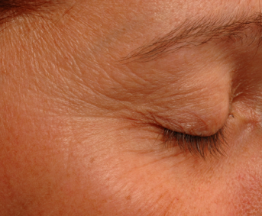
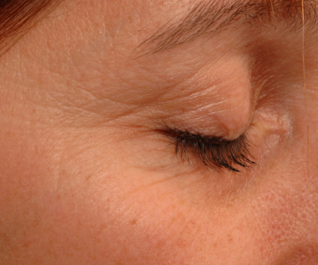
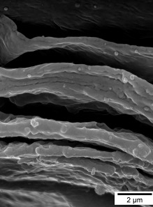
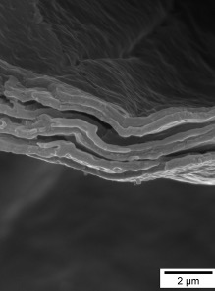
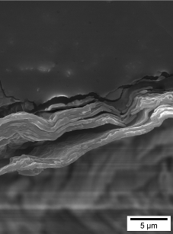
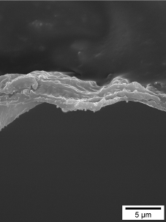
Fewer wrinkles and more compact skin
  Visible reduction of wrinkle appearance
Improved compactness and communication between skin layers
A clearly improved
cohesion, number of cell layers torn off is reduced
Before
After
Before
After
Before
After
Macrophotograph of a 45-year-old volunteer after
56 days of treatment with 1% SYN®-TACKS CB
Scanning electron microphotographs of tape stripping of a 62-year-old
volunteer after 84 days of treatment with 1% SYN®-TACKS CB

Slide 6
Disclaimer
Copyright © DSM Nutritional Products Ltd 2025, 4002 Basel, Switzerland.
www.dsm-firmenich.com. All rights reserved.
dsm-firmenich has used diligent care to ensure that the information provided herein is accurate and up-to-date to the best of its knowledge. However, dsm-firmenich makes no representation or warranty, either expressly or implied, of the accuracy, reliability, completeness, or suitability thereof. The information provided herein contains scientific and product information for business-to-business use and does not constitute or provide scientific or medical advice, diagnosis or recommendation for treatment options. Country or region-specific information should be considered when labelling or advertising to final consumer. In no event shall dsm-firmenich be liable for any direct or indirect damages arising from or reliance upon, or use of, any information provided herein. The content of this document is subject to change without further notice. Please contact your local dsm-firmenich representative for the latest information. All trademarks listed in this document are either (registered) trademarks of, or trademarks licensed by, the dsm-firmenich group of companies, unless explicitly stated otherwise.
Disclaimer Formulation Guideline
The information provided herein is provided for information purposes only and has been prepared by dsm-firmenich in accordance with its own methodology.
dsm-firmenich has used diligent care to ensure that it is accurate and up-to-date, however, dsm-firmenich makes no representation or warranty, either expressly or implied, of the accuracy, reliability, or completeness thereof. In no event shall dsm-firmenich be liable for any damages arising from or reliance upon, or use of, any information provided herein. Further, dsm-firmenich shall not bear any liability for the application and/or use of any processed material containing its product(s). The formulation of the finished product is the customer’s sole responsibility. It is the customer’s responsibility to determine the suitability of dsm-firmenich’s products regarding user specific purposes, assess compatibility and stability of their finished product(s) and to ensure compliance of their finished product(s) with relevant laws and regulations. Any product, marketing or other claims made by customer are its sole responsibility. The content of this document is subject to change without further notice. Please contact your local dsm-firmenich representative for further details. © DSM Nutritional Products AG, 2025.

