Slide 1
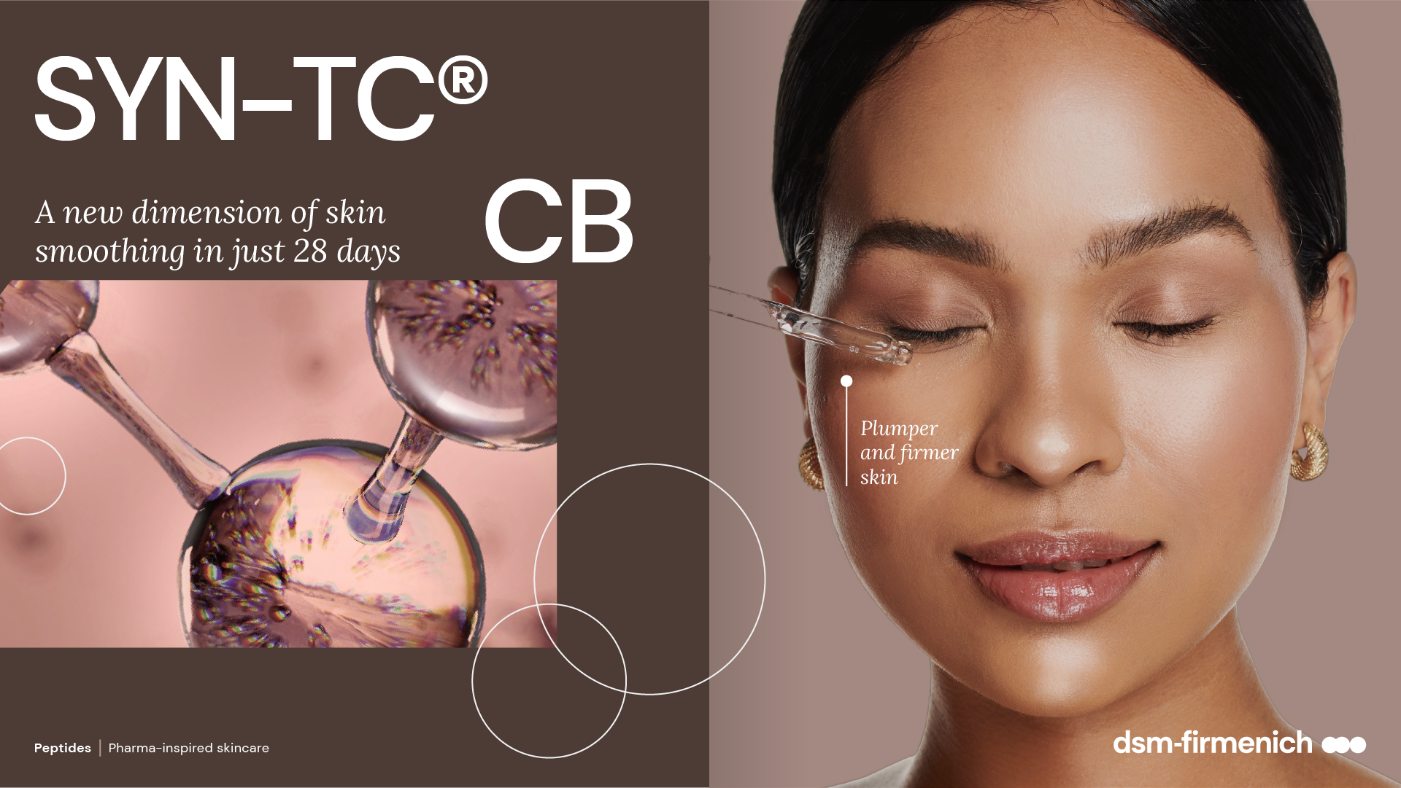
April 2025

Slide 2
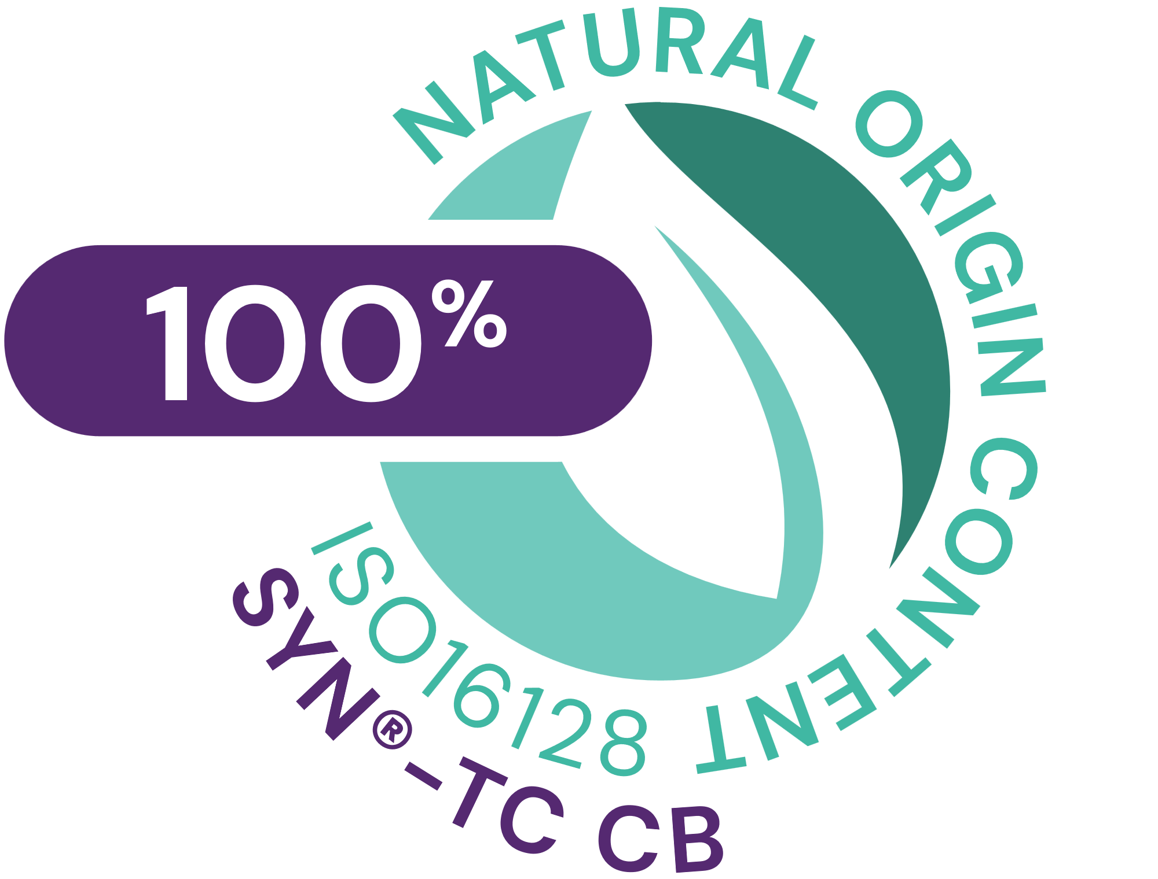



SYN®-TC CB
ID Card
INCI NAME:
Tetradecyl Aminobutyroylvalylaminobutyric Urea Acetate, Palmitoyl Dipeptide-5 Diaminobutyroyl Hydroxythreonine, Palmitoyl Tripeptide-5, Aqua, Glycerin, Magnesium Chloride
Combination of three highly active patented tri- and tetrapeptides, made by the latest cutting-edge SYN®-Peptide technology via Green Chemistry Science, designed to increase the amount of collagen type I, III, IV, VII and XVII
TFA-free¹
100% of natural origin (according to ISO 16128)
TECHNOLOGY:
TECHNICAL:
Form: Liquid
pH of use: 3.0 - 7.0
Use level: 1–2.5%
Preservative: Free
Solubility: Water miscible
Significantly stimulates Collagens I, III, IV, VII and XVII all at once*
Skin is smoother with a softer touch and improved overall young- looking appearance**
Skin appears plumper**
Skin appears firmer**
Appearance of fine lines and wrinkles is visible reduced** ​
BENEFITS:
REGISTRATION
CERTIFICATION
* in vitro ** in vivo
¹ Non-intentionally added TFA

Slide 3
Unique and efficient
  A tailor-made peptide combination provides the best performance.
  Patented tripeptide with a unique amino acid sequence Palm-Lys-Val-Lys-OH.
  Patented tripeptide with a unique amino acid sequence TDAC-Dab-Val-Dab-OH.
  Patented tripeptide with a unique amino acid sequence Palm-Lys-Val-Dab-Thr-OH.
  Award winning, best new ingredient C&T Asia.
  Skin smoothing activity in vitro at a glance
 | Palm-Lys-Val-Lys-OH | TDAC-Dab-Val-Dab-OH | Palm-Lys-Val-Dab-Thr-OH | Main skin benefit
Collagen I |  | +110% |  | More and stable Collagen fibers in the skin, enhanced resiliency
Collagen III | +39% |  |  | Hare of “youth” Collagen increased, fine tunes homogeneity and flexibility of collagen fibers
Collagen IV |  |  | +190% | Improved stability of the DEJ
Collagen VII |  |  | +60% | Improved anchor functionality of the DEJ towards dermis
Collagen XVII |  |  | +120% | Improved anchor functionality of the DEJ towards dermis
Total skin Collagen | SYN-TC® CB | SYN-TC® CB | SYN-TC® CB | Quantity, quality and functionality improvement
Palm-Lys-Val-Lys-OH = Palmitoyl-Lysine-Valine-Lysine
TDAC-Dab-Val-Dab-OH = Tetradecylaminocarbonyl-Diaminobutyric acid-Valine-Diaminobutyric acid
Palm-Lys-Val-Dab-Thr-OH = Palmitoyl-Lysine-Valine-Diaminobutyric acid-Threonine

Slide 4
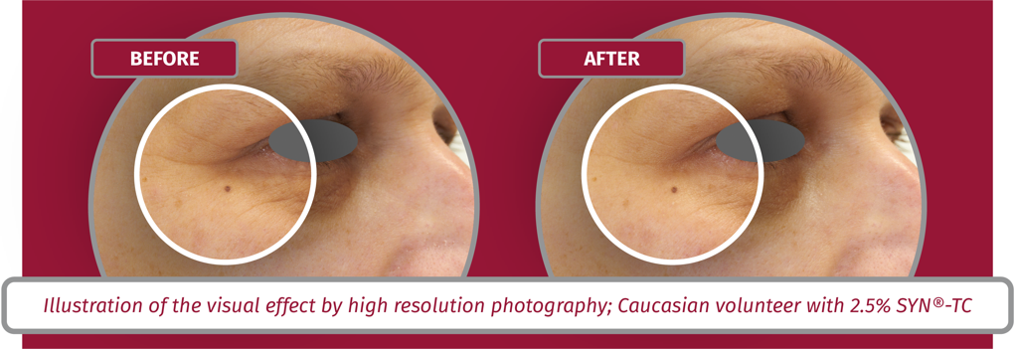

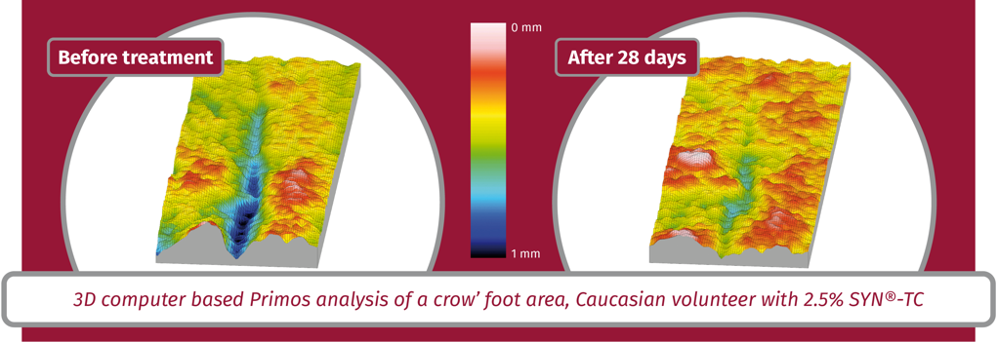
Visible deep wrinkle reduction and skin smoothing
Appearance of deep wrinkles is visibly reduced in only 28 days
SYN-TC® CB
Visible skin smoothing
in only 28 days
SYN-TC® CB

Slide 5
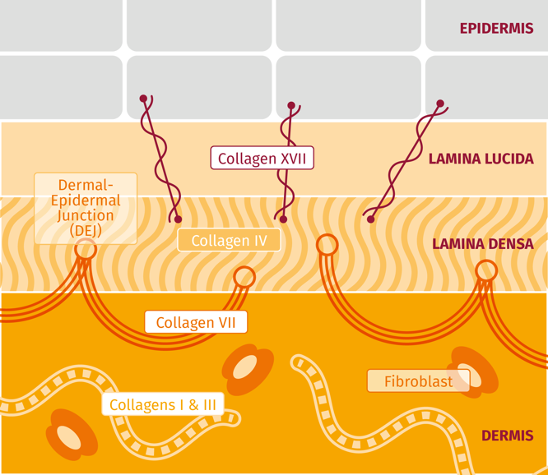
Experience the benefits of Total Collagen Care
Biological concepts
Significantly increases the amount of collagen type I, III, IV, VII and XVII to facilitate their unique contribution to beautiful smooth skin.
  Collagen type I
  Main components of the dermis making up 75% of the dermis protein content. Collagen fibers support the skin’s mechanical strength, volume and texture.
  Collagen type III
  In association with Collagen I, high levels in young, smooth skin.
  Collagen type IV
  Key molecule to ensure functionality of the Dermal-Epidermal Junction (DEJ). It forms a sheet to which the anchoring peptides are connected.
  Collagen type VII
  Forms anchoring fibrils in the dermal epidermal junction. Connects the dermis to the DEJ.
  Collagen type XVII
  Plays a major role in holding the layers of skin together as it anchors the epidermis to the DEJ
  Consumer Benefits
  Appearance of fine lines and wrinkles is visibly reduced in only 28 days
  Visible skin smoothing in only 28 days
  Skin appears firmer
  For high performing facial anti-ageing solutions

Slide 6
Disclaimer
Copyright © DSM Nutritional Products Ltd 2025, 4002 Basel, Switzerland.
www.dsm-firmenich.com. All rights reserved.
dsm-firmenich has used diligent care to ensure that the information provided herein is accurate and up-to-date to the best of its knowledge. However, dsm-firmenich makes no representation or warranty, either expressly or implied, of the accuracy, reliability, completeness, or suitability thereof. The information provided herein contains scientific and product information for business-to-business use and does not constitute or provide scientific or medical advice, diagnosis or recommendation for treatment options. Country or region-specific information should be considered when labelling or advertising to final consumer. In no event shall dsm-firmenich be liable for any direct or indirect damages arising from or reliance upon, or use of, any information provided herein. The content of this document is subject to change without further notice. Please contact your local dsm-firmenich representative for the latest information. All trademarks listed in this document are either (registered) trademarks of, or trademarks licensed by, the dsm-firmenich group of companies, unless explicitly stated otherwise.
Disclaimer Formulation Guideline
The information provided herein is provided for information purposes only and has been prepared by dsm-firmenich in accordance with its own methodology.
dsm-firmenich has used diligent care to ensure that it is accurate and up-to-date, however, dsm-firmenich makes no representation or warranty, either expressly or implied, of the accuracy, reliability, or completeness thereof. In no event shall dsm-firmenich be liable for any damages arising from or reliance upon, or use of, any information provided herein. Further, dsm-firmenich shall not bear any liability for the application and/or use of any processed material containing its product(s). The formulation of the finished product is the customer’s sole responsibility. It is the customer’s responsibility to determine the suitability of dsm-firmenich’s products regarding user specific purposes, assess compatibility and stability of their finished product(s) and to ensure compliance of their finished product(s) with relevant laws and regulations. Any product, marketing or other claims made by customer are its sole responsibility. The content of this document is subject to change without further notice. Please contact your local dsm-firmenich representative for further details. © DSM Nutritional Products AG, 2025.

