Slide 1
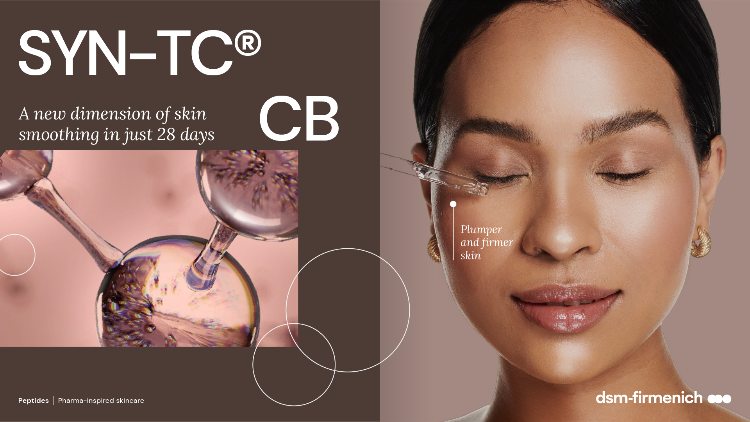
June 2025

Slide 2
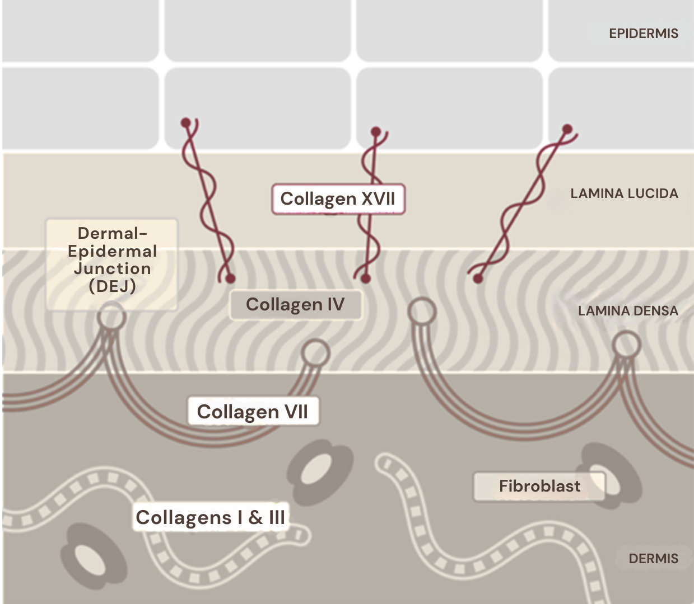
Collagens
The most abundant proteins in skin
Collagens are mainly responsible for the skin´s smoothness
and strength​, provide structure and firmness to the skin. Different collagens work hand in hand:
Collagen type I
Main components of the dermis making up 75% of the dermis protein content. Collagen fibers support the skin’s mechanical strength, volume and texture.
Collagen type III
In association with Collagen I, high levels in young, smooth skin.
Collagen type IV
Key molecule to ensure functionality of the Lamina densa. It forms a sheet to which the anchoring peptides are connected.
Collagen type VII
Forms anchoring fibrils in the dermal epidermal junction.
Connects the dermis to the DEJ.
Collagen type XVII
Plays a major role in holding the layers of skin together as
it anchors the epidermis to the DEJ.
Notes:
Collagen fibers in skin are of mixed composition of collagen I and collagen III
Collagen I gives more stiffness and strength to the fibers and collagen III gives more elasticity
Collagen III regulates fiber assembly and reduces the fiber diameter (higher collagen III content gives smaller diameter)
Collagen III is generally less abundant in the dermis compared to collagen I (ratio highly variable depending on publication)

Slide 3




SYN® TC CB
ID CARD
INCI NAME:
Tetradecyl Aminobutyroylvalylaminobutyric Urea Acetate, Palmitoyl Dipeptide-5 Diaminobutyroyl Hydroxythreonine, Palmitoyl Tripeptide-5, Aqua, Glycerin, Magnesium Chloride
Combination of three highly active patented tri- and tetrapeptides, made by the latest cutting-edge SYN®-Peptide technology via Green Chemistry Science, designed to increase the amount of collagen type I, III, IV, VII and XVII
TFA-free1
100% of natural origin (according to ISO 16128)
TECHNOLOGY:
TECHNICAL:
Form: Liquid
pH of use: 3.0-7.0
Use level: 1-2.5%
Preservative: Free
Solubility: Water miscible
Significantly stimulates Collagens I, III, IV, VII and XVII all at once*
Skin is smoother with a softer touch and improved overall young- looking appearance**
Skin appears plumper**
Skin appears firmer**
Appearance of fine lines and wrinkles is visible reduced**
BENEFITS:
REGISTRATION
CERTIFICATION
¹ Non-intentionally added TFA
* in vitro ** in vivo

Slide 4
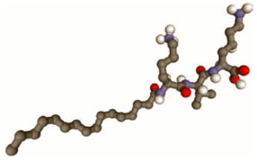
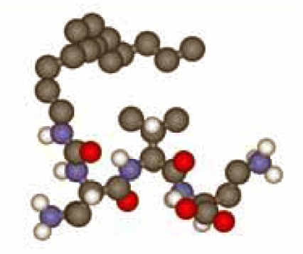
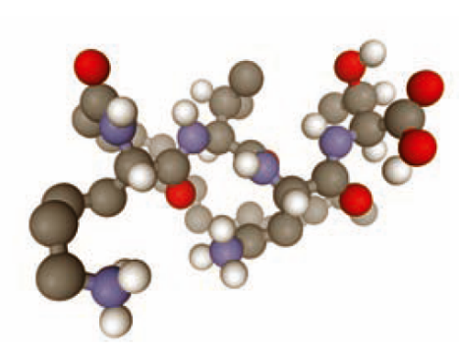
SYN-TC® CB
A tailor-made peptide combination provides best performance
Palm-Lys-Val-Lys-OH
TDAC-Dab-Val-Dab-OH
Palm-Lys-Val-Dab-Thr-OH
INCI: Palmitoyl Tripeptide-5
Activity: Significant effect on collagen III
INCI: Tetradecyl Aminobutyroylvalylaminobutyric Urea Acetate
Activity: Significant effect
on collagen I
INCI: Palmitoyl Dipeptide-5 Diaminobutylroyl Hydroxythreonine
Activity: Significant effect on DEJ anchoring collagens IV,VII, and XVII

Slide 5

SYN-TC® CB
Skin smoothing activity at a glance
 | Palm-Lys-Val-Lys-OH | TDAC-Dab-Val-Dab-OH | Palm-Lys-Val- Dab-Thr-OH | Main skin benefit
Collagen I |  | +110% |  | More and stable collagen fibers in the skin, enhanced resiliency
Collagen III | +40% |  |  | Share of “youth” collagen increased, fine tunes homogeneity and flexibility of collagen fibers
Collagen IV |  |  | +190% | Improved stability of the DEJ
Collagen VII |  |  | +60% | Improved anchor functionality of the DEJ towards dermis
Collagen XVII |  |  | +120% | Improved anchor functionality of the DEJ towards epidermis
Total skin collagen | SYN-TC® CB | SYN-TC® CB | SYN-TC® CB | Quantity, quality and functionality improvement
in vitro efficacy

Slide 6
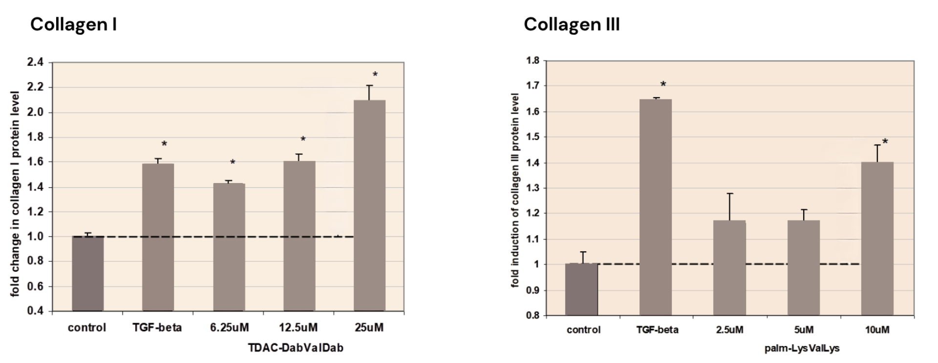
Significant up-regulation of dermal Collagen I and III in human skin fibroblasts
TDAC-Dab-Val-Dab-OH stimulates Collagen 1 Synthesis in a dose dependent manner up to 110%.
Palm-Lys-Val-Lys-OH stimulates Collagen III Synthesis in a dose dependent manner up to 40%.
in vitro efficacy
Notes:
Peptide Tetradecylaminocarbonyl-DabVal-Dab stimulates collagen I synthesis
Measurement of Collagen I or Collagen III Synthesis in Normal Human Fibroblasts:
We grew normal human fibroblasts (NHF) in 96well cell culture plates (Nunclon). After three days we added TDAC-Dab-Val-Dab-OH peptide in medium without FCS and incubated the cells for an additional three days. To measure Collagen I or III synthesis we performed an enzyme linked immunoassay (EIA). In brief: we fixed the cells with 4% paraformaldehyde, and permeabilized them with 0.5 Triton-X100 followed by blocking of unspecific binding sites with 5% skim milk. To stain for Collagen I we incubated the cells with mouse-anti-collagen I antibody (Chemicon, MAB1340) and for Collagen III we used a anti collagen III antibody. We detected then the primary antibody with goat-anti-mouse HRP conjugated (Pierce) secondary antibody. After addition of substrate, we measured Collagen I or III synthesis at 492nm in an absorbance plate reader (Multiskan Ascent, Thermolabsystems). The staining intensity positively correlates with the relative amount of protein produced by the cells and can be compared to the “positive control”, that are cells stimulated by TGF-beta (10ng/ml). TGF-beta is a natural stimulator of collagen synthesis.
Collagen I: The y-axis shows absorption units at 492nm representing relative amount (RA) of collagen I protein. The peptide increases Collagen I synthesis in NHF up to 210% compared to the control (100%) and TGFbeta 1 (positive control).
Collagen III:The peptide palm-KVK stimulates Collagen III Synthesis in NHF in a dose dependent manner. The y-axis shows absorption units at 492nm representing relative amount (RA) of collagen III protein. The peptide increases Collagen 3 synthesis in NHF up to 139% compared to the control (100%) and TGFbeta 1 (positive control). * significance p< 0.01 student t
Collagen fibers in skin are of mixed composition of collagen I and collagen III
Collagen I gives more stiffness and strength to the fibers and collagen III gives more elasticity
Collagen III regulates fiber assembly and reduces the fiber diameter (higher collagen III content gives smaller diameter)
Collagen III is generally less abundant in the dermis compared to collagen I (ratio highly variable depending on publication)

Slide 7
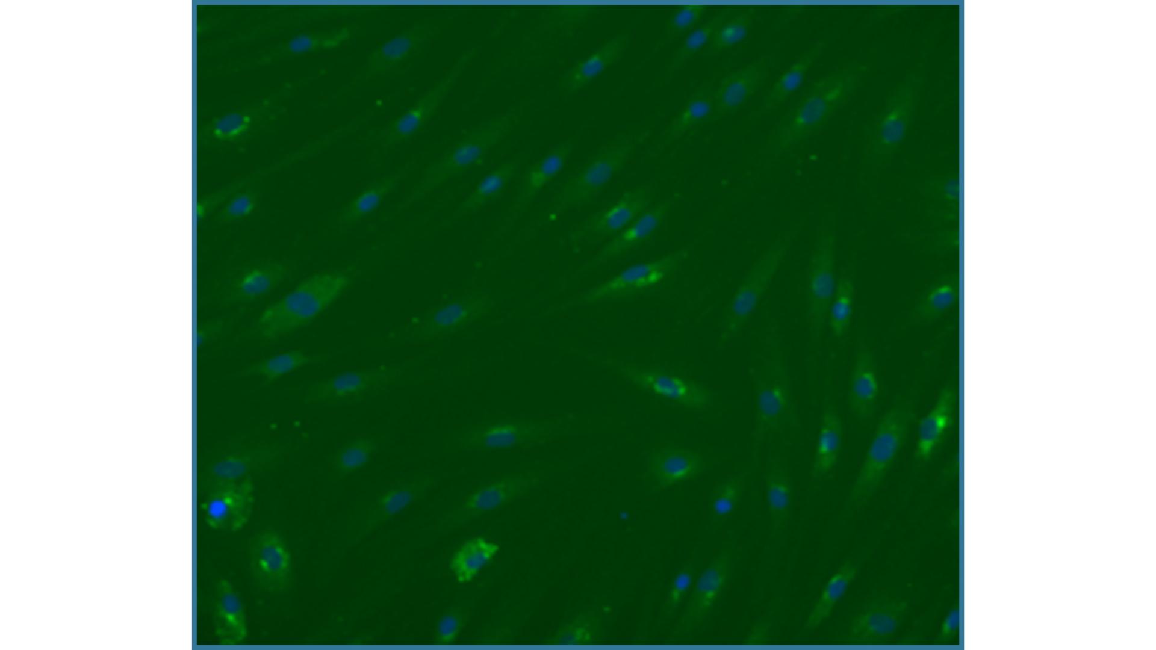
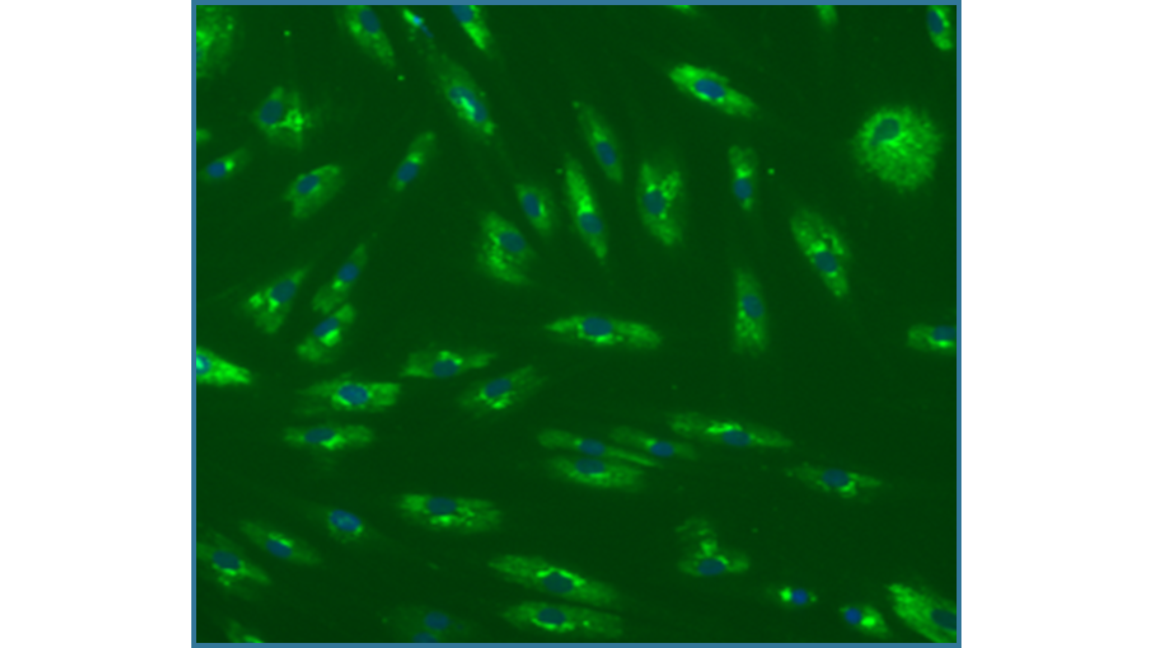
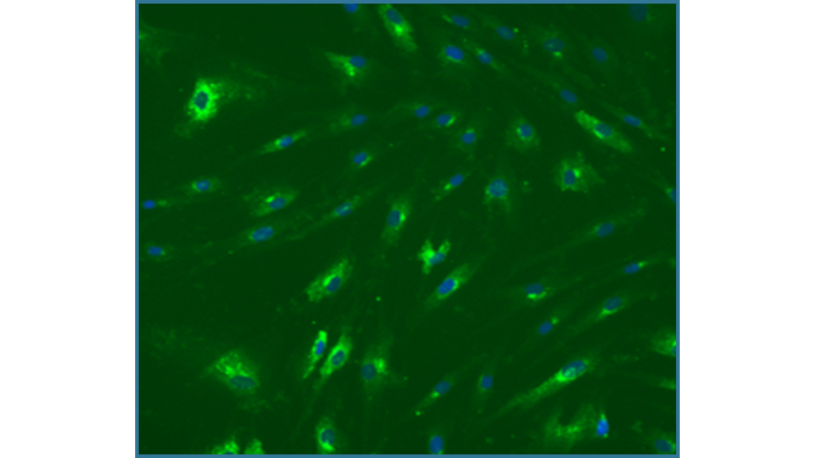
Positive effect on collagen III production in human fibroblasts
    Collagen III is particularly found in quickly-growing tissue, mature skin has higher levels of Collagen I
    Particularly young skin is characterized by high levels of Collagen III, accounting for smooth skin
Negative control
Positive control TGF b
10 uM Palm-LysValLys
in vitro efficacy
Notes:
Figure 3: Immunofluorescent staining of collagen III (bright green) in NHF:
Cells were incubated with A= untreated control, B= TGFbeta and
C= 10uM of palmKVK peptide

Slide 8
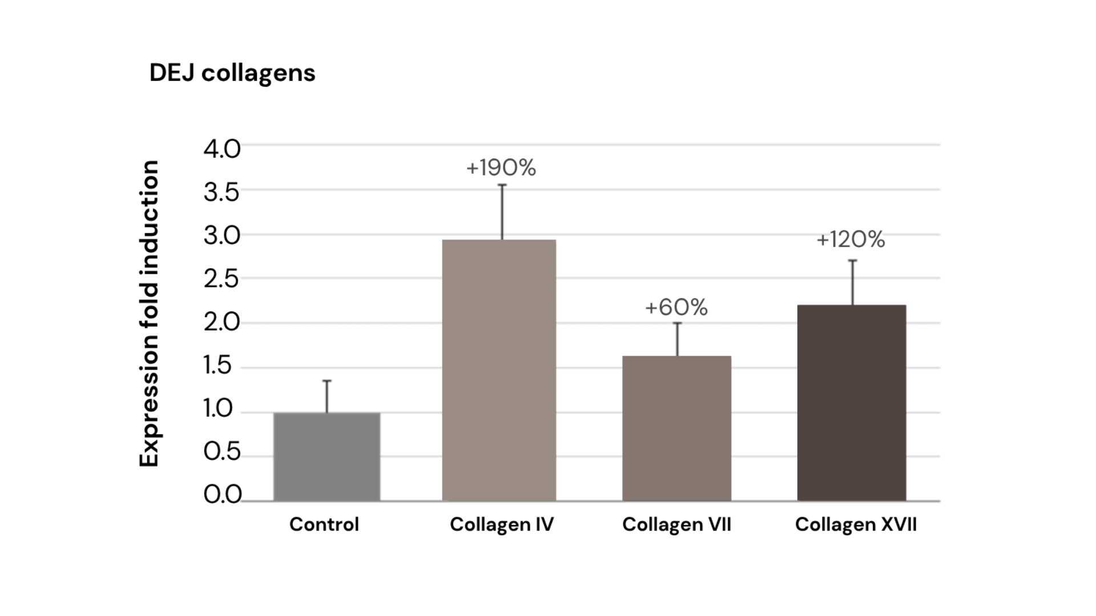

Positive effect on collagen III production in human fibroblasts
The peptide Palm-Lys-Val-Dab-Thr-OH was added at 50uM to a human Keratinocytes cell culture (HaCaT cells) and the expression level for three different collagen genes was measured after
16 hours of incubation time.
in vitro efficacy
Notes:
Peptide palmitoyl-LysValDabThr stimulates collagens IV, VII and XVII of the dermal epidermal junction (DEJ)
Isolation of total RNA and Gene Expression Analysis:
HaCaT cells between passage 10-15 were seeded at 6x104/cm2 in DMEM 10% fetal calf serum and antibiotics. Cells were grown to subconfluency and test substance (palmitoyl-Lys-Val-Dab-Thr-OH) were added and incubated for 16h in growth medium. Total RNA was isolated using the RNeasy Mini Kit (Qiagen) according to manufacturer’s instructions. Subsequently cDNA was prepared using the First Strand cDNA Synthesis Kit (Roche) according to manufacturer’s instructions.
Gene expression analysis was done by Biolytics AG (Witterswil, Switzerland) using a TaqMan® real time PCR-system.
The peptide palmitoyl-Lys-Val-Dab-Thr-OH was added at 50uM to a human keratinocytes cell culture (HaCaT cells) and the expression level for three different collagen genes was measured after 16 hours of incubation time. Data are average values and shown as fold induction as compared to the untreated control cells (collagen XVII 2.2-fold, collagen VII 1.6-fold and collagen IV was stimulated 2.9-fold)

Slide 9

SYN-TC® CB
Skin smoothing activity at a glance - in vivo
Parameter | 1 month | 2 months | Consumer benefit
Smoothness increase | + 9.1% | + 12.2% | Improves skin touch and softness Smoother skin
Firmness increase | + 7.6% | + 10.8% | Improves the look of skin
Wrinkle depth reduction | - 5.6% | - 10.3% | Reduces the appearance of lines and wrinkles
Wrinkle volume reduction | - 6.9% | - 11.9% | Reduces the appearance of lines and wrinkles
Comparison against initial conditions (average values)
in vivo efficacy
Notes:
All four parameters show a visible improvement of the skin status already after 28 days, however the effect gets more prominent after 2 month.

Slide 10
SYN-TC® CB
in vivo study set-up
Design:
  Methodology - Double blind, 30 volunteers
  Female volunteers, age 30 – 50y (average 42y), with visible facial skin wrinkles
  Application twice daily and test area on face and on forearms
  Formulation with/without 2.5% SYN-TC® CB
Parameters:
  Measurement of the skin firmness on the forearm using Cutometer®
  Measurement of skin smoothness using PRIMOS technology on the forearm
  Measurement of wrinkle parameters in crow’s feet area by 3D PRIMOS topography recording technology
  Illustration of the visual effect by high resolution photography
in vivo efficacy
Notes:
Test areas:
in face at crow‘s feet left and right (Placebo vs Product)
Inner side of forearm
Study performed by Dermaconsult GmbH in Bonn (Germany)
Primos is a trademark of GFMesstechnik, Berlin (Germany)

Slide 11
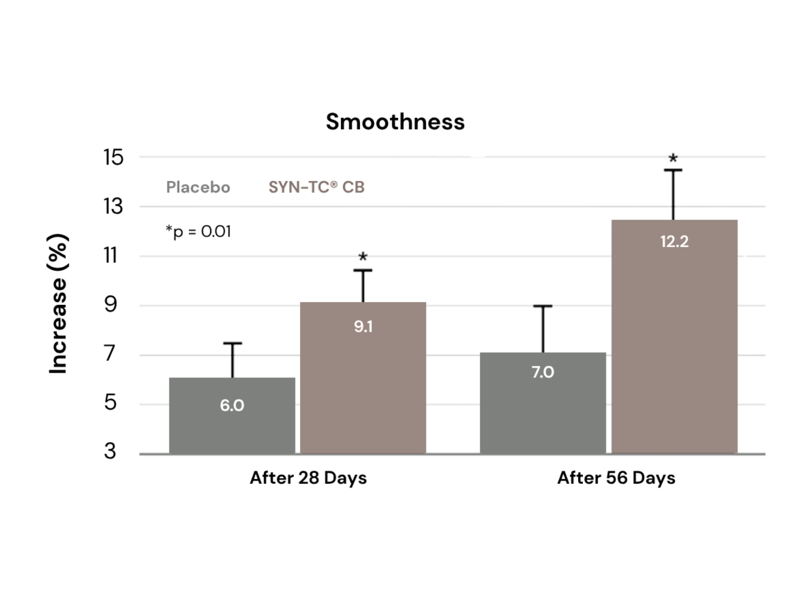
Significant improvement of skin smoothness
SYN-TC® CB shows after already one month
a significant improvement of skin smoothness (+9.1%), the effect is further pronounced after
two months (+12.2%).
  Comparison against initial conditions (average values)
in vivo efficacy

Slide 12
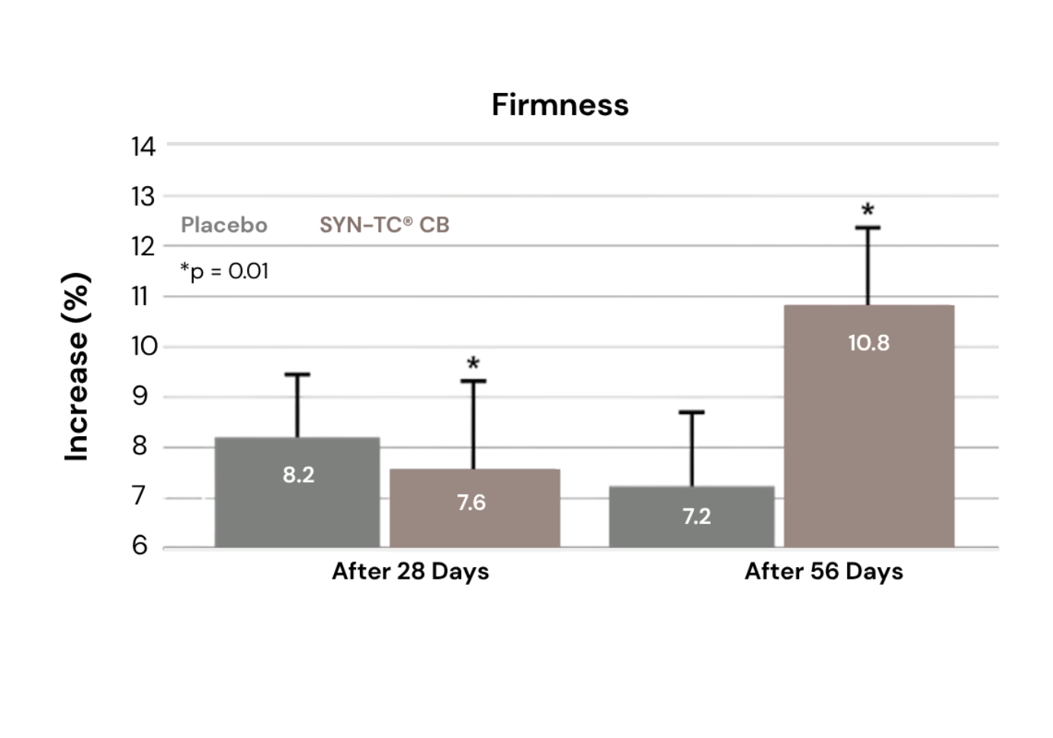
Skin gets significantly firmer using SYN-TC® CB
SYN-TC® CB shows after already one month
a skin firming effect (+7.6%) that is further enhanced after two months (+10.8%).
  Comparison against initial conditions (average values)
in vivo efficacy

Slide 13
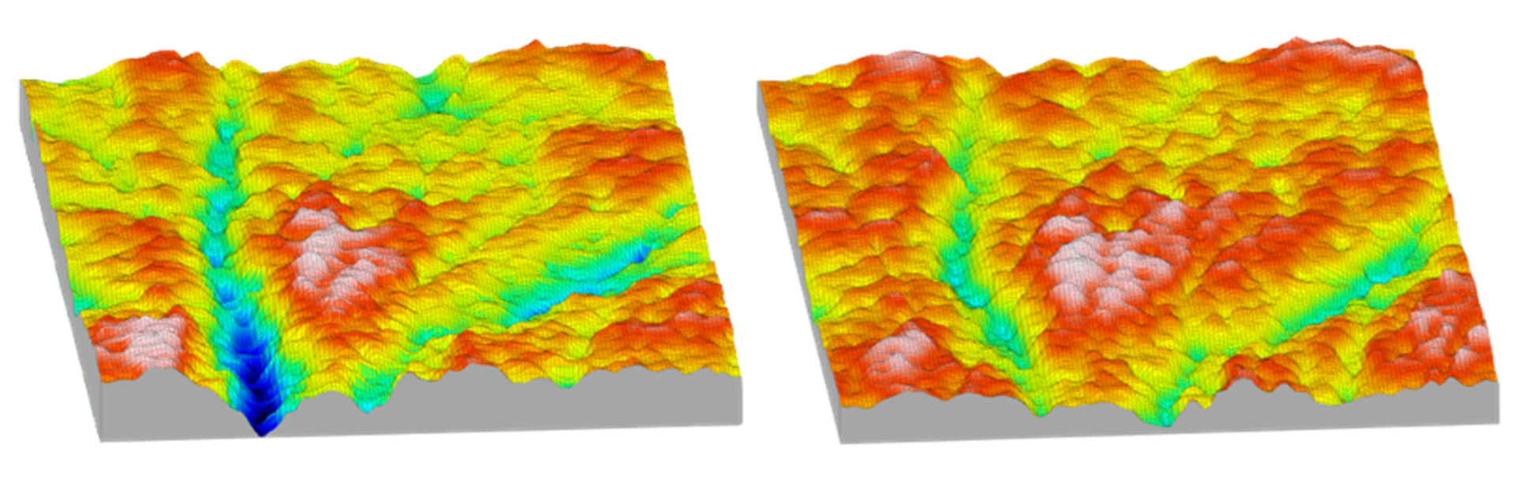
Visible skin smoothing in only 28 days
1/2
0 mm
1 mm
Before treatment
After treatment
3D computer based Primos analysis of Crow’ foot area, Volunteer no. 11
The skin surface becomes smoother with an overall reduced appearance of wrinkles (depth, area, volume)
Graph: Dermaconsult 2012

Slide 14
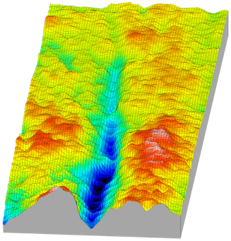
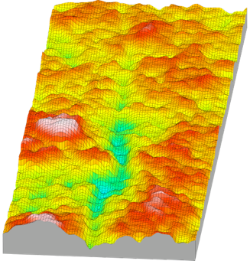
Visible skin smoothing in only 28 days
2/2
0 mm
1 mm
Before treatment
After treatment
3D computer based Primos analysis of Crow’ foot area, Volunteer no. 24​
The skin surface becomes smoother with an overall reduced appearance of wrinkles (depth, area, volume)
Graph: Dermaconsult 2012

Slide 15
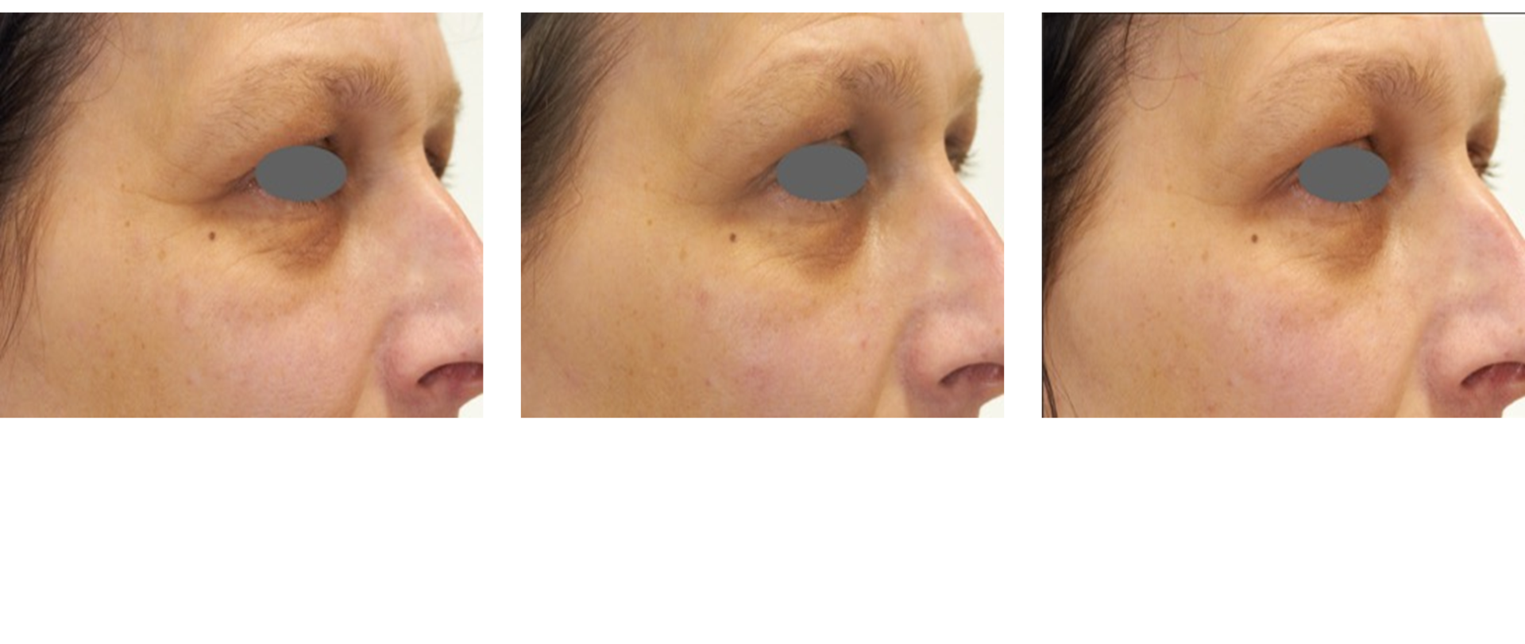

Reduced appearance of deep wrinkles and iron out smaller wrinkles
Photographic documentation, Volunteer no. 6​
Wrinkle appearance in the crow feet is reduced, the skin looks younger
Day 0
Day 28
Day 56

Slide 16
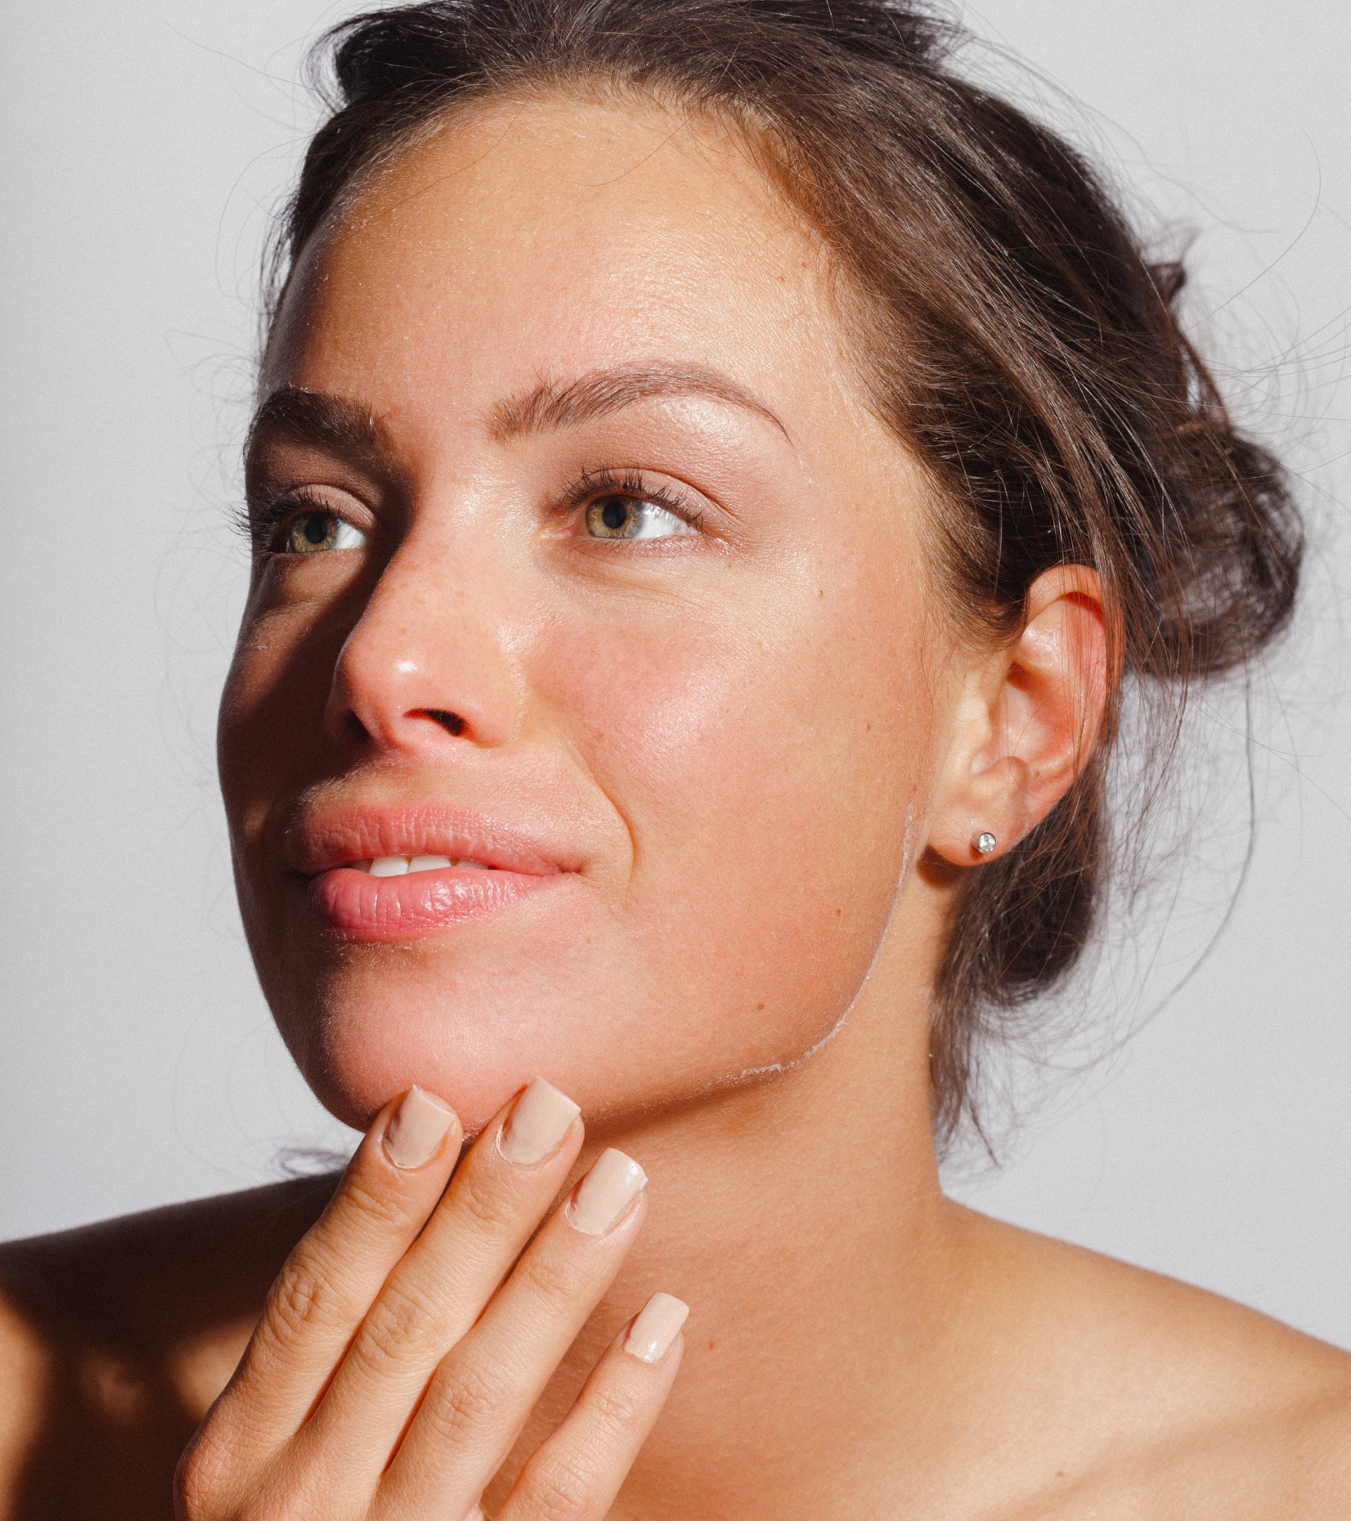
SYN-TC® CB
Experience the benefit of total collagen
care in only 28 days​
Skin is smoother with a softer touch​
Younger looking appearance​
Skin appears plumper​
Skin appears firmer​
Appearance of fine lines and
wrinkles is visibly reduced​

Slide 17
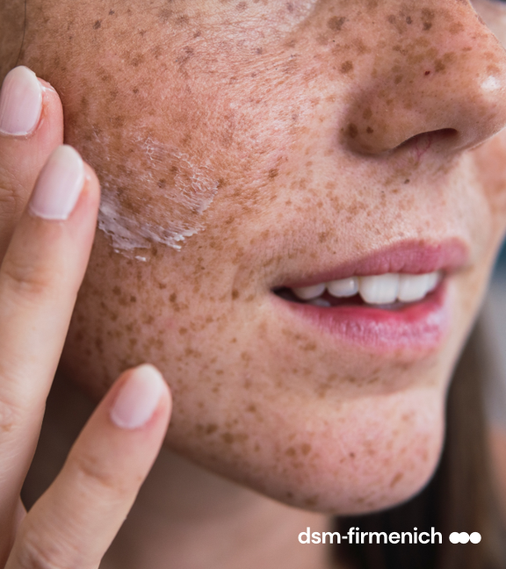
SYN-TC® CB
Formulation guidelines
Offered as a glycerine-based aqueous solution
No preservative
Optimal pH range in formulations from 3 to 7
Stable at elevated temperature (80°C)
for up to 2 hours
Recommended concentration: 2.5%
Guide formulations are available upon request

Slide 18

Disclaimer
Copyright © DSM Nutritional Products Ltd 2025, 4002 Basel, Switzerland.
www.dsm-firmenich.com. All rights reserved.
dsm-firmenich has used diligent care to ensure that the information provided herein is accurate and up-to-date to the best of its knowledge. However, dsm-firmenich makes no representation or warranty, either expressly or implied, of the accuracy, reliability, completeness, or suitability thereof. The information provided herein contains scientific and product information for business-to-business use and does not constitute or provide scientific or medical advice, diagnosis or recommendation for treatment options. Country or region-specific information should be considered when labelling or advertising to final consumer. In no event shall dsm-firmenich be liable for any direct or indirect damages arising from or reliance upon, or use of, any information provided herein. The content of this document is subject to change without further notice. Please contact your local dsm-firmenich representative for the latest information. All trademarks listed in this document are either (registered) trademarks of, or trademarks licensed by, the dsm-firmenich group of companies, unless explicitly stated otherwise.
Disclaimer Formulation Guideline
The information provided herein is provided for information purposes only and has been prepared by dsm-firmenich in accordance with its own methodology.
dsm-firmenich has used diligent care to ensure that it is accurate and up-to-date, however, dsm-firmenich makes no representation or warranty, either expressly or implied, of the accuracy, reliability, or completeness thereof. In no event shall dsm-firmenich be liable for any damages arising from or reliance upon, or use of, any information provided herein. Further, dsm-firmenich shall not bear any liability for the application and/or use of any processed material containing its product(s). The formulation of the finished product is the customer’s sole responsibility. It is the customer’s responsibility to determine the suitability of dsm-firmenich’s products regarding user specific purposes, assess compatibility and stability of their finished product(s) and to ensure compliance of their finished product(s) with relevant laws and regulations. Any product, marketing or other claims made by customer are its sole responsibility. The content of this document is subject to change without further notice. Please contact your local dsm-firmenich representative for further details. © 2025 dsm-firmenich group.

