Slide 1
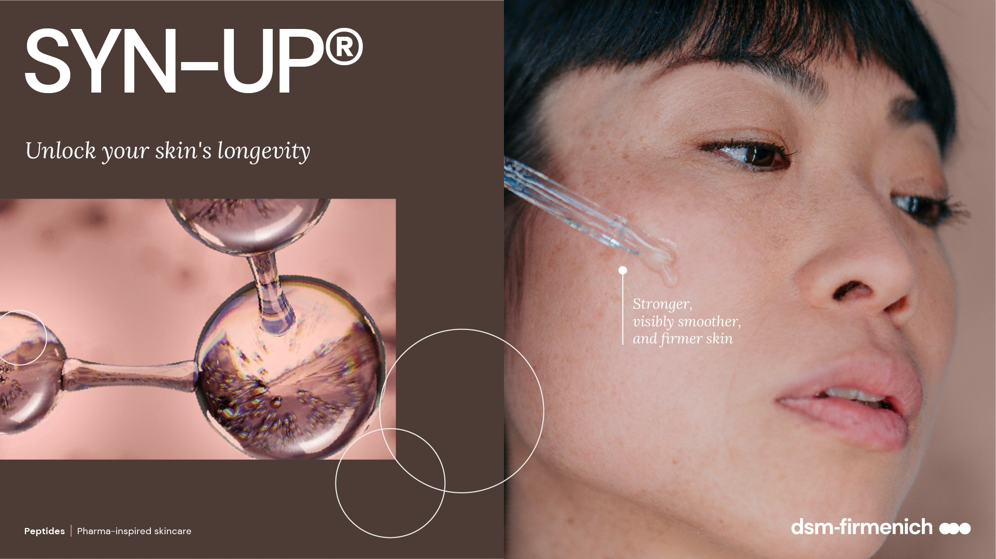
August 2026

Slide 2



SYN-UP®
ID Card
INCI NAME:
Amidinobenzyl Benzylsulfonyl D-Seryl Homophenylalaninamide Acetate, Aqua, Glycerin, Citric Acid, Sodium Hydroxide
TECHNOLOGY:
Highly potent patented dipeptide derivative, made by cutting-edge SYN®-Peptide technology via Green Chemistry Science to rebalance Plasmin activities, which is important for healthy-looking skin
In silico structure-based peptide design and artificial intelligence (AI), visualized with molecular modelling
TFA-free¹
99.9% of natural origin (according to ISO 16128)
TECHNICAL:
Form: Liquid
pH of use: 3.0-7.5
Use level: 1%
Preservative: Free
Solubility: Miscible in water
BENEFITS:
Promotes healthy-looking skin by inhibiting Plasmin levels* and rebalancing key bacteria S. Aureus and S. Epidermidis**​
Reduces skin sensitivity and redness by modulation MMP 9*/***, CXCL5* and IL-8 activities*​
Helps to smooth the skin by preventing the degradation of type IV Collagen*/*** and by stimulating type I Collagen* ​
Down-regulates melanin synthesis* ​
Makes the skin more resilient against stress attacks day-by-day**
Real, significant prevention of dry skin conditions**
Reduces redness and unpleasant skin sensations**
Visibly smoother and firmer skin**
Lighter age spots in just 2 weeks **
REGISTRATION
CERTIFICATION:
1. Non-intentionally added TFA
* in vitro ** in vivo *** ex vivo

Slide 3
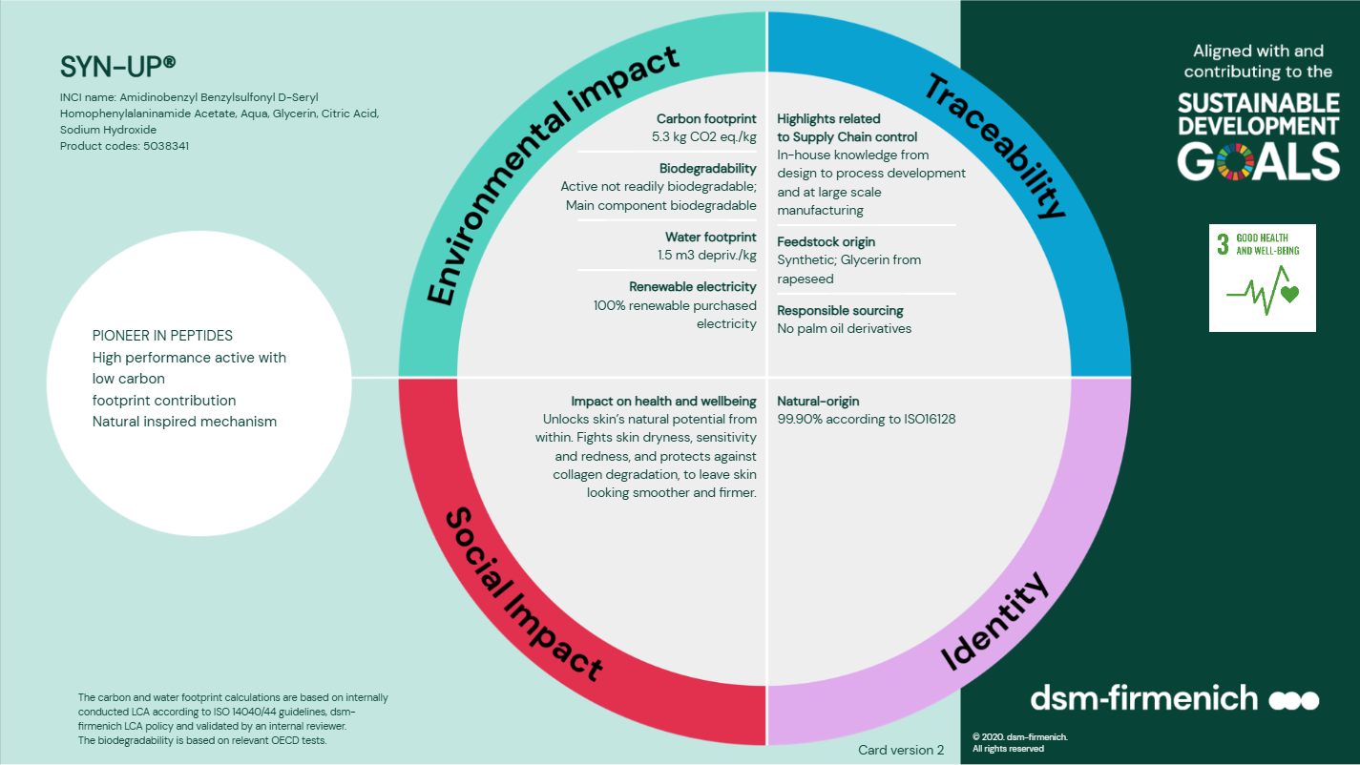

Slide 4
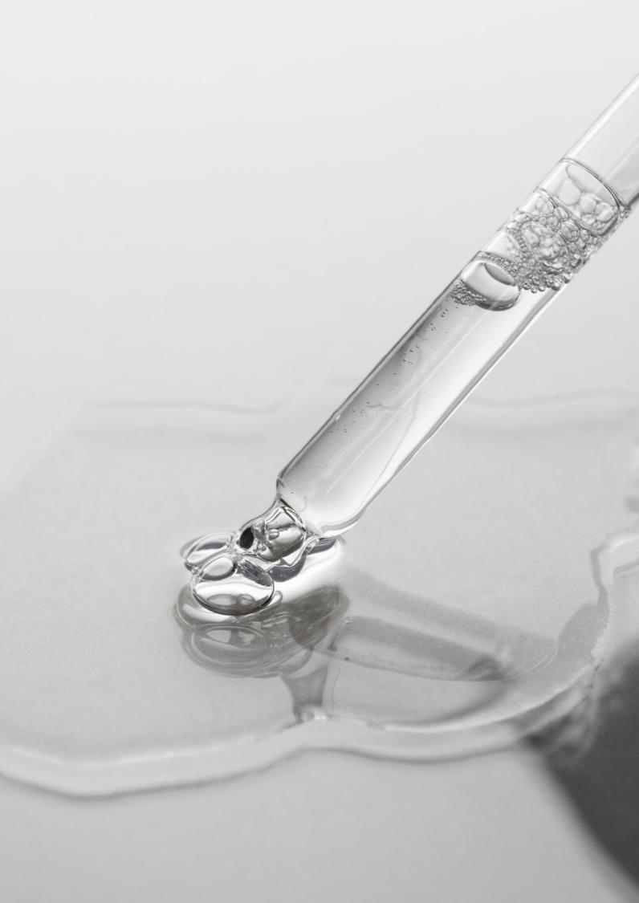

SYN-UP® : a combination of Efficacy and Sustainability
Carbon footprint of 5.3 kg CO2 eq./kg. High efficiency allowing a low carbon footprint in use(1).
Green chemistry reaction type(2) and waste minimization with an 80% solvent recovery
Manufactured in Switzerland with 100% renewable electricity(3)
>99% naturality according to ISO 16128(4) and suitable for Clean Beauty
(1) Considering the 1% recommended use-level, 53 g CO2 per kg of final formulation.
(2) Main reaction type is amidation
(3) The last production step in Aesch
(4) The full SYN-UP® formulation
Notes:
Activity profile allows for very low use levels, thus allowing for a minimal CO2 footprint in the final formulation
Calculation for the carbon footprint in use of SYN-UP:
With 1% use level (recommended): 0.01kg/kg*5.3 kg CO2/kg = 0.053 kg CO2 / kg formulation = 53 grams CO2 / kg formulation
Major reaction type is amidation, specifically mentioned in ISO 16128 as green chemistry
80 % of the waste solvents are recycled by the external companies and are used for future industrial purposes in the market for the sake of saving energy and reducing carbon emissions. Whereas the other 20% of waste solvents are burned and some of them are used for heat recovery systems as well.
Manufactured in Aesch, Switzerland, with 100% renewable electricity

Slide 5

The exposome threat
Every day external stressors, such as UV irradiation, climate, pollution or chemicals can disbalance the skin.
This process activates the production of pro-inflammatory molecules (cytokines) and proteolytic enzymes (MMP’s, Plasmin, Urokinase…) triggering a series of skin damages and signs of aging.
Over time, the epidermis becomes thinner and more vulnerable, which also makes it more permeable to attack. This leads to the alteration of the Dermo-Epidermal Junction and the deterioration of Collagen in the Dermis.
The result?
The skin becomes more fragile, prone to sensitization, loses its vitality and firmness… in short, looks unhealthy.
Not part of approved library

Slide 6
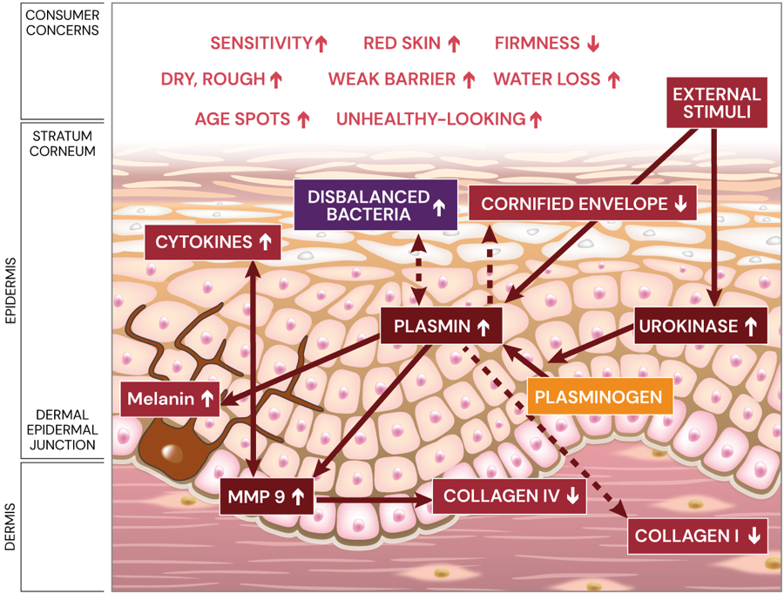
What’s happening inside the skin?
High Plasmin & Bacteria disbalance play a central role in unhealthy-looking skin
Plasmin is an enzyme responsible for protein activation and degradation and is widely present in the epidermis of the skin.
High Plasmin activities:
  disbalance bacteria: S. aureus affects skin barrier function via bacterial proteases, inflammation is triggered, and Plasmin is further activated leading to an even more vulnerable barrier¹.
  affect the Cornified Envelope, important for the protection and maintenance of the skin barrier
  activate MMP 9 leading to increased levels of inflammatory cytokines and red skin conditions. Increased levels of MMP 9, which are also elevated in sun-exposed skin, mediate degradation of type IV Collagen, a major component in the Dermal Epidermal Junction.
  activate MMP 1 levels leading to the degradation of type I Collagen so the skin has less structural support². When Collagen is compromised, skin loses elasticity & firmness.
  increase melanin synthesis leading to uneven skin tone and age spots.
Allergy Asthma Immunol Res. 2019 Sep;11(5): 593-603
Experimental Dermatology 2018;27:520–525.
Notes:
-Voegeli et. al, 2017, Int J Cosmet Sci, 39, 109-120
-Voegeli et al, 2017, IFSCC Magazine, 3, 111-118
-Sonoki et al, 2018, Exp Dermatol, 27, 520-525

Slide 7
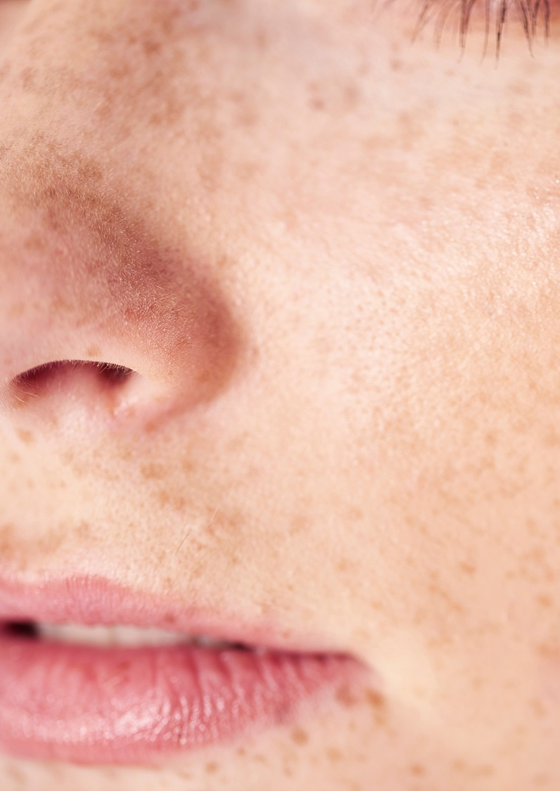
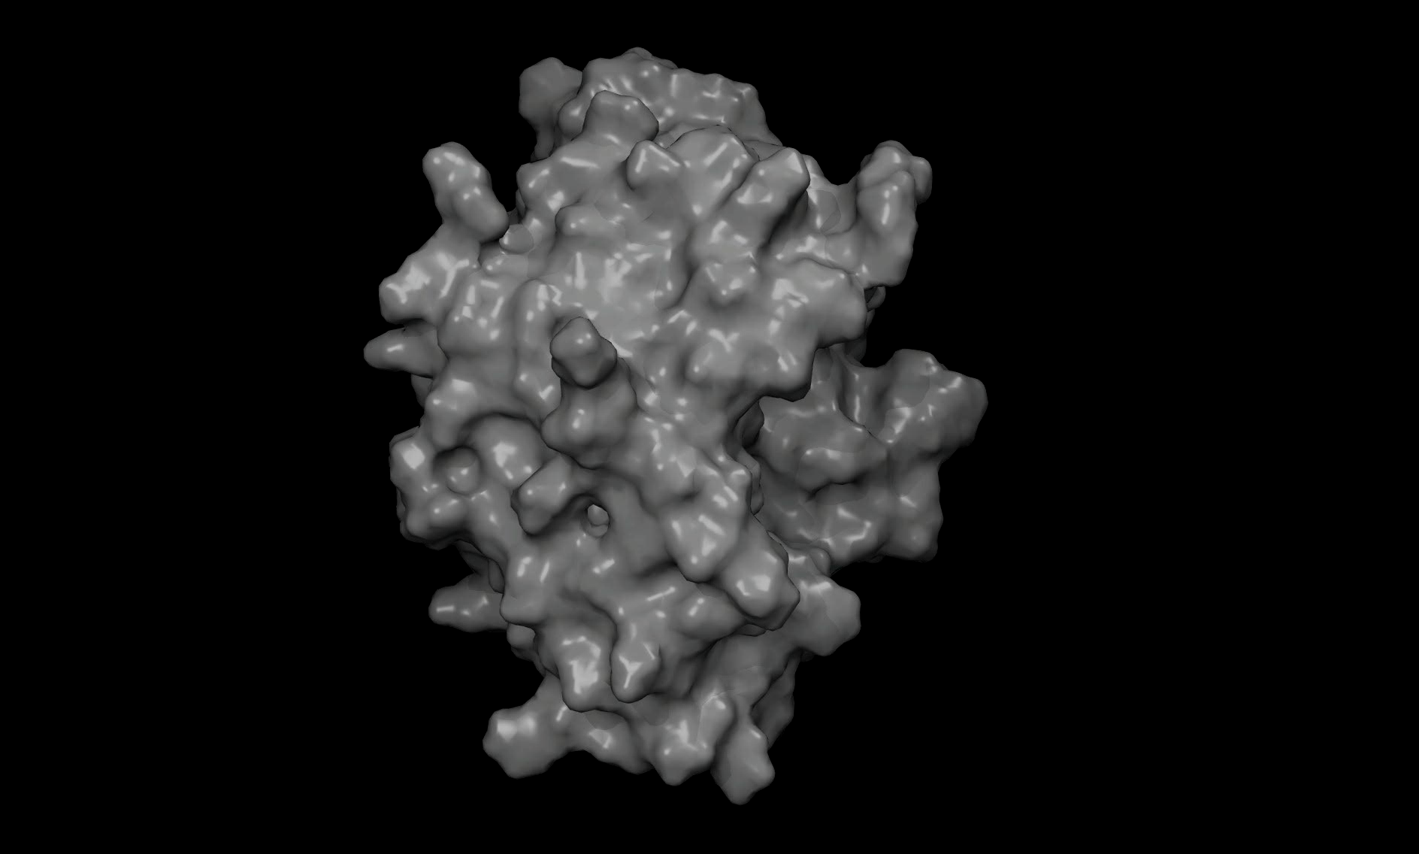
SYN-UP® peptide targets Plasmin
Visualized with molecular modelling
Molecular modelling approach and Artificial Intelligence (AI) provides accurate prediction of the mode of action
SYN-UP® peptide (in blue) fits with the perfect size and shape like a key into a lock of the active site (the key-hole) of Plasmin (the lock - in green)

Slide 8
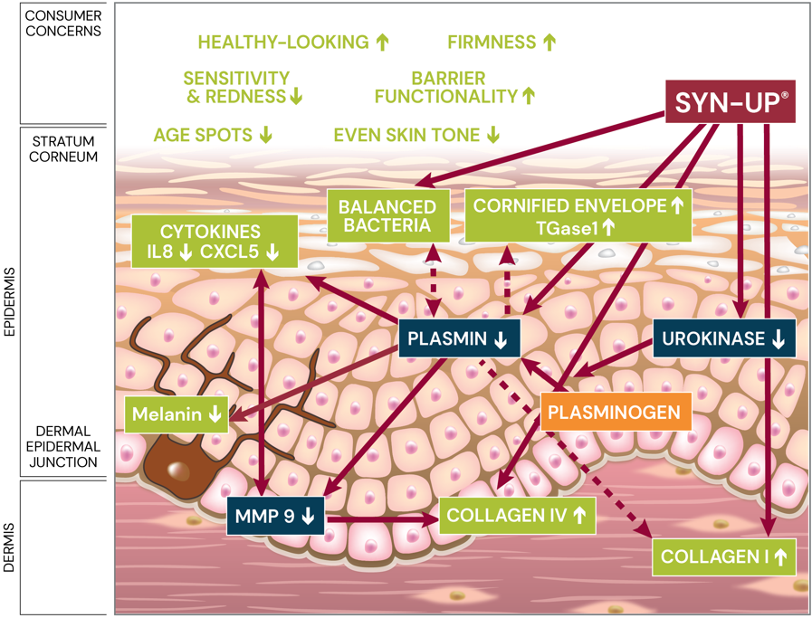
SYN-UP® unlock your skin’s longevity
One biological target (Plasmin) to drive improvement across all skin layers
SYN-UP® promotes healthy-looking skin by inhibiting Plasmin and Urokinase* activities and balancing key bacteria S. Aureus* and S. Epidermidis**.
SYN-UP® reduces skin sensitivity and redness by modulation of MMP 9, CXCL5 and IL-8 activities*.
SYN-UP® increases skin barrier functionality by up-regulation of Transglutaminase 1 (TGase1)*.
SYN-UP® helps to smooth and firm the skin by preventing the degradation of type IV Collagen* and by stimulating type I Collagen*.
SYN-UP® down-regulates melanin synthesis* leading to more even skin tone and age spot reduction**.
*in vitro, **in vivo

Slide 9
SYN-UP®: in vitro proven efficacy
Significant facts & benefits
Benefits | Skin Biomarker | Facts | Method
Healthy-looking skin | Plasmin Urokinase | -60%¹ -97%¹ | In vitro In vitro
Skin barrier protection | Transglutaminase 1 | +10x¹ | In vitro
Skin sensitivity improvement | CXCL5 | -60%¹ | In vitro
Skin redness reduction | IL-8 | -51%¹ | In vitro
Skin redness reduction | MMP-9 | -79%¹ | Ex vivo
Increased smooth & firm skin | Collagen IV | +14%¹ | Ex vivo
Increased smooth & firm skin | Collagen I | +88%¹ | In vitro
Even skin tone | Melanin | -58%¹ | In vitro
¹ Significant vs control

Slide 10
SYN-UP®: in vivo proven efficacy
Significant & visible facts & benefits
Benefits | 14 Days | 28 Days | 56 Days
Skin dryness reduction° | n/a | 95% volunteers | n/a
Skin sensitivity reduction° | n/a | 100% volunteers³ | n/a
Skin barrier improvement°° | + 8%¹ | + 15%¹ | +19%¹
Collagen boost (cheek)°° | +33%¹ | +55%¹ | +78%^{1,2}
Collagen boost (crow’s feet area)°° | +11%¹ | +30%¹ | +29%^{1,2}
Skin elasticity boost (cheek)°° | +7%¹ | +11%¹ | +16%¹
Skin elasticity boost (crow’s feet area)°° | +8%¹ | +12%¹ | +19%¹
Forehead wrinkle reduction°° | -6%^{1,2} | -8%^{1,2} | -10%^{1,2}
Crow’s feet wrinkle reduction°° | -7%^{1,2} | -7%^{1,2} | -10%^{1,2}
Lighter age spots°° | +9%¹ | +20%¹ | +26%^{1,2}
Smaller age spots°° | -6%¹ | -10%¹ | -12%^{1,2}
°Caucasian skin, °°Chinese skin
¹ significant vs placebo, ² visible, ³ significant vs control

Slide 11
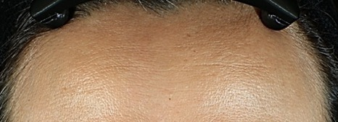
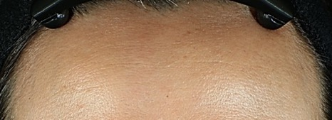
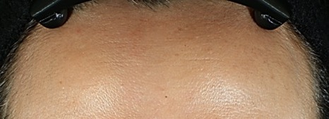
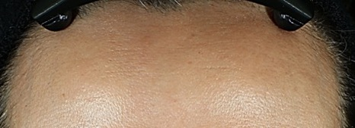
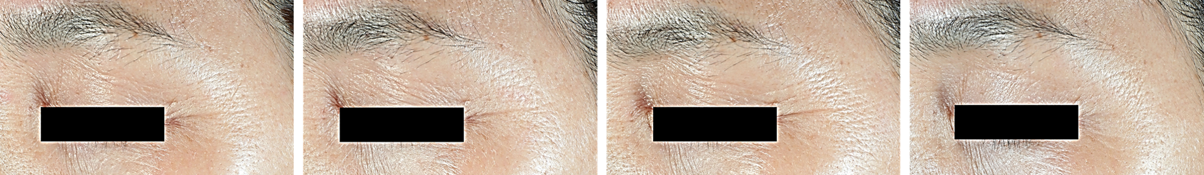
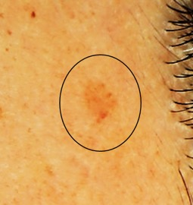
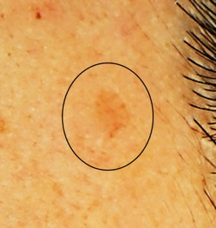
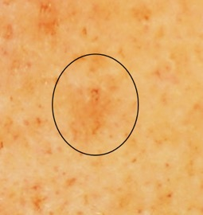
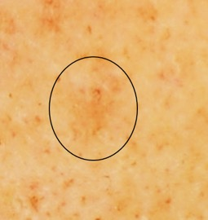
Strong visible results – in vivo
Forehead wrinkles reduction with 1% SYN-UP®, Volunteer #26
D0
D14
D28
D56
Crow’s feet wrinkles reduction with 1% SYN-UP®, Volunteer #25
Age spots reduction with 1% SYN-UP®, Volunteers #36 and #60
D0
D56
D0
D56

Slide 12






Slide 13
Disclaimer
Copyright © DSM Nutritional Products Ltd 2026, 4002 Basel, Switzerland.
www.dsm-firmenich.com. All rights reserved.
dsm-firmenich has used diligent care to ensure that the information provided herein is accurate and up-to-date to the best of its knowledge. However, dsm-firmenich makes no representation or warranty, either expressly or implied, of the accuracy, reliability, completeness, or suitability thereof. The information provided herein contains scientific and product information for business-to-business use and does not constitute or provide scientific or medical advice, diagnosis or recommendation for treatment options. Country or region-specific information should be considered when labelling or advertising to final consumer. In no event shall dsm-firmenich be liable for any direct or indirect damages arising from or reliance upon, or use of, any information provided herein. The content of this document is subject to change without further notice. Please contact your local dsm-firmenich representative for the latest information. All trademarks listed in this document are either (registered) trademarks of, or trademarks licensed by, the dsm-firmenich group of companies, unless explicitly stated otherwise.
Disclaimer Formulation Guideline
The information provided herein is provided for information purposes only and has been prepared by dsm-firmenich in accordance with its own methodology.
dsm-firmenich has used diligent care to ensure that it is accurate and up-to-date, however, dsm-firmenich makes no representation or warranty, either expressly or implied, of the accuracy, reliability, or completeness thereof. In no event shall dsm-firmenich be liable for any damages arising from or reliance upon, or use of, any information provided herein. Further, dsm-firmenich shall not bear any liability for the application and/or use of any processed material containing its product(s). The formulation of the finished product is the customer’s sole responsibility. It is the customer’s responsibility to determine the suitability of dsm-firmenich’s products regarding user specific purposes, assess compatibility and stability of their finished product(s) and to ensure compliance of their finished product(s) with relevant laws and regulations. Any product, marketing or other claims made by customer are its sole responsibility. The content of this document is subject to change without further notice. Please contact your local dsm-firmenich representative for further details. © DSM Nutritional Products AG, 2026.

