Slide 1

TILAMAR®
OP 40
One-for-all with improved
long-term stability
April 2025

Slide 2
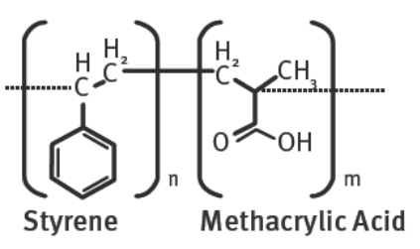
TILAMAR® OP 40
One-for-all by improved formulation stability
INCI: Styrene/Acrylates Copolymer
CAS Number: 9010-92-8
Key benefits:
Fast & easy product exchange
One-for-all by improved formulation compatibility
(high salt, cationic, low viscosity, etc)
Better formulation stability
Preservative-free
2

Slide 3
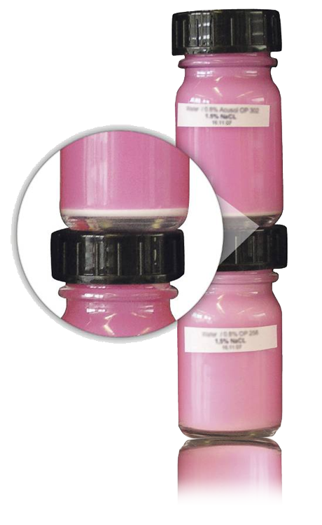
TILAMAR® OP 40
One-for all by improved formulation stability
  High Salt Compatibility
  Consumer benefits
  Creamy & nourishing texture
  Improved color effects
Competitor*
TILAMAR® OP 40 used today in …
  Body wash
  Shower gel
  Shampoo
  Hand wash
  Baby wipes
  Detergents (liquid)
  Softeners
TILAMAR® OP 40
* currently leading market technology

Slide 4
TILAMAR® OP 40
Specification vs Benchmark
 | TILAMAR® OP 40 | Competitor 1
Color | White to light greenish, dispersion | White, dispersion
Total Solids | 39-41% | 40%
pH | 2.0 – 3.0 | 2.0 – 2.5
Average particle size (µm) | 0.17 | 0.22
Viscosity (25°C, Brookfield) | < 50 | < 50
Density (g/ml) | 1.03 | 1.03
Preservatives | none | paraben-free
Notes:
Competitor 1: ACUSOL™ OP 302P

Slide 5
TILAMAR® OP 40
Stability in regular surfactant systems
 | Low-viscosity | Normal-viscosity
Sodium Laureth Sulfate | 35% | 35%
Cocamidopropyl betaine | 5% | 5%
Preservative | 0.8% | 0.8%
Sodium Chloride | - | 1.5%
TILAMAR® OP 40 | 0.7% | 0.7%
Water | ad 100 | ad 100
Viscosity | ~100 mPa.s | 3500 mPa.s
All formulations were stored at 4°C, room temperature and at 43°C for 6 months.
No stability issues were observed.

Slide 6
TILAMAR® OP 40
Stability in salt solution
0.8% Opacifier dispersion in a x% sodium chloride solution.
  TILAMAR® OP 40
salt % | 0.5% | 1.0% | 1.5% | 2.0% | 2.5% | 3.0% | 3.5%
after 24h |  |  |  |  |  | Ø | Ø
after 6 weeks |  |  | Ø | Ø | Ø | Ø | Ø
after 6 months |  |  | Ø | Ø | Ø | Ø | Ø
  Benchmark
salt % | 0.5% | 1.0% | 1.5% | 2.0% | 2.5% | 3.0% | 3.5%
after 24h
after 6 weeks |  | Ø | Ø | Ø | Ø | Ø | Ø
after 6 months | Ø | Ø | Ø | Ø | Ø | Ø | Ø
These tests were carried out at room temperature.
Notes:
Benchmark: ACUSOL™ OP 301

Slide 7
TILAMAR® OP 40
Stability in a polyquaternium-7 solution
0.8% Opacifier dispersion in a x% Polyquaternium-7 (40% solids) solution.
  TILAMAR® OP 40
cationic % | 0.25% | 0.5% | 0.75% | 1.0% | 1.25% | 1.50% | 2.0% | 3.0%
after 24h
after 6 weeks
after 6 months
  Benchmark
cationic % | 0.25% | 0.5% | 0.75% | 1.0% | 1.25% | 1.50% | 2.0%
after 24h
after 6 weeks | Ø | Ø | Ø | Ø | Ø | Ø | Ø
These tests were carried out at room temperature.
Notes:
Benchmark: ACUSOL™ OP 301

Slide 8

We would like to help you to make TILAMAR® OP 40 the most convenient solution ever for all your rinse-off products with a creamy and nourishing texture.

Slide 9
Disclaimer
Copyright © DSM Nutritional Products Ltd 2025, 4002 Basel, Switzerland.
www.dsm-firmenich.com. All rights reserved.
dsm-firmenich has used diligent care to ensure that the information provided herein is accurate and up-to-date to the best of its knowledge. However, dsm-firmenich makes no representation or warranty, either expressly or implied, of the accuracy, reliability, completeness, or suitability thereof. The information provided herein contains scientific and product information for business-to-business use and does not constitute or provide scientific or medical advice, diagnosis or recommendation for treatment options. Country or region-specific information should be considered when labelling or advertising to final consumer. In no event shall dsm-firmenich be liable for any direct or indirect damages arising from or reliance upon, or use of, any information provided herein. The content of this document is subject to change without further notice. Please contact your local dsm-firmenich representative for the latest information. All trademarks listed in this document are either (registered) trademarks of, or trademarks licensed by, the dsm-firmenich group of companies, unless explicitly stated otherwise.
Disclaimer Formulation Guideline
The information provided herein is provided for information purposes only and has been prepared by dsm-firmenich in accordance with its own methodology.
dsm-firmenich has used diligent care to ensure that it is accurate and up-to-date, however, dsm-firmenich makes no representation or warranty, either expressly or implied, of the accuracy, reliability, or completeness thereof. In no event shall dsm-firmenich be liable for any damages arising from or reliance upon, or use of, any information provided herein. Further, dsm-firmenich shall not bear any liability for the application and/or use of any processed material containing its product(s). The formulation of the finished product is the customer’s sole responsibility. It is the customer’s responsibility to determine the suitability of dsm-firmenich’s products regarding user specific purposes, assess compatibility and stability of their finished product(s) and to ensure compliance of their finished product(s) with relevant laws and regulations. Any product, marketing or other claims made by customer are its sole responsibility. The content of this document is subject to change without further notice. Please contact your local dsm-firmenich representative for further details. © DSM Nutritional Products AG, 2025.

