Slide 1

TILAMAR® Quat 2240
Deep conditioning with weightless
feel for clear shampoos

Slide 2
TILAMAR® Quat 2240
Deep conditioning with weightless feel for clear shampoos
Product Specifications and Uniqueness
Performances
Formulation properties
Application & Formulation Concepts

Slide 3
TILAMAR® Quat 2240
INCI: | Polyquaternium-22​
CAS Number: | 53694-17-0
Chemical Name: | Acrylic acid / Diallyl dimethyl ​ ammonium chloride copolymer
Key benefits:
Deep conditioning based on superior sensorial attributes
Weightless feel and look due to easy removability without build-up
Clear to formulate in shampoos with low pH of 4,9

Slide 4
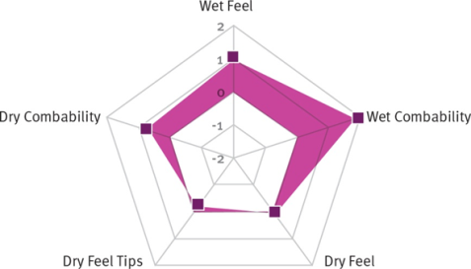
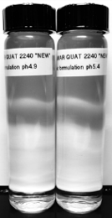
TILAMAR® Quat 2240
Unique Selling Points
General qualifiers
  Good feel and combability at wet and dry hair including tips
  Broad usage in various products such as colorants, relaxers, hair treatments and shampoos
  Very broad stability at pH ranges from 2-14
Differentiators
  Significant better wet performances than benchmark
  Clear and transparent shampoo formulations at relevant pH
  Excellent wash out and no build-up
Crystal Clear Shampoo with TILAMAR® Quat 2240

Slide 5
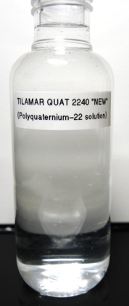
TILAMAR® Quat 2240
Specifications
External Characteristics
Chemical-physical properties
Appearance | clear to hazy, viscous liquid
Color | white to off-white
Shelf life | 18 Months
pH | 4.0 – 6.0
Molecular Weight | 1.0 – 1.7 x10⁵ Da
Viscosity | 1.000 – 10.000 mPa.s
Composition
Total solids | 39.0% - 43.0% m/m
Preservative | Sodium benzoate
Residual Monomer: Diallyl dimethyl ammonium chloride | max 3.5 %
Acrylic Acid | max 100 ppm
Heavy metals | max 10 ppm
Arsenic | max 1 ppm
Lead | max 1 ppm

Slide 6
TILAMAR® Quat 2240
Benchmark Comparison
Specifications comparison with ‘best in class’ benchmark
  TILAMAR® Quat 2240 is paraben-free and easy to handle thanks to a low molecular weight and a low viscosity.
Features | TILAMAR® Quat 2240 | Benchmark 1
Color | Clear to hazy, white to off white, viscous liquid | Clear to slightly hazy, white to off-white, viscous liquid
Total Solids | 39 – 43 % | 39 – 43 %
pH | 4.0 -6.0 | 4.2 – 5.3
Molar ratio DADMAC: Acrylic acid (mol/mol) | 65 : 35 | 65 : 35
Viscosity (spindle 4 @ 60 rpm) | 1.000 - 10.000 | 3.000 – 6.000
M_{W} (Daltons) | 1.0 –1.7 x 10⁵ | 4.5 x 10⁵
Preservatives | Paraben-free | Methyl-, Propyl Paraben
Notes:
Benchmark 1: Merquat™ 280

Slide 7
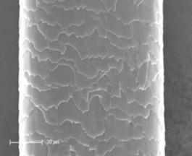
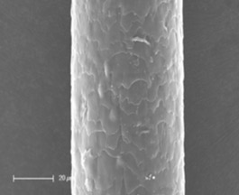
TILAMAR® Quat 2240
Performance
Excellent wash out and no build-up (no accumulation on hair)
  Assessment by Scanning Electron Microscopy (SEM) for the depositioning and wash out properties on hair.
  SEM pictures show an excellent wash out performance of TILAMAR® Quat 2240, which does not lead to any build-up effects and is even better than used benchmark.
Procedure: hair switches were dipped into a water solution of 1% TILAMAR® Quat 2240 and respectively 1% of the benchmark polymer for 10 minutes. Then the switches were pulled and washed with warm water for 90s.
SEM pictures: left: TILAMAR® Quat 2240; right: benchmark 1
Notes:
Benchmark 1: Merquat™ 280

Slide 8
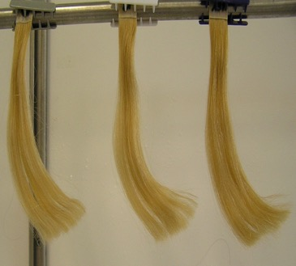

TILAMAR® Quat 2240
Performance
Better Combability and Feel than benchmark
  Excellent wet and dry combability in sensory assessment.
  Ahead of benchmark in particular at wet combability.
Procedure: 2-times bleached Caucasian hair (Kerling) was used at 2g per hair switch. Switches are pre-washed with standard shampoo (10% SLES) and dried for 24 hours at 20°C/65% rel. humidity. Afterwards each switch was washed two times with 0.25 ml test shampoo/g hair (30s foaming/
90s rinsing). Test shampoos had the same base formulation and contain 1% of polymer
solution, which means 0.4% TILAMAR® Quat 2240 and 0.4% benchmark 1.
Notes:
Benchmark 1: Merquat™ 280

Slide 9
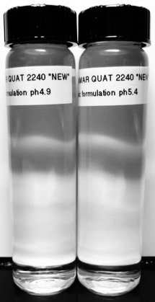
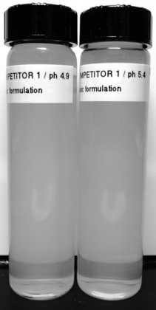
TILAMAR® Quat 2240
Formulation: Ideal for crystal clear shampoo
TILAMAR® Quat 2240 provides crystal clear shampoo at relevant pH
Crystal Clear Shampoo with
TILAMAR® Quat 2240
Hazy Shampoo with benchmark
Crystal Clear Shampoo with
TILAMAR® Quat 2240 at pH 4.9 and 5.4
Hazy Shampoo with benchmark 1 at pH 4.9 and 5.4
Notes:
Benchmark 1: Merquat™ 280

Slide 10
TILAMAR® Quat 2240
Formulation Stability
Excellent formulation stability
  Solubility (in formulation) better than benchmark
  Easy to handle thanks to its low viscosity
  Very broad pH compatibility from about 2 to 14
  No discoloration at standard formulations
  No odor development
  Viscosity remains stable
  Compatibility with other ingredients
TILAMAR® Quat 2240 is stable at all tested criteria and at least as good as ‘best in class’ benchmarks.
Procedure: Stability data were assessed in standardized shampoos over 3 month at 5°C, RT and 43°C with 1% and 3% of respective polymer.
As comparison ‘best in class’ benchmarks were used.

Slide 11
TILAMAR® Quat 2240
Recommendations
Formulation features and recommendations:
TILAMAR® Quat 2240 is a water-soluble polymer that can easily be formulated without restrictions.
TILAMAR® Quat 2240 is
  effective over a wide pH range of 2 – 14
  suitable for hot and cold processes.
TILAMAR® Quat 2240 has the ability to build up viscosity in shampoo formulation.
TILAMAR® Quat 2240 gives clear formulation in shampoos (pH 4.9 and higher).
The suggested starting concentrations are 1% in shampoo and conditioner and 3% in other formulations.
In skin or body care formulations such as soaps the suggested starting concentration is 1.5%.

Slide 12
TILAMAR® Quat 2240
Applications
Application and Benefits for Hair Care Products
Shampoos, conditioners, hair treatments, colorants and styling products and permanent waves.
Provides silky feel, luster and softness
Confers excellent wet and dry combability
Compatible with most anionic and amphoteric surfactants
Delivers superior conditioning properties under wide range of pH
Does not negatively affect the mechanism of hair coloring
Helps to hold curl without curling
Application and Benefits for Skin Care Products
Bar soaps, shower products, face and body care products (moisturizing lotions, shaving products, antiperspirants and deodorants)
Contributes excellent moisturizing properties
Imparts a smooth, velvety feel, reduce tightness after drying skin
Provides lubricity and could improve easier application of skin care products
Enhances stability and foam formation when added to liquid cleansing products

Slide 13
Concept formulations
ColorLock Shampoo
  Keeps fresh & vibrant color​
  Provides silky feel, luster and softness ​
  Rich & nourishing texture​
  Sulfate-free​
Phase | Ingredients | % w/w
A | AQUA​ | ad 100​
 | ACRYLATES/BEHENETH-25 METHACRYLATE COPOLYMER​ | 4.00​
 | AQUA, SODIUM HYDROXIDE​ | 0.18​
 | COCAMIDOPROPYL BETAINE, AQUA, SODIUM CHLORIDE​ | 16.00​
 | ​
B | PERFUME​ | q.s.​
 | PARSOL® SLX​ | 0.25​
 | Phytantriol​ | 0.10​
 | SODIUM LAUROYL SARCOSINATE, SODIUM LAURYL SULFOACETATE, AQUA​ | 26.00​
 | ​
C | AQUA​ | 5.00​
 | TILAMAR® Quat 2240​ | 1.00​
 | ​
D | AQUA​ | 5.00​
 | PRESERVATIVE | q.s.​
 | TILAMAR® OP 40​ | 1.00​
 | ​
E | CITRIC ACID, AQUA​ | 0.47​

Slide 14
Concept formulations
Rescue Calm Shampoo
  Crystal clear formulation​
  Excellent detangling properties on wet hair​
  Provides silky feel and softness ​
  For dry and itchy scalp​
Phase | Ingredients | % w/w
A | WATER DEM. ​ | ad 100​
 | TILAMAR® Quat 2240​ | 1.5​
B | PERFUME​ | q.s.​
 | PARSOL® Guard | 0.1​
 | ​ | ​
 | SODIUM LAURETH SULFATE​ | 27​
C | SODIUM COCOAMPHOACETATE​ | 8​
D | SODIUM BENZOATE​ | 0.5​
E | PENTAVITIN®​ | 1​
F | CITRIC ACID​ | 0.5​
G | CI 42090​ | 0.2​
H | SODIUM CHLORIDE​ | 2​

Slide 15
TILAMAR® Quat 2240
offers formulations that are clear,
even at a low pH. This makes it particularly suitable for shampoos
designed to deliver tangible and visible benefits.

Slide 16
Disclaimer
Copyright © DSM Nutritional Products Ltd 2025, 4002 Basel, Switzerland.
www.dsm-firmenich.com. All rights reserved.
dsm-firmenich has used diligent care to ensure that the information provided herein is accurate and up-to-date to the best of its knowledge. However, dsm-firmenich makes no representation or warranty, either expressly or implied, of the accuracy, reliability, completeness, or suitability thereof. The information provided herein contains scientific and product information for business-to-business use and does not constitute or provide scientific or medical advice, diagnosis or recommendation for treatment options. Country or region-specific information should be considered when labelling or advertising to final consumer. In no event shall dsm-firmenich be liable for any direct or indirect damages arising from or reliance upon, or use of, any information provided herein. The content of this document is subject to change without further notice. Please contact your local dsm-firmenich representative for the latest information. All trademarks listed in this document are either (registered) trademarks of, or trademarks licensed by, the dsm-firmenich group of companies, unless explicitly stated otherwise.
Disclaimer Formulation Guideline
The information provided herein is provided for information purposes only and has been prepared by dsm-firmenich in accordance with its own methodology.
dsm-firmenich has used diligent care to ensure that it is accurate and up-to-date, however, dsm-firmenich makes no representation or warranty, either expressly or implied, of the accuracy, reliability, or completeness thereof. In no event shall dsm-firmenich be liable for any damages arising from or reliance upon, or use of, any information provided herein. Further, dsm-firmenich shall not bear any liability for the application and/or use of any processed material containing its product(s). The formulation of the finished product is the customer’s sole responsibility. It is the customer’s responsibility to determine the suitability of dsm-firmenich’s products regarding user specific purposes, assess compatibility and stability of their finished product(s) and to ensure compliance of their finished product(s) with relevant laws and regulations. Any product, marketing or other claims made by customer are its sole responsibility. The content of this document is subject to change without further notice. Please contact your local dsm-firmenich representative for further details. © DSM Nutritional Products AG, 2025.

