Slide 1

TILAMAR® Quat 640
Ultimate conditioning
with weightless feel

Slide 2
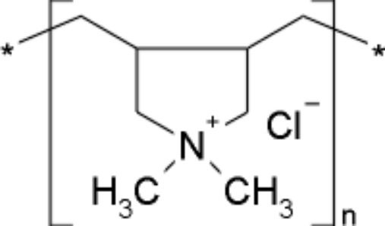
TILAMAR® Quat 640
Product Overview
INCI: Polyquaternium-6
Chemical Name: Diallyldimethylammonium chloride homopolymer
CAS Number: 26062-79-3
Key benefits:
Ultimate conditioning based on superior combability and sensorial attributes
Weightless feel as easy to be removed without build-up
Low viscosity promotes easier handling and processing of a finished product
Acrylamide-free
➔ For extra caring and moisturizing hair
(i.e. chemically treated hair or leave-in detangling products)
(DADMAC)n

Slide 3
TILAMAR® Quat 640
Specification
External Characteristics
Chemical-physical properties
Appearance | Clear liquid
Color | yellowish
Shelf life | 27 Months
pH | 5.0 – 7.5
Molecular Weight | 0.8 – 1.2 x10⁵ Da
Viscosity | 900 – 2.200 mPa.s
Composition
Total solids | 34.0% - 36.0% m/m
Preservative | NONE
Residual Monomer: Diallyl dimethyl ammonium chloride | max 2 %
Heavy metals | max 10 ppm
Arsenic | max 1 ppm
Lead | max 1 ppm

Slide 4
TILAMAR® Quat 640
Product Uniqueness
General qualifiers
  Good feel and combability at wet and dry hair
  Broad usage at different pH ranges, different salt and detergent
  concentrations at various products such as conditioners, shampoos
  and colorants
Differentiators
  Ultimate conditioning based on superior combability and sensorial attributes
  Weightless feel as easy to be removed without build-up and leaves even fine hair looking and feeling weightless
  Low viscosity promotes easier handling and processing of a finished product

Slide 5
TILAMAR® Quat 640
Benchmark Comparison
Lower viscosity (compared to market benchmarks)
  Lower molecular weight due to specific production parameters
  Considerably lower viscosity
  Clear handling and processing advantage for end product production
Features | Benchmark 1 | TILAMAR® Quat 640 | Benchmark 2
Appearance | Clear, slightly yellow & highly viscous liquid | Clear, slightly yellow & low viscous liquid | Clear, slightly yellow & highly viscous liquid
Odor | Mild, aldehydic | Mild, aldehydic | Mild, aldehydic
Color, APHA | 125 max (Test Lot = 94.46) | 125 max (Test Lot = 95.37) | 125 max (Test Lot = 95.87)
Total Solids, % | 39 % - 44 % | 34 % - 36 % | 38 % - 42 %
pH | 5.5 - 7.0 | 5.0 – 7.5
Viscosity (mPas) 25°C Brookfield #3 @ 6 rpm | 8.000 – 12.000 (Test Lot = 10.200) | 900 – 2.200 (Test Lot = 1.500) | 7.000 – 11.000 (Test Lot = 11.500)
Molecular Weight | 1.5 x 10⁵ | 0.8 – 1.2 x 10⁵ | N .A
Notes:
Benchmark 1: Merquat™ 100
Benchmark 2: Genamin® PDAC

Slide 6
TILAMAR® Quat 640
Formulation concepts
Shampoo | wt-% | Conditioner | wt-% | Color cream | wt-%
Sodium laureth sulfate | 16 | Cetearyl alcohol | 5 | Cetearyl alcohol | 10
Cocamidopropyl betaine | 15 | Cetyl trimonium chloride, Isopropyl alcohol | 1 | Glyceryl stearate SE | 2.5
Disodium cocoamphodiacetate | 5% |  |  | Ceteareth-25 | 2.0
Preservative | 0.7 |  |  | Ethanolamine | 0.5
 |  |  |  | INCI : CI 26100 | 0.015
Sodium chloride | 0.65 |  |  | Glycol distearate | 0.5
Citric acid | 0.35 | Citric acid | 0.25 | Disodium EDTA | 0.05
TILAMAR® Quat 640 | 1%, 3% | TILAMAR® Quat 640 | 1%, 3% | TILAMAR® Quat 640 | 1%, 3%
Water | ad. 100 | Water | ad. 100 | Water | ad. 100
pH | 5.2-5.7 | pH | 2.4-2.5 | pH | 11.0
Notes:
Viscosity (Brookfield, spindle 3 @ 10 rpm, 20°C)

Slide 7
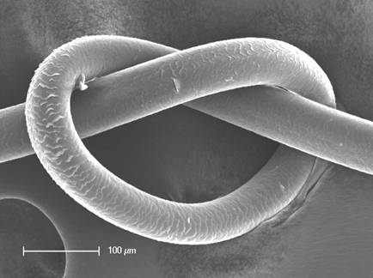
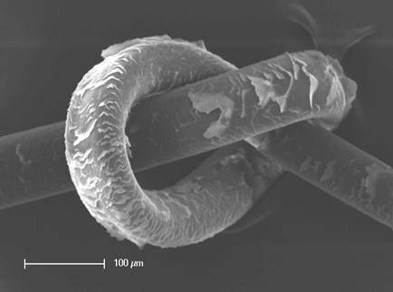
TILAMAR® Quat 640
Performance
Weightless feel as easy to be removed without build-up
  Assessment by Scanning Electron Microscopy (SEM) for the depositioning and wash out properties on hair.
  SEM pictures show an excellent wash out performance of TILAMAR® Quat 640, which does not lead to any build-up effects and is even better than used benchmark.
Procedure: hair switches were dipped into a water solution of 1% TILAMAR® Quat 640 and respectively 1% of the benchmark polymer for 10 minutes. Then the switches were pulled and washed with warm water for 90s.
SEM pictures: left: TILAMAR® Quat 640; right: benchmark

Slide 8
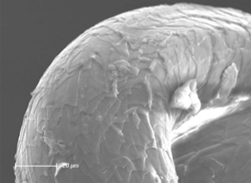
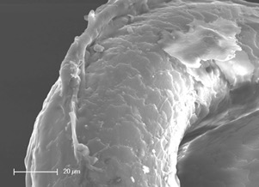
TILAMAR® Quat 640
Performance
Weightless feel by lower depositioning at excellent performance
  SEM pictures showed a lower depositioning on the hair comparing TILAMAR® Quat 640 and used benchmark.
  Sensory assessment for wet and dry feel, wet and dry combability and dry tips feel was excellent and equal to benchmark.
Procedure: hair switches were dipped into a water solution of 1% TILAMAR® Quat 640 and respectively 1% of the benchmark polymer for 10 minutes. SEM pictures: left: TILAMAR® Quat 640; right: benchmark

Slide 9
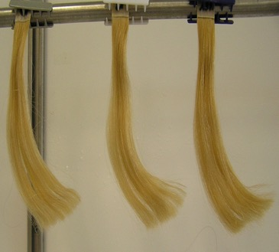
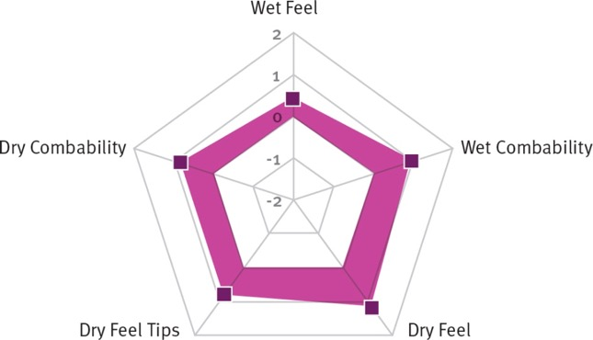
TILAMAR® Quat 640
Performance
Ultimate conditioning based on superior combability and sensorial attributes
  Excellent wet and dry combability in sensory assessment.
  Ahead of benchmark in dry feel including tips.
Procedure: 2-times bleached Caucasian hair (Kerling) was used at 2g per hair switch. Switches are pre-washed with standard shampoo (10% SLES) and dried for 24 hours at 20°C/65% rel. humidity. Afterwards each switch was washed two times with 0.25 ml test shampoo/g hair (30s foaming/ 90s rinsing).
Test shampoos had the same base formulation and contain 1% of polymer solution,
which means 0.35% TILAMAR® Quat 640 and 0.4% benchmark.

Slide 10
TILAMAR® Quat 640
Stability
Ultimate conditioning based on superior combability and sensorial attributes
  Solubility (in formulation)
  Very broad pH compatibility from about 1 to 14
  No discoloration at standard formulations
  No odor development
  Viscosity remains stable
  Compatibility with other ingredients
TILAMAR® Quat 640 is stable at all tested criteria and at least as good as ‘best in class’ benchmarks.
Procedure: Stability data were assessed in shampoos, conditioners and color creams over 3 month at 5°C, RT and 43°C with 1% and 3% of respective polymer.
For comparison ‘best in class’ benchmarks were used.

Slide 11
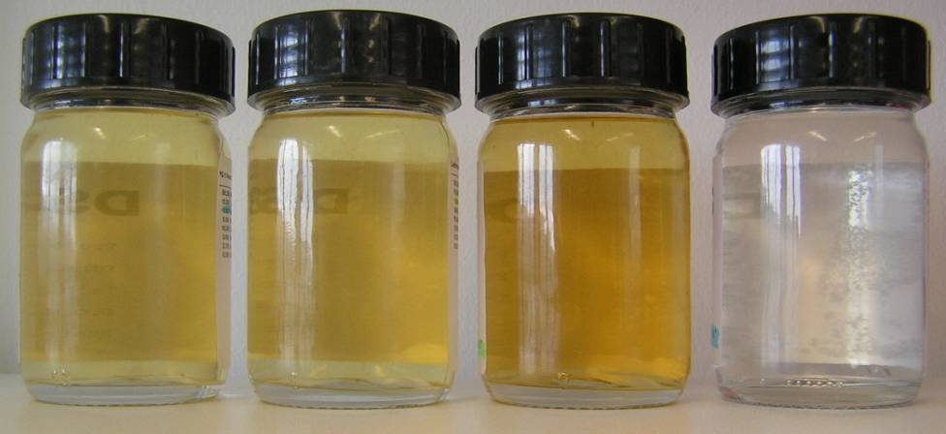
TILAMAR® Quat 640
Stability
Special case formulation with amphoteric surfactant in mild shampoos
Benchmark 1
TILAMAR® Quat 640
Benchmark 2
Initial
TILAMAR® Quat 640 shows a slight discoloration at high storage temperature.
TILAMAR® Quat 640 is better than benchmark 2 and comparable
to benchmark 1.
Procedure: Stability data are assessed after 3 month at 43°C with 1% of respective polymer. Standard shampoo formulation was used with a color challenge due to the presence of amphoteric surfactant. For comparison ‘best in class’ benchmarks were used.
Notes:
Benchmark 1: Nalco Merquat™ 100
Benchmark 2: Clariant Genamin® PDAC

Slide 12
TILAMAR® Quat 640
Recommendations
Formulation features and recommendations:
TILAMAR® Quat 640 is a water-soluble polymer which can easily be formulated.
It is recommended to add the product to the water phase of your system.
TILAMAR® Quat 640 is
  effective over a wide pH range of 2 – 14
  suitable for hot and cold processes
  compatible with cationic and nonionic co-ingredients.
  Partly incompatible with anionic surfactants due to high cationic charge
  (up to 5% anionic surfactant possible in case of changed ingredient order).
For shampoo formulations, it is recommended to use an amphoteric or nonionic
surfactant such as Disodium Cocoamphodiacetate, Cocamidopropyl Betaine/Coco
Betaine or Alkyl Polyglucosides (APG) as primary surfactant.
In liquid cleansing products, first dilute TILAMAR® Quat 640 in parts of the water phase before adding to the surfactants.

Slide 13
TILAMAR® Quat 640
Applications
Application and Benefits for Hair Care Products
Shampoos, conditioners, hair treatments, colorants and styling products
Provides advantages in wet and dry feel
Confers excellent wet and dry combability
Contributes to gloss and a silky feel
Delivers extraordinary detangling
Imparts excellent lubricity and dry feel of tips
Suggested concentrations: 1% in shampoo and conditioner and 3% in hair treatments
Application and Benefits for Skin Care Products
Bar soaps, shower products, face and body care products
Contributes excellent moisturizing properties
Imparts a smooth and tenderize feel
Provides lubricity and could improve easier application of skin care products
Enhances stability and foam formation when added to liquid cleansing products
Suggested starting concentrations: 1%

Slide 14

TILAMAR® Quat 640
is strongly recommended when extra caring and moisturizing properties are needed, for example for chemically treated hair, and for leave-in
detangling products.

Slide 15
Disclaimer
Copyright © DSM Nutritional Products Ltd 2025, 4002 Basel, Switzerland.
www.dsm-firmenich.com. All rights reserved.
dsm-firmenich has used diligent care to ensure that the information provided herein is accurate and up-to-date to the best of its knowledge. However, dsm-firmenich makes no representation or warranty, either expressly or implied, of the accuracy, reliability, completeness, or suitability thereof. The information provided herein contains scientific and product information for business-to-business use and does not constitute or provide scientific or medical advice, diagnosis or recommendation for treatment options. Country or region-specific information should be considered when labelling or advertising to final consumer. In no event shall dsm-firmenich be liable for any direct or indirect damages arising from or reliance upon, or use of, any information provided herein. The content of this document is subject to change without further notice. Please contact your local dsm-firmenich representative for the latest information. All trademarks listed in this document are either (registered) trademarks of, or trademarks licensed by, the dsm-firmenich group of companies, unless explicitly stated otherwise.
Disclaimer Formulation Guideline
The information provided herein is provided for information purposes only and has been prepared by dsm-firmenich in accordance with its own methodology.
dsm-firmenich has used diligent care to ensure that it is accurate and up-to-date, however, dsm-firmenich makes no representation or warranty, either expressly or implied, of the accuracy, reliability, or completeness thereof. In no event shall dsm-firmenich be liable for any damages arising from or reliance upon, or use of, any information provided herein. Further, dsm-firmenich shall not bear any liability for the application and/or use of any processed material containing its product(s). The formulation of the finished product is the customer’s sole responsibility. It is the customer’s responsibility to determine the suitability of dsm-firmenich’s products regarding user specific purposes, assess compatibility and stability of their finished product(s) and to ensure compliance of their finished product(s) with relevant laws and regulations. Any product, marketing or other claims made by customer are its sole responsibility. The content of this document is subject to change without further notice. Please contact your local dsm-firmenich representative for further details. © DSM Nutritional Products AG, 2025.

