Slide 1
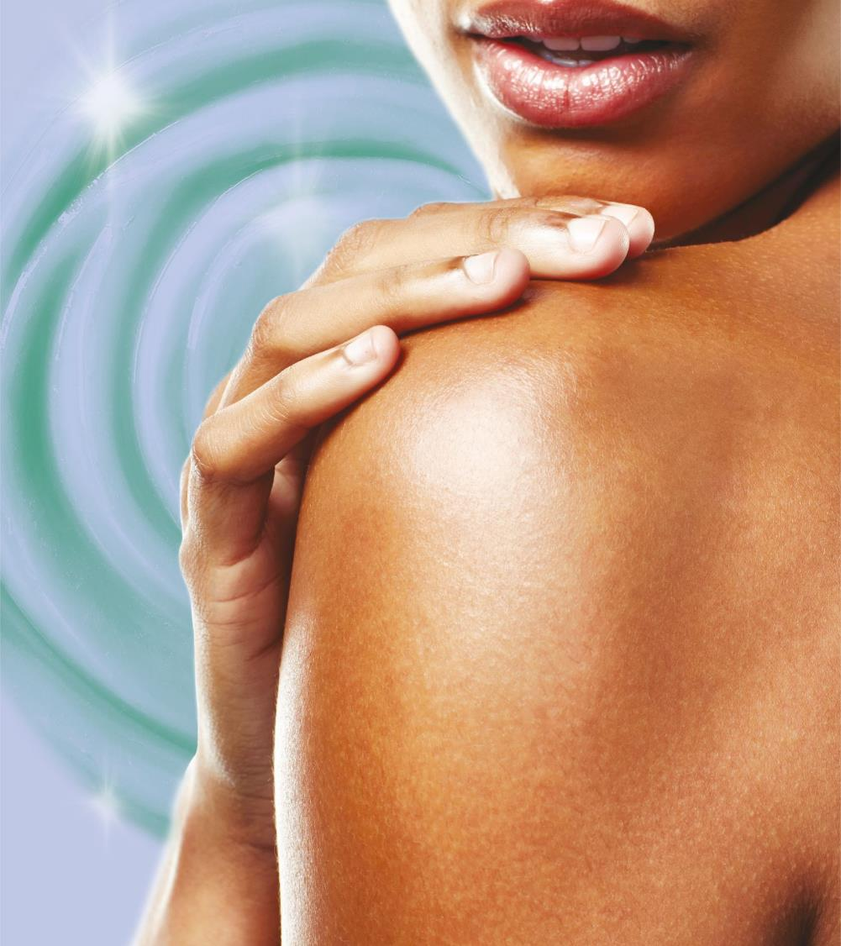
ALL-Q® plus
to unveil the secret of beauty
Master Presentation
07.2020

Slide 2
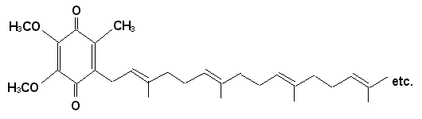

What is Coenzyme Q₁₀?
Natural, fat-soluble compound found in most plant and animal cells
The only oil-soluble antioxidant synthesized by human body (from amino acid tyrosine)
Also known as ubiquinone or Coenzyme Q10 (short: CoQ10)
“Ubi” = latin for “everywhere”
“Coenzyme” = activity of enzymes depend on the presence of Q10
H
10

Slide 3
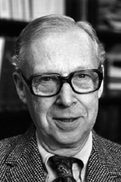
History of CoQ10
1957 Coenzyme Q10 first isolated from beef heart mitochondria by Dr. Frederick Crane of Wisconsin
Named ubiquinone (=ubiquitous quinone)
1958 Prof Karl Folkers of Merck determined chemical structure
1975 CoQ10 synthesis developed by Japanese
1978 Peter Mitchell received Nobel Prize for biological energy transfer theory, including role of CoQ10
Early 90 First larger promoted use in a cosmetic product: Beiersdorf
Karl Folkers

Slide 4
CoQ10 - The Ultimate Benefits
CoQ10 or just Q10 is synthesized by the body and also consumed in the diet.
CoQ10 is a fat-soluble super antioxidant that can neutralise free radicals.
CoQ10 works to sustain energy production to fulfil the skin’s vital functions.
CoQ10 protects the deeper layers of your skin from damage caused by UVA*.
CoQ10 fights against wrinkles*.

Slide 5
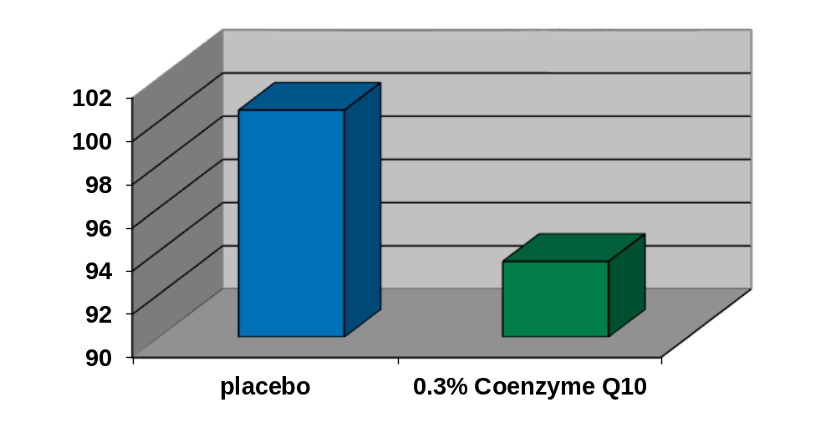
CoQ10 protects the skin from UVA damage
UVA-induced ultra weak photon emission after application of CoQ10
n = 12
n = 12
Blatt et al. 1999
Notes:
Deleterious oxidative events in the skin can be detected by means of ultra-weak photon emission (UPE). In the basal state, cells emit low levels of photons.
UVA-radiation increases the level of photons emitted, whereas the presence of antioxidants in the skin reduces it. Therefore, the level of photons emitted is an indication of the antioxidant status of the skin.
The graph shows the protective effect of CoQ10 to UVA-induced increase of photons: The UPE was measured in 12 healthy, volunteers (mean age 49+/- 6 years), who applied twice daily for 7 days either 0.3% CoQ10 or the vehicel on the volar forearm. Following exposure to UVA-light (50mJ/cm2) the skin treated with COQ10 had significantly lower levels of UPE.

Slide 6
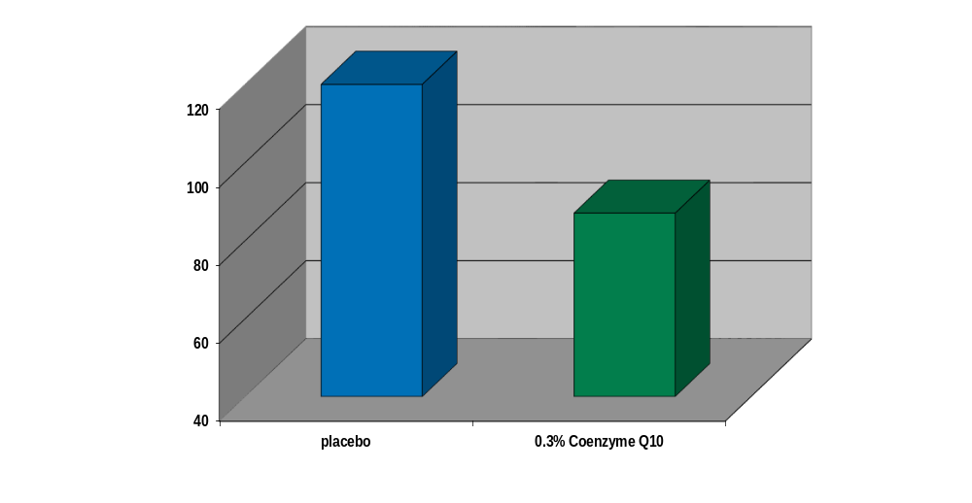
CoQ10 reduces wrinkles
Reduction of wrinkles around the eyes after application of CoQ10 for 6 months
n = 24
Rt-Value
Blatt et al. 1999
n = 24
Notes:
A placebo-controlled study involving two groups of 24 healthy, aged volunteers proved that visible wrinkles around the eye (crow’s-feet) were significantly reduced by topical application of Coenzyme Q10.
0.3% CoQ10 were once daily applied. The reduction of the wrinkle depth was measured by profilometry. Silicon replicas were taken from defined skin area around the eye and the Rt-value = max wrinkle depth was measured by means of a laser.
There was a 27% reduction in the mean peak to valley depth of the skin*.
(Study by Beiersdorf scientists: Blatt et al., published in: Zeitschrift für Gerontologie und Geralogie 1999 – in German; no further study details available in this paper but in the paper Hoppe et al*., BioFactors 9, 1999, 371-378)

Slide 7
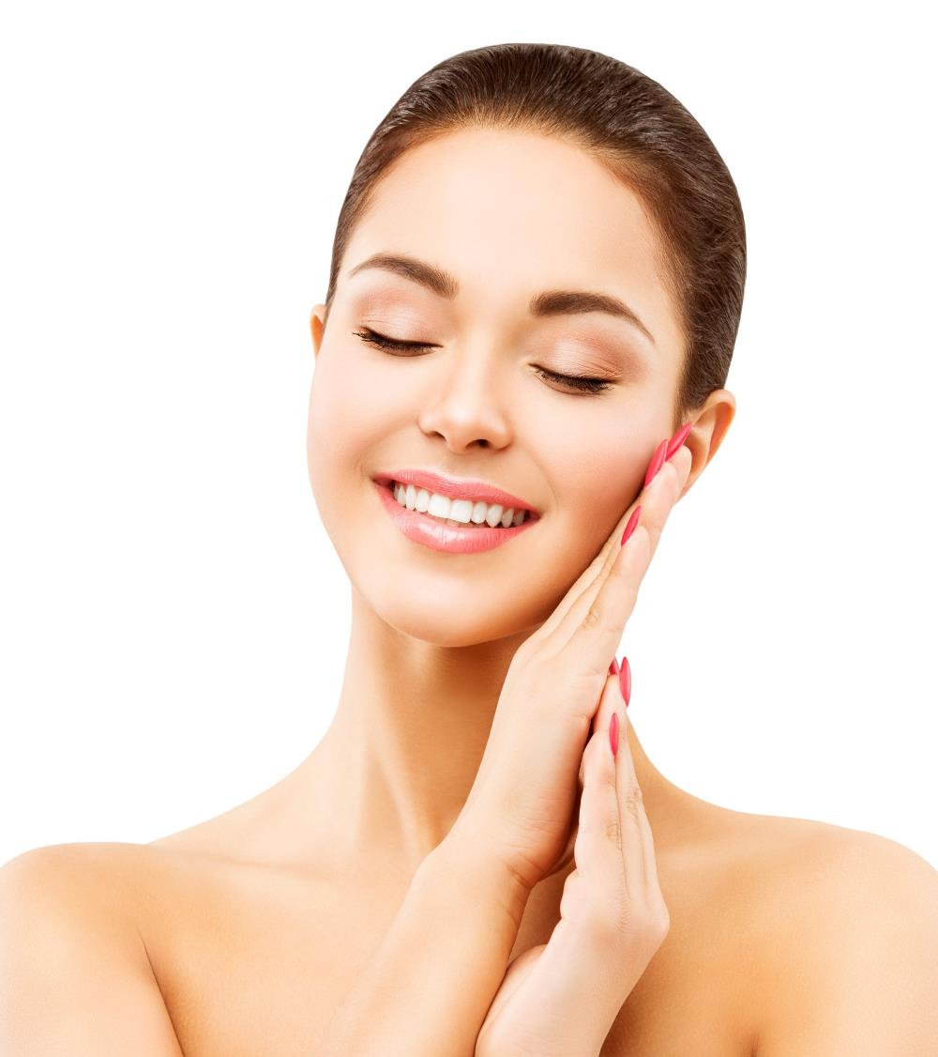
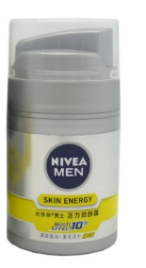
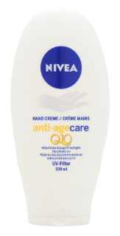
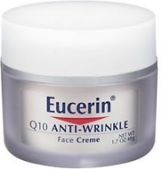
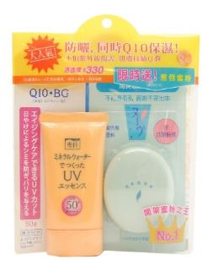
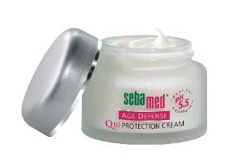
Q10 a still unbroken trend
Skin Energy
Anti-Wrinkle
Anti-Age Care
Hand Cream
Protection
Cream
Q10 Sunscreen

Slide 8
ALL-Q® plus at a glance
Well balanced combination of the two major anti-oxidants CoQ10 and Vitamin E in a liquid form
Composition ALL-Q® plus (INCI):
  7.5% Ubiquinone
  20% Tocopheryl Acetate
  72.5% C12-15 Alkyl Benzoate
the ideal anti-ageing active ingredient

Slide 9
ALL-Q® plus mirrors the natural presence of Coenzyme Q10 and Vitamin E in the skin
Vitamin E
as antioxidant
Coenzyme Q₁₀
as antioxidant
skin surface lipids
(SSL)
(SSL)
living skin cells
Coenzyme Q₁₀
as electron carrier

Slide 10

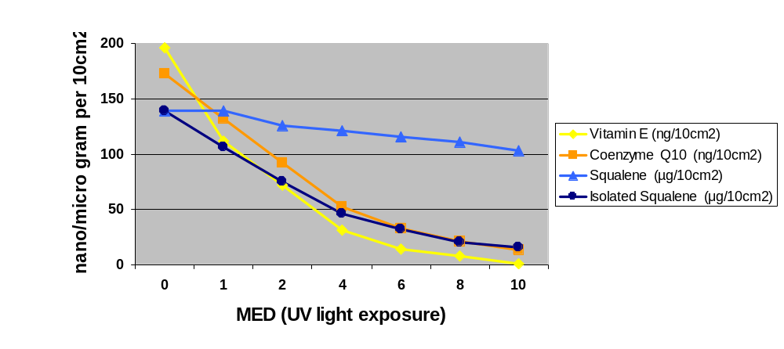
CoQ10 protects together with Vitamin E the skin surface lipids from peroxidation
Influence of UV light on levels of skin lipids and antioxidants
*
* pure squalene without protecting sebum
Passi et al. 2002
Notes:
The data presented in this graph confirm that sebum and its lipophilic antioxidants – Coenzyme Q10 and Vitamin E – play a synergic, active role in the defense of the outer skin.
Skin surface lipids (mixture of sebum and lipids originating from corneocytes) were collected from healthy volunteers. Coenzyme Q10 and Vitamin E were determined as the only antioxidants present in skin surface lipids.
Irradiation of the skin surface lipids with increasing amounts of UV light led to an almost complete depletion of CoQ10 and Vitamin E, whereas squalene was only marginally decreased i.e. oxidized.
The protective effect of CoQ10 and Vitamine E on squalene becomes obvious when isolated squalene is exposed to UV-irradiation. It is almost completely peroxidized.
Topical application of CoQ10 and Vitamin E acetate helps to balance the endogenous antioxidant level and to protect of peroxidation. This is important mainly for young and older skin, which have are known to have a significantly decreased Vitamin E and CoQ10 content compared to people in their thirties.
Lit: Passi et al.: Lipophilic antioxidants in human sebum and aging. Free Radical Research, 36, 471-477 (2002)

Slide 11
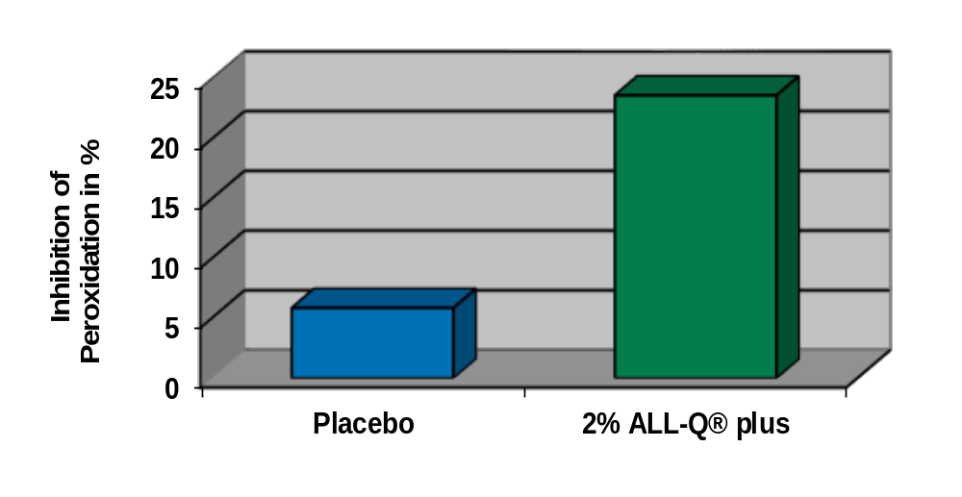
ALL-Q® plus protects the skin
20 volunteers
7 days, once daily application on inner forearm
UVA-irradiation (10J/cm2)
Determination (HPLC) of squaleneperoxide formed
ALL-Q® plus protects the skin lipids from UV-induced peroxidation
Notes:
ALL-Q™ plus is a powerful antioxidant active ingredient to protect against damage from UV radiation.
Our placebo-controlled study proves that ALL-Q™ plus significantly prevents UVA-induced sebum peroxidation.
20 healthy volunteers (37 – 65 years) were treated once daily for seven days with the tests products, which were applied on the inner forearm. The forearm was then irradiated with UVA light (10J/cm2) and the peroxides formed were quantitatively determined.
On a pure active level, 2% ALL-Q™ plus corresponds to 0.4% Vitamin E acetate and 0.15% Coenzyme Q10.

Slide 12
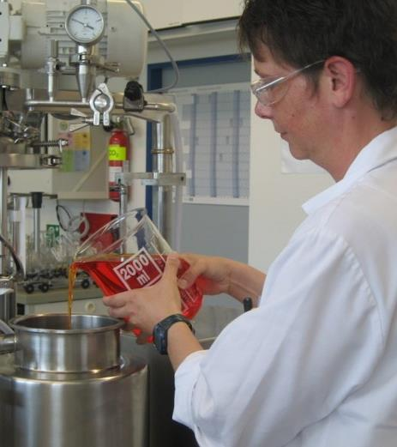
Convenient handling of ALL-Q® plus
ALL-Q® plus is a very easy to use liquid
It is oil-miscible
Can be directly added to the emulsion

Slide 13
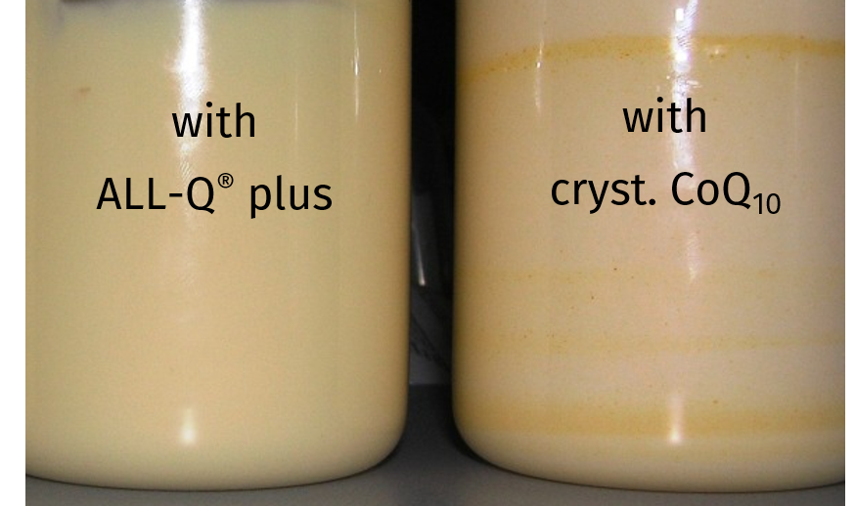
Superior emulsion aspect with ALL-Q® plus
4% ALL-Q plus or 0.3% crystalline Coenzyme Q₁₀ were added under intensive mixing and homogenization for several hours ➔ photos taken

Slide 14
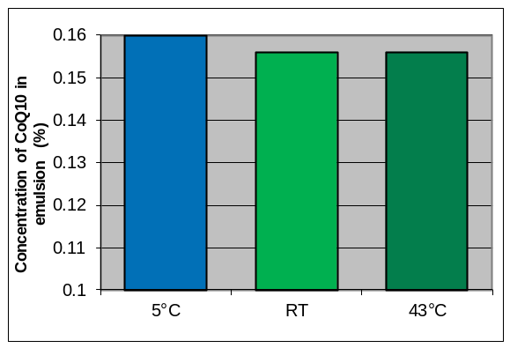
ALL-Q® plus is stable in formulations with reference to lead component CoQ10
Moisturizing Body Lotion with ALL-Q® plus (100162-012/001)
Stability checked at 5°C, RT and 43°C after 3 months
Ingredients | INCI Nomenclature | %
Arlatone 2121 | Sorbitan Stearate & Sucrose Cocoate | 2.5
Lipocire Na 10 Pastilles | Hydrogenated Coco-Glycerides | 2.5
Tegin M | Glyceryl Stearate | 0.8
Myritol 318 | Caprylic/Capric Triglyceride | 12.5
Phenonip | Phenoxyethanol & Methylparaben & Ethylparaben & Butylparaben & Propylparaben & Isobutylparaben | 1
D-Panthenol 75 L | Panthenol | 0.5
Keltrol CG T | Xanthan Gum | 0.7
Carbopol Ultrez 21 | Acrylates/C10-30 Alkyl Acrylate Crosspolymer | 0.15
Glycerin | Glycerin | 4
Water dem. | Aqua | 72.55
Disodium EDTA | Disodium EDTA | 0.1
ALL-Q® plus | Ubiquinone & Tocopheryl Acetate & C12 15 Alkyl Benzoate | 2
KOH 10% solution | Potassium Hydroxide | 0.7
stable formulation: viscosity,pH
smell, color: i.O
ALL-Q plus: compoment CoQ₁₀ (0.15% nominal in emulsion)

Slide 15
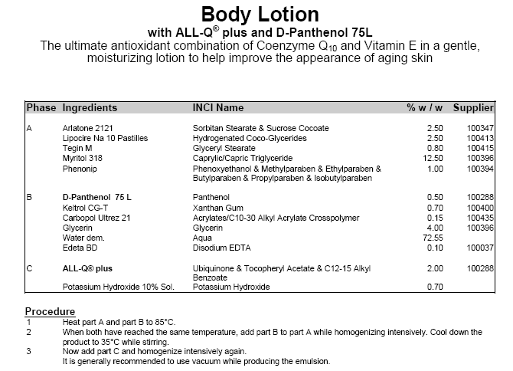
Evaluating the color impact of ALL-Q® plus
0.5 – 5.0%

Slide 16
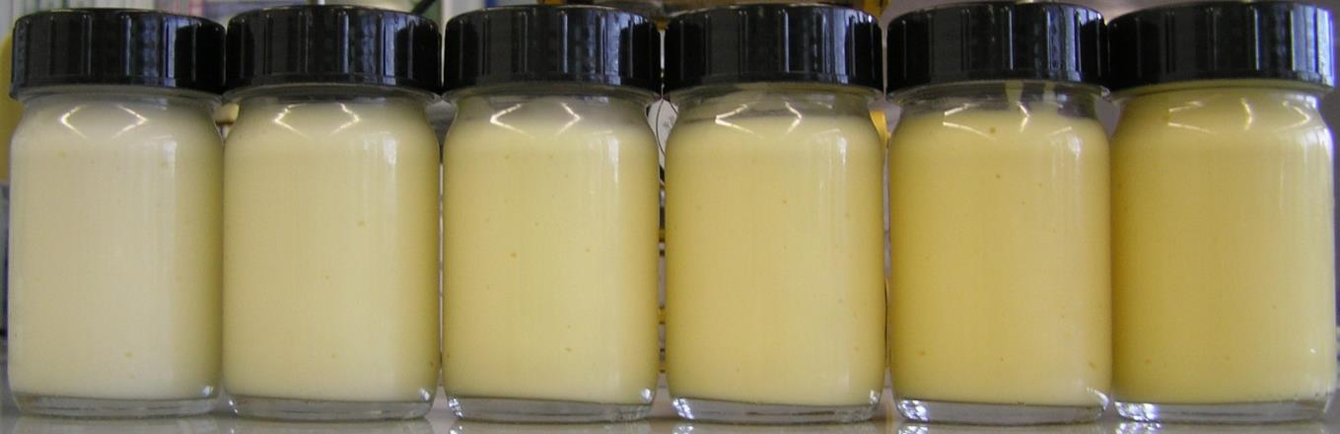
Visual aspect indicates ALL-Q® plus concentration
0.5% 1.0%
0.5%
1.0%
2.0%
3.0%
2.0%
3.0%
4.0%
5.0%
4.0%
5.0%

Slide 17

APPLICATION CONCEPTS
ALL-Q® plus is the ideal active ingredient for
skin protection formulations (sun care, environmental stress, etc.).
regenerating products such as night creams to reduce wrinkles
intensive treatment products: eye or hand care
energising applications (wake-up formulations)
Recommended use concentration
0.5 to 2.0%
Intensive treatment: up to 4.0%

Slide 18
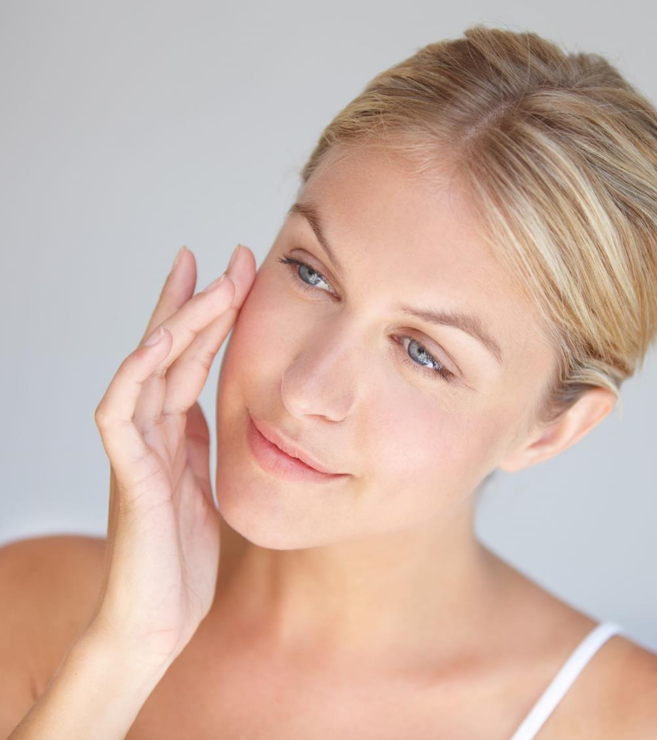
CONCLUSION
ALL-Q® plus is a well balanced combination of the two skin antioxidants Coenzyme Q₁₀ and Vitamin E.
ALL-Q® plus is an easy to use product form of Coenzyme Q₁₀ for personal care applications.
ALL-Q® plus has proven skin protecting activities

Slide 19
DISCLAIMER
Copyright © 2020 DSM Nutritional Products, 4002 Basel, Switzerland.
www.dsm.com/personal-care. All rights reserved.
Although DSM has used diligent care to ensure that the information provided herein is accurate and up to date, DSM makes no representation or warranty of the accuracy, reliability, or completeness of the information. This presentation only contains scientific and technical information for business to business use. Country- or region-specific information should also be considered when labeling or advertising to final consumers. This publication does not constitute or provide scientific or medical advice, diagnosis, or treatment and is distributed without warranty of any kind, either expressly or implied. In no event shall DSM be liable for any damages arising from the reader’s reliance upon, or use of, these materials. The reader shall be solely responsible for any interpretation or use of the material contained herein. The content of this document is subject to change without further notice. Please contact your local DSM representative for more details. All trademarks listed in this brochure are either registered trademarks or trademarks of DSM in The Netherlands and/or other countries unless explicitly otherwise stated.
DISCLAIMER FORMULATION GUIDELINES
This information is for illustration purposes only and based upon our current knowledge and experience at the time of printing. We do not make any representation or warranty of any kind, express or implied, including merchantability or fitness for a particular use, with respect to such information or its application. Use of this information is at your discretion and risk. Nothing herein relieves you from carrying out your own suitability determinations and tests. You are responsible for observing all laws and regulations relevant to your products, uses or processes. We do not assume any liability in connection with your product and its use. The foregoing information and suggestions are also provided without warranty of non-infringement as to the intellectual property rights of third parties, and shall not be construed as any inducement to infringe the rights of third parties.

