Slide 1
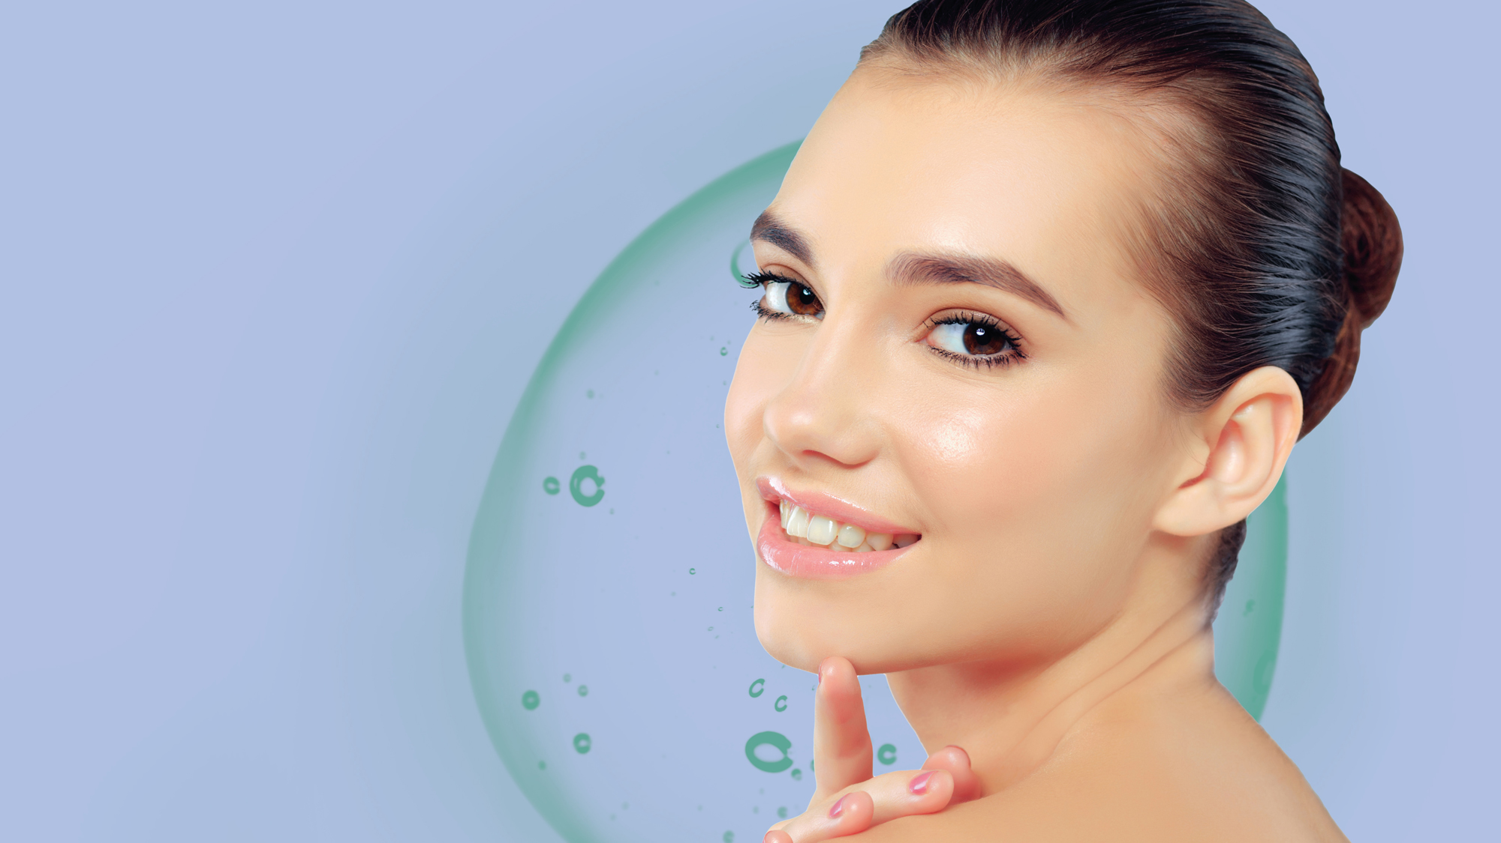
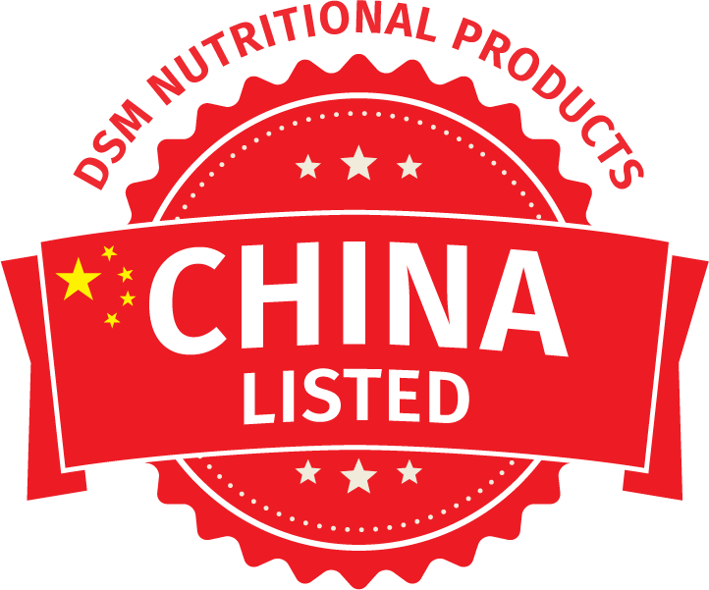


Allantoin
Multifunctionality for unique skin sensation
04.2021

Slide 2


Allantoin Launches
Steady launches in Skin Care
In 2020, Face/Neck Care accounted for 44% of the launches
Source: Mintel

Slide 3
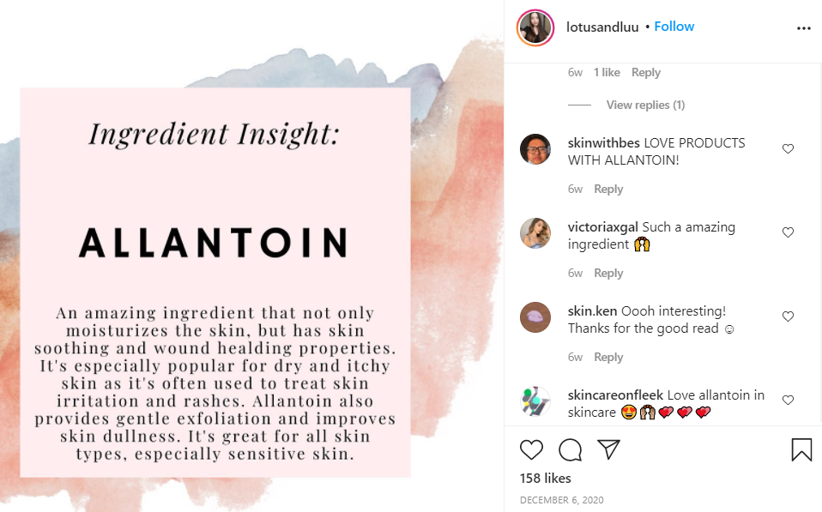
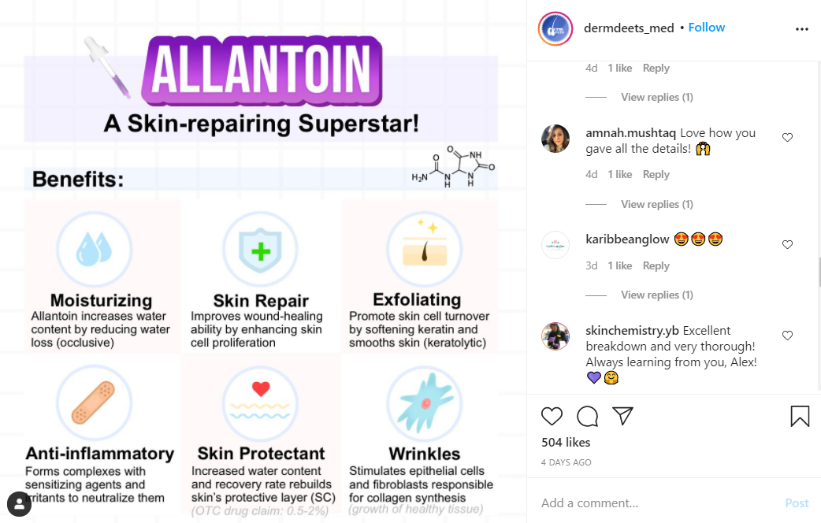
Consumer Awareness of Allantoin
Social media posts highlight the benefits of allantoin
Key Benefits:
Moisturizes • Repairs Skin • Good for Sensitive Skin • Exfoliates • Addresses Wrinkles
Source: Instagram
Notes:
https://www.instagram.com/p/CKH7NApDqRY/?utm_source=ig_web_copy_link
https://www.instagram.com/p/CIeENfpnFID/?utm_source=ig_web_copy_link

Slide 4


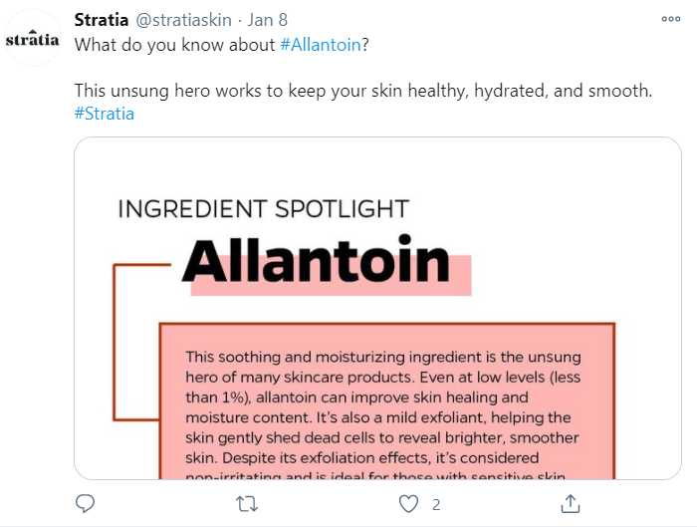
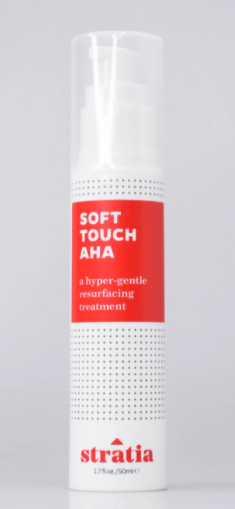
Brand Messaging
Brands call attention to allantoin
Stratia
Soft Touch AHA
Allantoin soothes, heals, and moisturizes while stimulating cell regeneration. Highly effective and well-studied.
Source: Twitter
Notes:
https://twitter.com/stratiaskin/status/1347589148568285185?s=20

Slide 5



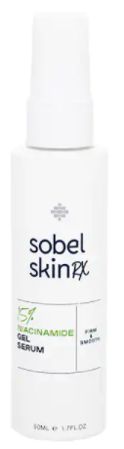
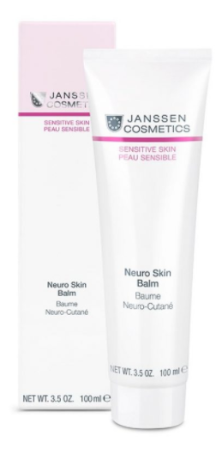
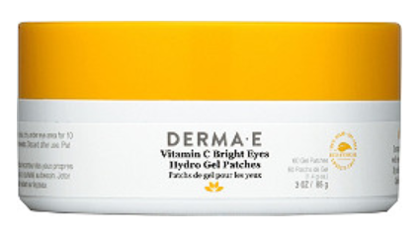
Notable Products with Allantoin
Launches from 2020
Derma E
Vitamin C Bright Eyes Hydro Gel Patches
Patches enriched with vitamins C & B3 to visibly brighten the look of dark circles while Caffeine depuffs, and Allantoin and Aloe combine to soothe, leaving your under-eye area refreshed and brightened.
Sobel Skin Rx
15% Niacinamide
Gel Serum
A gel serum that improves the appearance of enlarged pores and dull skin and helps to visibly plump skin to reduce look of fine lines. Niacinamide helps nurture, firm, smooth, and minimize the appearance of large pores. Allantoin calms and soothes skin.
Janssen
Sensitive Neuro Skin Balm
This easily spreadable lotion contains active ingredients that regenerate the skin’s impaired barrier function, reduce inflammation and leave the skin feeling pleasant. Allantoin soothes irritated skin and prevents redness.
Source: Brand Sites
Notes:
Derma E's Vitamin C Bright Eyes Hydro Gel Patches: Water (Aqua), Glycerin, Niacinamide, Carrageenan, Ethyl Ascorbyl Ether (Vitamin C), Allantoin, Cucumis Sativus (Cucumber) Fruit Extract, Caffeine, Sodium Hyaluronate, Aloe Barbadensis (Aloe Vera) Leaf Juice, Arginine, Ricinus Communis (Castor) Seed Oil, Ceratonia Siliqua (Carob) Gum, Cyamopsis Tetragonoloba (Guar) Gum, Glucomannan, Cellulose Gum, Calcium Lactate, Calcium Chloride, Potassium Chloride, Mica, Hydroxyacetophenone, Chlorphenesin, CI 77891, CI 77491, 1,2-Hexanediol, Polysorbate 80, Sucrose.
Sobel Skin Rx 15% Niacinamide Gel Serum: Water, Niacinamide, Glycerin, Hydroxyethylcellulose, Allantoin, Chamomilla Recutita (Matricaria) Flower Extract,Cucumis Sativus (Cucumber) Fruit Extract,Bisabolol,Zingiber Officinale (Ginger) Root Extract, Phenoxyethnaol, Ethylhexylglycerin.
Janssen Sensitive Neuro Skin Balm: Ingredients: Aqua, Butylene Glycol, Isostearyl Isostearate, Methyl Glucose Sesquistearate, Hydrogenated Coco-glycerides, Cetearyl Alcohol, Caprylic/Capric Triglyceride, Glycerin, 1,2-hexanediol, Octyldodecanol, Glyceryl Stearate, Squalane, Butyrospermum Parkii Butter, Saccharide Isomerate, Tocopheryl Acetate, Ophiopogon Japonicus Root Extract, Sodium Hyaluronate, Allantoin, Bisabolol, Lecithin, Cardiospermum Halicacabum Flower/Leaf/Vine Extract, Ribes Nigrum Seed Oil, Helianthus Annuus Seed Oil Unsaponifiables, Helianthus Annuus Seed Oil, Xanthan Gum, Sodium Stearoyl Glutamate, Citric Acid, Sodium Citrate, Sodium Hydroxide, Maltodextrin, Hydroxyacetophenone, Tocopherol, Ascorbyl Palmitate, Rosmarinus Officinalis Leaf Extract, Tetrasodium Glutamate Diacetate, parfum (fragrance)

Slide 6
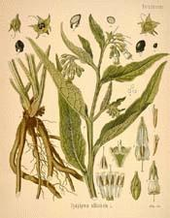
Allantoin
Key facts
1912 : Allantoin was first discovered in the Comfrey plant
Allantoin also found in many other plants
Wheat, Soy, Rice, Cauliflower, Green Beans
Allantoin is used to treat wounds and the appearance of burns.
Allantoin is also been used in cosmetic products as an ideal addition to anti-aging products to help to reduce aging and skin damage.
Comfrey: Symphytum officinalis
Notes:
Moisturizing & smoothing
How? Allantoin increases the water binding capacity in the outermost part of the skin layer (corneocytes), reinforcing the skin’s natural protective barrier and improving its moisture retention, providing a smoothening effect to the skin.
Exfoliates & boosts radiance
How? Since allantoin increases the water binding capacity for the outermost part of the skin containing dead skin cells, it causes it to soften and shed the dead skin (keratolytic activity) by loosening the protein bridges (desmosomes) that maintain the adhesion of corneocytes to each other. Thus the surface of the skin is smoother, softer and becomes supplier.
Supports natural regeneration of the skin barrier
How? By supporting skin’s integrity
Anti-irritant
How? Helps to counter discomfort caused by harsh actives

Slide 7

Allantoin
At a glance
Natural identical ingredient.
Benefits
Provides a smoothening and moisturizing effect
Anti-irritant properties helping to counter discomfort skin
Leaves the skin’s appearance more supple and radiant
Helps to exfoliate dry and damaged cells
Henning, Evaluation of the efficacy of allantoin, NutraCos, March/April 2002
AraújoI et al, Profile of wound healing process induced by allantoin, Acta Cirúrgica Brasileira - Vol. 25 (5) 2010 - 460

Slide 8
Allantoin – Multifunctionality for unique skin sensation
Cosmetic claim : moist, soft, smooth and supple skin
Stratum corneum
Allantoin
= keratoplastic
It has similar properties as the components of the natural moisturization factor (NMF), binding water, reinforcing skin barrier and improving moisturization.
Due to keratinolytic properties it softens skin and helps desquamation to minimize the appearance of aging and skin damage.
Notes:
Moisturizing & smoothing
How? Allantoin increases the water binding capacity in the outermost part of the skin layer (corneocytes), reinforcing the skin’s natural protective barrier and improving its moisture retention, providing a smoothening effect to the skin.
Exfoliates & boosts radiance
How? Since allantoin increases the water binding capacity for the outermost part of the skin containing dead skin cells, it causes it to soften and shed the dead skin (keratolytic activity) by loosening the protein bridges (desmosomes) that maintain the adhesion of corneocytes to each other. Thus the surface of the skin is smoother, softer and becomes supplier.
Supports natural regeneration of the skin barrier
How? By supporting skin’s integrity
Anti-irritant
How? Helps to counter discomfort caused by harsh actives

Slide 9
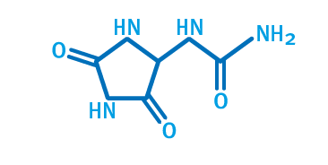
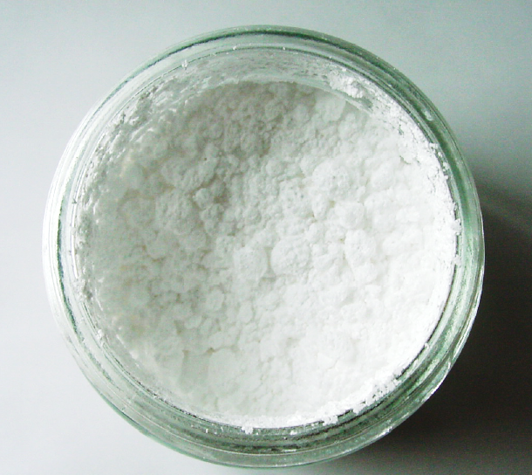
Allantoin
Product features
Allantoin, the diureide of glyoxylic acid, is a crystallized oxidation product of uric acid found naturally in comfrey roots.
INCI name: Allantoin
Chemical names: 5-ureido-hydantoine 2,5-dioxo-4-imidazolidinyl urea
Appearance: White to off-white, practically odourless powder
Application: Allantoin can be used for almost all product types and applications
Suggested concentration: 0.05 – 0.3%
Notes:
Moisturizing & smoothing
How? Allantoin increases the water binding capacity in the outermost part of the skin layer (corneocytes), reinforcing the skin’s natural protective barrier and improving its moisture retention, providing a smoothening effect to the skin.
Exfoliates & boosts radiance
How? Since allantoin increases the water binding capacity for the outermost part of the skin containing dead skin cells, it causes it to soften and shed the dead skin (keratolytic activity) by loosening the protein bridges (desmosomes) that maintain the adhesion of corneocytes to each other. Thus the surface of the skin is smoother, softer and becomes supplier.
Supports natural regeneration of the skin barrier
How? By supporting skin’s integrity
Anti-irritant
How? Helps to counter discomfort caused by harsh actives

Slide 10
Allantoin
Formulation
Solubility
soluble in the aqueous phase
insoluble in commonly used oils
add to water and dissolve at 50°C
alternatively add at 25°C under stirring
Stability
aqueous solutions: pH range 4 to 8 recommended
decomposition after extensive, long heating (> 1h @ 80°C) to urea and glyoxylic acid with allantoic acid as intermediate product
strong alkaline treatment (pH > 11 leads to hydrolysis)

Slide 11
Allantoin
Consumer applications
Skin care: facial care, facial cleansing, body care, baby care,
hand care creams and lotions
Decorative cosmetics / make-up: lipsticks and glosses
Toiletries: shower and bath gel, as well as after-shave lotions and creams
Hair care: shampoos, conditioners and styling
Sun care: sun protection, after-sun and self-tanning formulasSolubility

Slide 12
Disclaimer
Copyright © 2021 DSM Nutritional Products, 4002 Basel, Switzerland.
www.dsm.com/personal-care. All rights reserved.
DSM has used diligent care to ensure that the information provided herein is accurate and up-to-date, however, DSM makes no representation or warranty, either expressly or implied, of the accuracy, reliability, or completeness thereof. The information provided herein contains scientific and product information for business to business use and does not constitute or provide scientific or medical advice, diagnosis or recommendation for treatment. Country or region-specific information should be considered when labeling or advertising to final consumer. In no event shall DSM be liable for any damages arising from or reliance upon, or use of, any information provided herein. The content of this document is subject to change without further notice. Please contact your local DSM representative for further details. All trademarks listed in this document are either (registered) trademarks of, or trademarks licensed by, the DSM group of companies in the Netherlands and/or other countries, unless explicitly stated otherwise.

