Slide 1
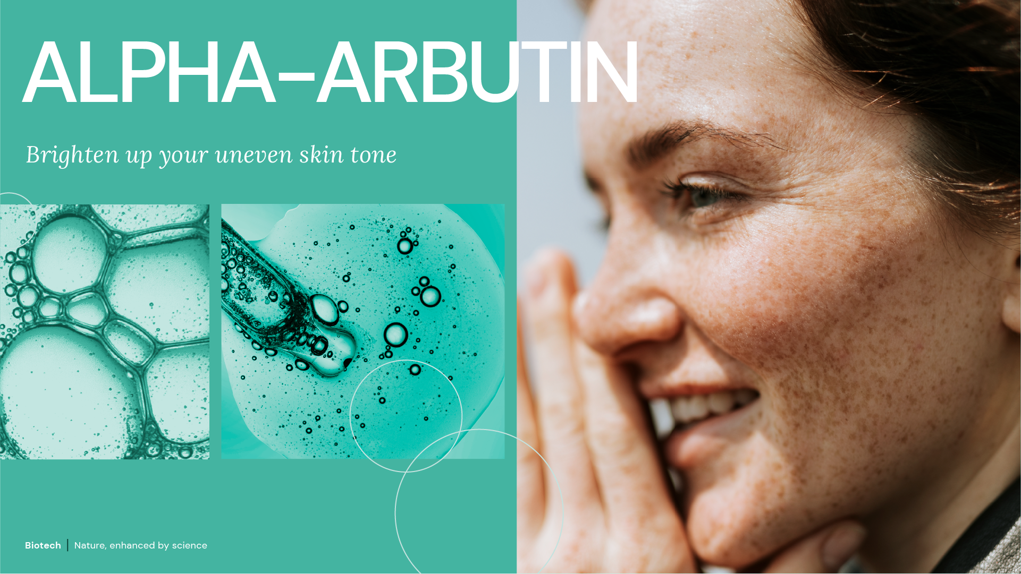
September 2026
Notes:
Most efficient skin whitener

Slide 2
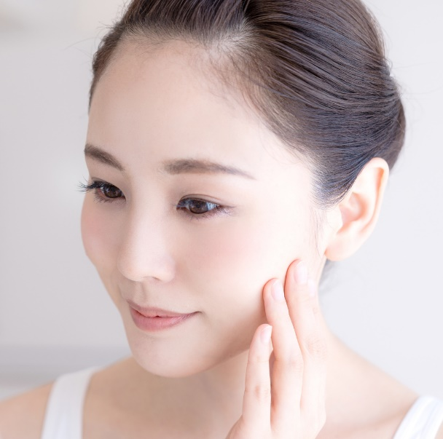

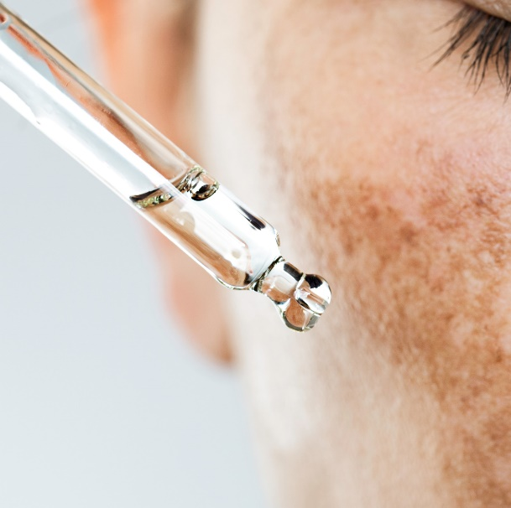
Uneven Skin Tone: A Global Concern
Asia: A Long-Standing Beauty Priority
Across Asia, healthy skin is often associated with a bright, radiant, and even skin tone.
The West: From Brightening to Healthy Aging
In Western markets, reducing age spots and maintaining an even skin tone are increasingly associated with healthy aging.
Pigmentation Irregularities: A Global Skin Concern
Pigmentation irregularities, dark spots, and post-acne marks affect consumers worldwide, making an even skin tone one of the most universal skincare needs.
2
Biotech | Nature, enhanced by science

Slide 3
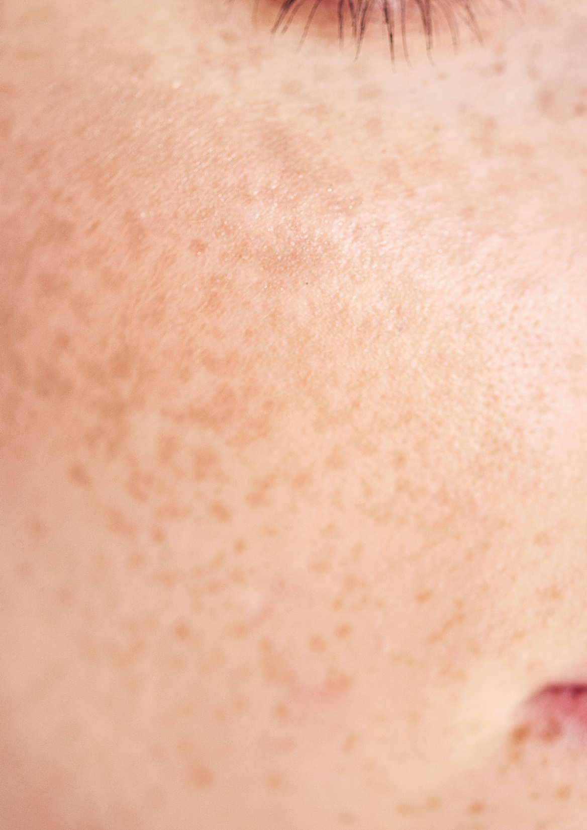
Broadly, there are 4 main types of pigmentation issues
Age spots also known as sunspots or solar lentigines:
  Over time as our skin is exposed to UV, and even blue light from the sun and other sources, it is less able to regulate the production of melanin.
Freckles
  Freckles are small, flat patches of pigment on the skin, caused by genetics or exposure to the sun.
Post-inflammatory hyperpigmentation (PIH) marks:
  This occurs in response to inflammation in the skin.
  It’s commonly found among acne sufferers and can also be caused by cosmetic procedures such as dermabrasion, laser treatment and chemical peels.
Melasma:
  Also known as chloasma, melasma is a condition where larger brown or greyish patches of hyperpigmentation develop mainly on the face.
  Although it can affect both men and women, melasma is most common in women and is thought to be triggered by changes in hormone levels.
3

Slide 4

Melanin, the vital pigment
Melanin is the pigment that gives our skin its natural color
Melanin provides some protection against UV radiation
  But melanin alone isn’t enough to protect your skin from sun damage. That’s why it’s so important to wear sunscreen
Types of melanin
  Eumelanin is a brown-black pigment, and the most common pigment that we see in skin
  Pheomelanin is a yellow-red pigment, which we typically see in people with lighter skin.
Several factors can trigger an increase in melanin production
  The main causes are sun exposure, hormonal influences, age, skin injuries and inflammation.
4

Slide 5
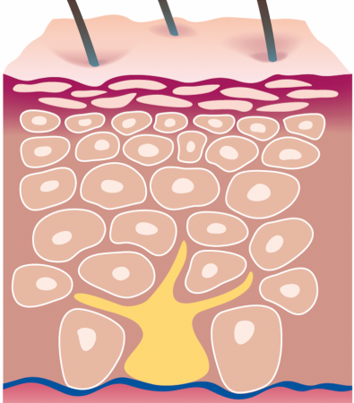
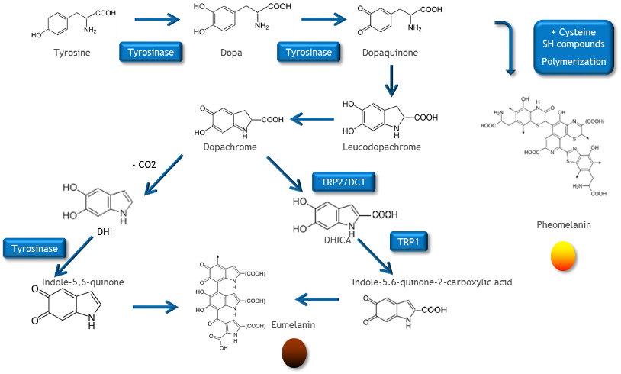
Melanocytes produce the pigment melanin
Melanocytes are the cells responsible for production melanin
Melanocytes are part of the basal layer of the epidermis, forming long, finger-like dendrites which reach to neighboring keratinocytes
Melanocytes bear some resemblance to an octopus
Melanocytes produce specific organelles, termed melanosomes (melanin-containing envelops), in which melanin pigment is synthesized and deposited.
Melanosomes convert the amino acid Tyrosine in Eumelanin (brown - black) and Phaeomelanin (yellow – red)
Once the melanin is formed it is packed into melanosomes, which are then transferred into the adjoining keratinocytes via the dendrites.
5

Slide 6



ALPHA-ARBUTIN (50 1637 2)
ID Card
INCI NAME:
Alpha-Arbutin
High performing enzyme related biotechnology, optimized manufacturing process with one enzyme
Highest product quality, purity > 99%, guaranteed absence of hydroquinone (< LOQ 3 ppm)
66% of natural origin (according to ISO 16128), sugar origin: sucrose from sugar cane
TECHNOLOGY:
TECHNICAL:
Form: white powder
pH of use: 3.5-6.5
Use level: face care up to 2%; body care up to 0.5%
Preservative: free
Solubility: water soluble
Biodegradability: readily biodegradable
Ensures a lighter skin tone after only one month**
Helps to minimize the appearance of dark spots**
Outperforms Hydroquinone and Beta-Arbutin after only one month**
Combination with NIACINAMIDE PC for lighter skin tone, patented*
Combination with NIACINAMIDE PC and REGU®-FADE for lighter dark spots**
BENEFITS:
More than 20 times stronger inhibition of tyrosinase than with Beta Arbutin*
More efficient than Ascorbylglucoside*
Has anti-oxidant properties *¹
REGISTRATION
CERTIFICATION
* in vitro ** in vivo, ¹ Frontiers in Physiology, November 2020 | Volume 11 | Article 586843

Slide 7
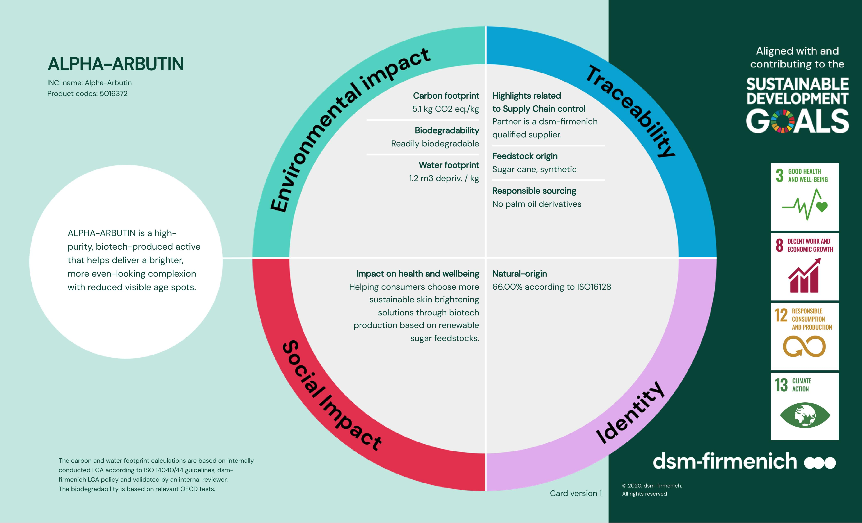
7

Slide 8
dsm-firmenich PREMIUM ALPHA-ARBUTIN
Differentiated solution
dsm-firmenich is the pioneer & leader of ALPHA-ARBUTIN
dsm-firmenich ALPHA-ARBUTIN has become a widely trusted ingredient, rated highly for its superior performance
dsm-firmenich made ALPHA-ARBUTIN popular all over the world
High investments in efficacy, safety and market studies to understand the needs of customers and consumers.
KEY
DIFFERENTIATORS:
ALPHA-ARBUTIN (50 1637 2): Purity > 99%, guaranteed absence of hydroquinone (< LOQ 3 ppm)
ALPHA-ARBUTIN (50 1637 2): Halal certified
Comprehensive product dossier including all aspects relevant and needed by cosmetic customers
Meets all regulatory and safety requirements in global and regional markets
HIGHEST
PRODUCT QUALITY
dsm-firmenich science power demonstrated the superior efficacy of ALPHA-ARBUTIN as Tyrosinase Inhibitor
Outperforms market benchmarks
Even better in combination with NIACINAMIDE PC, patented in India
SUPERIOR
EFFICACY
dsm-firmenich has been the only company who responded to the EU calls for data between 2012 and 2022 to demonstrate the safe use of ALPHA-ARBUTIN. Scientific data were generated in various test programs for the submitted dossiers.
dsm-firmenich ALPHA-ARBUTIN is safe for use in cosmetics in a concentration of up to 2% in face creams and up to 0.5% in body lotions assessed by the European Scientific Commitee for consumer safety
dsm-firmenich science power demonstrated the stability of ALPHA-ARBUTIN in cosmetic formulations, on the skin surface and on deeper layers.
SAFETY:

Slide 9
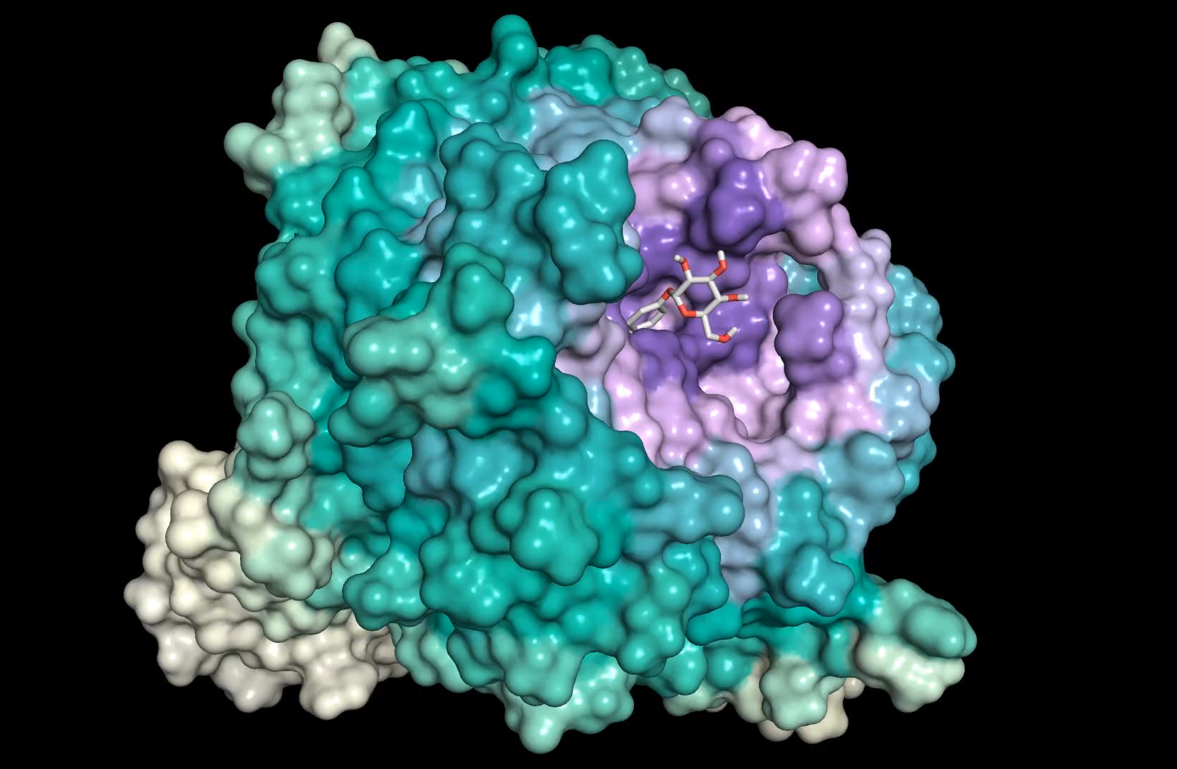
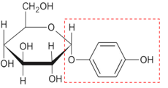
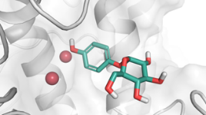
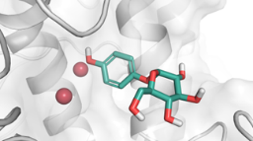
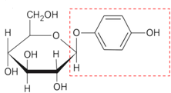
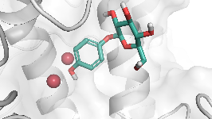
dsm-firmenich science power
Molecular Docking ¹ Study of ALPHA-ARBUTIN as Tyrosinase Inhibitor
Molecular docking results
ALPHA-ARBUTIN with a strong binding energy (ΔG = -2.9 kcal/mol) shows a similar orientation as the natural substrate L-Tyrosine
ALPHA-ARBUTIN has the best binding energy of -2.9 kcal/mol, while that of Beta Arbutin is only -2.1 kcal/mol indicating that Beta-Arbutin has difficulties to control melanin
ALPHA-ARBUTIN has the best orientation to interact in the binding site of Tyrosinase (His85, His244) different to Beta-Arbutin (Gly281)
Molecular docking of ALPHA-ARBUTIN as Tyrosinase inhibitor
Compounds | Interaction Energy (Kcal/mol) | Tyrosinase Hydrogen-Bonds Interactions | Tyrosinase Intermolecular forces
ALPHA-ARBUTIN | -2.9 | His85, His244 | Cu401
Beta-Arbutin | -2.1 | Gly281 | Cu401
Glucose
moiety
Phenol
moiety
The glucose moiety of ALPHA-ARBUTIN forms a strong hydrogen bond network in the binding site of Tyrosinase (His85, His244)
The phenol moiety of ALPHA-ARBUTIN is close to the Tyrosinase copper (Cu)
Glucose
moiety
Phenol
moiety
¹ Molecular docking refers to a computational technique used in structure-based drug design to predict the binding of small molecules to macromolecular targets. It aids in studying biomolecular interactions and developing therapeutic agents by analyzing bond conformations and free energies of binding Molecular Docking - an overview | ScienceDirect Topics

Slide 10
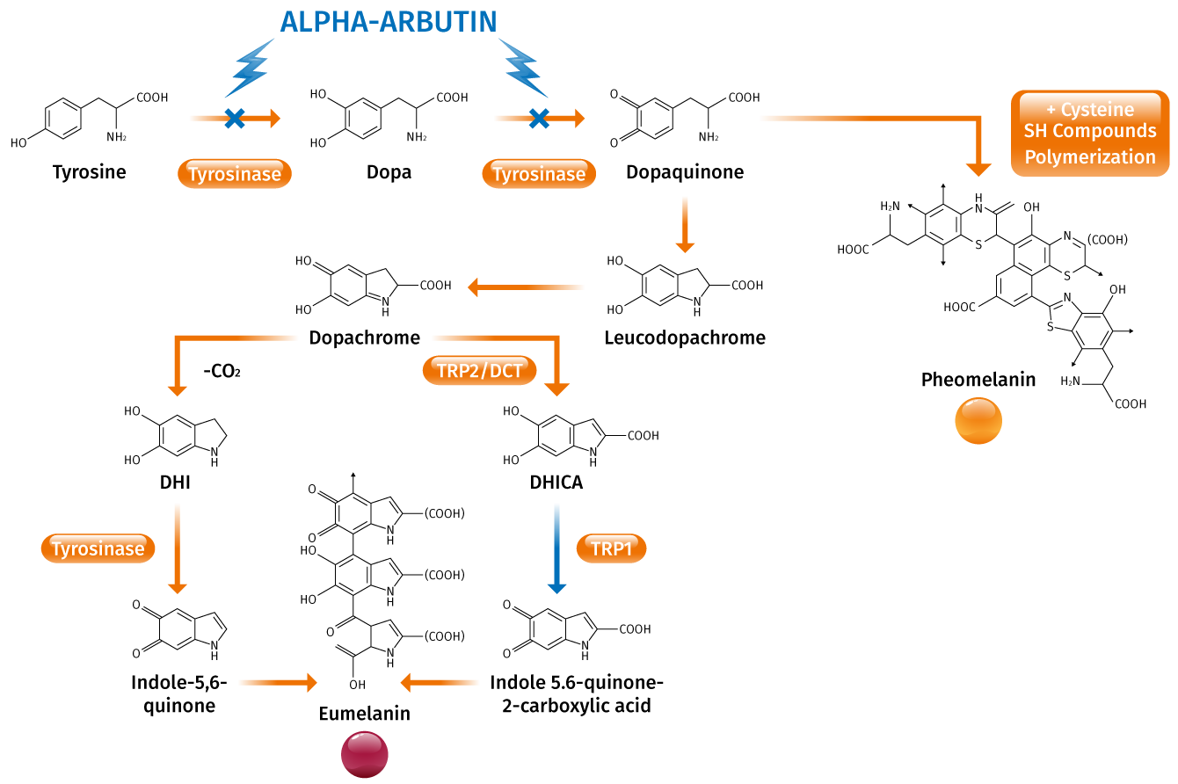
More than 10 times stronger inhibition of tyrosinase than with Beta Arbutin in vitro dsm-firmenich study
 | MOUSE MELANOMA CELL (B16-F1) | HUMAN TYROSINASE
 | IC50 | IC50
ALPHA-ARBUTIN | >0.231mM | 1.8-2.1 mM
Beta Arbutin | 1.874mM | >30 mM
ALPHA-ARBUTIN exhibits impressive tyrosinase inhibition and is ten times more effective than Beta Arbutin.
Very low IC50 values indicates the power of ALPHA-ARBUTIN.
ALPHA-ARBUTIN inhibits tyrosinase activity to regulate melanin production

Slide 11
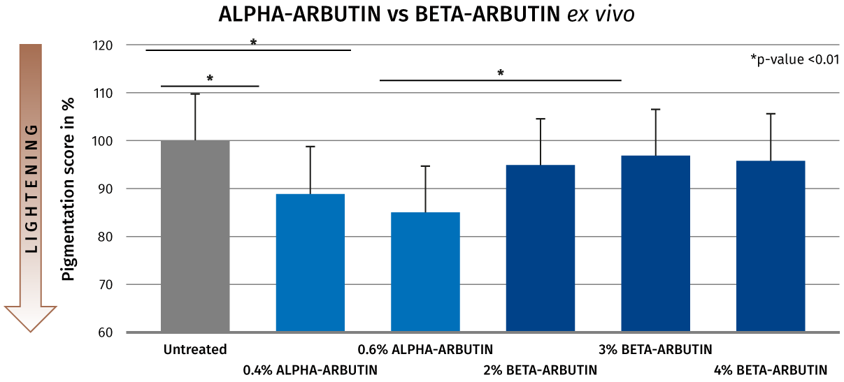
Up to 10 times more efficient than with Beta-Arbutin ex vivo dsm-firmenich study
ALPHA-ARBUTIN (0.4%)
is more effective than
Beta-Arbutin (2%, 3%, 4%) after 6 days ex vivo
Tested on human abdominal skin, 35 years old female donor.
Comparison of treatments versus untreated at day 6

Slide 12
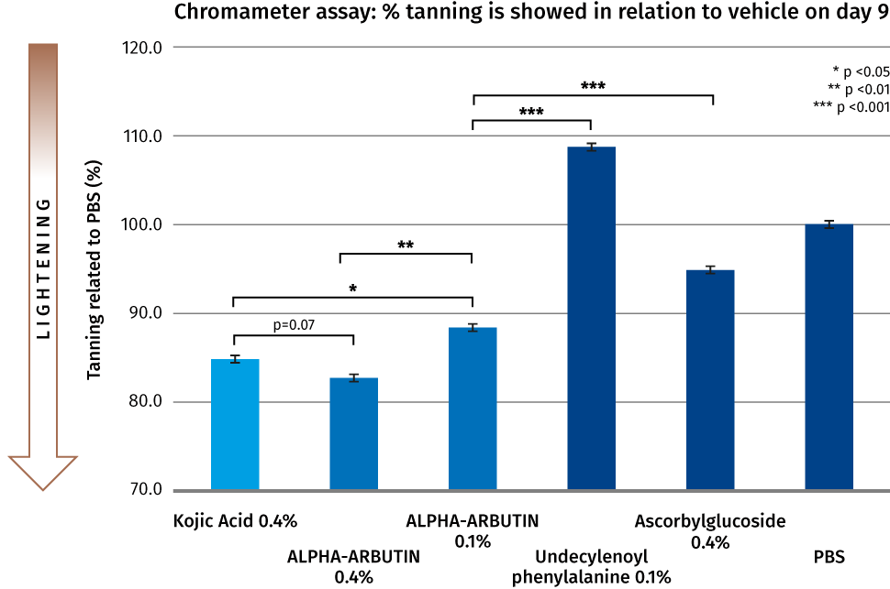
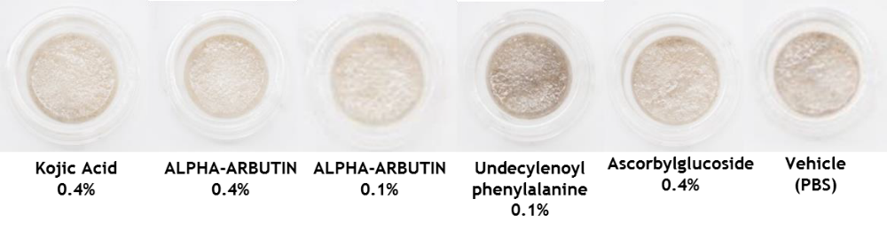
ALPHA-ARBUTIN demonstrated superior brightening efficacy compared to Ascorbyl Glucoside
Study design
Reconstituted tanned human skin model (epiCS-M, Fitzpatrick skin type V)
Topical application every second day over a 9-day study period
Chromameter measurements
Results
ALPHA-ARBUTIN is significant more efficient than Ascorbylglucoside

Slide 13
ALPHA-ARBUTIN Outperforms Hydroquinone and Beta-Arbutin in a One-Month Clinical Study
Study Design
80 Chinese female volunteers (25-40 years)
1% ALPHA-ARBUTIN, Kojic Acid, Hydroquinone, and Beta-Arbutin evaluated side-by-side
Twice-daily forearm application for 1 month
Skin lightness assessed using a chromameter (L* value)
Key Results
>3× greater skin-lightening efficacy vs. 1% Hydroquinone
Outperformed Beta-Arbutin
Biotech | Nature, enhanced by science

Slide 14
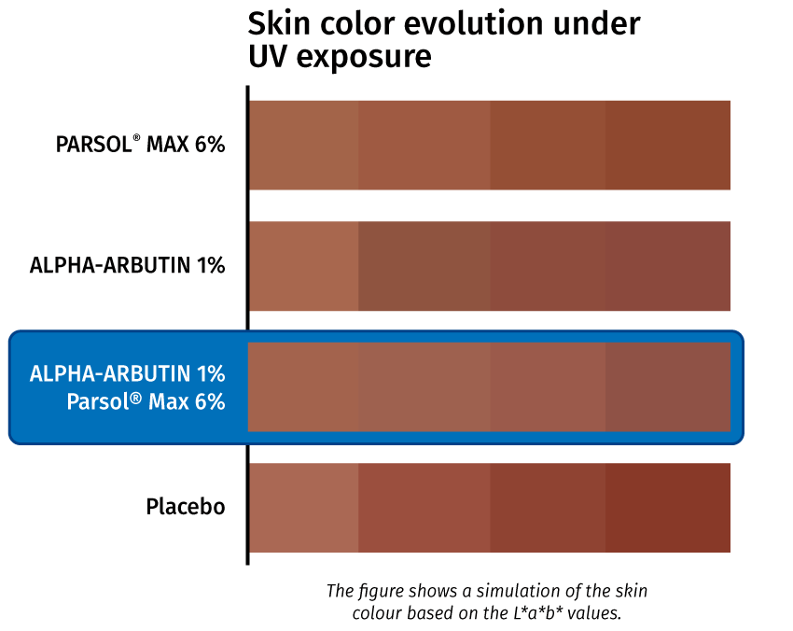
Even skin tone with ALPHA-ARBUTIN and UV-filter in vivo dsm-firmenich study
20 female Asian volunteers, mean age 35 years
The formulations were applied twice on each volunteer in a dose of 2 mg/cm2 once a day 60 minutes before UV stress
Sun light exposition (< 1 MED) three times each week
Evaluation time 12 weeks
Skin Colour was assessed according to the L*a*b* system (CIELAB) with a Minolta spectralphotometer 508i
ALPHA-ARBUTIN reduces the degree of skin tanning after UV exposure
Even skin tone with ALPHA-ARBUTIN (1%) and PARSOL® MAX (6%)
*H. Moser, Personal Care July 2005

Slide 15
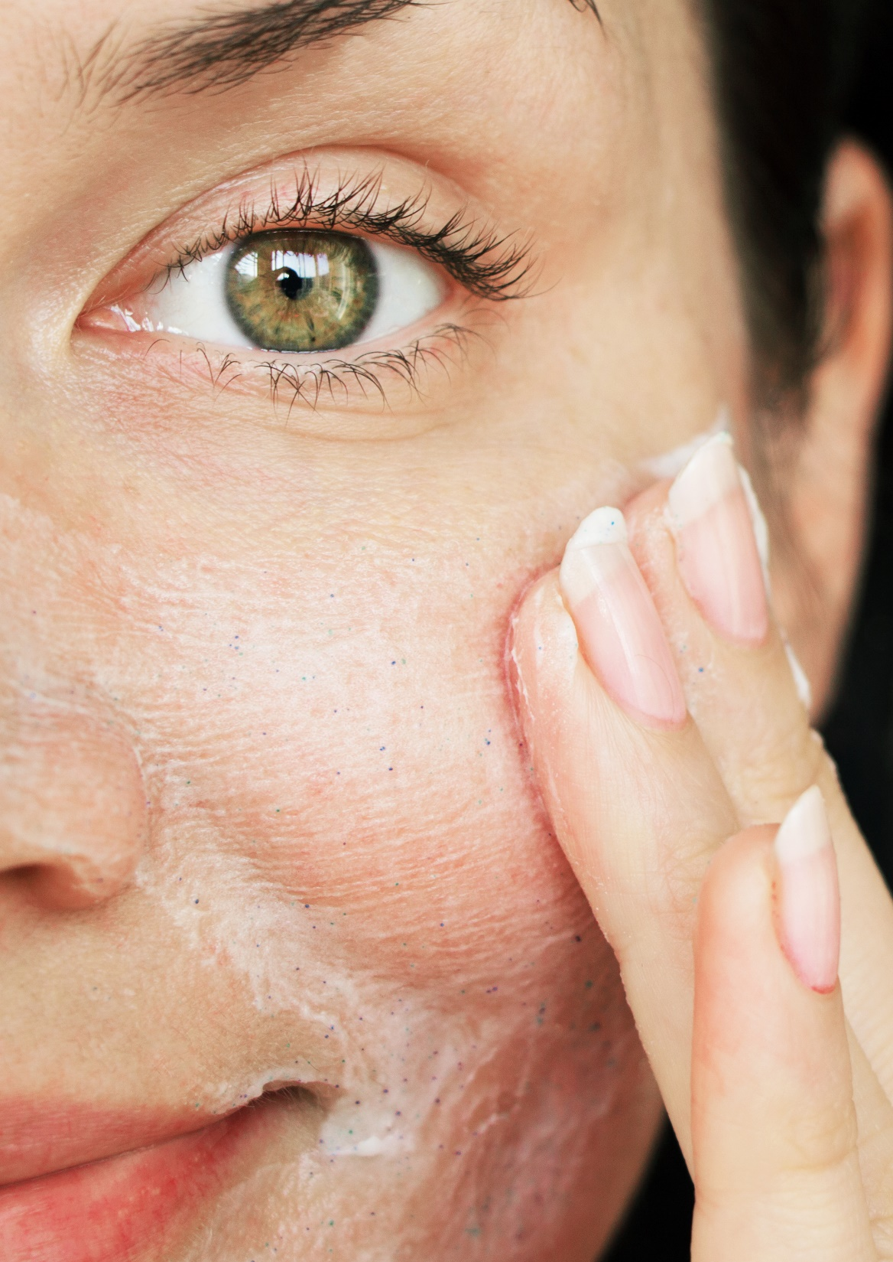
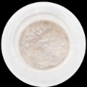
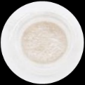
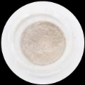
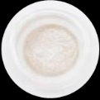
Even better with NIACINAMIDE PC in vitro dsm-firmenich study
… due to 2 different levels of actions:
ALPHA-ARBUTIN directly inhibits the tyrosinase enzyme
NIACINAMIDE PC inhibits melanosome transfer from
melanocytes to surrounding keratinocytes
Tested on reconstituted tanned human skin (Fitzpatrick skin type V)
Skin lightening was measured with Chromameter
Visible results
Significant skin lightening improvement
Patented in India

Slide 16
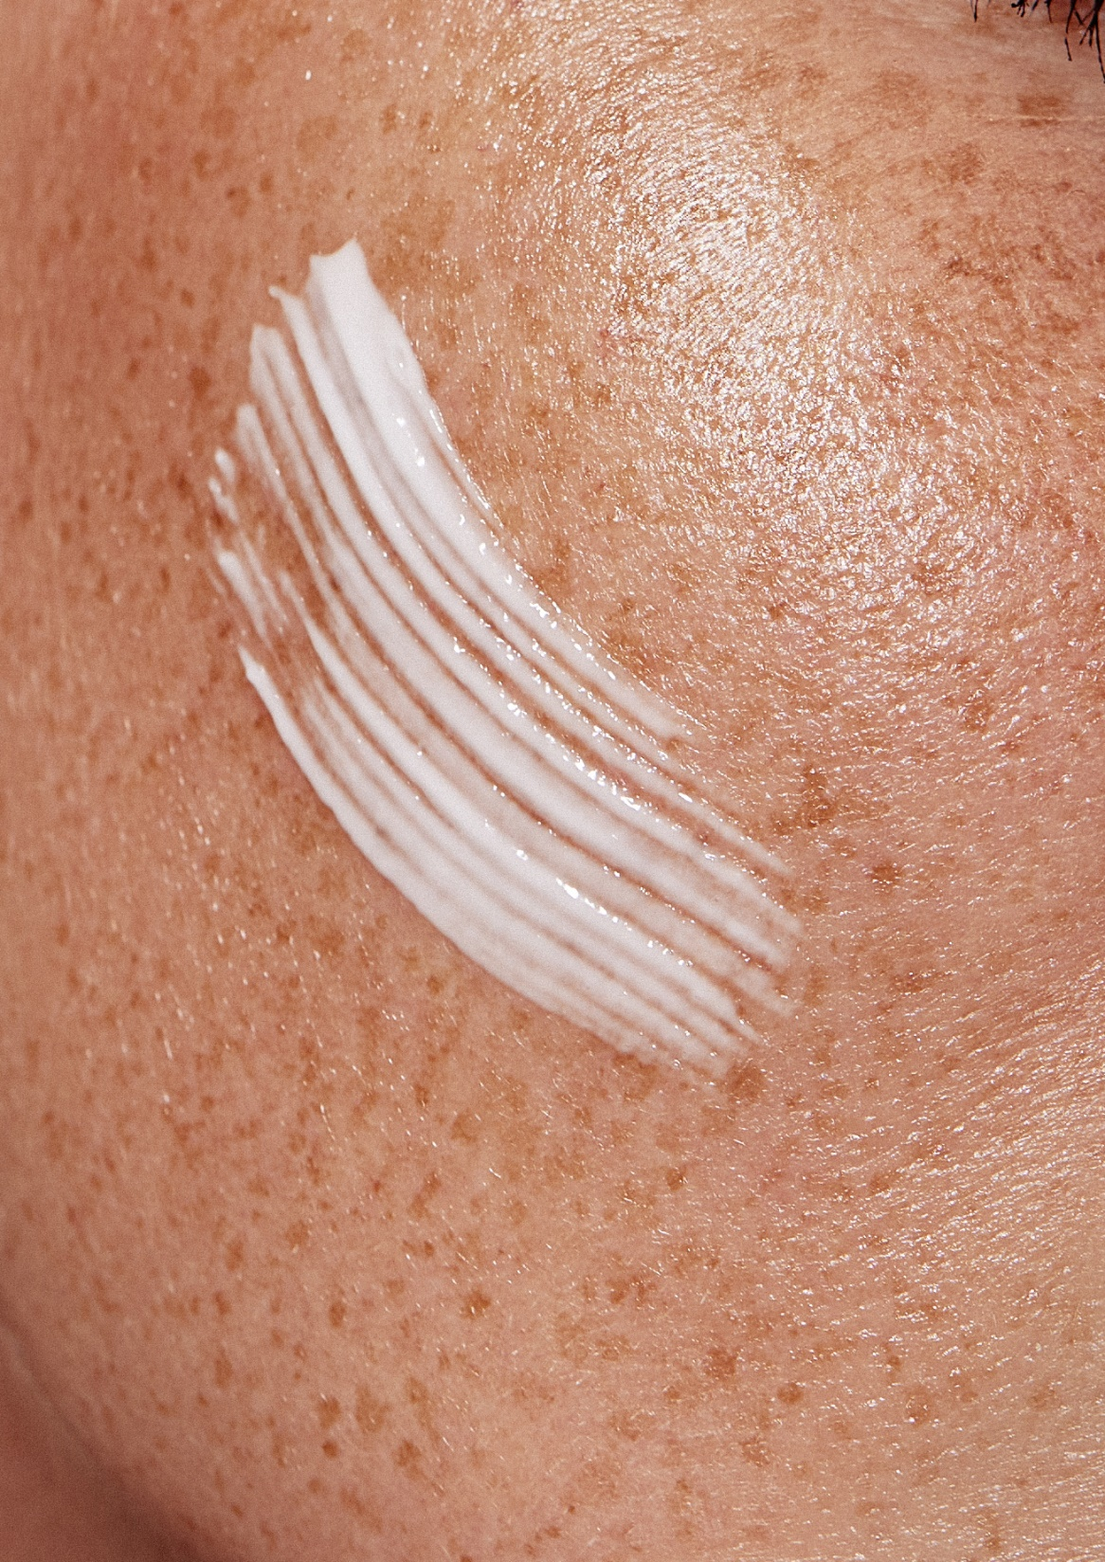
TRIPLE ACTIVE for lighter dark spots in vivo
ALPHA-ARBUTIN + NIACINAMIDE PC + REGU®-FADE
dsm-firmenich study
5 different levels of action for lighter dark spots
Help to minimize redness^{1,3}
Act as a strong antioxidant ^{1,3}
Intervening in the pre-melanin synthesis processes³
Directly inhibiting the tyrosinase enzyme^{2,3}
Inhibits melanosome transfer from melanocytes
to surrounding keratinocytes^{1,3}
Dermatologically tested in China According NMPA (National Medical Products Administration) skin whitening standard test (II) in China
¹ NIACINAMIDE PC, ² ALPHA-ARBUTIN, ³ REGU®-FADE

Slide 17
TRIPLE ACTIVE: ALPHA-ARBUTIN + NIACINAMIDE PC + REGU®-FADE
Study design
 | D0 | Week 2 | Week 4 | Week 8
Product application¹ | - | X | X | X
Skin ITA° measurement² | X | X | X | X
Melanin index (MI) measurement³ | X | X | X | X
Study design
according NMPA China⁴ skin whitening standard test (II)
Single-blind, placebo controlled, randomized clinical study performed in China
30 Chinese subjects
(test product group)
30 Chinese subjects
(placebo group) aged from 23 – 58 years old
Test area: facial age spot areas
Formulation placebo
Formulation with 3% NIACINAMIDE PC 0.3% ALPHA-ARBUTIN 0.05% REGU®-FADE
Measuring time points:
D0, Week 2, Week 4, Week 8
¹ Product application: twice a day
² Skin ITA° (lightening) characterizes human skin color by measuring skin L*a*b* data with a skin colorimeter
³ Melanin index (MI) is an optical skin parameter related to the melanin content in the tissue. It can be measured by spectrophotometry (Melanin meter)
⁴ NMPA (National Medical Products Administration) China
17

Slide 18
TRIPLE ACTIVE: ALPHA-ARBUTIN + NIACINAMIDE PC + REGU®-FADE
Significant lighter age spots*
After 2 week
+6% lighter age spots
-3% melanin
After 4 weeks
+23% lighter age spots
-5% melanin
After 8 weeks
+29% lighter age spots
-9% melanin
Significant results
* in-vivo

Slide 21
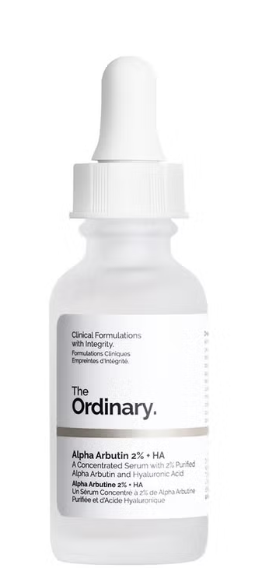
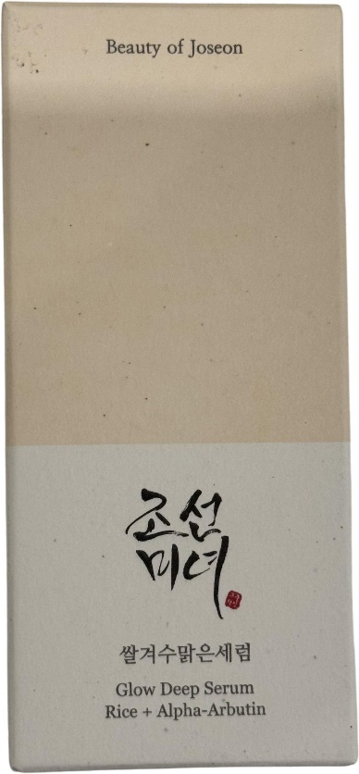
Innovative approaches with ALPHA-ARBUTIN to combat dark spots …
Fade dark spots & skin barrier strengthening
Target dark spots and uneven skin tone
Visible results with Alpha Arbutin 2% + Hyaluronic acid
Highly concentrated formula
Support absorption into the skin.
Top Korean skincare brand, that combines traditional with modern ingredients.
Featuring 68.6% Rice Bran Water, long known for its skin beautifying effect throughout Korean history, it will help to nourish and strengthen the skin barrier, while brightening and clarifying.
2% ALPHA-ARBUTIN included in this serum helps to fade dark spots and prevent hyperpigmentation.
21

