Slide 1
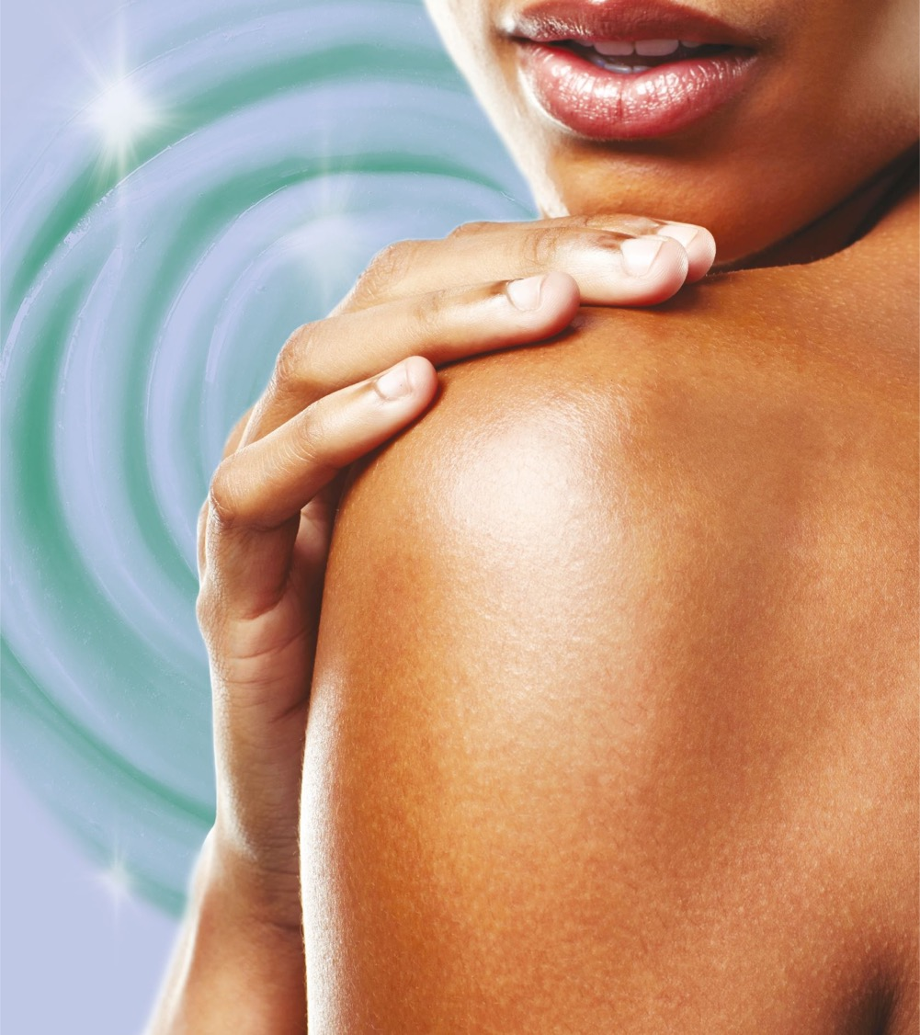




ARGAN OIL
Nourishment and Shine from the Tree of Life
04-2022

Slide 2
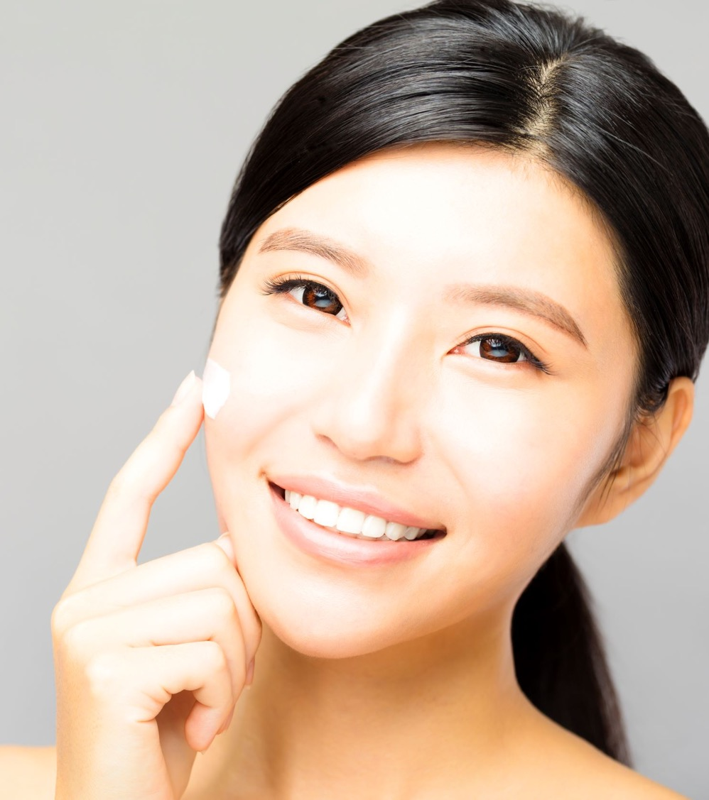
Agenda
Insights into Current Consumer Trends
DSM ARGAN OIL
Nourishing Elixir for Skin Care
Natural Shine Enhancer for Hair Care

Slide 3
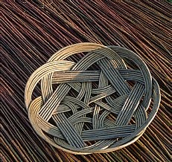
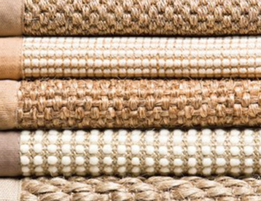
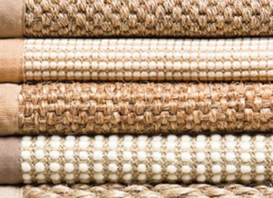
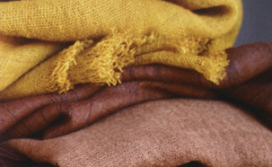


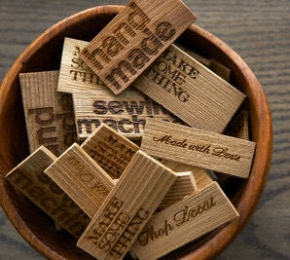
Trend: Artfully Crafted Nature
Moods
Natural materials and shapes,
warm and soft
Eco-avantgarde - authentic & casual –
positive & open attitude
Notes:
The trend agency Springpool developed beauty trends 2012/2013 for DSM based on Trend Union (one of the world famous trend institute).
„Artfully Crafted Nature“ is the trend which is best fitting for natural products and lifestyles.
Visuals and key words on this slide describe the moods of this trend:
First line: Natural materials and shape, warm and soft:
Natural materials appeal with their individual haptic feel.
Respect for handicraft like weaving or wicker wattling.
Colors and materials are warm, soft and intuitively pleasing.
Second line: Eco-avantgarde – authentic & casual – positive & open attitude:
Eco-avantgarde – feeling to be ahead of mainstream with one´s „green“ mindset.
The typical authentic, casual and eclectic style shown in clothing and home décor.
Positive, and open „we“-attitude → think „we can save the planet together, and do it in style“.

Slide 4




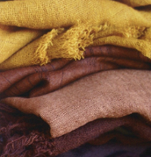
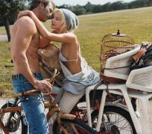
Trend: Artfully Crafted Nature
Consumer’s Lifestyle
Inspiration: Root
Style: young, “avantgardistic”, and casual
fascinated by nature and old handcraft techniques as basis for new solutions
„Idealistic hedonism“: they want to make the world better and have fun at the same time
Need: sustainable products that make them feel good
Community focus:
belonging to a special group
Notes:
Consumers in this target group are younger and have an avantgardistic and casual sense of style.
They are fascinated by nature and old handcraft techniques as basis for new solutions.
They are idealistic; they want to make the world better and have fun at the same time.
They want sustainable products that make them feel good.
Motto: „I want to belong to the right ones“

Slide 5

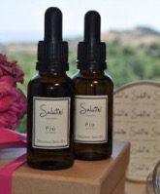

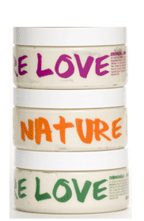

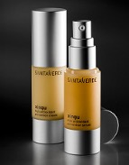
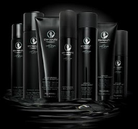
Trend: Artfully Crafted Nature
Consumer Insights for Beauty
Overall:
Always looking for new products, new stories
Beauty: nothing mainstream, rather eclectic and avantgardistic
Products:
Haptic quality (pack & product)
Beauty rituals (traditional/historical, ethnic etc.)
Benefits:
Unknown combination of different benefits
Appealing to higher level on need hierarchy
Manifestations:
Inspirations from food, health (pharmacy) etc.
Organic, sustainable plus (…“made with organic and wild crafted ingredients, peace, love, and harmony.“)
Notes:
This target group is always looking for new products or interesting stories as stimulation.
The approach to beauty is very much individual, eclectic (komponiert aus verschiedenen Quellen) and avantgardistic.
Products: the touch and feel of the products and their packs are very important. Background stories like ancient or ethnic beauty rituals appeal to them.
Benefits should offer a combination of different benefits to avoid being dull. They could also appeal to a higher level than just the intended performance on skin, hair etc. – think „peace on earth“ or at least „at home“.
Examples: packs and products inspired by old pharmacies (e.g. Salutini from Tuscany) or going further than just being organic/sustainable, like Nature Girl with the promise „made with organic and wild crafted ingredients, peace, love, and harmony “.

Slide 6

Artfully Crafted Nature
In a Nutshell
Strong trend for exotic high valuable products with new applications
Increasing demand for organic and sustainable solutions
Search for products with traditional beauty rituals
Growing fair trade expectations
DSM organic certified ARGAN OIL
completely fulfill these needs
Notes:
To summarize this trend analysis:
There is a strong trend for exotic and high valuable products, which may be used with new stories / applications
Additionally, these products should be available in an organic and sustainable way
This target group is interested in stories on traditional uses or beauty rituals
And there is also increasing fair trade expectations in the market
Therefore DSM organic certified ARGAN OIL completely fulfill these needs, demonstrated through the following slides.

Slide 7
Agenda
Insights into Current Consumer Trends
DSM ARGAN OIL
Nourishing Elixir for Skin Care
Natural Shine Enhancer for Hair Care

Slide 8
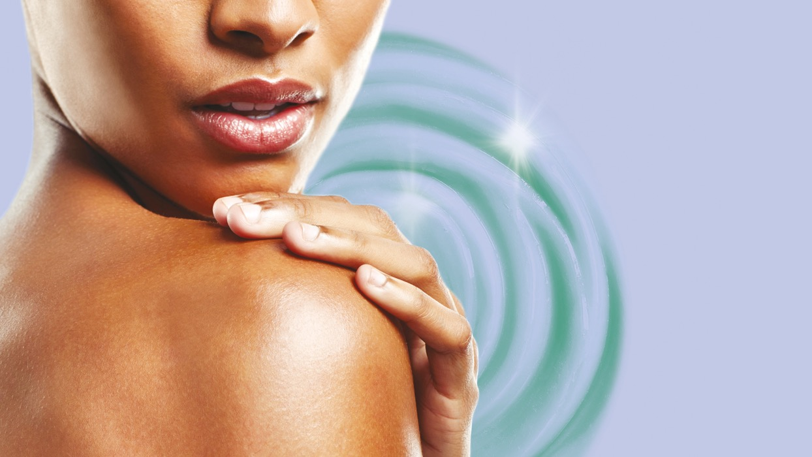
ARGAN OIL
Nourishment and shine from the tree of life
Notes:
This is DSM key visual for its ARGAN OIL.
The woman looks relaxed, she radiates life and health, she feels protected within the tree of life.
Her face reflects her delighted feeling by using argan oil on her skin. She looks young, her skin looks radiant and nourished.
The illuminated oil drop expresses the exclusivity and the value of this oil, this Moroccan elixir.
The drop is directly flowing from an argan fruit, expressing the gentle cold-pressing process, without solvents. Direct from the fruit onto the skin.

Slide 9
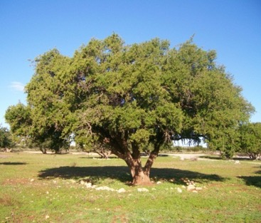
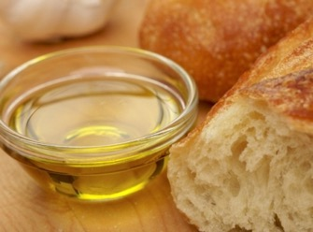
ARGAN TREE
The Moroccan Tree of Life
ARGANIA SPINOSA – its multifunctional attributes
Endemic tree from south-west Morocco
Last rampart against advancing desert, thanks to its deep root system
Leaves used as feed for goats and camels
Most important, ARGAN OIL, traditionally extracted by hand from Moroccan women, is used for many applications
ARGAN OIL – an elixir for body and soul
Traditional beauty elixir for Moroccan woman
Topical applications for skin, hair and nail care
Dietary use today and in traditional medicine for its health properties

Slide 10
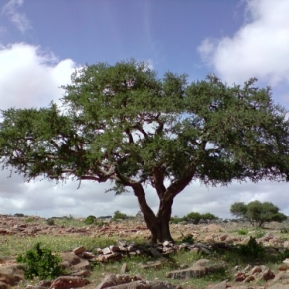
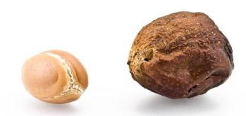
DSM ARGAN OIL
A Highly Valuable Oil
Specific origin
Kernels of the endemic tree Argania spinosa growing in the South West of Morocco
Special processing
Virgin oil by exclusive first and cold processing
Specifically deodorized resulting in a clear and nearly colorless product
Exceptional composition
Very rich in unsaturated fatty acids such as oleic acid and linoleic acid
High antioxidant power with natural tocopherols and phenols
Natural squalene provides a pleasant non oily skin feeling
Notes:
Processing:
Hydraulic cold processing using cotton disks (without using solvents) for extraction of the oil = virgin oil
Deodorized by steam injection under vacuum to eliminate volatile compounds
Composition
About 80% unsaturated fatty acids (oleic acid and linoleic acid) and about 20% essential fatty acids (palmitic and stearic)
Linoleic Acid is present in Argan Oil at a concentration three times higher than in olive oil.
More information on the components in the backup.

Slide 11
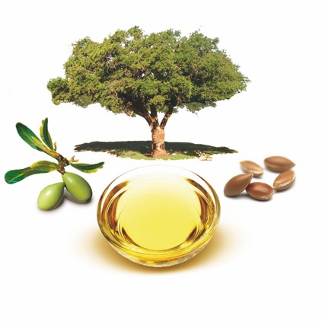
DSM ARGAN OIL
100% Organic Certified
100% pure and organic certified
from both COSMOS and NATRUE
Strong focus on sustainability and quality
DSM named No1 in the Dow Jones World Sustainability
Index in 2004, 2005, 2006, 2009, 2010 and 2011
Acting responsible by following fair trade principles
Each time you buy ARGAN OIL from DSM Nutritional Products you contribute to
sustainability projects in Morocco
Notes:
Fair Trade principles:
Local project basically focusing on prevention against desert spread and on education of the local children
Dow Jones World Sustainability Index (DJWSI):
The DJWSI includes over 300 companies from 34 countries that rank among the top 10% in their industries in terms of corporate sustainability. It tracks the performance of the leading sustainability-driven companies worldwide through a thorough assessment of companies’ economic, environmental and social performance.
In 2011, this is the third consecutive year that DSM has once again retained its number one position in the chemical industry sector in the DJWSI. This is the sixth time in total since 2004. In 2007 and 2008, the two years when DSM wasn’t ranked number one, it was still among the leaders in the sector. This year, DSM once again took concrete steps to actively reduce its carbon and ecological footprint with innovative products and processes. In the first half of 2011, 87% of DSM's innovation pipeline were ECO+ solutions (products and services that, when considered over their whole life cycle, offer clear ecological benefits, compared to the mainstream solutions they compete with). DSM also further built its successful and long-standing collaboration with the United Nations World Food Program and increased its advocacy and implementation activities to fight hidden hunger and malnutrition around the world.

Slide 12
Agenda
Insights into Current Consumer Trends
DSM ARGAN OIL
Nourishing Elixir for Skin Care
Natural Shine Enhancer for Hair Care

Slide 13
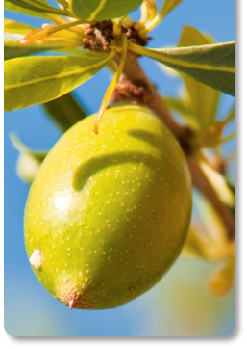
The Organic Nourishing Elixir
…..supported by outstanding composition
A nourishing care is essential for smooth and healthy-looking radiant skin.
Thanks to its high concentration in unsaturated fatty acids and squalene, DSM ARGAN OIL helps to replenish and restore skin's barrier. It leaves a non-greasy, smooth and moisturized skin.
The age-defying phenolic acids and tocopherols additionally provide significant protection against ageing processes. Skin complexion is improved.
Notes:
Literature:
1. Therapeutic potential of argan oil, Hanae El Monfalouti, Journal of Pharmacy and Pharmacology, 2010, 62:1669-1675
2. Argan oil and other argan products: use in dermocosmetology, Dominique Guillaume, Eur. J. Lipid Sci. Technol. 2011, 113, 403-408

Slide 14
… with an Outstanding Composition
For exceptional skin care properties
Unsaturated fatty acids help to prevent and reduce skin inflammation
Linoleic acid (omega 6) helps to maintain skin permeability barrier
Phenolic acids protect the skin against free radicals
& Tocopherols
Squalene provides a non oily pleasant skin feeling,
softens and protects the skin
Notes:
Minor components (literature datas):
Tocopherols: 50-70mg / 100g Argan oil
In olive oil: approx. 320mg/kg.
Linoleic acid: is an essential fatty acid, that cannot be synthesized by the body and therefore must be obtained from the diet. Linoleic acid is required for the synthesis of arachidonic acid, the progenitor of prostaglandins and leukotrienes, involved in the stimulation of the circulation, strengthening the body's natural defences, and suppressing inflammation and controlling cell growth. Epidermis has also a requirement for linoleic acid per se in order to maintain its permeability barrier.
Literatur: Epidermal lipids and scaling diseases of the skin, Mary L. Williams, Seminars in Dermatology, vol 11, N°2, 1992: pp 169-175.
Antioxidants (vitamin E / Tocopherol) quenches free radicals and neutralizes destructive oxidation.
Phenols with antioxidant power and known for their antiseptic, antioxidant, anti-inflammatory, anti-allergenic, and anti-aging properties.
Squalene‘s chemical similarity to human skin sebum makes it ideal to soften and protect the skin, providing natural moisturization. Squalene is unsaturated hydrocarbon, which can easily produce oxygen by combining with water. Plant squalene less oily from its texture.
More data in the backup.

Slide 15
An Easy to Formulate Elixir…
Formulation Guidelines
Can be processed either warm (< 60°C) or cold
Not water soluble, is incorporated into the oily phase or in an emulsion
Stable at a broad pH range up to pH 12
No preservative, no added antioxidant
Recommended use for facial care: 1–3%; can even be used as pure material.
Heat stability:
short term test at 50°C for 2 weeks;
4 O/W emulsions, containing a stable synthetic oil, Argan oil, and Avocado oil and sweet Almond oil.
ARGAN OIL showed a higher heat stability than avocado oil and almond oil
Notes:
Background of the short term heat stability test:
Vegetable oils are known to be sensitive to oxidation, that’s why it is usual to add antioxidants in the formulation, to avoid the development of a rancid odor.
As ARGAN OIL already contain high amounts of Tocopherols, we wanted to prove that this oil is easier to formulate than common cosmetic vegetable oils such as Avocado Oil and sweet Almond Oil.
Formulation: an Oil-in-Water (O/W) emulsion (see formula in back-up).
Test procedure:
Stability test at 50°C for 2 weeks.
Parameters: colour, odour (oxidation), aspect.

Slide 16
… for a Wide Field of Cosmetic Applications
Nourishing elixir for skin applications
Additionally, protecting and regenerating properties for facial and body care dedicated to sensitive skin
Provides formulation support to help prevent stretch marks
Pleasant skin feeling in make up

Slide 17
Agenda
Insights into Current Consumer Trends
DSM ARGAN OIL
Nourishing Elixir for Skin Care
Natural Shine Enhancer for Hair Care

Slide 18
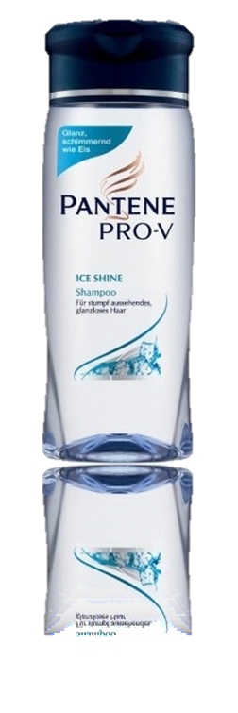
ARGAN OIL
Panelist Study on Shine Enhancement
Study Design
  Trained panelists (2x10; performed by Fresenius)
  2 different rinse-off formulations, a shampoo and a conditioner
  Pantene PRO-V ICE SHINE shampoo and conditioner as market benchmark
  Test formulations using the same ingredient composition
  as the benchmark
  Ingredient concentrations: 0.1%, 0.3% in shampoo and 0.5%, 1.0% in conditioner of both ARGAN OIL and standard mineral oil
  Caucasian hair switches color number 4/0 (middle brown)
  Paired comparison test in 2 blocks - for shampoo and conditioner
  Visual assessment on shine for “glossier”, “no difference” and “comparison glossier”
Notes:
Results from shine study are only valuable for this tested group (same study design are used at our customers).
Argan Oil is better than the basis and the market product ....and we confirmed the result in a shampoo and a conditioner formulation.......therefore the results can be generalized !!!
Advantage of this test design is that the result is for a person visualbe ......that is much better that quantified number for shine. It‘s a praxis relevant context!!!
Shine can be assessed in different ways such as light reflection on single hair and/or tresses and by panellist or home use tests
Panellist studies are also performed by our customers and are more powerful/meaningful than getting quantitive numbers on reflection
Shine on hair can also be influenced by different factors such as color, parallelism of single hairs within the tresses (as more frizzy as less shine) and surface properties
Pantene is selected as leading market brand and basic formulation mimiks Pantene formulation
Argan Oil used in cost-efficient concentrations for shampoo and conditioner
Mineral oil: Paraffinum Perliquidum Ph.Eur 6.0 (Fa. Gustav Hess) with low viscosity and comparable to ARGAN OIL

Slide 19
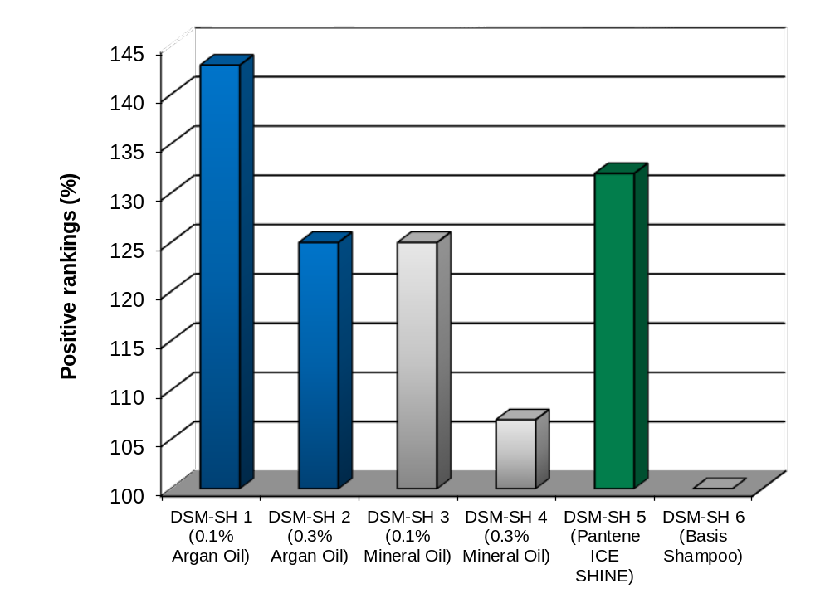
ARGAN OIL
Results Shampoo Test
Ranking of paired comparison test in shampoo
Shampoo formulation containing 0.1% ARGAN OIL shows best shine enhancement beating the leading market brand!
Notes:
3 possilbe answers as result is not suitable for statistical evaluation (statistics compare 2 results with each other)
basis shampoo is adapted according to market brand and sets already a high quality as base line
shampoo with the best performance is DSM-SH 1 containing 0.1% Argan Oil
this formulation was preferred over the leading market brand DSM-SH 5
the DSM Argan Oil (DSM-SH 1 and DSM-SH 2), delivers more shine than the ingredient benchmark Mineral oil (DSM-SH 3 and DSM-SH 4)
lower oil levels in the shampoos (DSM-SH 1 / DSM-SH 3) gives a better shine than using higher oil concentration (DSM-SH 2 / DSM-SH 4) meaning less is better
all tested shampoos improve the shine of the basic formulation. All of them are better ranked than DSM-SH 6
Why is a lower concentration better for shine:
In the case of leave-on products, the rule "higher levels -> better shine" is true: because the factors surface property and anti-frizz effect are influenced positively with higher amounts of product.
our tests are with rinse-out products (shampoos, cream conditioner); in that case the surface properties and "Anti-Frizz effect" are influenced from that part of the product which stay on the hair surface after rinsing the product out; that means: Usage of lower concentrations of oils in the products lead to the best shine results!

Slide 20
ARGAN OIL
Results Shampoo Test
Ranking of paired comparison test in conditioner
 | DSM-SH 1 | DSM-SH 2 | DSM-SH 3 | DSM-SH 4 | DSM-SH 5 | DSM-SH 6 | SUM | Rank
DSM-SH 1 (0.1% Argan Oil) |  | 9 | 7 | 7 | 9 | 8 | 40 | 1
DSM-SH 2 (0.3% Argan Oil) | 9 |  | 7 | 4 | 6 | 9 | 35 | 3
DSM-SH 3 (0.1% Mineral Oil) | 7 | 7 |  | 7 | 8 | 6 | 35 | 3
DSM-SH 4 (0.3% Mineral Oil) | 7 | 4 | 7 |  | 8 | 4 | 30 | 5
DSM-SH 5 (Pantene ICE SHINE) | 9 | 6 | 8 | 8 |  | 6 | 37 | 2
DSM-SH 6 (Basic Shampoo) | 8 | 9 | 6 | 4 | 1 |  | 28 | 6
Table 1: Results of the shampoo shine test:
Matrix evaluates all positive entries for the individual comparison. For the ranking analysis sums of total positive entries for one test formulation are compared. The ranking with 1 is the best and with 6 is the worst, meaning the formulation with a ranking of 1 is the most shiniest one as tested.
Notes:
3 possilbe answers as result is not suitable for statistical evaluation (statistics compare 2 results with each other)
basis shampoo is adapted according to market brand and sets already a high quality as base line
shampoo with the best performance is DSM-SH 1 containing 0.1% Argan Oil
this formulation was preferred over the leading market brand DSM-SH 5
the DSM Argan Oil (DSM-SH 1 and DSM-SH 2), delivers more shine than the ingredient benchmark Mineral oil (DSM-SH 3 and DSM-SH 4)
lower oil levels in the shampoos (DSM-SH 1 / DSM-SH 3) gives a better shine than using higher oil concentration (DSM-SH 2 / DSM-SH 4) meaning less is better
all tested shampoos improve the shine of the basic formulation. All of them are better ranked than DSM-SH 6

Slide 21
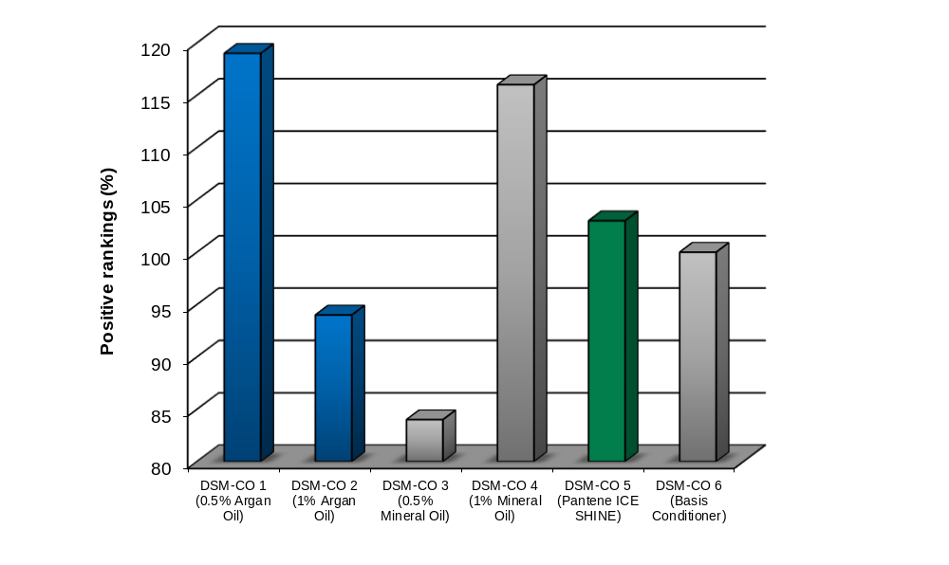
ARGAN OIL
Results Conditioner Test
Ranking of paired comparison test in conditioner
Conditioner formulation containing 0.5% ARGAN OIL shows best shine enhancement beating the leading market brand!
Notes:
basis conditioner is also adapted according to market brand and sets as well a high quality as base line
conditioner with the best performance is DSM-CO 1 containing 0.5% Argan Oil
closely followed by DSM-CO 4 containing 1% Mineral Oil
both formulations are shinier than the market benchmark DSM-CO 5 and the basic formulation DSM-CO 6
Argan Oil improves shine already at lower levels (0.5%)
Why is a lower concentration better for shine:
In the case of leave-on products, the rule "higher levels -> better shine" is true: because the factors surface property and anti-frizz effect are influenced positively with higher amounts of product.
our tests are with rinse-out products (shampoos, cream conditioner); in that case the surface properties and "Anti-Frizz effect" are influenced from that part of the product which stay on the hair surface after rinsing the product out; that means: Usage of lower concentrations of oils in the products lead to the best shine results!

Slide 22
ARGAN OIL
Results Conditioner Test
Ranking of paired comparison test in conditioner
 | DSM-CO 1 | DSM-CO 2 | DSM-CO 3 | DSM-CO 4 | DSM-CO 5 | DSM-CO 6 | SUM | Rank
DSM-CO 1 (0.5% Argan Oil) |  | 5 | 9 | 8 | 6 | 9 | 37 | 1
DSM-CO 2 (1% Argan Oil) | 5 |  | 5 | 8 | 7 | 4 | 29 | 5
DSM-CO 3 (0.5% Mineral Oil) | 9 | 4 |  | 3 | 5 | 5 | 26 | 6
DSM-CO 4 (1% Mineral Oil) | 8 | 8 | 6 |  | 7 | 5 | 36 | 2
DSM-CO 5 (Pantene ICE SHINE) | 6 | 7 | 5 | 7 |  | 7 | 32 | 3
DSM-CO 6 ( Basic Conditioner) | 9 | 4 | 5 | 5 | 8 |  | 31 | 4
Table 1: Results of the conditioner shine test:
Matrix evaluates all positive entries for the individual comparison. For the ranking analysis sums of total positive entries for one test formulation are compared. The ranking with 1 is the best and with 6 is the worst, meaning the formulation with a ranking of 1 is the most shiniest one as tested.
Notes:
basis conditioner is also adapted according to market brand and sets as well a high quality as base line
conditioner with the best performance is DSM-CO 1 containing 0.5% Argan Oil
closely followed by DSM-CO 4 containing 1% Mineral Oil
both formulations are shinier than the market benchmark DSM-CO 5 and the basic formulation DSM-CO 6
Argan Oil improves shine already at lower levels (0.5%)

Slide 23
ARGAN OIL
Formulation Guidelines
No preservative and free of specified pathogens
Easy to formulate
Incorporated into the oil phase of conditioners
Pre-solubilization for shampoos
Processed either warm (< 60°C) or cold
Stable at a broad pH range up to pH 12
Recommended use level for shampoos is 0.1% and for conditioners 0.5%
No influence on foaming properties
Basic guide formulations are available upon request
Notes:
Shampoos do not have an oily phase
Oils are stable in each range of ph (they are independent of the pH-value)
Argan Oil is unsoluble in water therefore it is recommended to premix with a solubilizator. (/slightly soluble in Ethanol)
Oil is known to influence foaming – but as we have tested ARGAN OIL with a less concentration level (-> 0.3%) in shampoos, it has got no influence on the foam

Slide 24
ARGAN OIL
Natural Shine Enhancer
Key Benefits
Superior shine enhancer compared to leading market brand
Cost-effective for shine boosting
Provides stable foam properties
and allows clear products
Superior purity
100% natural and preservative free
Natural light oil – no greasy hair
Notes:
Results from shine study are only valuable for this tested group (same study design are used at our customers).
Argan Oil is better than the basis and the market product ....and we confirmed the result in a shampoo and a conditioner formulation.......therefore the results can be generalized !!!
Advantage of this test design is that the result is for a person visualbe ......that is much better that quantified number for shine. It‘s a praxis relevant context!!!

Slide 25
DISCLAIMER
Copyright © 2022 DSM Nutritional Products, 4002 Basel, Switzerland.
www.dsm.com/personal-care. All rights reserved.
Although DSM has used diligent care to ensure that the information provided herein is accurate and up to date, DSM makes no representation or warranty of the accuracy, reliability, or completeness of the information. This presentation only contains scientific and technical information for business to business use. Country- or region-specific information should also be considered when labeling or advertising to final consumers. This publication does not constitute or provide scientific or medical advice, diagnosis, or treatment and is distributed without warranty of any kind, either expressly or implied. In no event shall DSM be liable for any damages arising from the reader’s reliance upon, or use of, these materials. The reader shall be solely responsible for any interpretation or use of the material contained herein. The content of this document is subject to change without further notice. Please contact your local DSM representative for more details. All trademarks listed in this brochure are either registered trademarks or trademarks of DSM in The Netherlands and/or other countries unless explicitly otherwise stated.
DISCLAIMER FORMULATION GUIDELINES
This information is for illustration purposes only and based upon our current knowledge and experience at the time of printing. We do not make any representation or warranty of any kind, express or implied, including merchantability or fitness for a particular use, with respect to such information or its application. Use of this information is at your discretion and risk. Nothing herein relieves you from carrying out your own suitability determinations and tests. You are responsible for observing all laws and regulations relevant to your products, uses or processes. We do not assume any liability in connection with your product and its use. The foregoing information and suggestions are also provided without warranty of non-infringement as to the intellectual property rights of third parties, and shall not be construed as any inducement to infringe the rights of third parties.

Slide 26
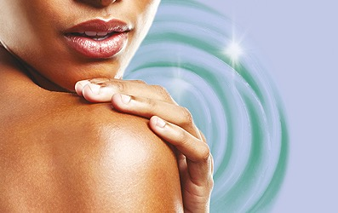
Back up ARGAN OIL
Nourishment and shine from the tree of life

Slide 27
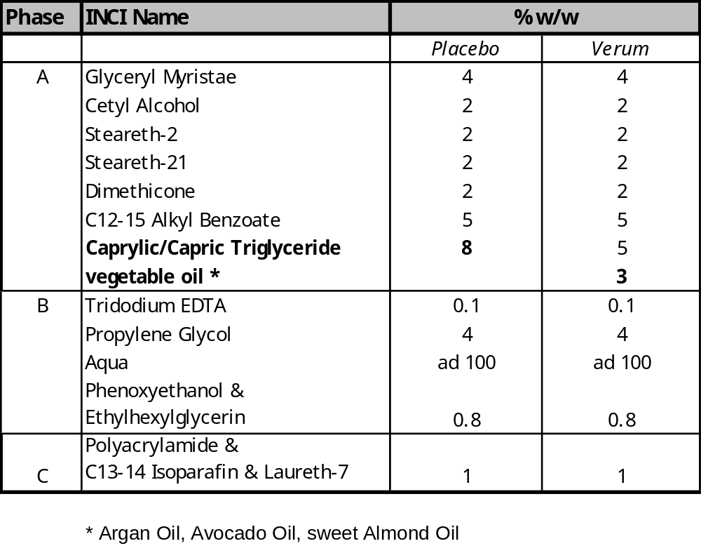
Short term heat stability test
Guide formulation

Slide 28
Additional information on ARGAN OIL’s compounds
Essential Fatty Acids cannot be synthesized by the human body and therefore must be obtained through diet or skin treatments such as ARGAN OIL. They are building compounds to manufacture and repair cell membranes, enabling the cells to obtain optimum nutrition. These fatty acids perform an important role in the lipid management of the epidermis, sebum production, and are required for the formation of prostaglandin. They all have water-binding, moisturizing and antioxidant properties.
Prostaglandin is a lipid compound derived enzymatically from essential fatty acids within the cell. It serves as catalysts for a large number of processes. It helps to regulate skins functions such as the immune function. Prostaglandin is a natural anti-inflammatory and acts as a controlling factor in overall cell growth and development.
Polyphenols are natural components of a wide variety of plants. These active compounds are known for their antiseptic, antioxidant, anti-inflammatory, anti-allergenic, and anti-aging properties. They enhance immune response, enhance cell-to-cell communication, repair DNA damage caused by smoking and other toxic exposures, and assist the body to detoxify carcinogens through the activation of the body’s immune system.

Slide 29
Additional information on ARGAN OIL’s compounds
Squalene is a fat-soluble antioxidant with the unique ability to anchor itself to the body’s cell membrane. It can deactivate free radicals that are generated by exposure to the UV radiation. Squalene is involved in the process of cell growth. It is able to penetrate deeper and more readily than most other oils. Its compatibility with skin lipids can be attributed to the fact that human sebum, the skin’s own moisturizer, is comprised of 25% squalene. It is proven to have a positive effect on mature and rosacea skin.
Vitamin E (Tocopherol) is a fat-soluble vitamin. It is a powerful antioxidant and excellent free-radical scavenger. Vitamin E protects essential fatty acids and vitamin A levels in the body. Vitamin E prevents cellular aging due to oxidation, aids in bringing nourishment to cells, and decreases inflammation. It has been shown to significantly help in the reduction of scarring from wounds and the appearance of stretch marks.

Slide 30
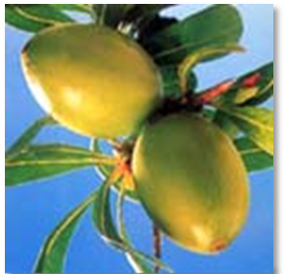
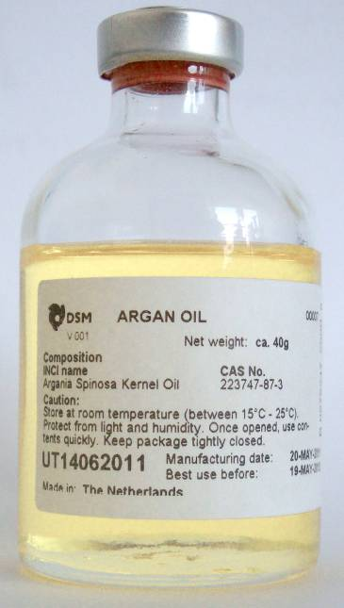
ARGAN OIL
Specification
INCI Argania Spinosa Kernel Oil
External Characteristics
Appearance: | clear, yellow colored, slightly viscous liquid
Quality: | virgin cold pressed, deodorized
Shelf life: | 24 months
Composition
Palmitic acid: | 10.0 – 15.0 w/w %
Stearic acid: | 4.3 – 7.2 w/w %
Oleic acid: | 43.0 – 50.0 w/w %
Linoleic acid: | 29.3 – 37.0 w/w %
Preservative: | free
Chemical-physical properties
Acid value: | < 4
Peroxide value: | < 10
Relative density d20/20: | 0.90 – 0.93

Slide 31
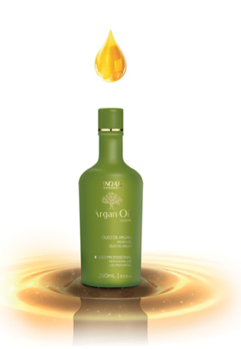

Recent launches with Argan Oil
Nov 2010
Argan Oil System by Inoar contain the exclusive Kem3 Complex with Argan Oil and Acid Glyoxylic, which replaces the formaldehyde.
Kem3 Complex is an exclusive and patented formula Inoar, which allows the sealing of the cuticle through the attraction between the positive charge deposited on the hair cortex (located in the center of the hair strand) and negative charge of the cuticle, which lie at the outer hair strand, then setting composed of acid ph (1,5) in the cuticle, allowing the durability of the smooth and incredible shine effect for up to 60 days.

Slide 32
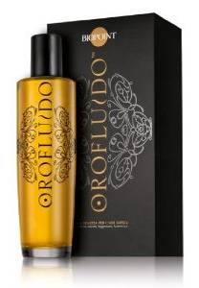
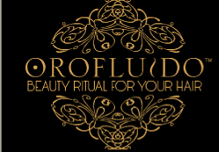
Recent launches with Argan Oil
April 2010/Febr 2011
Revlon: Orofluido Beauty Elixir For Your Hair
A beauty elixir for all hair types, with a pure luxuriance which envelops your hair. Three organic natural oils in an exquisite mixture with a pleasant, silky texture, absorbed rapidly and leaving no residue in the hair. Non-rinse treatment for all hair types.
Fluid, silky and pleasant to the senses, reminiscent and evocative of the treasured gold.
Argan oil: liquid gold for your hair
Extracted from the seeds of the Argania spinosa fruit, Argan oil is rich in vitamin E and essential fatty oils, similar in composition to our own skin. It strengthens hair and makes it extremely light and incredibly silky.

Slide 33
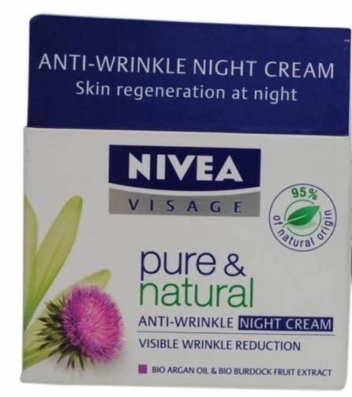
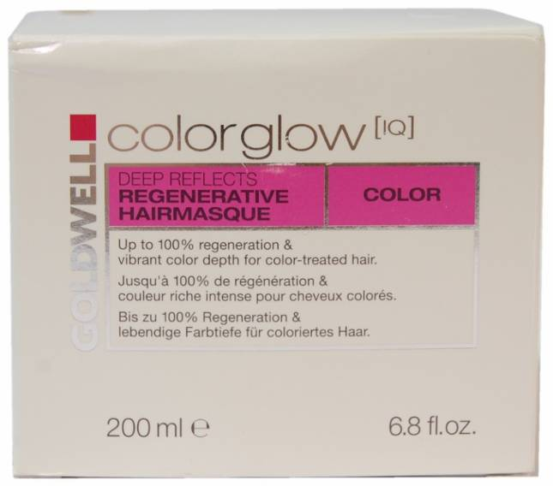
Recent launches with Argan Oil
Nov 2010 Feb 2011
France:
Nivea Pure & Natural Anti-Rides Soin de Nuit (Anti-Ageing Night Cream) is said to visibly reduce wrinkles, as it features organic argan oil, which is rich in vitamin E and antioxidants to nourish the skin, and organic burdock extracts to stimulate collagen production during nighttime. According to the manufacturers, wrinkles are pulped from inside, and skin brightness restored
USA:
Goldwell Color Glow [IQ] Deep Reflects Regenerative Hairmasque for color treated hair is claimed to provide up to 100% regeneration, with its exclusive blend of extra-nourishing ingredients such as argan oil and lipids. It is claimed to leave hair perfectly regenerated with vibrant color depth, and features the MultiGloss System

Slide 34
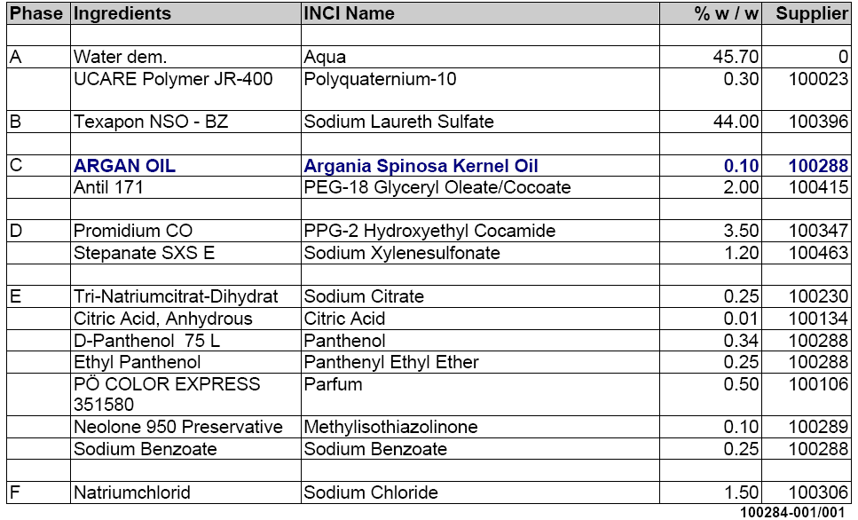
ARGAN OIL
Conditioner Formulations
Test formulation DSM-SH 1 with 0.1% Argan Oil

Slide 35
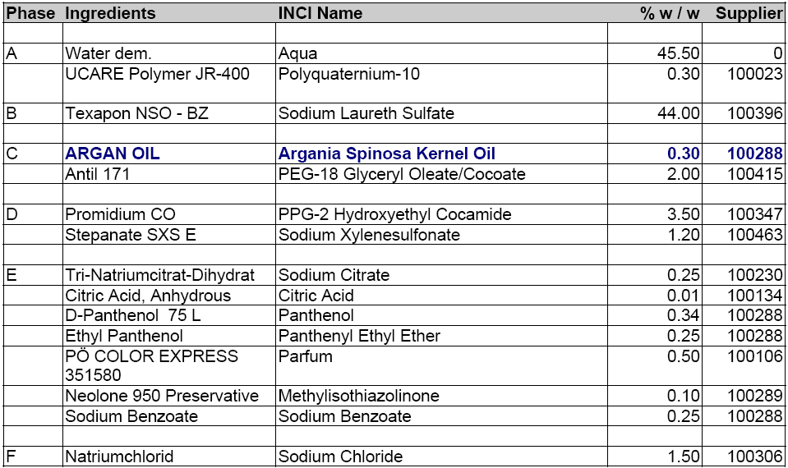
ARGAN OIL
Conditioner Formulations
Test formulation DSM-SH 2 with 0.3% Argan Oil

Slide 36
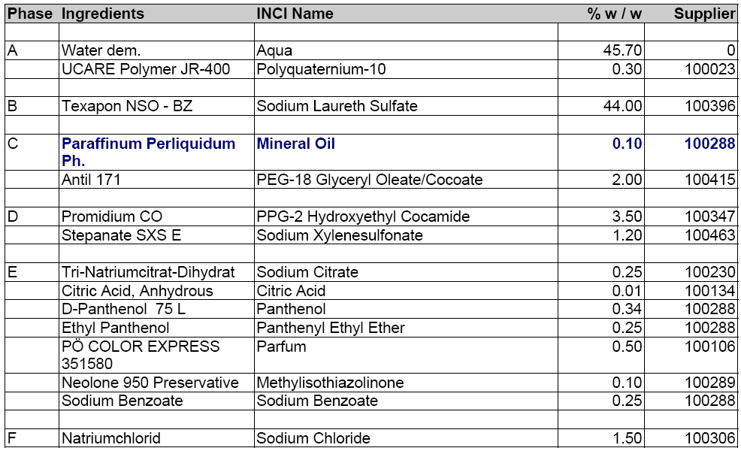
ARGAN OIL
Conditioner Formulations
Test formulation DSM-SH 3 with 0.1% Mineral Oil

Slide 37

ARGAN OIL
Conditioner Formulations
Test formulation DSM-SH 4 with 0.3% Mineral Oil

Slide 38
ARGAN OIL
Conditioner Formulations
Test formulation DSM-SH 5
Pantene PRO-V ICE SHINE Shampoo
Ingredients
Water, Sodium Laureth Sulfate, Sodium Lauryl Sulfate, PPG-2 Hydroxyethyl Coco/Isostearamide, Sodium Chloride, Citric Acid, Sodium Citrate,
Fragrance, Panthenol, Panthenyl Ethyl Ether, Polyquaternium-10,
Sodium Benzoate, Tetrasodium EDTA, Methylchloroisothiazolinone, Methylisothiazolinone, Sodium Xylenesulfonate

Slide 39
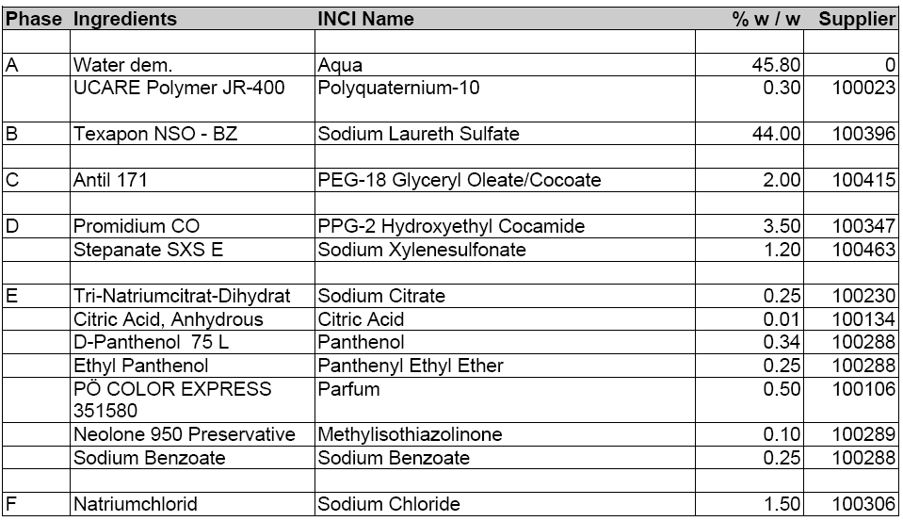
ARGAN OIL
Conditioner Formulations
Test formulation DSM-SH 6 – basic shampoo

Slide 40
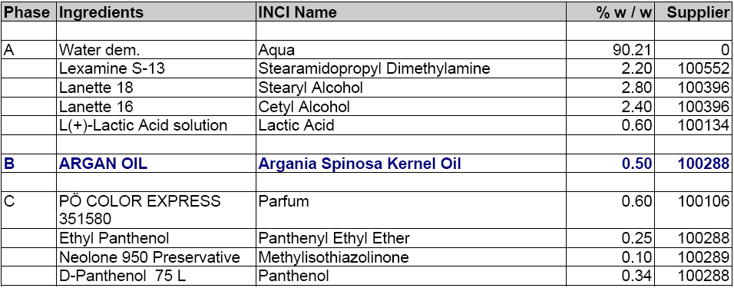
ARGAN OIL
Conditioner Formulations
Test formulation DSM-CO 1 with 0.5% Argan Oil

Slide 41
ARGAN OIL
Conditioner Formulations
Test formulation DSM-CO 2 with 1.0 % Argan Oil

Slide 42
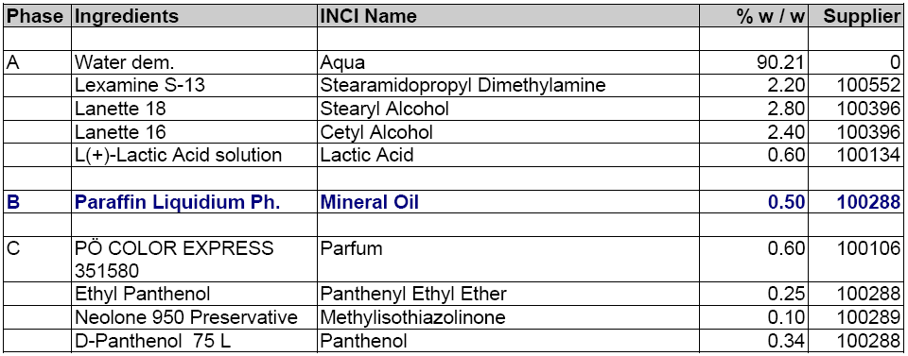
ARGAN OIL
Conditioner Formulations
Test formulation DSM-CO 3 with 0.5 % Mineral Oil

Slide 43
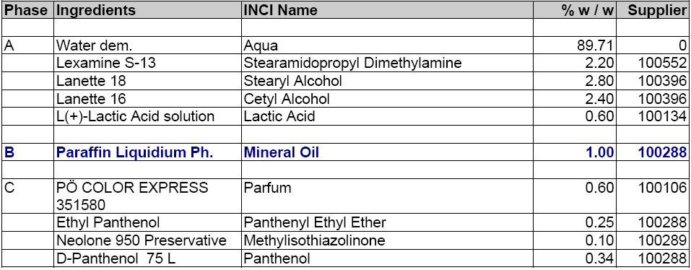
ARGAN OIL
Conditioner Formulations
Test formulation DSM-CO 4 with 1.0 % Mineral Oil

Slide 44
ARGAN OIL
Conditioner Formulations
Test formulation DSM-CO 5
Pantene PRO-V ICE SHINE Conditioner
Ingredients
Water, Stearyl Alcohol, Cyclopentasiloxane, Cetyl Alcohol, Stearamidopropyl Dimethylamine, Glutamic Acid, Panthenol, Panthenyl Ethyl Ether, Dimethicone, Benzyl Alcohol, Fragrance, EDTA, Methylchloroisothiazolinone, Methylisothiazolinone

Slide 45
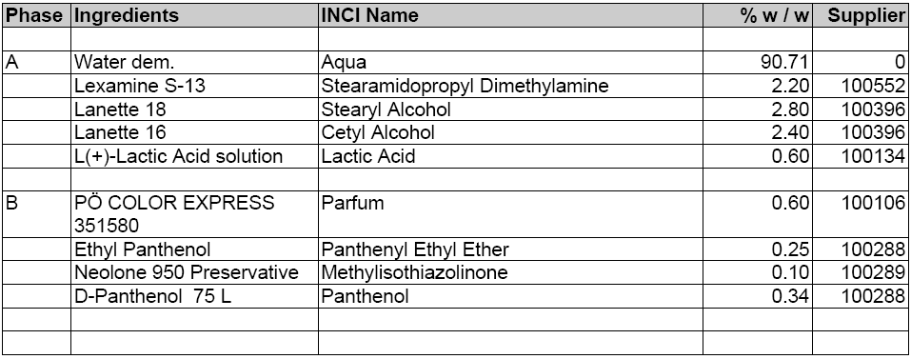
ARGAN OIL
Conditioner Formulations
Test formulation DSM-CO 6–basic conditioner

