Slide 1

BEL-EVEN®
Future-proof your skin from the effects of daily stress
Master Presentation
04.2022

Slide 2

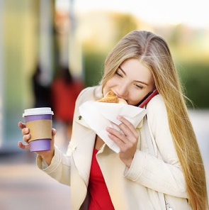


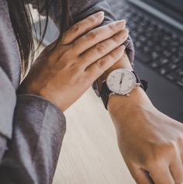

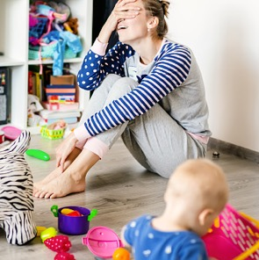


Today’s 24/7 stressful lifestyle affects us
physically and mentally, impacting our overall wellbeing

Slide 3



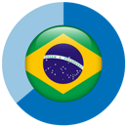


Across the globe, consumers increasingly perceive stress as health issue...
74% of UK adults declared “to be so stressed that they were unable to cope” at least once during the last year. Percentage raises to 81% for women, 93% for 18-24 y.o.*
In US, Gen Z and Millennials’ self-reported stress levels were +40% higher than the ones perceived as “healthy” **
84% of Brazilian consumers actively seek ways to reduce stress ***
2017 Health and Nutrition Survey Report shows that ≈40% of the Japanese population fails to sleep more than 6 hours per night ****
*Source: from Mintel, reference to a study into the impact of stress, commissioned in UK by the Mental Health Foundation, May 2018
**Source: American Psychology Association. Stress in America, Generation Z. APA, October 2018. https://www.apa.org/news/press/releases/stress/2018/stress-gen-z.pdf. Accessed 10 Dec. 2019
***Source: Mintel's 35-market survey, December 2019. Base: 1,000 adults aged 16-55 in Brazil
**** Source: Japanese Beauty 2020 Consumer Trends

Slide 4

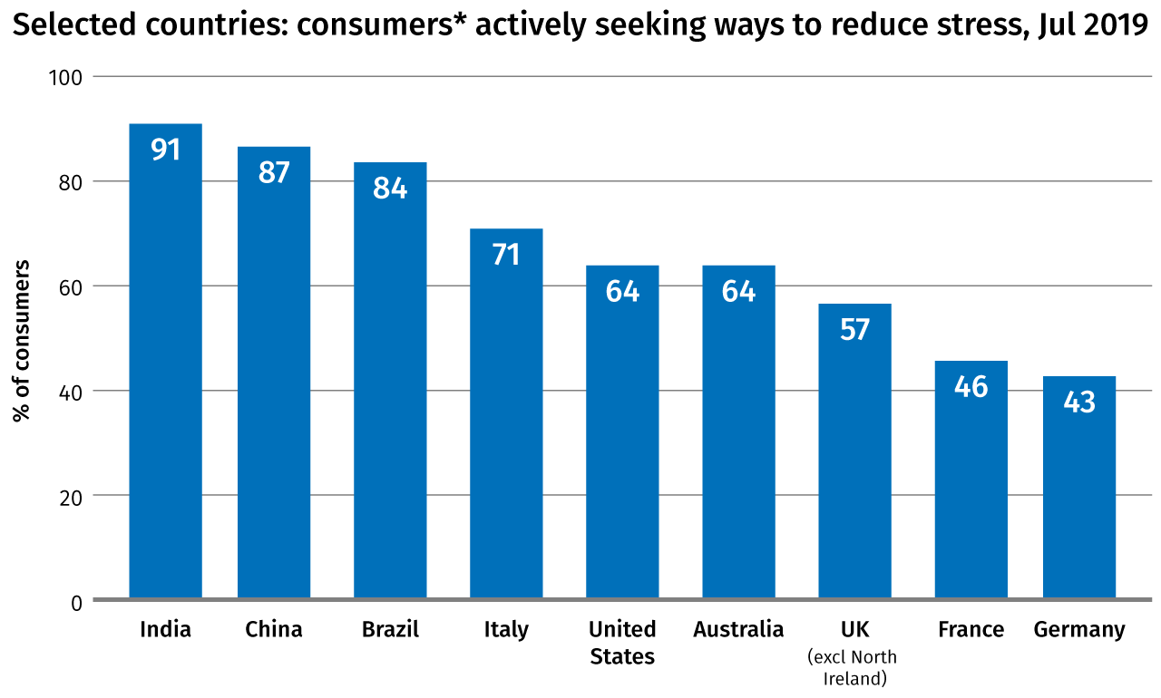
…and actively look for solutions to reduce it
Selected Countries: consumers actively seeking ways to reduce stress, jul 2019
* taken from Mintel’s 35-market consumer research study
Base: India, China, US, Australia: 1,000 internet users aged 18+ in each country; Brazil, Italy, UK, France, Germany: 1,000 internet users aged 16+ in each country
Source: Dynata/Mintel; KuRunData/Mintel; Lightspeed/Mintel

Slide 5
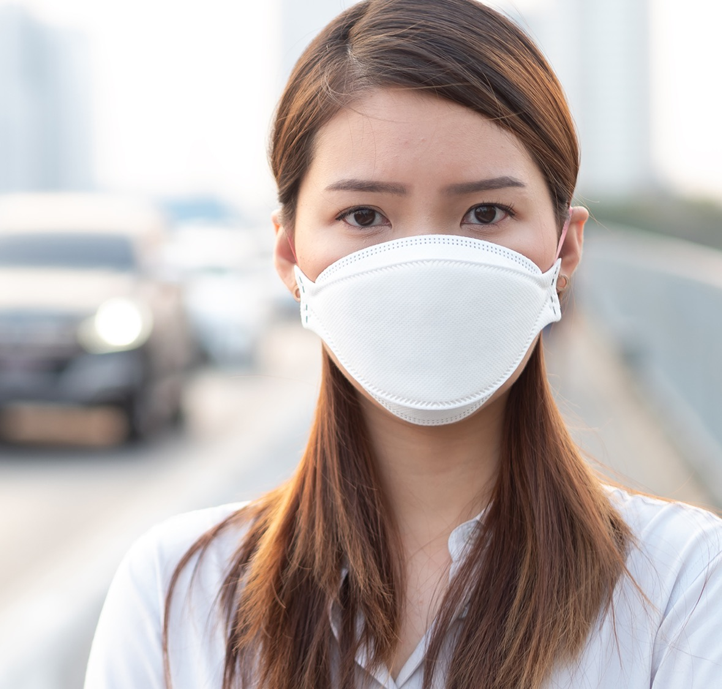

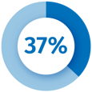
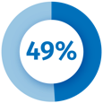
COVID-19 context triggers anxiety
Consumers are concerned of protecting and maintaining their mental health, whatever will happen next
Raising of new concerns, beyond just the exposure to the virus.
From a recent Chinese digital consumers survey*:
declare to be moderately/extremely worried about future impact on lifestyle
say their financial status is worse-off
are most concerned about stress at work or their employment
Interest and use of products with mood boosting or stress reduction qualities is expected to increase further, due to the psychological toll from the pandemic
*Base: China: 1,200 internet users aged 18-59, 25 Mar-1 Apr 2020. Source: KuRunData/Mintel; Mintel's Global COVID-19 Tracker

Slide 6

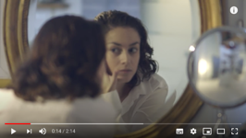



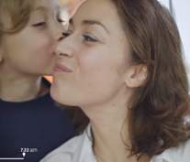
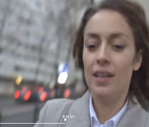


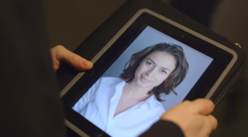
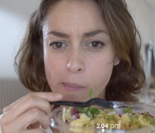
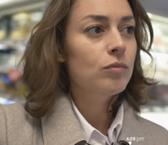
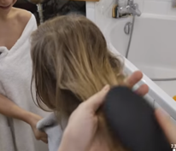

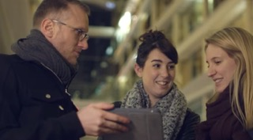
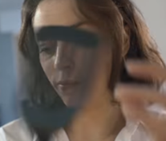
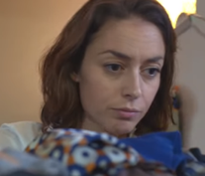
Sustained stress can also affect skin appearance
CLICK TO WATCH
IN THE MORNING
DAILY ROUTINE
IN THE EVENING
“into a woman’s skin”
video experiment
Kids
Commuting
Meetings
Desk lunch
Shopping
Kids
WATCH OUT!
Perceived
+10 yrs
in just 1 day
How old is she?
How old is she?
From 27 to 32 y.o.
Cooking
Laundry
From 35 to 40 y.o.
Source: Garnier experiment «into a woman’s skin» https://www.youtube.com/watch?v=zga0SUuzw-M

Slide 7
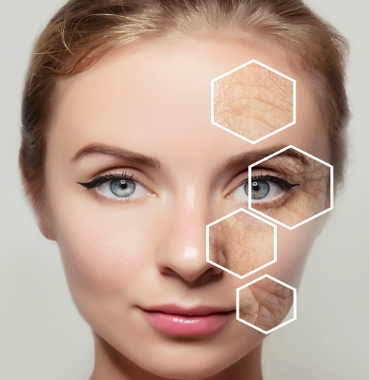
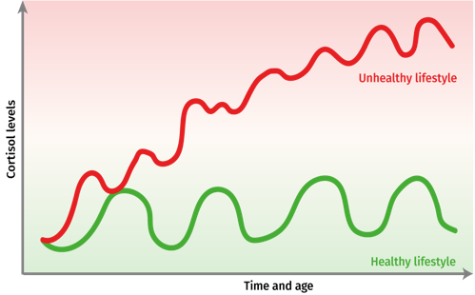


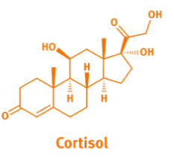
How can chronic stress trigger skin aging?
To cope
with stress,
human body
produces
Cortisol,
the so called
“stress hormone”
To focus on stress-response
& prevent inflammation
to spread, Cortisol temporary
diverts resources
from skin normal functioning,
slowing down important
skin processes
such as:
fibroblast growth,
Collagen and Elastin production,
epidermal cells turnover
Small amounts of Cortisol are good to manage stress,
but chronic stress
results in permanently high and unhealthy levels of Cortisol
with negative impact on skin’s health & appearance.
Persistent production of Cortisol jeopardizes skin vitality,
resulting in premature signs of ageing:
cells can’t rebuild Elastin & Collagen, with consequent
wrinkles’ appearance and loss of elasticity,
while compromised epidermal cells’ turnover
drives to dull tone
and tired look.
7

Slide 8
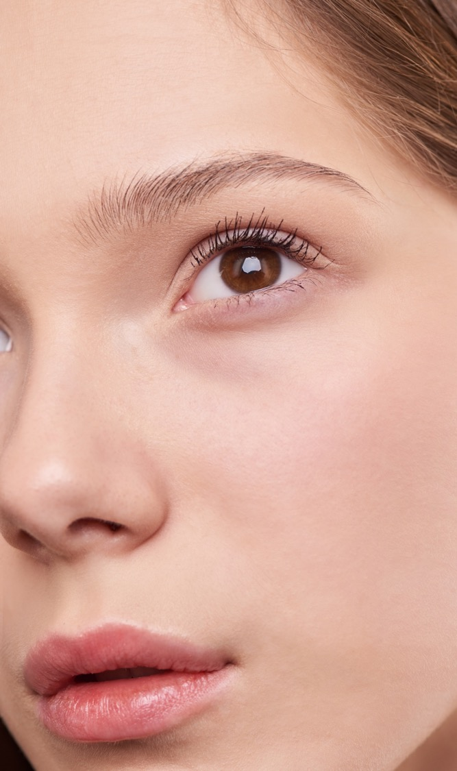
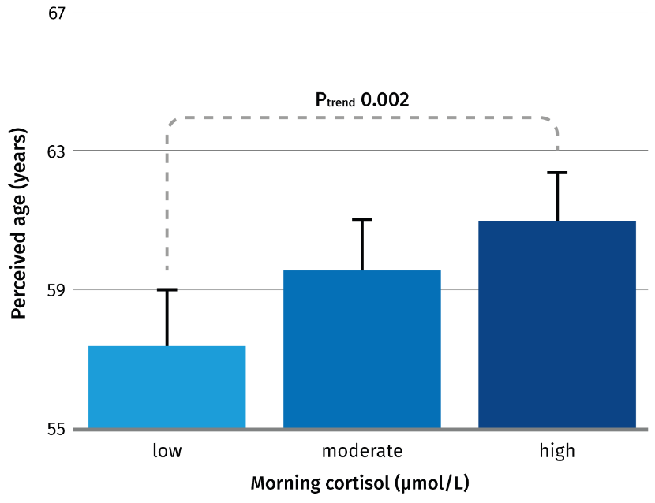
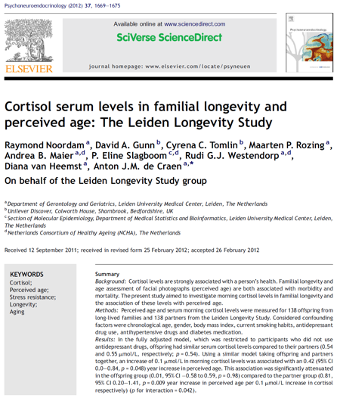
Higher Cortisol level is associated with higher perceived age
Sources: Noordam, R., Gunn, D. A., Tomlin, C. C., Rozing, M. P., Maier, A. B., Slagboom, P. E., … de Craen, A. J. M. (2012). Cortisol serum levels in familial longevity and perceived age: The Leiden Longevity Study. Psychoneuroendocrinology, 37(10), 1669–1675. https://doi.org/10.1016/j.psyneuen.2012.02.013

Slide 9


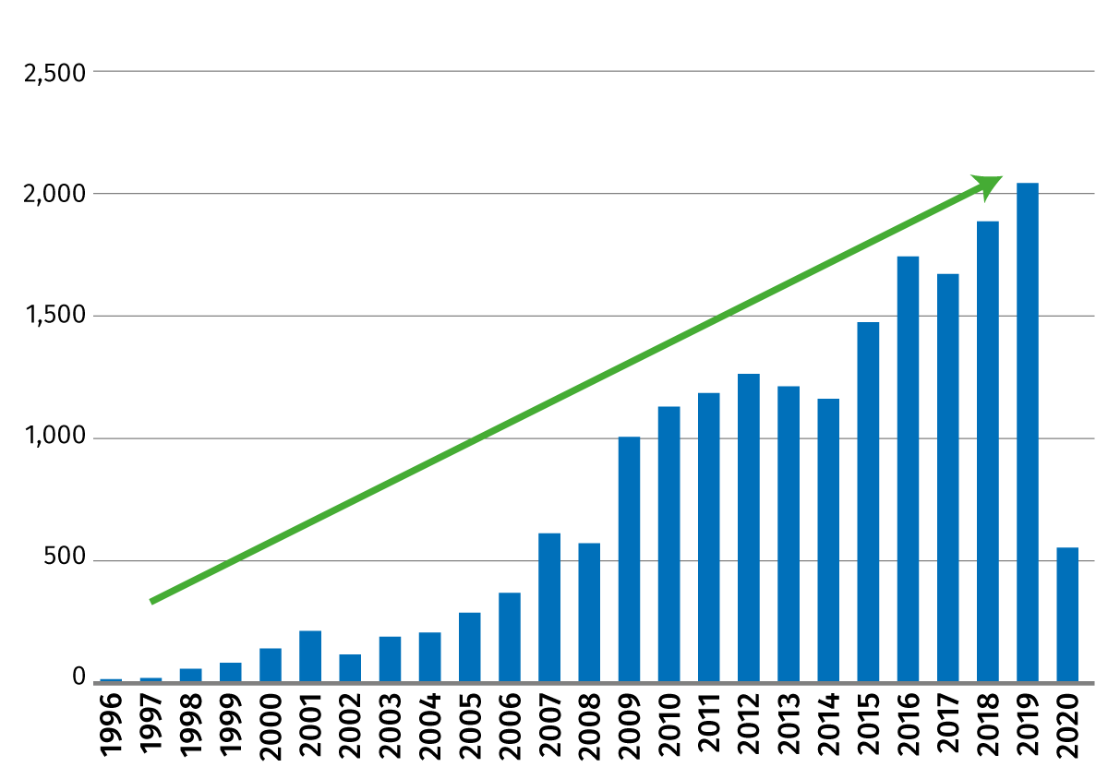


Increasing demand for beauty products solving stress-related signs of aging
Facial innovations with “stress” related claims
Consumers increasingly link stress, diet, hydration, and UV exposure to skin health
66%
of UK women feel that lifestyle, including stress, has the biggest impact on
the skin
Source: Mintel GNDP and DSM Trend Landscaping

Slide 10

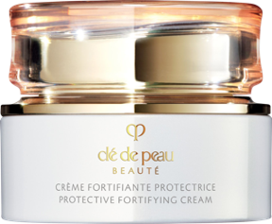

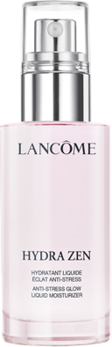
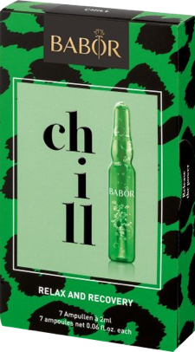
Ultimately “stress” offers a new angle to the anti-aging story
Clé de Peau
Beauté Key Radiance Care
Fights the damaging effects of stress on skin. Awakens and restores, balances and revives, moisturises and resists and activates skin’s intuitive ability to repair and defend.
Babor
Stress rescue super serum
Fights signs of stress-induced ageing. Helps skin quickly recover from stress and reduce redness, strengthening the skin barrier, for beaming, resilient, youthful and stress-free skin
De-stresses skin
Lancome
Anti-Stress Glow Liquid Moisturizer
Hydrates, visibly de-stresses skin and supports the skin's moisture barrier for an instant glow that lasts all day, leaving skin softer, smoother, and revitalized.
Promotes the regeneration of the stressed skin barrier
Babor
Hemp Rebel De-Stress Ampoules
Helps the skin feel relaxed, recovered, fresh, and velvety soft. Hemp seed oil, to promote the regeneration of the stressed skin barrier.

Slide 11

Introducing
BEL-EVEN®!
DSM’s
perfect
proposition
for this market framework

Slide 12
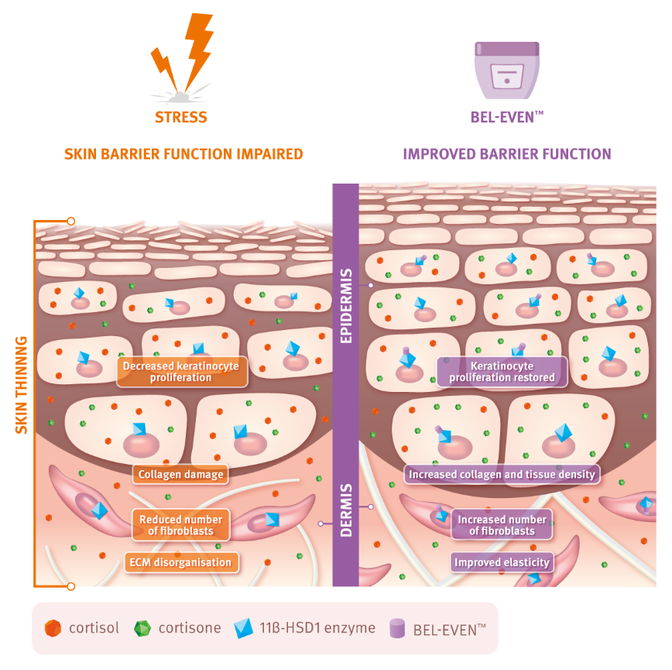
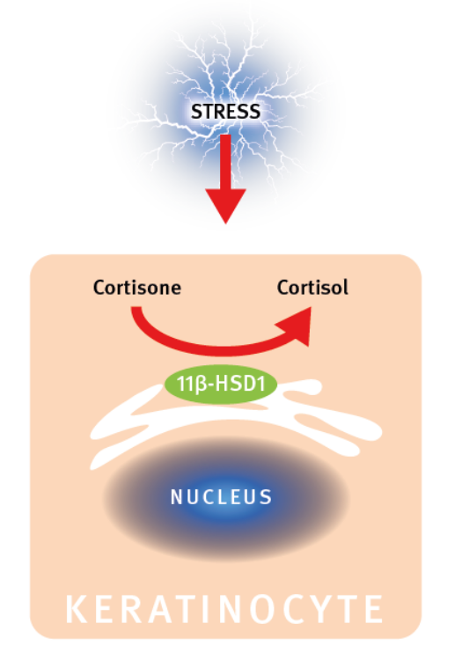
A unique mode of action that helps protect Collagen
In human skin, Cortisol is generated from Cortisone by the Enzyme 11β-HSD1
BEL-EVEN® selectively inhibits the Enzyme 11β-HSD1, rebalancing Cortisol levels in skin
As a result, skin barrier (TEWL) is improved, Collagen is protected which leads to improved skin elasticity and density.

Slide 13
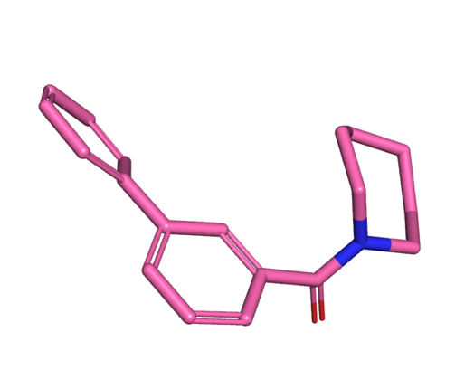
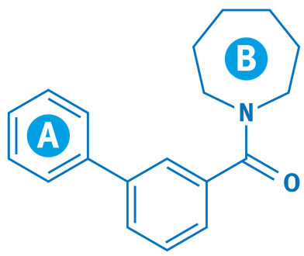

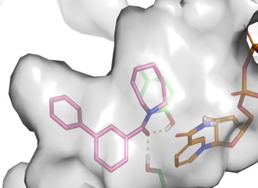
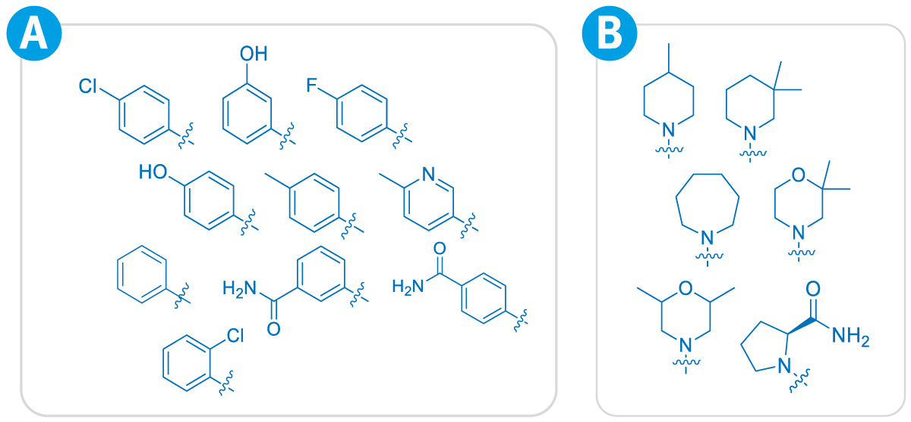
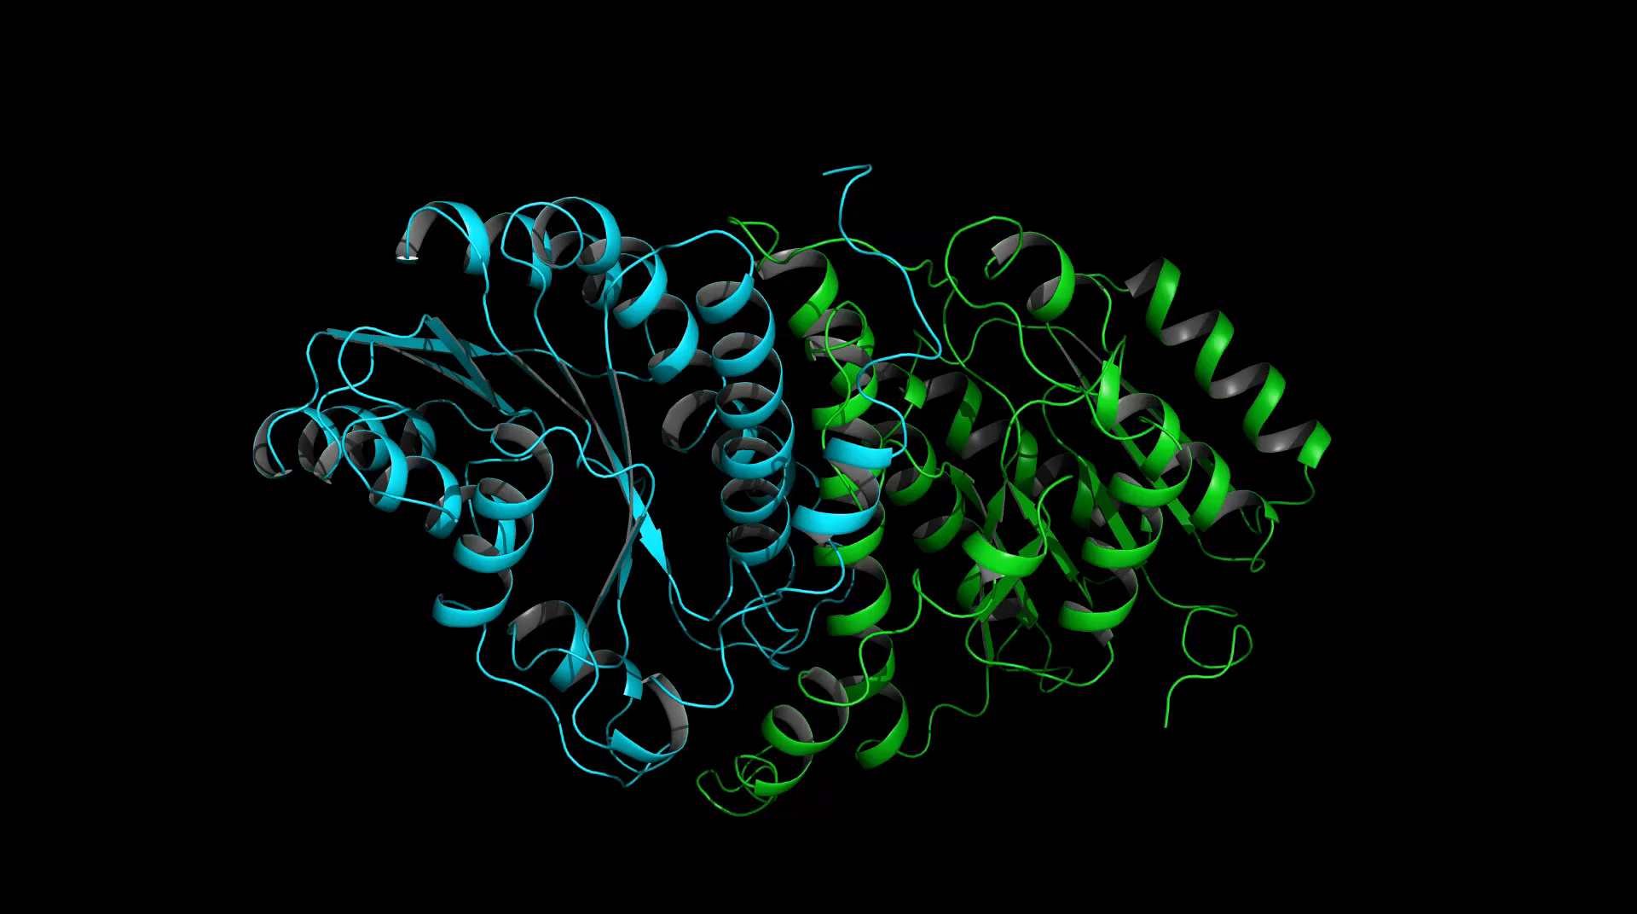
RATIONAL DESIGN: The key to reproducible effects
Library with different substitutions
BEL-EVEN®
INCI:
Biphenyl Azepanyl Methanone.
IUPAC name: Azepan-1-yl-[1,1’-biphenyl-3-yl]-methanone
Synonyms:
N-(3-Phenylbenzoyl)-azepane
CAS: 1910069-14-5
IC50: 23 nM
Phenyl Amide core

Slide 14
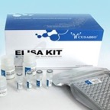
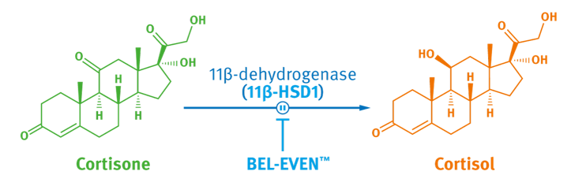
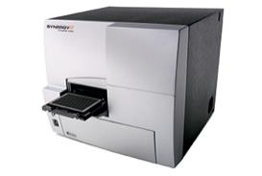
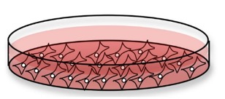
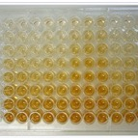
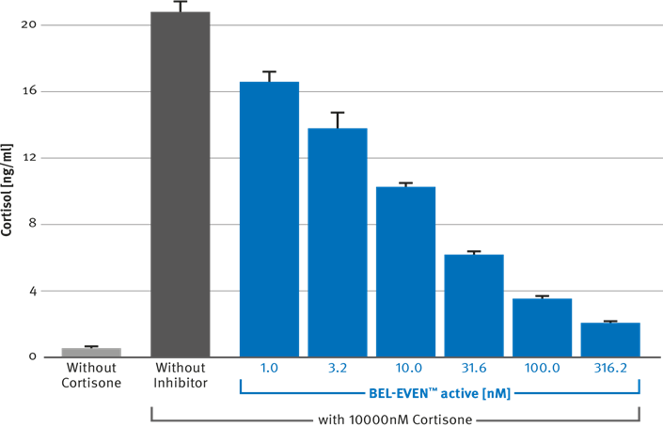
BEL-EVEN® inhibits conversion of cortisone
into cortisol in human keratinocytes
Assay principle
Addition of Cortisone
+/-
Inhibitor
2D cell culture with keratinocytes
Detection of the yellow signal by absorption
Cortisol Assay Kit
The more cortisol the less yellow the colour
IN VITRO PROOF
In vitro shows dose-dependent Cortisol inhibition.
Conversion of Cortisone into Cortisol was inhibited by the lead candidate

Slide 15



BEL-EVEN® is produced in a sustainable way
Concise, patented
two-step synthesis
Catalytic reaction in pure water
with very low catalyst loading
No intermediate purification between the two steps
Only one, non-toxic,
organic solvent is used
1,3-propanediol as solvent
obtained by corn fermentation
15

Slide 16


The efficacy
of BEL-EVEN®
has been proven
ex vivo and in vivo
with
amazing results!
16

Slide 17

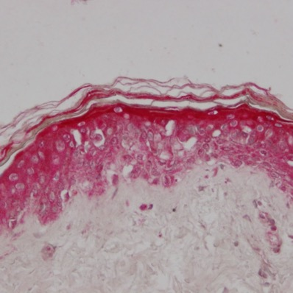
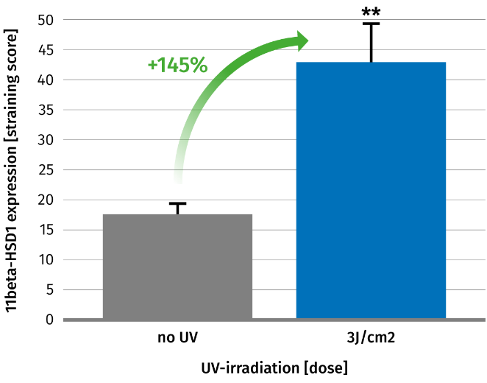
SCIENTIFIC
VALIDATION
ex vivo
11β-HSD1 expression increases under stress of
UV Irradiation
Our ex-vivo skin studies confirm that:
11β-HSD1 is expressed in the skin epidermis and dermis
Upon UV irradiation (3J/cm2) expression of 11β-HSD1 increases significantly
Stratum corneum
*
Epidermis
Dermis
Non-irradiated skin
UV-irradiated skin
*p<0.01 versus placebo
11β-HSD1 protein expression (red staining).
There is a clear and visible increase in
red staining intensity in the UV-irradiated tissues compared to non-irradiated skin
Human abdominal skin, 43 years old female donor

Slide 18
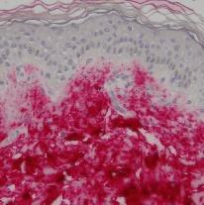
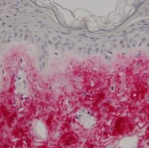
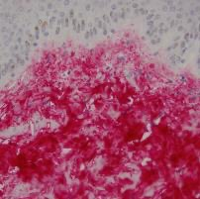
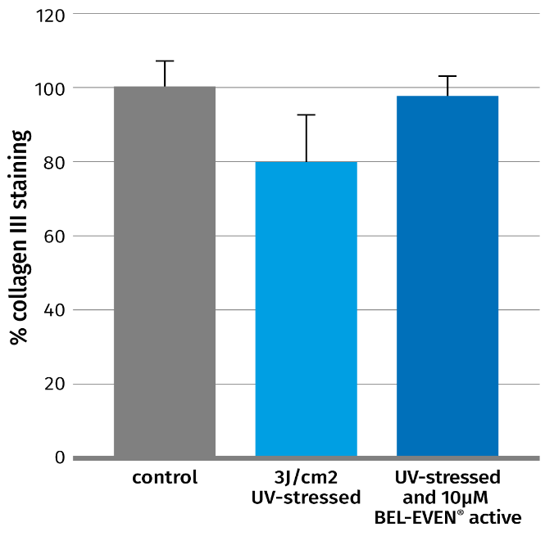
SCIENTIFIC
VALIDATION
ex vivo
BEL-EVEN® prevents from UV-induced
Collagen degradation
By inhibiting the enzyme 11β-HSD1, BEL-EVEN® prevents from UV-induced Collagen III damage
Non-irradiated skin
Vehicle,
3 J/cm2 UV
BEL-EVEN®,
3 J/cm2 UV
Increased Collagen III levels using
BEL-EVEN®
Human abdominal skin, 43 years old female donor

Slide 19
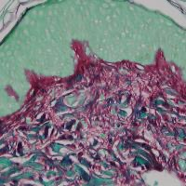
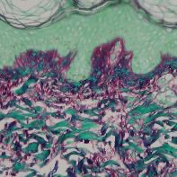
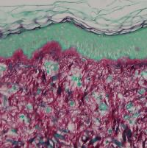

SCIENTIFIC
VALIDATION
ex vivo
BEL-EVEN® prevents from Cortisol induced
Collagen degradation
BEL-EVEN® inhibits the transformation of
added Cortisone (0.1 µm) to Cortisol
Vehicle
Vehicle,
0.1µm Cortisone
BEL-EVEN®,
0.1µm Cortisone
More Collagen
(red color) and Improved skin density with
BEL-EVEN®
Human abdominal skin, 45 years old female donor
# p < 0.01 vs untreated and * p< 0.01 vs cortisone alone

Slide 20

SCIENTIFIC
VALIDATION
in vivo
In vivo study design
3 months study, Oct-Dec in Switzerland
Two groups of 30 female Volunteers 45-65 y.o. Blinded and placebo controlled
1 % use level (20ppm)
20

Slide 21



SCIENTIFIC
VALIDATION
in vivo
BEL-EVEN® improves skin elasticity and density
*p<0.05 versus placebo
* p<0.01 versus t=0
epidermis
dermis
hypodermis
After 12 weeks with BEL-EVEN® facial skin elasticity significantly improves
by +15.7% relatively to placebo
BEL-EVEN® helps increase skin density significantly after 4 & 12 weeks.
A higher skin density is resulting from an increased protein (mostly collagen) content in the dermis
Example of Dermascan image

Slide 22



SCIENTIFIC
VALIDATION
in vivo
BEL-EVEN® improves barrier function vs placebo as panelists move into the winter months
In the placebo group, TEWL increase over time was driven by seasonal stress (study Oct-Dec in Switzerland): TEWL increase means skin barrier becomes weaker
In the BEL-EVEN® group the TEWL stayed low vs Placebo and the skin barrier was stable
With BEL-EVEN® skin was better protected against external stress factors, such as cold driving to dryness

Slide 23

SCIENTIFIC
VALIDATION
in vivo
Visual assessment on crow’s feet wrinkles
Set-up:
Standardized facial images
Assessors could look at two pairs of images from two different individuals before and after treatment
They did not know how the individuals were treated (placebo or BEL-EVEN®)
They had to judge which individual showed better reduction of wrinkles over time
0 week
12 weeks
Conclusion:
BEL-EVEN® treated subjects were significantly better rated in terms of visual wrinkle development (p<0.001)
BEL-EVEN® revealed visual effects
on the reduction of wrinkles
In total 2700 votes were given
(30x placebo treated compared to 30x BEL-EVEN® treated rated by 3 assessors)

Slide 24




SCIENTIFIC
VALIDATION
in vivo
With BEL-EVEN® skin appears firmer and smoother
Wrinkles visible improvement
Click to watch the video: evolution T0-T3
Week 0
Amazing
result
of
BEL-EVEN® application
on
Volunteer 24
Week 4
Week 12

Slide 25

SCIENTIFIC
VALIDATION
in vivo
Standardized controlled conditions
The standard lighting allows to visualize in an optimal way the crow’s feet wrinkles.
A color registration is performed on the images to avoid the lighting variations between the acquisitions.
0 weeks
12 weeks
Volunteer 24

Slide 26


Alternative video
Volunteer 44

Slide 27


Powerful supported claims!
BEL-EVEN® rebalances the negative impact of daily stress on skin
BEL-EVEN® visibly relieves the premature signs of stress-induced skin ageing
BEL-EVEN® significantly improves skin elasticity and strengthens skin barrier functionality
With BEL-EVEN® skin is visibly firmer and smoother
BEL-EVEN® eases skin stress:
it’s like yoga for the skin!
27

Slide 28



“Skin:Yoga” concept
Inspiration for execution
Help your skin to unwind and rebalance,
regulating its stress levels for a youthful, healthy look.
BEL-EVEN® Stress-recovery pro-aging serum
supports skin cells’ natural repairing process,
helping reduce and prevent premature stress-induced signs of aging,
for a renewed skin vibrancy. It’s like yoga for your skin!
Skin is more resilient, firmer, youthful
& supple looking.
Ease your stress and bounce-back,
with BEL-EVEN®
Products are for experimental use only and are not for sale.
DSM is not responsible for final products claims

Slide 29


BEL-EVEN® Stress-recovery pro-aging serum
BEL-EVEN® visibly reduces signs of a stressful lifestyle, for fuller, more supple-looking skin with improved skin elasticity and greater barrier integrity
Procedure
Heat Phase A to 75-80ºC under stirring.
Heat Phase B to 75-80ºC under stirring.
Add phase B to A and homogenize with high shear mix (2 min at 13500 rpm).
Cool down to 40ºC while stirring and add ingredients of phase C one by one.
Adjust the pH with phase D.
This serum helps to rebalance skin from the visible effects on daily stress. Its “memory form” texture instantly engages the senses by quickly recovering when pressed, for a true
“anti-stress” effect.
DISCLAIMER:
This information is for illustration purposes only and based upon our current knowledge and experience at the time of printing. We do not make any representation or warranty of any kind, express or implied, including merchantability or fitness for a particular use, with respect to such information or its application. Use of this information is at your discretion and risk. Nothing herein relieves you from carrying out your own suitability determinations and tests. You are responsible for observing all laws and regulations relevant to your products, uses or processes. We do not assume any liability in connection with your product and its use. The foregoing information and suggestions are also provided without warranty of non-infringement as to the intellectual property rights of third parties, and shall not be construed as any inducement to infringe the rights of third parties.

Slide 30
BEL-EVEN® Formulation Guidelines
Solubility:
BEL-EVEN® is miscible in water
BEL-EVEN® is well soluble in alcohol,
glycols and glycerin
Use level
For skin care preparations, the addition of a concentration up to 1 % BEL-EVEN® is recommended
Incorporation
BEL-EVEN® is easy to use
BEL-EVEN® can be incorporated into the aqueous phase of a cosmetic formulation
BEL-EVEN® can be processed either cold or warm (≤ 85°C). The incorporation at the end of the production at T<40°C is still recommended to avoid unnecessary heating of the active
Compatibilities
In general, BEL-EVEN® shows very good compatibility with all groups of raw materials like emulsifier systems, emollients and waxes, preservatives, hydrocolloids, sunscreens, detergents and other commonly used substances
Recommended pH of the final formulation:
3.5 – 7.5, it can be adjusted with commonly used neutralizing agents
Compatible with up to 50% ethanol
(max. concentration tested
30

Slide 31

Let DSM ease
your stress!
31

Slide 32
DISCLAIMER
Copyright © 2022 DSM Nutritional Products, 4002 Basel, Switzerland.
www.dsm.com/personal-care. All rights reserved.
Although DSM has used diligent care to ensure that the information provided herein is accurate and up to date, DSM makes no representation or warranty of the accuracy, reliability, or completeness of the information. This presentation only contains scientific and technical information for business to business use. Country- or region-specific information should also be considered when labeling or advertising to final consumers. This publication does not constitute or provide scientific or medical advice, diagnosis, or treatment and is distributed without warranty of any kind, either expressly or implied. In no event shall DSM be liable for any damages arising from the reader’s reliance upon, or use of, these materials. The reader shall be solely responsible for any interpretation or use of the material contained herein. The content of this document is subject to change without further notice. Please contact your local DSM representative for more details. All trademarks listed in this brochure are either registered trademarks or trademarks of DSM in The Netherlands and/or other countries unless explicitly otherwise stated.
DISCLAIMER FORMULATION GUIDELINES
This information is for illustration purposes only and based upon our current knowledge and experience at the time of printing. We do not make any representation or warranty of any kind, express or implied, including merchantability or fitness for a particular use, with respect to such information or its application. Use of this information is at your discretion and risk. Nothing herein relieves you from carrying out your own suitability determinations and tests. You are responsible for observing all laws and regulations relevant to your products, uses or processes. We do not assume any liability in connection with your product and its use. The foregoing information and suggestions are also provided without warranty of non-infringement as to the intellectual property rights of third parties, and shall not be construed as any inducement to infringe the rights of third parties.

Slide 33
UV Sensitivity Test
Inflammation is an important immunological response to protect the body against harmful stimuli. It signals the body about tissue damage and starts the tissue repair process. However, prolonged inflammation has harmful effects to the tissue and it is important to carefully regulate this process.
Cortisol plays an important role in the regulation of inflammation in the body. It fights against inflammation reducing the amount of proinflammatory cytokines and helps stop the inflammatory process once it has served its purpose.
As 11β-HSD1 inhibitors reduce cortisol levels at the local level, it was important to rule out that they interfere with the inflammation process.
A UV-B challenge study was performed to see if the BEL-EVEN® treatment induces a different response than placebo or no treatment.
UV-B challenge test is commonly used to measure SPF response. In this type of studies subjects are typically exposed to varying amounts of UV radiation and the redness of the skin is measured with the aim of determining the minimum dose that causes Erythema
(a typical sign of inflammation).
A study was performed were volunteers where exposed to different doses of UV irradiation and the redness of the skin was assessed.
The test showed that there were no difference in the response toward UV irradiation between BEL-EVEN®, placebo and no treatment.
No influence on UV-sensitivity could be detected after 7 days of treatment with BEL-EVEN®

